Slide 1

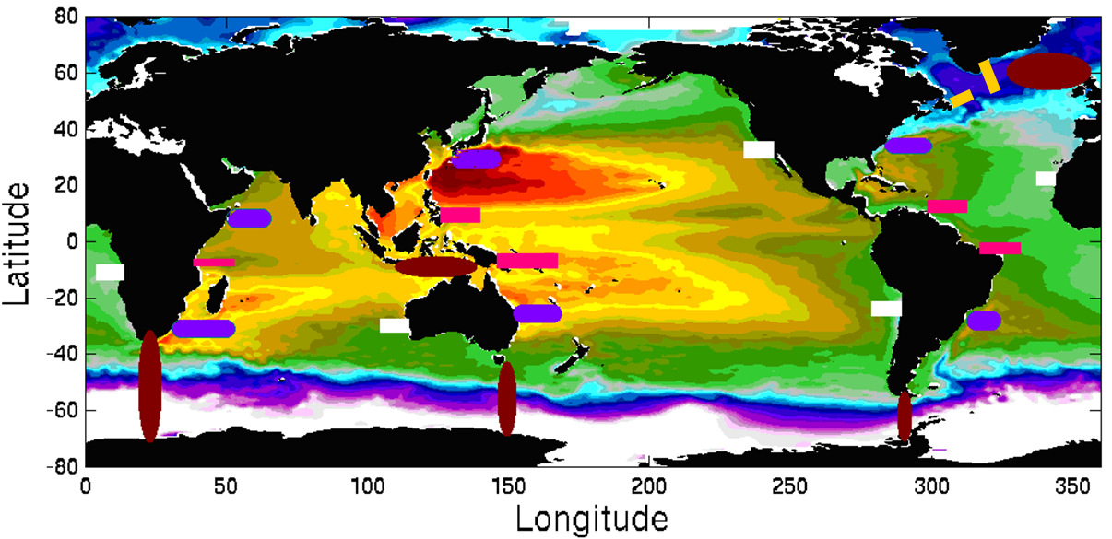
Boundary Currents: Progress and forward looking to OceanObs’19
Renellys C. Perez, UM/CIMAS and NOAA/AOML
w/input from: L.Beal, M.Cronin, R.Davis, S.Dong, D.Legler, G.Goni, R.Lumpkin, C.Meinen, U.Send, E.Smith, D.Roemmich, D.Rudnick, T.Rossby, R.Todd, J.Wilkin, N.Zilberman, OceanObs’09 white paper, IMSOO Workshop report, …
Funding: U.S. (NOAA, NSF, ONR, …) and international (Australia, Argentina, Brazil, Canada, China, France, Germany, Japan, Korea, Netherlands, South Africa, U.K., …)
Figure: Conceptual global network of boundary current arrays. Send et al. (2010) Boundary Current white paper.
OOMD Workshop
Ocean Obs’19, Sep 2019
Notes:
Figure: Conceptual locations for a global network of boundary current arrays. Subpolar boundary currents are shown in yellow, poleward subtropical western boundary systems in purple, equatorward low-latitude boundary systems in pink, major eastern boundary systems in white. Brown show the possible locations of arrays to monitor key interbasin exchanges. The background field is surface dynamic height from Rio et al., (2007). Figure is from the Send et al. (2010) Boundary Current white paper.
Caveats:
Overview presentation
Vision set forth OceanObs’09
Different regimes, what is boundary current and what isn’t
Funding sources change overtime for sustained programs.

Slide 2
Why observe boundary currents (BCs)?
“Society experiences the changes in the
global ocean through the ocean’s boundaries.”
OceanGliders Boundary Ocean Observing Network

Slide 3
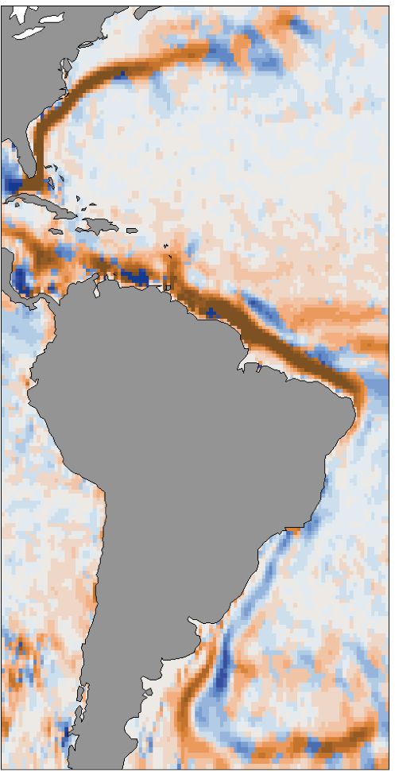
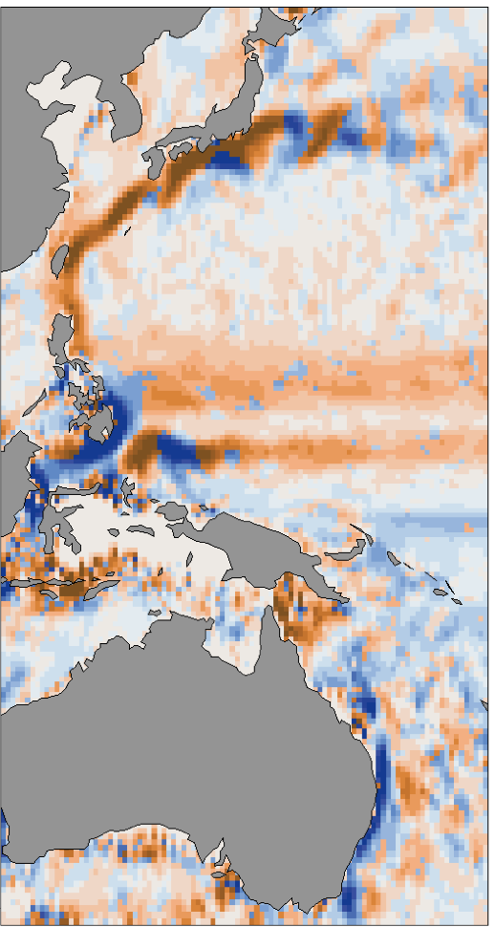
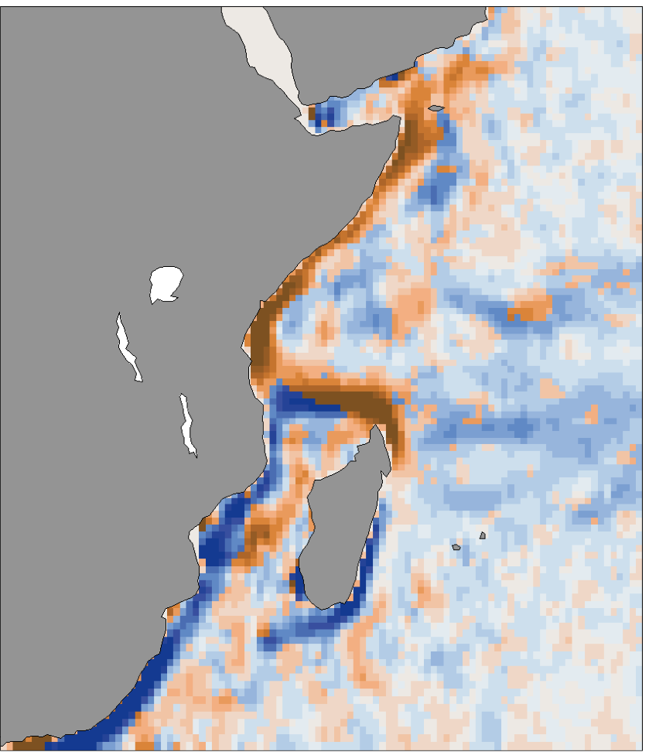
Why observe western BCs (WBCs)?
  Key drivers of climate variability
  Meridional heat/freshwater transport
  Surface and deep conduits for thermohaline circulation
  Sea level variations
Figure: Surface speeds from Global Drifter climatology. Color indicates orientation of meridional velocity (brown = northward, blue = southward).
Notes:
Examples of why certain boundary currents are important to society – may not apply to all

Slide 4
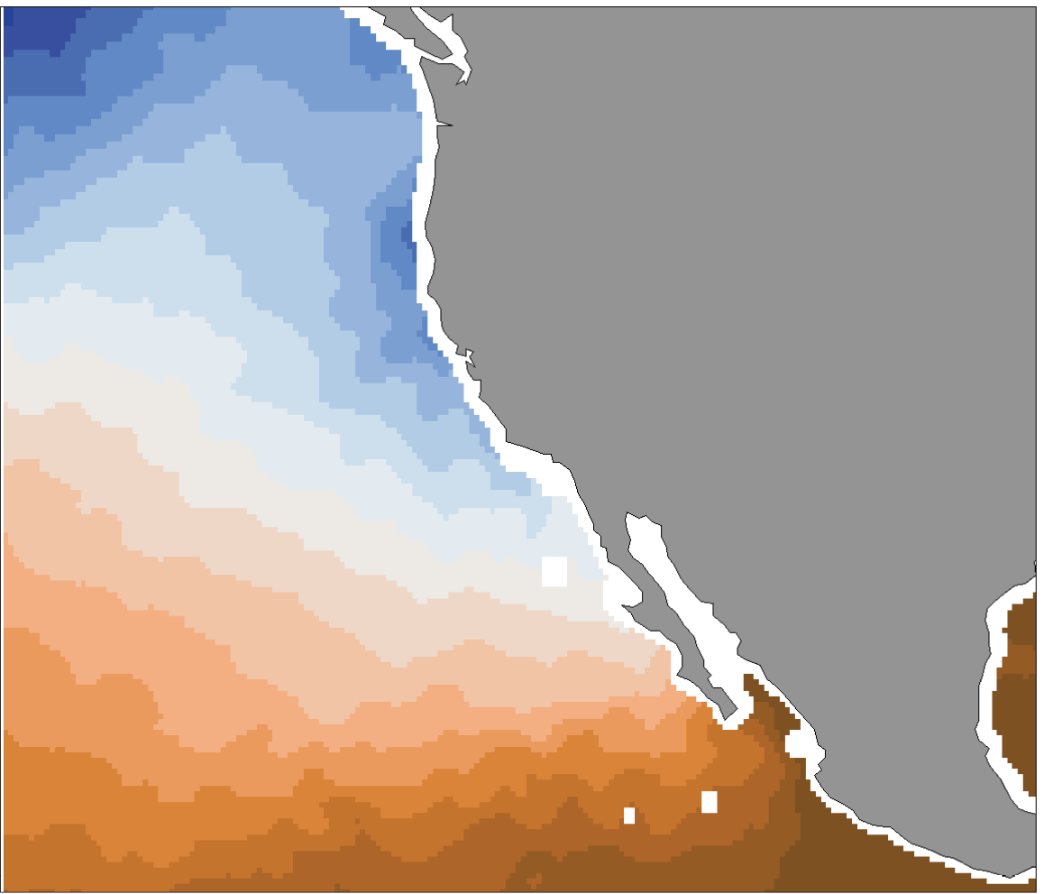
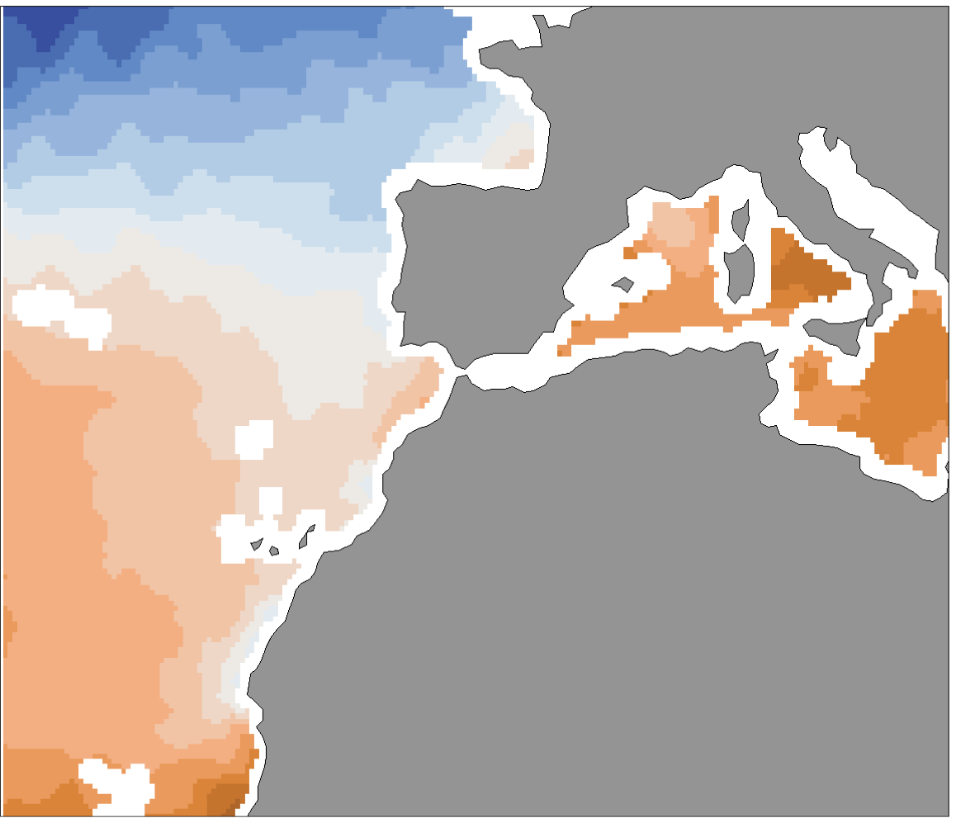
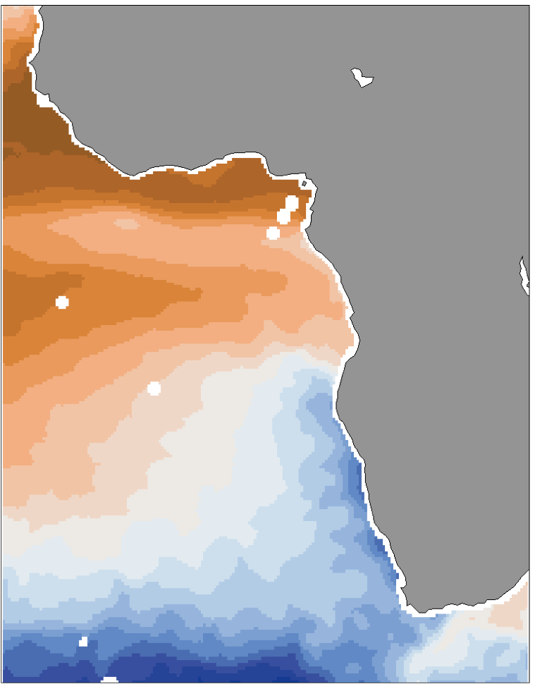
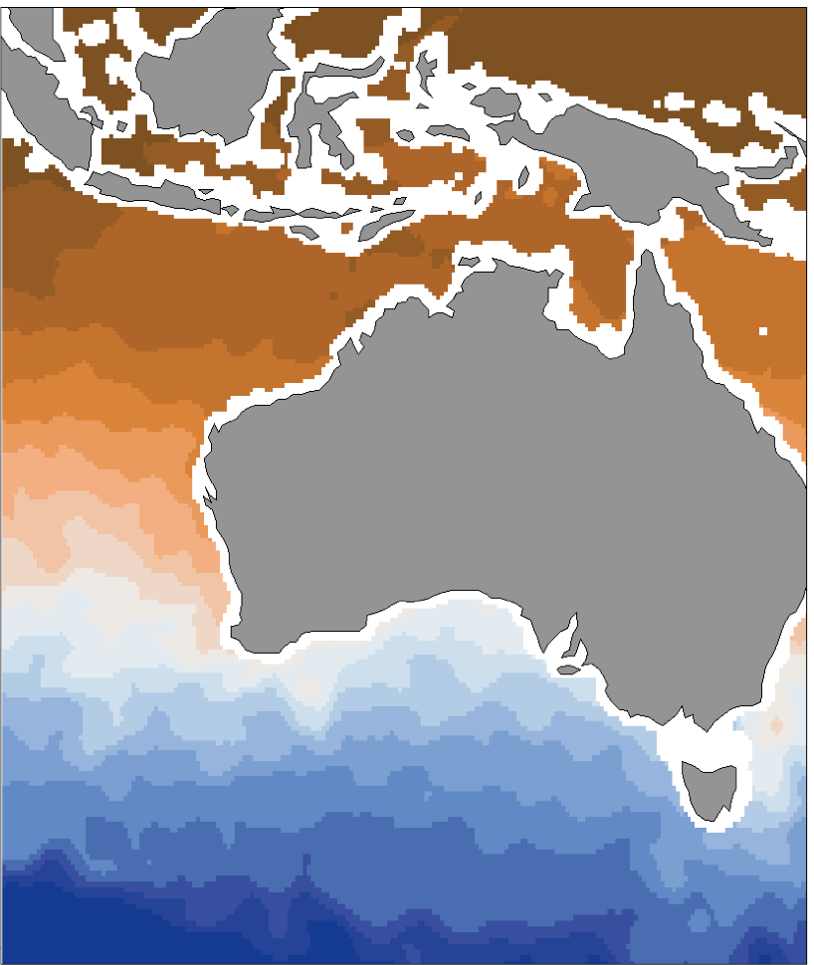
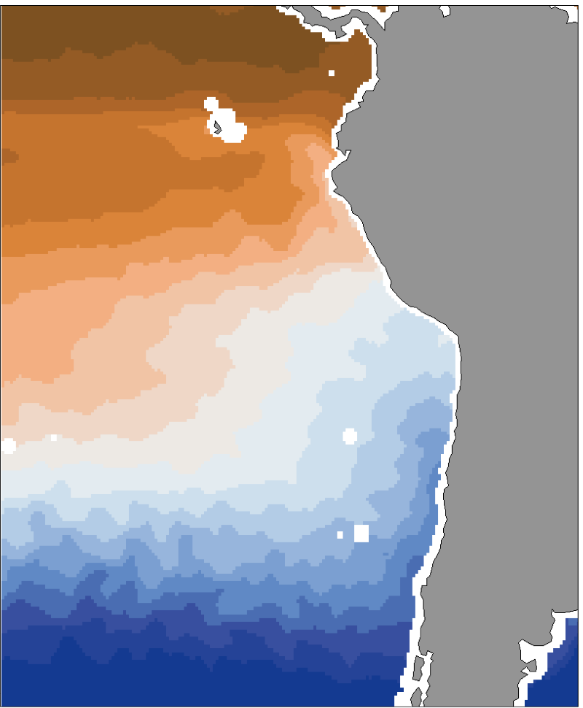
Why observe eastern BCs (EBCs)?
  Societally relevant effects of climate
  Upwelling, cross-shore exchange (nutrients, carbon)
  Ecological hotspots
  Equatorial interactions (ENSO-blob)
  Oxygen minimum zones (OMZs)
Figure: Surface temperatures from RSS Combined Microwave for June-August 2015. Blue = cold SSTs, brown = warm SSTs.

Slide 5
Why observe low-latitude, high-latitude, marginal sea BCs?
Low-latitude BCs: equatorward mass and property flux, ENSO
High-latitude BCs: Water mass formation/transport, interbasin exchanges
Marginal Sea BCs: Coastal-open ocean exchange, water mass formation
Figure: Pink = low-latitude BCs, yellow = high-latitude BCs, brown = interbasin-exchange. Send et al. (2010) Boundary Current white paper.

Slide 6
Where are BCs being observed?*
*List incomplete, a census is needed
Subtropical WBCs
  Atlantic: Gulf Stream, Florida C., Antilles C., Guiana C., North Brazil C., Brazil C., Malvinas C., DWBC
  Pacific: Oyashio C., Kuroshio C., East Australian C., East Auckland C.
  Indian: Somali C., Agulhas C.
Subtropical EBCs
  Atlantic: Canary C., Guinea C., Angola C., Benguela C.
  Pacific: California C., Peru-Humboldt C., Chile C.
  Indian: Leewin C.
Low-latitude BCs: Indonesian Throughflow, Mindanao C., New Guinea Coastal C., Solomon Sea
High-latitude BCs: Labrador C., E/W Greenland C., Norwegian C., East Iceland C., North Atlantic C., Alaska C., Antarctic Circumpolar C., Weddell Sea
Marginal Sea BCs: Mediterranean, Gulf of Mexico
Notes:
Blue indicates being observed in some format, but not necessarily sustained and not necessarily in a sufficiently complete way to capture all of the necessary variables/processes

Slide 7
Technology (*multidisciplinary)
Moored buoys (T, S, current meters, ADCPs, PIES, O2*, Carbon*, …)
Cabled observatories, integrated observational networks*
Research vessels*
Ship of opportunity program (XBTs, XCTDs, ADCPs)
Underwater autonomous gliders*
Argo profiling floats*
Surface drifting buoys
Sail drones*
Coastal HF-Radar
Satellites*
Blended in situ-satellite products
Some Examples…
(a subset)

Slide 8
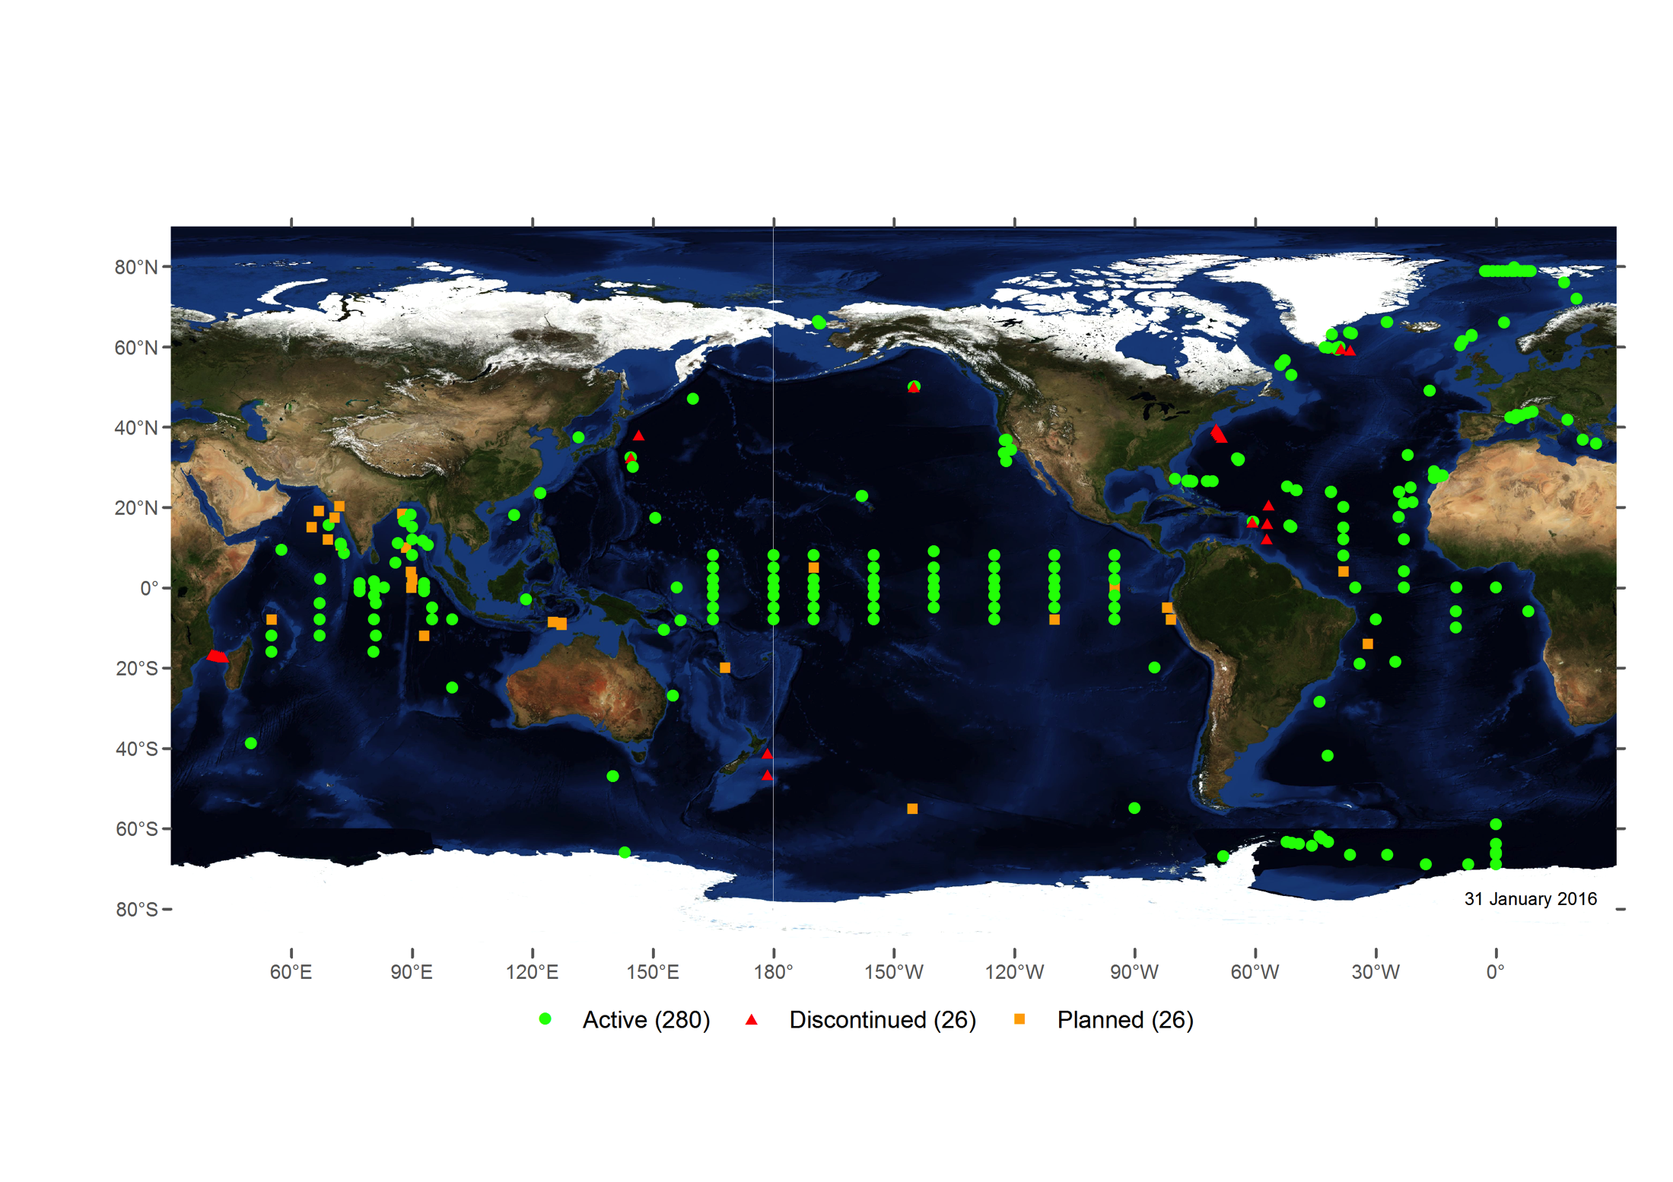
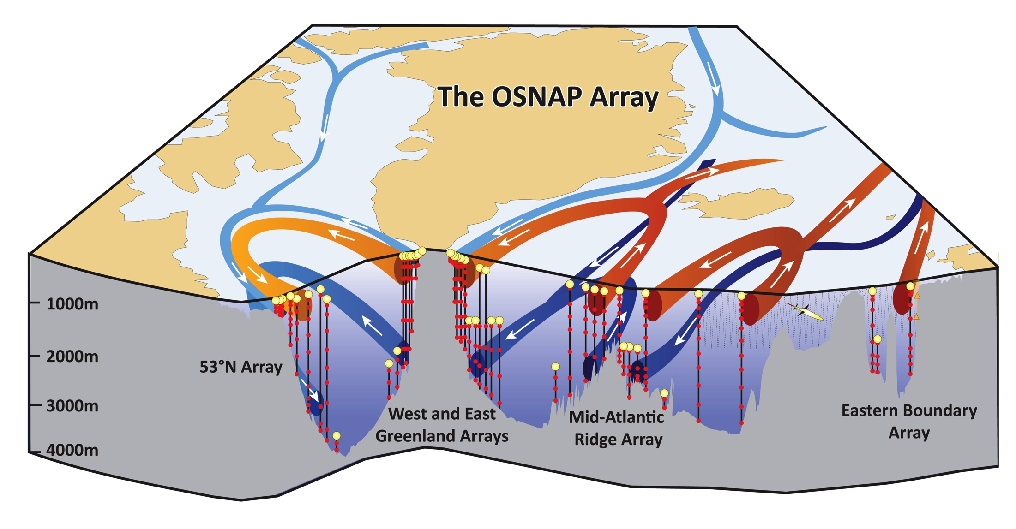
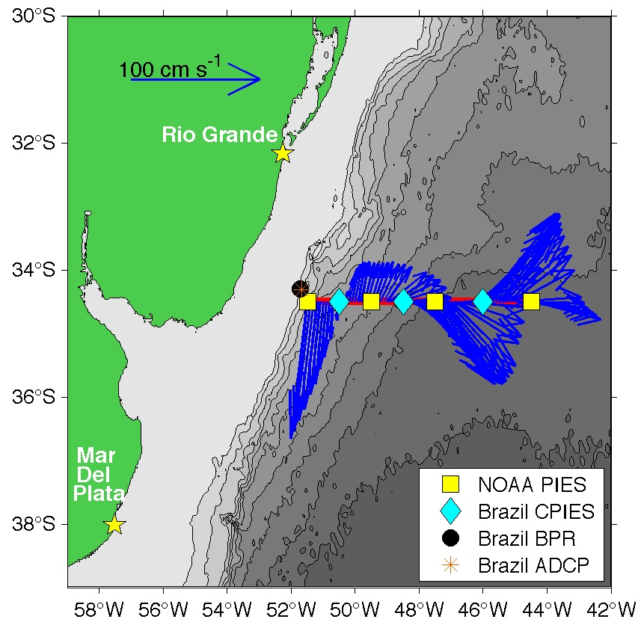
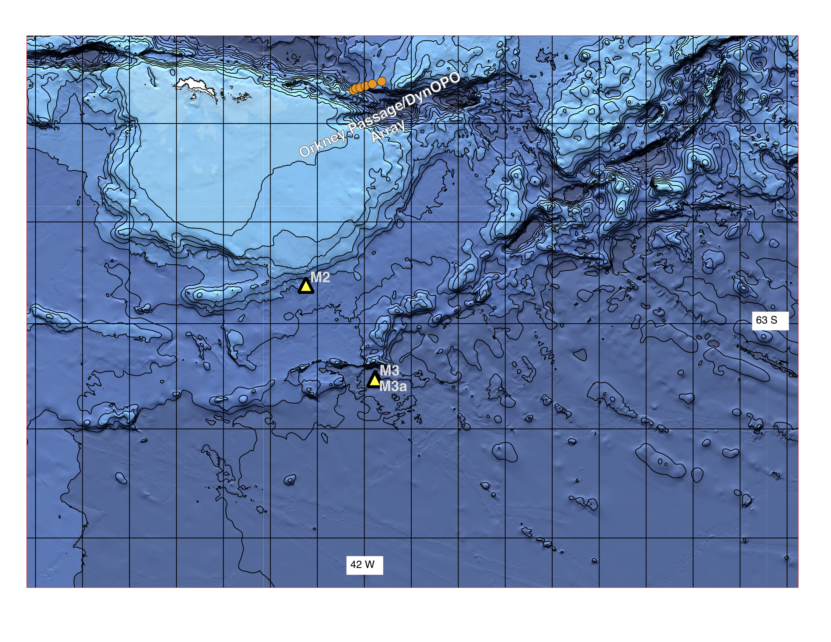
Moored buoy arrays
OceanSITES
Overturning in the Subpolar North Atlantic
Southwest Atlantic MOC
Weddell Sea Transport Station
Agulhas System Climate Array

Slide 9
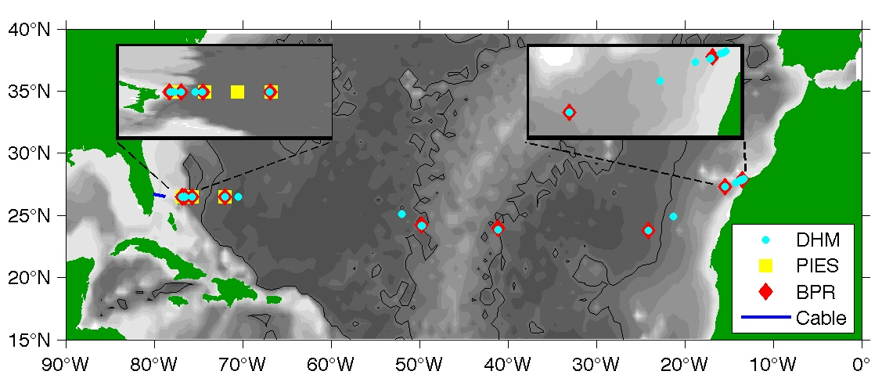
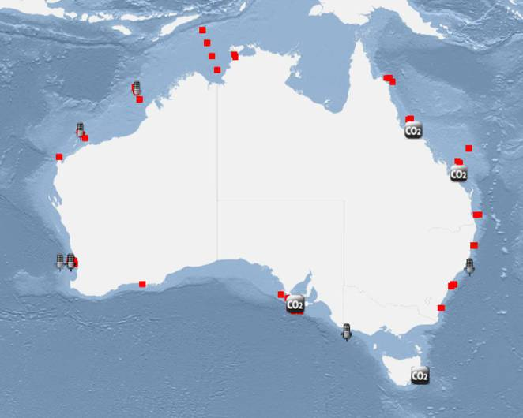
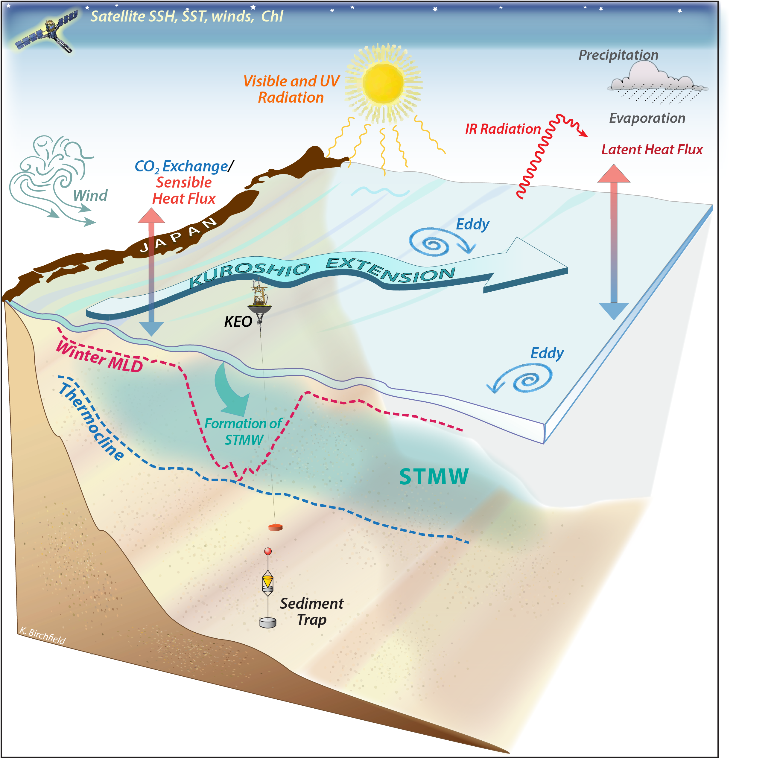
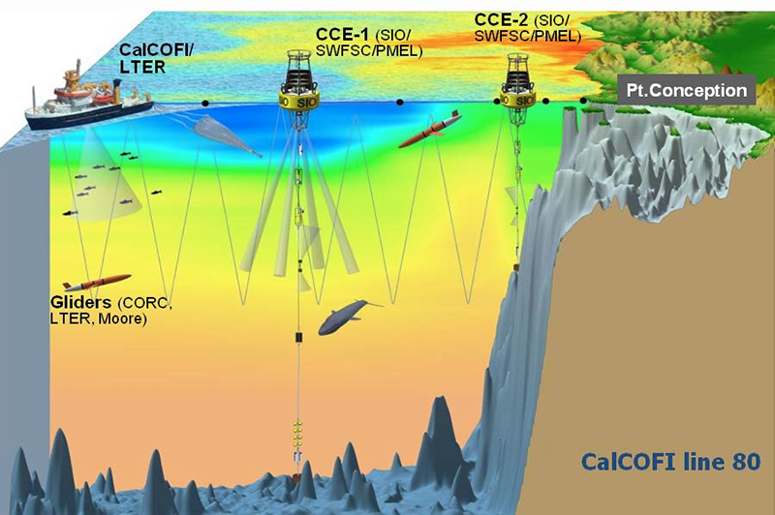
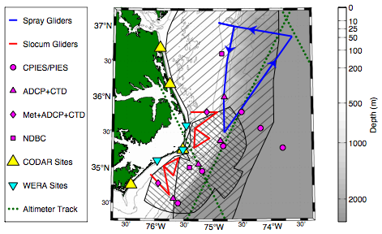
Cabled observatories, integrated observational networks
RAPID/MOCHA/WBTS/ABC
Integrated Marine Observing System
Kuroshio Extension
Moored Climate, Carbon, BGC, and Ecosystem, South California Current
Processes driving Exchange at Cape Hatteras
Notes:
Developed organically,
Very diverse
Difficult to standardize or implement a centralized control

Slide 10
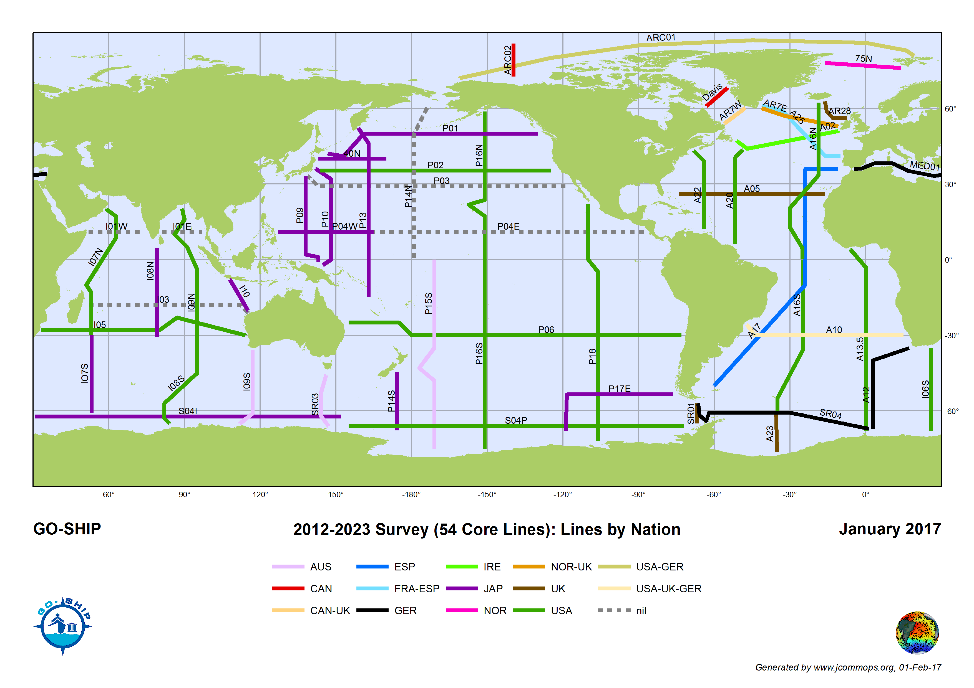
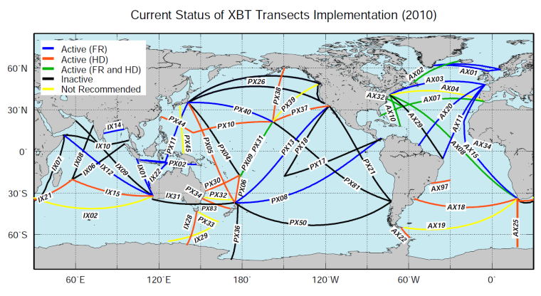
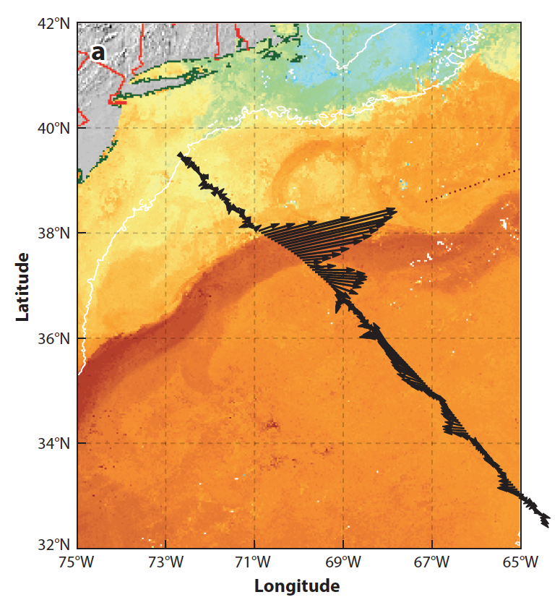
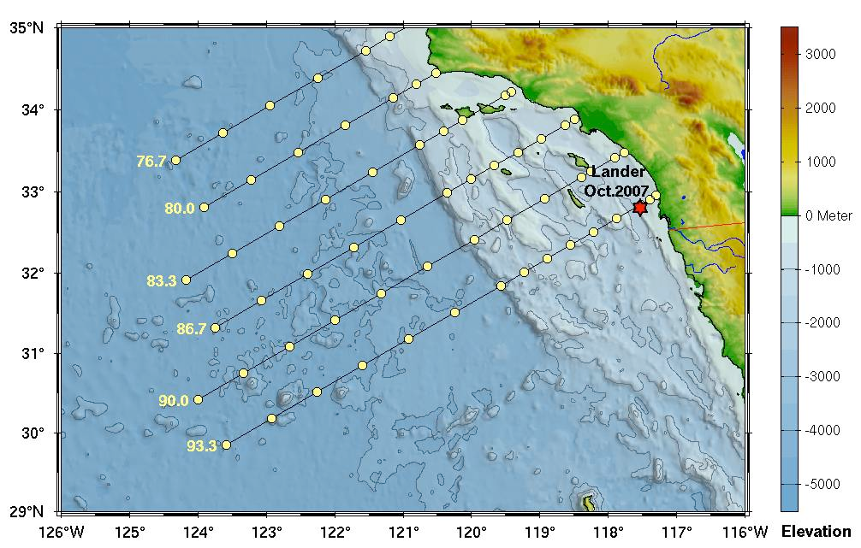
Research vessels, SOOP
GO-SHIP
XBT network
: Boundary currents sampled by the HRX Network
Oleander Project
Drake Passage
CalCOFI (hydrography, biology)

Slide 11
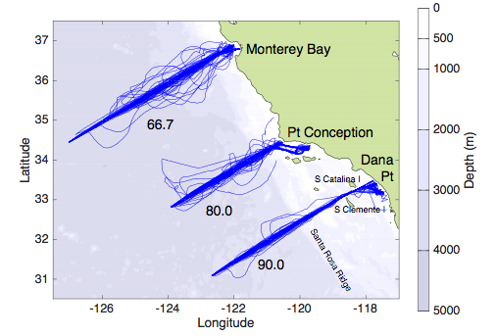
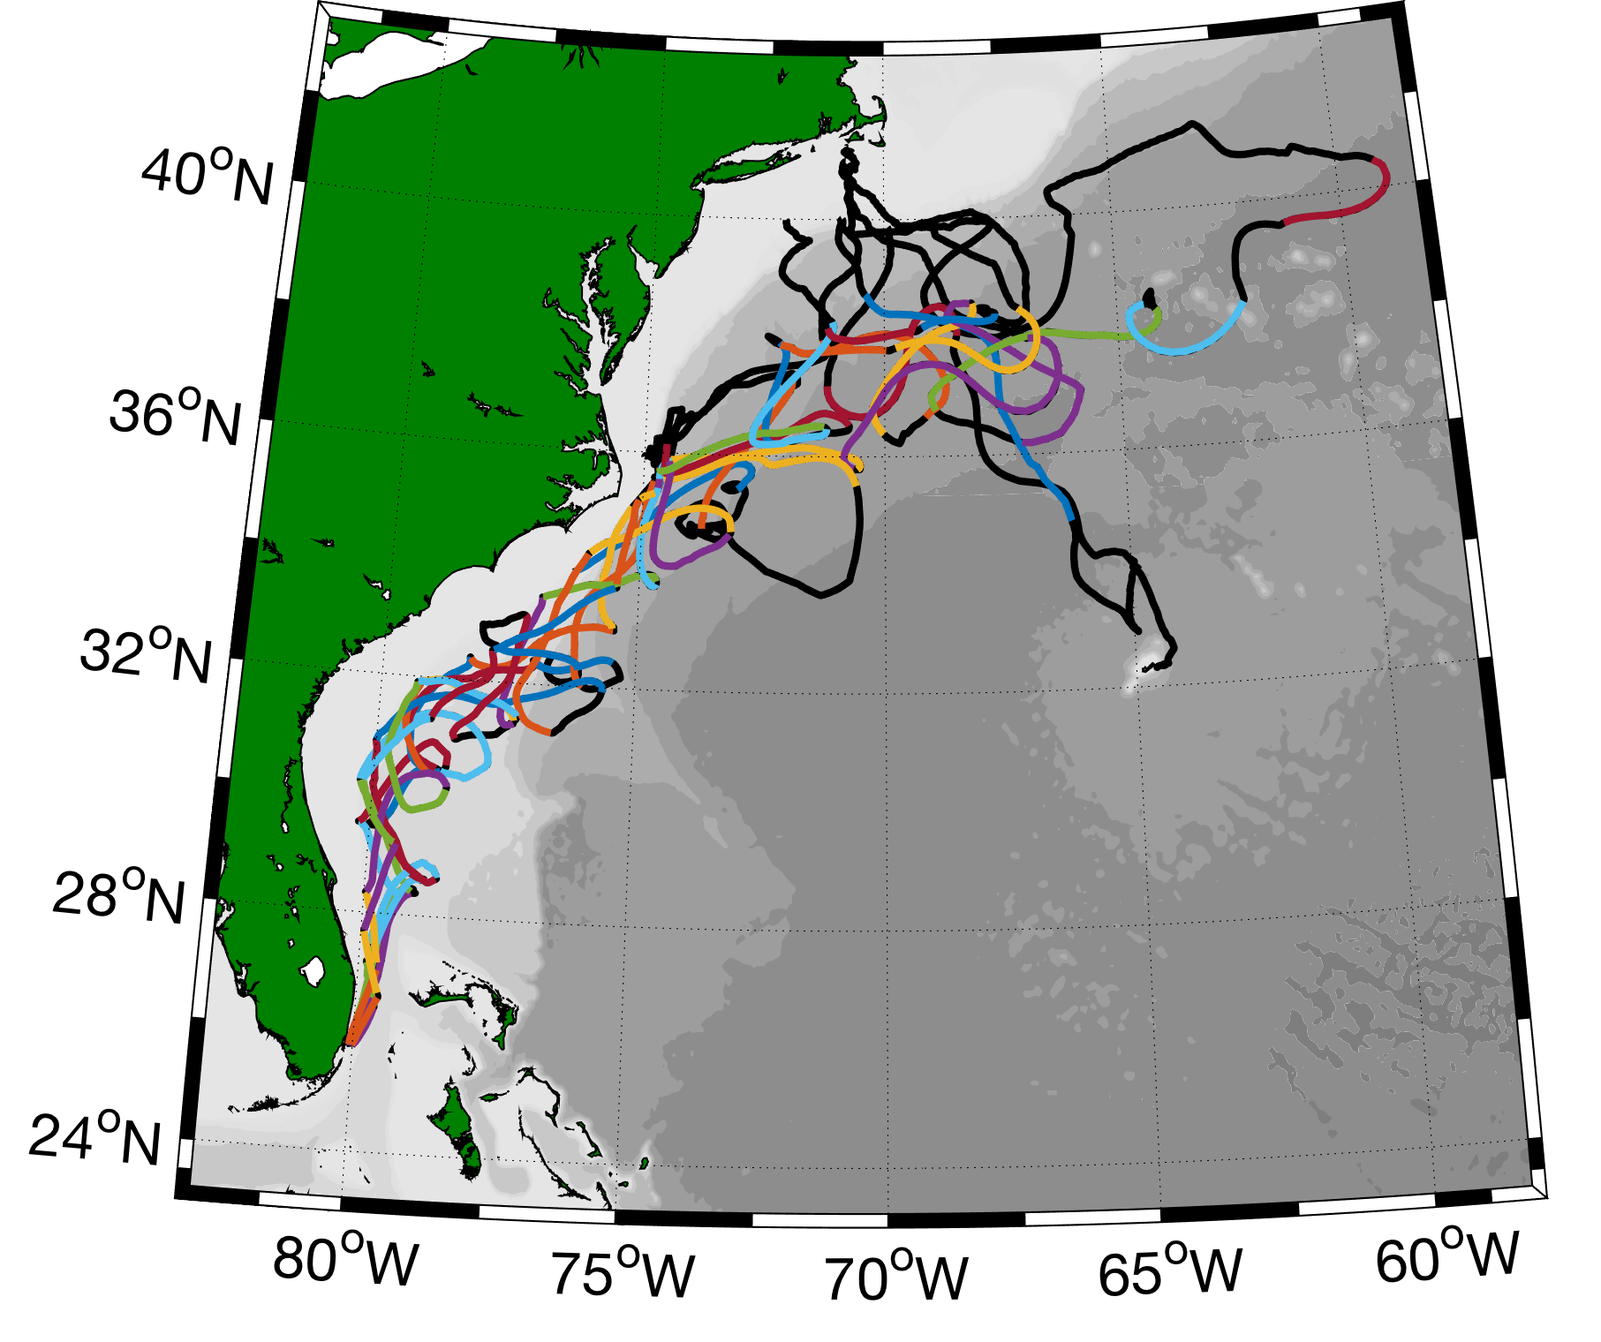
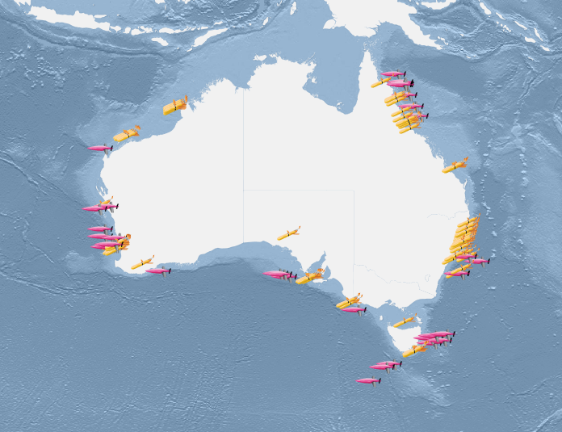
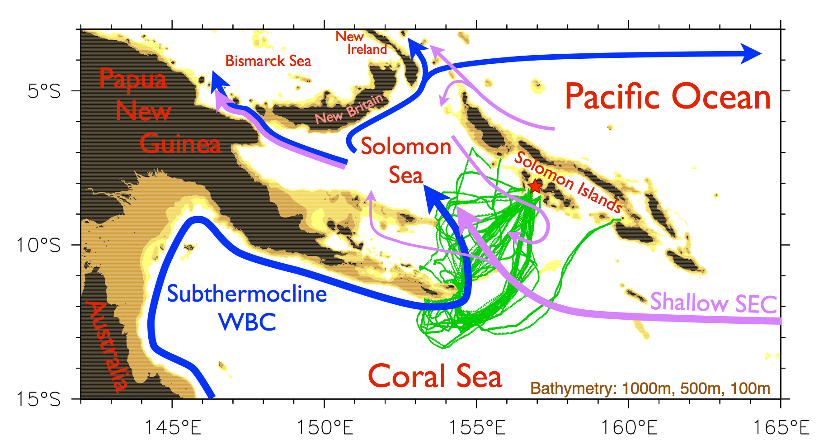
Autonomous underwater gliders
California Underwater Glider Network
Glider Surveillance of Gulf Stream
Australia National Facility for Ocean Gliders
Gliders in the Solomon Sea

Slide 12
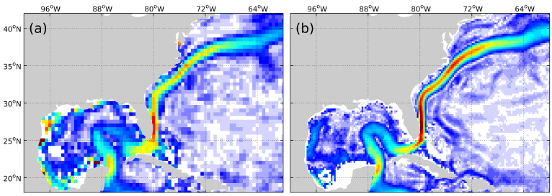
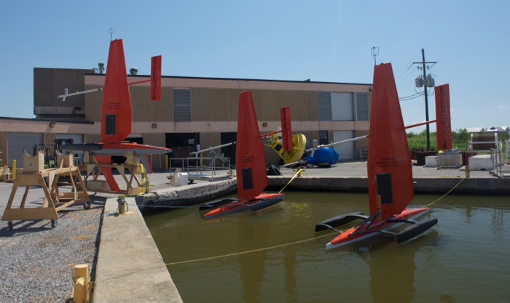
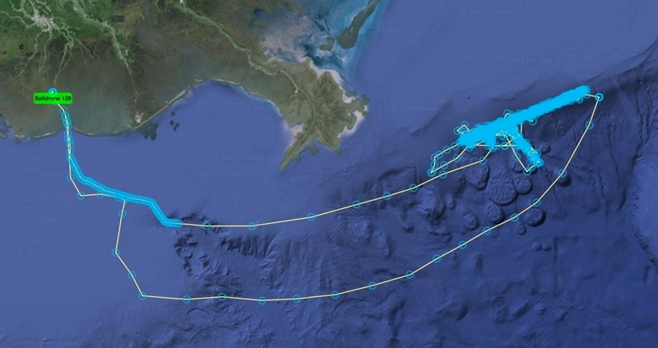
Blended data, drifting buoys, saildrones
XBT + Argo + altimetry (EAC)
Global Drifter Program Climatology in Gulf Stream
Laurindo et al. (2017)
Zilberman et al. (sub)
SailDrones in Gulf of Mexico (shelf-slope interaction)

Slide 13
An informal survey
Progress towards OceanObs’19
P1
P2
P3
Notes:
We’re making progress since OceanObs’09, but is slow and inconsistent because of funding challenges and ship time limitations.
We’ve lost things…
Technology
Coastal-ocean
Multi-

Slide 14
Towards integrated BC observing systems...
Focus topics identified at IMSOO meeting:
How ecosystem structure/dynamics in coastal ocean is affected by interannual variability of currents and water properties, including O₂/OMZs, pH/acidification…
Cross-shore exchange between land, shelf and deep ocean (mesoscale)
Ecological hotspots, episodic (e.g. fronts, eddies, upwelling) and persistent (e.g. canyons, headlands, shelf break)
cross-shelf
cross-shelf
along-shelf
Focus Topic
Processes/phenomena
EOVs/Scales/Range
Observing platforms
Implementation of Multi-Disciplinary Sustained Ocean Observations (IMSOO), Feb 2017
Notes:
At the Implementation of Multi-Disciplinary Sustained Ocean Obs (IMSOO) meeting discussed as one of its themes “Boundary Currents and Deep Ocean – Shelf Interactions”
IMSOO tried to come up with an updated multi-disciplinary rationale for observing BCs (“focus topics”), as well as a framework for identifying processes corresponding to those focus topics, variables to observe with appropriate spatial/temporal resolution, and then suitable technologies to observe those processes.
Note the first two we can do with cross-shelf obs– and overlap of physical/biological obs – the third one may require biological obs to be made downstream of upstream of physical obs
For example, for the first focus topic, one process could be “depth of the pycnocline”, you need to measure temperature and salinity, with certain horizontal/vertical/temporal scales (e.g., z 1-10 m down to thermocline, lower res below), such that gliders, moorings, and XBTs might be good platforms depending on their impact/feasibility.
This is a valuable process. However, boundary currents are very different, as are resources. Won’t be able to have uniform method to observe these phenomena.

Slide 15
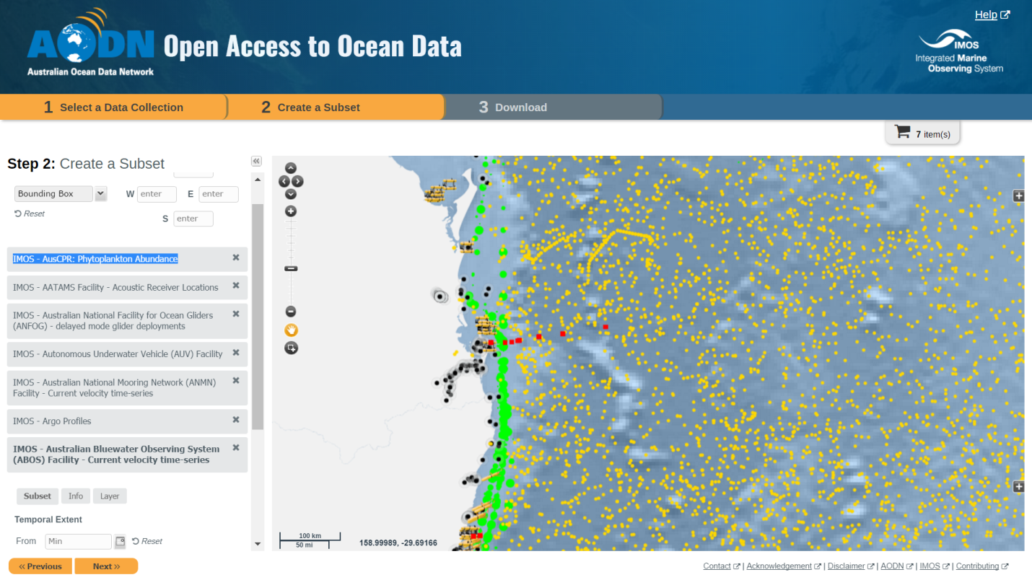
IMSOO phased approach
Update societal rationale for BC observation
Organize review of two BC observing systems (short term):
California Current
East Australian Current
Develop white papers for OceanObs’19 (short term)
Develop concept for “backbone” observing system (mid term)
Develop concept for “pilot flexible/relocatable” observing systems (long term)
Do we want to identify long-term/mature observing systems to undergo similar process? (if funds are available)
Notes:
Hard to come up with cookie cutter
Funding limited
Organic processes
We would value observations even if not “perfect” array
Ship limitations
Uniform plan/metrics
Good observing system for a boundary current system like this one… all different
“Gold standard” that others can follow
Limitations/benefits

Slide 16
Recommendations…
First action items
Backbone
Pilot studies
Notes:
Identified a few long-term/mature observing systems that funding agencies want to undergo a similar self-evaluation (if funding available) as put forth by IMSOO…
Boundary currents have so many unique features
Not one size fits all… complex system doesn’t lend itself to simple metric
Propose ways forward:
Census – fund a postdoc (blend society/oceanography) and get funding managers to get programs they fund to talk to postdocs plus web designer/expenses to do a survey. Need buy in from program managers as well from program managers overseas.
Funding agencies to give us ideas of resources/ship time available in the future
More guidance from funding agencies on the future that they see...
Workshop on the future of time series observing of boundary currents.
Review of boundary current system observations
Workshops to bring together multi-disciplinary systems, open ocean-coastal collaborations etc.
Boundary currents are poorly represented in most models, so still not ready for proper nature run
Some boundary current observing networks are further along at using models to re-design or forecast

