Slide 1
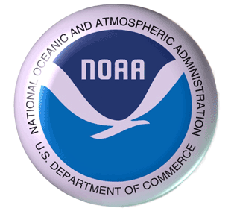
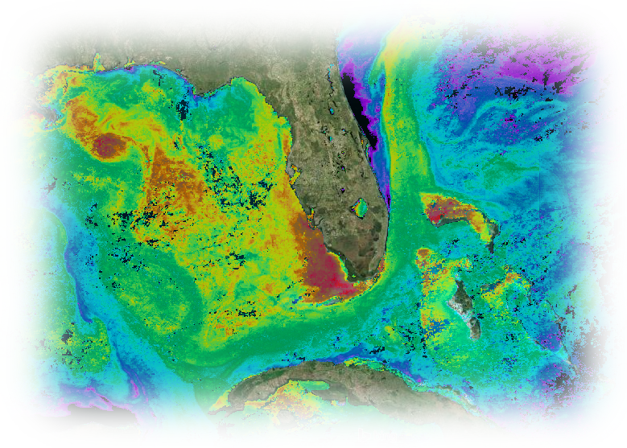
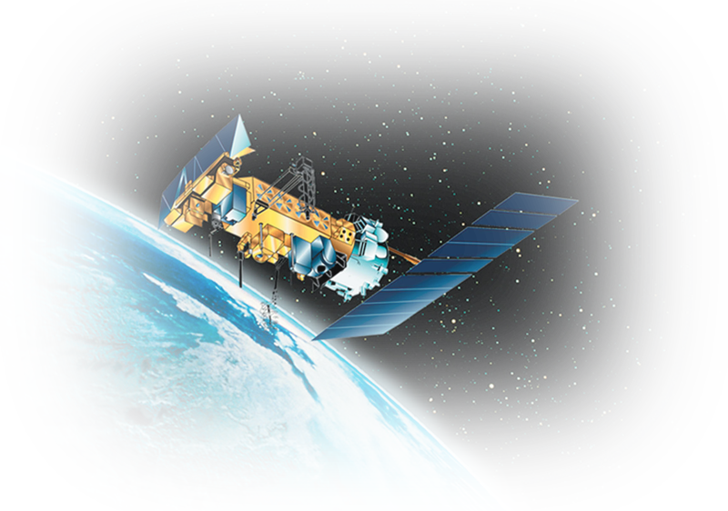
CoastWatch and PhOD satellite and ocean products in support of HRD 2016 hurricane season activities
Joaquin.Trinanes@noaa.gov CGoM CW & AOW Op. Manager

Slide 2
CoastWatch/OceanWatch
This year, AOML became home to one of the two nodes of the NESDIS OceanWatch Program, the Atlantic OceanWatch node.
Gustavo.Goni Atlantic OceanWatch Node Manager
Some details
  Will provide integrated data and tools to scientists to better understand the physical, biological, and chemical ocean processes.
  Both CoastWatch and OceanWatch efforts will run in parallel, with the latter focusing on a larger region of interest, primarily the Atlantic basin and global oceans.
  Scientific quality products and near-real time datasets will be provided and geared towards supporting climate, ocean, ecosystems, and weather studies.
  Tools will be developed and implemented to deliver interoperable products through a service-oriented architecture, using international recognized standards for data and metadata.

Slide 3
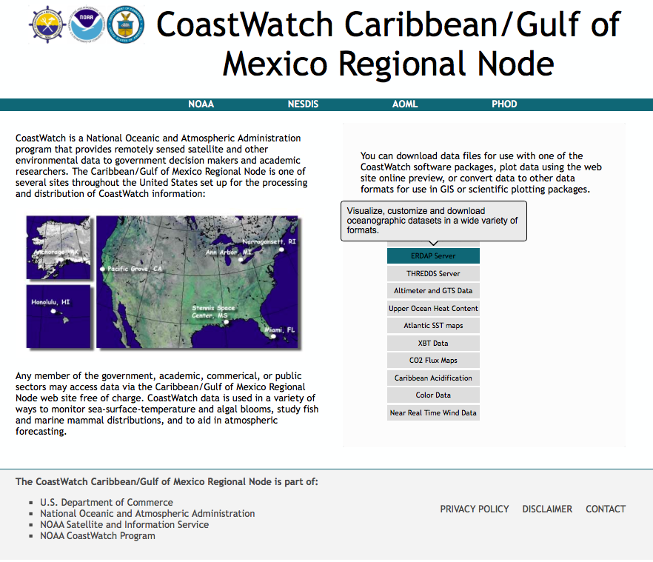
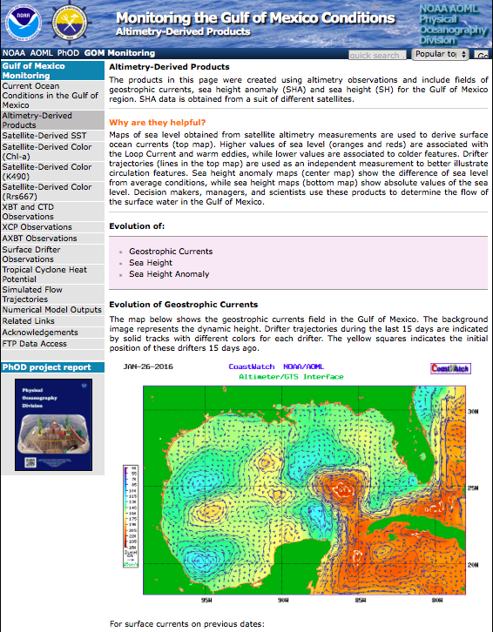
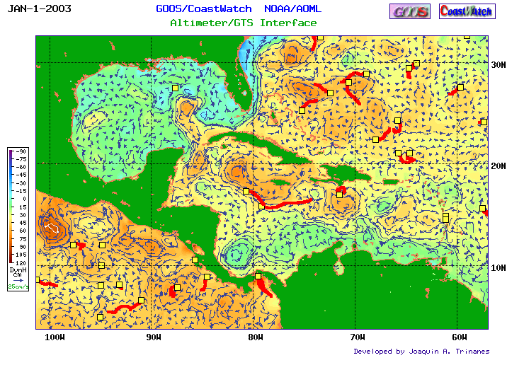
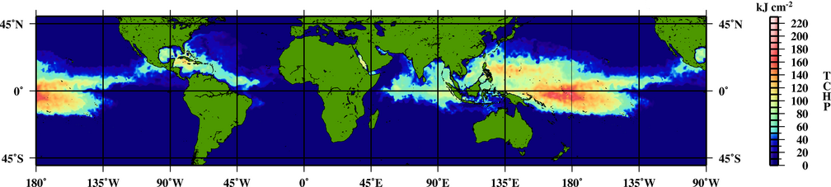
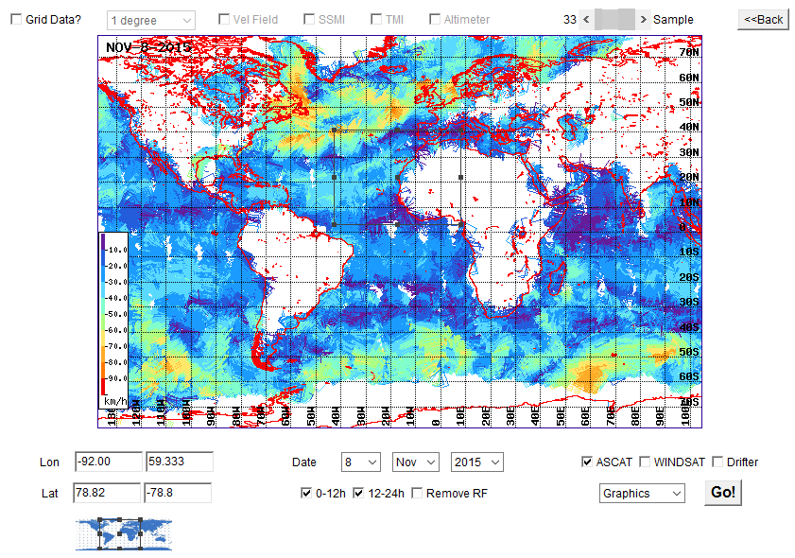
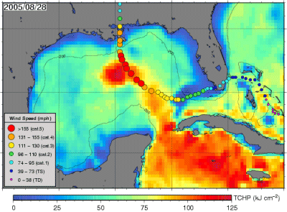
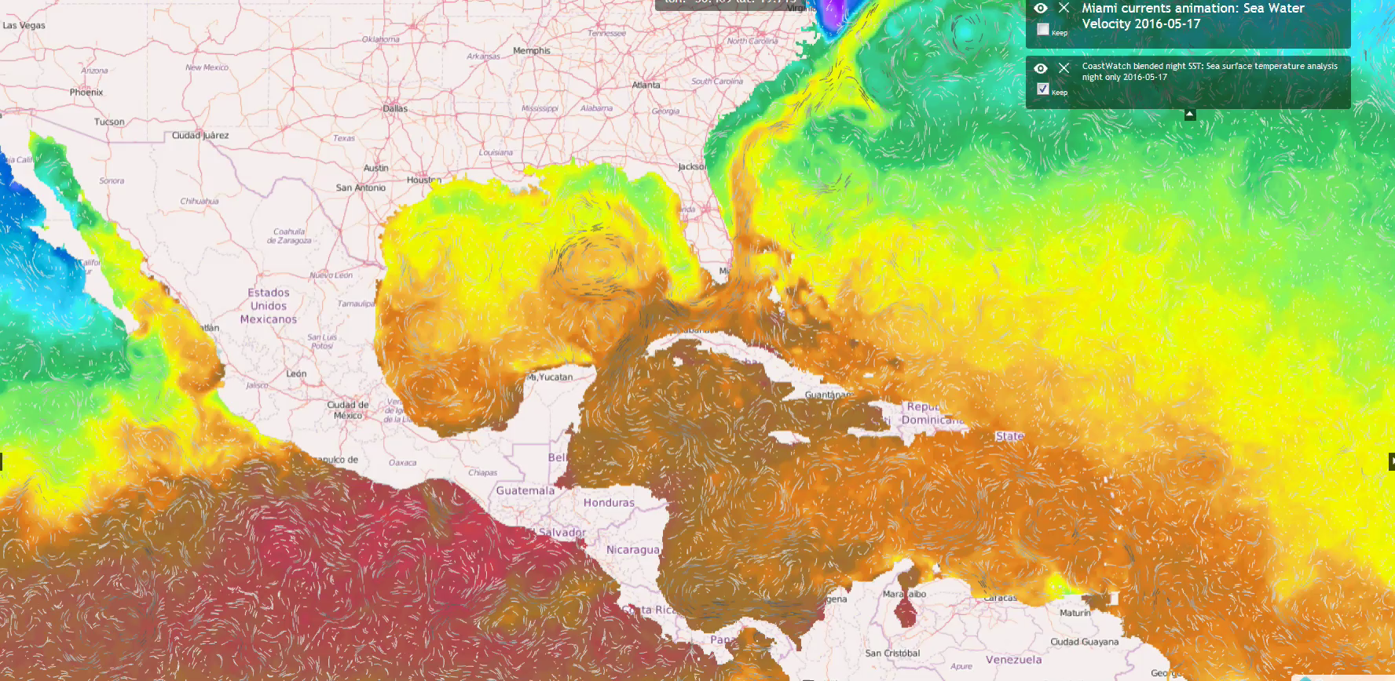
Large suite of products

Slide 4
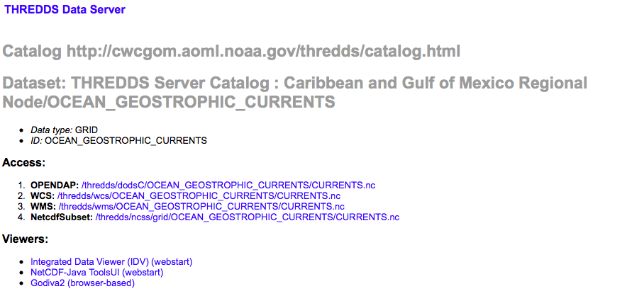
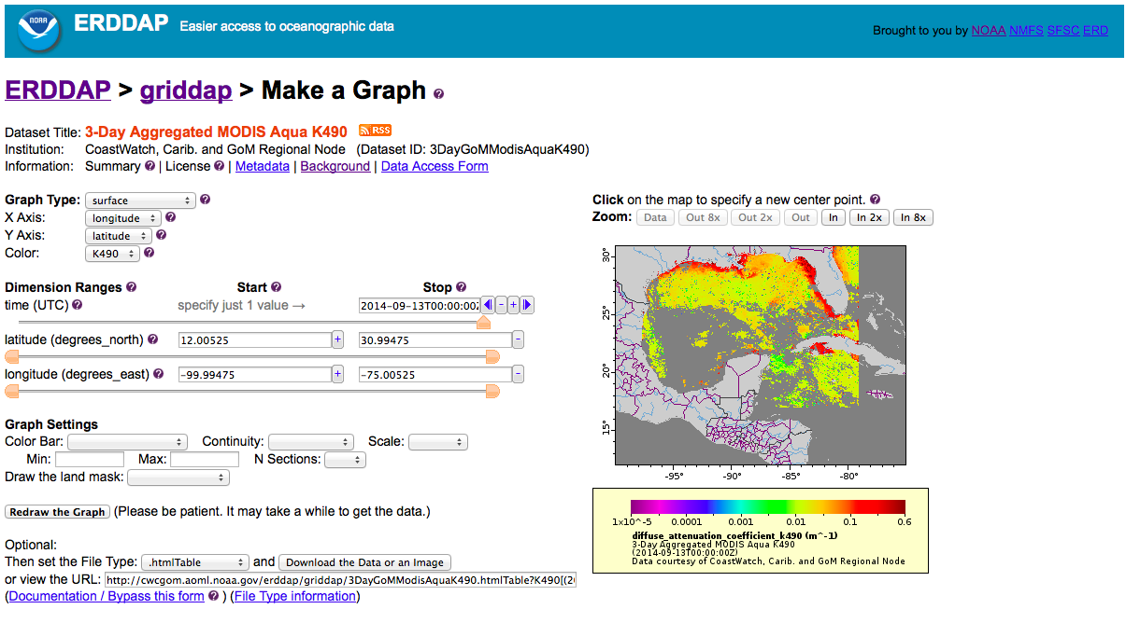
Tools

Slide 5
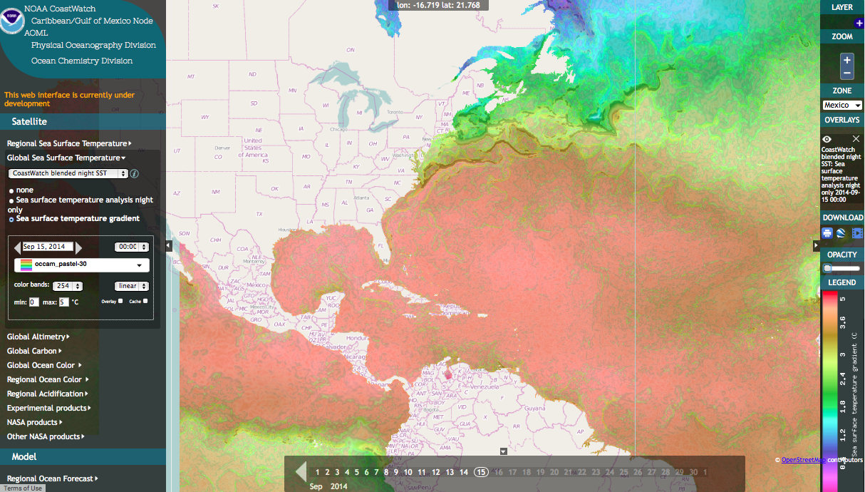
OceanViewer

Slide 6
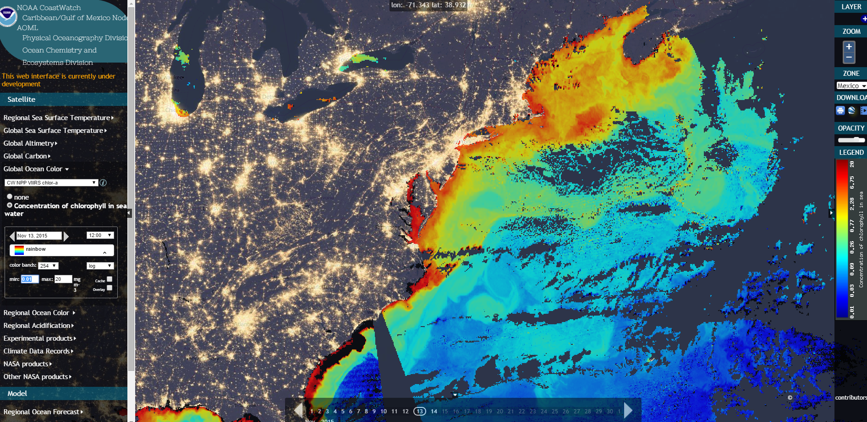
OceanViewer

Slide 7
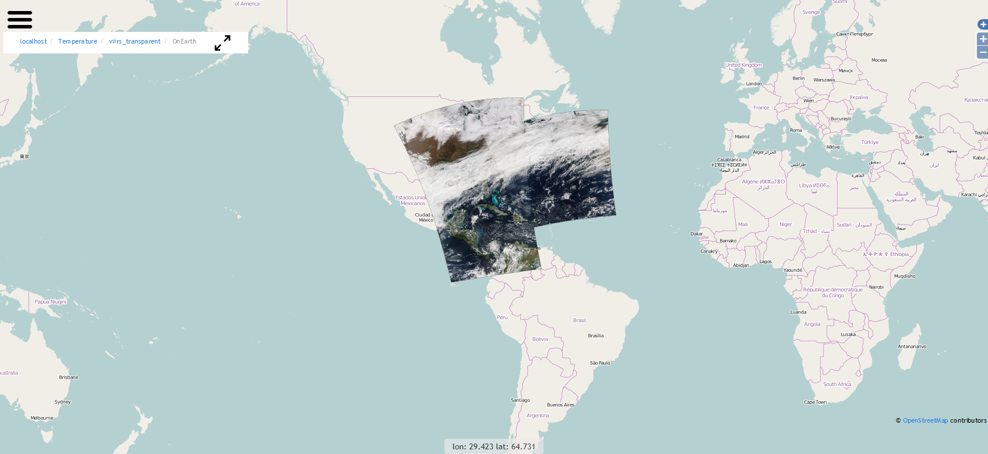
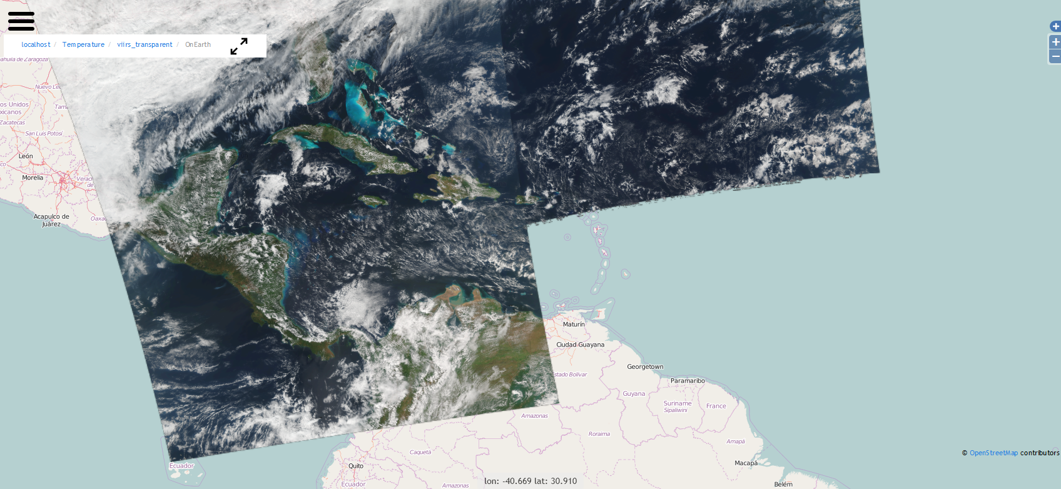
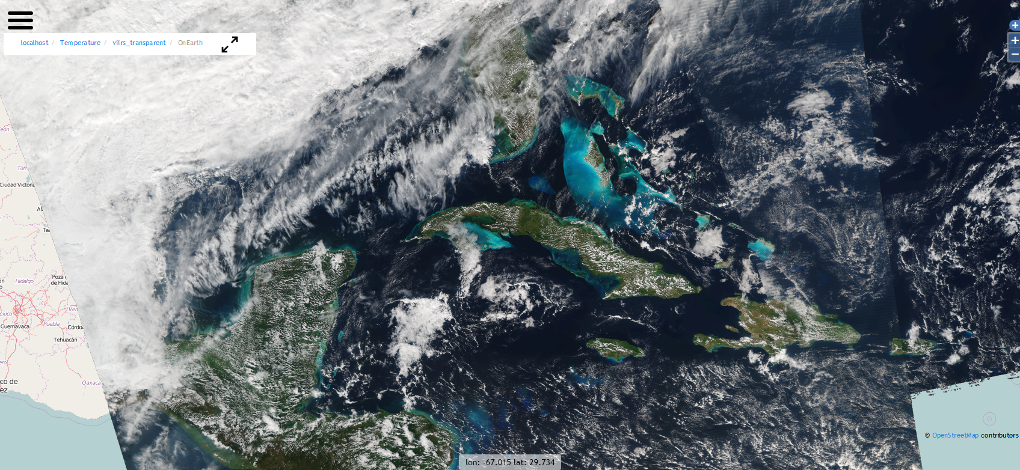
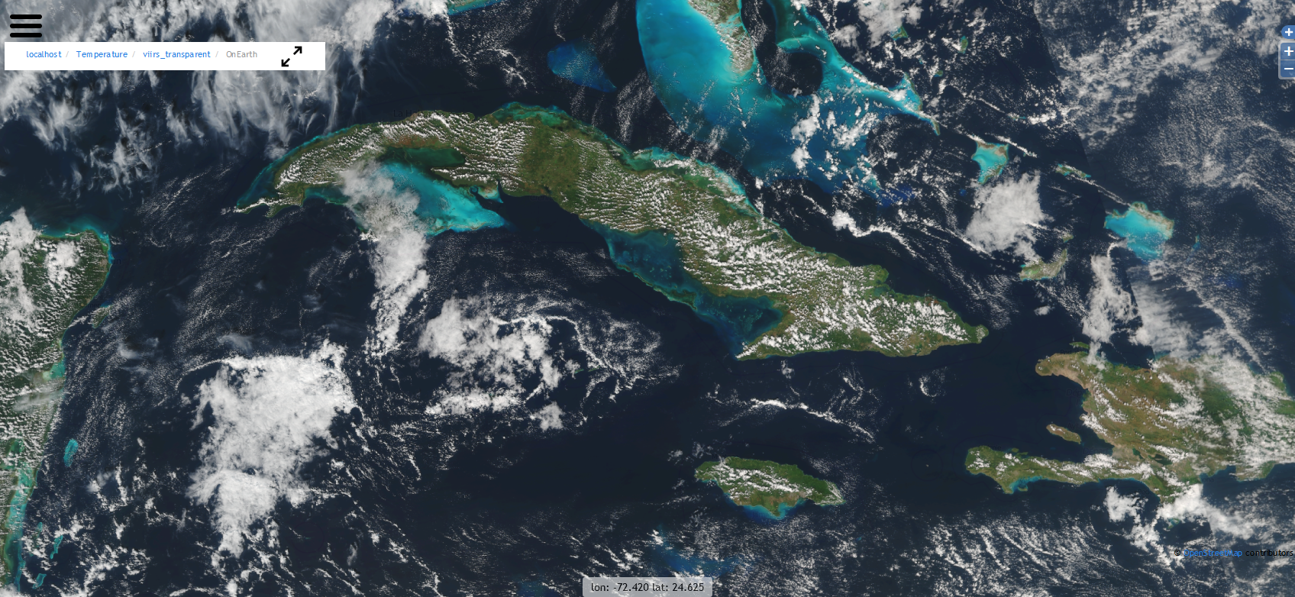
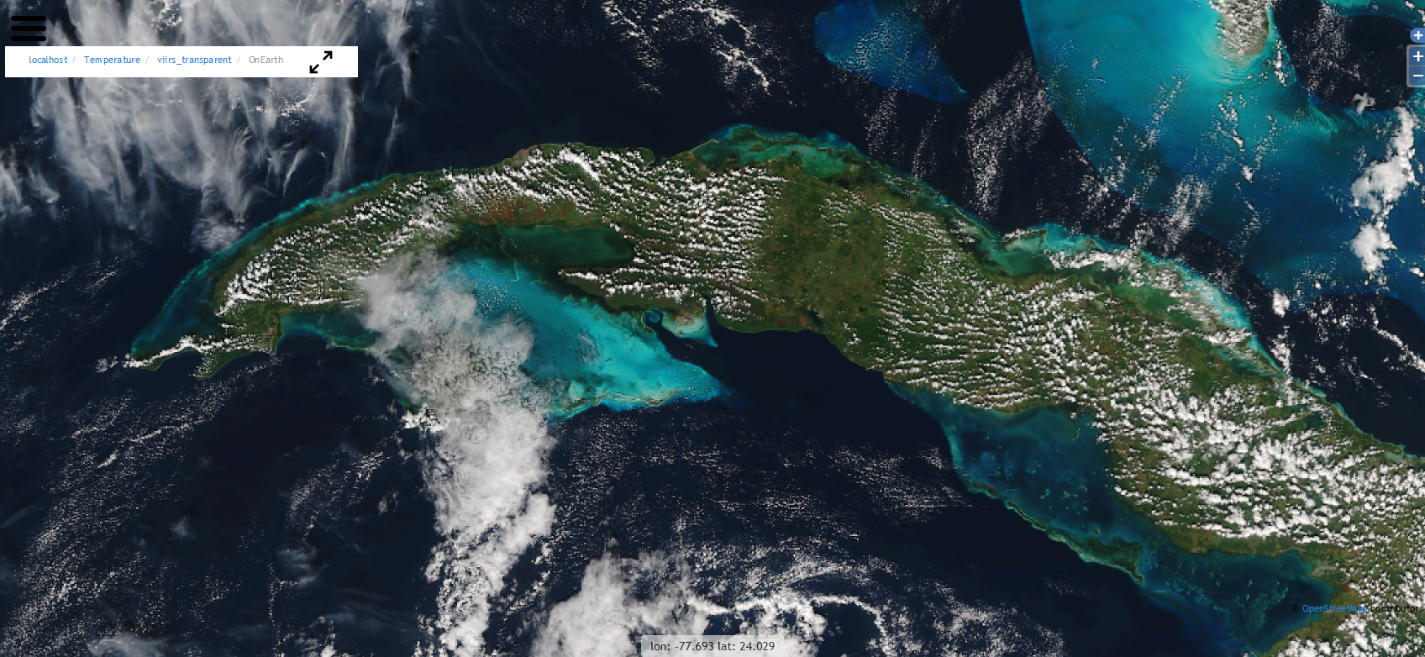
OceanViewer

Slide 8
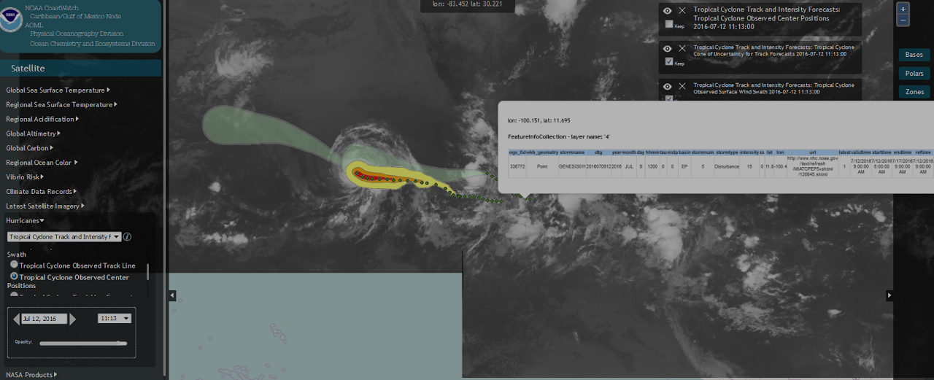
OceanViewer

Slide 9
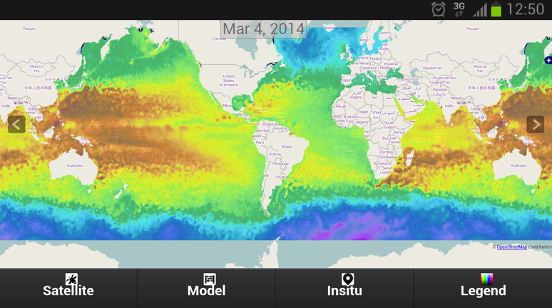
(OceanViewer mobile)
Notes:
Mobile applications are a must today. We have developed Android and IOS versions of our viewer that you can use in your smartphone, ipad or tablet.

Slide 10
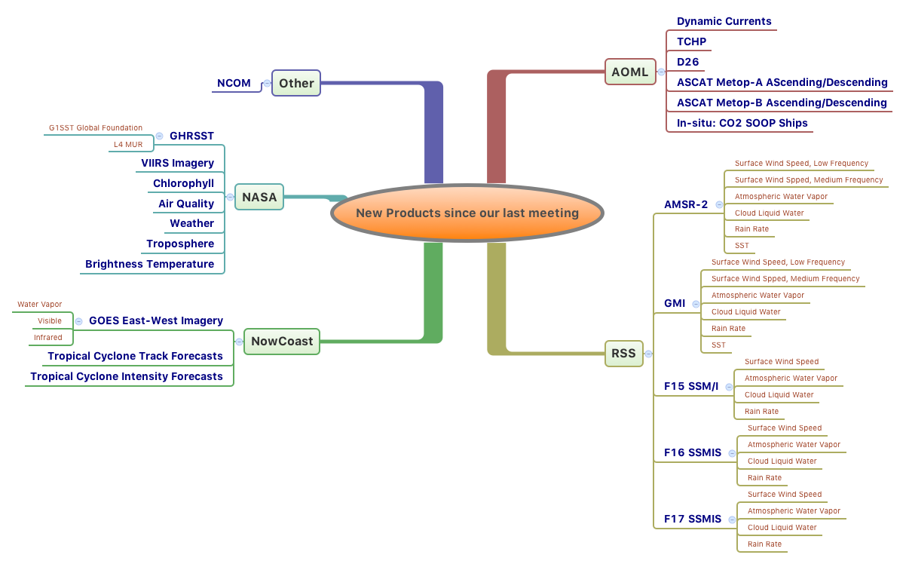

Slide 11
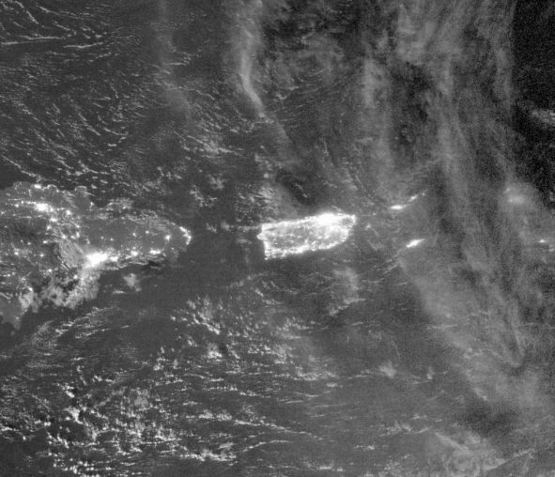
Ongoing Work
  Multiday composites, frontal areas and additional vector features
  Anomalies and trends
  Improve metadata
  Improve computer infrastructure
  Regional algorithms (e.g. TSM)
  Exploring new Technologies&Concepts:LCS,Models, SOS, WPS, Big Data-VM
  Sentinel Constellation & X-band antenna
High (temporal/spatial) resolution products
Regional indicators

Slide 12
Thank you!
http://cwcgom.aoml.noaa.gov/hrdviewer.html
Please, don’t hesitate to contact us in case you need further information, want to provide feedback, or have an specific data/feature request.
I would like to conduct a tutorial to also receive feedback from users. Date/time: Next week?
Joaquin.Trinanes@noaa.gov

