Slide 1
The Ship Of Opportunity Programme Implementation Panel
SOOPIP
Joaquin A. Trinanes
on behalf of the SOOPIP
UM/CIMAS and NOAA/AOML
Miami, FL
Joaquin.trinanes@noaa.gov
WOC Smart Ocean/Smart Industries Workshop

Slide 2
WMO/IOC JCOMM
SOT Ship Observations Team:
SOOPIP Ship Of Opportunity Implementation Panel
ocean observations from ships of opportunity
VOS voluntary observing ships
marine met observations
DBCP Data Buoy Cooperation Panel
Drifters, moorings
Argo
Profiling floats
Ocean Sites
Time series
GLOSS Global Sea Level Observing System
Tide gauges
IOCCP Ocean Carbon Coordination Project
Ocean carbon observations

Slide 3
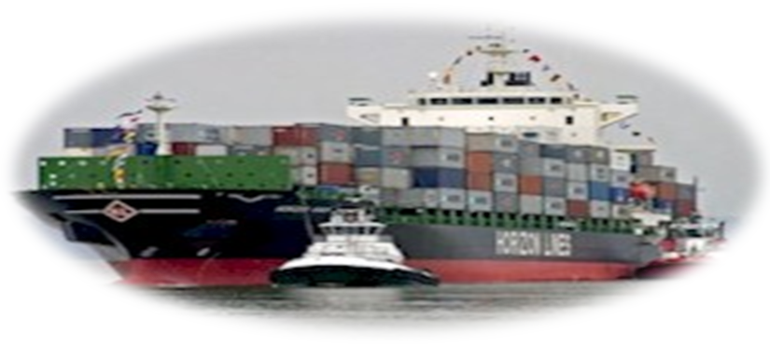
Ship Of Opportunity Program
Main mission:
  Facilitate the international collaboration and interaction between the scientific and operational communities with the shipping industry, and to establish the standards of data acquisition, transmission, quality control, distribution, and archiving of XBT, TSG, and other underway data.

Slide 4
Ship Of Opportunity Program
In order to accomplish this, SOOP:
  Collects XBT and TSG observations
  Closely collaborates with other observational programmes (e.g. VOS, pCO2, ADCP, drifters, XCTDs, Argo, CPR, …)
  Sets data management standards (e.g. ensures the transmission of data in real time from participating ships)
  Maintains close collaboration with the scientific community and shipping industry
  Closely collaborate with private industry (Lockheed Martin/Sippican, Sea-Bird Electronics, …)

Slide 5
International Key Players
Science and Forecasting
NOAA, NRL, SIO, NASA, … (US)
CSIRO, BoM, …(AU)
IRD, IFREMER, … (FR)
Tohoku Univ, … (JP)
NIO, …(IN)
…..
Implementation
NOAA/AOML, SIO (US)
CSIRO, BoM (AU)
IRD, U. Paris (FR)
JMA , Tohoku Univ./JAMSTEC (JP)
BSH (DE)
Coast Guard, Navy (CA)
NIO (IN)
UCT (South Africa)
FURG and Navy (Brazil)
.....
CP = Chairperson
TC = Technical Coordinator (M
athieu Belbeoch)
DS = Derrick Snowden
JT = Joaquin Trinanes
FB = Francis Bringas
SM = Shawn Smith
LP = Loic Petit de Lavilleon
TR = Thomas Rossby
Shipping Industry
Bermuda Container Line
E.R. Schiffahrt GmbH & Cie. KG
Hapag-Lloyd
Hermann Buss
Hoegh
Horizon Lines
Maersk Line
Pacific Forum Line
P&O Nedlloyd
Safmarine
Seabulk International
Schiffahrtsgesellschaft Oltmann mbH & Co.
....
Data Management
NOAA, IOC/IODE, WMO, Coriolis ,ISDM,
CSIRO, SIO, Tohoku Univ.

Slide 6
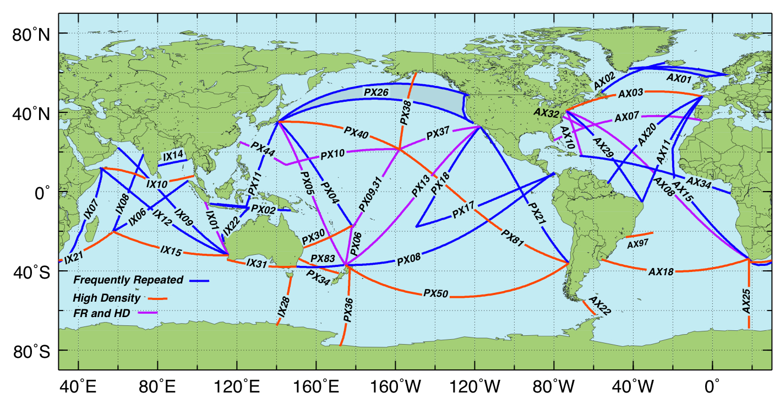
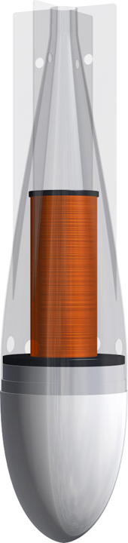
Recommended XBT Sampling Network
(OceanObs09)
CP = Chairperson
TC = Technical Coordinator (Mathieu Belbeoch)
DS = Derrick Snowden
JT = Joaquin Trinanes
FB = Francis Bringas
SM = Shawn Smith
LP = Loic Petit de Lavilleon
TR = Thomas Rossby
50+ Transects: Solid SCIENTIFIC justification
Deployment modes: spatial and temporal sampling (LD, FR, HD)
JCOMM facilitates the implementation of scientific community’s recommendations

Slide 7
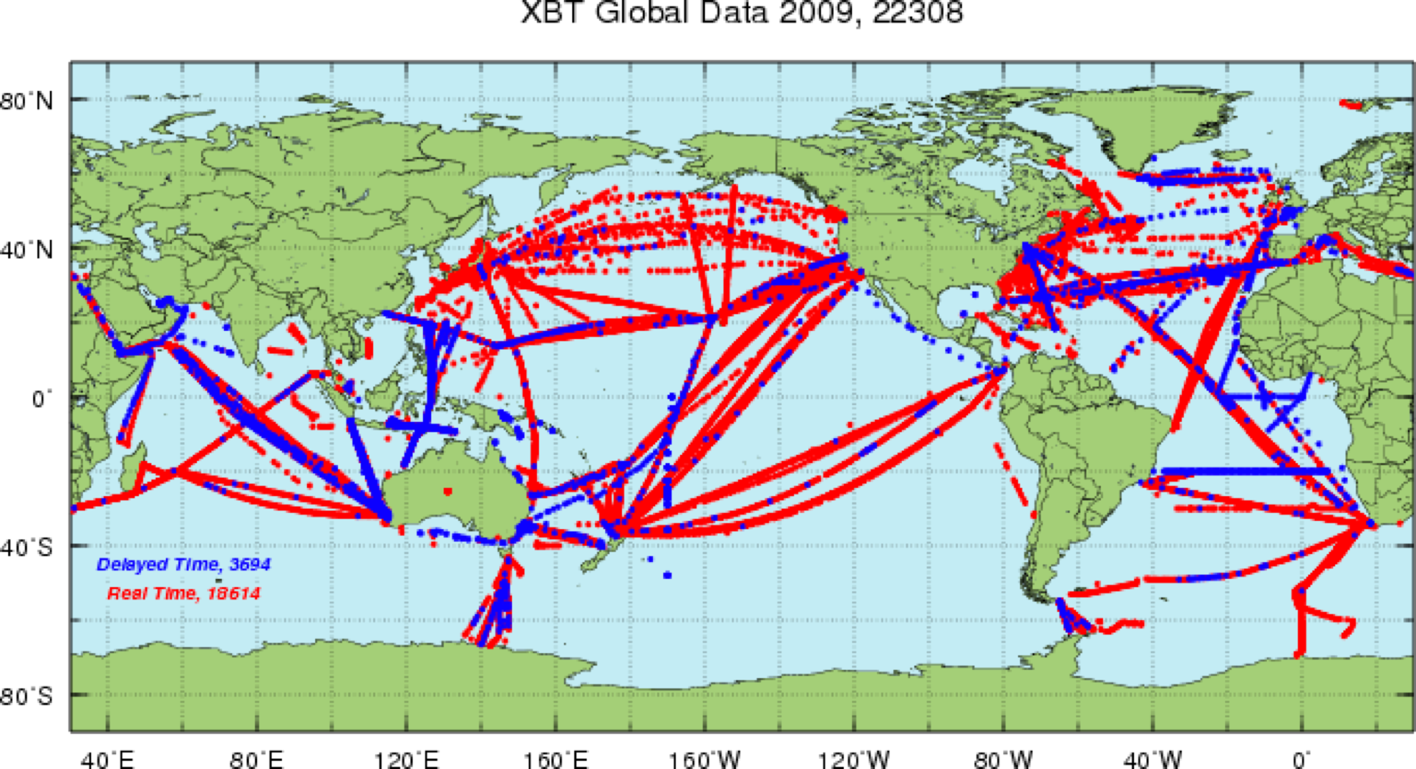
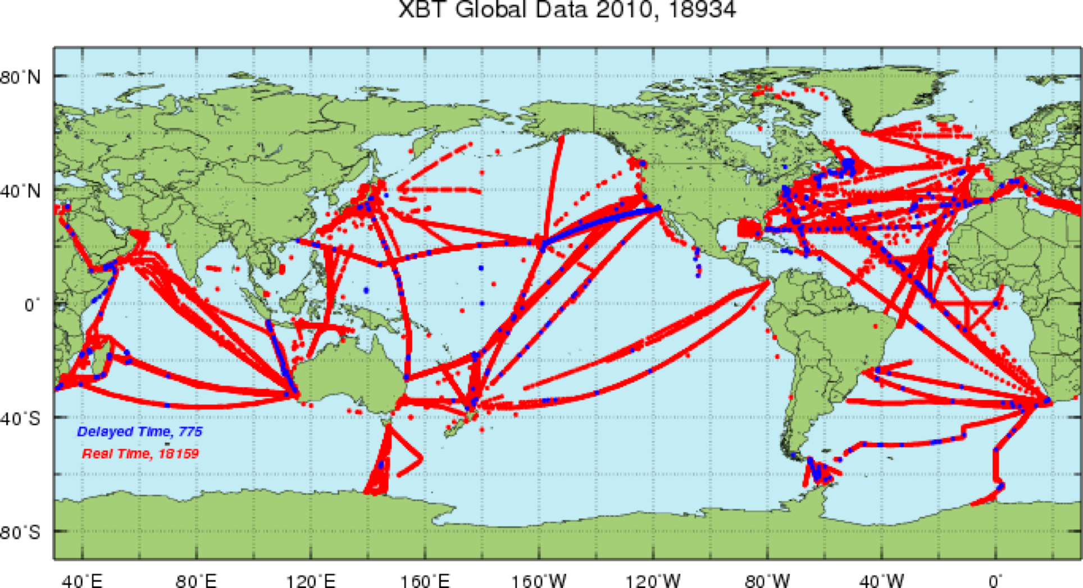
XBT deployments
2009:
Approx 22,500
~ 100 ships
2010:
Approx 19,000

Slide 8
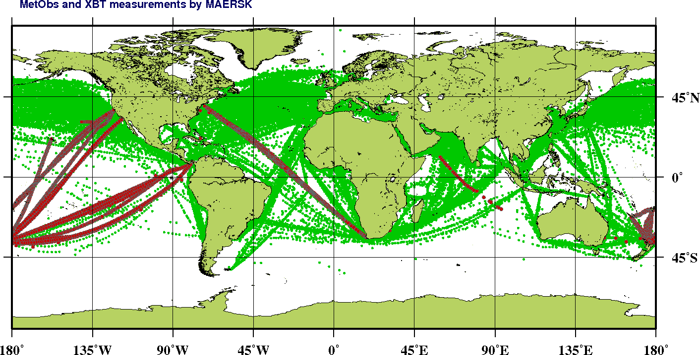
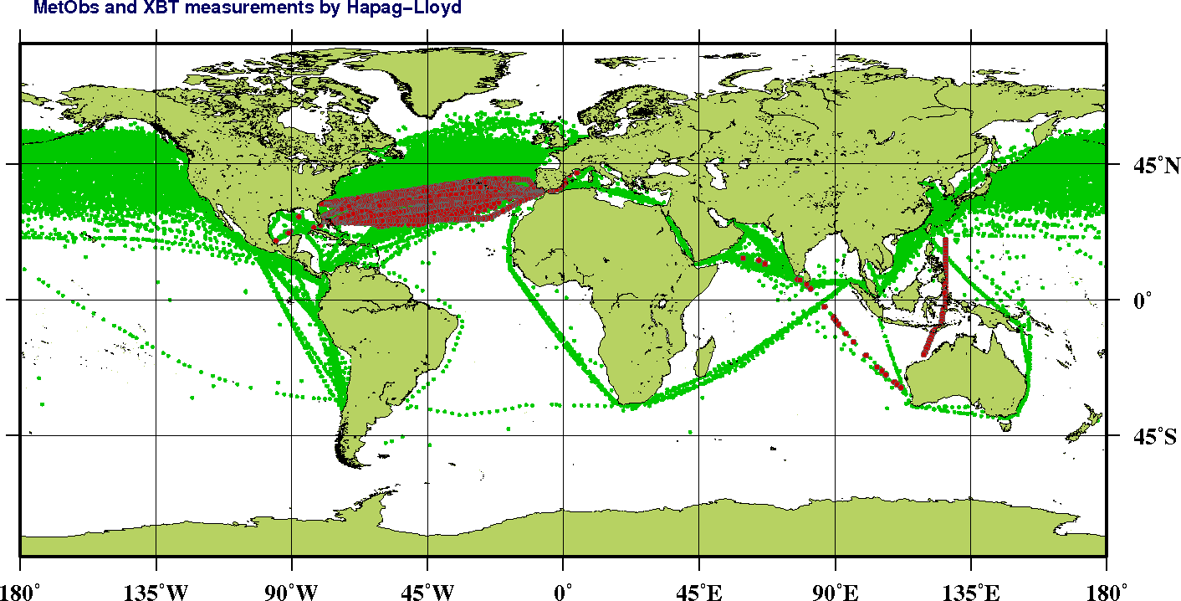
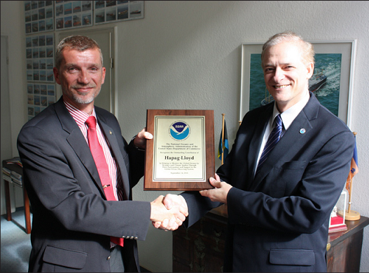
Some of SOOP Key Partners
Maersk
PoCs:
Capt. Kapil Bansal
Maersk Operations in Singapore
Mr. Nahush Paranjpye
Maersk Operation Manager
Mr. Lars Klingenberg Jacobsen
Assistant General Manager, CentralFleet Ops
Hapag-Lloyd
PoCs:
Mr. Morten Stamm Kristensen
Senior Director Chartering
Ms. Sabine Borrmann
G. Goni (NOAA) presenting Recognition plaque to Mr. Kristensen for their continuous support to SOOP in ocean and met observations.

Slide 9
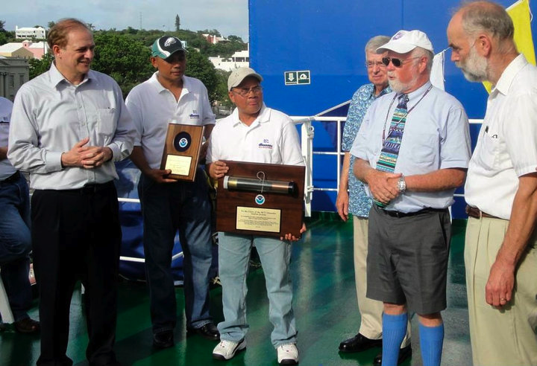
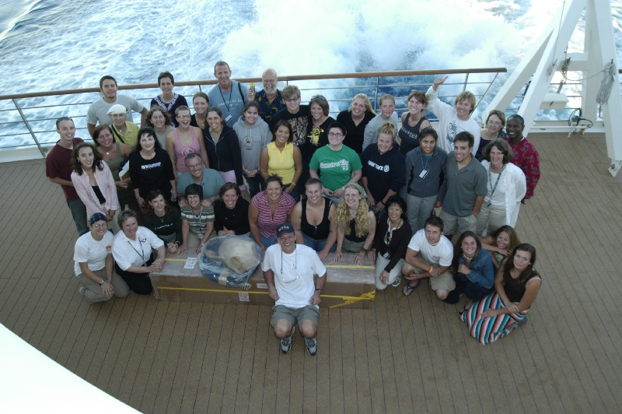
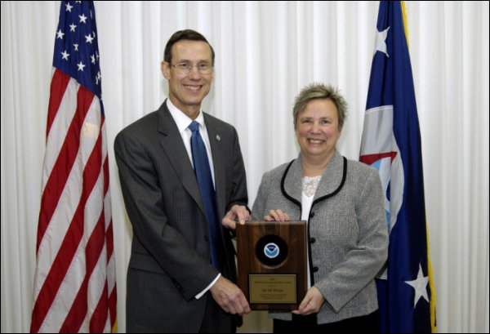
Some of SOOP Key Partners
G. Goni and D. Smith (NOAA) presenting crew and BCL owner with NOAA environmental Hero Award
Bermuda Container Line
In collaboration with URI and SUNY-SB
NOAA Environmental Hero Award 2010
Royal Caribbean
In collaboration with University of Miami
Semester At Sea (SAS) Program
In collaboration with University of Virginia
NOAA Environmental Hero Award 2007
Students of SAS Program before deploying one Argo Float in the Indian Ocean
Former NOAA Administrator C. Lautenbacher presenting Academic Dean of SAS with 2007 NOAA environmental Hero Award.

Slide 10
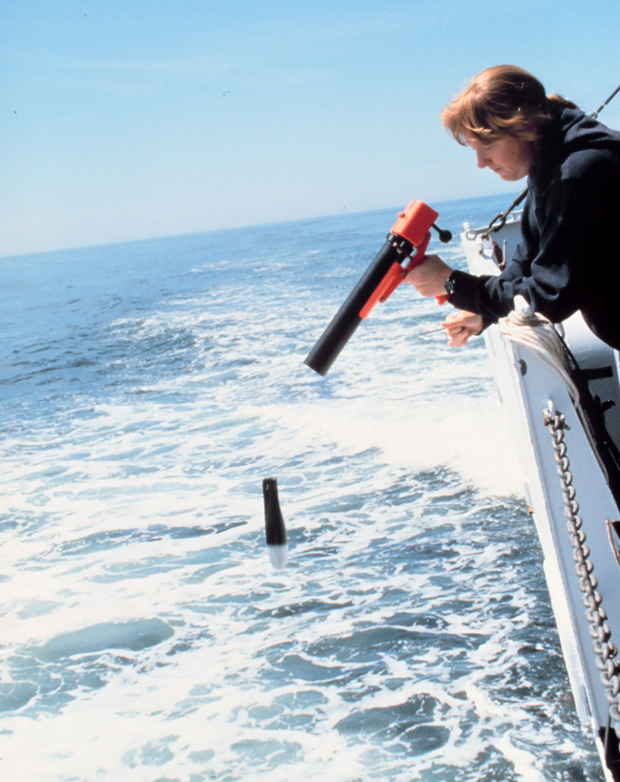
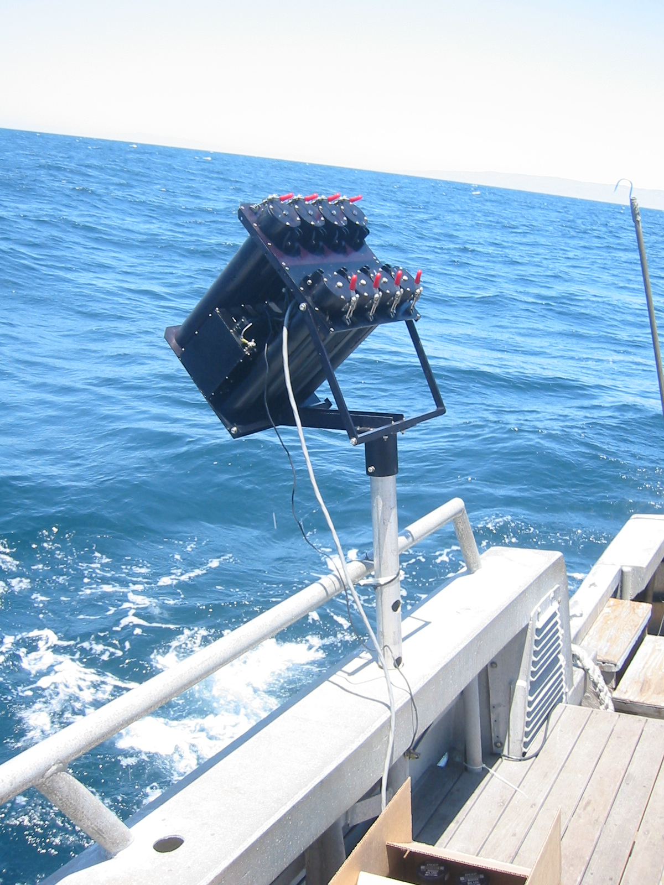
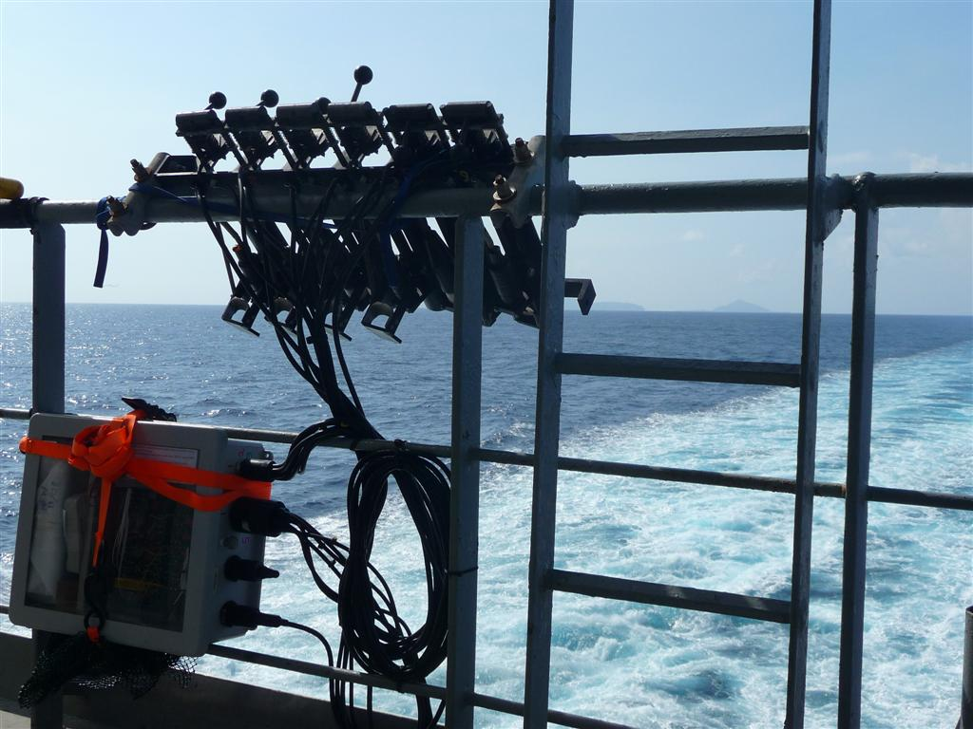
Engineering
  SOOPIP support efforts for Improved Autolaunchers (AL) used for multiple types of probes
  Supported creation of prototypes of new AL systems
CP = Chairperson
TC = Technical Coordinator (Mathieu Belbeoch)
DS = Derrick Snowden
JT = Joaquin Trinanes
FB = Francis Bringas
SM = Shawn Smith
LP = Loic Petit de Lavilleon
TR = Thomas Rossby
LM3A Hand Launcher NOAA/AOML AL SIO AL

Slide 11
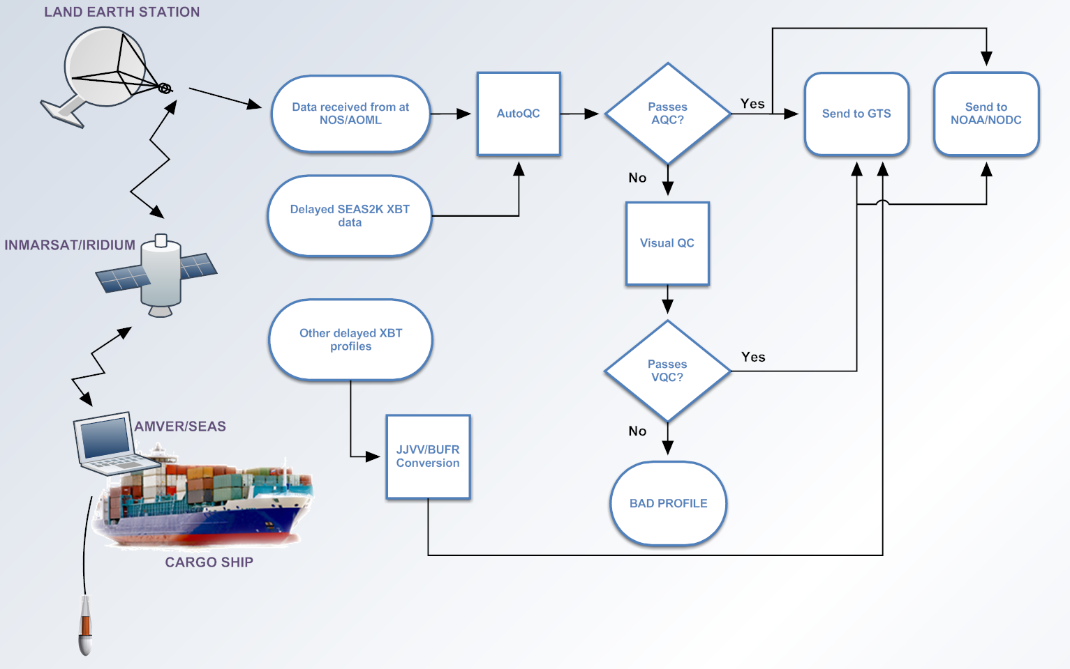
XBT Operational Data Flow

Slide 12
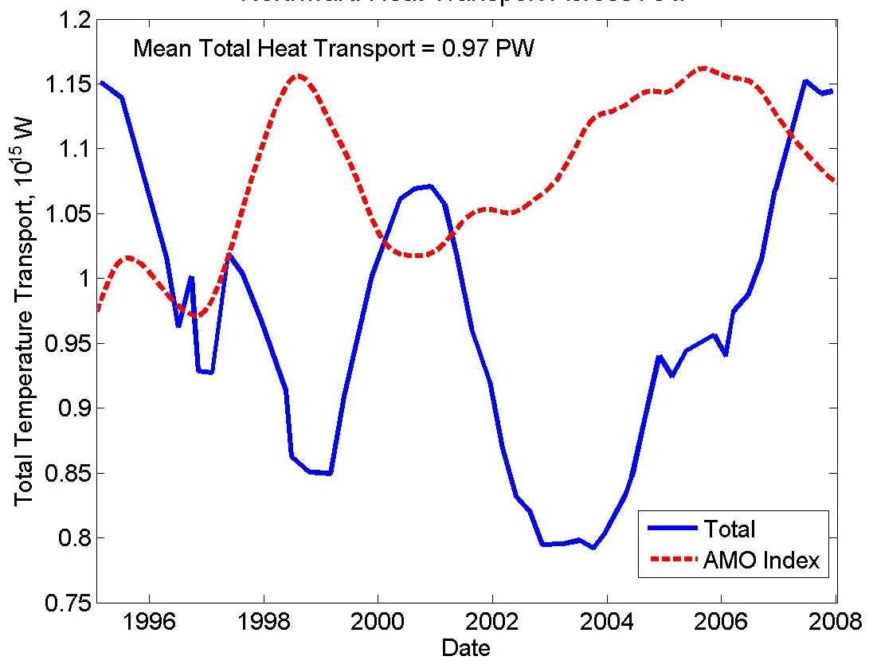
Science
Originally designed to investigate ENSO, SI variability
Current Scientific uses:
  Eddy resolving, Identification of surface, subsurface currents, compute their mass transports
  Meridional heat transport
  Strength of gyres
  Validation of models
  Water mass formation
  Initialization of models
  Heat budget
Figure by M. Baringer;
Goni et al, 2010

Slide 13
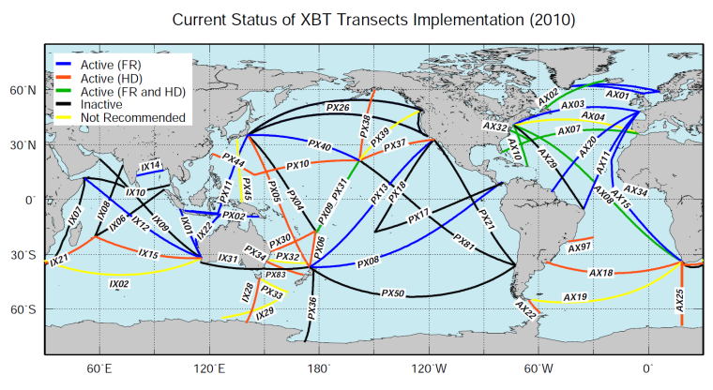
Science
Observing Boundary Currents
: Boundary currents sampled by the HRX Network
HD transects are sampling:
  Kuroshio (3 transects)
  Gulf Stream (3 transects)
  Agulhas
  Brazil Current (2 transects)
  East Australian Current (2 transects)
  East Auckland Current and Tasman Outflow
  Eastern boundary currents (California Current, Alaska Current, Leeuwin Current, …)
  Low latitude WBCs: Solomon Sea, Indonesian Throughflow
  Antarctic Circumpolar Current (3 transects)
  ……
AOML status map
Notes:
1. After slide 16
global network of boundary current observations
By combining HRX and Argo (and altimetry) we can make accurate estimates of boundary current transport and contributions to basin-wide mass and heat budgets

Slide 14
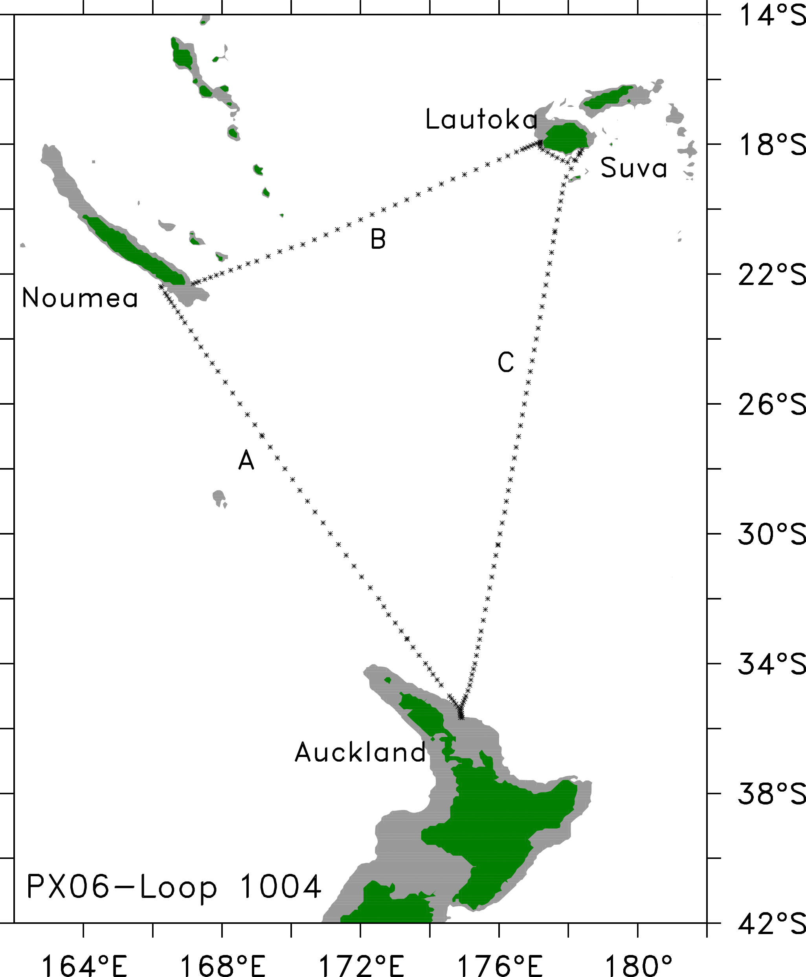
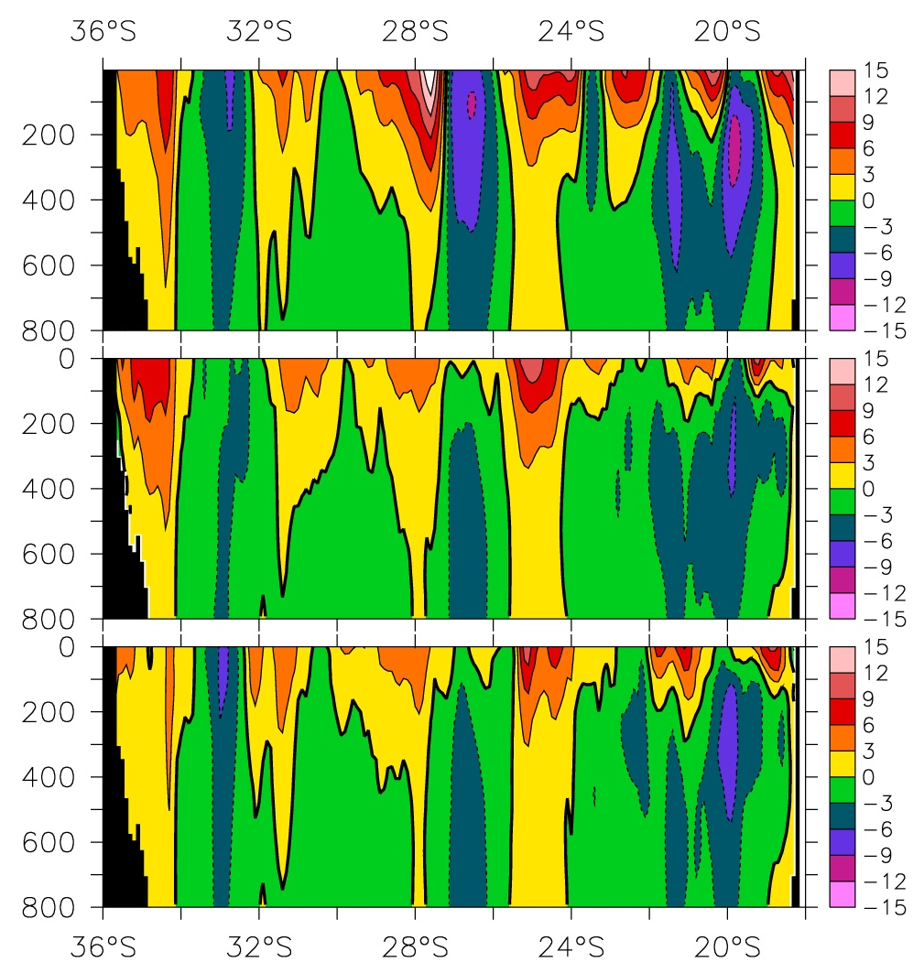
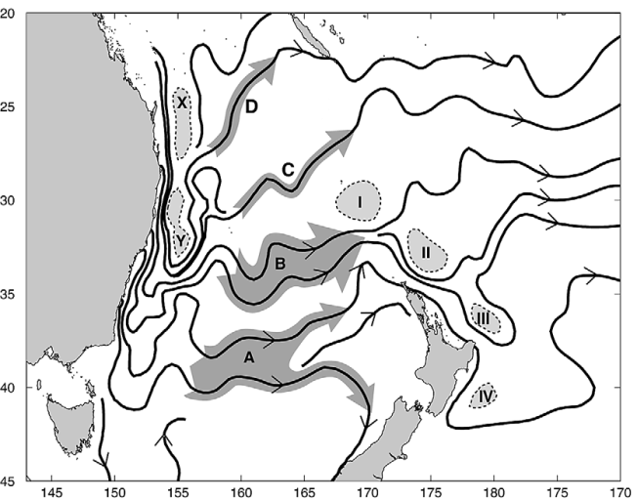
Science
The East Auckland Current outflow: a 25-year time-series (PX06)
Argo mean velocity (a high resolution 1/6º mapping) 2004-2010
PX06 mean velocity 1986-2003 with Argo 800 m reference.
PX06 changed the paradigm of a filamented EAC outflow (fig from Ridgway and Dunn, 2003)
PX06 mean velocity 2004-2010 with Argo 800 m reference
Permanent filaments of eastward flow
Figures provided by D. Roemmich (SIO)
Notes:
2. After slide 16

Slide 15
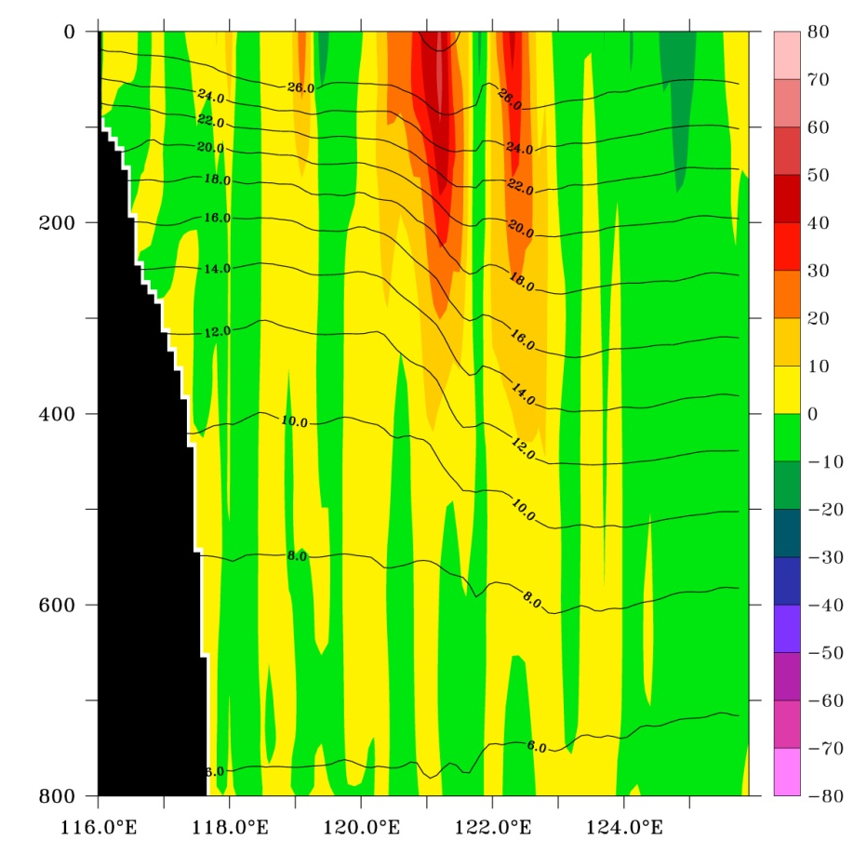
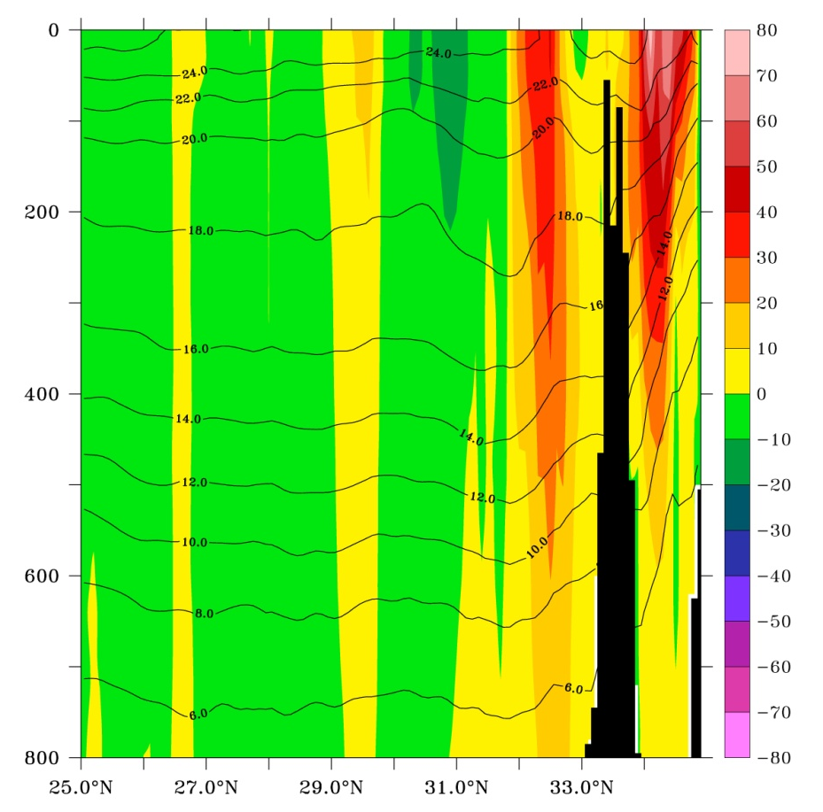
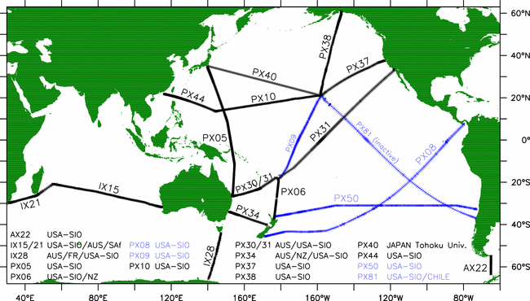
Science
Kuroshio Current (PX44 & PX05)
“Upstream” Kuroshio near Taiwan, PX44
“Downstream” Kuroshio near Yokohama, PX05
Ship:
Horizon Hawk
Ship:
Safmarine Meru
w/Argo ref. velocity; 0-800m Kuroshio 21 Sv (120ºE – 123ºE); similar to Gilson and Roemmich (2002)
w/Argo ref. velocity; 0-800m Kuroshio 39 Sv
Consistent with Imawaki et al (2001) “throughflow”
Figures provided by D. Roemmich (SIO)
Notes:
3. After slide 16
PX37/10/44 was recently dropped by Horizon Line, so we're now in need of new
shipping to continue that transect

Slide 16
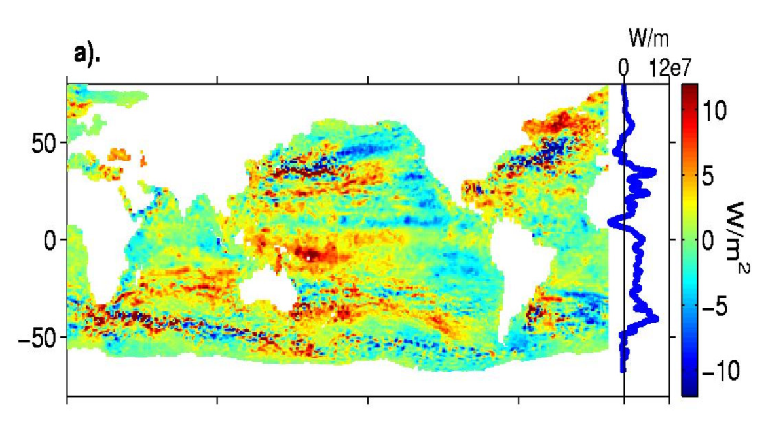
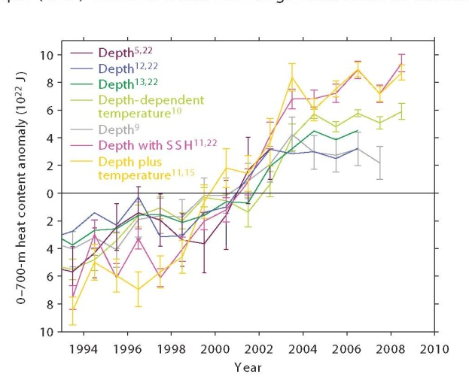
Global Ocean Health
XBT Temperature profiles constitute the majority of historical ocean profiles for studying changes in the global upper ocean heat content. They currently provide ~15% of all ocean temperature profiles.
The global pattern of warming (W/m²) from 1992 to 2002, from Willis et al (2004).
Significant global average rate of heating of ~0.6 W/m² from 1993-2008 over upper 700 m, from Lyman et al (2010)
Notes:
4. After slide 16.
Note pattern from SOP network in temperature profiles that contributed to Willis et al., study
Lyman et al (2010) assessed impact of accounting for different XBT bias corrections in global heat content estimates but still found statistically significant linear trend of 0.64 W/m^2

Slide 17
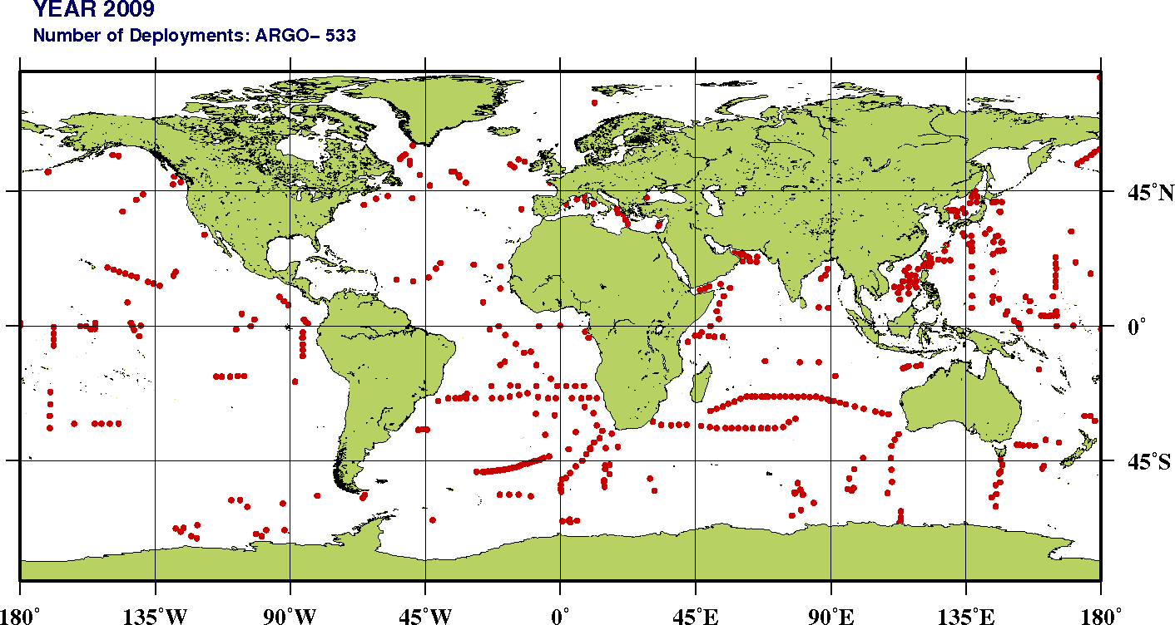
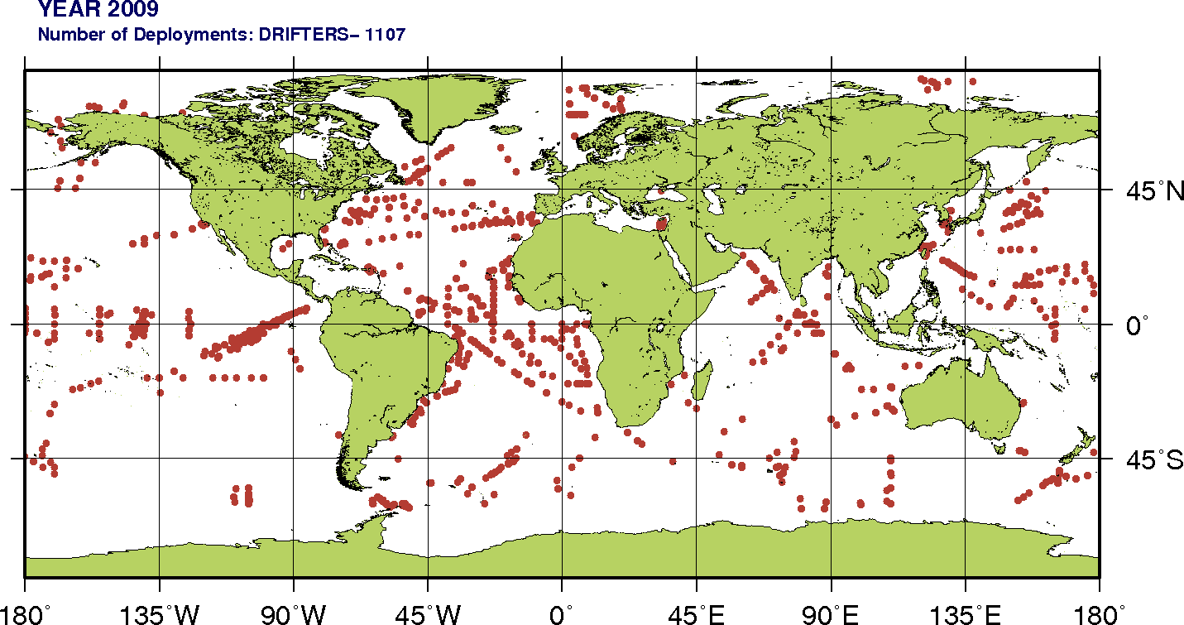
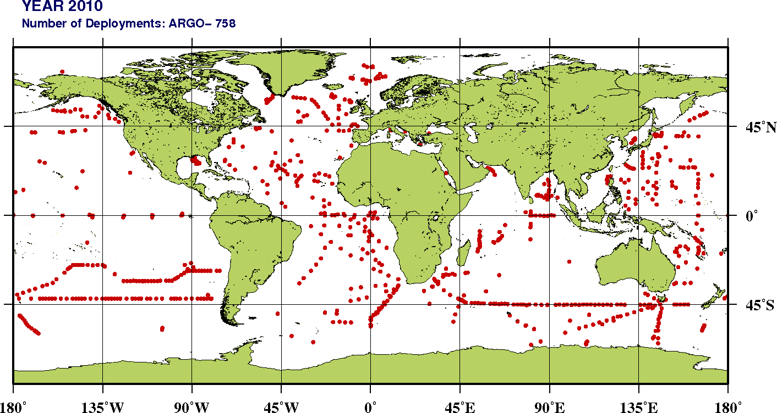
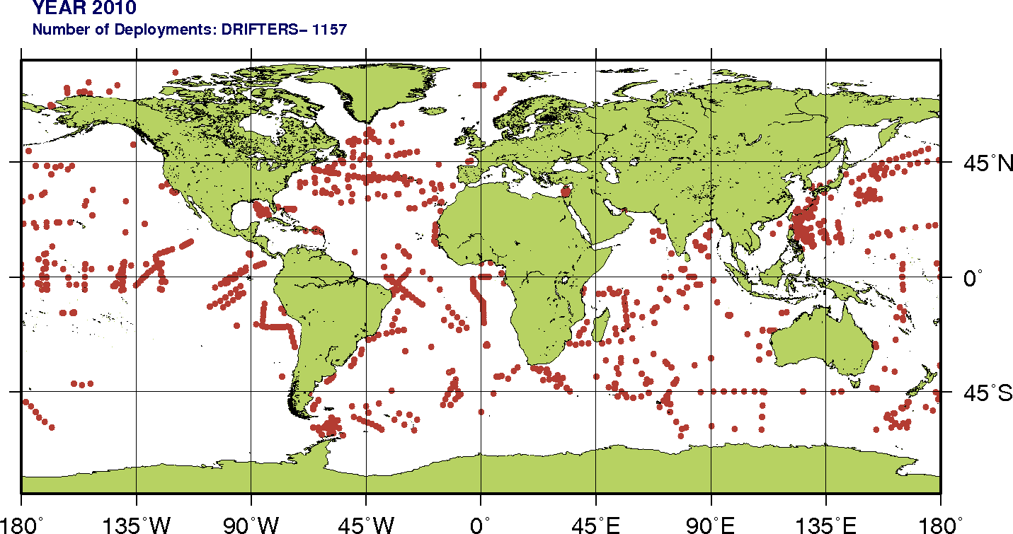
Other Deployments
ARGO
DRIFTERS

Slide 18
How WOC can collaborate with SOOP?
Help to fill gaps in observations
  Facilitate the identification and utilization of existing shipping routes and encourage active participation of new shipping agencies in the High Density XBT Network. Provide support to recruit ships on recommended transects that SOOP has difficulty to recruit ships.
Help improve current technology
  Provide support to develop improved technology of current instrumentation (e.g. wireless launchers, …).
Help develop new technology
  work with SOOP engineers, provide expertise, and provide a link to engineering companies to develop, test, and implement new technologies to measure ocean parameters as required by scientific community.

Slide 19
Thank you
SUPPLEMENTAL SLIDES FOLLOW

