Slide 1
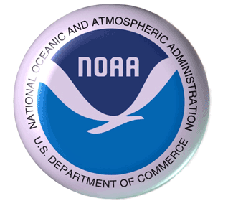
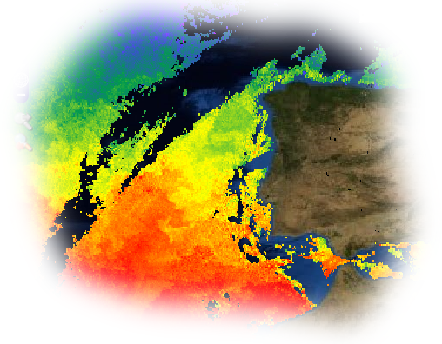
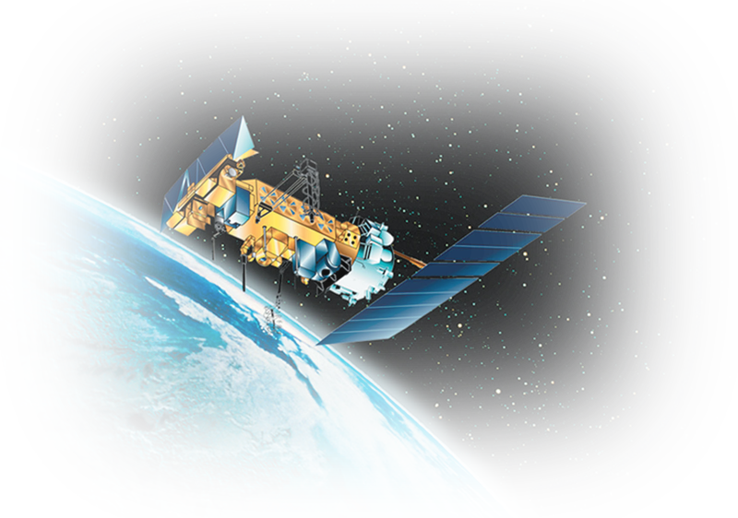
OceanWatch and CoastWatch Data and Products
Joaquín A. Triñanes PhOD/CIMAS
Joaquin.Trinanes@noaa.gov

Slide 2
Index
What are those ???Watch things?
Do they generate actual data?
I’m a Matlab guy, give me a mat
An antenna in the room

Slide 3
CoastWatch Program
Makes environmental satellite data products and in-situ data available to Federal, state and local marine scientists, coastal resource managers, and the public.
Managed by NOAA National Environmental Satellite Data and Information Service (NOAA/NESDIS), it routinely processes satellite data in near real-time.
Two core components: Central Operations and Regional Nodes. Five regional nodes and a central office provide for the distribution pathway for CoastWatch data products. Central Operations, operated within NOAA NESDIS, coordinates the processing, delivery, quality control and storage of data products. Other NOAA line offices participate in the NOAA CoastWatch Program by hosting equipment and personnel that make up a CoastWatch Regional Node providing for near real-time data distribution and regional scientific expertise to the local user community.

Slide 4
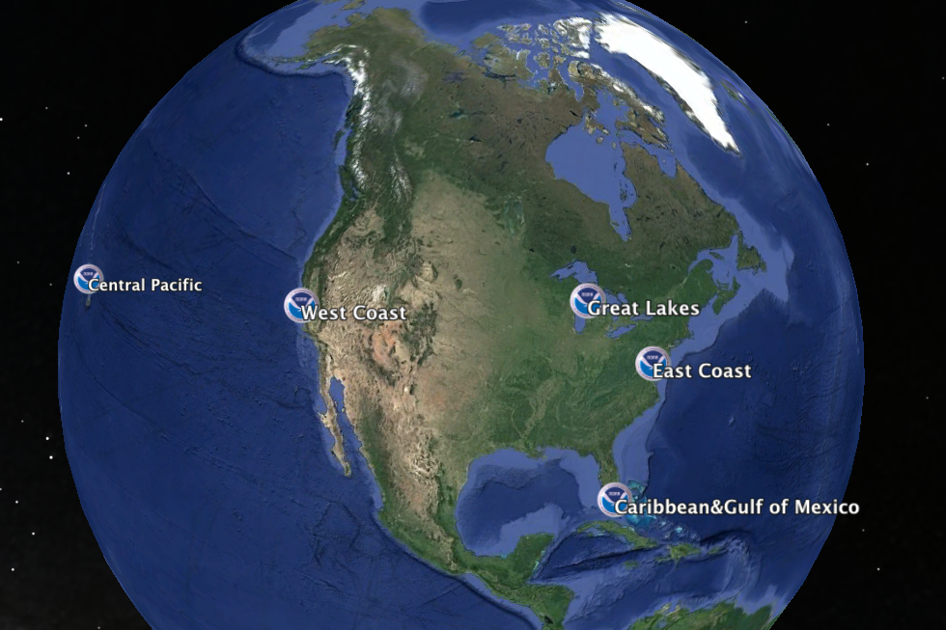
Since 1999, AOML hosts the CW Caribbean and Gulf of Mexico regional node.
Main purpose: to serve NRT satellite-derived products for the eastern US coastal region and Gulf of Mexico
Intensive collaboration with PhOD (G.G.) and OCD (R.W.)

Slide 5
OceanWatch
In a step forward in this partnership, AOML will soon become home to one of the two nodes of the NESDIS OceanWatch Program, along with Hawaii.
Some details
  Will provide integrated data and tools to scientists to better understand the physical, biological, and chemical ocean processes.
  Both CoastWatch and OceanWatch efforts will run in parallel, with the latter focusing on a larger region of interest, primarily the Atlantic basin and global oceans.
  Scientific quality products and near-real time datasets will be provided and geared towards supporting climate, ocean, ecosystems, and weather studies.
  Tools will be developed and implemented to deliver interoperable products through a service-oriented architecture, using international recognized standards for data and metadata.

Slide 6
Remote Sensing
Fundamental Advantages Synoptic view
  Short revisit times
  Operational data availability
  Integration with GIS
In line with CW objectives
  Continuity: Promote follow-on sensors/Archival
  Accessibility:OPeNDAP/THREDDS/ LAS (Open&Free)
  Quality: NRT Products
  Utilization: Regional and global, multipurpose

Slide 7
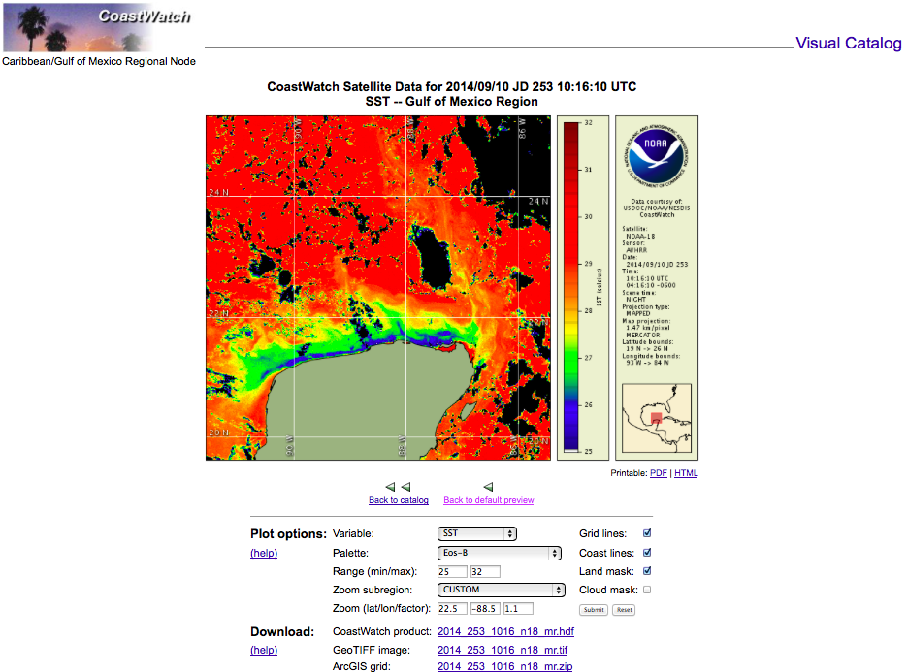
HRPT Products

Slide 8
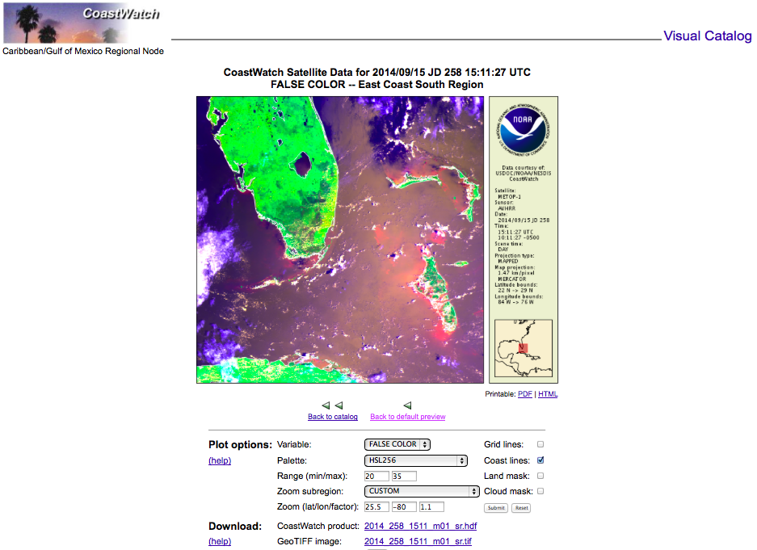
HRPT Products

Slide 9
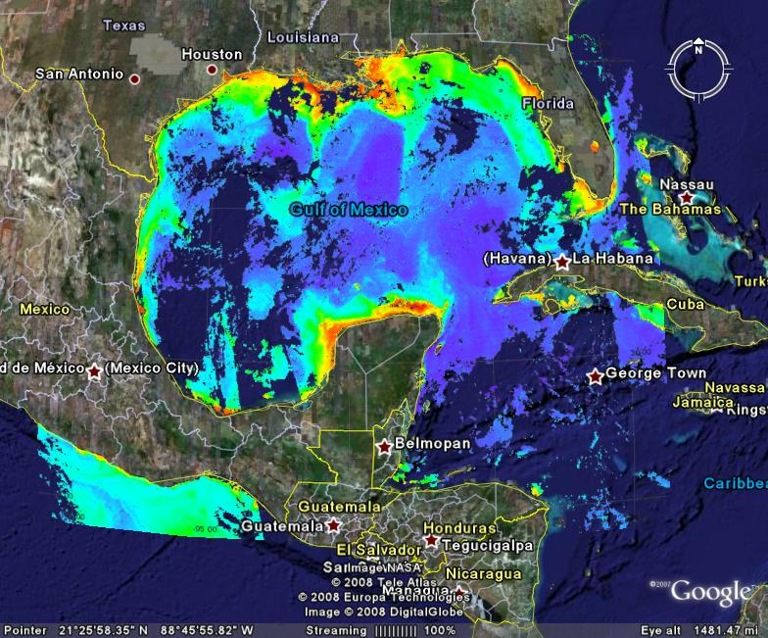
Ocean Color

Slide 10
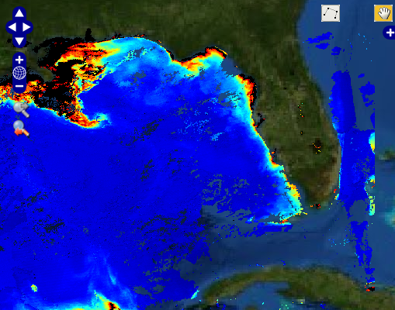
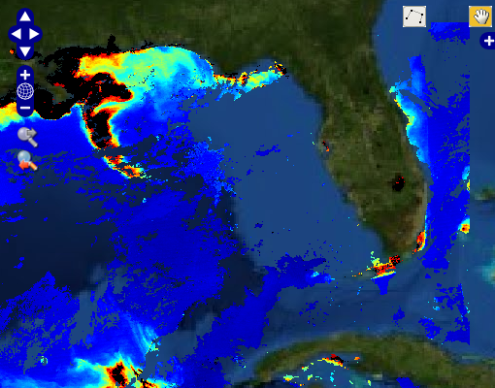
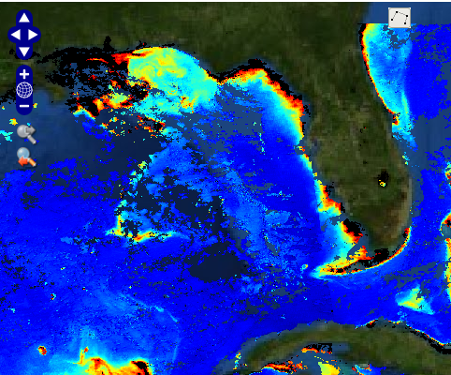
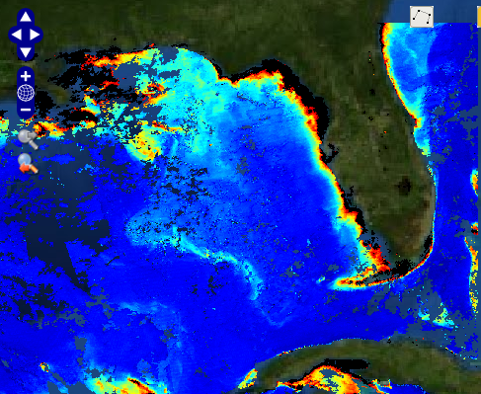
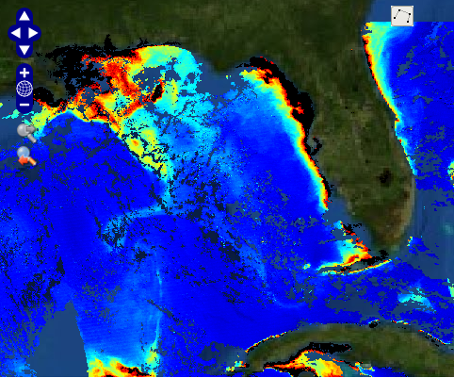
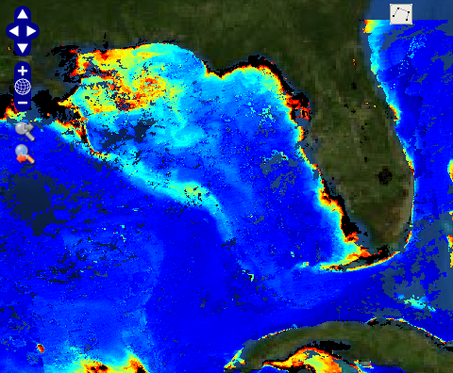
Ocean Color
Mississippi River Water Discharge

Slide 11
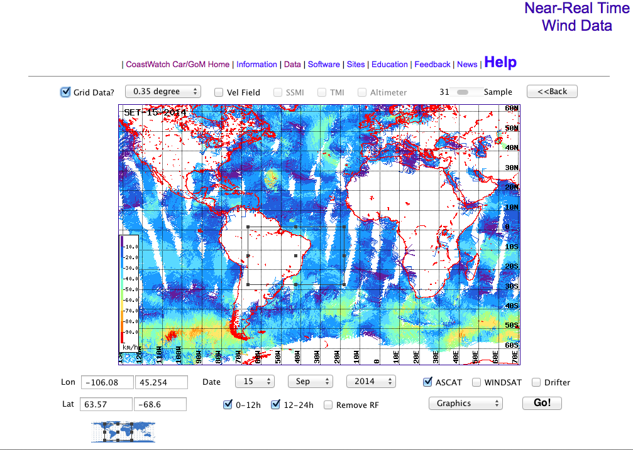
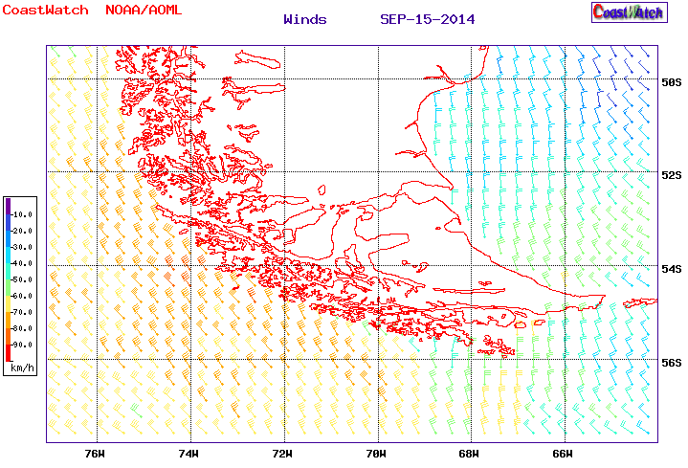
Ocean Winds

Slide 12
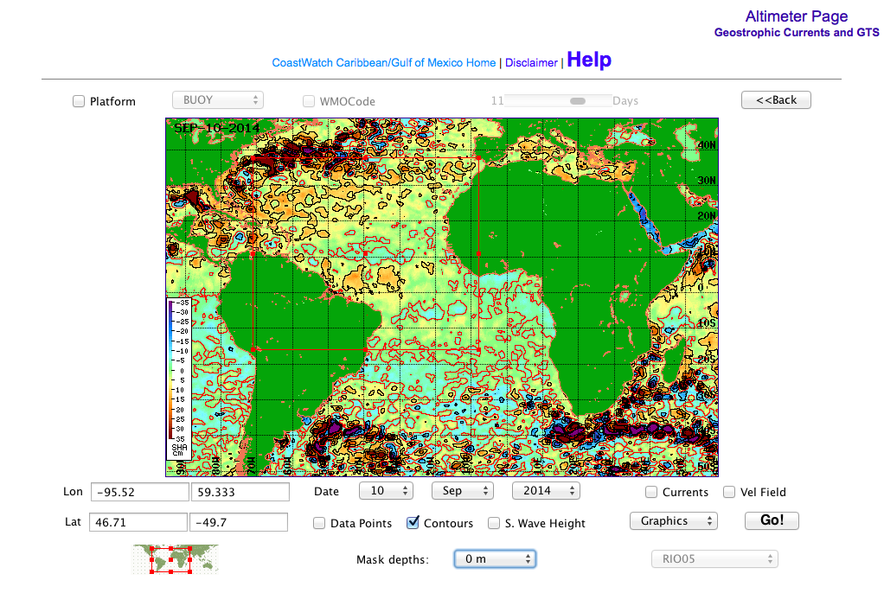
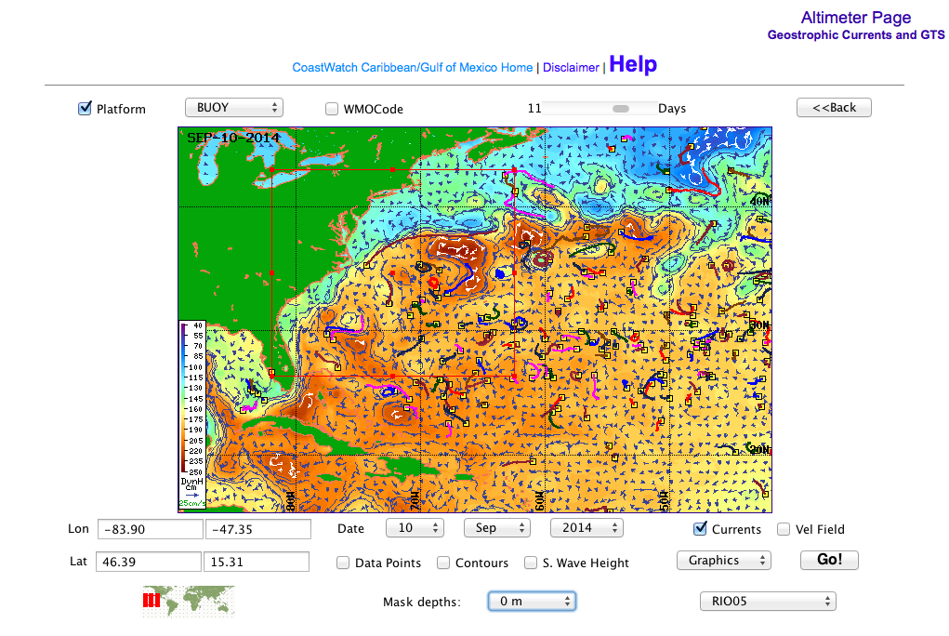
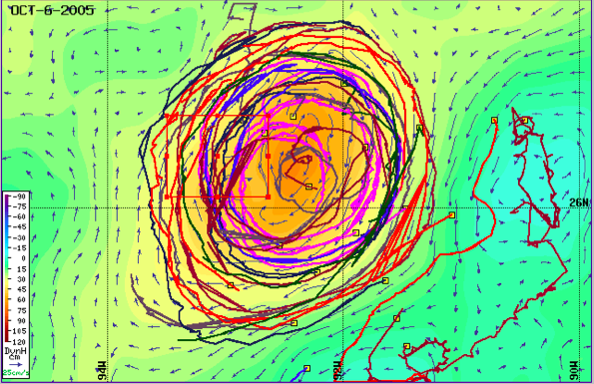
Altimetry
Notes:
Data from drifter buoys allow us to validate the quality of our estimates and provide an additional insight on the surface current field.

Slide 13
Carbon Fluxes (OCD/Rik Wann.)
Goals
Quantify the fluxes using satellite-derived parameters
Constrain regional fluxes to 0.2 Pg C year-1, using the synoptic capabilities of satellite sensors
Assess the regional extent over which the algorithms can be applied
Monthly and Seasonal
Study the spatial and temporal variability

Slide 14
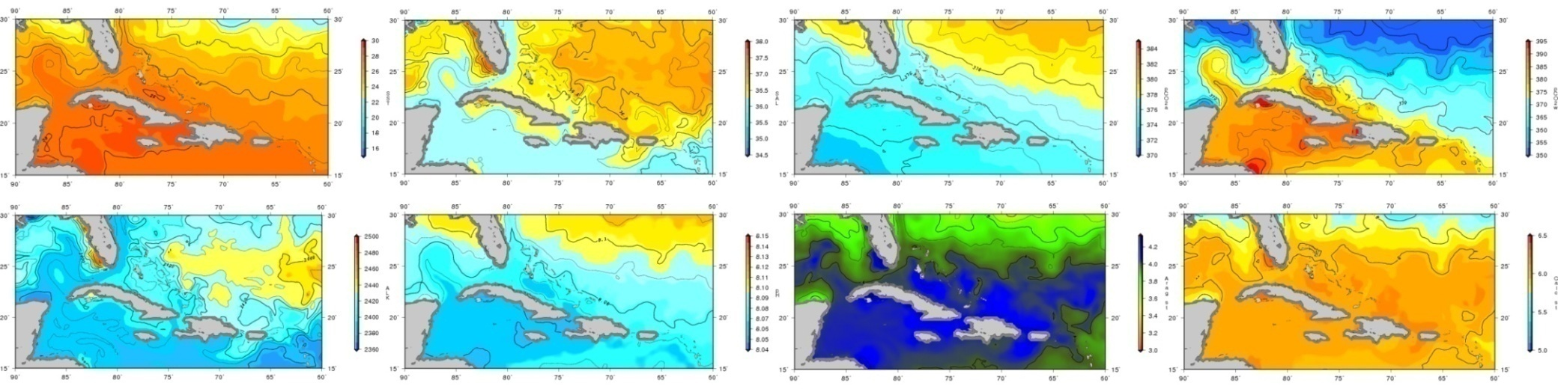
Acidification (OCD/Rik Wann.)
New approach for the Caribbean region
Temporal scales: monthly, weekly and daily
Nominal spatial resolution: 1/5 degree
Suite of products include: SST, SSS, pCO2a, pCO2w, Alk, pH, Ωarg and Ωcal.

Slide 15
Public Health
Some facts about Vibrio species
Pathogenic vibrios present in marine environment
Proliferate in warm and low salinity seawater
Clinical manifestations: Wound infections, gastroenteritis, septicaemia (100 fatalities /year USA)
Other factors: ageing population, shellfish consumption, contact with water, etc.
Can RS help to track Vibrio disease emergence?
Open questions Can pathogenic Vibrios move with currents?
Regional & Global models?

Slide 16
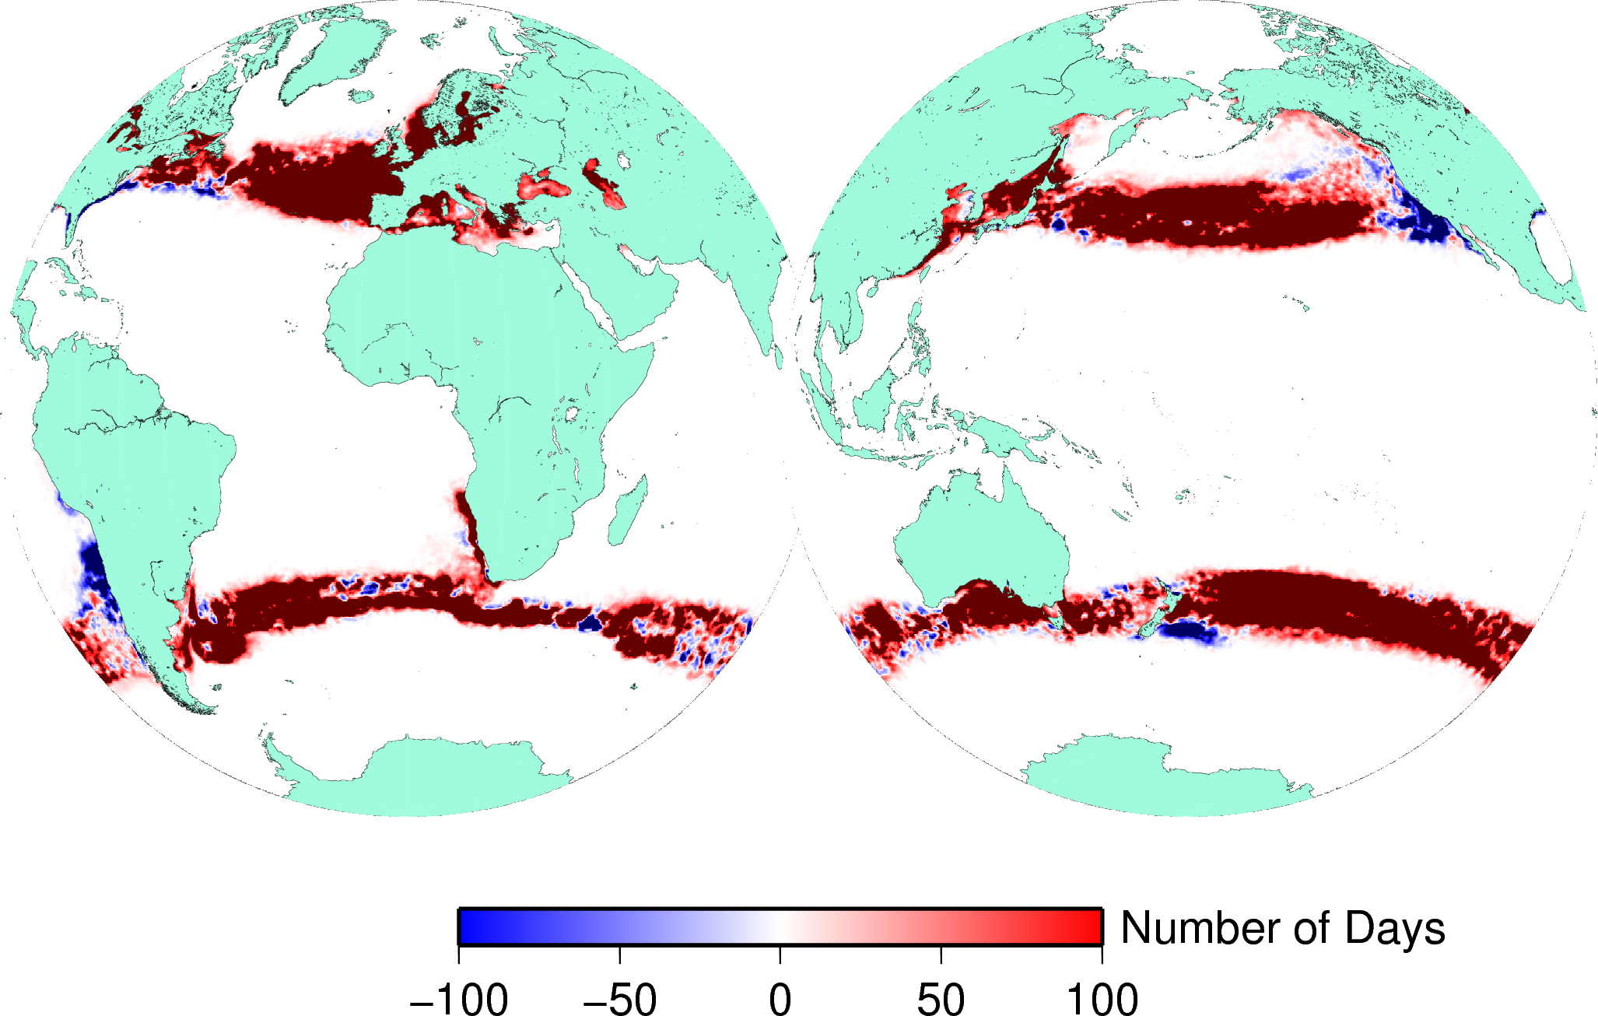
Public Health
1982-1989 vs 2004-2011
Notes:
Difference in the number of days above 18C between 2004-2011 and 1982-1989. Indicates potential areas of Vibrio expansion in responseto ocean warming. We see that many temperate regions around ~ 40N/S are affected.

Slide 17
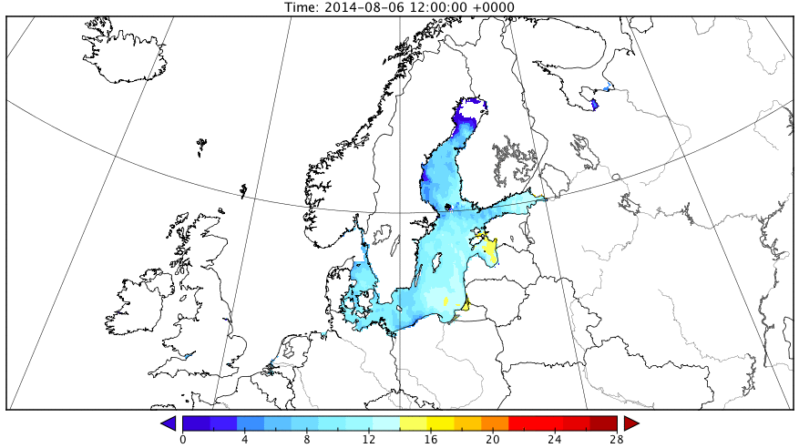
Public Health

Slide 18
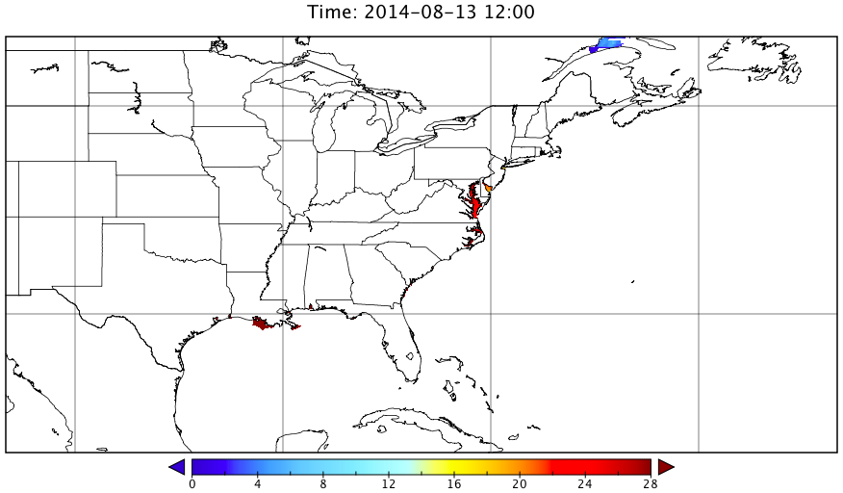
Public Health

Slide 19
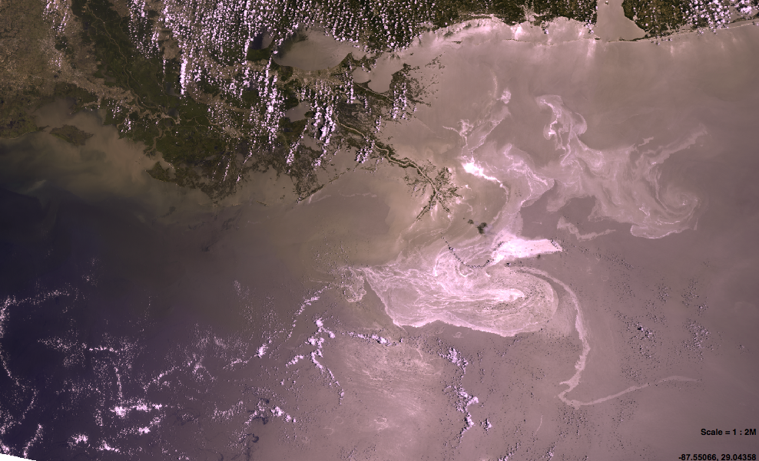
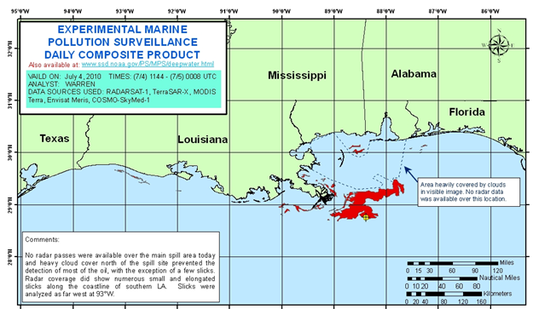
DWH
  MERIS, May 27th 2010

Slide 20
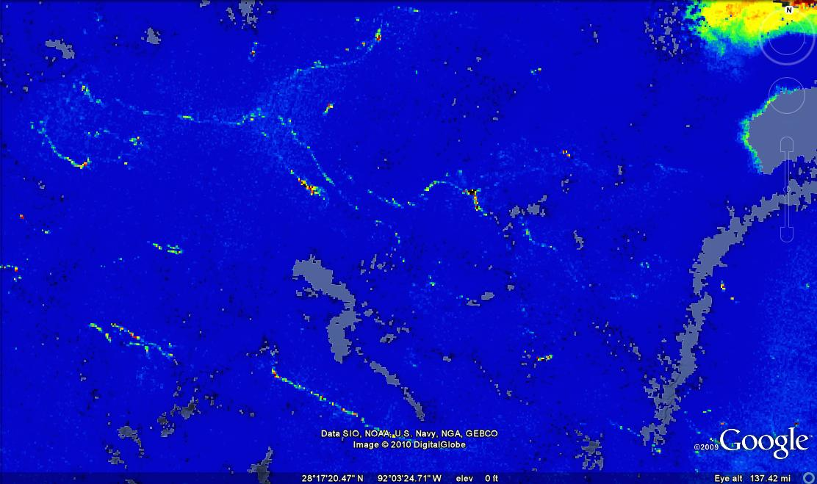
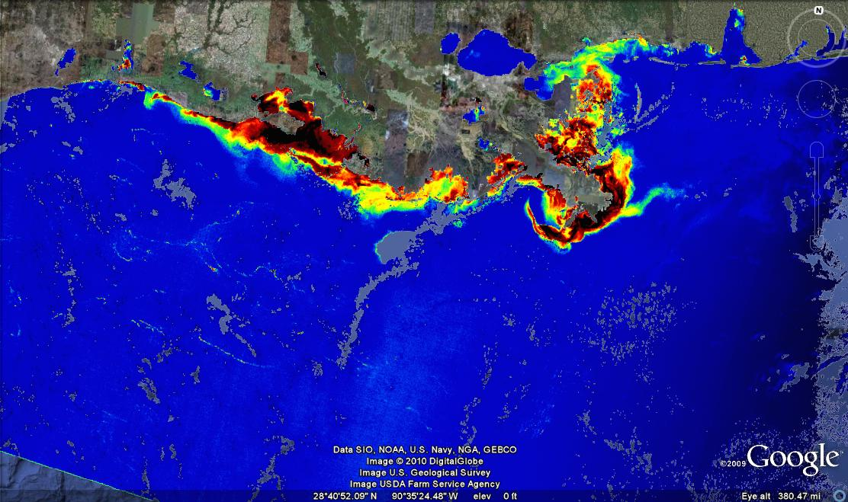
DWH
  MCI Jun 25th 2010

Slide 21
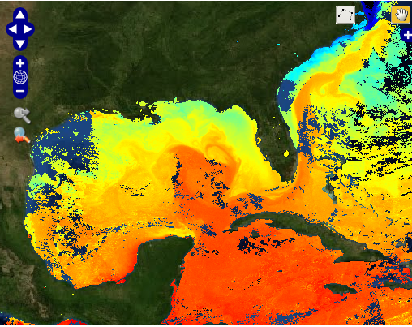
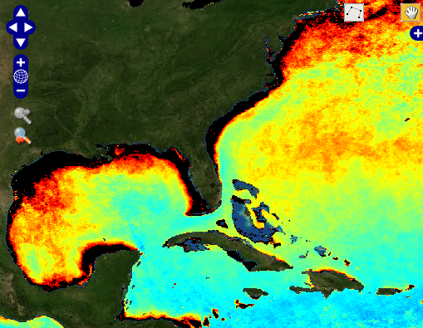
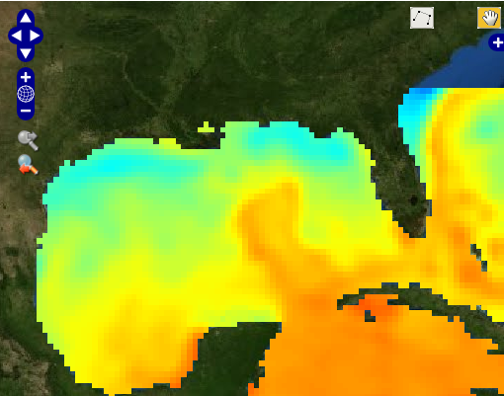
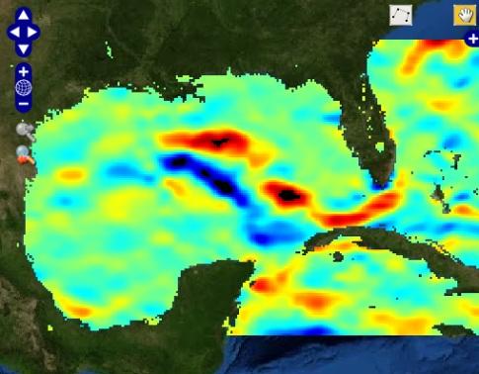
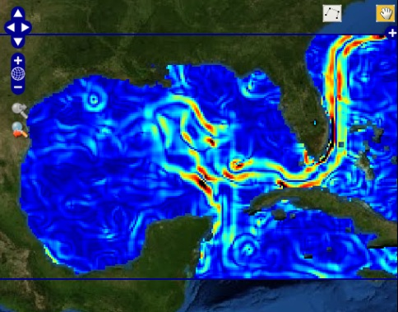
DWH
  DWH Natural Resources Damage Assessment
  In collaboration with SEFSC and NCDDC

Slide 22
Formats and Tools
Metadata are also data
Adoption of standards and protocols
Interoperability and SOA
Controlled vocabulary and data encoding convention (CF)
Decision-support systems / Climate Change
Remote Sensing
  Larger volume of data and formats
  Hyperspectral RS
  More platforms and sensors
  New actors on scene (China, Brazil, India, …)

Slide 23
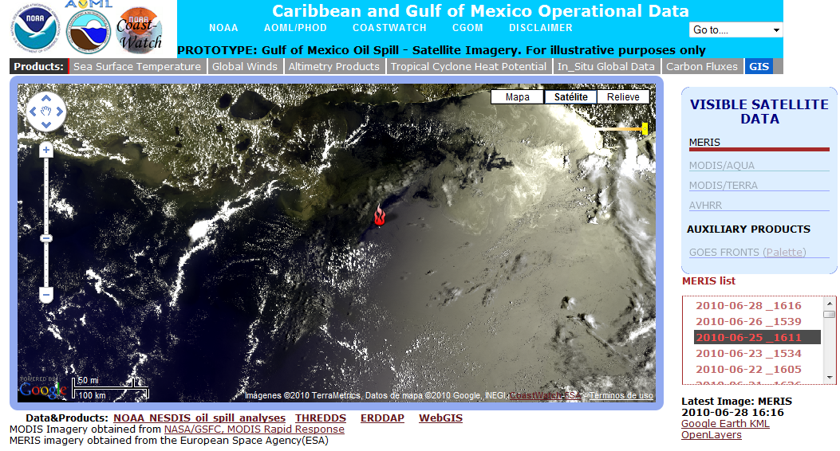
Tools

Slide 24
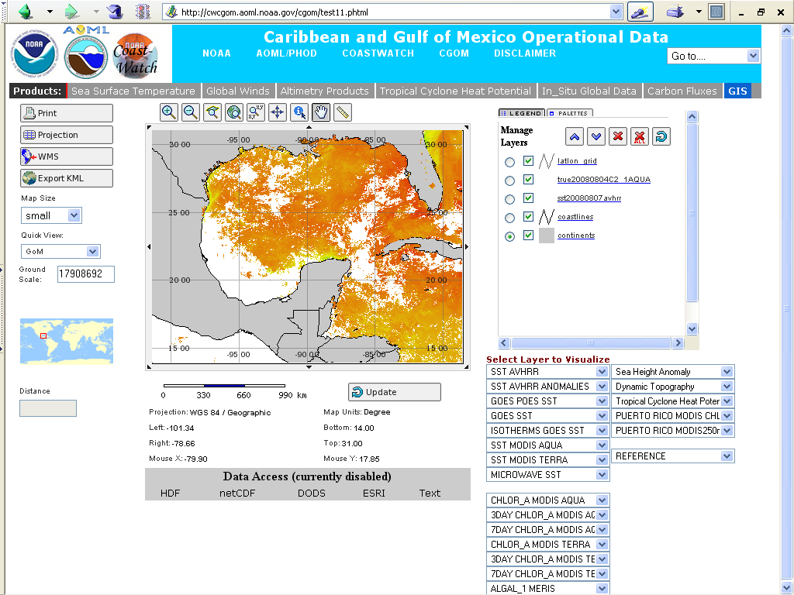
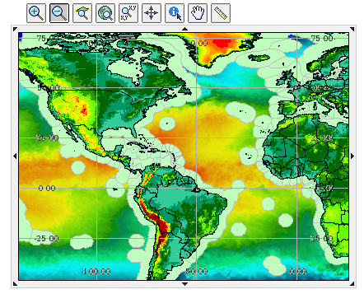
Tools

Slide 25
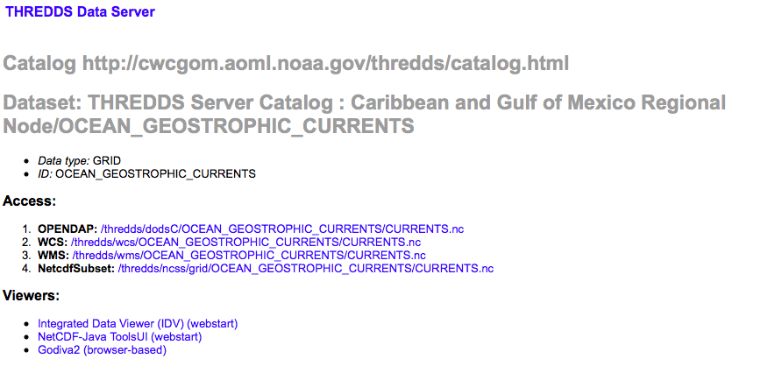
Tools

Slide 26
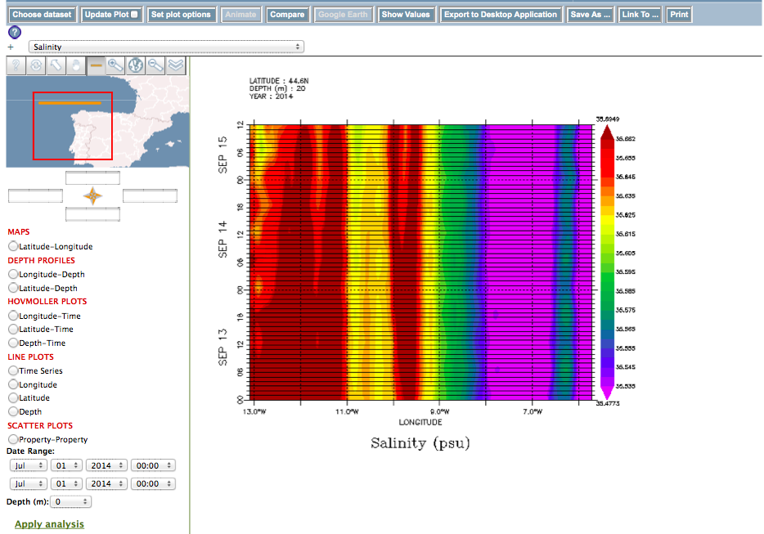
Tools

Slide 27
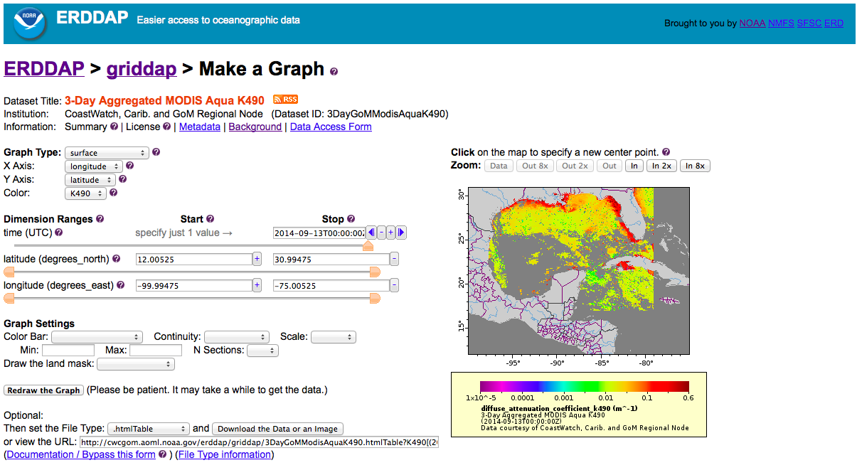
Tools

Slide 28
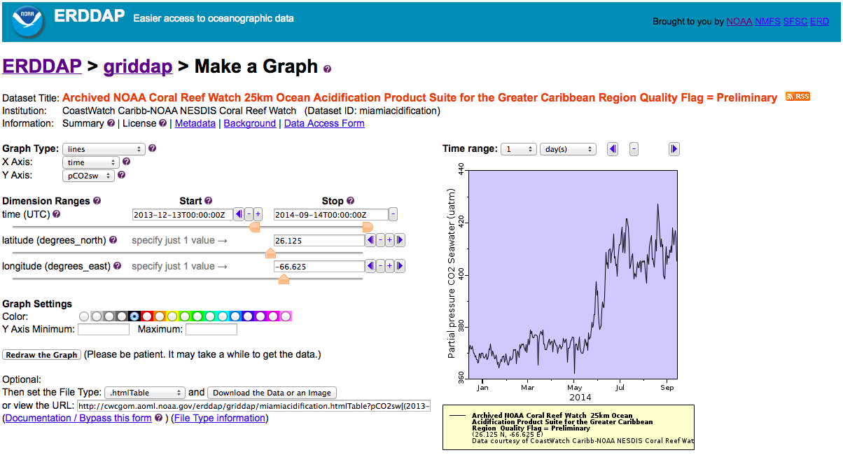
Tools

Slide 29
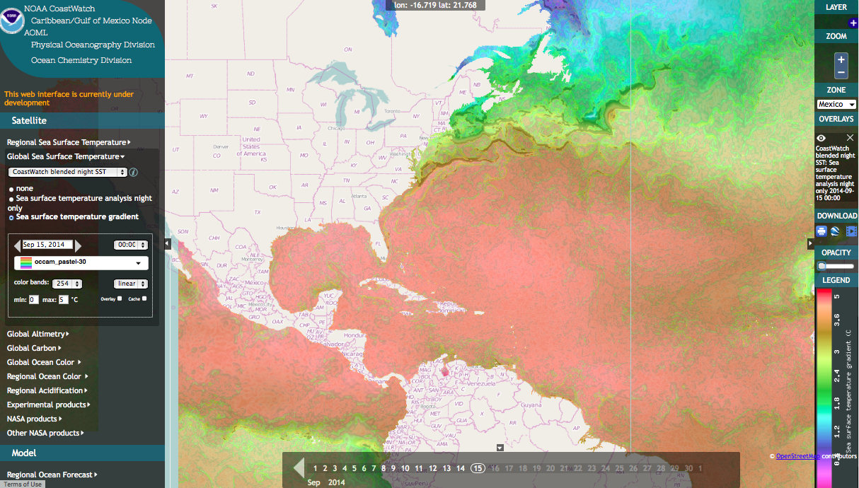
Tools

Slide 30
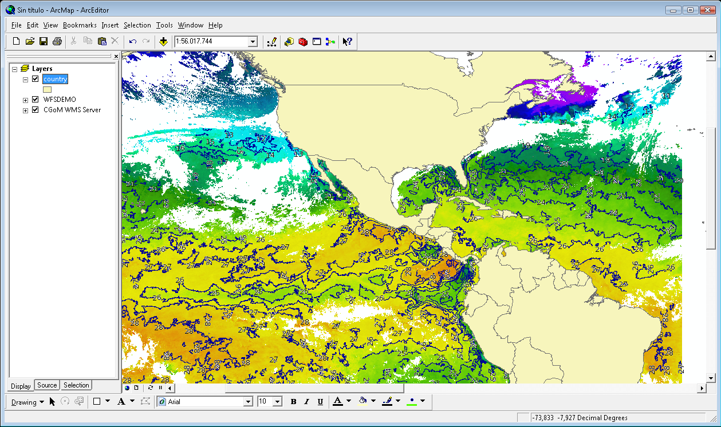
Web Services

Slide 31
Ongoing Work
  Multiday composites and additional vector features
  Anomalies and trends
  Improve metadata
  Improve computer infrastructure
  Regional algorithms (e.g. TSM)
  LCS SOS WPS
  Sentinel Constellation
Long term risk forecast&retrospective
Upwelling indexes
SST/Chlor/Currents frontal product (strength-related, persistence), GIS layers, marine sanctuaries, etc.
Notes:
The Caribbean/Gulf of Mexico web-based GIS became publically available last spring and allows users to view, retrieve, and overlay oceanographic variables. Web Map Service (WMS) and Web Feature Service (WFS) servers are available to provide raster and vector data. The user can also retrieve data from local and remote servers.

Slide 32
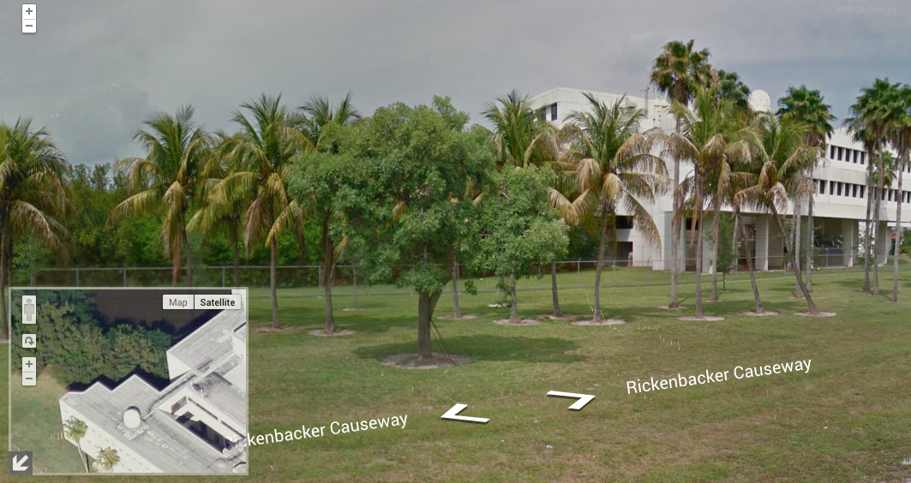
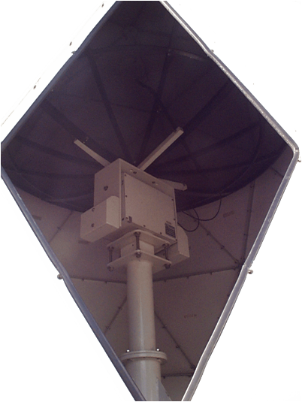
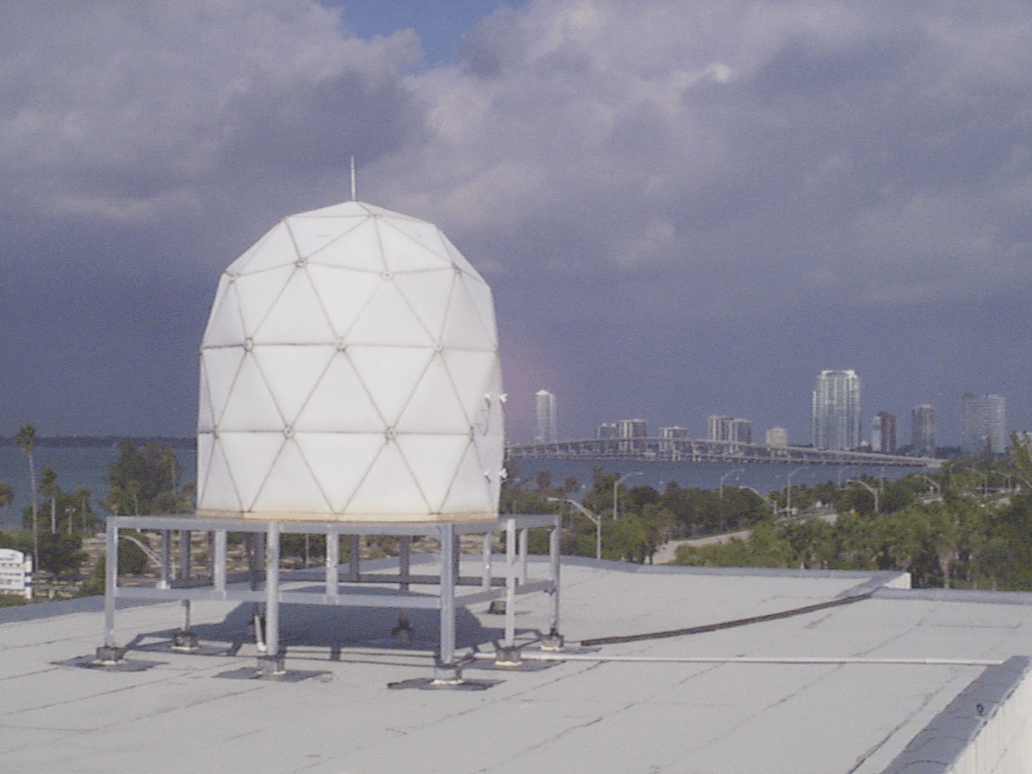
L-Band Antenna

Slide 33
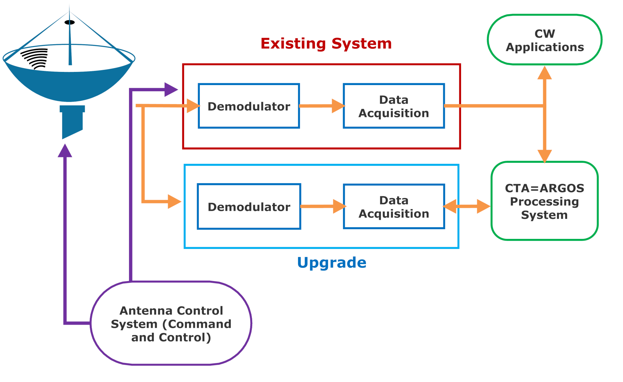
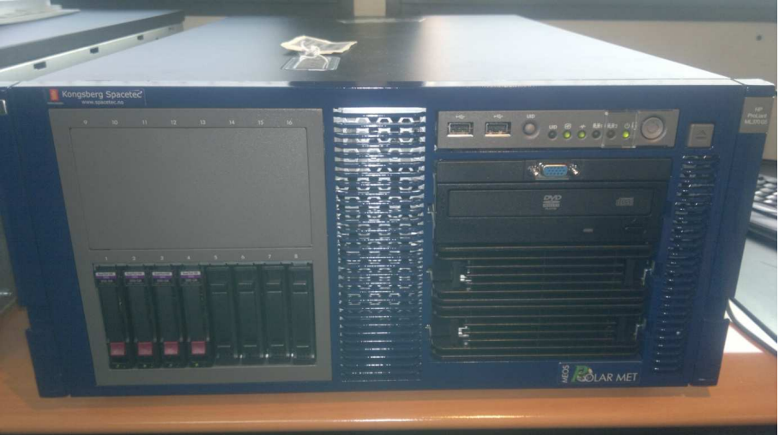
L-Band Antenna

Slide 34
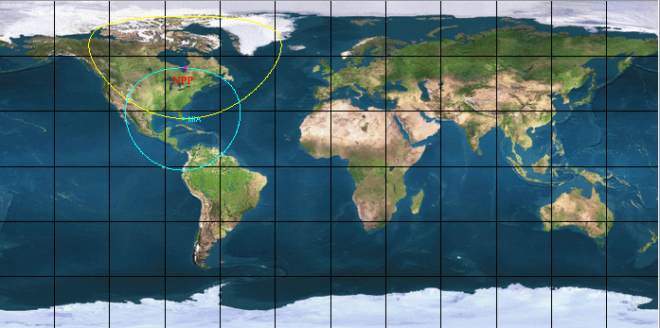
X-Band Antenna

Slide 35
X-Band Antenna
Image of new antenna
AOML will be able to generate VIIRS ocean color products, SST, etc. which will greatly support ocean/coastal ecosystem efforts.

Slide 36
X-Band Antenna
AOML’s location provides an excellent coverage of the Gulf of Mexico and Caribbean, and the US East coast up to Canada.
Improve the rapid availability of high spatial/temporal/spectral resolution products from a number of X-Band remote sensing satellites. High bandwidth through UM enable rapid transfer of large volumes of data.
The upgrade would integrate with NOAA operational requirements and needs, and allows Miami to act as a backup site for central operations in the region.
The upgrade focuses on receiving data from S-NPP, JPSS and probably TERRA and AQUA. Other satellites like GCOM-C and Oceansat-2 are considered options at this stage.

Slide 37
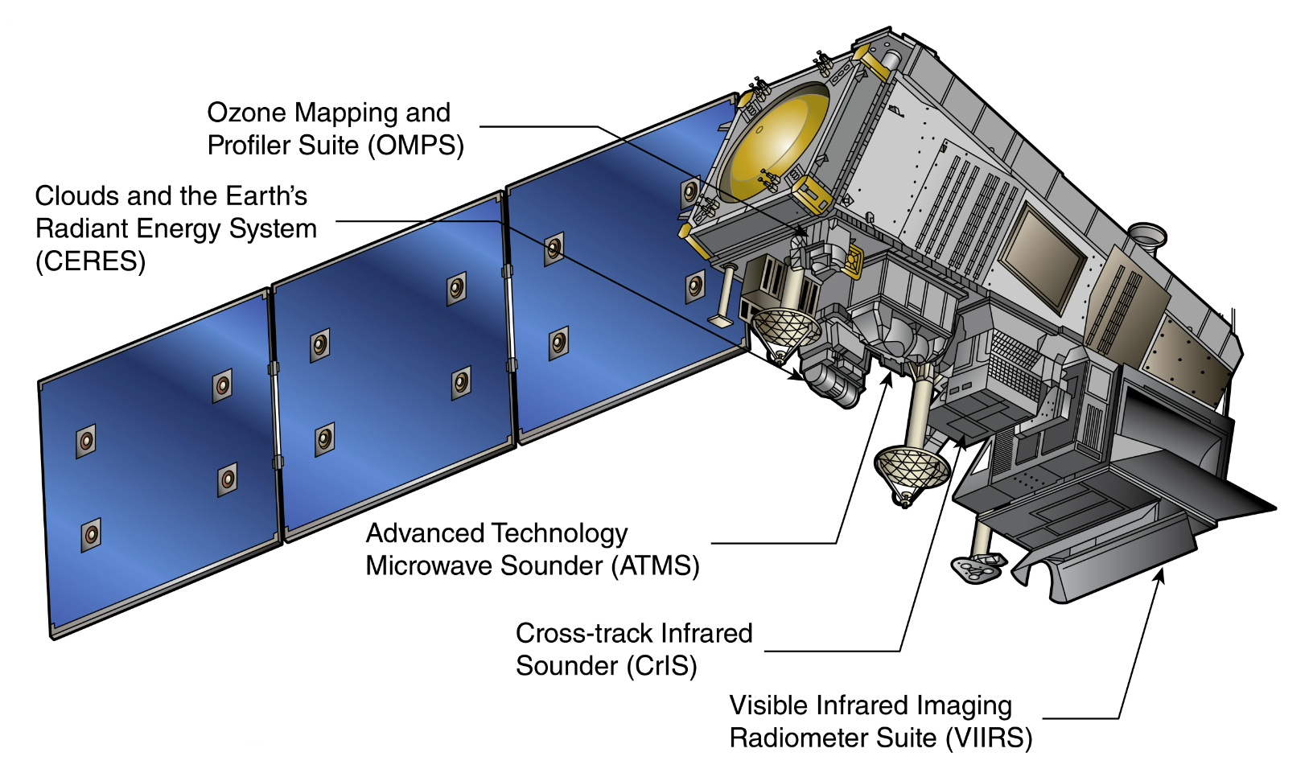
X-Band Antenna
Ozone concentration
Cloud properties, reflected solar radiation and emitted terrestial radiation
Temperature and moisture profiles
High resolution visible and infrared imagery!!
Atmospheric temperature, water vapour and trace gases

Slide 38
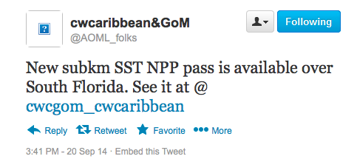
Final Considerations
AOML hosts a CW&OW node (could it be good for all of us?)
We welcome suggestions about potential enhancements and new product requests
We would be happy to collaborate, discuss, research, publish and brainstorm with you.
Do you have a product and want to distribute it? Contact us!
(Joaquin.Trinanes@noaa.gov)

