Slide 1
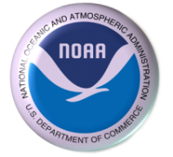
SAB/STAR Ocean Brief
Jul 22th 2010
OIL SPILL REPORT
Caribbean and Gulf of Mexico Regional Node
NOAA/AOML
Joaquin Angel Triñanes
University of Santiago de Compostela

Slide 2
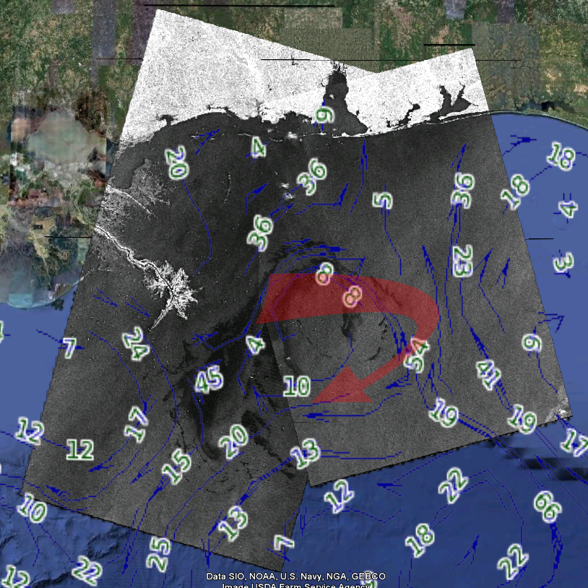
SAR + G. Currents

Slide 3
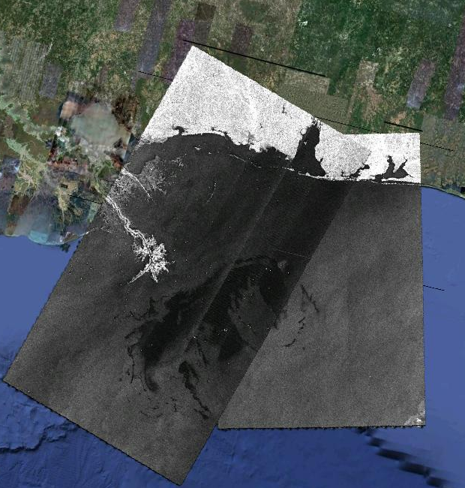
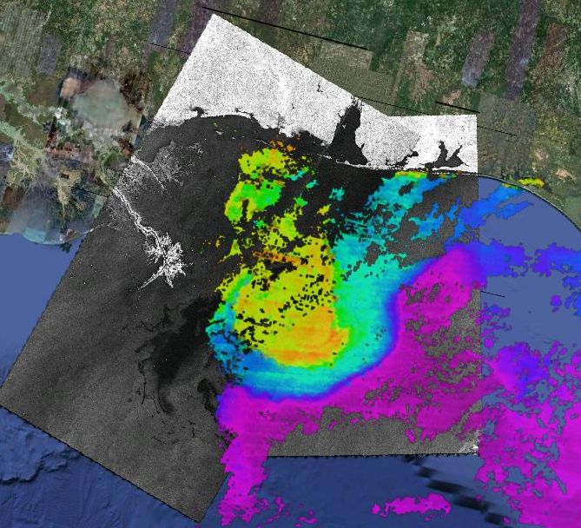
SAR + AQUA 3D Chlor

Slide 4
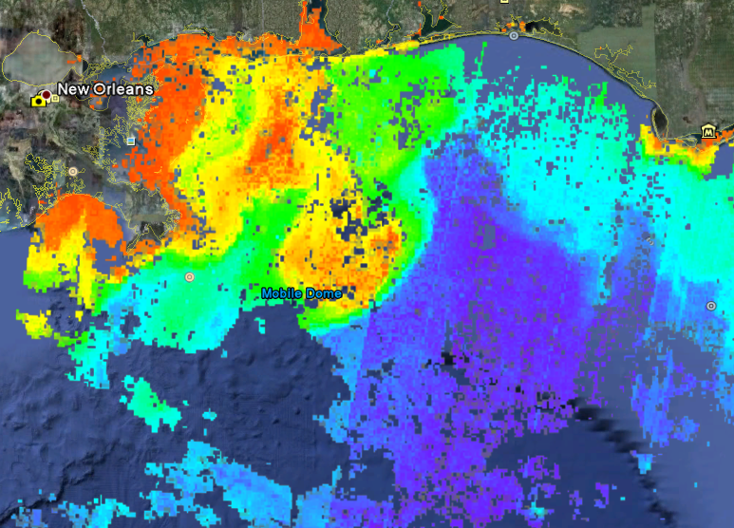
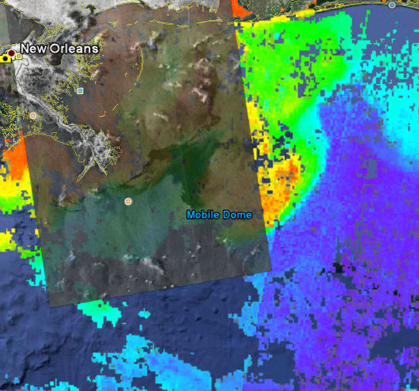
SAR + MERIS Algal1 (2010-07-21)

Slide 5
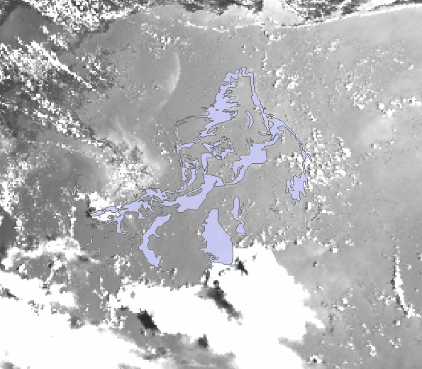
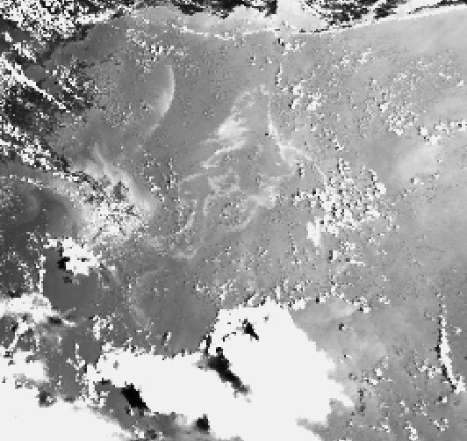
AVHRR 2010-07-21 + Daily Comp. Product

Slide 6
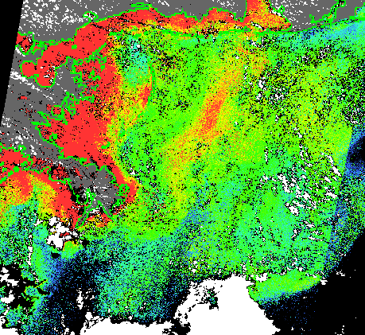
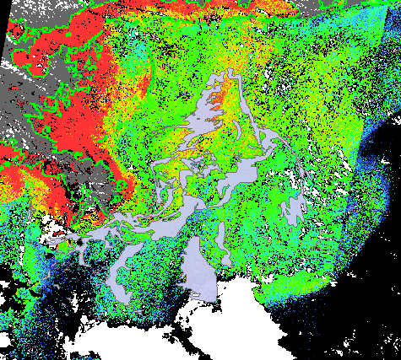
MERIS YS 2010-07-21

Slide 7
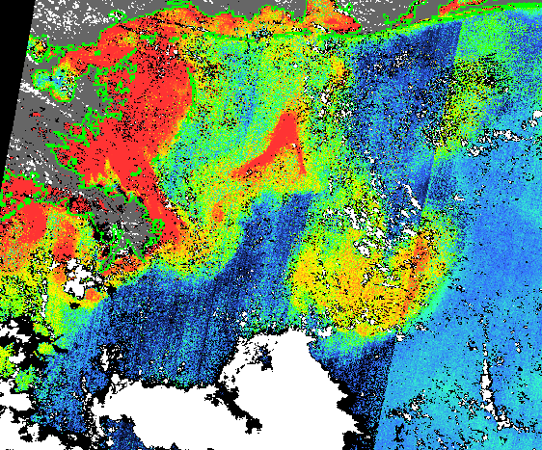
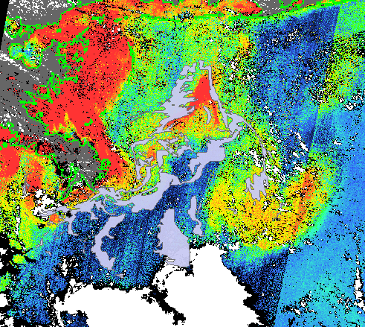
MERIS Algal2 2010-07-21

Slide 8
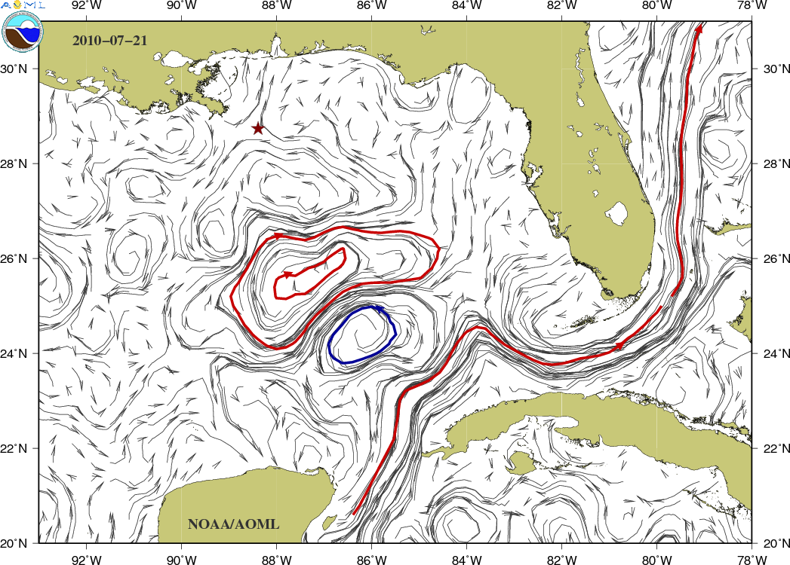
Current Conditions in the Gulf (NOAA/AOML)

Slide 9
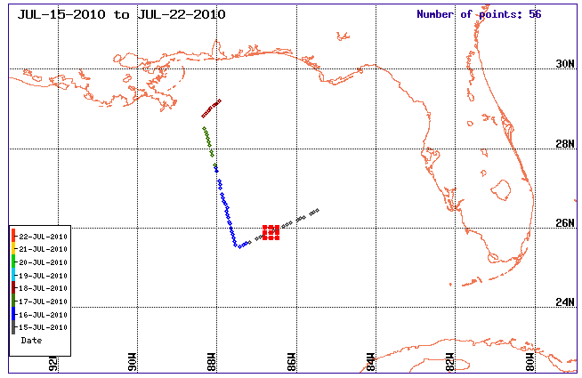
XBT Data
Nancy Foster

Slide 10
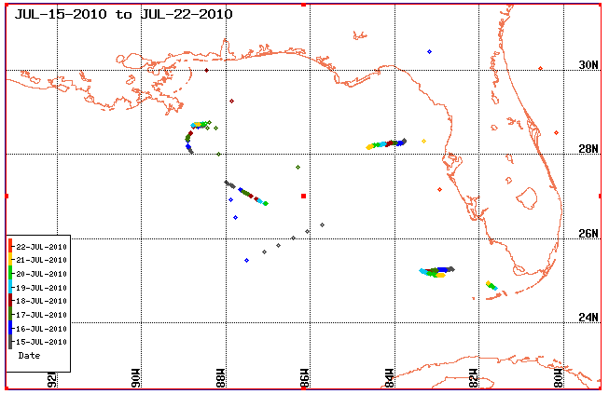
CTD Data
Glider

