Slide 1
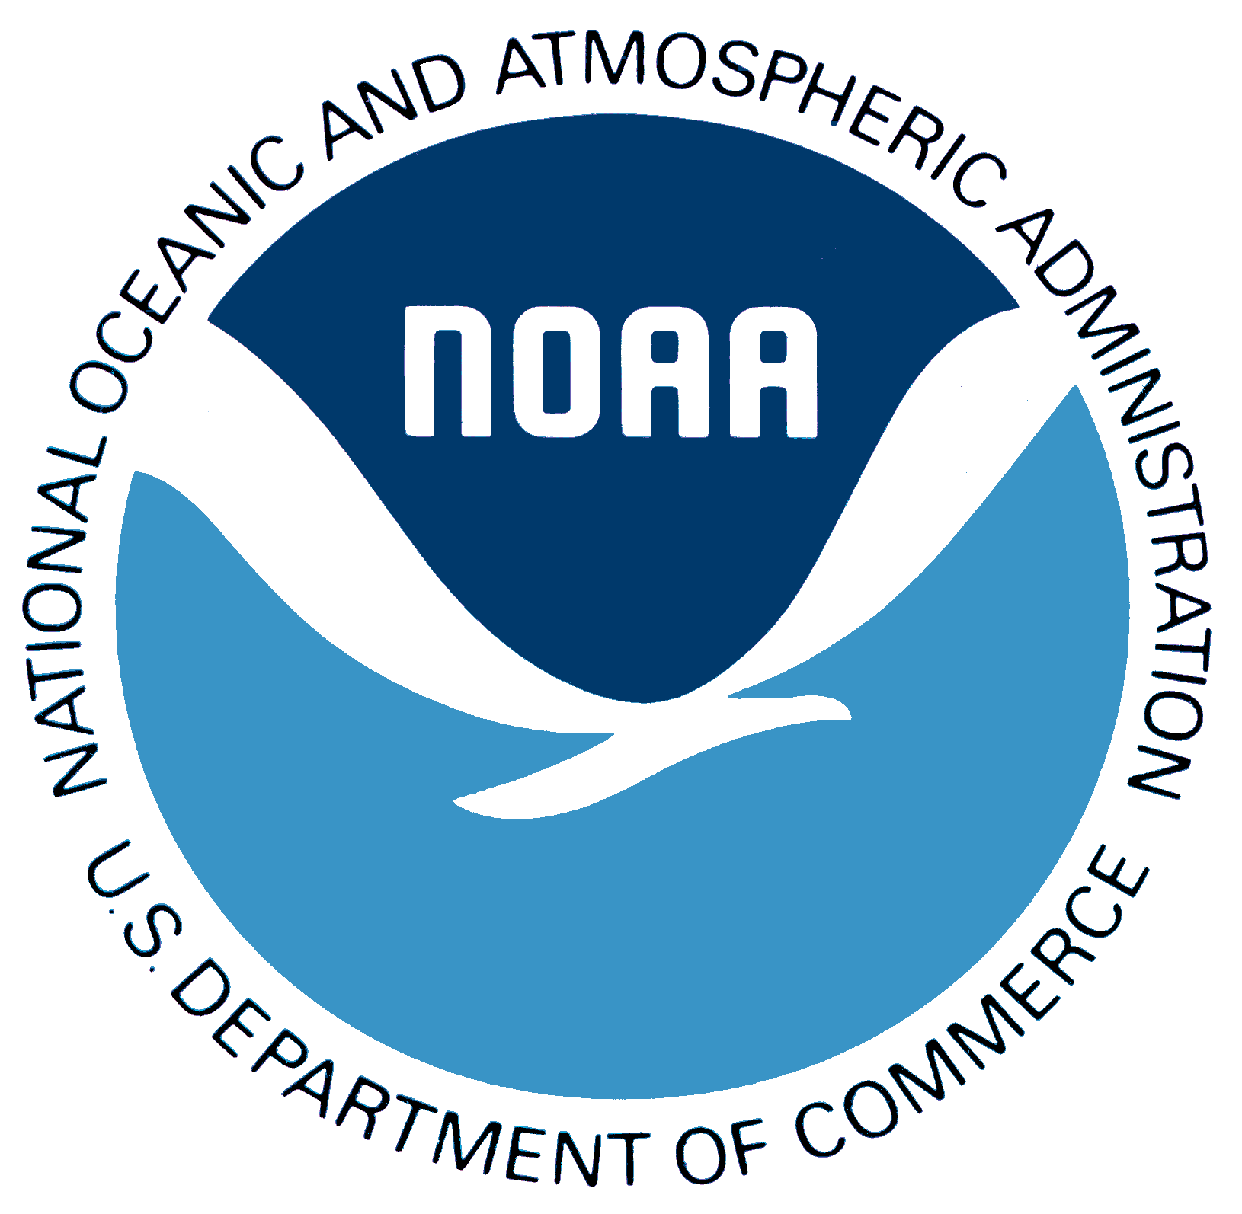
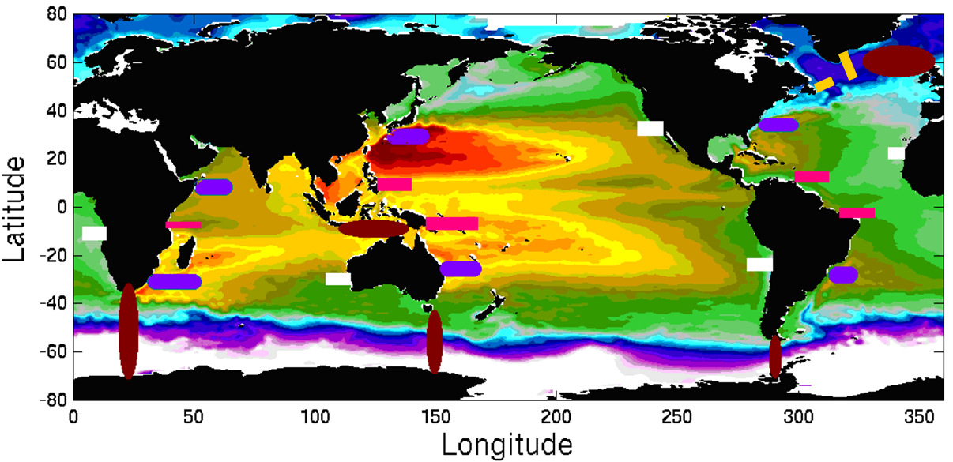
Boundary Currents: Progress and forward looking to OceanObs’19
Renellys C. Perez, UM/CIMAS and NOAA/AOML
w/input from: L.Beal, M.Cronin, R.Davis, S.Dong, G.Goni, W.Kessler, D.Legler, R.Lumpkin, C.Meinen, D.Roemmich, T.Rossby, D.Rudnick, U.Send, E.Smith, J.Sprintall, R.Todd, J.Wilkin, N.Zilberman, OceanObs’09 white paper, IMSOO Workshop report, …
Funding: U.S. (NOAA, NSF, ONR, …) and international (Australia, Argentina, Brazil, Canada, China, France, Germany, Japan, Korea, Netherlands, South Africa, U.K., …)
Figure: Conceptual global network of boundary current arrays. Send et al. (2010) Boundary Current white paper.
OOMD Workshop
Ocean Obs’19, Sep 2019

Slide 2
Why observe boundary currents (BCs)?
One of the important ways society experiences the changes in the global ocean is through the ocean’s boundaries.

Slide 3
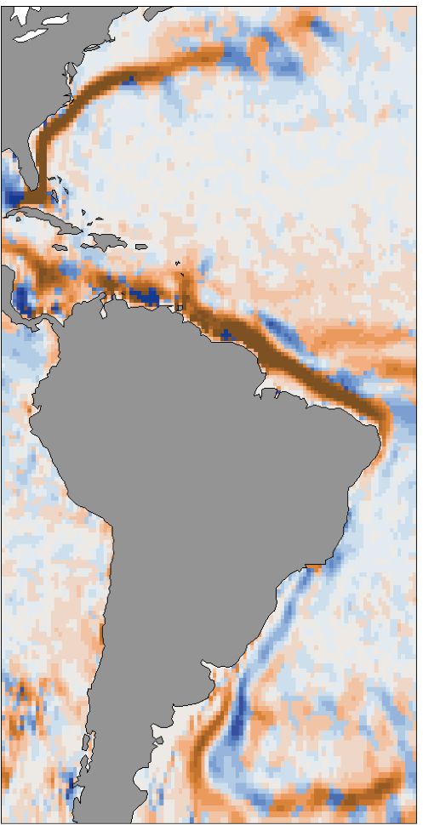
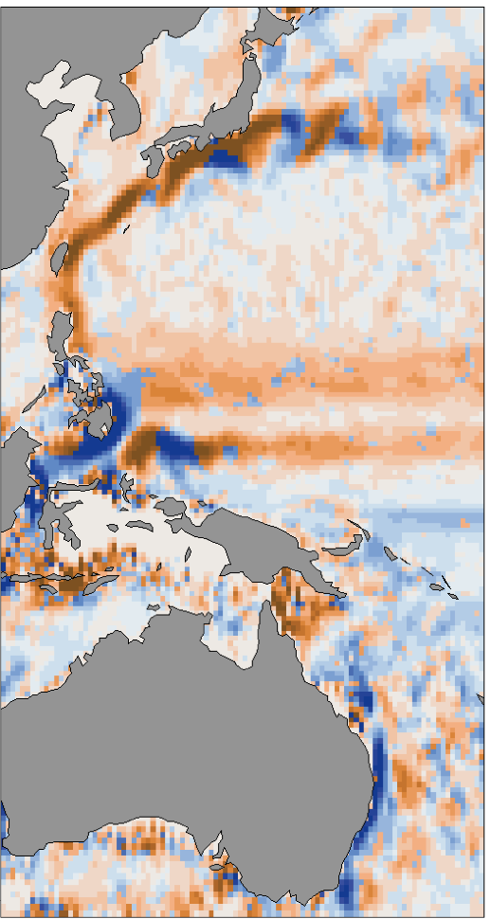
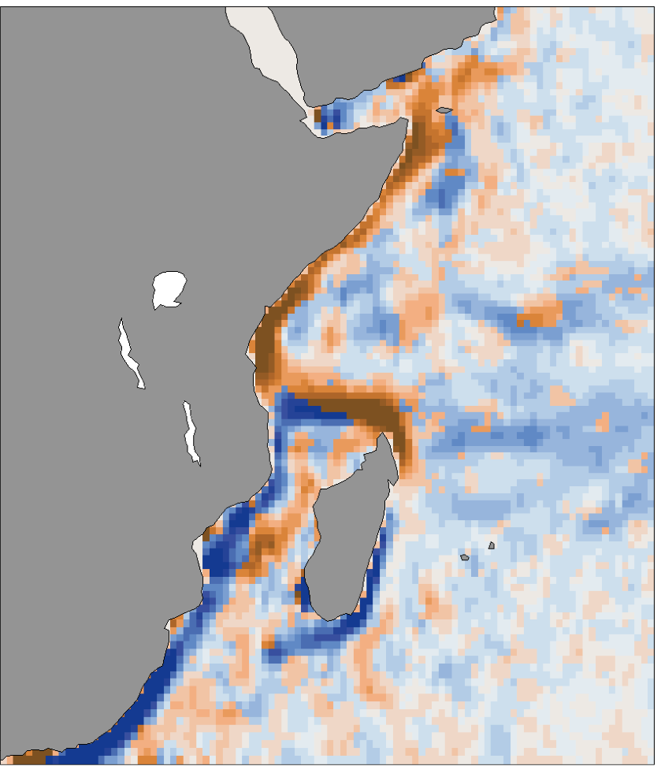
Why observe western BCs (WBCs)?
  Key drivers of climate variability
  Meridional heat/freshwater transport
  Surface and deep conduits for thermohaline circulation
  Sea level variations
Figure: Surface speeds from Global Drifter climatology. Color indicates orientation of meridional velocity (brown = northward, blue = southward).

Slide 4
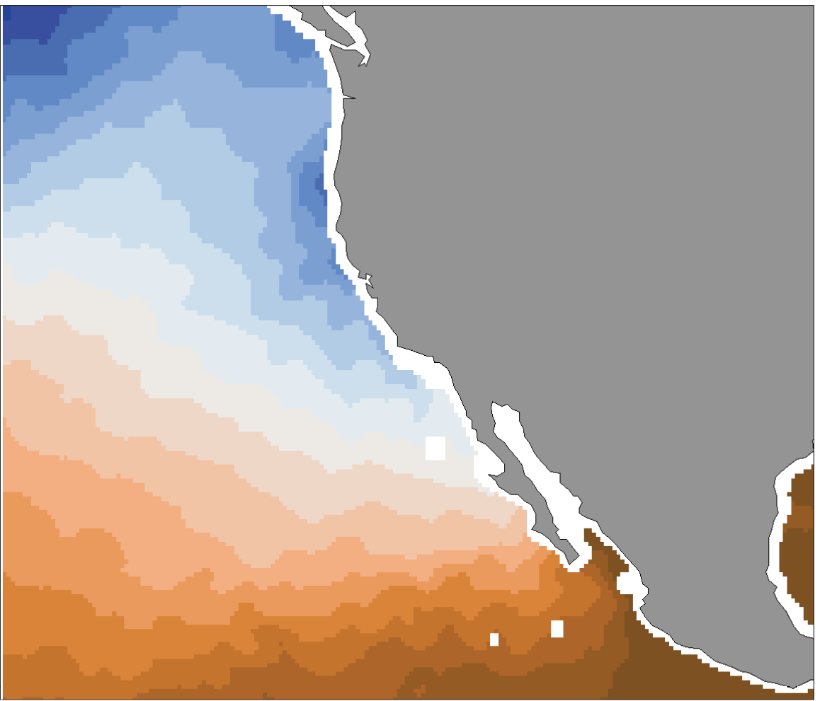
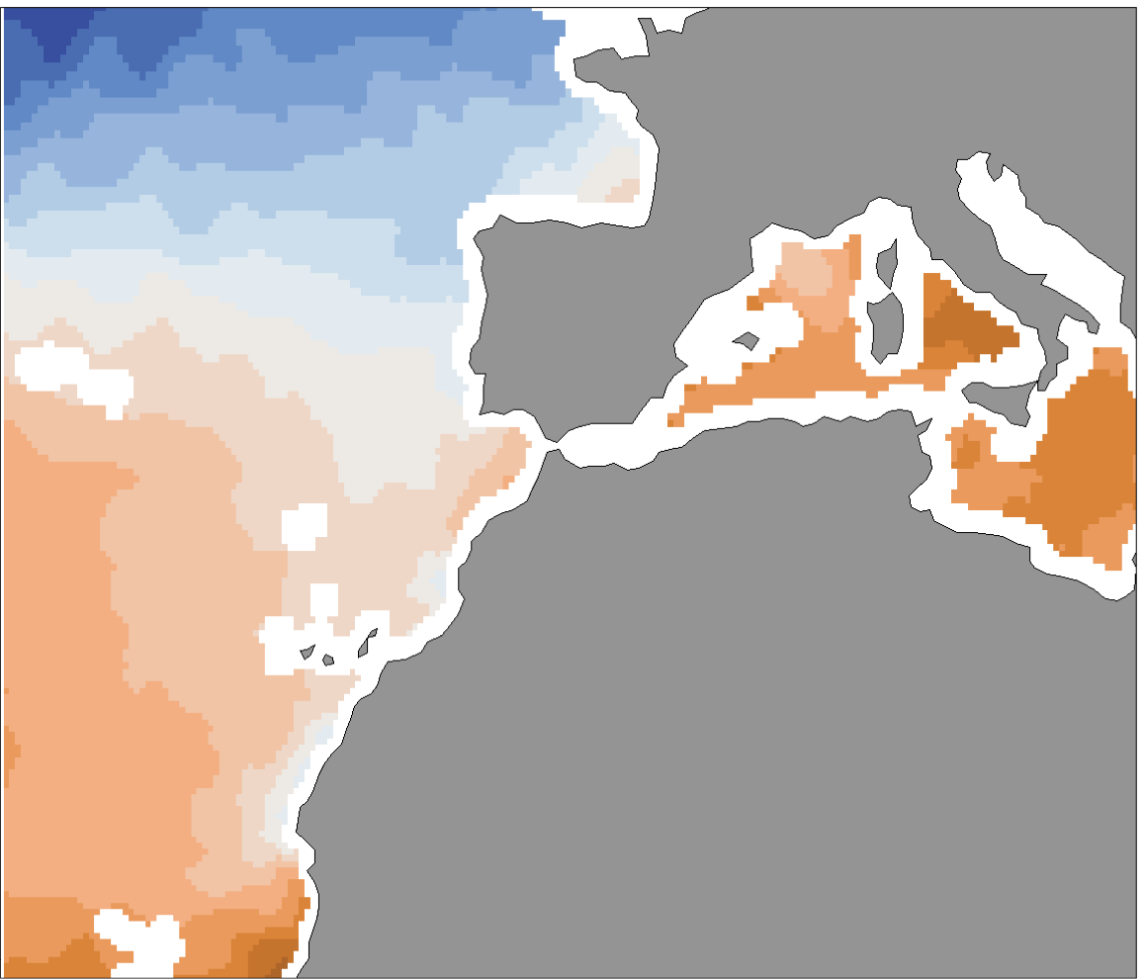
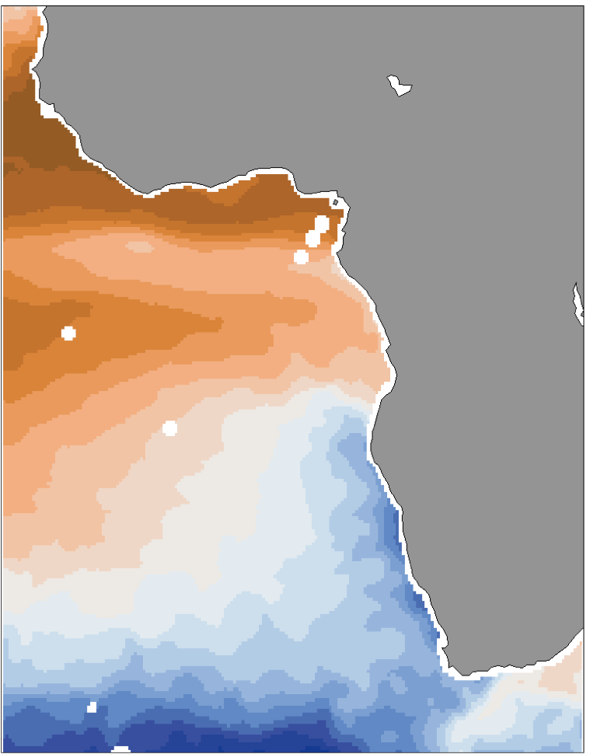
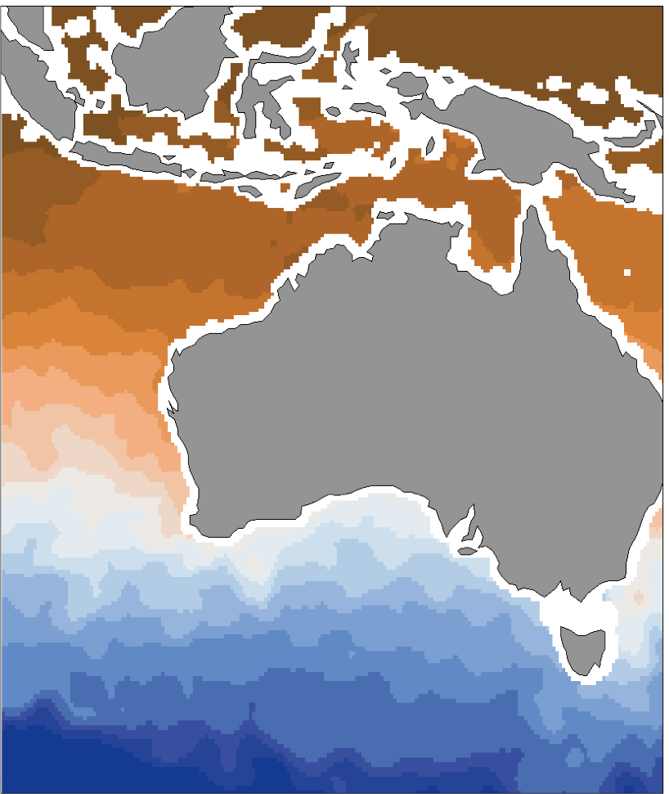
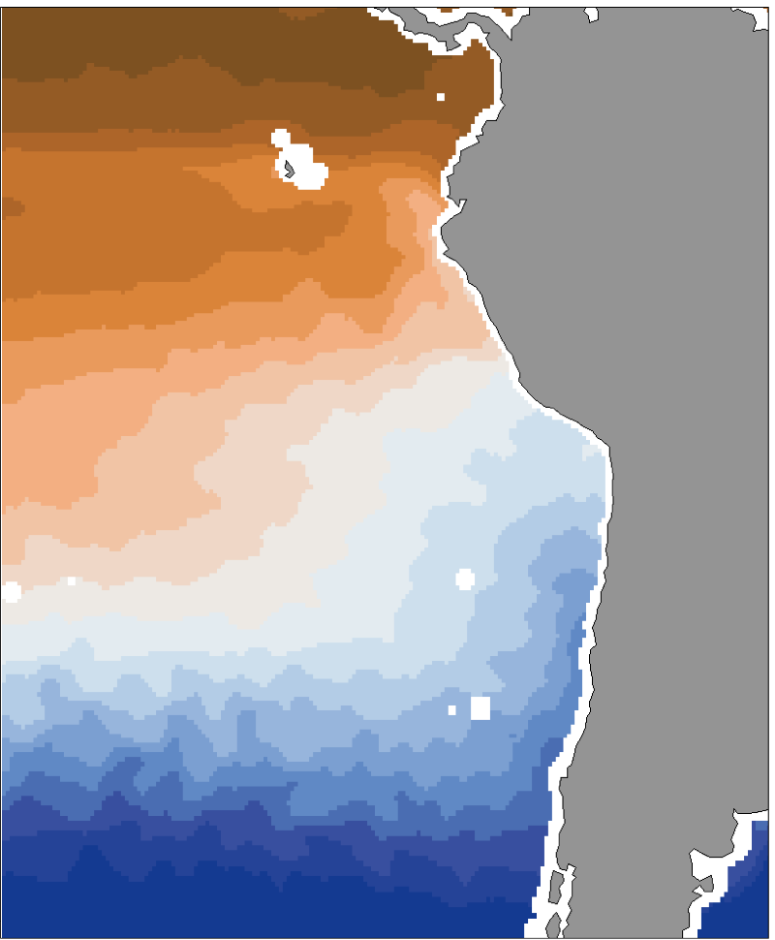
Why observe eastern BCs (EBCs)?
  Societally relevant effects of climate
  Upwelling, cross-shore exchange (nutrients, carbon)
  Ecological hotspots
  Equatorial interactions (ENSO-blob)
  Oxygen minimum zones (OMZs)
Figure: Surface temperatures from RSS Combined Microwave for June-August 2015. Blue = cold SSTs, brown = warm SSTs.

Slide 5
Why observe low-latitude, high-latitude, marginal sea BCs?
Low-latitude BCs: equatorward mass and property flux, ENSO
High-latitude BCs: Water mass formation/transport, interbasin exchanges
Marginal Sea BCs: Coastal-open ocean exchange, water mass formation
Figure: Pink = low-latitude BCs, yellow = high-latitude BCs, brown = interbasin-exchange. Send et al. (2010) Boundary Current white paper.

Slide 6
Where are BCs being observed?*
*List incomplete, a census is needed
Subtropical WBCs
  Atlantic: Gulf Stream, Florida C., Antilles C., Guiana C., North Brazil C., Brazil C., Malvinas C., DWBC
  Pacific: Oyashio C., Kuroshio C., East Australian C., East Auckland C.
  Indian: Somali C., Agulhas C.
Subtropical EBCs
  Atlantic: Canary C., Guinea C., Angola C., Benguela C.
  Pacific: California C., Peru-Humboldt C., Chile C.
  Indian: Leewin C.
Low-latitude BCs: Indonesian Throughflow, Mindanao C., New Guinea Coastal C., Solomon Sea
High-latitude BCs: Labrador C., E/W Greenland C., Norwegian C., East Iceland C., North Atlantic C., Alaska C., Antarctic Circumpolar C., Weddell Sea
Marginal Sea BCs: Mediterranean, Gulf of Mexico

Slide 7
Technology (*multidisciplinary)
Moored buoys (T, S, current meters, ADCPs, PIES, O2*, Carbon*, …)
Cabled observatories, integrated observational networks*
Research vessels*
Ship of opportunity program (XBTs, XCTDs, ADCPs)
Underwater autonomous gliders*
Argo profiling floats*
Surface drifting buoys
Sail drones*
Coastal HF-Radar
Satellites*
Blended in situ-satellite products
Some Examples…
(a subset)

Slide 8
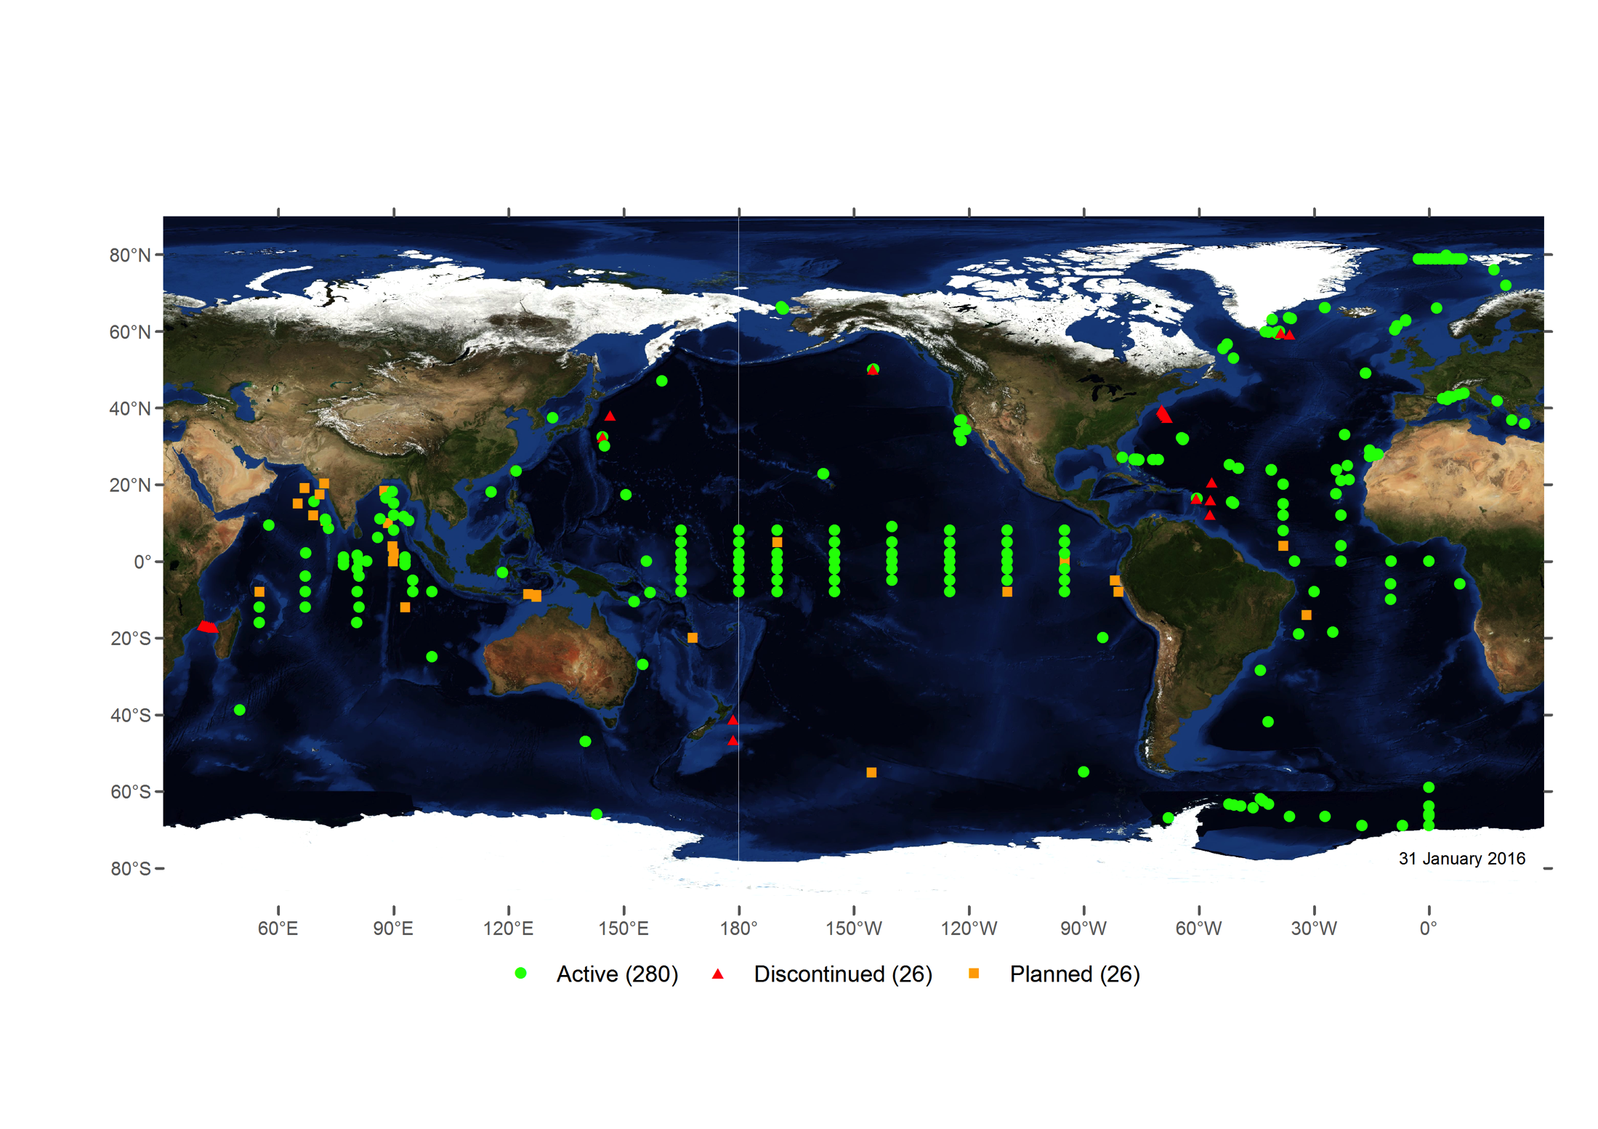
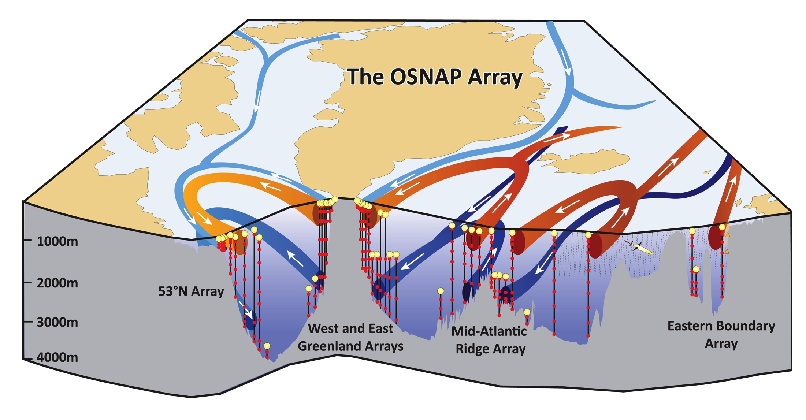
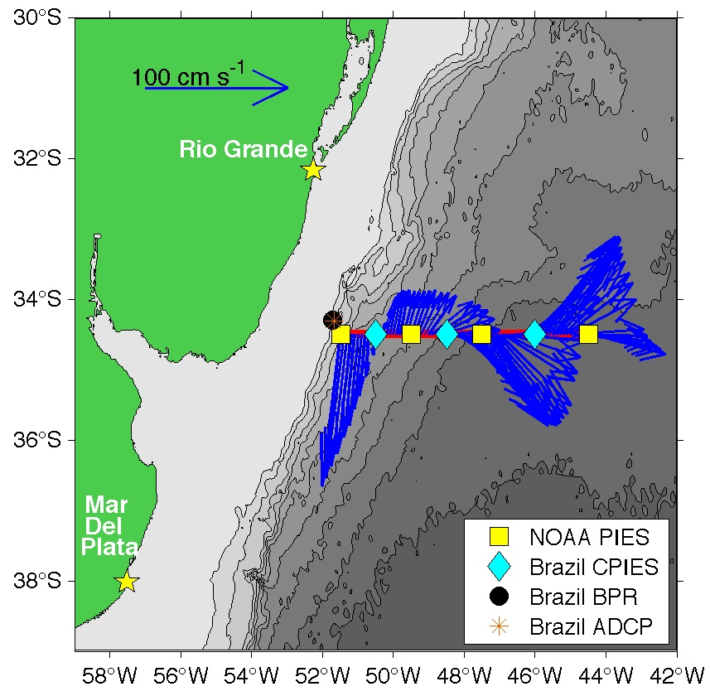
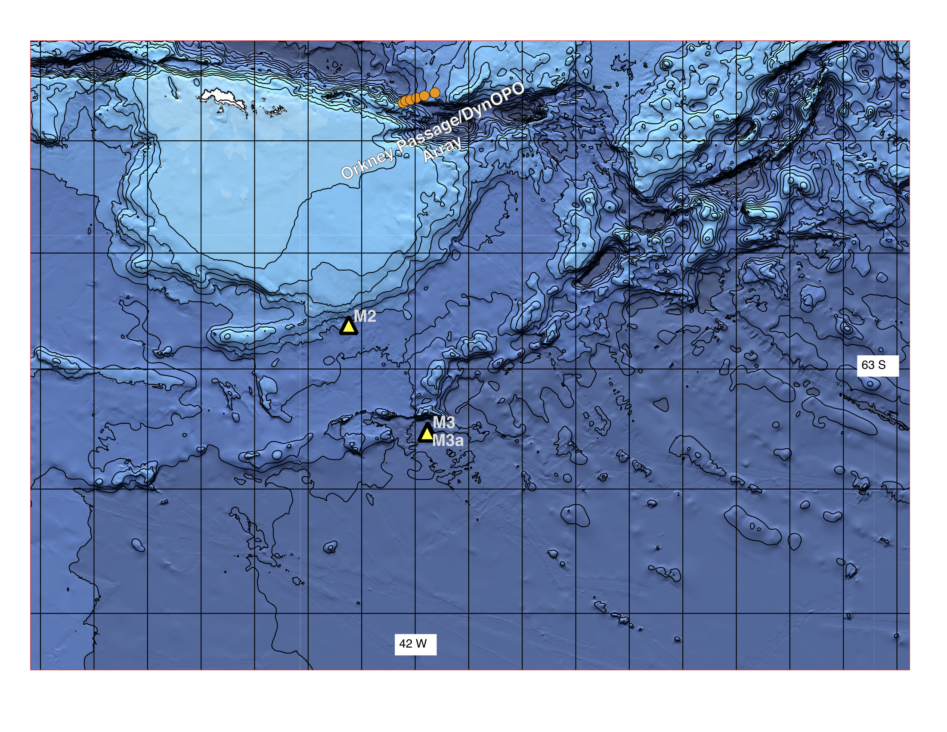
Moored buoy arrays
OceanSITES
Overturning in the Subpolar North Atlantic
Southwest Atlantic MOC
Weddell Sea Transport Station
Agulhas System Climate Array

Slide 9
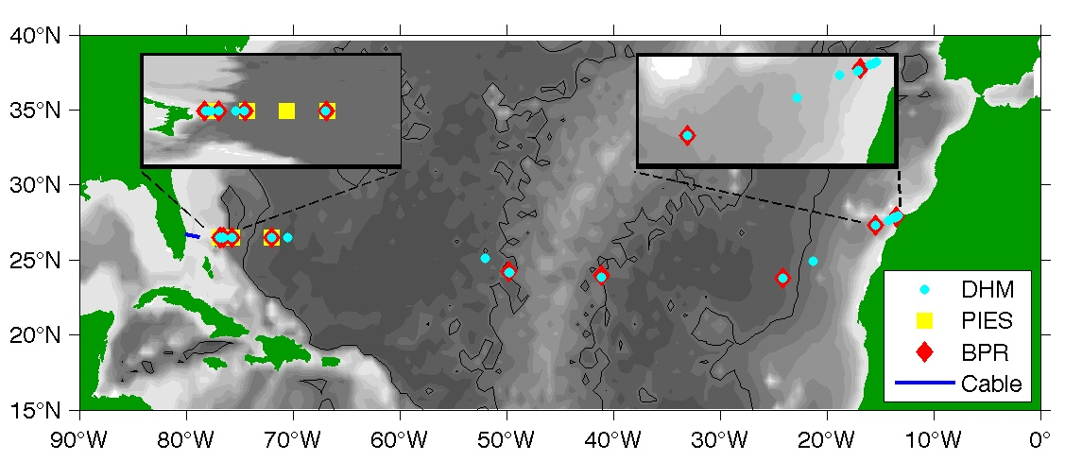
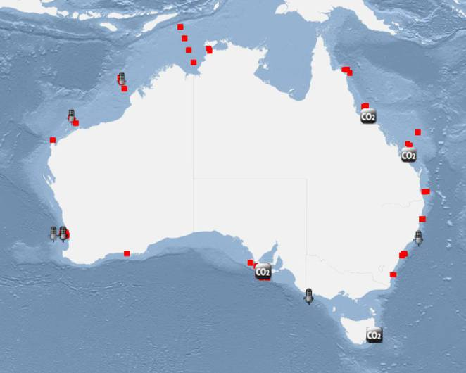
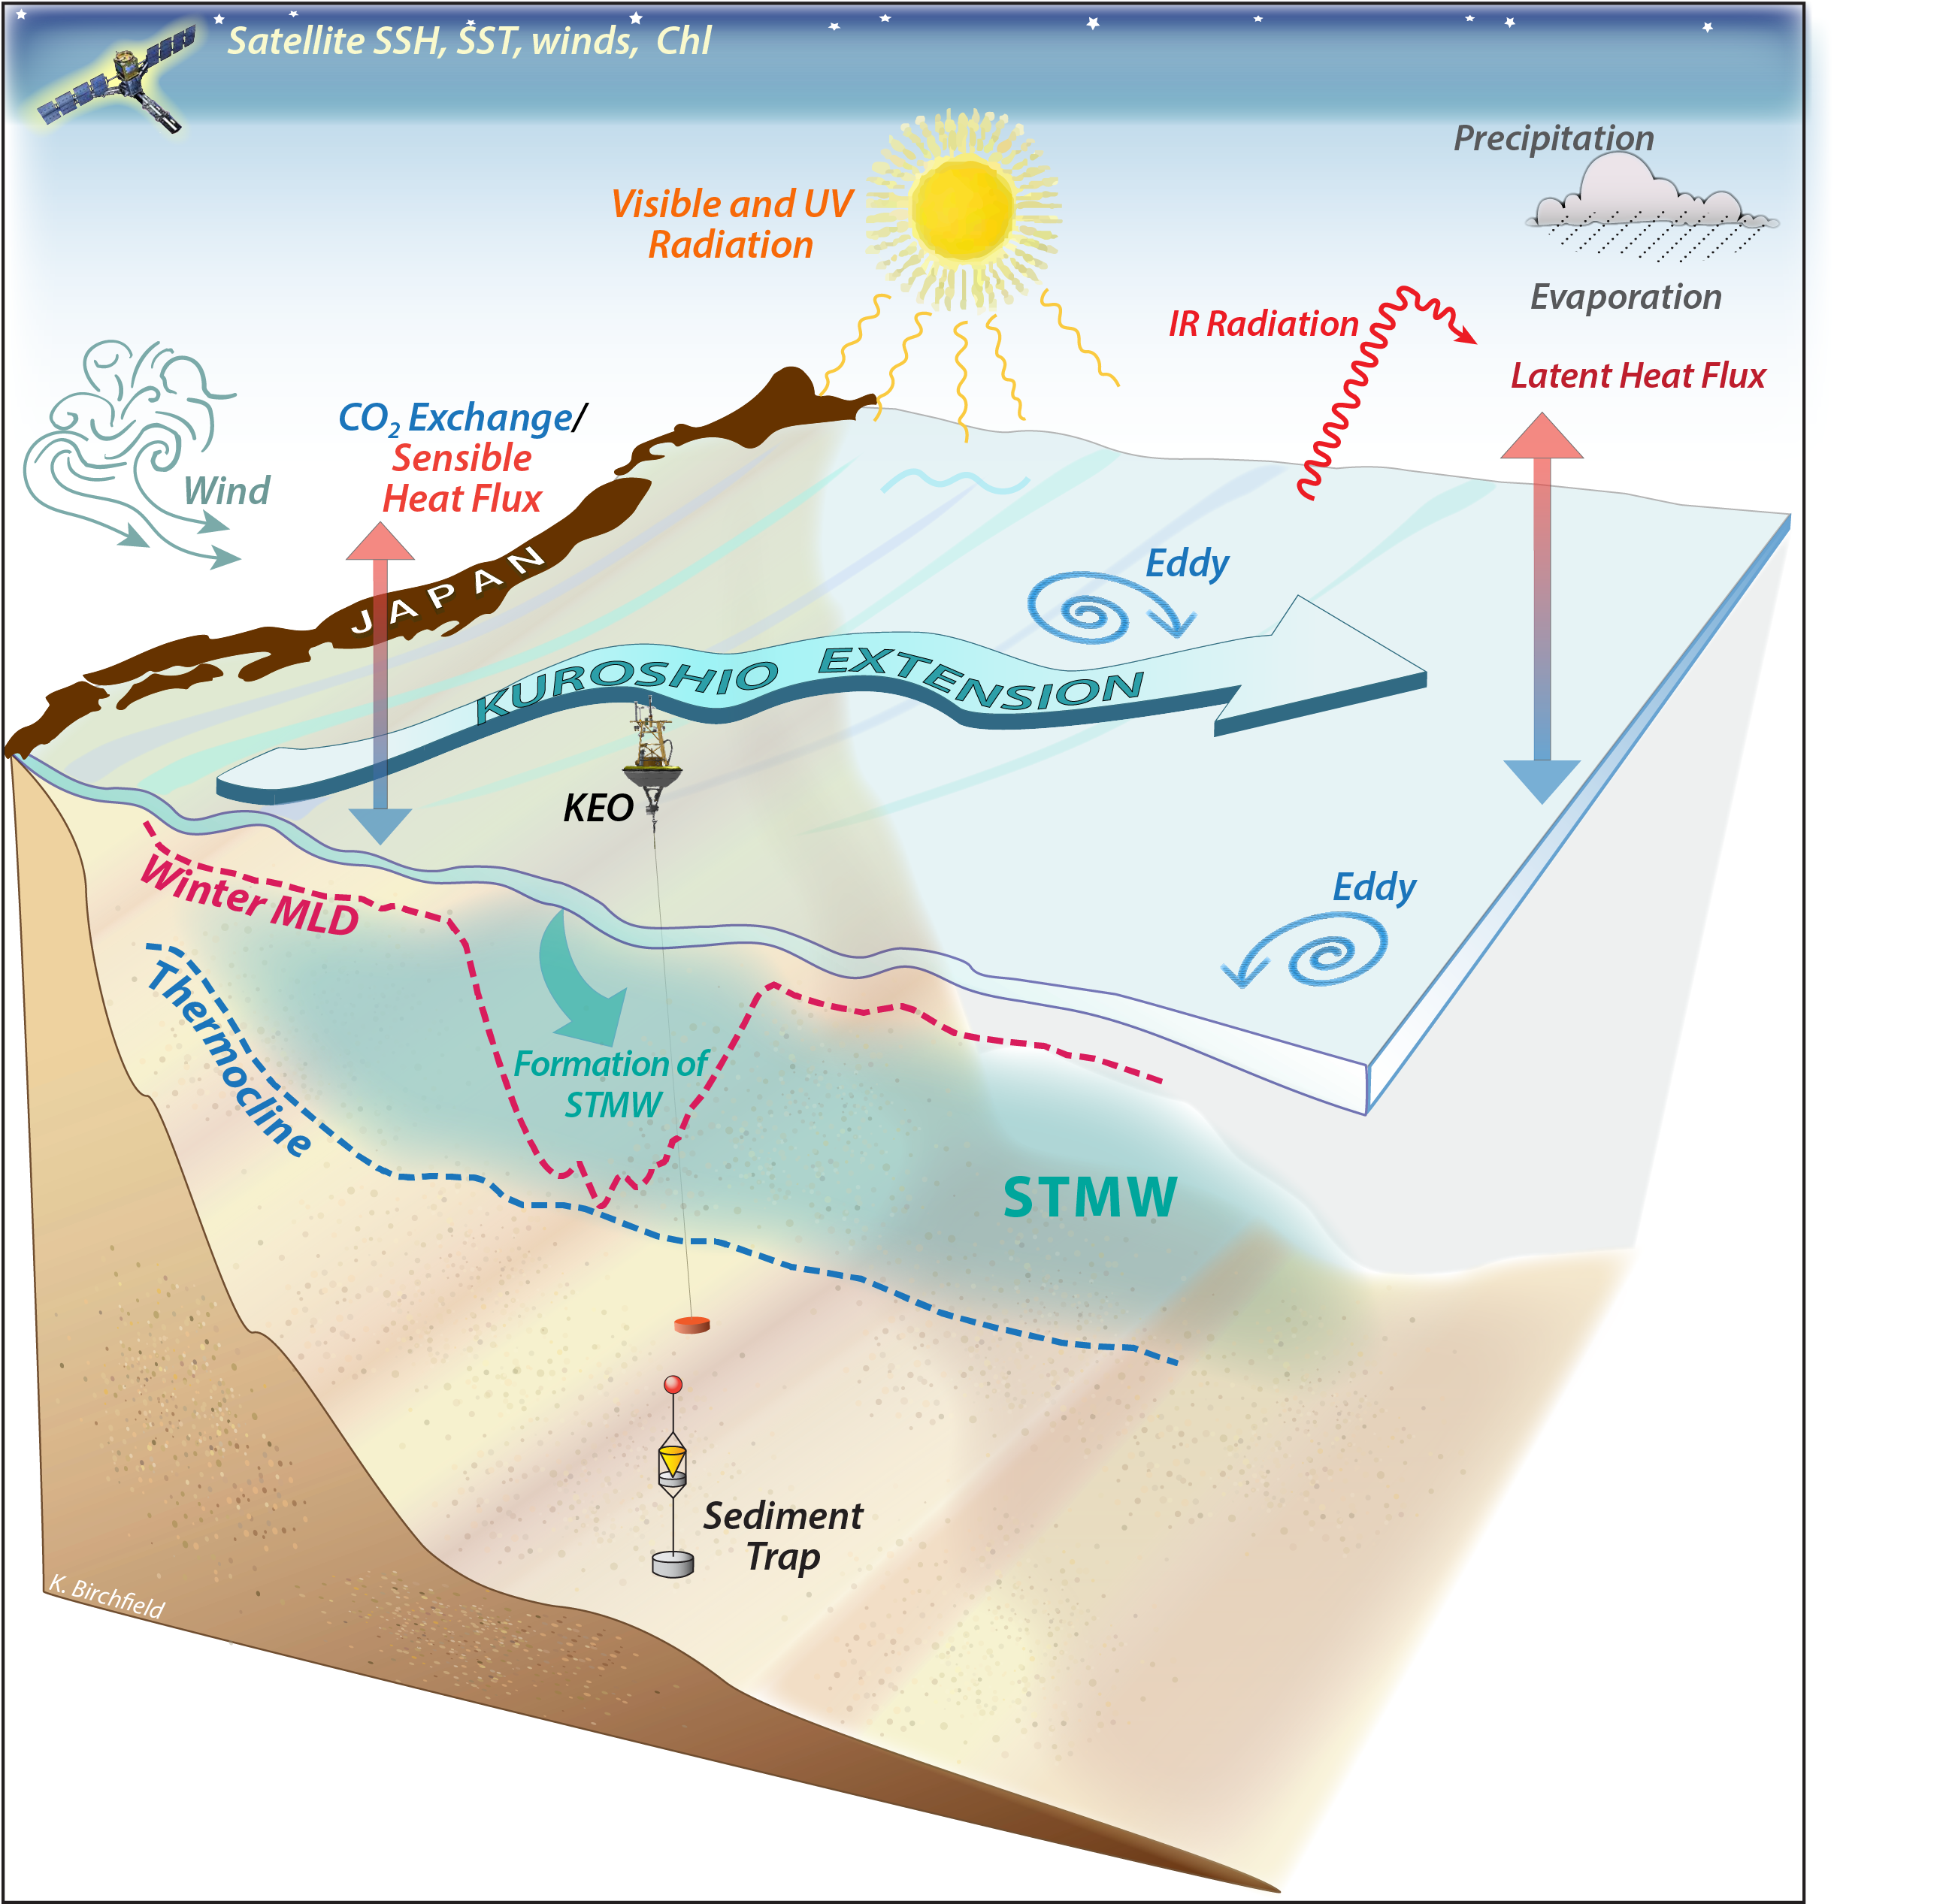
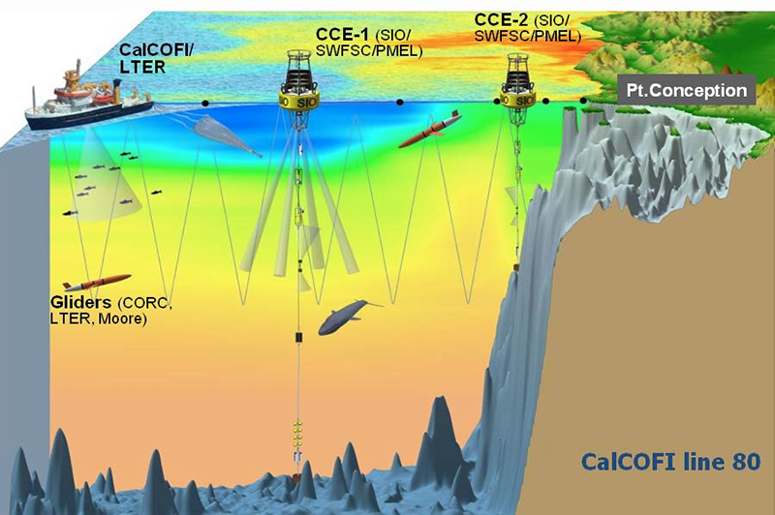
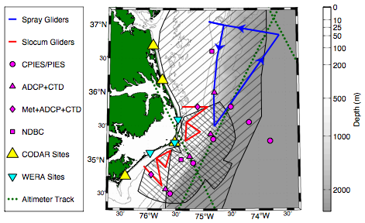
Cabled observatories, integrated observational networks
RAPID/MOCHA/WBTS/ABC
Integrated Marine Observing System
Kuroshio Extension
Moored Climate, Carbon, BGC, and Ecosystem, South California Current
Processes driving Exchange at Cape Hatteras

Slide 10
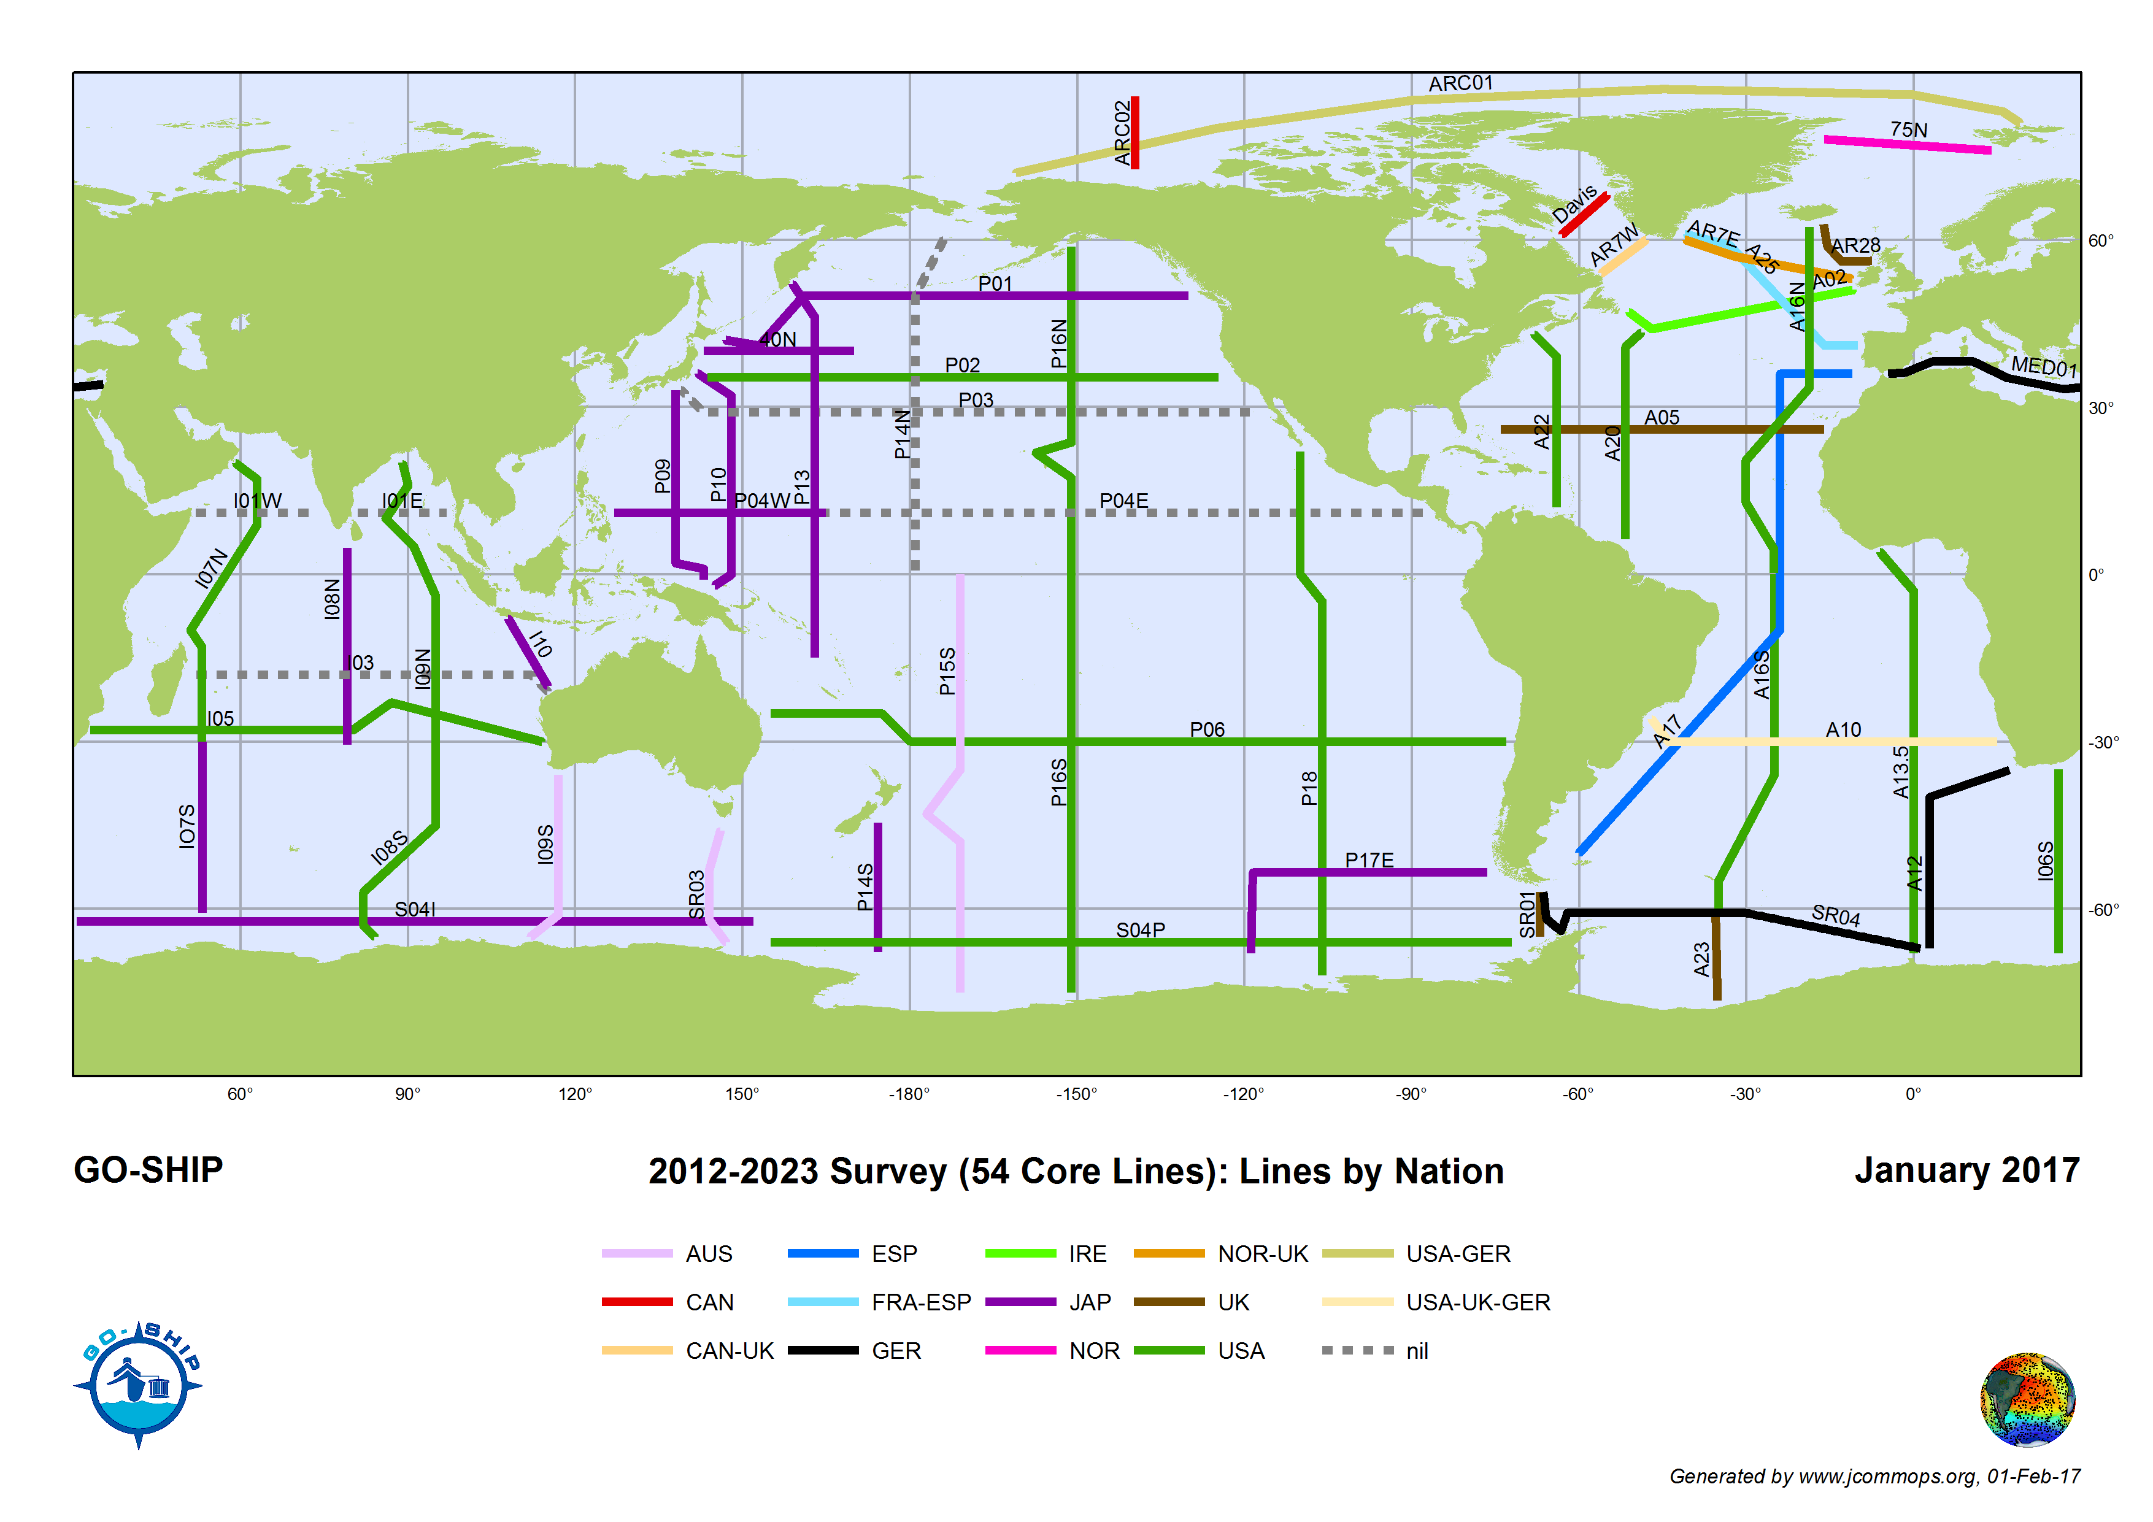
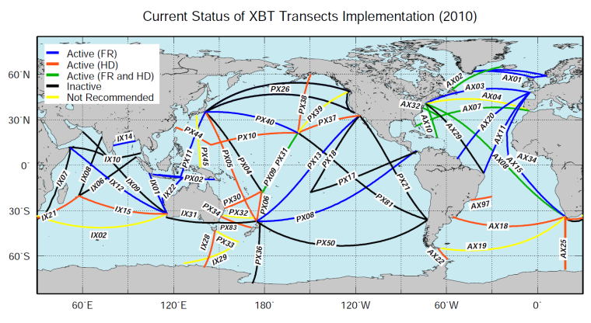
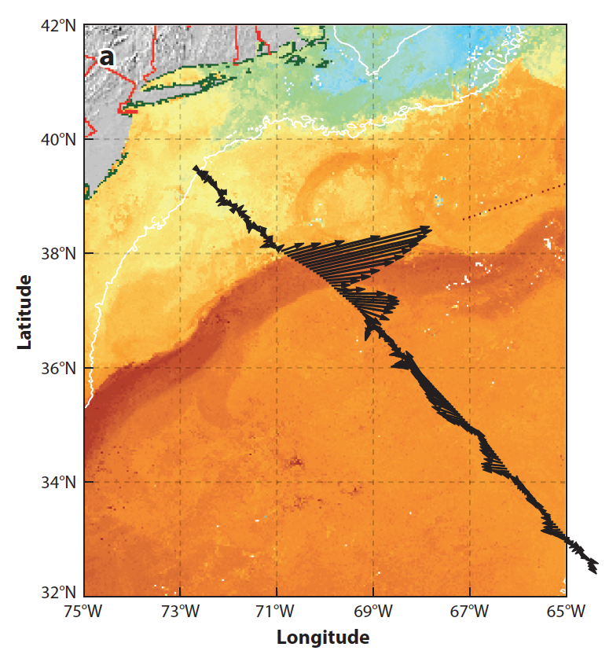
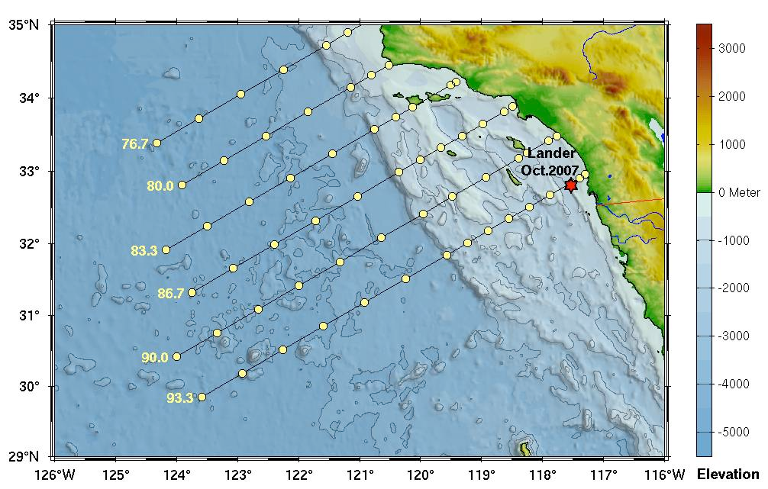
Research vessels, SOOP
GO-SHIP
XBT network
: Boundary currents sampled by the HRX Network
Oleander Project
Drake Passage
CalCOFI (hydrography, biology)

Slide 11
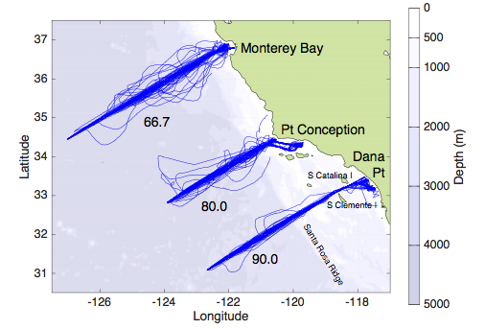
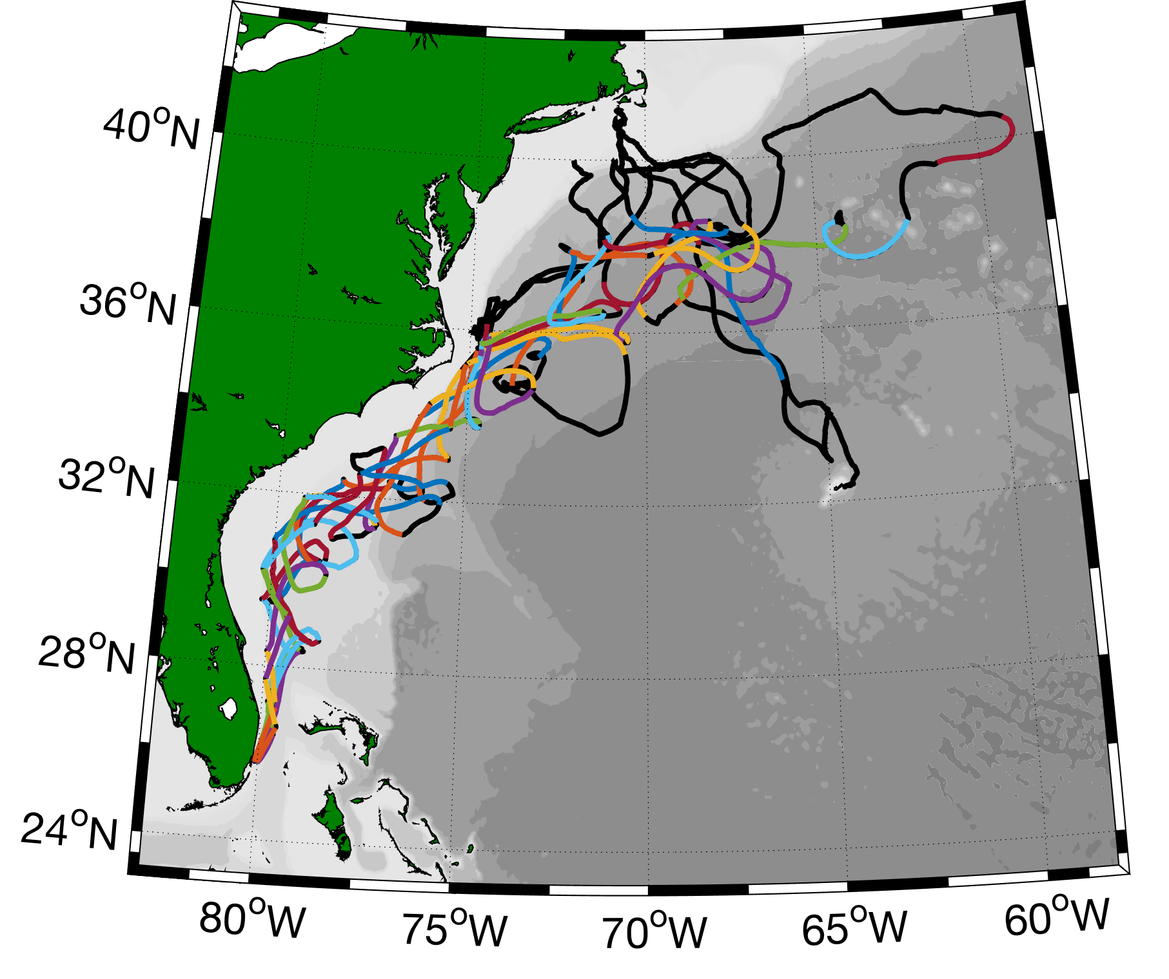
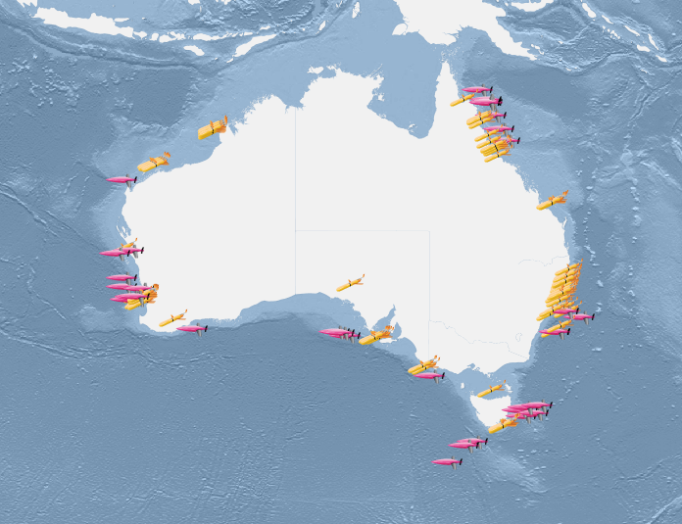
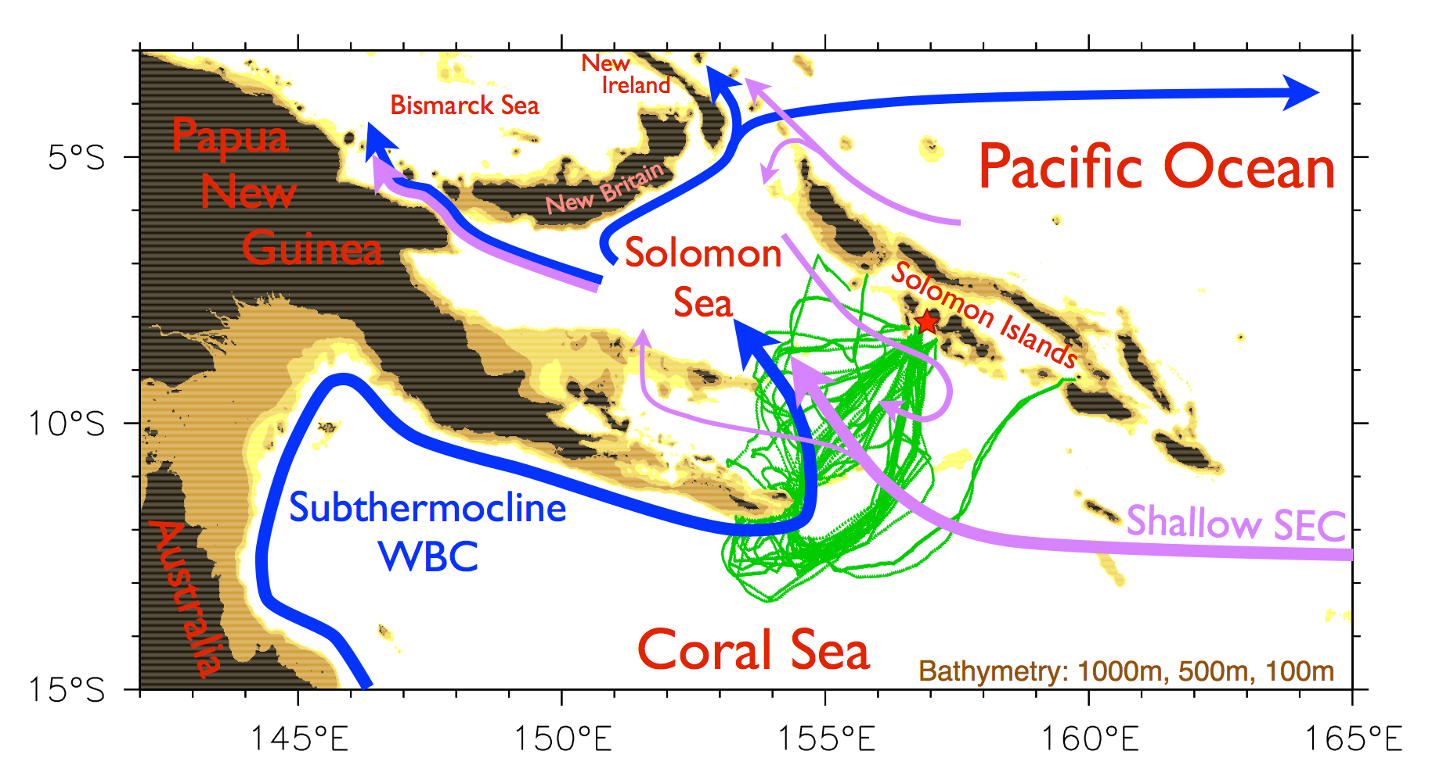
Autonomous underwater gliders
OceanGliders boundary ocean observing network
California Underwater Glider Network
Glider Surveillance of Gulf Stream
Australia National Facility for Ocean Gliders
Gliders in the Solomon Sea

Slide 12
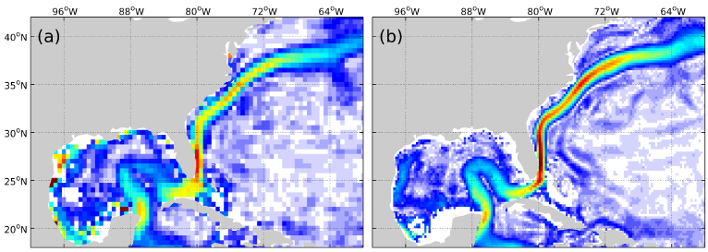
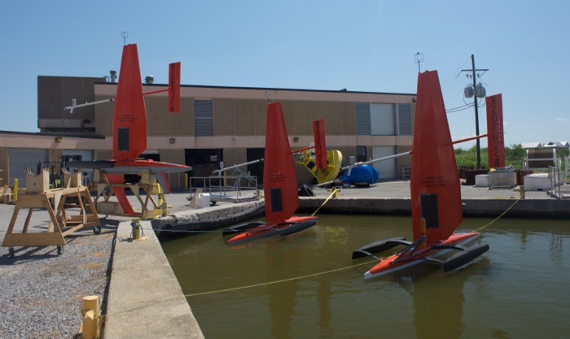
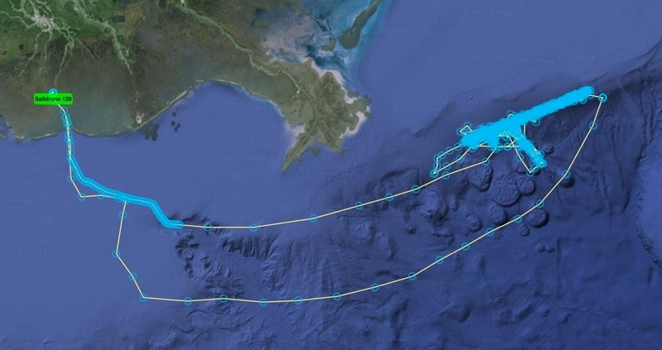
Blended data, drifting buoys, saildrones
XBT + Argo + altimetry (EAC)
Global Drifter Program Climatology in Gulf Stream
Laurindo et al. (2017)
Zilberman et al. (sub)
SailDrones in Gulf of Mexico (shelf-slope interaction)

Slide 13
Towards integrated BC observing systems...
Focus topics identified at IMSOO meeting:
How ecosystem structure/dynamics in coastal ocean is affected by interannual variability of currents and water properties, including O₂/OMZs, pH/acidification (large-scale)
Cross-shore exchange between land, shelf and deep ocean (mesoscale)
Ecological hotspots, episodic (e.g. fronts, eddies, upwelling) and persistent (e.g. canyons, headlands, shelf break)
cross-shelf
cross-shelf
along-shelf
Focus Topic
Processes/phenomena
EOVs/Scales/Range
Observing platforms
Implementation of Multi-Disciplinary Sustained Ocean Observations (IMSOO), Feb 2017

Slide 14
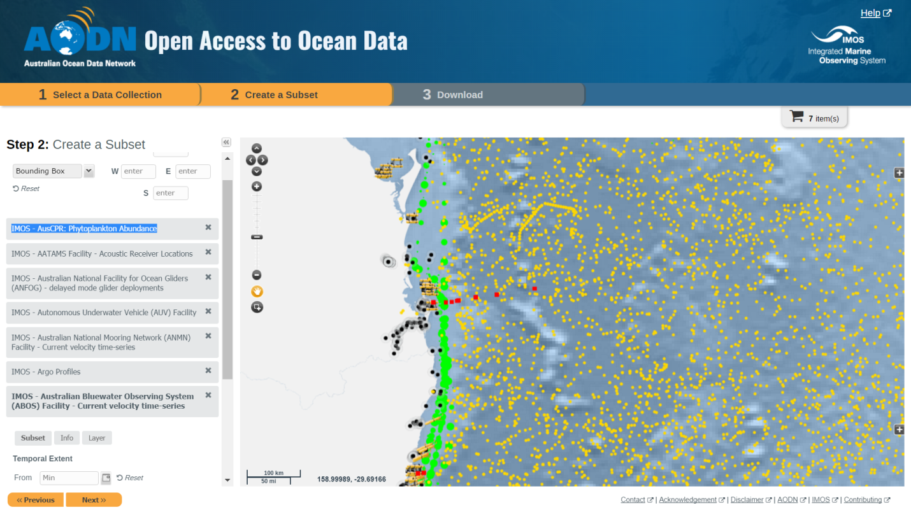
IMSOO phased approach
Update societal rationale for BC observation
Organize review of two BC observing systems (short term):
California Current
East Australian Current
Develop white papers for OceanObs’19 (short term)
Develop concept for “backbone” observing system (mid term)
Develop concept for “pilot flexible/re-locatable” observing systems (long term)
Do we want to identify additional long-term/mature observing systems to undergo similar process? (if funds are available)

Slide 15
Recommendations…
Census of BC observational networks (U.S. and international)
Fund a web designer to do survey and a postdoc (oceanography, social science) to analyze results. Results will be complex as not one-size-fits-all. Will need program managers to spread word to get high response rate. Need a companion model census.
Series of workshops to bring together diverse communities, foster collaboration
(1) Coastal-open ocean (GOOS-IOOS), (2) Observational-modeling, (3) Multi-disciplinary, or (4) Scientists-Stakeholders-Applications
Identify a few BC regions with long-term/mature observing systems to undergo a self-evaluation process (similar to IMSOO)
Need to have discussion about what is limiting growth/maturation of observing networks and get guidance from funding agencies on likelihood of future expansion/longevity of BC observational networks in those regions.

Slide 16
Informal summary of informal survey
Progress towards OceanObs’19
Has the global ocean boundary current network grown since OceanObs’09?
Yes. We are observing in some new boundary currents (e.g., Agulhas, East Australian Current, Solomon Sea, AMOC arrays). Many programs have now produced decadal time series. Increased use of glider arrays in some BCs. We’ve lost some observational programs (e.g., Line W, Drake Passage moored array).
Have we learned what are essential components of boundary current arrays?
Not clear yet (even for physical EOVs). Observational arrays develop in organic fashion depending on regional processes/scales and available resources (e.g., ship time, funding). Moorings can provide high-frequency temporal variability at key locations. Other platforms are better suited to resolve cross- and along-shelf variability. Shipboard measurements still needed to measure full suite of physical (and BGC, biological) parameters. Gliders can be used in some BCs to observe in remote regions, connect coastal-open ocean, and make interdisciplinary measurements. Need global (or downscaled) models with fidelity in BC regions to be able to use those models to design integrated observing systems.

Slide 17
Informal summary of informal survey
Progress towards OceanObs’19
How have we advanced in our ability to make interdisciplinary observations?
More BGC sensors available on moorings, Argo floats, and gliders. Optical sensors for biological parameters, acoustic sensors for animal detection have been developed.
How have we advanced in our ability to use new technology?
Underwater gliders have been proven in a number of BC regimes. Increased use of in-situ measurements (e.g., Argo, drifters, XBTs) paired with altimetry in BC regions. Pilot deployments of Deep Argo/Deep gliders which can be used to observe deep BCs. Improvements in numerical model’s ability to portray BCs and use real-time data.
How have we progressed in connecting the open ocean with coastal ocean?
Soon we will have satellites with better coastal resolution (e.g., swath altimetry, winds). Expansion of coastal HF radar networks. Gliders and emerging technology (e.g., Sail drones) can help connect coastal-open ocean. Caveat: these new technologies are personnel intensive and there is a learning curve. We need to develop more merged data sets (e.g., autonomous systems with ship surveys, in situ with satellite data).

Slide 18
Informal summary of informal survey
Progress towards OceanObs’19
Pilot activities we can engage in prior to drafting OceanObs’19 white paper?
Census. Clarify our achievements. Review some long-term observing systems and develop multidisciplinary backbone system for EBCs and WBCs (IMSOO approach). Develop more along-shelf BC systems. More development of optical sensors for BCs. Pilot system for whole western BC system in tropical Pacific. More ADCPs on ships.
How can we better leverage existing U.S. resources as well as international investments through partnerships/collaborations?
Continued, increased support for sustained BCs is needed. More cross-line office interaction, cooperation, sharing of resources, and expertise. Cross-agency sharing is important (e.g., OOI Endurance array). Networks become cheaper/more efficient with economies of scale. Long-term observational networks often require international partnerships for ship time, resources, ability to collect measurements in EEZs. Need to promote partnerships with local people, especially key in less developed/remote areas. Work with international efforts (e.g., GOOS, OOPC).

