Slide 1


ISABP REPORT
Presented by:
Mayra Pazos
DBCP-27, September 26-30, 2011 – Geneva, Switzerland

Slide 2
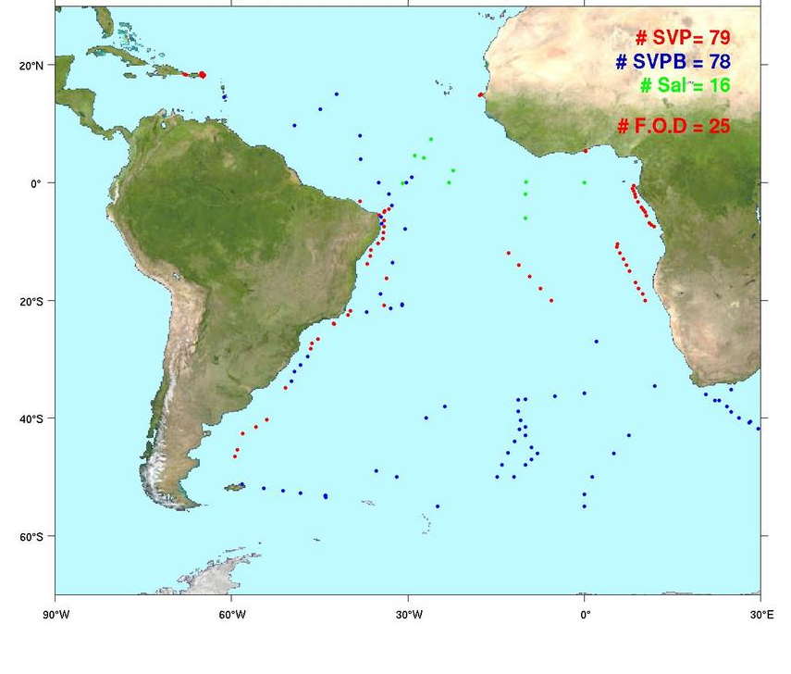
Drifters Deployed in the South Atlantic
July 2010 – June 2011
A total of 173 drifters were deployed in the area, 25 of which failed on deployment.
There were 12 additional SVPB Argos-3 pilot project drifters deployed of which 2 failed on deployment.
Deployments carried out by:
  US Navy vessels
  Brazilian Navy
  South Africa Weather Service
  Falkland Islands fishing vessels
  Tristan da Cuhna
  University of Cape Town
  University of Ghana

Slide 3
Report from South Africa Weather Service
Six drifters were given to the Administrator or Tristan da Cuhna in September 2010 to be deployed during this year
Four Argo floats and a PIE were deployed on the Gough relief voyage on behalf of the oceanographic department of the University of Cape Town
SAWS will deploy about 15 drifters on the annual Gough Island voyage on the S A Agulhas
Tristan da Cunha received five more drifters to be deployed by their Fisheries Department during the course of the year.

Slide 4
Report from Brazil
Brazil will deploy a total of 88 drifters in 2011
  30 SVP provided by GDP and 35 SVPB upgraded by Brazil.
There were 3 moored buoys deployed in February/March 2011 but one of them was damaged. Only two are now operational.
Three more buoys will be deployed in the next months, after implementing improvements on vent safety.
Three damaged buoys are being repaired, one coastal and two platform buoys. The aim is to mainted 6 moored buoys from S to NE off Brazilian coast this year.

Slide 5
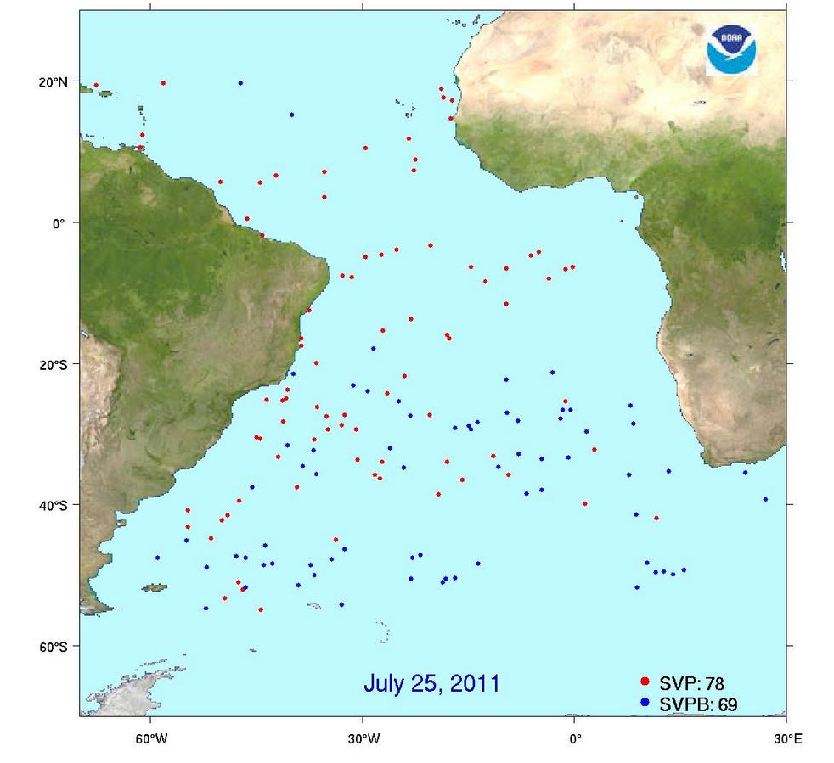
Status of the ISABP Drifter Array as of July 25, 2011
Total: 147
SVP: 78
SVPB: 69
The number of barometer drifters include those upgraded by participating countries

Slide 6
Deployment Plans for 2012
The GDP deployment plans from June 1, 2011 – May 31, 2012 are as follows:
Tropical Atlantic (20⁰S – 30⁰N):
SVP=150 SVPB=25
(upgraded by AOML or Meteo-France )
Extra Tropical Atlantic (40⁰S – 20⁰S):
SVP=25 SVPB=75
(Upgraded by Brazil, AOML SAWS)
Southern Atlantic (60⁰S – 40⁰S):
SVP=0 SVPB=174
(Upgraded by AOML)

Slide 7
The US Navy will continue its African Partnership Station Program in 2012 and will carry out more deployments in the hard to reach areas, specially Gulf of Guinea and Angola Basin
Argentina will continue to deploy drifters in the area

Slide 8
Dankie

