Slide 1
Task Team on Data Management Report
Chair: Mayra Pazos (GDP representative)
Members:
Bruce Bradshaw – RNODC representative
Bill Burnett – NDBC data manager
Jean Rolland – SOC representatvie
Pierre Blouch – Meteo-France
Yann Bernard – CLS data manager
Joan Stander – SAWS
Kelly Stroker– DBCP-TC
Emily Daniels – Metocean
DBCP-27, Geneva, Switzerland - September 26 – 30, 2011

Slide 2
Receive and Review Reports from the Data Management Centers
The two data centers specializing in buoy data, Meteo-France (SOC)/DB (Pierre Blouch) and ISDM, Canada, RNODC/DB (Bruce Bradshaw) compared GTS bulletin headers they actually receive and are working on the differences they found. It was agreed :
  To have these checks produced by automatic procedures
  Repeat the cross checks every 6 months
  Make results available on the web through Meteo-France QC-Tools and published by the Technical Coordinator on the JCOMMOPS website

Slide 3
Real Time Distribution of Data
The DAC continues to distribute and monitor all data from AOML and Korean drifters going out on the GTS and makes sure only good data are being disseminated, taking immediate action after recommendations from the QC centers are received.
Meteo-France QC-tools allow now to query drifters using either their 5 or 7 digit WMO number to check GTS data against model outputs. The 7-digit WMO number are mandatory for buoys having already their 3rd or 4th digits different from “0” and reporting through BUFR only
QC-tools allows now to monitor transmission delays for individual buoys. Graphs showing this parameter over the last two weeks period may be displayed the same way as for the other measured parameters. Monthly statistics for transmission delays are also available.
Reports of Sea Surface Salinity (SSS) on the GTS have increased during this past year. This parameter can also be monitored using QC-tools, as well as graphs of differences with Mercator model outputs for SSS over the past 15 days, and monthly statistics

Slide 4
Real Time Distribution of Data (Cont.)
Meteo-France has been providing the Coriolis center on a weekly basis drifter sensor observations, current data deduced from positions and collocated winds and winds stress for all buoys reporting on the GTS with drogue on only. Work on adding two additional tests is ongoing to determine drogue presence to then distribute all data, but flag the undrogued data. For the moment, drifter data are only used for the validation of the models, but in the near future, it could be assimilated into the models.
Meteo-France reported that by the beginning of July 2011, SBD iridium data from 97 drifting buoys were processed at on real time. Hourly observations messages from these buoys are sent on the GTS either in FM18-BUOY or in FM94-BUFR code

Slide 5
Real Time Distribution of Data (Cont.)
NDBC reported that during this period, they provided 24x7x365 data analysis and quality control support for 115 NDBC moored buoy platforms, 51 coastal marine stations, 221 water level stations, 39 deep-ocean tsunameters, 55 Tropical Ocean Atmospheric moored buoys in the equatorial Pacific, 40 oil and gas platforms in the Gulf of Mexico and 250 Integrated Ocean Observing Systems (IOOS) partner platforms (moored buoys and coastal stations). Through this effort, NDBC provided over 12 million quality-controlled observations to the Global Telecommunications System (GTS) in real-time
NDBC began to implement the new techniques to support the archive of climate observations. Starting in January 2011, NDBC began using Open Geospatial Consortium Inc. standards and Sensor Observation Services to provide all their archived observations in the National Oceanographic Data Centers (NODC) approved netCDF format.

Slide 6
Real Time Distribution of Data (Cont.)
2010-2011 GTS processing enhancements at CLS
Upon a request from Expert Team on WIS-GTS Operation and Implementation (ET-OI), BUFR headers for buoys have been changed from IOZXiiLFVW to IOBXiiLFVW on the 20th of April 2011 at 12H00 UTC.
Improvements on the precision of the software module SAL_78 which computes salinity values with conductivity and sea temperature especially for BUFR. This work was made in collaboration with Dr. Iwao UEKI from JAMSTEC.
Implementation of the GTS processing template for salinity drifters of ICM (Instituto de Ciencias del Mar, Barcelona, Spain).
GTS statistics by WMO areas are available at CLS since August 15, 2011. CLS is waiting the new DBCP TC to find a solution to publish these statistics on the JCOMMOPS website.

Slide 7
Real Time Distribution of Data (Cont.)
2010-2011 GTS processing enhancements at CLS
BUFR coding for SYNOP observations is in course of validation. Deadline = end of 2011.
CLS is working on the implementation of the latest BUFR version (V.4) in the Argos-GTS processing center. Deadline is by the end of 2011.
New options in the CFG tool (allows PI to modify automatically GTS settings by emails and XML files) available before the end of 2011:
  Bulletins headers (T1T2A1A2ii)
  Drogue depth (ZdZdZd)
  Drogue type (XtXt)

Slide 8
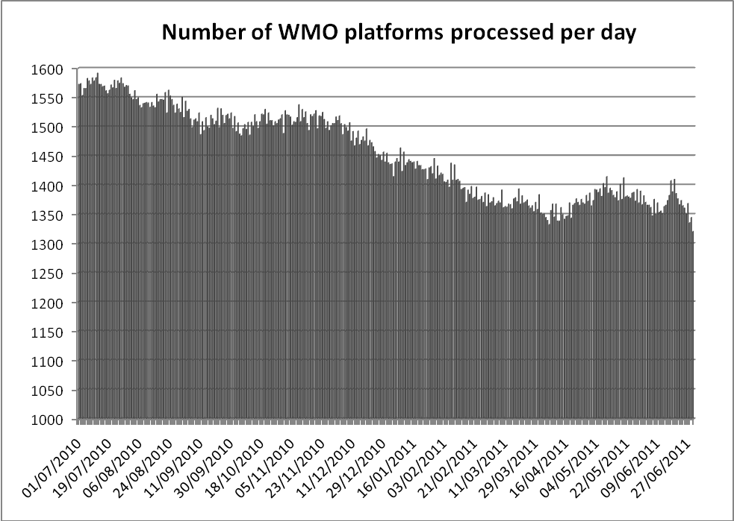
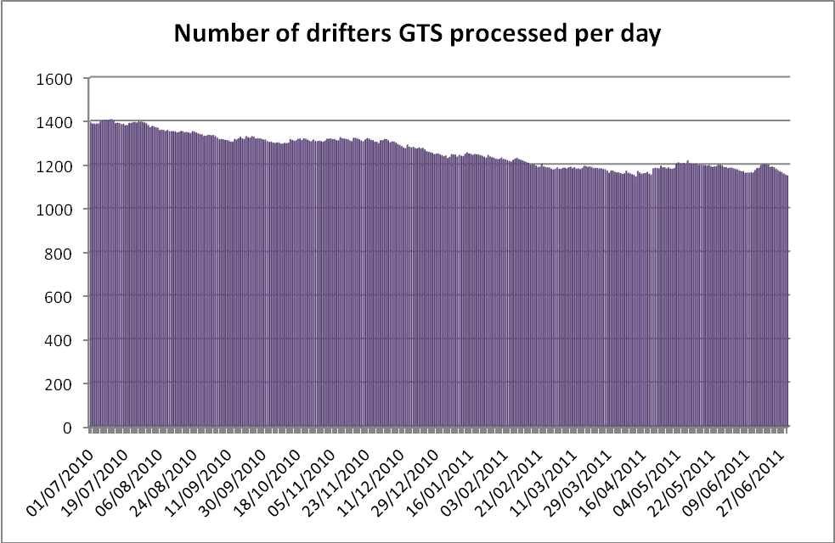
CLS- Statistics from the GTS
Number of WMO Platforms processed per day
June 2010 – Jun 2011
Number of drifters on GTS processed per day
June 2010 – Jun 2011
Graphs provided by CLS-France

Slide 9
Delayed mode Distribution and Archiving of Data
The Drifter Data Assembly Center (DAC) at AOML, submitted to ISDM, an updated version of the SVP data set for the period July 2007 through December 2010, for archival and distribution. ISDM expects to have it available through the web by the end of September 2011. Quality-controlled interpolated drifter data through June 2011 can be downloaded from the DAC web page: www.aoml.noaa.gov/phod/dac/dacdata.php
DAC has been providing a version of the deployment log file on the web as a .csv file on the ftp server, as requested at DBCP-26 in Oban. It is available at: ftp://ftp.aoml.noaa.gov/phod/pub/pazos/deplog/deployed.csv

Slide 10
Delayed mode Distribution and Archiving of Data
  The DAC continues to monitor drifter’s performance by deploying clusters of drifters from different manufacturers at the same time and at the same location, (ADB study). During 2010 there were a total of 10 clusters deployed, five clusters were all SVP type drifters and five clusters of SVPB type drifters
  The DAC has maintained a table, regularly updated and posted on the web showing ADB comparison study results as a response to an action item from DBCP-26, Oban, 2010 www.aoml.noaa.gov/phod/dac/dacdata.php , under “other presentations, posters and links”
  DAC is acquiring, applying quality-control procedures and and adding to its database Iridium data from Joubeh web site. Weekly updates of iridium data from Meteo-France are also being received and will be processed at AOML soon

Slide 11
Delayed mode Distribution and Archiving of Data
The GDP announced on its web site in May 2011 that a new study demonstrates that a significant fraction of drifters in the time period January 2004 through December 2008 may have undiagnosed drogue loss, resulting in significantly greater windage than experienced by drogued drifters. While the GDP assesss these data fro drogue presence reanalysis, it is recommended that users interested in exclusively drogue-on data use only the first 90 days of data for drifters deployed during this time period
ISDM will be presenting a new online archive with historical data from 1978 to present, later this year. Typical surface parameters will be available for download and visualization. Online mapping and inventory applications will support data discovery, visualization and data download. Monthly summary statistics and interactive track maps will be available on demand

Slide 12
Format Issues
There were several problems this year with Argos PMTs used as PTTs but their format was not changed and they remained set up at CLS-America as PMTs, causing decoding errors and confusion. Also, many of these PMTs were in the manufacturers testing program, and remained there, even after the drifters were deployed, this caused concern when data from recently deployed drifters could not be found. With the help of CLS-America, the problem was sorted out, data was found and transferred from the manufacturers testing program to the user’s program, and the format was changed.
Iridium buoys should use pilot project (PP-iridium) formats. New formats maybe created if present ones are unsuitable. Meteo-France would be glad to maintain the list and description of these data formats
REMINDER: BUFR allows to report SST with a resolution of 0.01K (instead of 0.1K) through FM18-BUOY format. This is essential for the PP-HRSST project

Slide 13
Non-GTS data Comparison to models
Meteo-France reports there has not been any progress with regards to the comparisons of non-GTS buoy data with NWP/ocean models open to anyone via the web. Meteo-France internal tools are correctly working assuming several conditions are met. For technical reasons, it is not planned yet to make these tools available on the web, however, Meteo-France offers to provide results of occasional requests sent by e-mail

Slide 14
Other Issues
ISDM has a page which summarizes and provides access to the most recent month of GTS DRIBU data. The page provides access to a Google Earth KML file with drift tracks, meta-data, CSV data download and data graphics/plots. The URL is http://isdm.gc.ca/isdm-gdsi/drib-bder/KML/MonthlyKML-eng.htm
Regarding the coordination between SOC and ISDM, it was reported at IODE (iode21_doc35.pdf) in February that SOC and ISDM would work at assembling a workshop based on the recommendations contained in the Report by the Ad Hoc Task Team on Responsible National Ocean Data Centers (RNODCs) and Specialized Oceanography Data Centers (SOCs) . No progress to report at this time
The Panel is reminded that BUFR will be the only way to communicate on the GTS after 2012
CLS/CLS America transmit all drifter data on GTS in both, BUOY and BUFR formats

Slide 15
Action Items
Continue to promote standardization of data transmission formats using DBCP-M2 concept
Convert all 5-digits WMO numbers to use the equivalent 7-digit WMO number to refer to drifters in all metadata files (e.g. GDP deployment log, JCOMMOPS cross-reference lists, etc)
The Technical Coordinator (TC) should continue to assist Pierre Blouch and Jon Turton in preparing a methodology to compare non-GTS buoy data with NWP/Ocean models, open to anyone via the web (Continuation of DBCP-25 Action 8.8.2). The Panel requests the TC to report any progress made with respect to related web tools by the next DBCP Session (action; TC DBCP; DBCP-28)
The cross reference list of WMO IDs vs. Transmitter ID provided by JCOMMOPS on the web is very useful. However, due to the Technical Coordinator’s position having been vacant, it was last updated on October 13, 2010. The Panel requests the list to be updated ASAP ftp://ftp.JCOMMOPS.org/JCOMMOPS/GTS/wmo/wmo_list.txt
TC should publish the results after cross-checks of GTS Bulletin Headers received/sent between ISDM and Meteo-France have been performed, on the JCOMMOPS web site
TT-DM Reviewed the SSS QC document and sent to TT-IBP, it was finalized and submitted for publication

Slide 16

Many thanks to all who provided input to TTDM report
And for taking time to prepare and review the documents

