Slide 1
All You Wanted To Know About Drifters’ Operations
Prepared by: Mayra Pazos
Drifter Data Assembly Center, NOAA, AOML, Miami, Florida

Slide 2
Global Drifter Program
The Global Drifter Program (GDP) is the principle component of the Global Surface Drifting Buoy Array, a branch of the National Oceanographic and Atmospheric Administration (NOAA) Global Ocean Observing System (GOOS) and a scientific project of the Data Buoy Cooperation Panel (DBCP)

Slide 3
Components of the Global Drifter Program
Manufacturers
Operational Partners
Drifter Operations Center (DOC)
Drifter Data Assembly Center (DAC)

Slide 4
Drifter Operations Center
Objectives:
To maintain a global 5x5 array of Argos tracked Lagrangian Drifters to meet the need for accurate and global in-situ observation of SST and surface circulation.
These data support:
Short term climate prediction
Satellite observation calibration
Climate research and monitoring

Slide 5
Drifter Data Assembly Center
Objectives:
The goal of the Drifter Data Assembly Center is to assemble and provide uniform quality controlled data of research quality for sea surface temperature and surface velocity measurements.

Slide 6
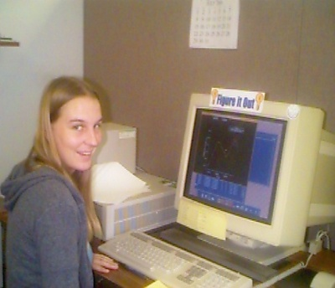
The DOC and The DAC Work Together But …They Have Different Tasks
DOC
DAC
Takes care of logistics, from the request of the Argos IDS, to the deployment of the buoy
Develops & coordinates drifter deployment plans
Finds ships for deployments
Distributes IDS to manufacturers
Maintains Metadata
Shaun Dolk
Maintains a database with drifter data from deployment until buoy stops transmitting, and QC data
Decodes raw data & applies calibrations
Quality controls and interpolates data
Makes data available through web and distributes for archiving
Disseminate buoys going on/off GTS
Mayra Pazos,
and Erik Valdes

Slide 7
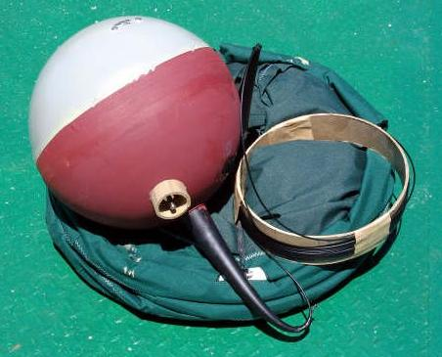
What Is A Drifter?
The modern drifter is a high-tech version of the "message in a bottle". It consists of a surface buoy and a subsurface drogue (sea anchor), attached by a long, thin tether. The buoy measures temperature and other properties, and has a transmitter to send the data to passing satellites. The drogue dominates the total area of the instrument and is centered at a depth of 15 meters beneath the sea surface.

Slide 8
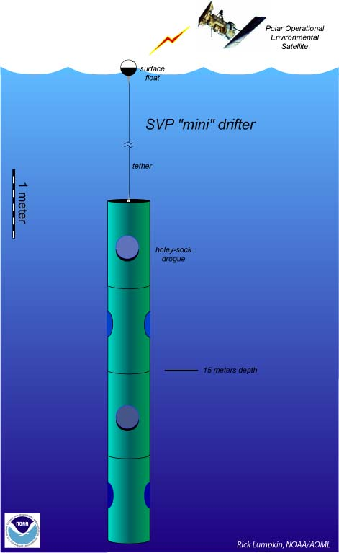
Basic SVP Drifter
Spherical plastic float
Poly Urethane impregnated wire
Holey Sock drogue centered at 15-m depth
D-cells batteries inside the float
Sensors:
Drogue: Observes the submersion rate of the float. Float stays on the surface if drogue is lost.
SST: To measure Sea Surface Temperature
Voltage: Indicates batteries’ life
Cost: ~$1800
Other Sensors that can be added:
Barometric pressure, wind, salinity,etc
Holey-sock drogue
(sea anchor)
Notes:
Batteries provide power, nominal operation of 2 years. Average life ~ 400 days
Cost of basic drifter ~ $1800, ~ $3000 Barometer, ~ $1200 for baro upgrade
Drogued at 15-m depth to measure mixed layer currents.
Original SVP made out of ordura nylon, original designed: 7 sections each 92 cm long and 92 cm in diameter.

Slide 9
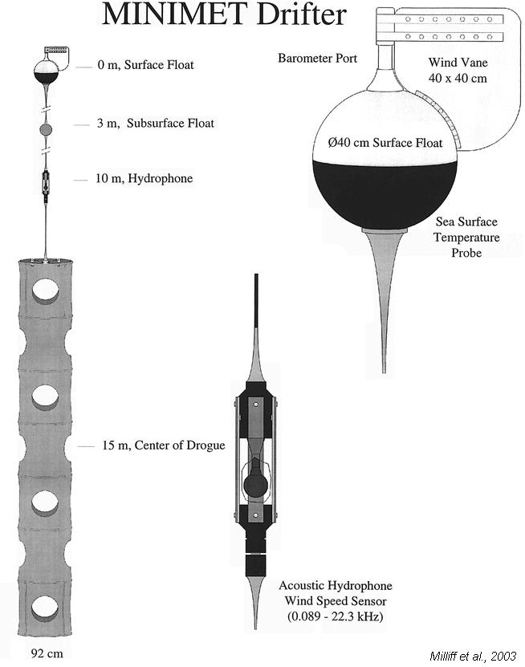
SVP + Barometer + Wind
Barometer to measure air pressure.
Wind Direction is measured by a vane on the surface float
Wind speed by a subsurface hydrophone.
Cost: ~$3000.00
We offer option to upgrade!
SVP with Barometer

Slide 10
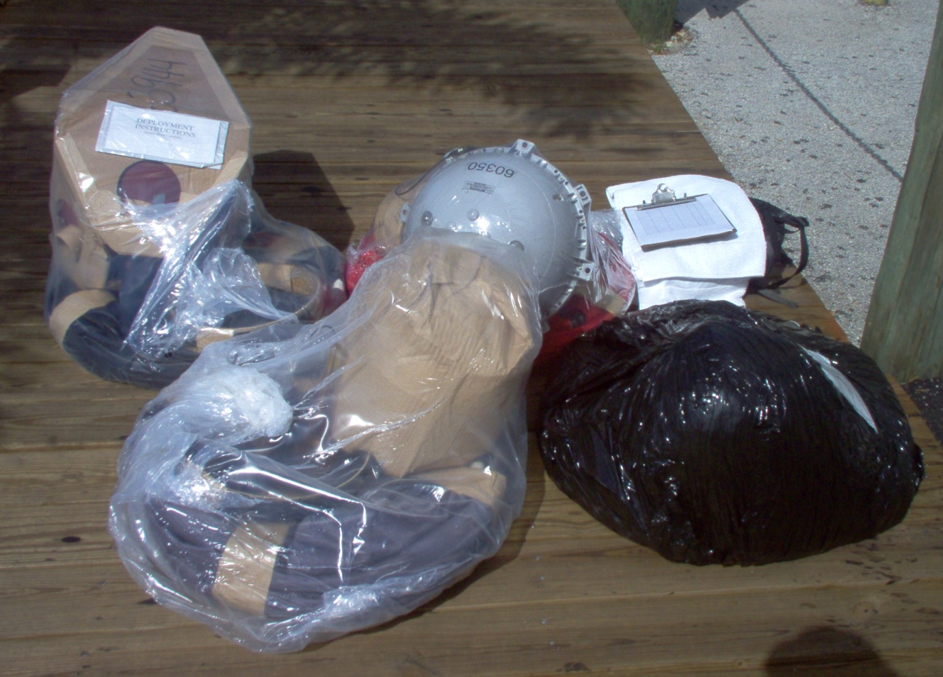
Drifter Packaging
Hulls covered with cardboard
Uncovered Hulls
Deployment Instructions
Plastic wrap
Notes:
Some manufacturers cover the hull with soluble cardboard boxes some don’t

Slide 11
Pull-Pin Activation Magnet
Some drifters have a pull-pin magnet to activate the buoy.
Without removal of the magnet, the buoy remains “off”.
Some drifters have the magnet attached with water-soluble tape, that don’t require removal prior to deployment.

Slide 12
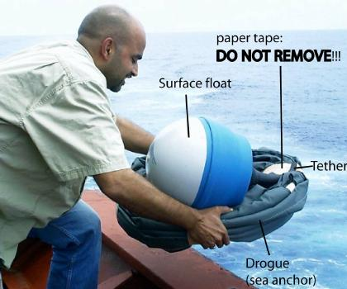
Drifter Ready To Be Deployed

Slide 13
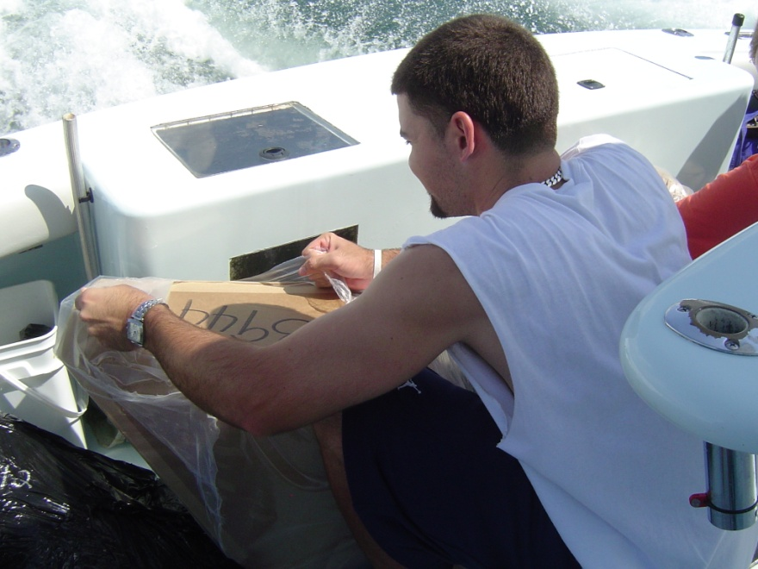
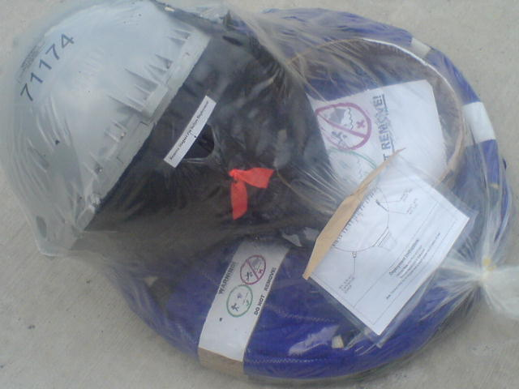
How To Deploy A Drifter
1- Remove ONLY plastic shrink wrap
Some drifters have cardboard around the float. DO NOT remove the cardboard surrounding the surface float.
Notes:
Each drifter weghts 45 kg (100 lbs) and can be deployed by a single person although
It is recommended that in heavy seas, 2 people deploy an original SVP
Mini drifters weighs 20 kg (44 lbs), can be easily deployed by one person.

Slide 14
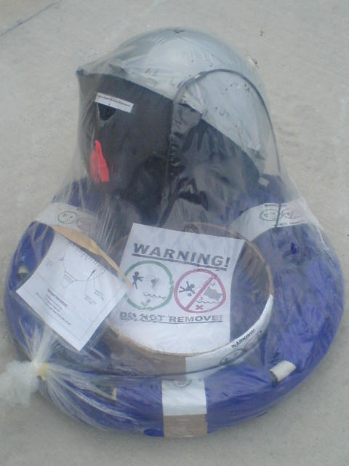
How To Deploy A Drifter (Cont.)
2- DO NOT remove the paper tape securing the tether and drogue
DANGER!
DANGER!
Paper tape
Paper tape
If you do, the drogue and/or tether can unfurl during deployment and cause injury!!!

Slide 15
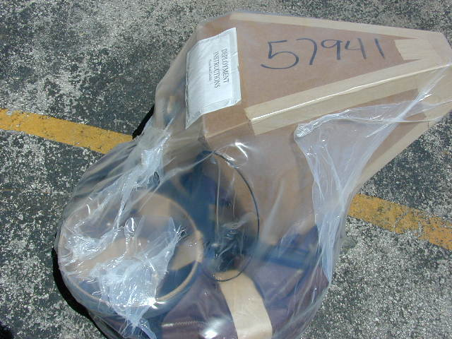
How To Deploy A Drifter (Cont.)
3- Record the five digit ID number of the drifter. This number can be found on the shipping container, the plastic shrink wrap or the protective cardboard box. It is also inscribed on the surface float.
ID number on the surface float

Slide 16
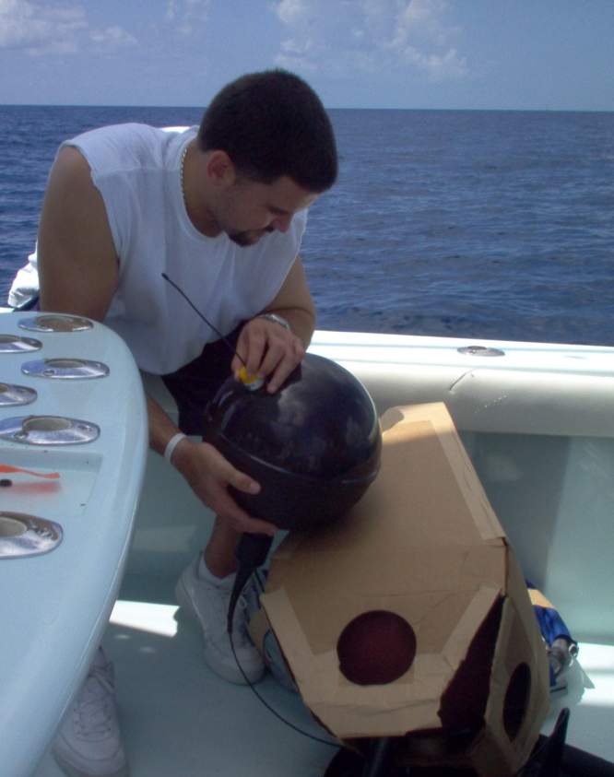
How To Deploy A Drifter (Cont.)
4- If testing the buoy is desired prior to deployment, the magnet can be removed from the drifter by separating it from the surface float. This action will start the Argos transmitter for testing, reattaching the magnet in the same position, will turn off the transmitter.
Remove magnet through hole in the box.
Test if transmitting.
magnet
Hole in box to remove magnet

Slide 17
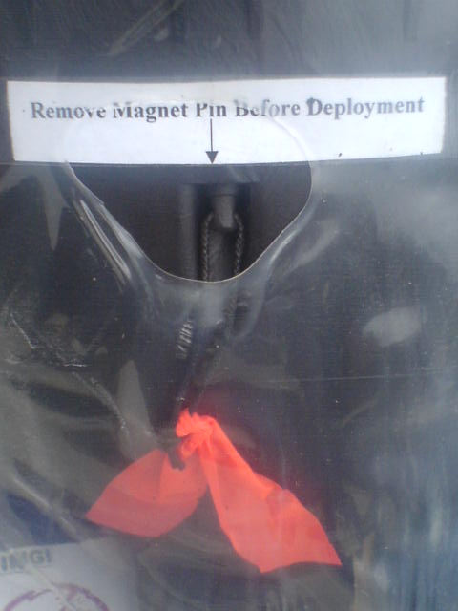
Some drifters don’t have a safety pin magnet to be removed,
instead they have the magnet attached with soluble tape that will
dissolve once the drifter is in the water.
**Read instructions carefully to know if you need to pull the magnet
manually or not.**

Slide 18
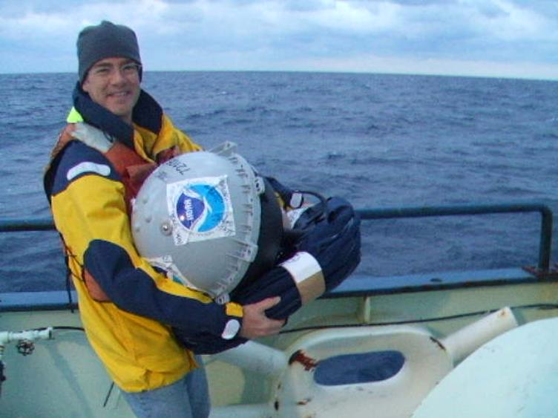
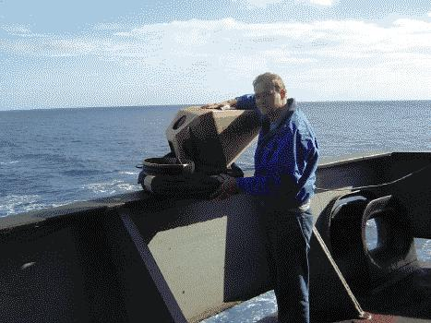
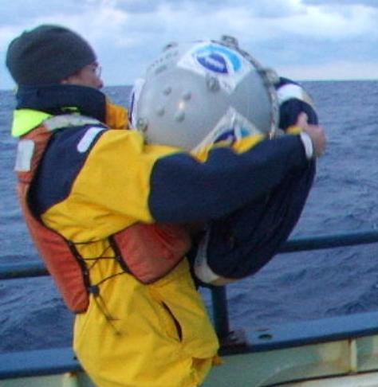
How To Deploy A Drifter (Cont.)
5- Throw the drifter from the stern, lowest possible deck (preferably less than 10 meters including heave) into the sea. The ship may be traveling between 2-25 knots. The tether and drogue are secured with paper tape that will dissolve in the water.
Throw buoy from stern, lowest possible deck.
Notes:
Each drifter weghts 45 kg (100 lbs) and can be deployed by a single person although
It is recommended that in heavy seas, 2 people deploy an original SVP
Mini drifters weighs 20 kg (44 lbs), can be easily deployed by one person.

Slide 19
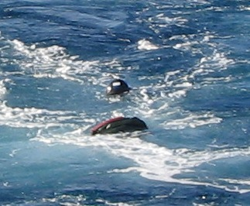
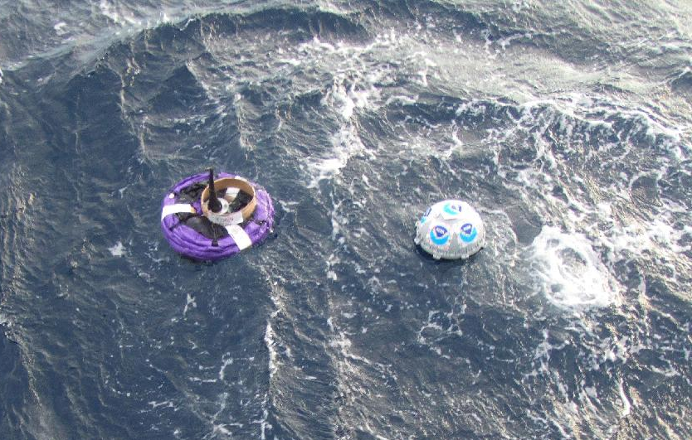
Tether and drogue secured with paper tape that will dissolve in water
Drogue starts sinking minutes after deployment
Drogue stretches vertically, when tape dissolves
Notes:
Tether is sometimes wrapped around a water-soluble cardboard tube to protect it from kinking.
Drogue starts sinking, and will extend to vertical position when all the Tape is dissolved.
It takes approximately 1 ahour for the drogue to become fully soaked, allowing the tape to
Dissolve and trapped air bublles to be released before the drogue sinks.

Slide 20
How To Deploy A Drifter (Cont.)
6- Record the five(5) digit Buoy ID, Date of Deployment, Time (GMT) of Deployment, Longitude and Latitude of deployment and send this information to the Global Drifter Program.
Contact Persons:
Shaun.Dolk@noaa.gov
and
Mayra.Pazos@noaa.gov

Slide 21
Instructions Included With Each Drifter
(Page 1)

Slide 22
Deployment Instructions (Page 2)
1) Remove the buoys from the shipping container. REMOVE ONLY the plastic shrink-wrap.
2) DO NOT REMOVE paper tape securing the drogue and tether. DO NOT REMOVE cardboard surrounding the float.
DANGER: DO NOT REMOVE the paper tape securing the tether and drogue. If you do, the drogue and/or tether can unfurl during deployment and cause injury!!!
3) Record the five digit ID number of the drifter. This number can be found on the shipping container, the plastic shrink-wrap or the protective cardboard box. It is also inscribed on the surface float.
4) If testing the buoy is desired prior to deployment, the magnet can be removed from the buoy by separating it from the float through a hole in the box surrounding the float. This action will start the ARGOS transmitter for testing. Re-attaching the magnet in the same position will turn off the transmitter and reset the program starting point. The transmitter will restart on its original program when the magnet is again removed.
5) Throw the buoy from the stern, lowest possible deck (preferably less than 10 meters including heave), into the sea. The ship may be traveling between 2 - 25 knots. The tether and drogue are secured with paper tape that will dissolve in the water.
6) Record the date, time (GMT) and location of deployment as well as the five digit ID, and send this information to the Global Drifter Program.
Thank you very much for your help!
CONTACT PERSON

Slide 23
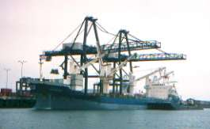
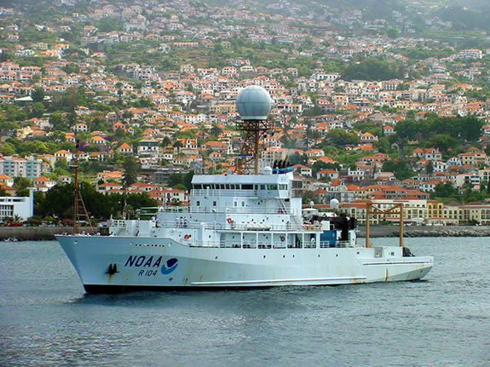
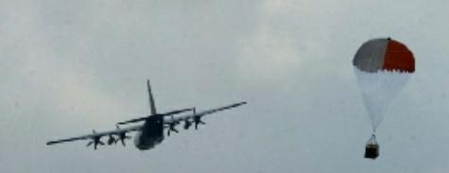
Drifters Are Deployed From:
Cruise ships
Cargo ships
Research Vessels
Aircrafts
Assistance from national and international
Governmental Agencies
Notes:
Volunteer observing ships are usually container vessels traveling from port to port, transporting goods of any kind. These vessels have taken on the responsibility of deploying drifters throughout the world while on their
Journeys.
Research vessels are scientific ships that are out doing various sea and weather studies, they visit particular areas of interest on a regular scheduled, while other areas are visited less frequently
Air deployments are done by C-130 Hercules “Hurricane Hunters”,Us Air force, also US Navy had been involved in previous years. Air deployments are usually done in front of hurricanes passing through the Tropical Atlantic
Region, the data is transmitted in real time through the GTS system to operational centers such as the Environmental Modeling Center (EMC) and is used to improve weather forecasting. These data is also used along with many other data collected from Satellite imagery and P-3 aircraft data, by the National Hurricane Center In Miami, to issue public bulletins during the hurricane season

Slide 24
Drifters Deployed By Aircrafts
Drifters are also deployed by aircraft to help seed those regions that otherwise it would be hard to reach.
Every year during the hurricane season in the Atlantic Ocean
(June 1 – November 30) NOAA/AOML has coordinated
Deployments with NAVOCEANO in the past, and also with the
National Hurricane Center in Miami, Florida, to deploy drifters
in front of hurricanes using the hurricane hunter planes from the
air force to provide forecasters and researchers with surface
meteorological data to help in the prediction and forecast of
hurricanes.
These drifters besides measuring SST, also measure:
Barometric pressure
Wind speed and wind direction
Notes:
Usually weather data over the oceans is observed and sent by merchant ships, but obviously these
Ships will divert from their normal tracks to avoid ares of rough weather so there is missing
Data where and when it is needed the most. So buoy data and data collected by satellite and special
Research aircraft are very important.

Slide 25
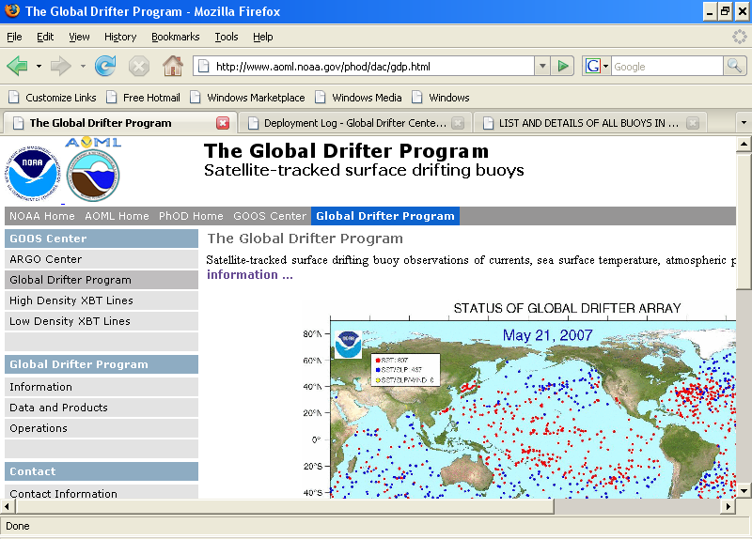
Deployment Information On The Web
www.aoml.noaa.gov/phod/dac
Click to see the current status of the array
Enter DOC page

Slide 26
Sample Drifter Deployment Log

Slide 27
Some Drifter’s Facts
Drifters average life: ~450 days
Longest Lived: 10 years, 4 months, 21 days
Drogue average life: ~300 days
Longest Drogue on : 5 years, 6 months, 21 days (and still on)
Average failure on deployment: ~3%
Death Reasons: Run aground, picked up by fishermen, stop transmitting

Slide 28
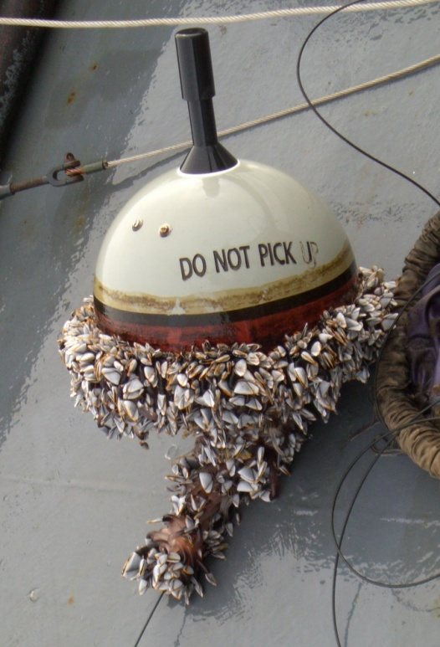
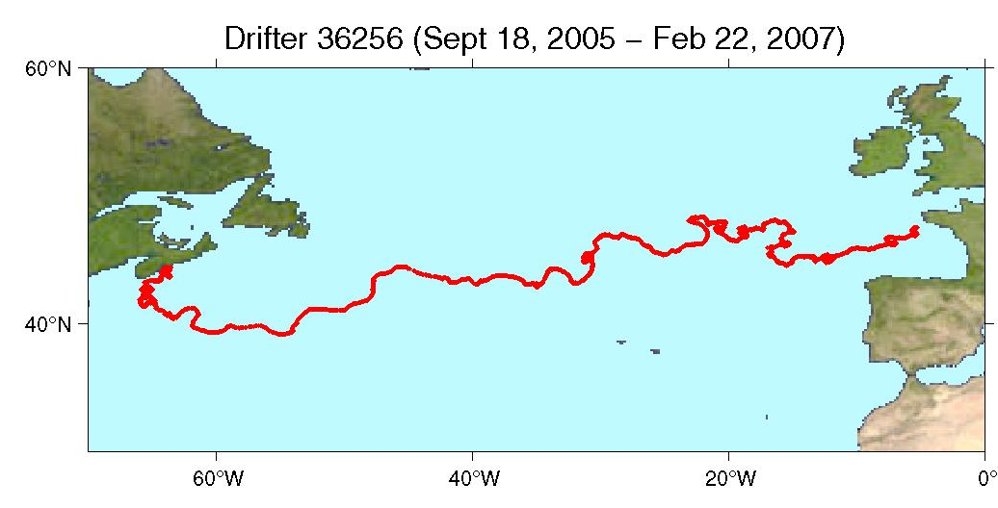
Global Drifter # 1250
Scientific design of the global drifting network called for 1250 buoys to be deployed and maintained worldwide to ensure total coverage of the global ocean and to calibrate the satellites.
Retrieved after crossing North Atlantic, off the cost of Brest, France
Traveled for 521 days, with drogue on to the end, and transmitting good SST, and barometric pressure. All data went out on the GTS.
Notes:
The 1250 figure was derived by dividing the ocean into a 500x500 nautical mile grid. By doing so,
1,250 buoys were needed or one buoy every 500 nautical miles to ensure
I was deployed near Halifax, Nova Scotia on Sep 18, 2005

Slide 29
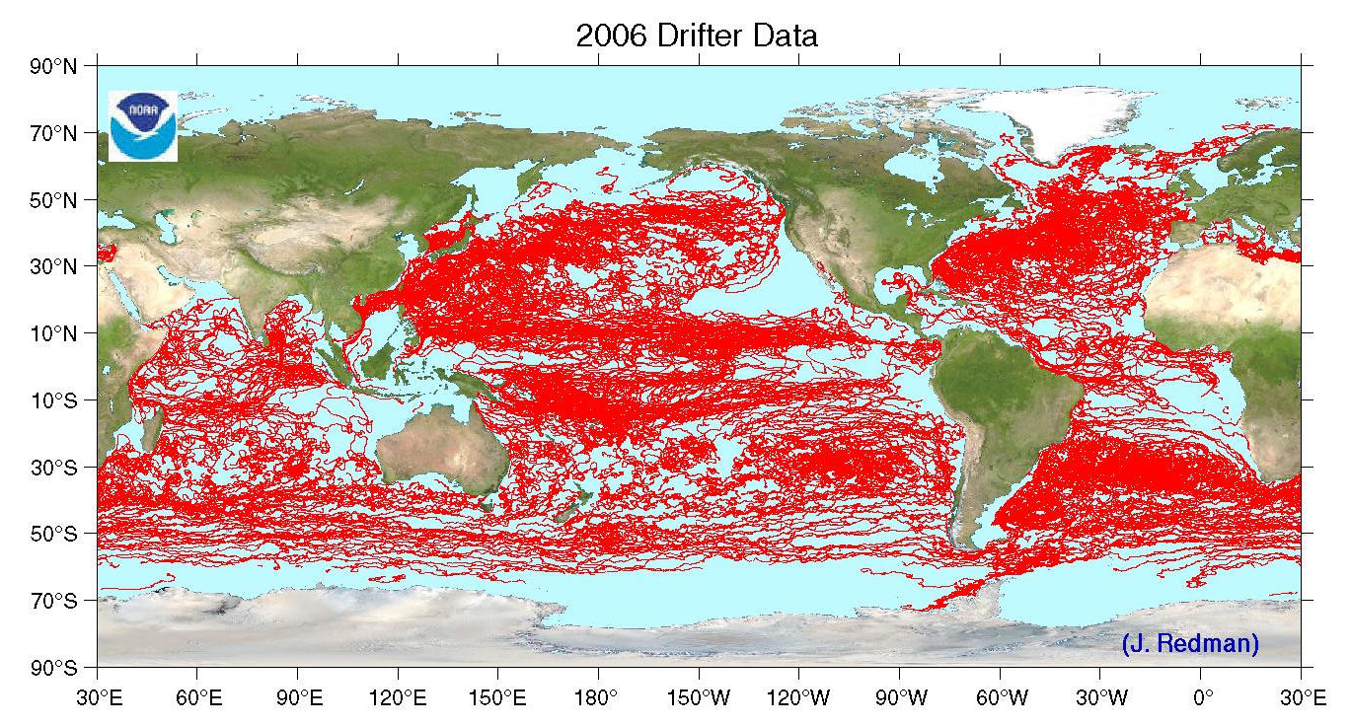
Tracks of Drifters During 2006

Slide 30
Thanks
Our appreciation to the following Operational Partners for their contributions to GDP activities
Ships of Opportunity program
International Ice Patrol
Institut de Recherche pour le Développement;
Météo-France (France)
New Zealand Met. Service
Australian Bureau of Meteorology
Fundação Universidade Federal do Rio Grande; Instituto Nacional de Metereologia; Centro de Hydrografia de Marinha; INPE (Nacional Space Institute); Brazilian Navy (Brazil)
Fisheries Research Institute; Servicio de Hidrografía Naval (Argentina)
Instituto Canario de Ciencias Marinas; Universidad de Las Palmas de Gran Canaria (Spain)
Instituto Nazionale di Oceanografia e di Geofisica Sperimentale (Italy)
Marine Fisheries Research Division – Ghana
Fisheries Department – Tristan Da Cunha
National Institute of Oceanography; National Institute of Ocean Technology (India)
Centro de Investigacion Cientifica y de Educacion Superior de Ensenada (Mexico)
Ministry of Maritime Affairs and Fisheries NORI, NFRDI (Korea)
United Kingdom Met Office
Environment Canada
University of Cape Town; South African Weather Service (South Africa)
Scripps Institution of Oceanography
Woods Hole Oceanographic Institution
United States Air Force
Oregon State University
Marine Resources Research Institute
US Naval Oceanographic Office
United States Coast Guard
Raytheon Polar Services … and many others

