Slide 1

All You Wanted To Know About Drifters’ Data Management
Prepared by: Mayra Pazos
Drifter Data Assembly Center, NOAA, AOML, Miami, Florida

Slide 2
Quality Control
Practical implementation at the Drifter Data Assembly Center
Importance of Metadata
Delayed Mode Quality Control Procedures
Web Access to Data and Products
GTS
Distribution

Slide 3
Importance of Metadata

Slide 4
Importance of Metadata
METADATA= DOCUMENTATION
Metadata describes the characteristics of the data. The drifter metadata describes:
Argos ID number
GDC unique ID
WMO number
Program number
Contact Information
Deployment time, latitude and longitude
Manufacturer
Buoy type
Drogue type, length, and brief description of its characteristics
Sensors transfer functions
Track inventory of drifters, both in storage and in transit
Metadata helps share reliable information, and maintain homogeneity of the database
Without METADATA no data set is complete

Slide 5
Sample Specification Sheet
Manufacturers are required to send DAC specification sheets
Argos ID(s) 70850-70857
Manufacturer
Technocean
Sensor array
SVPB Battery voltage, drogue sensor, SST, barometer
Surface float description
41 cm. diameter, ABS plastic surface float.
Tether description
a) 0.32 cm OD polypropylene-impregnated wire rope between surface
float and drogue.
b) Tether attachment to 2.0 cm steel ring at base of surface float;
marine epoxy filled cavity surrounding ring for restraint.
c) 5 cm dia. by 32 cm long polyurethane strain relief molded below
surface float. Attachment point of tether to drogue hub covered by 5 cm
dia. by 32 cm long polyurethane strain relief.
Drogue description
a) Holey sock made from Cordura nylon cloth; diameter 61 cms, length 610
cms. construction consists of 5 cylindrical sections, each 122 cms long. Two
30 cm dia. holes cut opposite each other in each section. Axis joining holes
is rotated by 90° between successive sections.
Drogue is centered at 15 m.
Drogue depth
15 m at center
Drogue length
6.1 meters
Message Length
56 bits
Message format
8 bits Checksum
4 bits Rank
6 bits Age
11 bits Barometric pressure
9 bits Sea surface temperature
9 bits Air pressure tendency
6 bits Submergence count
3 bits Battery voltage

Slide 6
Delayed Mode Quality Control Procedures

Slide 7
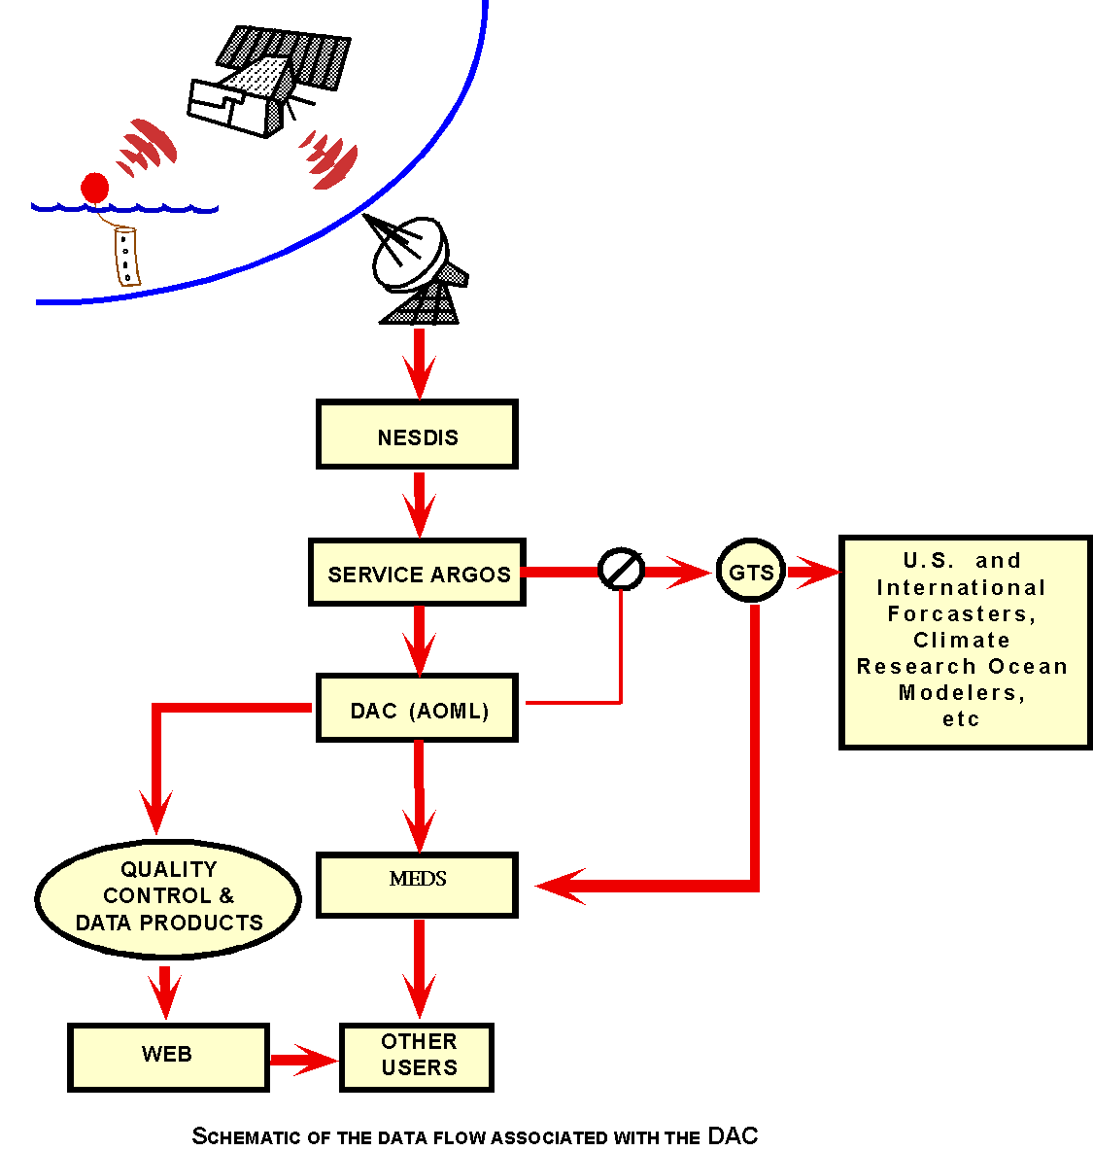
DAC
Data
Flow

Slide 8
Drifter Database
Information Files
  Relational database using flat files linked by ARGOS ids
  Data starts in February 1979 and continues to present
  All buoys are standard WOCE/SVP drogued at 15 meters
DIRECTORY FILE
(information
about ea. Drifter)
CALIBRATION FILE
(coefficients to calibrate
each sensor)
GROUND FILE
(holds time interval
not to be interpolated)
TEMPERATURE
FILE
(holds last day SST is good)

Slide 9
Drifter Database
Data Files
Data from Argos
Apply calibrations and split
into individual files by ID
B-files
B00000.DAT
(raw data for ea. buoy)
Edit Position and SST
Split into P and S files
P-files
P00000.DAT
(Edited Position)
S-files
S00000.DAT
(Edited SST)
Reside in AOML
database, available
through the WEB
K-files
K00000.DAT
(Interpolated - Kriging)

Slide 10
Quality Control Steps
Drifter data is downloaded from Argos daily and also received at AOML once a month on CDs
Convert raw data into engineering units and add to individual B-file by ID
Determine deployment time and position of first good transmission from the water
Run programs that identify buoys that are dead:
a) Transmit from the same location after a successful deployment (grounded)
b) Do not have any new data after last update (quit)
  Such dates and positions are entered into the DIRECTORY file

Slide 11
Quality Control Steps (Continuation)
Software are run to check bad locations from ARGOS raw data based on speed between consecutive locations, bad points are deleted (P-files)
Deviant SST values are removed by applying a temperature change criterion relative to the recent temperatures measured by the buoy (S-files)
SST’s from each drifter are compared with Reynold’s climatology to determine temperature sensor failure, last good day is entered into the TMPFL file. SST after this date will be discarded
We decode, archive and handle GTS data transmissions and deletions of other sensor data like pressure and wind, but NO quality control is applied to them

Slide 12
Quality Control Steps (Continuation)
Buoys that possibly lost their drogues are identified. Drogue lost date is determined and entered in the DIRECTORY file
All active buoys are processed and interpolated to 6 hour intervals,
using the Kriging method
P (position edited) file + S (SST edited) file = K (interpolated) file
Refer to paper by Hansen and Poulain for details on the Editing and Kriging procedures:
Hansen, D.V. and P.-Marie Poulain, 1996. Quality Control and Interpolations of WOCE/TOGA Drifter Data. J. Atomos. Oceanic Tec., 13, 900-909
Kriged drifter data can be accessed through the WEB WWW.AOML.NOAA.GOV/PHOD/DAC/DACDATA.HTML > Interpolated database
Database is updated every 2-3 months and sent to MEDS for distribution and archival

Slide 13
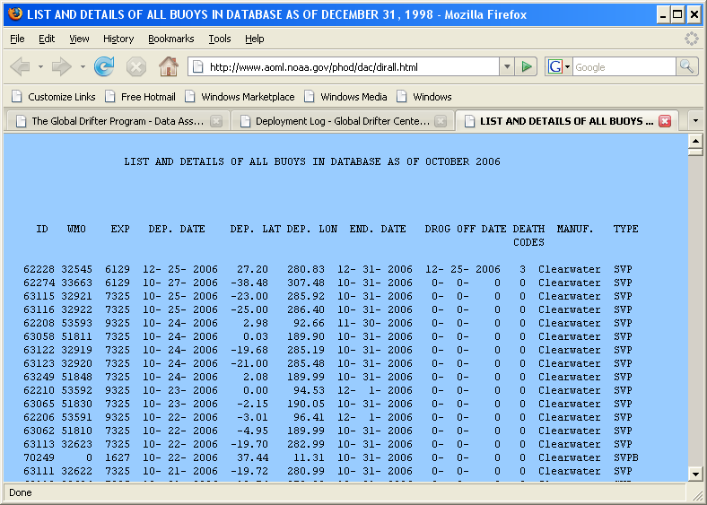
Sample Directory file
http://www.aoml.noaa.gov/phod/dac/dacdata.html
> Details of all drifters in database

Slide 14
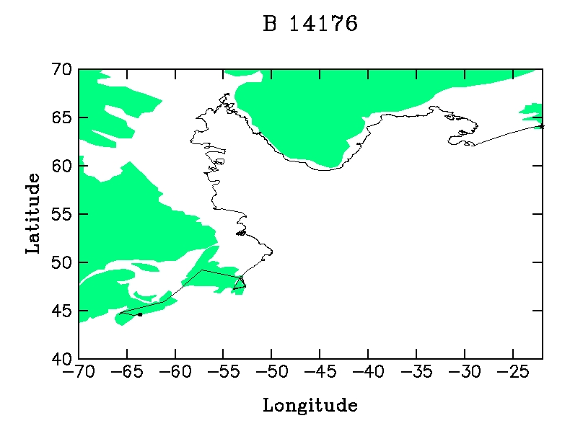
QC Examples
Drifter 14176 raw file
Ship track
Deployed here
11-Oct-2000
Picked up

Slide 15

Drifter 14176 Cleaned and Interpolated File
QC Examples
After editing and interpolation procedures have been applied
15-Mar-1999
Ship track
Deployed here
30-Jul-2000
Raw Data
11-Oct-2000
Picked up
Ship track
Deployed
11-Oct-2000
Picked up

Slide 16
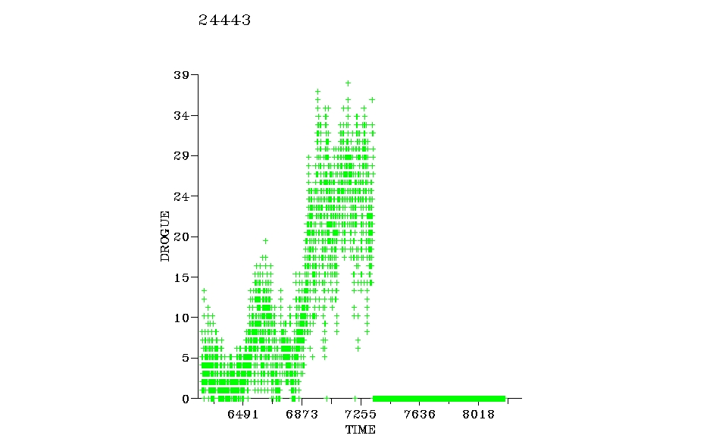
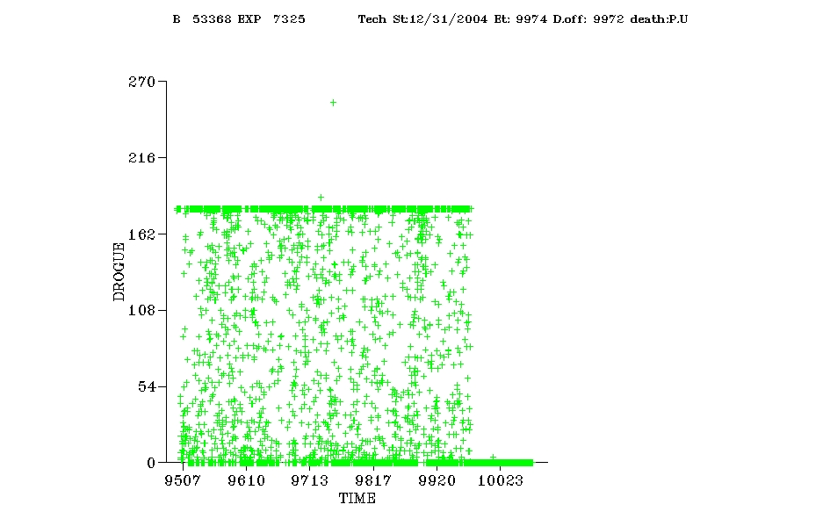
QC Examples
Determining drogue off time… NOT an easy task
53368
Drogue
lost day 1/29/99
Drogue lost
10/8/96 10/25/97 11/11/98 11/27/99 12/13/00
Typical submergence record for Technocean “drogue loss”
(sharp drop to zero when drifter is picked up).

Slide 17
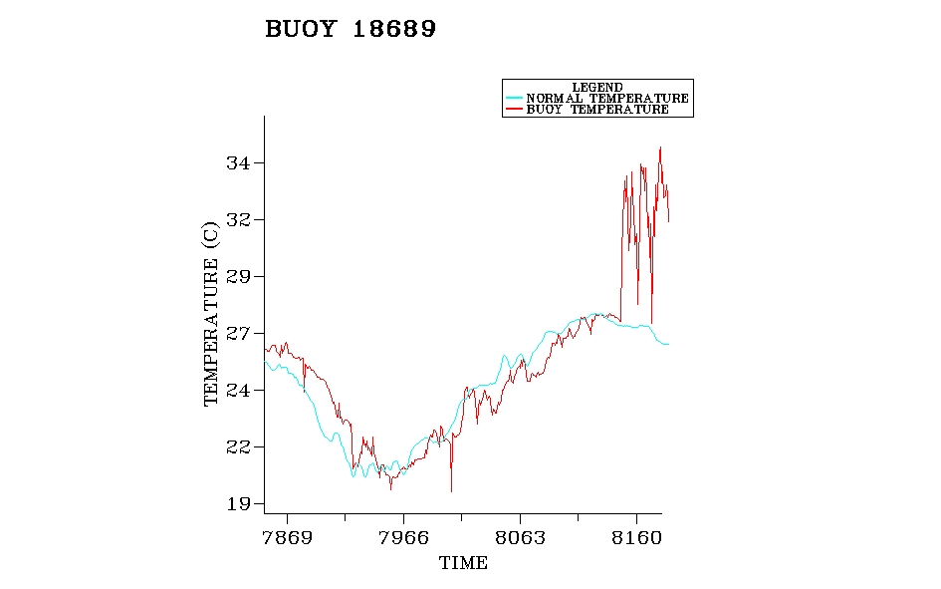
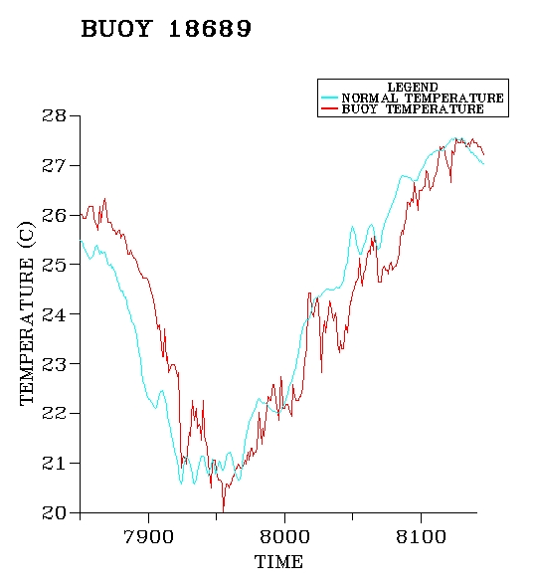
QC Examples
Compare SST with Reynold’s Climatology
SST after removing bad data
Bad SST day
4/21/01
7/17/00 10/22/00 1/27/01 5/4/01
8/17/00 11/25/00 3/5/01

Slide 18
Web Access
to Data and
Products

Slide 19
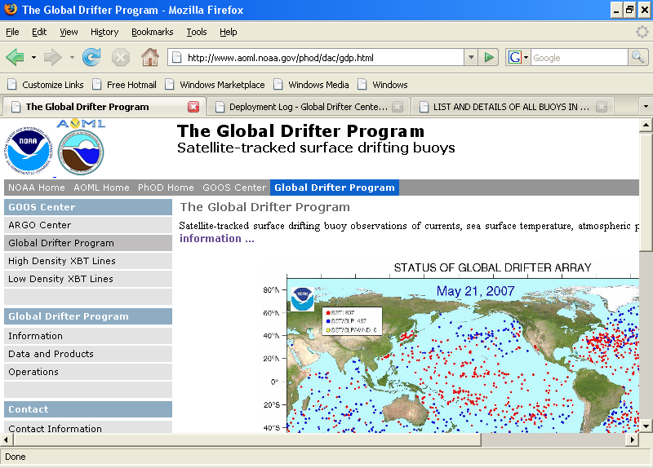
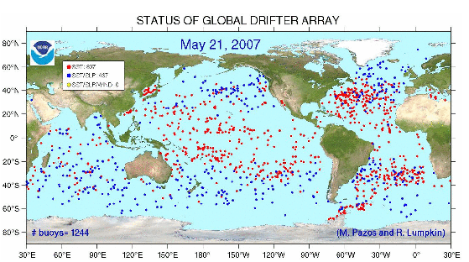
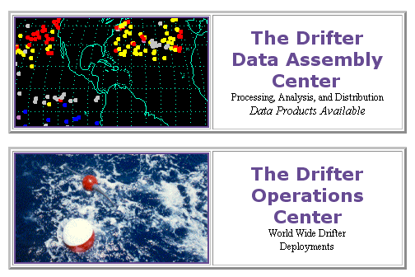
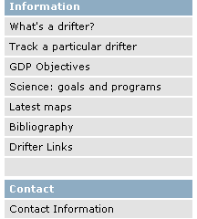
Accessing Data and Products
www.aoml.noaa.gov/phod/dac
Click to see the status of the array

Slide 20
Accessing Data and Products
www.aoml.noaa.gov/phod/dac
Enter DAC page

Slide 21
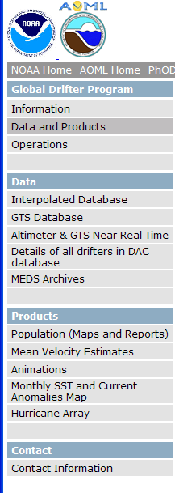
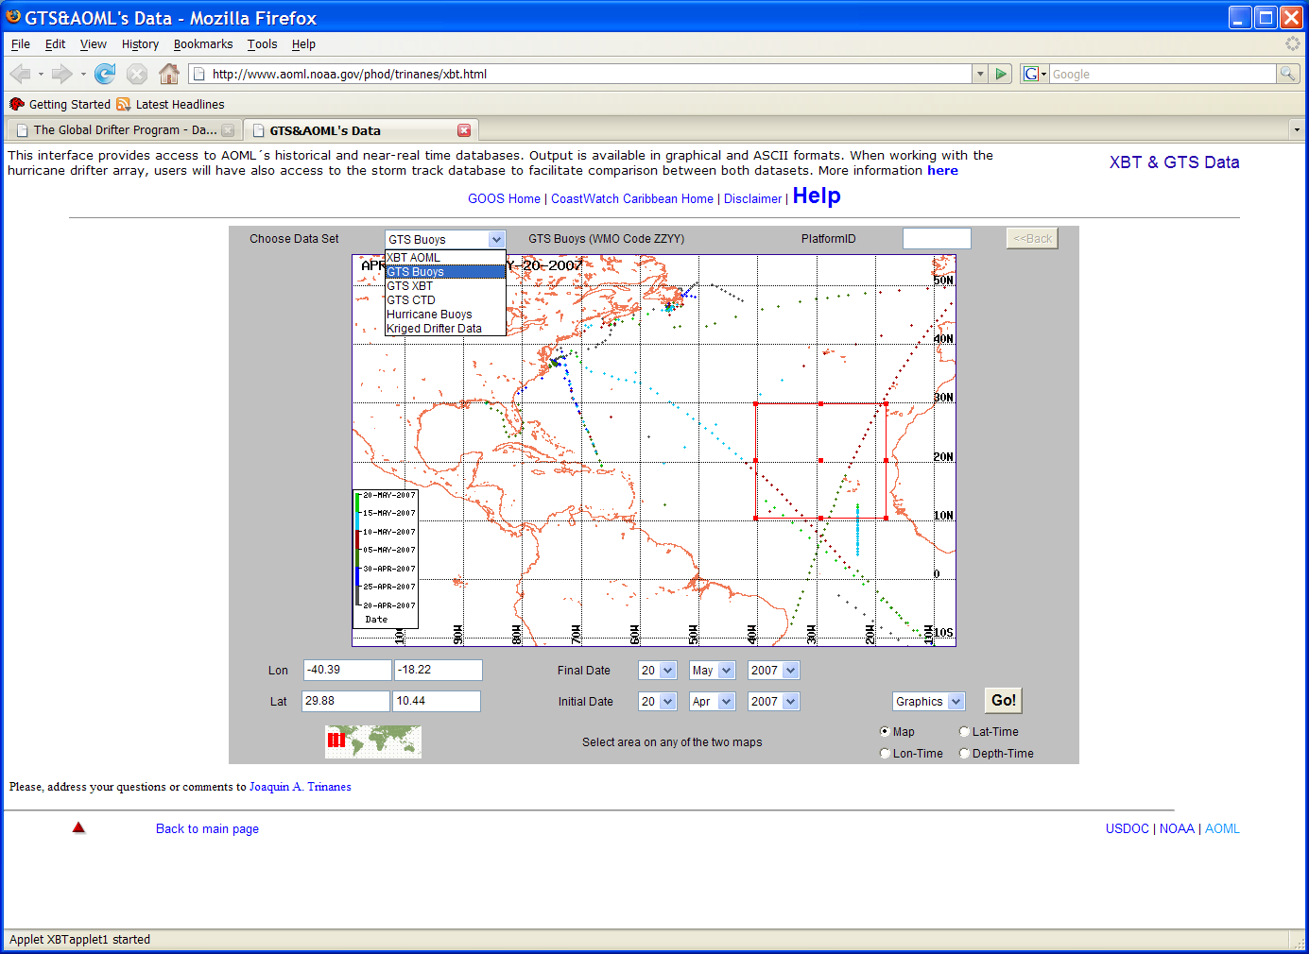
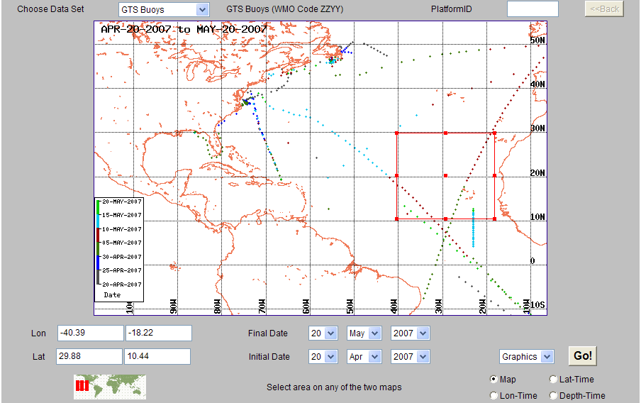
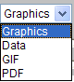
How To Access Drifter Data
http://www.aoml.noaa.gov/phod/dac/dacdata.html
Near real time (graph) from GTS
(Optional ) for one WMO#
Select region

Slide 22
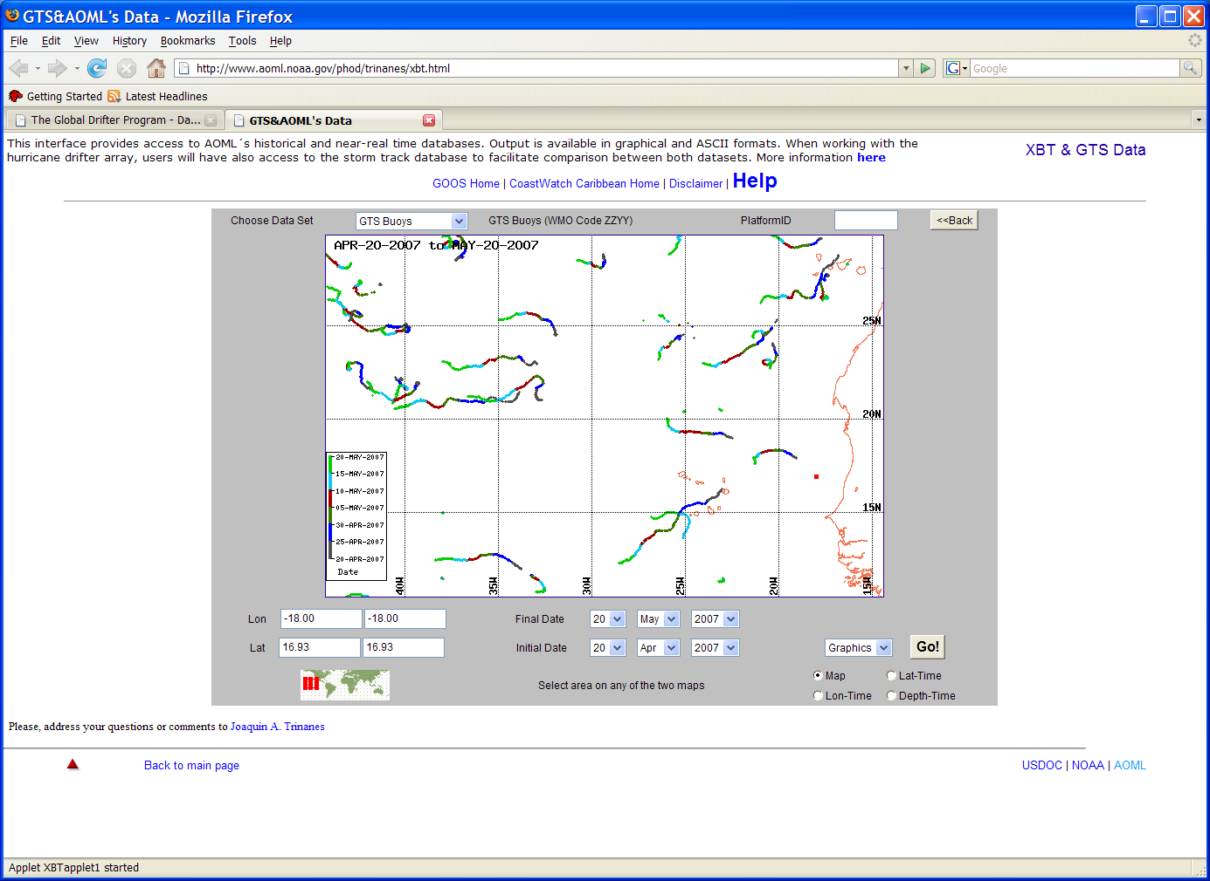
Results
Select results to save data
Data

Slide 23
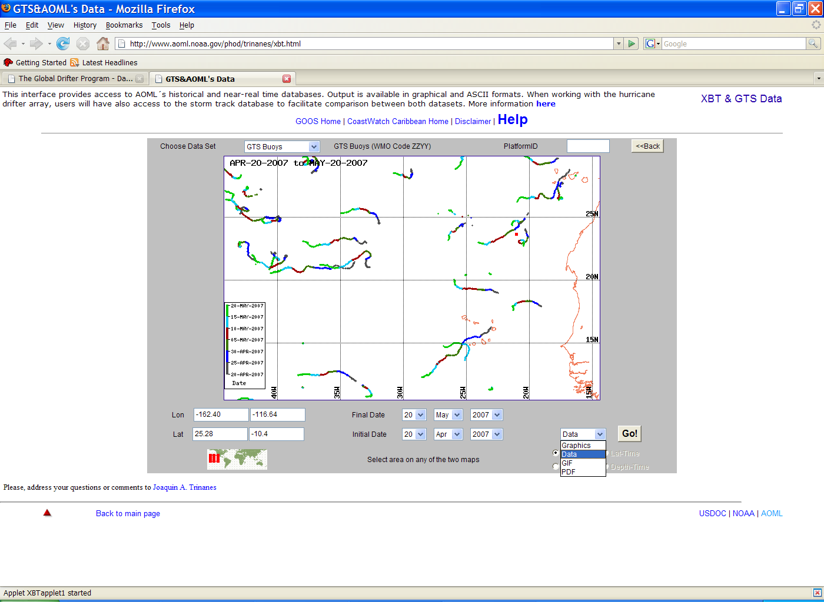
How To Access Drifter Data
Near real time (data) from GTS
http://www.aoml.noaa.gov/phod/dac/dacdata.html
(Optional) for one WMO#
Select region

Slide 24
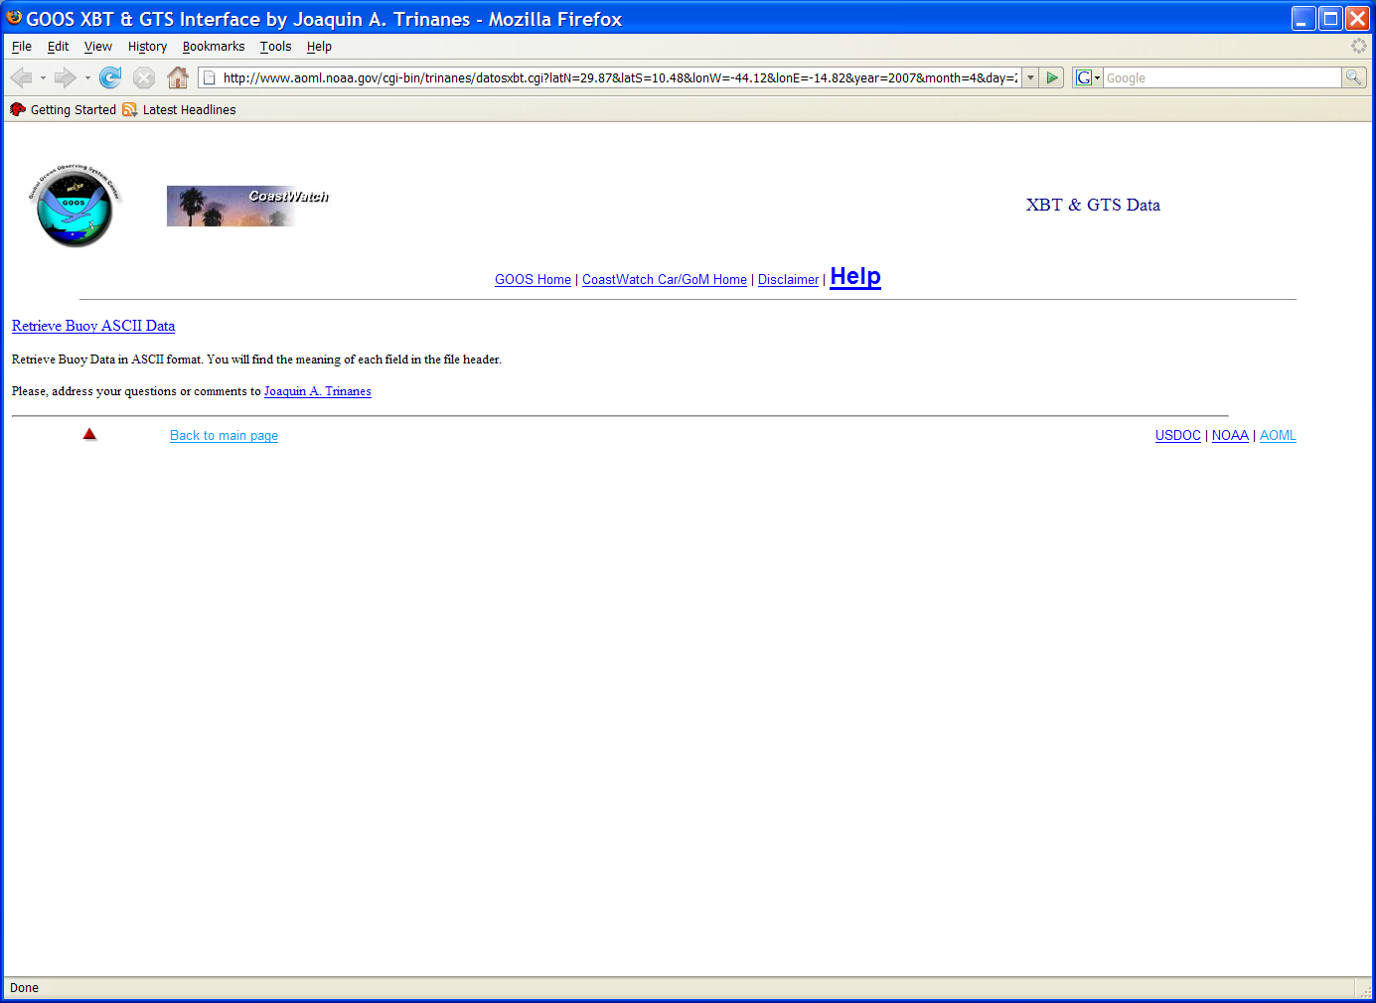
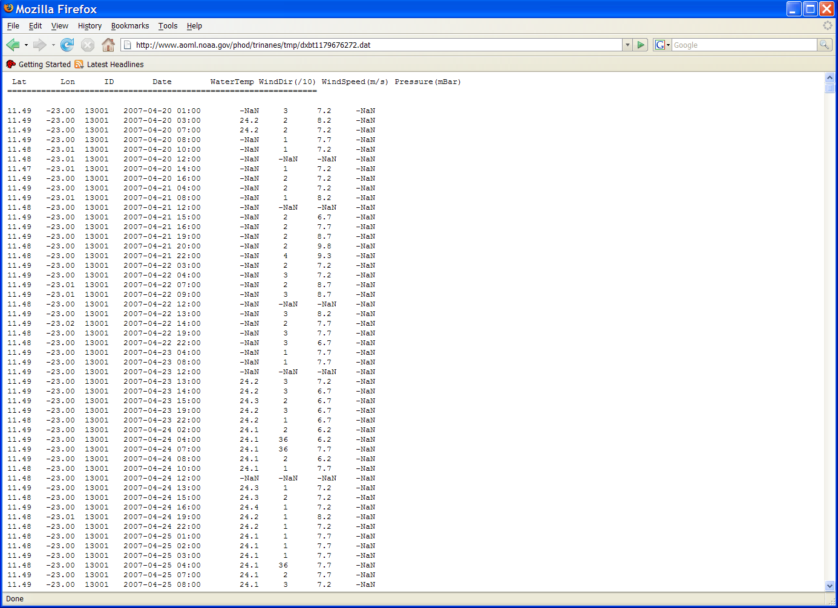
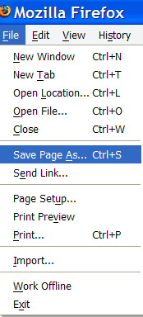
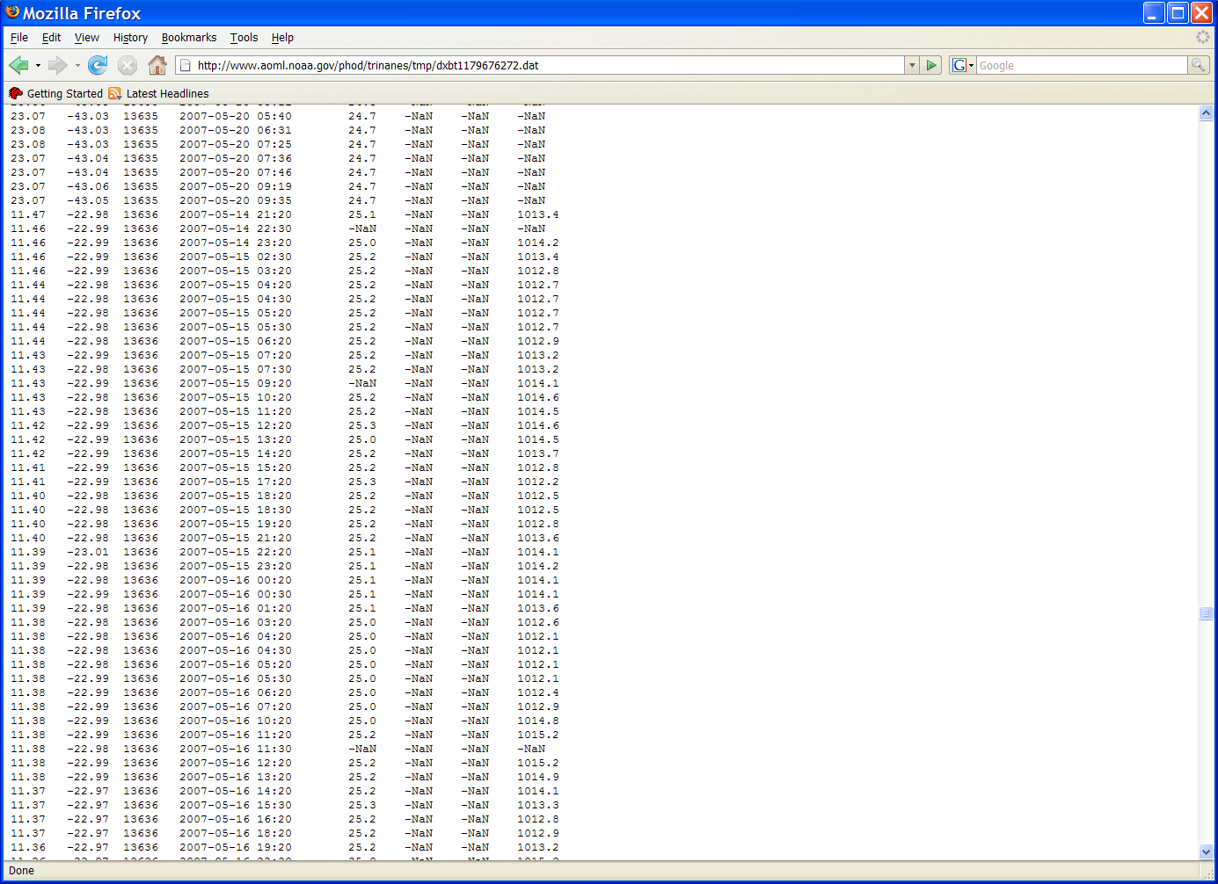
Results
Retrieve Buoy ASCII Data
Save file

Slide 25
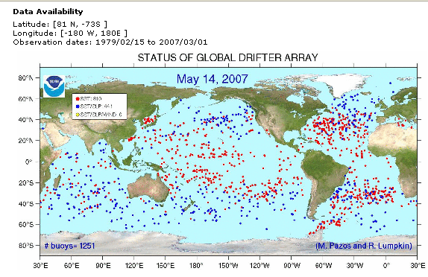
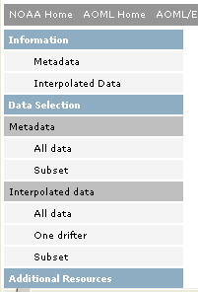
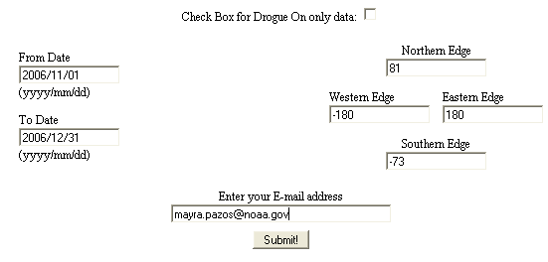
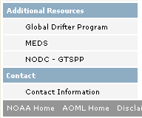
How To Access Drifter Data
Interpolated Historical Metadata
http://www.aoml.noaa.gov/phod/dac/dacdata.html

Slide 26
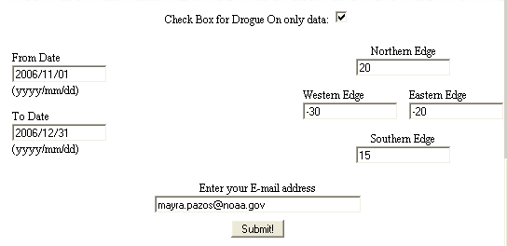
How To Access Drifter Data
Interpolated Historical Data
http://www.aoml.noaa.gov/phod/dac/dacdata.html

Slide 27
E-mail Received To Retrieve Data
To download the data files(s) proceed as follows: By clicking on the following hyper-link(s)
ftp://ftp.aoml.noaa.gov/od/pub/envids/metadata_gld.20070521_101943.zip ftp://ftp.aoml.noaa.gov/od/pub/envids/interpolated_gld.20070521_101943.zip
Or By using the following ftp instructions :
1. ftp ftp.aoml.noaa.gov
2. enter 'anonymous' for userid.
3. enter your 'email address' for password.
4. enter 'binary' to set the transfer type
5. enter 'cd /od/pub/envids'
6. enter 'get metadata_gld.20070521_101943.zip'
7. enter 'get interpolated_gld.20070521_101943.zip'
8. enter 'quit' to log off. NOTICE: files are removed 5 days after creation date.

Slide 28
How To Access Drifter Data
Details of all drifters in DAC database
http://www.aoml.noaa.gov/phod/dac/dacdata.html

Slide 29
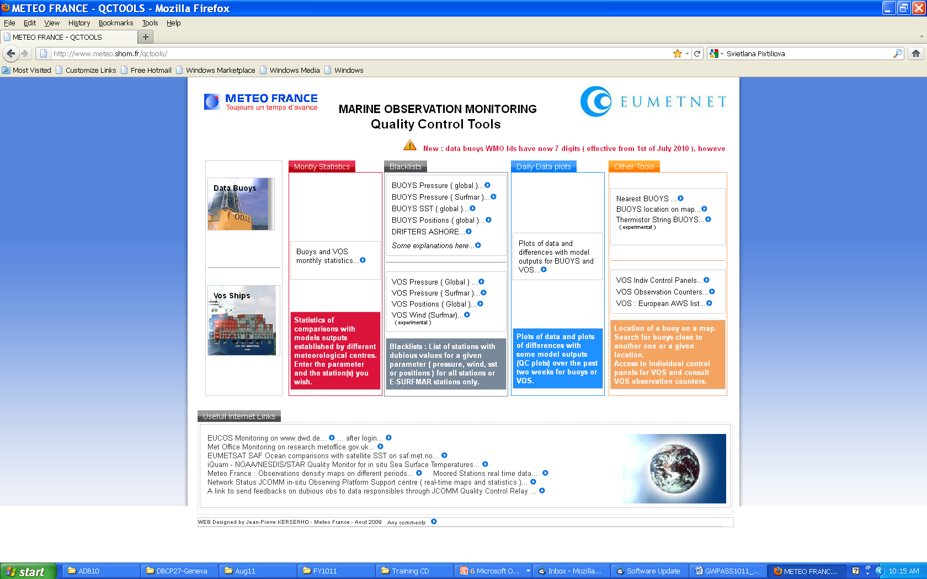
How To Access Drifter Data
Using QC Tools to check sensors on GTS
http://www.meteo.shom.fr/qctools

Slide 30
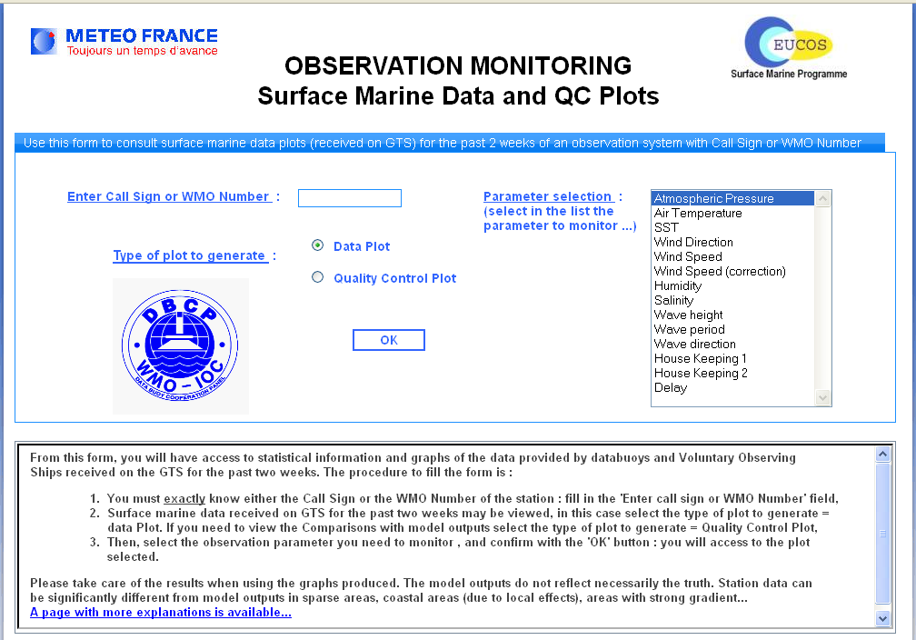
How To Access drifter Data
Using QC Tools to check sensors on GTS
http://www.meteo.shom.fr/qctools
3200915
or
Select one

Slide 31
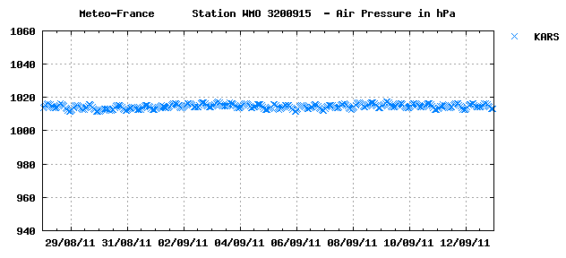
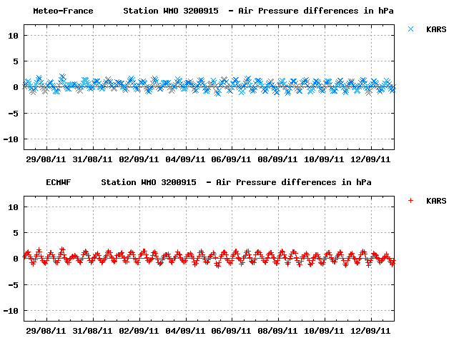
How To Access Drifter Data
Data Plot
or
Quality Control Plot

Slide 32
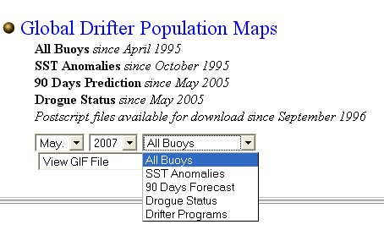
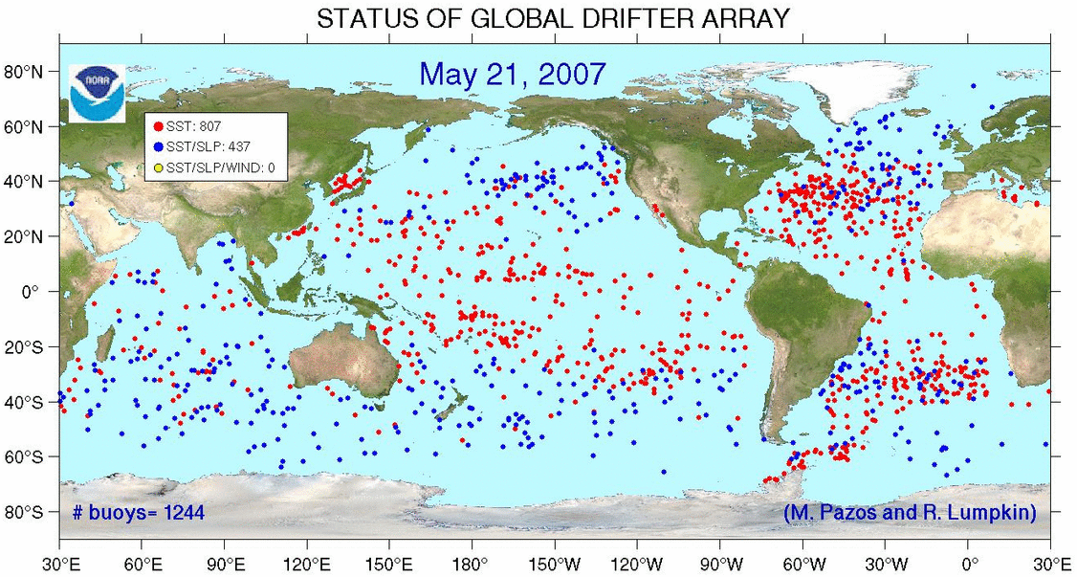
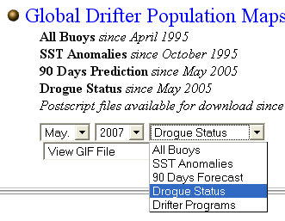
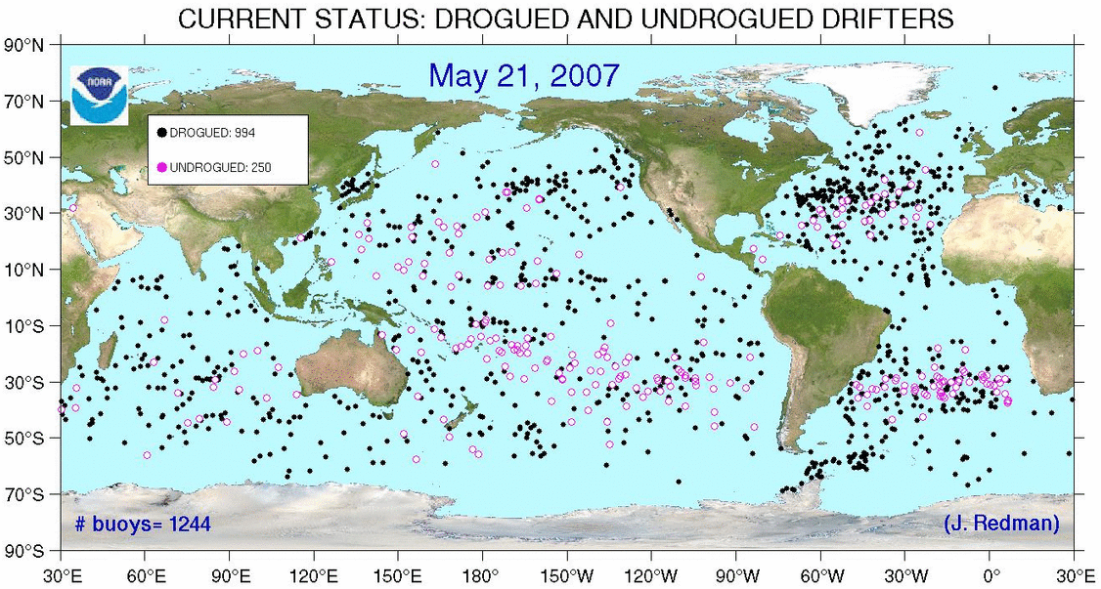
How To Access Drifter Products
http://www.aoml.noaa.gov/phod/dac/dacdata.html

Slide 33
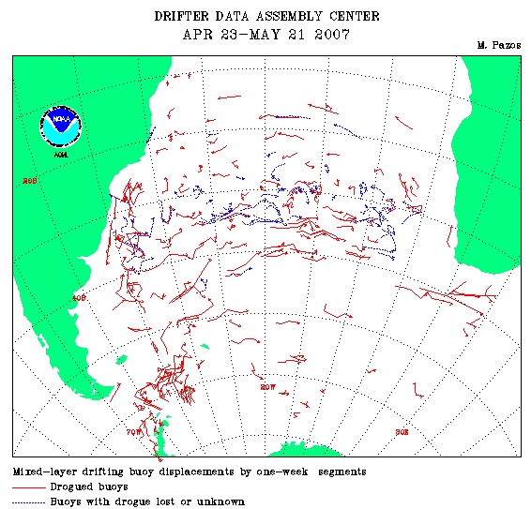
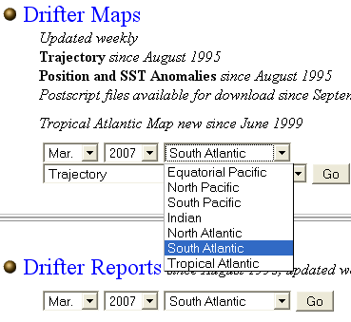
How To Access Drifter Products
http://www.aoml.noaa.gov/phod/dac/dacdata.html
May

Slide 34
GTS Distribution

Slide 35
GTS Responsibilities
Insertion and deletion of buoy data onto the GTS
Follow up and make sure data distributed through GTS goes out
Monitor accuracy of data on the GTS and take off from GTS if sensor reports bad data
Notify ARGOS after each database update of buoys that lost their drogues to be noted in the GTS message

Slide 36
Contacts
Dr. Rick Lumpkin, Global Drifter Program Manager e-mail: Rick.Lumpkin@noaa.gov
Mr. Shaun Dolk, Drifter Operation Center Manager e-mail: Shaun.Dolk@noaa.gov
Mrs. Mayra Pazos, Drifter Data Assembly Center Manager e-mail: Mayra.Pazos@noaa.gov
Mr. Erik Valdes, Drifter DAC, Research Assistant e-mail: Erik.Valdes@noaa.gov

Slide 37
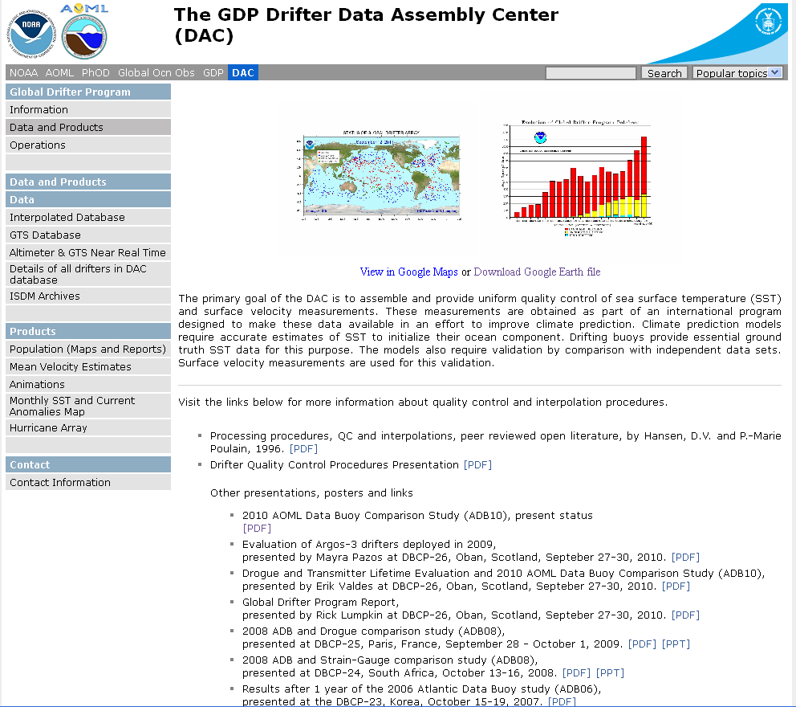
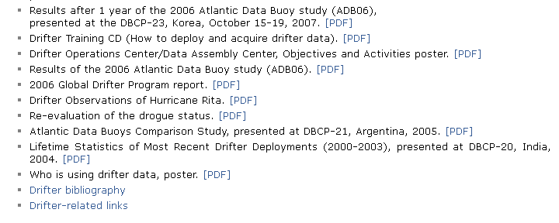
Training CD on the web
www.aoml.noaa.gov/phod/dac/dacdata.php

Slide 38
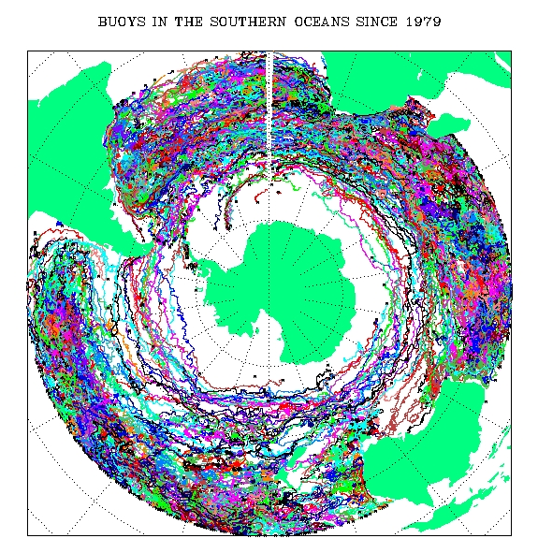
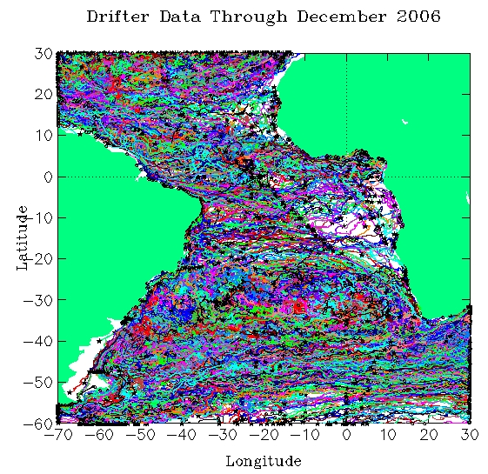
Drifter Tracks
Thank You!

Slide 39
Contents
Global Drifter Program Overview
What Is A Drifter?
Things You Need To Know Before Deploying A Drifter
How To Deploy A Drifter?
Deployment Instructions (English, French, Korean and Portuguese)
Other Types of Deployments
How To Obtain Deployment Information On The Web
Some Drifter Facts
Partners
Quality Control Procedures, Practical Implementation At The DAC
Importance Of Metadata
Delayed Mode Quality Control Procedures
Web Access To Data and Products
GTS Distribution
Contacts

