Slide 1

All You Wanted To Know About Drifters
Training CD
Prepared by: Mayra Pazos
Drifter Data Assembly Center NOAA/ AOML, Miami, Florida
Updated June 27, 2018
Notes:
1

Slide 2
Contents
Global Drifter Program Overview
What Is A Drifter?
Things You Need To Know Before Deploying A Drifter
How To Deploy A Drifter?
Deployment Instructions (English, French, Korean and Portuguese)
Other Types of Deployments
How To Obtain Deployment Information On The Web
Some Drifter Facts
Partners
Quality Control Procedures, Practical Implementation At The DAC
Importance Of Metadata
Delayed Mode Quality Control Procedures
Web Access To Data and Products
GTS Distribution
Contacts
Notes:
2

Slide 3
Global Drifter Program
The Global Drifter Program (GDP) is the principle component of the Global Surface Drifting Buoy Array, a branch of the National Oceanographic and Atmospheric Administration (NOAA) Global Ocean Observing System (GOOS) and a scientific project of the Data Buoy Cooperation Panel (DBCP)
Notes:
3

Slide 4

Organization of the Global Drifter Program
NOAA/AOML (Miami, FL)
Rick Lumpkin (Manager)
Scripps (La Jolla, CA)
Luca Centurioni
Supervises the industry, upgrades the technology, purchases most drifters, and develops enhanced data sets.
Manufacturers
(who build the drifters according to closely monitored specifications)
Operational Partners
(help with deployments and/or share their data)
Drifter Operations Center (DOC)
Drifter Data Assembly Center (DAC)
Notes:
4

Slide 5
Drifter Operations Center
(DOC)
Objectives:
To maintain a global 5⁰x5⁰ array of approximately 1300 satellite tracked surface Lagrangian drifters to meet the need for accurate and global in-situ observation of mixed layer currents, sea surface temperature (SST) and surface circulation.
Notes:
5

Slide 6
Drifter Data Assembly Center
(DAC)
Objectives:
The goal of the Drifter Data Assembly Center is to assemble and provide uniform quality controlled data of research quality for sea surface temperature and surface velocity measurements.
These data support:
  Short term climate prediction
  Satellite observation calibration
  Climate research and monitoring
Notes:
6

Slide 7




The DOC and The DAC Work Together But …They Have Different Tasks
DOC
DAC
Takes care of logistics, from the request of the IDS, to the deployment of the drifters
Develops & coordinates drifter deployment plans
Finds ships for deployments
Maintains Metadata
Shaun Dolk
Maintains a database with drifter data from deployment until buoy stops transmitting, and QC data
Decodes raw data & applies calibrations when needed
Quality controls and interpolates data
Makes data available through web and distributes for archiving
Initiates and QC drifters on/off GTS
Mayra Pazos
Erik Valdes
Notes:
7

Slide 8
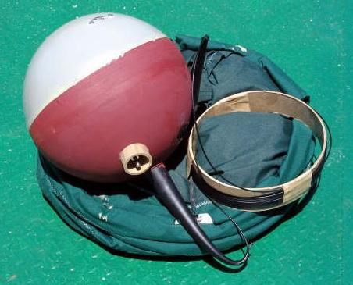
What Is A Drifter?
The modern drifter is a high-tech version of the "message in a bottle". It consists of a surface buoy and a subsurface drogue (sea anchor), attached by a long, thin tether. The basic drifter measures temperature and other properties, and has a transmitter to send the data to passing satellites. The drogue dominates the total area of the instrument and is centered at a depth of 15 meters beneath the sea surface.
Notes:
8

Slide 9
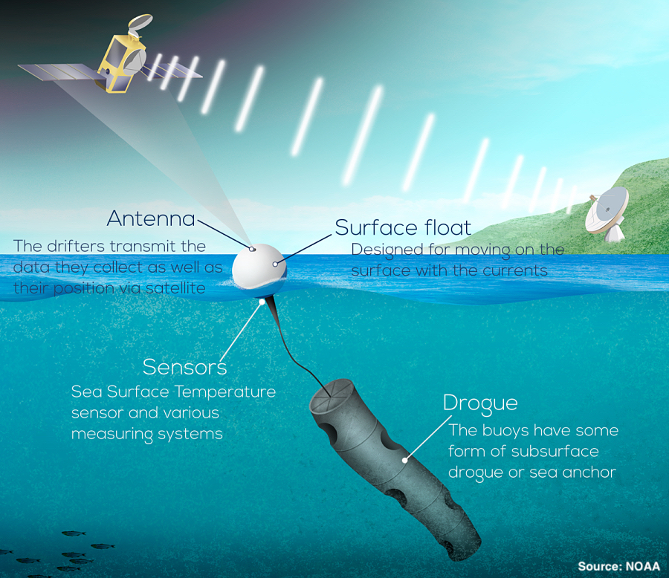
Parts of a drifter

Slide 10
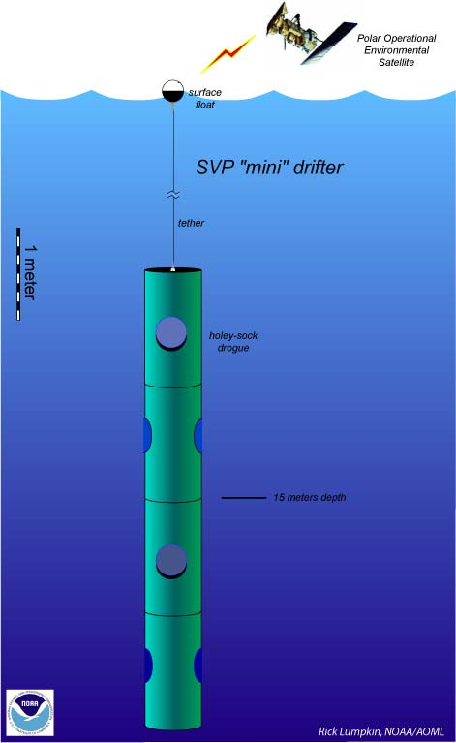
Basic SVP Drifter
Spherical plastic float
Poly Urethane impregnated wire
Holey Sock drogue centered at 15-m depth
D-cells batteries inside the float
Sensors:
Drogue: Observes the submersion rate of the float. Float stays on the surface if drogue is lost.
SST: To measure Sea Surface Temperature
Voltage: Indicates batteries’ life
Cost: ~$1800
Other Sensors that can be added:
Barometric pressure, wind, salinity,etc
Holey-sock drogue
(sea anchor)
Notes:
10
Batteries provide power, nominal operation of 2 years. Average life ~ 400 days
Cost of basic drifter ~ $1800, ~ $3000 Barometer, ~ $1200 for baro upgrade
Drogued at 15-m depth to measure mixed layer currents.
Original SVP made out of ordura nylon, original designed: 7 sections each 92 cm long and 92 cm in diameter.

Slide 11
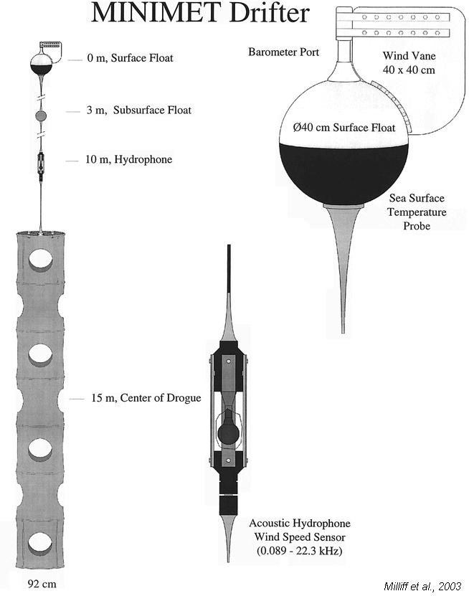
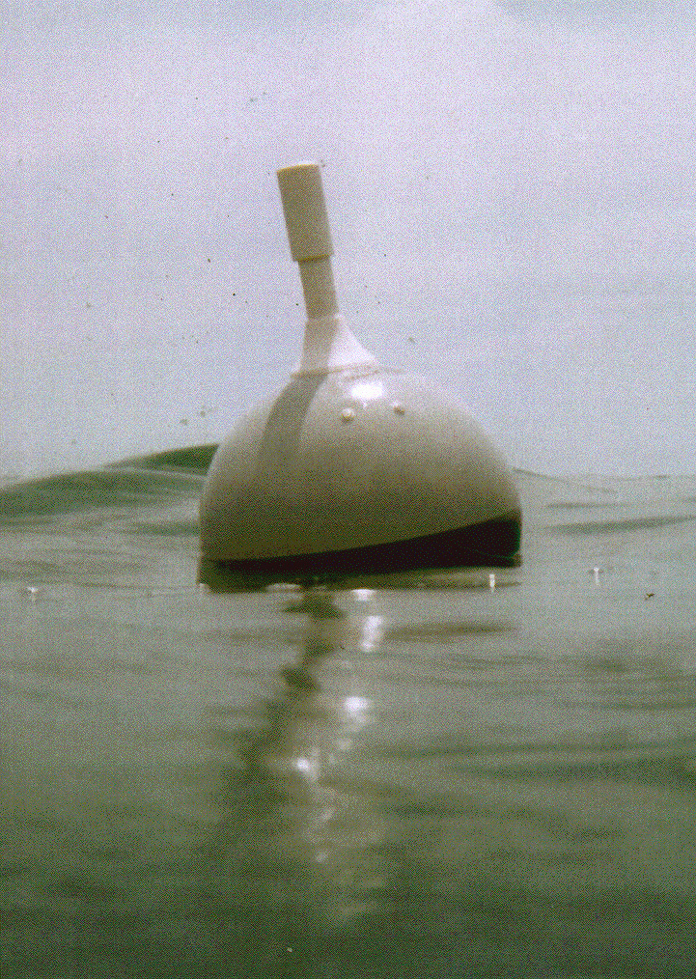
SVP + Barometer + Wind
Barometer to measure air pressure. Cost: SVP+$1500
Wind Direction is measured by a vane on the surface float
Wind speed by a subsurface hydrophone.Cost: SVP+$5000
We offer option to upgrade!
SVP with Barometer
Notes:
11

Slide 12
What is the option to upgrade?
GDP offers its partners the option to add a barometric pressure sensor to a basic SVP drifter.
For each upgraded drifter, the GDP pays for:
The cost to buy the basic drifter
All telecommunication costs associated with its transmissions
GDP will arrange for their shipment
The upgrading agency will pay for the cost of the barometer
Upgrade opportunities are available with commercial manufacturers from which GDP purchases standard drifters.
Visit GDP web page for more information on this opportunity:
www.aoml.noaa.gov/phod/gdp/images/Baro_Upgrade_Brochure.pdf

Slide 13
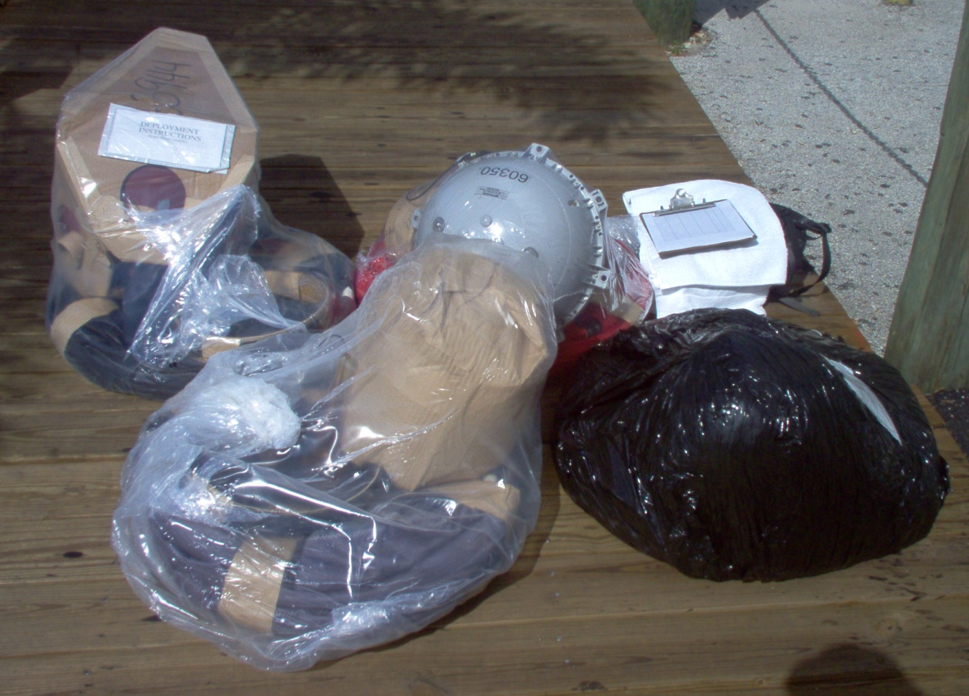
Drifter Packaging
Ask Shaun for better pic
Hulls covered with cardboard
Uncovered Hulls
Deployment Instructions
Plastic wrap
Notes:
13
Some manufacturers cover the hull with soluble cardboard boxes some don’t

Slide 14
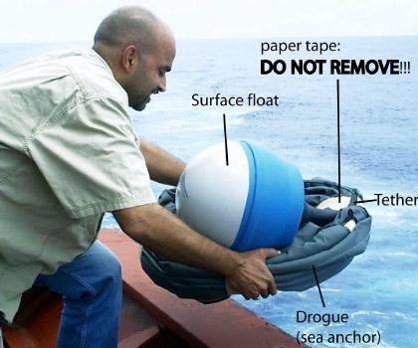
Drifter Ready To Be Deployed
Replace
Ask Shaun for better pic
Notes:
14

Slide 15
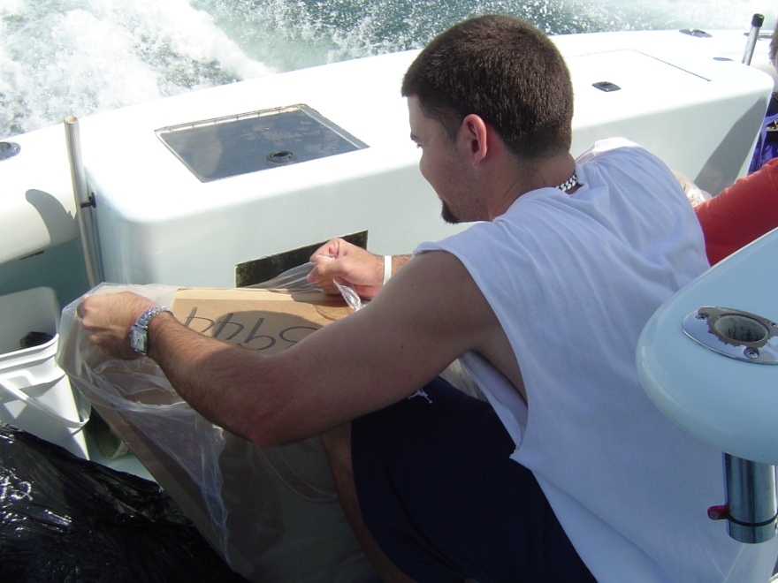
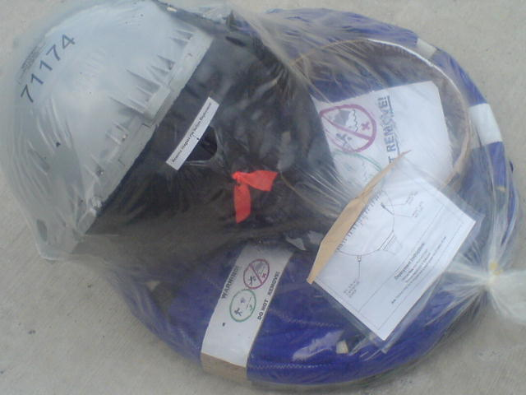
How To Deploy A Drifter
1- Remove ONLY plastic shrink wrap
Some drifters have cardboard around the float. DO NOT remove the cardboard surrounding the surface float.
Notes:
15
Each drifter weghts 45 kg (100 lbs) and can be deployed by a single person although
It is recommended that in heavy seas, 2 people deploy an original SVP
Mini drifters weighs 20 kg (44 lbs), can be easily deployed by one person.

Slide 16
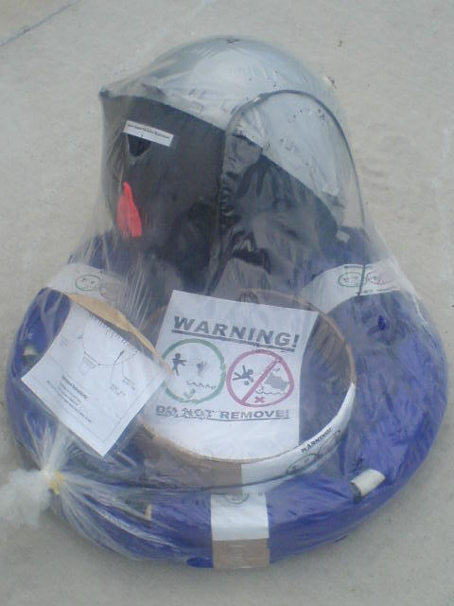
How To Deploy A Drifter (Cont.)
2- DO NOT remove the paper tape securing the tether and drogue
Paper tape
Paper tape
If you do, the drogue and/or tether can unfurl during deployment and cause injury!!!
Notes:
16

Slide 17
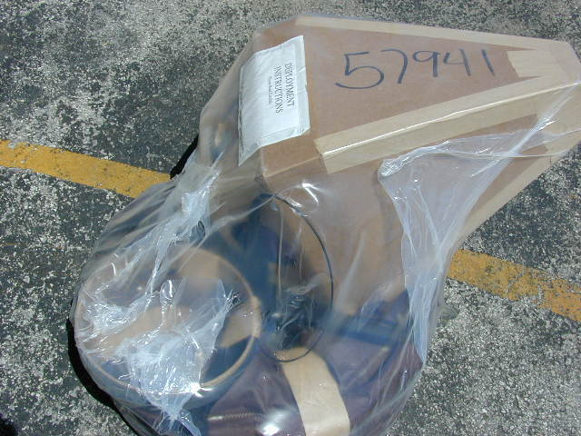
How To Deploy A Drifter (Cont.)
3- Record the ID number of the drifter. This number can be found on the shipping container, the plastic shrink wrap or the protective cardboard box. It is also inscribed on the surface float.
ID number on the surface float
Notes:
17

Slide 18
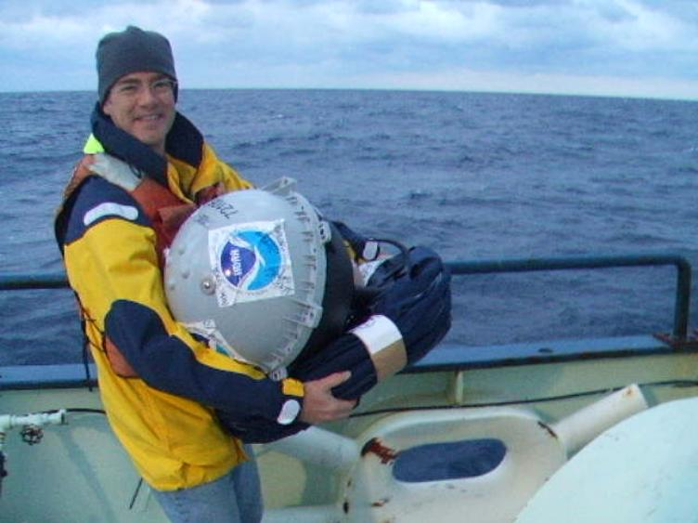
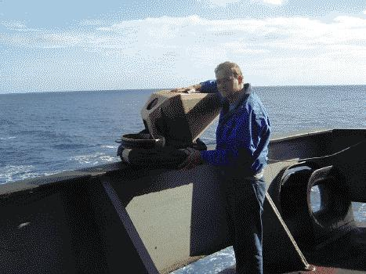
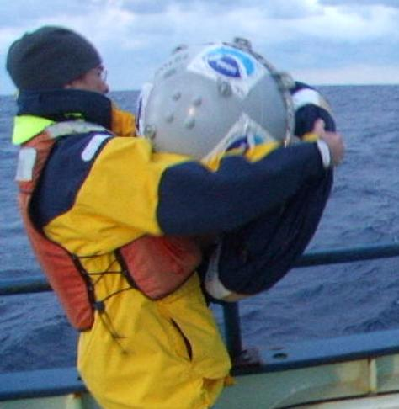
How To Deploy A Drifter (Cont.)
5- Throw the drifter from the stern, lowest possible deck (preferably less than 10 meters including heave) into the sea. The ship may be traveling between 1-20 knots. The tether and drogue are secured with paper tape that will dissolve in the water.
Throw buoy from stern, lowest possible deck.
Notes:
18
Each drifter weghts 45 kg (100 lbs) and can be deployed by a single person although
It is recommended that in heavy seas, 2 people deploy an original SVP
Mini drifters weighs 20 kg (44 lbs), can be easily deployed by one person.

Slide 19
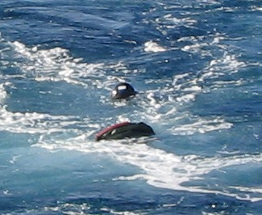
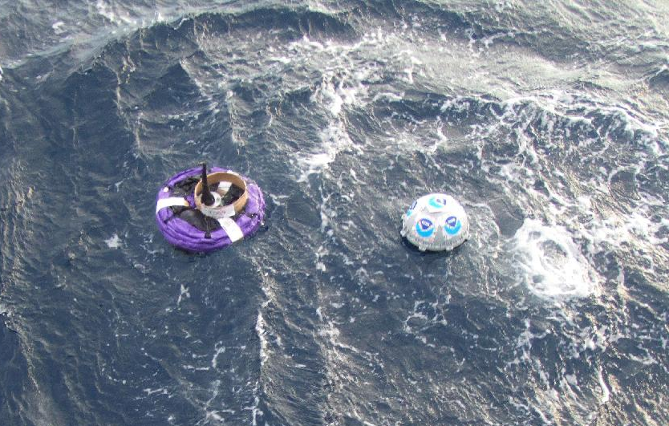
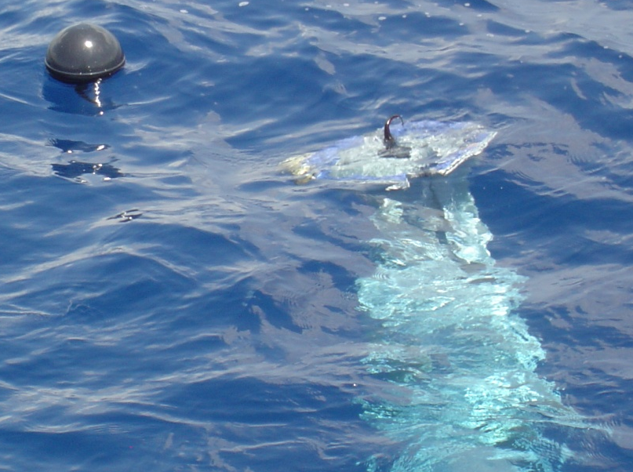
Tether and drogue secured with paper tape that will dissolve in water
Drogue starts sinking minutes after deployment
Drogue stretches vertically, when tape dissolves
Notes:
19
Tether is sometimes wrapped around a water-soluble cardboard tube to protect it from kinking.
Drogue starts sinking, and will extend to vertical position when all the Tape is dissolved.
It takes approximately 1 ahour for the drogue to become fully soaked, allowing the tape to
Dissolve and trapped air bublles to be released before the drogue sinks.

Slide 20
How To Deploy A Drifter (Cont.)
6- Record the drifter ID number, Date of Deployment, Time (GMT) of Deployment, Longitude and Latitude of deployment and send this information via web at:
www.aoml.noaa.gov/phod/gdp/deployment_submission_form.php
or via e-mail to:
Drifter.deployment@noaa.gov
Complete instructions, in multiple languages, can be found at: www.aoml.noaa.gov/phod/gdp/deployment_instructions.php
Notes:
20

Slide 21
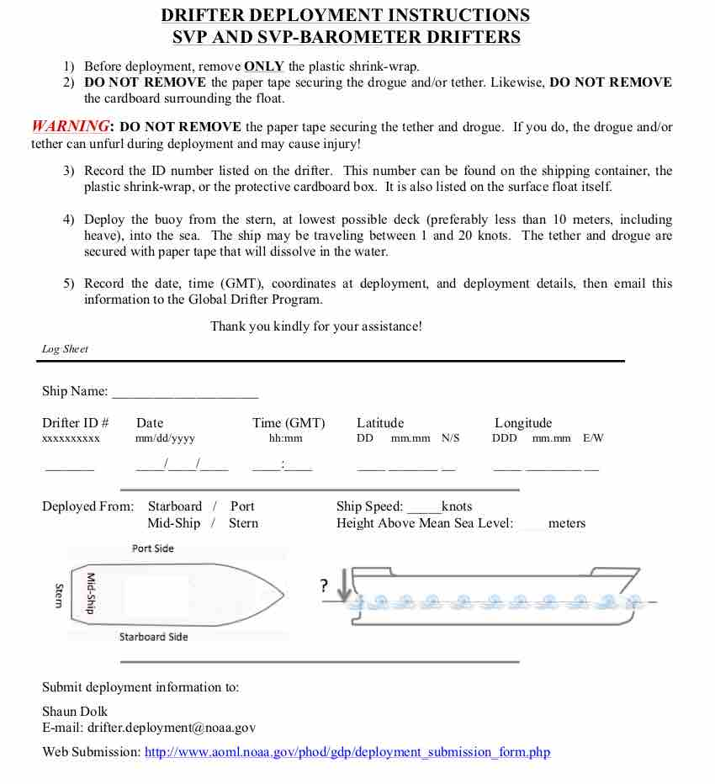
Instructions Included With Each Drifter
Notes:
21

Slide 22
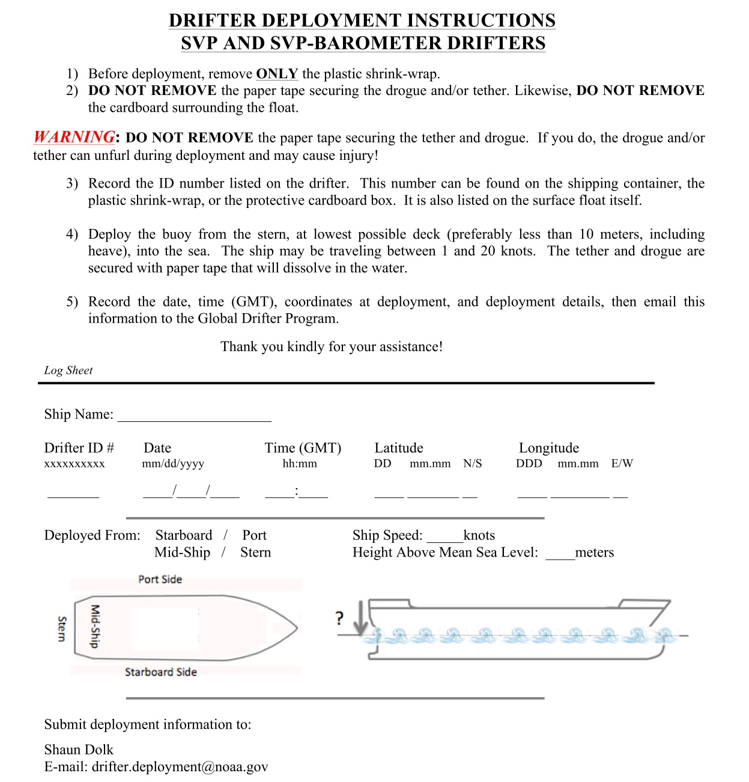
Instructions Included With Each Drifter
Notes:
22

Slide 23
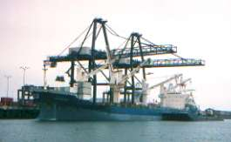
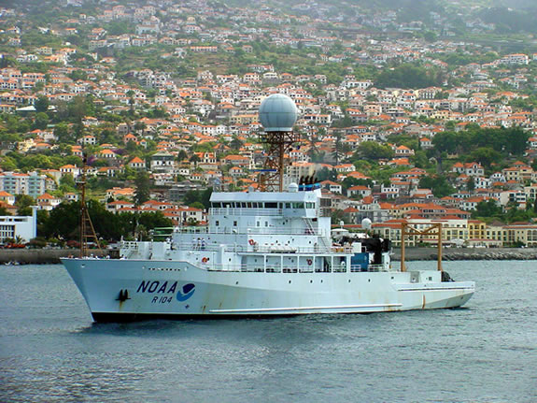
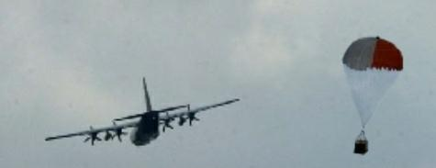
Drifters Are Deployed From:
  Cruise ships
  Cargo ships
  Research Vessels
  Aircrafts
With assistance from national and international
Governmental Agencies
Notes:
23
Volunteer observing ships are usually container vessels traveling from port to port, transporting goods of any kind. These vessels have taken on the responsibility of deploying drifters throughout the world while on their
Journeys.
Research vessels are scientific ships that are out doing various sea and weather studies, they visit particular areas of interest on a regular scheduled, while other areas are visited less frequently
Air deployments are done by C-130 Hercules “Hurricane Hunters”,Us Air force, also US Navy had been involved in previous years. Air deployments are usually done in front of hurricanes passing through the Tropical Atlantic
Region, the data is transmitted in real time through the GTS system to operational centers such as the Environmental Modeling Center (EMC) and is used to improve weather forecasting. These data is also used along with many other data collected from Satellite imagery and P-3 aircraft data, by the National Hurricane Center In Miami, to issue public bulletins during the hurricane season

Slide 24
Drifters Deployed By Aircrafts
Drifters are deployed by aircraft to help seed those regions that otherwise would be hard to reach.
Every year during the hurricane season in the Atlantic Ocean
(June 1 – November 30) NOAA/AOML has coordinated
Deployments with NAVOCEANO in the past, and also with the
National Hurricane Center in Miami, Florida, to deploy drifters
in front of hurricanes using the hurricane hunter planes from the
air force to provide forecasters and researchers with surface
meteorological data to help in the weather prediction and forecast.
These drifters besides measuring SST, also measure:
  Barometric pressure
  Wind speed and wind direction
Notes:
24
Usually weather data over the oceans is observed and sent by merchant ships, but obviously these
Ships will divert from their normal tracks to avoid ares of rough weather so there is missing
Data where and when it is needed the most. So buoy data and data collected by satellite and special
Research aircraft are very important.

Slide 25
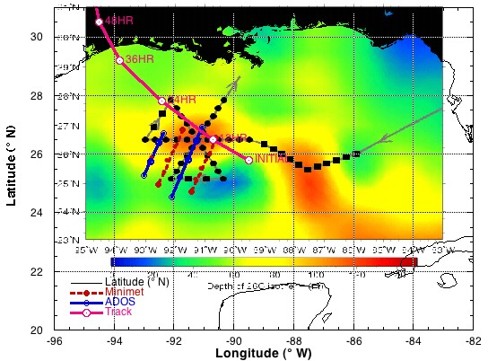
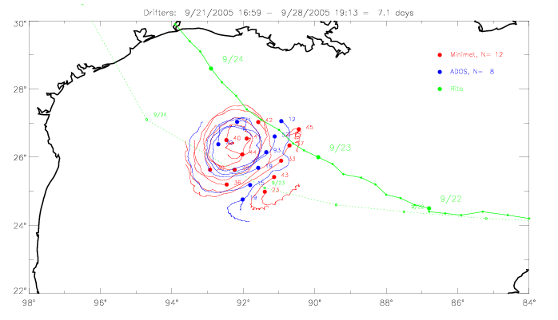
Drifters in front of Hurricane Rita Sep 21, 2005
A total of 20 drifters were deployed in front of the cat 5 hurricane Rita. All drifters survived and sent good data.
Air pressure, SST, wind direction and wind speed were reported and transmitted onto the GTS. The 8 ADOS drifters were also equipped with 100m thermister chains and measured temperature to 100m depth.
These data provided an excellent data set for improvements of wind speed algorithms from hydrophone observations. SST was measured at much higher resolution than many satellite products and helped calibrate these products.
September 21-28, 2005
30
28
Minimet, N=12
ADOS, N=8
Hurricane Rita
26
24
22
98
96
94
92
90
88
86
84
www.cora.nwra.com/~morzel/drifters.rita.html
Notes:
25
ADOS= Autonomous Drifting Ocean Station.
On Sep 18, Tropical Storm Rita formed from a depression in the SE Bahamas. Rita intensified to hurricane strength and passed between Florida and Cuba on Sep 20. By the 21 Rita was a Category Five hurricane predited to make landfall on the Texas or Louisiana coast. The hurricane hunters sprung into action and were able to deploy the arrya in the projected path of Rita on Sep 21. The projected path of Rita at the time of deployment was to the left of the array, which would have placed the drifters on the stronger right-hand side of the storm. However the actual path was north of the prediction and as a consequence the drifters mostly sampled the left hand side of the storm.
Data from these drifters, transmitted via the GTS to operational centers such as the
Environmental Modeling Center, to improve forecasting.

Slide 26
How to determine where to deploy drifters
The goal of the drifter program is to implement one drifter in each 5 x 5 degree grid across the globe. The GDP works closely with more than fifty domestic and international agencies to coordinate deployment efforts. To maximize spatial drifter coverage and ensure its goals are met, the GDP created a set of Drifter Deployment Value maps based of where are drifters located at the moment as well as the chance of longer survivability, which are used throughout the community to identify the best deployment locations.
www.aoml.noaa.gov/phod/gdp/valule_maps.php

Slide 27

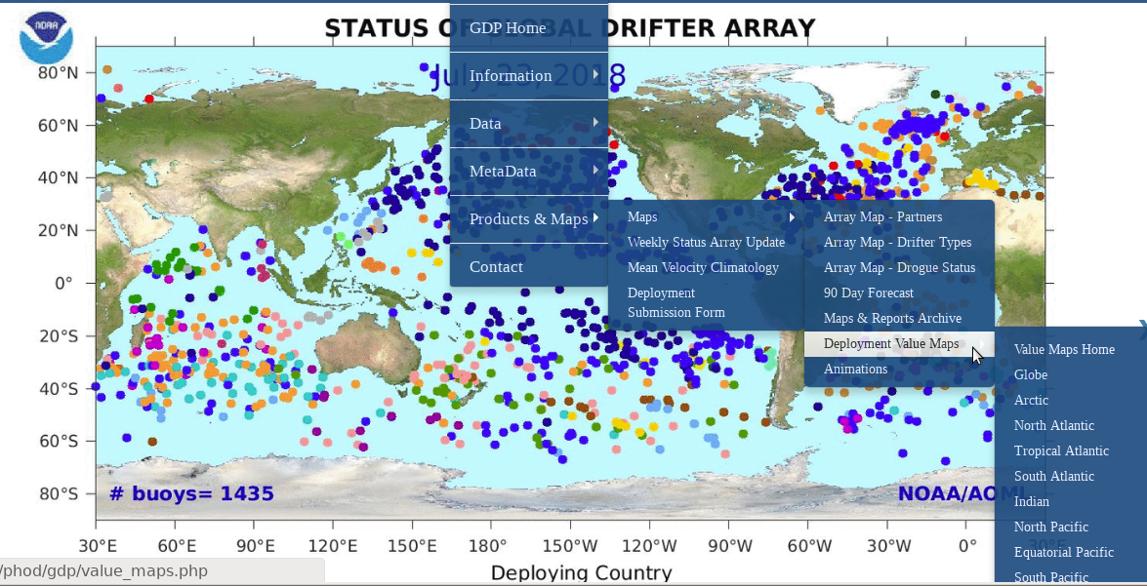
Deployment Value Maps on the web
Value maps are useful to determine where valuable deployment locations exists.
Choose Globe
Or
Choose a region
www.aoml.noaa.gov/phod/gdp

Slide 28
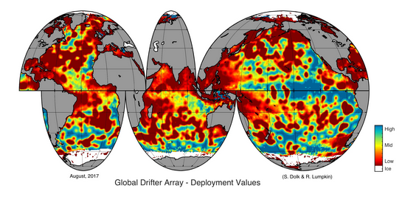
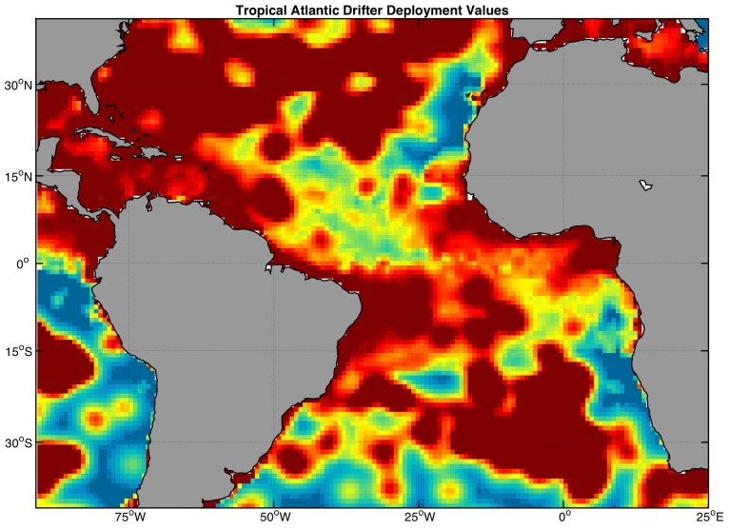
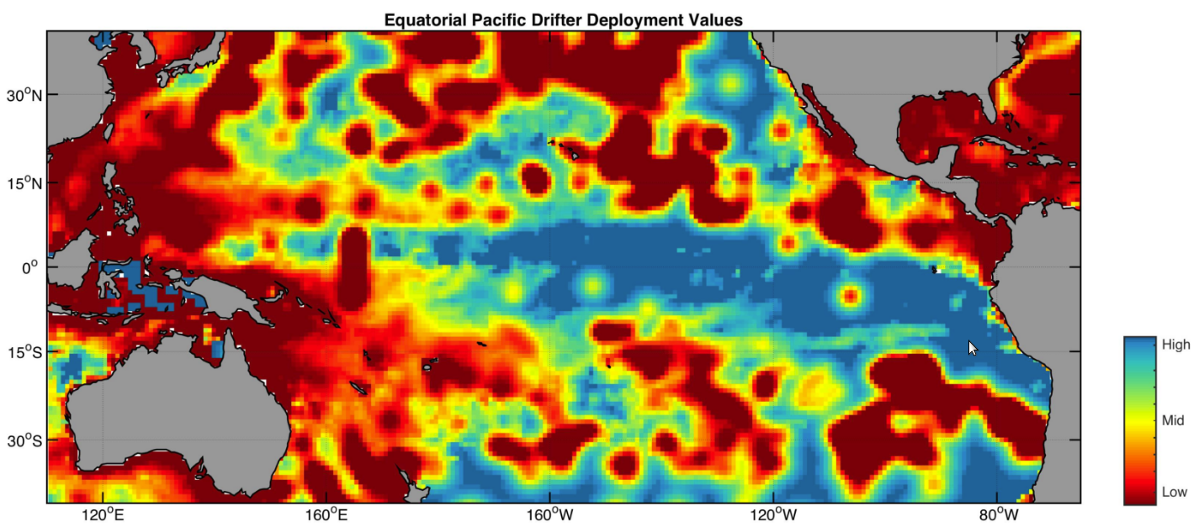
Deployment Value Maps
Global Value Map
Regional Value Maps
Blue areas have the highest value deployment locations

Slide 29
Update facts
Some Drifter’s Facts
Drifters average life: ~450 days
Longest Lived: 10 years, 4 months, 21 days
Drogue average life: ~300 days
Longest Drogue on : 5 years, 6 months, 21 days (and still on)
Average failure on deployment: ~3%
Death Reasons: Run aground, picked up by fishermen, stop transmitting
Notes:
29

Slide 30
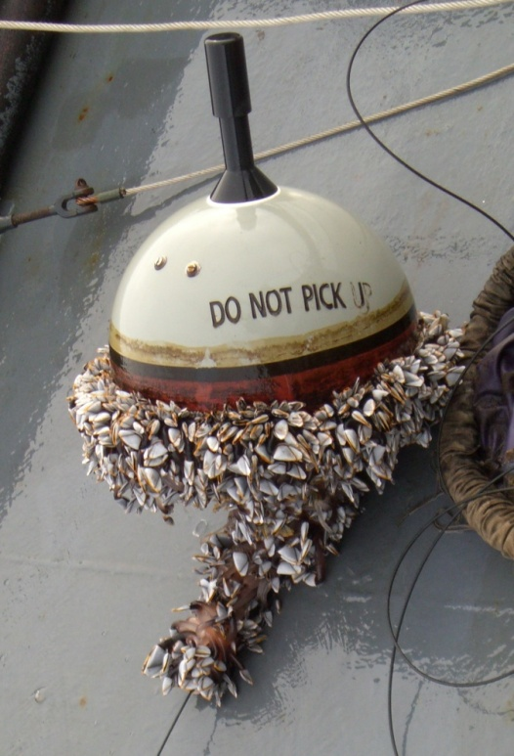
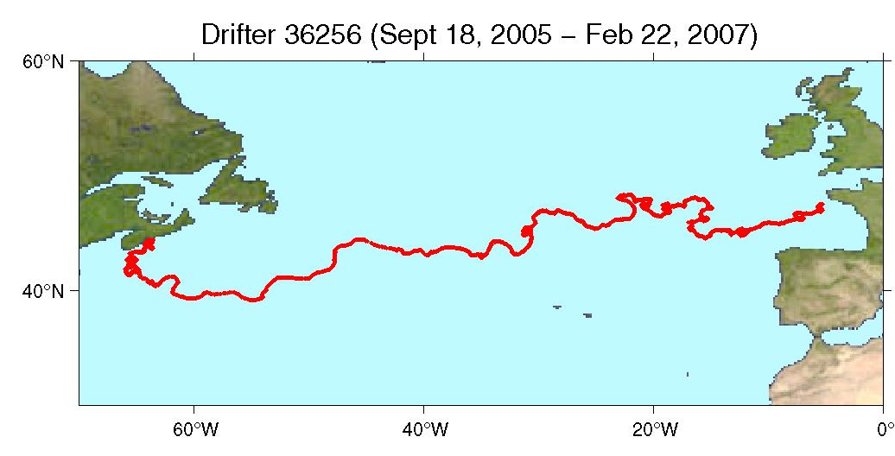
Global Drifter # 1250
Scientific design of the global drifting network called for 1250 buoys to be deployed and maintained worldwide to ensure total coverage of the global ocean and to calibrate the satellites. On September 18, 2005 this goal was achieved.
This drifter was retrieved after crossing the North Atlantic ocean, off the cost of Brest, France
Traveled for 521 days, with drogue on to the end, and transmitting good SST, and barometric pressure. All data were disseminated on real time on the Global Telecommunication System (GTS)
Notes:
30
The 1250 figure was derived by dividing the ocean into a 500x500 nautical mile grid. By doing so,
1,250 buoys were needed or one buoy every 500 nautical miles to ensure
I was deployed near Halifax, Nova Scotia on Sep 18, 2005

Slide 31
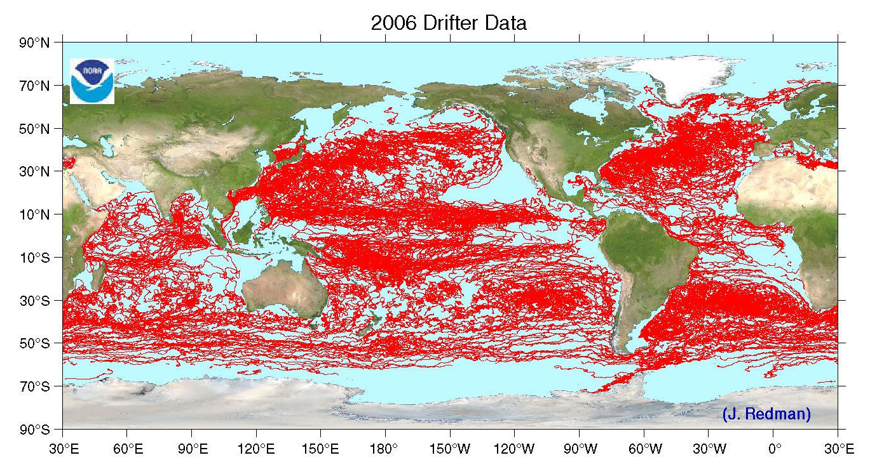
Tracks of Drifters During 2006
Notes:
31

Slide 32

Thanks
Our appreciation to the following partners for their contributions to GDP activities
NOAA’s Voluntary Observation Ships, Ships of Opportunity, and National Marine Fisheries Service programs; NOAA/Pacific Marine Environmental Laboratory, NOAA/National Data Buoy Center
Argo program
International Ice Patrol
Institut de Recherche pour le Développement;
Météo-France (France)
Leibniz-Institut für Meereswissenschaften an der Universität Kiel (Germany)
New Zealand Met. Service
Australian Bureau of Meteorology
Fundação Universidade Federal do Rio Grande; Instituto Nacional de Metereologia; Centro de Hydrografia de Marinha; INPE (Nacional Space Institute); Brazilian Navy; Brazilian Naval Directorate of Hydrography and Navigation (Brazil)
Fisheries Research Institute; Servicio de Hidrografía Naval (Argentina)
Instituto Canario de Ciencias Marinas; Universidad de Las Palmas de Gran Canaria (Spain)
Instituto Nazionale di Oceanografia e di Geofisica Sperimentale (Italy)
National Institute of Oceanography; National Institute of Ocean Technology (India)
Institute of Hydrological and Oceanic Services (Taiwan)
Centro de Investigacion Cientifica y de Educacion Superior de Ensenada (Mexico)
Korean Oceanographic Research and Development Institute, National Oceanographic Research Institute; Ministry of Maritime Affairs and Fisheries (Korea)
Instituto del Mar del Peru
Tristan da Cunha Administration, Tristan Island
United Kingdom Met Office
Fisheries Department of Falkland Islands
Environment Canada
University of Cape Town; South African Weather Service (South Africa)
Scripps Institution of Oceanography, Woods Hole Oceanographic Institution, Oregon State University, Marine Resources Research Institute, (United States)
United States Air Force
US Naval Oceanographic Office
United States Coast Guard
Raytheon Polar Services
Universidad de Valparaiso (Chile)
Chilean Navy
Hong Kong Observatory
Kenya Meteorological Services

Slide 33
DATA AND METADATA
Practical implementation at the Drifter Data Assembly Center
Real Time and Delayed Mode Data Quality Control Procedures
Importance of Metadata
Web Access to Data and Products
GTS
Distribution
Notes:
33

Slide 34
Importance of Metadata
Notes:
34

Slide 35
Importance of Metadata
METADATA= DOCUMENTATION
Metadata describes the characteristics of the data. The drifter metadata describes:
ID number
GDC unique ID
WMO number
Program number
Contact Information
Deployment time, latitude and longitude
Manufacturer
Buoy type
Drogue type, length, and brief description of its characteristics
Sensors transfer functions
Track inventory of drifters, both in storage and in transit
Metadata helps share reliable information, and maintain homogeneity of the database
Without METADATA no data set is complete
Notes:
35

Slide 36
Specification Sheets
Specification sheets contain metadata about each drifter. All manufacturers are required to send them to the DAC prior to shipping the drifters. They are stored in a database and all the information they contain are made available on the web in two different kind of files, html and csv.
www.aoml.noaa.gov/phod/dac/Drifter_Specifications.html (.csv)
www.aoml.noaa.gov/phod/dac/Barometer_Metadata.html (.csv)
www.aoml.noaa.gov/phod/dac/Drogue_Specifications.html (.csv)

Slide 37
Sample Specification Sheet
Drogue description
a) Holey sock made from Cordura nylon cloth; diameter 61 cms, length 660 cms. construction consists of 5 cylindrical sections, each 132 cms long. Two 30 cm dia. holes cut opposite each other in each section. Axis joining holes is rotated by 90° between successive sections. Seams are double cross
Drogue depth
15 m at center
Drogue length
6.6 meters
Message Length
160 bits
Message format
8 bits Format identifier
7 bits Year
4 bits Month
6 bits Day
5 bits Hour
6 bits Minute
11 bits Air pressure
12 bits SST
9 bits Pressure tendency
6 bits Strain gauge reading
6 bits Battery voltage
8 bits Iridium transmission duration
8 bits 2nd Iridium Tech. parameter (Iridium RSSI)
12 bits GPS fix time delay
20 bits GPS Latitude
21 bits GPS Longitude
7 bits GPS acquisition time
4 bits GPS satellites in solution
Iridium IMEI / Date of Manufacture (DOM) / Buoy Version
300234066306380 FEB - 28 2018 (DBi Version IRID 1.0)
300234066306430 FEB - 28 2018 (DBi Version IRID 1.0)
300234066307460 FEB - 28 2018 (DBi Version IRID 1.0)
Manufacturer:
Data Buoy Instrumentation, LLC (DBi)
Sensor array:
SVP-B Battery voltage, drogue sensor, SST, air pressure
Surface float description
39 cm diameter surface float from .635 cm. thick ABS plastic
Tether description
a) 0.40 cm OD polypropylene-impregnated wire rope between surface float and drogue.
b) The drogue cable is wrapped around a bio-degradable cardboard reel . Each turn of cable is taped to the reel using water-soluble glued tape.
c) Tether attachment to 2.0 cm stainless steel eyebolt at bottom of surface float; marine epoxy filled ABS neck surrounding eyebolt/tether attachment for restraint.
d) 6.2 cm dia. by 28.5 cm long polyurethane strain relief molded below surface float. Attachment point of tether to drogue hub covered by 6.2 cm dia. by 28.5 cm long polyurethane strain relief.
e) Drogue hub consisting of ABS plastic housing with drogue bridle (see below).
Notes:
37

Slide 38
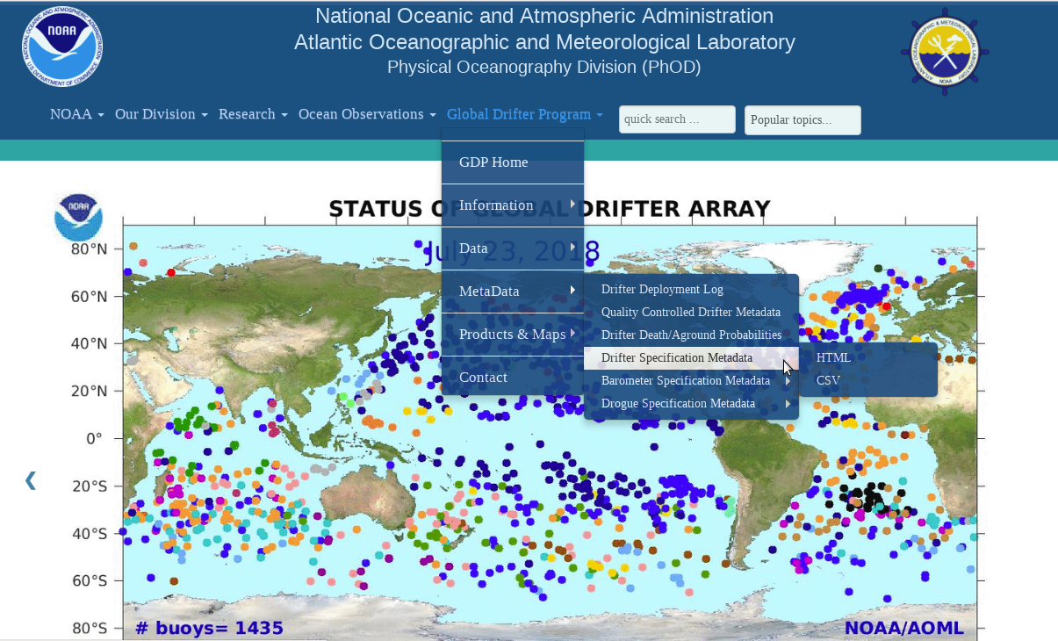
Specification Sheets on the web
www.aoml.noaa.gov/phod/gdp

Slide 39
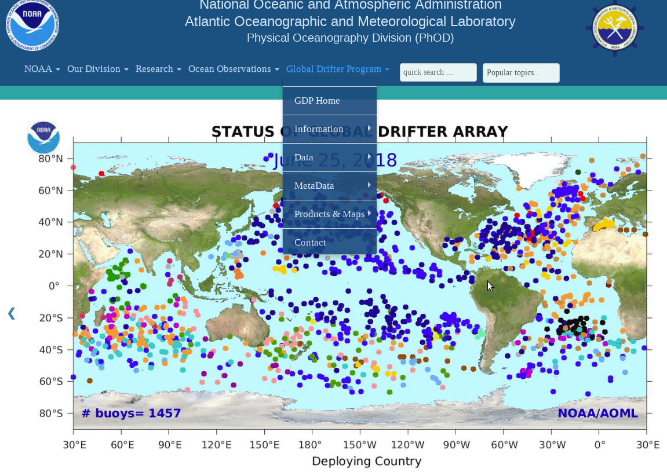

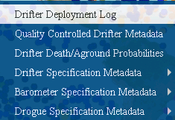
Deployment Information on the web
www.aoml.noaa.gov/phod/gdp
(click) to see deployment log

Slide 40
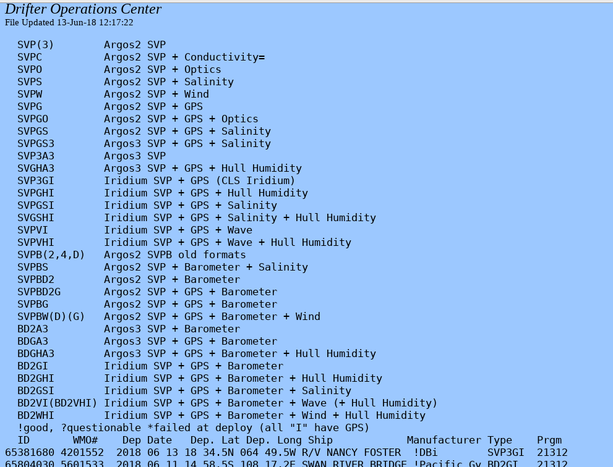
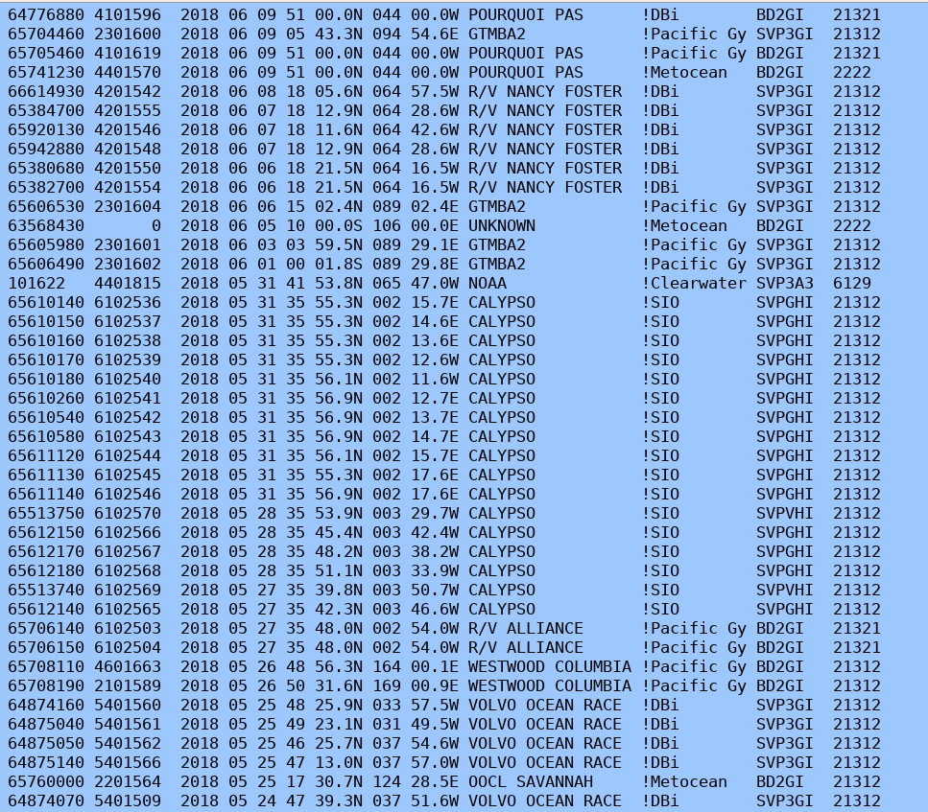
Sample Drifter Deployment log
The Deployment log has information on when and where drifters were deployed, ship name, status after deployment, manufacturer, buoy type and program associated with each drifter.

Slide 41
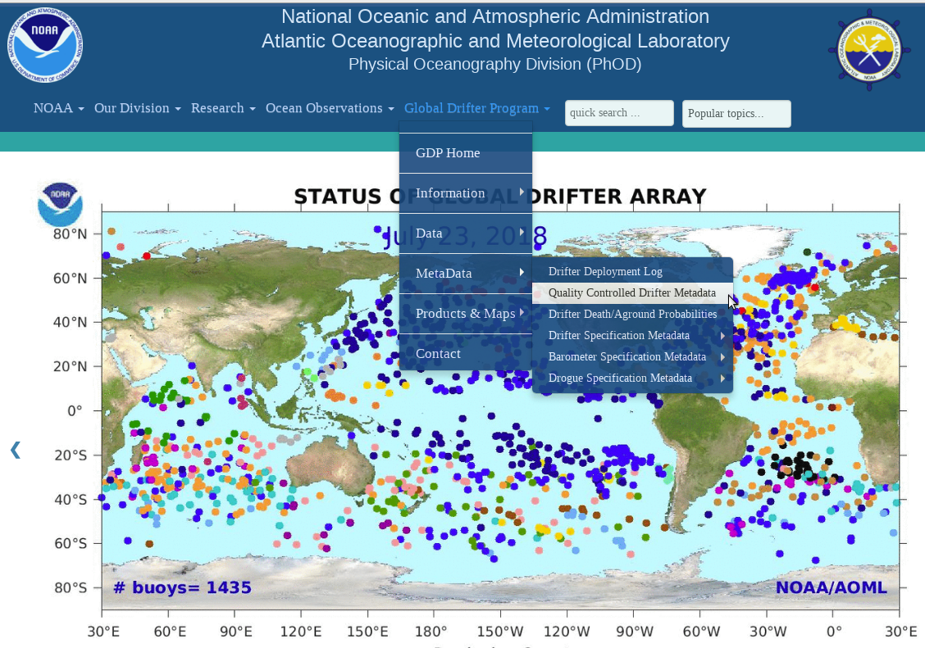
Quality Controlled Metadata
The quality controlled (QC) metadata has more information about each drifter after QC procedures have been applied.
It has the drifter ID, the time and position of the first and last good transmission, the date and position drogue was lost, a code for reason of death, manufacturer and type
www.aoml.noaa.gov/phod/gdp

Slide 42
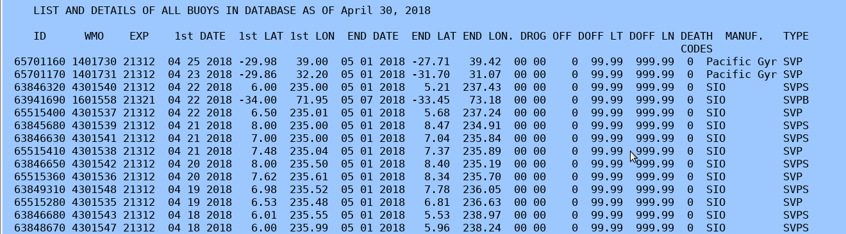
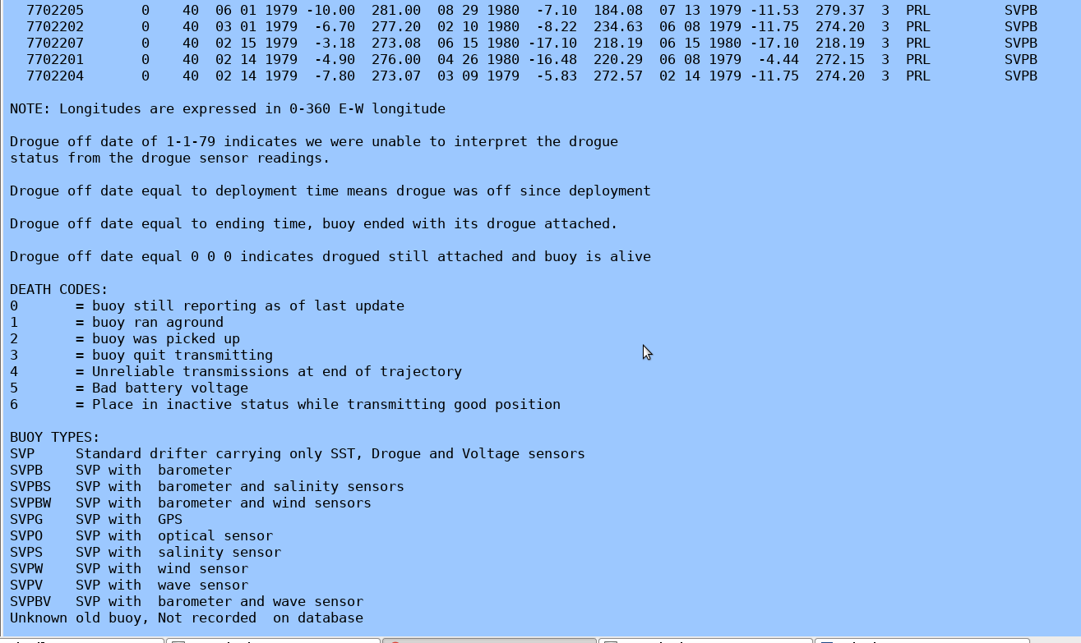
SAMPLE QC METADATA

Slide 43
Data:
Real Time
&
Delayed Mode
Notes:
43

Slide 44
Drifters transmit ocean data to an orbiting satellite.
These data are sent in real time to data centers which are responsible for:
  decoding
  assemble
  quality control
  disseminate these data
Data are also distributed through the Global
Telecommunication System (GTS) in real time,
using a World Meteorological Organization (WMO) number associated with its ID

Slide 45
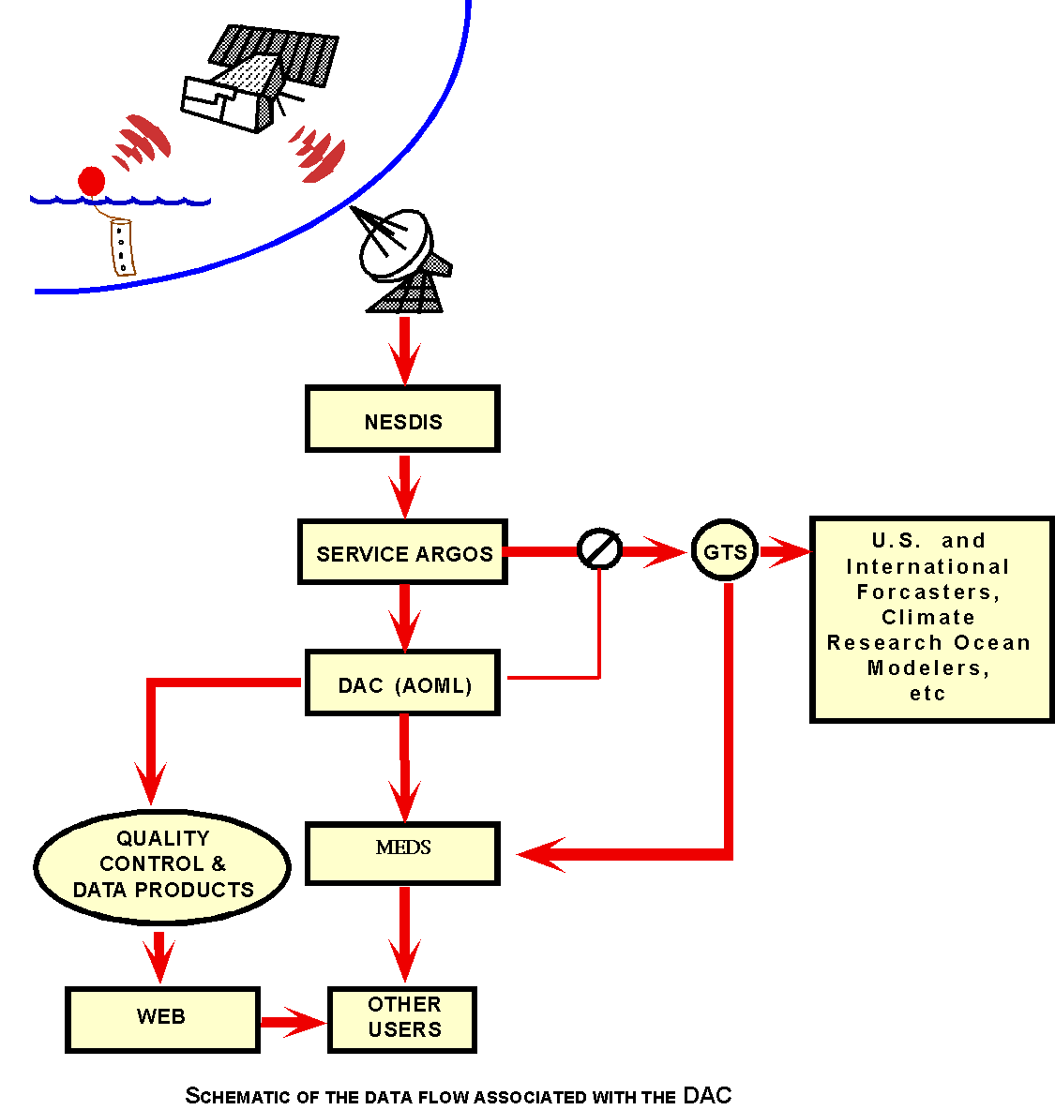
Data
Flow
Data Centers
Data Centers
GTS
U.S. & International forecasters, climate research ocean modelers, etc
AOML applies quality control procedures &
interpolates data
Regional Data Centers for archival and distribution
(MEDS, NCSI)
web
Users
Notes:
45

Slide 46
At AOML, Drifter data are collected, assembled, quality controlled and Interpolated to 6 hour intervals, then sent to Marine Environmental Data Services (MEDS) in Canada and to NCSI for further archival and distribution.
AOML receives position data computed from Doppler measurements from ARGOS tracked drifters or from GPS installed in Iridium drifters. These data are irregularly distributed in time and may contain erroneous positions and/or bad Sea Surface Temperature values, therefore not suited for many kinds of analysis or displays.
The Drifter Data Assembly Center (DAC) at AOML applies quality control procedures to edit these data (position and temperature) and interpolates them to 6-hour intervals using an optimum interpolation procedure called kriging, which is commonly used for two and three-dimensional analyses.

Slide 47
Some drifters have other sensors attached such as barometric pressure, salinity, wind speed and direction, etc. but these data are stored in its raw form and kept in the archives, no further editing is done at the present time. See the paper by Hansen, D.V. and P.-Marie Poulain, 1996, http://www.aoml.noaa.gov/phod/dac/Hansen-Poulain_QC.pdf, for a complete description of the quality controlled and interpolation procedures applied to the drifter data in this database.

Slide 48
Real Time Data
Drifter data are distributed in near real time on the Global Telecommunication System (GTS). These data are used for weather forecast and prediction, satellite calibrations and climate research and monitoring
Each drifter is identified by a unique number (ID). They are also assigned a World Meteorological Organization (WMO) number which is used for GTS transmission
Data on the GTS is monitored and transmissions are stopped as soon as any sensors start giving dubious values or if the drifter is transmitting from a fixed position (not moving), it is considered grounded and not measuring ocean currents

Slide 49
Delayed Mode Data
Data are received at AOML from different sources, daily, weekly:
- Short Burst Data (SBD) e-mails
- FTP transfer from other centers
These data are assembled and kept in AOML’s database to be used to create products for daily, weekly analysis and to ultimately apply quality control and interpolation procedures to create a dataset of research quality and make it available to the research community through the web.

Slide 50
Delayed Mode Quality Control Procedures
Notes:
50

Slide 51
Drifter Database
Information Files
  Relational database using flat files linked by ID/IME number
  Data starts in February 1979 and continues to present
  All buoys are standard WOCE/SVP drogued at 15 meters
DIRECTORY FILE
(information
about ea. Drifter)
CALIBRATION FILE
(coefficients to calibrate
each sensor)
GROUND FILE
(holds time interval
not to be interpolated)
TEMPERATURE
FILE
(holds last day SST is good)
Notes:
51

Slide 52
Drifter Database
Data Files
Assemble data from
different sources
Apply calibrations and split
into individual files by ID/IME
B-files
B00000.DAT
(raw data for ea. buoy)
Edit Position and SST
Split into P and S files
P-files
P00000.DAT
(Edited Position)
S-files
S00000.DAT
(Edited SST)
Reside in AOML
database, available
through the WEB
K-files
K00000.DAT
(Interpolated - Kriging)
Notes:
52

Slide 53
Quality Control Steps
Drifter data are received at AOML and downloaded daily
Convert raw data into engineering units and add to individual B-file by ID/IMEI number
Determine deployment time and position of first good transmission from the water
Run programs that identify buoys that are dead:
a) Transmit from the same location after a successful deployment (grounded)
b) Do not have any new data after last update (quit)
  Such dates and positions are entered into the
  DIRECTORY file
Notes:
53

Slide 54
Quality Control Steps (Continuation)
Software are run to check bad locations from the raw data based on speed between consecutive locations, bad points are deleted creating the edited non-interpolated files (P-files)
Deviant SST values are removed by applying a temperature change criterion relative to the recent temperatures measured by the buoy creating the edited sensor files (S-files)
SST’s from each drifter are compared with Reynold’s climatology to determine temperature sensor failure, last good day is entered into the TMPFL file. SST after this date will be discarded
Decode, archive and monitor GTS data transmissions and deletions of other sensor data like pressure and wind, but NO quality control is applied to them
Notes:
54

Slide 55
Quality Control Steps (Continuation)
Buoys that possibly lost their drogues are identified. Drogue lost date is determined and entered in the DIRECTORY file and also marked in the GTS
All active buoys are processed and interpolated to 6 hour intervals,
using the Kriging method
P (position edited) file + S (SST edited) file = K (interpolated) file
Refer to paper by Hansen and Poulain for details on the Editing and Kriging procedures:
Hansen, D.V. and P.-Marie Poulain, 1996. Quality Control and Interpolations of WOCE/TOGA Drifter Data. J. Atomos. Oceanic Tec., 13, 900-909
Kriged drifter data can be accessed through the WEB WWW.AOML.NOAA.GOV/PHOD/GDP/ > Interpolated database
Database is updated every 2 months, posted on the web and sent to MEDS, in Canada, for further archival and distribution.
Notes:
55

Slide 56
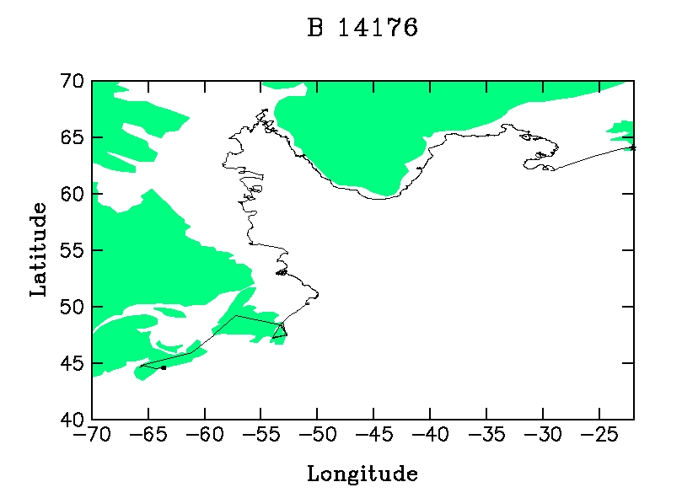
QC Examples - Trajectory
Drifter 14176 raw file
Ship track
Deployed here
11-Oct-2000
Picked up
Notes:
56

Slide 57

Drifter 14176 Cleaned and Interpolated File
QC Examples
After editing and interpolation procedures have been applied
15-Mar-1999
Ship track
Deployed here
30-Jul-2000
Raw Data
11-Oct-2000
Picked up
Ship track
Deployed
11-Oct-2000
Picked up
Notes:
57

Slide 58
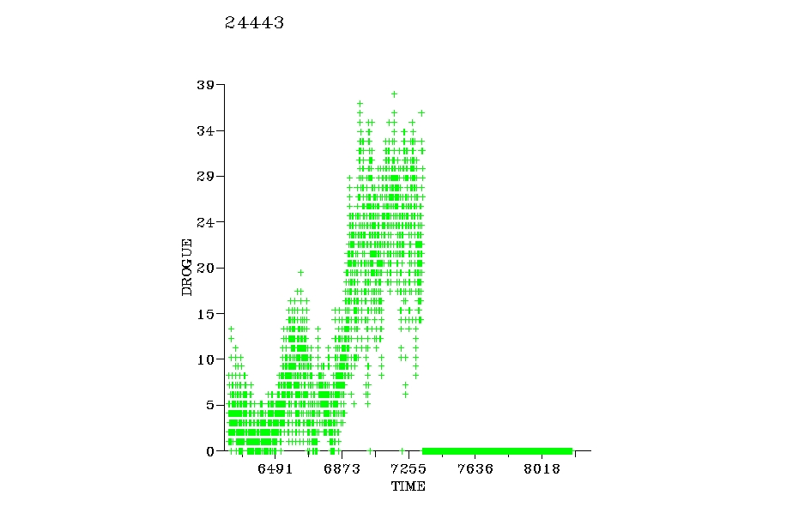
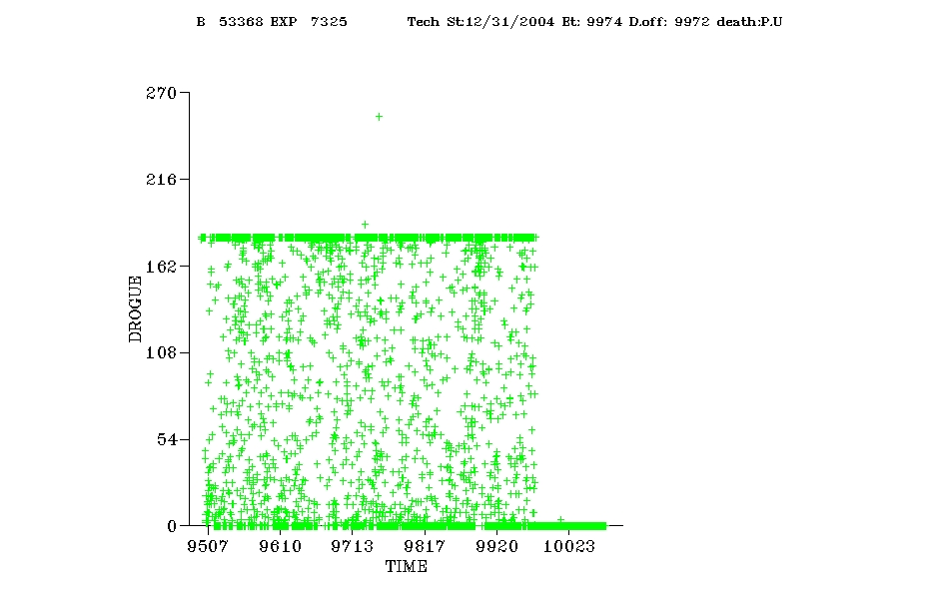
QC Examples – Drogue Sensor
Determining drogue off time
53368
Drogue
lost day 1/29/99
Drogue lost
10/8/96 10/25/97 11/11/98 11/27/99 12/13/00
Submergence record of a well behaved drogued sensor of an Argos drifter.
Typical submergence record for “drogue loss” of an Argos drifter, (noisy record ) but sharp drop to zero when drifter is picked up, and no longer has its drogue submerged.
Notes:
58

Slide 59
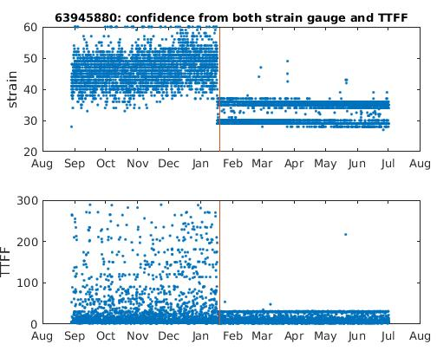
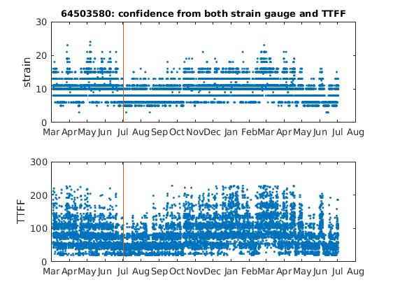
QC Examples – Drogue Sensor
Determining drogue off time is NOT always easy
?
Strain gauge and time to first fix (TTFF) record of a well behaved drogued sensor from an Iridium drifter
Even though the QC software finds this Iridium drifter lost its drogue, where the red line is drawn, based on statistical values, it is not clear it really lost its drogue.
Notes:
59

Slide 60
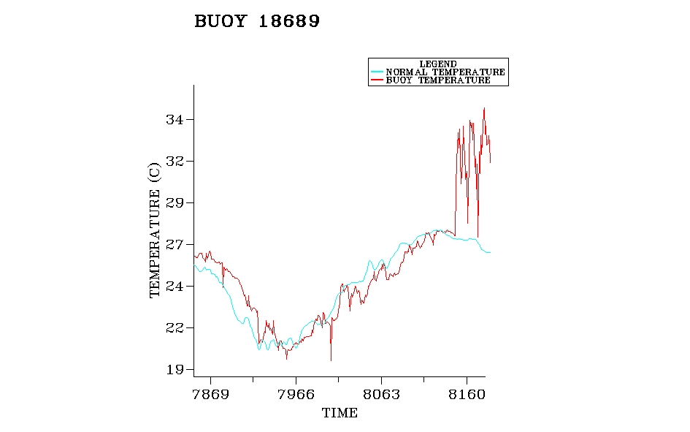
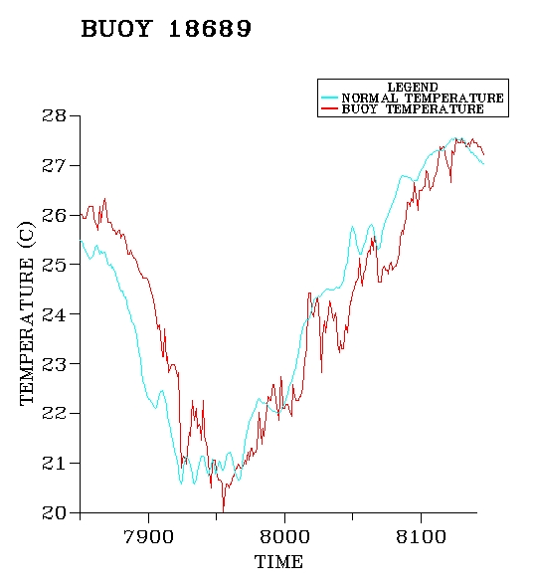
QC Examples – SST sensor
Compare SST with Reynold’s Climatology
SST after removing bad data
Bad SST day
4/21/01
7/17/00 10/22/00 1/27/01 5/4/01
8/17/00 11/25/00 3/5/01
Notes:
60

Slide 61
Web Access,
Data,
Products and Maps
Notes:
61

Slide 62
Web Access
There is a lot of information and maps that can be accessed from the Global Drifter Program web site home page:
Recent maps of the global drifter array
Database update status
News
Contact information
Tabs to navigate through the web pages at the top and bottom of the home page
www.aoml.noaa.gov/phod/gdp/index.php

Slide 63
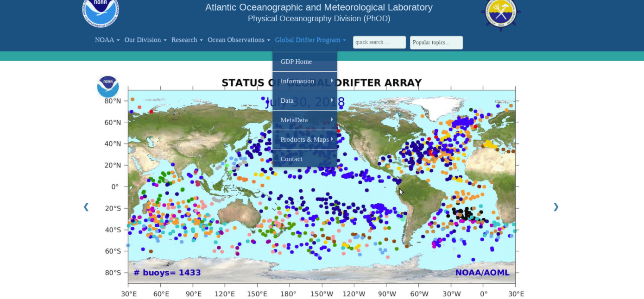
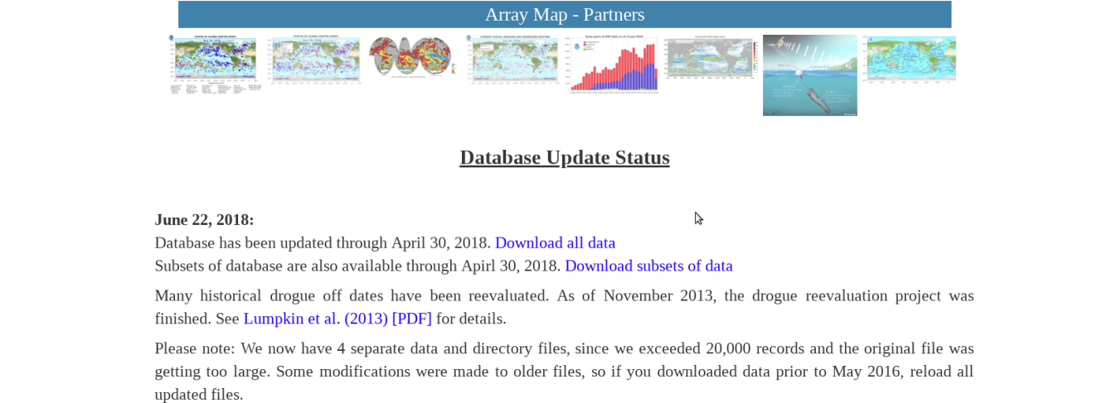
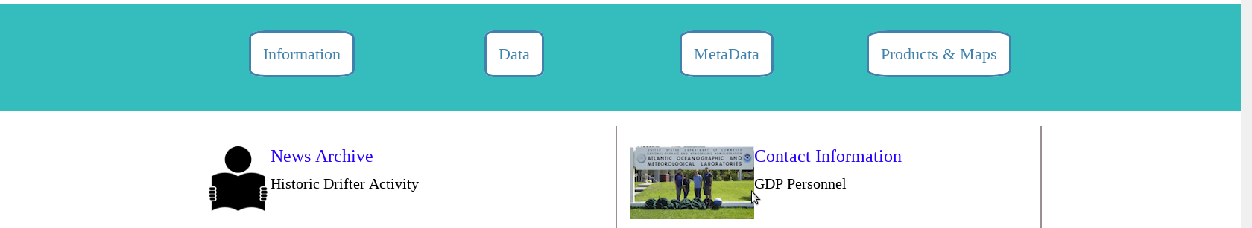
NAV
IGAT
I
NG
THE
WEB
www.aoml.noaa.gov/phod/gdp/index.php
Tabs to navigate web pages
Quick access to recent maps
Tabs to navigate web pages

Slide 64






www.aoml.noaa.gov/phod/gdp/index.php
Each of these give more options as outlined below

Slide 65
Real Time Data Access
www.aoml.noaa.gov/phod/gdp/index.php

Slide 66

Real Time Data Access
There are different possibilities to obtain drifter trajectories and sensor data graphs or data downloads from the web:
ex:1
ex:2
ex:3

Slide 67

Real Time Data Access – Graphs
EX 2:
To get trajectory and most recent sensor drifter data (up to 15 days), using Meteo-France QC Tools: from dropdown menu, enter WMO number, select desired parameter or all in the same page to see all sensors at once, and click OK
http://esurfmar.meteo.fr/qctools/dataplotsurfmar.htm

Slide 68





QC-Tools Results

Slide 69


Real Time Data Access – Graphs
http://osmc.noaa.gov/Monitor/OSMC/OSMC.html
– Ex 1: A Specific Drifter
Web Access

Slide 70



Slide 71



results

Slide 72


Real Time Data Access – Graphs
http://osmc.noaa.gov/Monitor/OSMC/OSMC.html
– Ex 3: All Drifters in a region
Web Access

Slide 73



Slide 74



Slide 75

Real Time Data Access – Downloads
There are different possibilities to download real time data
www.aoml.noaa.gov/phod/gdp/real-time_data.php

Slide 76


Example

Slide 77


* Please note: if you desire specific coordinates, and/or a time parameter you must enter these values in the “Optional Constraint” boxes to the right of each field

Slide 78


Slide 79
Download Real Time Data - links
For more instructions on how to access real time data and graphs, please visit the GDP Real-Time Drifter Data website at:
www.aoml.noaa.gov/phod/gdp/real-time_data.php
To get non-QC data for the last 90 days
www.aoml.noaa.gov/phod/gdp/images/ERDDAP_Data_Access_90Days.pdf
To obtain data from all drifters in formats such as ASCII, NetCDF or Matlab
www.aoml.noaa.gov/phpd/gdp/images/ERDDAP_Data_Access_Template_basic.pdf
For more advanced queries, like getting data in a desired format from a specific drifter or a batch of drifters spanning a particular time period and/or region
www.aoml.noaa.gov/phod/gdp/images/ERDDAP_Data_Access_Template_Advanced.pdf

Slide 80

Delayed Mode Interpolated Data
WAIT UNTIL FINAL VERSION
Notes:
80

Slide 81


Delayed Mode Interpolated Data
WAIT UNTIL FINAL VERSION
Notes:
81

Slide 82
Access Delayed Mode Interpolated Data
http://www.aoml.noaa.gov/phod/gdp/interpolated
WAIT UNTIL FINAL VERSION
Notes:
82

Slide 83




How To Access Drifter Data
Interpolated Historical Data
http://www.aoml.noaa.gov/phod/dac/dacdata.html
Notes:
83

Slide 84
E-mail Received To Retrieve Data
To download the data files(s) proceed as follows: By clicking on the following hyper-link(s)
ftp://ftp.aoml.noaa.gov/od/pub/envids/metadata_gld.20070521_101943.zip ftp://ftp.aoml.noaa.gov/od/pub/envids/interpolated_gld.20070521_101943.zip
Or By using the following ftp instructions :
1. ftp ftp.aoml.noaa.gov
2. enter 'anonymous' for userid.
3. enter your 'email address' for password.
4. enter 'binary' to set the transfer type
5. enter 'cd /od/pub/envids'
6. enter 'get metadata_gld.20070521_101943.zip'
7. enter 'get interpolated_gld.20070521_101943.zip'
8. enter 'quit' to log off. NOTICE: files are removed 5 days after creation date.
Notes:
84

Slide 85
Products and Maps
www.aoml.noaa.gov/phod/gdp/index.php

Slide 86



Examples of different maps
Array map – drifter types
90 Day forecast
Deployment Values

Slide 87

Products and Maps

Slide 88


Sample Product

Slide 89
GTS Distribution
Notes:
89

Slide 90
GTS Responsibilities
Assign WMO numbers to all drifters and give directives for insertion and deletion of drifter data onto the GTS
Follow up and make sure data distributed through GTS is being received
Monitor accuracy of data on the GTS and provide directives to stop distribution of any sensors that report bad data
Notify responsible party for releasing data to the GTS of buoys that lost their drogues to be noted in the GTS message
Notes:
90

Slide 91
Frequently asked questions
Why is this instrument called a drifter?
These instruments sit at the surface of the ocean and are transported via near-surface ocean currents. They are not fixed to the ocean bottom, therefore they “drift” with the currents. For this reason, these instruments are referred to as drifters, or drifting buoys.
How do drifters work?
The surface float contains sensors that measure different parameters, such as sea surface temperature, barometric pressure, salinity, wave height, etc. Data collected from these sensors are transmitted to satellites passing overhead, which are then relayed to land-based data centers. , all drifters are equipped with ae ocean surface.
Do all drifters measure ocean current velocities?
Yes, as long as the drogue remains attached, all drifters measure near-surface ocean current velocities. If the drogue is lost at sea, the wind and waves play a greater role in moving the drifter.

Slide 92
What is a drogue?
The drogue, also known as a sea anchor, extends approximately 20m deep and is designed to move with the near-surface ocean currents. Because the drogue and surface float are connected by a long tether, the surface float is therefore moving with the near-surface currents as well. Without the presence of a drogue, the surface float will also be transported by wind and waves, much as a ping pong ball or beach ball is pushed across the surface of a pool.
Why do the drogues have different colors and patterns?
The GDP requires that drogues are made of cordura nylon with rip-stop, with specific dimensions, but the GDP does not require a specific color for their drogues. As a result, drogue manufacturers often use surplus cordura nylon material from other jobs, which may consist of fluorescent pink, neon green, or even camouflage.
For more frequently asked questions:
Get link from Shaun

Slide 93
Contacts
Dr. Rick Lumpkin, Global Drifter Program Manager e-mail: Rick.Lumpkin@noaa.gov
Mr. Shaun Dolk, Drifter Operation Center Manager e-mail: Shaun.Dolk@noaa.gov
Mrs. Mayra Pazos, Drifter Data Assembly Center Manager e-mail: Mayra.Pazos@noaa.gov
Mr. Erik Valdes, Drifter DAC, Research Assistant e-mail: Erik.Valdes@noaa.gov
Notes:
93

Slide 94


Drifter Tracks
Thank You!
Notes:
94

Slide 95
END

Slide 96
DAC
Data
Flow
NEEDS UPDATING
Notes:
96

