Slide 1


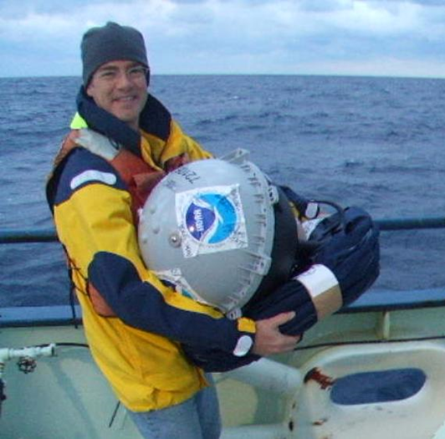
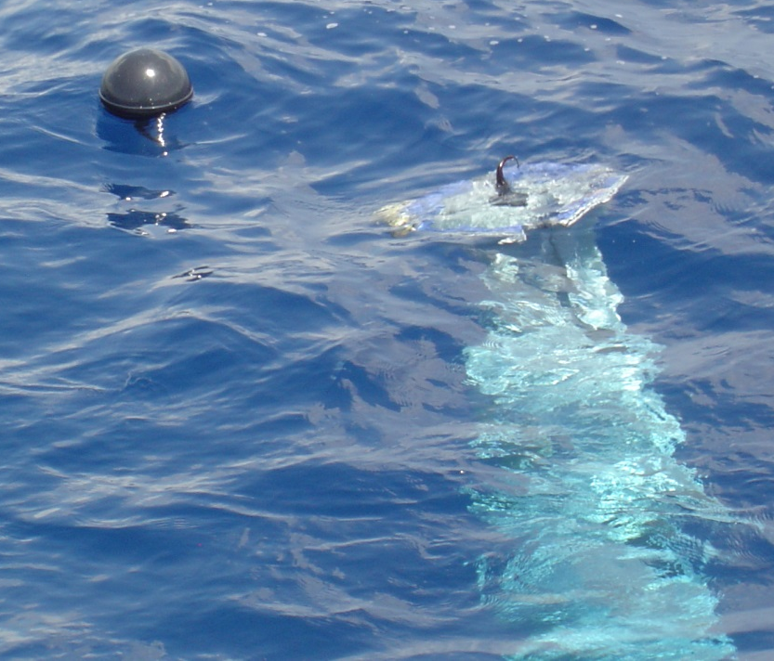

Data Management and Activities of the
Global Drifter Program/
Data Assembly Center(DAC)
Mayra Pazos – Manager , DAC

Slide 2

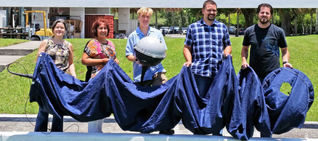
Organization of the Global Drifter Program
AOML (Miami, FL)
Rick Lumpkin (Manager, PI)
Renellys Perez (co-PI)
Scripps (La Jolla, CA)
Luca Centurioni
Supervises the industry, upgrades the technology, purchases most drifters, and develops enhanced data sets.
Manufacturers
(who build the drifters according to closely monitored specifications)
Operational Partners
(help with deployments and/or share their data)
Drifter Operations Center (DOC)
Shaun Dolk (Manager)
Drifter Data Assembly Center (DAC)
Mayra Pazos (Manager) Erik Valdes (quality control)

Slide 3
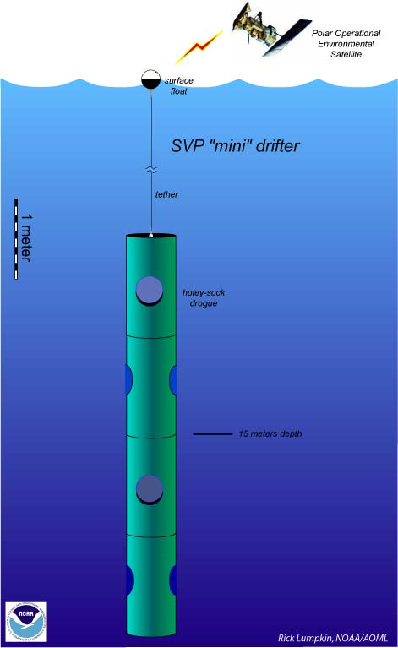
The satellite-tracked drifter
Spherical surface float
Polyurethane impregnated tether
Holey Sock nylon drogue centered at 15-m depth
D-cells batteries inside the float
Sensors:
Drogue: drogue detection by submergence or tether strain sensor
Thermistor: measure SST
Voltage: Indicates batteries’ life
Cost: ~$2000-$3000
Other Sensors that can be added:
Barometric pressure, wind, subsurface temperatures, salinity, GPS
Holey-sock drogue
(sea anchor)

Slide 4
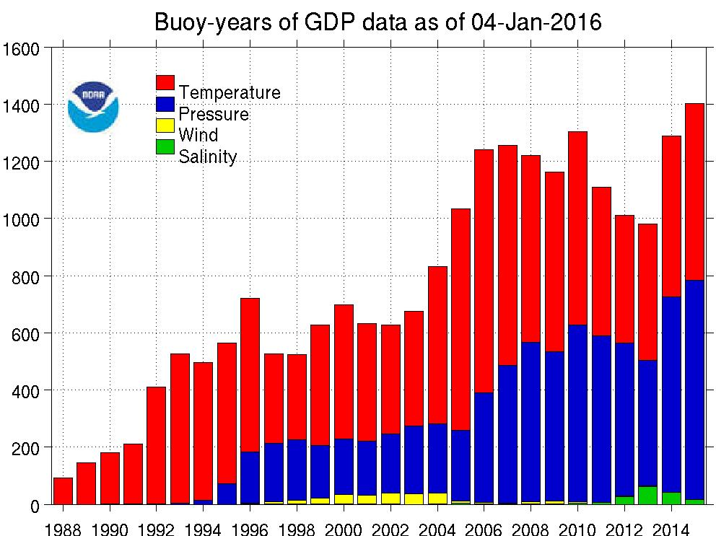
Drifter Data Assembly Center (DAC)
Objectives:
The goal of the Drifter Data Assembly Center is to assemble and provide uniform quality controlled data of research quality for sea surface temperature and surface velocity measurements, to support:
  Short term climate prediction
  Satellite observation calibration
  Climate research and monitoring

Slide 5
Activities of the DAC
Drifter data are collected by Argos (70%) and Iridium systems (30%)
Data arrive at AOML in different ways and from several sources:
  Argos system data comes directly from CLS-America.
  Iridium data comes in several different ways:
    On FTP server (from Scripps and Meteo-France)
    Downloads from Joubeh’s web portal
    E-mail messages with Short Bust Data (SBD)
    Once the data are assembled, we proceed to
    Delayed Mode and Real Time (GTS)
    Quality Control & Monitoring
Notes:
- The data are received at AOML in many different ways and from different sources

Slide 6
Activities of the DAC
Delayed Mode and Real Time (GTS)
Quality Control and Monitoring
Maintain a database with drifter data from deployment until buoy stops transmitting.
Keep metadata with information about each drifter:
  first and last good time and position, drogue off date, buoy type, cause of death.
Decode raw data & apply calibrations to convert from raw counts to units.
Notes:
- The data are received at AOML in many different ways and from different sources

Slide 7
Activities of the DAC
Delayed Mode and Real Time (GTS)
Quality Control and Monitoring
Run quality control programs to edit positions and SST and then interpolate data to 6-hour intervals.
Make data, metadata and products available on web weekly or monthly.
Send updates to MEDS, the RNODC for Drifting Buoys, for archival and further distribution.
Start GTS process and monitor data for GTS insertion or removal.
Notes:
- The data are received at AOML in many different ways and from different sources

Slide 8
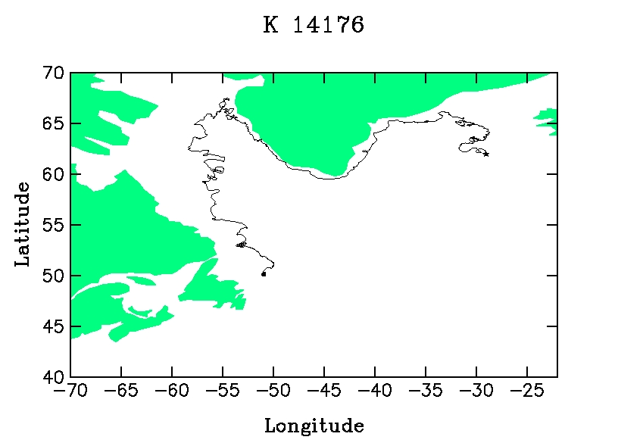
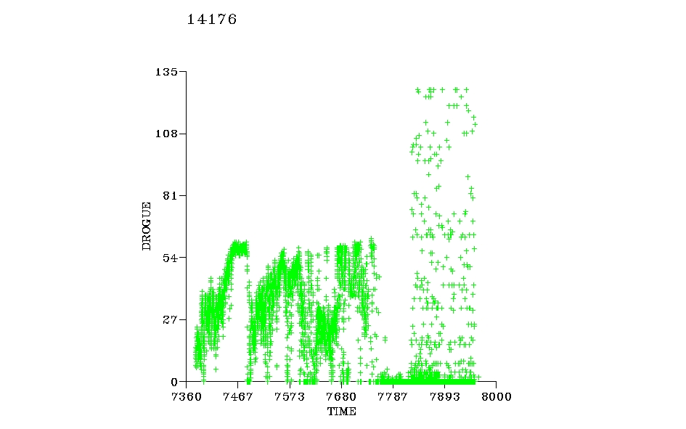

15-Mar-1999
Drogue lost day
21-Mar-2000
30-Jul-2000
Ship track
Deployed
11-Oct-2000
Picked up
2/24/99 6/11/99 9/25/99 1/10//00 4/26/00 8/10/00 11/25/00
2/24/99 6/11/99 9/25/99 1/10/00 4/26/00 8/10/00 11/25/00

Slide 9
Some Drifter’s Facts
Drifters average life: ~450 days
Longest Lived: 10 years, 4 months, 21 days
Drogue expected average life: ~300 days
Longest Drogue on : 5 years, 6 months, 21 days
Average failure on deployment: ~2% -3%
Common death reasons: Run aground, picked up, stop transmitting

Slide 10
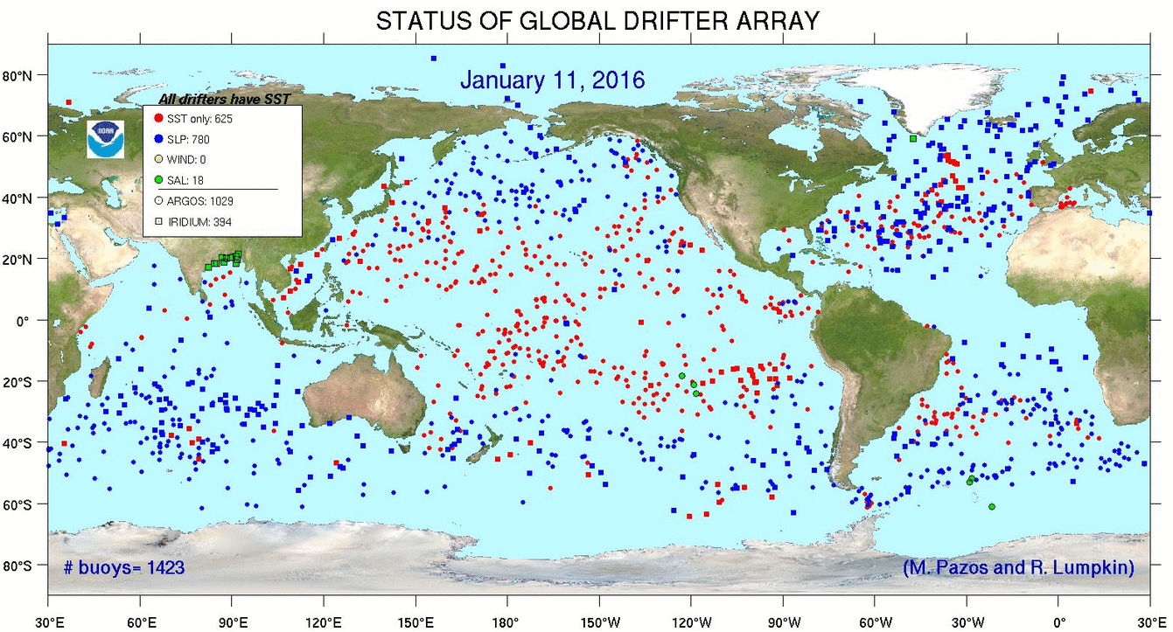
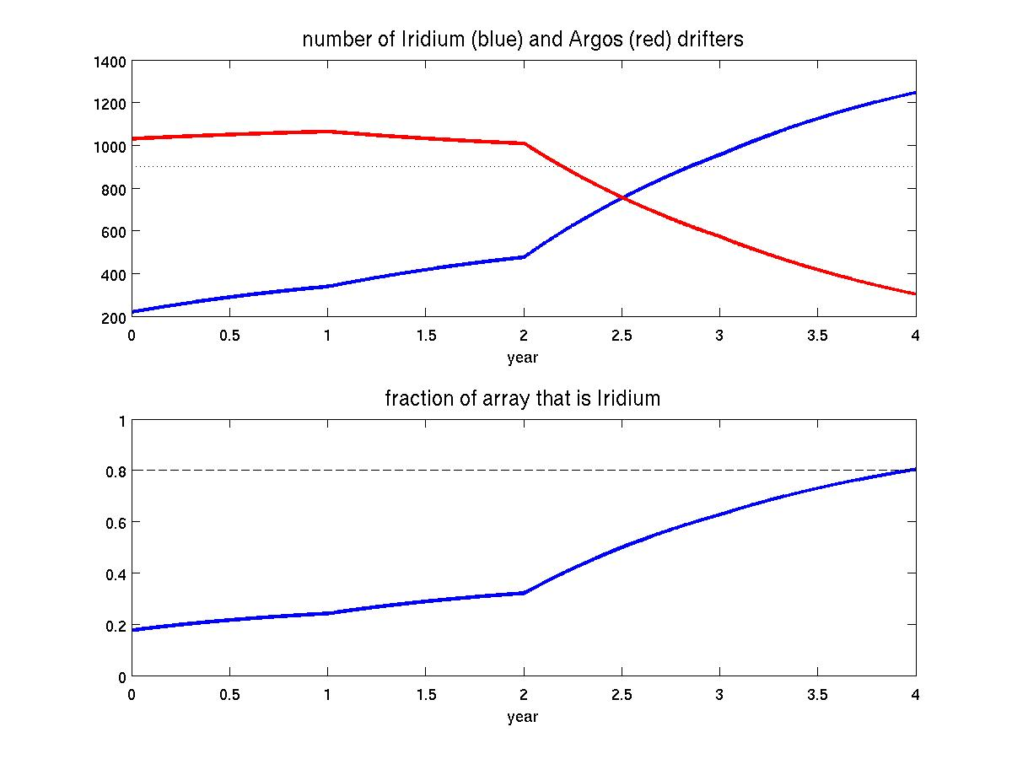
Weekly
Maps
70% Argos 30% Iridium
At end of 2018: 20% Argos
80% Iridium
FY15
FY16
FY17
FY18

Slide 11
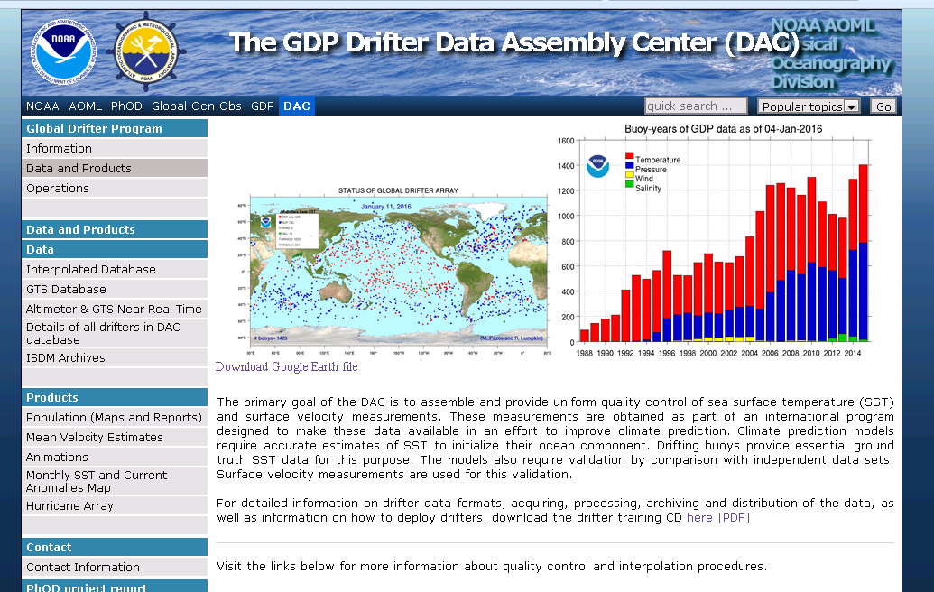
Data and Products updated on the web (weekly or monthly)
www.aoml.noaa.gov/phod/dac/dacdata.php

Slide 12
Other Activities of the
Global Drifter Program
Evaluate Drifter performance
  The Global Drifter Program has been conducting comparison studies by deploying drifters from different manufacturers in clusters, at the same time and location since 2005 to evaluate their performances (2005, 2006, 2008, 2010, 2014). Results from these studies have been communicated to manufacturers to address and correct problems found
Additional methods to determine drogue off:
  Tether strain versus GPS information

