Slide 1


XBT Network Summary Report
GTSPP Meeting
Oostende, Belgium
June 17-20, 2014
2012 Meeting of the Joint IODE-JCOMM Steering Group for the GTSPP
16 - 20 April 2012, Oostende, Belgium
Joint IODE-JCOMM Steering Group for the GTSPP, Oostende, Belgium June 17-20,2014

Slide 2
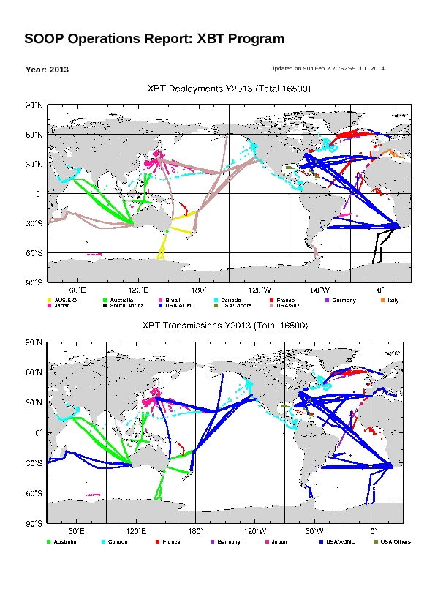
XBT Network Summary Report
Joint IODE-JCOMM Steering Group for the GTSPP, Oostende, Belgium June 17-20,2014

Slide 3
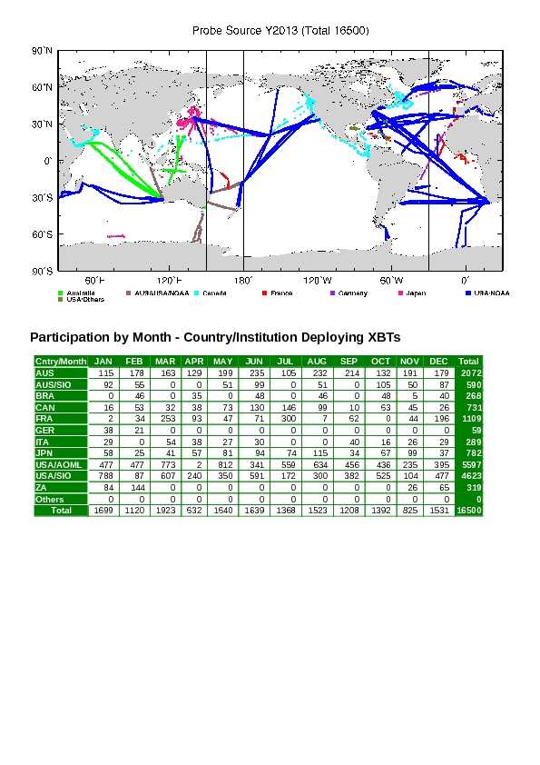
XBT Network Summary Report
Joint IODE-JCOMM Steering Group for the GTSPP, Oostende, Belgium June 17-20,2014

Slide 4
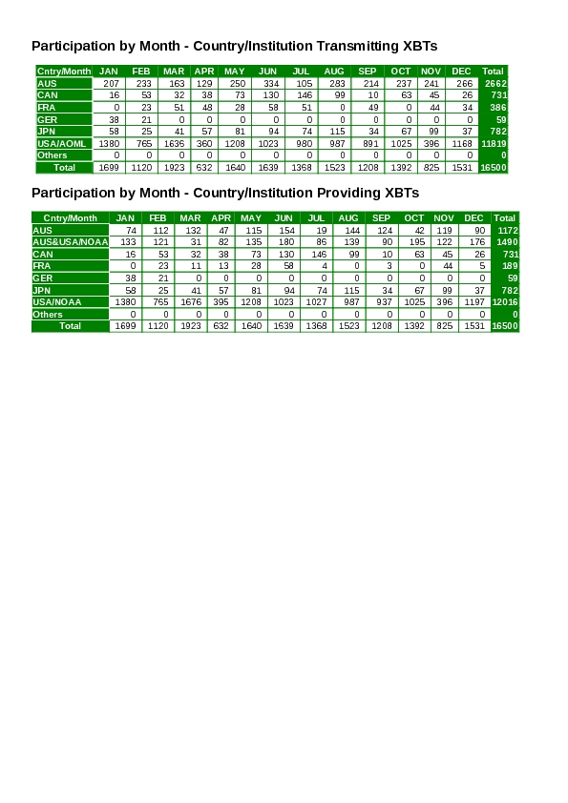
XBT Network Summary Report
Joint IODE-JCOMM Steering Group for the GTSPP, Oostende, Belgium June 17-20,2014

Slide 5
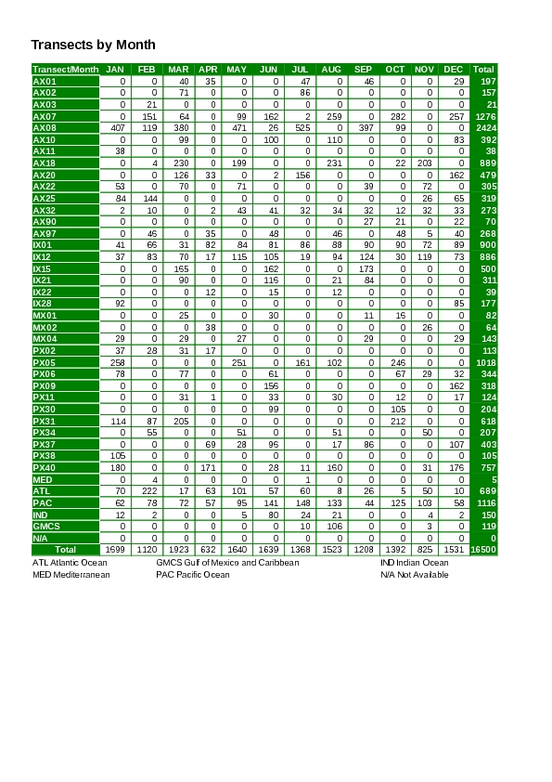
XBT Network Summary Report
Joint IODE-JCOMM Steering Group for the GTSPP, Oostende, Belgium June 17-20,2014

