Slide 1
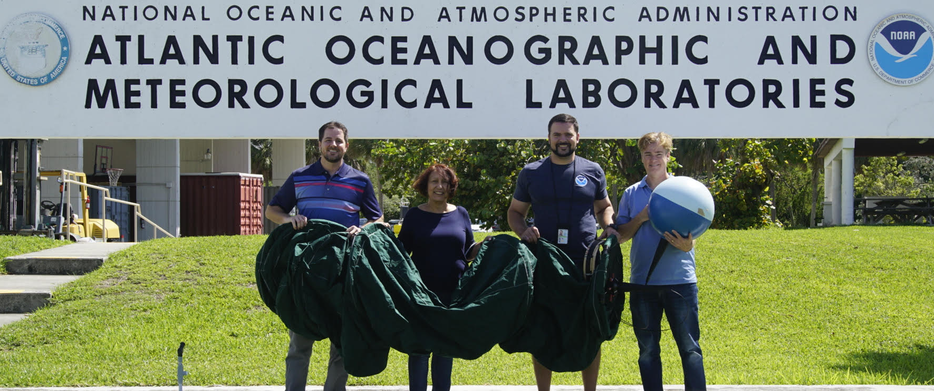

In-situ observations of near-surface ageostrophic and submesoscale ocean currents
Rick Lumpkin, NOAA/AOML
World Ocean Circulation User Consultation Meeting
21 February 2019
Frascati, Italy
Notes:
Introduction.

Slide 2
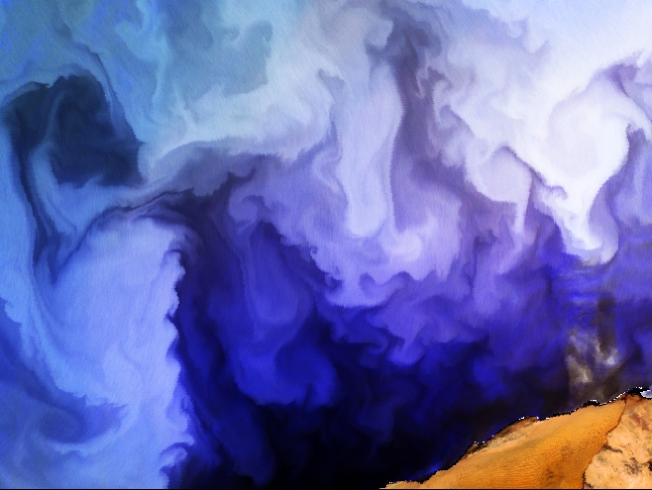
GDP purpose
In-situ observations of ocean circulation at short time and space scales describe the submesoscale and ageostrophic components of the flow field not well resolved in satellite measurements.
Observations are a unique tool for validating state of the art ocean circulation products and for better understanding their gaps.
Goal: obtain a better description of the submesocale, near-inertial, tidal, and near-equatorial currents.
Notes:
Submesoscale: plays significant role in upper ocean budgets, mixing, stirring, and energetics of larger-scale circulation.
Upcoming SWOT mission
Note that satellite-derived products have a difficult time with even time-mean flow near equator, where Coriolis force becomes very weak

Slide 3
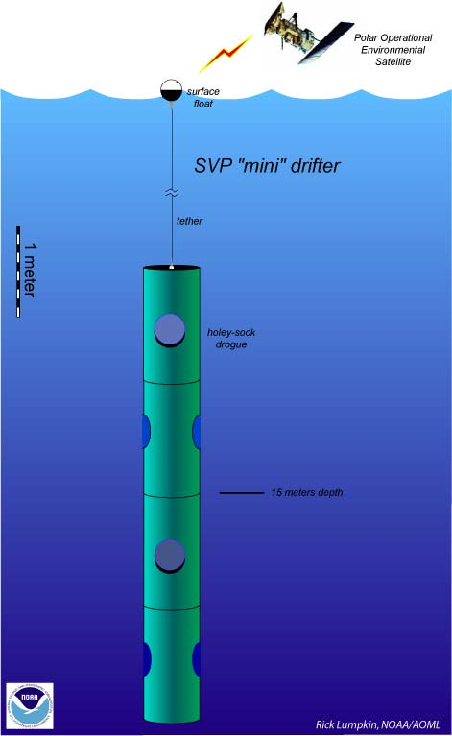
The Global Drifter Program drifter
Spherical surface float, tether, holey sock drogue centered at 15-m depth.
Inside the float: D-cell alkaline batteries, GPS receiver, Iridium satellite transmitter (older drifters: Argos)
Data transmitted every hour on the hour to the Global Telecommunications System (GTS) for worldwide distribution.
SST: measured by a thermistor on base of surface float
Cost: ~$1,800
Other Sensors that can be added:
Barometric pressure (+$1,500), wind, salinity, subsurface temperatures, water clarity, etc.
If drogue is lost, drifter can measure waves.
Notes:
Batteries provide power, nominal operation of 2 years. Average life ~ 400 days
Cost of basic drifter ~ $1800, ~ $3000 Barometer, ~ $1200 for baro upgrade
Drogued at 15-m depth to measure mixed layer currents.

Slide 4
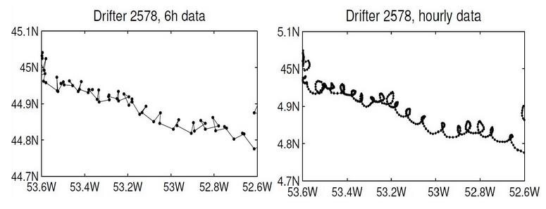
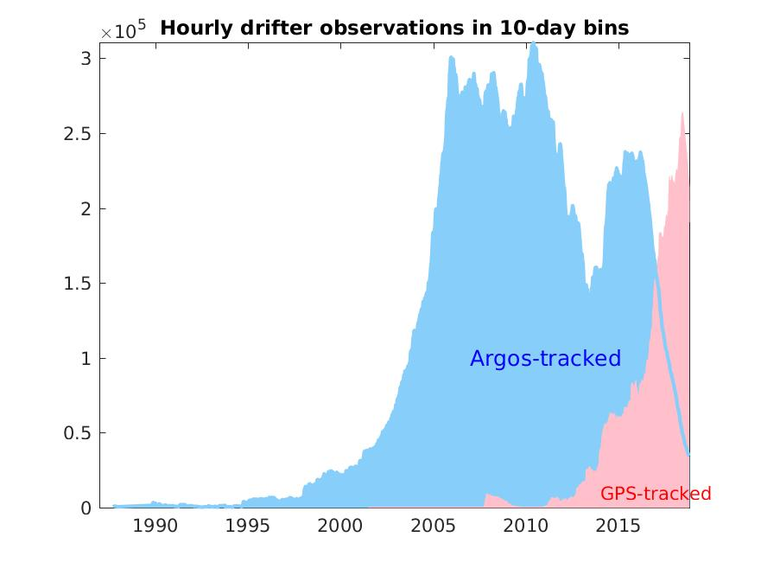
Hourly drifter observations
Methodology for interpolating positions and velocities to regular hourly intervals described in Elipot et al. (2016). Hourly product with accompanying error bars available on the Global Drifter Program web site.
Notes:
Note that drifter obs are INTEGRATING (position), so unresolved motion doesn’t bias lower-frequency motion

Slide 5
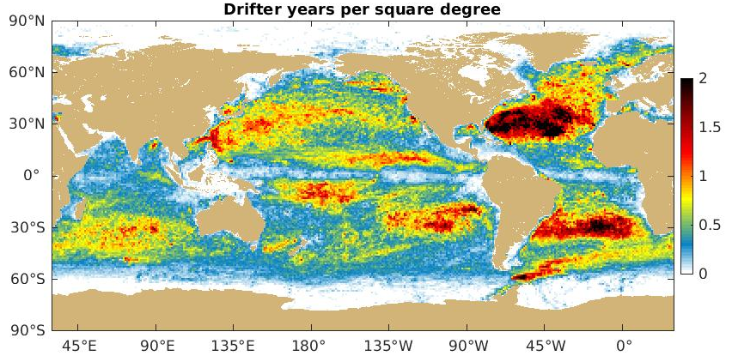
Spatial density of hourly drifter data
As of version 1.02 (released Dec. 2018, with data through Nov. 2018)
Notes:
Spatially, much of the world has over a quarter drifter YEARS of hourly observations. Data still sparce in divergent regions such as the equator.

Slide 6
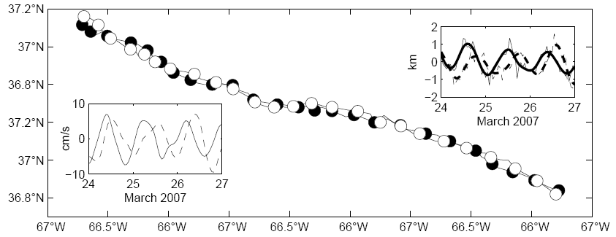
Submesoscale vortices in drifter data
Cyclonic submesoscale vortex, orbital period 0.87-0.9 days (IP: 0.83d), radius <3km. Lower left inset: u (solid) and v (dashed) velocity around center of mass. Upper right inset: zonal (solid) and meridional (dashed) displacement from center of mass. From Lumpkin and Elipot (2010).
Notes:
Examples of what can be seen in high-frequency drifter data. Here: deployments of pairs to study relative dispersion had two, by luck, enter a very small submesoscale vortex in the winter Gulf Stream.

Slide 7
Global distribution of inertial energy
Near-inertial variance from hourly drifter position, from Elipot et al. 2010
Notes:
Global distribution of near-inertial energy mapped by drifters. This study also used AVISO altimetry to show that the background vorticity associated with the geostrophic eddy field altered the frequency of inertial motion, consistent with theory.

Slide 8
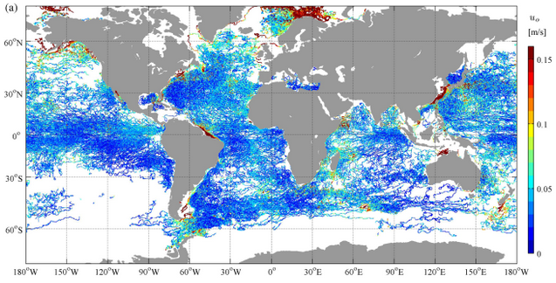
Global distribution of tidal energy
High-resolution distribution of M2 tidal amplitude derived from high frequency drifter data
Kodaira et al. (2016)
Notes:
Global distribution of tidal energy can also be measured by drifters. Here: M2 tide.

Slide 9
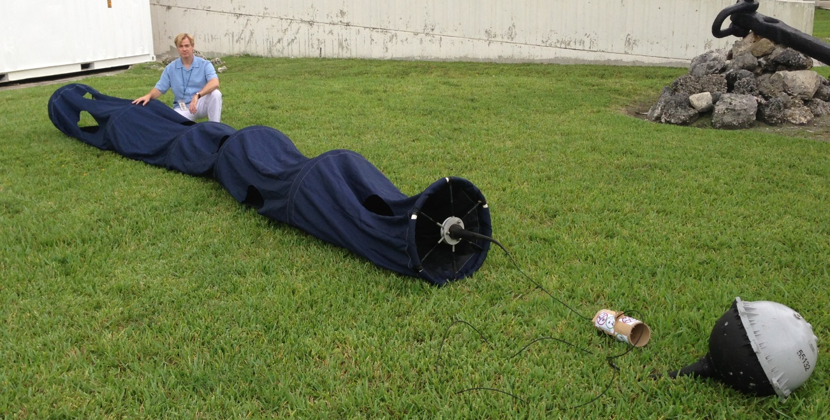
Drogue (sea anchor)
Cross-sectional area: 40:1
drogue:(tether + surface float)
Centered at 15m depth
Approximately 10m long
When attached, motion relative to 15m currents is <1 cm/s per 10 m/s wind
Frequently pulls surface float underwater
Drifters typically lose drogue after ~200 days (drifter half-life ~450 days)
~50% of historical data is drogue-off
An undrogued drifter moves differently than a drogued one because:
  velocity shear between 15 m and surface
  direct wind forcing
  Stokes drift
Notes:
Complication with these data: about half of observations are from drifters that have lost their drogues.
Opportunity to track buoyant objects floating at surface (relevant for marine debris problem)
Possible opportunity to understand shear between 15m and surface, role of surface waves in dispersion, etc.

Slide 10
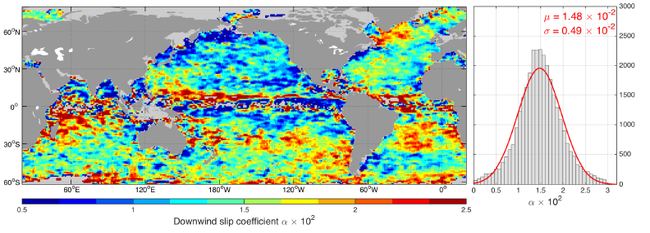
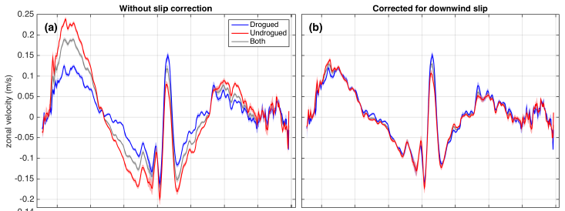
Slip correction reveals complex structure of gain coefficient
Downwind slip of undrogued drifters corrected with spatially-varying coefficient to make velocities consistent with drogued velocities
Laurindo et al., 2017
Notes:
For low frequency motion, slip correction can be applied to adjust undrogued data to be consistent with drogued data.
Typical approach: undrogued = drogued + alpha * wind.
Laurindo et al: by construction, this makes mean zonal velocities be consistent, but spatial distribution of alpha is extremely complicated. Waves? Vertical shear? Something else?

Slide 11
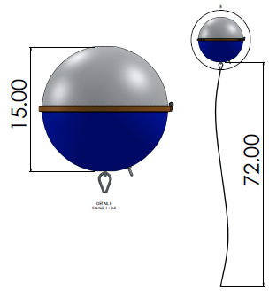
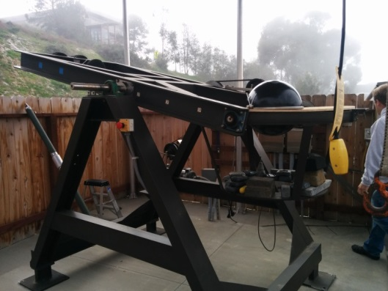
NEW: directional wave spectrum drifters (DWSD), developed at Scripps Institution of Oceanography, currently being field tested in open ocean. Preliminary results look very promising. Targeted deployments planned for 2019 in regions of strong wave/current interaction.
Figures courtesy Luca Centurioni, SIO
Notes:
Until recently, most wave measurements were collected at a few fixed sites. Now, we have figured out how to measure directional wave spectra from undrogued drifters. These drifters are currently being tested in the open ocean, with targeted observations planned in 2019.

Slide 12
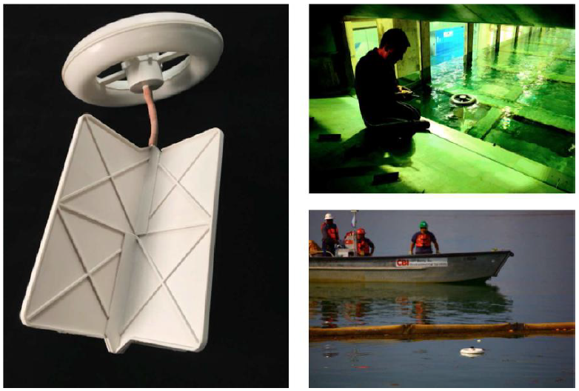
The LASER drifter
The LAgrangian Submesoscale ExpeRiment (LASER) drifter is a low-cost, mostly biodegradable, short lifespan drifter developed by the CARTHE consortium to study ocean dispersion and mixing with extremely dense deployments. From Lumpkin et al. (2016).
Notes:
GDP drifters are relatively inexpensive compared to most equipment, but they aren’t ideal to deploy in clusters of 100+ for extremely fine-scale measurements of ocean stirring and dispersion.
LASER drifters: designed by Tamay Ozgokmen (UM) and colleagues as part of the CARTHE consortium.
They move very similary to Davis/CODE drifters.

Slide 13
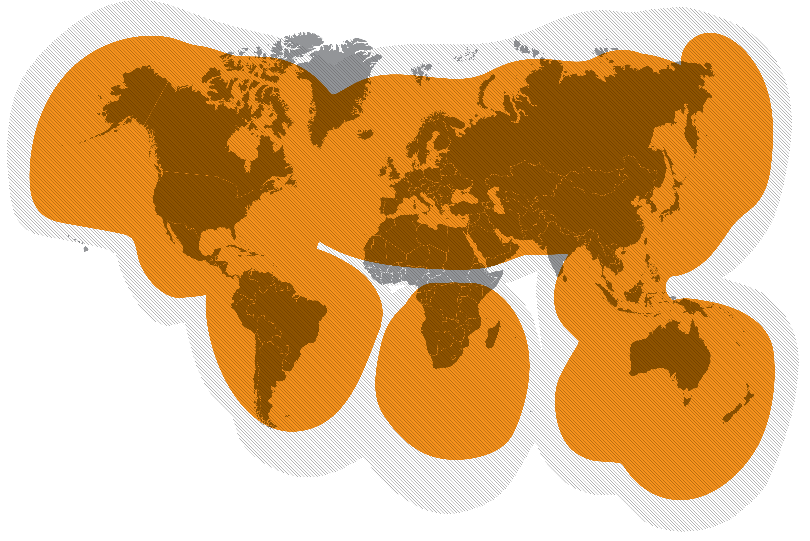
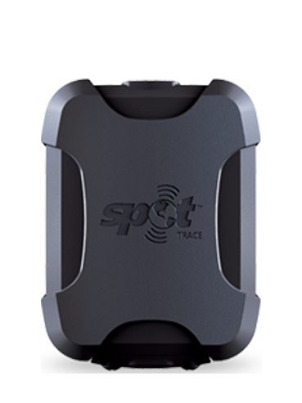


Globalstar coverage for SPOT trace
Notes:
LASER drifters use off-the-shelf ~$100 SPOT traces, which relay GPS position using Globalstar (not global coverage).

Slide 14
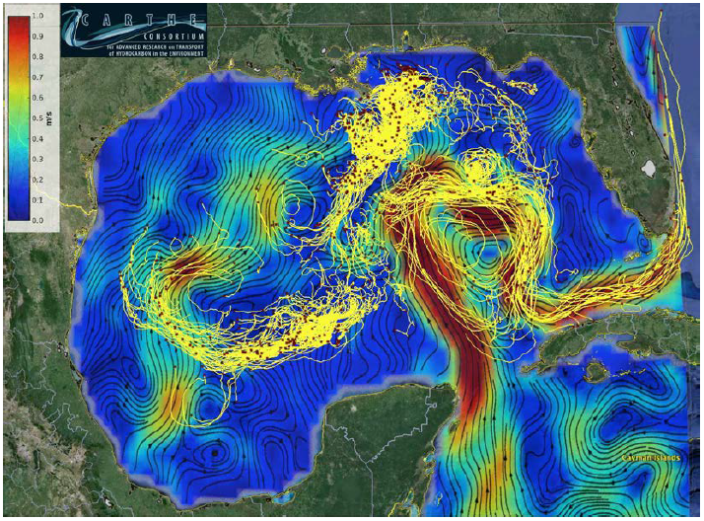
Trajectories of LASER drifters in the Gulf of Mexico superimposed on surface currents. Red squares mark positions on March 9, 2016; tails are 14 days long. Surface current field from AVISO. From Lumpkin et al. (2016).
Notes:
Dense deployments of LASER drifters have revealed the fine-scale structure of fronts, submesoscale filaments and vortices, and mesoscale eddies. Recent studies have come to contradicting conclusions regarding how significant the submesoscale is in driving particle dispersion.

Slide 15
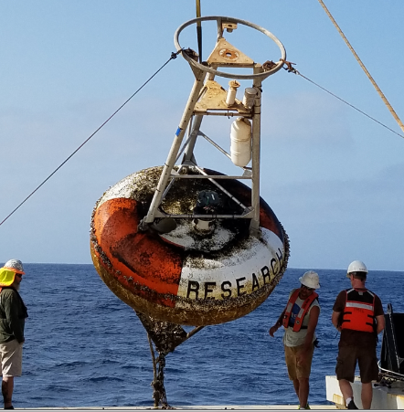
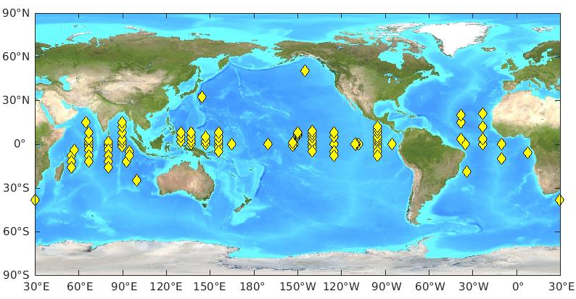
Moored current meters
PAPA
KEO
TAO/TRITON
RAMA
PIRATA
ARC
Most sites have one point acoustic meter at a nominal depth of 10m.
Some host ADCPs or multiple point meters for upper ocean current profiles.
Hourly data: all in delayed mode, increasingly all in real-time as arrays switch from Argos (ATLAS-type moorings) to Iridium (T-FLEX, TAO Refresh, etc.).
Near-real time data available on GTS, Coriolis, etc. Delayed-mode QC and data distribution by NOAA/PMEL available at 10-min intervals.
Notes:
Moorings: particularly valuable near the equator where surface drifters diverge rapidly.

Slide 16
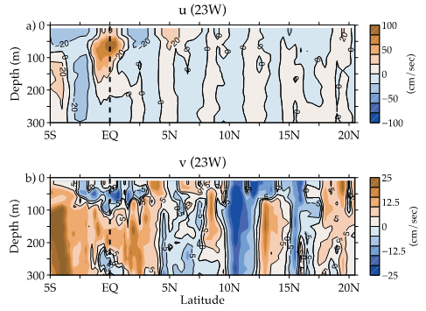
Lowered Acoustic Doppler Current Profiler (LADCP)
Example from the PIRATA Northeast Extension 2017 cruise, courtesy chief scientist Renellys Perez. LADCP can also be collected by gliders.
Main problem using these data: representativeness.
Notes:
Satellite based models face large challenges near equator, esp. for meridional flow, even for time-mean flow.
Shipboard LADCP: upper 30m not sampled
Meridional LADCP section has TIWs (which a satellite-based model might want) plus BT tides, internal waves, noise. This can be addressed by repeated sampling, e.g., by LADCP on a glider.

Slide 17
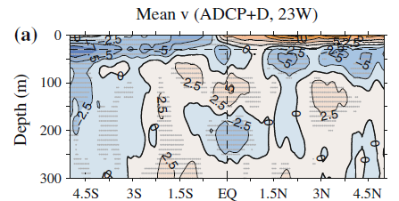
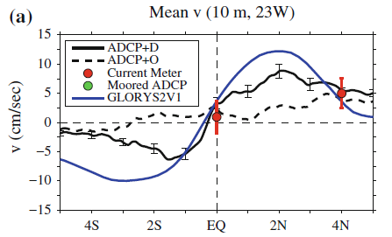
Composite LADCP for time-mean equatorial meridional flow
Composite of 36 LADCP sections in the equatorial Atlantic between 22 and 29W.
Drifters used for upper 30m.
Comparison of composite (solid black) with GLORYS2v1 simulation (blue), OSCAR (dashed), and current meter measurements at PIRATA moorings (red dots).
From Perez et al. (2014).

Slide 18
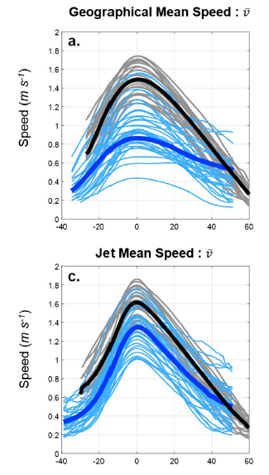
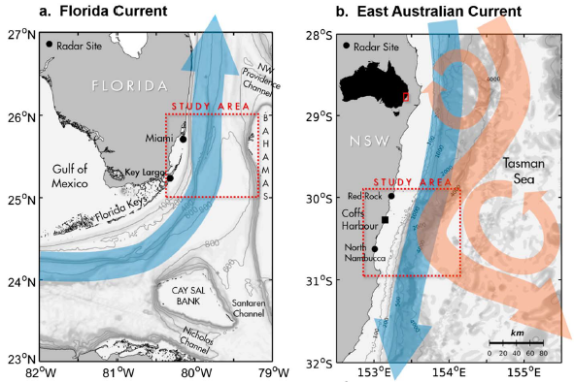
High Frequency (HF) Radar
HF radar sites can observe surface currents at ~1km and hourly resolution, sufficient to see energetic submesoscale motion, inertial and tidal variations, etc.
Shown here: the structure of the geographically-constrained Florida Current and unconstrained East Australia Current, which have very different structures in geographic coordinates but are quite similar in jet coordinates (Archer et al., 2018).
Notes:
HF radar: pushing “in situ” a bit, but extremely valuable to monitor surface currents in particular areas with 1 km, hourly resolution. Shown here …

Slide 19
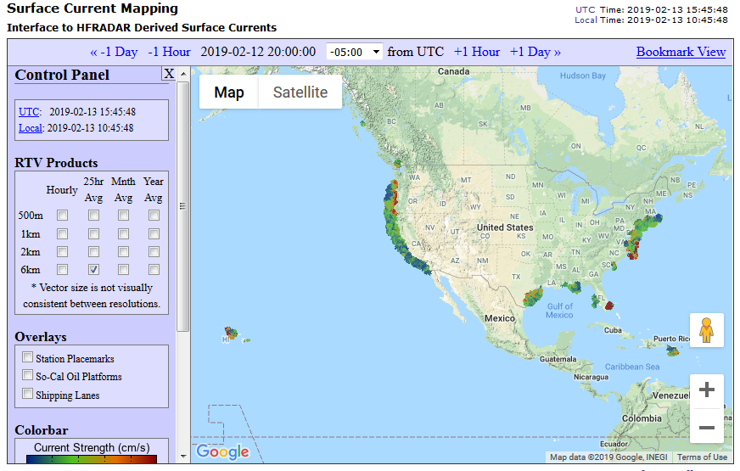
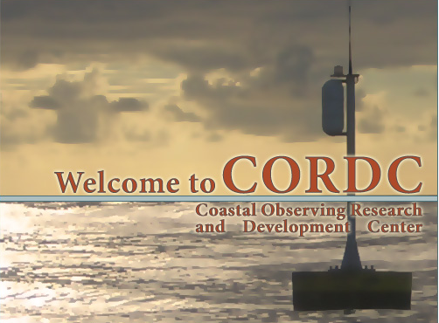
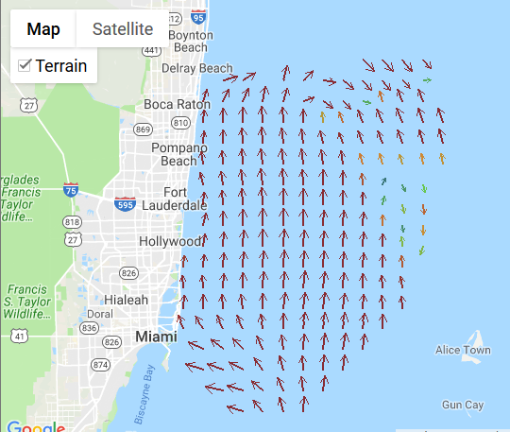
Real-time HF radar portal (data access via NOAA/National Data Buoy Center)
Notes:
HF radar portal shows density of network around the US coasts and Hawaii. Zoom in: southeast FL measurements of the Florida Current

Slide 20
References
Hourly Global Drifter Program data: http://www.aoml.noaa.gov/phod/gdp/hourly_data.php
Global Tropical Moored Buoy Array data: https://www.pmel.noaa.gov/gtmba/
Ocean Climate Station data: https://www.pmel.noaa.gov/ocs/data/disdel/
USA HF Radar Network data: http://cordc.ucsd.edu/projects/mapping/maps/
Archer et al. 2018: The kinematic similarity of two western boundary currents revealed by sustained high-resolution observations. Geophys. Res. Lett. 45, 6176—6185, doi:10.1029/2018GL078429.
Elipot et al. 2010: Modification of inertial oscillations by the mesoscale eddy field. J. Geophys. Res.-Oceans, 115, C09010, 20 pp, doi:10.1029/2009JC005679.
Elipot et al. 2016: A global surface drifter data set at hourly resolution. J. Geophys. Res.-Oceans, 121 (5), 2937-2966, doi:10.1002/2016JC011716.
Kodaira et al. 2016: Prediction of M₂ tidal surface currents by a global baroclinic ocean model and evaluation using observed drifter trajectories, J. Geophys. Res. Oceans, 121, 6159–6183, doi:10.1002/2015JC011549.
Laurindo et al. 2017: An improved surface velocity climatology for the global ocean from drifter observations. Deep-Sea Res. I, 124, 73—92, doi:10.1016/j.dsr.2017.04.009.
Lumpkin and Elipot, 2010: Surface Drifter Pair Spreading in the North Atlantic. J. Geophys. Res.-Oceans, 115, C12017, doi:10.1029/2010JC006338.
Lumpkin et al. 2016: Advances in the applications of surface drifters. Annu. Rev. Mar. Sci., 9, 59-81, doi:10.1146/annurev-marine-010816-060641.
Perez et al., 2014: Mean meridional currents in the central and eastern equatorial Atlantic. Climate Dynamics, 43, 2943-2962, doi:10.1007/s00382-013-1968-5.
Notes:
References. Questions can be sent to Rick dot Lumpkin at noaa dot gov. Moderators Nikolai Maximenko and Rosemary Morrow can undoubtedly field questions as well.

