Slide 1
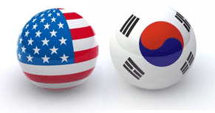
GDP/kiost Partnership
NOAA-Ministry of Oceans and Fisheries (MOF) Joint Project Agreement Ocean Research Panel
Honolulu, HI
25 February, 2014
Presented by: Rick Lumpkin, NOAA/AOML
Created by: Shaun Dolk, CIMAS/AOML

Slide 2
Outline
What is a Drifter?
Global Drifter Program (GDP) Goals
GDP Partnerships
GDP/Korean Collaborative Evolution
Increased Communication and Collaborative Efforts
POSEIDON Deployments
Equatorial Pacific
R/V ARAON Deployments
Southern Ocean
Future Plans

Slide 3
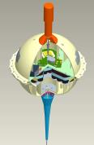
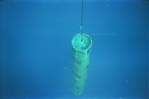
GDP Drifter
Surface Float
-expected life: 450 days
D-Cell Battery Packs (4-5)
Satellite Transmitter
Sea Surface Temperature Sensor
Drogue (sea-anchor)
-expected life: 300 days
Tether Strain Sensor
Drogue Detection
Cost: ~$1700
Additional Sensors Can Be Added
Barometer Sensor
Salinity Sensor
Wind Sensor
Speed and Direction

Slide 4
GDP Goals And Objectives
The GDP is the principal component of the Global Surface Drifting Buoy Array, a branch of NOAA’s Global Ocean Observing System (GOOS) and Global Climate Observing System (GCOS) and a scientific project of the DBCP.
Objectives:
Maintain a global 5°x5° array of 1250 satellite-tracked Lagrangian surface drifting buoys to meet the need for an accurate and globally dense set of in-situ observations: mixed layer currents, SST, atmospheric pressure, winds, and salinity.
Provide data processing system for scientific use of these data.
Drifter data support short-term (seasonal-to-interannual) climate predictions as well as climate research and monitoring.

Slide 5
Successful GDP Partnerships
Based on the nature of the drifting buoy, continuous deployments and strategic reseeding is imperative. In order to achieve adequate coverage (5° x 5° array of 1250 drifters), frequently repeated, routine deployment opportunities are needed.
Vested International Collaborators are agencies that either purchase drifters, or upgrade GDP drifters with additional sensors.
International Collaborators include partners who regularly deploy drifters on behalf of the GDP. Though these collaborators do not purchase drifters, they are of great importance in seeding regions otherwise inaccessible.
Domestic Collaborators conduct research using drifters and assist in the deployment of GDP drifters.
GDP Affiliates include NOAA employees and NOAA contractors.

Slide 6
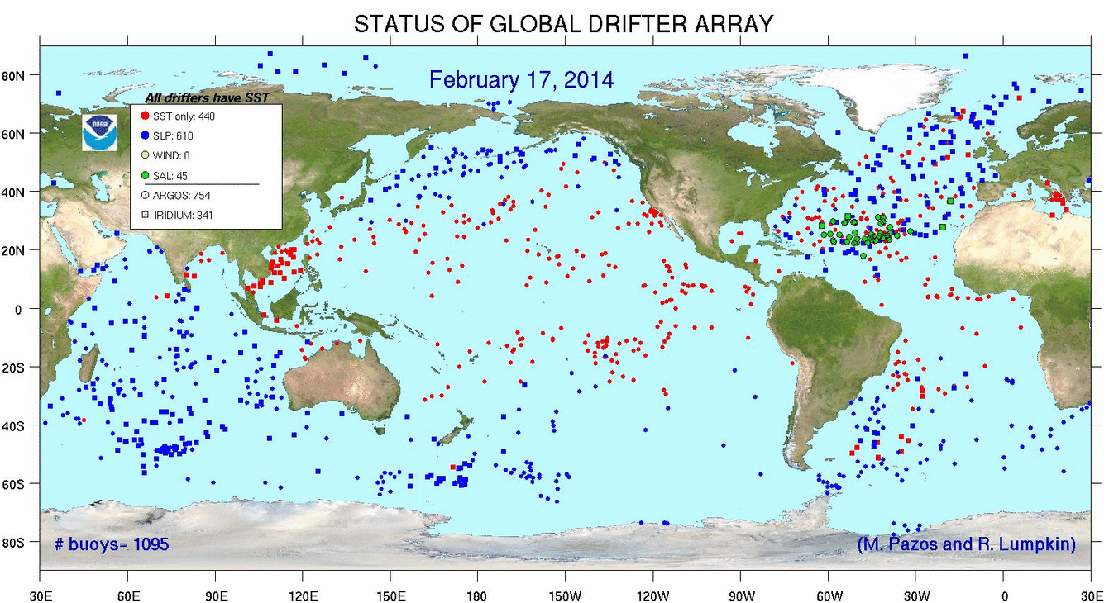
SUCCESSFUL GDP PARTNERSHIPS
Vested International Collaborator
(purchase and/or upgrade drifters)
Global Drifter Program (GDP)
International Collaborator
US Collaborator
GDP Affiliates

Slide 7
Collaboration maturation
1st Coastal and Ocean Observation Panel Meeting
– Jeju, Korea – 11-12 October, 2007
Addressed:
Missing Deployment Reports
Data Formatting Issues
Communication Concerns
2nd Coastal and Ocean Observation Panel Meeting
– Miami, Florida – 22-23 April, 2009
Addressed:
Communication Concerns
Established Agency Contacts within KIOST
Mutual Benefits Using Drifter Deployments
3rd Seminar on Ocean Climate Collaboration
– Seattle, Washington – 15-16 April, 2013
Addressed:
Accomplishments Achieved
Desire to Continue Collaborative Efforts
Possible Expansion of Current Parameters
4th Joint Project Agreement Ocean Research Panel
– Honolulu, Hawaii – 25 February, 2014
Address:
Successful Deployments from R/V ARAON
Desire to Continue Collaborative Efforts
Possible Expansion of Collaboration into Arctic/Antarctic Regions
Work with KIOST Scientists at NOAA/AOML on Drifter-Related Research

Slide 8
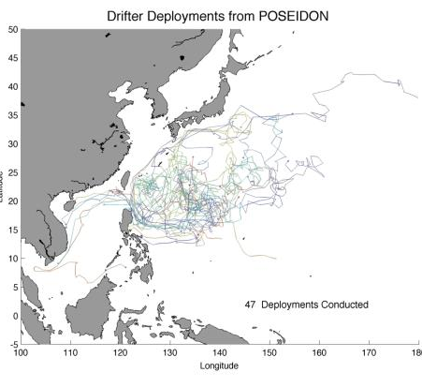
Collaborative Achievements
Annual POSEIDON Cruise
2009
8 Drifter Deployments
2010
20 Drifter Deployments
2011
0 Drifter deployments
Shipping Constraints
2012
19 Drifter Deployments
2013
0 Drifter Deployments
Drifter Inventory Shortage
2014 (planned)
20 Drifter Deployments
Total: 47 SVP Drifters Deployed

Slide 9
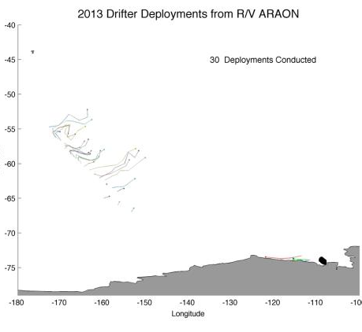
Collaborative Achievements (cont.)
Southern Ocean Deployments
2013
30 Drifters Deployments
2014 (planned)
30 Drifters Deployments
Total: 30 SVPB Drifters Deployed

Slide 10
R/V ARAON Deployment Impacts
Southern Ocean Deployment Limitations
Limited Container Ship Traffic
Few Scientific Cruises
Seasonal Opportunities
Storage Constraints
Logistic Requirements
ACC Assistance Required

Slide 11
Future Plans
Current collaboration between the GDP and KIOST is a success – THANK YOU DR. JEON and DR. LEE!!!
Continue Collaborating in the Western Equatorial Pacific Ocean
Increase the deployment plan to incorporate an additional 10 drifters (30 GDP drifters in total)
Continue Collaborating in the Southern Ocean
GDP and KIOST desire to expand the current collaboration to include additional deployment opportunities of mutual interest:
Arctic Ocean
Including the Bering Sea
Indian Ocean
GDP and KIOST desire to work together on drifter-related research.

Slide 12
Thank you

