Slide 1
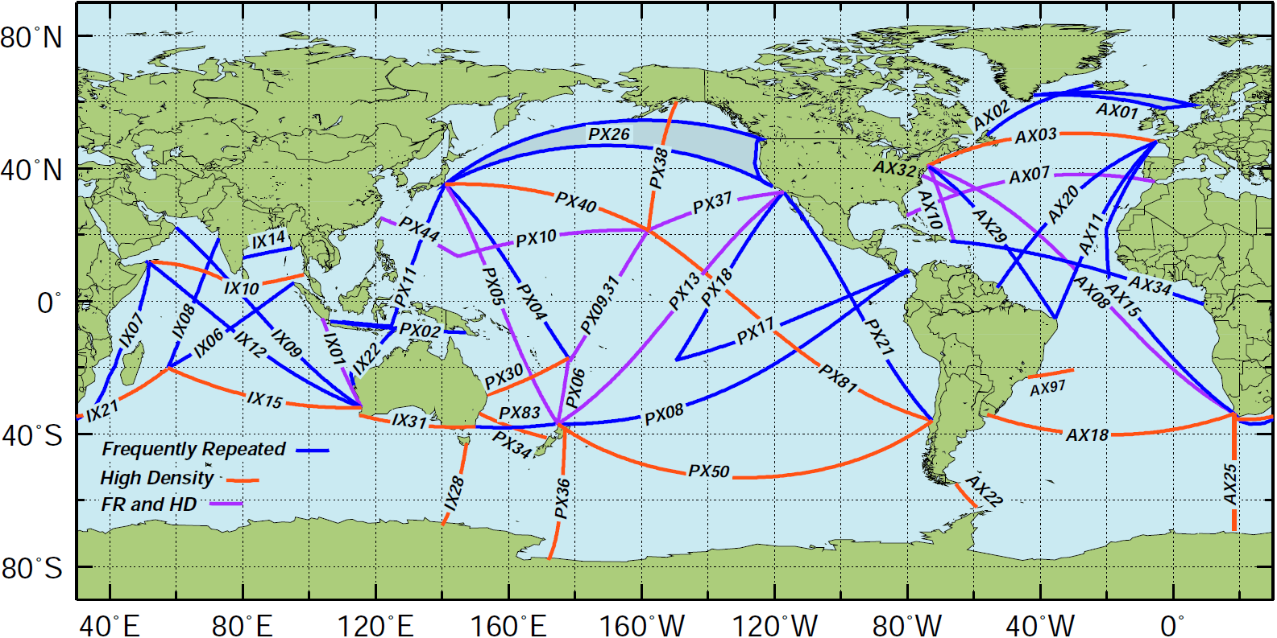
The Global XBT Network
Notes:
The Global XBT Network of 50 transects. Most transects are repeated 4 times a year and approximately 20,000 are deployed annually. AOML leads most of the Atlantic Ocean transects and partners with international institution in some Pacific and Indian Ocean transects.

Slide 2
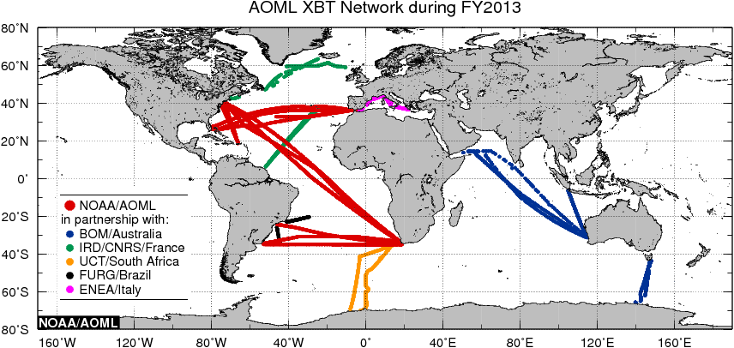
NOAA/AOML XBT Deployments
Notes:
The XBT observations carried out in 2013, by AOML and by AOML in collaboration with its international partners.

Slide 3
Contribution of the AOML XBT Observations to Study Meridional Heat Transport, Boundary Currents, and gyres
Meridional Heat Transport South Atlantic (AX18)
Meridional Heat Transport North Atlantic (AX07)
Gulf Stream (AX32, AX10, AX07)
Agulhas Currents and rings(AX08, AX18, AX25, IX21)
Brazil Current (AX18, AX97)
Tropical Atlantic zonal equatorial currents (AX08, AX20)
Kuroshio Current (PX44, PX40, PX05, PX04)
Antarctic Circumpolar Current (AX25, AX22, IX28)
East Australian Current (PX30, PX34)
East Auckland Current and Tasman Outflow (PX06)
Eastern boundary currents: California Current, Alaska Current, Leeuwin Current, …(PX37, IX15, )
Low latitude WBCs: Solomon Sea
Indonesian Throughflow (PX05, IX01)
Mediterranean Sea (MX01, MX02, MX04)
South Atlantic Subtropical gyre (AX08, AX18)
North Atlantic Subtropical gyre (AX08, AX10, AX07, AX20, AX04)
North Atlantic Subpolar gyre (AX02, AX01)
In bold transects in which AOML is involved.
Notes:
XBT transects are used to monitor and study the variability of key surface and subsurface currents and undercurrents, including some western boundary currents; to monitor the variability of the Meridional Heat Transport in the Atlantic Ocean, and to investigate the variability of ocean gyres.

