Slide 1

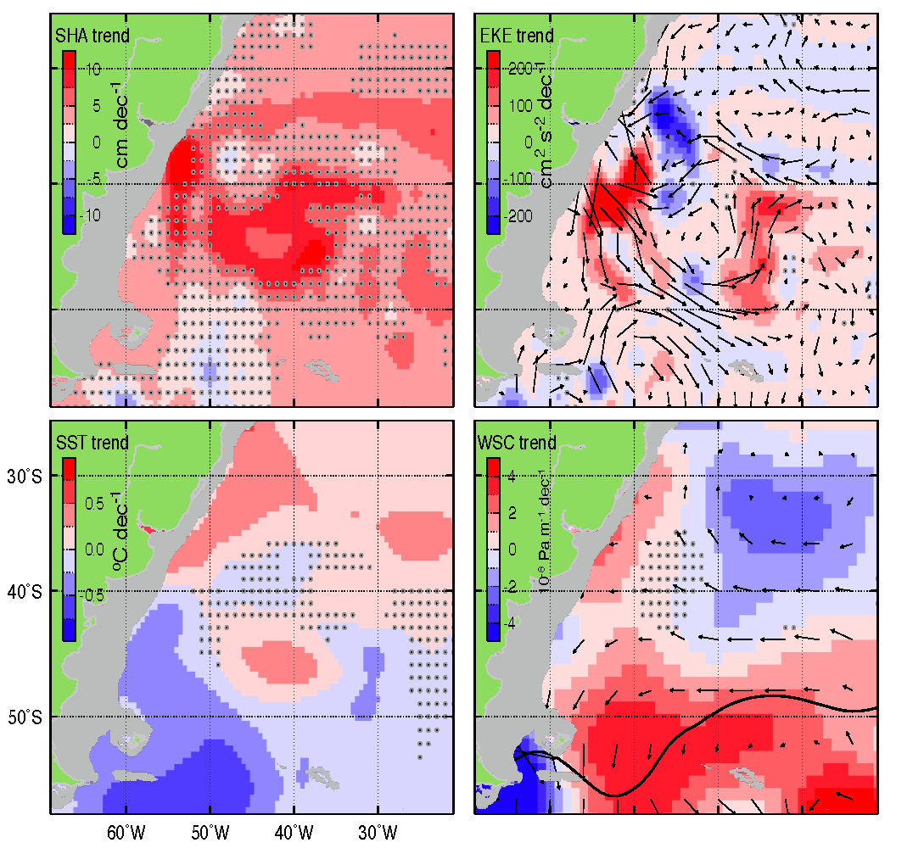
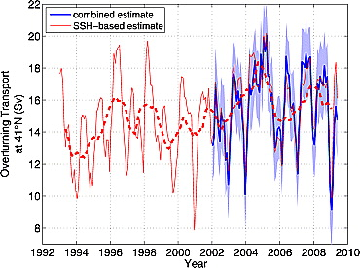
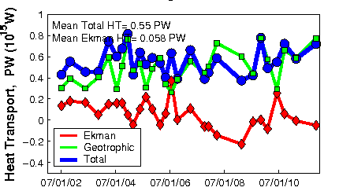
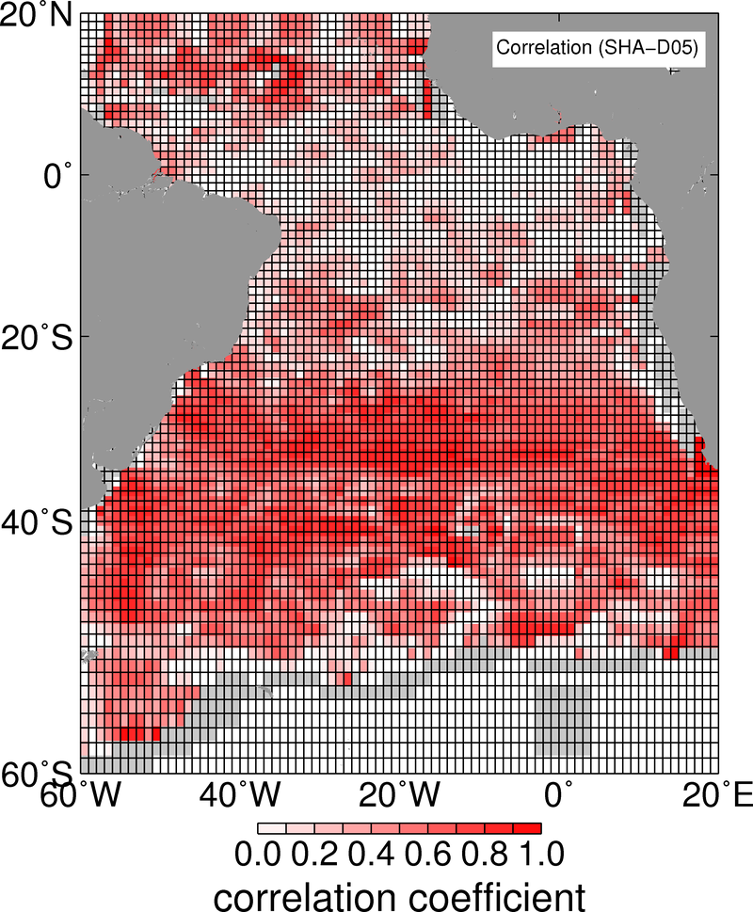
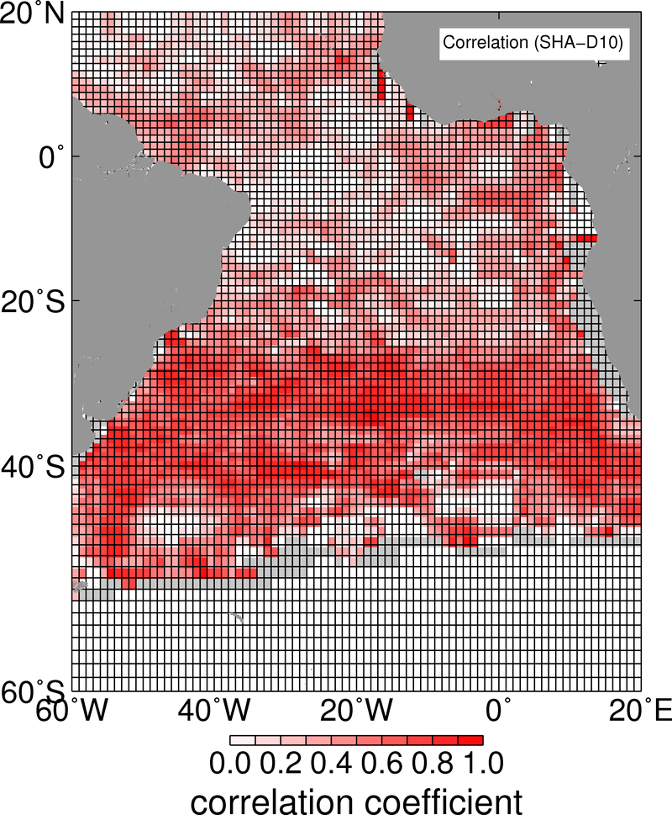
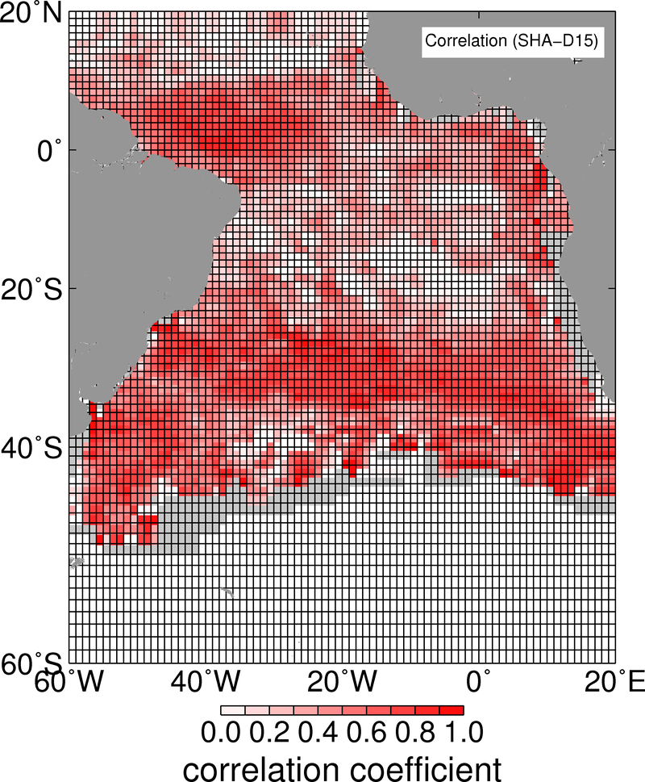
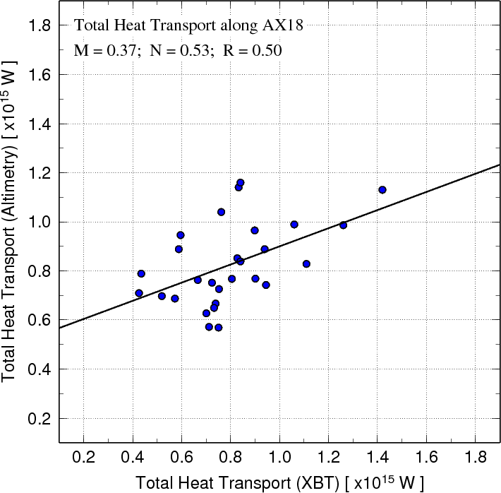
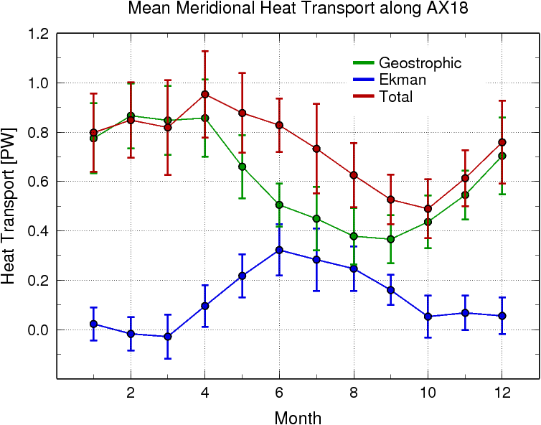
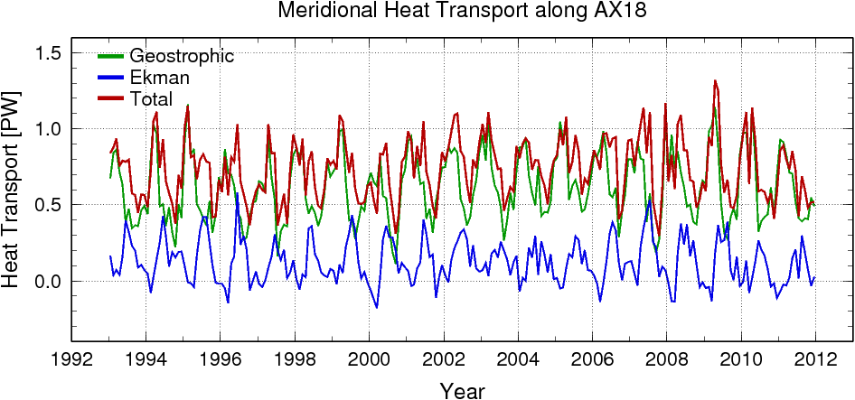
Variability of the Meridional Heat Transport in the South Atlantic since 1993
Gustavo Goni¹, Shenfu Dong^{2,1}, Molly Baringer¹, Silvia Garzoli¹, and Francis Bringas¹
⁽¹⁾ National Oceanic and Atmospheric Administration, Atlantic Oceanographic and Meteorological Laboratory, Miami, FL
⁽²⁾ University of Miami, Cooperative Institute for Marine and Atmospheric Studies, Miami, FL
Gustavo.Goni@noaa.gov
In recent years there has been great interest in determining the driving mechanism of the AMOC and its variability on various time scales because it has been linked to past abrupt climate change and anthropogenic climate forcing. However, despite the increasing interest in the AMOC and its substantial role in global climate, little is known about its variability and the mechanisms underlying its variability. This lack of knowledge of the AMOC is largely due to the fact that direct observations of the AMOC are limited. Our current understanding of the AMOC and its governing mechanisms depends on the use of numerical models, the trans-basin moored array at 26.5°N in the North Atlantic and XBT transects, which have provided important insights into AMOC behavior.
A method is proposed here, in which satellite altimetry observations is the main data set used to monitor the temporal and spatial variability of the meridional heat transport (MHT) along 35°S since 1993. The geostrophic component of this transport is obtained using statistically-derived profiles of temperature and salinity. Results are compared against XBT estimates derived using data from the High Density XBT transect AX18. The Ekman contribution to the MHT is obtained using the xxxxx wind field. Similar to previous work, the geostrophic and Ekman components of the MHT are out of phase.
Results obtained from this study demonstrate the importance of satellite altimetry observations for MOC studies in the South Atlantic Ocean, and in particular to extend the in situ observational record for the longer time scales needed for understanding climate dynamics.
Motivation
During the last 20 years the dynamics in the South Atlantic Ocean NS several components of the subtropical gyre have exhibited changes as evidenced by linear trends in sea height (SH, Figure 1), sea surface temperature (SST, Figure 1), eddy kinetic energy (EKE, Figure 1) and wind stress (WS, Figure 1). These changes are evidenced, for example, by:
Long period fluctuations in the location of the Brazil retroflection in the SW, as observed from linear trends of EKE (Goni et al, 2010);
Thermal changes in the southern portion of the subtropical gyre, as evidenced by the increase of SH between 30°S and 35°S;
Large interannual variability of the shedding of Agulhas rings in the SE;
Increase in wind stress curl in the SW Atlantic and decrease in the center of the SA subtropical gyre.
Objectives
In this work proposes we make use of the 20-year of continuous altimetry measurements combined with sea surface temperature (SST) satellite-derived and in situ data to estimate the MHT in the South Atlantic, with the goal of investigating its latitudinal and temporal changes. To accomplish these goals, this work includes several components:
Estimate the temporal evolution of the MOC/MHT at every 5° of latitude from 20°S to 40°S since 1993;
Assess the error of the above estimates through comparisons with XBT-derived estimates at 35°S and with CLIVAR A10 section estimates at 30°S;
Assess the individual contributions of the geostrophic and Ekman components to the MOC/MHT at different latitudes;
Investigate year-to-year and inter-annual variability of the MOC/MHT and of their components (e.g., Ekman/geostrophic, gyre/overturning, boundary currents/interior, eddies/large-scale flow) and investigate potential links with wind forcing;
We present here preliminary results of some of the above mentioned goals.
Background and Previous Results
Estimates from blended satellite altimetry and profiling float observations in the North Atlantic have provided new understanding of the seasonal to interannual variability of the MOC and concluded that the MOC has not exhibited a slowing in the North Atlantic (Figure 2 and Willis, 2010).
A time series of the Meridional heat transport across 35°S obtained using 27 realizations of the XBT transect AX18 carried over a period of 8 years (Figure 3, left) has shown that, unlike the North Atlantic, Geostrophic and Ekman components of the MOC are out of phase (Figure 3, right).
SH
EKE
SST
WSC
Figure 1. Linear trends in the South Atlantic during 1993-2010 of the (top left) altimetry-derived sea height (SH) in the South Atlantic during 1993-2010; (top right) altimetry-derived eddy kinetic energy (EKE); (bottom left) satellite-derived sea surface temperature (SST); and (bottom right) satellite-derived wind stress curl (WSC)
Figure 2. Variability of the AMOC at 41°N between the surface and 1130 m using a combination of Argo and altimeter data (blue line). Shading indicates error bounds. The thin red line shows an estimate of the AMOC where the geostrophic transport is computed using only the altimeter data and regression coefficients. The dashed red line shows a one-year running mean of the SSH-based estimate.(From Willis, 2010).
Figure 3. (right) Annual cycle of the strength of the MOC (red) and contributions from the geostrophic (green) and Ekman (black) components in the South Atlantic at 35°S from the trans-basin high-density XBT transect AX18 (Dong et al., 2009); and (left) XBT-derived Meridional heat transport (blue) and contributions from the geostrophic (green) and Ekman (red) components estimated from the XBT transect AX18 (Cape Town to Buenos Aires).
Satellite altimetry estimates of MHT in the South Atlantic Ocean
Temperature profiles along 35°S were estimated using historical sea height anomaly – depth of isotherm relationships obtained from XBT/CTD/Argo temperature profiles in the South Atlantic Ocean (Figure 4). Salinity profiles were also obtained using historical T-S relationships (Thacker, 2008). For most isotherms, the correlation between T and SHA is higher than 0.6 south of 20°S. When correlations are low, the depth of an isotherm tends to the climatological value. Across 35°S, errors in temperature estimates for individual section are larger (~0.5°C) at the depth of the main thermocline (Figure 4).
Using the synthetic temperature and salinity profiles, and following the same methodology used to compute the MHT from XBT observations (Garzoli and Baringer, 2007), the MHT was estimated at the same times and locations than the XBT High Density realizations of the AX18 transect. The correlation coefficient between both estimates is slightly above 0.5 (Figure
The MHT was then estimated once a month (using the altimetry record closer to the 15th day of each month) with synthetic temperature and salinity profiles computed every 25km along 35°S. A time series of MHT is then constructed since 1993 (Figure 6). The geostrophic and Ekman components of the MHT exhibit seasonal variations, with the geostrophic (Ekman) maximum (minimum) occurring during the summer months. Although the Ekman component is smaller than the geostrophic component, their amplitudes are approximately the same, approximately 0.4x10¹⁵ PW (Figure 6 and 7). Between June and August, the Ekman and geostrophic components have similar values, which differs from previous results (Dong et al, 2010). No significant trend was found in the altimetry-derived time series of MHT.
This methodology will be used to compute the MHT at 30°S, 25°S, and 20°S; which are in a region where the correlation between SHA and the depth of the isotherms are larger than 0.6, and will allow to assess for the first time the latitudinal variability of the MHT.
Figure 4. Correlation coefficients between sea height anomaly and the depth of the (starting on left) 5°C 10°C and 15°C isotherms in the South Atlantic; and (right) difference between altimetry-derived (estimated using these correlations) and XBT-derived temperature profiles along 35°S during June 2010.
Figure 5. Altimetry-derived vs XBT derived MHT estimates across 35S, using 28 realizations of High Density XBT transect AX18.
Figure 7. Seasonal cycle of the geostrophic (in green), Ekman (in blue), and total (in red) MHT since 1993.
Immediate Future Work
The time series obtained from this work will be used to link the variability of the MHT with the wind stress.
Results obtained here will be also used to evaluate the sampling strategy along the XBT High Density transect AX18.
We expect to develop South Atlantic 20-year proxies against which the performance of ocean general circulation models (e.g. HYCOM) and coupled climate models (e.g. CCSM4 and GFDL CM 2.1 and 2.4) can be evaluated; and
Future work also includes the assessment of differences between different MHT estimates including those derived from Argo observations.
Figure 6. Time series of the geostrophic component of the MHT derived from satellite altimetry (in green), the Ekman component (in blue) and total MHT (in red) since 1993.
References
Dong, S., S. L. Garzoli, M. O. Baringer, C. S. Meinen, and G. J. Goni, 2009: Interannual variations in the Atlantic Meridional Overturning Circulation and its Relationship with the Net Northward Heat Transport in the South Atlantic, Geophys. Res. Lett. 36, L20606, doi:10.1029/2009GL039356.
Garzoli, S.L., and M.O. Baringer, 2007: Meridional heat transport determined with expendable bathythermographs, Part II: South Atlantic transport. Deep-Sea Research, Part I, 54(8):1402-1420.
Goni, G.J., F. Bringas, and P.N. Di Nezio, 2011: Observed Low Frequency Variability of the Brazil Current Front. Journal of Geophysical Research, 116, C10037, doi:10.1029/2011JC007198.
Thacker, W.C., 2008: Estimating Salinity between 25° and 45°S in the Atlantic Ocean Using Local Regression. Journal of Atmospheric and Oceanic Technology, 25:114-130.
Willis, J. , 2010: Can in situ floats and satellite altimeters detect long-term detect changes in the Atlantic Ocean Overturning? Geophys. Res. Let.,. 37, doi:10.1029/2010GL042372
Acknowledgements
This work is partly supported by NOAA’s Climate Program Office and by NOAA/AOML

