Slide 1
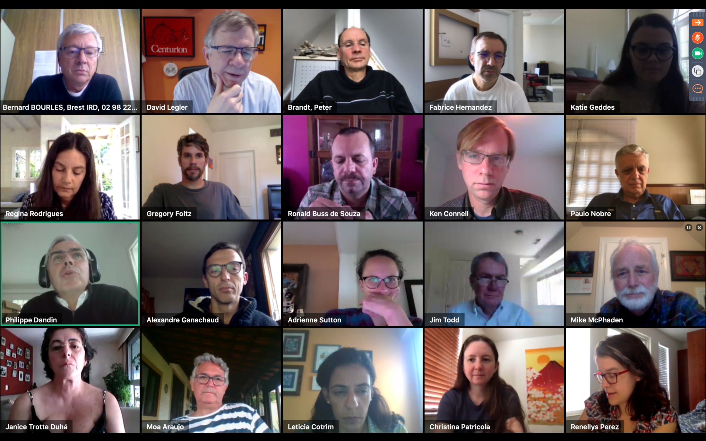
PIRATA-24 Participants
Notes:
1
20 people spanning three continents.

Slide 2
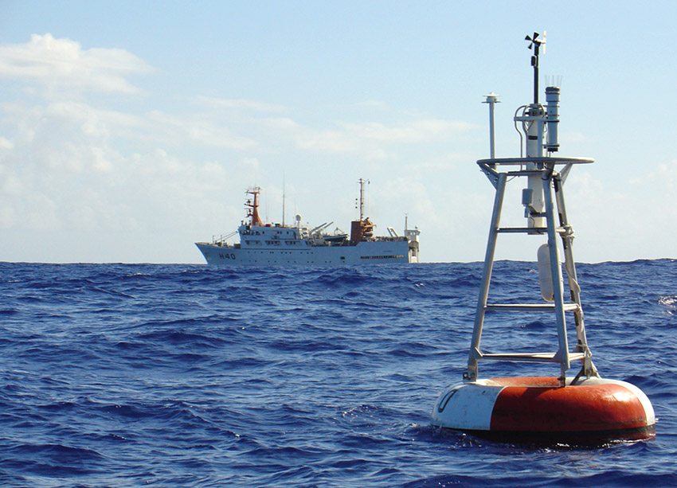
2020 PMEL Report
Mike McPhaden
Status of the array
Progress since PIRATA-23
Plans for 2020
PIRATA-24 (Virtual)
22 April 2020

Slide 3
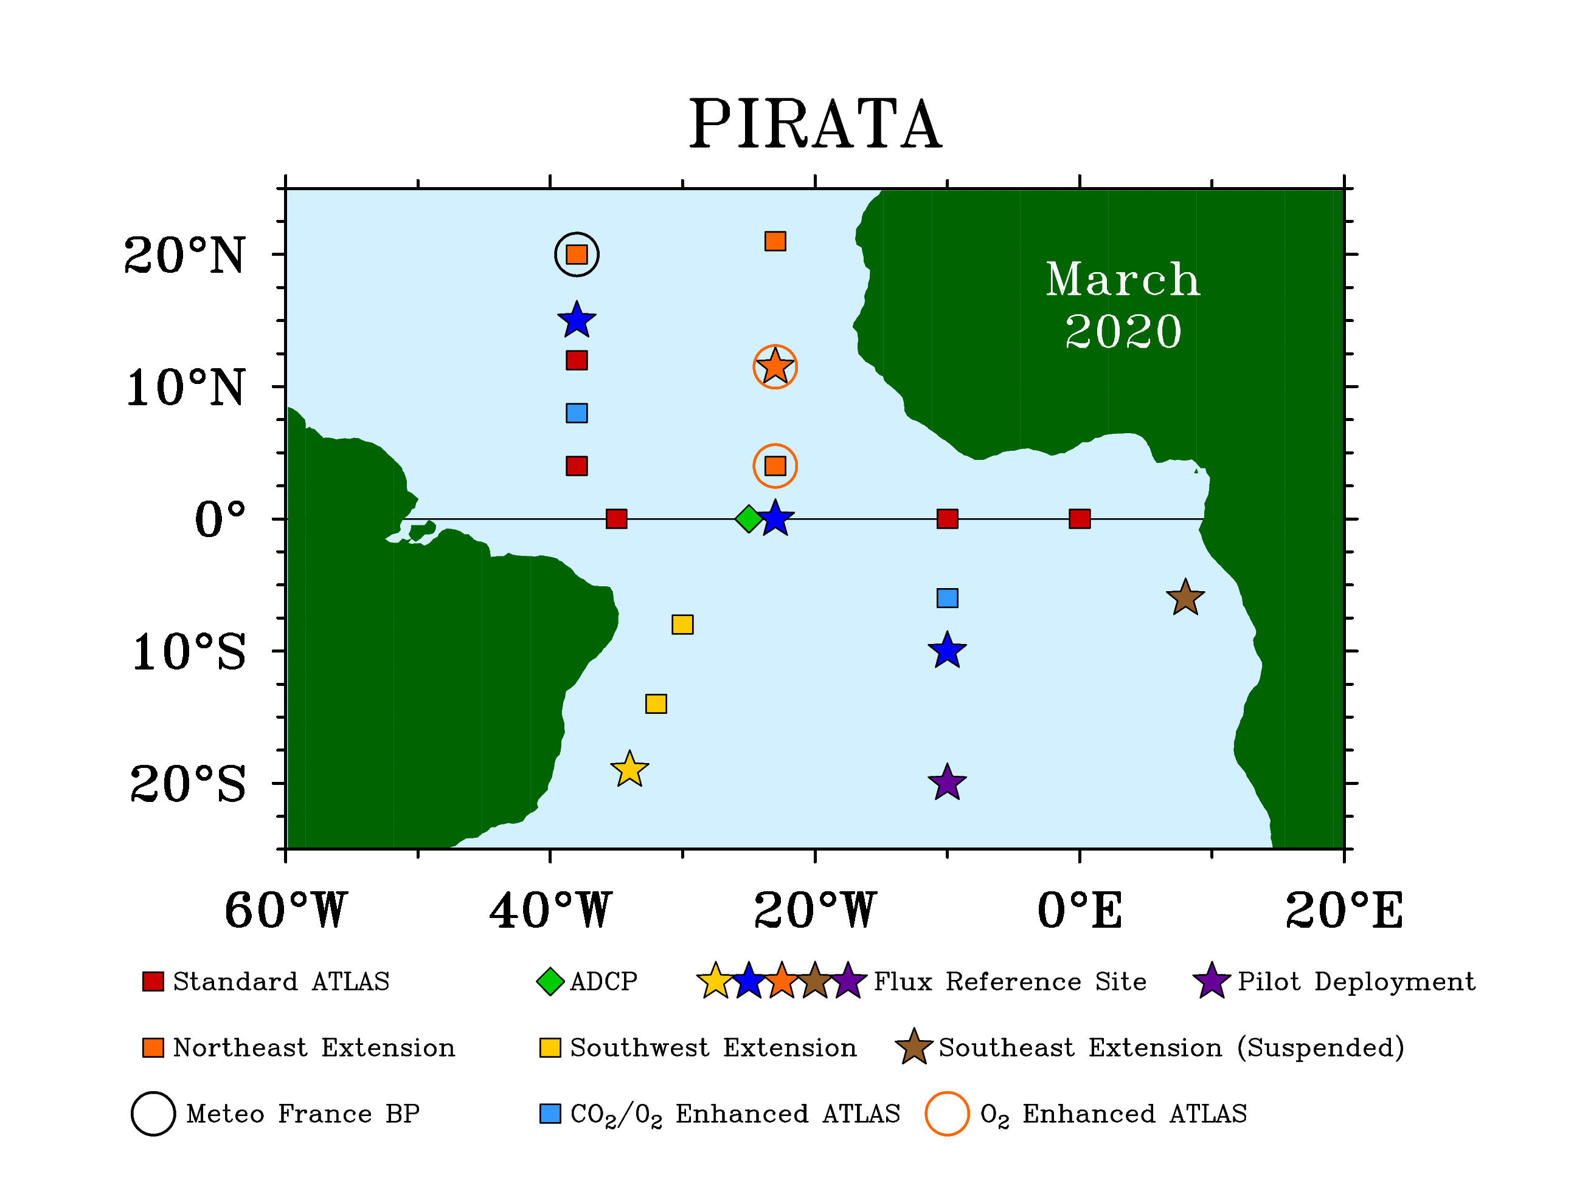
✓
✓
2019/20 Status
✓OTN ✓ChiPod
✓+ CMs
✓
✓
✓
✓
✓
✓✓
✓
✓✓
✓✓
✓
✓
✓
✓
✓
✓
✓
✓
✓
Notes:
OTN by Dalhousie. ChiPod by OSU.
Currently 8 IFM/GEOMAR subsurface O₂ Sensors with 6 reporting real-time data in 2019 at 11.5N23W (80m, 300m, & 500m), 20N23W (80m, 150m, & 300m), and an additional two with onboard data only at 4N23W (300m & 500m).
There are 5 each ChiPods on the 0-10W and 0-23W moorings at the following depths:
21m
35m
50m
65m
81m

Slide 4
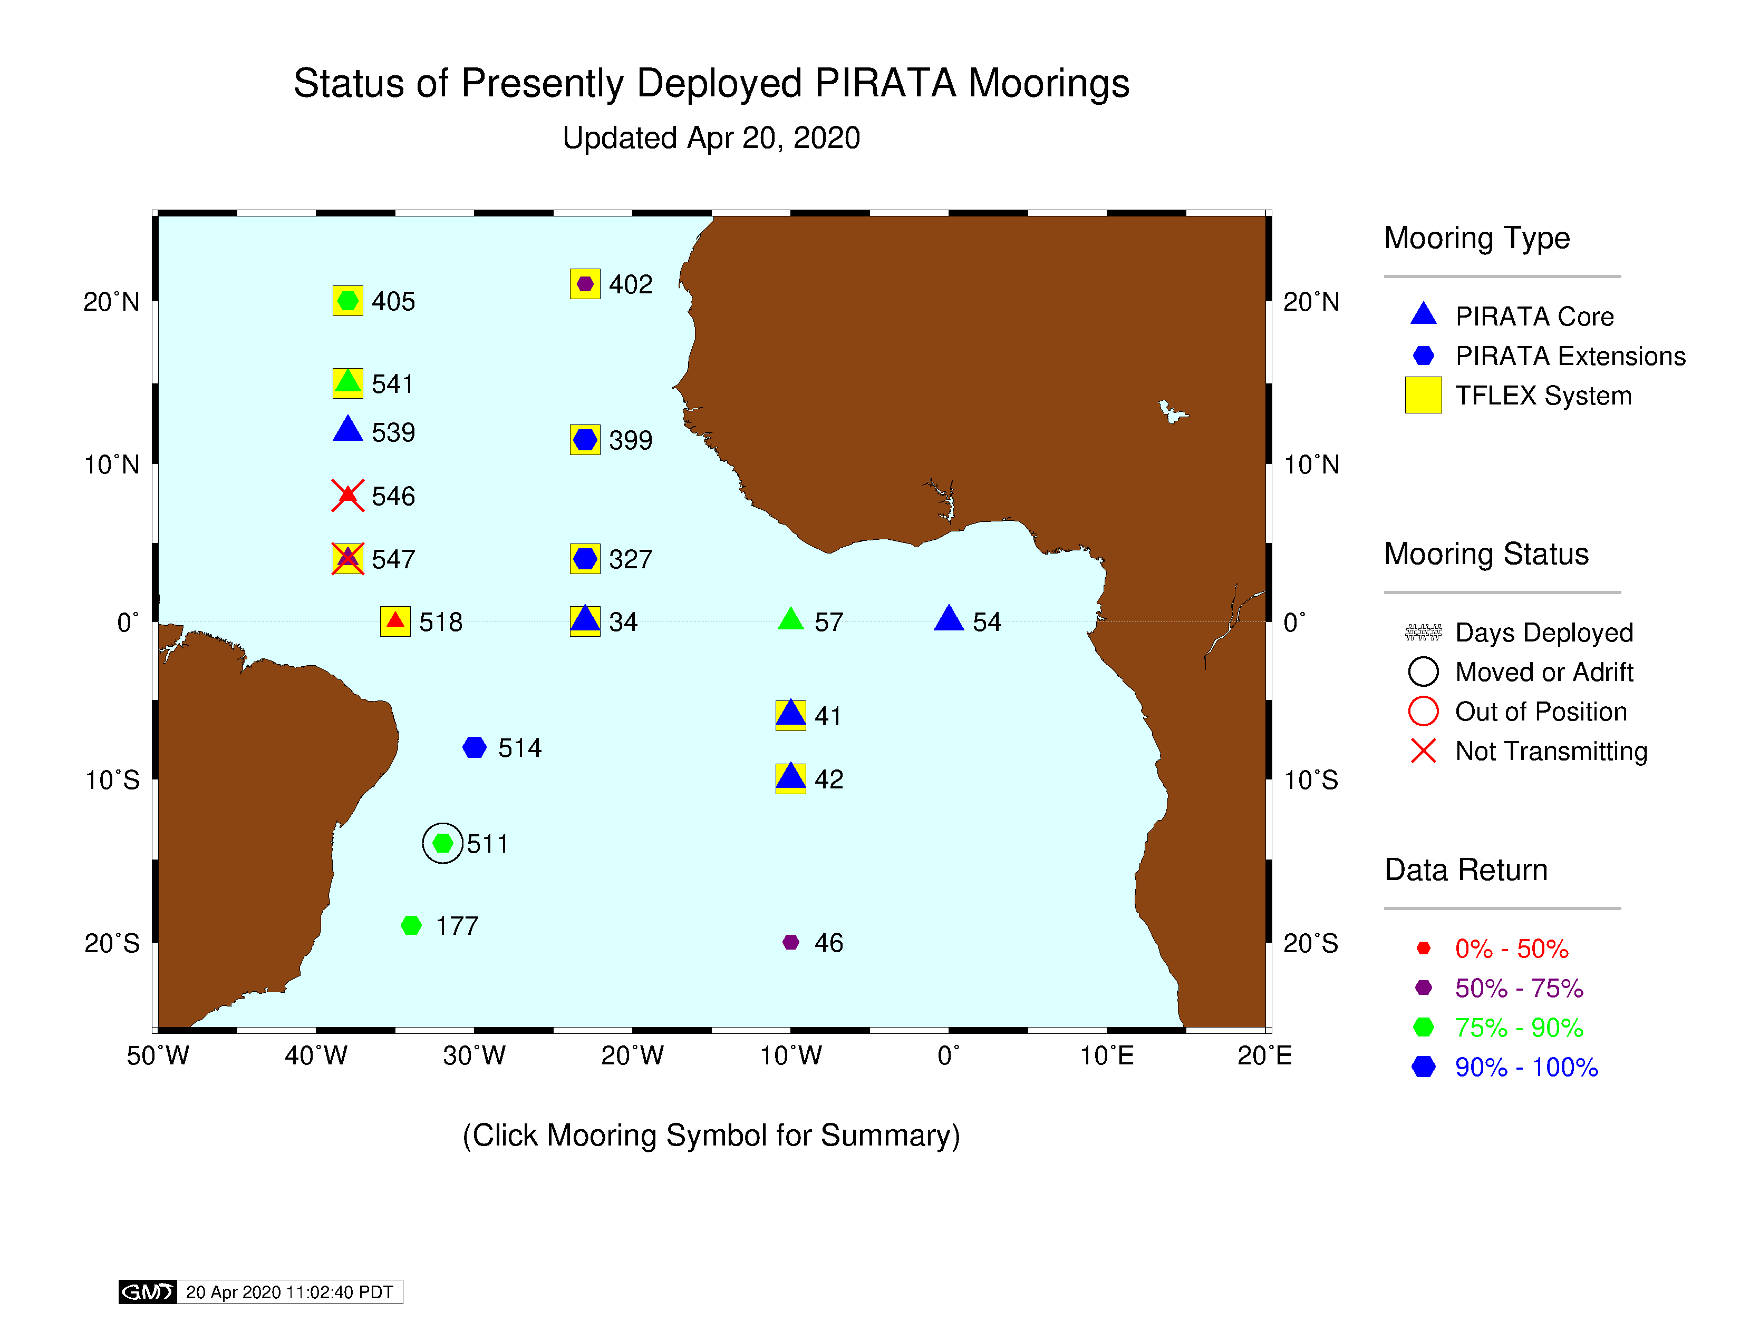
Notes:
4

Slide 5
Replacement planned for May/Jun 2020:
Postponed
Replacement not yet rescheduled
Replacement not yet rescheduled
Serviced on 26 Oct 2019
Cruise diverted for oil spill
New Pilot Mooring Site
Deployed: 5 Mar 2020
Subsurface stopped 22 Mar 2020
Notes:
5

Slide 6
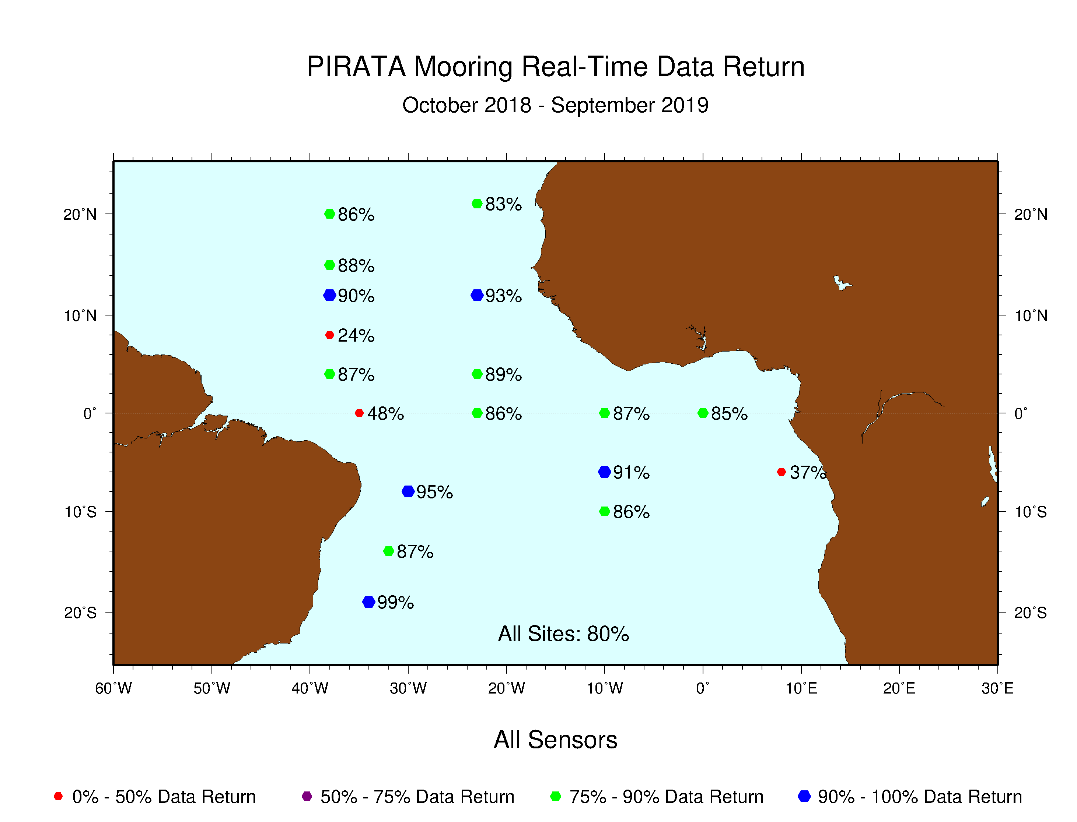
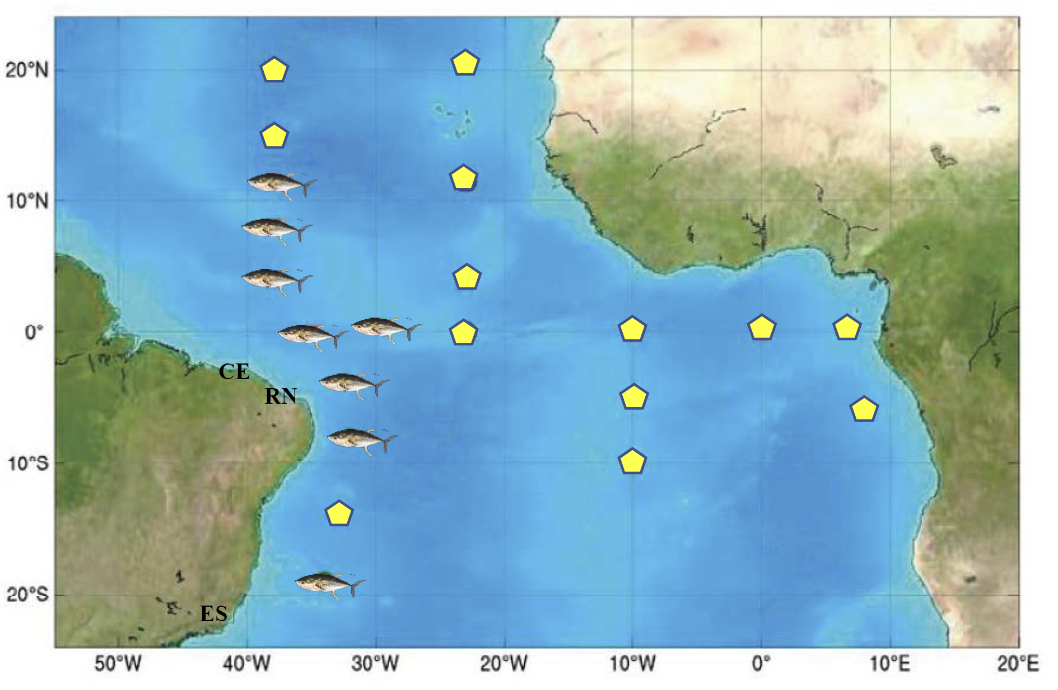
All sensors stopped transmitting after 83 days.
Da Silva et al (2018)
Subsurface stopped transmitting after 130 days.
Good data return March-July, but went adrift on 8 Aug 2019 (2nd year in a row). Lost all subsurface instruments. Recovered in São Tomé on 16 Dec 2019
Notes:
6
Most recent 12 month real-time data return (October 2018 to September 2019).
Moorings with less than 80% total data return Oct 2018 through Sep 2019:
6S8E 37%
-----------
TFLEX PT029 [Start Date 2019-03-15 20:20:00 :: 275 Days Deployed]
Buoy Moved or Adrift since 2019-08-08…recovered in São Tomé and Príncipe on 16 Dec 2019.
Good data return March-July, but went adrift on 8 Aug 2019. Lost all subsurface instruments.
0-35w 48%
-----------
TFLEX PT026 [Start Date 2018-11-18 21:08:00 :: 451 Days Deployed]
All subsurface failed after 130 days. Rain failed after 293 days. SWR failed after 432 days. Still moored in place.
8N38W 24%
-----------
ATLAS PI253A [Start Date 2018-10-22 20:08:00 :: 478 Days Deployed]
Stopped transmitting after 83 days. No Data Transmissions since 2019-01-15
4N38W 87% for FY2019.....but no longer transmitting (as of 2/13/2020)
-----------
TFLEX PT024 [Start Date 2018-10-20 19:04:00 :: 480 Days Deployed]
Stopped transmitting after 331 days. No Data Transmissions since 2019-09-16

Slide 7
PIRATA Real-Time Data Return
Oct 2018 – Sep 2019
 | Air T | SST/SSC | T(Z) | Wind
% Data Return | 85 | 71/66 | 83 | 91
 | RH | Rain | SWR | Salinity
% Data Return | 79 | 77 | 88 | 75
 | Currents (11 sites) | LWR (6 sites) | Atm Pres (7 sites) | All Sensors
% Data Return | 78 | 90 | 86 | 80
Notes:
7
FY 2019: October 2018 to Sep 2019 Real-time Data Return Summary by Sensor (Table View)
All PIRATA Sensors: 80%

Slide 8
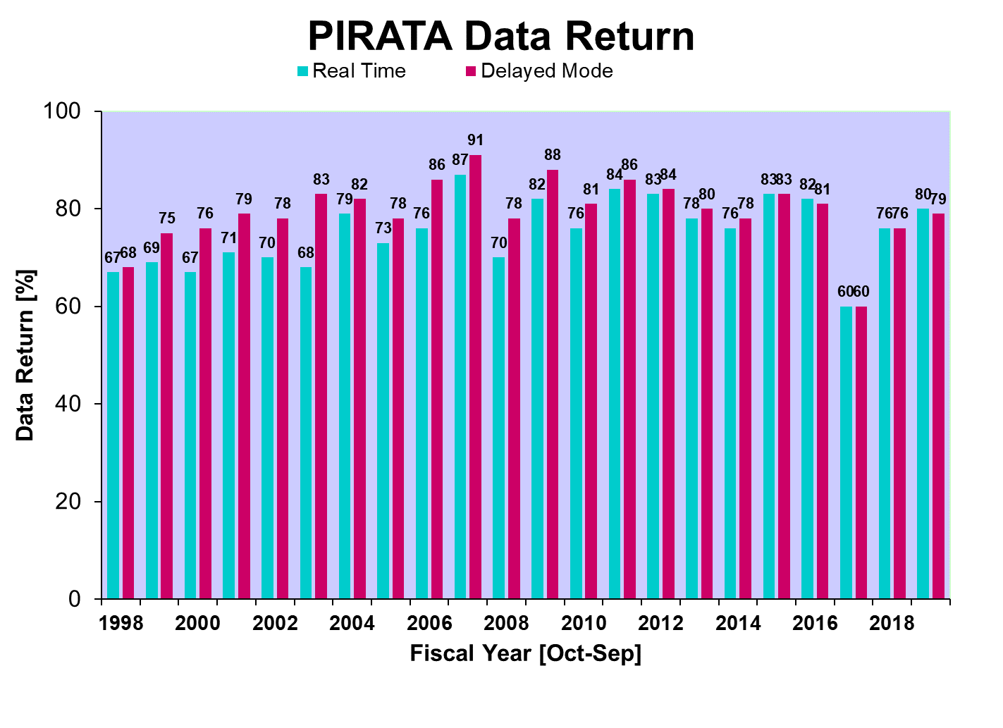
Notes:
8
Data Return Oct 1998 to Sep 2019 (Bar Chart)

Slide 9

Notes:
9
PIRATA Data Return over past 15 years (2004 – 2019)

Slide 10
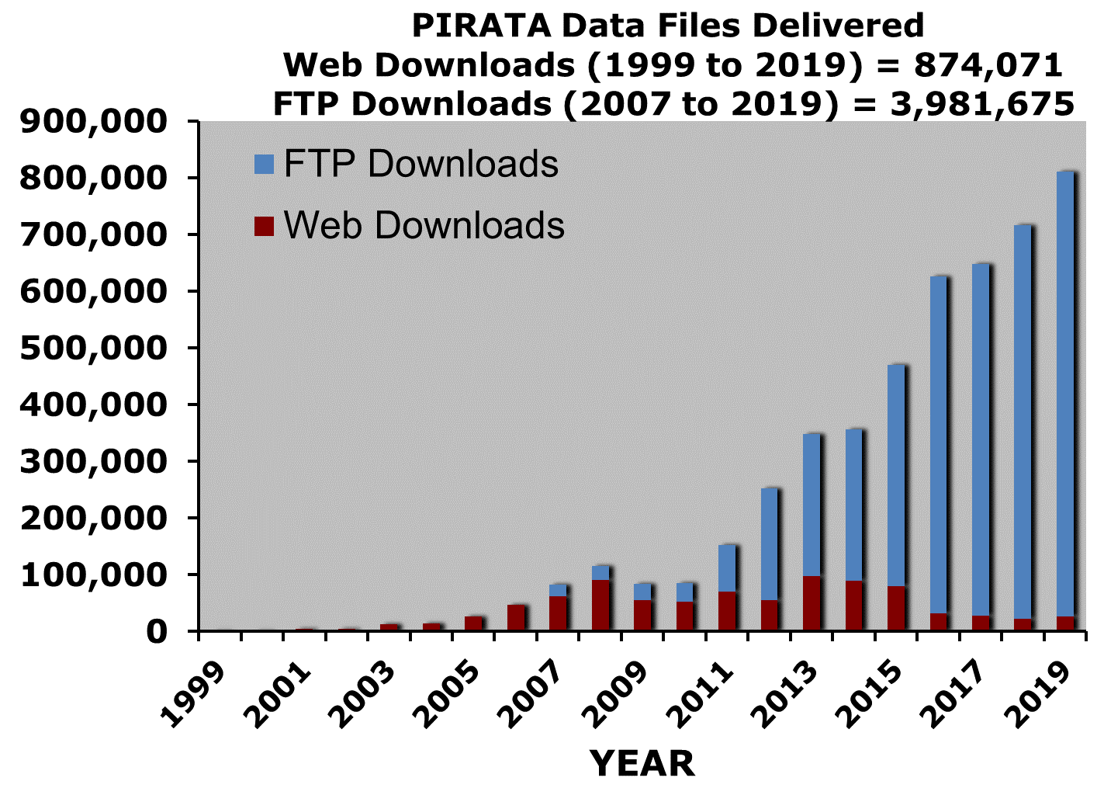
Recent decrease in Web file downloads is offset by increase in ftp file downloads
Notes:
Annual data is by Fiscal Year (1 Oct to 30 Sep)
Maroon is Web Downloads; Blue is FTP downloads.
Decreasing web downloads offset by increase in FTP downloads.
No FTP-specific data available prior to 2007.

Slide 11
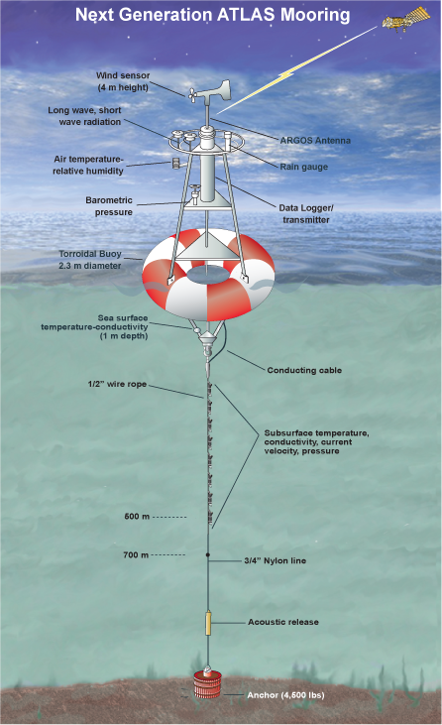
Field Work (Oct 2018-Sept 2019)
18 Moorings Deployed:
7 ATLAS + 11 T-Flex
Cruises: 135 days at sea
  -VITAL DE OLIVEIRA in 2 legs: 47
  (16 Oct - 10 Nov 2018;15 Nov - 5 Dec 2018)
  -RON BROWN (1 Mar - 29 Mar 2019): 29
  -THALASSA (1 Mar - 4 Apr 2019): 35
  -THOMPSON (17 May - 9 Jun 2019): 24
PMEL Person-days at sea: 106
(Ronald H. Brown & Thomas G. Thompson)
Notes:
Medevac during the RHB cruise required a second NOAA cruise to service 4N, 23W in May/June.

Slide 12
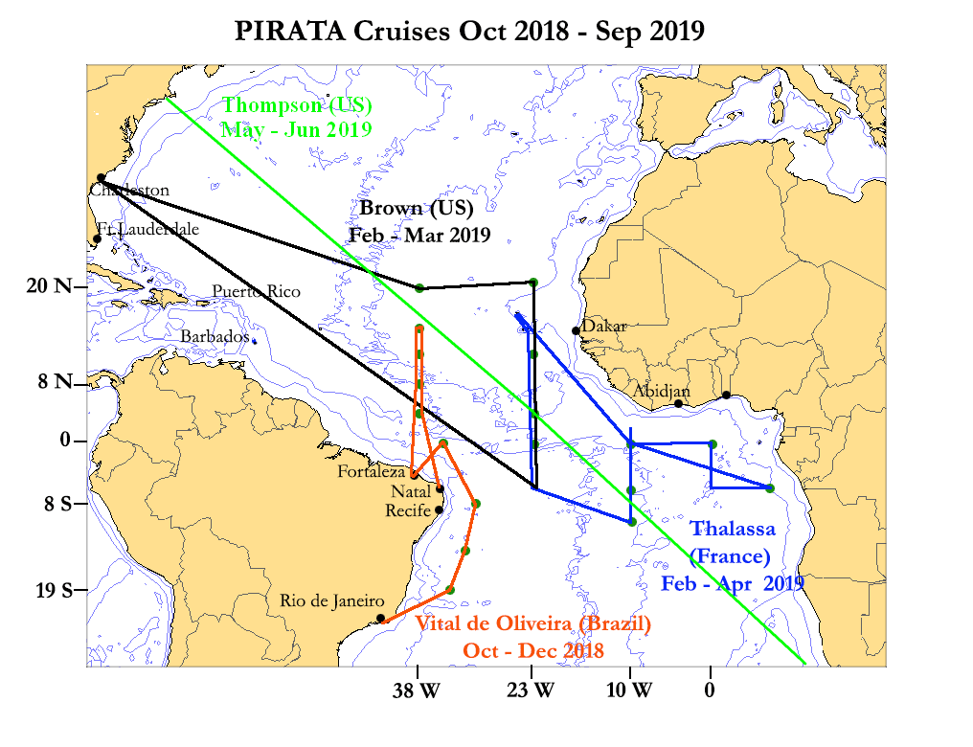
Notes:
Completed PIRATA Cruises FY 2018
Brazil PIRATA cruise aboard the Vital de Oliveira (Oct 2018 - Dec 2018)
PNE 2019 cruise aboard the Ronald H. Brown (Mar 2019 to Mar 2019; Charleston, SC, USA to Charleston, SC, USA)
French PIRATA cruise aboard the Thalassa (Mar 2019 to Apr 2019; Mindelo to Mindelo, Cape Verde)
NOAA emergency cruise for 4N, 23W aboard the Thomas G. Thompson (17 May – 9 Jun 2019; Cape Town, South Africa to Woods Hole, MA, USA)

Slide 13
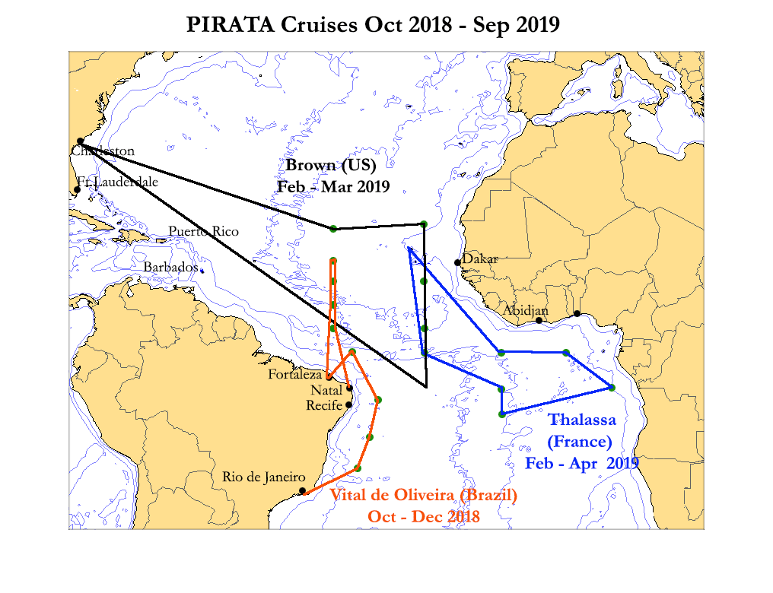
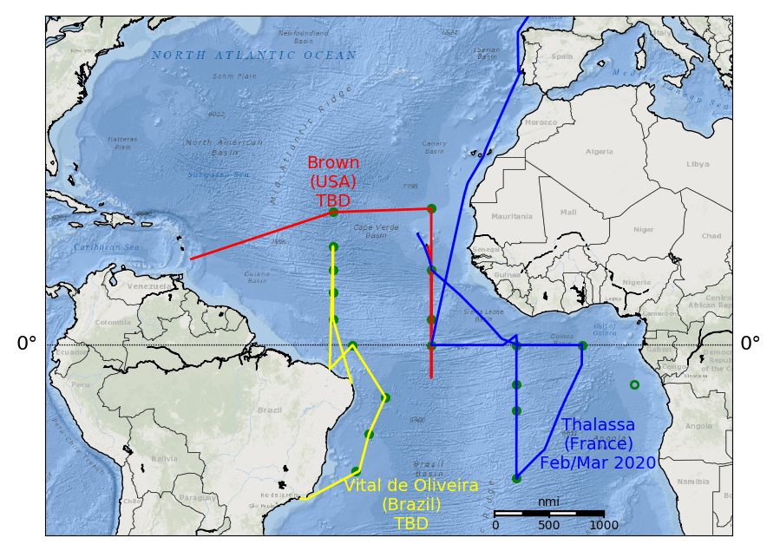
PIRATA Cruises Oct 2019 – Sep 2020
Notes:
Planned PIRATA Cruises FY 2020
Brazil PIRATA Cruise aboard the Vital de Oliveira not yet scheduled
Boreal Spring 2020 proposed on Ronald H. Brown (Originally scheduled for May/Jun 2020; Praia, Cape Verde to Barbados; cruise postponed for COVID-19; new cruise not yet scheduled)
French PIRATA cruise aboard the Thalassa underway, Mar 2020; Mindelo to Mindelo, Cape Verde

Slide 14
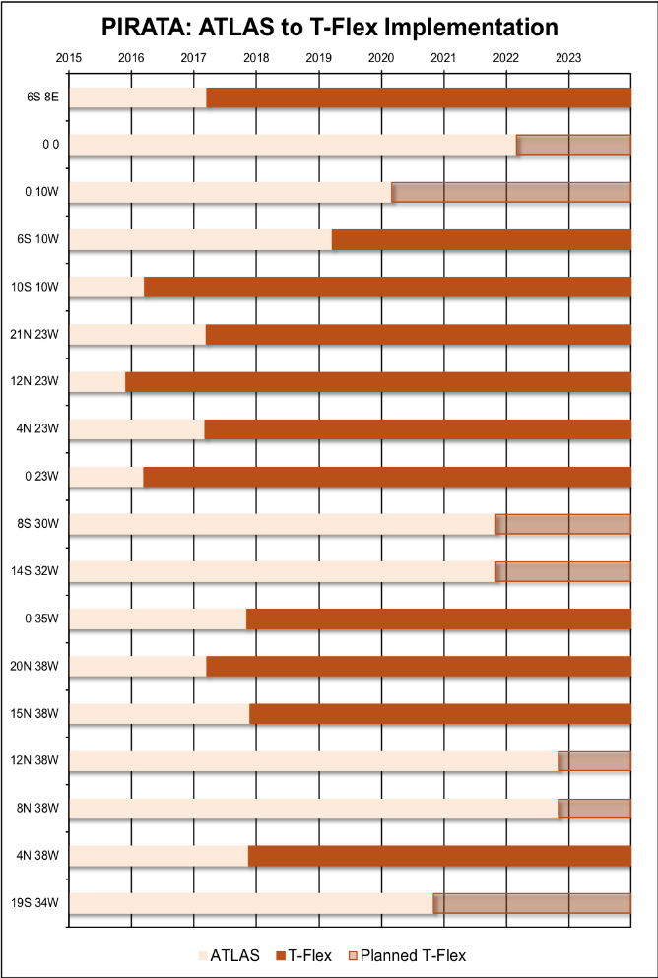
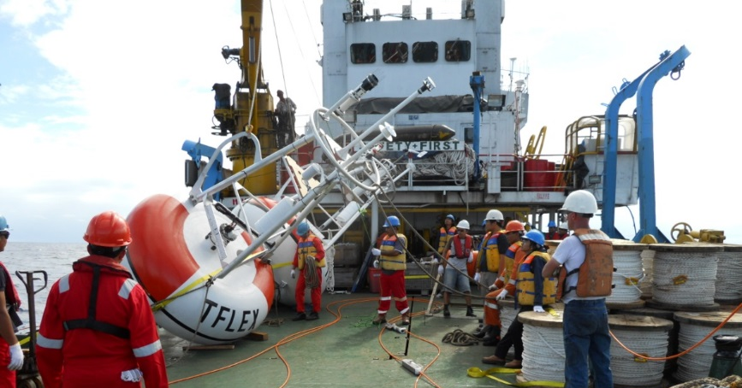
Transition from ATLAS to T-Flex (Suspended)
Notes:
PMEL has developed Tropical Flex, or T-Flex, to replace the ATLAS mooring. T-Flex incorporates new or updated commercially available sensors and uses Iridium for telemetry of higher temporal resolution data. Eight prototype T-Flex systems were deployed next to ATLAS moorings in RAMA and PIRATA over the past several years (2011-15) to test their performance and confirm equivalency of observations.
Currently (Oct 2019), there are 20 T-Flex systems deployed in RAMA and PIRATA combined, with 9 T-Flex systems deployed in RAMA and 11 T-Flex systems deployed in PIRATA.

Slide 15
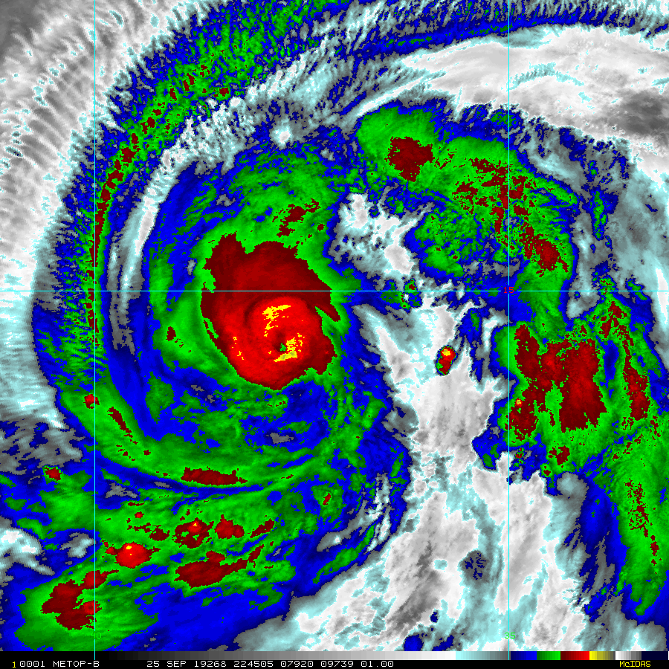
Hurricane Lorenzo 25 Sep 2019
Notes:
Hurricane Lorenzo tracked directly over the PIRATA T-Flex mooring at 15°N, 38°W on 26 Sep 2019. Despite the direct hit, the mooring remained in position and continued transmitting high-quality, high-resolution data in real-time.
This is the approximate location of the PIRATA mooring superimposed over the Enhanced Infrared (IR) Imagery (1 km Mercator, from MODIS/AVHRR) of Lorenzo immediately prior to passing over the PIRATA mooring:
Imagery: 25 Sep 2019 @ 22:45 UTC
Source: NOAA/NESDIS (and CIRA):
http://rammb.cira.colostate.edu/products/tc_realtime/products/storms/

Slide 16
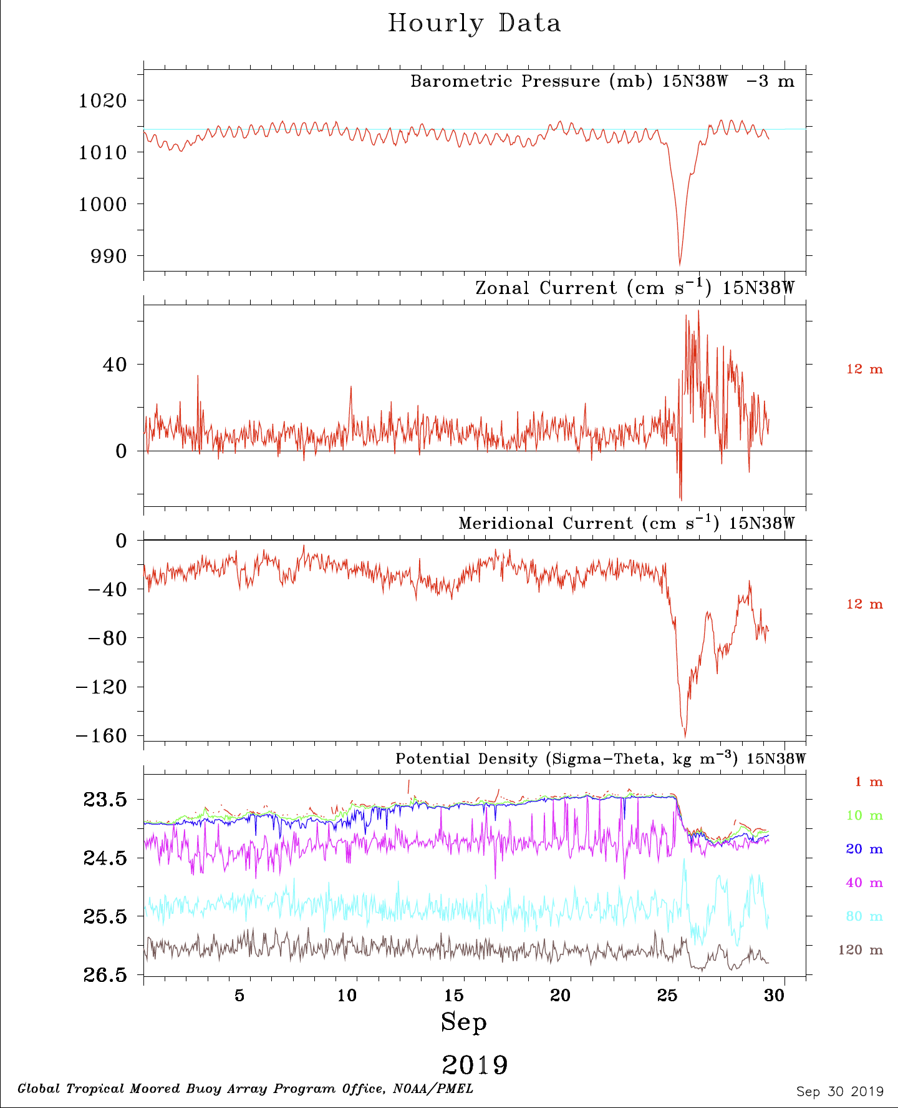
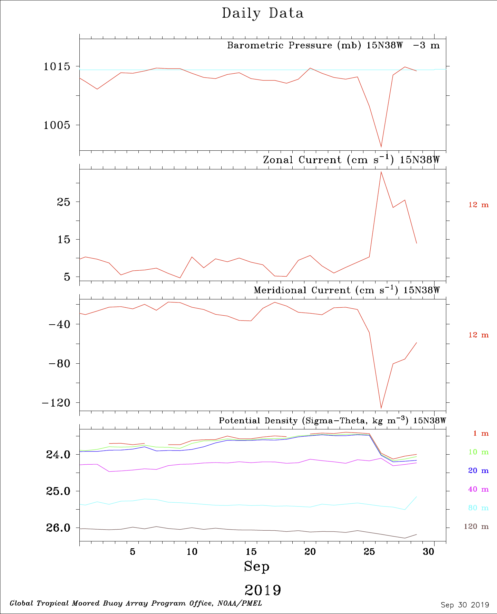
PIRATA Real-Time Hourly vs. Daily Average Data, Hurricane Lorenzo, 26 Sep 2019
Notes:
When compared to these daily-average figures, the hourly data figures (left side) highlight the advantages of T-Flex moorings, which provide hourly data in real-time as compared to ATLAS moorings, which provide daily averages (right side) in real-time.

Slide 17
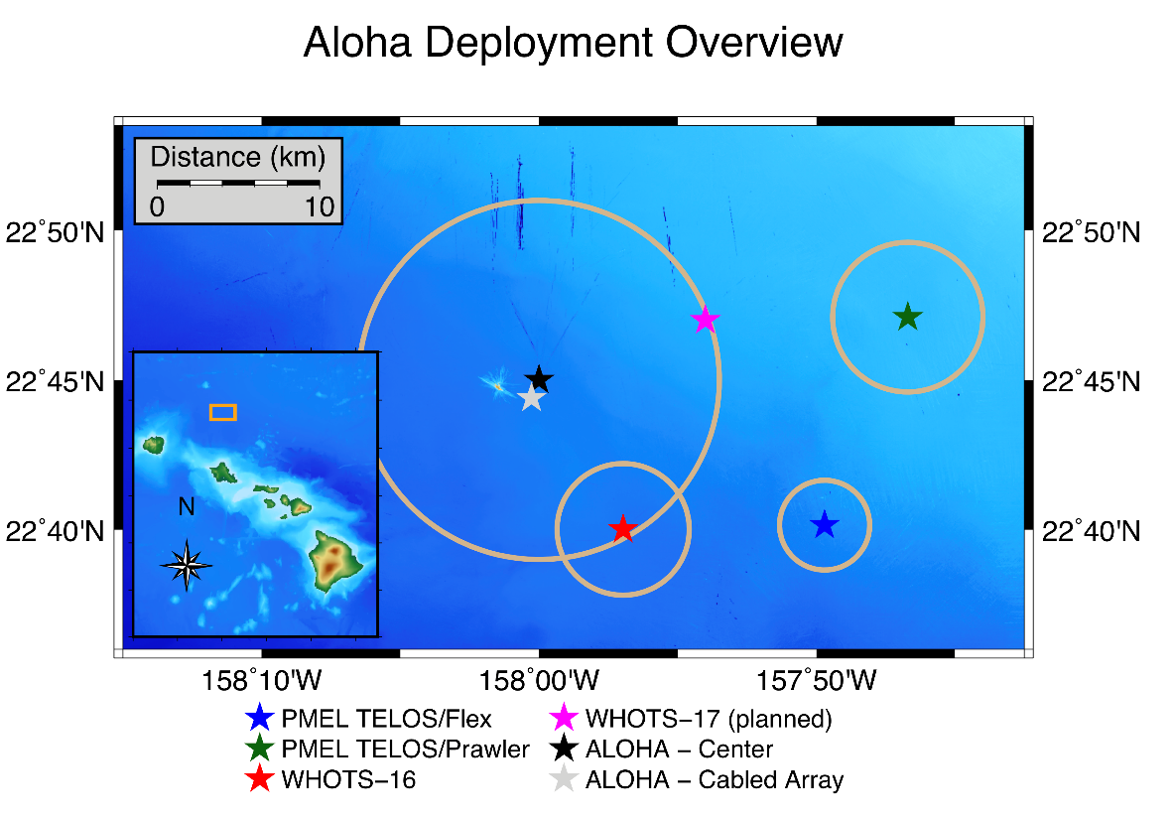
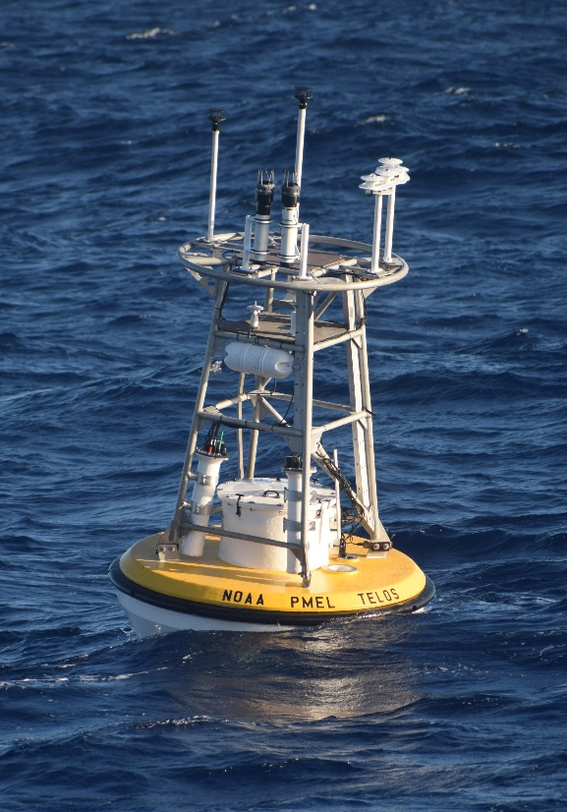
Technology Development:
TELOS Data Acquisition System
Nov 2019-Present
Τέλος
/ˈte-läs/
noun
1. Philosophical ultimate purpose, goal, or objective (origin: Greek)
2. TELOS: Telemetry and Electronics for Logging of Ocean Sensors (origin: PMEL)
Notes:
The two deployments near Station ALOHA represent the first open-ocean moorings with TELOS.
PIRATA-type: 13 line-mounted TC sensors 1-500 m, 2 CMs, and a full suite of 6 surface met sensors + Redundant suite of of 6 surface met sensors and SSTC sensor on same mooring w/T-Flex system (compare)
Prawler: PMEL subsurface Prawler device for 500m profiles and a full suite of 6 surface met sensors

Slide 18
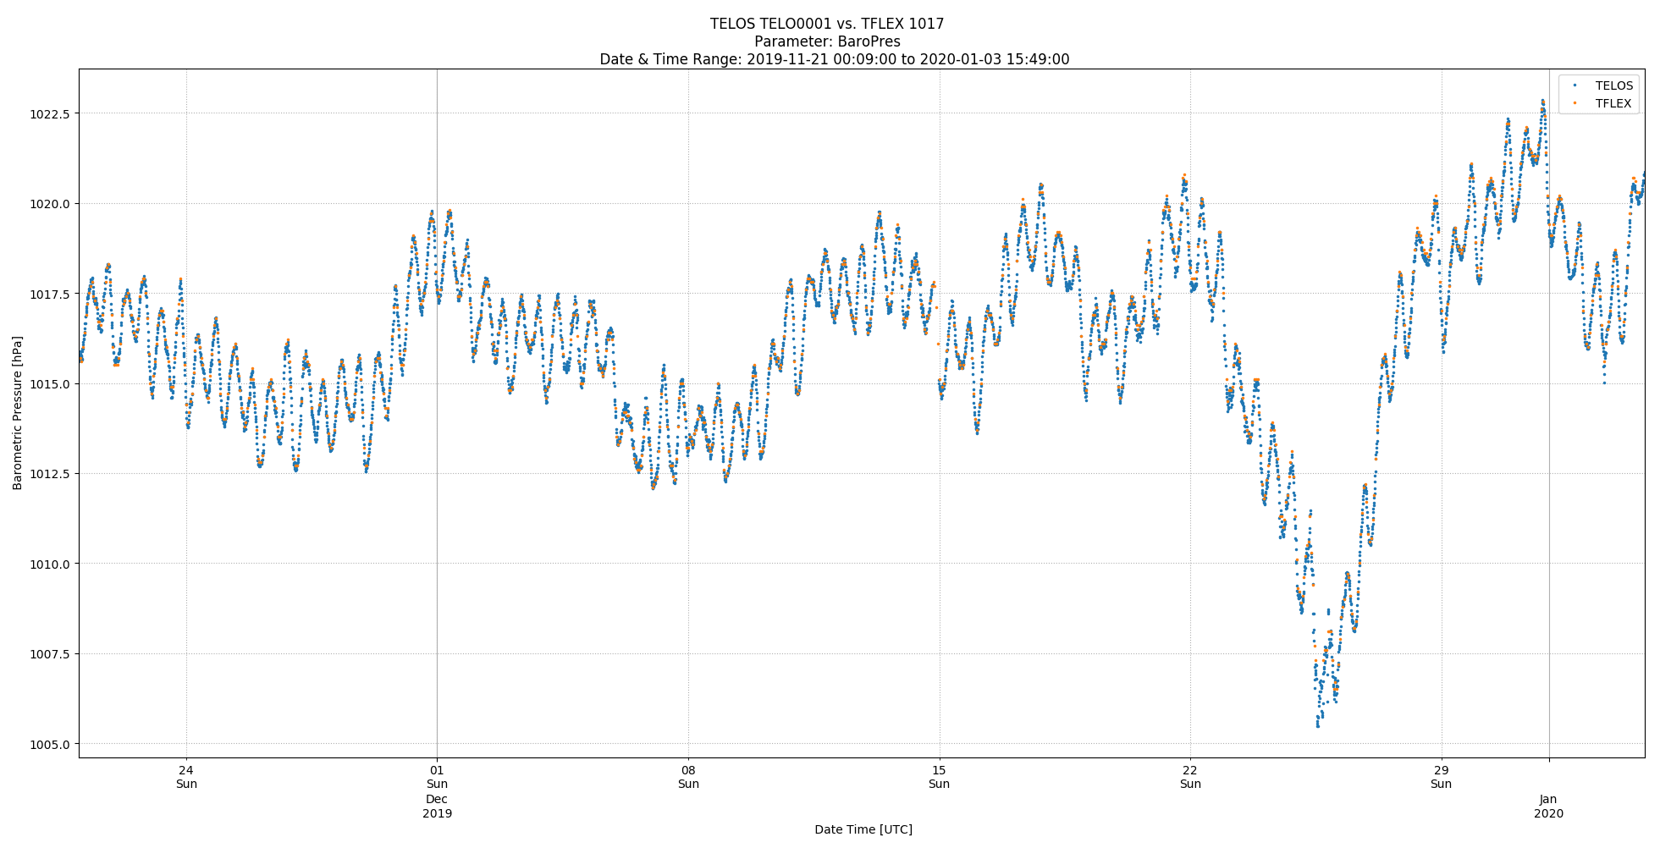
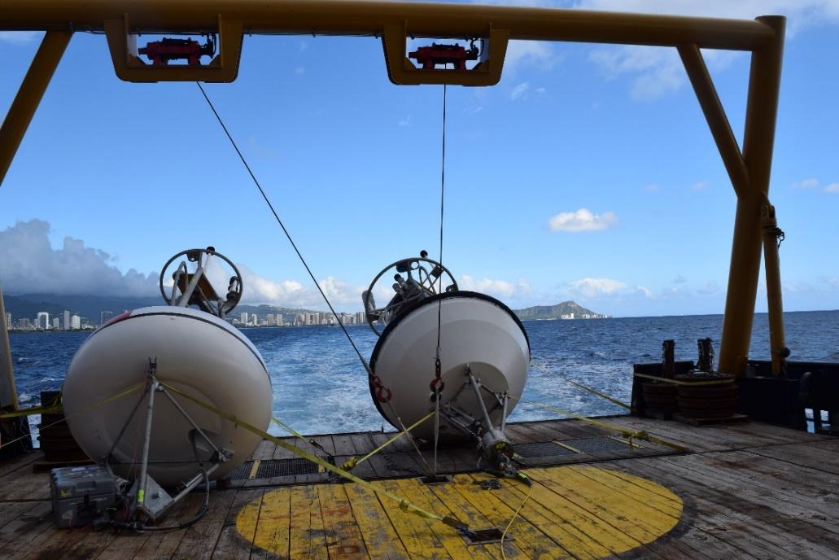
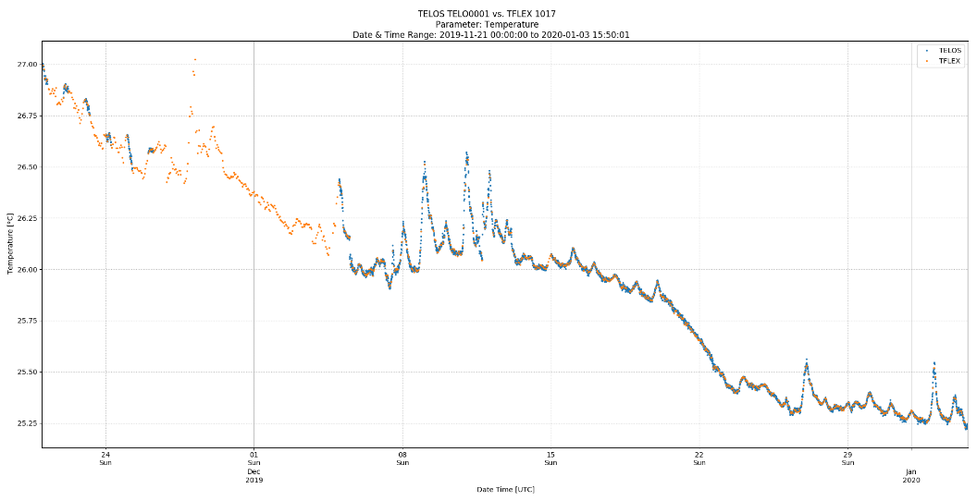
Technology Development:
TELOS Data Acquisition System
Real-Time 10 min BP
Real-Time 10 min SST

Slide 19
Issues
Corona virus pandemic
Cruises
T-Flex implementation
Vandalism
MOU
Budget
Notes:
19

Slide 20
Extras
Notes:
20
20
Mooring Survival Data Return over past 21 years (1997 – 2018)

Slide 21
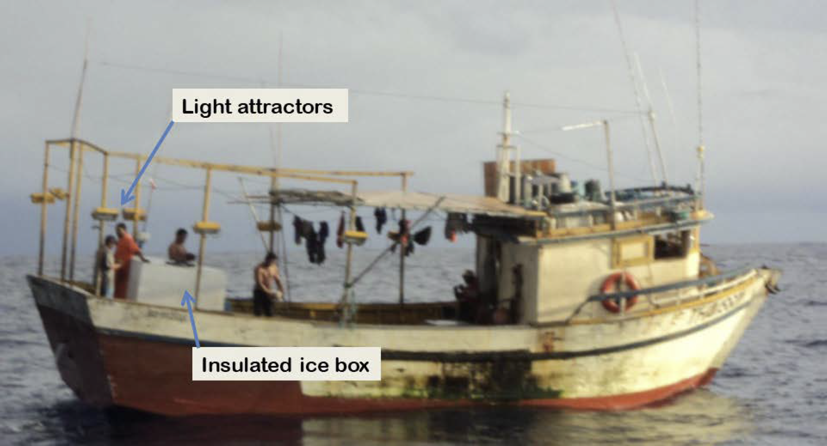
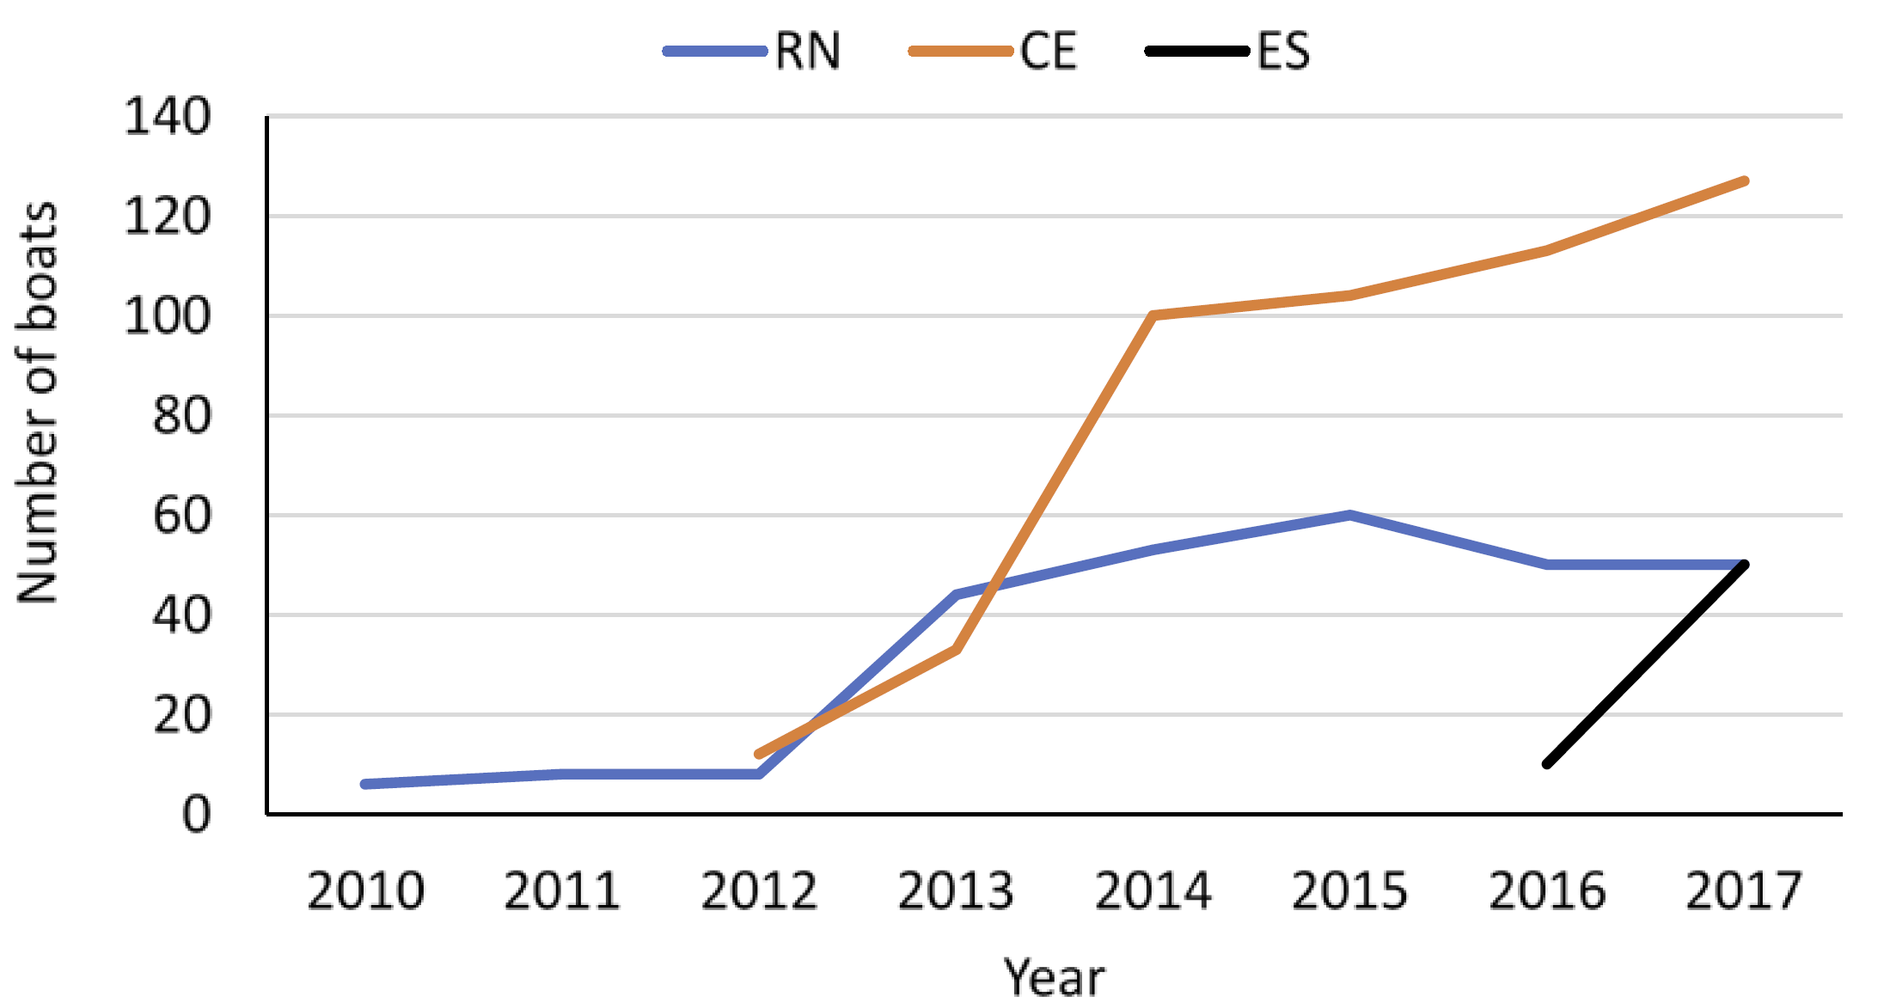
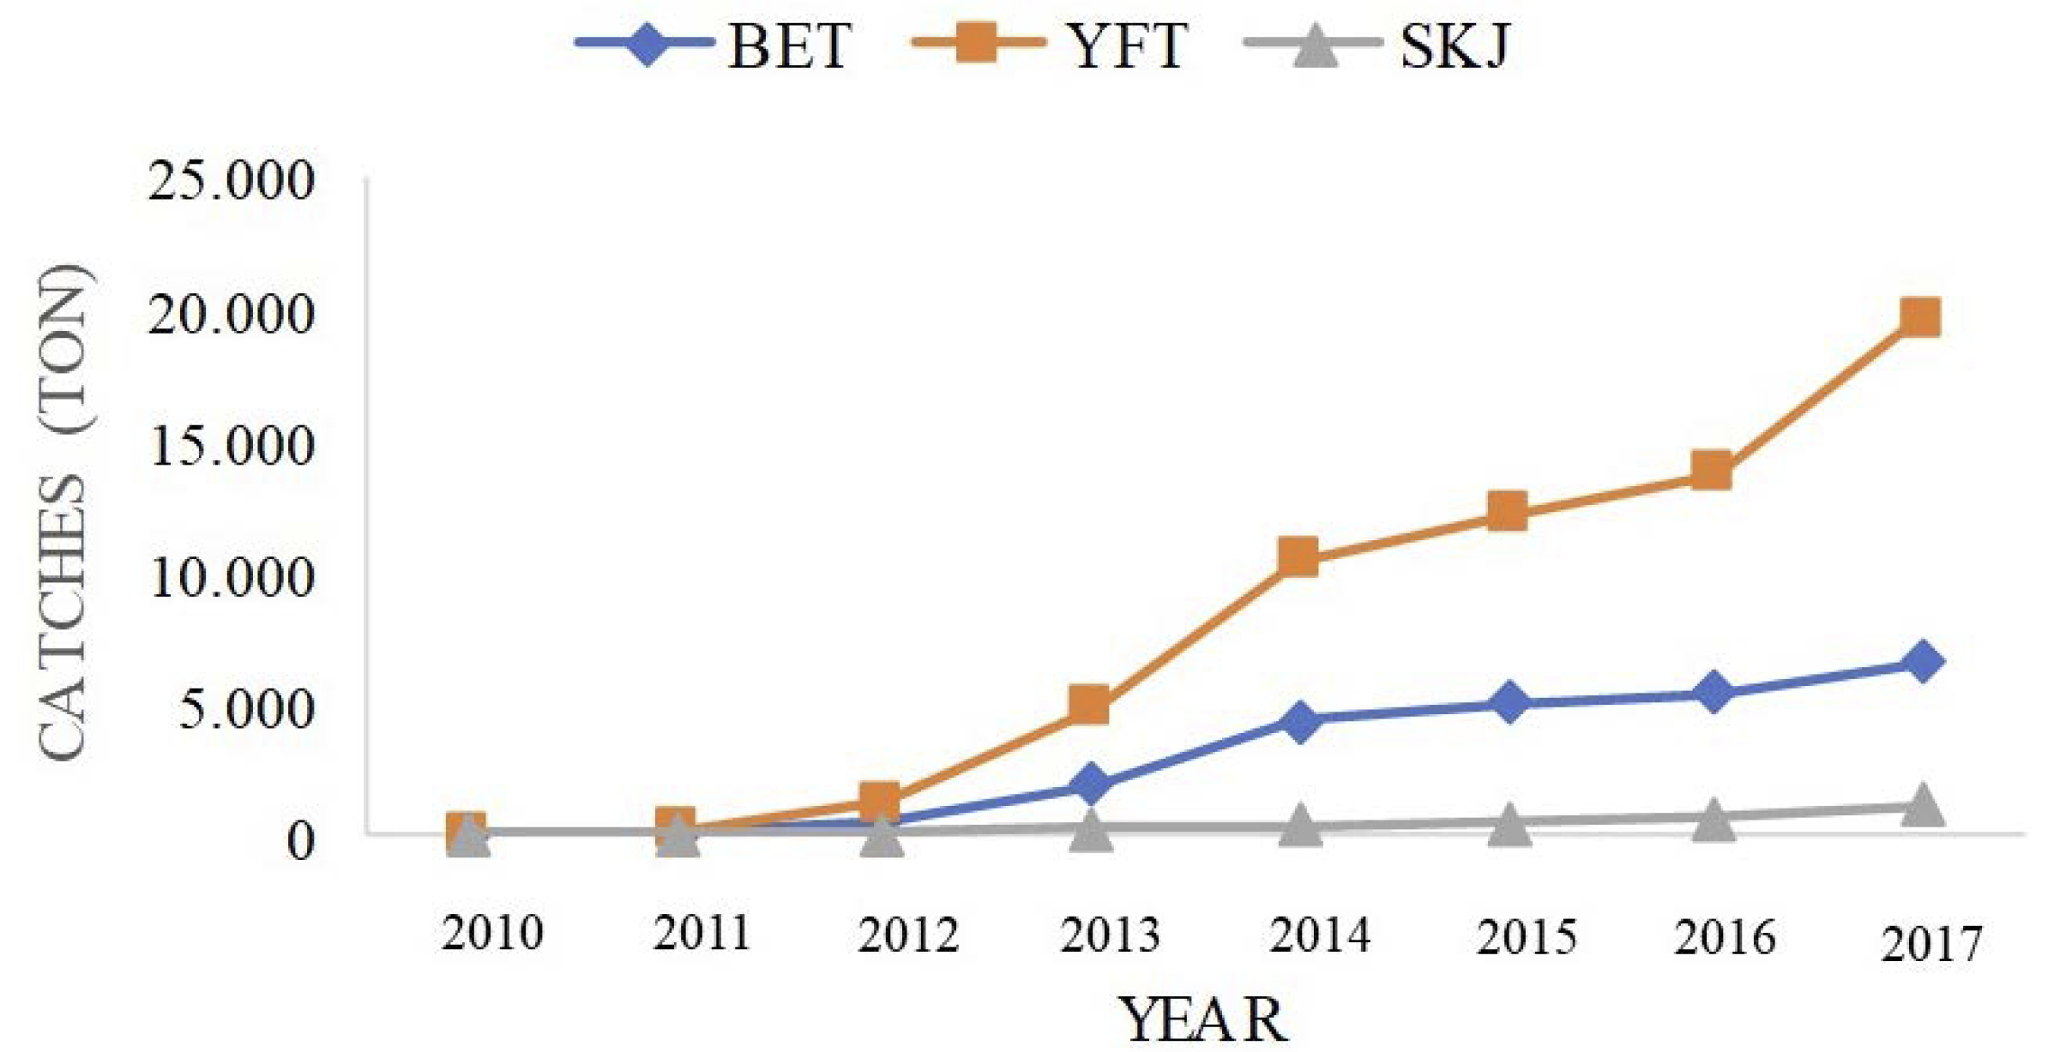
Fishing Trends: Brazil
Da Silva et al. (2018)
Notes:
21
All Figures on this slide sourced from: Da Silva et al. (2018)
Figure 1 (top left). Location of the PIRATA buoy array (yellow) in the Atlantic and the main States in Brazil (CE, RN and ES) where the fleet is based. Buoys with interaction with fisheries are marked with tunas (Adapted from Bourlés et al, 2008)
Figure 2 (top right). Features of a typical boat operating in the associated school fisheries in the western Atlantic, with indication of the main adjustments done to adapt the boat to this fishing activity.
Figure 3 (lower left). Temporal evolution of the number of boats operating in the associated school fisheries in Brazil.
Figure 6 (lower right). Annual variation in the catches (t) in live weight from yellowfin (YFT), bigeye (BET), and skipjack (SKJ) from fisheries on associated schools off Brazil.

Slide 22
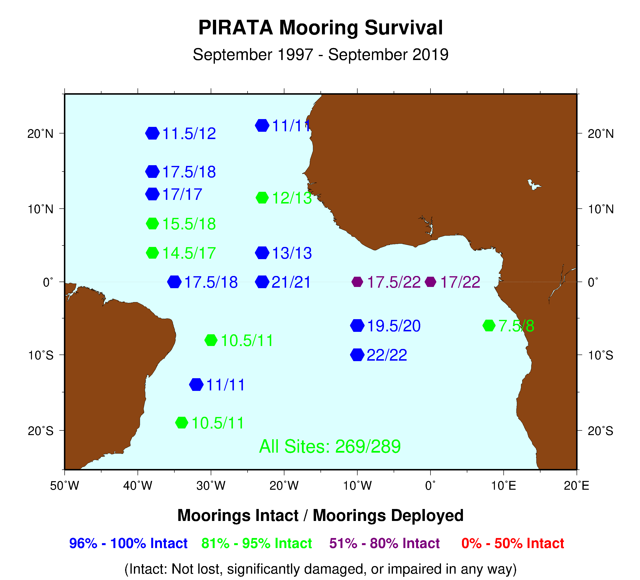
Notes:
22
22
Mooring Survival Data Return over past 21 years (1997 – 2018)

Slide 23
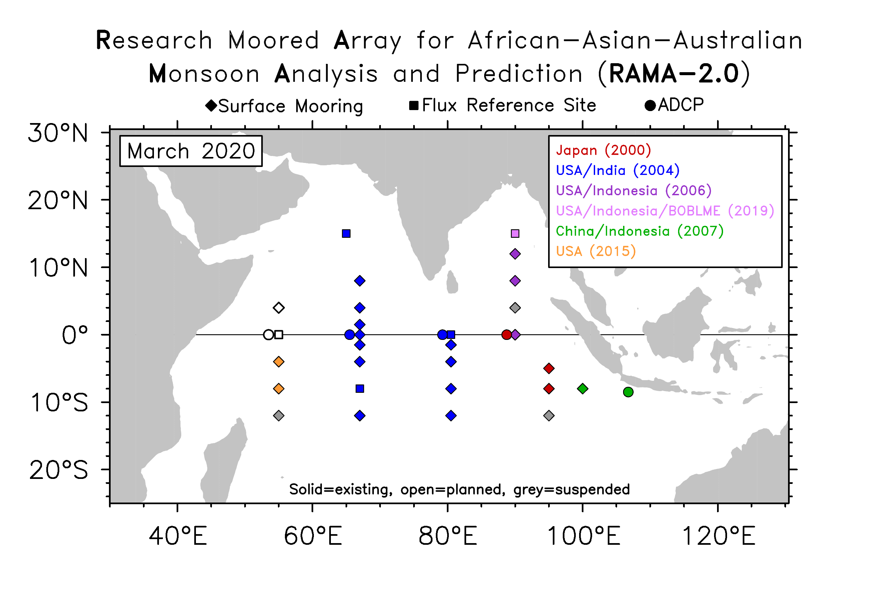
T-Flex Implementation Underway
T-Flex and ATLAS systems provide equivalent data and T-Flex performance (real-time & delayed-mode data return, record length) equal to or better than ATLAS.
T-Flex systems currently in RAMA (9 sites) and PIRATA (11 sites)
Notes:
6S,8E has been suspended due to two T-Flex losses in a row due to vandalism.

Slide 24







PIRATA Enhancements/Collaborations
Core measurements on all moorings:
  Wind, AT/RH, Rain, SWR, SST, SSS, 10 subsurface T, 3 subsurface S, 2 subsurface P
6 Flux Reference Sites (15N38W, 19S34W, 12N23W, 0-23W, 10S10W, 6S8E):
  LWR, BP, 10m CM, 2 add’l. subsurface T (5m, 10m), 4 add’l. S (5m, 10m 60m, 80m)
Continued enhancement of EU AtlantOS funded sensors (T/C and Vel.)
3 Surface CO₂/O₂ (LOCEAN)
8 Subsurface O₂ (IFM/GEOMAR); 6 in real-time
1 Surface Pressure (BP) at 20°N, 38°W (Meteo France)
2 Sites w/5 Thermal microstructure sensors (10 total) (ChiPods, OSU)
18 Acoustic monitors (OTN, Dalhousie University)
AEROSE (Aerosols and Ocean Science Expeditions, NCAS)
9 new T/C sensors planned for each of 3 sites (FUNCEME) in 2020 at:
  8°N, 38°W; 4°N, 38°W; and 0°-, 35°W
4 additional current meters at 4°N, 23°W (AOML)
Notes:
10 additional current meters at 4°N, 23°W (AOML)
OTN = Ocean Tracking Network
FUNCEME has purchased and will deploy 9 new T/C sensors at each of 3 sites (9 x 3 x 2 sensor = 54 SBE sensors total) at:
8N38W, 4N38W, and 0-35W (planned for early FY 2020)
There are 5 each chipods on the 0-10W and 0-23W moorings at the following depths:
21m
35m
50m
65m
81m
AEROSE = Saharan Dust AERosols and Ocean Science Expeditions (http://ncas.howard.edu/research-programs/aerose/)
NCAS = National Center for Atmospheric Sciences

Slide 25
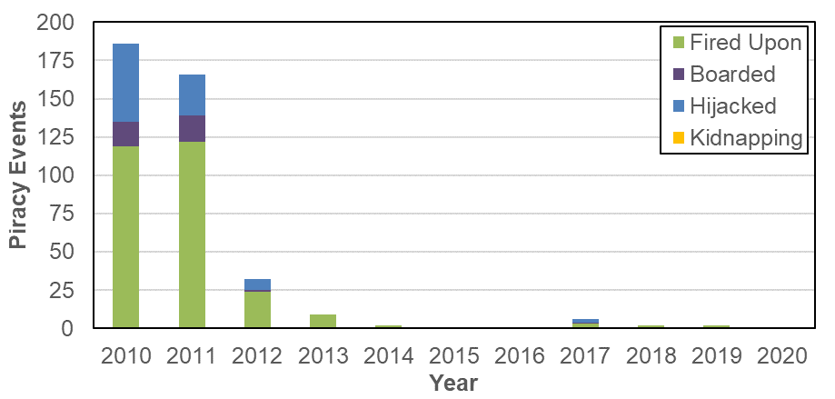
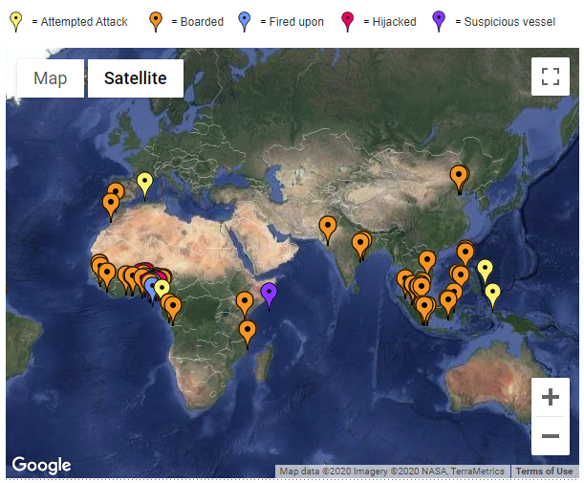
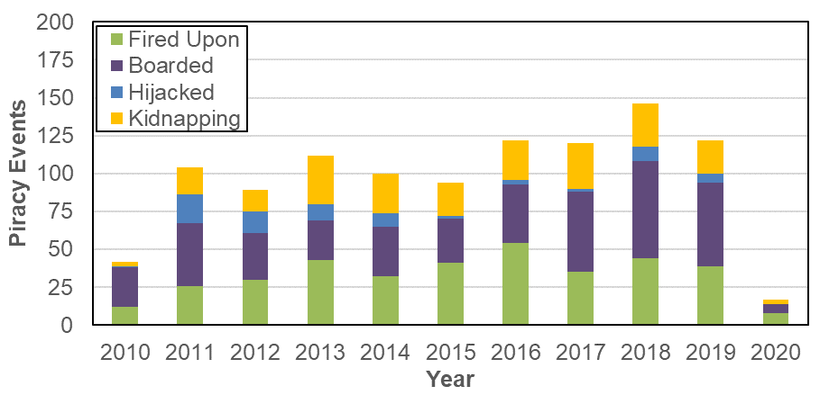
PIRACY
Incidents in Gulf of Guinea continue
Confined mainly to coastline
Abating in Horn of Africa
Horn of Africa
(2020 as of 27 Feb)
Gulf of Guinea
(2020 as of 27 Feb)
Notes:
2020 counts are as of 27 Feb 2020
Sources:
Office of Naval Intelligence: https://www.oni.navy.mil/News/Shipping-Threat-Reports/
IOC Commercial Crime Services: https://www.icc-ccs.org/piracy-reporting-centre/live-piracy-map

