Slide 1
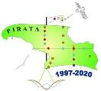
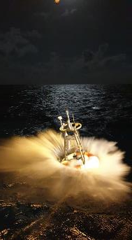


PIRATA,
French national report & status
Just a « summary » to save time for discussions..
For information, lockdown in France until May 11st (for the best)
=> homeworking for all …
Members in FRANCE of the PIRATA-SSG:
Bernard BOURLÈS (IRD-LEGOS, Brest; coordination PIRATA in France)
Fabrice HERNANDEZ (IRD-LEGOS, Toulouse)
Hervé GIORDANI (Météo-France, CNRM, Toulouse)
  + Jérôme LLIDO (IRD-LEGOS, Toulouse), co-coordination in France (and future…)

Slide 2

PIRATA status in France :
FIRST: One good news (yes, sometimes there is still some good news…)
In 2019: PIRATA-France evaluated by CNRS (as every 5 years) with succes:
=> renewal of its label « National Observations Service for Ocean-Atmosphère »
(important for institutional support & fundings, cruises’ vessel time etc.)

Slide 3
PIRATA status in France :
PIRATA Fr fundings & support :
IRD: ~50k€/y
METEO-France: 30k€/y
through a « commitment » for the PIRATA maintenance, established between IRD & Meteo-France, and available until December 2020.
=> to be renewed by 2021….
OMP (Observatoire Midi-Pyrénées): ~3k€/y
INSU/CNRS (only through call offer for material purchasing):
56k€ in 2018-2019
+ IRD : 40k€ + 34k€ = 74k€ in 2018-2019
mostly dedicated to purchasing ADCP moorings material
(1 ADCP + buoyancy, releasers, cable, weights,…).
+ National « Research Fleet » Service Unit (Ifremer, CNRS, IRD, …) for vessel time.
PIRATA 24b / PIRATA visio Meeting, April 22, 2020

Slide 4
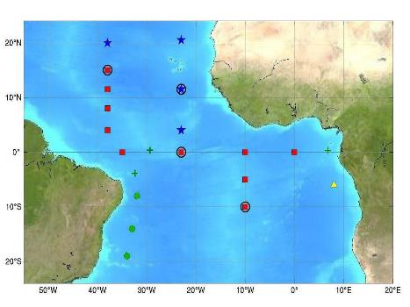
What has been done in 2019 « on the field » ?
The PIRATA FR29 cruise:
February 28 - April 5, 2019 (from Cabo-Verde)
6 buoys replaced (+ CO2 sensors replacement at 6S-10W & 6S-8E):
2 ATLAS, 3 T-TLEX and…
1 ATLAS replaced by T-FLEX at 6S-10W with new CO2 sensor
1 ADCP mooring at 0N-10W
PIRATA FR29 :
Sections CTD 0°E (1°N-3°S), 10°W (10°S-1°30’N), 23°W (2°S-2°N)
Major last moment issues:
« shutdown » in USA
« stressfull » shipping…
No SVPs from AOML/NOAA
Dakar
1
Abidjan
8
7
2
3
Pointe Noire
6
4
5

Slide 5
What has been done in 2019 « on the field » ?
PIRATA FR29 cruise:
February 28 - April 5, 2019 (from Cabo-Verde)
ADCP mooring at 10W-0N
SUCCESS :
2 full years of data
(2017-2019)

Slide 6
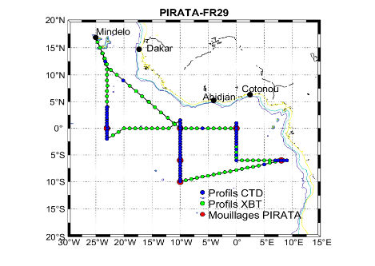
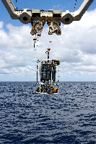
What has been done in 2019 « on the field » ?
PIRATA FR29 cruise:
February 28 - April 5, 2019 (from Cabo-Verde)
61 CTD-O2/LADCP profiles (3 x 4000m ; 27 x 2000m ; 30 x 500m ; 1x40m):
sections along 10W, 0E, 6S and 23W
- 84 XBTs
sea water samplings (surface: SSS, CO2, nutrients, Chl pigments & along the vertical during CTD-O2 casts: S, O2, nutrients, Chl pigments, CO2 at 6S-10W & 8S-6E )
Continuous ADCP, Tsgraph + ACOUSTIC measurements (vertical & horizontal) + pCO2
Sargassum samplings (+ tuna Hg; micro-plastics…)

Slide 7
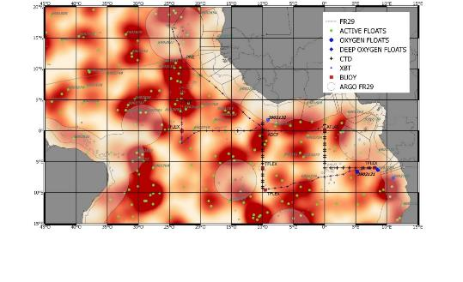
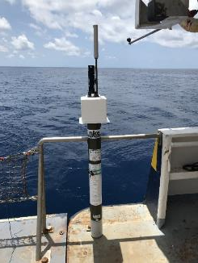
What has been done in 2019 « on the field » ?
PIRATA FR29 cruise:
February 28 - April 5, 2019 (from Cabo-Verde)
6 ARGO profilers deployed (ARGO/CORIOLIS):
(+ 1 0-4000m CTDO2/LADCP profiles close to a Deep ARGO deployed in 2018 off Congo )
Iridium
Iridium O2
Argos

Slide 8
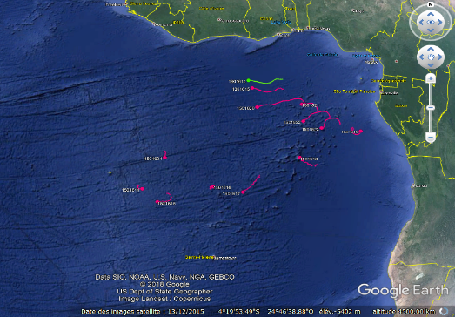
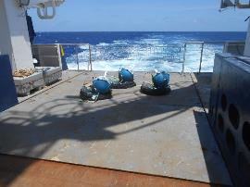
What has been done in 2019 « on the field » ?
PIRATA FR29 cruise:
February 28 - April 5, 2019 (from Cabo-Verde)
13 SVP-B deployed (Meteo-France contribution to AtlantOS)

Slide 9
What have been done in 2019 « in the lab » ?
1) Actualized French PIRATA website:
http://www.brest.ird.fr/pirata/
Information about cruises
Pirata related reports, presentations & documents (SSG…).
Easy access to in situ Pirata cruises data sets (with some DOIs)
    DOI for all PIRATA-FR cruises (yearly actualized)
    Acoustic data with DOI (J.Habasque et al., NEW, early 2020)
    L-ADCP data set with DOI (P. Rousselot et al., NEW, 2019)
    Chemistry data sets with DOI (B.Bourlès, et al. NEW, late 2018)
    S-ADCP data set with DOI (B.Bourlès, et al.)
    ADCP moorings data set with DOI (B.Bourlès, et al.)
    CTD-O2 data set with DOI (B.Bourlès, et al.)
2) 1 week visit to PMEL
by Jérôme Llido (LEGOS) & Pierre Rousselot (IMAGO)
Will be back to this latter…

Slide 10
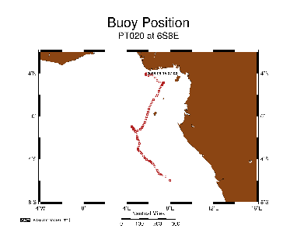
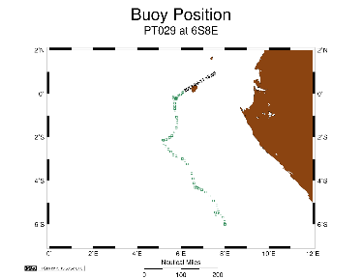
ABOUT the 6S-8E (Kizomba) buoy !
2018: T-FLEX + new CO2 sensor + equipped with additional T/C & Aquadopp…
2019: replaced…
Went adrift on August 4th, 2018…
Went adrift again on August 8th, 2019
Some material & sensors retrieved in Nigeria and sent back to PMEL in 2019
(through Benin & France… ).
Some material & sensors retrieved in Sao Tome and will be sent back to PMEL ASAP
(through France… ):
Tube, atm sensors, TC surface & CO2 sensors.
Note: in addition to material loss and costs,
This also induces significant extra-expenses
(for shipping, customs…)!

Slide 11
=> PIRATA 23b meeting during 0ceanObs19:
Were present:
Mike Mc Phaden, Gregory Foltz, Renellys Perez and James Todd (NOAA); Leticia Cotrim (UERJ), Regina Rodrigues (UFSC), Ronald Guss de Souza (INPE), Fabrice Hernandez and Bernard Bourlès (IRD).
Report sent to all..
Abstract (as a remind…) :
About the 6S-8E different options are evoked and discussed:
to replace again with a T-Flex; such option is too risky and expensive, if vandalized again in 2020 (fishers well know that it is there…);
to replace by an ATLAS system; this is also costly for few potential data return and same risk of vandalism in 2020!
to stop maintaining this site, at least for one or a few years (also depending of the fishing activities evolution and actions taken toward the fishers community -ICCAT, FAO, etc-. ).
This last option is chosen. Bernard Bourlès informs that the next PIRATA-FR30 cruise will be carried out from mid-February 2020; material for this cruise has to be decided as soon as possible. He suggests to think about an alternative option: deploy a T-Flex system in the South-Atlantic (around 20S-10W), as suggested as potential extension from several years (and stated in the AtlantOS Deliverable 3.19, the PIRATA and TAOS 2019 papers). => DONE!

Slide 12
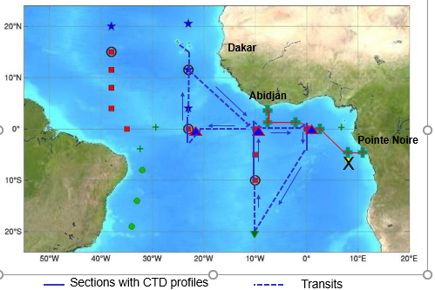
=> What has been done in 2020 « on the field » ?
The PIRATA FR30 cruise:
February 16 – March 23 (extended to 31rd !), 2020 (from Cabo-Verde to BREST due to Covid19)
6 buoys replaced (+ CO2 sensors replacement at 6S-10W & 0N-10W):
2 ATLAS, 3 T-TLEX and… 1 ATLAS equiped as T-FLEX at 20S-10W
1 ADCP mooring at 0N-0E
Major last moment issues:
Seabird issues => 0N-10W kept as ATLAS
Strikes in France, stressfull shipping!
1 Tflex buoy missing => 20S10W ATLAS
No news from 0N23W!....
+
Last issues: COVID19…

Slide 13
What has been done in 2020 « on the field » ?
The PIRATA FR30 cruise:
February 16 – March 31, 2020
ADCP mooring at 0E-0N
Full time series (2016-2020)
SUCCESS :
2 full years of data
(2018-2020)

Slide 14
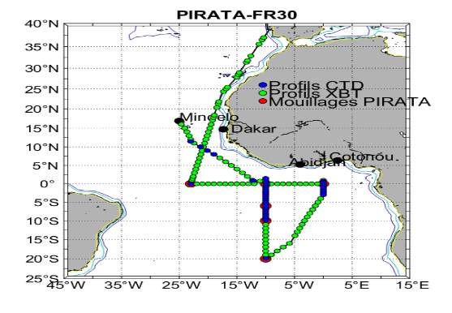
What has been done in 2020 « on the field » ?
The PIRATA FR30 cruise:
February 16 – March 31, 2020
42 CTD-O2/LADCP profiles : 1x5215m ; 4x~4000m, 25x2000m ; 3x1000m ; 8x500m ; 1x200m
sections along 10W and 0E
- 87 XBTs (South of 16N; then continued during transit to Brest for CORIOLIS…)
sea water samplings (surface: SSS, CO2, nutrients, Chl pigments & along the vertical during CTD-O2 casts: S, O2, nutrients, Chl pigments, CO2 at 6S-10W & 8S-6E )
Continuous ADCP, Tsgraph + ACOUSTIC measurements (vertical & horizontal)
Sargassum samplings (+ tuna Hg;…)

Slide 15
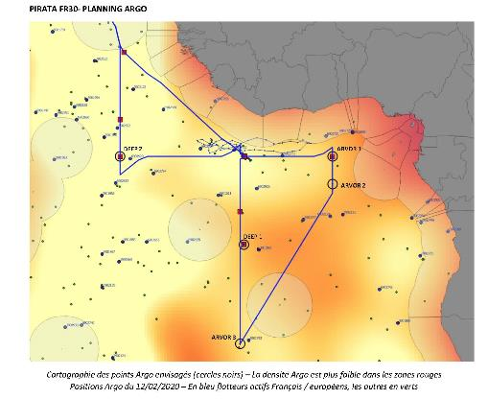
What has been done in 2020 « on the field » ?
The PIRATA FR30 cruise:
February 16 – March 31, 2020
Deployment of 4 ARGO profilers, including 2 Deep-ARGO (ARGO/CORIOLIS):
(+, for the 1st time, retrieval of 1 Deep-Argo deployed in 2018 (refer to BluePrint => We can do it….).
Iridium
DEEP-ARGO

Slide 16
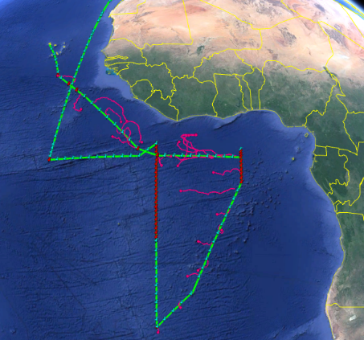
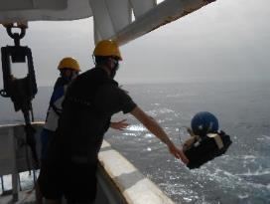
What has been done in 2020 « on the field » ?
The PIRATA FR30 cruise:
February 16 – March 31, 2020
22 SVP-B deployed (Meteo-France contribution to AtlantOS)

Slide 17

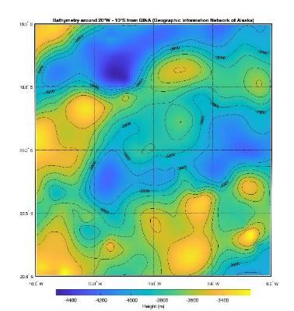
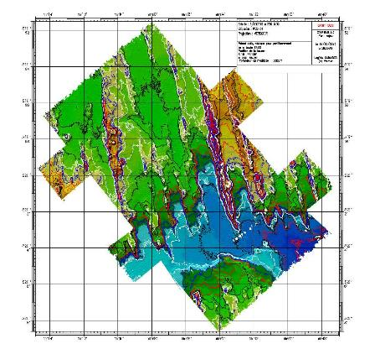
What has been done in 2020 « on the field » ?
The PIRATA FR30 cruise:
February 16 – March 31, 2020
Bathymetry at 20S-10W (the ’NEW’ « FADO » buoy):
Climatology (before):
Real bathy (after EM304 survey)
=> BUOY LOCATION: 19°56’S / 009°58’W

Slide 18
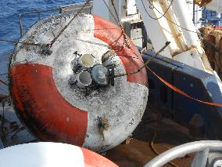
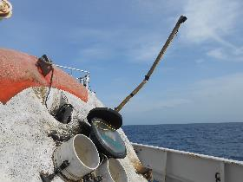
What has been done in 2020 « on the field » ?
The PIRATA FR30 cruise:
February 16 – March 31, 2020
Last info, ABOUT the buoy at 0N-23W:
no news from 12/25/2019… => was it still there???
March 16th…
No radar echo, but after 2h looking for around we found it!
New type of vandalism…. :
- upper tripode & tube/batteries properly dismantled
-fishermen tinkered with a lamp powered by the solar battery
from a stolen acoustic beacon
- exactly as if the fishermen wanted to be the only ones
who knew where the buoy was ....
Loss of the tube (ie HF data) & met sensors!!!
It was the 1st time we saw such a fisher's vandalism feature!

Slide 19
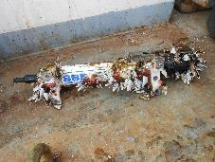
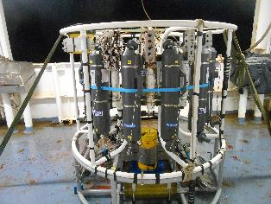
What has been done in 2020 « on the field » ?
Issue with SSS data provided in Delayed Mode by PMEL… ?
The delayed mode QC process typically involves comparing against adjacent sensors and CTD casts when CTD data are available in close proximity to the mooring.
BUT fouling ! (sensors are cleaned before sending them back to PMEL!!!! => source of error!
Proposal during the Jérome & Pierre’s visit to PMEL: NEW experiments made onboard:
Uncleaned SBE TC sensors on the bathysonde:
- 45’ around 50m or 200m
=> TO BE COMPARED WITH CTD sensors….

Slide 20
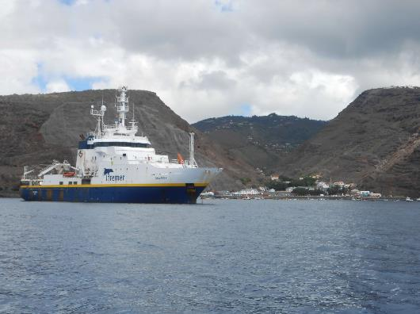
What has been done in 2020 « on the field » ?
The PIRATA FR30 cruise:
February 16 – March 31, 2020
Last info & view (just for « the fun »): The 6h short stop at anchor off Ste Helena Island!

Slide 21
At now & perspectives for PIRATA in France ?
Waiting for the end of the lockdown (probably mid-May):
    Retrieval of the PIRATA material onboard the R/V THALASSA & shipping back to PMEL
    Retrieval of the 6S8E buoy material from Sao Tomé & shipping back to PMEL
2) Evaluation by the French « national fleet scientific committee » of PIRATA cruises,
in order to maintain the annual vessel time (no worry!).
3) GOOD NEWS… Potential recruitement at IRD/US IMAGO of a « chemistry engineer »!
This should allow to maintain the nutrients analysis (risk after the retirement of F.Baurand in 2022… confirmation in a few weeks!).
4) Jérôme Llido will soon replace B.Bourlès as coordinator (2021 or 2022).
He should be part of the PIRATA SSG and B.Bourlès should leave (but as/if invited… ).
    MOST IMPORTANT: the MoU and fishing activities…

Slide 22
=> DISCUSSIONS: A few issues to be discussed (to be completed…) with/by PRB:
To think for the PIRATA MoU:
Worrisome perspectives (budgets & institutional supports)
Issues with fishing activities off Brazil, along the equator (23W) and in the Gulf of Guinea
(discussions to have with CICTA-ICCAT, in order they take same decisions than IOTC-CTOI in the Indian Ocean… even not always efficient! Some inputs in annex slide.)
How to deal with the 20S-10W buoy in the close future (see Mike’s presentation)?
Other sources of fundings for sensors purchasing (in support of PMEL expanses?).
SSG composition : …. Issue with Nathalie who left (who for biogeochemistry in France/or Germany?)
Brazilian cruises data
DOI: Pirata buoys data

Slide 23
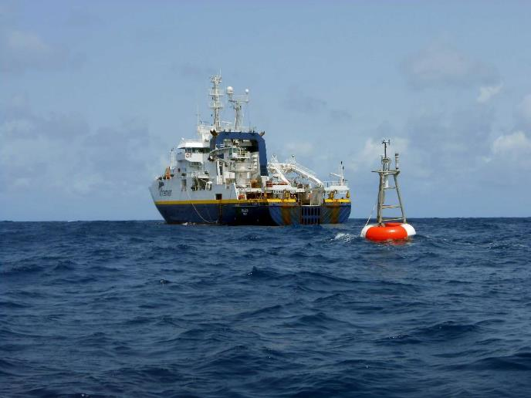
OBRIGADO / THANKS / MERCI

Slide 24
Inputs (from Daniel Gaertner, IRD/MARBEC, Sète) about tuna fishing in the Atlantic.
in the case of Brazil this fishery concerns trolling and hand line fishing. It has increased in recent years and seems to be the cause of the very large increase in Brazil's bigeye catches (when the bigeye quotas were established by CPC at ICCAT Brazil was fishing less than the threshold established at at the time, which enabled it to escape these measures and increase its catches; which of course is strongly criticized by the CPCs subject to the quota). Scientific contacts in Brazil are Paulo Travassos pautrax@hotmail.com & Gelson Da Siva : guelson@ufersa.edu.br .
I don't think the EU has a fisheries agreement with Gabon. On the other hand, it is likely that there are private fishing agreements and that the 2 professional organizations of Spanish purse seiners (OPAGAC and ANABAC) as well as the vessels of CPCs of convenience sheltering purse seiners belonging to Spanish shipowners (Guatemala, Salvador, Panama , Belize) fish in the Gabonese EEZ.
I do not think there is a resolution by ICCAT similar to that of the IOTC on the prohibition of fishing near an oceanographic buoy. However, this should be checked with the Executive Secretary of ICCAT: Camille Jean Pierre Manel : camille.manel@iccat.int
If not, and therefore considering asking for the same type of regulation as in the O. Indian, it is difficult that the Pirata program can directly request it from ICCAT. FAO, for example, should be the bearer of this request, unless it goes directly through the CPC Delegations, which have the possibility of proposing regulations during the ICCAT Commission meeting. Without excluding the first possibility, this second solution seems to me the most logical. Of the three countries carrying Pirata: France, Brazil, USA, only Brazil could have a measured opinion on this proposal. I can hardly see the USA opposing it and France either as a direct ICCAT CPC (under St Pierre and Miquelon) or as a member of the "European Union" CPC can put this on the table. In both cases (St Pierre and UE) you have to go through the Department of Fisheries and Aquaculture (DPMA) via Tristan Diefenbacher: tristan.diefenbacher@agriculture.gouv.fr &t Benoit Archambaud : benoit.archambault@agriculture.gouv.fr
It is not impossible that Gabon, which is not in favor of the development of purse seine fishing in its waters and in particular under FADs but which happily gives private fishing rights to armaments, supports this type of resolution as well as other African CPCs (contacts at the highest level of fisheries administrations are to be seen with the DPMA or DG Mare). In case of reluctance by CPCs, there is the alternative of NGOs which, although they cannot propose a resolution, speak orally and in writing during the Commission.
Before implementing all of this, the easiest way would be to send a letter / email to the representatives of the Professional Organizations of European armaments in the purse seine so that they can send this good practice information to their crews: Michel Goujon, Director Orthongel (mgoujon@orthongel.fr ); for OPAGAC: Julio Morón (julio.moron@opagac.org ) or his assistant Miguel Herrera (miguel.herrera@opagac.org ); for Anabac I don't know who the director is but the email seems to be: anabac@anabac.org

Slide 25
French PIRATA dedicated cruises : 30 French cruises from 1997 to 2020
Nom de la campagne | Navire | Dates | Chef de mission
PIRATA FR1 | ANTEA | 09/09-16/09 1997 | Jacques SERVAIN
PIRATA FR1 bis | ANTEA | 30/01-03/02 1998 | Jacques SERVAIN
PIRATA FR2 | ANTEA | 30/10-10/11 1998 | Jacques SERVAIN
PIRATA FR3 | ANTEA | 23/01-01/02 1999 | Jacques SERVAIN
PIRATA FR4- EQUALANT 1999 | THALASSA | 13/07-21/08 1999 | Yves GOURIOU
PIRATA FR5 | ANTEA | 25/10-08/11 1999 | Jacques SERVAIN
PIRATA FR6 | SUROIT | 08/03-19/03 2000 | Jacques GRELET
PIRATA FR7 – EQUALANT 2000 | THALASSA | 23/07-21/08 2000 | Bernard BOURLÈS
PIRATA FR8 | ATALANTE | 17/11-03/12 2000 | Jacques GRELET
PIRATA FR9 | ATALANTE | 20/10-11/11 2001 | Jacques GRELET
PIRATA FR10 | ATALANTE | 06/12-21/12 2001 | Jacques SERVAIN
PIRATA FR11 | SUROIT | 17/12-03/01 2002-2003 | Jacques GRELET
PIRATA FR12 | ATALANTE | 28/01-19/02 2004 | Bernard BOURLÈS
PIRATA FR13 | SUROIT | 23/05 - 05/06 2005 | Jacques GRELET
PIRATA FR14 – EGEE 1 | SUROIT | 07/06 - 05/07 2005 | Bernard BOURLES
PIRATA FR15 – EGEE 3 | ATALANTE | 24/05 - 05/07 2006 | B.BOURLÈS/Y.GOURIOU
PIRATA FR16 | ANTEA | 19/05 - 01/06 2007 | Jacques GRELET
PIRATA FR17 – EGEE 5 | ANTEA | 04/06 – 09/07 2007 | Frédéric MARIN
PIRATA FR18 | ANTEA | 01/09 – 06/10 2008 | Jacques GRELET
PIRATA FR19 | ANTEA | 16/06 – 24/07 2009 | Jacques GRELET
PIRATA FR 20 | ANTEA | 13/09 – 22/10/2010 | Jacques GRELET
PIRATA FR 21 | SUROIT | 01/05 – 16/06/2011 | B.BOURLÈS/J.GRELET
PIRATA FR 22 | SUROIT | 19/03 – 02/05/2012 | B.BOURLÈS/J.GRELET
PIRATA FR 23 | SUROIT | 09/05 – 20/06/2013 | B.BOURLÈS/J.GRELET
PIRATA FR 24 | SUROIT | 09/04 – 22/05/2014 | B.BOURLÈS/Y.GOURIOU
PIRATA FR 25 | THALASSA | 18/03 – 16/04/2015 | Bernard BOURLÈS
PIRATA FR 26 | THALASSA | 07/03 – 13/04/2016 | Bernard BOURLÈS
PIRATA FR 27 | THALASSA | 27/02 – 03/04/2017 | Bernard BOURLÈS
PIRATA FR 28 | THALASSA | 27/02 – 05/04/2018 | Bernard BOURLÈS
PIRATA FR 29 | THALASSA | 28/02 – 05/04/2019 | Bernard BOURLÈS
PIRATA FR 30 | THALASSA | 16/02 – 31/03/2020 | Bernard BOURLÈS
=> >900 days at sea

