Slide 1
SAMOC: South Atlantic Meridional Overturning Circulation
Shenfu Dong
CIMAS/University of Miami, and NOAA/AOML
on behalf of SAMOC participants
Special thanks to Silvia L. Garzoli
September 13, 2012
http://www.aoml.noaa.gov/phod/SAMOC_international/

Slide 2
Objective
The overarching goal of the SAMOC initiative is to observe and understand the mechanisms that control the mean and time-varying MOC in the South Atlantic and the inter-ocean exchanges. Advance our knowledge of the South Atlantic MOC is crucial to improving our understanding of climate system variability.

Slide 3
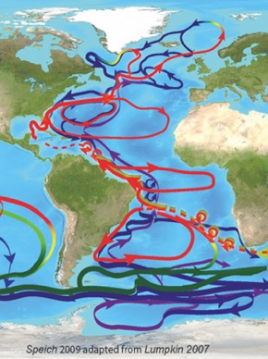
Motivation
The South Atlantic is the only ocean basin transporting heat equatorward as upper layer warm water spreads northward to compensate for the southward export of colder North Atlantic Deep Water. As such, it plays a unique role in the global energy balance.
Our ability to understand and quantify this northward flow is crucial to properly model and forecast weather and climate.

Slide 4
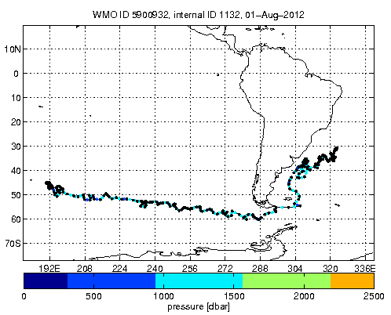
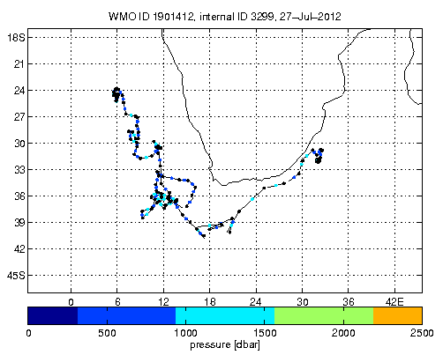
Motivation
A portion of the South Atlantic upper waters is produced locally, but most of the South Atlantic upper waters are thought to originate in the Pacific and Indian oceans.
The South Atlantic is not just a passive conduit for NADW and other deep water-masses formed in the North Atlantic and Southern Ocean, but instead actively participates in their transformation as they are exchanged with the other ocean basins
Notes:
Numerical models and observations demonstrated that the South Atlantic is not just a passive conduit for NADW and other deep water-masses formed in the North Atlantic and Southern Ocean, but instead actively participates in their transformation as they are exchanged with the other ocean basins.
At issue are not only the relative importance of these sources but also the mechanisms of entrainment. It is not sufficient, for example, to know the inflows at the Drake Passage and the Cape of Good Hope to determine the South Atlantic export of thermocline water to the North Atlantic. Indeed, it can be argued that, since the South Atlantic circulation depends on the interoceanic fluxes and those in turn depend on the South Atlantic circulation, any attempt to determine one independently of the other leads to an ill-posed problem.

Slide 5
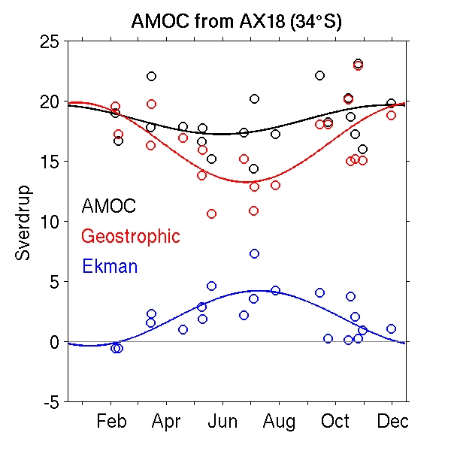
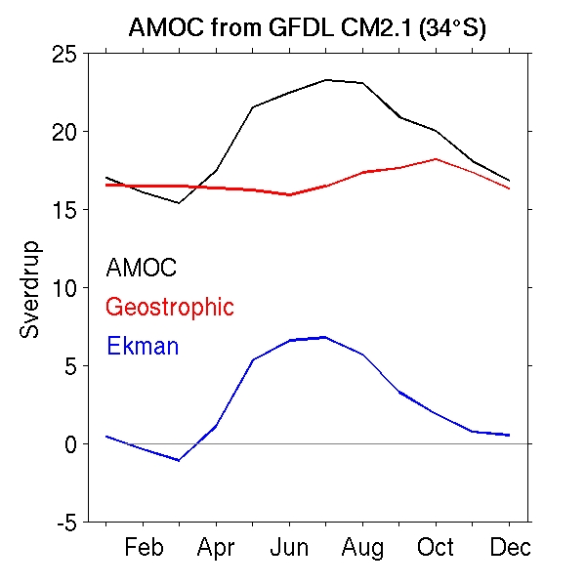
Motivation
Disagreements between models and observations:
The observed annual cycles of the MHT and the MOC are almost non-existent. Models, in contrast, show a strong annual cycle for the MHT and MOC, which is dominated by the Ekman component.
The direction of the freshwater flux within the South Atlantic sector, which is an indicator for the stability of the overturning circulation.
  Observations: M_{ov}< 0 (positive freshwater flux feedback), MOC is bistable.
  Models: M_{ov}> 0 (negative freshwater flux feedback), MOC is stable.

Slide 6
SAMOC Workshops
Four international SAMOC workshops have been held to date, bringing together the international scientific community to share results on the South Atlantic MOC and to design an integrated observational system.
SAMOC I (Buenos Aires, Argentina, May 2007)
SAMOC II (Paris, France, July 2009)
SAMOC III (Rio de Janeiro, Brazil, May 2010)
SAMOC IV (Simons Town, South Africa, September 2011)
Participants at the workshops have come from Argentina, Brazil, France, Germany, Italy, Spain, Netherlands, Russia, South Africa, Uruguay, the United Kingdom, and the United States.
SAMOC has been endorsed by the CLIVAR Scientific Steering Group in May 2012

Slide 7
Outcome of SAMOC Workshops
Community agrees that 30-35°S is the best latitude to monitor the MOC variability based on numerical and theoretical modeling studies.
  Higher latitudes provide stronger density gradients and larger Coriolis parameter, leading to improved signal-to-noise characteristics for geostrophic velocity calculations.
  The strongest signals are more tightly confined to the boundaries at higher latitudes, indicating that a smaller portion of the trans-basin array requires more intense horizontal resolution.
  Estimation of the stability of the MOC is more favorable at higher latitudes.
  At higher latitudes it is possible to utilize less expensive mooring technologies (i.e. PIES), reducing the cost of the overall system and its maintenance.

Slide 8
Partner Institutions
(in alphabetical order with country and contacts listed)
Argentina: Servicio de Hidrografia Naval (A. Triosi)
  Universidad de Buenos Aires (A. Piola)
Brazil: Universidade de Sao Paulo (E. Campos and A. Fetter)
  Universidade Federal do Rio Grande-FURG (M. Mata)
France: Laboratoire de Physique des Oceans (S. Speich)
Germany: Alfred Wegener Institute (O. Boebel)
  IFM-GEOMAR, Leibniz-Institut fur Meereswissenschaften (P. Brandt)
Russia: Shirshov Institute of Oceanology (S. Gladysgev)
South Africa: Department of Environmental Affairs
University of Cape Town (I. Ansorge, C. Reason, and M. Roberts)
Spain: Institut de Ciencies del Mar, CSIC (J. Pelegri and A. Olivares)
USA: NOAA/AOML (S. Garzoli, G. Goni, C. Meinen, and M. Baringer)
  University of California San Diego/Scripps Institute of Oceanography (J. Sprintall)
  University of Miami/RSMAS (S. Dong, R. Perez, and R. Fine)
  Massachusetts Institute of Technology (S. Baker-Yeboah and G. Flierl)
  Others…

Slide 9
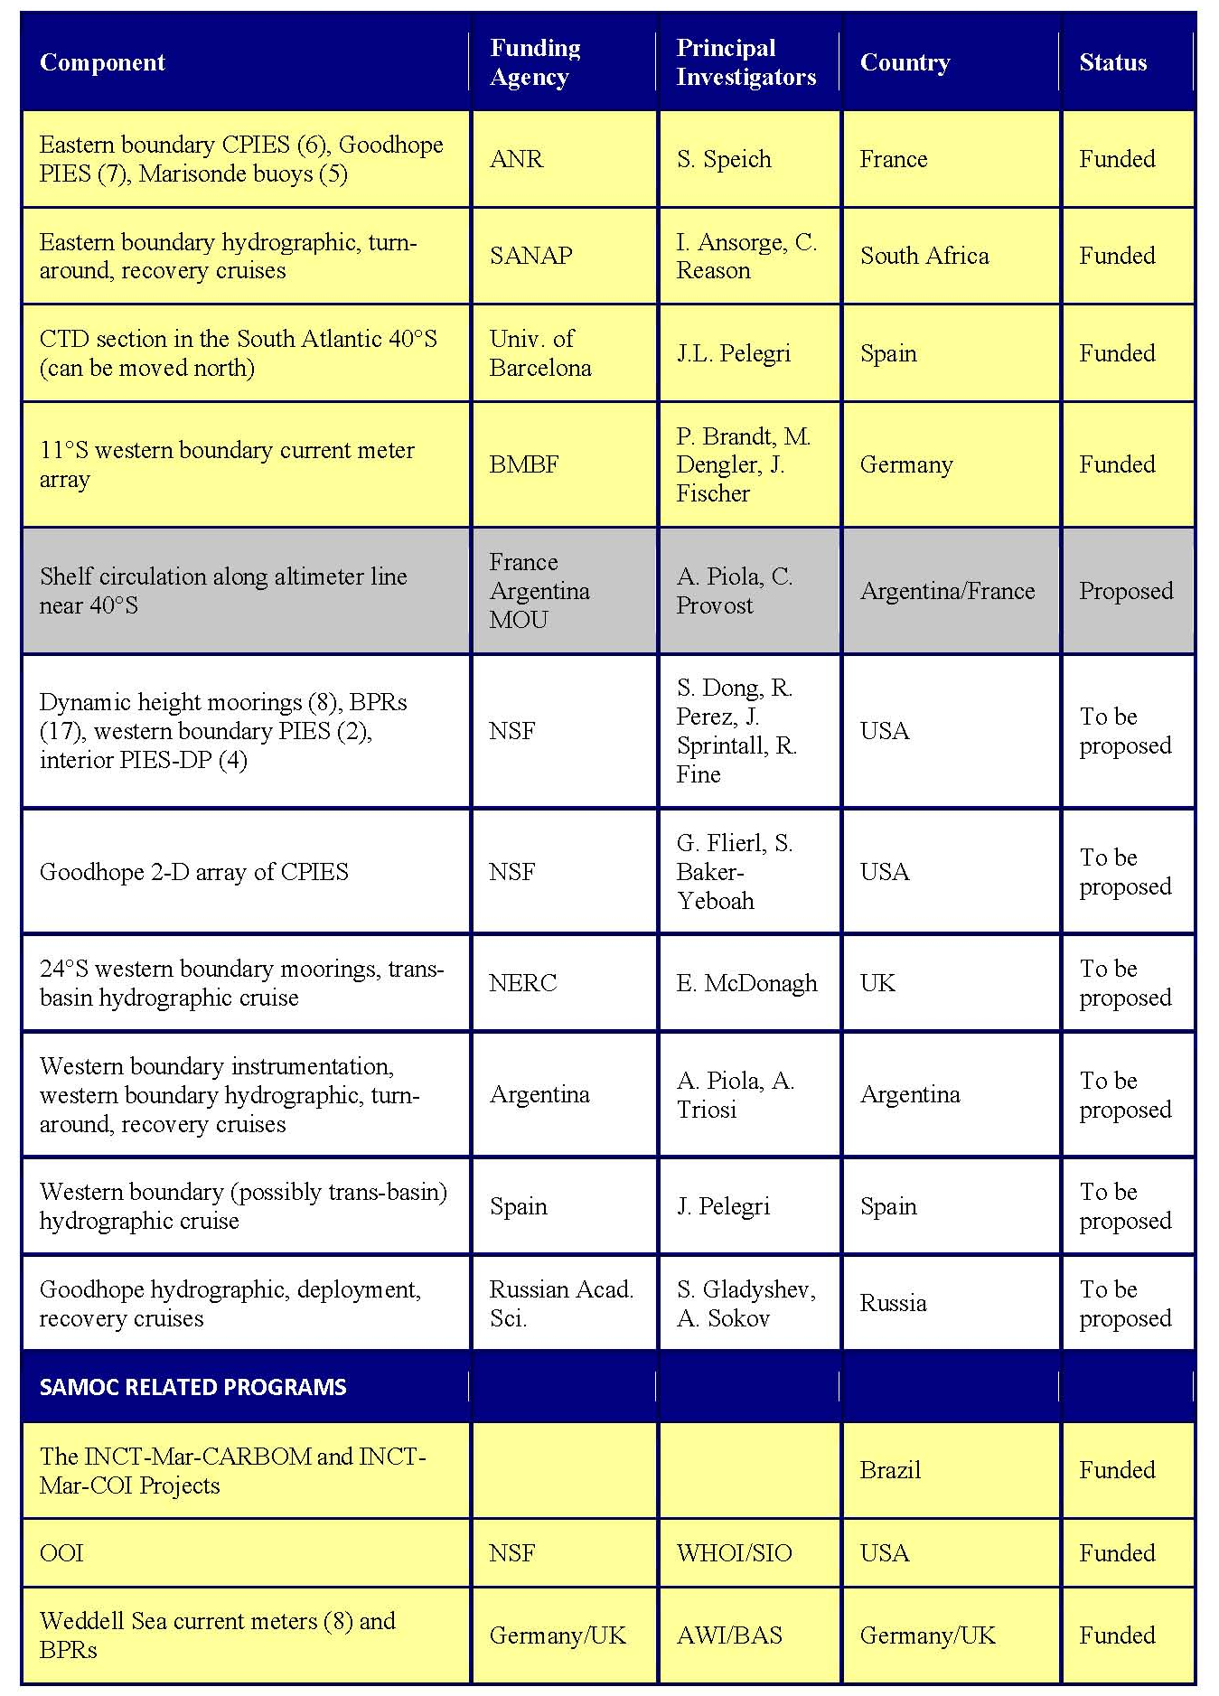
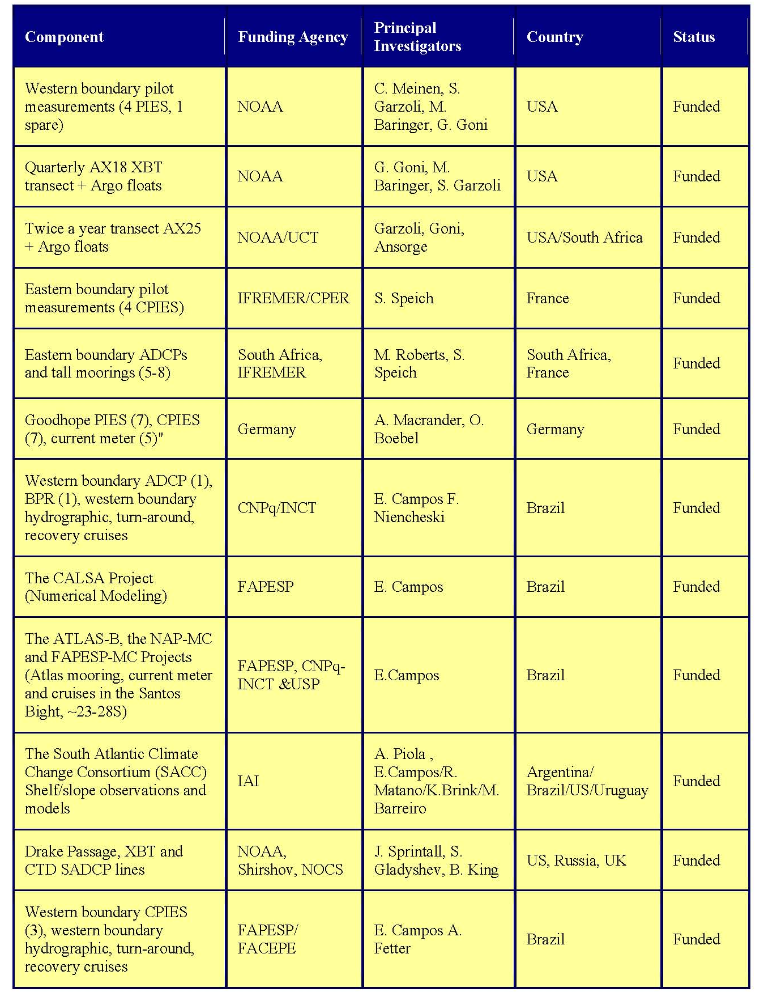
Several components of SAMOC have been funded through national agencies.

Slide 10
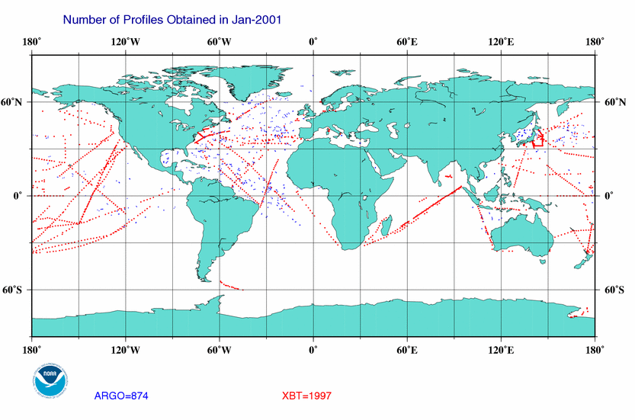
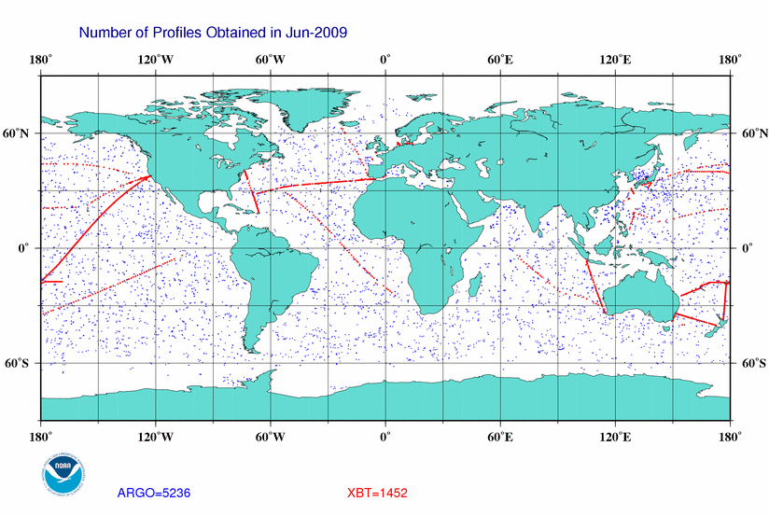
Existing Observations
South Atlantic is previously highly under sampled. The data coverage in the South Atlantic has been staidly increasing in recent years, which improves the estimates of mean MHT and the MOC in the region
Notes:
Observations indicate that the annual cycle of the Ekman component of the flux is out of phase and of the same order of magnitude as the geostrophic component. As a consequence, the observed annual cycles of the total MHT and the MOC are almost non-existent. Models, in contrast, show a strong annual cycle for the total MHT, as well as for the MOC, that depends very little on the geostrophic component, the dominant variability arises from the Ekman component of the fluxes that has a marked seasonal cycle.
Another important concept for which observations and models are in disagreement is the direction of the salt flux within the Atlantic sector, which is an indicator for the stability of the overturning circulation

Slide 11
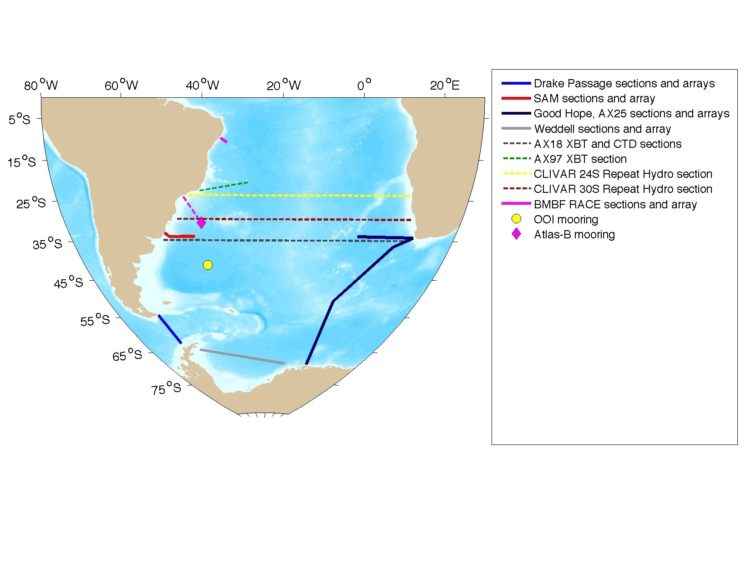
Existing Observational Projects Related to SAMOC

Slide 12
Sustained Observations
AX18: started in 2002, 4 sections per year
  Monitoring the upper lime of the MOC in the South Atlantic
AX22: started in 1996, 6-7 sections per year
AX25: started in 2004, 2 sections per year
AX97: started in 2004, 4-6 sections per year
      Monitoring the Brazil Current
Argo float measurements
Satellite measurements
Inter-ocean exchanges
AX18
AX22
AX25

Slide 13
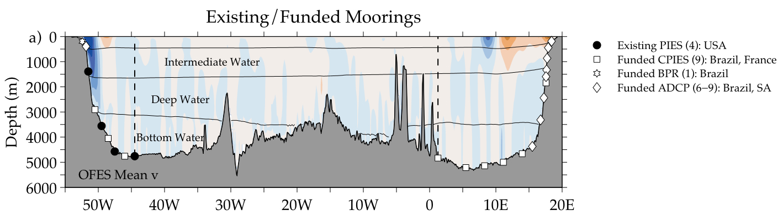
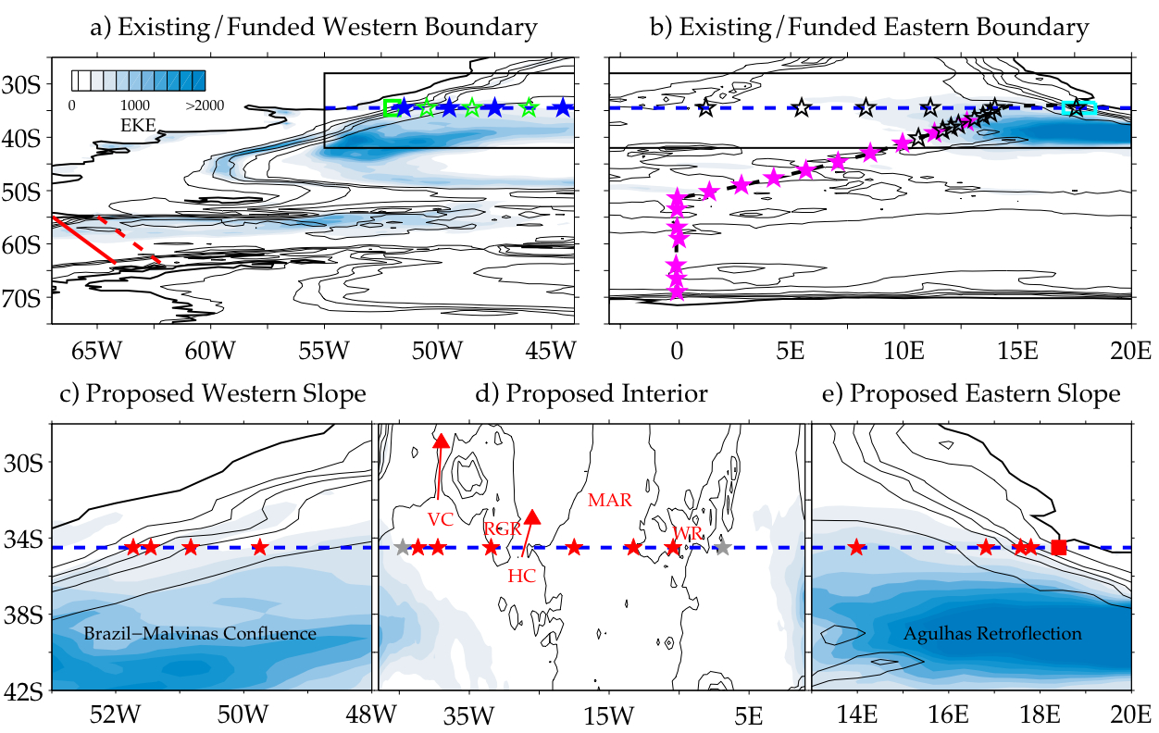
Existing and Funded Boundary Array

Slide 14
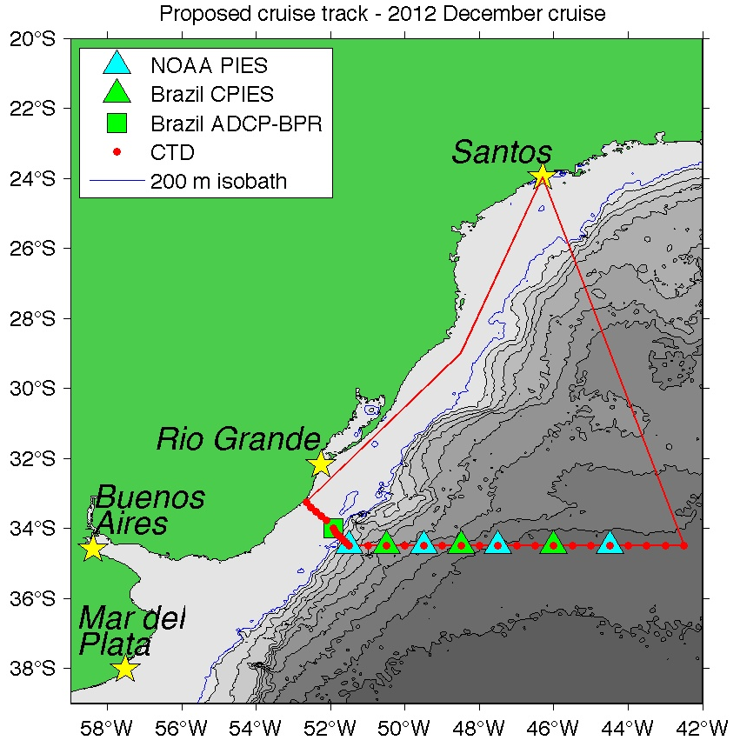
Upcoming augmentations/expansions of the existing SAM pilot array at 34.5°S
The first turn-around for the NOAA pilot array will be done in December 2012 as part of a joint Brazilian, Argentine, and US cruise.
In addition to the NOAA turn-arounds, this cruise represents a crucial expansion of the MOC observing system in the region, as Brazil will be deploying additional instruments to improve the existing western boundary array and to expand it up onto the continental shelf.
High resolution hydrographic/biogeochemical data will be collected during the cruise.
Tentative cruise track for the planned December 2012 joint cruise on the Brazilian research vessel Alpha Crusis. Three of the four existing NOAA instruments will be recovered and redeployed, while the new Brazilian moored instruments will be deployed for the first time. A joint Brazilian/Argentine science party will also collect a detailed hydrographic section.

Slide 15
Deployment of eastern boundary array at 34.5°S
Colleagues in France and South Africa have received funding to deploy an array similar to the western boundary array on the eastern boundary of the South Atlantic at 34.5°S. The eastern boundary array contains 7-8 CPIES and 6-9 ADCPs, which is planned to deploy in July 2013. This deployment may also include the 7 PIES along the Goodhope line.

Slide 16
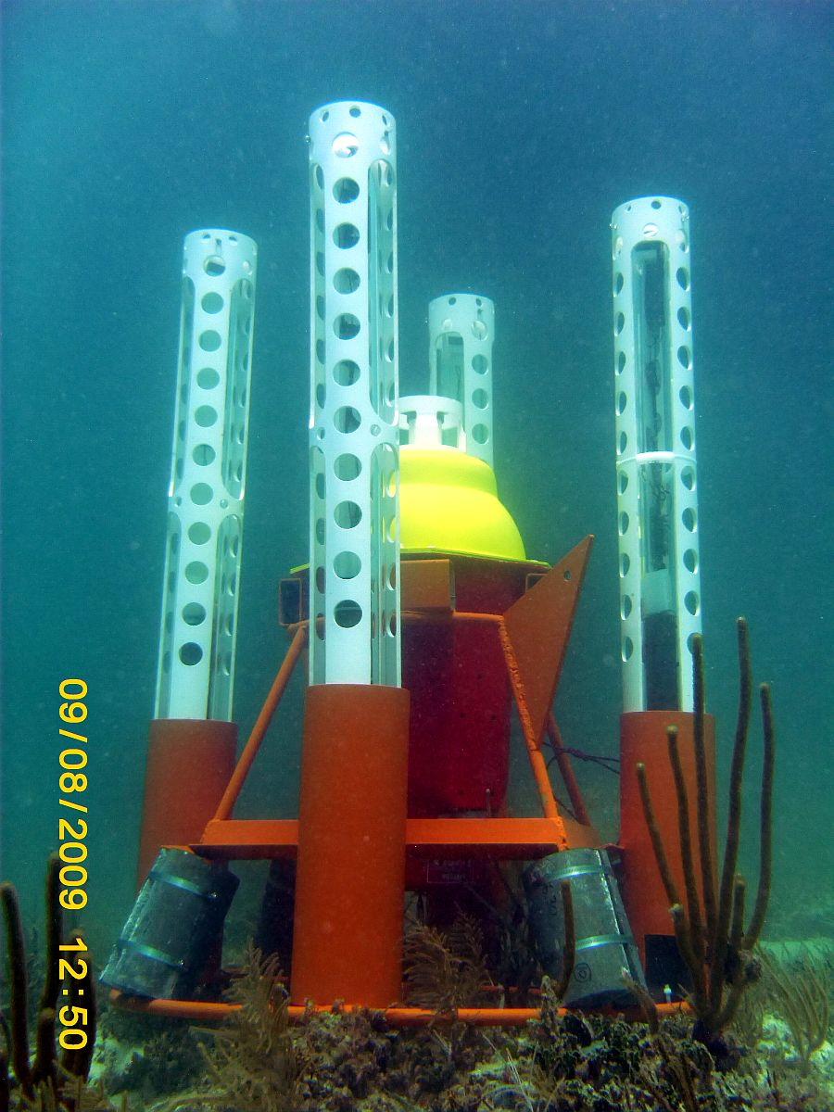
Adaptable Bottom Instrument Information Shuttle System
(ABIISS)
A deep ocean data retrieval system, once fully operational will allow scientific instruments anchored on the ocean bottom to send their data back via expendable data pods that will release from the ocean floor on a programmable schedule.
ABIISS has been tested in shallow water, The first deep water test is schedule in October 2012.

Slide 17
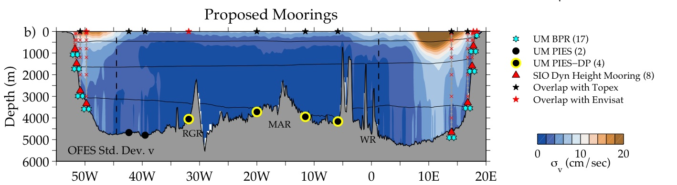
Monitoring Ocean Interior Region
The proposed array along 35°S consists of bottom pressure gauges (cyan squares), upward-looking ADCPs, mid-depth and deep moorings with full water-column T, S, p and discrete current measurements, PIES (black circles), PIES-with datapods (green circles), and CPIES (black squares). Color contours are of 27-year mean OFES meridional velocity along 34.5°S.

Slide 18
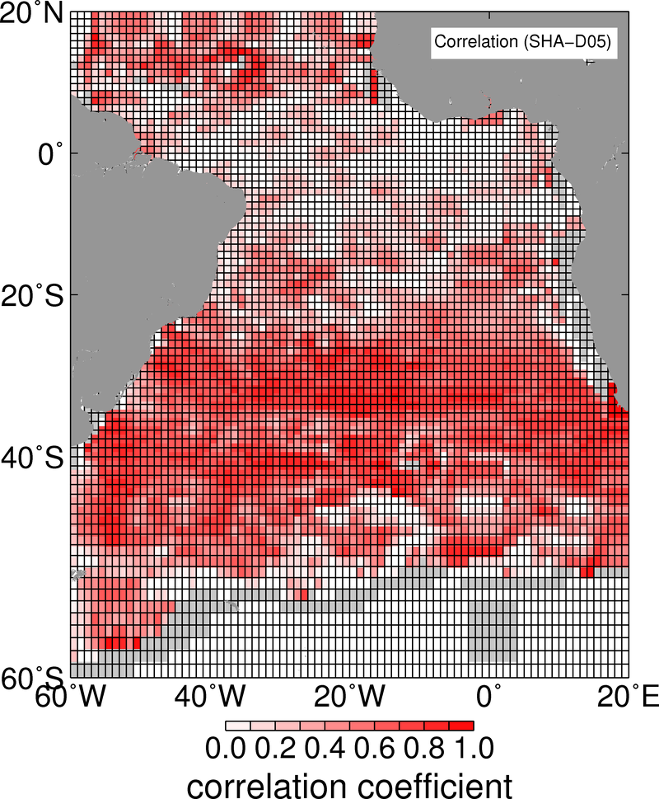
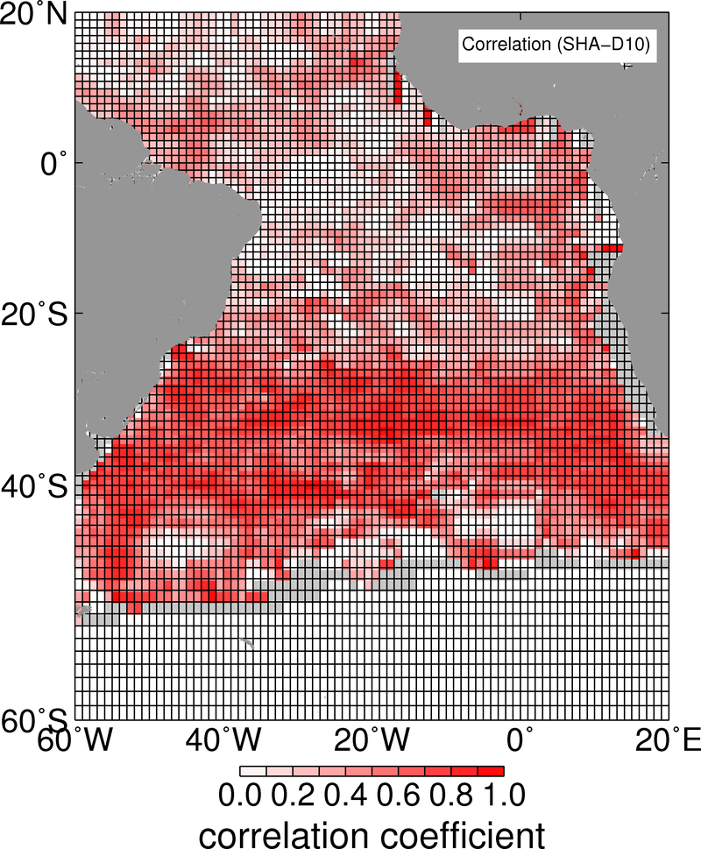
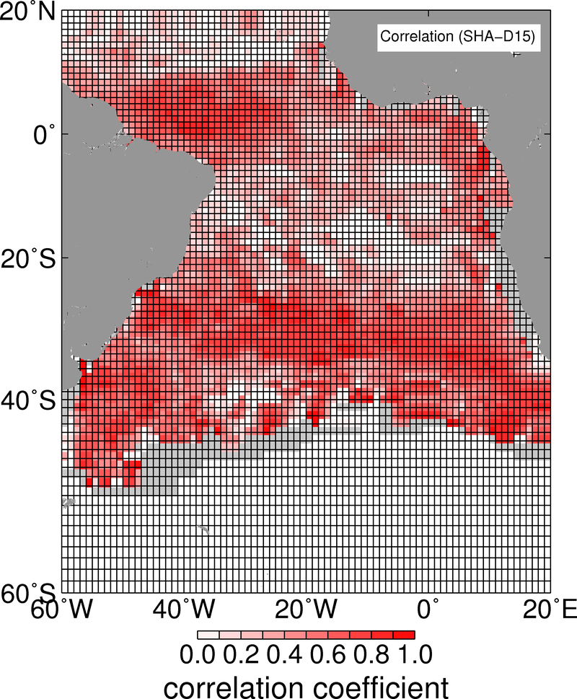
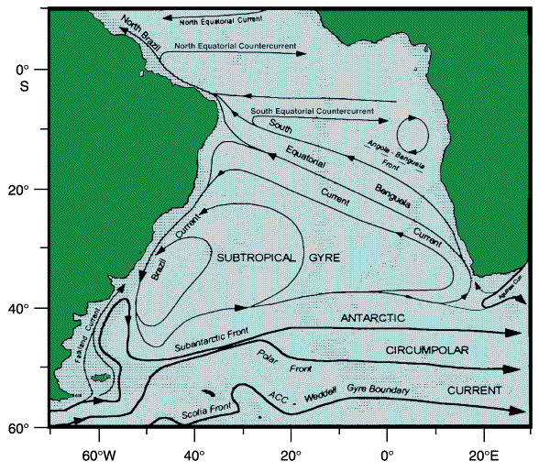
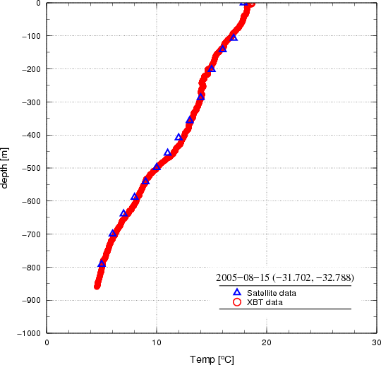
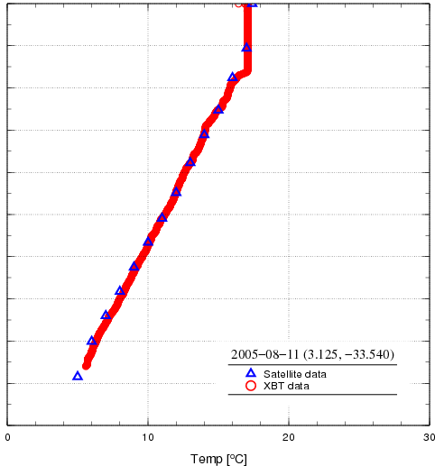
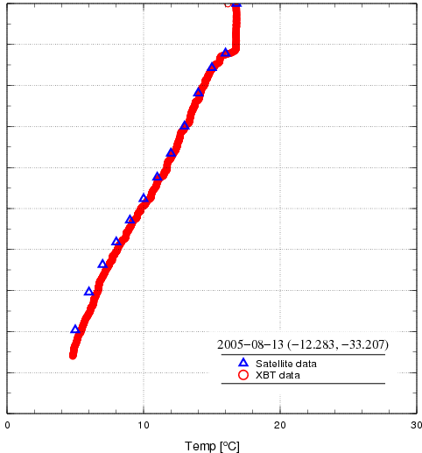
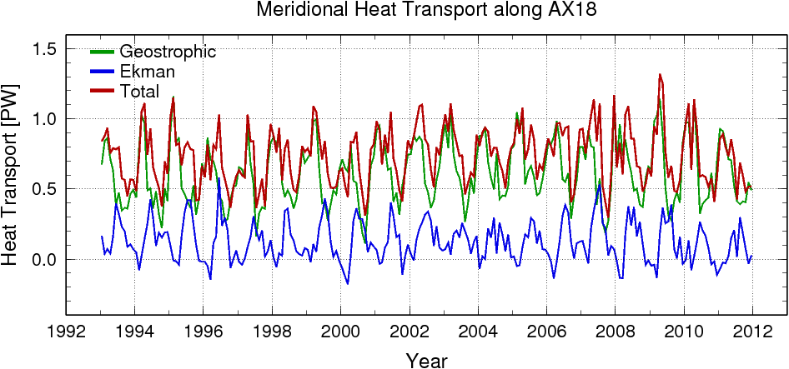
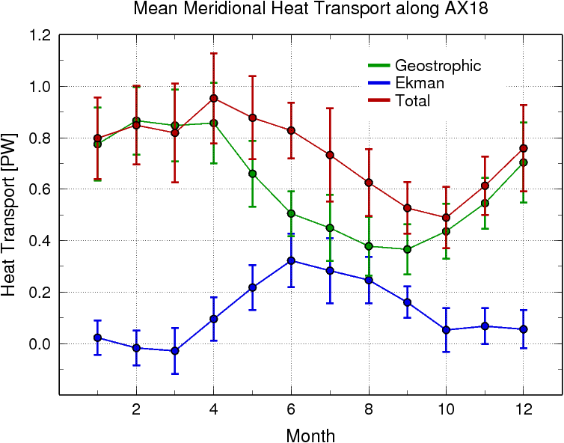
MOC/MHT from Satellite Altimetry
5°C
10°C
15°C
Notes:
The objective of this work is to make use of the high correlation that exist between SH and depth of isotherms between 20S and 35S in the
SA Ocean to monitor the variability of the MHT in this regions.
The top three maps show the correlation coefficient between three selected isotherms (5, 10, and 15C) and SH since 1993, using XBT/CTD/Argo data.
Temperature profiles are computed along fixed zonal sections at 20,25,30,25S. We use the profiles obtained at 35S from AX18 to compare altimetry
Estimates against XBT temperature profiles.
We construct a time series of geostrophic and Ekman components at 35S and obtained the seasonal variability (bottom plots).
We are currently estimating the time series for the other latitudes.

Slide 19
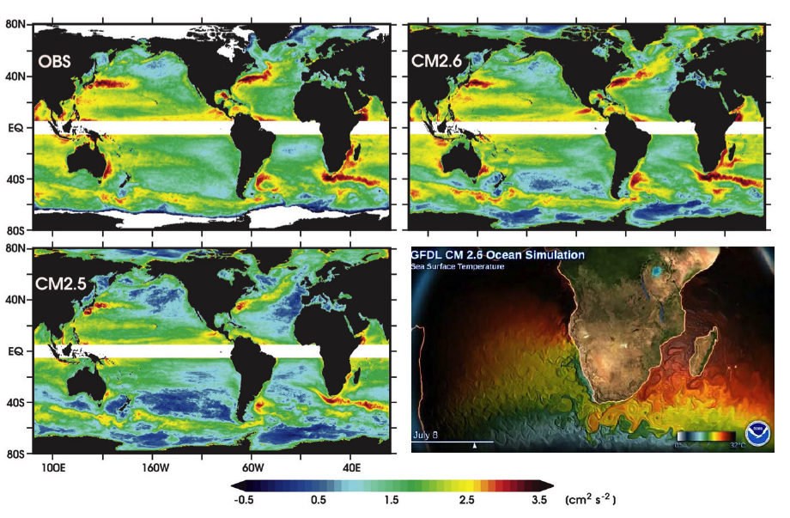
Collaborative Research: South Atlantic Meridional Overturning Circulation modeling proposal
NSF PIs: R. Matano (OSU), R. Perez (UM/CIMAS, NOAA/AOML), R. Msadek (UCAR, NOAA/GFDL)
Goal: advance understanding of processes controlling the MOC pathways in the South Atlantic, and their sensitivity to predicted climate change scenarios using state-of-the-art eddy-permitting and eddy-resolving climate models.
Figure: Logarithm of EKE calculated from AVISO SSH and from GFDL climate models, CM2.5 and CM2.6 (adapted from Delworth et al. 2012). Bottom right is a snapshot of SST from CM2.6 simulation.

Slide 21
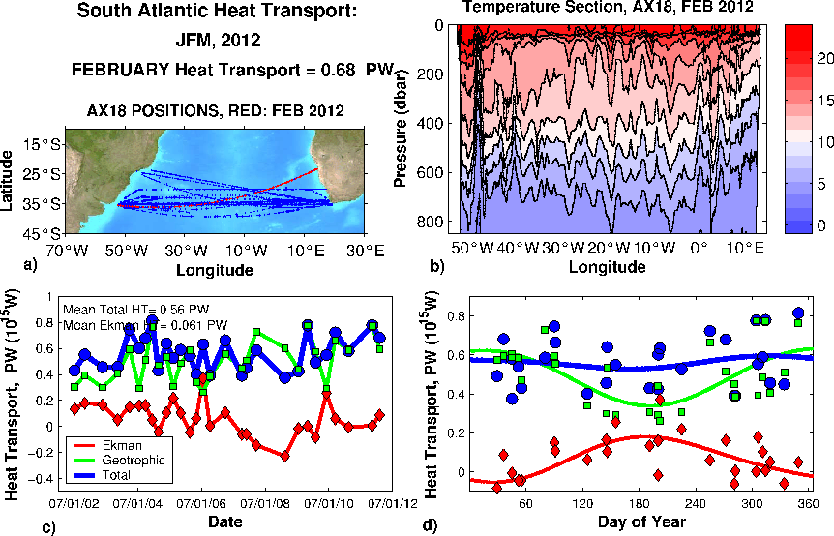

Slide 22
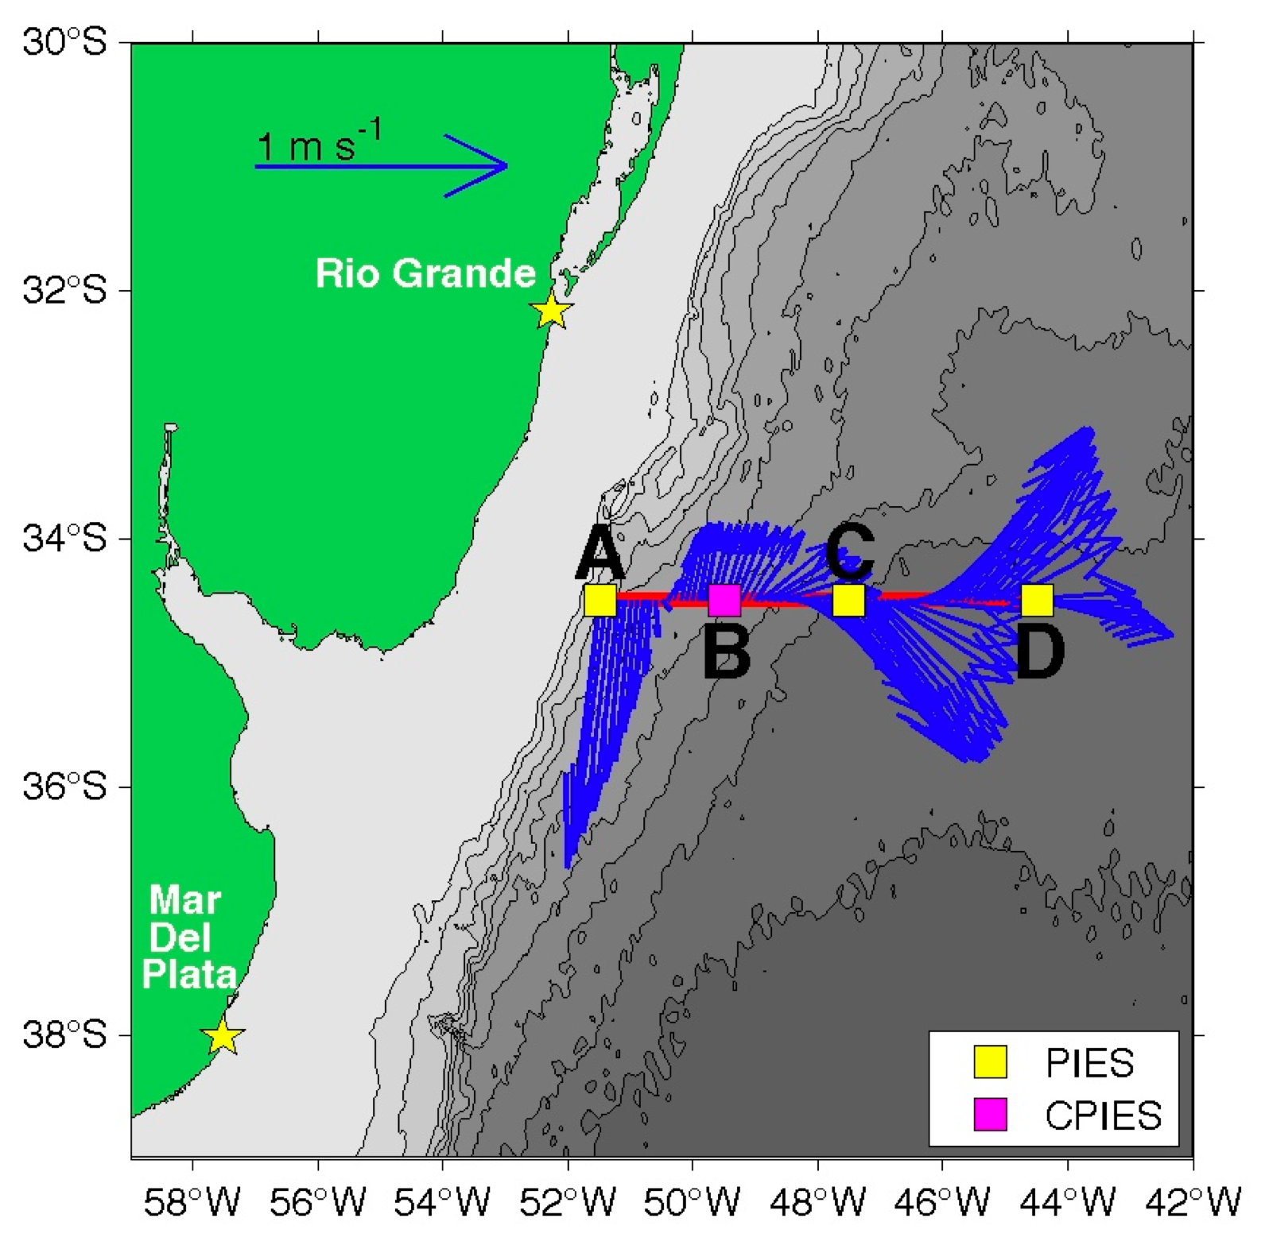
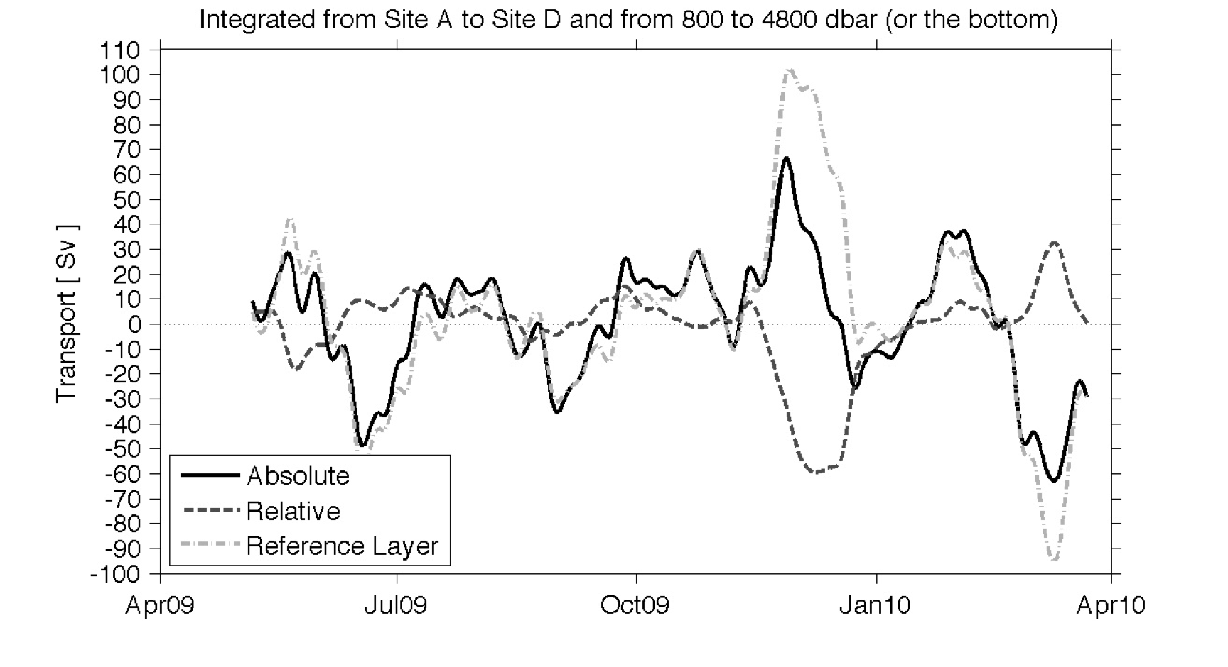
Deep Western Boundary Current transport variability in the South Atlantic – Preliminary results from the ‘Southwest Atlantic MOC’ (SAM) pilot array at 34.5°S
Map illustrating the locations of the four PIES/CPIES deployed in the ‘Southwest Atlantic MOC’ pilot array in March 2009. Blue vectors are velocity at 20 m measured by SADCP during the deployment cruise.
The Deep Western Boundary Current flow observed over the first year of the pilot array. Absolute flow is shown as well as transports relative to an assumed level of no motion (i.e. baroclinic) and the reference layer transports (i.e. barotropic); the two components demonstrates occasional compensation, but no correlation.
Meinen, C. S., A. R. Piola, R. C. Perez, and S. L. Garzoli, Deep Western Boundary Current transport variability in the South Atlantic: Preliminary results from a pilot array at 34.5°S, Ocean Science, (submitted), 2012.

