Slide 1
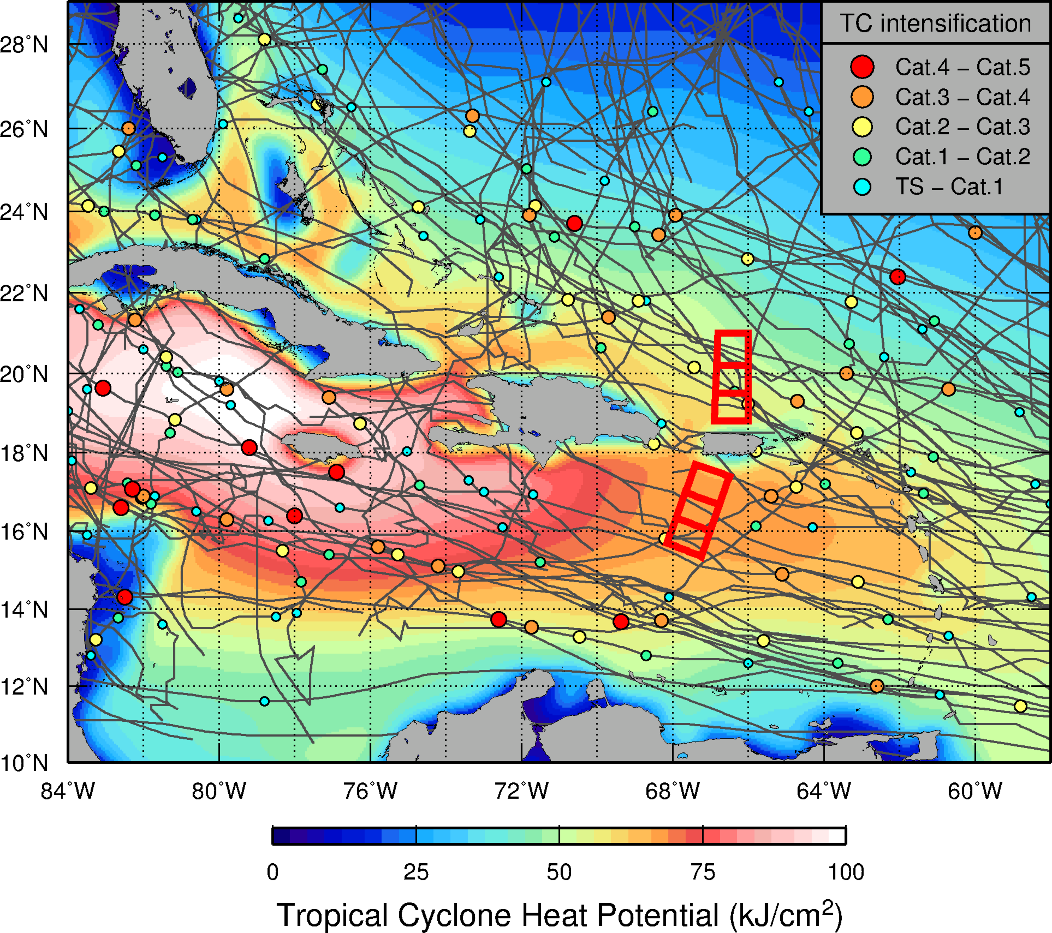
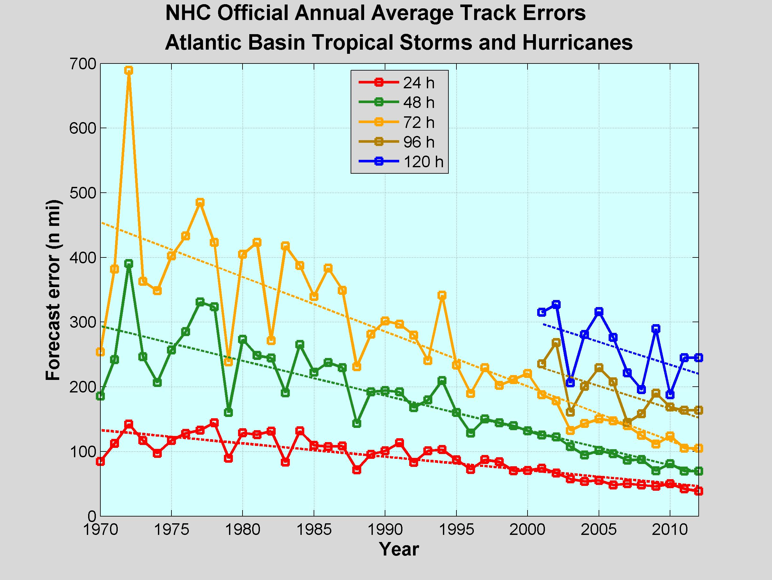
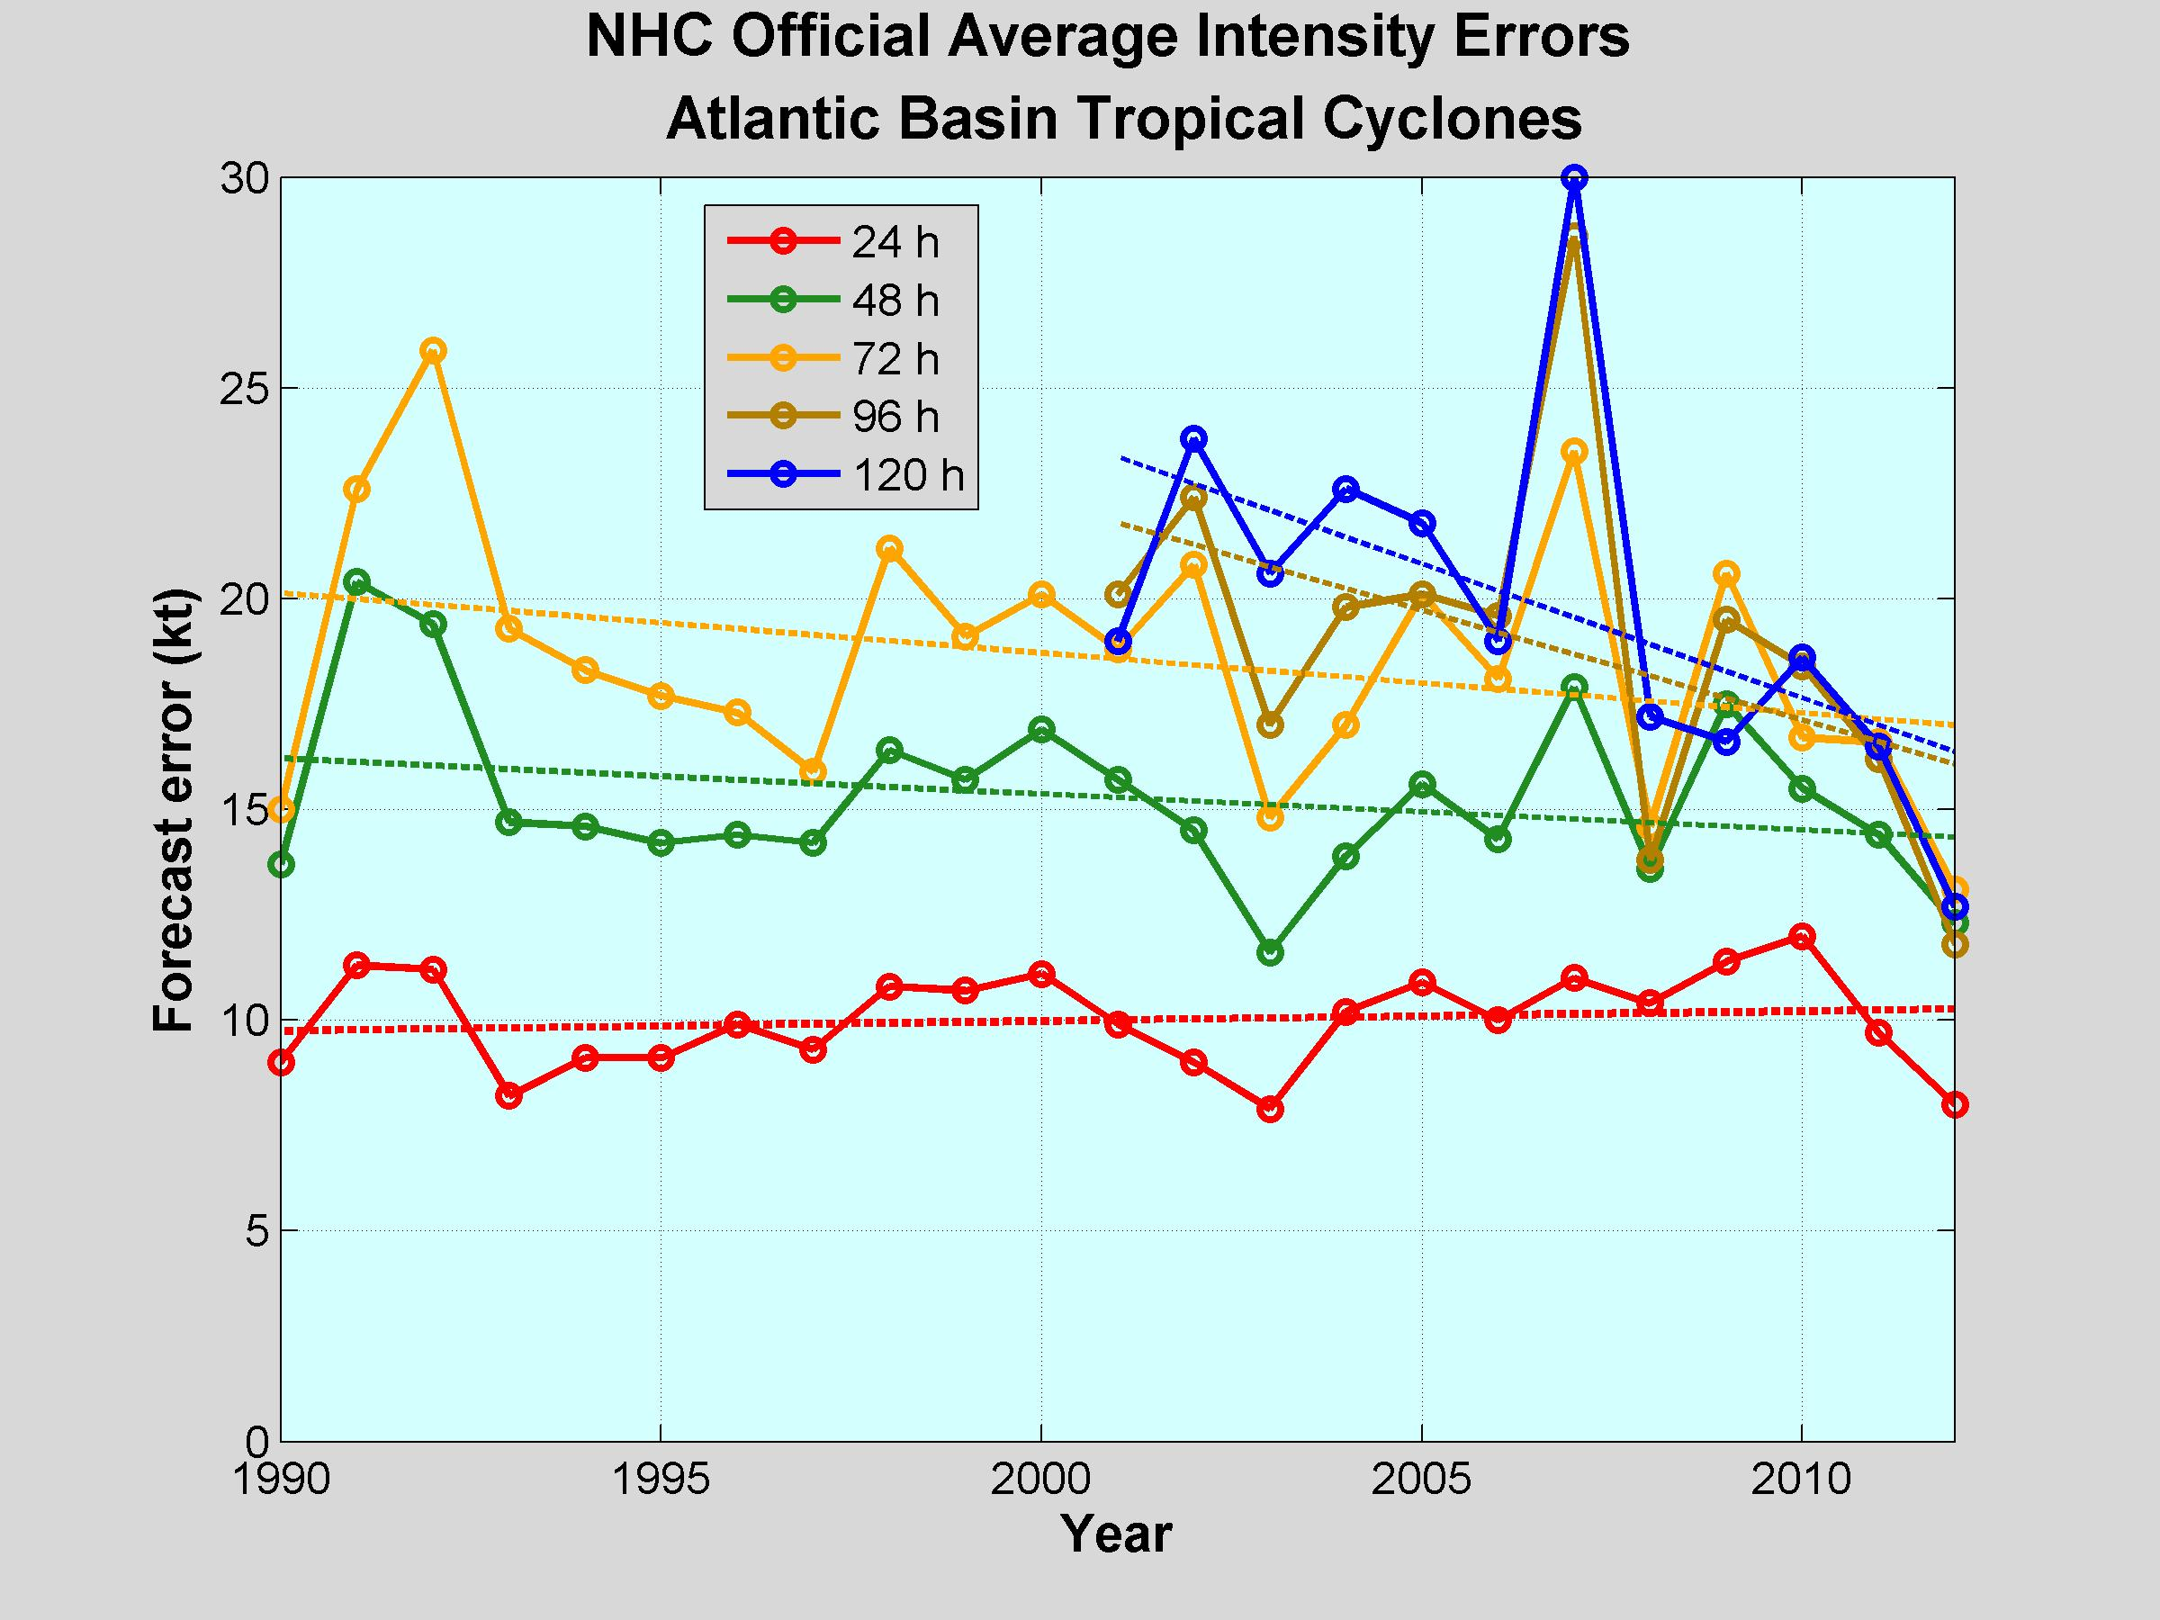
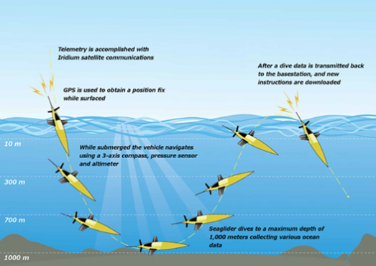
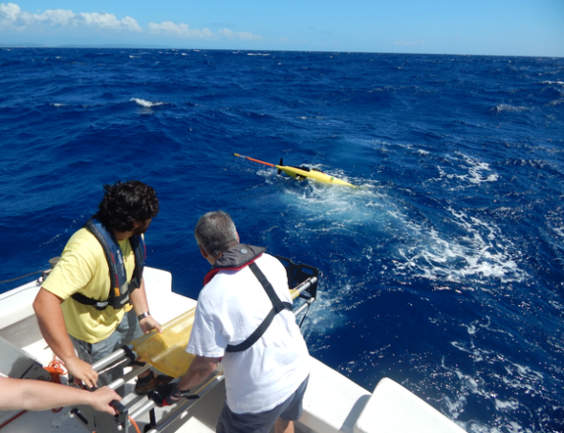
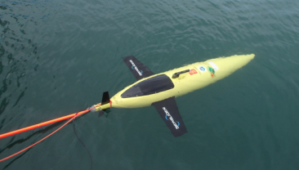
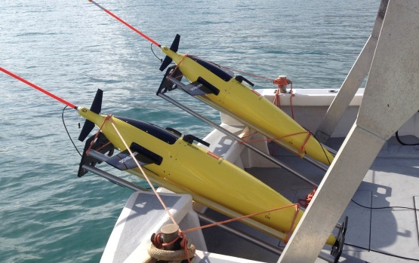
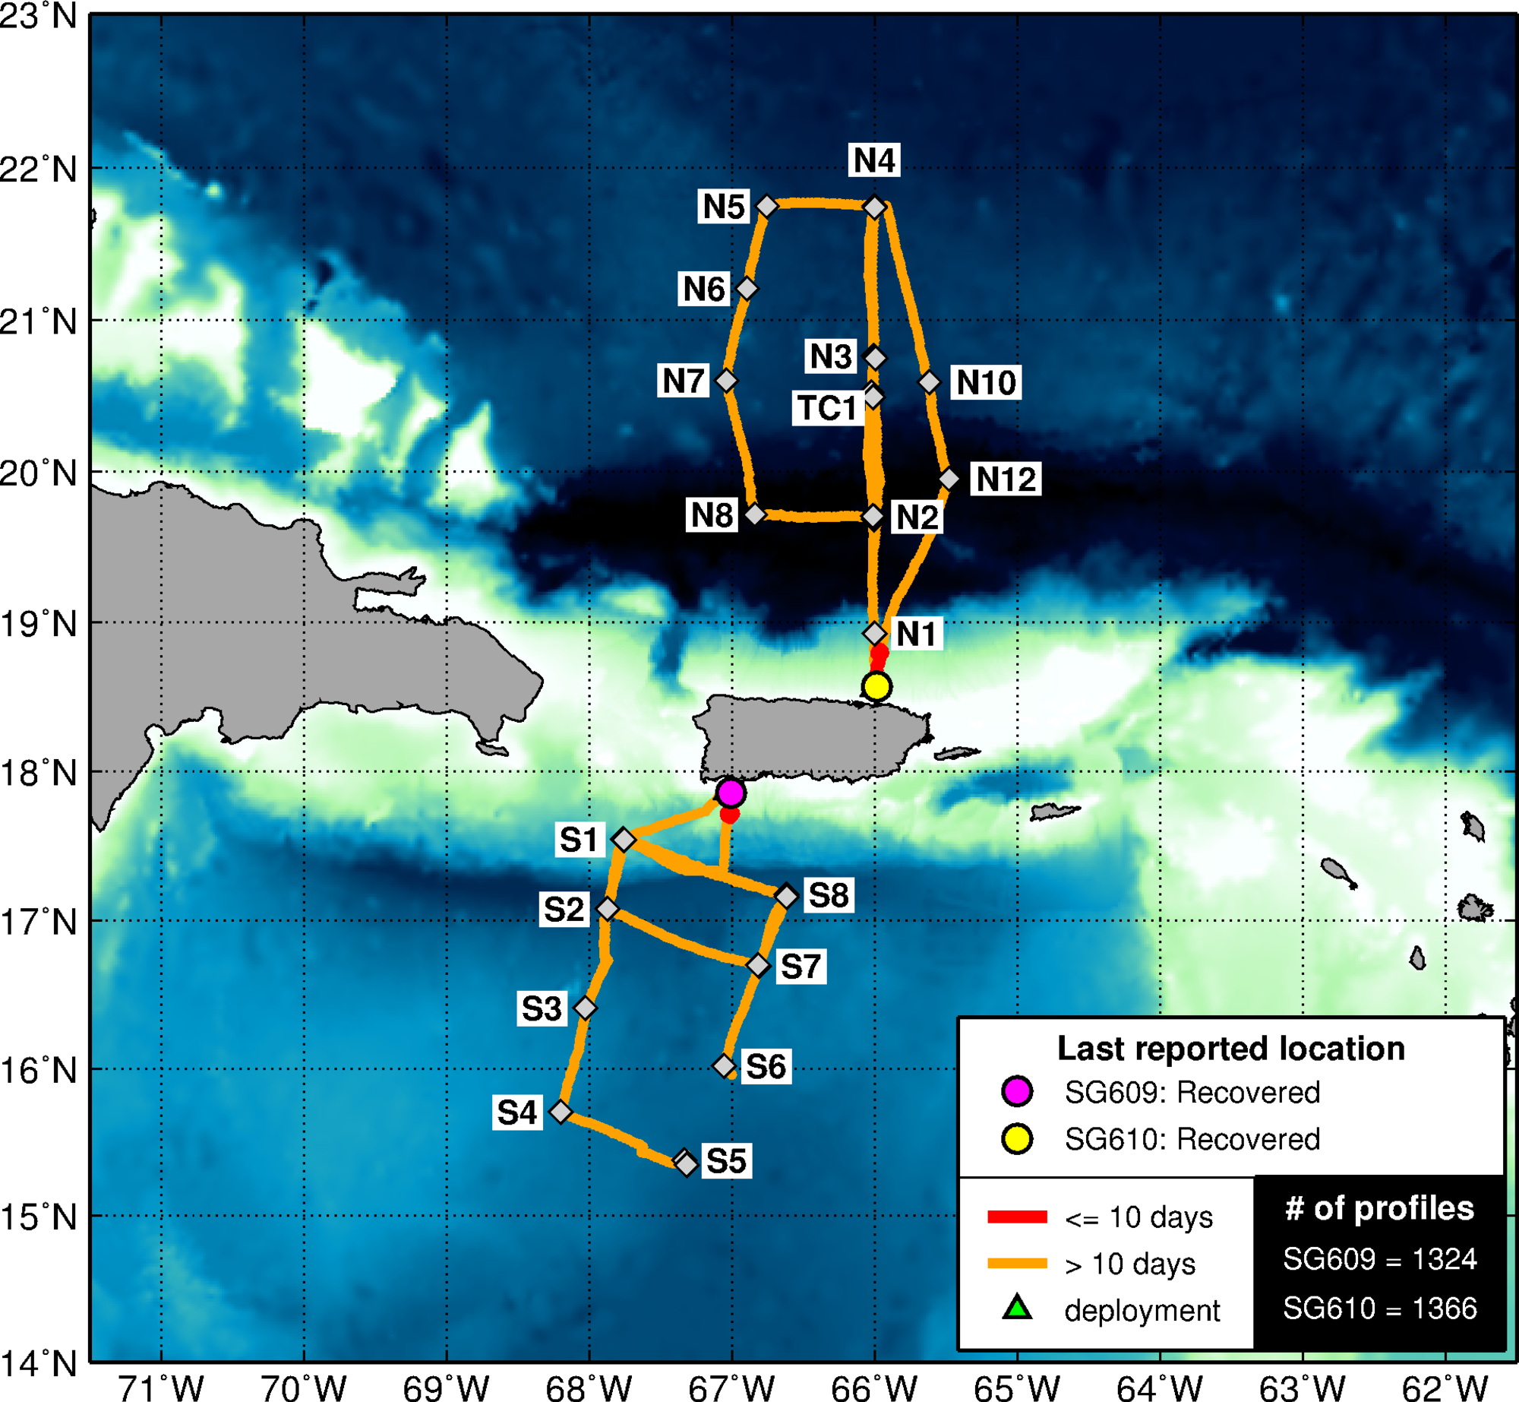
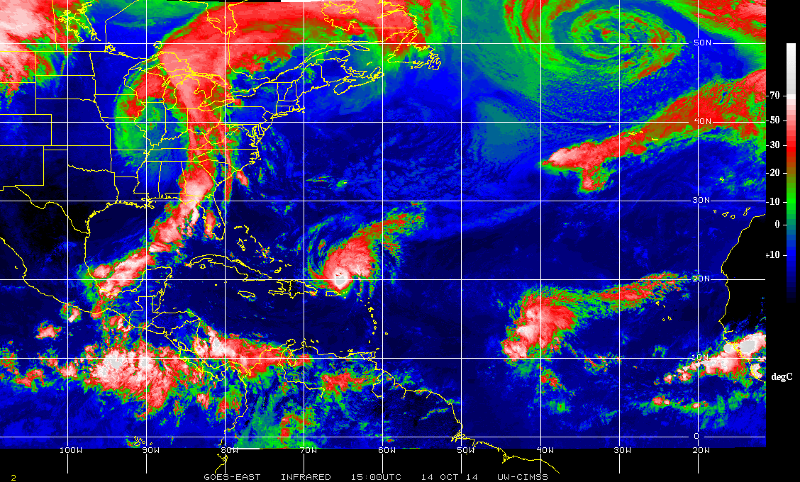

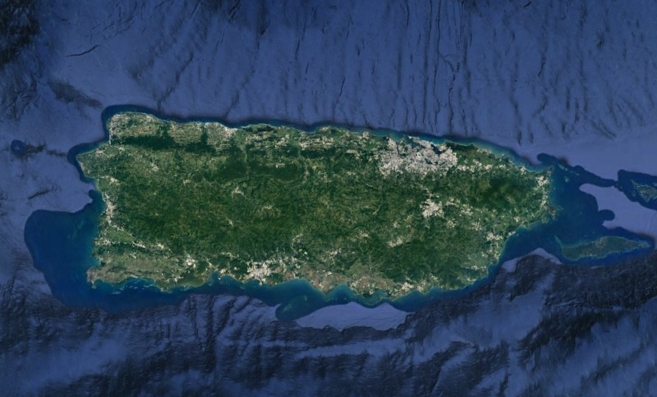

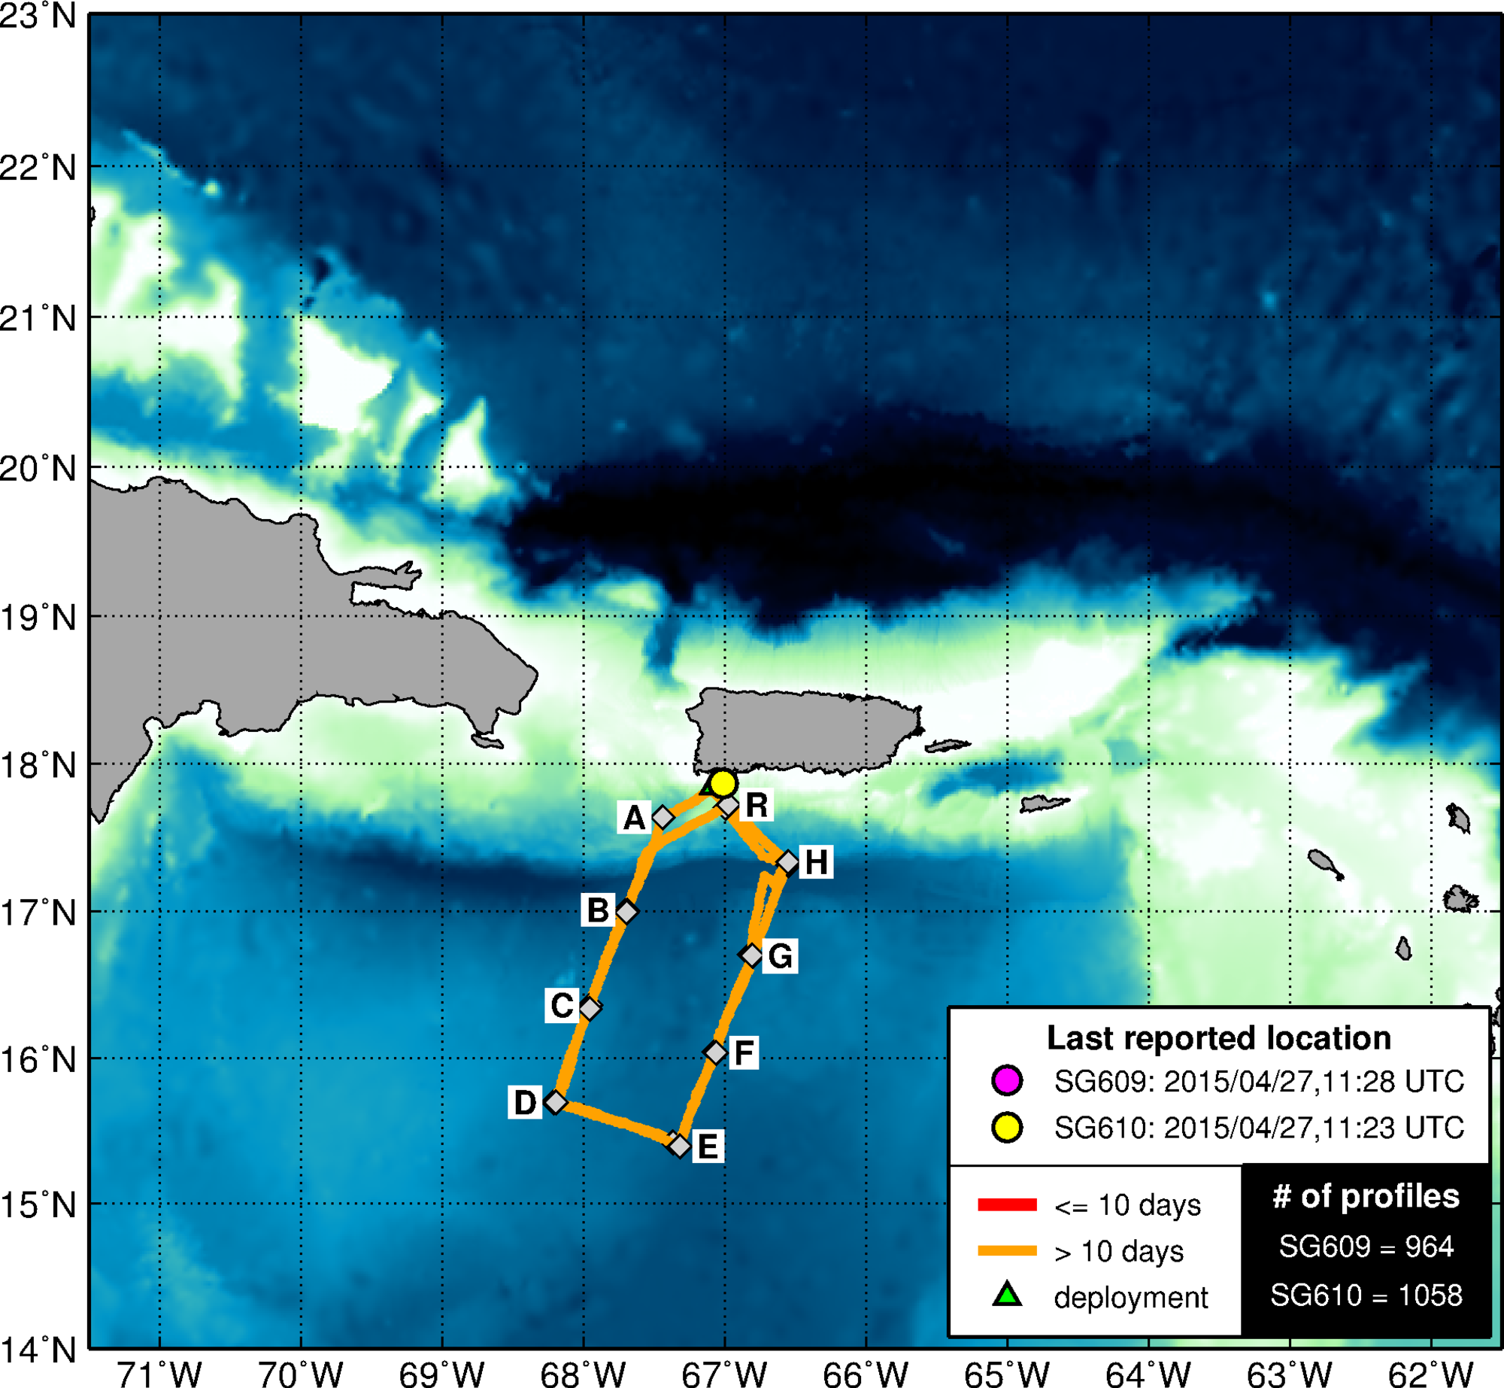
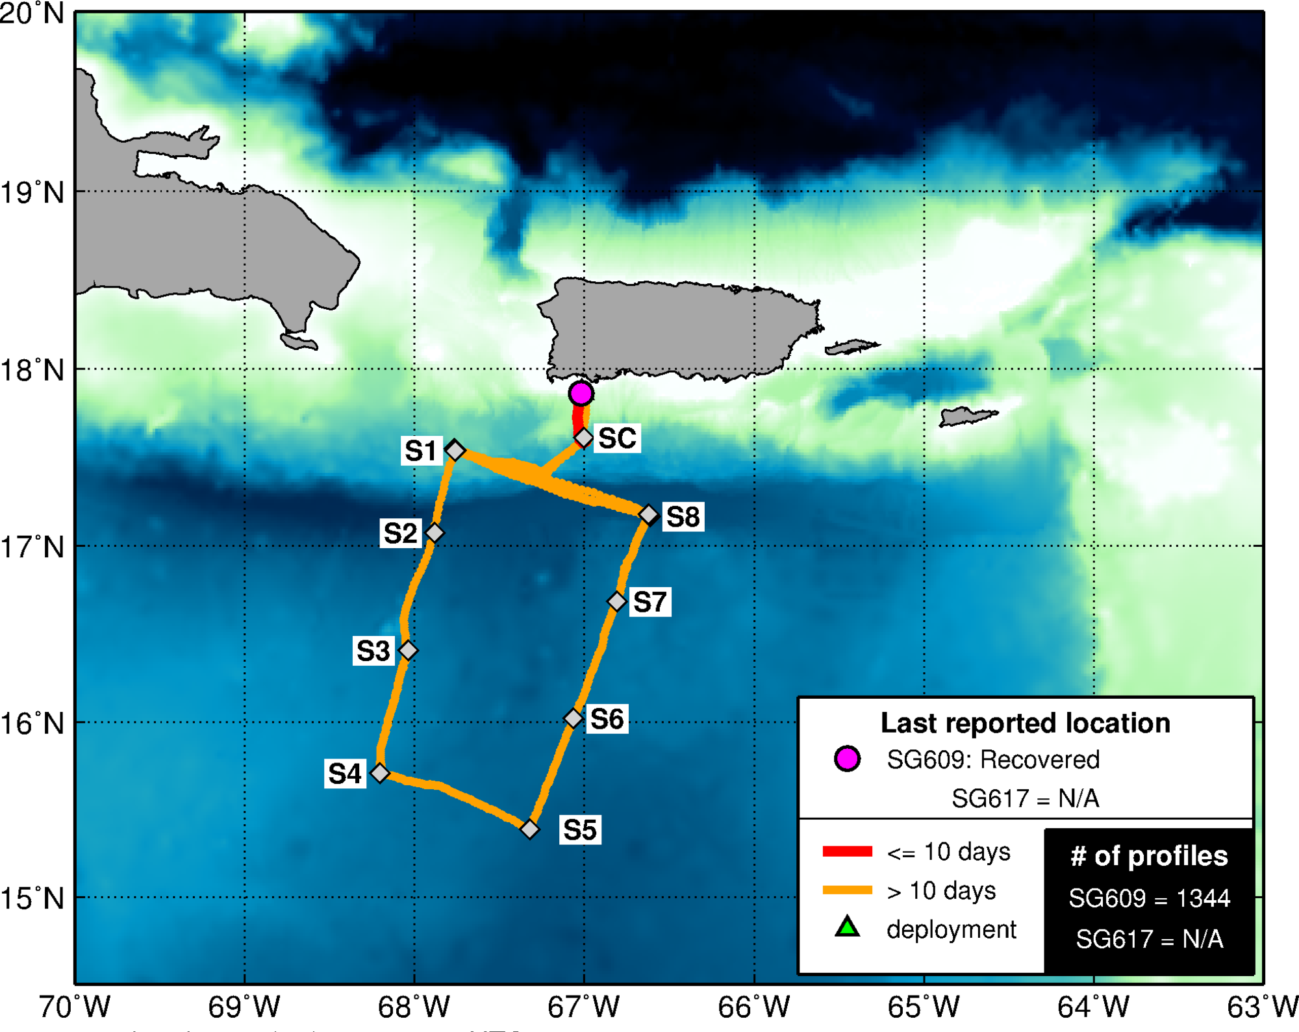
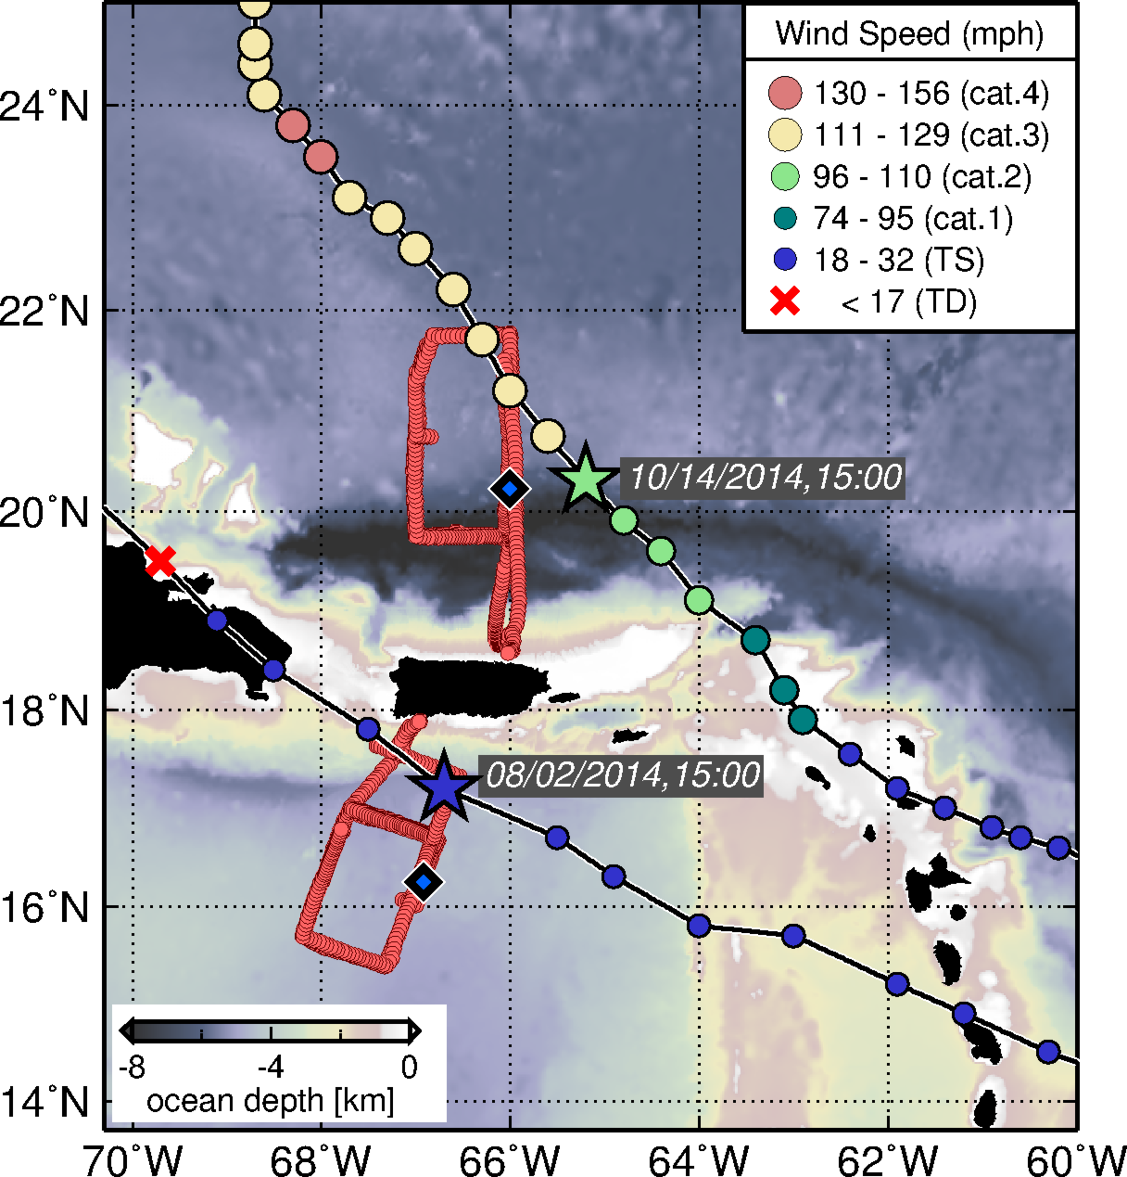
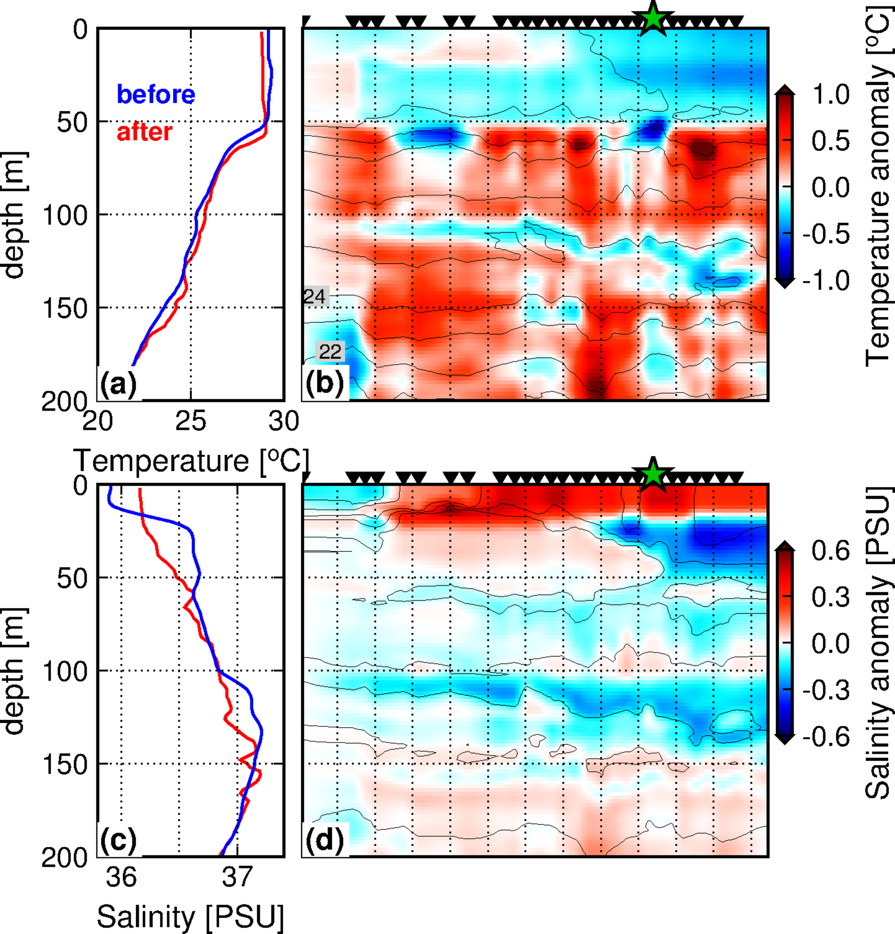
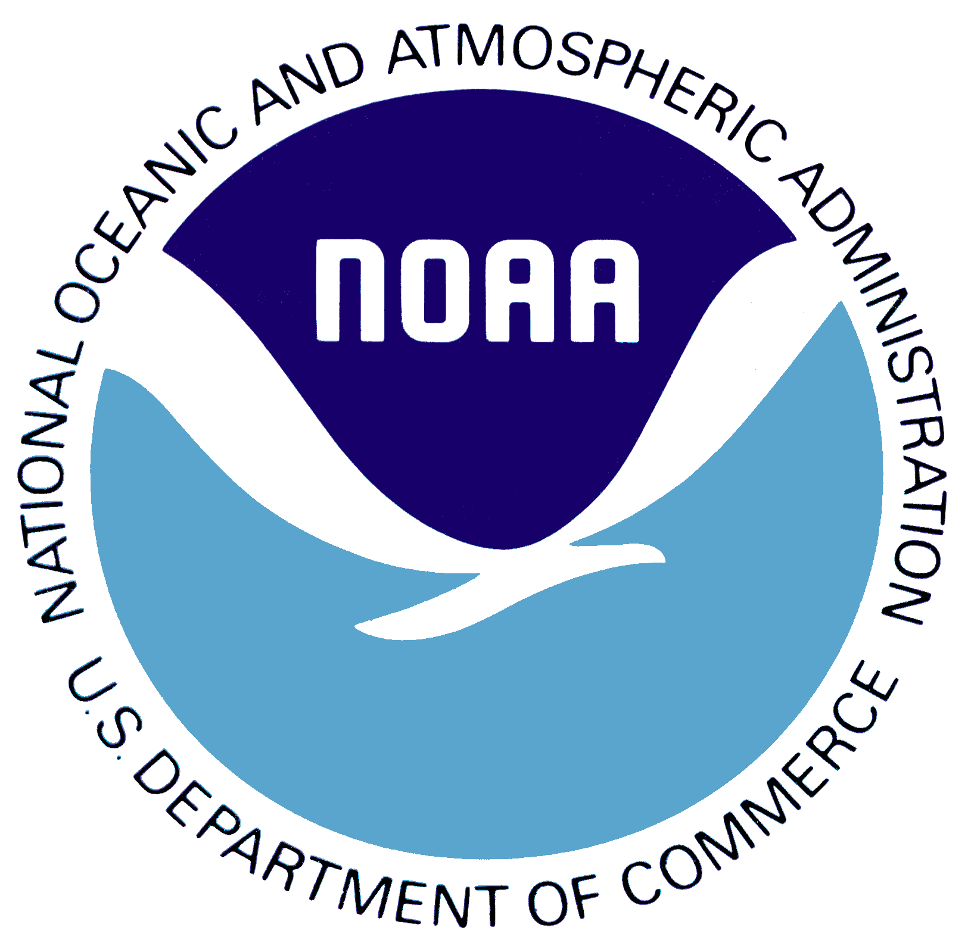
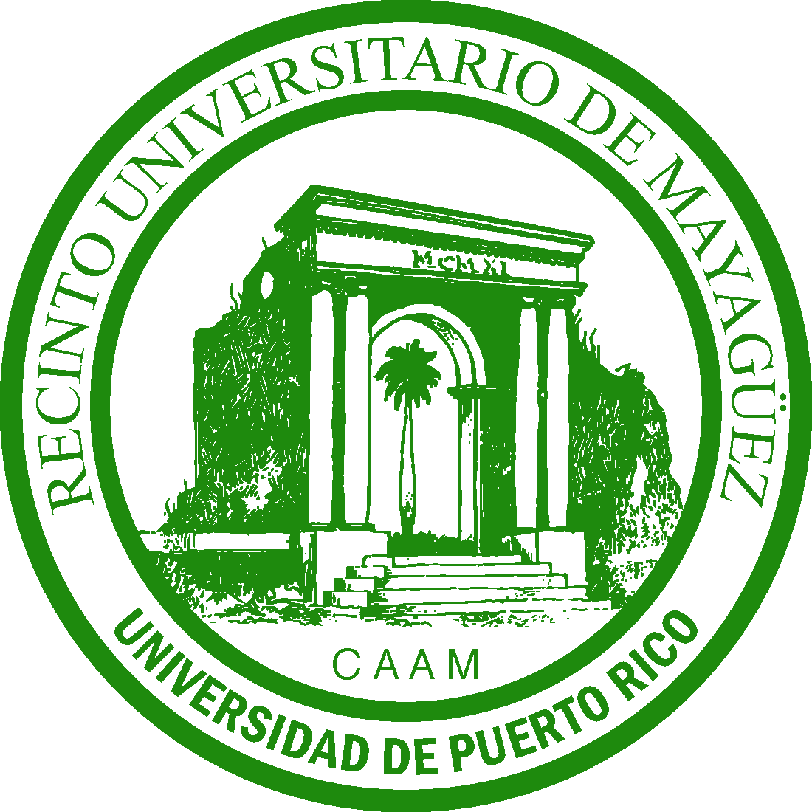
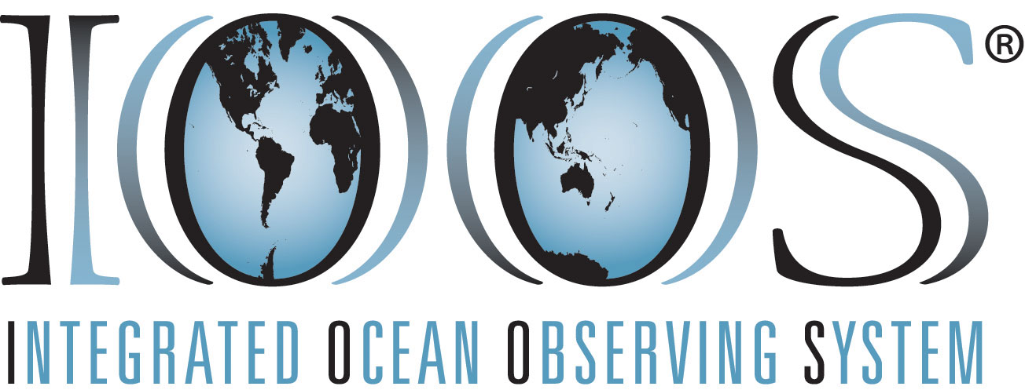

NOAA/AOML – CariCOOS Hurricane Underwater Glider Operations
Gustavo Jorge Goni¹, Francis Bringas¹, Ricardo Domingues^{2,1}, Jili Dong ^{2,1}, Grant Rawson^{2,1}, Julio Morell³, George Halliwell¹, Sang-Ki Lee¹, Hyun-Sook Kim⁴, Luis Pomales³, Becky Baltles⁵, Richard Bouchard⁶, Yamil Rodriguez⁷
PR
NOAA Emerging Technologies Conference, Washington DC, July 2016
2. Goal
Enhance our understanding of air-sea interaction processes during hurricane force wind events
Objectives
Assess impact of hurricane force winds on upper ocean density structure, and
Assess impact of ocean profile data from underwater gliders in hurricane intensity forecasts
1. Motivation
3. Underwater Gliders
SOME TEXT GOES HERE
SOME TEXT GOES HERE
4. Operations timeline
Hurricane Gonzalo
(October, 2014)
TS Bertha
(August, 2014)
Funded
(December 2013)
Purchase of Gliders
(March 2014)
Training
(June 2014)
Gliders Delivered
(July 2014)
Mission 01
July – November 2014
Mission 02
February – April, 2015
Mission 04
March– June, 2016
Proposal
(October 2013)
Disaster Relief Appropriations Act of 2013
Glider port at La Parguera
Mission 03
July – November, 2015
TS Erika
(August, 2015)
5. Key results
IR-NHC: CIMSS
Glider Ocean Observations
Coupled Hurricane Forecast
6. Data Distribution
Hurricane Gonzalo
7. Operation Highlights
TS Bertha
Bullets with Key Findings go Here
Acknowledgments
This work was funded by the Disaster Relief Appropriations Act of 2013 known as the Sandy Supplemental, and supported by NOAA/AOML, UPRM, UM/CIMAS, NOAA/NDBC, NOAA/IOOS, CariCOOS, and ANAMAR.
Affiliations
1 NOAA/AOML, Miami, Florida, USA
2 University of Miami, CIMAS, Miami, Florida, USA
3 University of Puerto Rico, Mayagues, Puerto Rico, and CariCOOS
4 NOAA/EMC, College Park, Maryland, USA
5 IOOS Office, Silver Spring, MD, USA
6 NOAA/NDBC, Stennis, Miss, USA
7 ANAMAR, Santo Domingo, Dominican Republic
QR Code
QR Code

