Slide 1


Hurricane Gonzalo (2014): upper-ocean processes and hurricane intensity forecast using underwater gliders data
Ricardo Domingues^{1,2}
Jili Dong³
Gustavo Goni²
Francis Bringas²
George Halliwell²
Sang-Ki Lee²
Julio Morell⁴
Hyun-Sook Kim³
Luis Pomales⁴
1 University of Miami, Cooperative Institute for Marine and Atmospheric Studies - CIMAS, Miami, Florida, USA
2 NOAA Atlantic Oceanographic and Meteorological Laboratory - AOML, Miami, Florida, USA
3 NOAA Environmental Modeling Center , College Park, Maryland, USA
4 University of Puerto Rico, Mayagues, Puerto Rico, and Caribbean Coastal Ocean Observing System - CARICOOS

Slide 2
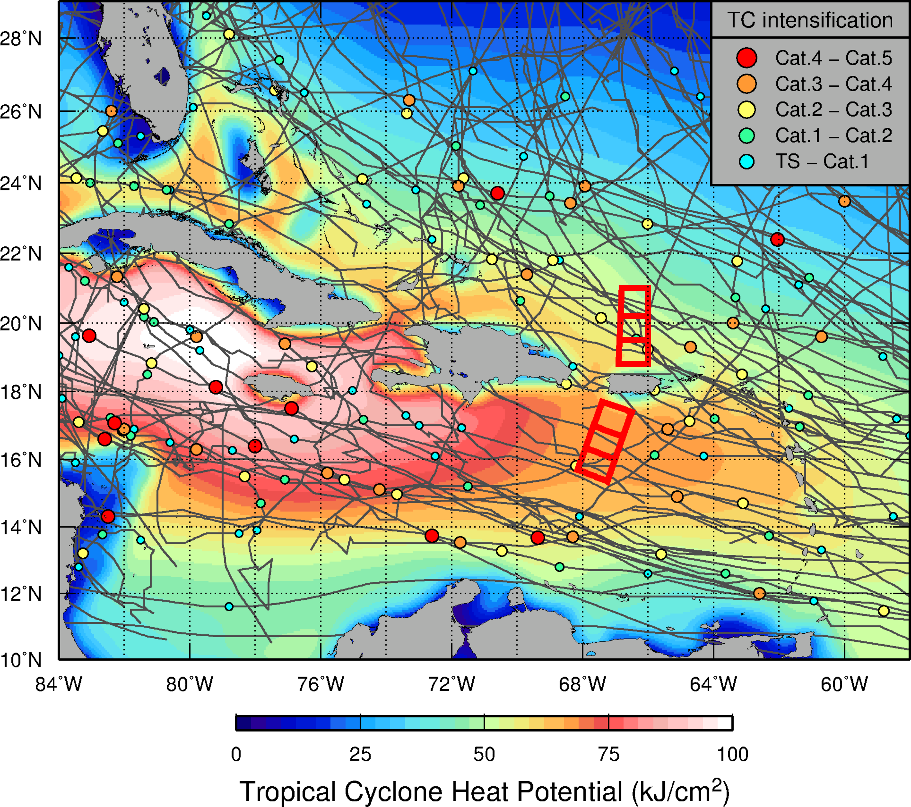
NOAA/AOML – CariCOOS Hurricane Underwater Glider Operations
Goal: Enhance our understanding of air-sea interaction processes during hurricane force wind events:
Objectives:
  Assess impact of hurricane force winds on upper ocean density structure, and
  Assess impact of ocean profile data from underwater gliders in hurricane intensity forecasts.
Implemented in 2014
  Four successful missions completed
    With 9 deployments
  Fifth mission currently underway with 4 gliders
  Over 10,000 T & S profiles sampled up-to-date
”NOAA/AOML – CariCOOS Hurricane Underwater Glider Operations” talk
  Tuesday, September 27, 11:45AM
http://www.aoml.noaa.gov/phod/gliders

Slide 3
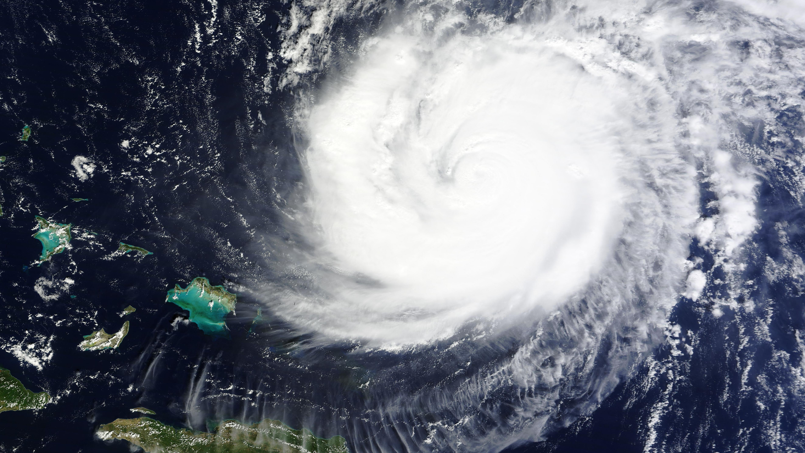
Hurricane Gonzalo (2014)
”
"At the time, the strongest Atlantic hurricane since Igor (2010)”
October 15, 2014

Slide 4
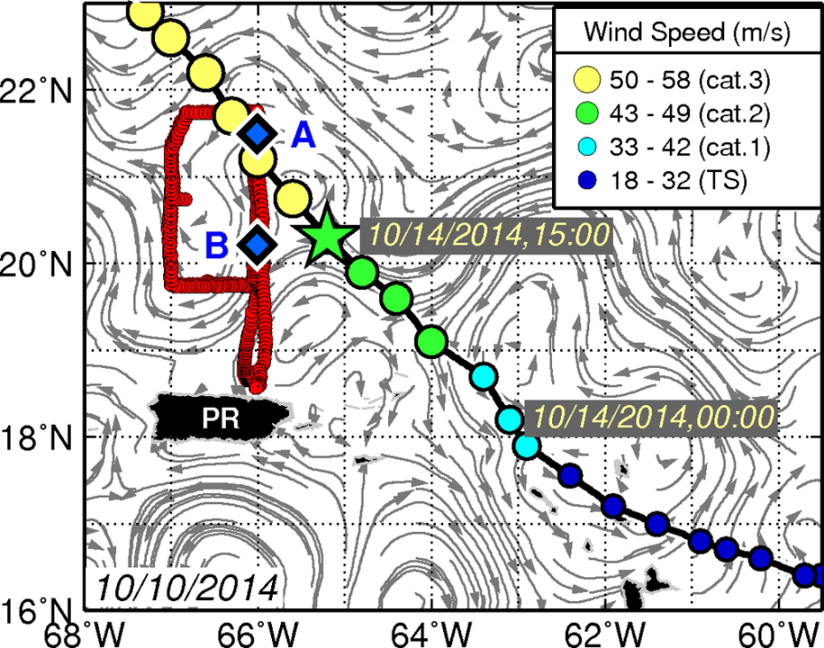
Hurricane Gonzalo (2014)
Glider Sampling strategy
A
A
B
1st pass
Oct 8-13
2nd pass
Oct 15-23
3rd pass
Oct 23-28
Site B
Oct 13-15
B
Pre-storm
During storm
Post-storm
PR – Puerto Rico

Slide 5
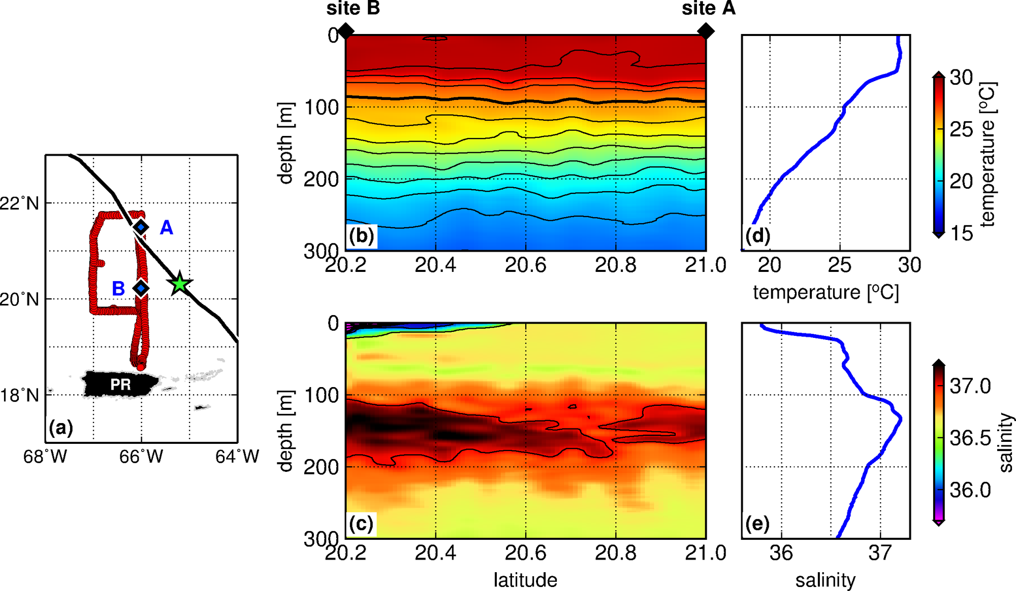
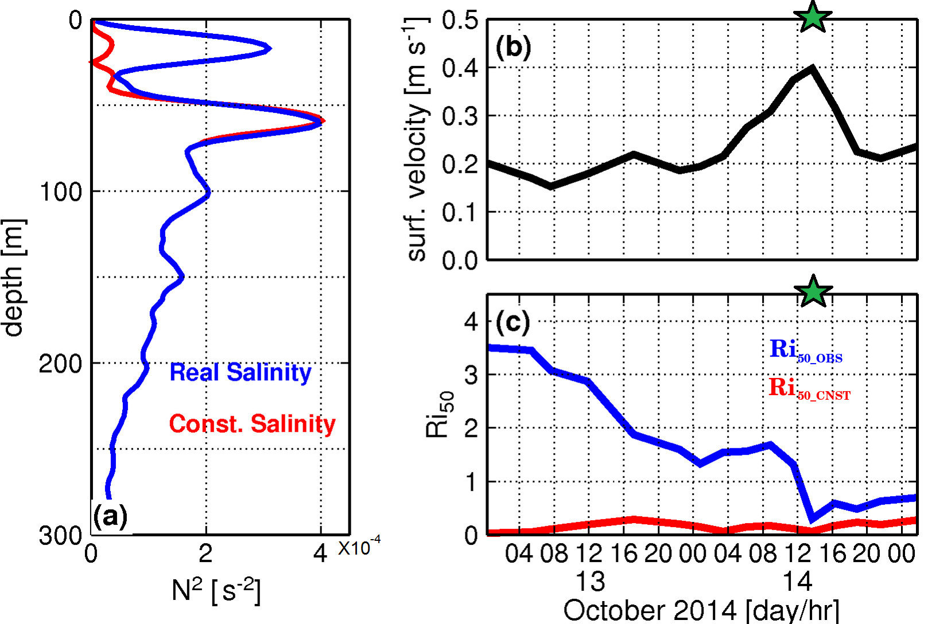
Pre-storm: glider observations
Profile at site B
Buoyancy Frequency at site B
SST of 29C above 50m
TCHP of 86 kJ/cm²
Shallow low salinity layer above 20 m -> barrier layer

Slide 6
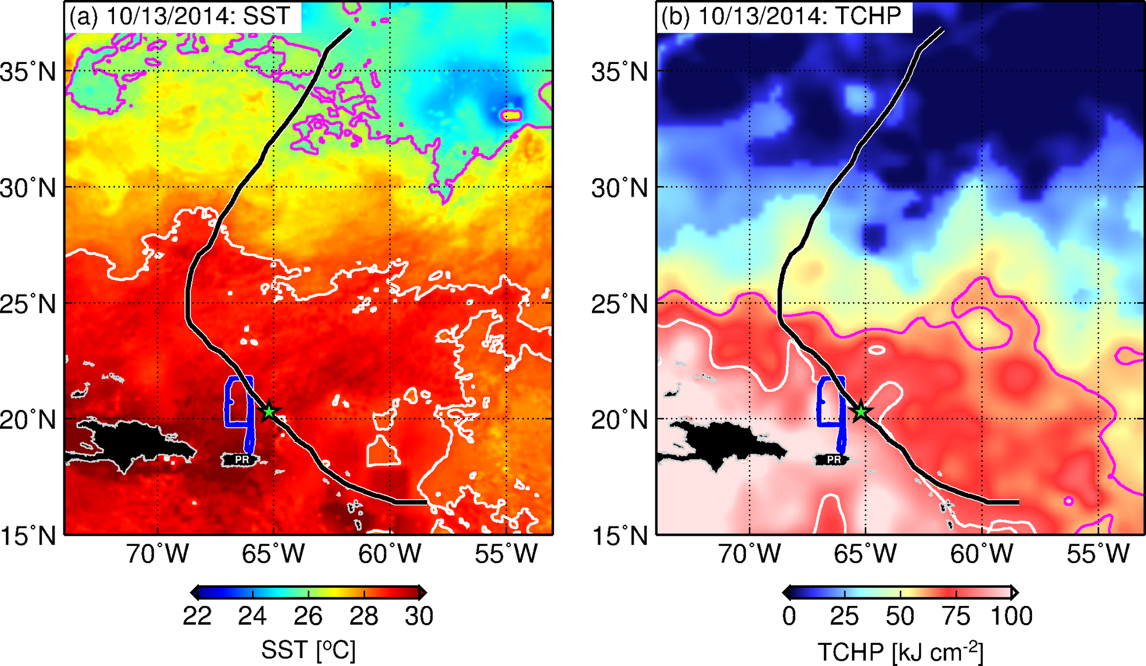
Pre-storm: satellite-derived observations
SST
  28.5C (white line, warm pool)
  26C (magenta line)
TCHP
  80 kJ/cm² (white line)
  60 kJ/cm² (magenta line)

Slide 7
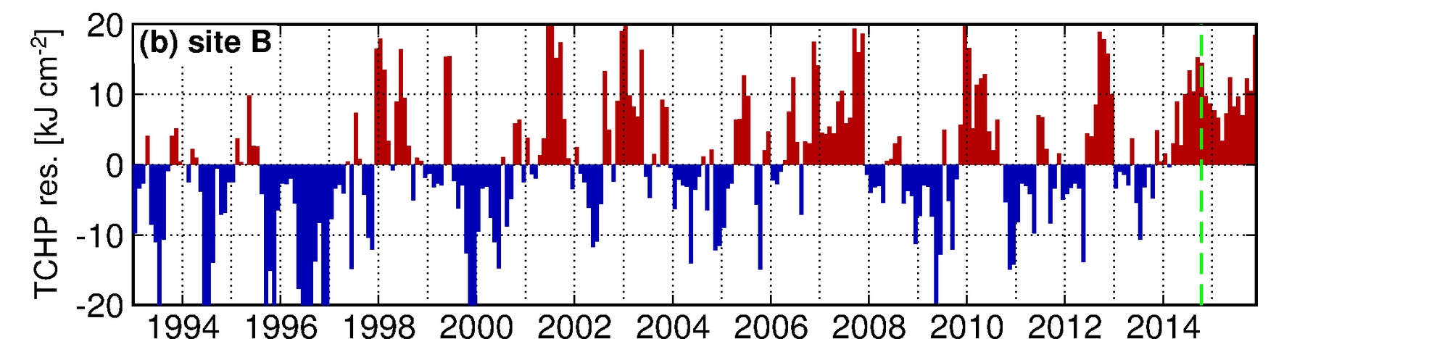
Pre-storm: warm conditions during October 2014
TCHP residuals (annual cycle removed)
  +15 kJ/cm² above average values at site B

Slide 8
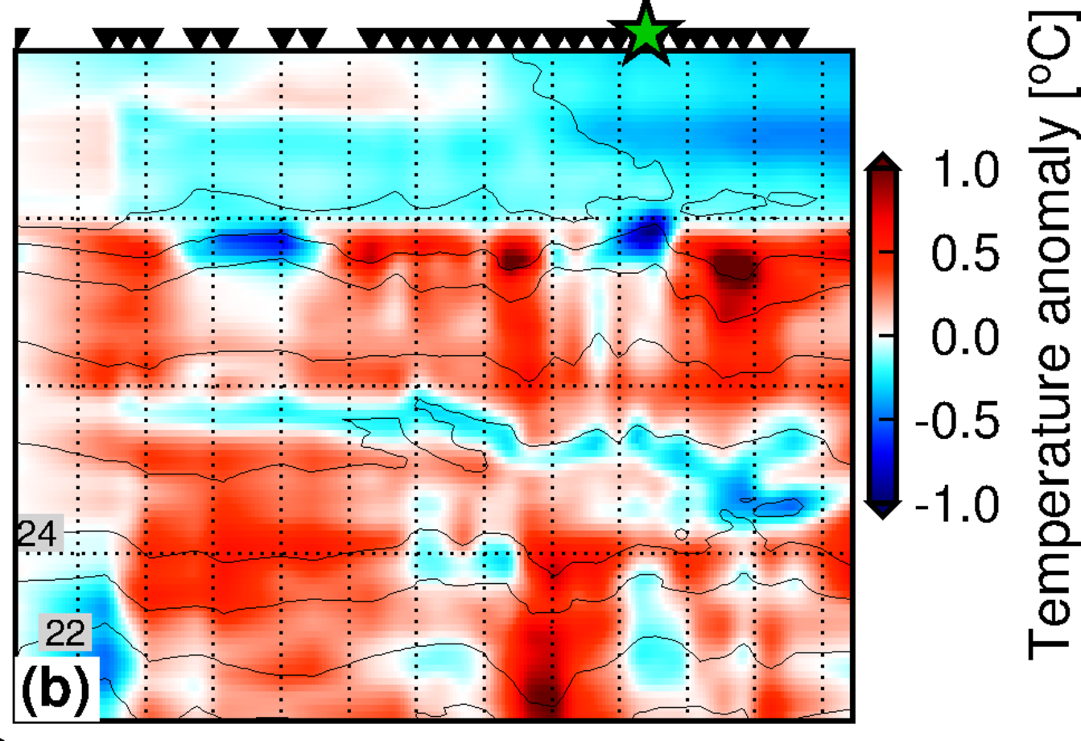
During-Storm: glider observations at site B
Time-series of temperature anomalies at site B referenced to initial conditions
Cooling anomalies observed in the layer above 50 m
  Maximum cooling of ~0.4C 4h after closest location from Hurricane Gonzalo
Time-series of Ri indicate that the Barrier layer is slowly eroded as Gonzalo approaches the location of the glider
Main finding: Upper-ocean cooling at the location of the glider was likely largely suppressed by the Barrier layer.
50
100
Depth [m]
150
200
Time-series of Richardson Number above 50m
Domingues et al., (2015), Upper ocean response to Hurricane Gonzalo (2014): Salinity effects revealed by targeted and sustained underwater glider observations, Geophys. Res. Lett., 42, doi:10.1002/2015GL065378.

Slide 9
AOML Underwater Glider Observations:
Impact of ocean data on Hurricane Gonzalo coupled Forecast
The model: Hurricane Weather and Research Forecast (HWRF)-Hybrid Coordinate ocean model (HYCOM) coupled forecast system, HWRF-HYCOM
HWRF-HYCOM: NOAA’s next generation hurricane forecast model
Numerical Experiments
NODA - HYCOM with no data assimilated
GLID - HYCOM with only glider data assimilated
CTRL - HYCOM with all ocean data minus gliders assimilated
ALL - HYCOM with all ocean data assimilated
ocean: HYCOM
atm: HWRF

Slide 10
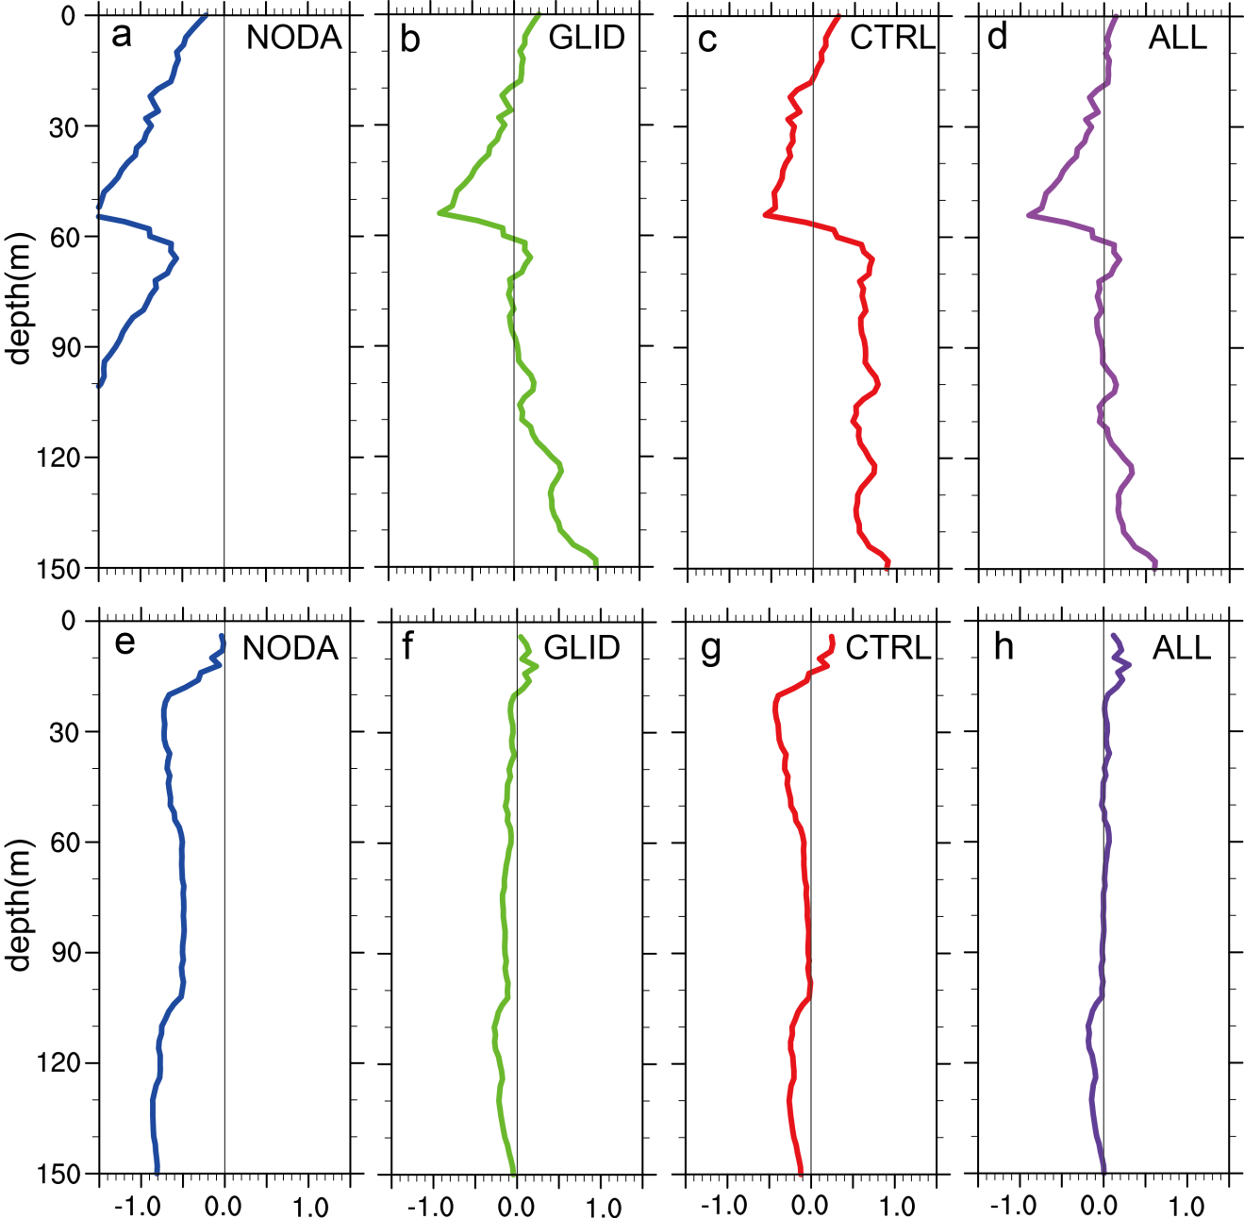
AOML Underwater Glider Observations:
Impact of ocean data on Hurricane Gonzalo coupled Forecast
HYCOM minus glider data at Site B
HYCOM with no data assimilated
HYCOM with only glider data assimilated
HYCOM with all ocean data – gliders assimilated
HYCOM with all ocean data assimilated
Temperature differences
NODA – negative biases throughout water column
HYCOM simulates shallower homogeneous temperature layer
Assimilation of glider T/S profiles improved the vertical thermal and saline structure by reducing biases throughout most of the upper 150 m.
Salinity differences

Slide 11
AOML Underwater Glider Observations:
Impact of ocean data on Hurricane Gonzalo coupled Forecast
Pre-storm temperature conditions
Pre-storm salinity conditions
Observation (glider)
HYCOM with no data assimilated
HYCOM with glider data assimilated
No data
No data

Slide 12
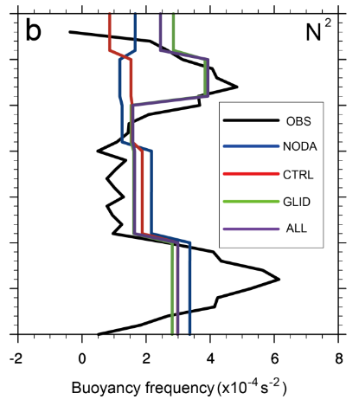
AOML Underwater Glider Observations:
Impact of ocean data on Hurricane Gonzalo coupled Forecast
Barrier layer
Pre-storm salinity conditions
Pre-storm buoyancy frequency
Observation (glider)
HYCOM with no data assimilated
HYCOM with glider data assimilated
No data
Thermocline
Barrier layer stratification is ONLY included in the simulations when glider data is assimilated into HYCOM

Slide 13
AOML Underwater Glider Observations:
Impact of ocean data on Hurricane Gonzalo coupled Forecast
Minimum Pressure
NOAA-NHC Best Track
HYCOM-HWRF: no data
HYCOM-HWRF: ALL data
Pressure: assimilation of ocean obs. allowed for 100% error reduction
Maximum wind: assimilation of ocean obs. reduced ~50% the error in terms of maximum wind
Maximum Wind

Slide 14
Main conclusions:
Upper ocean cooling during Hurricane Gonzalo was likely partly suppressed by the presence of a barrier layer, providing favorable conditions for further intensification
Ocean conditions during October 2014 were unusually warm and favorable for the development and intensification of Tropical Cyclones, given the appropriate atmospheric conditions
Analysis from Hurricane Gonzalo coupled forecast indicates that:
  Assimilation of underwater glider data improves pre-storm ocean thermal and saline structures
  Barrier layer is ONLY retrieved with underwater glider data assimilated
  Ocean data assimilation significantly improves Hurricane Gonzalo intensity forecast; when added to the standard ocean observations, underwater glider shows larger impact than assimilated alone
Future work:
Continue collecting ocean profile data in areas of Tropical Cyclone activity
Continue to assess the impact of underwater glider observations on intensity forecast for individual hurricanes and create long record and statistical analysis.
Assess optimal observational strategy to improve TC intensity forecast using a suite of ocean observations.
Publications
Domingues, R., G. Goni, F. Bringas, S.-K. Lee, H.-S. Kim, G. Halliwell, J. Dong, J. Morell, and L. Pomales (2015), Upper ocean response to Hurricane Gonzalo (2014): Salinity effects revealed by targeted and sustained underwater glider observations, Geophys. Res. Lett., 42, doi:10.1002/2015GL065378.
Dong et al, Impact of underwater glider data on Hurricane Gonzalo (2014) forecast, 2016, to be submitted.

Slide 15
Hurricane Gonzalo (2014): upper-ocean processes and hurricane intensity forecast using underwater gliders data
Ricardo Domingues^{1,2}
Jili Dong³
Gustavo Goni²
Francis Bringas²
George Halliwell²
Sang-Ki Lee²
Julio Morell⁴
Hyun-Sook Kim³
Luis Pomales⁴
1 University of Miami, Cooperative Institute for Marine and Atmospheric Studies - CIMAS, Miami, Florida, USA
2 NOAA Atlantic Oceanographic and Meteorological Laboratory - AOML, Miami, Florida, USA
3 NOAA Environmental Modeling Center , College Park, Maryland, USA
4 University of Puerto Rico, Mayagues, Puerto Rico, and Caribbean Coastal Ocean Observing System - CARICOOS
Thank you
Ricardo.Domingues@noaa.gov

