Slide 1
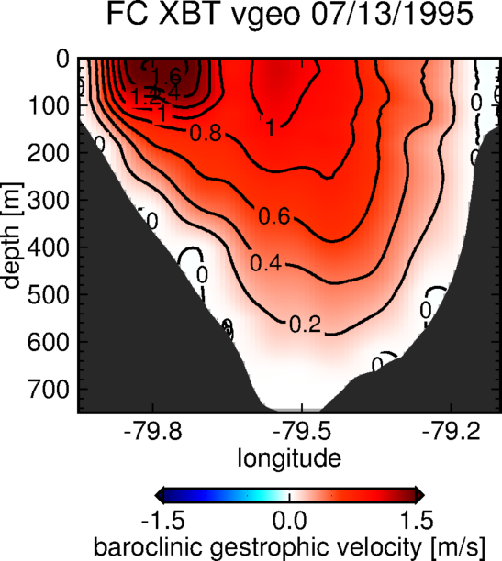
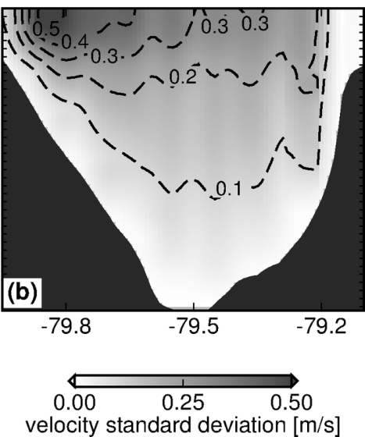
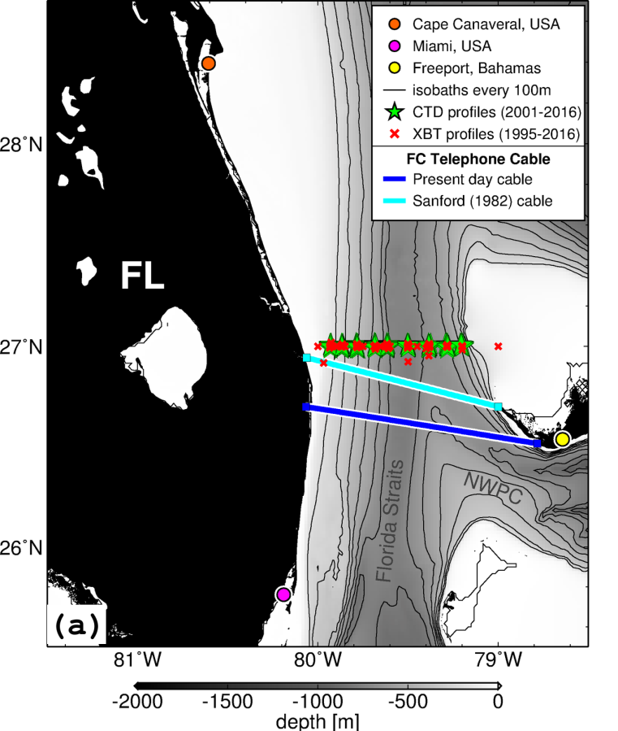
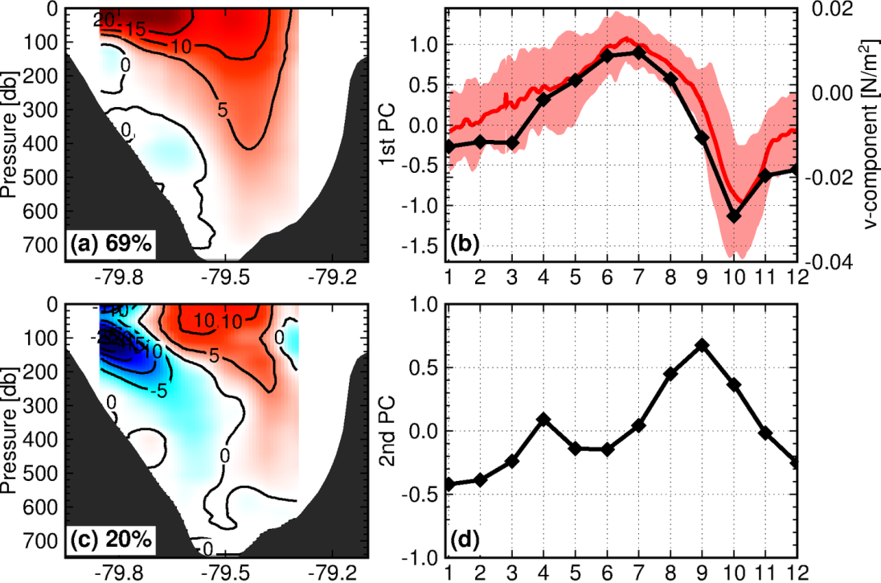
Assessing the Florida Current Baroclinic Variability at 27N using XBTs/CTDs sections
Preliminary results using data from AX_WBTS
Florida Current baroclinic velocity
07/13/1995
Seasonal modes of velocity variability
AX_WBTS XBT deployments
- Operations started in 1995
- Total of 135 transects
- ~ 9 XBTs per transect
(a) 69%
Principal component
Along-channel wind
(b) 20%
Notes:
SL variability range of 0.5 m in the Florida side.

Slide 2
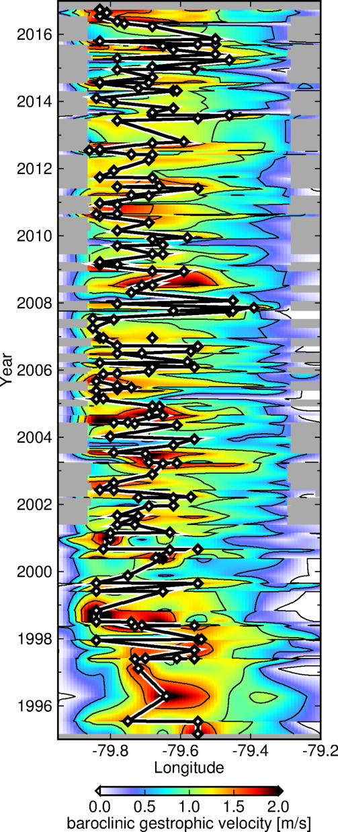
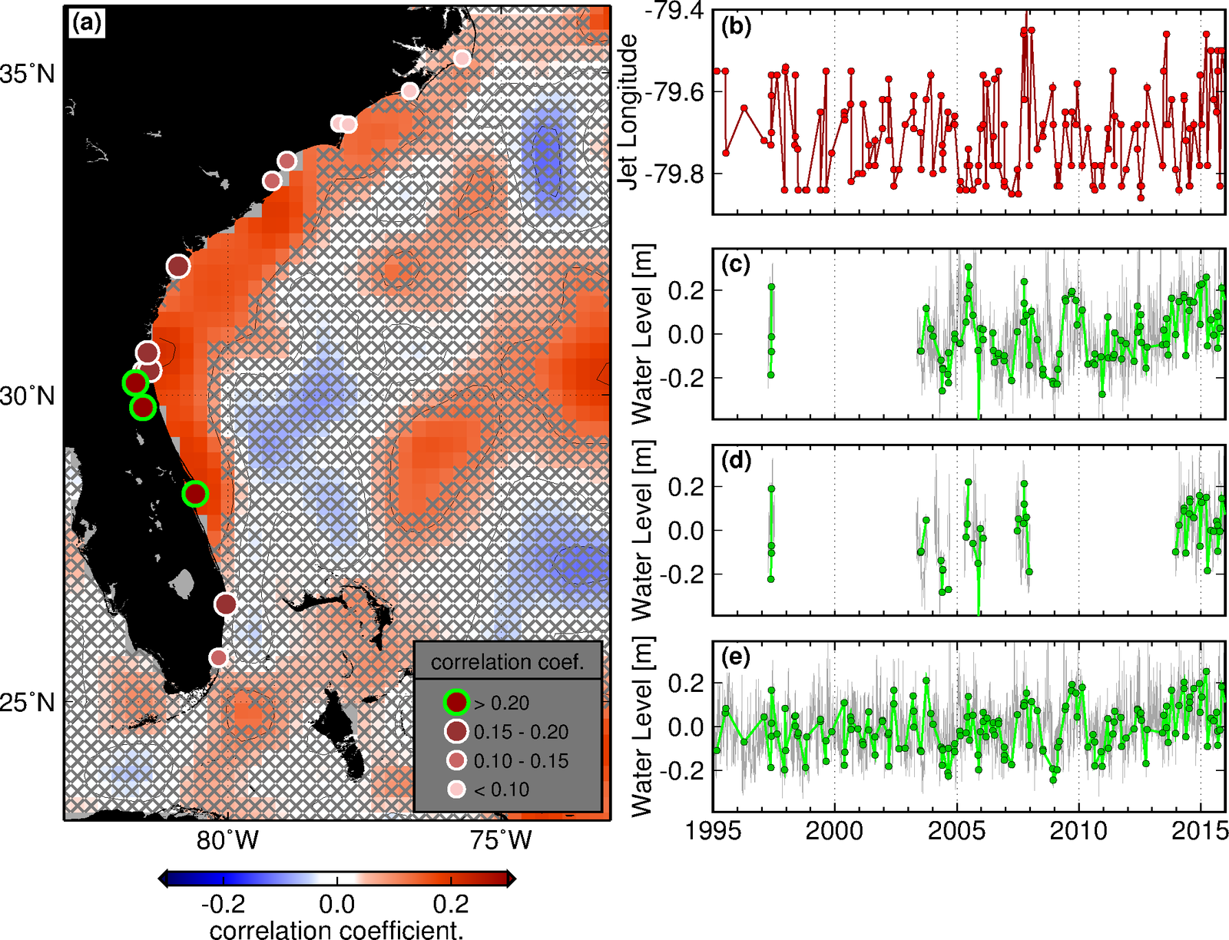
Assessing the Florida Current Baroclinic Variability at 27N using XBTs/CTDs sections
Preliminary results using data from AX_WBTS
Preliminary Results
On seasonal time-scales, the variability is dominated by the presence of an intensity-mode, essentially forced by the wind, and by a meandering-mode
The Florida Current jet exhibits meandering variability on different time-scales at 27N
  Offshore-meandering is associated with higher sea-level in the central Florida coast
  Approximately 15 cm higher-than-usual sea-level associated with offshore FC meandering
Relationship between location of Florida Current jet location and sea-level
References
- Domingues et al. (2016), Remote sources for year-to-year changes in the seasonality of the Florida Current transport. JGR-Oceans.
- Domingues et al., Manuscript in preparation.

Slide 3
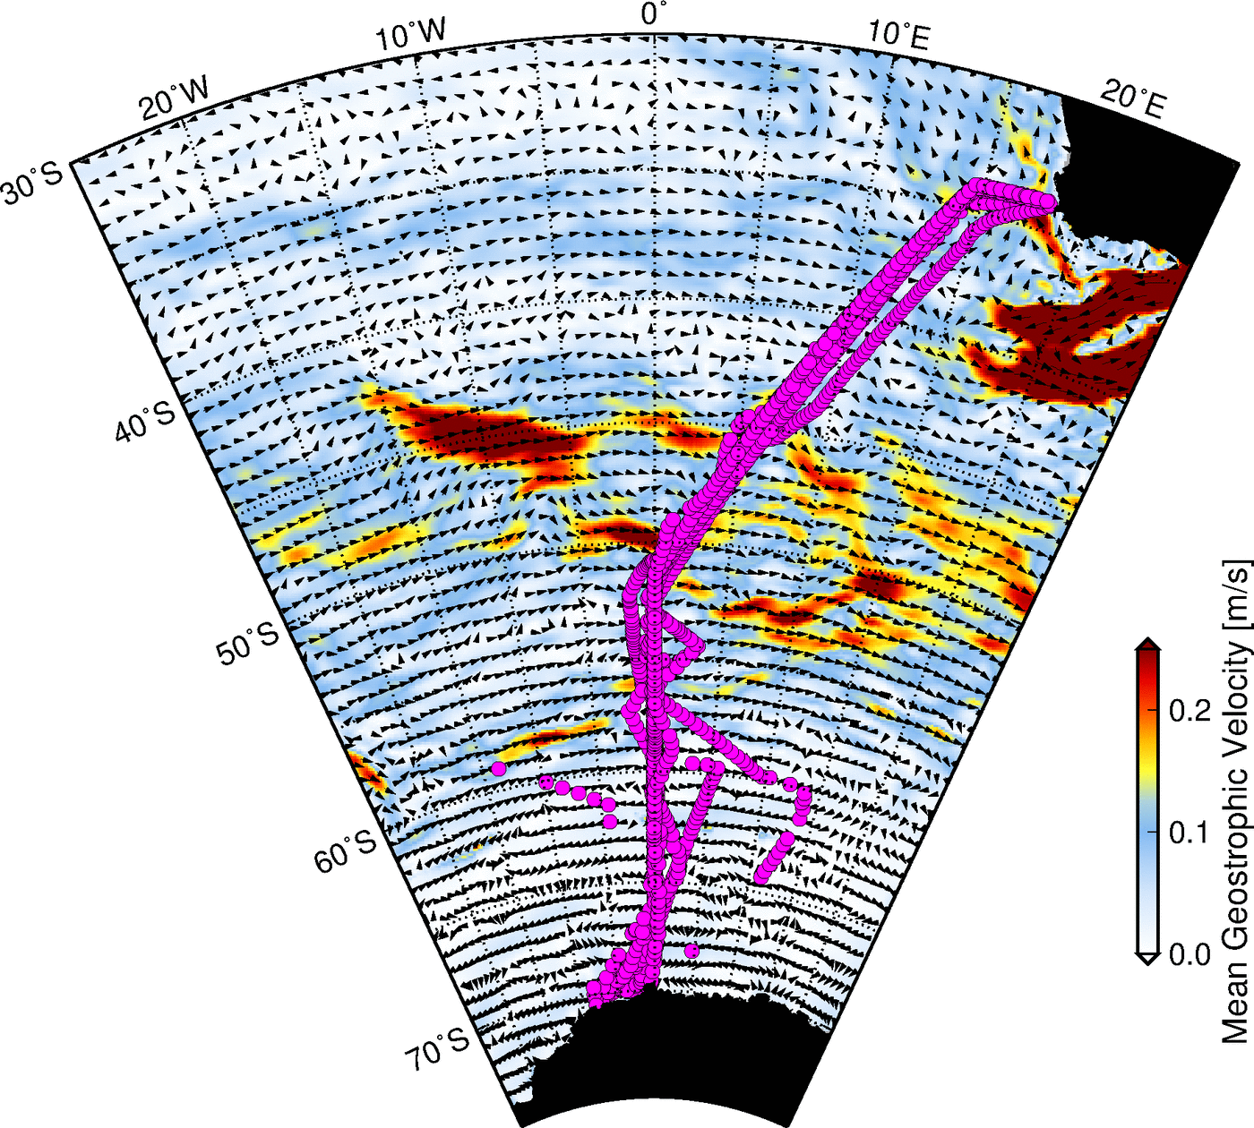
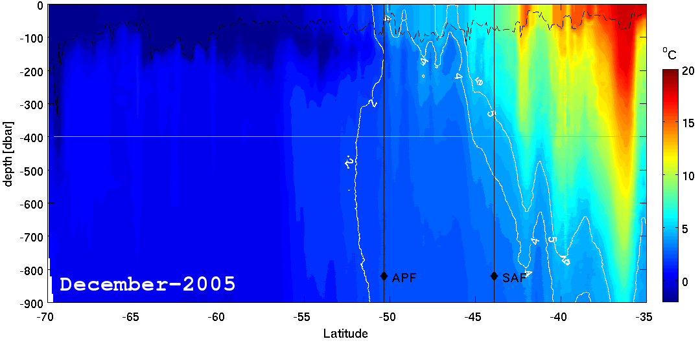
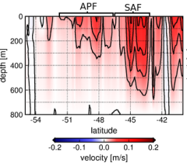
Antarctica Circumpolar Current variability between South Africa and Antarctica
AX25 XBT deployments
- Operations started in 2004
- Total of 33 transects up to date
- ~200 XBTs per transect
AX25
ACC flow
SAF
APF
ACC – Antarctica Circumpolar Current
SAF – Subantarctic Front
APF – Antarctic Polar Front
In partnership with the University of Cape Town – Goodhope Project

Slide 4
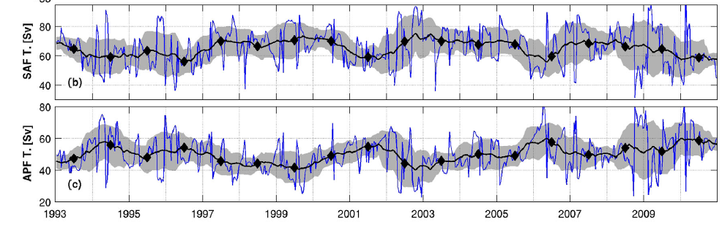
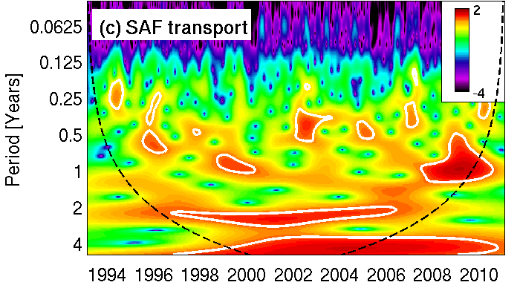
Antarctica Circumpolar Current variability between South Africa and Antarctica
Results using data from AX25
SAF and APF transports derived from AX25 and atltimetry data
Key Results
The individual behavior of the SAF and APF account for most of the ACC variability.
Year-to-year changes in the SAF and APF transports associated with wind-driven variability due to the Southern Annular Mode – SAM.
References
- Domingues et al. (2014), Wind forced variability of the Antarctic Circumpolar Current south of Africa between 1993 and 2010, J. Geophys. Res.
- Swart et al. (2008), Transport and variability of the Antarctic Circumpolar Current south of Africa. J. Geophys. Res.

