Slide 1



A GRAVEST EMPIRICAL MODE SHORT RANGE FORECAST SYSTEM
PHOD retreat, March 28-29, 2012

Slide 2
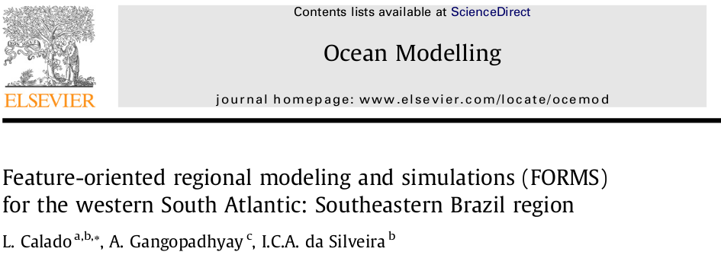
Introduction
“Synoptic ocean prediction and simulation require the best possible speciﬁcation of the initial conditions”
The lack of real-time data has led to the application of techniques such as the Feature-Oriented Models.

Slide 3
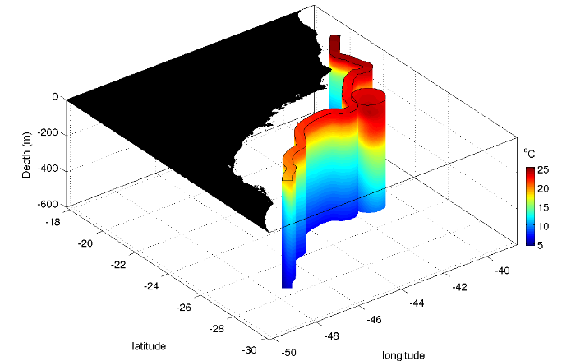
Introduction
The Feature-Modeling technique consist of building a synoptic mass structure for a specific oceanographic feature using parametric equations and past observations.
Disadvantage: produces spatially discontinuous fields

Slide 4
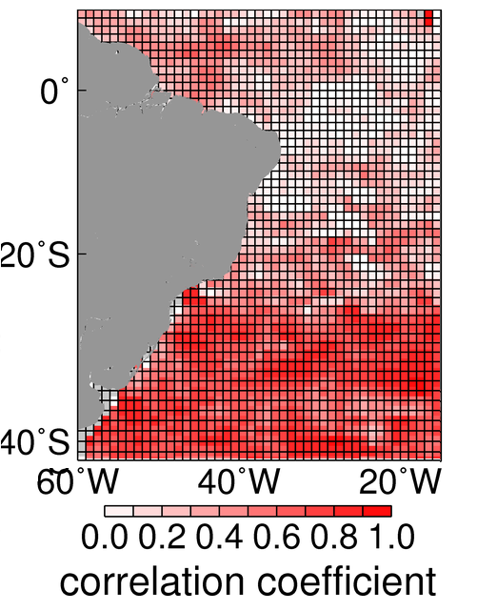
Objective
Investigate the feasibility of the Gravest Empirical Mode technique to produce an realistic density/momentum structure for the ocean.
How well can we perform a short forecast with this technique?

Slide 5
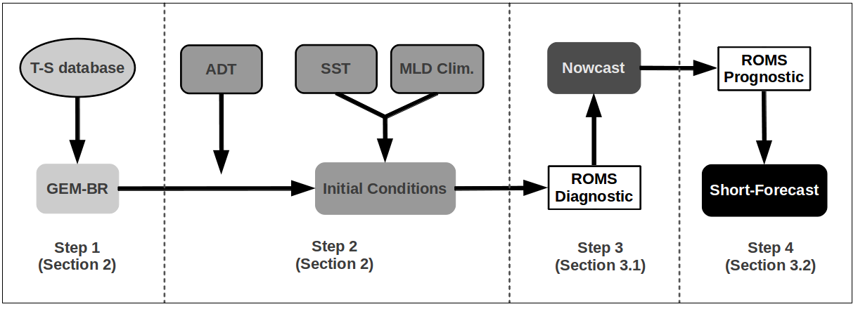
Method

Slide 6
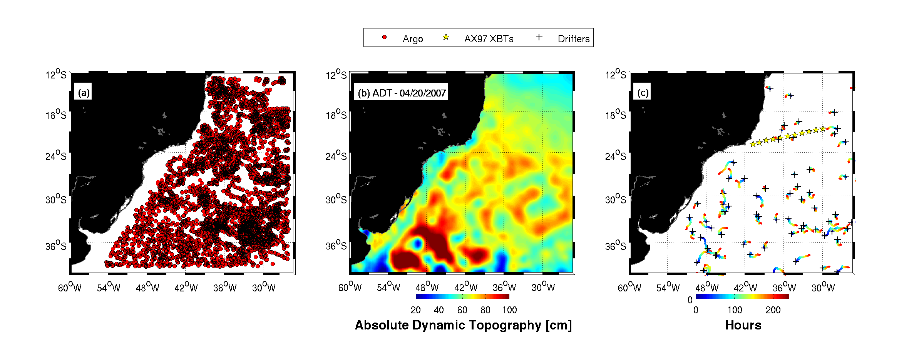
Data
ADT : 04/20/2007
Short-Range forecast: 04/20 – 05/01

Slide 7
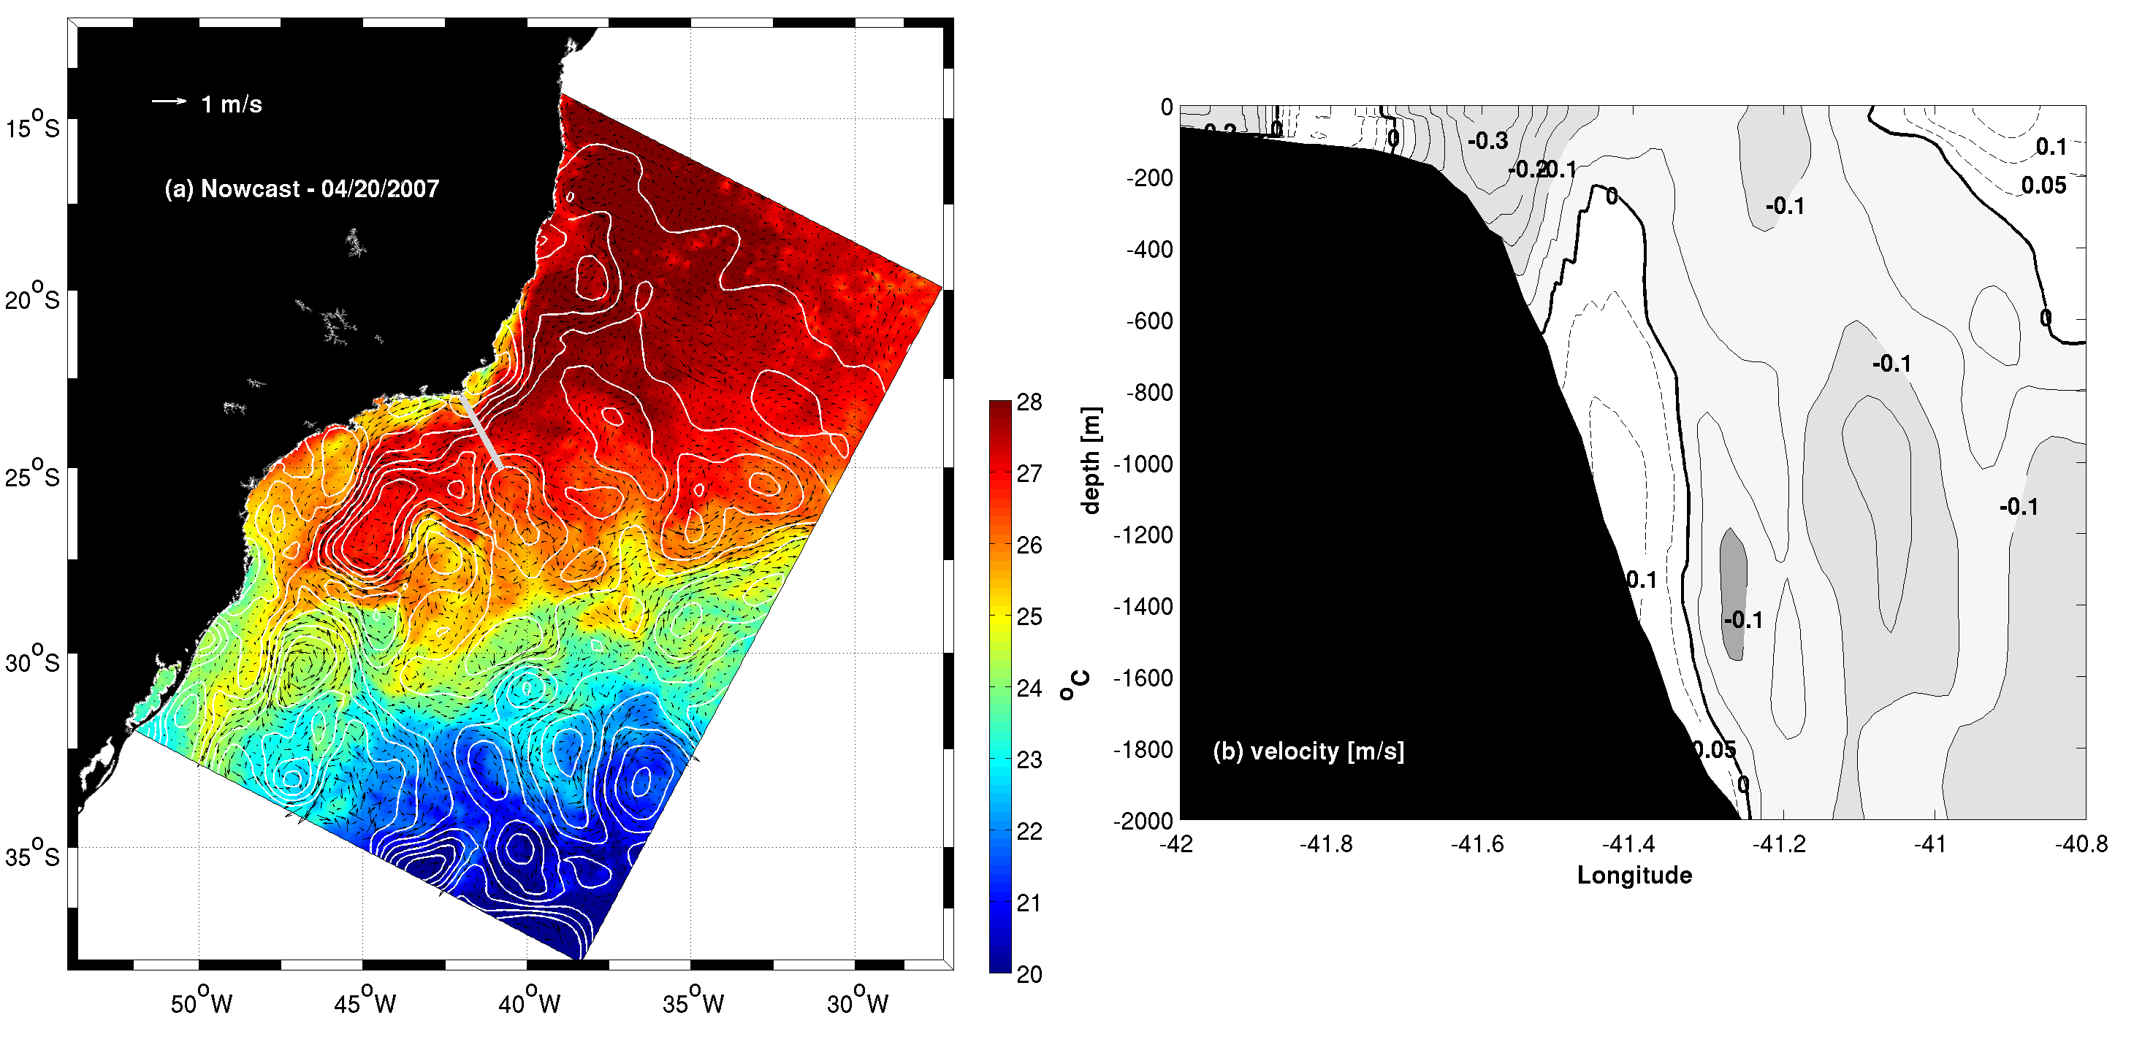
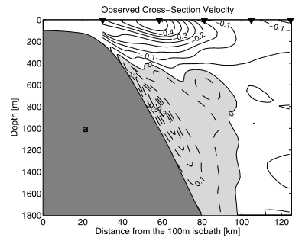
Preliminary Results - Nowcast
Silveira et al. 2004

Slide 8
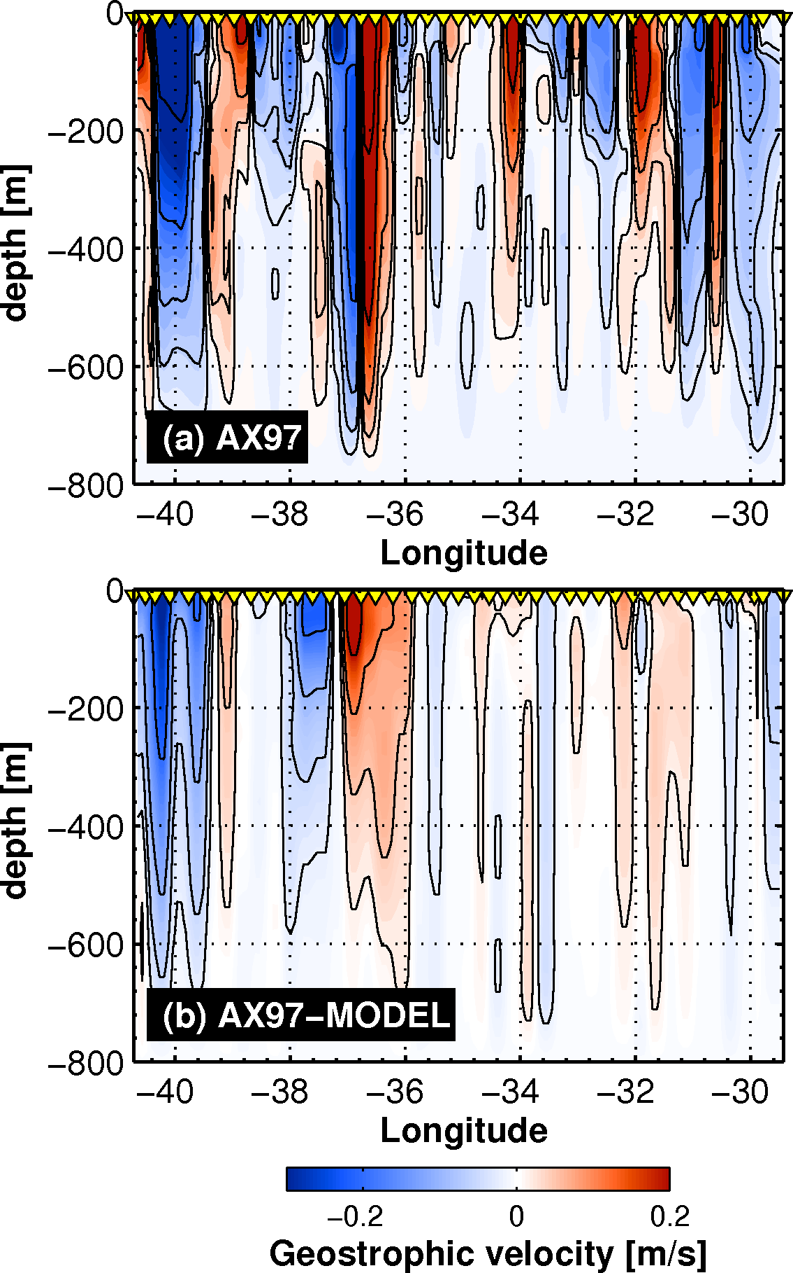
Preliminary Results - Forecast
AX97 APR04 – 04/21/2007 – 04/23/2007

Slide 9
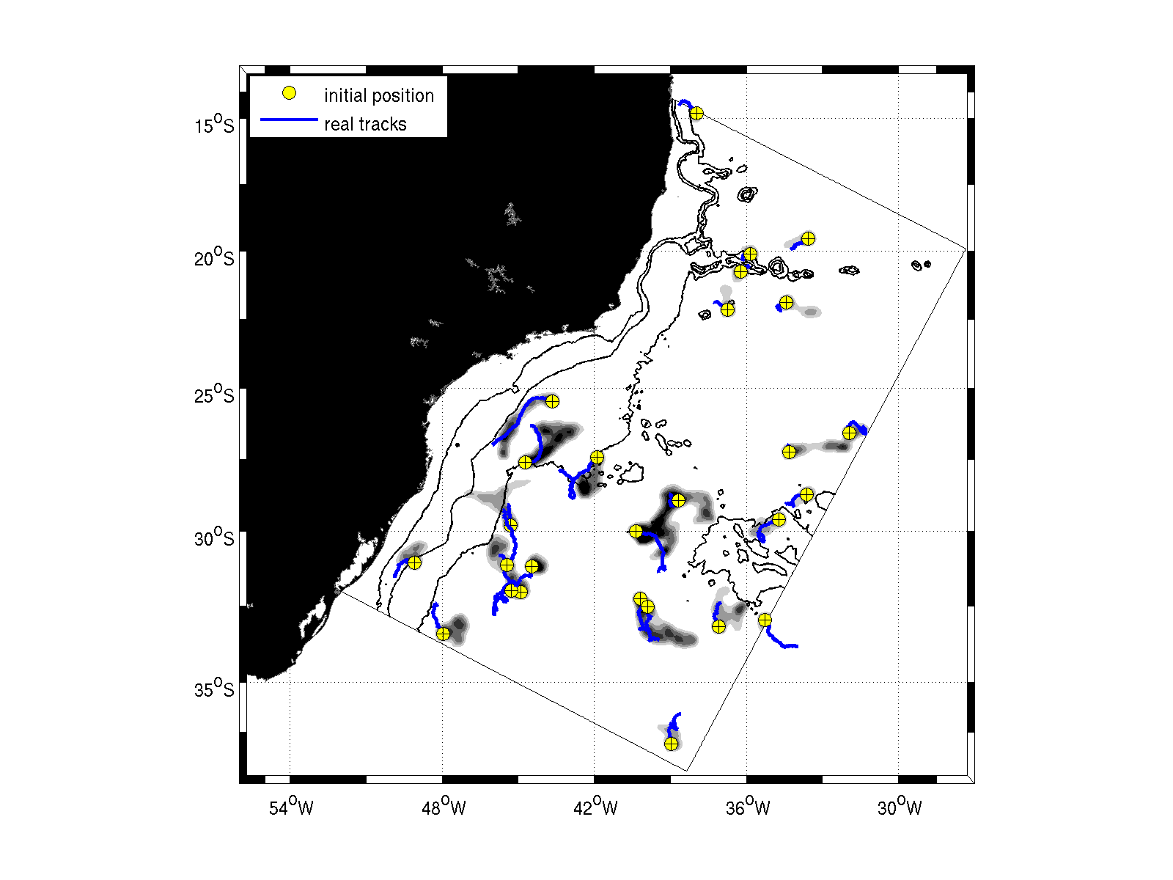
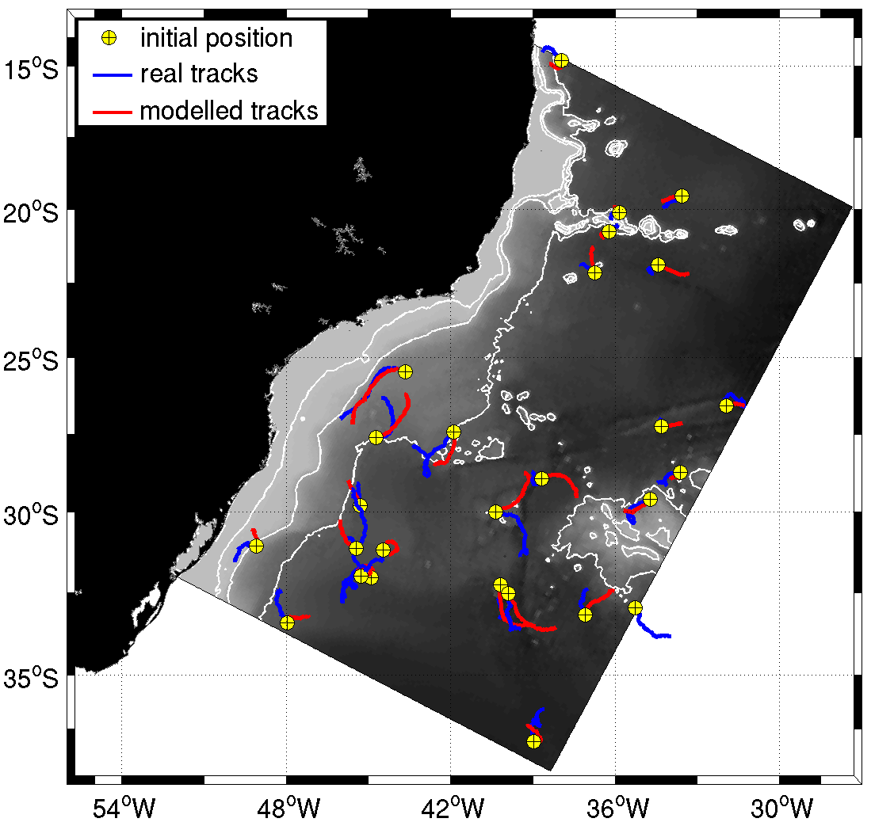
Preliminary Results - Forecast

