Slide 1
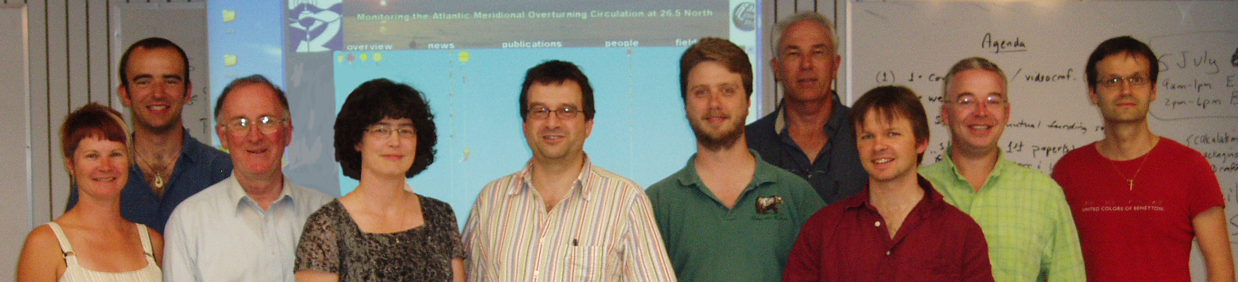

Western Boundary Time Series:
M. Baringer, C. Meinen, S. Garzoli, S. Dong, G. Goni, R. Domingues, R. Garcia, J. Hooper, R. Smith
NOAA/AOML, Miami, FL
B. Johns, L. Beal, Z. Garraffo RSMAS, University of Miami, Miami FL
H. Bryden, S. Cunningham, T. Kanzow,, J. Hirschi, D. Rayner
D. Smeed, B. Moat, G. McCarthy, E. Frajka-Williams,
A. Duchez, C. Roberts, M.P. Chidichimo, C. Atkinson
National Oceanography Centre, Southampton, U.K.
J. Marotzke
Max Planck Institut, Hamburg, Germany
E. McDonagh, B. King
National Oceanography Centre, Southampton
Founding active
Founding friend
New active
New friend

Slide 2
WBTS GOALS
Monitoring the intensity of the Florida Current and the Antilles Current as an index of interannual variability in the strength of the subtropical gyre.
Monitoring of the DWBC for water-mass and transport signatures related to changes in the strengths and regions of high latitude water mass formation in the North Atlantic.
Providing the western boundary endpoint of a subtropical Meridional Overturning Circulation and heat transport monitoring array designed to measure the thermohaline overturning circulation at 26.5°N and the time varying meridional heat transport.

Slide 3
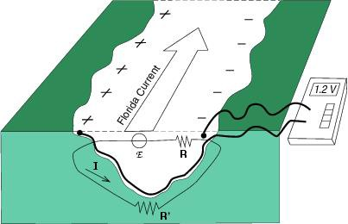
Components of WBTS
Florida Current (warm upper limb)
Continuous time series of the volume transport using a submarine telephone cable - Observations began in 1982
Regular ship sections of velocity and water properties (CTDO₂/LADCP and XBT/dropsonde) - Observations began in 1982, with different technologies over time

Slide 4
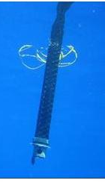
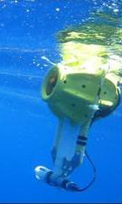
Components of WBTS: Florida Current
Cable voltages calibrated by total volume transport section estimates.
Garcia and Meinen, 2014
Notes:
Example of the wealth of data available for observing the long-term variability of the Florida Current (top), and of the robust agreement we have between dropsonde cruise transports and the cable transports (bottom). From Meinen et al. (2010).

Slide 5
Components of WBTS: Florida Current
Cable voltages have been calibrated to provide heat transport as well as volume transport.
Shoosmith et al. (2005)

Slide 6

Components of WBTS: Florida Current
Heat transport calibration further refined to include the effects of seasonally varying temperature
Following Shoosmith et al (2005) the Florida Current heat transport is computed by multiplying the flow weighted temperature of the Florida Current with the volume transport using section data to derive a season climatology.
Mean Flow Weighted Temperature 19.4 C
Seasonal amplitude 0.5 C
Johns et al, 2011
Notes:
Figure 6. Seasonal variation of the flow-weighted temperature (FW) of the Florida Current (dashed
line) based on the ensemble of available direct velocity and temperature sections acquired during
cable calibration cruises (dots).

Slide 7
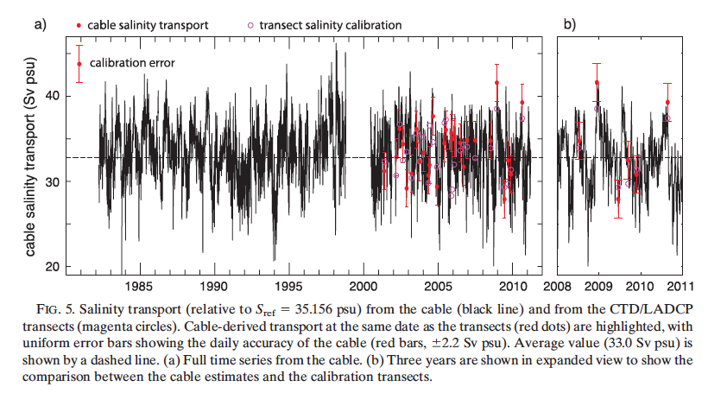
Components of WBTS: Florida Current
Florida Current Cable Voltages also calibrated to provide Salinity Transport
Szultz and Meinen, 2012
Compounding the value of section and cable measurements
Notes:
This paper produced the first-ever calibration of the Florida Current cable measurements into a salinity transport. The voltages measured on the cable have been and are normally calibrated to produce estimates of the volume transport via techniques that date back to the 1980s and earlier. More recently Shoosmith et al. (2005) demonstrated that the cable voltages could be calibrated to also produce an estimate of the temperature transport by the Florida Current. The key new result of the Szuts and Meinen paper is that through comparing to concurrent CTD/LADCP sections it is possible to derive a calibration that can be used with the cable voltages to get estimates of how much salt is being carried by the Florida Current – i.e. the salinity transport.
Included here is a figure from the Szuts and Meinen paper illustrating the resulting time series of salinity transport from 1982 to 2011.

Slide 8
Components of WBTS
Deep Western Boundary Current (cold deep limb)
Continuous time series of the volume transport using a line of PIES/CPIES moorings - Observations began in 2004
Regular ship sections of velocity and water properties (CTDO₂/LADCP) - Observations began in 1984
Notes:
Potentially helpful maps

Slide 9
Components of WBTS: DWBC
Deep Western Boundary Current Variability at the Depth of Classic Labrador Sea Water
van Sebille et al, 2011
Notes:
Figure 2. Hovmoller plots of (a) salinity and (b) temperature on the s1.5 = 34.67 kg/m3 density surface
(the core of the classical Labrador Sea Water) just off the Abaco coast. The black plusses indicate locations
and timing of conductivity-temperature-depth (CTD) stations. Additional CTD stations outside of
the domain shown here were used for the interpolation toward the domain boundaries. This figure is an
extension of a similar figure (on approximately the same color scale) by Molinari et al. [1998] which
showed that between 1994 and 1996 the core of the cLSW freshened and became colder. This extension
shows that since then temperature and salinity have not come back to 1980s levels.

Slide 10
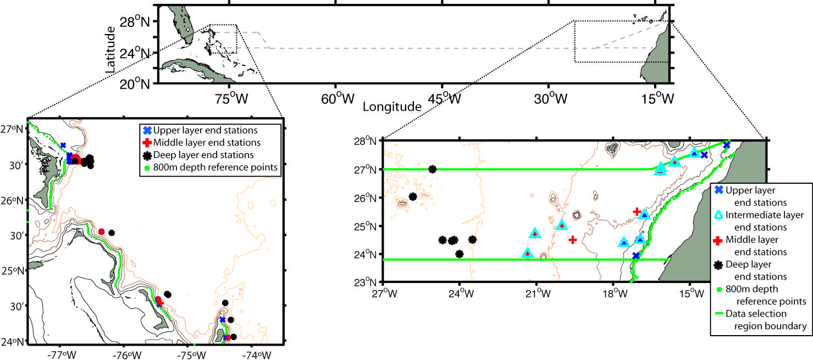
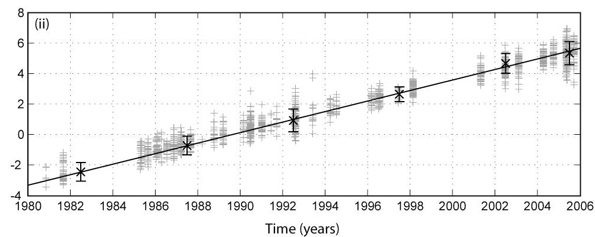
Components of WBTS: DWBC
Denmark Strait Overflow Water (1.95-2.45 C)
Salinity
1992 - Observed
0.0034 /decade freshening
Historical Variability in Atlantic meridional baroclinic transport at 26.5ºN from boundary dynamic height observations
Increase in southward upper ocean transport = decrease in the MOC
Longworth, Bryden and Baringer, 2011
Notes:
Figure 1 Locations of the eastern and western boundary study regions in relation to the cruise
tracks of the 24.5.N transatlantic sections shown with dashed lines of the upper plot (e.g. Bryden et
al., 2005b). Selected end stations shown in each boundary region along with the 800m isobath. At
the west, no stations are taken west of San Salvador Spur (74.5.W, 24.N) due to intervening
topography. Depth contours are indicated at 1000m intervals to 5000m with land shaded.
Stations had to be 2 days apart in time and contain data all through the layer in question and be no further than 160km, 500km, 500km and 1000km offshore (equivalent of 1 Sv)
10, 11, 9 and 7 end stations for each transport anomaly layer
Offshore limits on the western side are much tighter: 14 km, 20 km, and 37 km for each of the upper, middle and deep layers,
Stations separated by 7 days and 1 degree.
39 stations for each of the upper and intermediate/middle
layers and 29 stations for the deep layer
3200m reference level in east, 1000m level in west.
Only considered anomalies relative to reference of Hesperides section.
Figure 2 Salinity anomalies (HeÅLsperides reference minus measured) on 0.1.C potential temperature
levels between 2.55 to 2.95.C for ISOW (i), and 1.95 and 2.45.C for DSOW (ii) as a function of
time. CTD casts are within 150km of the 800m isobath between 24 and 27.N. Linear regression
over time of the five year mean salinity anomalies from 1980 to 2005 and 2005-2006 annual mean
(x) (with error bars of ± 2s) after rejection of points outside the mean Å}0.003 (––) shows freshening
over the 25 years at approximately 0.0031 and 0.0034 per decade for ISOW and DSOW
respectively.
Over whole record this is freshening of 0.0085 and
0.0077 from 1980 to 2005 for DSOW and ISOW respectively
Larger than measurement error of 0.003 psu
Set to have anomally relative to Hesperides = 0 of DSOW
No trend in east – only measurment error – so the deepest layer S was corrected by applying an offset to make there be no salinity anomally.
Freshening consistent with Dickson et al 2002 onservations at Greenland

Slide 11
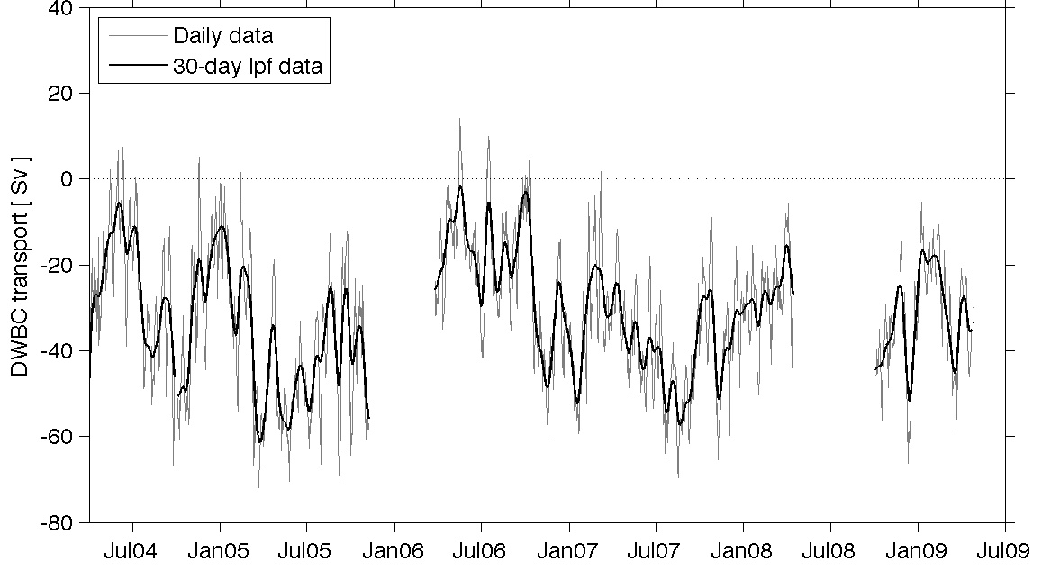
Components of WBTS: DWBC
DWBC transport time series derived from PIES shows large variability.
Mean transport
32 ±16 Sv
vs. Mean MOC
18 ± 5 Sv
% Variance
37% T <2mos
36% 2 < T <11 mos
1% 11 < T <13 mos
26% T >13 mos
No annual cycle
Meinen et al, (2012)
Notes:
DWBC in North Atlantic – Analysis combining the measurements from the NOAA long-term WBTS program with the international MOCHA/RAPID-MOC projects at 26N demonstrates that the DWBC is much more variable than had previously been believed and that the deep flows west and east of the Mid-Atlantic Ridge must be compensating one another since the DWBC variability west of the Ridge significantly exceeds the variability of the total basin-wide MOC.

Slide 12
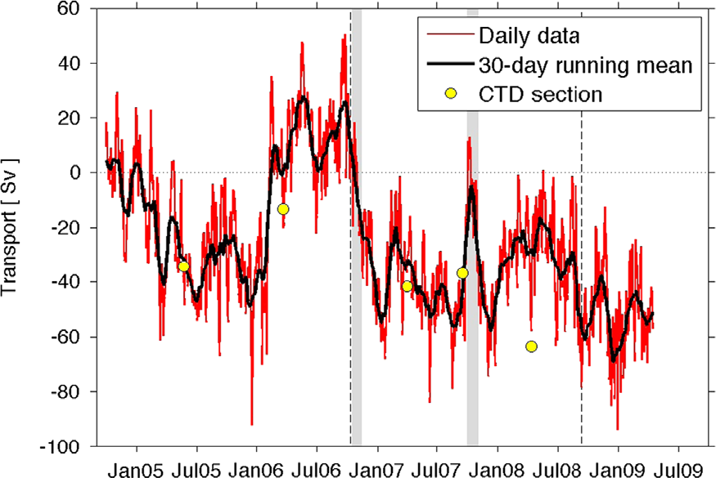
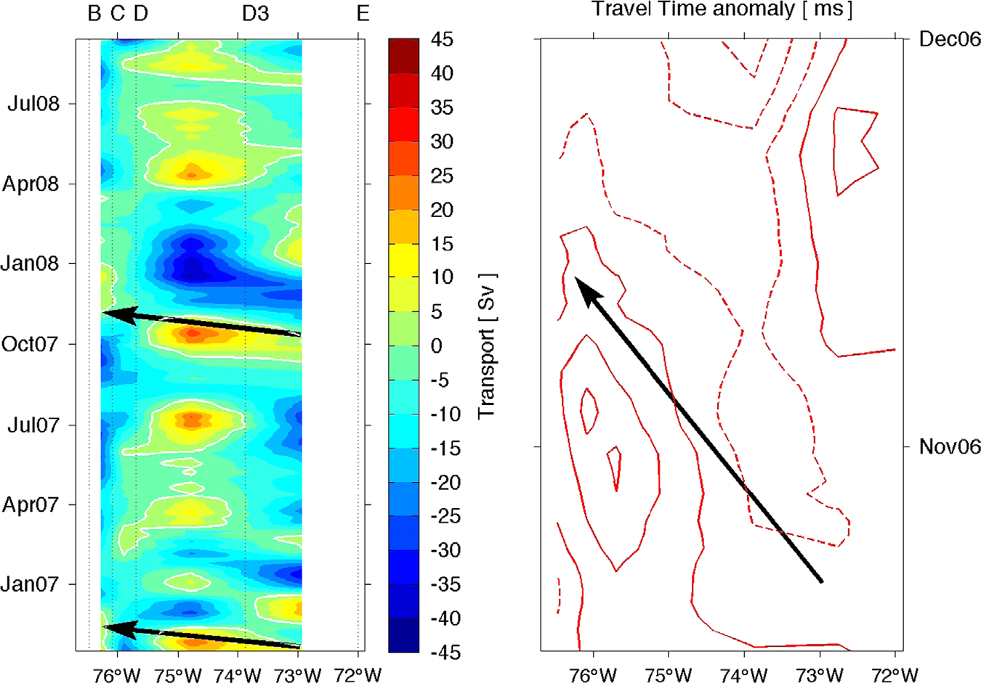
Components of WBTS: DWBC
Spatial sampling of PIES spanning the DWBC allows for the attribution of anomalous transport.
Grey bars highlight two time periods where strong northward transport anomalies are shown propagating westward.
Time series of DWBC absolute transport integrated between 800 and 4800 dbar and from Site B out to Site E. Yellow circles indicate hydrographic (CTD) section geostrophic transport estimates where the barotropic flow component has been provided by the PIES.
Meinen and Garzoli, 2014
Notes:
Illustration of how the PIES data have been used to evaluate the time variability of the DWBC, and how it has been used to identify the sources of the largest observed variations. From Meinen and Garzoli, 2014.

Slide 13
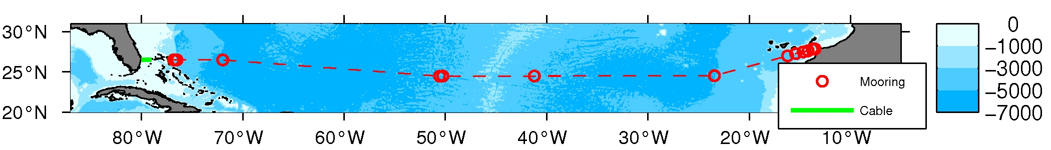
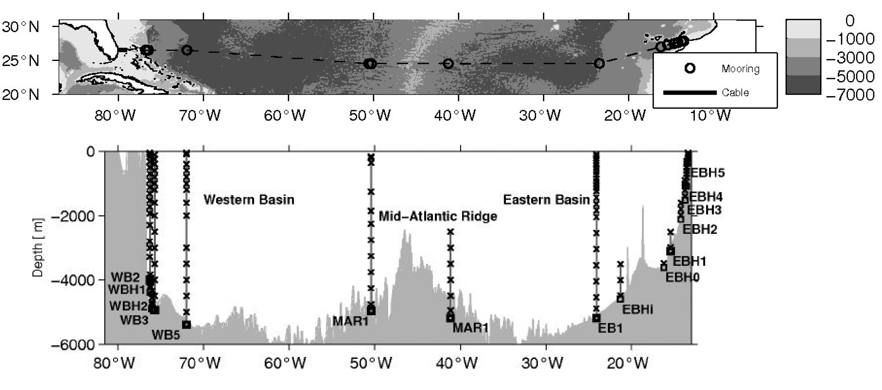
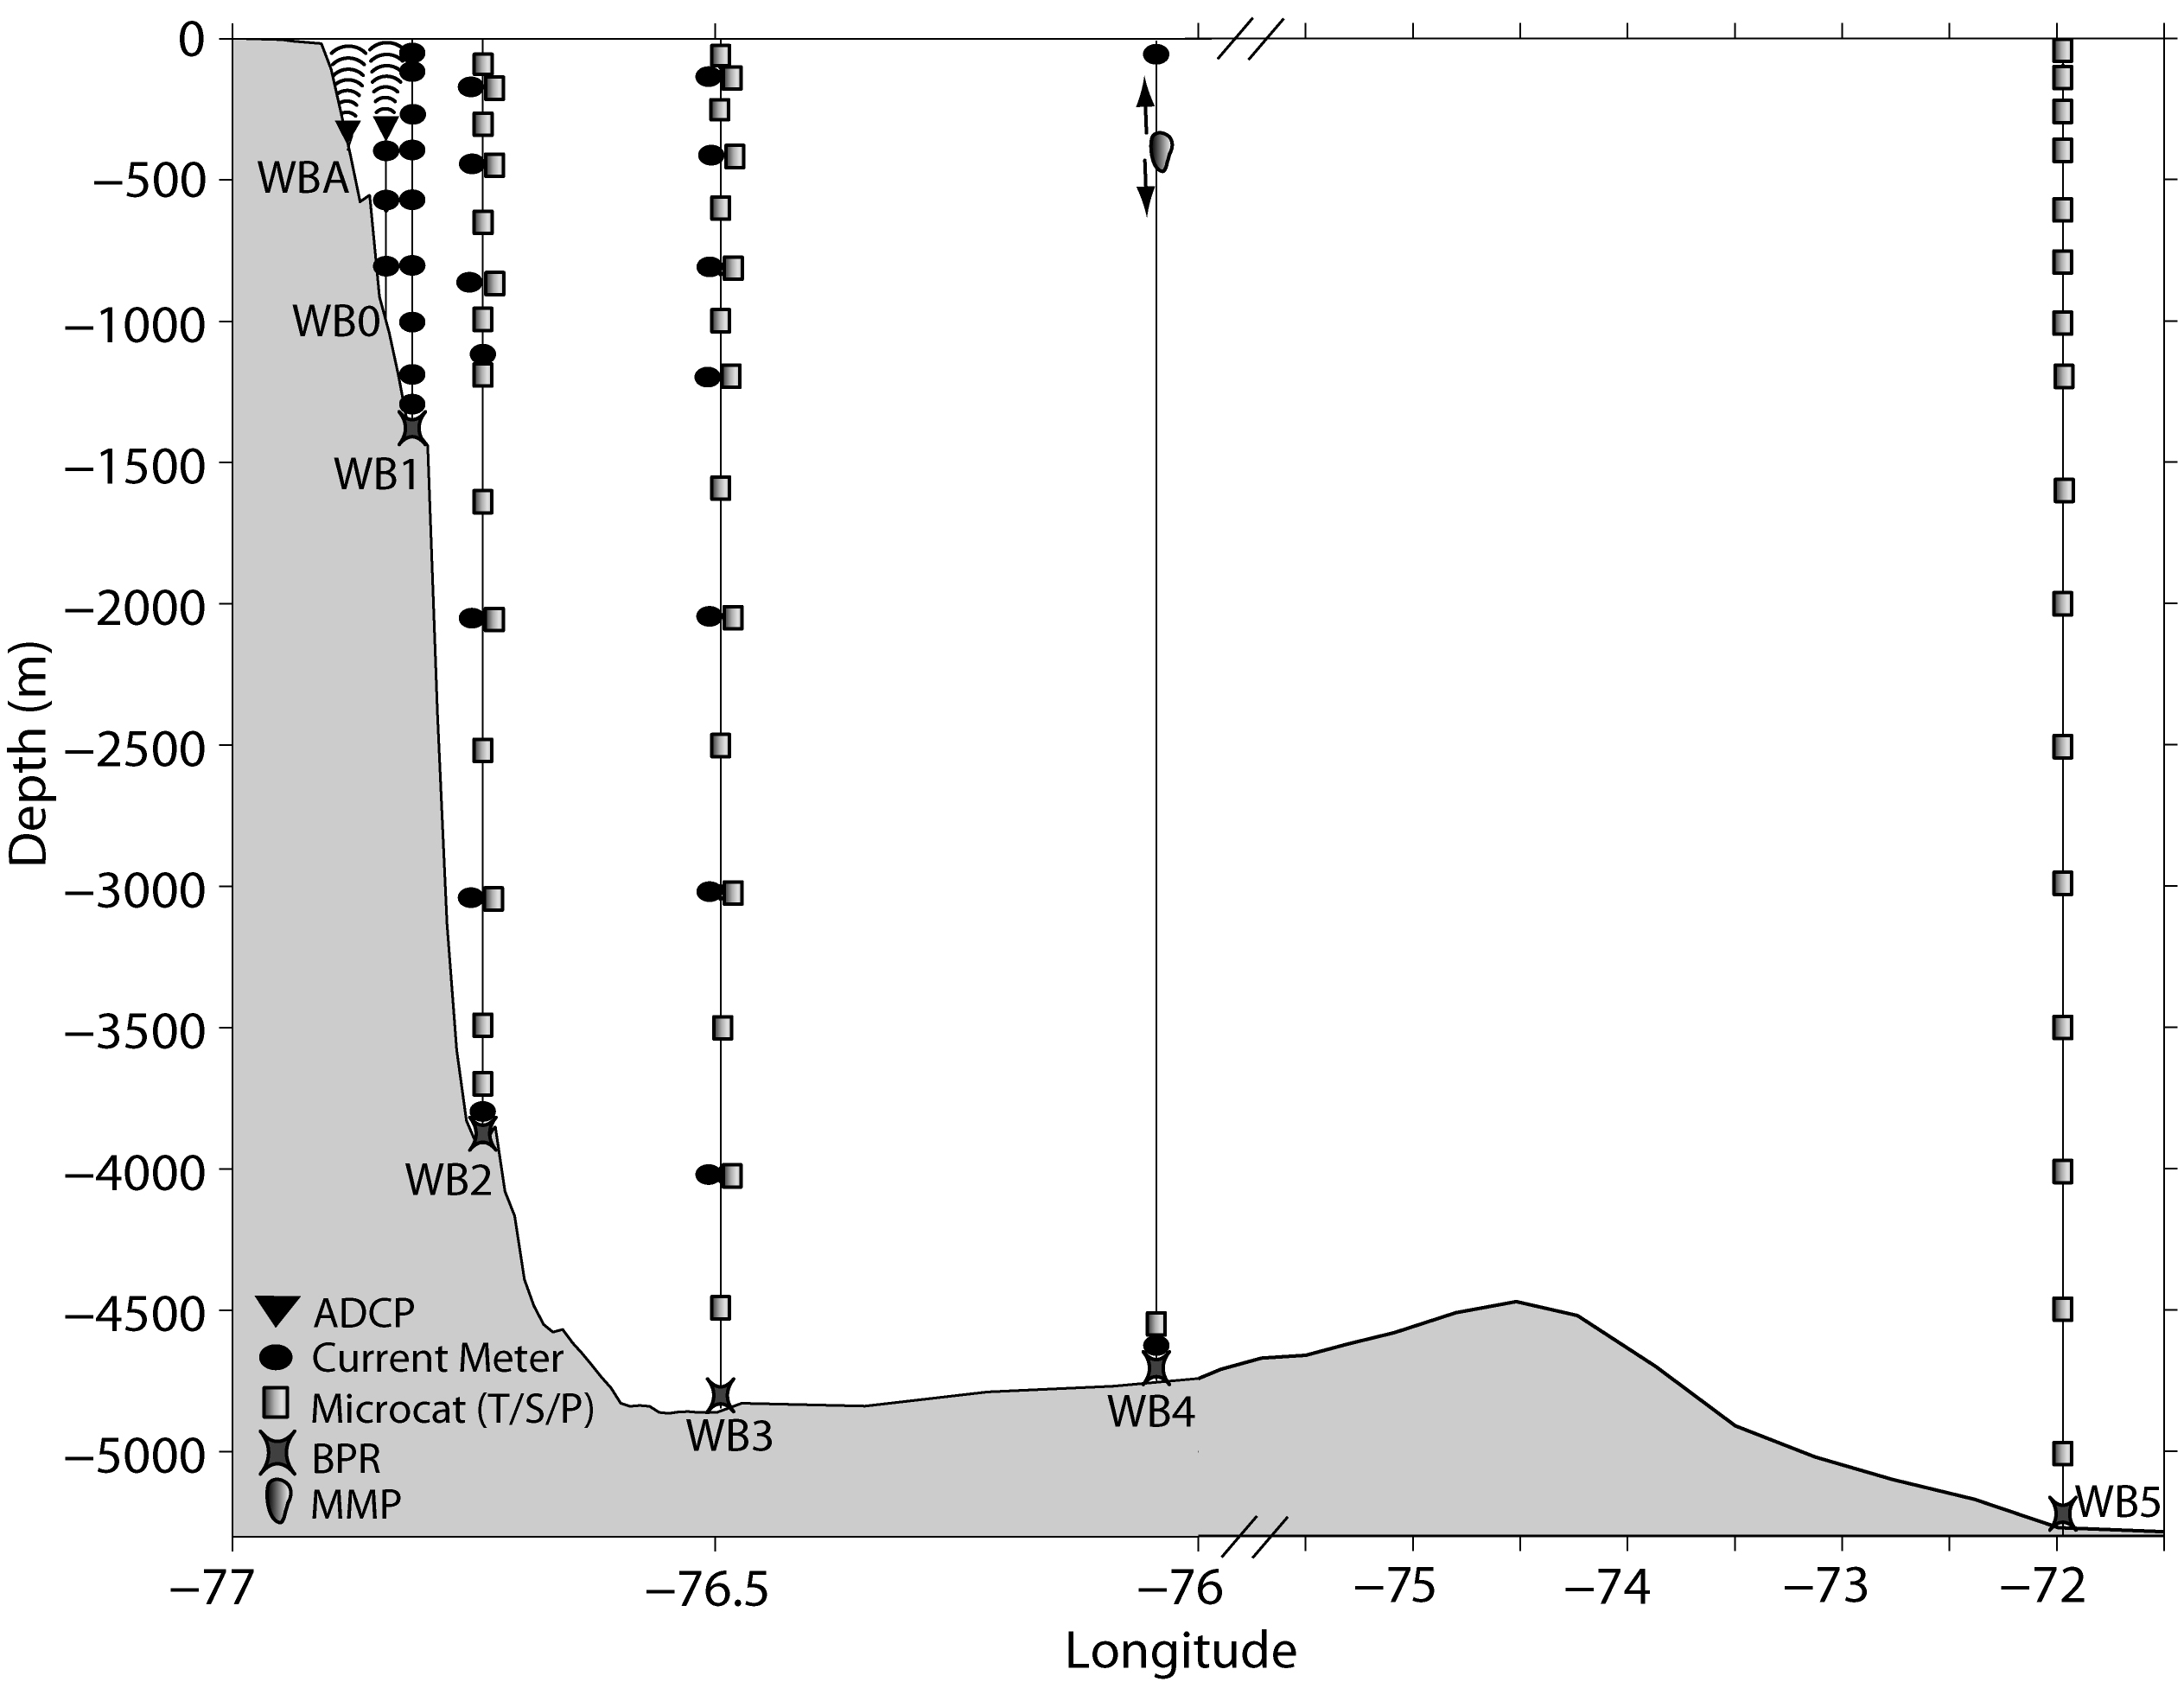
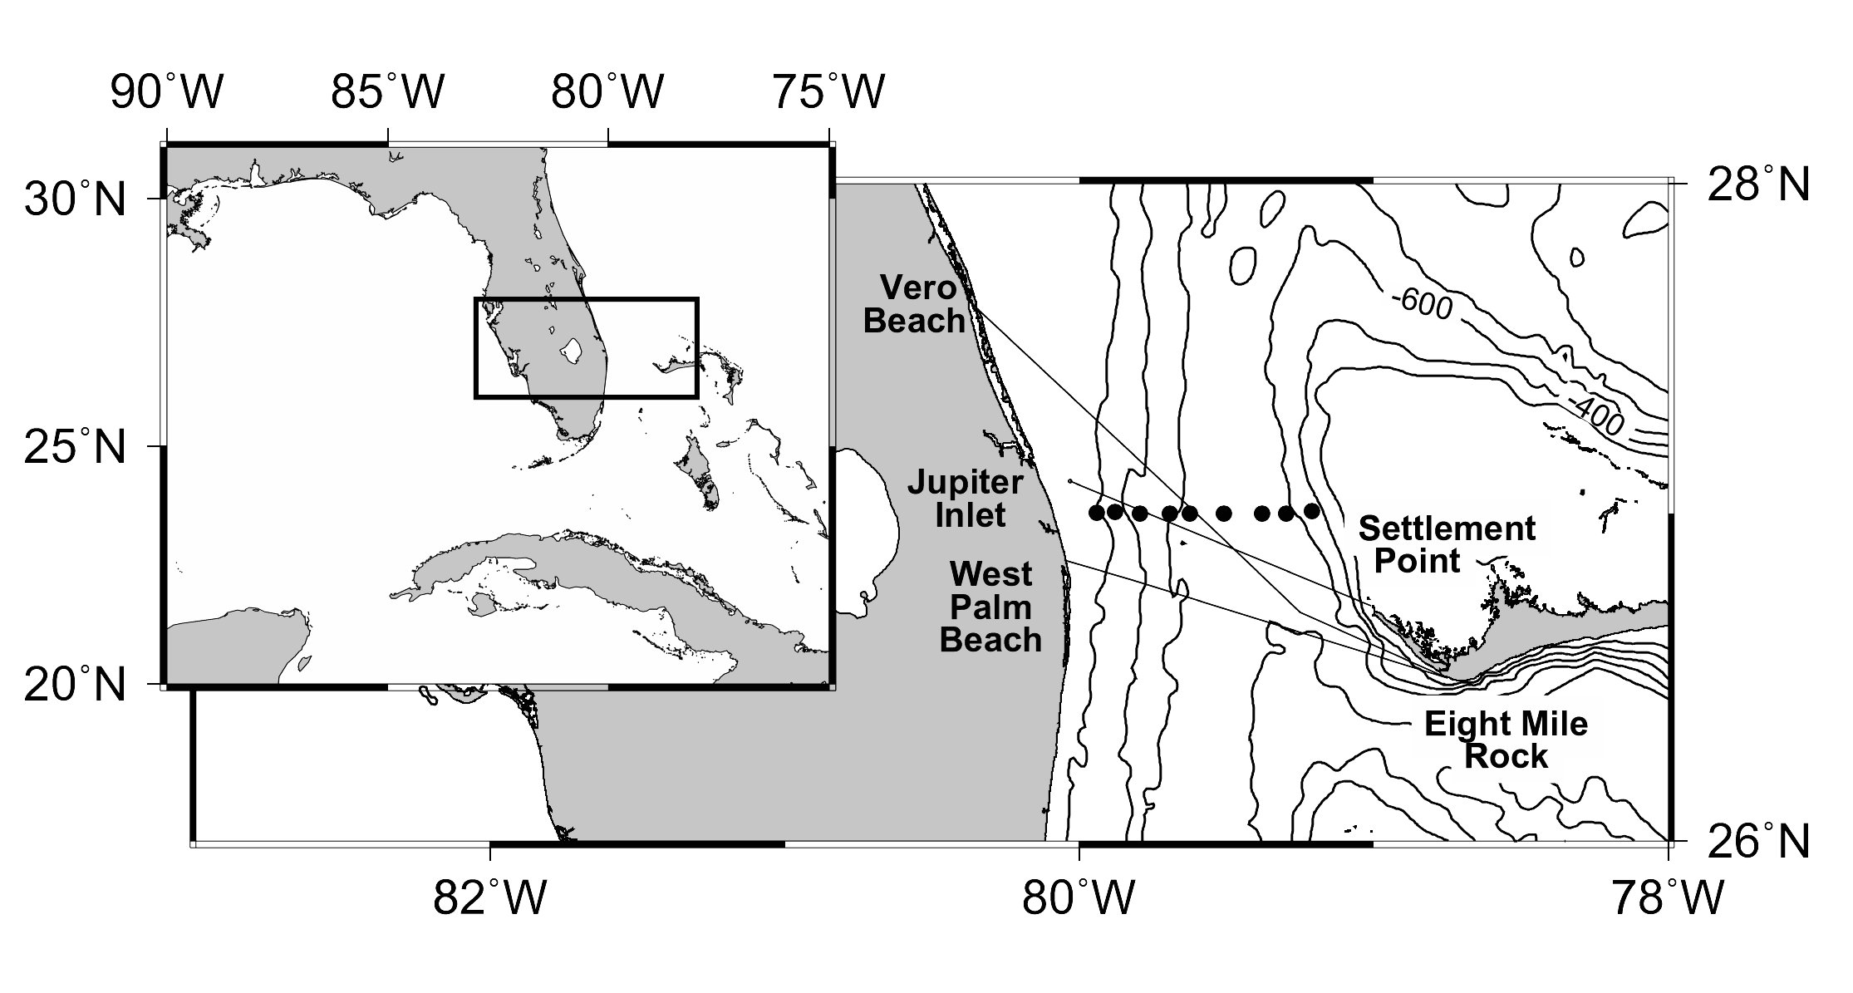
Extension of WBTS: RAPID/MOCHA 26.5°N Array
Mid-ocean Array (Cunningham et al., 2007)
Florida Current/Gulf Stream Monitoring by cable (Baringer and Larson, 2001; Meinen et al 2010; Garcia and Meinen, 2014)
Western Boundary array (Johns et al., 2008)
Notes:
Ekman from Quikscat – and now being re-evaluated.

Slide 14
MOC Highlights
Within first 4 years of array we learned:
Florida Current
System works (10-day LP)
Mean 18.7 Sv +/- 4.8 SV
Seasonal peak-to-peak 6.8 Sv
Seasonal variability dominated by Interior Ocean (boundary anomalies) and GS
Beyond 4 yrs of data: interannual variability!
MOC
Ekman
Upper Mid-Ocean
Srokosz, et al, 2012.
Notes:
3. 26.5°N AMOC time series for April 2004 to Dec 2011, measured in Sverdrups (1 Sv = 106 m3 s-1). Red – 10-day averaged values; black – 6-month low pass filtered values. Note unexpected and as yet not fully understood significant decrease in the winter of 2009/10.

Slide 15
Interannual variability of meridional heat transport in the North Atlantic
90% of the heat transport is associated with the overturning circulation
Meridional heat transport is derived from the 26°N array using moorings, cable, XBTs, Argo and wind stress data.
The mean meridional heat transport is 1.22 ± 0.11 PW (about 25% of the total ocean and atmospheric heat transport at this latitude).
Ekman contributes most variance to total, followed by Mid-Ocean and Florida Current.
2004-2008 is 0.2 PW higher than 2009-2015
Gulf Stream
1.38
1.36
1.36
1.29
1.27
1.07
1.07
1.25
1.13
1.21
1.11
1.14
Total
Ekman
Mid-ocean
Johns et al. (2010)
McCarthy et al 2014
Notes:
The mean heat transport over the 2004-2012 period is smaller than the earlier estimate of 1.33 PW in (Johns et al. (2011)) based on the first four years of the record (2004-2008), This is due to the very low heat transports that occurred in 2009 and 2010, associated with the large downturn in the AMOC during those years. The annual mean MHT values recorded in those years were 1.07 and 1.08 PW, respectively.
The breakdown into the overturning and gyre MHT components shows that most of the heat transport (~90%)—and essentially all of the interannual variability observed thus far—is contained in the overturning component. The gyre component on the other hand shows a fairly regular seasonal cycle which is mainly dominated by the annual cycle of the Florida Current.
Updated time series shown in Smeed et al (2014) and Baringer et al (2014).

Slide 16
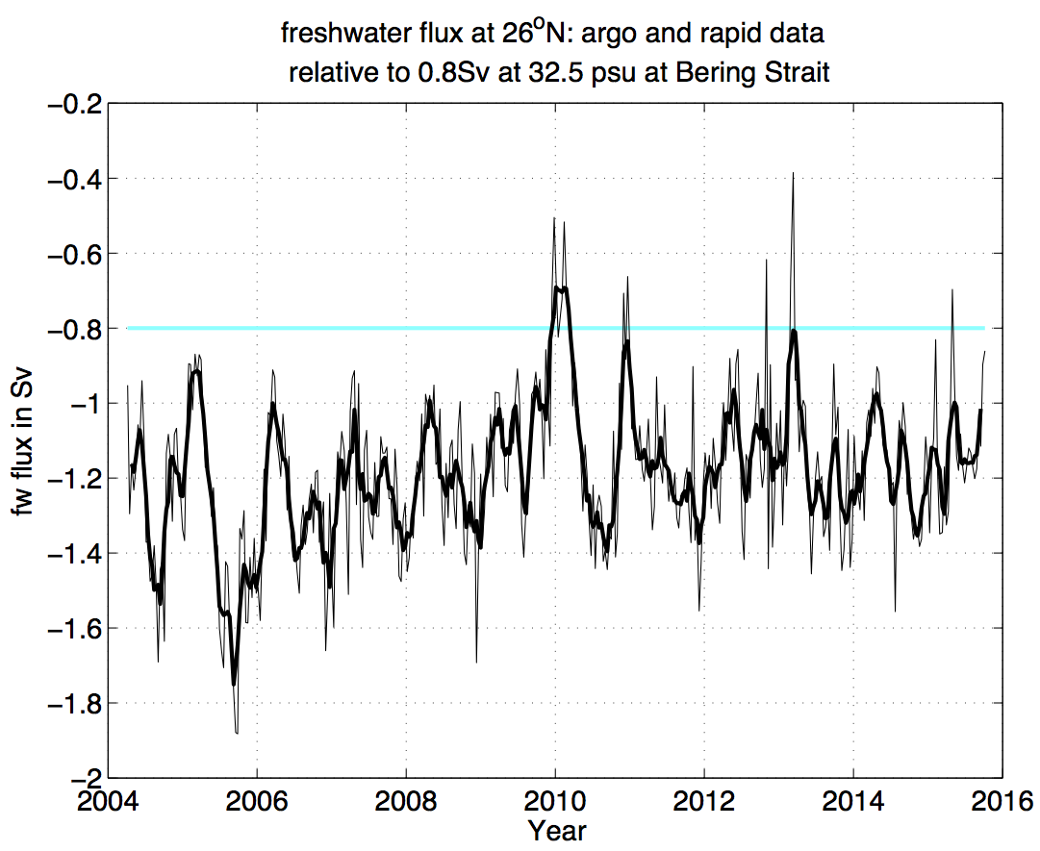
Freshwater Transport at 26N
E>P
Net freshwater loss
Bering Strait
-0.8 Sv
(McDonagh et al., 2015)
E<P
Input of freshwater
Into the ocean
Freshwater Transport (Sv)
Southwards
B. Moat pers. Comm. Update from McDonagh et al 2015
For further information, contact Mr. Gerry Scott, NOC Commercialisation Manager
National Oceanography Centre, European Way, Southampton. SO14 3ZH
Tel: +44(0)23 8059 6223 email: gerry.scott@noc.ac.uk noc.ac.uk
For further information, contact Mr. Gerry Scott, NOC Commercialisation Manager
National Oceanography Centre, European Way, Southampton. SO14 3ZH
Tel: +44(0)23 8059 6223 email: gerry.scott@noc.ac.uk noc.ac.uk
For further information, contact Mr. Gerry Scott, NOC Commercialisation Manager
National Oceanography Centre, European Way, Southampton. SO14 3ZH
Tel: +44(0)23 8059 6223 email: gerry.scott@noc.ac.uk noc.ac.uk
World class marine research
and technology for your business
World class marine research
and technology for your business
World class marine research
and technology for your business
Notes:
The fresh water flux is a volume flux added at each time step at the section average salinity of 35.17
2004 to 2013
Increase in upper ocean salinity.

Slide 17
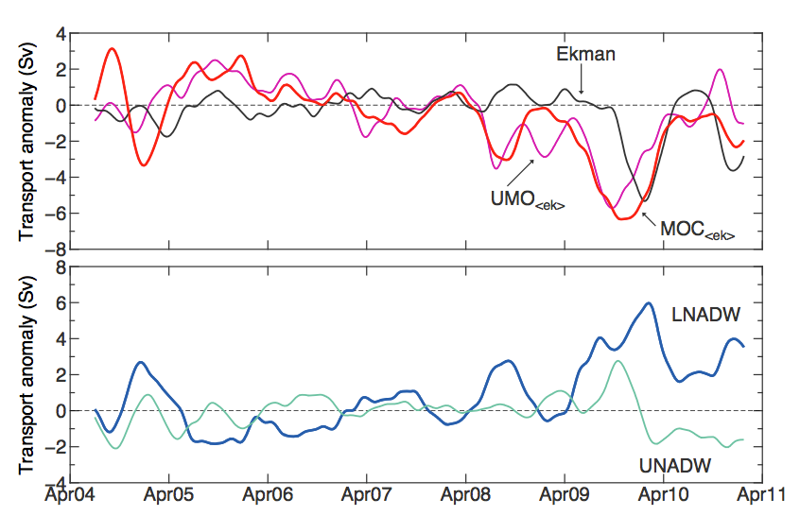
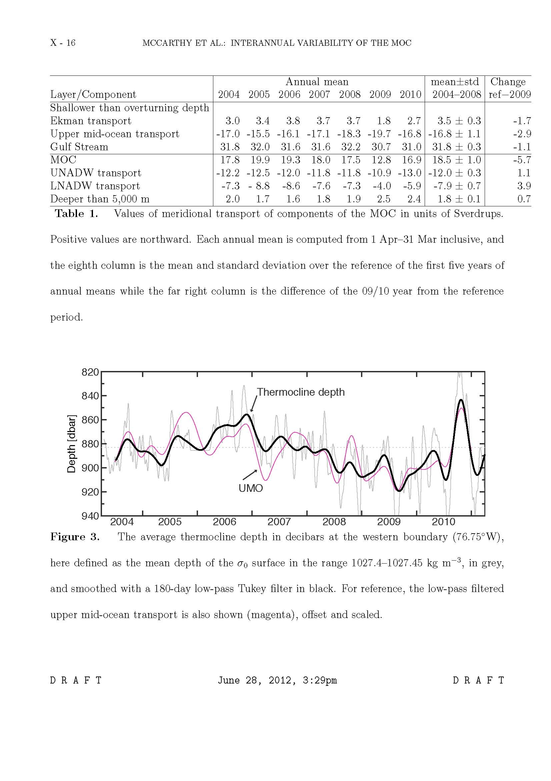
Understanding the state of the MOC at the 26°N array and its forcing
MOC variability forced by internal density changes in the ocean
The MOC showed a pronounced decrease in the winter on 2009 (6 Sv below average).
The MOC decrease was largely due to mid-ocean transport changes.
Interannual variability in the deepest part of the ocean is not always in phase.
Thermocline depth in west drives interannual variability.
MOC decline in deep water driven by reduction in lowest layer southward transport.
Upper Limb
Lower Limb
The annual cycle was removed from all the MOC components of the 26°N array.
McCarthy et al. (2012)
Smeed et al, 2014
Notes:
Interannual Meridional Overturning variability
(Ekman transport response and mean seasonal cycle removed)
One example of understanding the forcing of MOC variability – we examined the Slow down of the MOC seem in the winter of 2009/2010.
Partners include (associated with North Atlantic MOC observations, validation and production of the BAMS MOC report)
Rosenstiel School of Marine and Atmospheric Science, Miami, FL
National Oceanography Centre, European Way, Southampton, SO14 3ZH, U.K.
Jet Propulsion Laboratory, California Institute of Technology, Pasadena, CA
Cooperative Institute for Marine and Atmospheric Science, Miami, FL
Scripps Institution of Oceanography, University of California, San Diego, La Jolla, CA
Scottish Marine Institute, Oban, Argyll, United Kingdom
Helmholtz-Centre for Ocean Research Kiel (GEOMAR), Kiel, Germany
Massachusetts Institute of Technology, Cambridge, MA
Woods Hole Oceanographic Institution, Woods Hole, MA
Max-Planck-Institut für Meteorologie, Hamburg, Germany
Merchant ships, Research Vessels, Small fishing vessels
ECMWF

Slide 18
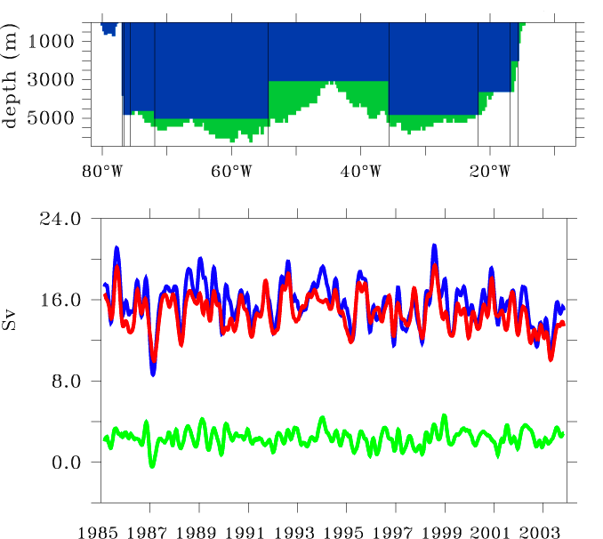
Model Evaluations
OCCAM 0.25° resolution model used as Observation Simulation Experiment
Model MOC “truth”
Observational MOC
Ekman transport
Units of Sv
Rayner et al., 2011, DSR, “Monitoring the Atlantic Meridional Overturning Circulation”
Notes:
Figure 3: Testing the MOC monitoring strategy in an eddy-permitting ocean model (OCCAM,
Webb 1996). The horizontal resolution is 0.25º in both longitude and latitude. Top: placement of
“moorings” (vertical lines) and area where velocity can be calculated based on zonal density
differences (blue area). Bottom: MOC at 26.5ºN and 1100m depth (blue), reconstruction (red, see
main text) and Ekman contribution (green).

Slide 19
Model Evaluations: Deep Ocean Water Mass Transformations and Pathways
Anomalies in the Labrador Sea < 50% and appear at Abaco 9 years later
Salinity
Abaco (26°N)
Salinity Anomaly at Abaco
Salinity
Labrador Sea (58°N)
Van Sebille et al 2011
Notes:
50% of the signal at Abaco – 9 years after LS
Two pathways in models – minimal influence of MOW
The first model is the 0.5° SODA model [Carton et al., 2000; Carton, 2008], which has 40 levels in the vertical
and is based on the POP code. The second model is the DePreSys model [Smith and Murphy, 2007], which has much lower resolution at 1.25° and 20 depth levels. The third model is the Cube84 run of ECCO2 [Marshall et al., 1997; Menemenlis et al., 2005], at a horizontal resolution of 0.25° and 50 depth levels.
The fourth and last model used is the OFES model [Sasaki et al., 2008]. At a horizontal resolution of 0.1° and 54 vertical levels the OFES model has the highest resolution used here. The OFES model is forced with NCEP winds and fluxes, but does not assimilate other data.

Slide 20
WBTS data used for Climate Assessments
IPCC, 2013. Observations: Ocean (Chapter 3) [Rhein, et al., 2013]. [in Climate Change 2013: The Physical Science Basis. Contribution of Working Group I to the Fifth Assessment Report of the Intergovern­mental Panel on Climate Change Stocker, T.F., et al (eds.)]. (M. Baringer, contributing author).

Slide 21
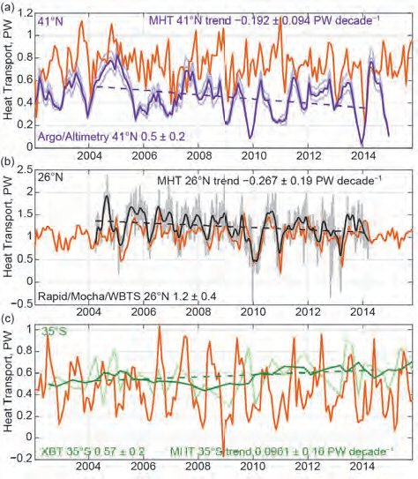
WBTS Data Used for annual BAMS State of the Climate Assessments
Meridional Heat Transport estimates at 41°N and 26°N show a small, but significant decrease while the 35°S data shows an increase. Together these suggest a convergence of heat in the tropical oceans
Baringer et al, 2015
Notes:
Observed time series of meridional heat transport (MHT) in the Atlantic at (top) 41°N (profiling floats), (middle) 26°N (mooring/hydrography), and (bottom) 30°S–35°S (XBTs). At 41°N (top) the black line is the estimated MHT and gray lines represent the uncertainties (Hobbs and Willis 2012). At 26°N (middle) the black line is the observed data filtered with a 3-month low-pass filter and the gray lines are the 12-hourly data. At 35°S (bottom) the gray line is the quarterly estimated MHT from XBTs and the black line is a yearly boxcar filter applied to those quarterly estimates.

Slide 22
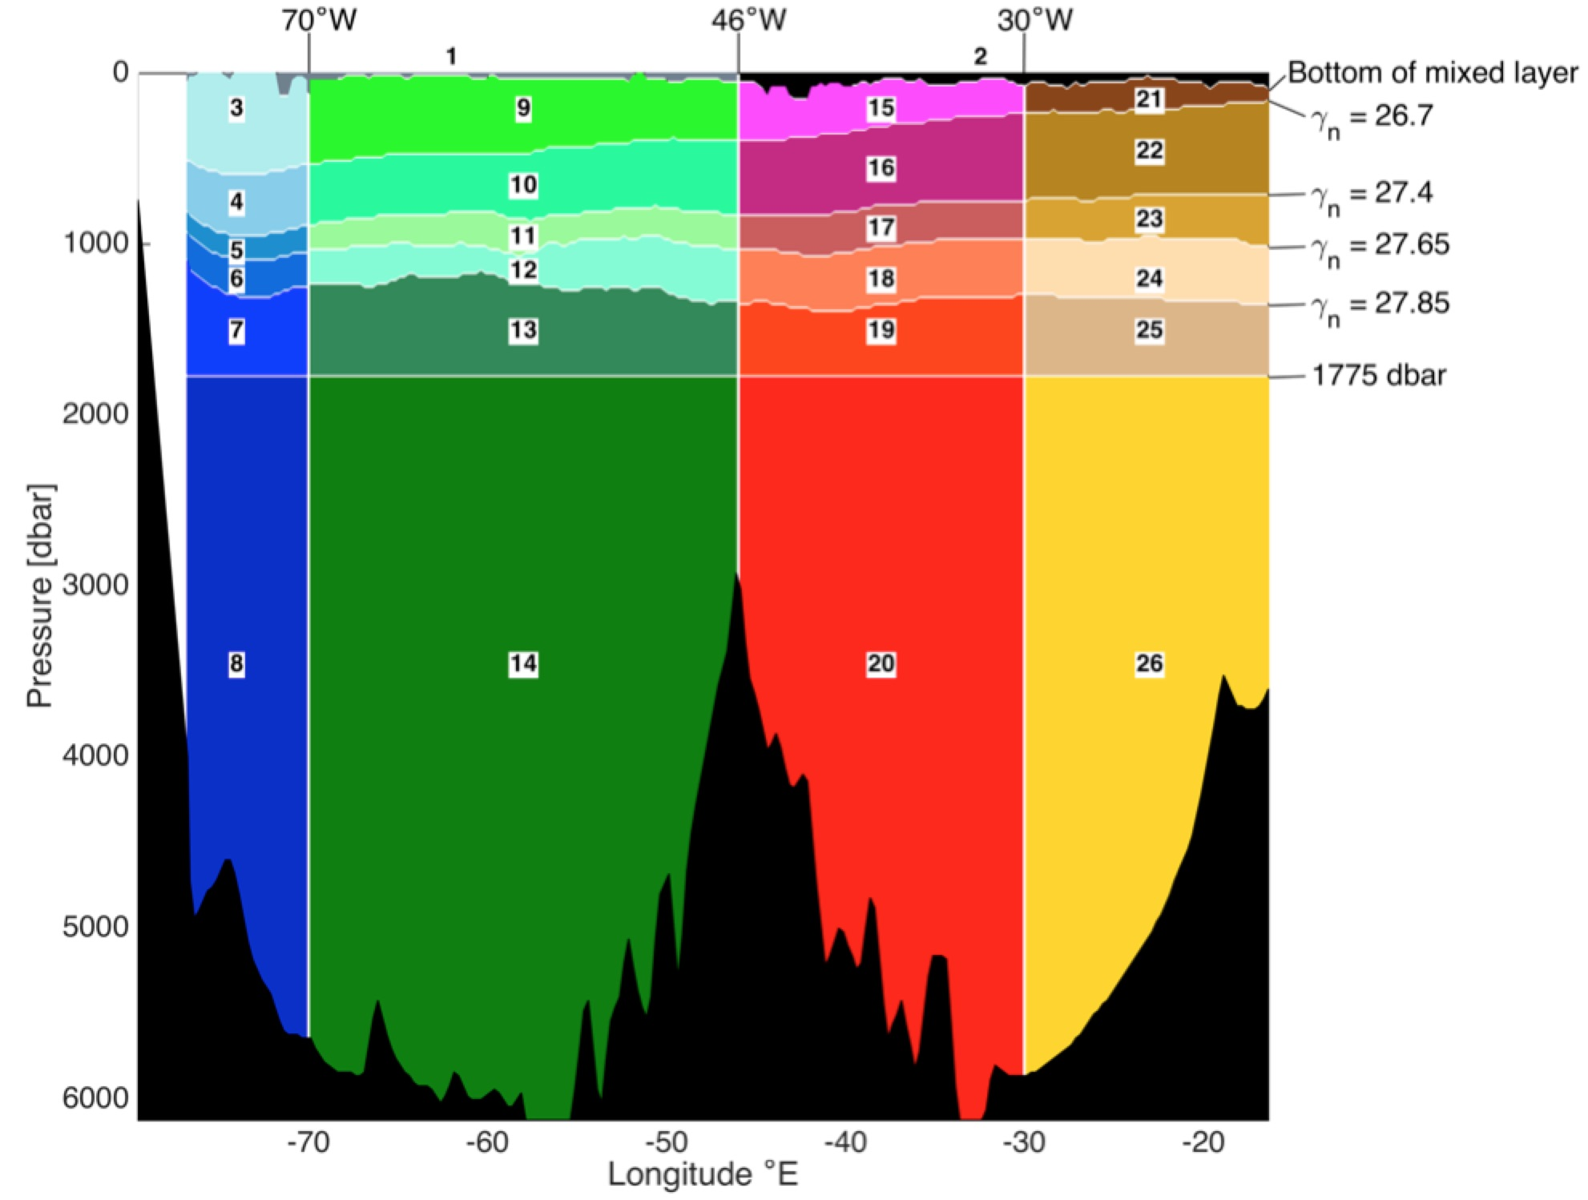
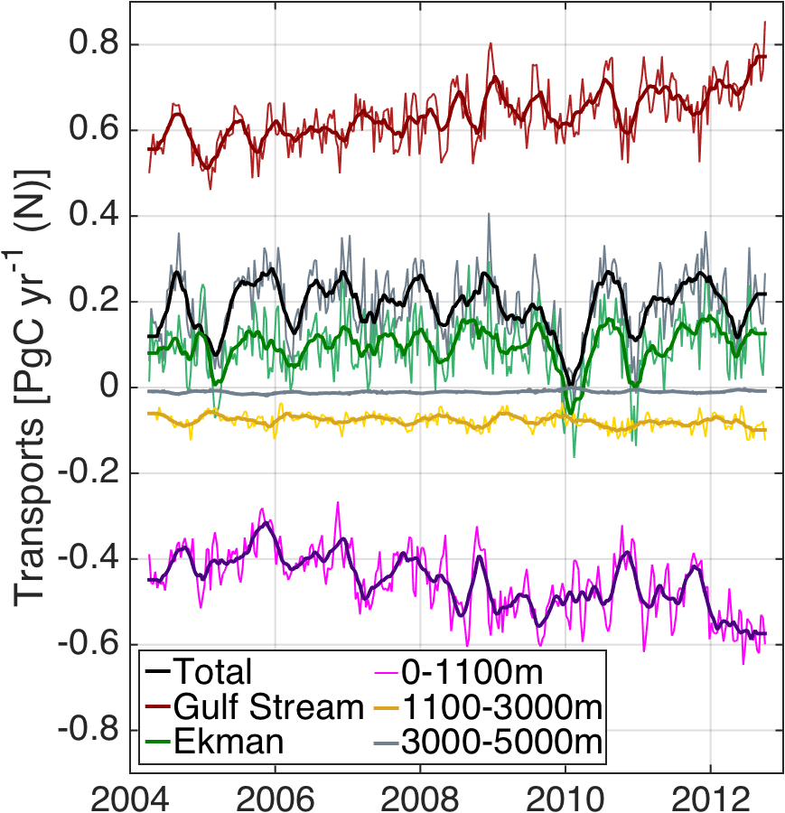
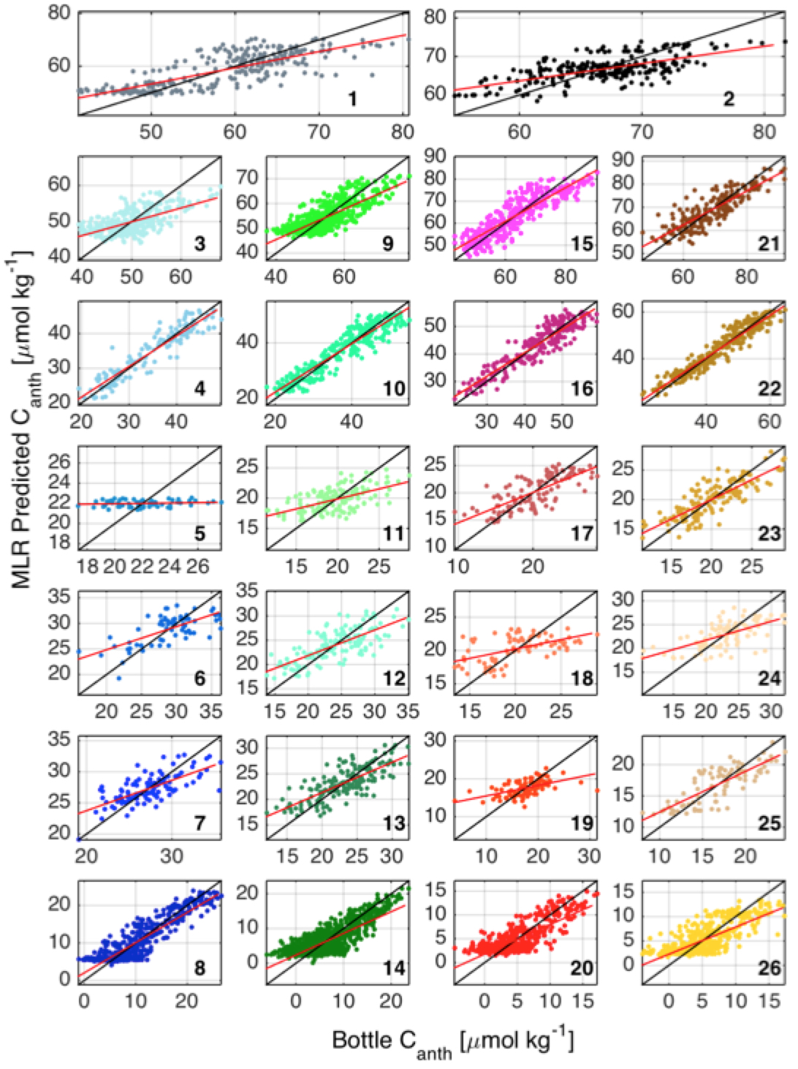
Impacts: Anthropogenic Carbon transports
Brown et al, in prep
Notes:
(Left) Ten-day (normal) and three month low-pass (bold) time-series of anthropogenic carbon transports in Florida Straits Gulf Stream (red), Ekman layer (green), top 1100m (pink), 1100-3000m (yellow) and 3000-5000m (grey) from April 2004 to October 2012. Total transport in black.
(Bottom right) Annual averages and standard error of the mean of C_{anth} transports for April-March.

Slide 23
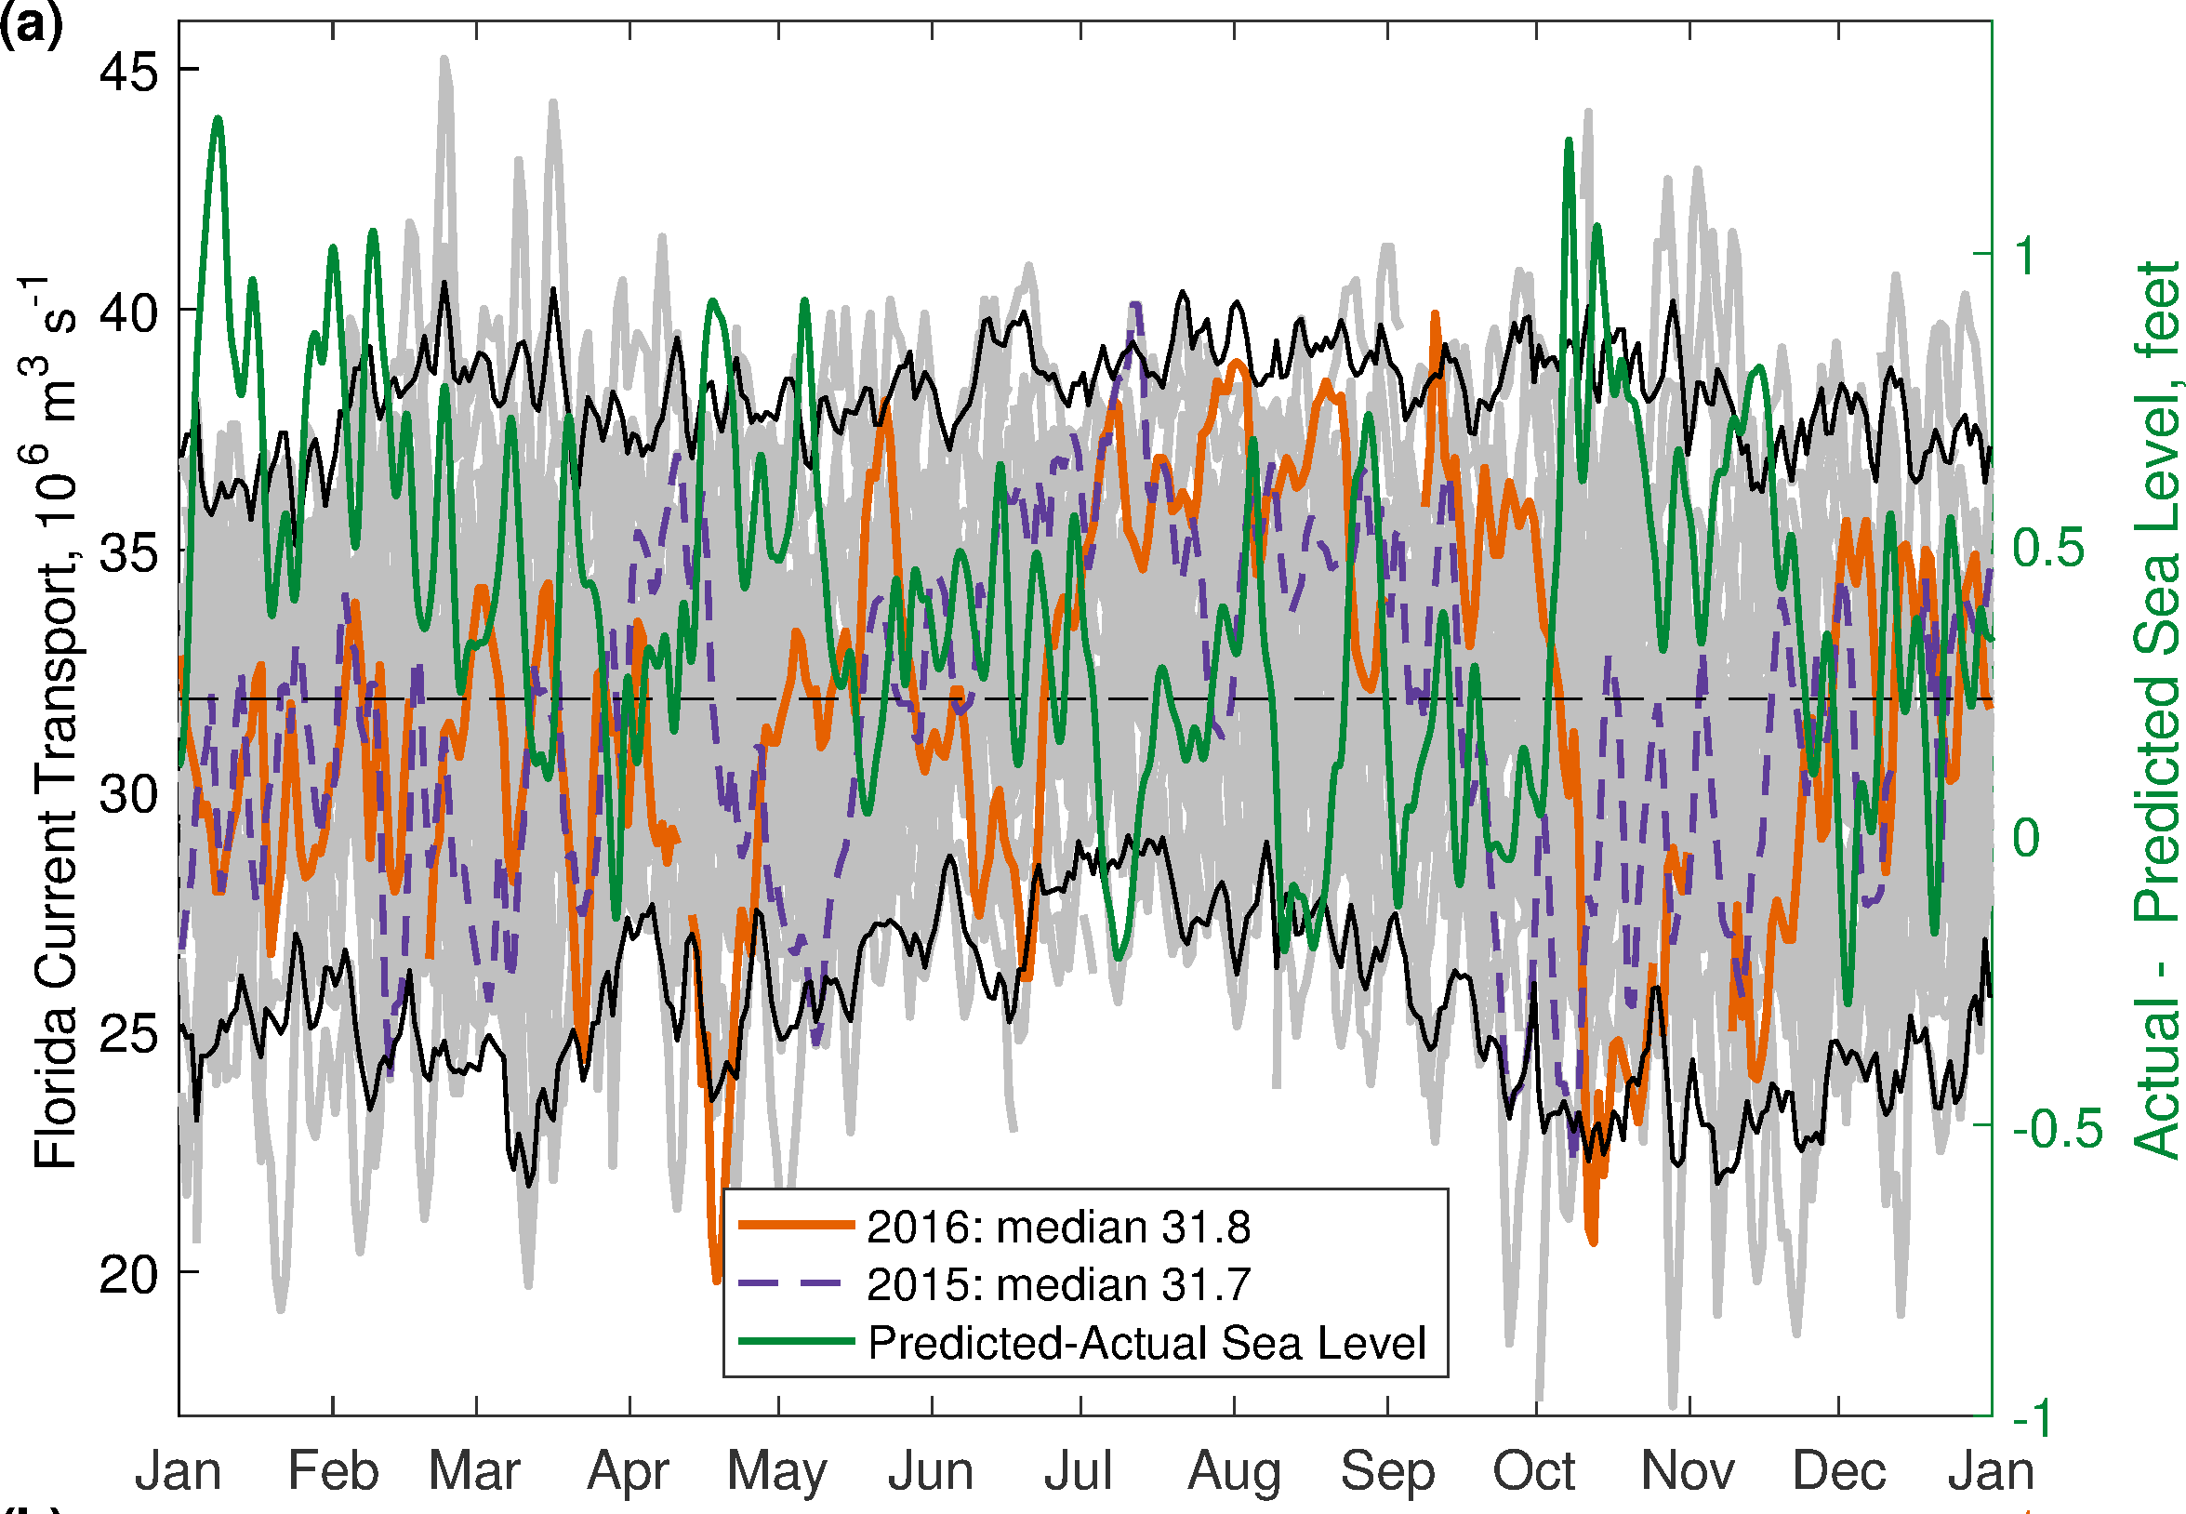
Impacts on Coastal Sea-Level
Daily FC transport
Observed – Predicted sea level 2016 (Lake Worth)
2016 F C transport
Low F C transport coincided with observed king tide events in October 2016
Baringer et al. (2017),
Domingues, R., Baringer, M., & Goni, G. (2016).

Slide 24
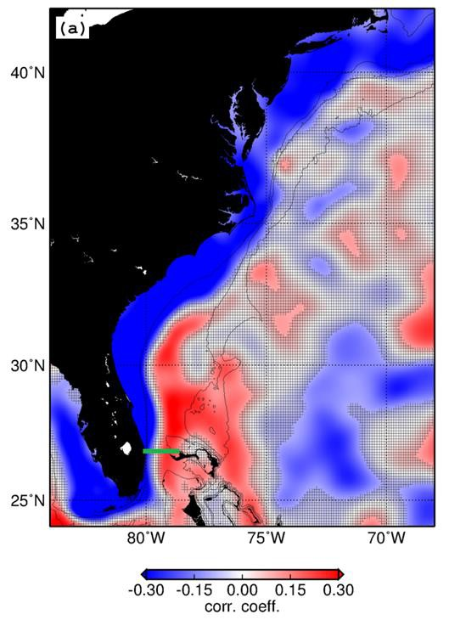
Florida Current and Gulf Stream Effect on Sea Level along east U.S. coast
along the Eastern Coast, West Palm Beach-FL, May 09 2017
0 lag
For every 1 Sv decrease in FC transport on seasonal time-scales:
~5 cm increase in coastal sea-level in most locations between 25N-42N
~10 cm increase in coastal sea-level in locations at the mid-Atlantic bight (SLR hot spot, Ezer et al., 2012)
5 cm decrease in coastal sea-level at the Bahamas
1 Sv = 10⁶ m³ s⁻¹
11

Slide 25
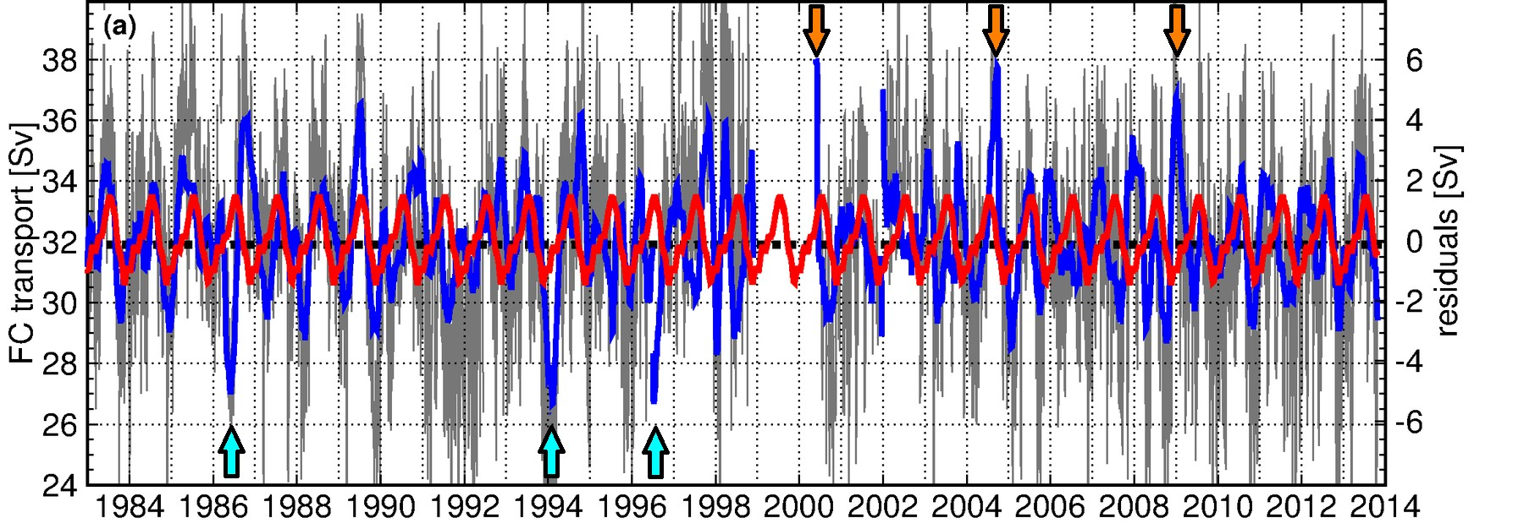
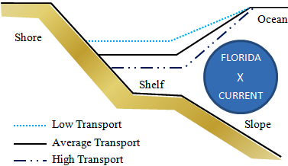
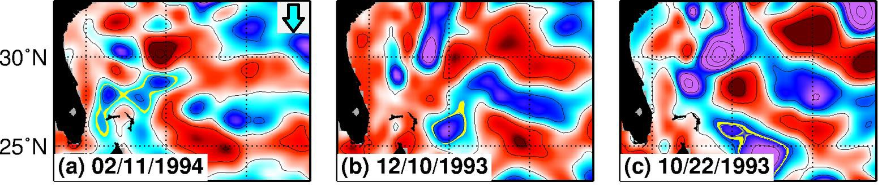
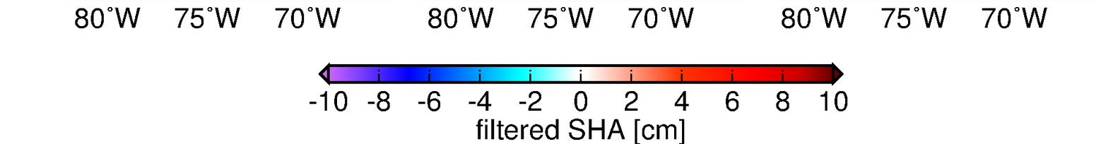
Year-to-year changes in the Florida Current seasonality: links with coastal sea-level changes
Satellite Altimetry vs. Florida Current transport
Notes:
The Florida Current is the western boundary current that feeds into the Gulf Stream, closing the subtropical gyre circulation in the North Atlantic
The physics of the Florida Current imply that changes in its flow are associated with sea level changes along the east coast of U.S.: a weak (strong) Florida Current flow is associated with higher (lower) sea level than usual along the U.S. coast
The Florida Current flow has been continuously monitored in the Florida Straits by NOAA-AOML since 1982, showing variability on different timescales
On seasonal timescales, the Florida Current flow shows an annual cycle (black line) characterized by stronger flow during July-September, and weaker flow during December-February. The seasonality of the Florida Current flow, however, changes remarkably from one year to the next (colored lines)
Year to year changes in the Florida Current seasonality are largely associated with westward propagating signals originated in the open ocean
Westward propagating signals behave approximately like first mode Rossby waves, taking years to cross the entire basin
As these signals reach the North Atlantic western boundary, they can cause sea level changes ranging between -10 cm and 10 cm associated with changes in the seasonality of the Florida Current flow (blue line, C)
Because these signals propagate approximately at an known rate, knowledge about this mechanism can be used to produce a seasonal outlook forecast of tidal range corrected due to Rossby waves

Slide 26
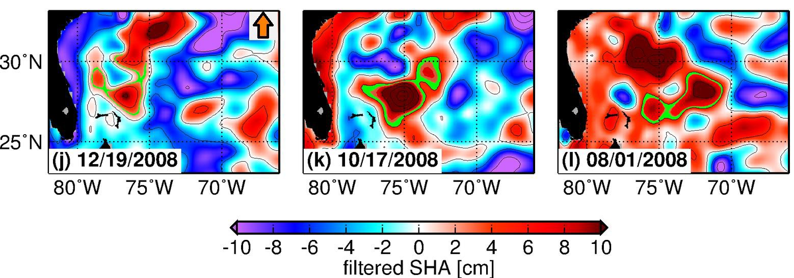
Year-to-year changes in the Florida Current seasonality: links with coastal sea-level changes
Satellite Altimetry vs. Florida Current transport
20

Slide 27
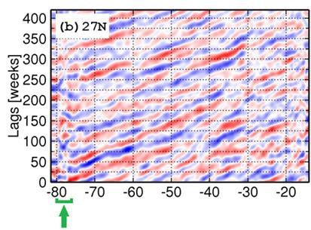
Year-to-year changes in the Florida Current seasonality: links with coastal sea-level changes
SHA signals propagate westward at an approximate fixed rate at 27N
Potential for producing seasonal outlook indicators for the FC transport and for coastal sea-level changes
Domingues, R., Baringer, M., & Goni, G. (2016).
Notes:
+/- 5 cm sl associated with seasonal cycle of FC
+/- 20 cm associated with typical amplitudes of ‘seasonal’ variability

Slide 28
Summary of Increased Understanding of MOC from Rapid/MOCHA/WBTS
Magnitude and variability of the MOC and associated heat and fresh water transport
  Short-term variability of the transport
  Seasonal cycle of the MOC
  Inter-annual variability
  Multi-year trend
AMOC Anomalies (positive is northward) relative to mean annual cycle (Smeed et al. 2013)
Processes
  Components of the MOC
  Vertical structure of MOC
  Relative importance of overturning and gyre circulation
  Impacts of eddy processes
  Forcing on seasonal and shorter time scale

Slide 29
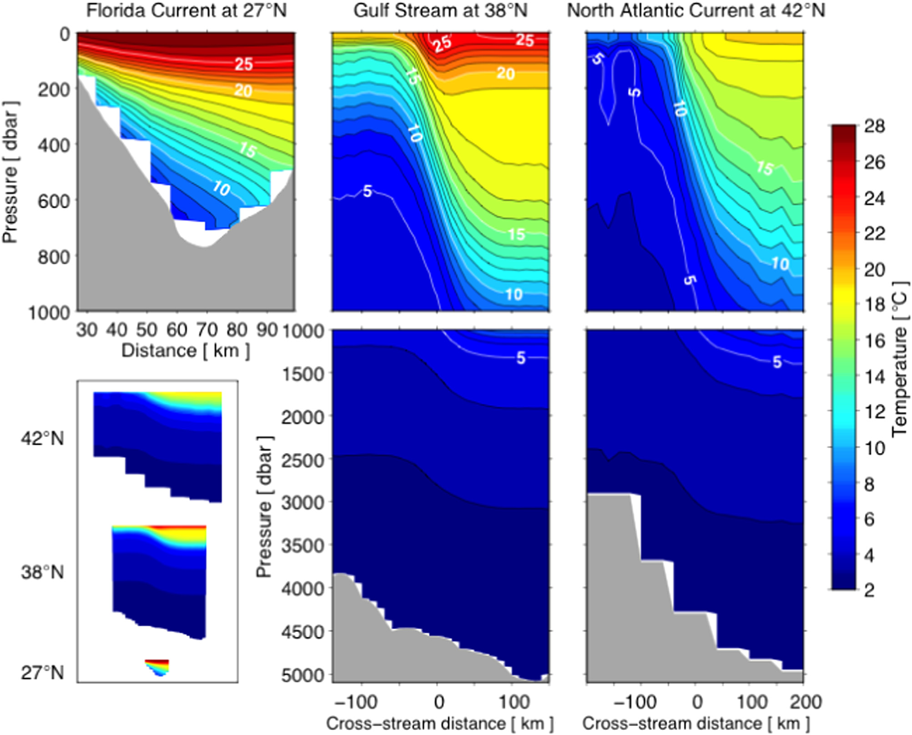
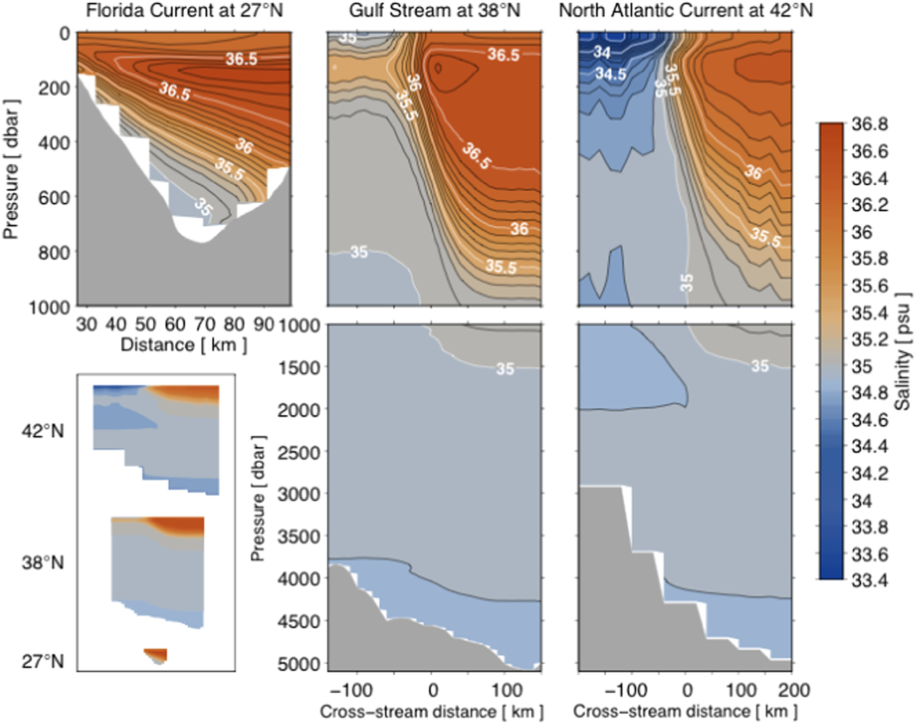
Future Directions: Comparison, Coherence, and Connectivity with other latitudes
Meinen and Luther, 2016
Notes:
Example figures that show how the data we collect in WBTS can be used together with historical data sets to study how the Gulf Stream properties change downstream. From Meinen and Luther (2016).

Slide 30
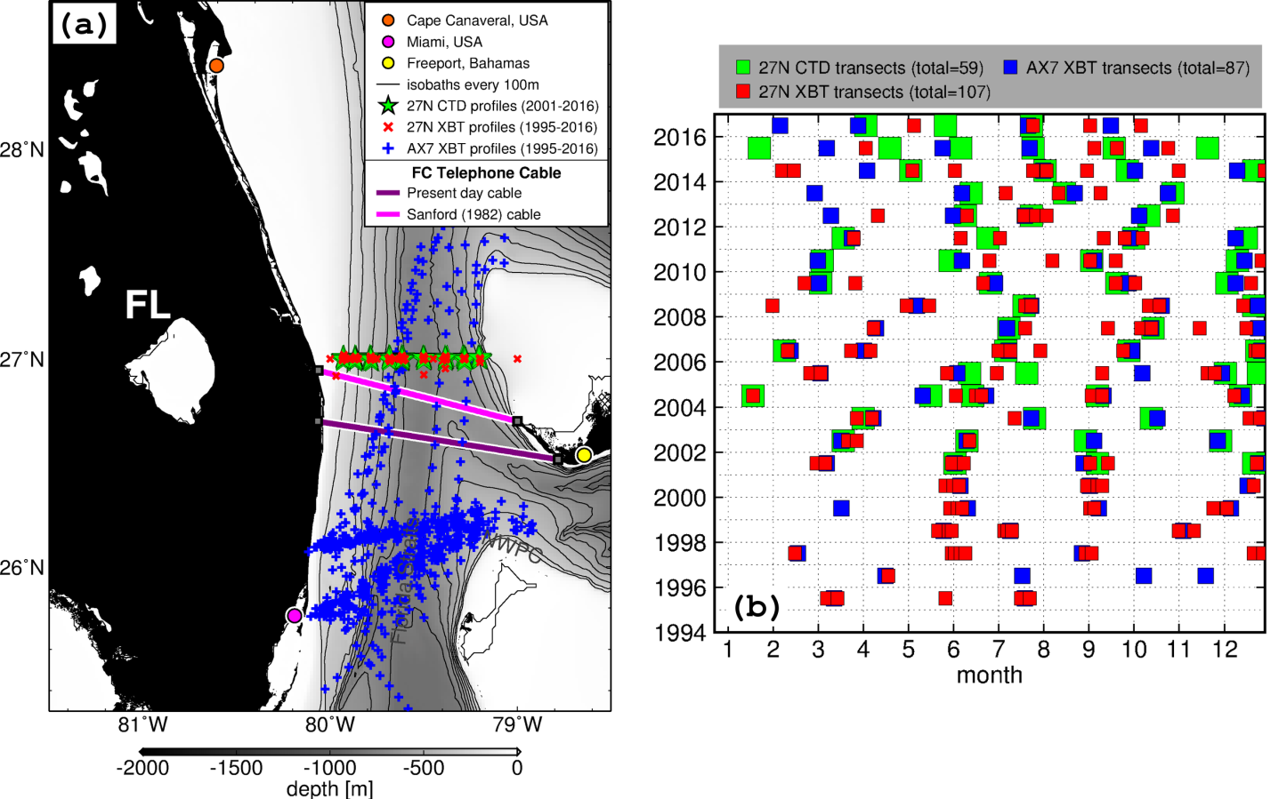
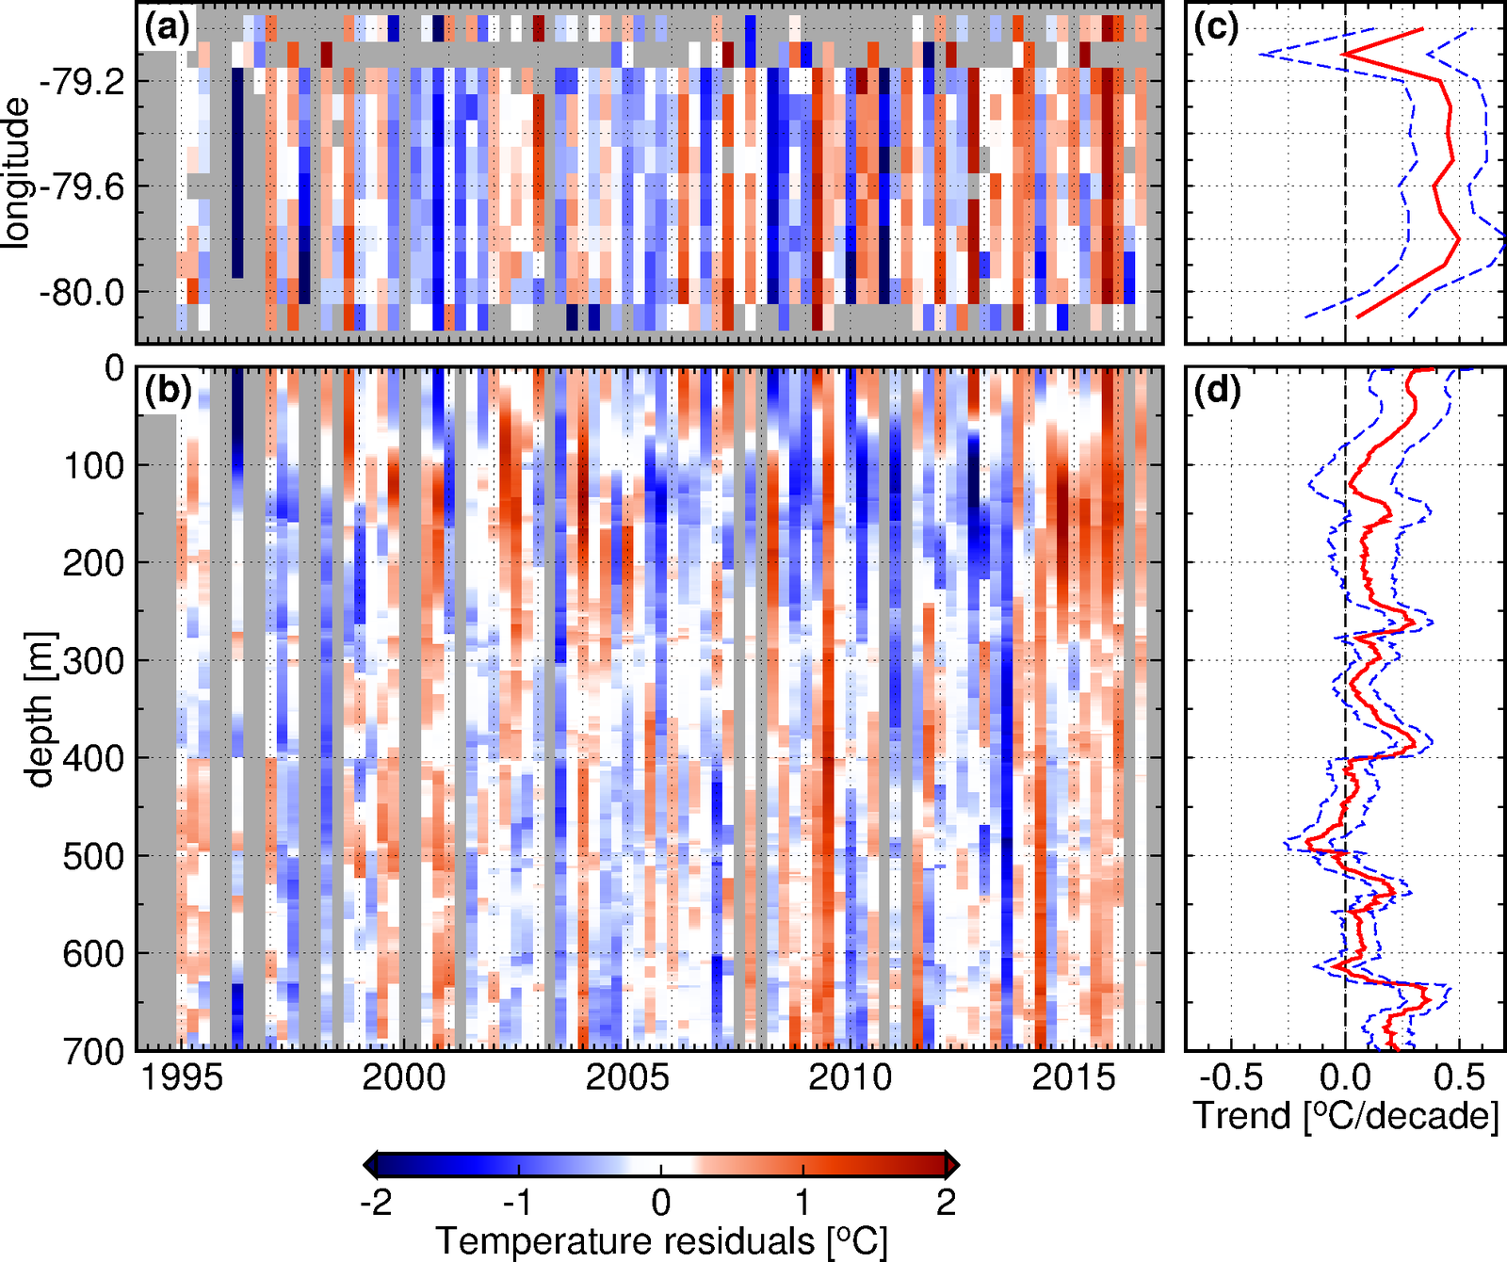
Future Directions: Florida Current Warming and steric impacts of Sea Level
Domingues et al, in prep.
Notes:
In situ ocean observations carried out in the Florida Straits across the Florida Current. (a) Map showing the location of ocean observations collected at the Florida Straits. (b) Table showing the time for occupations of CTD and XBT transects in the Florida Straits at 27°N, totaling 253 transects across the Florida Current.

Slide 31
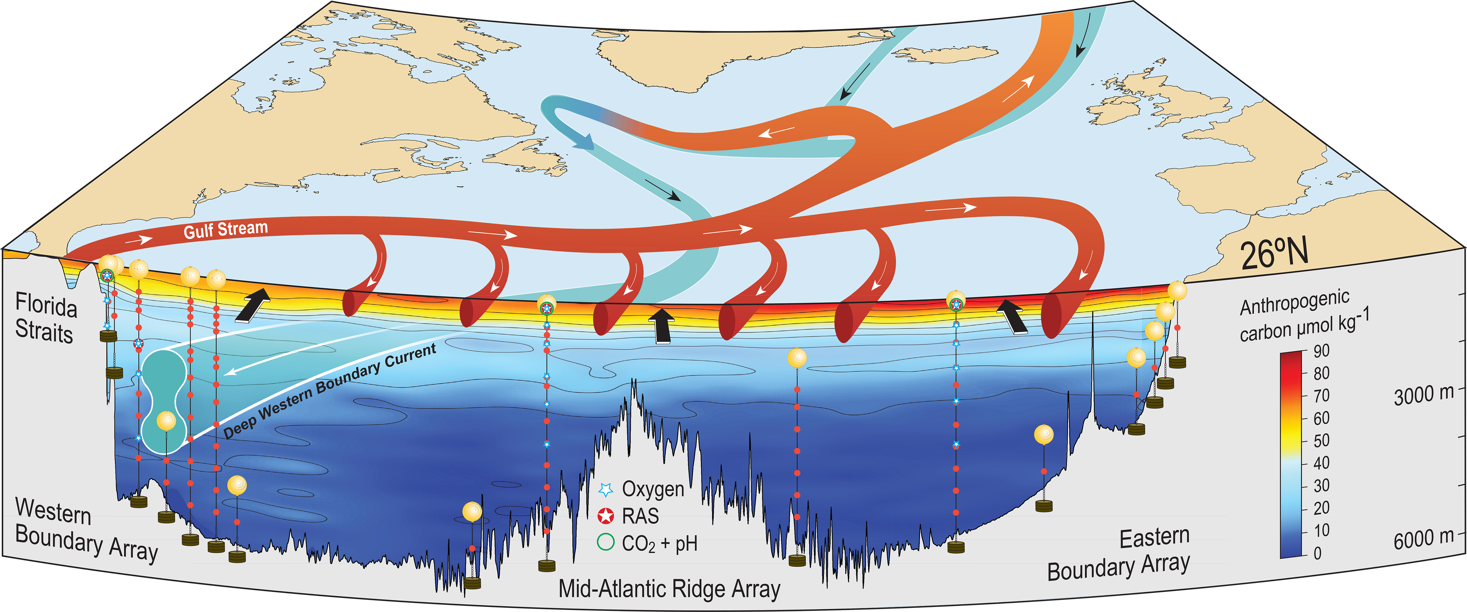
Future of Rapid Array
Anthropogenic Carbon, Oxygen, Nutrient transports.
Schematic courtesy Pete Brown, SOC
Notes:
Figure 1. Schematic diagram of the components of the Atlantic Meridional Overturning Circulation and the observing system mooring array at 26°N with superimposition of distribution of anthropogenic carbon concentrations from April 2010. Ekman transport is represented by black arrows, warm water circulation in the top 1100m is represented by red arrows, and blue arrows represent the mainly southward flow of colder, deeper waters.

Slide 32
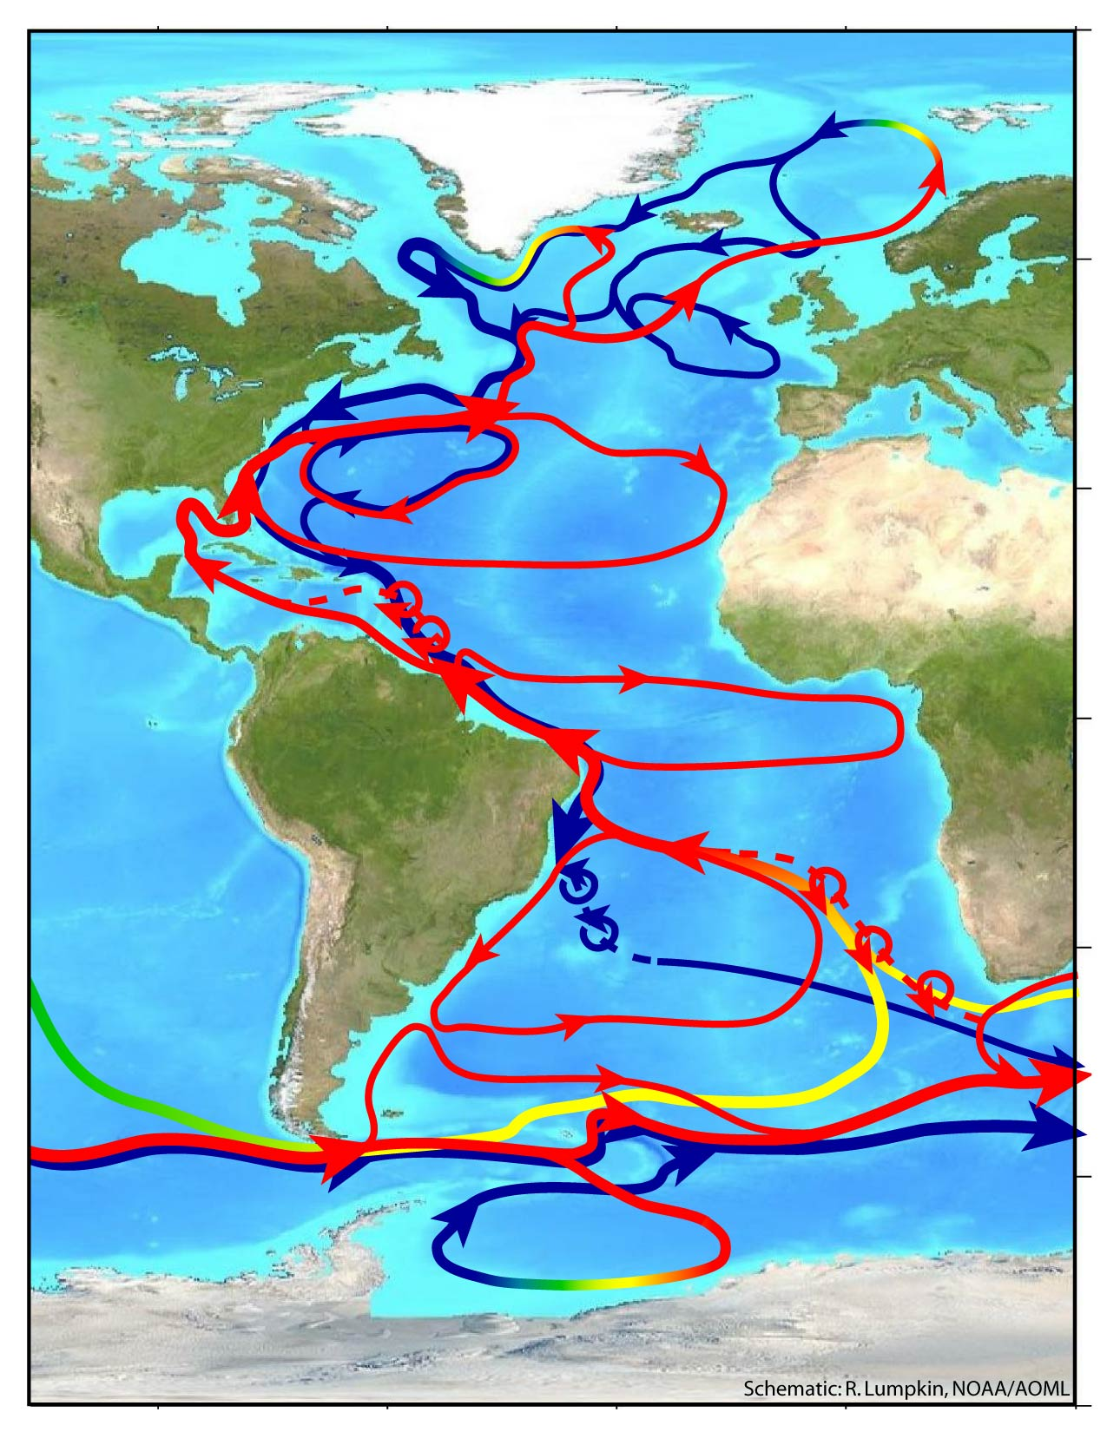
AMOC Monitoring Strategy
“To set in place a system for continuous observation of the meridional overturning circulation and northward heat transport in the Atlantic Ocean, with which to document its variability and its relationship to observed climate fluctuations, and to assess climate model predictions.” AMOC Implementation Plan, 2007.
O-SNAP
RAPID
Value:
Accurate multi-year mean AMOC estimates, for comparison with future (and past) AMOC states
Understanding of processes underlying short-term (intraseasonal to annual) variability
Benchmarks for evaluation of modeled AMOC variability (GCMs, data synthesis models)
MOVE
SAMOC
Lumpkin and Speer (2007)

Slide 33
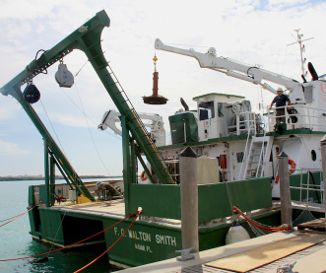
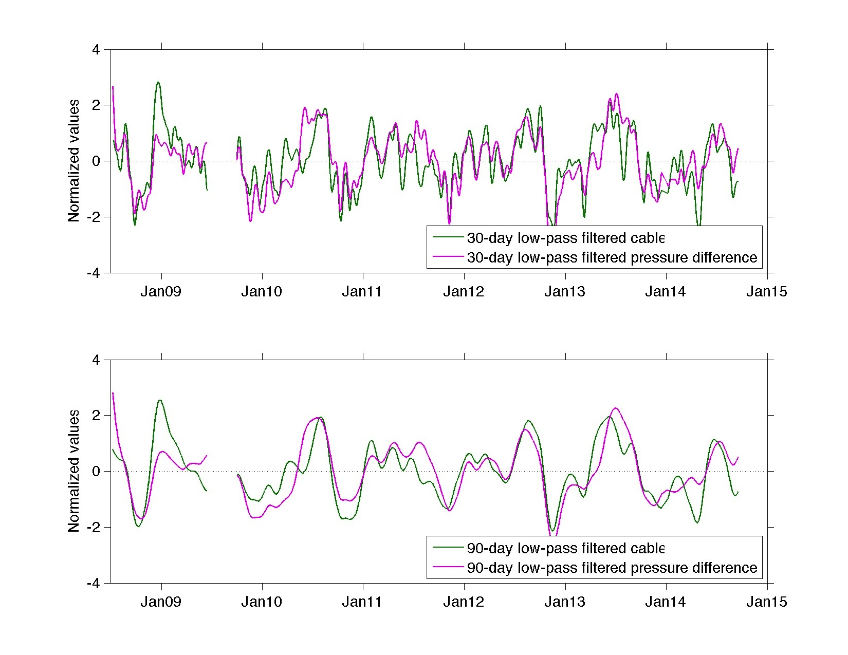
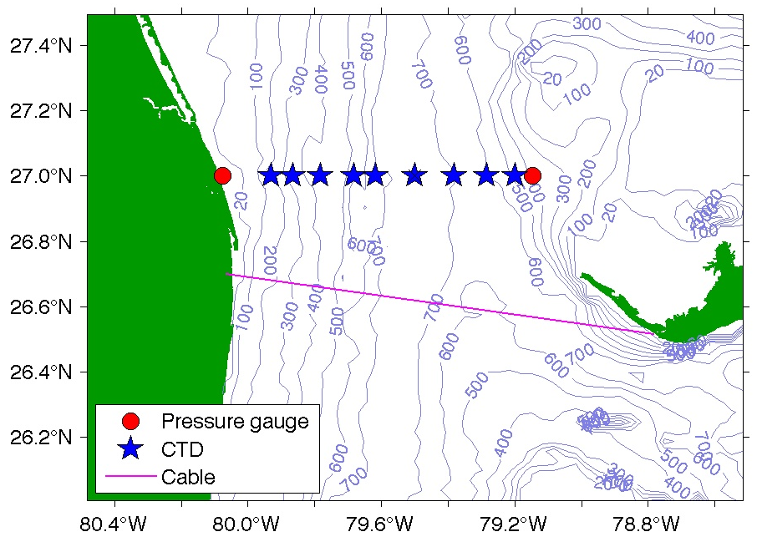
TECHNOLOGY: Alternative or back-up system to measure the Florida Current
Meinen, in prep.
Notes:
Comparison of low-frequency variability from the tide gauges and the cable, illustrating how we are looking to test new technologies and prepare for the eventual failure of the cable. From my presentation in 2015 at the RAPID-USAMOC meeting in Bristol.

Slide 34
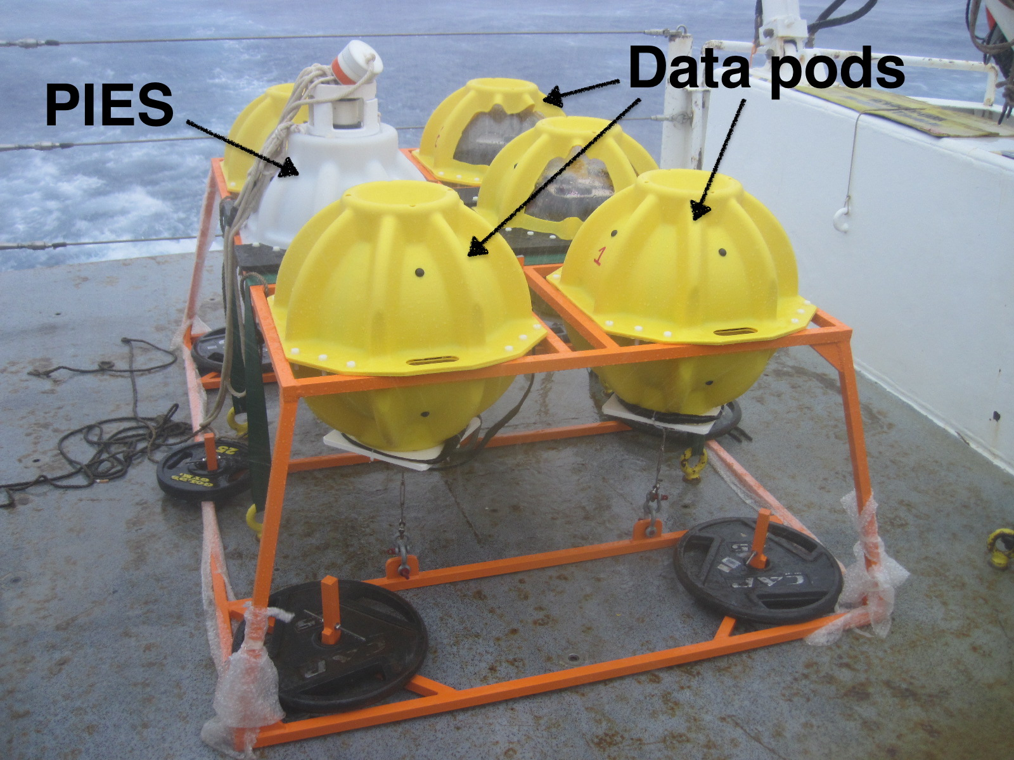
Future Technology: ABIISS
Adaptable Bottom Instrument Information Shuttle System
ABIISS deployed in 4500+ meters of water – representing for the first time a test in true deep ocean conditions (recovered in 2017). The ABIISS system has been mated to a pressure-equipped Inverted Echo Sounder (PIES) for an 18-month deployment alongside one of the existing PIES moorings that are part of the long-term AOML “Western Boundary Time Series” project.

Slide 35
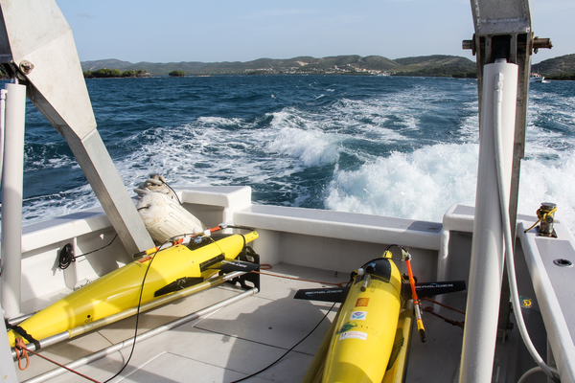
Future Technology: Underwater glider observations and data telemetry
Potential glider port
AOML-CARICOOS gliders in the Caribbean Sea
Underwater glider travelled distance: ~1000km. Temperature and salinity profiles every 5km: ~200 profiles to 1000m. Acoustics communications have been used with Seagliders, primarily been done using the WHOI Micro-Modem, data packages need to be relatively small, 100s of KB range

Slide 36
Future Science Questions
Connectivity of the AMOC – Subpolar North Atlantic, Subtropical South Atlantic, Boundary Currents
Understanding mechanisms and natural variability
Understanding the oceans response to changes in forcing
Role of AMOC in the global carbon cycle (does AMOC variability constrain CO2 uptake?)
Flow compensation in deep circulation (40 Sv DWBC reduced to 18 Sv net deep MOC transport)
How do these heat transport anomalies move/spread into the N. Atlantic? On what time scale?
What are the associated heat content tendencies and patterns resulting from ocean heat advection/divergence?
How does MOC impact coastal sea-level?

Slide 37
Western Boundary Time Series WHAT NEXT:
What roll will NOAA play post 2020 when NSF support for the 26N array ends?
Can the tall mooring array be transitioned to a reduced inverted echo sounder array?
Can MOC impacts be assessed with carbon, nutrient transports, etc?
Can MOC time scales be refined using chemistry e.g. CFCs, etc.?
Can ABIISS help reduce ship time needs?
Can deep gliders technology replace the hydrographic section and collect mooring data?
What systems can be used in the Florida Straits to replace Walton Smith sections or cable time series?

Slide 38
Thank you!

Slide 39






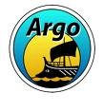

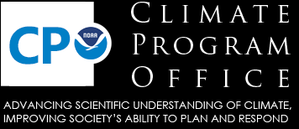



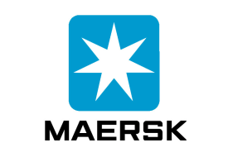

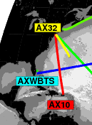







Partners and Stakeholders
Research at AOML on the WBTS involves many national, international partners, collaborators and stakeholders. A special few include:
Notes:
The research I’m going to show you was heavily leveraged by our partners. For example the observing systems we’ve developed are too large for one country to take on in isolation and hence have resulted from years of negotiations and planning with national and international partners.
The data we collect is dependent on private industries who make instruments, provide data collection platforms and in the end use NOAA products. Also much of this work is tightly involved with other NOAA labs, of particular note is PMEL for data collection, GFDL and ESRL for modeling studies and NCDC with whom we collaborate to produce the annual state of the climate report.
NOAA: e.g. PMEL, GFDL, NODC, NESDIS, NCDC
Outside NOAA: e.g. University of Miami, WHOI, SOI, UW,
Private partners – e.g. ships, equipment suppliers etc

Slide 40
STRENGTHS
Provides the longest open ocean transport time series in the world.
Key index of the climate system providing ~35 years of data on the state of the ocean.
Ongoing time series serve as the backbone for other observing programs (e.g. expansion to build a trans-basin monitoring array jointly supported by NSF and the United Kingdom).
Together with partner data sets, provides the longest continuous daily time series of the state of the MOC.
Located in the center of the subtropical gyre of the North Atlantic, where oceanic heat transport is a maximum and eddy noise is a minimum (i.e. provides high signal to noise).
Observations include full water column observations of WOCE-quality water properties.
Time series observations result in daily estimates of the Florida Current and DWBC.
Uses relatively low cost instrumentation in novel ways.
Routine occupations allow for testing of ancillary program instrumentation (e.g. “ABIISS” data pods system tested in the Florida Current and the DWBC, deep gliders, etc.)

Slide 41
WEAKNESSES
Located at a single latitude.
Requires ships.
Requires many different coordinated activities, instruments and methods and ship types
Novel, low cost instrumentation makes some trade-offs about what is observable e.g. sacrificing some horizontal or vertical structure of variability (e.g. net transport of the Florida Current or low-mode vertical structure of the DWBC)
Hydrographic sections provide only limited temporal snapshots (e.g. may be aliased in time).
Level funding reduces spare equipment, planned equipment replacement cycles instead become ‘fix when broken’.

Slide 42
OPPORTUNITIES
Ongoing program is attractive to other chemistry and ecosystem research (e.g. expansion to nutrient, carbon fluxes and ecosystem assessments through biological sampling).
Provides deployment opportunities for other projects (e.g. deployment opportunities for surface drifters, Argo, XBTs)
Provides additional data for validating and interpreting other observing systems (e.g. gravity missions, satellite, coastal sea level records).
New technology could reduce the need for ‘white hull’ cruises such as deep gliders, shallow gliders, wave gliders and ABIISS could replace hydrographic sections and telemeter data from subsurface moorings in the DWBC.
New technologies in the Florida Current could provide a back-up system to cable voltages and/or replace calibration cruises.
New MOC time series for the Subpolar Gyre in the North Atlantic (“O-SNAP”) and the Subtropical Gyre in the South Atlantic (“SAMBA”) compared to the 26N MOC time series will yield many new scientific advances.

Slide 43
THREATS
Risk the loss of key staff managing the all aspects of data collection and processing, when salary support is not adjusted for inflation.
Recruitment of the next generation of scientists to assume leadership of programs like this is impossible without dedicated resources for graduate students, Post Docs and junior staff.
Funding for some components of this project comes largely from two independent NOAA sources with unique pressures (e.g. NSF and United Kingdom providing support for University of Miami’s Cooperative Institute for Marine and Atmospheric Studies).
AOML funding support for base funds come from ‘climate’ while OOMD program funding comes from ‘ocean’ funding lines. Different funding sources within NOAA and outside of NOAA can have different funding pressures.
Other programs rely on WBTS data and data availability could adversely impact those programs (e.g RAPID/MOCHA) and hence NOAA and AOML’s reputation as a reliable partner.

Slide 44
Publications
Curated publication listing includes only papers that provide new analysis, calculation or figure that includes WBTS data explicitly.
Average = 9 publications per year for the last 6 years.

Slide 45
Budget
OOMD provides approximately 50% of the required funding.
AOML Base funds increase to fill the inflationary increases.
Supplemental funding from NSF provides support for CIMAS affiliates on cruises.
Supplemental funding from SOC/NERC supports Florida Current Hydrographic cruises.

Slide 46
Other Results: Reduced MOC and associated heat transport can lead to
  Reduced SSTs, Surafce Air T (Vellinga&Wood 2002)
  Cooling of N. Atlantic and adjacent lands (or reduction in anthropogenic T increases; e.g. Woolings et al 2012)
  Reduced AMO (Delworth and Mann 2009)
  Strengthening of winter storms (track changes; Jacob et al 2005))
  Increased Westerlies/Decreased Easterly Trades (Brayshaw et al 2009)
  Southward movement of ITCZ (precip changes; Stouffer et al 2006)
  Changes in drought (McCabe et al 2004)
  Changes in precipitation in monsoon regions (Zhang and Delworth, 2006)
  Rising N. Atlantic Sea-Level (1 m; e.g. Leverman et al 2005)
  Changes in circulation (e.g. Hakkinen and Rhines, 2004; Lozier et al 2010)
  Carbon export production from the North Atlantic (e.g. Schmittner 2005)
  Land Biogeochemistry (Bozbiyik et al 2011; Obata 2007) – e.g. reduction in net primary production on land due to cooling and decreased precipitation.
Srokosz, Baringer, Bryden, Cunningham, Delworth, Lozier, Marotzke and Sutton, 2012. Bull. Am. Met. Soc., doi: 10.1175/BAMS-D-11-00151.1, Nov 2012.

