Slide 1

AOML’s
Real Time & Delayed Mode XBT Quality Control
Yeun-Ho C. Daneshzadeh
Yeun-ho.chong@noaa.gov
2012 Meeting of the Joint IODE-JCOMM Steering Group for the GTSPP
16 - 20 April 2012, Oostende, Belgium
Joint IODE-JCOMM Steering Group for the GTSPP, Oostende, Belgium June 17-20,2014

Slide 2

AOML: XBT Data Flow
Data Centers
DM Data
SEAS RT
Transmission
SEAS Server
Data Download
Global Telecommunications System (GTS)
RT Profiles
for QC
QC Result
AOML Auto/Visual
QC
AOML Operational Data Base
Joint IODE-JCOMM Steering Group for the GTSPP, Oostende, 2012
Joint IODE-JCOMM Steering Group for the GTSPP, Oostende, Belgium June 17-20,2014

Slide 3
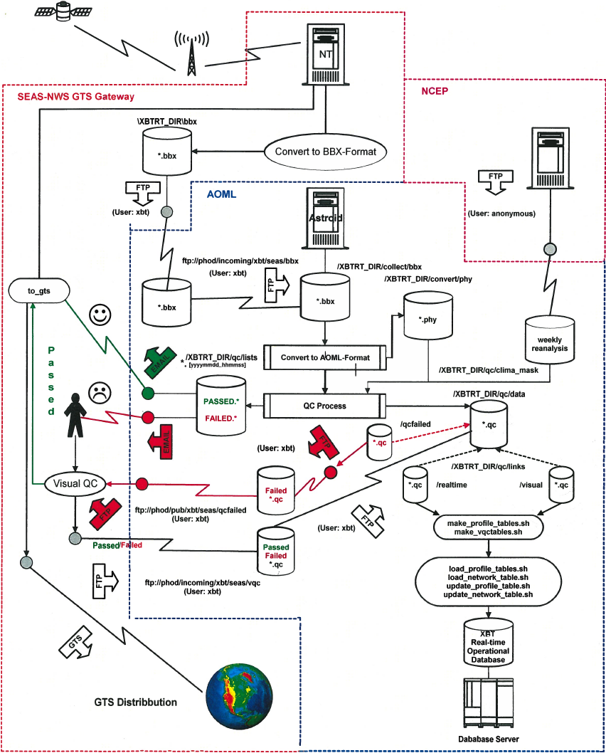
AOML: Quality Control for RT XBT Data
Automatic Quality Control Processing System for SEAS XBT Real-Time Data
Joint IODE-JCOMM Steering Group for the GTSPP, Oostende, 2012
Joint IODE-JCOMM Steering Group for the GTSPP, Oostende, Belgium June 17-20,2014

Slide 4
AOML: Automatic Quality Control for RT XBT Data
AOML Auto QC Tests:
● Gross check
● Constant value
● Spike
● Vertical Gradient
● Climatology
● Analysis
● Date
● Location
● Depth
Joint IODE-JCOMM Steering Group for the GTSPP, Oostende, 2012

Slide 5
AOML: Automatic Quality Control for RT XBT Data
AOML Auto QC Tests:
● Spike
A measurement fails this test if tolerance of 0.4°C for difference between observed temperature and the associated median (of 3 observations) is exceeded
T_{test} = | T₂ - ( T₃ + T₁ ) / 2 | - | ( T₃ - T₁ ) / 2 |
● Vertical Gradient
This test flags gradients and inversions. A measurement fails this test if the temperature gradient is outside of range 0.2 °C/m to 1.0°C/m
grad(T)_{test} = ( T₂ – T₁ ) / ( Z₂ – Z₁ )
Joint IODE-JCOMM Steering Group for the GTSPP, Oostende, 2012
Joint IODE-JCOMM Steering Group for the GTSPP, Oostende, Belgium June 17-20,2014

Slide 6
AOML: Automatic Quality Control for RT XBT Data
AOML Auto QC Tests:
● Gross check
This test checks the extreme depth and temperature values:
Good: -2.5°C < T < 40.0°C
0.0 ≤ Z < 11000.0 m
● Constant value (global flag)
This test checks if the profile is constant from top to bottom:
Good: T_{min} ≠ T_{max}
Joint IODE-JCOMM Steering Group for the GTSPP, Oostende, Belgium June 17-20,2014

Slide 7
AOML: Automatic Quality Control for RT XBT Data
AOML Auto QC Tests:
● Date (global flag)
This test checks for impossible date and time:
Good: Year > 1997; 0 ≤ Hour < 24
Month = 1, 2, …, 12; 0 ≤ Min. < 60
Day = 1, …., corresponding max.
● Location (global flag)
This test checks for impossible locations
Good: -180 ≤ Longitude ≤ 180
-90 ≤ Latitude ≤ 90
Joint IODE-JCOMM Steering Group for the GTSPP, Oostende, Belgium June 17-20,2014

Slide 8
AOML: Automatic Quality Control for RT XBT Data
AOML Auto QC Tests:
● Depth (global flag)
This test checks for profiles located at sea using ETOPO5.
Joint IODE-JCOMM Steering Group for the GTSPP, Oostende, Belgium June 17-20,2014

Slide 9
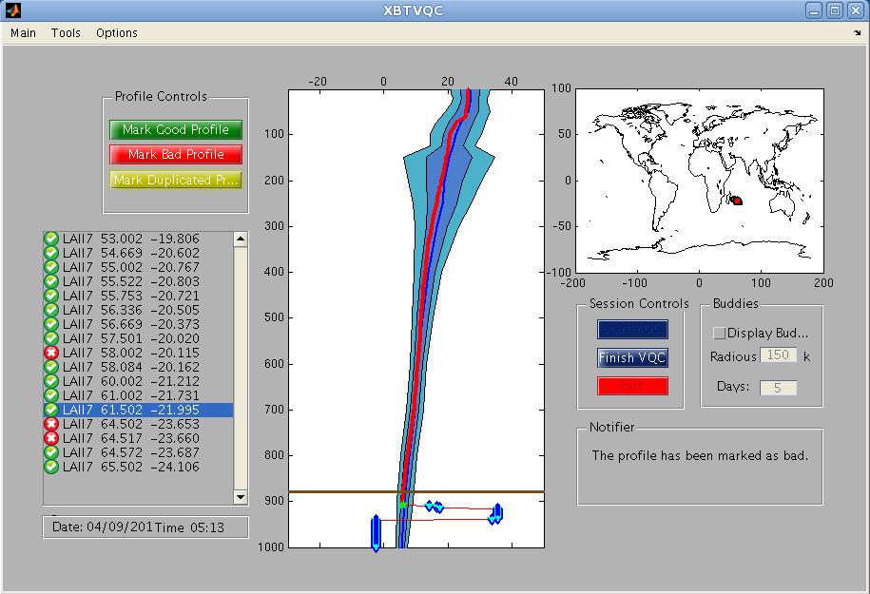
AOML: Visual Quality Control for RT XBT Data
Joint IODE-JCOMM Steering Group for the GTSPP, Oostende, Belgium June 17-20,2014

Slide 10
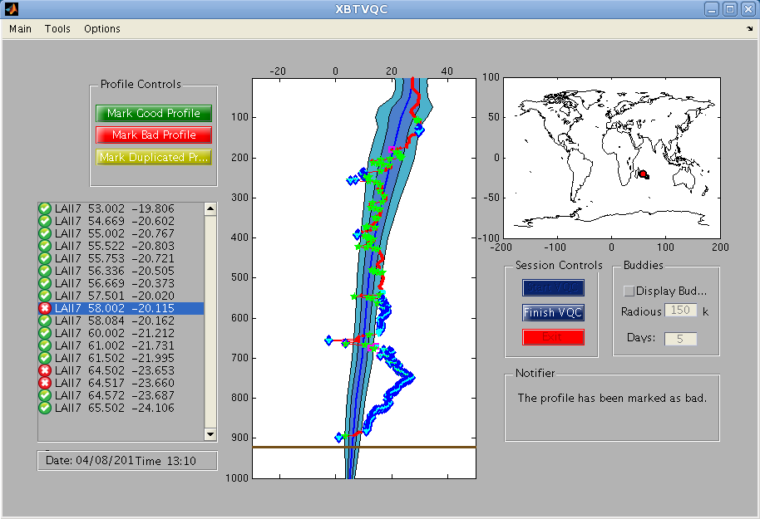
AOML: Visual Quality Control for RT XBT Data
Joint IODE-JCOMM Steering Group for the GTSPP, Oostende, 2012
Joint IODE-JCOMM Steering Group for the GTSPP, Oostende, Belgium June 17-20,2014

Slide 11
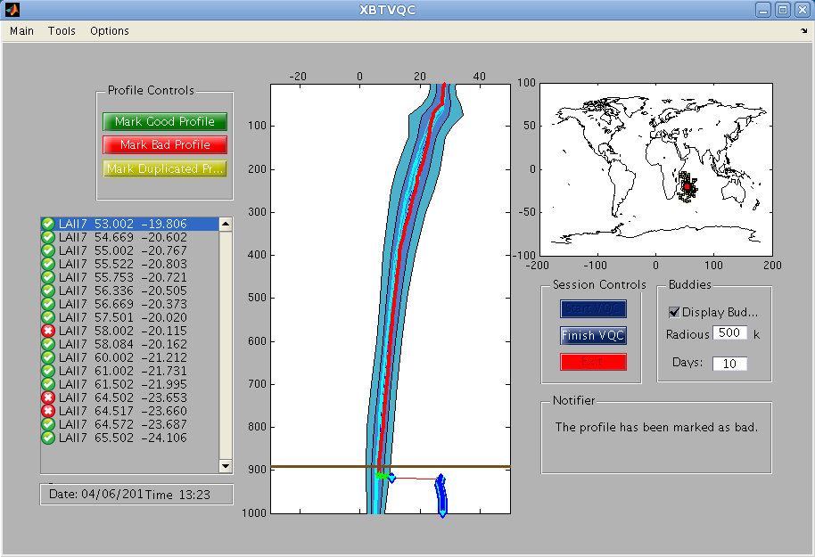
AOML: Visual Quality Control for RT XBT Data
Joint IODE-JCMM Steering Group for the GTSPP, Oostende, 2012
Joint IODE-JCOMM Steering Group for the GTSPP, Oostende, Belgium June 17-20,2014

Slide 12
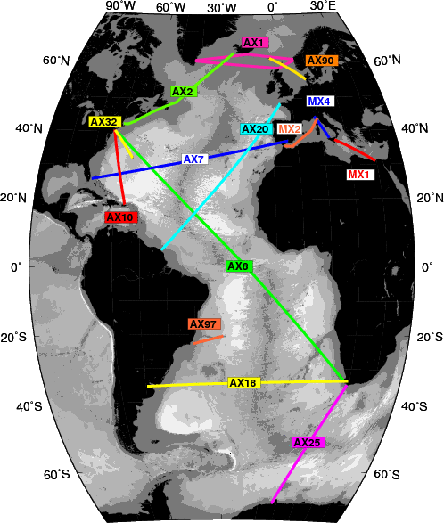

AOML: Data Flow for DM XBT data
● Data comes from the rider via e-mail
or in cd.
(ax7, ax8, ax10, ax18, ax25, ax97)
● Data comes from the rider via e-mail
or ftp downloaded. (ax1, ax2, ax20)
● Data comes from the rider via e-mail.
(mx1, mx2, mx4)
AOML
Joint IODE-JCOMM Steering Group for the GTSPP, Oostende, Belgium June 17-20,2014

Slide 13
AOML: Quality Control for DM XBT Data
AOML DM QC Tests:
● Location check
● Date/Time increasing check
● Speed check
● Levitus 2009 Climatology
● Local Climatology
● Duplicate check
● Waterfall check
Joint IODE-JCOMM Steering Group for the GTSPP, Oostende, 2012

Slide 14
DM Thresholds and Values used :
AOML: Quality Control for DM XBT Data
● Speed check : distances between drops more than 60 km or speed more than 20 m/s.
● Duplicate check : lon < 0.07 º & lat < 0.07 º & time < 2 min.
● Local climatology : nearest 25 profiles within +/- 45 days
● Levitus 2009 climatology
● Waterfall plot for consistency
Joint IODE-JCOMM Steering Group for the GTSPP, Oostende, Belgium June 17-20,2014

Slide 15
DM Typical Problems :
AOML: Quality Control for DM XBT Data
● Premature launch error
● Temperature offset error
● Wire break(stretch) error or touching side of ship
● Spike error
● High frequency error
● Just no good profile
Joint IODE-JCOMM Steering Group for the GTSPP, Oostende, Belgium June 17-20,2014

Slide 16
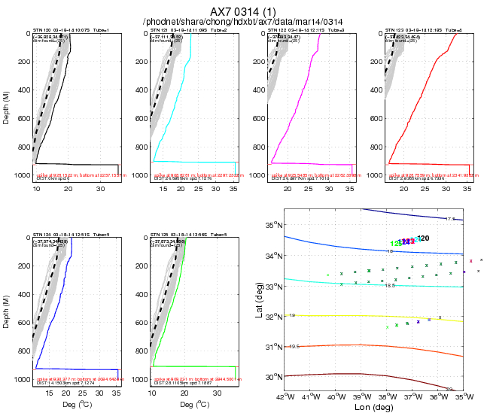
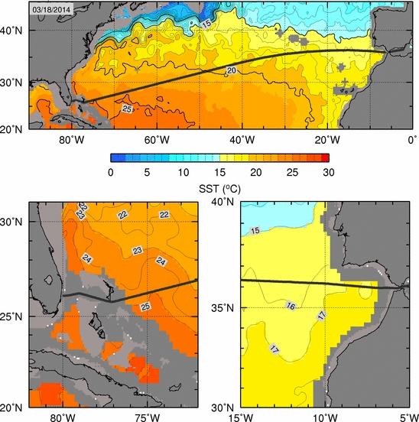
DM Temperature Offset Examples
AOML: Quality Control for DM XBT Data
Joint IODE-JCOMM Steering Group for the GTSPP, Oostende, Belgium June 17-20,2014

Slide 17
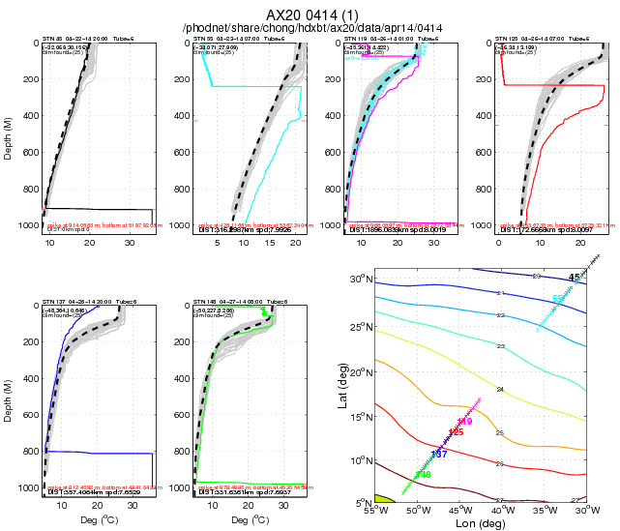
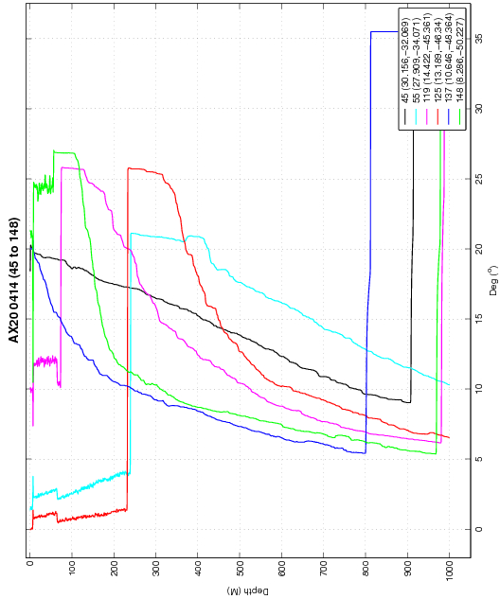
DM Pre-mature Launch & other errors
AOML: Quality Control for DM XBT Data
● malfunction in Tube #6
Joint IODE-JCOMM Steering Group for the GTSPP, Oostende, Belgium June 17-20,2014

Slide 18
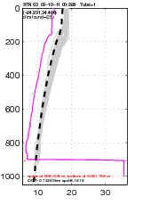
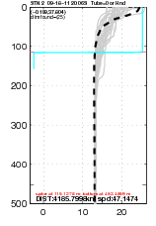
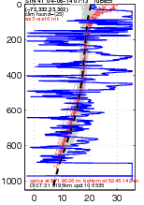
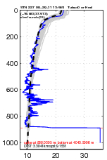
DM Examples of bad profiles
AOML: Quality Control for DM XBT Data
Temperature offset Just no good profile High frequency Leakage
Black dotted line : Levitus 2009 climatology
Grey lines : local climatology
Colored solid lines : profiles
Joint IODE-JCOMM Steering Group for the GTSPP, Oostende, Belgium June 17-20,2014

Slide 19
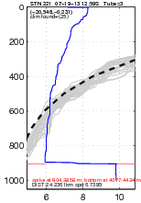
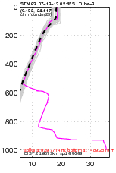
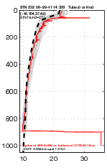
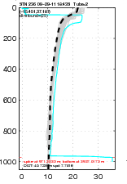
DM Examples of bad profiles
AOML: Quality Control for DM XBT Data
Bad probe Wire stretch Spike Premature Launch
Black dotted line : Levitus 2009 climatology
Grey lines : local climatology
Colored solid lines : profiles
Joint IODE-JCOMM Steering Group for the GTSPP, Oostende, Belgium June 17-20,2014

Slide 20
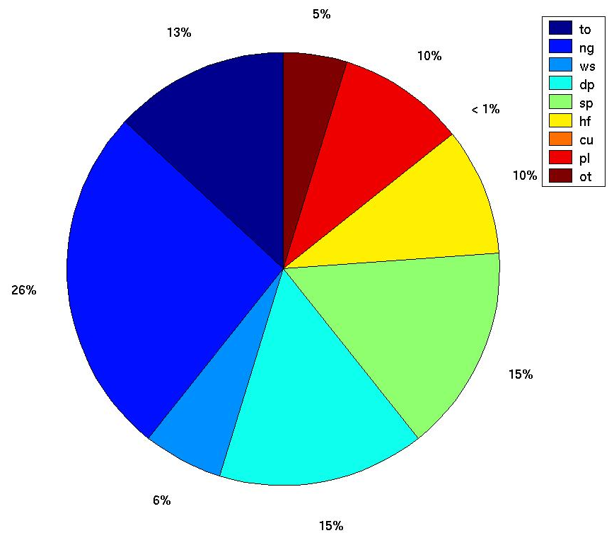
DM Most common problems in %
AOML: Quality Control for DM XBT Data
AX7 2013 Errors
Errors | # of XBTs
TOR | 11
NGR | 22
WSR | 5
DPR | 13
HFR | 13
CUR | 0
PLR | 8
OTHER | 4
Joint IODE-JCOMM Steering Group for the GTSPP, Oostende, Belgium June 17-20,2014

Slide 21
DM Number of Profiles QC’ed in FY2013: 7087
AOML: Quality Control for DM XBT Data
HD Line | # of XBTs
AX1 | 248
AX2 | 197
AX7 | 964
AX8 | 3055
AX10 | 438
AX18 | 885
AX20 | 476
AX25 | 305
AX97 | 268
MX1 | 56
MX2 | 79
MX4 | 116
Joint IODE-JCOMM Steering Group for the GTSPP, Oostende, Belgium June 17-20,2014

