Slide 1

AOML and the Global XBT Network
GTSPP Meeting
Oostende, Belgium
June 17-20, 2014

Slide 2
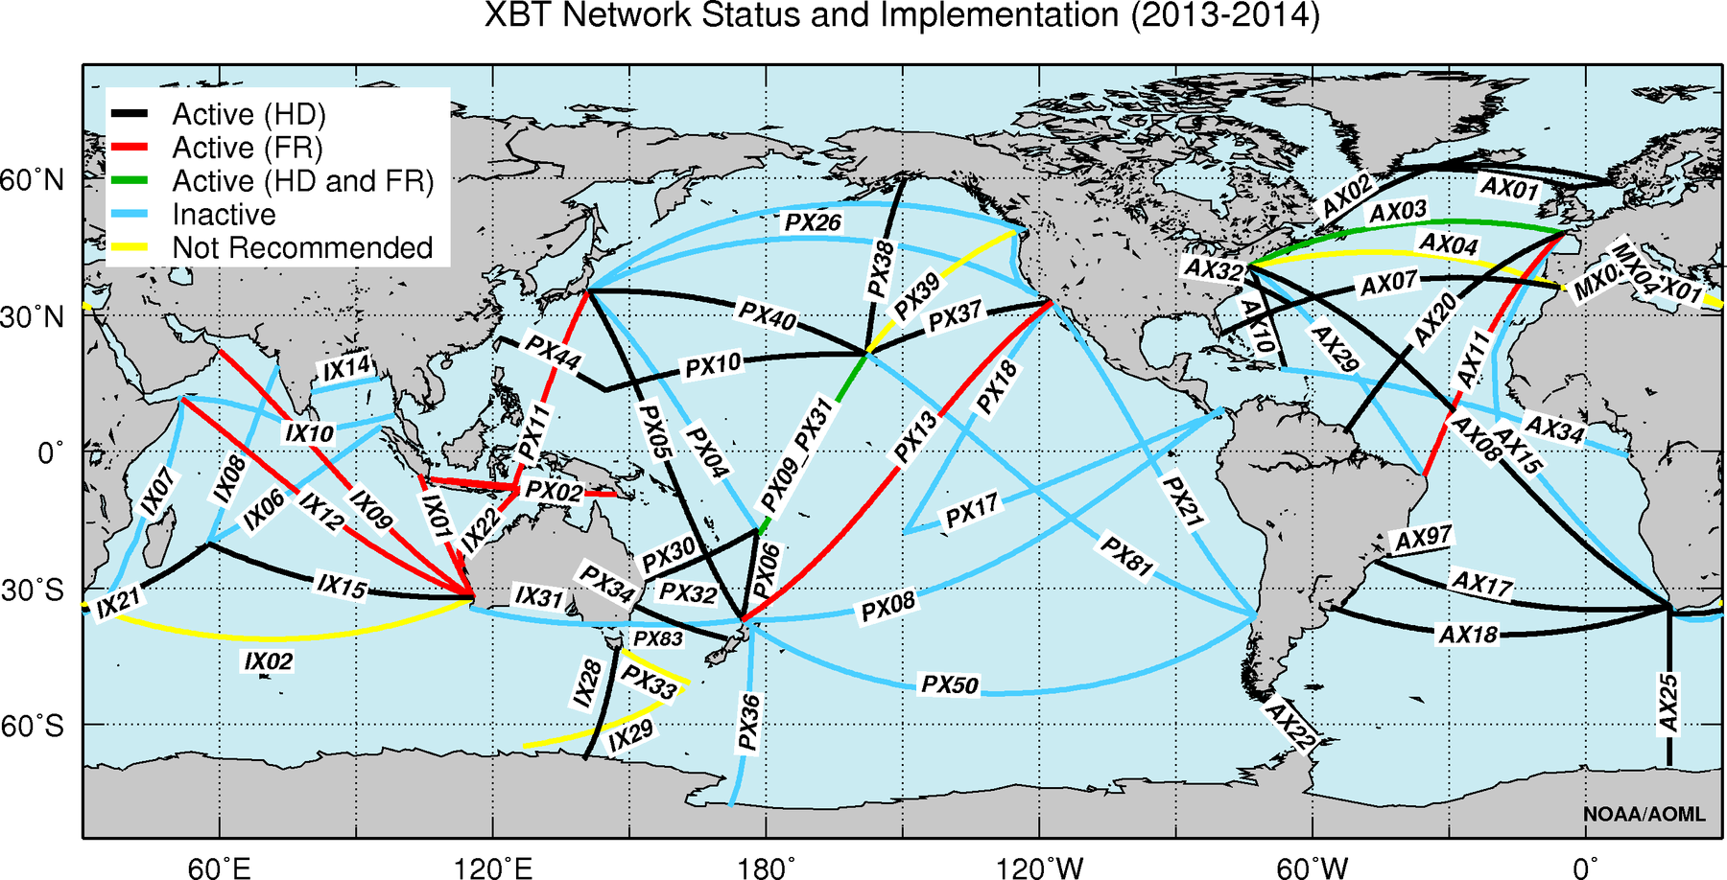

XBT network
(OceanObs09, CLIVAR panels, regional/national)

Slide 3
Recommended XBT deployments
Low Density (0):
4 deployments per day
12 transect per year
Replaced by ARGO
Frequently Repeated (33):
6-8 deployments per day
12-18 transect per year
Data not widely used
High Density (28):
1 deployment every 25-50 km
(18-35 deployments per day)
4-5 transects per year
Data widely used in scientific studies

Slide 4
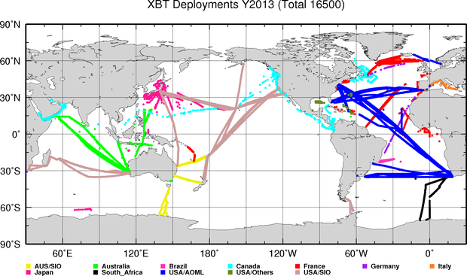
XBT deployment 2013

Slide 5
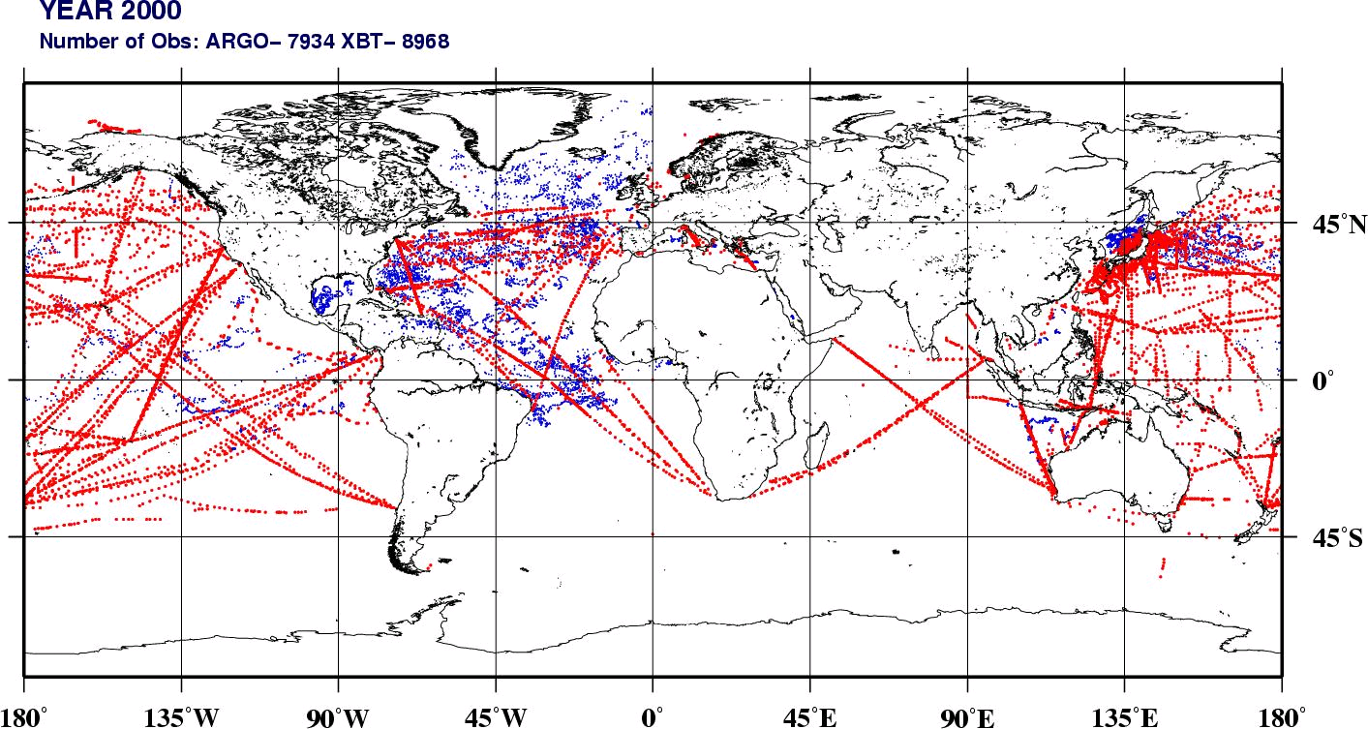
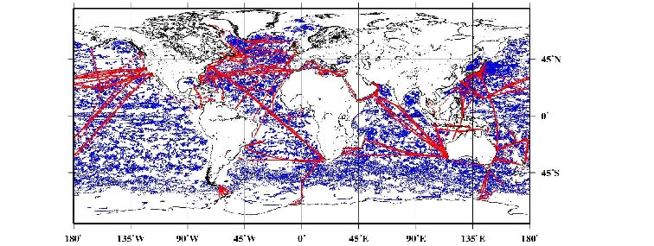
XBT and Argo floats observations
Spatial sampling
2000
2013
ARGO=149,443 XBT=13,650

Slide 6
XBT and Argo floats observations
Temporal sampling

Slide 7
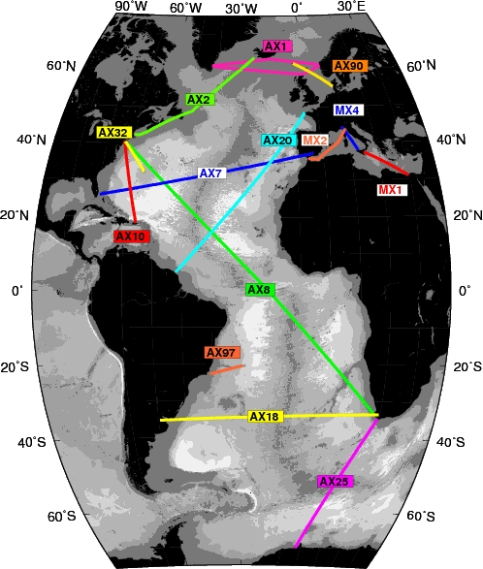
AOML HD XBT Network
(12 transects)
Collaboration Deployments:
AX01: Northern Europe to Iceland to Greenland,
in collaboration with the University of Paris
AX02: Boston to Iceland, in collaboration with NOAA/
Northeast Fisheries Science Center (NEFSC
and University of Paris.
AX07: Gibraltar to Miami (AOML only)
AX08: Cape Town to New York, in collaboration with the
University of Cape Town.
AX10: New York to Puerto Rico. (AOML only)
AX18: Cape Town to Buenos Aires, in collaboration with the
University of Cape Town and Argentine Hydrographic
Service.
AX20: France to France Guyana, in collaboration with the
University of Paris and IRD, France, and with BSH
of Germany.
AX25: Cape Town to Antarctica, in collaboration with the
University of Cape Town.
AX97: Rio de Janeiro to Isla de Trinidade, in collaboration with
the Federal University of Rio Grande (Brazil) and the
Brazilian Navy.
MX1, MX2, and MX4 : Meridional Mediterranean Sea
transects, in collaboration with ENEA/Italy.
IX1,IX12,and IX28: Fremantle to Sunda Straits, Fremantle to
Red Sea, and Hobart to Antarctica, in collaboration with
Australia’s Bureau of Meteorology and CSIRO.
Data flow/management:
NWS
NODC

Slide 8
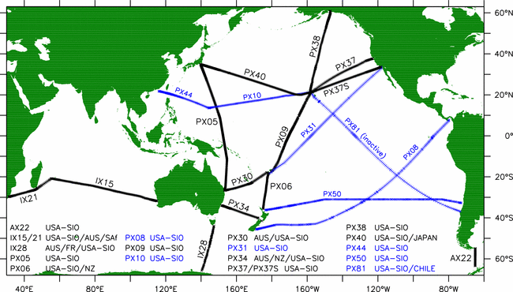
Scripps Institution of Oceanography (SIO) High Density XBT Network

Slide 9
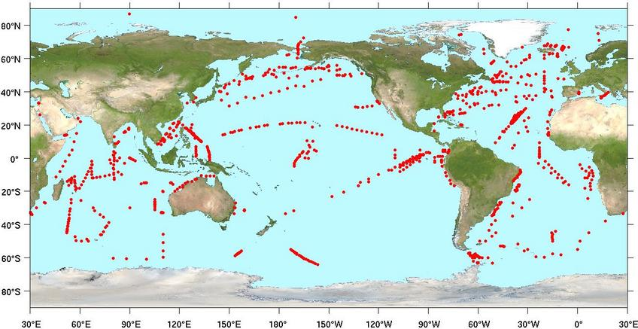
Deployment opportunity for other platforms - drifters
Year 2013
Number of Deployments: Drifter=1194
53 deployed by XBT HD lines.

Slide 10
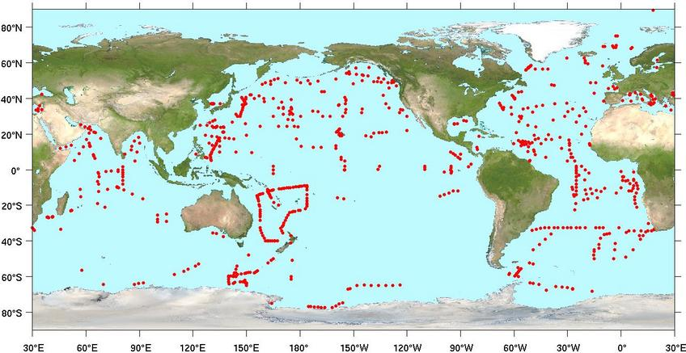
Deployment opportunity for other platforms - Argo
Year 2013
Number of Deployments: argo=810
32 deployed by XBT HD lines

Slide 11
Science applications of XBTs
Western boundary currents
Frontal regions
Subsurface currents and undercurrents
Meridional heat transport
Upper ocean heat content
Validation of numerical models
Initialization of numerical models for weather and climate forecasts
Excellent synergy with Argo floats and other observational platforms

Slide 12
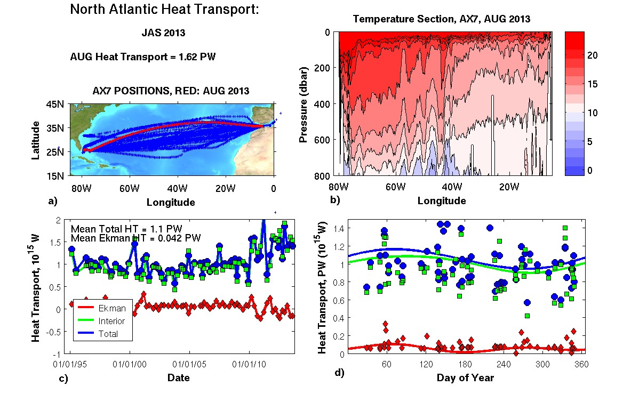
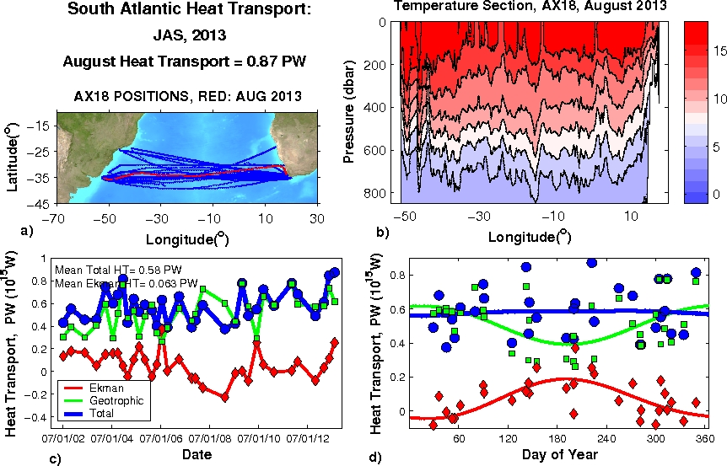
North/South Atlantic Meridional Heat Transport
AX07
AX18
/www.aoml.noaa.gov/phod/soto/mht/ax7/report.php
/www.aoml.noaa.gov/phod/soto/mht/ax18/report.php

Slide 13
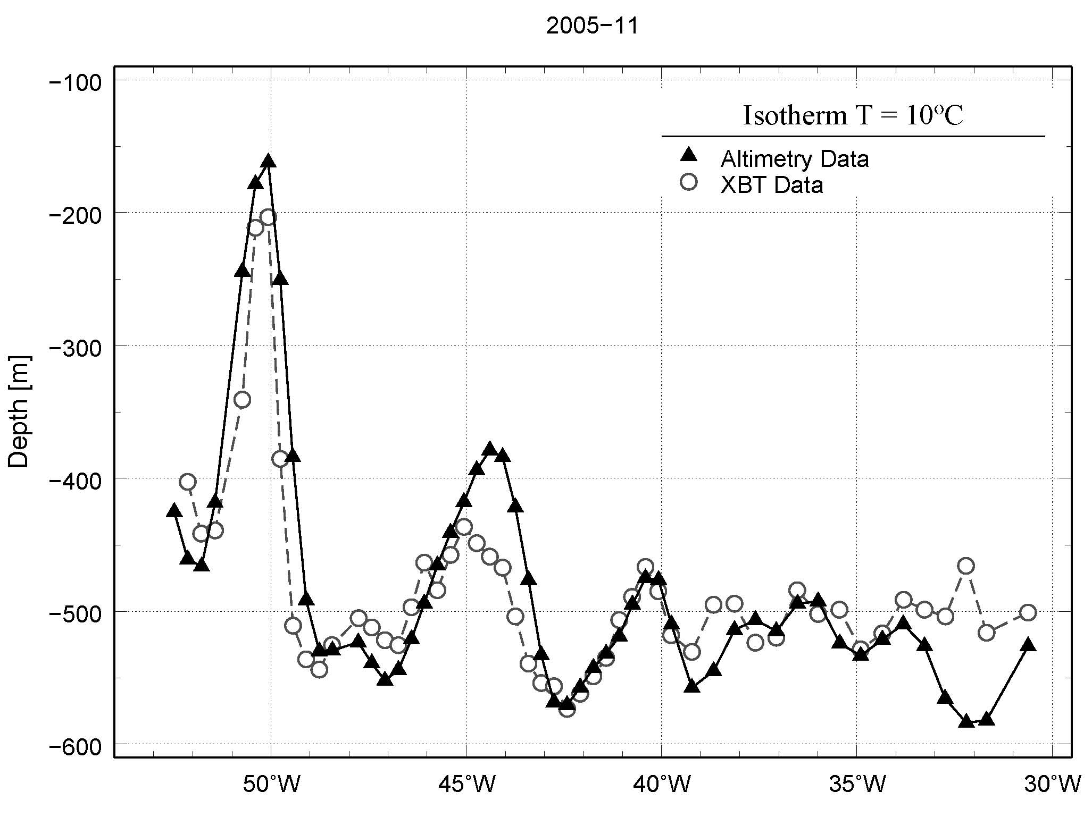
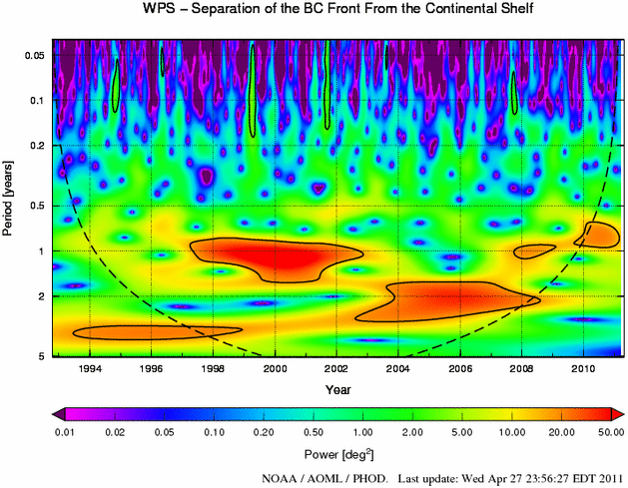
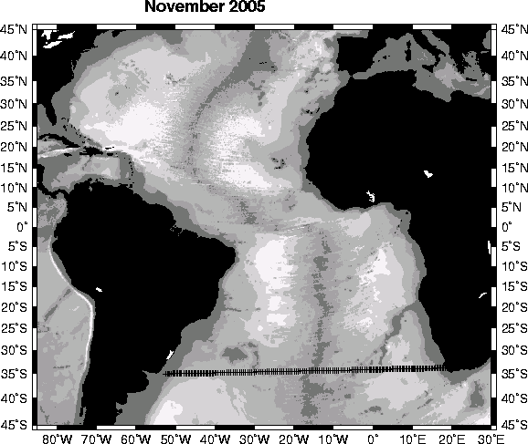
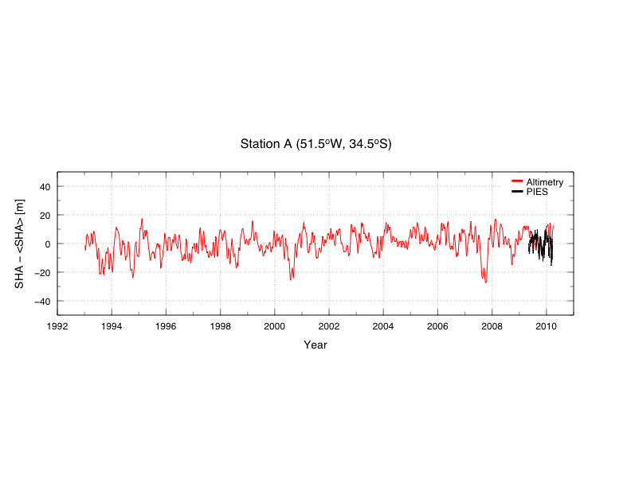
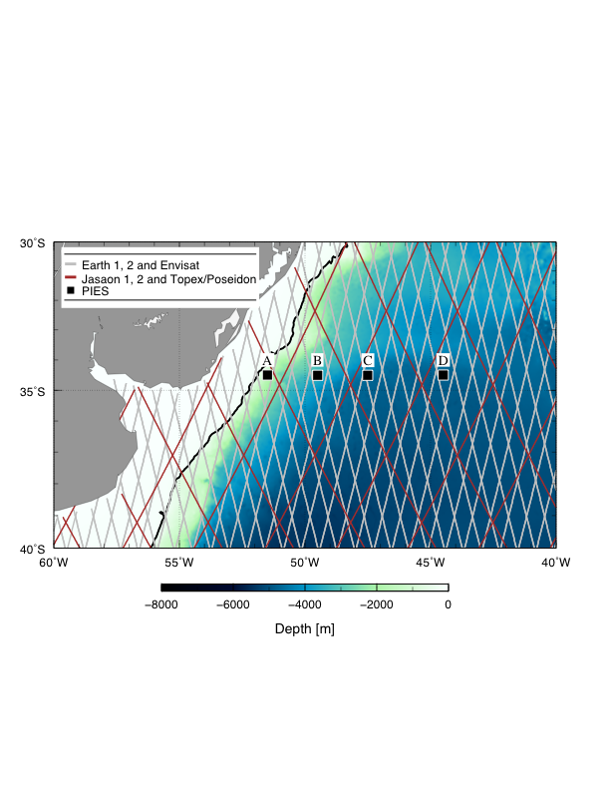
Western Boundary Currents (AX18)

Slide 14

Meridional Overturning Circulation (MOC) associated fluxes and transports in the South Atlantic at 35°S (AX18)
South Atlantic XBT observations can estimate MOC, heat and fresh water fluxes
Meridional heat transport at 35°S in the South Atlantic is 0.55 ± 0.14 PW, with larger variability than at 26°N.
MOC is 18.17 ± 2.3 Sv, similar in magnitude as 26°N, but with slightly lower variability.
Fresh Water fluxes are less than zero, implying that the MOC is bi-stable. Note that numerical models have a stable MOC with a positive slainity flux in the South Atlantic.

Slide 15
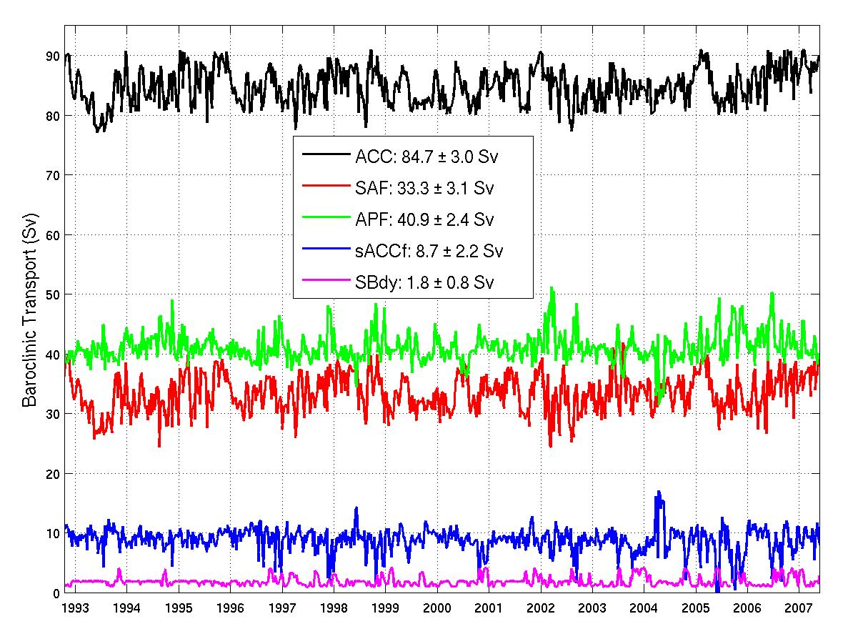
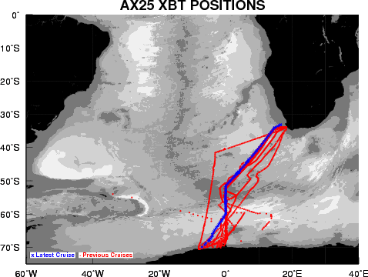
Frontal regions in the
Antarctic Circumpolar Current (AX25)
AX25 XBT obs + satellite altimetry
Detection of fine scale features that
form the fronts,
Subantarctic front contributes to 50%
of the total transport variance of the
ACC, even when its transport is less
than other fronts.
Figure by Sebastiaan Swart;
Goni et al, 2010

Slide 16
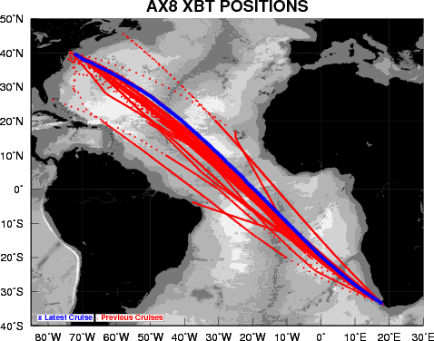
AX8 XBT transect is used to study the Atlantic Equatorial Current system
The tropical Atlantic current system is important for the interhemispheric and west-to-east transport of heat, salt and nutrients.
The AX8 transect has been used to monitor properties, such as velocity, transport and location, of the equatorial surface and subsurface currents.
XBT and altimetry are used together to investigate the mechanisms of the variability of these currents, from daily to interannual timescales.
NECC
Top: Mean zonal velocity (in m/s) across the AX8 section.
Bottom: Transport of the NECC (in Sv) estimated by XBT only (red dots) and using altimetry and XBT together (blue curve).
Goni and Baringer, 2002
Goes et all. 2013

Slide 17
Plans for the Future - XBT
Continue strong emphasis on research, mostly HD transects (importance of boundry currents, moc and mht including synergy with other observations)
Continue support of XBT Science Team. (www.aoml.noaa.gov/phod/goos/xbtscience/)
XBT improvements
Collaborate with Sippican in XBT FRE experiments.
Collaborate with Sippican to explore development of new climate quality XBT probe.
Third XBT Fall Rate Workshop to be held in China in October, 2014
Continue strong international collaboration

Slide 18
Recommendations
Explore the connection between SOOP and other groups with overlap in some objectives (Scientific Committee on Oceanic Research (SCOR) and World Ocean Council).
Continue collaboration with Global Ocean Surface Underway Data (GOSUD) and SAMOS
Urge all institutions to transmit profiles in RT or NRT into GTS.
Identify institutions, operators that are not currently transmitting XBT and TSG data into GTS (TC). Provide help, such as in equipment, expertise, etc.

