Slide 1


AAIW: Past, Present and Future
Collaborators: Ilana Wainer (USP), Lisa N. Murphy (RSMAS), Natalia Signorelli (USP), Esther Brady (NCAR)
February 20, 2014

Slide 2
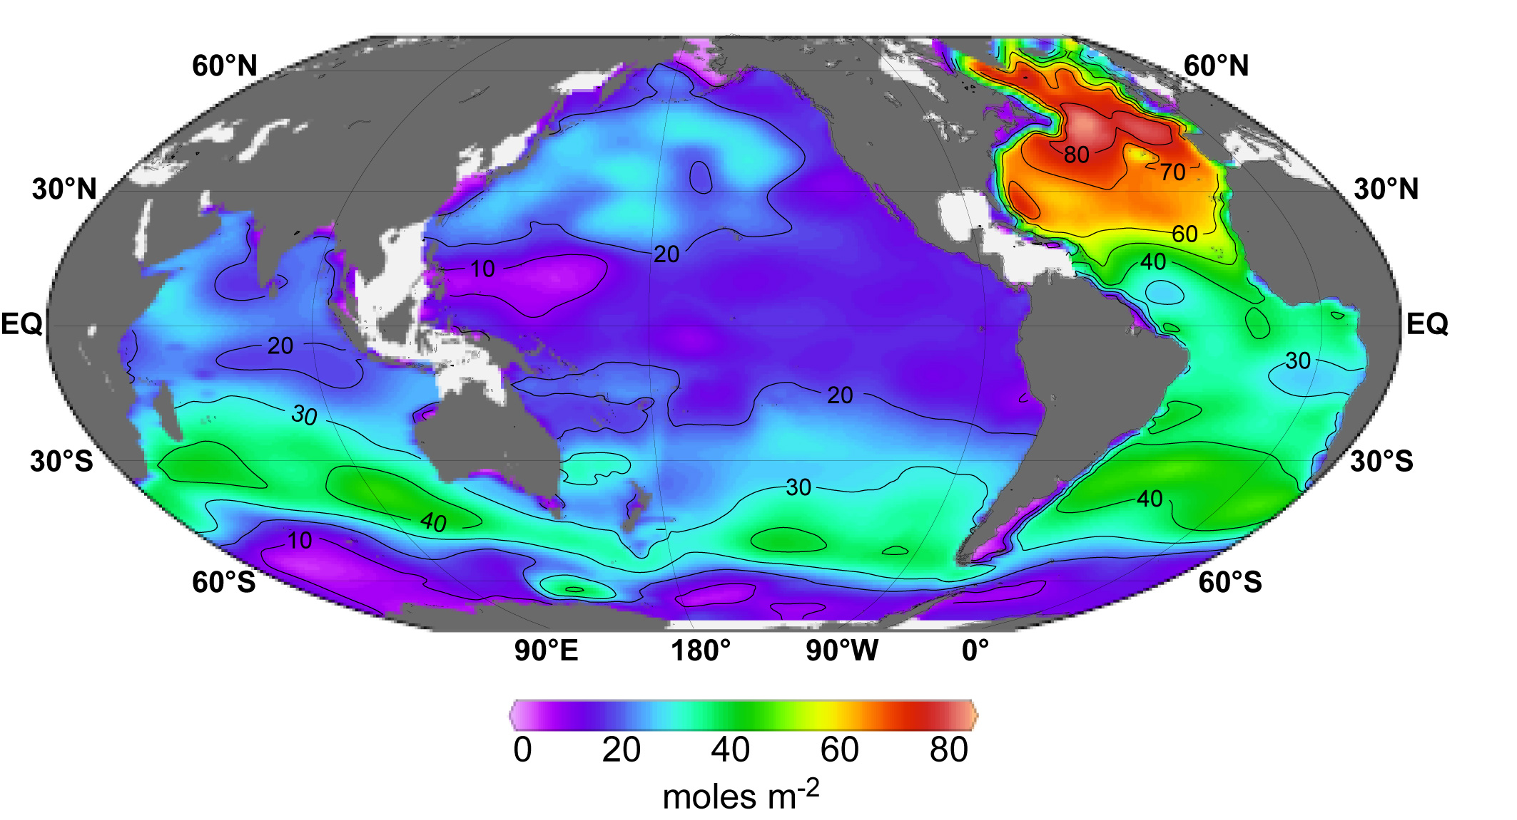
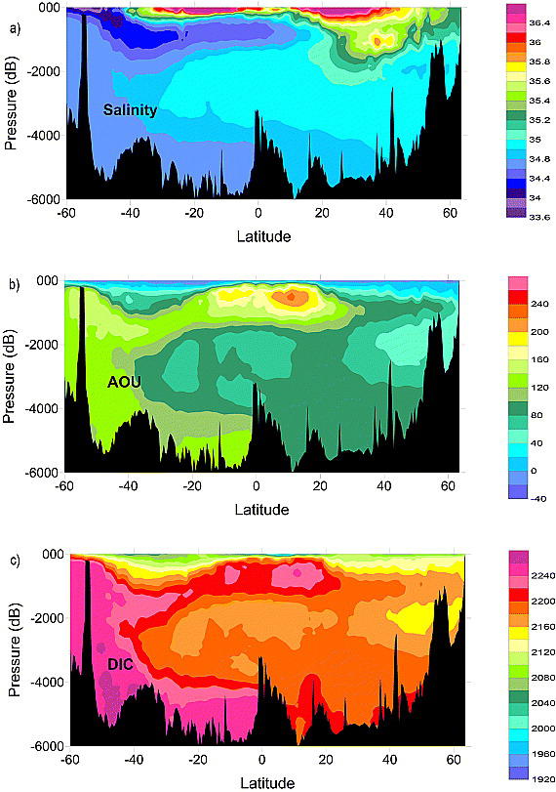
Ocean tracers and circulation
The highest inventories are found in the locations of the mode and intermediate waters.
(Sabine and Tanhua, 2010)
Wannikhof et al., 2010
Notes:
Analyzing how ocean tracers change over time allow the understanding of long term changes filtering weather and interannual noise in the data.

Slide 3
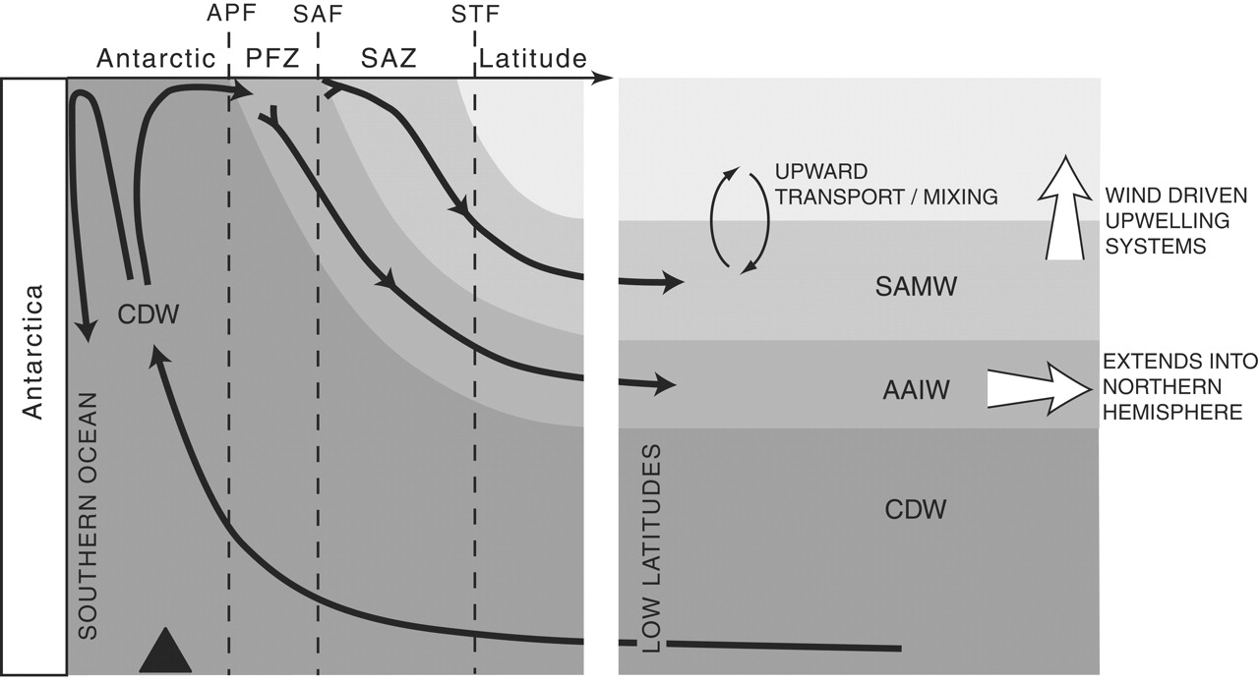
Mechanism for exchange of tracers
R F Anderson et al. Science 2009;323:1443-1448

Slide 4
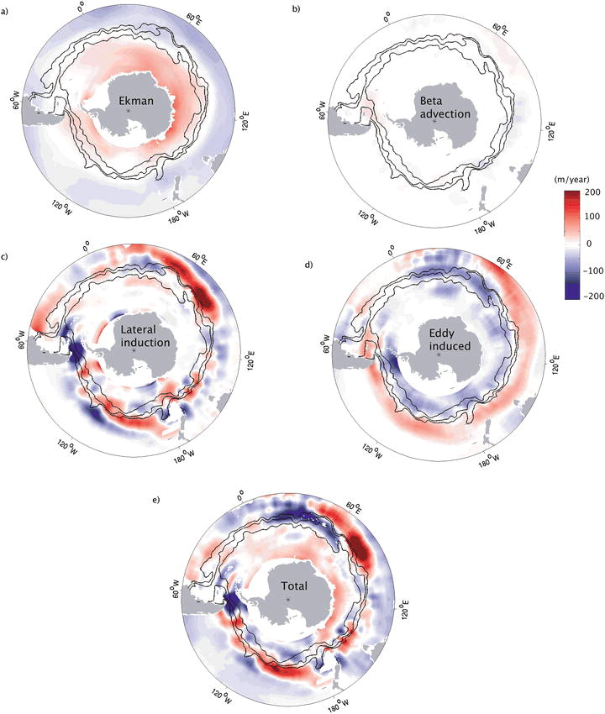
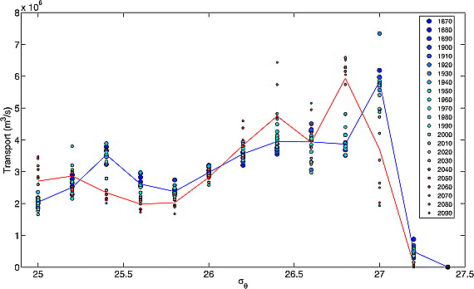
AAIW formation
Sallee et al., 2010
Goes et al., 2008

Slide 5
The spread of S. Atlantic AAIW
Schmid and Garzoli, 2010

Slide 6
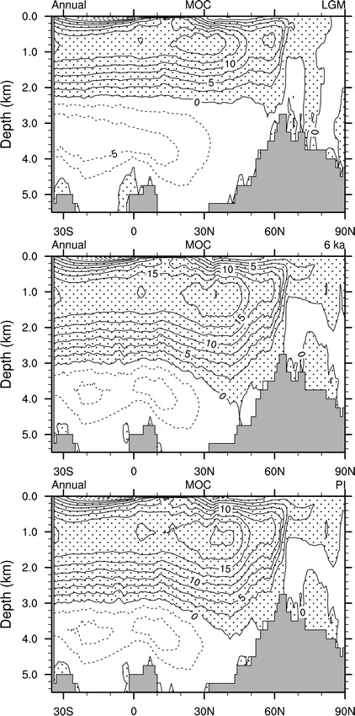
Past climates
Pahnke 2005, 2008
Otto-Bliesner et al., 2006: NCAR CCSM3 simulations of the Last Glacial Maximum (21kyr ago) and Mid-Holocene (6kyr ago) following the PMIP-2 protocol.
What is the Intermediate water formation response to changes in the NADW and AMOC?
Notes:
AMOC in the LGM is weaker and shallower then present.
PI is 21 Sv.

Slide 7
The Last Glacial Maximum (LGM)
The LGM (23-19 ka BP) was the coldest part of the most recent glacial period.
Climate models indicate the Earth’s average surface temperature was about ~3-5°C cooler than present day due to changes in orbital and greenhouse gas forcing and expanded ice sheets and glaciers (Braconnot et al., 2007).
Oceanic proxy records indicate cooling of tropical sea surface temperatures (~2.5°C and 3°C) and much greater cooling and expanded sea ice over the high-latitude oceans (Crowley, 2000).
During the LGM, the growth of ice sheets resulted in a global sea level lowering of about 120 meters (Peltier, 2004; Masson-Delmotte et al., 2006).
Figure: The extent of ice sheets and sea ice in the Northern and Southern Hemisphere during the LGM and the present day.
Mark McCaffrey , NGDC/NOAA
Source: http://www.ncdc.noaa.gov/paleo/slides/slideset/11/11_178_slide.html
Notes:
Orbital forcing caused cooling and maximum ice cover

Slide 8
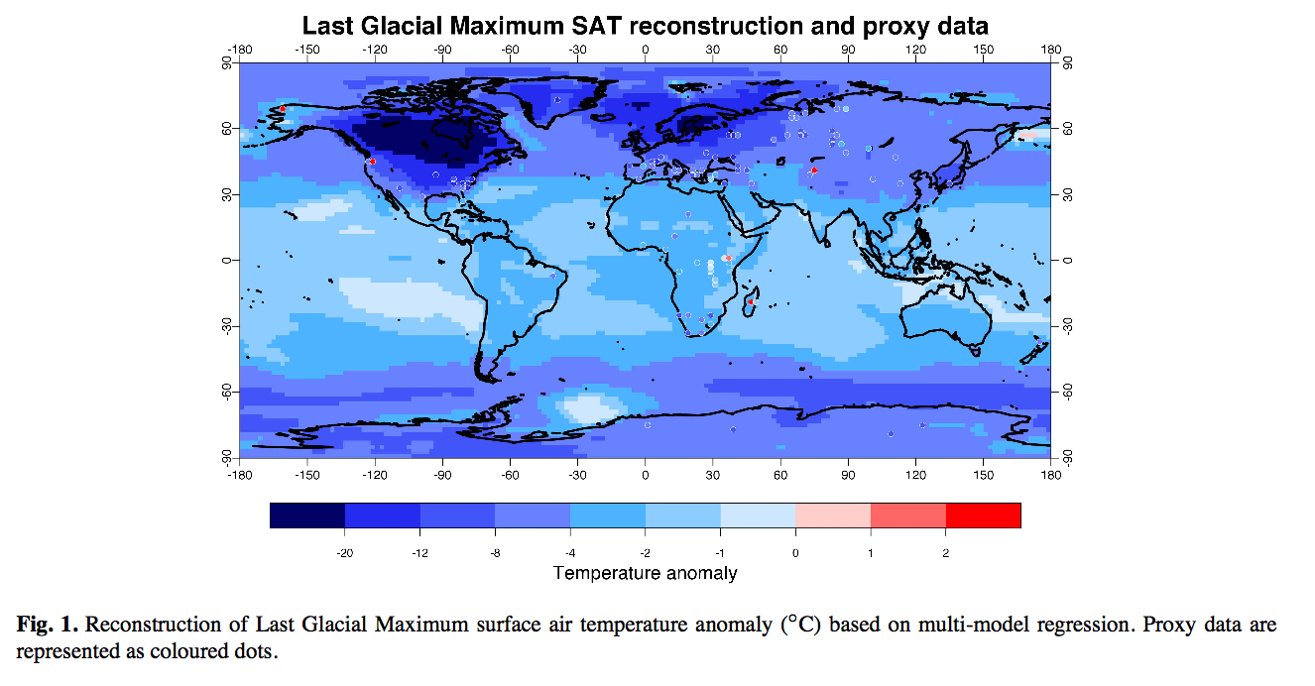
LGM SAT reconstruction and proxy data give a global mean cooling of 4.0 ± 0.8°C
Figure 1 from Annan and Hargreaves (2013).
Proxy data from land and ocean (MARGO Project Members, 2009; Bartlein et al., 2011; Shakun et al., 2012).
Model data from PMIP2 project (Braconnot et al., 2007).
Notes:
The 4C cooling is similar but opposite to what a 2x CO2 forcing warming.

Slide 9
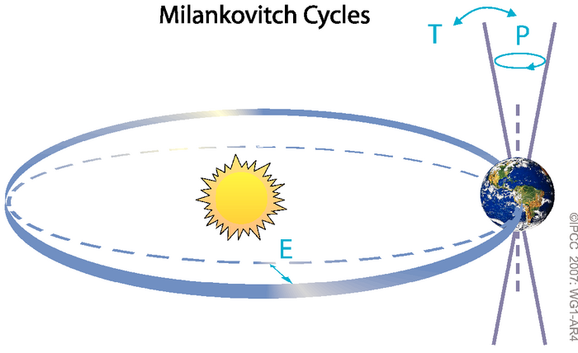
The Middle Holocene
Orbital changes resulted in increased seasonality in the Northern Hemisphere during the Mid-Holocene (8-6 ka BP).
Greater summer insolation resulted in more intense monsoons and higher lake levels in Africa and Asia (Kohfeld and Harrison, 2000; deMenocal et al., 2000), was well as northward shifts in boreal forests (Ritchie et al., 1987).
Figure 1: Schematic of the Earth’s orbital changes (Milankovitch cycles) that drive the ice age cycles. ‘T’ denotes changes in the tilt (or obliquity) of the Earth’s axis, ‘E’ denotes changes in the eccentricity of the orbit and ‘P’ denotes precession, that is, changes in the direction of the axis tilt at a given point of the orbit.
IPCC, 2007: WG1-AR4
Source: http://www.ipcc.ch/publications_and_data/ar4/wg1/en/box-ts-6-figure-1.html
Figure 2: Mean June mid-month insolation (W m⁻²) at 30 °N (Berger and Loutre, 1991) over the last 22 ka.
Notes:
middle of the current interglacial period.
It is well known from astronomical calculations that periodic changes in characteristics of the Earth’s orbit around the Sun control the seasonal and latitudinal distribution of incoming solar radiation at the top of the atmosphere (hereafter called ‘insolation’).
Precession refers to changes in the time of the year when the Earth is closest to the Sun, with quasi-periodicities of about 19,000 and 23,000 years. As a result, changes in the position and duration of the seasons on the orbit strongly modulate the latitudinal and seasonal distribution of insolation. Seasonal changes in insolation are much larger than annual mean changes and can reach 60 W m^{–2} (Box TS.6, Figure 1).
Paleobotanical evidence indicates boreal forests extended north of the modern treeline. Albedo implications (darker forests absorb more heat).
Implications for….
Hydrological cycle – P-E, warmer=wetter?, extremes
Storminess – hurricanes (warmer summers = more?), meridional temperature gradients are important for midlatitude storms, monsoons
Ocean circulation – wind driven gyres, overturning circulations.

Slide 10
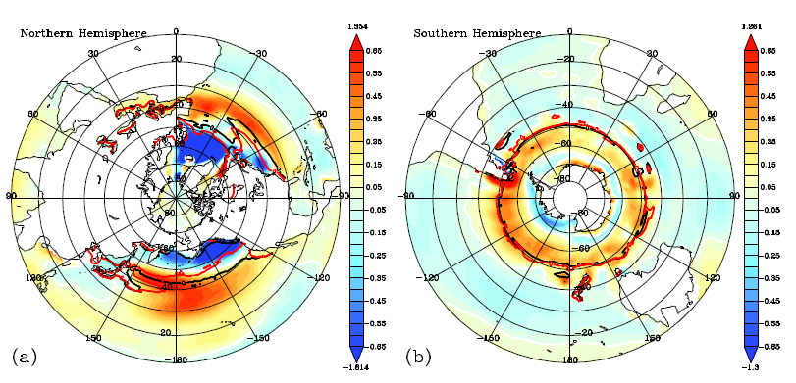
Zonal wind stress differences (LGM-PI)
Dyn/cm²
Dyn/cm²
ACC is much stronger in the LGM.
Weakened Icelandic low and Arctic oscillation.
Notes:
Difference field (LGM - PI) for (a) Northern and (b) Southern Hemisphere Zonal wind stress (NHZW and SHZW, respectively) in dyne/cm². Also shown are the positions of zero wind stress curl for the LGM (black contours) and PI (red contours). The LGM winds are more intense by 0.2–0.4 (dyne/cm²) in the south.

Slide 11
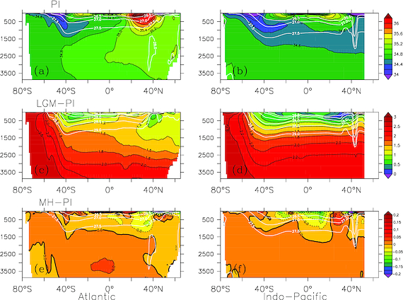
Salinity differences

Slide 12
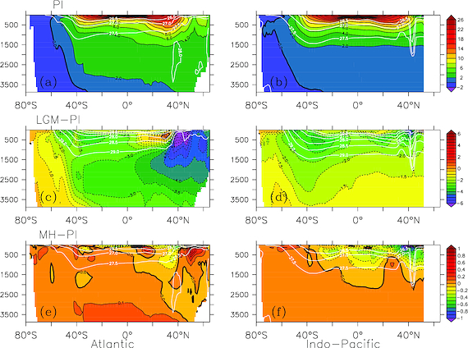
Temperature differences

Slide 13
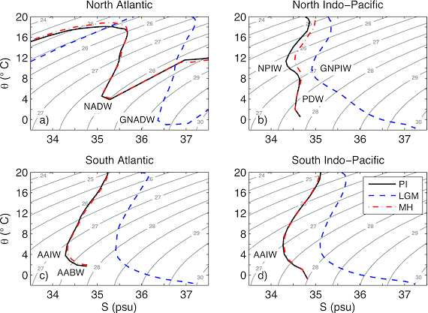

Slide 14
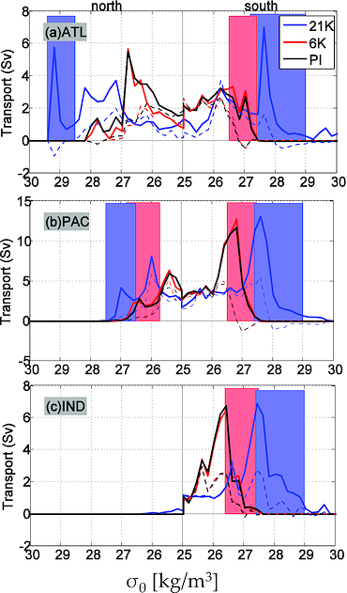

Intermediate water mass formation
Table: Transport (Sv) of subducted waters with respect to density levels of intermediate waters for each basin and time period.
 |  | Atlantic |  | Pacific |  | Indian
Simulation |  | South | North | South | North | South
PI | Sub (Sv) | 10.4 | 5.8 | 29.4 | 10.2 | 12.0
 | σ_{θ} (Kg/m³) | 26.5-27.4 | 27.4-28.2 | 26.5-27.5 | 25.7-26.8 | 26.4-27.5
MH | Sub (Sv) | 12.3 | 3.8 | 31.1 | 12.1 | 12.2
 | σ_{θ} (Kg/m³) | 26.5-27.4 | 27.4-28.2 | 26.5-27.5 | 25.7-26.8 | 26.4-27.5
LGM | Sub (Sv) | 16.2 | 8.6 | 43.4 | 10.5 | 24.3
 | σ_{θ} (Kg/m³) | 27.2-29.0 | 28.5-29.4 | 27.4-29.0 | 26.5-27.5 | 27.4-29.0
Notes:
When the fluid penetrates into the main thermocline, which is provided by a volume flux across the base of the winter mixed layer.

Slide 15
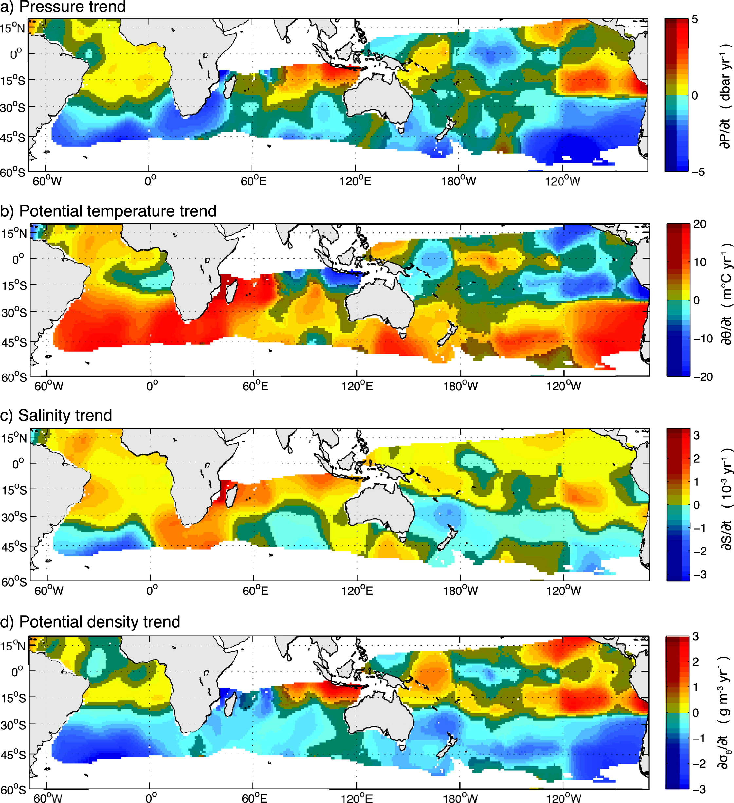
Historical trends over the last 30 yrs
The Sea level pressure (SLP) SAM index, specially in the winter, and winter SST near AAIW formation latitudes may be related to the AAIW core property variability.
Schmidtko and Johnson, 2011

Slide 16
What are the causes of historical changes in the AAIW core characteristics?
SODA 2.2.6 [Ray and Giese, 2012]: uses the POP model at a 1/4◦ horizontal resolution and 40 vertical levels at monthly averages. Surface boundary conditions used are from eight ensemble members of the NOAA’s 20Crv2 [Compo et al., 2011]. SODA 2.26 assimilates only SST data from the ICOADS 2.5.
Uvic ESCM v2.9 [Weaver et al., 2001]: Ocean is MOM2 [Pacanowski , 1995] with a 1.8◦ x 3.6◦ resolution in the horizontal and 19 depth levels. The atmospheric component is a one layer atmospheric energy-moisture balance model, which does not apply flux correction and is forced by prescribed winds from the NCEP/NCAR climatology. Diapycnal diffusivity is parameterized as K_{v} = K_{tidal} + K_{bg}, with K_{bg} = 0.3 cm² s⁻¹. Each experiment is spun up for 3000 years.
Notes:
Simple Ocean Data Assimilation (SODA) version 2.2.6 [Ray and Giese, 2012].
POP : Parallel Ocean Program model [Smith et al., 1992] spanning the period of 1871 to 2008.
Using a sequential estimation data assimilation method [Carton and Giese, 2008]. Heat and salt fluxes are calculated from bulk formulae using 20CRv2 daily variables.
By not assimilating in-depth hydrography and only SST, the model is more consistent dynamically over different decades than alternative versions. A complete overview of the ocean-reanalysis process is detailed by Carton and Giese [2008].
which consists of the mixing due to local dissipation of tidal energy (Ktidal) [Laurent et al., 2002; Simmons et al., 2004]

Slide 17
SODA x Argo
Salinity
Smin

Slide 18
Decadal TS properties at 25ºW
Notes:
Close to the A16 WOCE line.

Slide 19
Smin indices at 25ºW
Notes:
Detection of trends in the salinity minimum region.

Slide 20
TS effect on density
30ºS
35ºS
Correlation between the thermo- and halo-pycnal changes close to the AAIW core.
Notes:
Strong compensation between temperature and salinity south of 30ºS
This may explain the stronger trends observed by Schmidtko and Johnson.
Impact on the MOC changes in the region.

Slide 21
Smin in the SA
Smin between neutral densities γn=27.1-27.6 kg/m³

Slide 22

PV in the Smin layer
Increased negative (anti-cyclonic) PV region in the SA.
Southward expansion of SA subtropical gyre (Lumpkin and Garzoli, 2011; Goni et al., 2011)

Slide 23
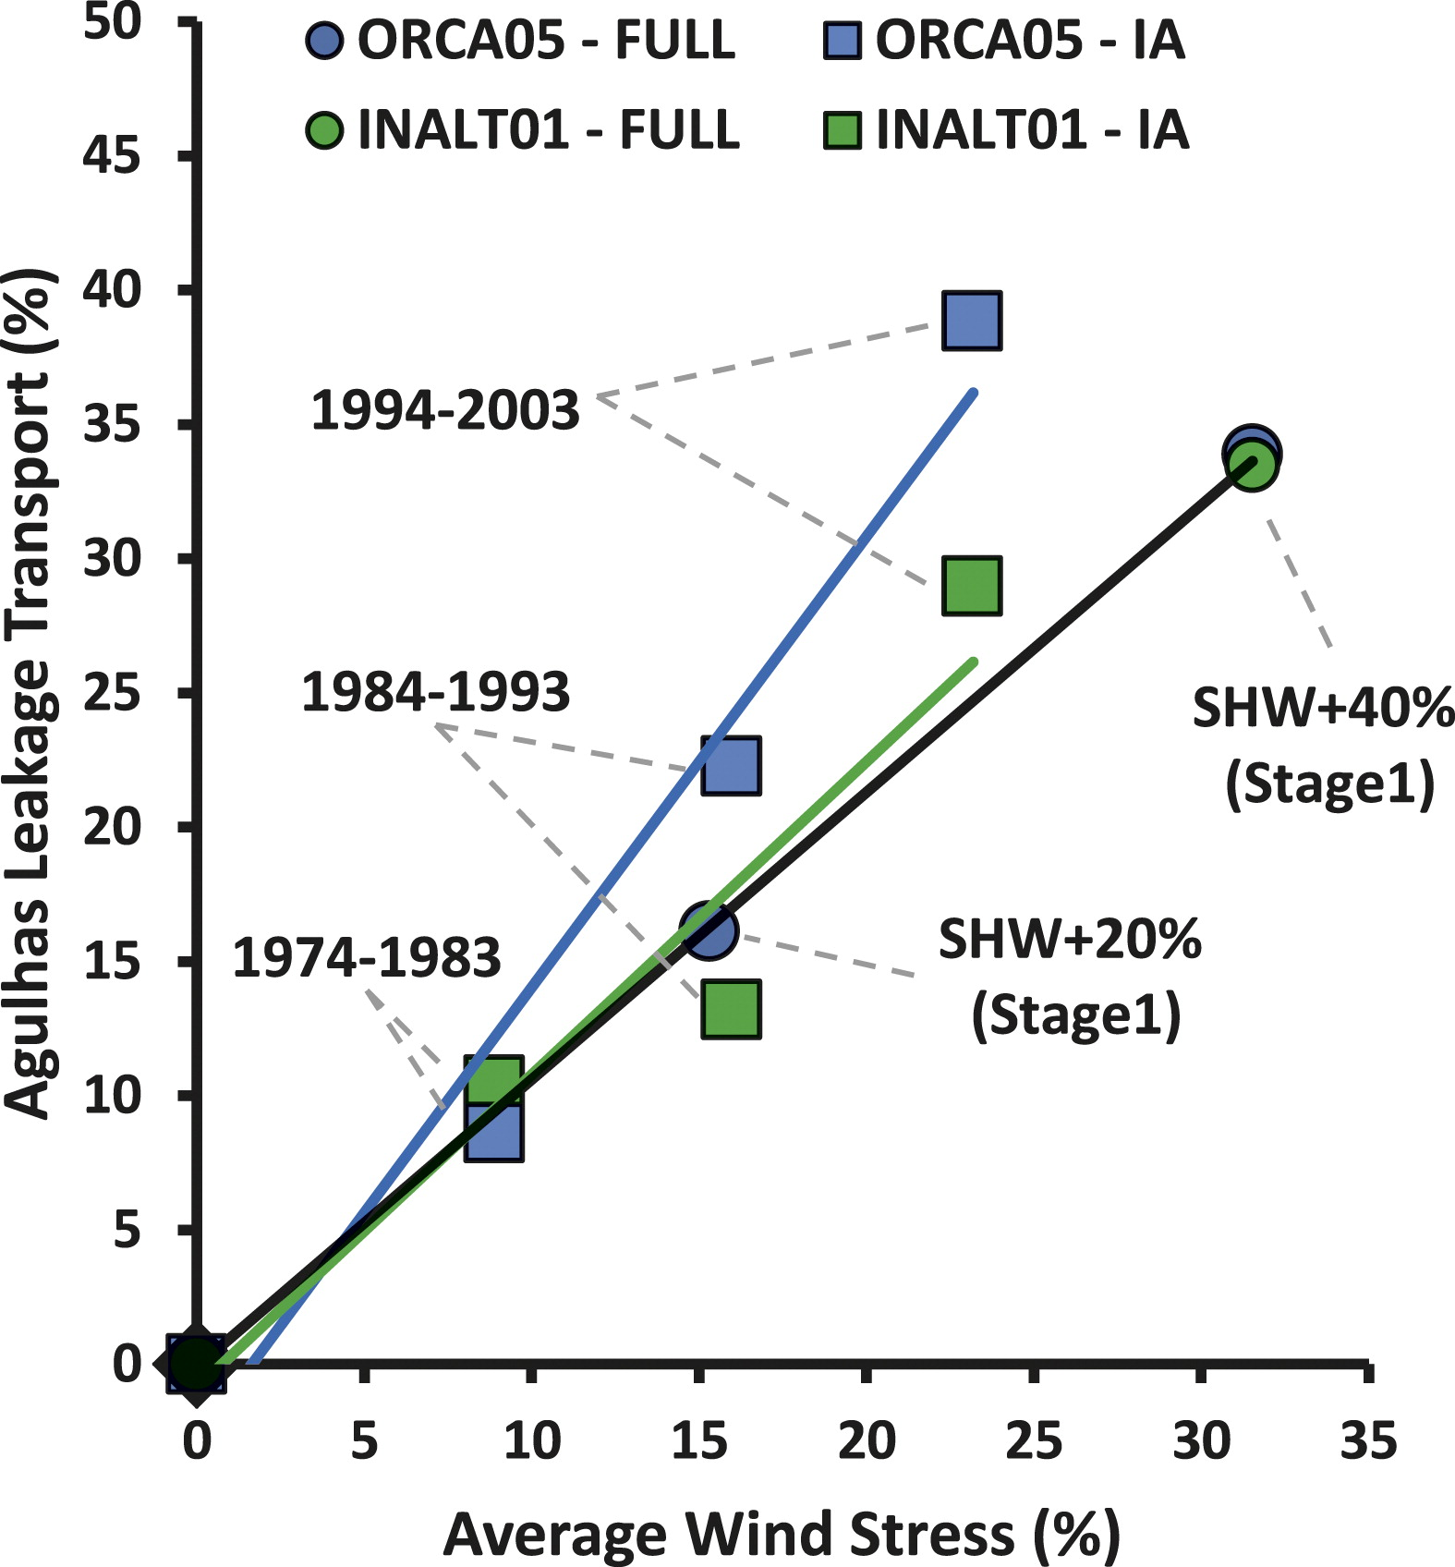
Smin and westerly winds
Durgadoo et al., 2013
TAUX index: 35º-65ºS/0º-20ºE

Slide 24
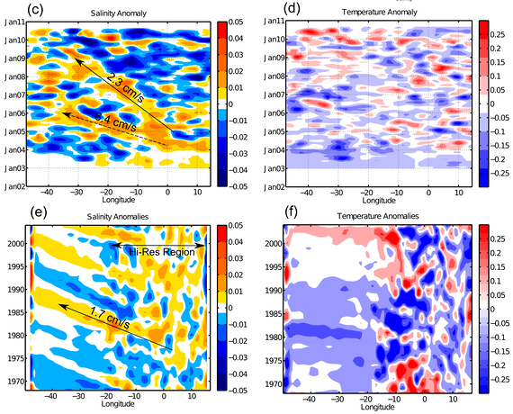
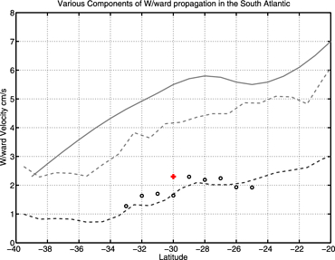
Westward propagation of Salinity
McCarthy et al., 2012
30°S
35°S

Slide 25
Uvic model simulations
Separate the effects of SST and wind forcing:
SST forcing is simulated by increasing the CO₂ level in the atmosphere following the historical path.
Wind forcing is simulated as the main modes of SLP anomaly in the southern and northern hemispheres., i.e., the Southern Annular Mode (SAM) and the North Atlantic Oscillation (NAO).
Forcings are added hierarchically, and the effect of each forcing is calculated by the difference to the immediate simulation with lower complexity.
# | Experiment | Wind Forcing | CO₂ Forcing
1 | CONTROL | NCEP climatology | 1800 level (284 ppmV)
2 | SAM | NCEP clim + SAM | 1800 level
3 | SAM + NAO | NCEP clim + SAM + NAO | 1800 level
4 | SAM + NAO + CO₂ | NCEP clim + SAM + NAO | Transient to 384 ppmV in 2009

Slide 26
SLP EOF 1
20th century reanalysis (Compo et al., 2011)
Notes:
SAM index rises since mid-1970s

Slide 27
Forced Smin changes

Slide 28
Conclusions

Slide 29
Future work

Slide 30
Thank you

Slide 31
Temperature and salinity in the Coriolis data

Slide 32
Mixing in the Southern Ocean
Adding upper SO mixing improves the representation of ocean traces in UVic
Goes et al., 2010

