Slide 1
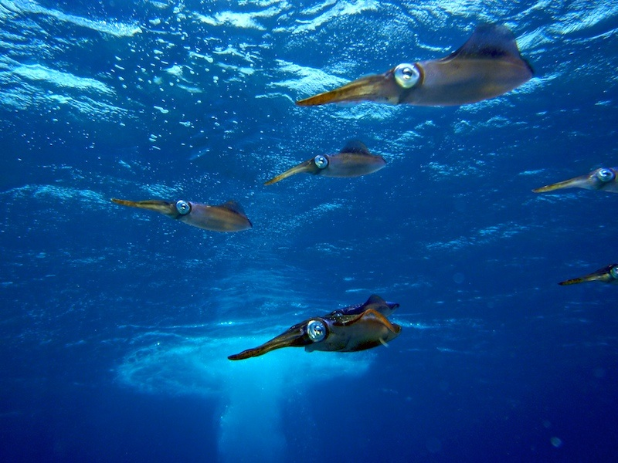
The Coral Reef Early Warning System (CREWS):
A Collaborative Project between
the Caribbean Community Climate Change Center and
the National Oceanic and Atmospheric Administration
Dr. Jim Hendee, Director
Ocean Chemistry and Ecosystems Division
Atlantic Oceanographic and Meteorological Laboratory
National Oceanic and Atmospheric Administration
4301 Rickenbacker Causeway
Miami, Florida 33149-1026 USA
Jim.Hendee@noaa.gov
Joe Bishop
Ocean Chemistry and Ecosystems Division
Atlantic Oceanographic and Meteorological Laboratory
National Oceanic and Atmospheric Administration
4301 Rickenbacker Causeway
Miami, Florida 33149-1026 USA
John Halas
Environmental Moorings International, Inc.
Key Largo, Florida 33037. USA
Halas48@gmail.com
Albert R Jones
Instrumentation Officer
Caribbean Community Climate Change Centre
Belmopan, Belize
Ajones@caribbeanclimate.bz
Michael Jankulak,
Dr. Lew Gramer, and
Dr. Natchanon Amornthammarong
Cooperative Institute for Marine and Atmospheric Studies
Rosenstiel School for Marine and Atmospheric Science
University of Miami
Miami, Florida 33149
Dr. Pamela Fletcher
Sea Grant Laboratory Liaison
Florida Sea Grant College Program
NOAA/AOML Ocean Chemistry and Ecosystems Division
4301 Rickenbacker Causeway, Miami, Florida 33149

Slide 2
Acronyms used:
Coral Health and Monitoring Program (CHAMP)
    (the umbrella coral program at AOML)
Integrated Coral Observing Network (ICON)
    (Web presence for in situ and satellite measured environmental parameters)
Coral Reef Early Warning System (CREWS)
    (in situ coral monitoring stations)
Atlantic Oceanographic and Meteorological Laboratory (in Miami)

Slide 3

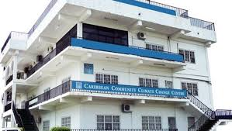
Our partner!
Caribbean Community Climate Change Center (C5)
Belmopan, Belize
http://www.caribbeanclimate.bz/
Funding for CREWS stations through
the European Union (and other sources)
Dr. Kenrick Leslie, Executive Director
Mr. Albert Jones, Instrumentation Officer

Slide 4
Key Research Questions:
What are the long term trends of meteorological and oceanographic parameters at key national and international coral reef areas?
Can various data sources be integrated in real time to provide ecological forecasts at coral and coastal ecosystem areas?
What are the key environmental correlates related to coral bleaching and other coral ecosystem concerns such as adaptation and resilience, disease, spawning and migrating organisms?

Slide 5
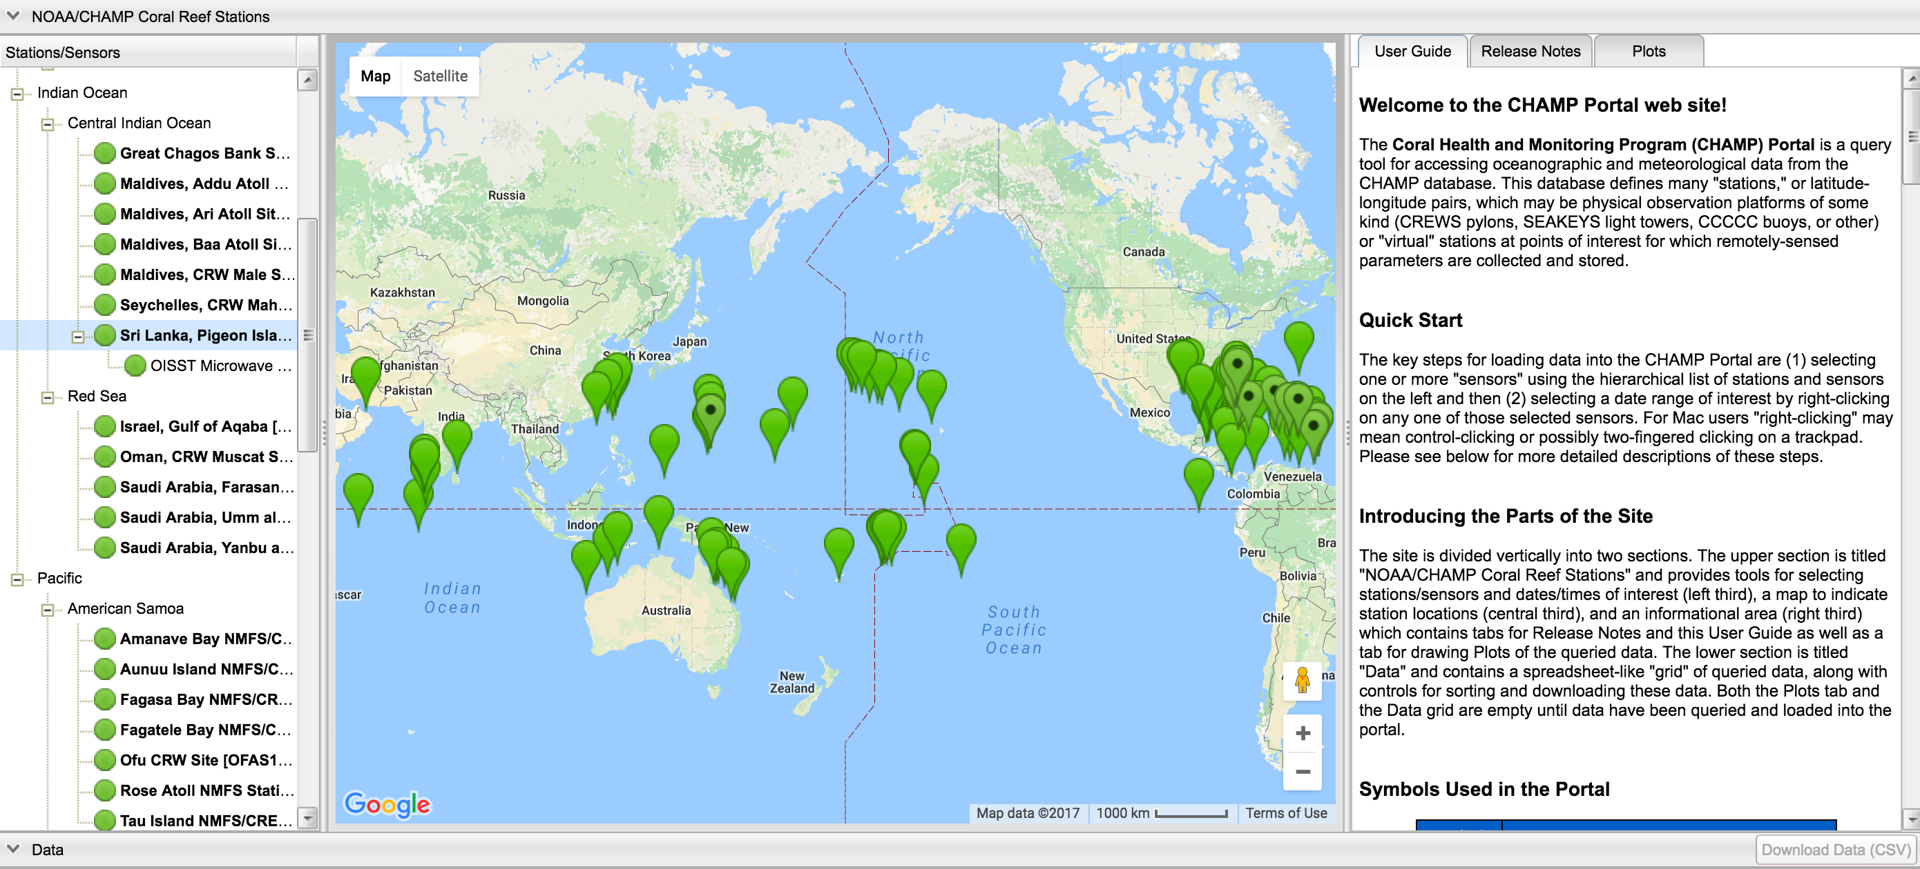
Two sources of data in the ICON Program:
  ~150 Virtual Station (satellite) data sites
  In situ CREWS stations
Data available at:
http://www.coral.noaa.gov/champportal

Slide 6
Nexsens 950 Buoy is the foundation for the CREWS Station

Slide 8
PRSK1 – Paradise Reef, St. Kitts & Nevis

Slide 9
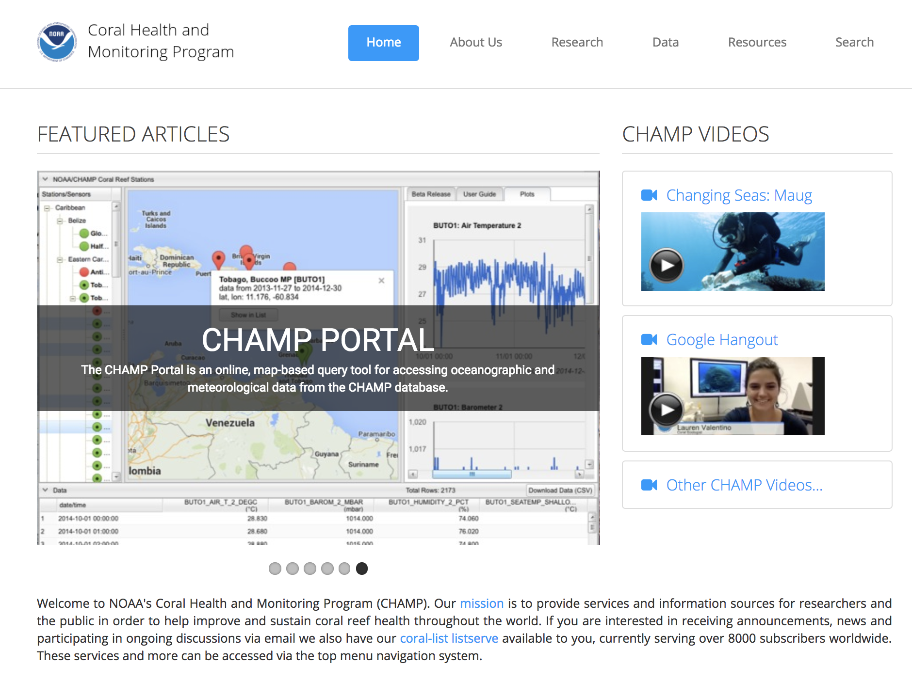
http://www.coral.noaa.gov/

Slide 10
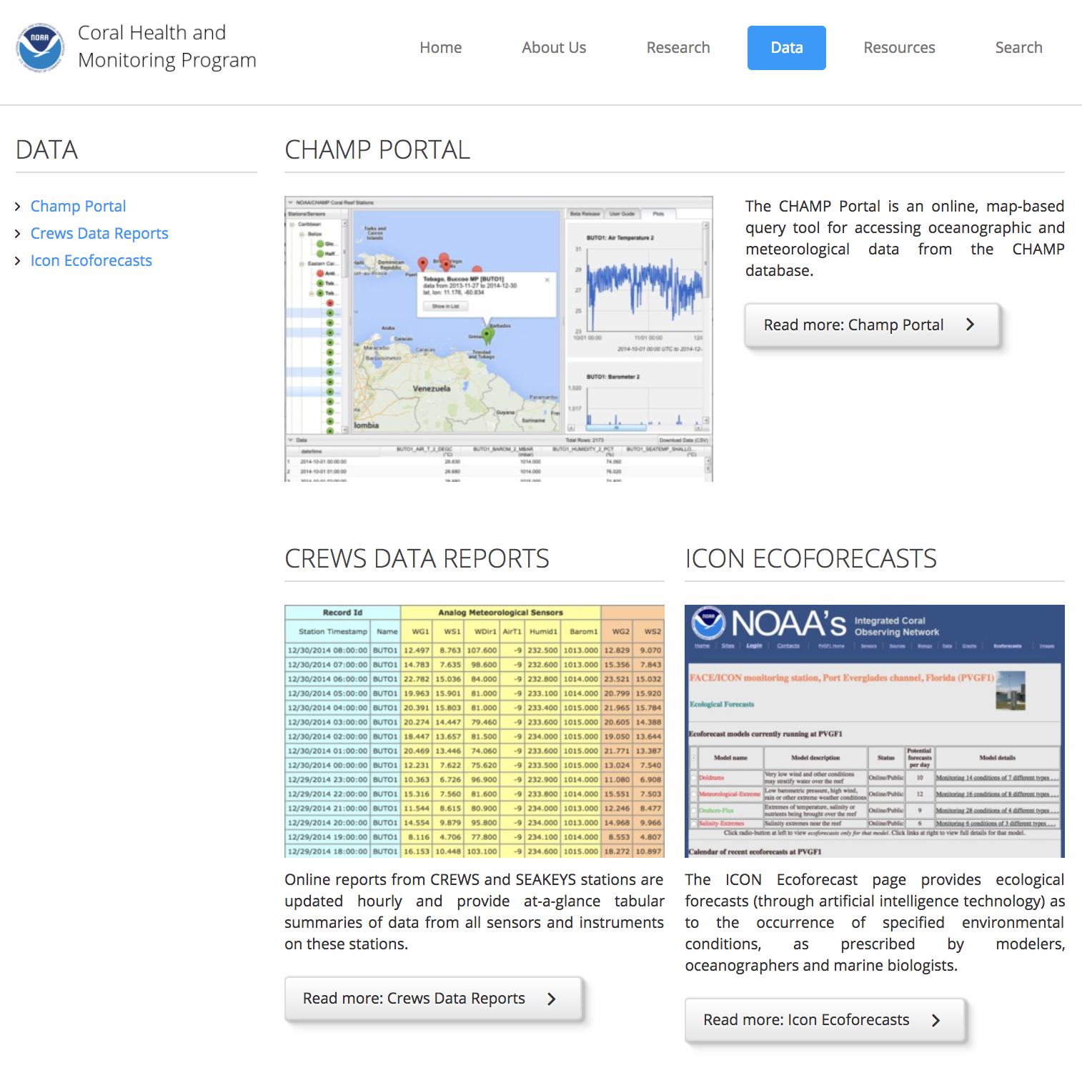

Slide 11
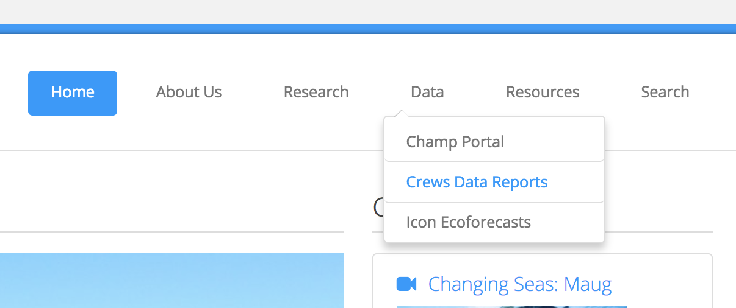
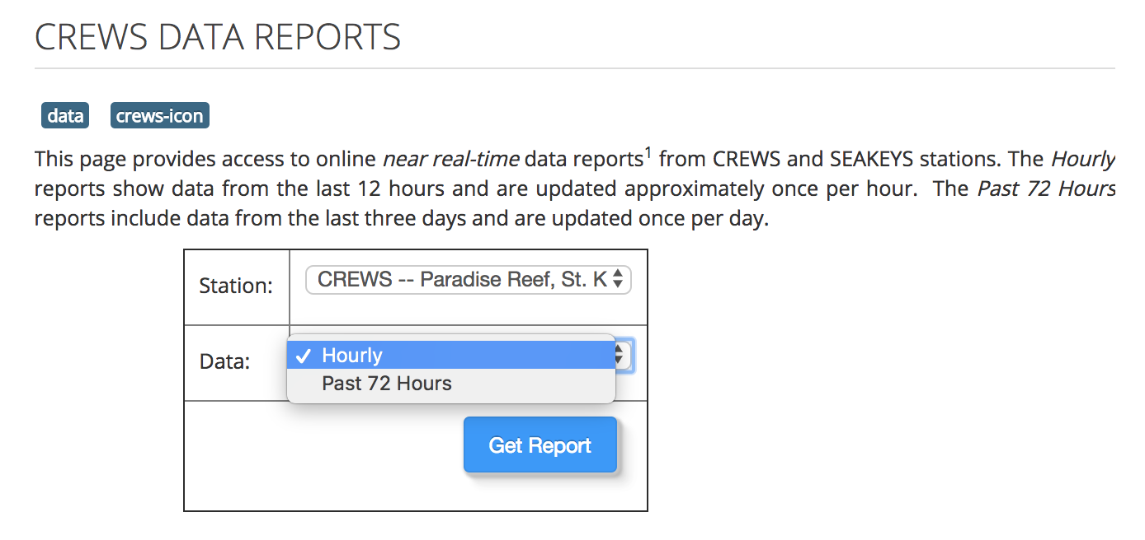

Slide 12
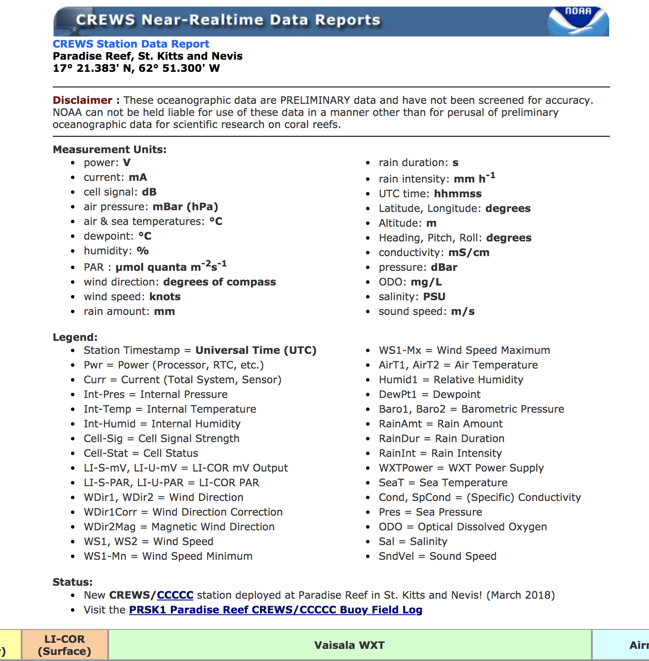

Slide 13
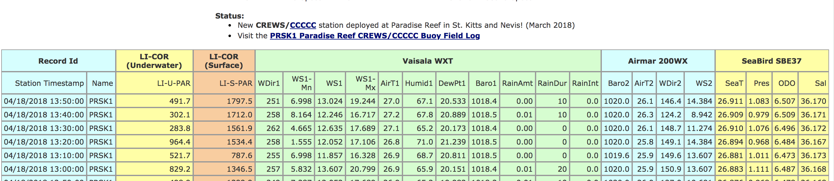
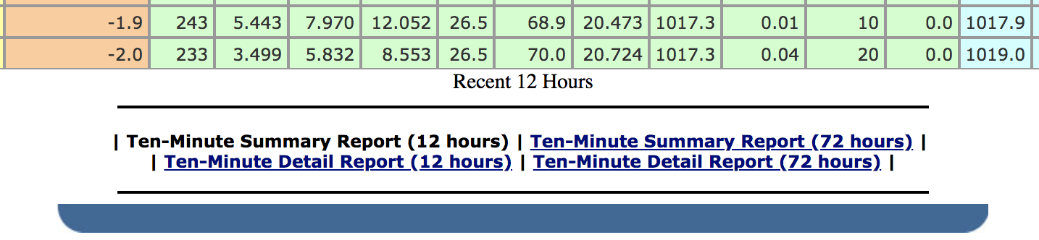
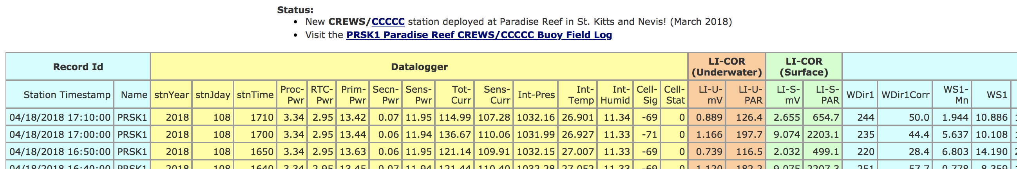

Slide 14
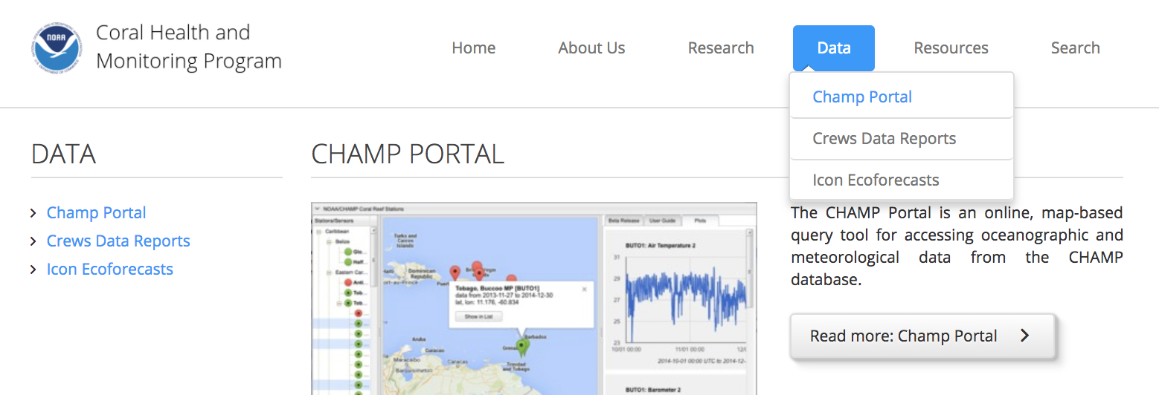

Slide 15
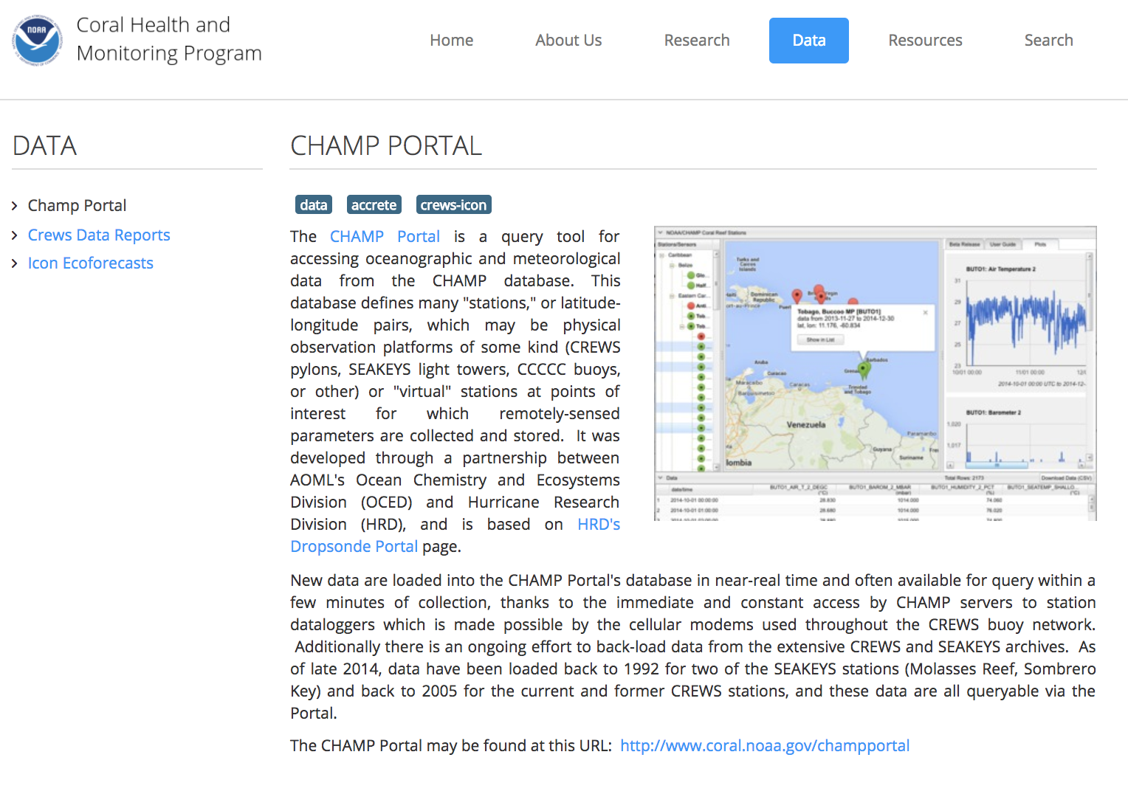

Slide 16
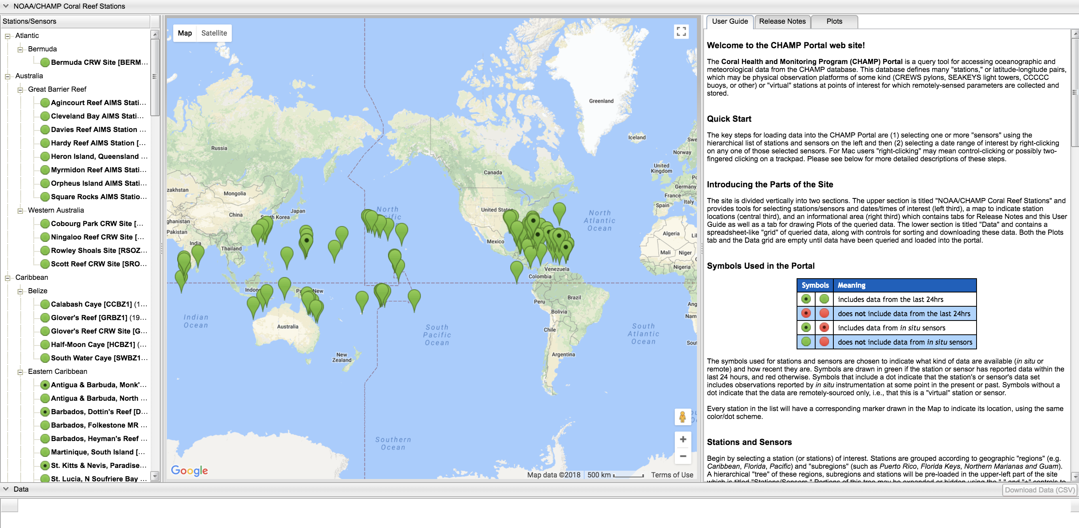
http://www.coral.noaa.gov/champportal

Slide 17
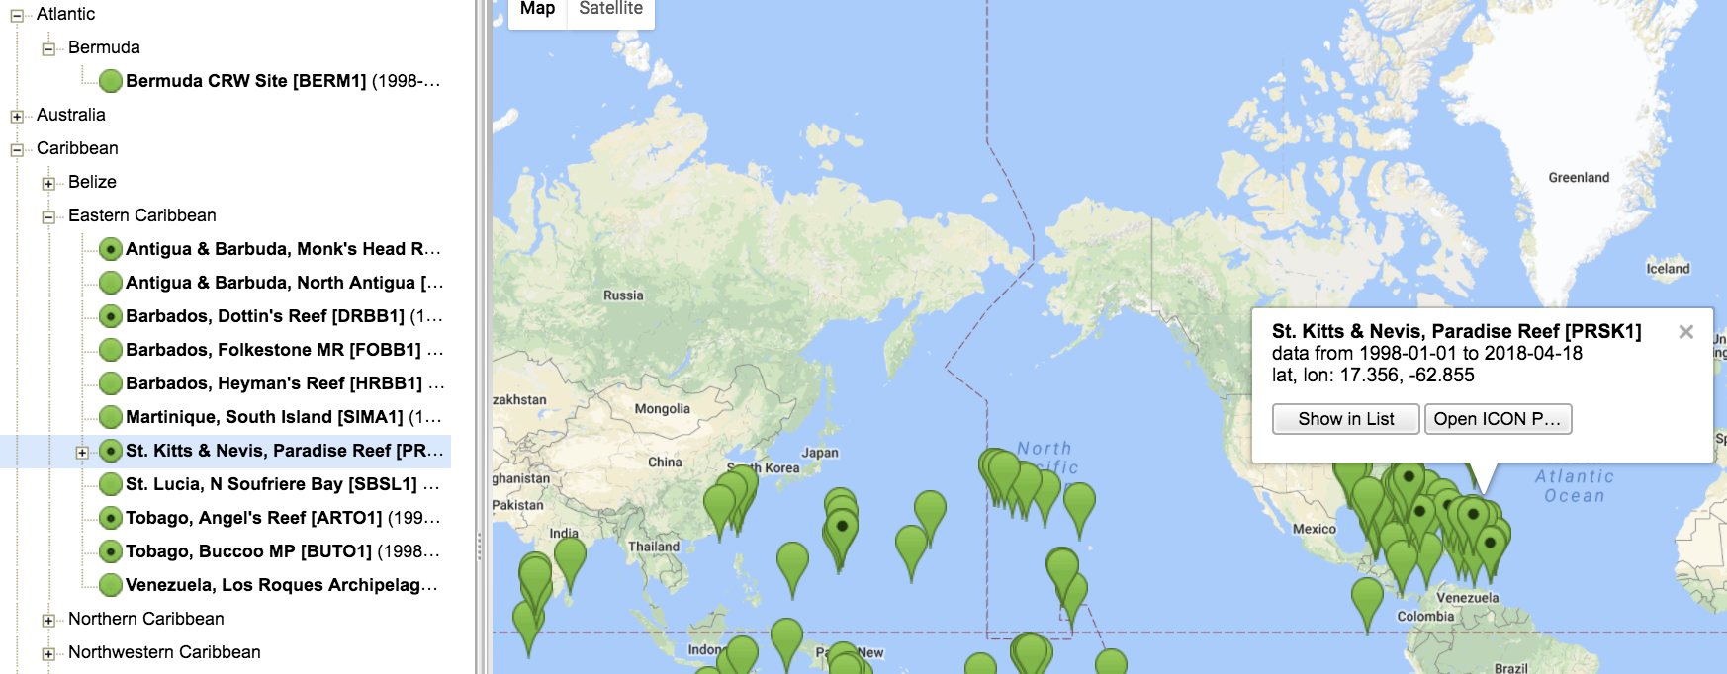

Slide 18
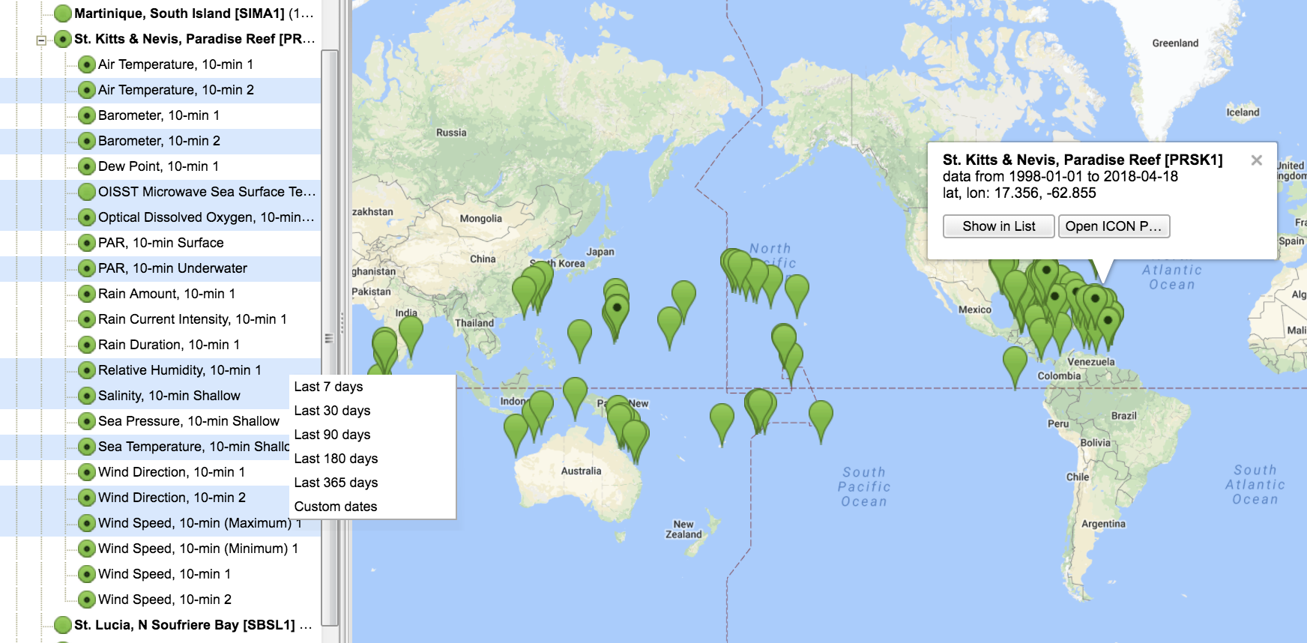

Slide 19
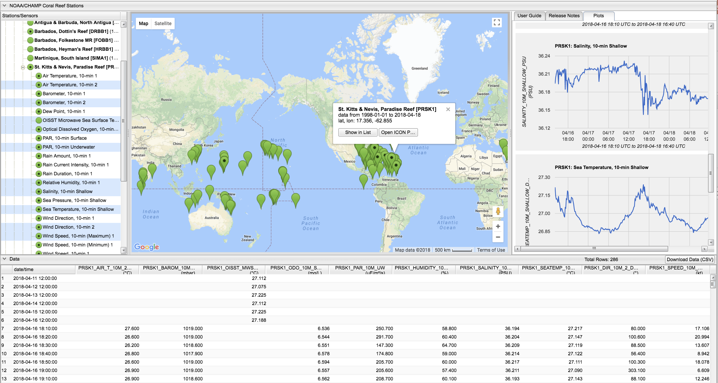
Make sure to allow pop-ups when downloading the data!

Slide 20
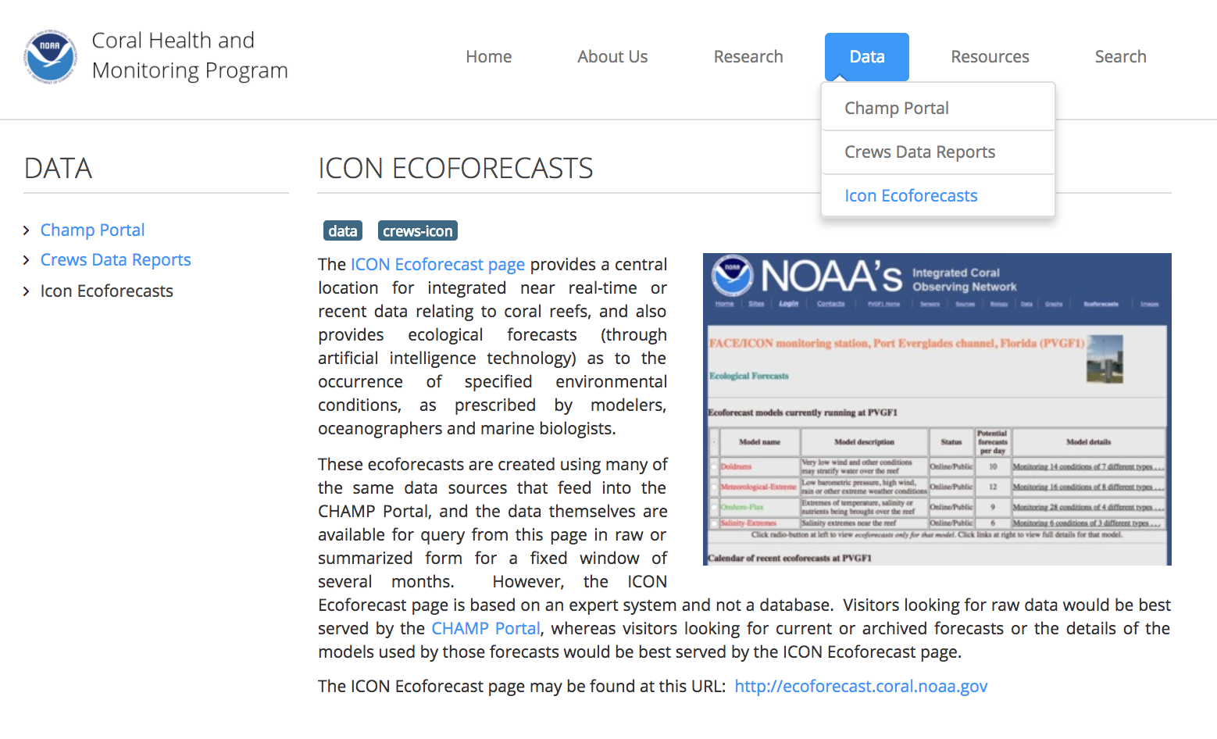

Slide 21
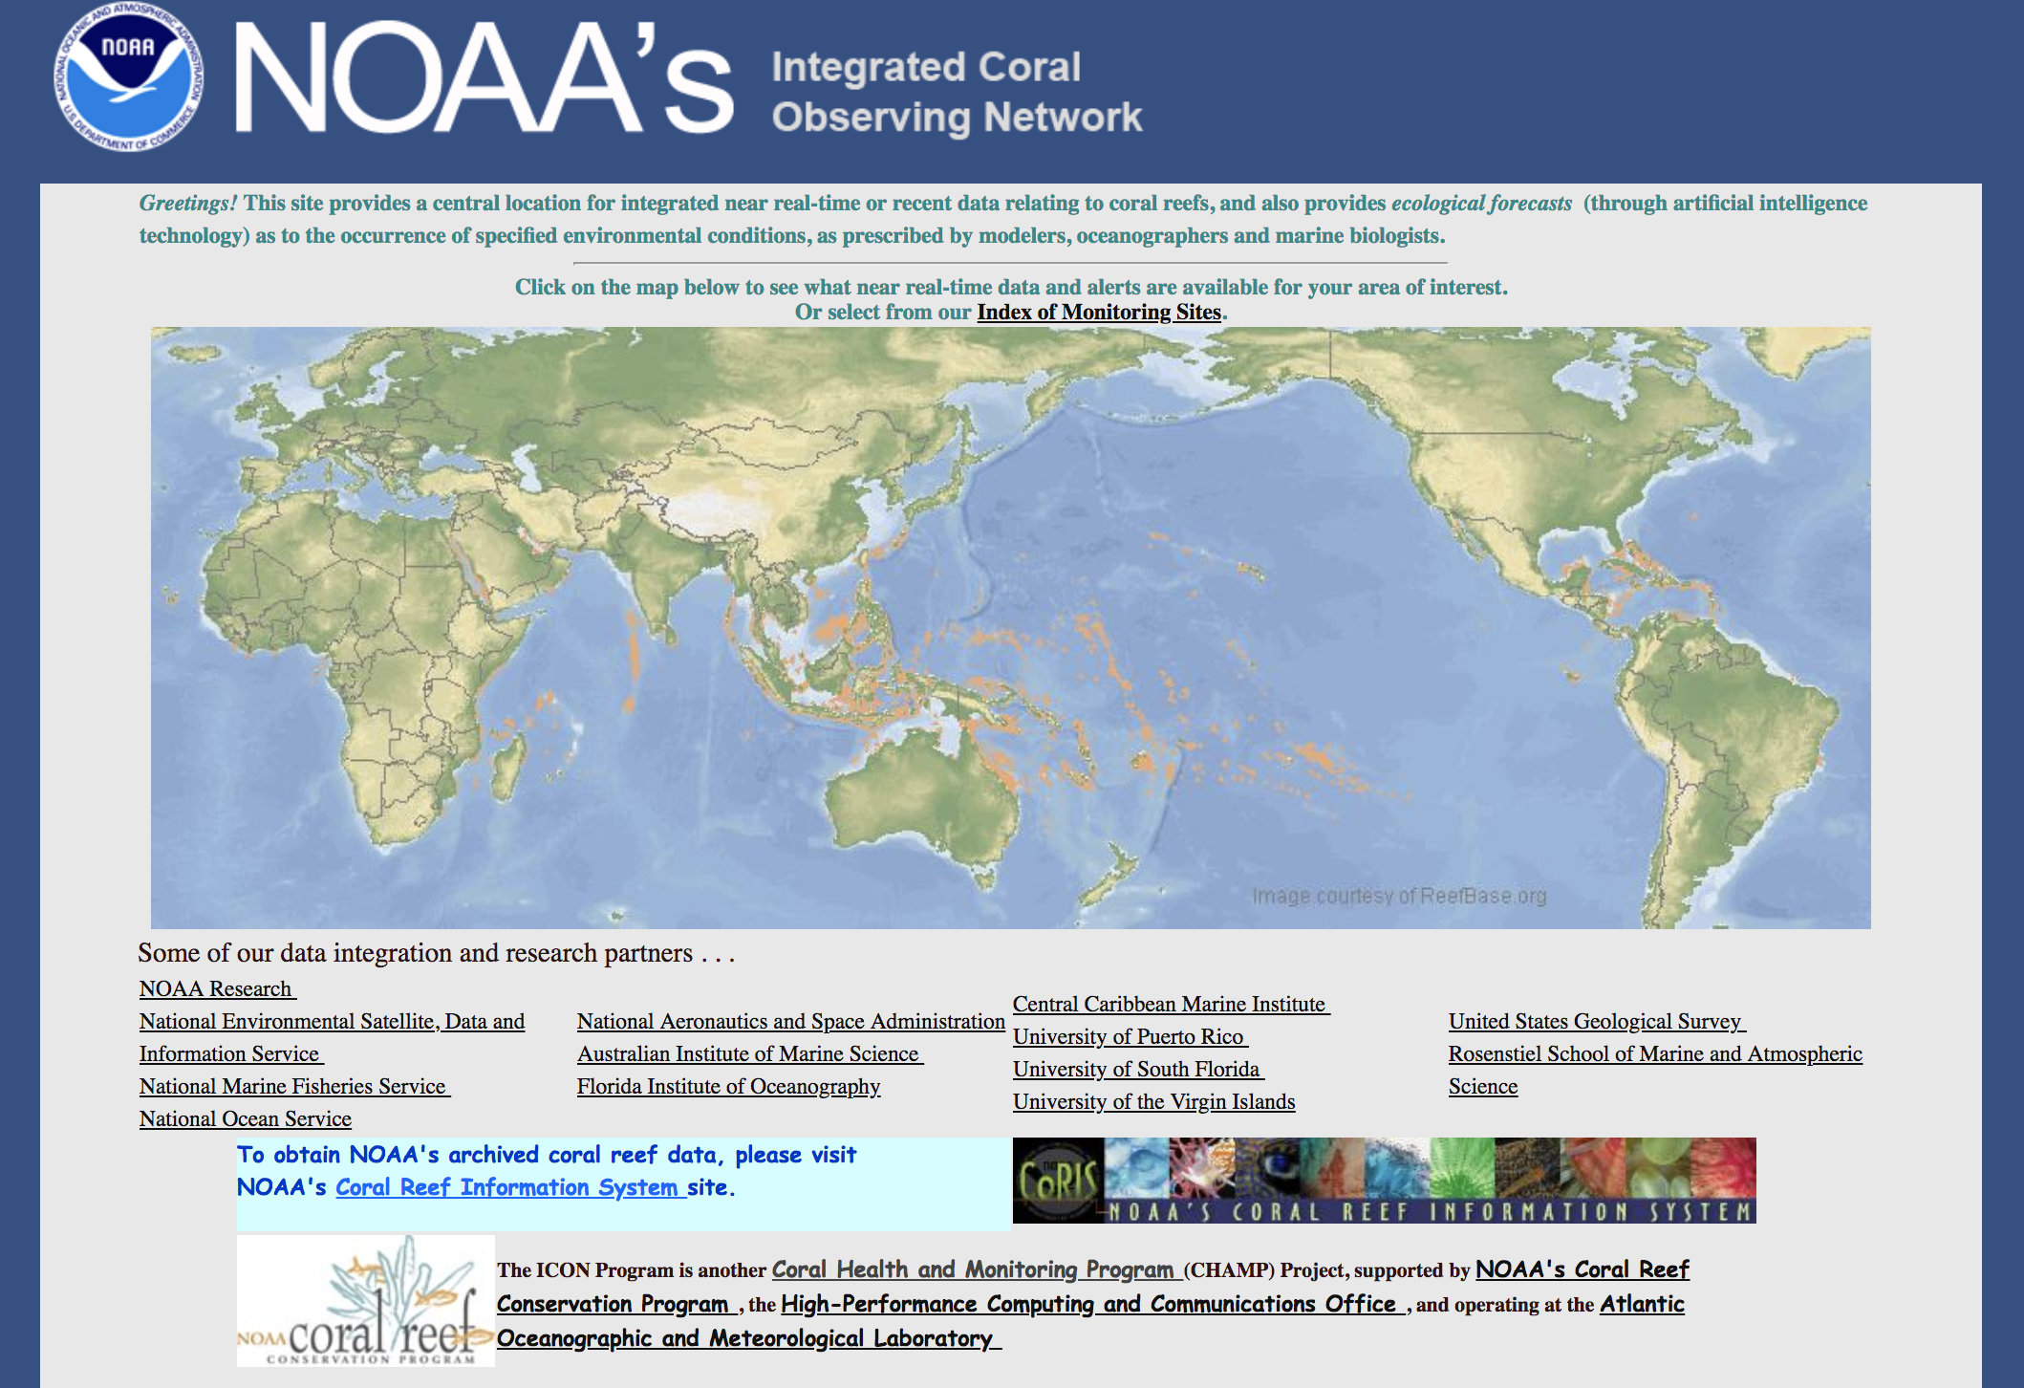
http://ecoforecast.coral.noaa.gov

Slide 22
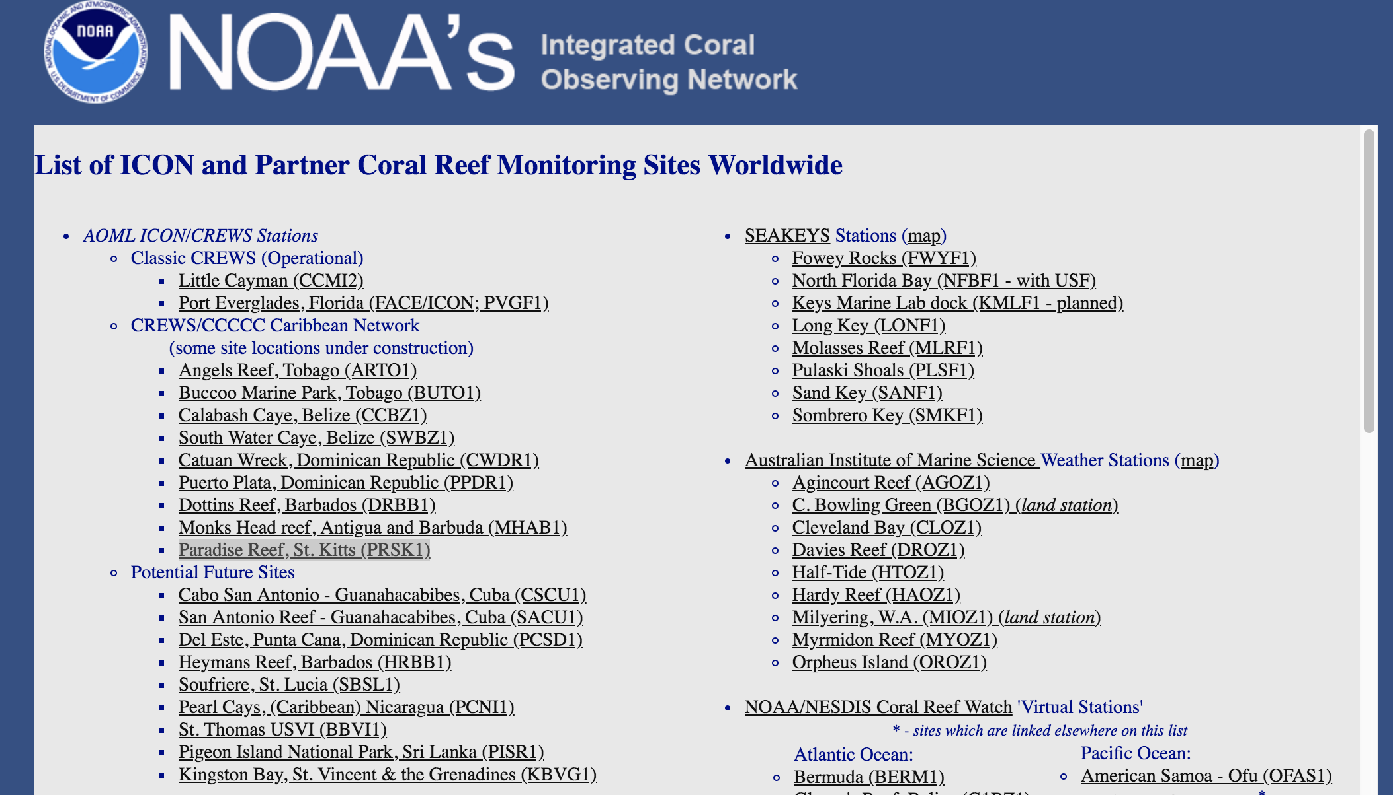

Slide 23
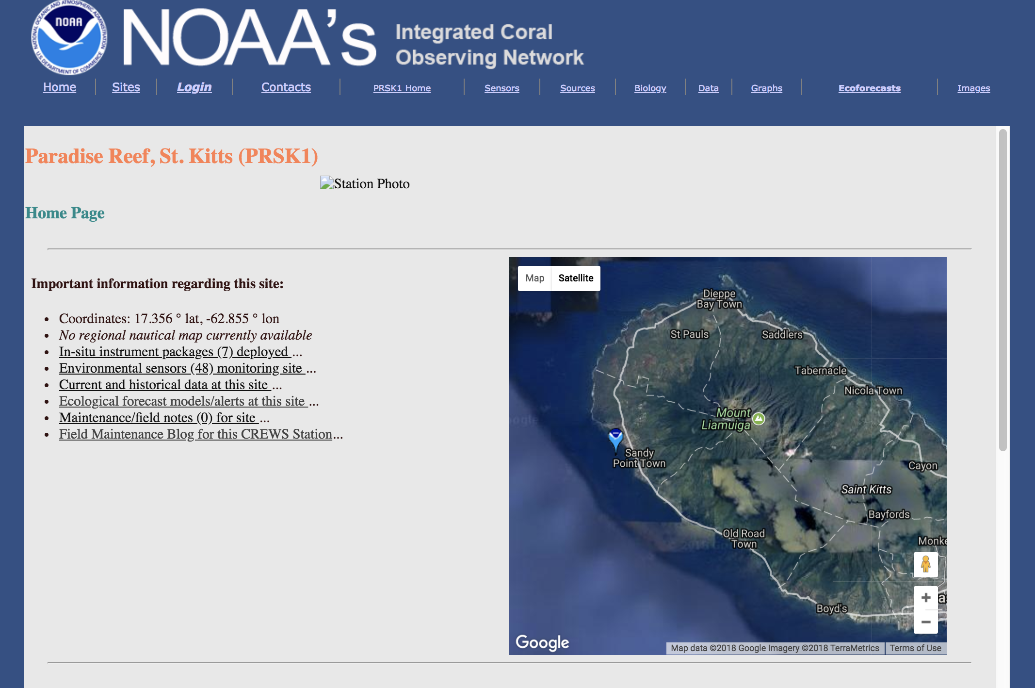

Slide 24
We model marine organismal response to the environment (an ecoforecast), utilizing a custom expert system, in terms of a
Stimulus/Response Index (S/RI)
This approach requires…
1) highly robust instrumentation (in situ, satellite, or other) deployed for long periods and producing high quality data in near real-time,
2) a basic understanding of the process, behavior and/or physiology being modeled, and,
3) a knowledge of approximate threshold levels for single or synergistically acting environmental parameters that elicit the phenomenon in question.

Slide 25
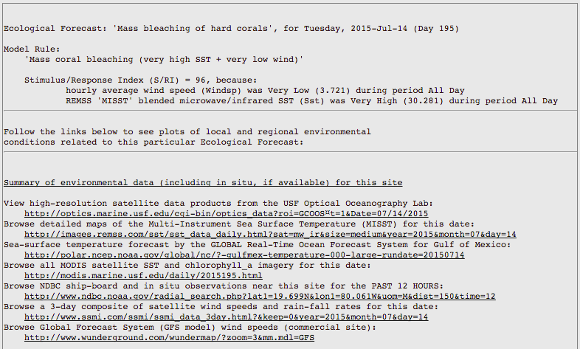
ICON Data are used for Ecological Forecasting
Ecological forecasts predict the impacts of physical, chemical, biological, and human-induced change on ecosystems and their components.
Little Cayman Bleaching Ecoforecast

Slide 26
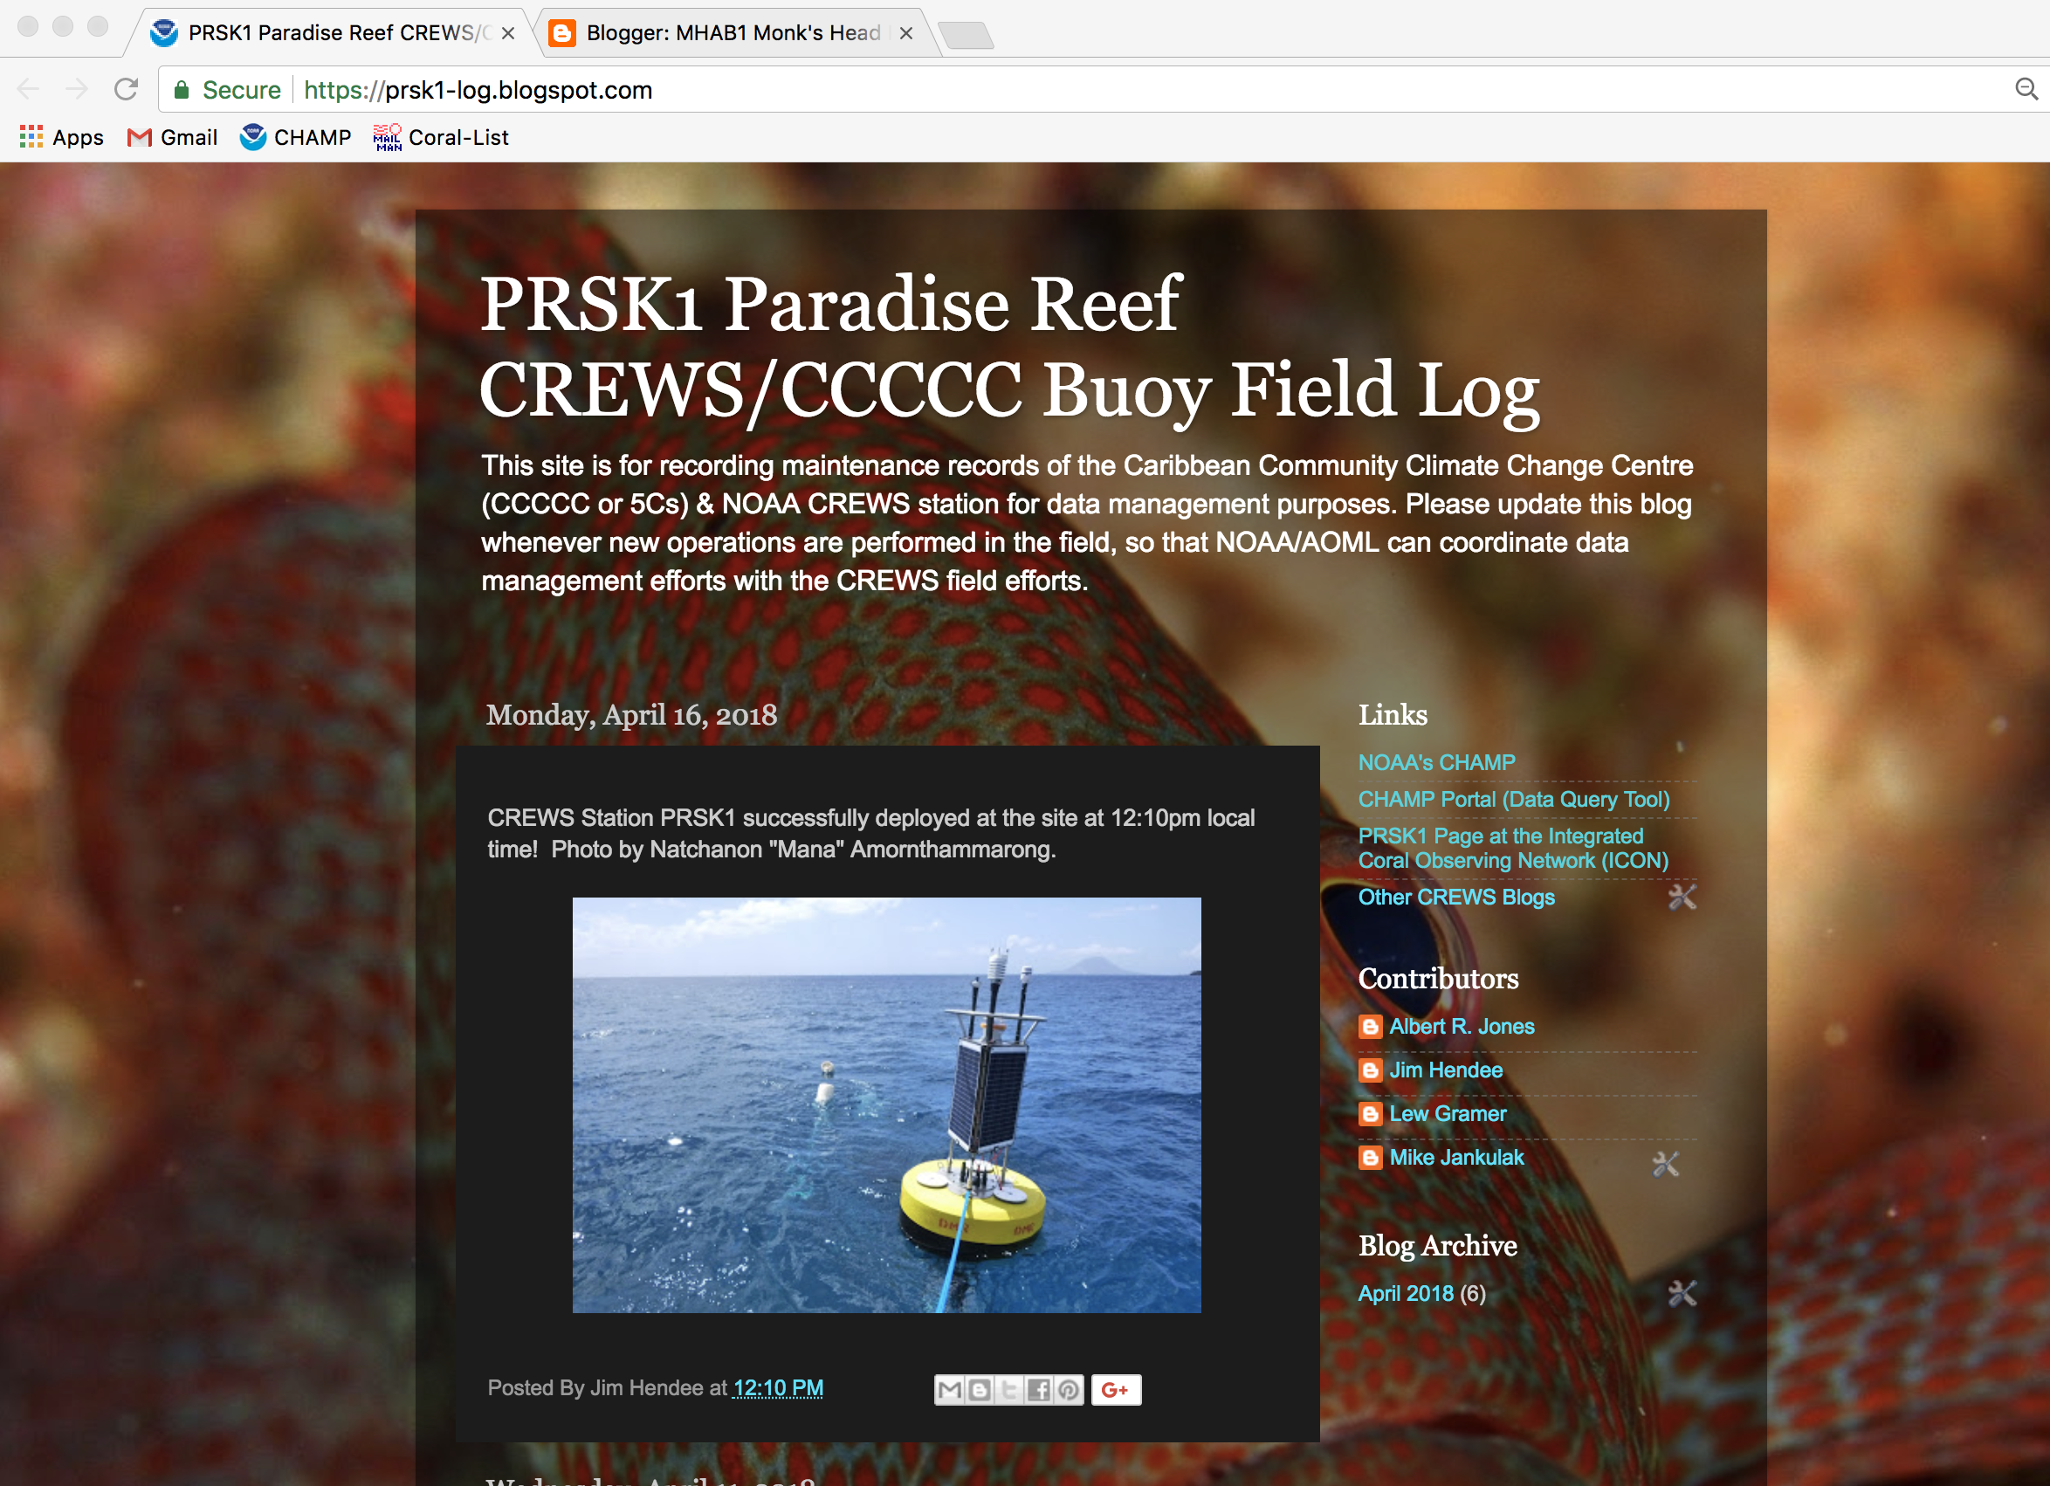
https://prsk1-log.blogspot.com/

Slide 27
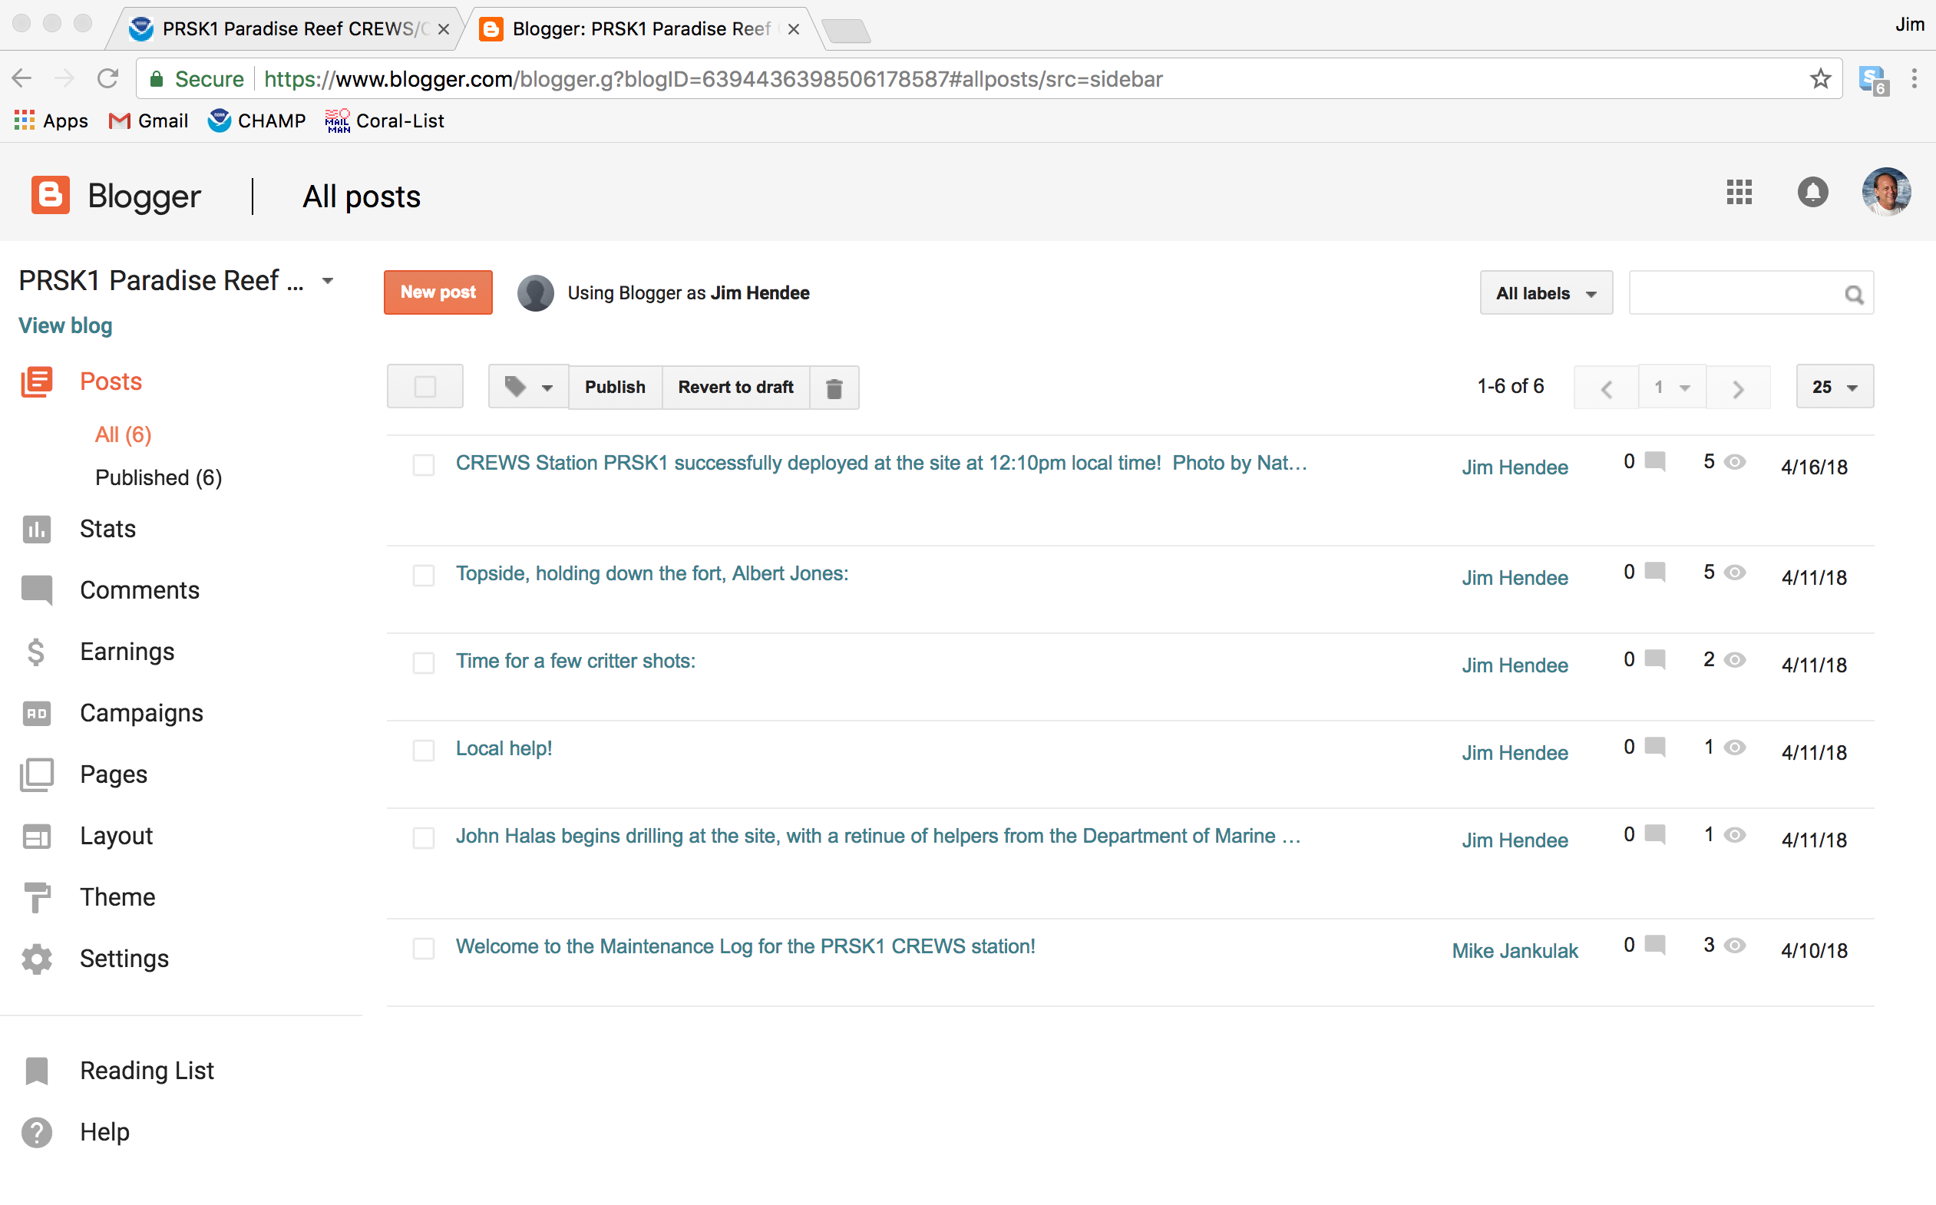
First sign in to http://www.blogger.com, then you’ll see this page:

Slide 28
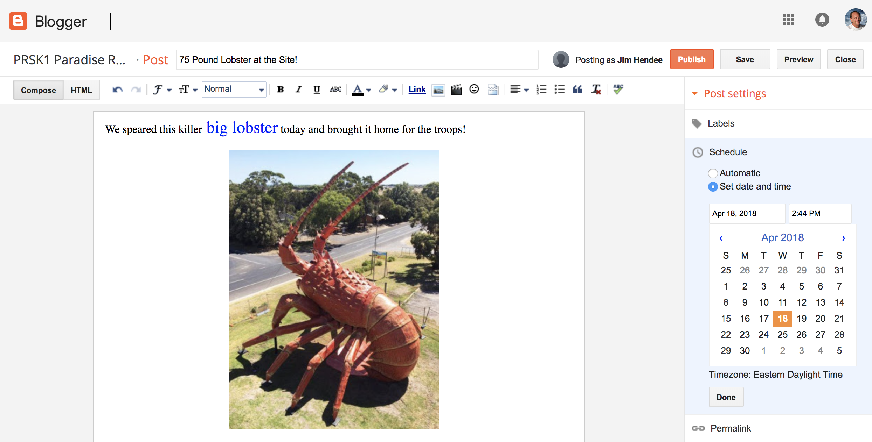

Slide 29
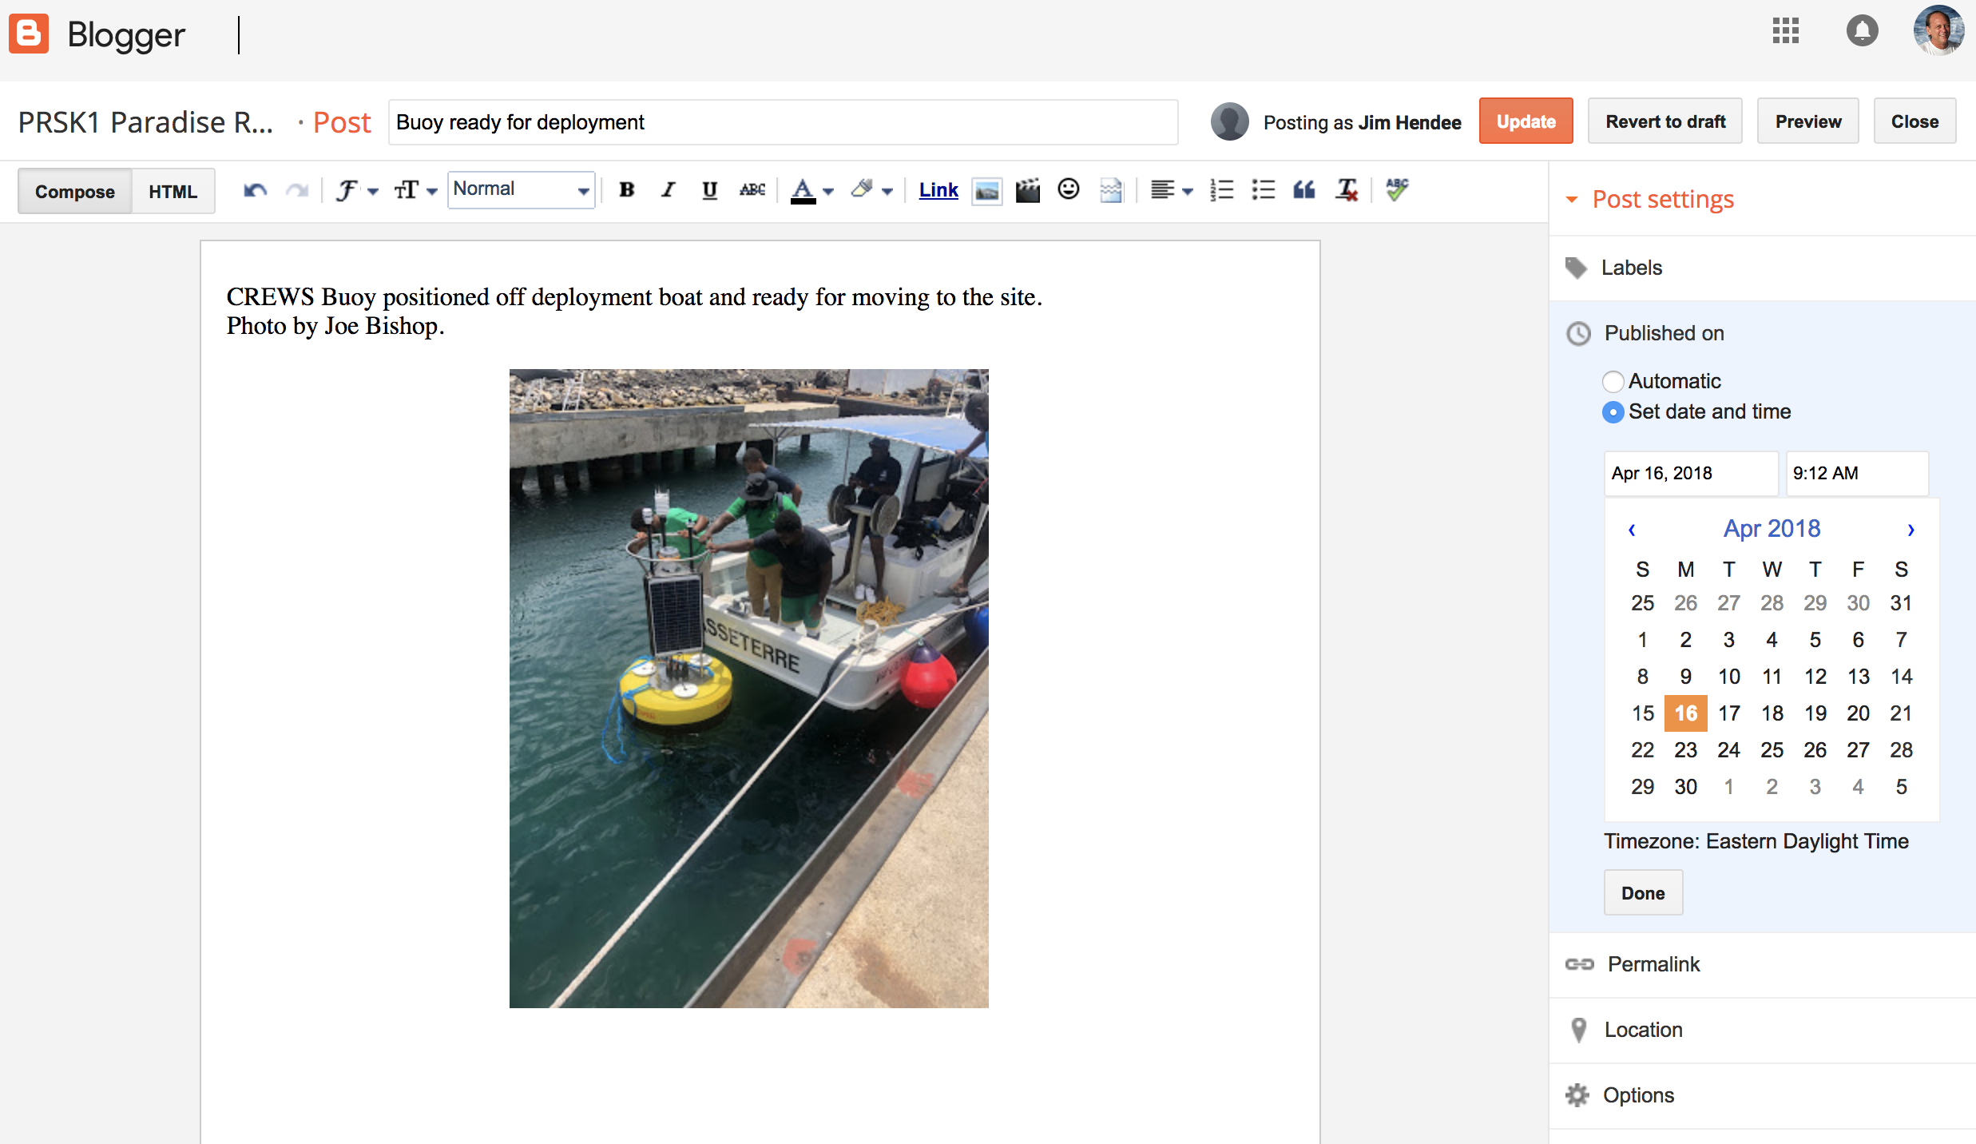

Slide 30
Lessons learned under CREWS project:
There must be a responsible, interested person or team at the host site to conduct routine maintenance (at least once per month, better if twice per month).
You can’t have a successful buoy deployment without a rigorous maintenance schedule and long-range maintenance plan (mostly easy stuff).
Part of the maintenance plan must include the proper instrument calibrations, some yearly, some biannual. (Why do this if you don’t want accurate data?)
Don’t buy/install more instruments than you really need to answer your conservation and/or research needs.

Slide 31
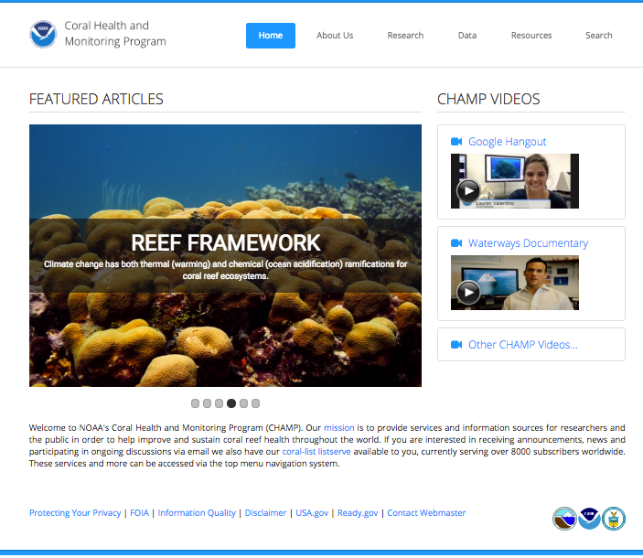
Thank you!
www.coral.noaa.gov
The World’s First Coral Reef Web Site
Questions?
Jim.Hendee@noaa.gov
The CHAMP Team
CREWS
Coral Bleaching
Ocean Acidification
Biodiversity
Coral Genomics
Physical Oceanography
Sensor Development
Coral-List

