Slide 1
NOAA Hurricane Underwater Gliders to improve Atlantic hurricane glider intensity forecasts
Prepared by Gustavo Goni
National Oceanic and Atmospheric Administration
Atlantic Oceanographic and Meteorological Laboratory
Miami, Florida
Partners: University of Miami, University of Puerto Rico Mayaguez, CARICOOS, ANAMAR (Dominican Republic), Island School (Bahamas), OCOVI/USVI, Rutgers University, IOOS, …
IOCARIBE MEETING,
Aruba
May 2019

Slide 2
NOAA Hurricane Underwater Gliders
Goal
To improve Atlantic hurricane intensity forecasts to improve preparation and mitigation operations
Objectives
To develop partnerships within government agencies, academic and research institutions, and private industry to design, implement, and maintain a dedicated ocean observing system in Caribbean Sea, Atlantic Ocean, and Gulf of Mexico, that will allow to reduce errors in Atlantic hurricane intensity forecasts.

Slide 3
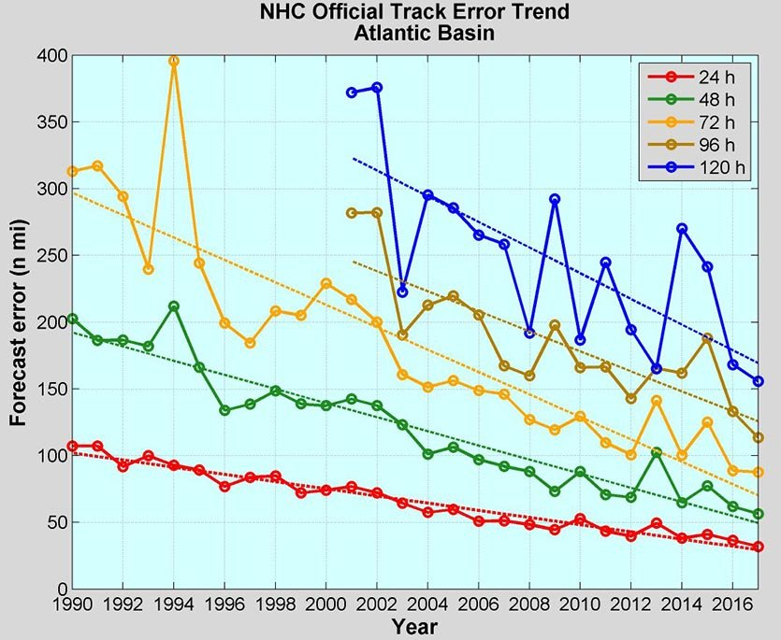
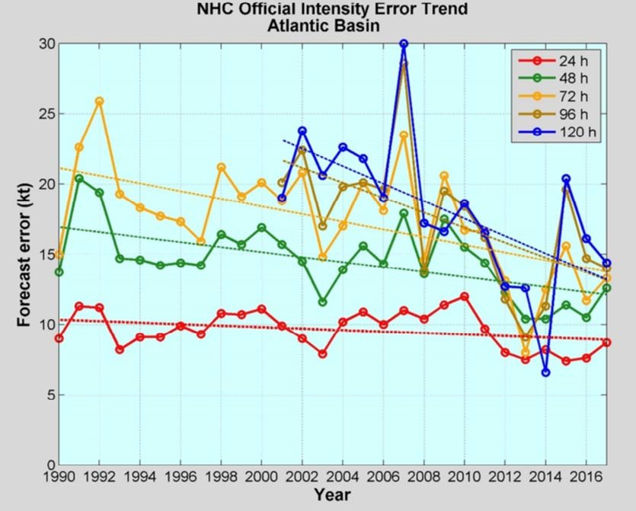
Reduction of errors in track and intensity forecasts
400
30
50
5
1990
2017
1990
2017
In average, errors in track forecasts continuously improve with time.
In average, errors in intensity forecast have remained almost unchanged (for 48hs forecasts or less) and larger than 15 knots (for 72hs or more) during last 25 years. In average, these errors may represent one category above or below the actual hurricane intensity.
An improved forecast allows local governments to better plan for evacuations, identify potential coastal inundations areas, urban design, and plan for upcoming mitigation efforts.

Slide 4
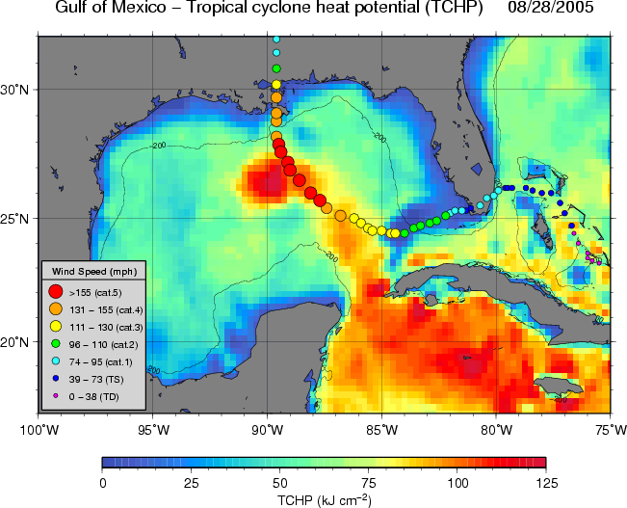
Role of the ocean in tropical cyclone intensification
Hurricane Katrina intensified when travelling over a warm ocean feature in the Gulf of Mexico
The upper ocean heat content matters.
The upper ocean temperature, salinity, density matters.
Hurricane Katrina (2005)
Hurricane Katrina
Background color is Tropical Cyclone Heat Potential,
similar to upper ocean heat content
Temperature and Salinity to 500 to 1000m deep need to be continuously monitored during hurricane season to improve intensity forecasts
Glider Technology for Sustained Oceanic Observations, Lima, November 2017

Slide 5
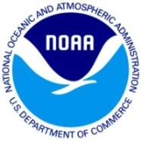
Ocean Field Observations in place
Profiling floats
Underwater gliders
Expendable BathyThermographs
Surface drifters
Moorings
Ships of Opportunity
Voluntary Observing Ships

Slide 6
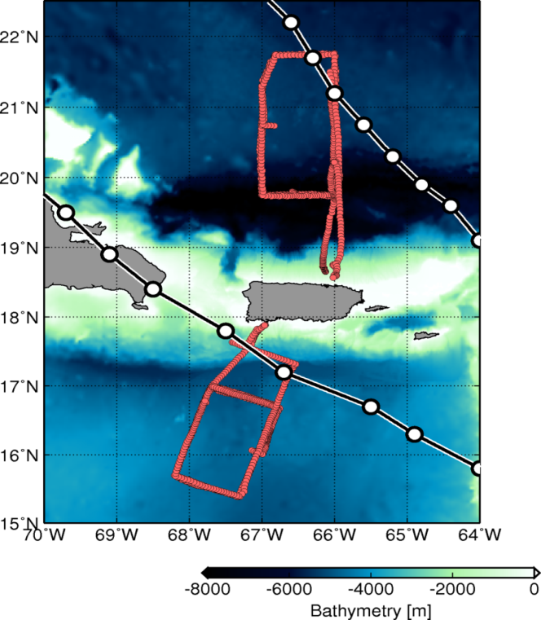
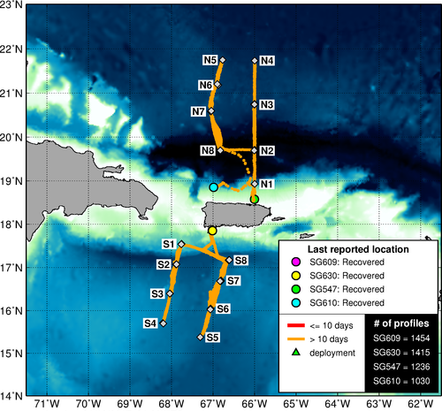
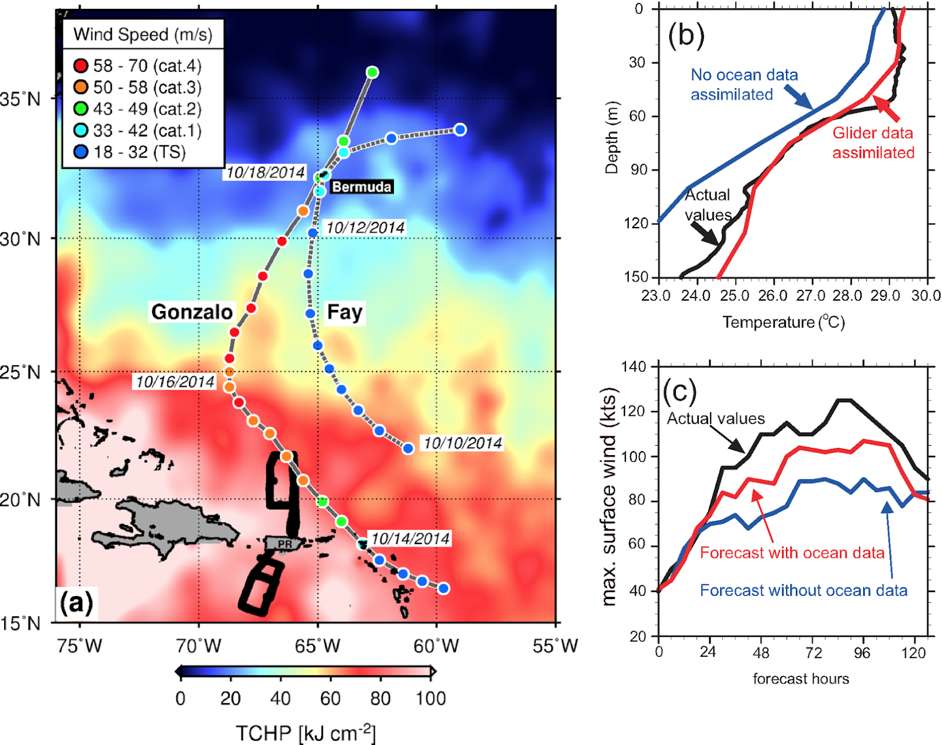
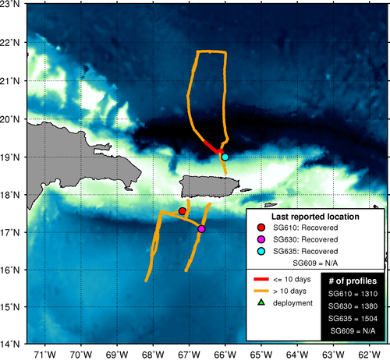
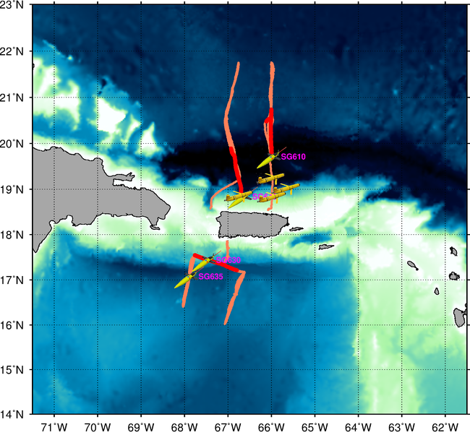
First dedicated glider network started in 2014 off the coast of Puerto Rico by NOAA/AOML and CARICOOS.
2014 hurricane season
2015
2016
Hurricane Gonzalo
(October, 2014)
TS Bertha
(August, 2014)
2017
2018
How glider observations reduced error in intensity forecast of Gonzalo by 1 cat
Glider Technology for Sustained Oceanic Observations, Lima, November 2017

Slide 7
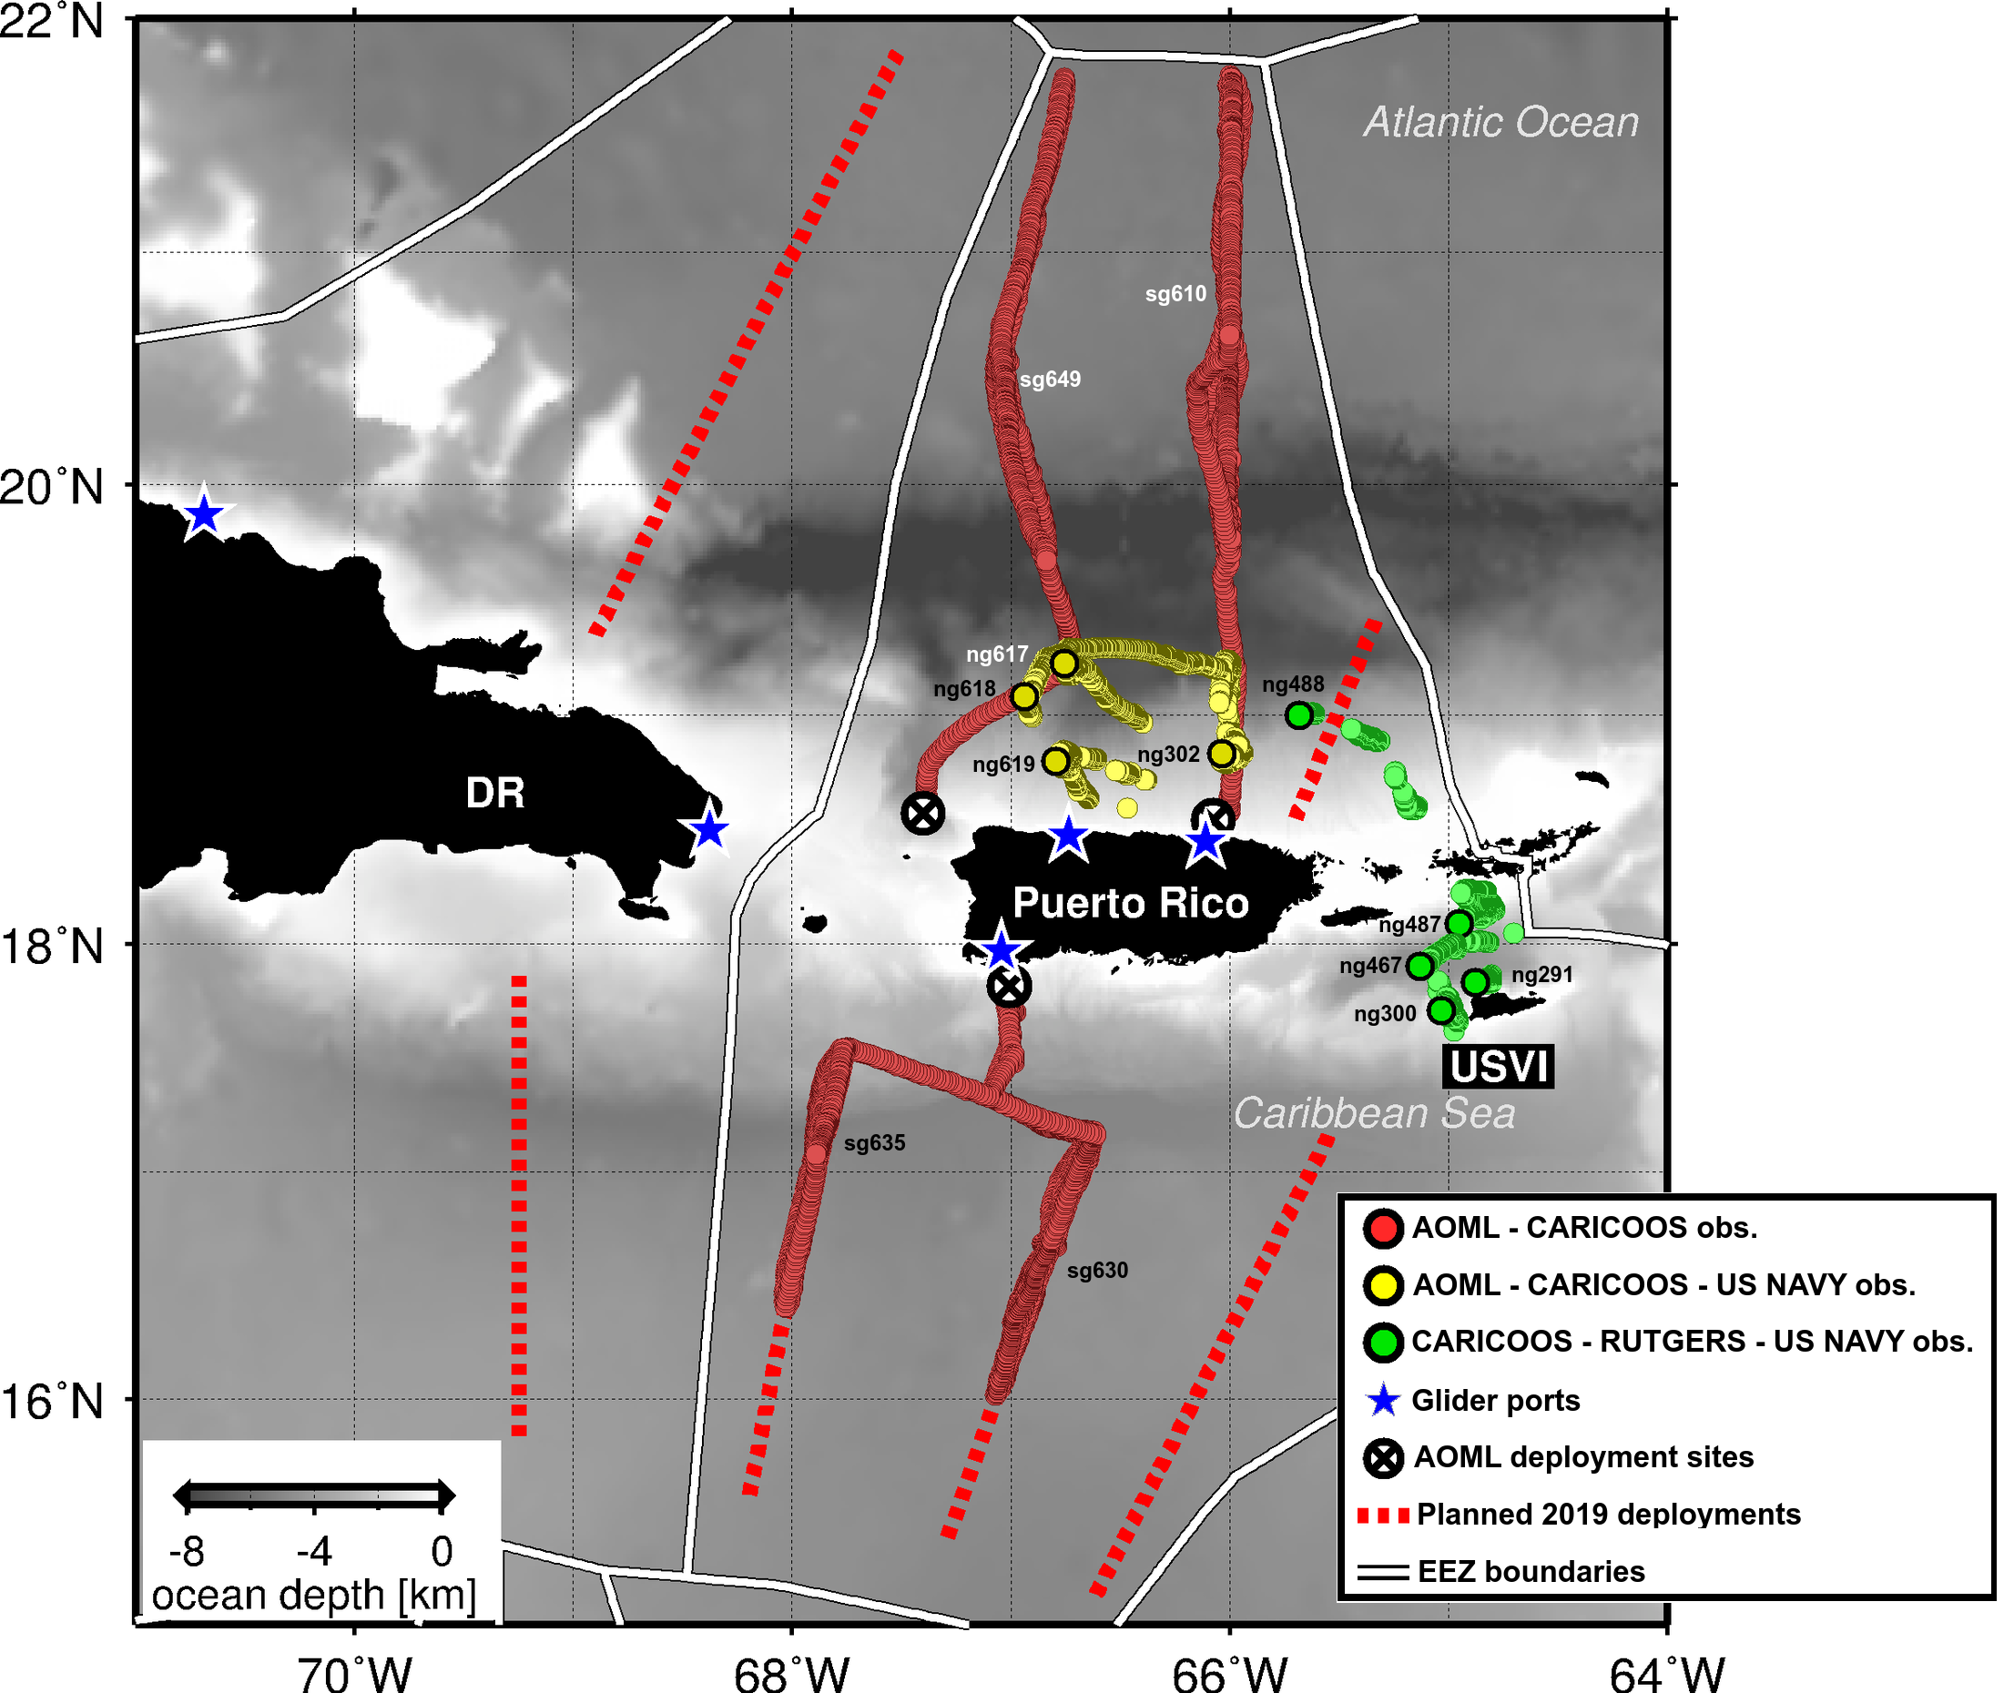
2018 NOAA and US Navy Glider observations in the tropical Atlantic and Caribbean Sea
Participant institutions:
NOAA/AOML, Miami (Lead)
U.S. Navy
University of Miami
University of Puerto Rico
CARICOOS
OCOVI, USVI
Rutgers University
99% of all ocean profile observations (>30,000) in this regions were provided by gliders during 2018

Slide 8
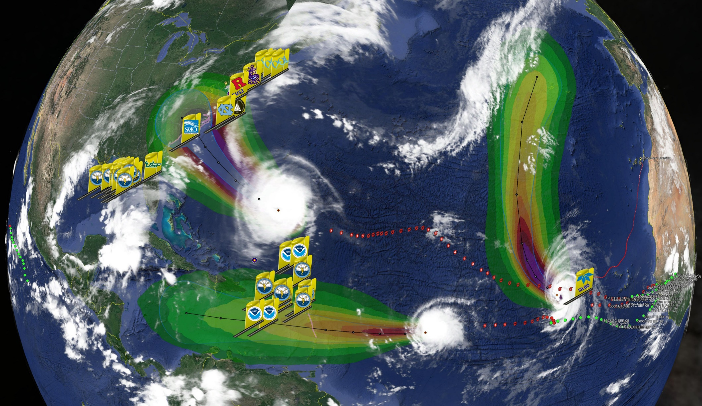
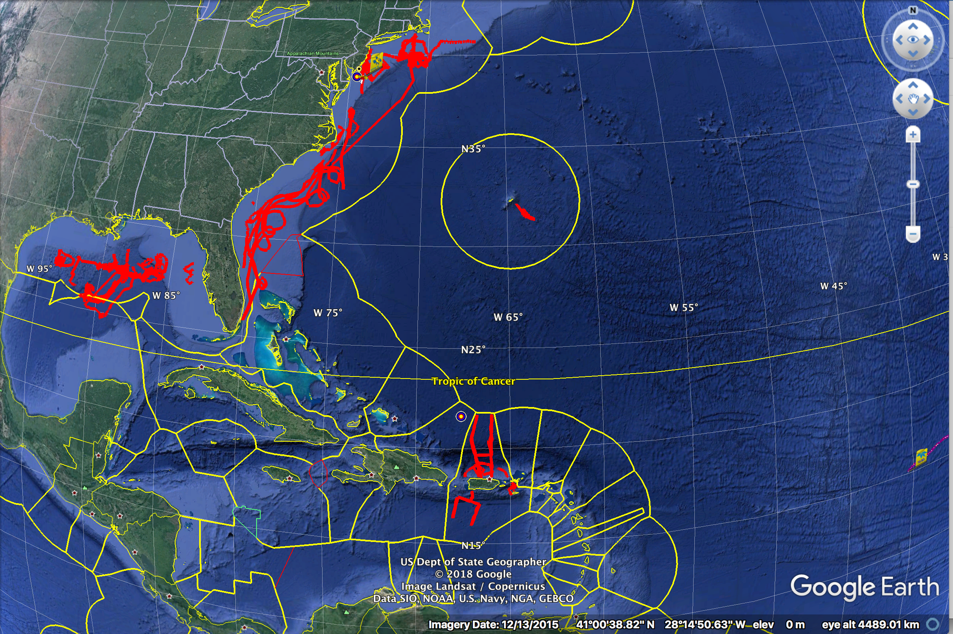
All 2018 Atlantic Hurricane Gliders
Florence
Helene
Isaac
>30 Hurricane Gliders from NOAA, NSF, NSF, Academic & Industry Partners
reporting ocean conditions through the U.S. IOOS Glider Data Assembly Center ahead of Hurricanes Florence, Isaac and Helene on September 11, 2018.

Slide 9
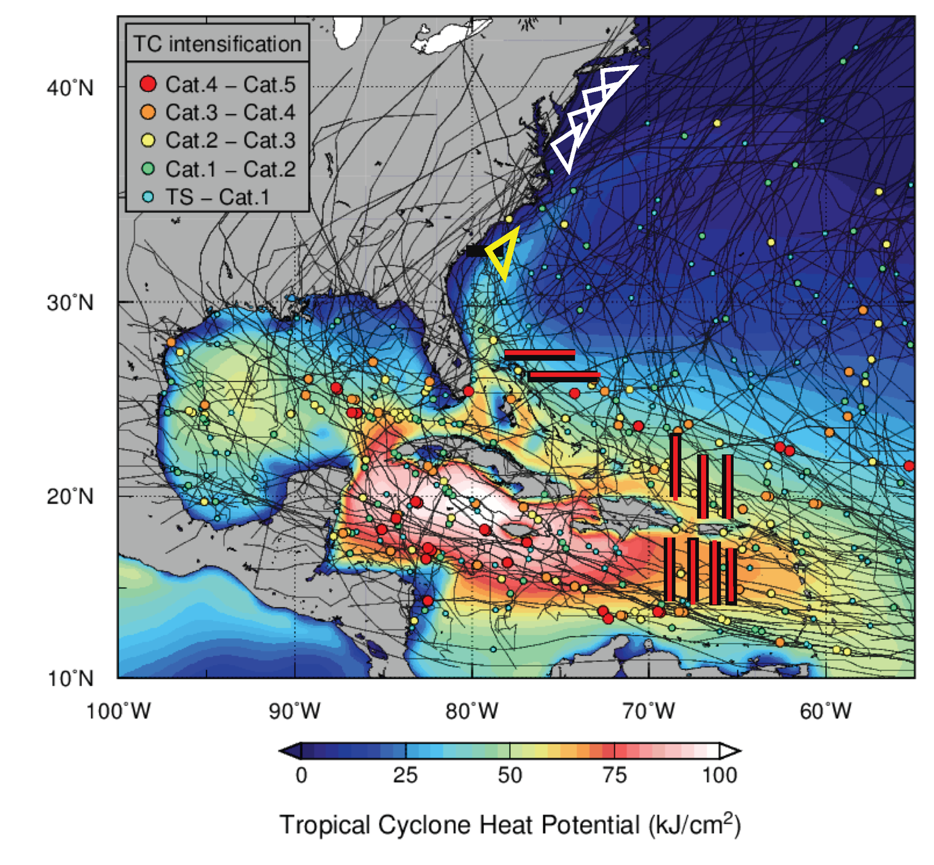
2019: A Picket line of hurricane gliders for Atlantic Hurricane Intensity Forecasts NOAA/AOML, US Navy, IOOS, Rutgers U, U of Miami, CARICOOS, MARACOOS, SECORA, ANAMAR (Dominican Republic), CEI (Bahamas), OCOVI/USVI
Through the US Hurricane Supplemental Funding, NOAA (Gustavo Goni, Lead PI) will support an enhance effort that will include > 30 gliders in the Atlantic, Caribbean Sea, and Gulf of Mexico, in support of hurricane intensity forecasts.
Orange circles indicate where US Navy gliders may be deployed in US EEZ waters.

Slide 10
Summary
This is the first international effort geared towards implementing an ocean observing system to improve Atlantic hurricane intensity forecasts.
Current Regional Participants:
NOAA/AOML, Miami (Lead)
CIMAS, University of Miami, Miami
CARICOOS, Puerto Rico
University of Puerto Rico, Mayaguez
OCOVI, US Virgin Islands
Island School, Cape Eleuthera Institute, Bahamas
ANAMAR, Dominican Republic
Navy and Coast Guard Auxiliaries, Dominican Republic
ONAMET, Dominican Republic
There is potential to increase number of participants from agencies in regions where observations are now not being implemented (eastern Caribbean, east of Lesser Antilles, etc). NOAA may be able to offer equipment and training opportunities. New participant may need to contribute with logistics, a glider port, vessels, technical/science personnel.
Please contact Gustavo Goni at Gustavo.Goni@noaa.gov with questions.

