Slide 1
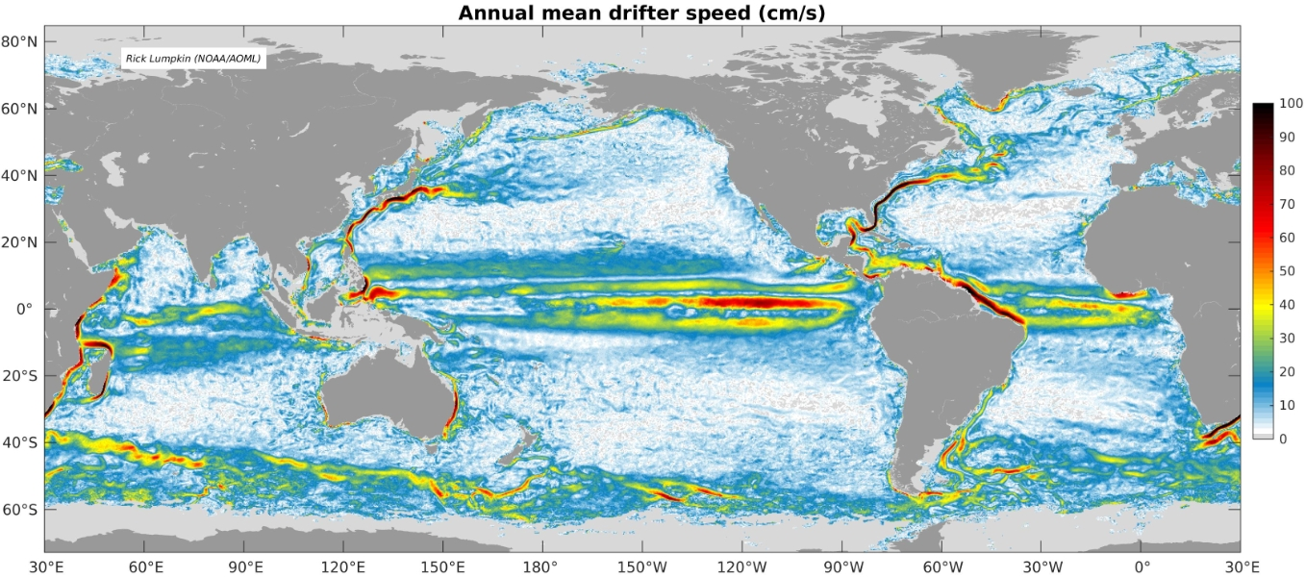
Global surface current climatology updated at GDC
¼º resolution global monthly climatology of surface currents and eddy kinetic energy, calculated from drogued and slip-corrected undrogued drifters
Version 3.03 of the GDP climatology: data through July 2018
Methodology: see Laurindo et al. (2017)

