Slide 1
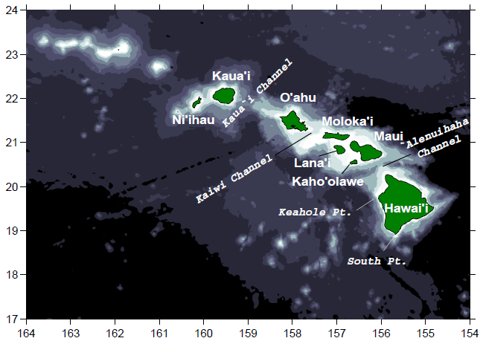
A new global surface current climatology, with application to the Hawaiian Island region
Rick Lumpkin
(Rick.Lumpkin@noaa.gov)

Slide 2
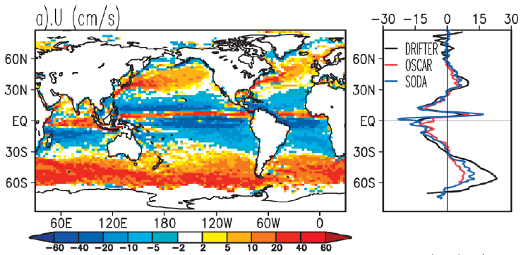
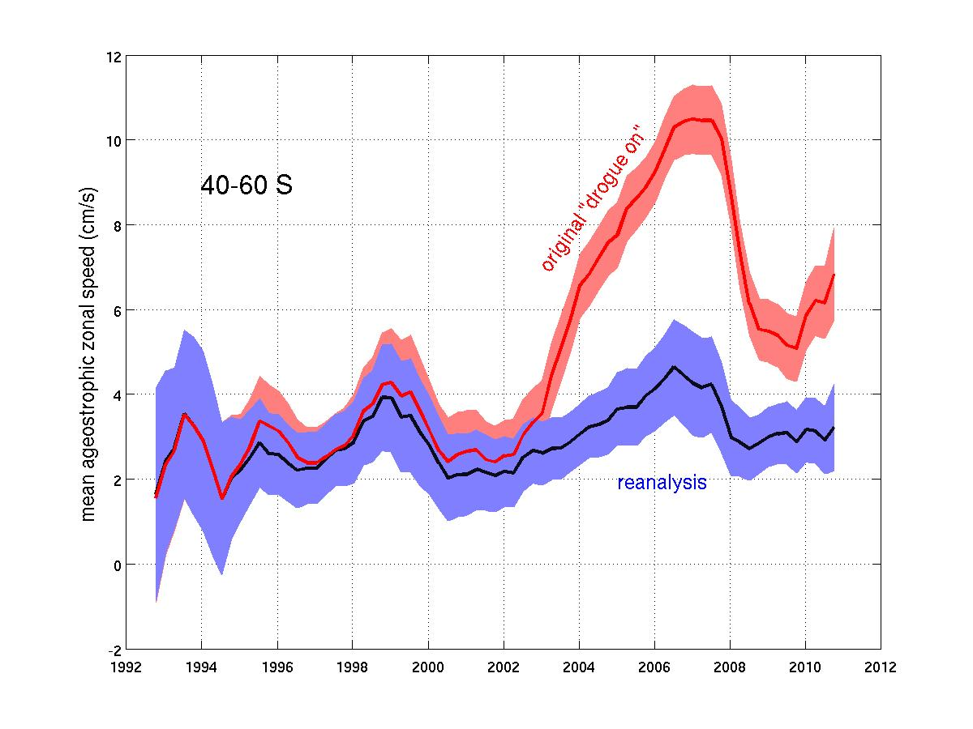
Drogue presence reanalysis
Left: time-mean zonal currents from drifters and two independent analyses (Grodsky et al., 2011).
Geostrophic component can be calculated from AVISO and CLS mean dynamic height (Rio et al.., 2011).
Time mean currents in the ACC band 40—60S before (red) and after (blue) drogue presence reanalysis (Lumpkin et al., 2012).
Notes:
Two independent analyses of surface current:
1) Ocean Surface Current Analysis – realtime (OSCAR) of Bonjean and Lagerloef [2002]. This analysis is based on combining geostrophic currents computed from satellite
altimetry with ageostrophic currents computed from the surface wind stress.
2) The Simple Ocean Data Assimilation (SODA) 2.2.4 reanalysis of Carton and Giese [2008] which uses data assimilation to ingest historical hydrographic information and SST into a meteorologically forced ocean general circulation model.
NOTE that the suspicious low-frequency variations were independently identified by Semyon Grodsky and Marie-helene Rio.

Slide 3
Observational density
Drogued drifter days per square degree in the bins.
<12: currents not mapped.
Lumpkin and Johnson (2013)

Slide 4
Methodology (Lumpkin and Johnson, 2013)
QC, interpolated 6h velocities from drifter DAC.
Only drogued values (according to recent reanalysis).
NCEP winds used to remove linear slip.
Lowpassed at 5 days (remove inertial, tidal).
Decimated to daily values.
Pseudo-Eulerian means:
Mapped in elliptical bins of area π×(1°)².
Eccentricity, orientation set by variance ellipse in bin.
Observations in each bin decomposed into time-mean, annual, semiannual, SOI, and spatial gradient components using Gauss-Markov estimation (also yields formal error estimates).
Eddy variations: u’ = <u> - u, v’=<v>-v.

Slide 5
Mean currents
Mean speed (color, in cm s⁻¹) with streamlines (black lines). Gray areas have less than 12 drifter days per square degree. Only bins with mean current speeds statistically different from zero at one standard error of the mean are shaded.
Lumpkin and Johnson (2013)

Slide 6
Residuals (eddies)
Variance ellipses centered every 5º longitude by 2º latitude. Shading indicates square root of magnitude of variance (cm s⁻¹). Gray areas have less than 12 drifter days per square degree
Lumpkin and Johnson (2013)

Slide 7
Southern Oscillation Index currents
Speed (colors in cm s⁻¹) shown for SOI = -1 (moderate El Niño). Arrows for subset of gridpoints shown to indicate directions. Gridpoints with values not significantly different from zero at one standard error of the mean not displayed
Lumpkin and Johnson (2013)

Slide 8
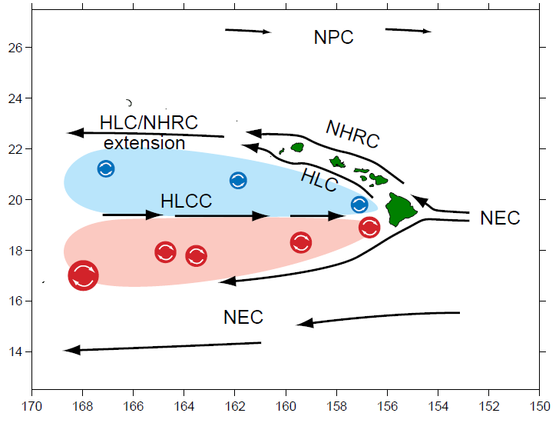
Islands embedded in large-scale oceanic flow
Lumpkin (1998)
Notes:
NEC: impinges on islands, creates NHRC and accelerated jet of NEC at ~18N. West of islands, instantaneous ocean flow is dominated by energetic cyclonic and anticyclonic eddies.

Slide 9
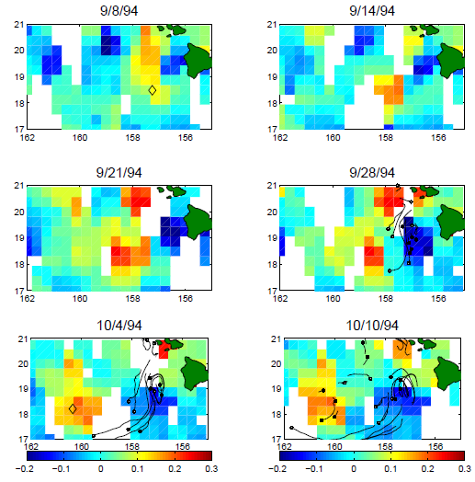
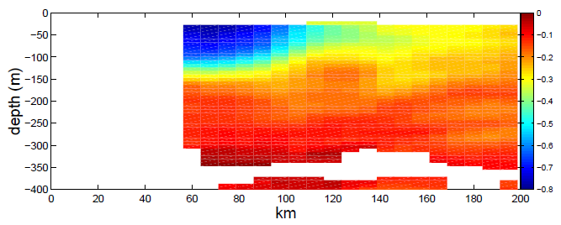
Lee eddies
Left: SLA from altimetry, with ADCP-determined center of AC94c (diamonds) and drifter trajectories (black).
Above: ADCP profile of azimuthal speed in AC94c.
Lumpkin (1998)

Slide 10
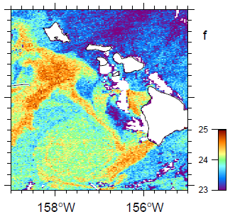
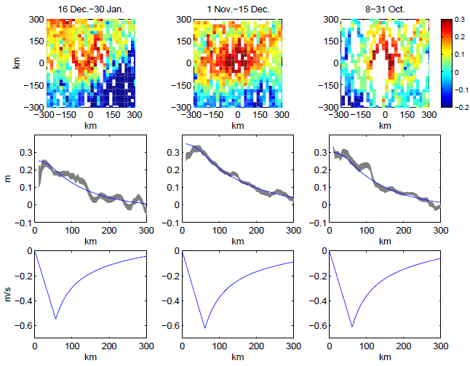
Top: eddy AC94c in AVHRR imagery. Right: altimetric passes in frame of reference moving with AC94c.
Lumpkin (1998)

Slide 11
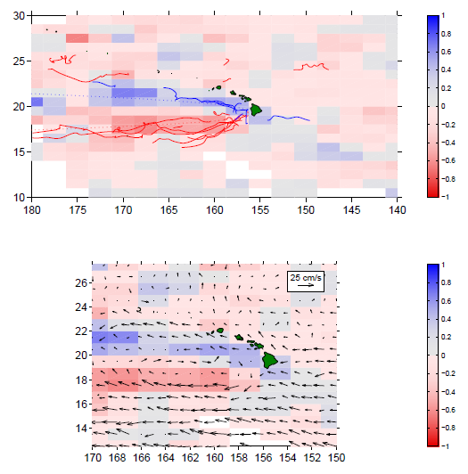
Lumpkin (1998)
Top: mean fraction of subinertial variance into CCW (blue) and CW (red) motion, with paths of cyclonic (blue) and anticyclonic (red) eddies tracked by drifters. Bottom: time-mean currents from drifters.

Slide 12
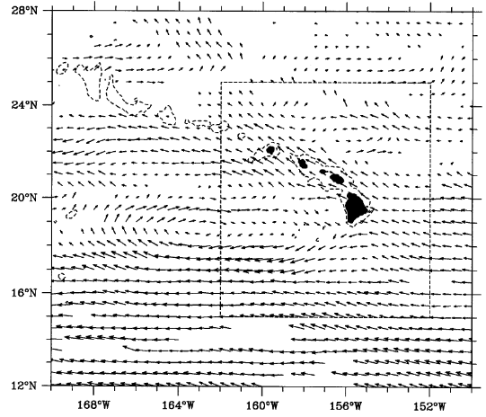
The Hawaiian Lee Countercurrent (HLCC)
Qiu, Koh, Lumpkin and Flament (1997)
First reported in grey literature from early drifter observations (Flament, 1993, 1994). First documented in peer-reviewed literature by Qiu et al. (1997). Extent: 157—168°W, 19—20°N.

Slide 13
What is the zonal extent of the HLCC?
Qiu et al. (1997), Lumpkin (1998): 157°W—168°W.
Drifter data through 1997 → simple bin averaging.
Xie et al. (2001): Hawaiian Islands to Asian coast (!)
1½ layer model, primitive equation model.
Kobashi and Kawamura (2002): “just west of Hawaii” to 150°E.
CTD, XBT casts → gridded monthly T, S; OI smoothed.
Yu et al. (2003): 158°W—172°W.
Drifter data through 1999 → simple bin averaging.
158°W—175°W.
2½ layer model. BC instability limits western extent.
Noted that zonal extent very sensitive to model resolution.

Slide 14
Does the barotropic energy flux play a significant role in the HLCC?
Lumpkin (1998): eddy-to-mean flux of 10±8 μW m⁻³ at 18—19°N, averaged in the band 160—168°W.
Drifter data through 1997.
Yu et al. (2003): no significant BT energy flux averaged in the band 157—172°W.
Drifter data through 1999.
Note: both studies suffered from relatively sparse data dominated by a few dense deployments. Both used simple bin averaging to separate mean/eddy velocities; this can result in biased results (Bauer et al., 1998).

Slide 15
Since 1999: many more drifter observations!
Drogued observations vs. time, 14—25°N, 180—150°W
130 drifter-years of drogued velocity data by 324 unique drifters (~ 2× data available through 1999: 64 drifter-years collected by 144 unique drifters).
Data no longer primarily from 1993, 1995 and 1996 deployments.

Slide 16
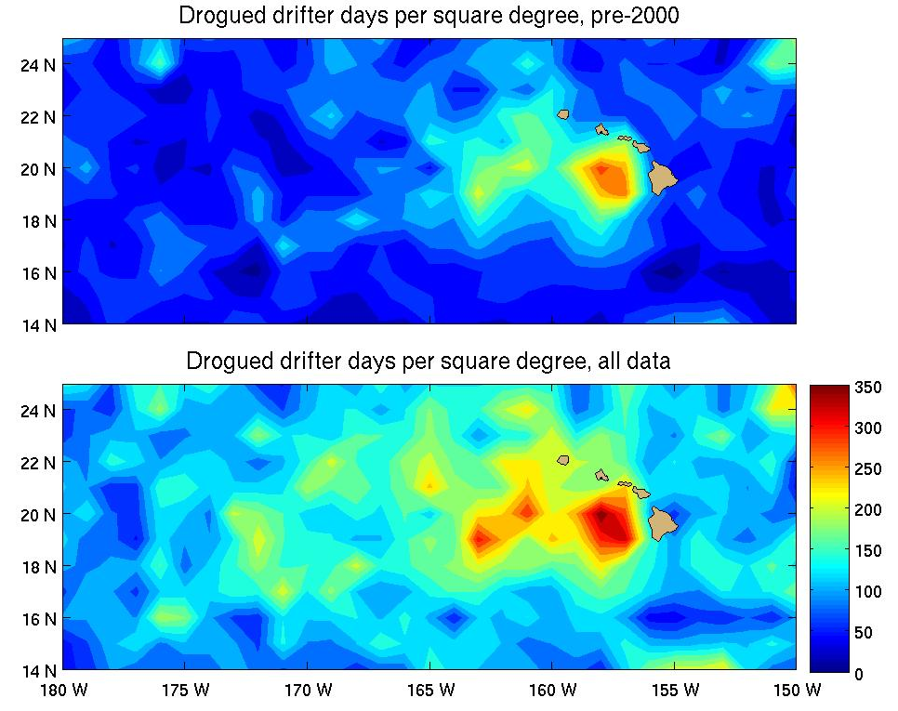
Since 1999: many more drifter observations!

Slide 17
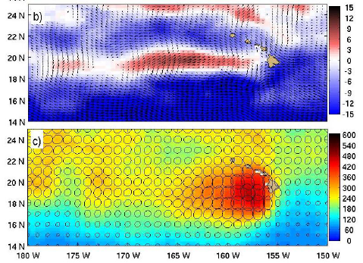
The island wake as seen by drifters
Significant eastward speeds: 170°W to 157°W
Eastward but not significant, 177.5°W—174°W
Lumpkin and Flament (2013)

Slide 18
(Animation of seasonal variations in surface currents)

Slide 19
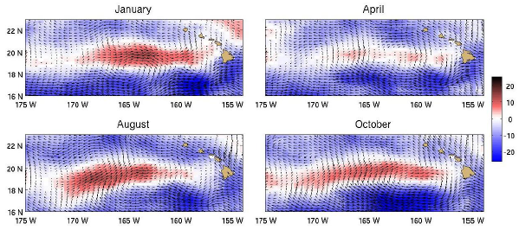
Seasonal variability of the HLCC
Peak: 13.2±0.2 cm/s
Peak: 5.3±0.2 cm/s
Peak: 13.6±0.3 cm/s
Peak: 10.2±0.2 cm/s
Lumpkin and Flament (2013)
Consistent with Kobashi and Kawamura (2002).

Slide 20
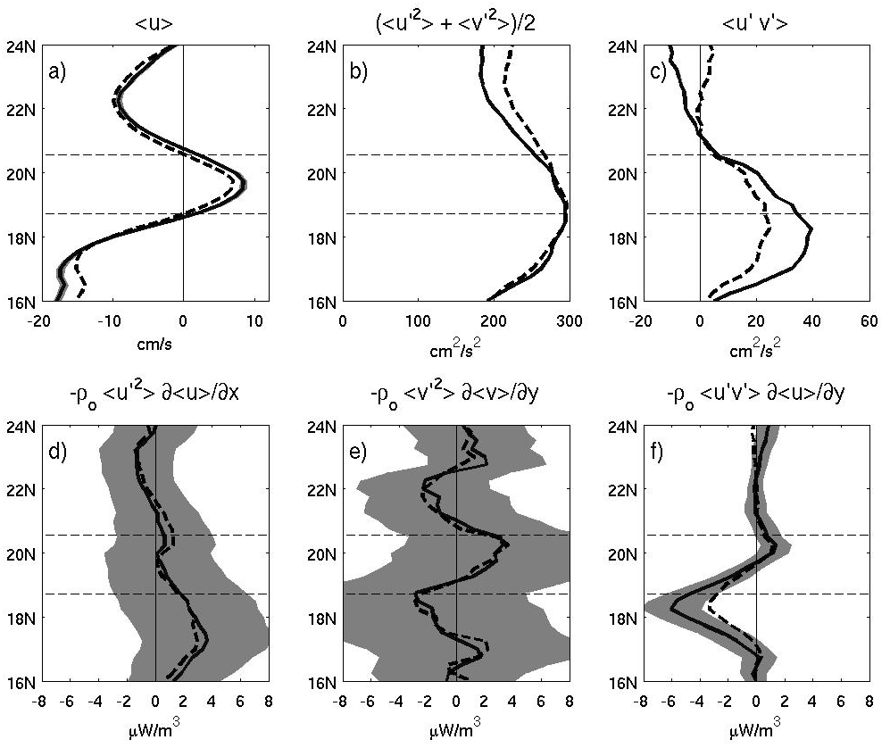
Lumpkin and Flament (2013)
Solid, with error bars: August-January (peak HLCC).
Dashed: annual mean.

Slide 21
The role of the barotropic eddy flux
South of the HLCC, where anticyclonic vorticity dominates
the oceanic wake of the Hawaiian Islands, the zonal speed U is strongly meridionally sheared (–10.2 cm s^{–1} at
18.0°N, +6.8 cm s^{–1} at 19.5°N, a mean gradient of 1.0 × 10^{–6} s^{–1}
averaged in the band 160°–168°W)
The Reynolds shear stress <u'v'> works to reinforce this gradient (25.7±3.0 cm² s^{–2} at 18.25°N, 39.5±3.6 cm² s^{–2} during peak HLCC months Aug-Jan). The associated eddy-to-mean flux (ρ<u'v'>∂U/∂y) is 3.3±1.2 μW m^{–3} (6.1±2.1 μW m^{–3} during peak months) at 18.25°N. Energetic anticyclonic lee eddies advect and deposit zonal momentum that maintains the meridional shear between the HLCC and the NEC to its south.
This energy flux could spin up an HLCC of U = 7 cm s^{–1} in time T = ρU²/(2 × [3 μW m^{–3}]) ~ 10 days, and during peak HLCC months (U = 8.5 cm s^{–1}) in seven days.

Slide 22
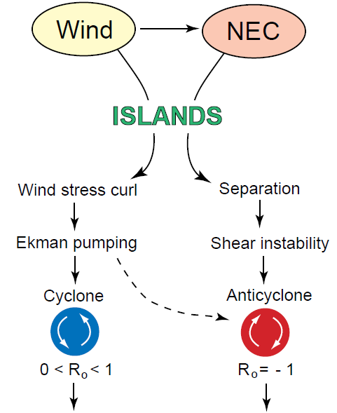
Lumpkin (1998)

Slide 23
Summary
Drifter observations used to map time-mean, seasonal and SOI-related surface currents.
Methodology produces formal error bars for all components and for monthly mean fields.
Study takes advantage of recent drogue reanalysis; only drogued drifters included.
Results show details of absolute surface circulation at unprecedented resolution.
Monthly climatology available upon request; to be made publicly available after peer review (manuscript to be submitted to J. Geophys. Res.)
Future Work
Include undrogued drifters using slip correction.
Separately examine motion that is correlated with local wind (Ekman and slip), and difference (geostrophic).

Slide 24
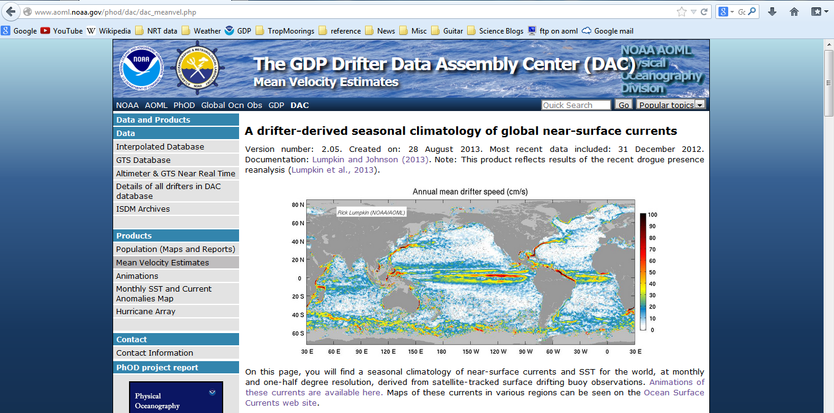
Climatology available in ASCII, NetCDF and Matlab formats on GDP web page.

Slide 26
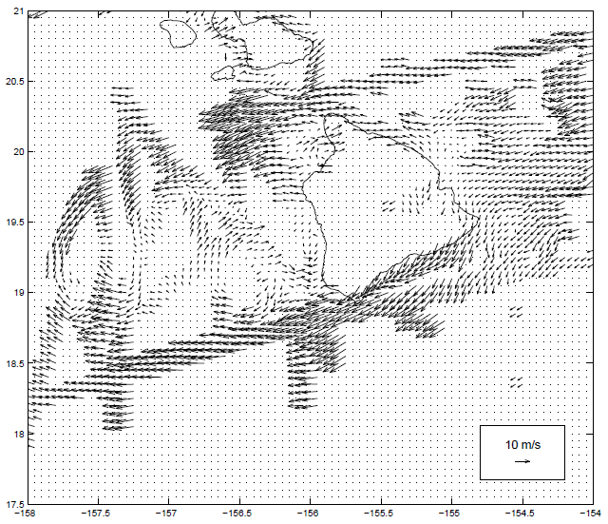
Winds around the Hawaiian Islands
Islands extend above Trade Wind inversion layer.
Wind shadows in island lees.
Wind jets between islands.
Winds at 0-500m measured from the NCAR aircraft Electra during HaRP experiment of July-August 1990 [Smith and Grubisic, 1993; Lumpkin, 1998].
Notes:
Islands extend above

Slide 27
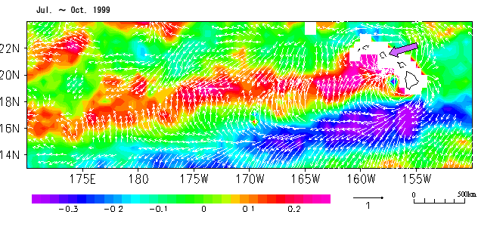
Evidence of large-scale atmospheric wake
Arrows: QuikSCAT wind stress. Shading: SST anomaly. [from NASA science page “Hawaii’s Wake”].

Slide 28
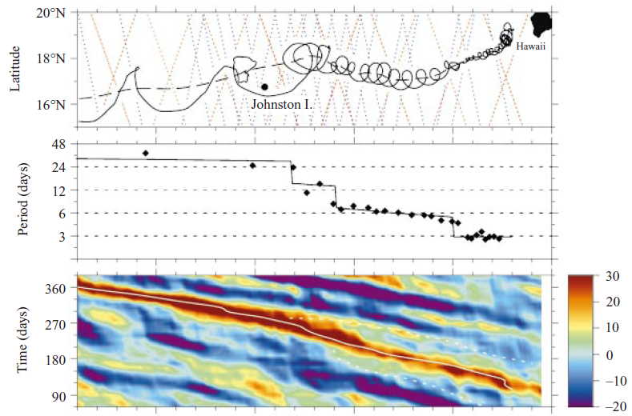
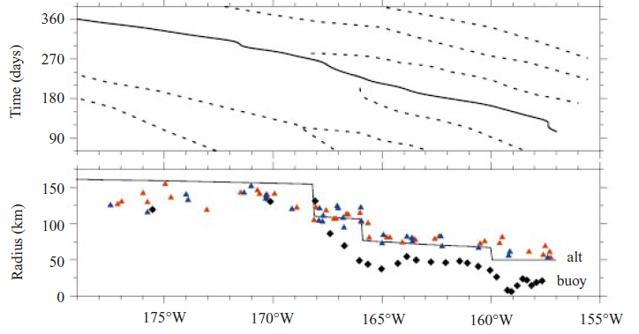
Evidence of downstream merging
Flament et al. (2001)

Slide 29
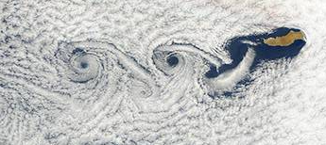
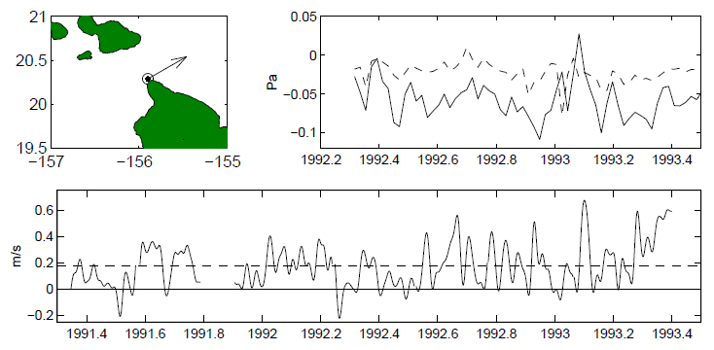
What generates the lee eddies?
McGary (1959), Pazert (1968): oceanic flow around the Hawaiian Islands has Reynolds number in the vortex shedding regime.
Lumpkin (1998): insufficient flow through Alenuihaha Channel. Unstable NEC separation from South Point of Hawaii. Kármán vortex street formation is stable.
Left: atmospheric flow around Guadelupe Island, visualized by clouds, forming Kármán vortex street. Source: http://www.weather.com/news/von-karman-vortices-20130131

Slide 30
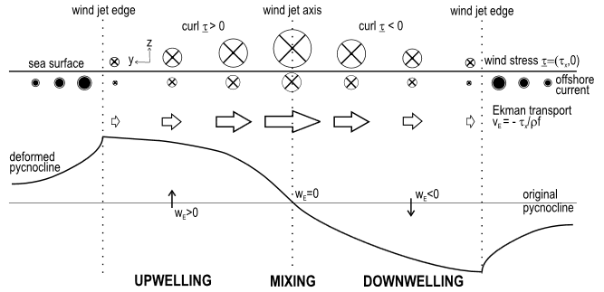
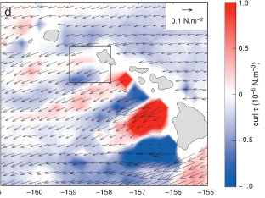
What generates the lee eddies?
Ekman pumping
Lumpkin (1998)
Willett et al. (2006)
Chavanne et al. (2010)

Slide 31
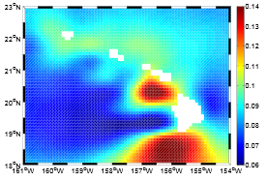
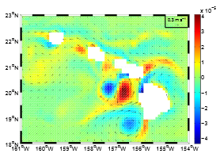
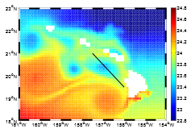
What generates the lee eddies?
Ekman pumping or oceanic flow around the Hawaiian Islands?
Lumpkin (1998): Ekman pumping generates cyclonic eddies; flow separation at South Point of Hawaii generates anticyclonic eddies (with Ekman pumping a secondary source of downwelling).
Kersalé (2011)
High-resolution simulations such as Kersalé (2011) indicate that both need to be present to generate realistically energetic eddies, along with sufficiently high resolution and forcing (QuikSCAT).

Slide 32
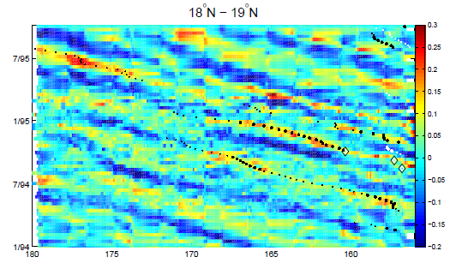
Eddies propagate westward …
Lumpkin (1998)

Slide 33
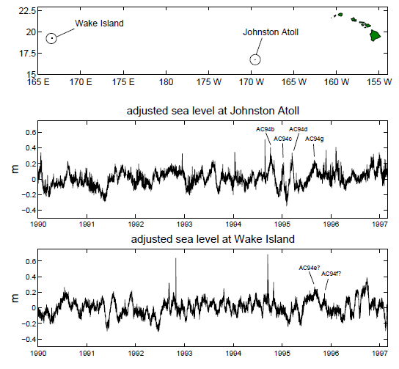
Lumpkin (1998)

Slide 34
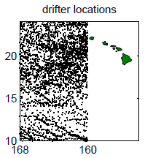
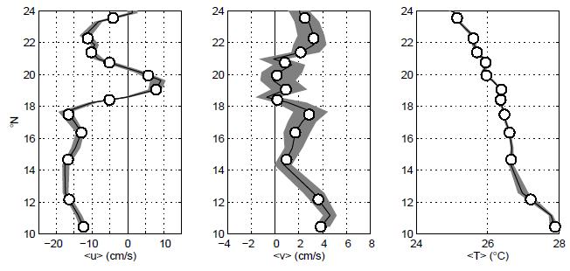
Drifter observations in the HLCC
Lumpkin (1998)
Zonally averaged drogued drifter observations, 160—168°W. White circles: independent observations. Shading: standard error.

Slide 35
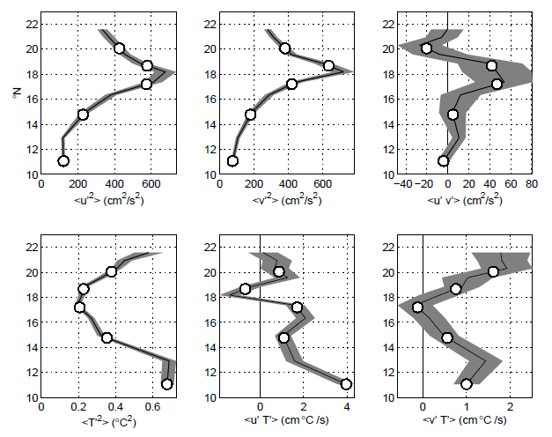
Lumpkin (1998)
Zonally averaged drifter observations, 160—168°W. White circles: independent observations. Shading: standard error.

Slide 36
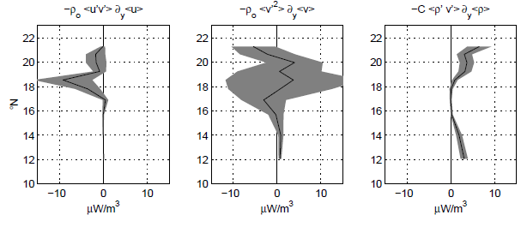
Lumpkin (1998)
Eddy fluxes from zonally averaged drifter observations, 160—168°W. Shading: standard error.

Slide 37
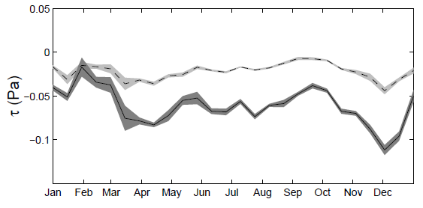
Seasonal variations of the HLCC
Wind variations
HLCC variations:
Kobashi and Kawamura (2002): HLCC strongest in July to February and weakest in April to June.
Very different from STCC at ~24°N (strongest in winter through summer, weakest in fall).
meridional
zonal
Lumpkin (1998)

Slide 38
What creates the HLCC?
Sverdrup response to large-scale wind wake (White and Walker, 1985; Leonardi, 1998; Leonardi et al., 1998; Xie et al., 2001).
Eddy rectification, barotropic eddy fluxes (Lumpkin, 1998; Kobashi and Kawamura (2002).
SST → wind feedback (Sasaki and Nonaka, 2006).

Slide 40
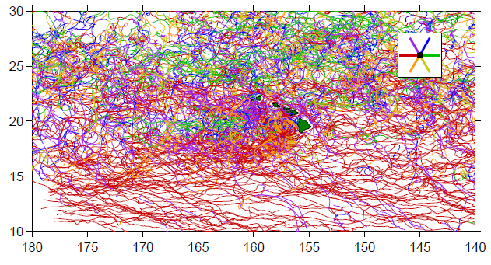
Drifter trajectories colored by direction

Slide 41
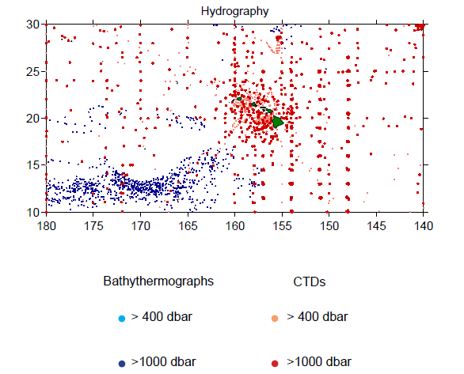

Slide 42
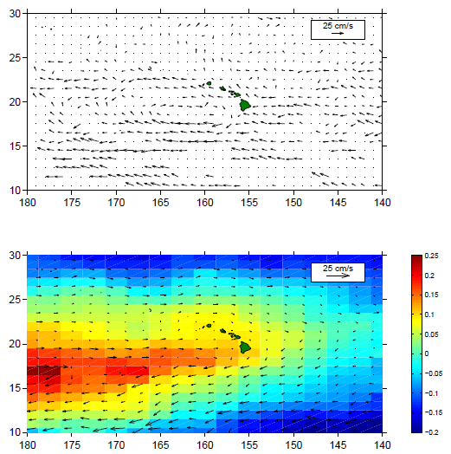
Top: mean currents from drifters.
Bottom: dynamic height anomalies relative to 400dbar from XBT, CTD (shading, m) and geostrophic currents (arrows)

Slide 43
