Slide 1
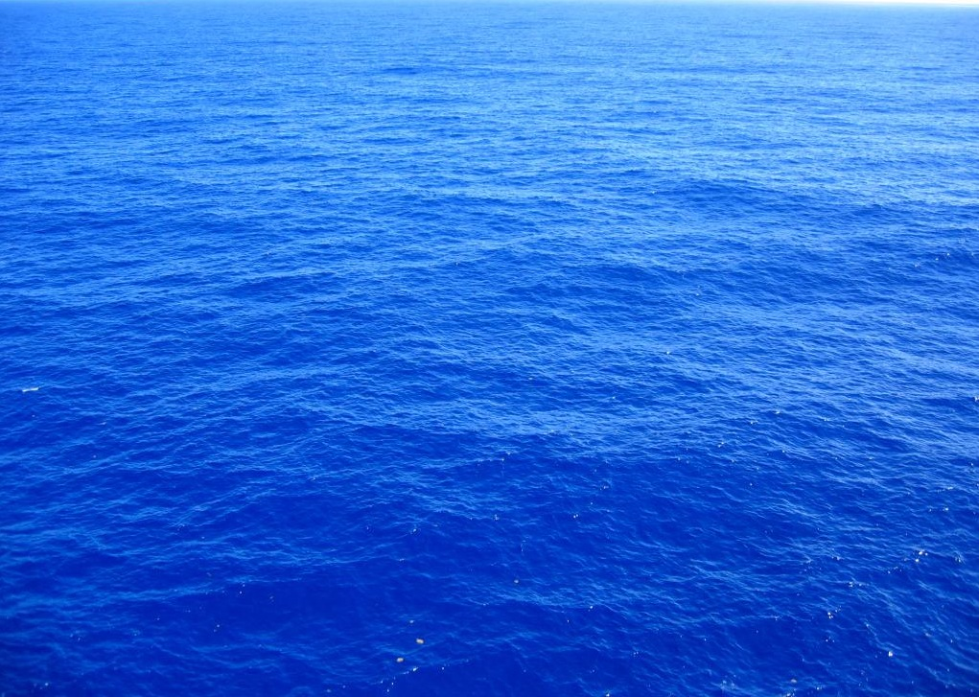
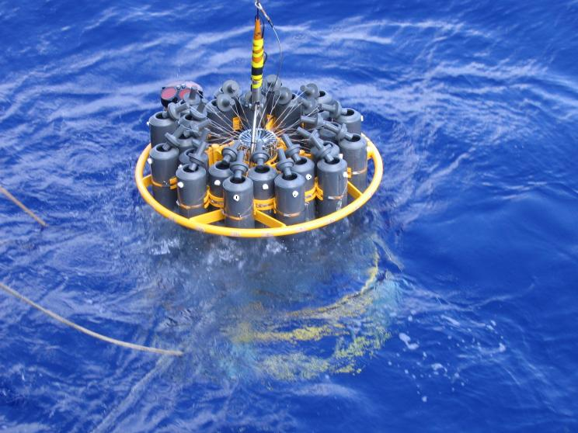
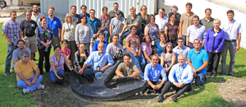
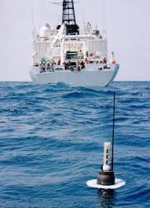
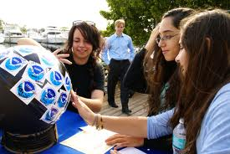
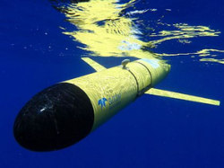
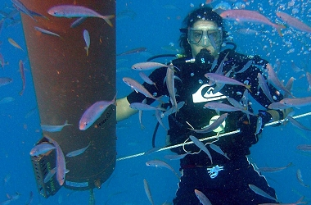


Oceans and Climate Research
Physical Oceanography Division (PHOD)
Gustavo Jorge Goni, Division Director
www.aoml.noaa.gov/phod
Division Goal: To strengthen our scientific understanding of the role of the ocean in climate, extreme weather events, and ecosystems, by enhancing our observational work, research, technological development, and science communications.
AOML Program Review
4-6 March 2014
Notes:
The Physical Oceanography Division (PhOD) is a part of the Atlantic Oceanographic and Meteorological Laboratory (AOML) together with the Ocean Chemistry Ecosystems and Hurricane Research Divisions. The Physical Oceanography Division carries out interdisciplinary scientific investigations of the physics of ocean currents and water properties, and on the role of the ocean in climate, extreme weather events, and ecosystems. The tools used to carry out these studies range from sensors on deep ocean moorings to satellite-based instruments to measurements made on research and commercial shipping vessels and autonomous vehicles, and include data analysis and numerical modeling as well as theoretical approaches.

Slide 2
PHOD Major Science Objectives
Assessment of the state of the ocean, with emphasis on the Atlantic Meridional Overturning Circulation and variability of key ocean currents;
Evaluation of processes that drive Tropical Atlantic climate variability;
Use of data and analysis to assess uncertainties of climate models and what cause them, with the goal to improve predictability;
Evaluation of the effect of the ocean on extreme weather events (tornados, hurricanes, droughts, etc);
Evaluation and design of ocean observing systems (OSE and OSSE);
Assessment of the link between climate signals and changes in ecosystems;
Development of new technology in support of climate, extreme weather, and ecosystem studies.
Notes:
Complete information about the Physical Oceanography Division is provided in the divisional web pages at: www.aoml.noaa.gov/phod and in the divisional project report located at: http://www.aoml.noaa.gov/phod/docs/PhOD_programs.pdf

Slide 3
Main Scientific Questions
What drives the variability of key ocean currents; how do numerical models reproduce their observed variability; and what are the main links to large scale/long period changes ?
What is the spatial and temporal variability of the Atlantic Meridional Overturning Circulation and regional ocean/climate patterns, and what are the processes driving them ?
What is the role of the ocean in driving extreme weather events and climate ?
How are climate models reproducing the state of the ocean ?
What are the optimal ocean observing systems and strategies that will improve ocean state estimates and forecasts for a broad range of applications ?
How are physical oceanography parameters linked to ecosystem variability ?

Slide 4
PHOD and NOAA’s Objectives
Climate Adaptation and Mitigation:
  What is the state of the climate and how is it evolving?
  What causes climate variability and change on global to regional scales?
  What improvements in global and regional climate predictions are possible?
Weather-Ready Nation:
  How does climate affect seasonal weather and extreme weather events?
Cross-Cuts: Observing, Modeling, and Engaging.
  What is the best observing system to meet NOAA’s mission?
  How can emerging technologies improve ecosystem-based management?

Slide 5
PHOD Budget
Includes CIMAS proposals
$*1000
#
#= Deepwater Horizon
*= Sandy Supplemental
*
Divisional budget: approximately $8.3M
Base: $3.6M
Proposals: $4.7M
Increased proposal funding by 50% ($3M) since 2000
Number of proposals: 34
FY
Notes:
The divisional base funds have approximately remained unchanged during the last ten years. External proposals are funded through CPO/COD, NSF, NASA. Two large proposals were funded in support of Deepwater Horizon and Sandy Supplemental efforts.

Slide 6
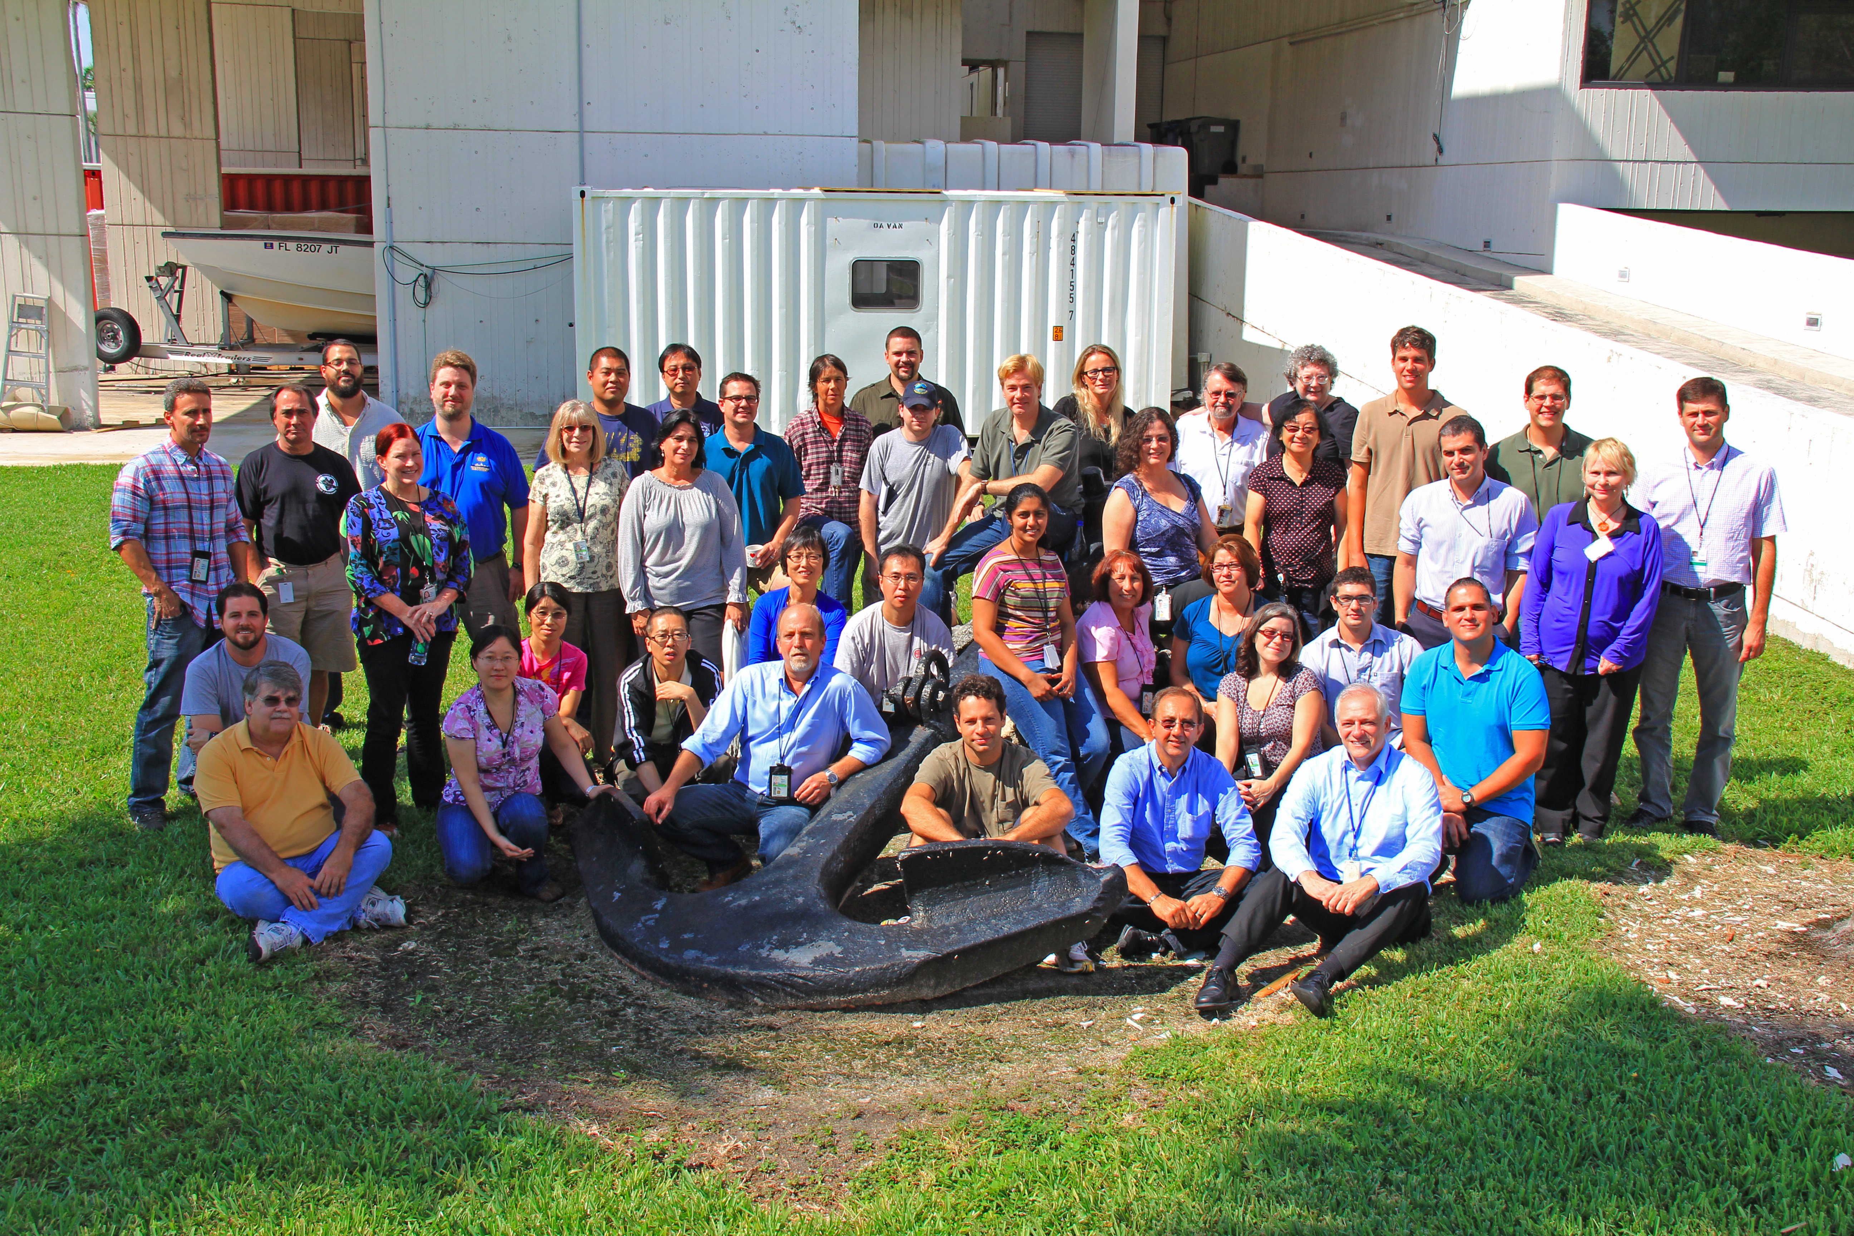
PHOD Personnel
 | Research Scientists | Research and Operation Support | Instrumentation | Administrative | TOTAL
Feds | 9 | 6 | 3 | 2 | 20
CIMAS | 8 | 14 | 3 | 1 | 26
Total | 17 | 20 | 6 | 3 | 46
Notes:
The total number of divisional staff (federal plus CIMAS) has remained largely unchanged during the years. However, the number of CIMAS employees is now larger than federals.

Slide 7
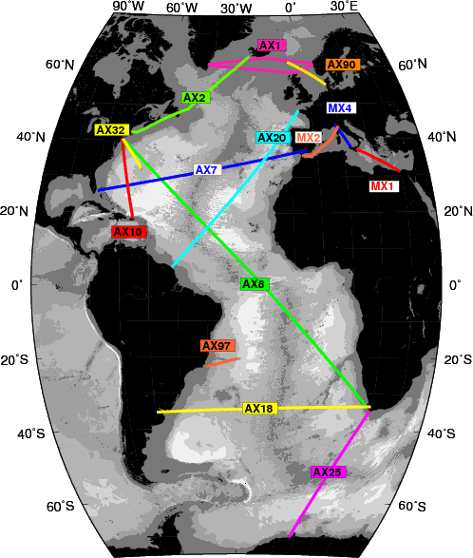
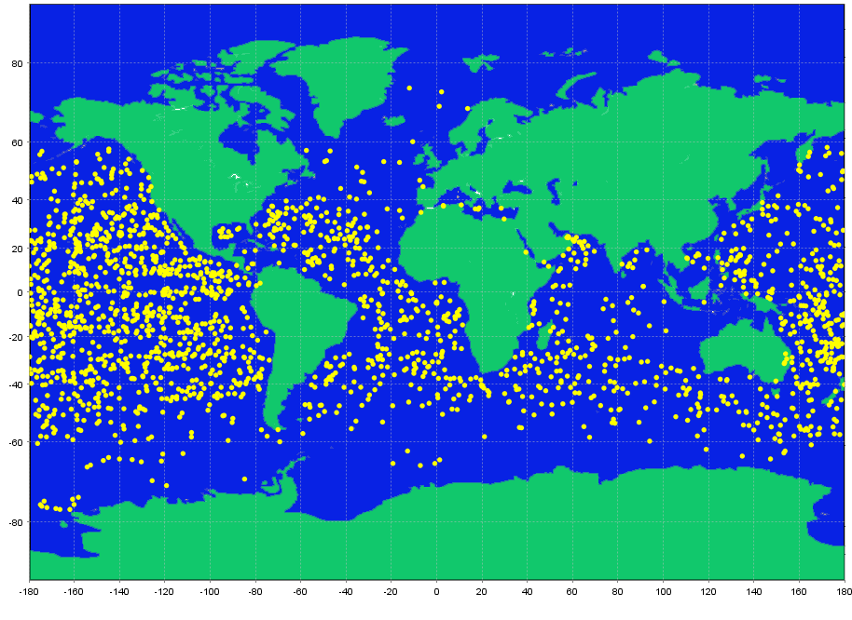
Major Observational Projects
XBT Network
Approximately 8,000 deployments per year along 15 fixed repeat transects, within an international effort of 10 countries, since 1983.
Sustained observations of the Meridional Overturning Circulation (MOC) and variability of major surface and near surface currents.
First time series of Meridional Heat Transport and heat fluxes in the Atlantic Ocean.
Argo Program
US Data Assembly Center. Collect and distribute ~70,000 profiles data annually from ~1900 floats.
Coordinate deployment of approximately 100 Argo floats per year in the Atlantic Ocean, within an international effort of 30 countries, since 2000.
Assessment of upper ocean heat content, salinity, dynamics, and atmosphere-ocean interactions.
Notes:
The Major observational programs and projects that relate to sustained ocean observations in which AOML scientists play a critical role in their design, implementation, and enhancements are: the XBT network, the Global Drifter Program, the Argo Program, the Western Boundary Time Series Program, the PIRATA Northeast Extension Array, the Southwest Atlantic MOC moorings, and Thermosalinograph (TSG) observations. We highlight here the main role of AOML in each program/project and some of their key objectives. Scientific presentations during this session will provide insights into how analyses of these observations, frequently in combination with satellite observations and numerical modeling outputs, are used at AOML to improve understanding of the role of the ocean in climate, extreme weather events, and ecosystems.
Complete information about the AOML contribution to sustained ocean observations can be found at: http://www.aoml.noaa.gov/phod/goos.php
For the XBT Network: AOML is in charge of the deployment of 8000 XBTs. These data are used to monitor the variability of the upper ocean thermal structure along fixed predetermined transects, with the objective of assessing the variability of the Meridional Heat Transport and Meridional Overturning Circulation in the Atlantic Ocean, and to investigate the variability of key surface and near-surface currents, and boundary currents. Information about the AOML XBT network can be found at: http://www.aoml.noaa.gov/phod/goos/xbt_network/ and about the international XBT effort at: http://www.aoml.noaa.gov/phod/goos/xbtscience/ Among the main contributions of the XBT network, its data has provided the first time series of the MHT and MOC in the South Atlantic Ocean, including the identification of the geostrophic component of the seasonal cycle, and the year-to-year variability of these parameters.
For the Argo Program: The US Argo Data Assembly Center is in charge of: (1) real-time processing, quality control and distribution to GTS and Argo Global Data Assembly Centers; (2) receiving, verifying and distributing of data to the Argo Global Data Assembly Centers after scientific quality control; (3) coordination of deployments with Argo partners; and (4) contributing to ensuring high quality of data in the South Atlantic region.

Slide 8
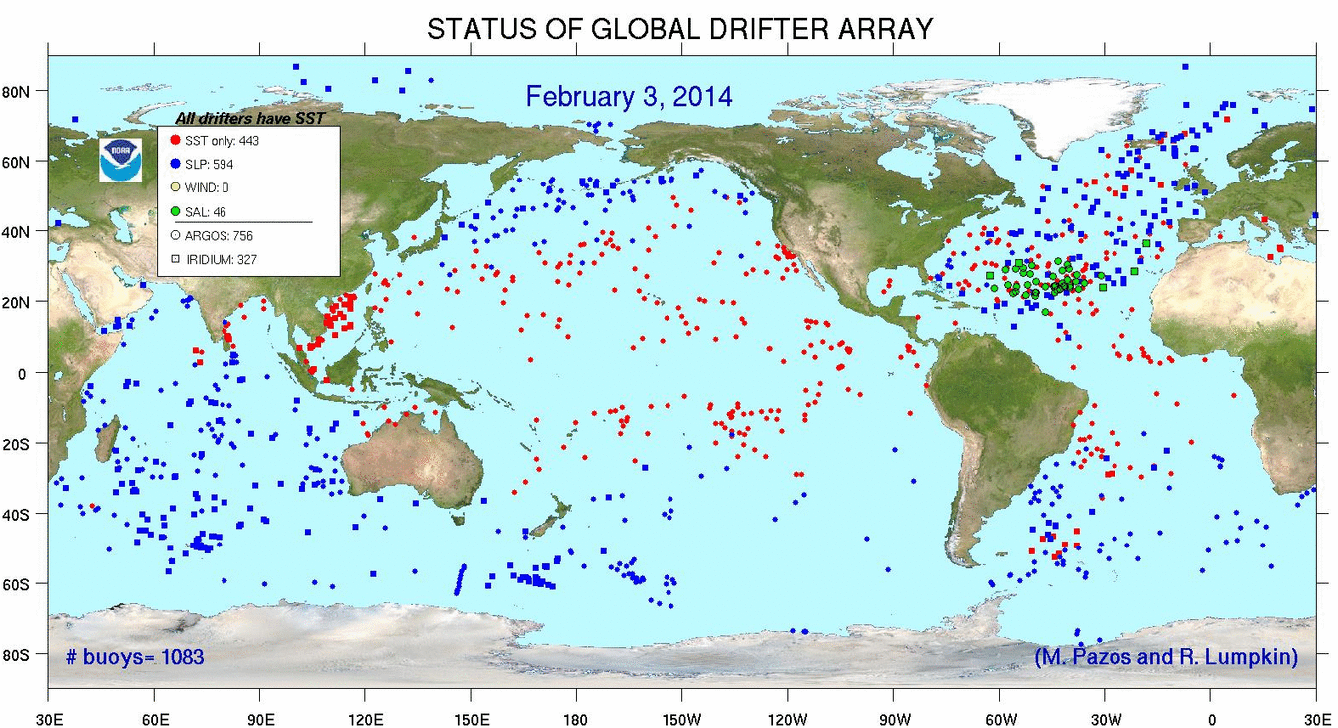
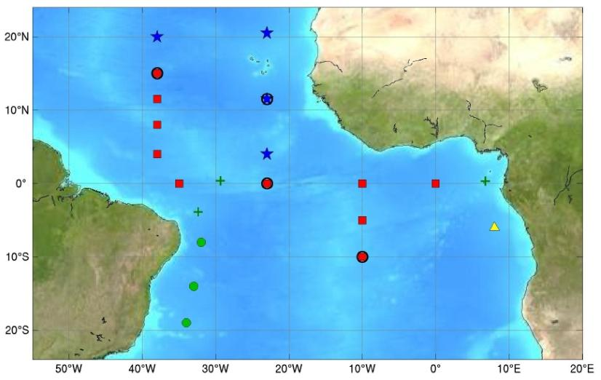
Major Observational Projects
Global Drifter Program
Maintenance of approximately 1200 drifter array, and coordination of around 1100 annual deployments within an international effort , since 2001. Data assembly, quality control, and distribution since mid 1980’s.
Comprehensive understanding of global ocean circulation and variability.
Validation and calibration of satellite-derived SSTs.
PIRATA Array
AOML Partnership with PMEL, Brazil, and France to maintain 18 moorings in the tropical Atlantic Ocean, since 2006; Annual hydrographic cruises during maintenance of four PIRATA Northeast Extension moorings.
Understanding tropical Atlantic climate variability.
Link of spatial and temporal variability of zonal current system with two climate modes of variability.
Please see poster by Schmid and Garzoli
Notes:
Global Drifter Program: Leading the international community effort (of more than 20 countries) AOML coordinates deployments and assembles and quality controls the surface drifter observations.
PIRATA ARRAY: Together with PMEL, AOML leads the efforts to maintain four moorings (indicated with blue in the map) and to conduct annual hydrographic cruises with the objective to improve our understanding of climate fluctuations in the tropical North Atlantic, which is the area of tropical cyclone formation. The talk by Dr. Rick Lumpkin will provide more insights on the work done with these and other in situ and satellite observations.

Slide 9
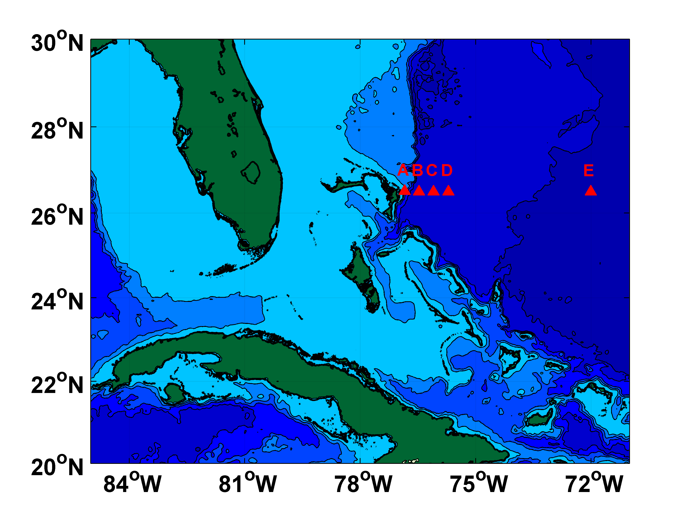
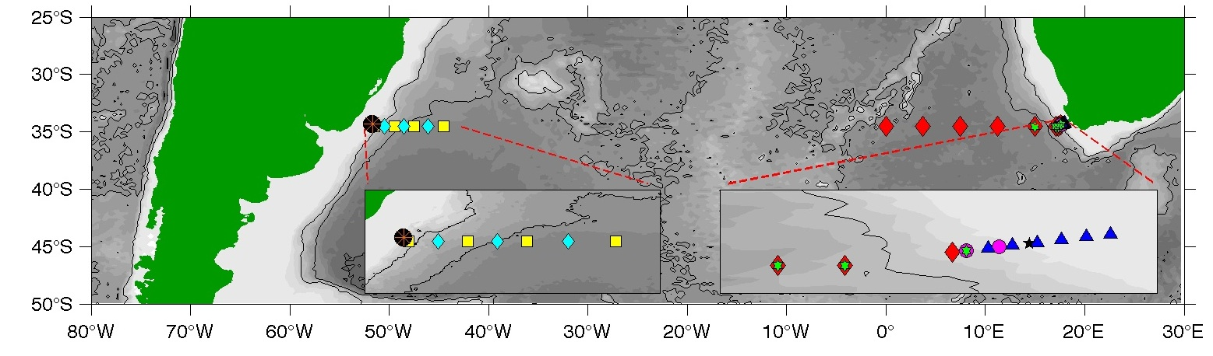
Major Observational Projects
Western Boundary Time Series
Partner in RAPID-MOCHA-WBTS array, since 2004; Sustained observations of Florida Current since 1982.
Monitoring upper and deep limbs of the MOC near the western boundary.
Longest open ocean time series of transport of GS/DWBC system
Southwestern Atlantic MOC
Maintenance of 4 moorings, of a larger array along 35°S, since 2009. Building towards a larger array with international partners.
Sustained observations of the water column in the SW Atlantic Ocean to understand the contribution of the SA to the MOC.
DWBC variability in the South Atlantic.
Notes:
PhOD leads two projects aimed at collecting continuous time series measurements of key components of the Meridional Overturning Circulation (MOC). Variations in the MOC have been shown in climate models to be correlated to changes in precipitation patterns across North America, to changes in upper ocean heat content and therefore to hurricane intensification, and to changes in surface air temperatures across wide swaths of the globe. Improving understanding of the MOC system is a key near-term priority in the US Interagency Ocean Research Priorities Plan released in 2007. AOML/PhOD has been at the forefront of making the necessary observations to improve our understanding, with moored time series in the North and South Atlantic.
PhOD leads the NOAA Western Boundary Time Series project, which has been collecting time series observations of the warm upper limb of the MOC in the Florida Current via submarine cable and ship sections nearly continuously since 1982. The WBTS project also has been collecting annual or semi-annual hydrographic sections across the Deep Western Boundary Current east of the Bahamas since 1984, and the volume transports of the currents east of the Bahamas have been measured continuously since 2004 using an array of pressure-equipped inverted echo sounders. The WBTS observing program also served as a crucial cornerstone for the international array (RAPID-MOC/MOCHA/WBTS) that has been making daily estimates of the basin-wide MOC at 26N since 2004 with our partners at the Univ. of Miami and at the National Oceanography Centre in Southampton, UK. The WBTS program is part of the Global Ocean Observing System, and it is envisioned to continue in perpetuity - although we are always looking into new technologies that will allow us to do the projects better and/or more efficiently.
PhOD also leads the Southwest Atlantic MOC (SAM) project that is providing measurements of the western boundary components of the MOC at 34.5S just east of South America. PhOD has maintained an array of pressure-equipped inverted echo sounders since 2009 that is providing daily estimates of the Deep Western Boundary Current as well as observations of the Brazil Current. The SAM project has also proven to be a cornerstone for a developing trans-basin array in the South Atlantic, with international partners from Brazil, France, Argentina and South Africa providing additional moored instruments in late 2012 and throughout 2013 as well as additional hydrographic observations to better observe the MOC in the South Atlantic. The SAM project is also part of the Global Ocean Observing System envisioned to continue in perpetuity - with the continuing goal to find ways to collect the needed observations better/faster/cheaper.

Slide 10
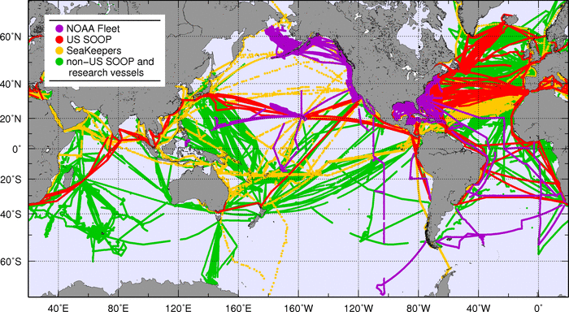
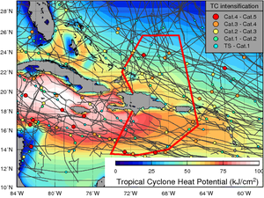

Major Observational Projects
Thermosalinographs
Maintain equipment and transmission in approximately 20 ships.
Repeat transects are carried out in support of pCO2 assessments, Aquarius SSS data, and process experiments (SPURS)
Gliders
2 gliders in the tropical Atlantic and Caribbean Sea, by July 2014; to provide ~5,000 T-S-O2 profiles per year.
Improving TC seasonal and intensification forecasts, by gaining a better understanding of air-sea processes during extreme weather events.
Notes:
The ThermoSalinoGraph (TSG) operations at AOML are mostly carried out in support of pCO2 assessment efforts. In addition, AOML maintains a TSG in the University of Virginia Semester At Sea Program ship, which has allowed us to obtain global observations during their ship’s twice a year around the world voyages. AOML also operates a TSG in partnership with the Argentine Coast Guard that operates in coastal waters off South America and in the Drake Passage. In addition, AOML also partnered with the University of Miami to operate the TSGs in two ships of the Royal Caribbean cruise line. All these data are transmitted to NODC, Coriolis, and other data centers. These data are particularly useful in the validation and calibration of satellite-derived sea surface salinity fields.
The glider project is a multi-institutional effort that brings together the research and operational components within NOAA and the university community to implement and carry out sustained and targeted ocean observations from Seagliders in the Caribbean Sea and southwestern tropical North Atlantic Ocean. The upper ocean thermal structure in this region has been linked to rapid intensification of tropical cyclones, and to the seasonal Atlantic hurricane activity. However, there are only a few (<300) upper ocean thermal observations carried out per year in this region, and sustained ocean observations are currently not in place or planned. This work will provide 4,500 to 5,500 profile observations per year. In addition, for the first time, current velocity profiles will be obtained from the Seagliders to assist hurricane forecast models to reproduce the key ocean dynamic processes associated with tropical storm-induced surface ocean cooling. The main objectives of this work are to implement upper ocean observations from Seagliders, to evaluate their impact on and to improve: (1) hurricane intensity forecasts and (2) hurricane seasonal forecasts; using a combination of these new sustained observations, targeted observations, data analysis, and current NOAA operational forecast models.

Slide 11
Major Observational Projects
Number of cruises (includes XBT transects)
Days at sea
2009 | 2010 | 2011 | 2012 | 2013
69 | 66 | 75 | 60 | 55
2009 | 2010 | 2011 | 2012 | 2013
464 | 561 | 479 | 420 | 422
Notes:
These cruises are conducted on cargo ships for the XBT network, and NOAA (e.g. NOAA (R/V Ronald H. Brown), UNOLS (R/V Walton Smith, R/V Endeavor), and from the University of Sao Paulo (R/V Alpha Crucis). The oceanographic cruises included the PIRATA Northeast Extension (PNE), Western Boundary Time Series (WBTS), CLIVAR Repeat Section A16N, CLIVAR Repeat Section 16S, Southwest Atlantic Meridional Overturning Circulation Program (SAM) and 27N Florida Straits cruise.

Slide 12
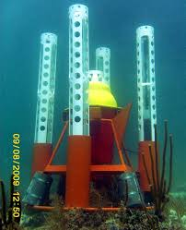
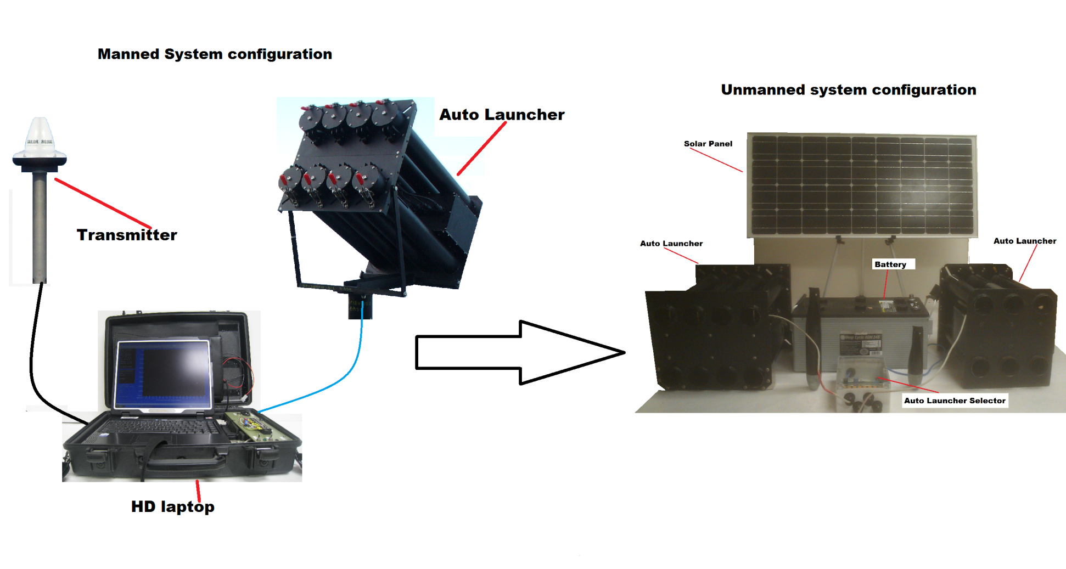
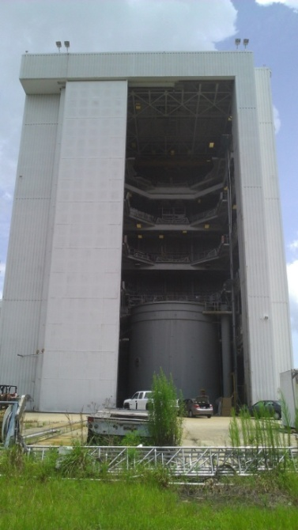
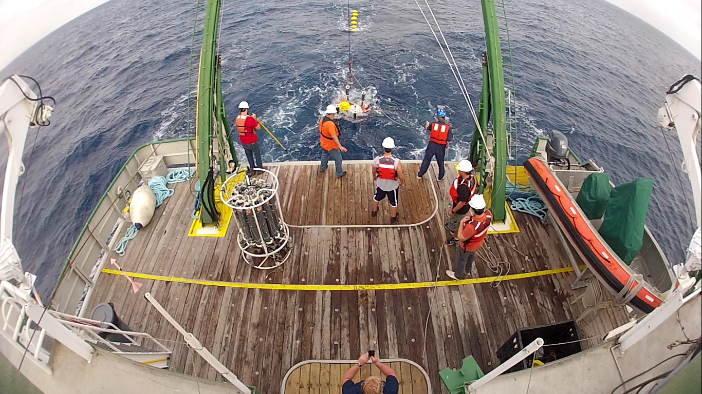
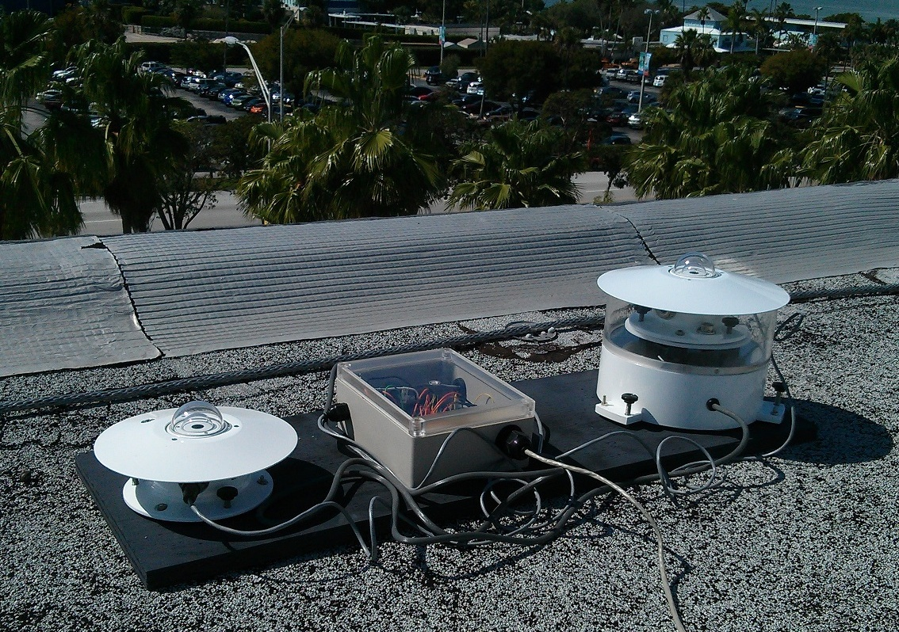
Major Technological Developments
Data Pods
XBT Climate Quality Probes
Autonomous XBT Autolauncher
PNE Radiometer
Please see technological work in poster area
Notes:
The Physical Oceanography Division has an Instrumentation Development Group that uses state-of-the-art technology and incorporates innovative design techniques for developing new oceanographic instruments.
A deep ocean data retrieval system, shown above on the upper left panel of the picture, once fully operational will allow scientific instruments anchored on the ocean bottom to send their data back via expandable data pods that will release from the ocean floor on a programmable schedule. The first deep ocean system was successfully deployed on January 15, 2014 (pictured on the lower left panel), and it is already providing data to AOML.
Because of the limited amount of deck space available for installation on some ships, a wireless XBT autolauncher using a standard wireless access point, a battery, a solar panel, and other off-the-shelf equipment and software tools, is being developed as a “cable replacement” for the standard XBT autolauncher system. The improved setup will consist of wifi technology coupled with a remote desktop client that in theory can be operated using only a tablet computer, shown on the upper right panel.
AOML has partnered with Lockheed Martin Sippican to help in the development of a new XBT probe (XBT Climate Quality Probes) that will have a thermistor and two pressure switches that will provide temperature profile measurements with errors less than approximately 0.02C and 1m, in temperature and depth. The new probe will be expected to cost no more than 50% of the current cost, making it a still cost effective platform to measure temperature profiles. In support of the new probe development, one test was carried out in a 20 meter high water tank, 2nd picture from left in the upper panel, to determine the current fall rate in the top 10m of the probe’s decent.
The PIRATA array consists of 18 moorings spanning the tropical Atlantic Ocean. Several of the moorings are directly downwind from the Sahara and Sahel regions of Africa, which together represent the largest source of mineral dust on the planet. Dust and biomass burning aerosols accumulate on the moorings’ solar radiometer domes, leading to biases as large as -150 W m⁻². Scientists and engineers at AOML are developing an automated radiometer dome cleaner, shown on the bottom right panel, that will rinse aerosols from the dome at regular 24-hour intervals while the instrument is deployed at sea. Tests at sea will begin after successful land tests, with the ultimate goal of developing a radiometer dome cleaner that is thorough and reliable enough to be installed on the PIRATA moorings.

Slide 13
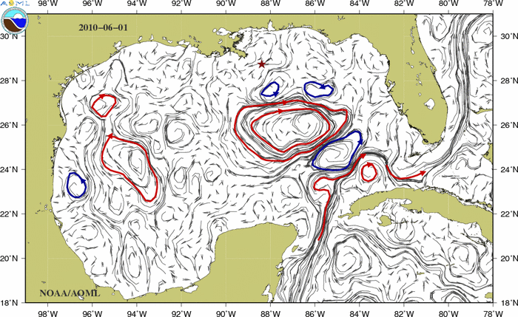
Science Support to other
Programs and Operations
Frontal maps to ORR
Deepwater Horizon: NOS/Office of Response and
Restoration. Please see Poster by R. Smith
and E. Johns.
OAR: Sandy-Related support.
NESDIS: Validation of satellite-derived sea surface
temperature observations.
NWS: Marine Meteorological Observations.
NASA SPURS (Salinity Processes Upper Ocean Regional Studies) geared towards understanding salinity maximum in the North Atlantic Ocean.
NMFS: Mandatory Ship Reporting (MSR) geared to reduce the number of collisions with North Atlantic right whales.
Notes:
Several divisional research projects also support extramural efforts that are closely related to our work. One example was the rapid response of AOML to monitor the ocean dynamics in the Gulf of Mexico during the Deepwater Horizon oil spill incident. During this incident, PHOD provided real-time blended satellite data products, including sea surface height and surface currents, that were used by the NOAA Office of Response and Restoration (ORR) and others as a tool in planning response efforts. Key results from this effort included quantification of the daily mean surface oil extent (20,000 km2), the southern extent of the surface oil (~27N, ~85W in early June), changes in oil coverage in space and time, and other metrics, which were critically important to the response effort. PHOD scientists also lead and supported several oceanographic cruises and drifter deployments, which provided real-time oceanographic data products (via web, ftp, and GTS). Key cruise results included the discovery of a subsurface carbon plume 15km SW of the wellhead at 1154m depth on July 17, 2010; and also an absence of a direct pathway from the northern Gulf to the Florida Straits via the Loop Current due to the location of the anticyclonic eddy Franklin.
Two divisional proposals were funded through the Sandy Supplemental funds 1) Evaluation of the satellite data fusion strategies using observing system simulation experiments (G. Halliwell, Lead PI), and 2) Sustained and Targeted Ocean Observations for Improving Atlantic Tropical Cyclone Intensity and Hurricane Seasonal Forecasts (G. Goni, Lead PI). These two projects are geared towards improving tropical cyclone intensification forecasts.
NESDIS: drifting buoy SSTs are used to validate and calibrate satellite SST, which can be biased by aerosols. The skill at which the overall ocean observing system is meeting this need is quantified as a "maximum potential satellite bias" at NOAA/NCDC; analysis of this record has shown that it is strongly correlated with the number of drifters, as drifting buoys are the primary source of observations away from the major shipping lines (i.e., much of the Southern Ocean).
Through its SEAS Program and together with the NWS, PHOD maintains a suite of marine meteorological observations from more than 1,000 volunteer ships that provide approximately 1M marine meteorological reports per year, the largest non-satellite source of marine meteorological observations.
NOAA/NWS: meteorological observations from drifters and from the PIRATA Northeast Extension are transmitted on the Global Telecommunication System for worldwide use in NWP efforts. Hurricane drifters are targeted for deployment in the paths of major hurricanes; their data (which also goes on the GTS) includes surface and subsurface temperatures to improve hurricane intensity forecasting efforts.
Several PHOD scientists are active members of the SPURS Science Steering Team and associated working groups. AOML actively participates in this NASA project by enhancing several sustained ocean observations in the tropical Atlantic. The objective of this work is to increase our understanding of the variability of the maximum sea surface salinity of North Atlantic Ocean. For example: AOML's drifter center is preparing to distribute a quality-controlled set of salinity observations from all drifting buoys worldwide that are a part of the GDP and measure salinity, including the SPURS drifters. These data will come with quality control flags that will facilitate their use in research. The XBT network was also enhance by carrying out additional realizations of transect that cross the North Atlantic Ocean.
The SEAS Program is now being used as the basis for the new Mandatory Ship Reporting, which provides information on how cargo ships can reduce the risk of collisions with whales.

Slide 14
Stakeholders
NOAA:
OAR, Ocean Observation Programs
NESDIS, Climate Prediction Center for improving forecast models
NWS, marine meteorological observations
NOS/ORR, emergency response for oil and debris
NOAA/EMC, for operational forecast improvements
NMFS (Mandatory Ship Reporting)
Government:
US Coast Guard, Amver SEAS for Search and Rescue
Non-NOAA Operational:
Operational Ocean Forecast and Monitoring Centers (NRL, Coriolis)
Worldwide weather services: Australian BOM, ECMWF, Meteo France, South African Weather Svc., etc.
Scientific Community, Researchers world-wide for Argo, XBT, drifters, PIRATA, WBTS, SAM, TSG data
Private:
Major shipping companies, for ocean currents and marine weather forecasts
Fisheries, for ocean currents and ocean fronts monitoring
Oil industry, for surface currents and eddy monitoring

Slide 15




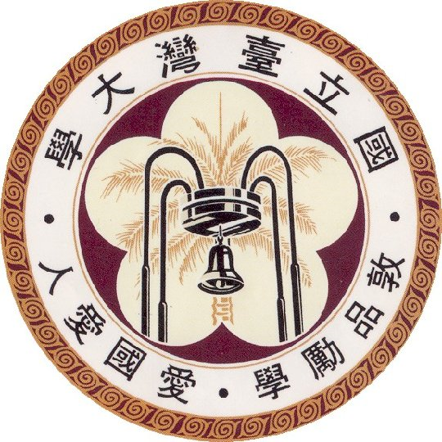

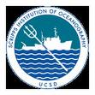
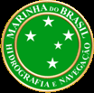







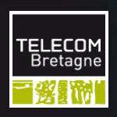
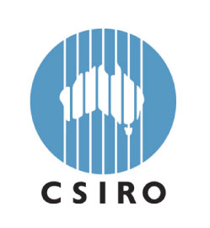


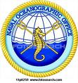

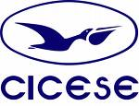
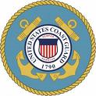
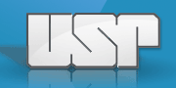

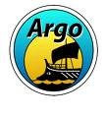

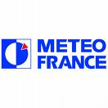
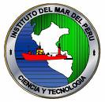


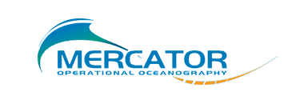


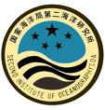





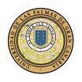

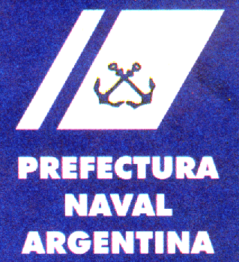


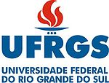
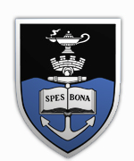
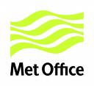
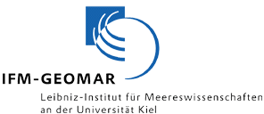



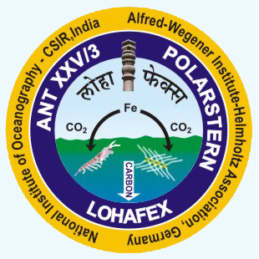





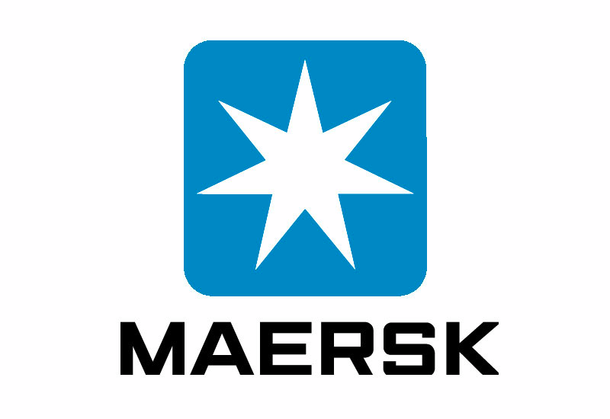



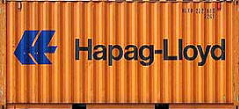
Partners and Collaborators
Educational
Research
Operational
Shipping Companies
Fishing Companies

Slide 16
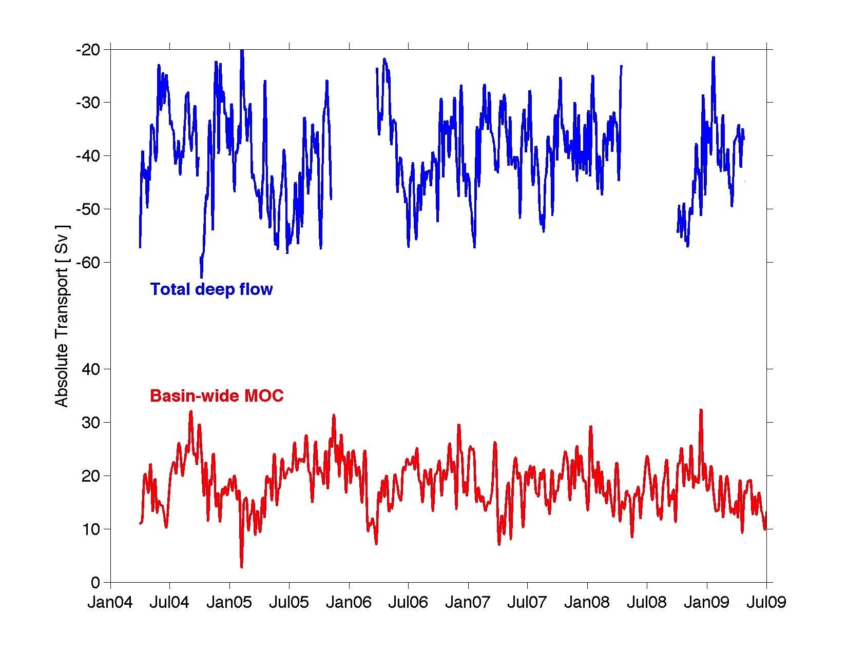
Major Science Accomplishments:
MOC in the North Atlantic Ocean
During the first 8.5 years of the MOCHA-RAPID-WBTS array, a small, but statistically significant (at the 95% confidence limit) decline in the MOC volume transport was observed.
The decrease is due to the upper-ocean interior flow.
This trend clearly highlights the importance of maintaining long-term, continuous, time series of observations to understand these questions.
Recent results show that the DWBC variability is much larger than the MOC variability.
Smeed et al., 2014; Meinen et al., 2013.
Notes:
The Physical Oceanography Division carries out interdisciplinary scientific investigations of the physics of ocean currents and water properties. The goal of PhOD is to strengthen our scientific understanding of the role of the ocean in climate, extreme weather events, and ecosystems, by enhancing our observational work, research, technological development, and science communications. The tools used to carry out these studies range from sensors on deep ocean moorings to satellite-based instruments to measurements made on research and commercial shipping vessels and autonomous vehicles, and include data analyses and numerical modeling as well as theoretical approaches. We show here five of the main divisional scientific accomplishments on MOC studies, Tropical Atlantic variability, tornado activity, and fisheries oceanography. Details on these and other scientific findings by PHOD personnel can be seen in the following oral and poster presentations and in the divisional web pages.
Variations in the MOC have been shown in climate models to be correlated to changes in precipitation patterns across North America, to changes in upper ocean heat content and therefore to hurricane intensification, and to changes in surface air temperatures across wide swaths of the globe. Improving understanding of the MOC system is a key near-term priority in the US Interagency Ocean Research Priorities Plan released in 2007. AOML/PhOD has been at the forefront of making the necessary observations to improve our understanding, with moored time series in the North and South Atlantic (the WBTS & SAM projects).
In the North Atlantic, the WBTS project provides key observations of the Florida Current, which are an essential element of the basin-wide MOC estimates being produced by the international RAPID-MOC/MOCHA/WBTS array at 26N. In a recent publication (Smeed et al., 2014), the first 8.5 years of the array have shown a small but statistically significant downward trend (upper figure), primarily resulting from changes in the ocean density structure within the basin interior. This change is likely to be associated with interannual and/or decadal variability, and it is superimposed on top of much stronger subannual variations that make extracting trends difficult. This illustrates the imperative need for making continuous daily estimates over long time scales in order to tease out these very important long-period signals.
Understanding the mechanisms causing variations in the MOC will also require careful, detailed observations of the components of the MOC system. Variations in the Deep Western Boundary Current, for example, greatly exceed those of the basin-wide MOC itself (Meinen et al., 2013), and understanding how those deep variations are compensated within the basin will be essential for understanding why the MOC changes as it does. The Deep Western Boundary Current observations made by the WBTS project and its partner programs are critical for this purpose.

Slide 17
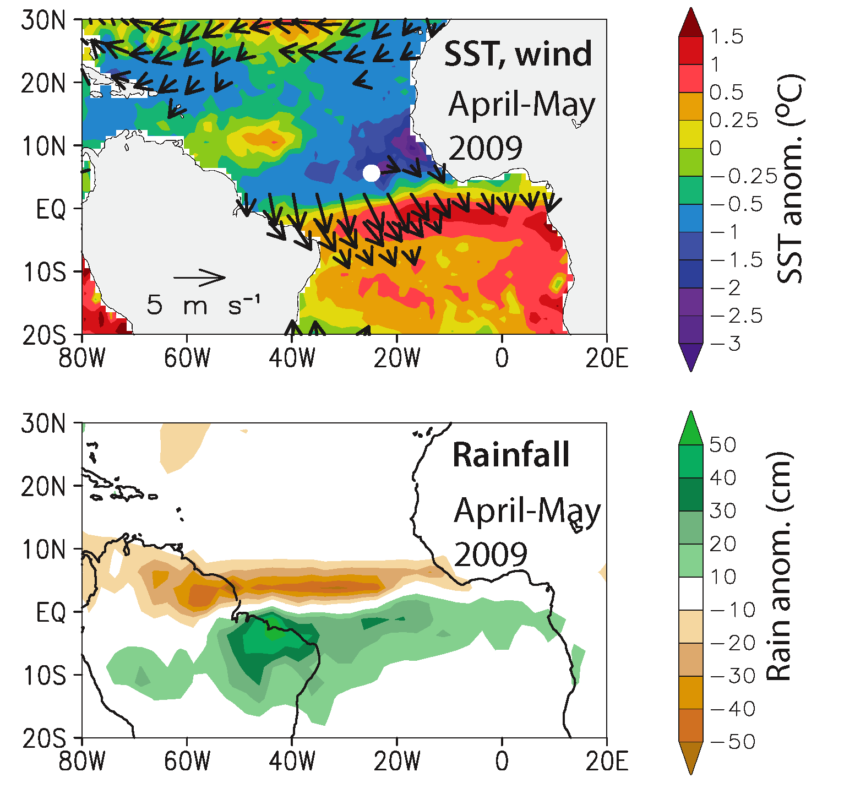
Major Science Accomplishments:
Tropical Atlantic Variability
A strong anomalous dipole of SST developed in the tropical Atlantic during the first half of 2009, peaking in April-May (top panel).
The ITCZ was displaced southward, resulting in extreme flooding in Northeast Brazil during April and May (middle panel).
Displacements of warm waters to the south coincide with a very weak Atlantic hurricane season.
Please see poster by Foltz and Wang
Foltz et al, 2012
Notes:
The goal of this study is to determine the causes of a strong meridional mode event that peaked in April-May 2009. Associated with the event was an anomalous dipole of sea surface temperature (SST) across the Equator. The anomalous SST pattern altered the atmospheric circulation causing extreme flooding in NE Brazil and a weaker than normal Atlantic hurricane season. Measurements from the sustained ocean observing system (PIRATA, Argo, surface drifters) revealed for the first time the importance of upper ocean dynamics (mainly changes in wind-induced upwelling and turbulent mixing) in the development of a meridional mode event. In addition, observations of near-surface currents from XBT transects confirmed the importance of upper ocean dynamics for driving tropical Atlantic SSTs variability. Future work involves the evaluation of coupled climate models to determine if these processes are properly represented.

Slide 18
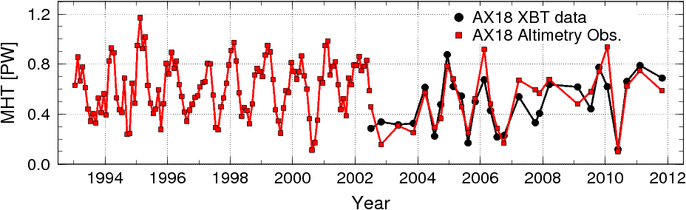
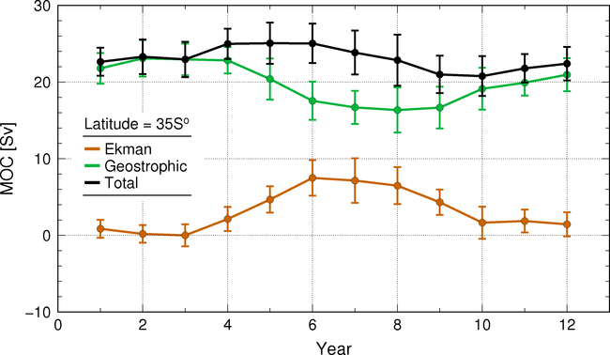
Major Science Accomplishments
MOC in the South Atlantic Ocean
Combined analysis of a suite of in situ, satellite, and numerical models outputs for South Atlantic MOC/MHT/Mov studies.
Identify and assess contributions from ocean interior and boundary currents and their temporal variations.
Significant seasonal cycles were identified from in situ observations, in which geostrophic and Ekman components are not in phase.
Before 2006 geostrophic transport controlled interannual variability. After 2006, Ekman transport controlled this variability.
Assess if climate models reproduce observational results.
Please see poster by Perez and Dong.
Dong et al, 2009; Dong et al, 2014
Notes:
NOAA/AOML/PhOD maintains several sustained observations that contribute to several international initiatives, aimed at capturing key components of the MOC in the South Atlantic.
The high-density XBT transect at 34.5S (AX18) has revealed may features, including the importance of both the boundary currents and the ocean interior region for the MOC variability, and the strong seasonal variations in the MOC geostrophic component, which is missing in numerical models. Daily estimates of the MOC at 34.5S from the western boundary SAM array and the eastern boundary French mooring array demonstrates strong MOC variability at periods shorter than 100 days. The altimetry observations have been used to investigate latitudinal and temporal changes of the MOC/MHT during the past 20 years. This study suggests that both the Ekman and geostrophic transports play important roles in the MOC/MHT interannual changes, and MOC experiences a strong seasonal cycle at 34.5S, but its amplitude decreases towards north.
These results from observations have been used to assess numerical models, which suggests that models do not capture the strong boundary currents, and they are unable to reproduce the seasonal cycle of the geostrophic transport.

Slide 19
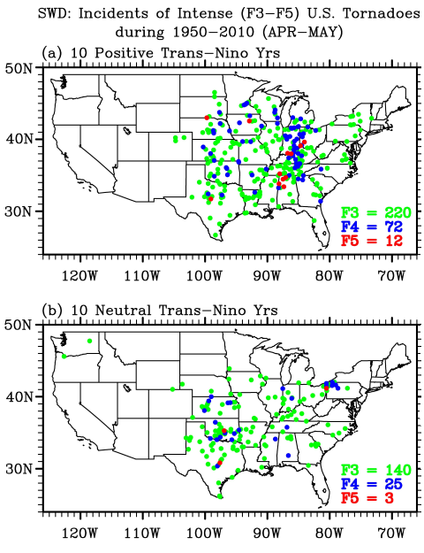
Major Science Accomplishments
US Tornado Activity
Of the top ten extreme outbreak years during 1950-2010, seven years including the top three are identified with a strongly positive phase Trans-Niño (top figure)
The number of intense tornadoes in April - May is nearly doubled during the top ten positive Trans-Niño years compared to those during ten neutral years (top, increased tornado activity during positive Trans-Nino years; bottom, normal tornado activity during neutral Trans-Nino years).
Trans-Niño represents the evolution of tropical Pacific sea surface temperatures (SSTs) during the onset or decay phase of the El Niño-Southern Oscillation.
Lee et al, 2013
Notes:
The record-breaking U.S. tornado outbreaks in the spring of 2011 prompted the need to identify long-term climate signals that could potentially provide seasonal predictability for U.S. tornado outbreaks. Research led by scientists in the Physical Oceanography Division of NOAA-AOML used both observations and model experiments to show that a positive phase Trans-Niño may be one such climate signal.
In the maps above, the dots indicate the incidence of intense tornadoes during the 10 positive Trans-Niño years in the upper panel, and for the 10 neutral Trans-Niño years in the lower panel. The number of intense tornadoes is nearly double during a (+) phase of Trans-Niño. We also found that 7 out of 10 extreme tornado outbreaks, including the top 3, during 1951-2010 were all associated with a (+) phase of Trans-Niño. Trans-Nino represents the evolution of tropical Pacific SST anomalies during the onset and decay phases of ENSO.
Other scientific research carried out in PHOD on on extreme weather events and oceans are listed in Sang-Ki Lee's presentation.

Slide 20


Major Science Accomplishments:
Fisheries Oceanography
Fisheries and mesoscale features
Real-time remote sensing methods to
estimate environmental parameters linked to
density of larvae of highly commercial species in the
Gulf of Mexico.
Frontal regions and anticyclonic rings were
identified as regions were larvae density is higher.
(IPCC) Projected changes of bluefin tuna spawning habitat in the Gulf of Mexico due to anthropogenic global warming.
Assessment of preferred spawning habitat, with yellow/orange (two panels on right) for favored locations and blue/purple for non-ideal regions.
IPCC results suggest that the area of bluefin tuna habitat may be drastically reduced in the future (figures). However, due to the changes in the ocean circulation pattern, the rate of the habitat loss will be much slower than the IPCC projection.
late 20th century
late 21st century
Please see poster by Johns and Lee
Liu et al, 2012; Muhling et al., 2011; Lindo et al., 2013
Notes:
We show here work that is carried out in partnership with NOAA/SEFSC and that is geared towards investigating and assessing the link between environmental parameters and key commercial fish species. This work has two main objectives:
Fisheries and Mesoscale Features: Satellite altimetry fields and fishery surveys indicate that when the Loop Current is farther to the south, larvae are more abundant in the eastern Gulf of Mexico than in the central and western portions of the basin. Analysis made from 23 rings shed by the Loop Current during 1993-2010 indicate that warm-core rings shed by the Loop Current are generally less likely to contain larvae. Eventually, associations between the inner and outer regions of mesoscale features and larval catches show higher abundances of bluefin tuna, little tunny, Thunnus, Auxis and red snapper in the boundaries and frontal areas of anticyclonic regions. Collaborative work will continue between AOML and SEFSC to analyze the link between ocean features and stock assessment.
Fisheries and climate variability: According to the IPCC results, the area of bluefin tuna habitat may be reduced in the future due to anthropogenic global warming as shown in the figures (Muhling et al. 2011). However, a downscaled model simulation performed by AOML scientists suggests that the rate of the habitat loss will be much slower due to the slowdown of the Loop Current and associated cooling in the northern Gulf of Mexico. More details on this work can be found in Libby Johns' poster presentation.

Slide 21
Scientific Publications
Increase of more than 100% in peer-reviewed scientific publications during the last ten years.
Total number of refereed publication during last 5 years: 237
Average H-Index of divisional scientist: 13
Notes:
PHOD performs an internal review process for all manuscripts to be submitted to peer-reviewed journals. The number of divisional publications has consistently increased during the last 10 years, while maintaining approximately the same number of scientific and science support personnel.

Slide 22
Panel Memberships
Participation in 60 panels, including:
International Clivar panels
US Clivar panels
IAPSO panel
MPOWIR
JCOMM Obs panels
Argo Science Steering Team
Argo Data Management
XBT Science Steering Team
NASA Ocean Surface Topography Science Team
Editorial, Journal of Geophysical Research
South Atlantic MOC (SAMOC)
PIRATA Steering Team
Repeat Hydrography Steering Team
NASA SPURS Steering Team
…
Organization of Scientific Meetings:
2013 NASA SPURS Meeting
2011 and 2013 XBT Science Workshops
2010 PIRATA Steering Team and Tropical Atlantic Climate Experiment
2010, 2011, and 2013 SAMOC Meetings
…

Slide 23
Retreats, Divisional Meetings
2009 PHOD-SEFSC Meeting
June 1, 2009
Theme: Finding Opportunities for New Collaborative Research
2011 PHOD Retreat
February 15-16, 2011
Theme: Integrating Observations for Multidisciplinary Research
2012 PHOD Retreat
February 29 and March 1, 2012
Theme: Synergy between Observations and Numerical Models for Weather, Climate, and Ecosystem Research
2014 AOML-SEFSC Meeting
May 2014
Theme: Continued Collaborative Success: Now and in the Future.
Notes:
In order to discuss current and future work in the division and to allow scientist to improve internal communications and partnerships, PHOD holds scientific retreats and divisional meetings that allow us to better coordinate efforts for scientific communications and proposal writing. The divisional retreats include participants of the University of Miami and NOAA/SEFSC. In addition, PHOD organizes and/or participates in the planning of AOML-SEFSC meetings, with the objective to increase partnership opportunities between the two laboratories.

Slide 24


Visitors, Scientific Exchanges
Dr. Monika Rhein, U. Bremen, Germany
Dr. Sabrina Speich, U. Brest, France
Dr. Mauricio Mata, FURG, Brazil
Dr. Rym Msadek, GFDL
Dr. Ricardo Matano, Oregon State University
Dr. Anne Thresher, CSIRO, Australia
Dr. Janet Sprintall, Scripps Inst. Oceanogr.
Dr. I-I Lin, U. Taiwan
Dr. Frank Muller-Karger, USF
Dr. Semyon Grodsky, U. Maryland
Dr. Xidong Wang, S. China Sea Inst. Ocean.
Dr. Susan Wijffjels, CSIRO, Australia
Dr. Josh Willis, NASA/JPL
Dr. Sybren Drifjhout, Netherlands
Dr. Edmo Campos, USP, Brazil
Lt. Cdr. Ariel Troisi, SHN, Argentina
Dr. Janice Trotte, Brazilian Ministry of Science
Dr. Ivan Perez Santos, U. Concepcion, Chile
Dr. Michael Roberts, University of Cape Town
Dr. Randy Watts, U. of Rhode Island
Dr. Sybren Drijfhout, KNMI, Netherlands
ANAMAR, Dominican Republic Ministry of Science
……..
Dillon Amaya (TAMU) and Alexandra Ramos (UPR), 2013 summer interns.
Lt. Cdr. Camila Cariccio (SHN, Brazil)
Notes:
PHOD receives has hosted many scientists, engineers, science support personnel during the last five years. In general, these visits are geared towards increasing partnerships and collaborations with scientists of other universities, both national and international. Visitors also include university graduate summer interns. For example, Mr. Dillon Amaya, a Texas A&M student and a Hollings Scholar that worked under the supervision of Dr. Gregory Foltz, and Ms. Alexandra Ramos from the University of Puerto Rico, Mayaguez, who visited AOML to work with several divisional scientists on air-sea interactions during tropical cyclones.

Slide 25




Communications
Videos (including YouTube) of main PHOD projects.
Live video streaming and recording of PHOD seminars through Gotomeeting.
aoml.noaa.gov/phod
Up-to-date PHOD
Project report: Annual update of projects, including technological developments
Comprehensive divisional web page with detailed and updated description of each project, data, and product distribution
Notes:
PHOD maintains a web page with updated description of all divisional projects, including an updated publication list with links to the manuscripts, real- and delayed-time ocean products derived from in-situ and/or satellite observations, quality controlled data distribution from some projects, and links to recent publications and news. PHOD maintains a divisional project report, which summarizes all information about each project. Links to videos of many divisional projects are also included in the web page. PHOD seminars are broadcasted live through the web and videos of past seminars are posted in the the divisional web page.

Slide 26






PHOD Outreach Highlights
U. Va. Semester At Sea
Adopt a drifter program
Teachers at Sea
University of Miami, Annual
undergraduate student visit
Annual AOML Open House and high school student tours and presentations
Global Ocean Observation
Google display

Slide 27
Looking Ahead
Continue as a premier science group for designing, implementing, and maintaining sustained ocean observations (some with time series longer than 30 years) for oceans and climate research;
Continue emphasis of synergy between observations (in situ and satellite), numerical modeling, and theoretical studies;
Continue leading studies of Ocean Observing System Simulation Experiments (OSSE) geared towards improving tropical cyclone intensity forecasts and improving ocean observing networks for climate studies;
Continue work on cutting edge scientific research to understand ocean-weather-climate system and impacts;
Continue strengthening partnerships benefiting and leading to operations and applications;
Continue strong partnership with other AOML divisions in support of ecosystems and hurricane studies; and
Continue partnership and collaboration with scientists from other NOAA LOs and national and international university and government laboratories.

Slide 28
Thank you very much
www.aoml.noaa.gov/phod
.

