Slide 1

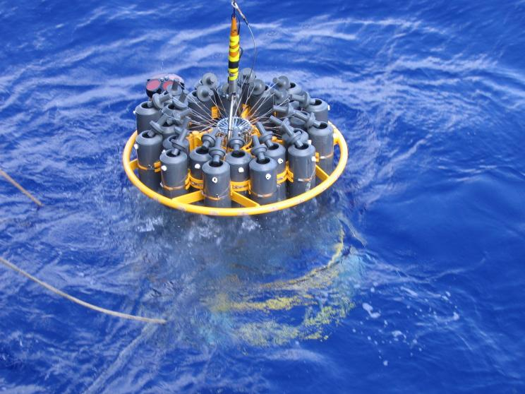
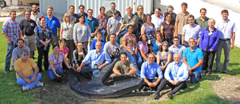
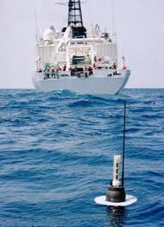
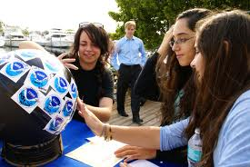
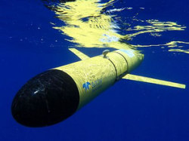
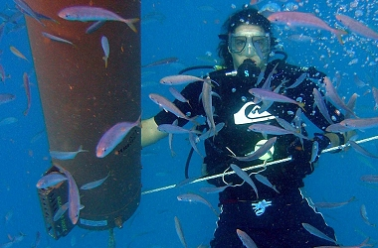


Oceans and Climate Research
Physical Oceanography Division (PHOD)
Gustavo Jorge Goni, Division Director
Division Goal:
To strengthen our scientific understanding of the role of the ocean in climate, extreme weather events, and ecosystems, by enhancing our observational work, research, technological development, and science communications.
AOML Program Review
4-6 March 2014

Slide 2
PHOD Major Science Objectives
Assessment of the state of the ocean, with emphasis on the Atlantic Meridional Overturning Circulation and variability of key ocean currents;
Evaluation of processes that drive Tropical Atlantic climate variability;
Use of data and analysis to assess uncertainties of climate models and what cause them, with the goal to improve predictability;
Evaluation of the effect of the ocean on extreme weather events (tornados, hurricanes, droughts, etc);
Evaluation and design ocean observing systems (OSE and OSSE);
Assessment of the link between climate signals and changes in ecosystems;
Development of new technology in support of climate, extreme weather, and ecosystem studies.

Slide 3
Main Scientific Questions
What drives the variability of key ocean currents; how do numerical models reproduce their observed variability; and what are the main links to large scale/long period changes ?
What is the spatial and temporal variability of the Atlantic Meridional Overturning Circulation and what are the process driving it ?
What is the role of the ocean in driving extreme weather events and climate ?
How are climate models reproducing the state of the ocean ?
What are the optimal ocean observing systems and strategies that will improve ocean state estimates and forecasts for a broad range of applications ?
How are physical oceanography parameters linked to ecosystem variability ?

Slide 4
PHOD and NOAA’s Objectives
Climate Adaptation and Mitigation:
  What is the state of the climate and how is it evolving?
  What causes climate variability and change on global to regional scales?
  What improvements in global and regional climate predictions are possible?
Weather-Ready Nation:
  How does climate affect seasonal weather and extreme weather events?
Cross-Cuts: Observing, Modeling, and Engaging.
  What is the best observing system to meet NOAA’s mission?
  How can emerging technologies improve ecosystem-based management?

Slide 5
PHOD Budget
Includes CIMAS proposals
$*1000
#
#= Deepwater Horizon
*= Sandy Supplemental
*
Divisional budget: approximately $8.3M
Base: $3.6M
Proposals: $4.7M
Increased proposal funding by 50% ($3M) since 2000
Number of proposals: 34
FY

Slide 6
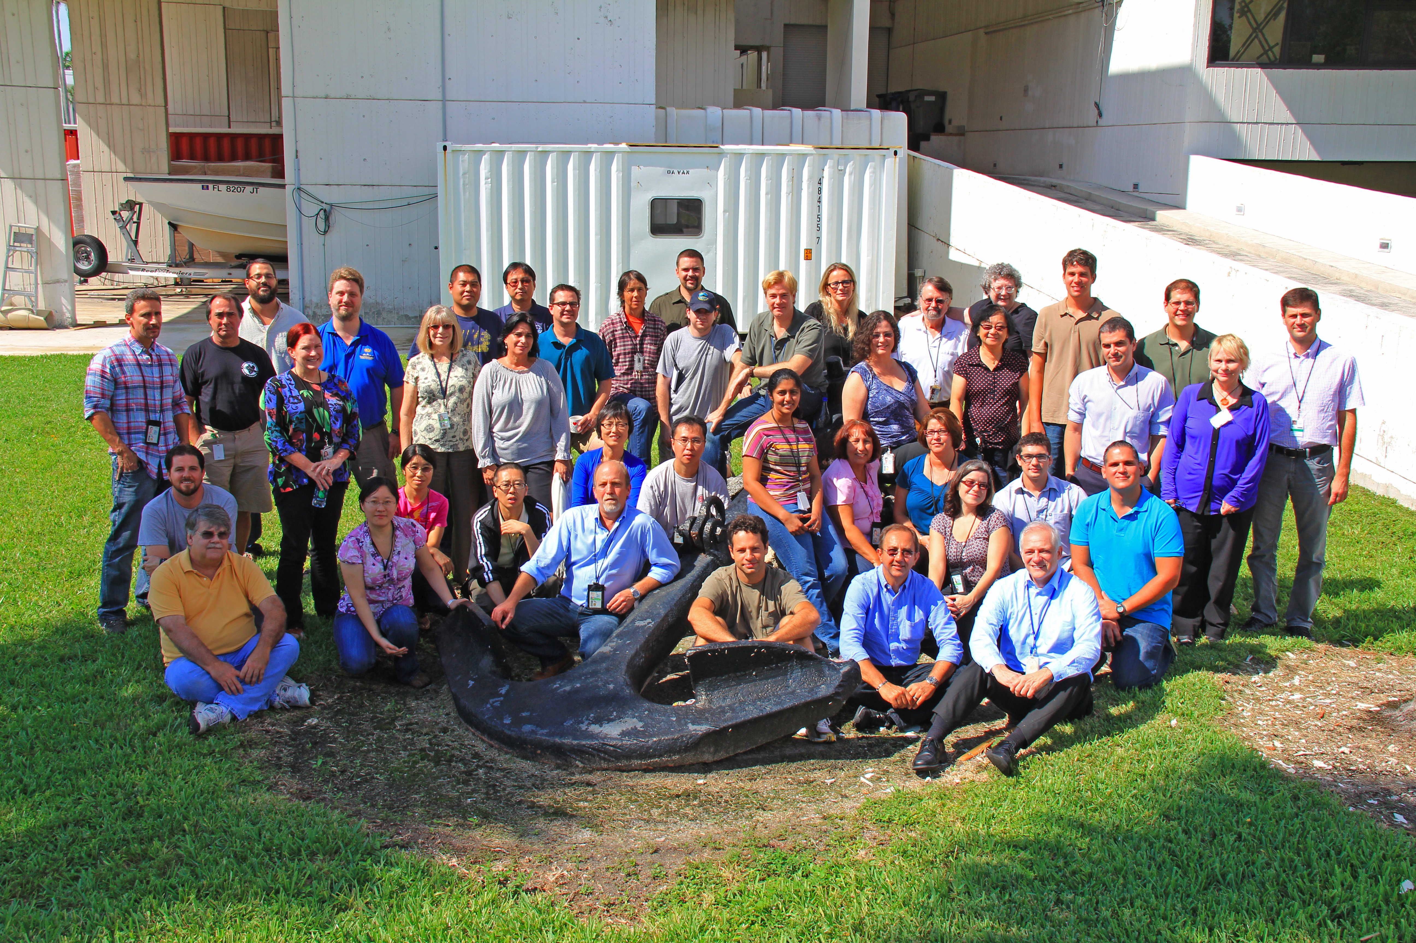
PHOD Personnel
 | Research Scientists | Research and Operation Support | Instrumentation | Administrative | TOTAL
Feds | 9 | 5 | 3 | 2 | 19
CIMAS | 8 | 14 | 3 | 1 | 26
Total | 17 | 19 | 6 | 3 | 45

Slide 7
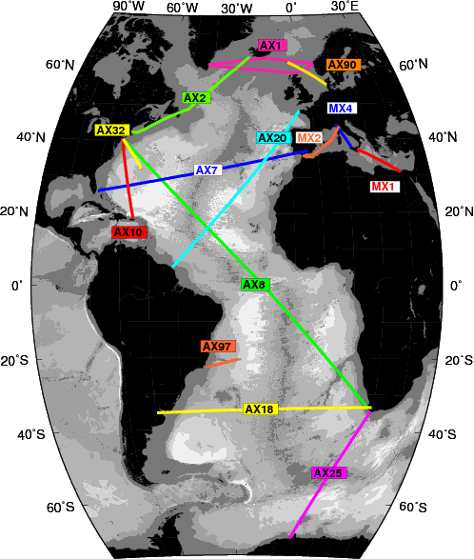
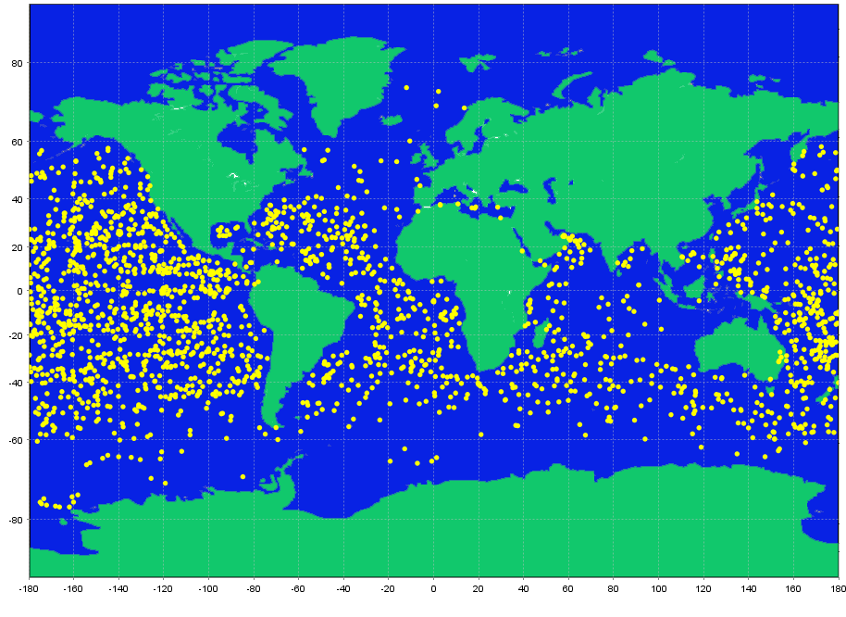
Major Observational Projects
XBT Network
Approx 8,000 deployments per year along 15 fixed repeat transects, within an international effort of 10 countries, since 1983.
Sustained observations of Meridional Overturning Circulation and variability of major surface and near surface currents.
First time series of MHT and heat fluxes in the Atlantic Ocean.
Argo Program
US Data Assembly Center
Coordinate deployment of approximately 100 Argo floats per year in the Atlantic Ocean, within an international effort of 30 countries, since 2000. US Data Assembly Center.
Assessment of global heat content and upper ocean dynamics.

Slide 8
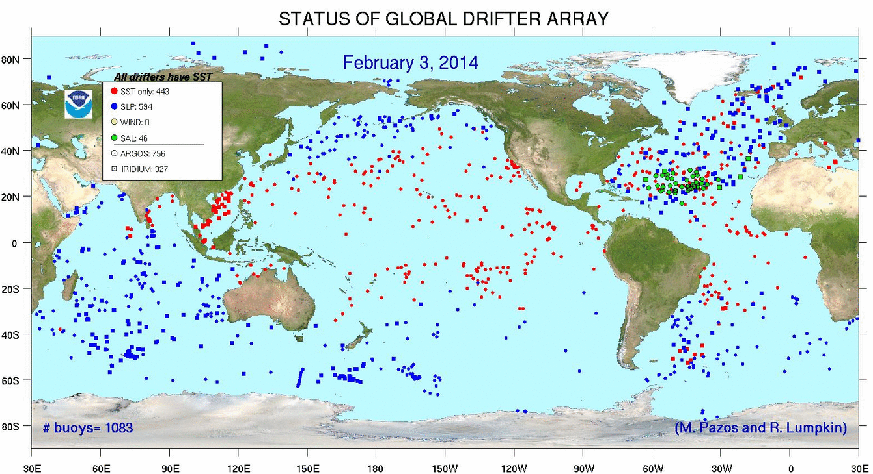
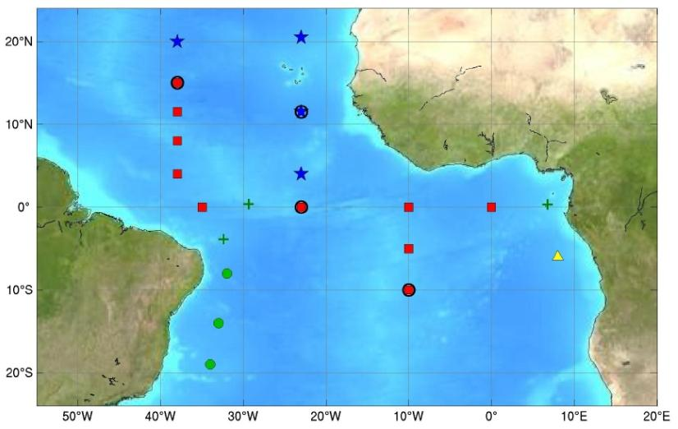
Major Observational Projects
Global Drifter Program
Maintenance of approximately 1200 drifter array, and coordination of around 1100 annual deployments, since 2005.
Comprehensive understanding of global ocean circulation and variability.
Improved understanding of ocean basin response to ENSO events.
PIRATA Array
Partnership with PMEL, Brazil, France to maintain 18 moorings in the tropical Atlantic Ocean, since 2006; Annual hydrographic cruises during maintenance of three PIRATA Northeast Extension moorings.
Understanding tropical Atlantic climate variability.
Link of spatial and temporal variability of zonal current system with two climate modes of variability.

Slide 9
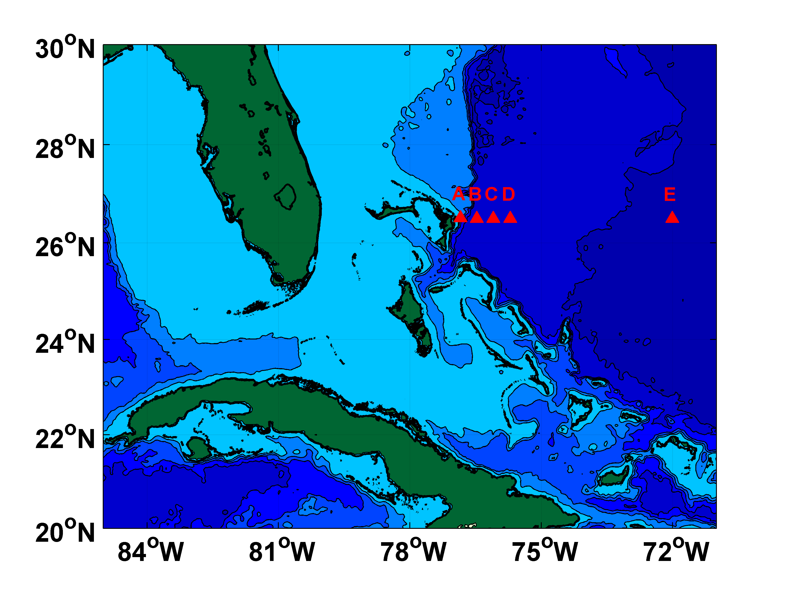
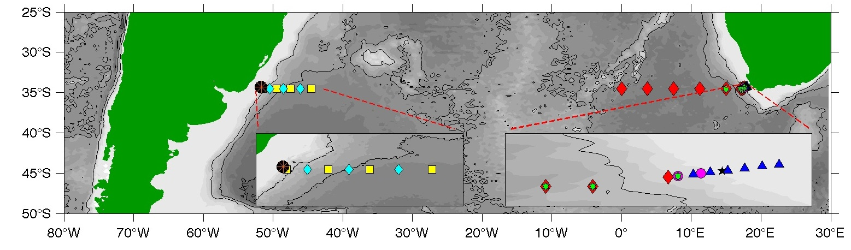
Major Observational Projects
Western Boundary Currents
Partner in RAPID-MOCHA-WBTS array, since 2004; Sustained observations of Florida Current since 1982.
Monitoring upper and deep limbs of the MOC near the western boundary.
Longest open ocean time series of transport of GS/DWBC system
Southwestern Atlantic MOC
Maintenance of 4 moorings, of a larger array along 35°S, since 2009. Building towards a larger array with international partners.
Sustained observations of the water column in the SW Atlantic Ocean to understand the contribution of the SA to the MOC.
DWBC variability in the South Atlantic.

Slide 10
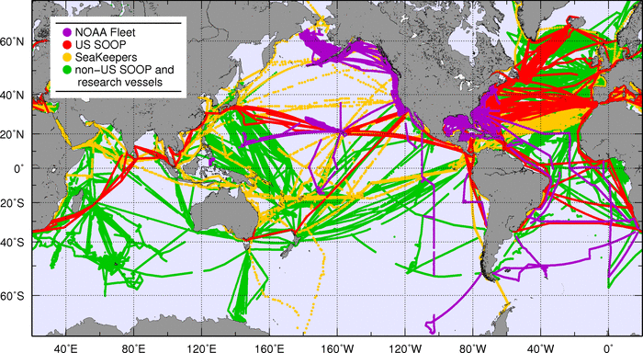
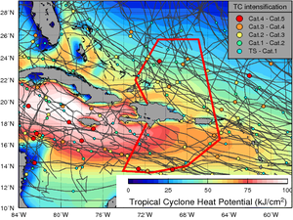

Major Observational Projects
Themosalinographs
Maintain equipment and transmission in approximately 20 ships.
Repeat transects are carried out in support of pCO2 assessments, Aquarius SSS data, and process experiments (SPURS)
Gliders
2 gliders in the tropical Atlantic, Caribbean, byJuly 2014; to provide ~5k T-S-O2 profiles per year.
Improving TC seasonal forecasts and role of the ocean in TC intensification studies/forecasts.

Slide 11
Major Observational Projects
Number of cruises (includes XBT transects)
Days at sea
2009 | 2010 | 2011 | 2012 | 2013
69 | 66 | 75 | 60 | 55
2009 | 2010 | 2011 | 2012 | 2013
464 | 561 | 479 | 420 | 422
Notes:
CLIVAR cruise this calendar year just finished a few weeks ago, with three AOML employees on board.

Slide 12
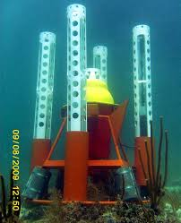
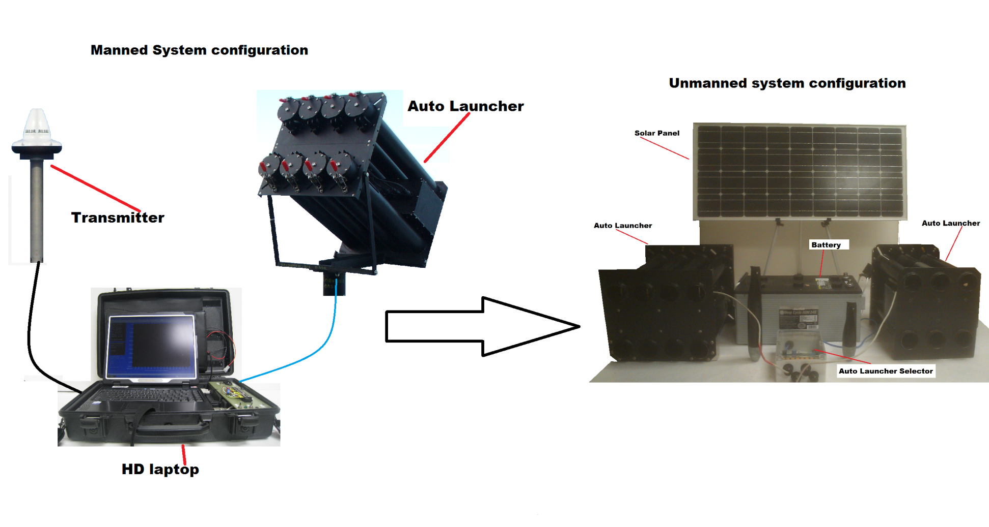
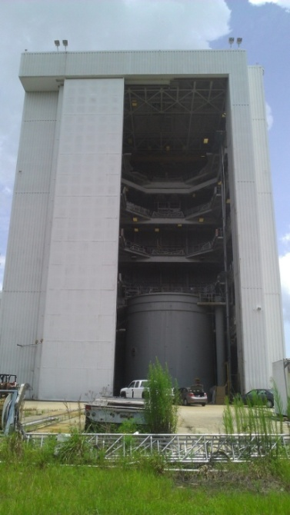
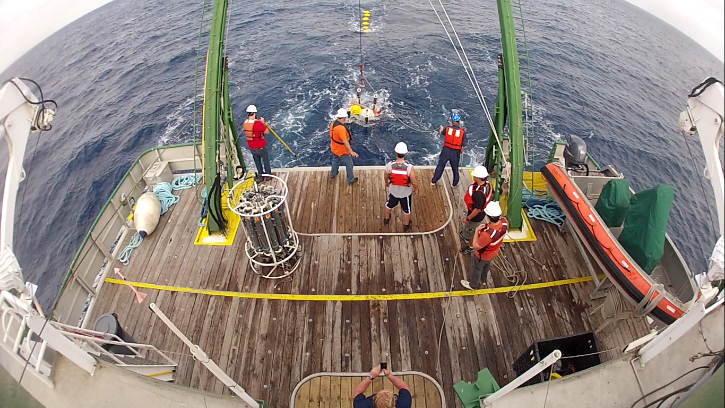
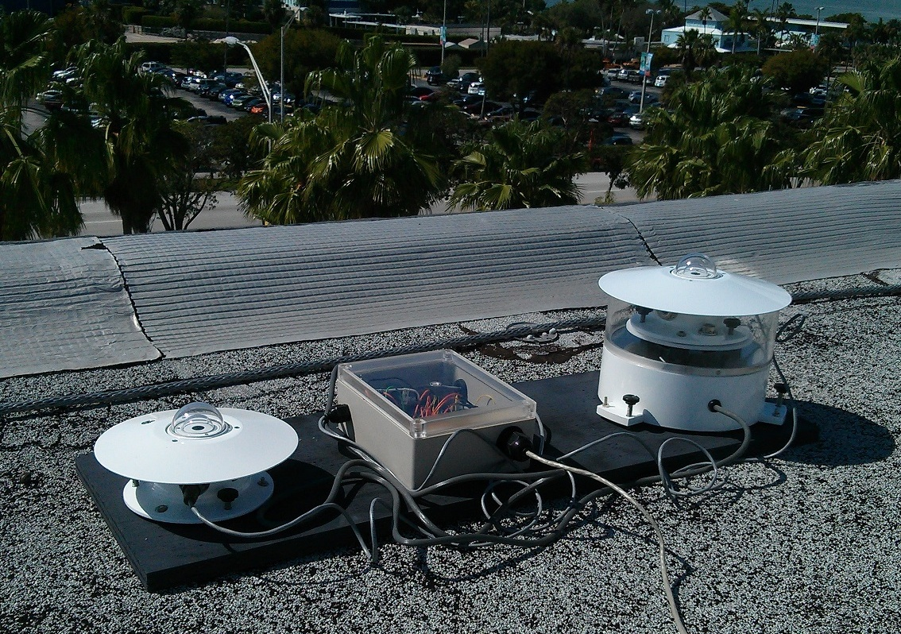
Major Technological Developments
Data Pods
XBT Climate Quality Probes
Autonomous XBT Autolauncher
PNE Radiometer
Please see technological work in poster area

Slide 13
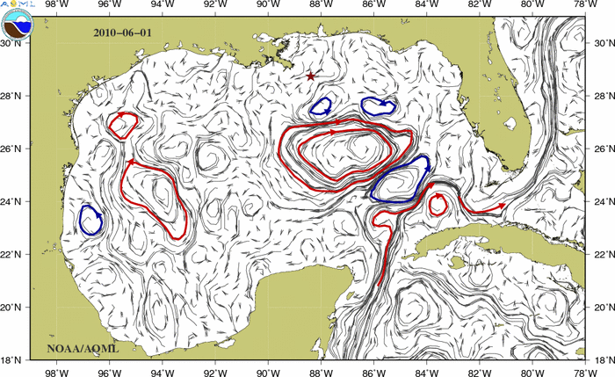
Science Support to other
Programs and Operations
Frontal maps to ORR
Deepwater Horizon (See Poster by R. Smith),
NOS/Office of Response and Restoration.
OAR: Sandy-Related support.
NWS: Marine Meteorological Observations.
NASA SPURS (Salinity Processes Upper ocean Regional Studies) geared towards understanding salinity maximum in the North Atlantic Ocean.
NESDIS: Validation of satellite-derived sea surface temperature observations.
NMFS: Mandatory Ship Reporting (MSR) geared to reduce number of collisions with North Atlantic right whales.

Slide 14
Stakeholders
NOAA:
OAR, Ocean Observation Programs
NESDIS, Climate Prediction Center for improving forecast models
NWS, marine meteorological observations
NOS/ORR, emergency response for oil and debris
NOAA/EMC, for operational forecast improvements
NMFS (Mandatory Ship Reporting)
Government:
US Coast Guard, Amver SEAS for Search and Rescue
Non-NOAA Operational:
Operational Ocean Forecast and Monitoring Centers (NRL, Coriolis)
Worldwide weather services: Australian BOM, ECMWF, Meteo France, South African Weather Svc., etc.
Scientific Community, Researchers world-wide for Argo, XBT, drifters, PIRATA, WBTS, SAM, TSG, etc. data
Private:
Major shipping companies, for ocean currents and marine weather forecasts
Fisheries, for ocean currents and ocean fronts monitoring
Oil industry, for surface currents and eddy monitoring

Slide 15




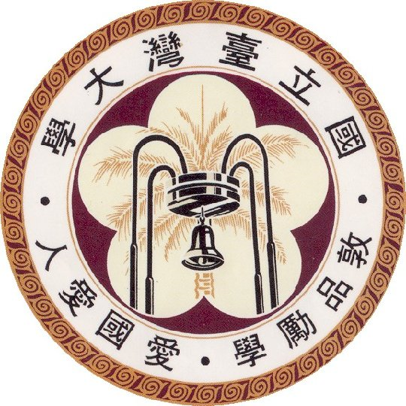

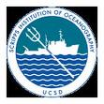








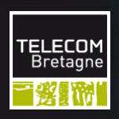
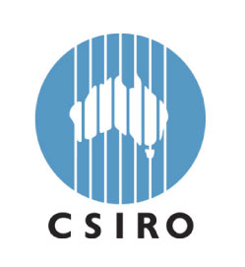


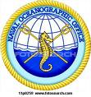


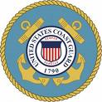
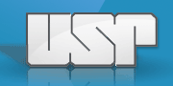

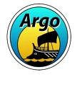


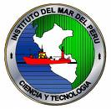





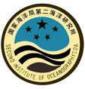





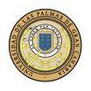

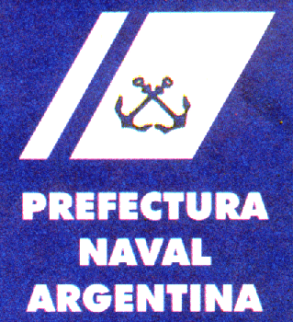









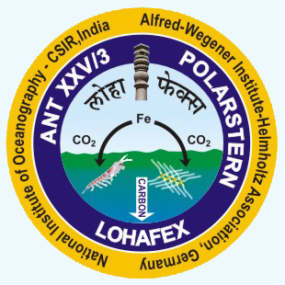





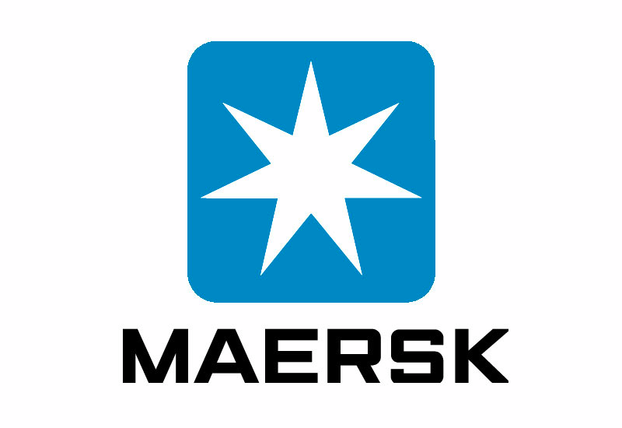



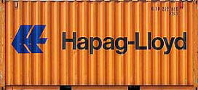
Partners and Collaborators
Educational
Research
Operational
Shipping Companies
Fishing Companies

Slide 16
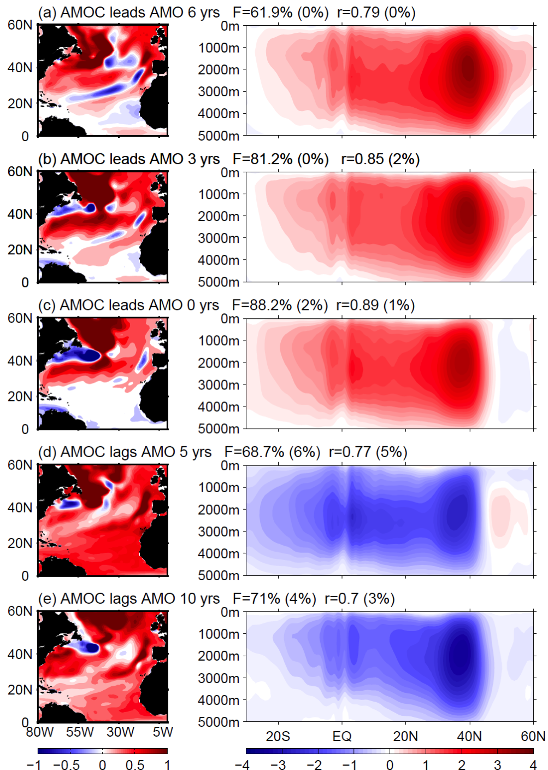
Major Science Accomplishments
Composite of 22 IPCC models exhibit a strong MOC associated with warm SST in the North Atlantic.
During the first 8.5 years of the MOCHA-RAPID-WBTS array, a small, but statistically significant (at the 95% confidence limit) decline in the MOC volume transport was observed.
Decrease is due to the upper-ocean interior flow.
This trend clearly highlights the importance of maintaining long-term, continuous, time series of observations to understand these questions.
Transport (Sv)
Temperature (C)
Wang et al, 2013;

Slide 17
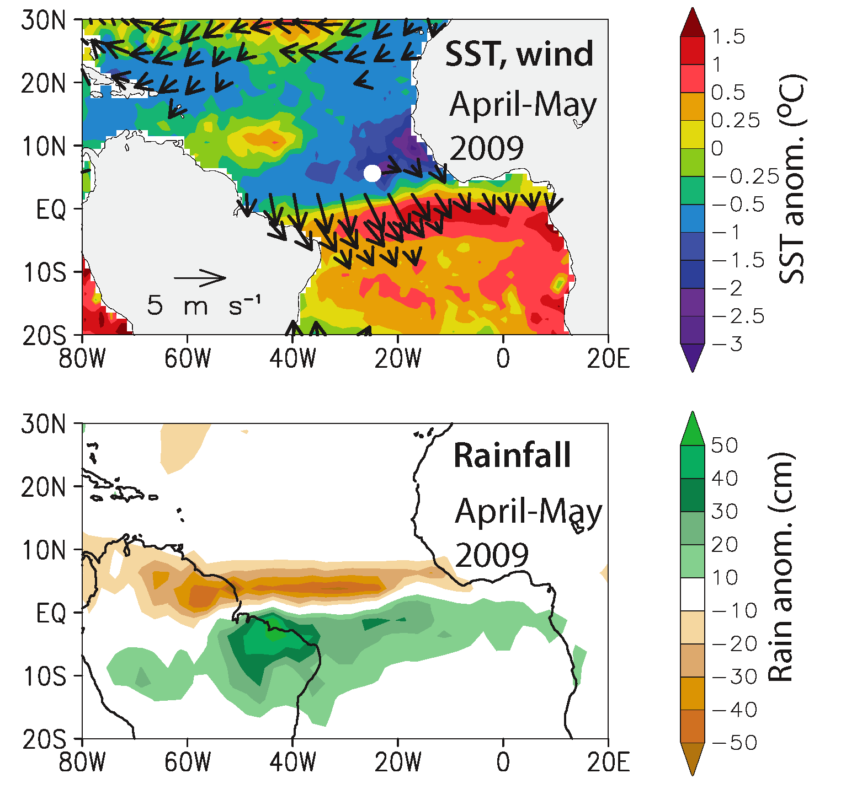
Major Science Accomplishments
A strong anomalous dipole of SST developed in the tropical Atlantic during the first half of 2009, peaking in April-May (top panel).
The ITCZ was displaced southward, resulting in extreme flooding in Northeast Brazil during April and May (middle panel).
Displacements of warm waters to the south coincide with a very weak Atlantic hurricane season.
Foltz et al, 2000

Slide 18
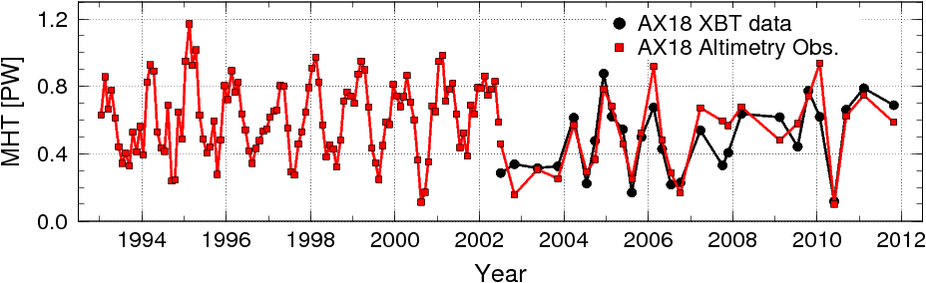
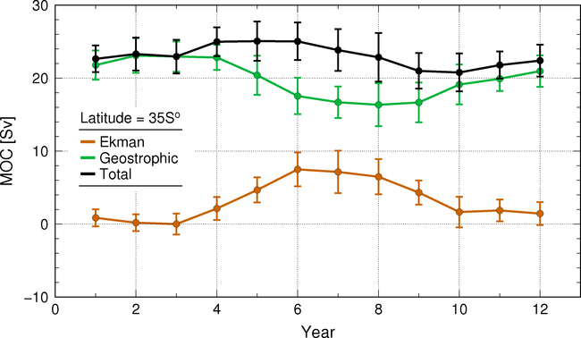
Major Science Accomplishments
Combined analysis of a suite of in situ, satellite, and numerical models outputs for South Atlantic MOC/MHT/Mov studies.
Identify and assess contributions from ocean interior and boundary currents and their temporal variations.
Significant seasonal cycles were identified from in situ observations, in which geostrophic and Ekman components are not in phase.
Before 2006 geostrophic controlled interannual variability. After 2006, Ekman controlled this variability.
Assess if climate models reproduce observational results.
Dong et al, 2000; Dong et al, 2014

Slide 19
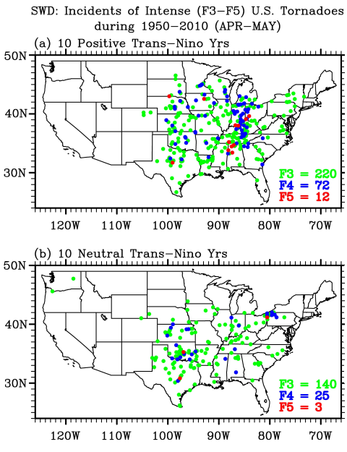
Major Science Accomplishments
Of the top ten extreme outbreak years during 1950-2010, seven years including the top three are identified with a strongly positive phase Trans-Niño (top figure)
The number of intense tornadoes in April - May is nearly doubled during the top ten positive Trans-Niño years compared to those during ten neutral years (top, intense outbreaks; bottom, normal tornado activity during neutral Trans-Nino years).
Trans-Niño represents the evolution of tropical Pacific sea surface temperatures (SSTs) during the onset or decay phase of the El Niño-Southern Oscillation.
Lee et al, 2000

Slide 20
Scientific Publications
Increase of more than 100% in peer-reviewed scientific publications during the last ten years. Total number of pubs by current scientists: XYZ
Notes:
Internal scientific review process
PHOD best manuscript selection

Slide 21
Scientific and Operational Panels
Participation in 59 panels, including:
International Clivar panels
US Clivar panels
IAPSO panel
JCOMM Obs panels
Argo Science Steering Team
Argo Data Management
XBT Science Steering Team
NASA Ocean Surface Topography Science Team
Editorial, Journal of Geophysical Research
South Atlantic MOC (SAMOC)
PIRATA Steering Team
Repeat Hydrography Steering Team
NASA SPURS Steering Team
Organization of Scientific Meetings:
2013 NASA SPURS Meeting
2011 and 2013 XBT Science Workshops
2010 PIRATA Steering Team and Tropical Atlantic Climate Experiment
2010 and 2011 SAMOC Meetings
…

Slide 22
Retreats, Divisional Meetings
2009 PHOD-SEFSC Meeting
June 1, 2009
Theme: Finding Opportunities for New Collaborative Research
2011 PHOD Retreat
February 15, 16, 2011
Theme: Integrating Observations for Multidisciplinary Research
2012 PHOD Retreat
February 29 and March 1, 2012
Theme: Synergy between Observations and Numerical Models for Weather, Climate, and Ecosystem Research
2014 AOML-SEFSC Meeting
May 2014
Theme: Continued Collaborative Success: Now and in the Future.

Slide 23
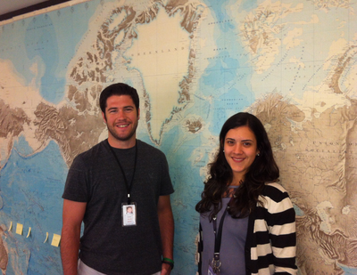
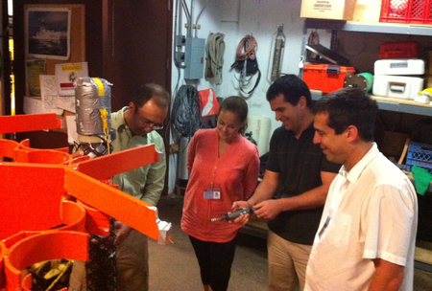
Visitors, Scientific Exchanges
Dr. Monika Rhein, U. Bremen, Germany
Dr. Edmo Campos, USP, Brazil
Dr. Sabrina Speich, U. Brest, France
Dr. Mauricio Mata, FURG, Brazil
Dr. Rym Msadek, GFDL
Dr. Ricardo Matano, Oregon State University
Dr. Anne Thresher, CSIRO, Australia
Dr. Janet Sprintall, Scripps Inst. Oceanogr.
Dr. I-I Lin, U. Taiwan
Dr. Frank Muller-Karger, USF
Dr. Xidong Wang, Affiliation
Dr. Susan Wijffjels, CSIRO, Australia
Dr. Josh Willis, NASA/JPL
Dr. Sybren Drifjhout, Netherlands
Lt. Cdr. Ariel Troisi, SHN, Argentina
Dr. Janice Trotte, Brazilian Ministry of Science
Dr. Ivan Perez Santos, U. Concepcion, Chile
Dr. Michael Roberts, University of Cape Town
Dr. Randy Watts, U. of Rhode Island
Dr. Sybren Drijfhout, KNMI, Netherlands
ANAMAR, Dominican Republic Ministry of Science
……..
Dillon Amaya (TAMU) and Alexandra Ramos (UPR), 2013 summer interns.
Lt. Cdr. Camila Cariccio (SHN, Brazil)

Slide 24
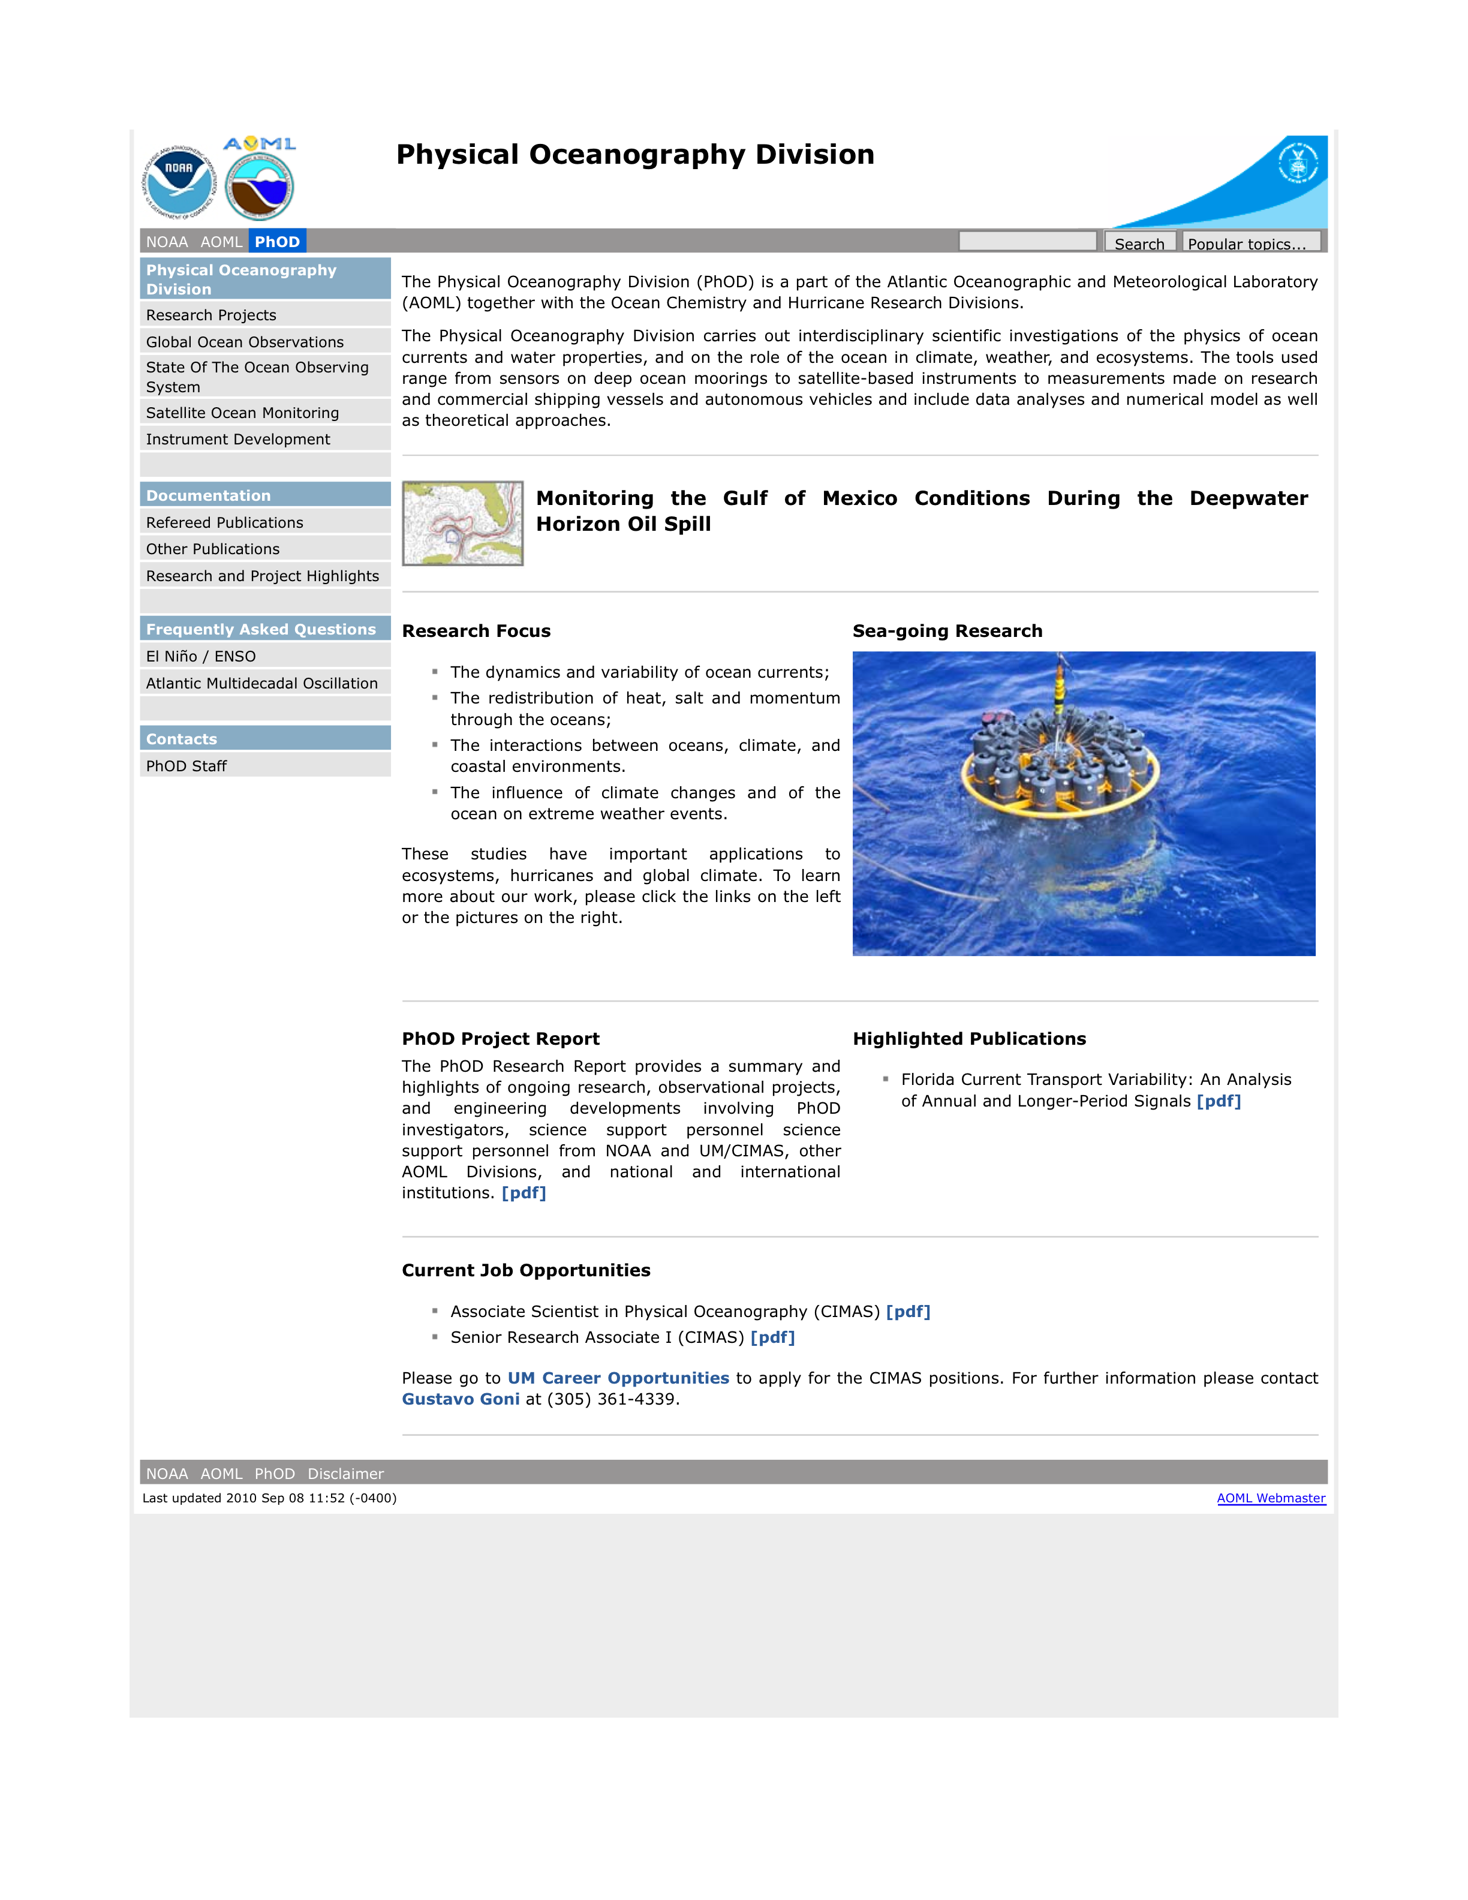
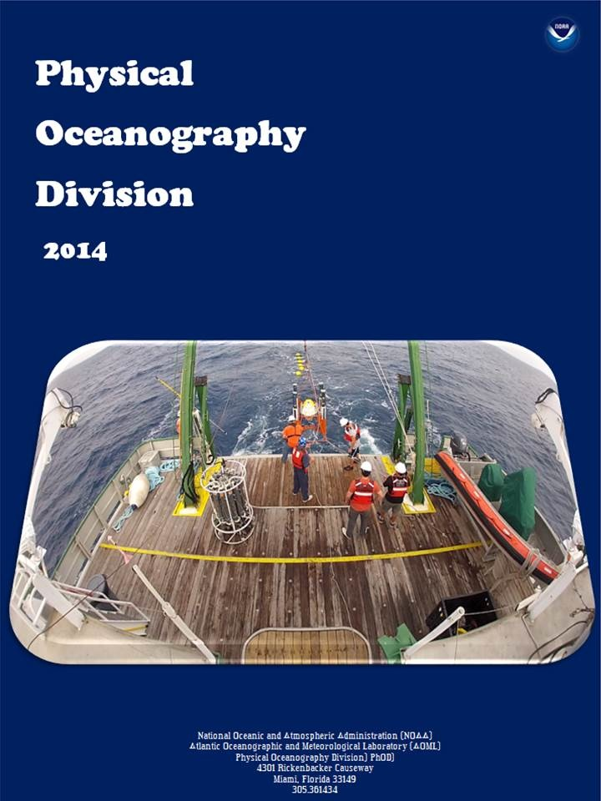
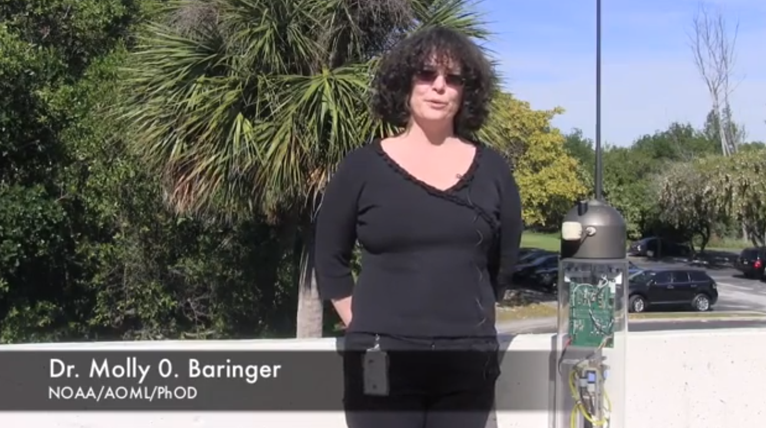
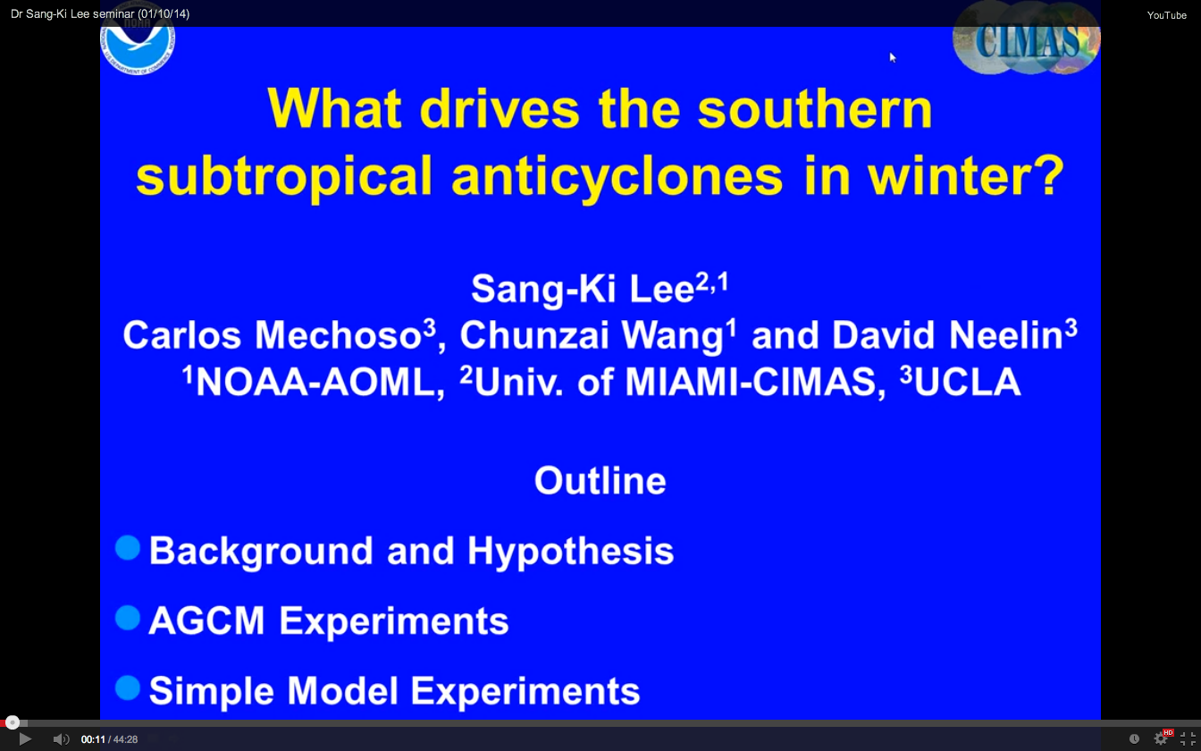
Communications
Videos (including YouTube) of main PHOD projects.
Live video streaming and recording of PHOD seminars through Gotomeeting.
Comprehensive divisional
web page: detailed and updated description of each project, data and product distribution
Up-to-date PHOD
Project report: Annual update of projects, including technological developments

Slide 25
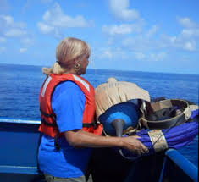
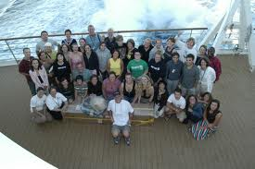
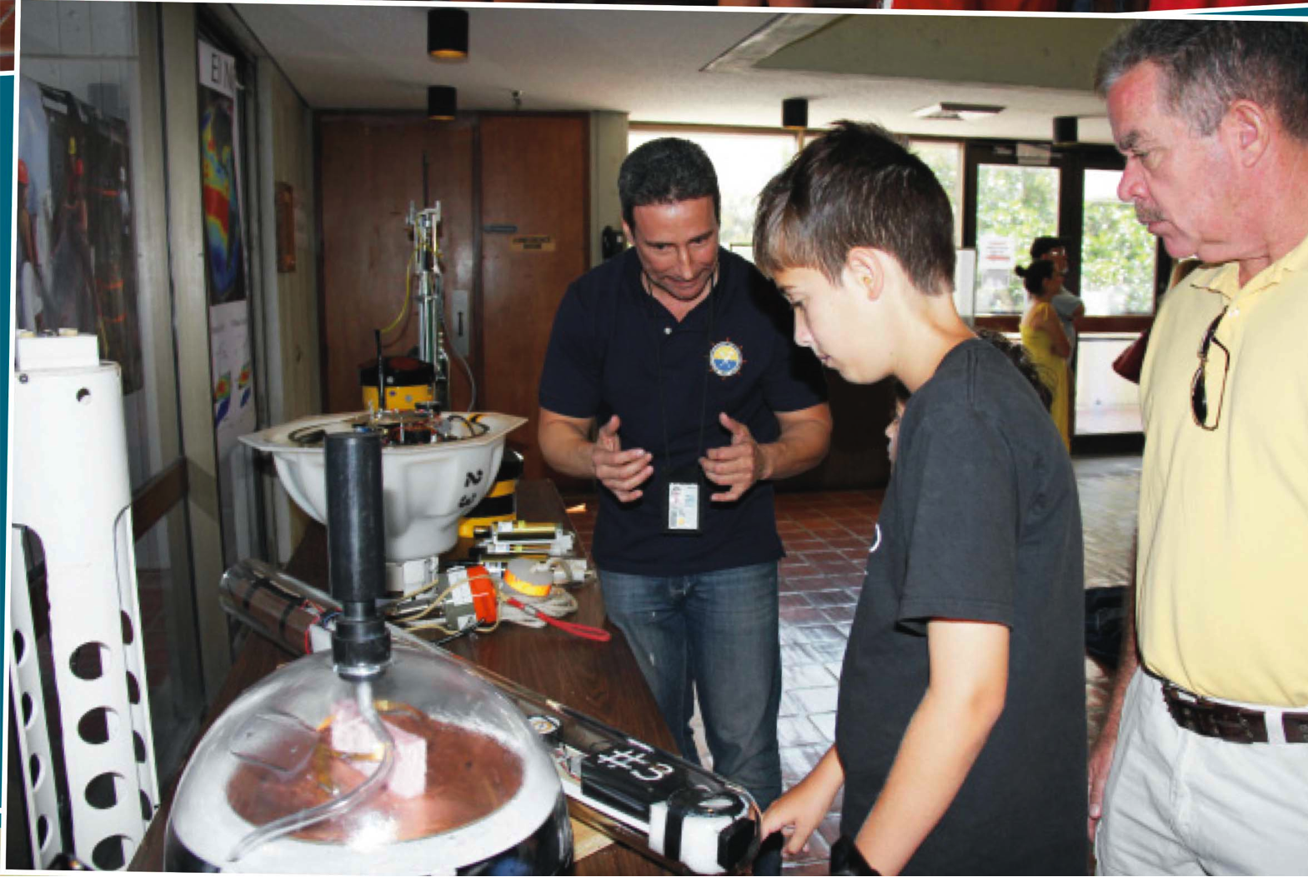



PHOD Outreach Highlights
U. Va. Semester At Sea
Adopt a drifter program
Teachers at Sea
University of Miami, Annual
undergraduate student visit
Annual AOML Open House and high school student tours and presentations
Global Ocean Observation
Google display

Slide 26
Looking Ahead
Continue as a premier science group for designing, implementing, and maintaining sustained ocean observations (some with time series longer than 30 years) for oceans and climate research;
Continue emphasis of synergy between observations (in situ and satellite), numerical modeling, and theoretical studies;
Continue leading studies of Ocean Observing System Simulation Experiments (OSSE) geared towards improving tropical cyclone intensity forecasts and improving ocean observing networks for climate studies;
Continue work on cutting edge scientific research to understand ocean-weather-climate system and impacts;
Continue strengthening partnerships benefiting and leading to operations and applications;
Continue strong partnership with other AOML divisions in support of ecosystems and hurricane studies; and
Continue partnership and collaboration with scientists from other NOAA LOs and national and international university and government laboratories.

Slide 27
Thank you very much
Questions?
.

