Slide 1
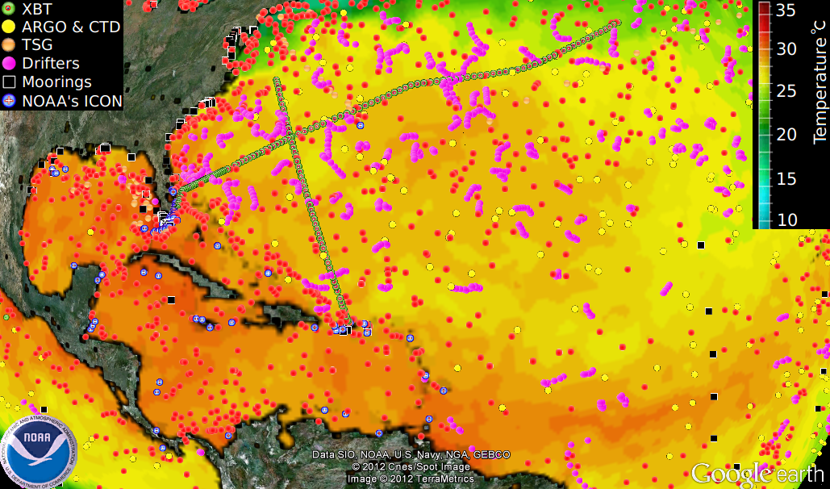
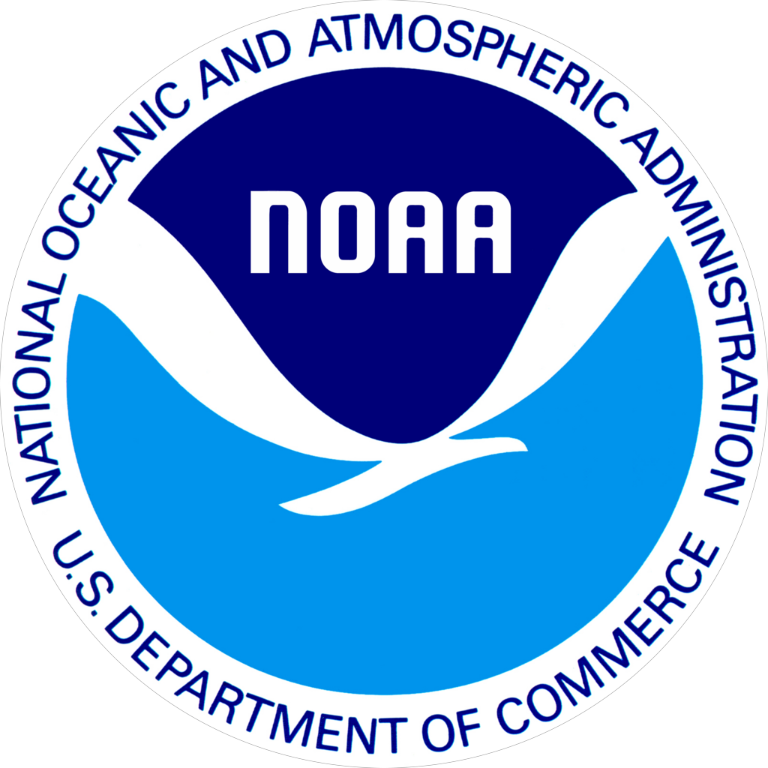
Ocean Observing System
Extreme Weather Events, through ocean and atmospheric observations carried out in the tropical Atlantic;
Ecosystem Studies, through cruises carried out regularly in the Florida Bay, West Florida Shelf, and Caribbean Sea;
Tropical Cyclone Intensification, through a combination of observations, analysis, and modeling efforts.
Marine Weather Forecast, AOML contributes to NWS with all marine weather observations/reports obtained from cargo ships.

Slide 2
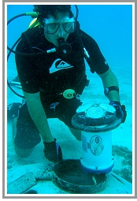
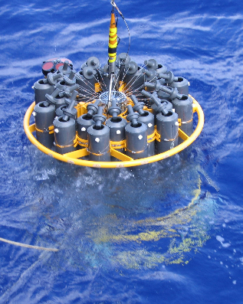
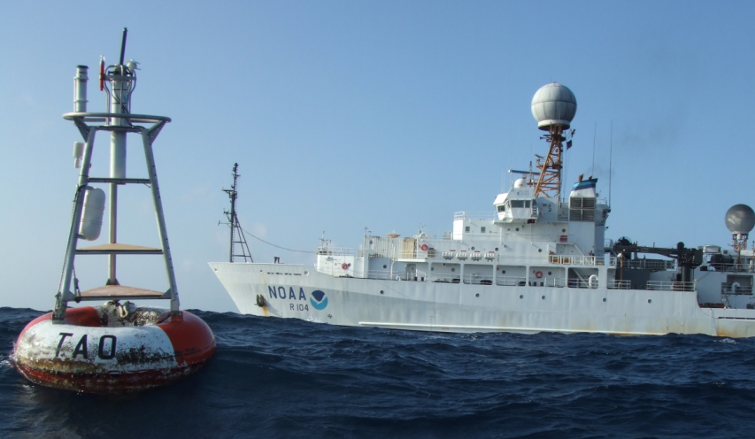
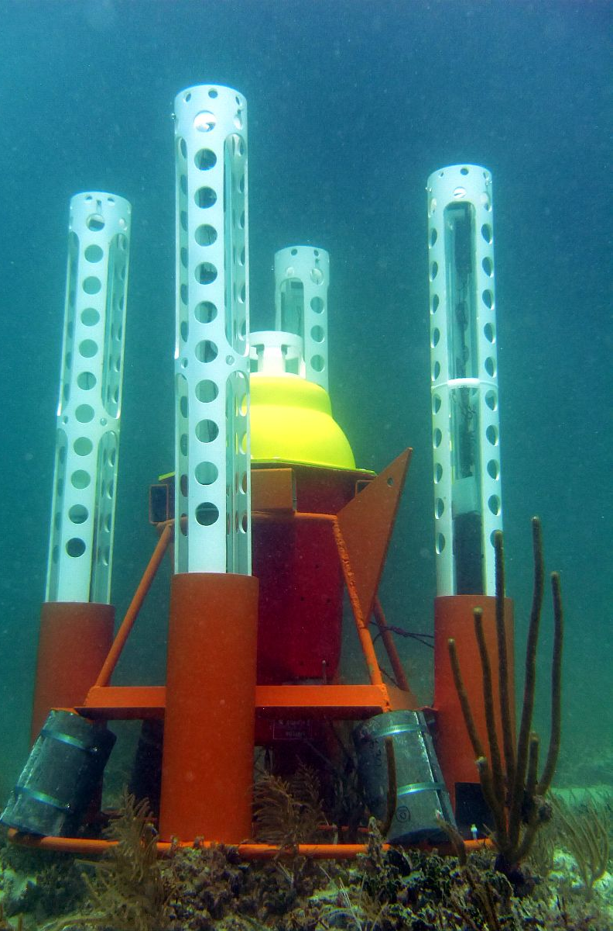
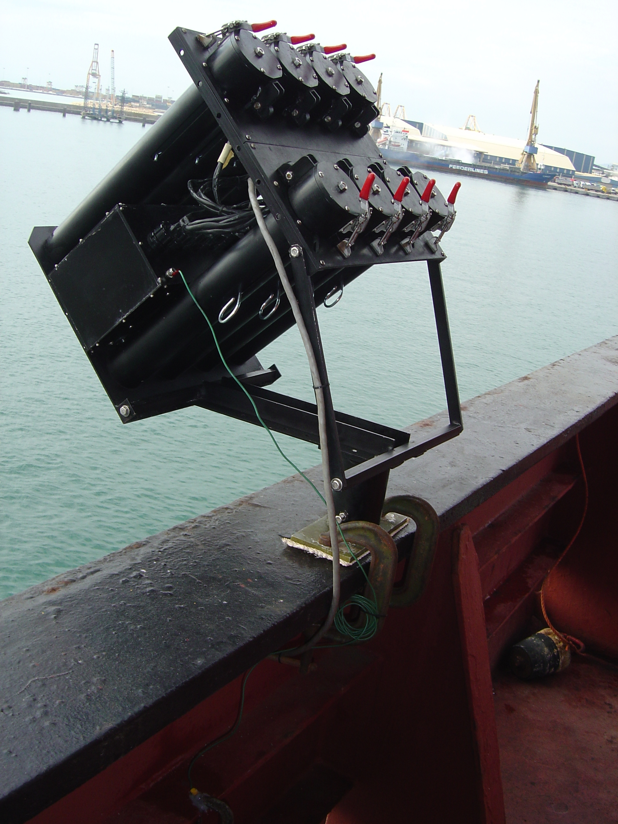
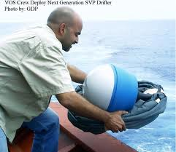
Ocean and Atmospheric Observations

Slide 3
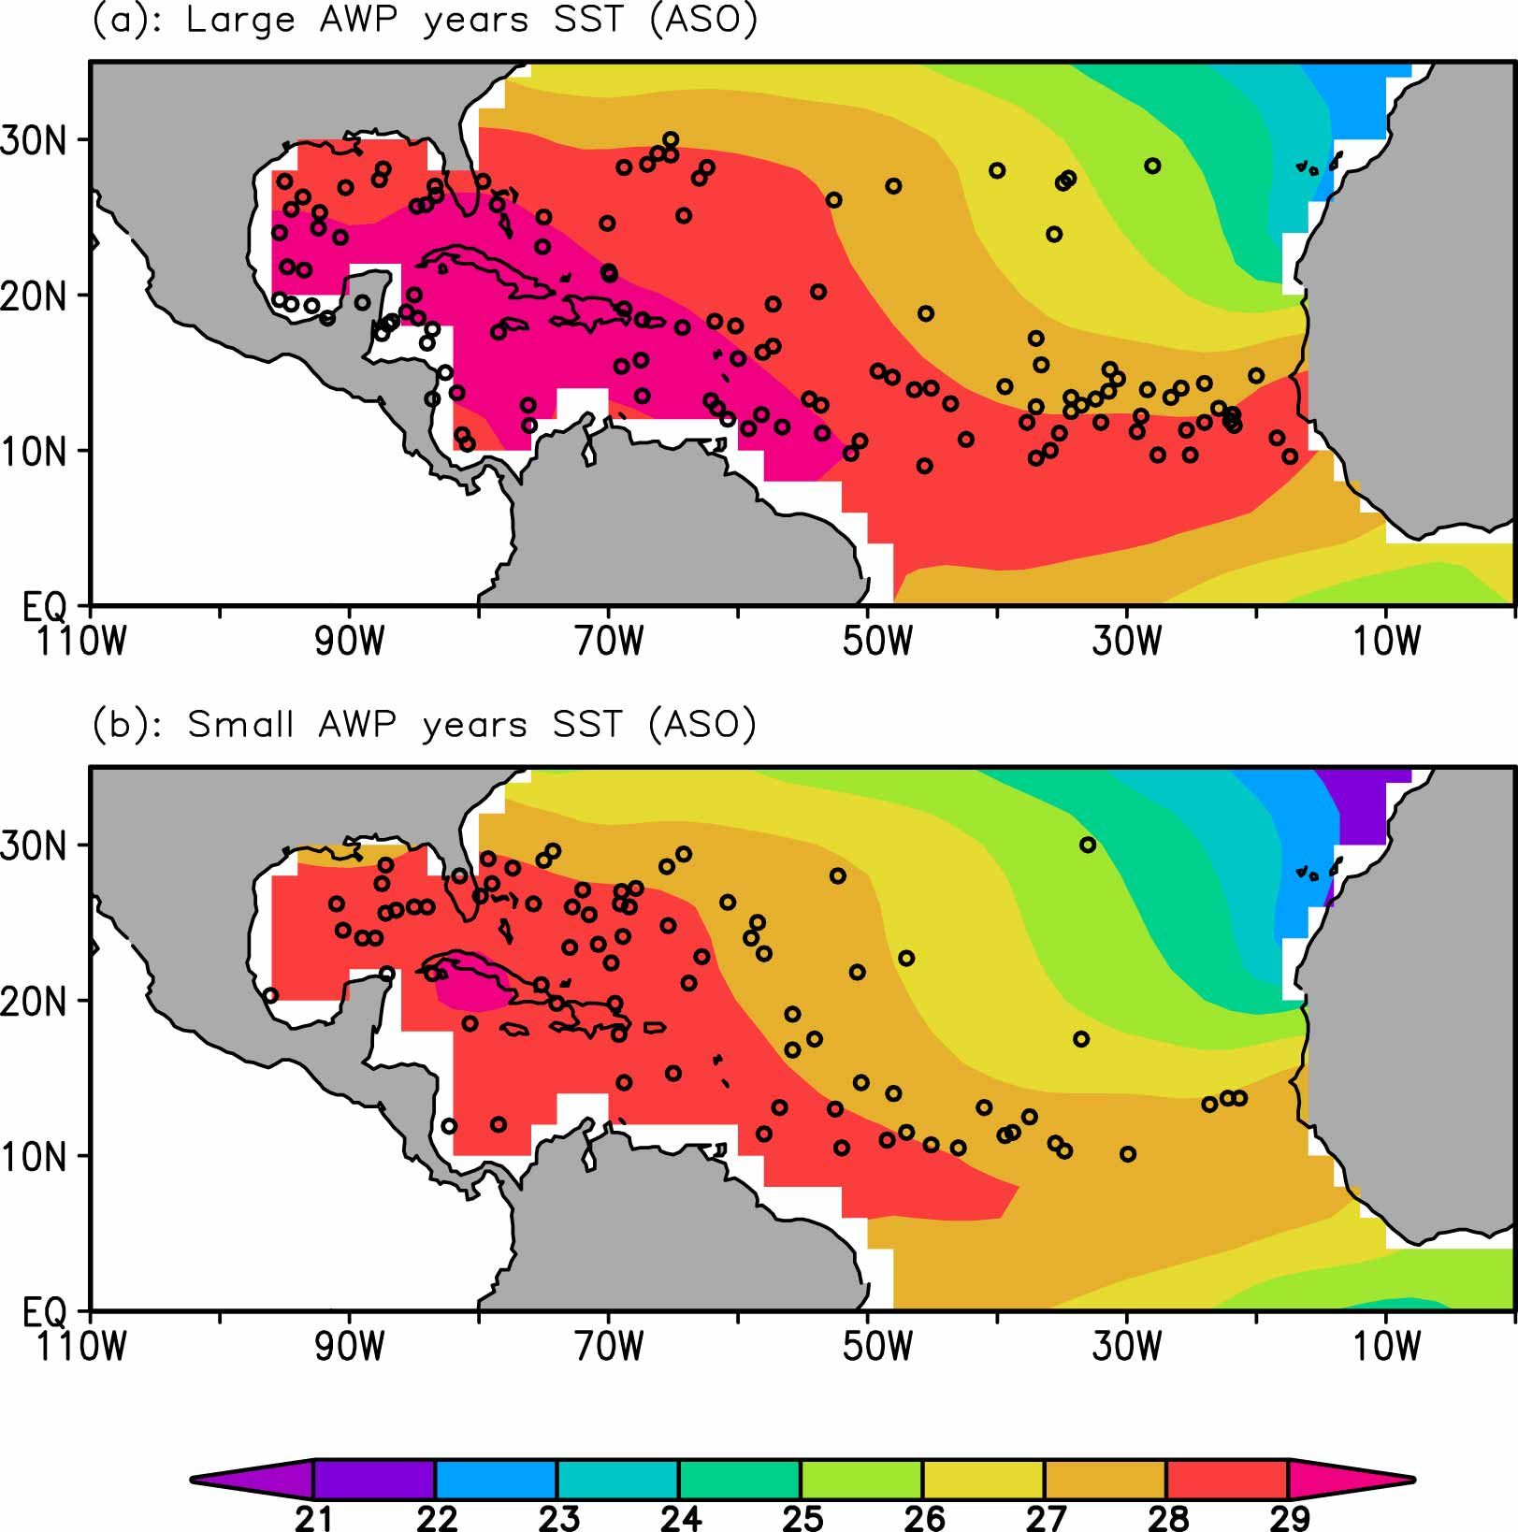
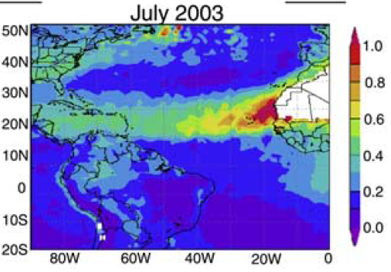
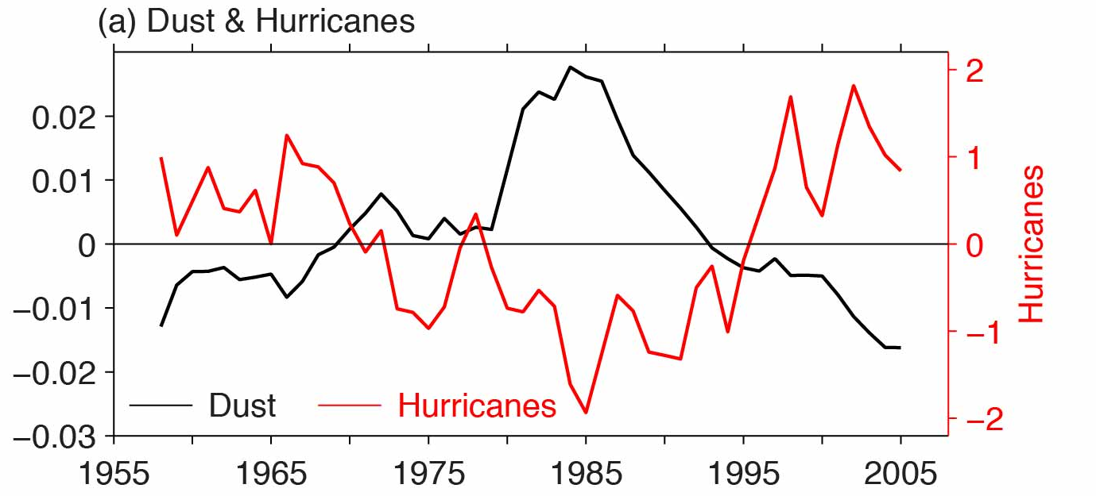
Oceans, Atmosphere, and Hurricanes
Extent of warm waters
Sea surface temperature (°C)
Large area of warm water: Hurricanes are less likely to make landfall in Florida
Small area of warm water: Hurricanes are more likely to make landfall in Florida
Extent of Saharan dust
Dust

Slide 4
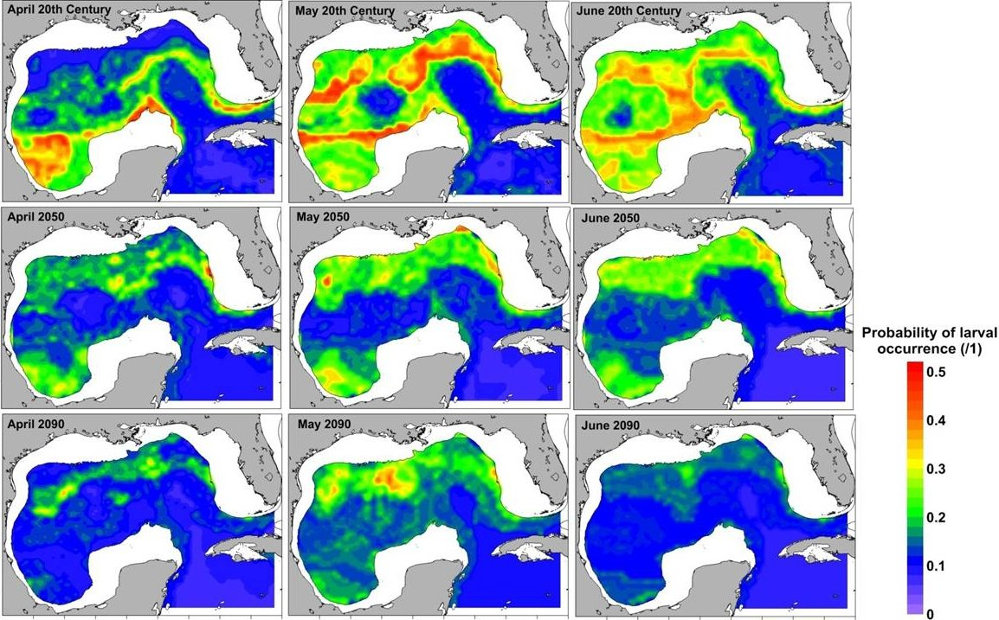
Oceans and Fisheries
April
May
June
The spawning of Atlantic bluefin tuna is predominantly in the northern Gulf of Mexico from April to June with the optimal temperature of 24 - 27°C.
Late-20C
Mid-21C
Probability of larval occurrence
Due to the projected warming, the areas with high larval occurrence will decrease by more than 90% toward the end of the 21st century.
Late-21C

