Slide 1
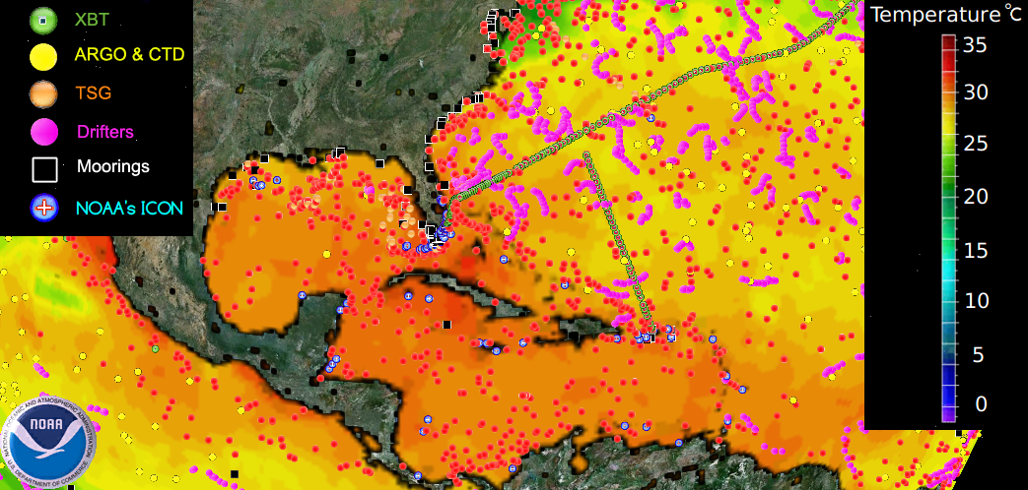
Ocean Observing System
Marine Weather Forecast
Extreme Weather Events
Ecosystem Studies
Tropical Cyclone Intensifications

Slide 2
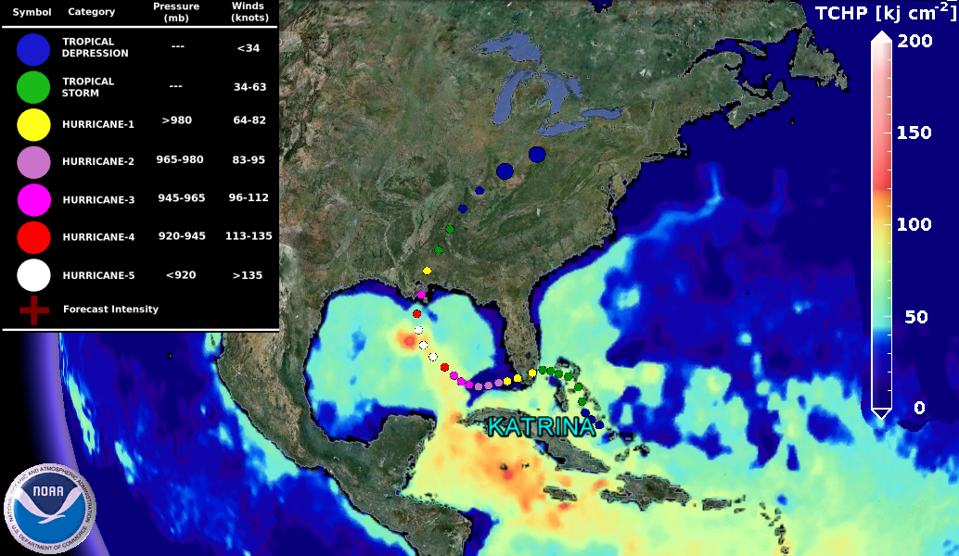
Tropical Cyclone Intensification

