Slide 1

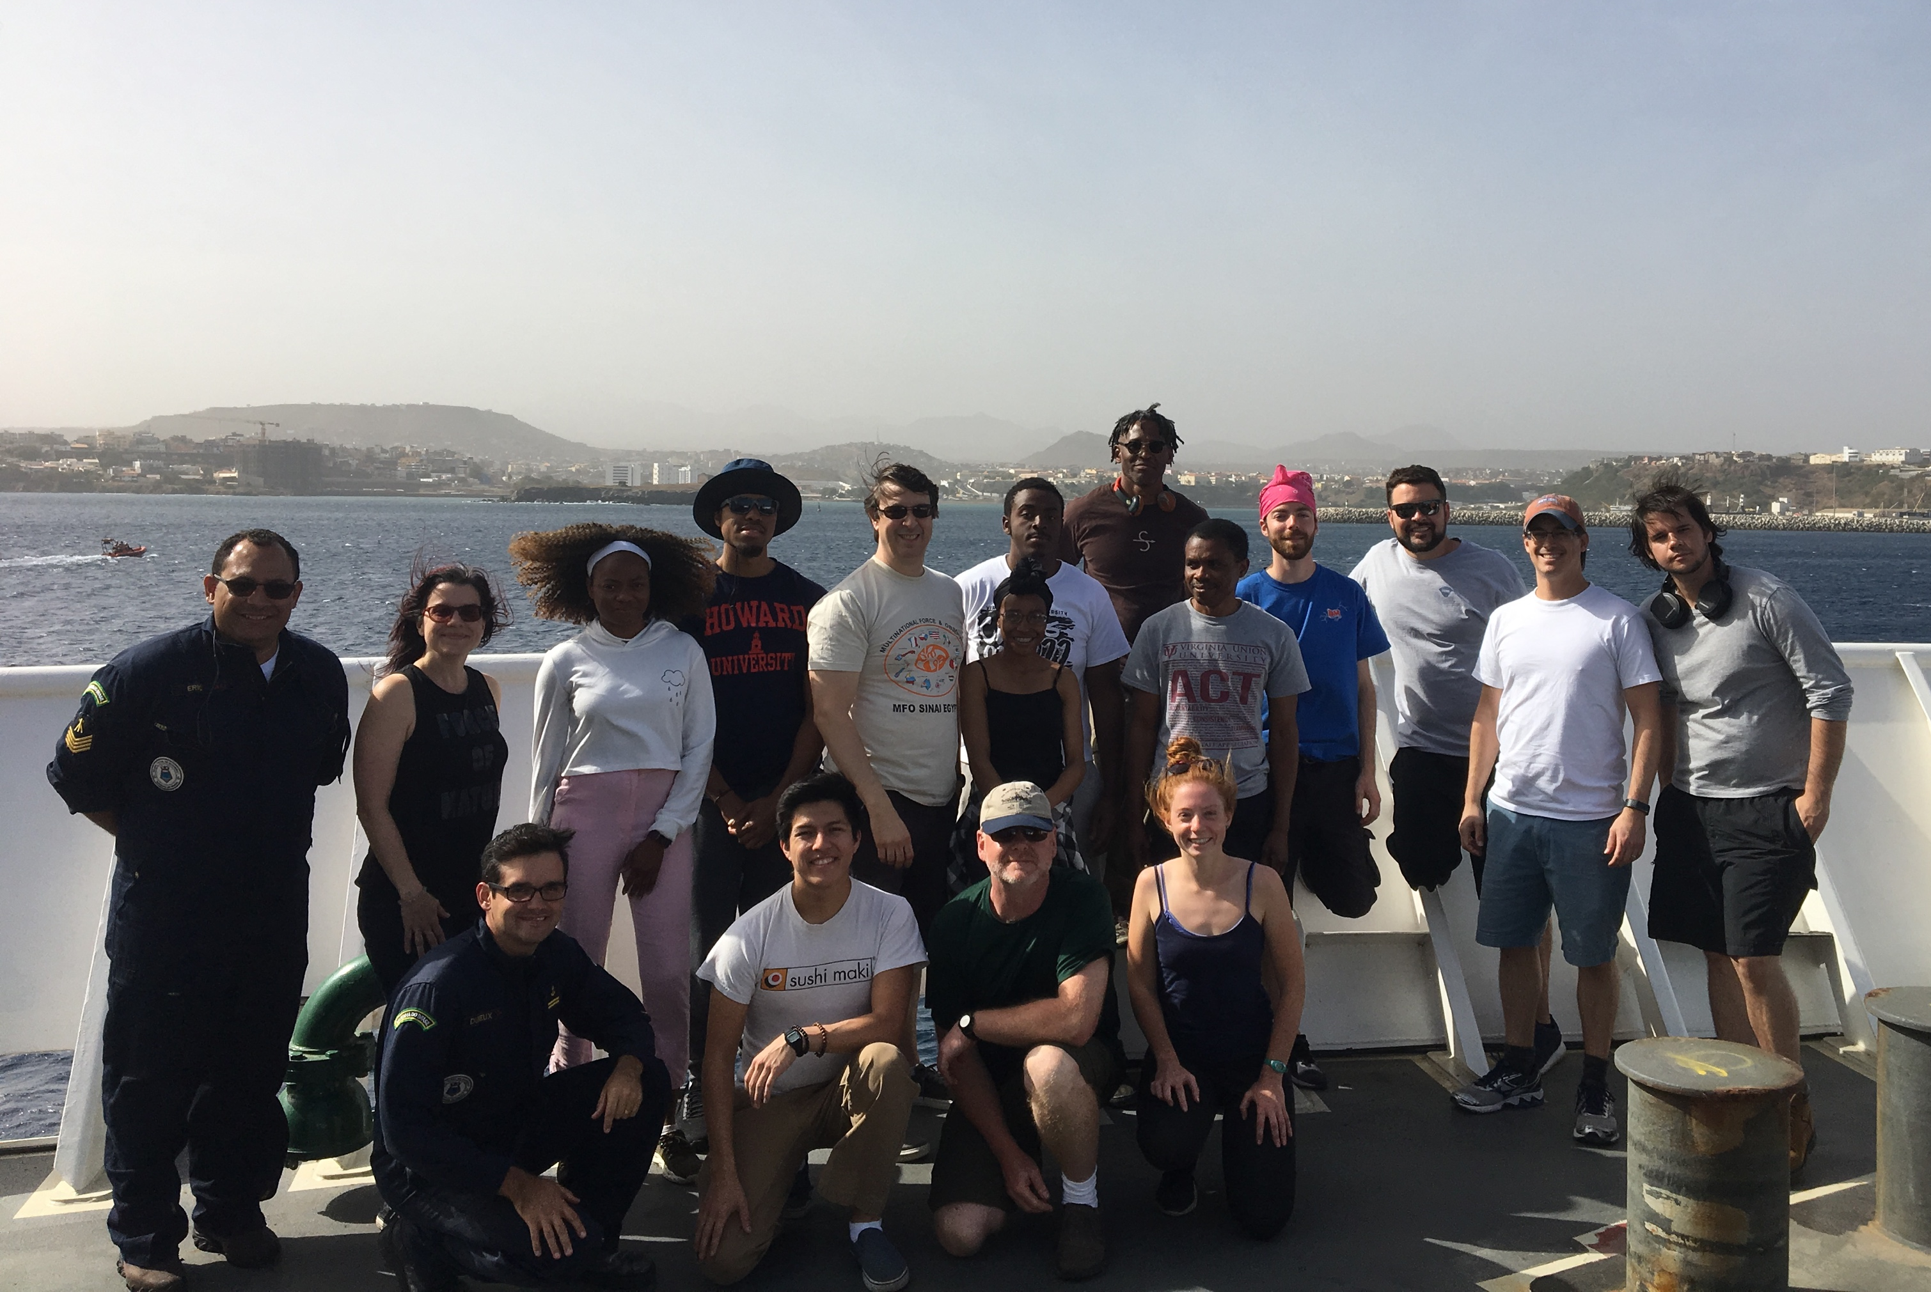
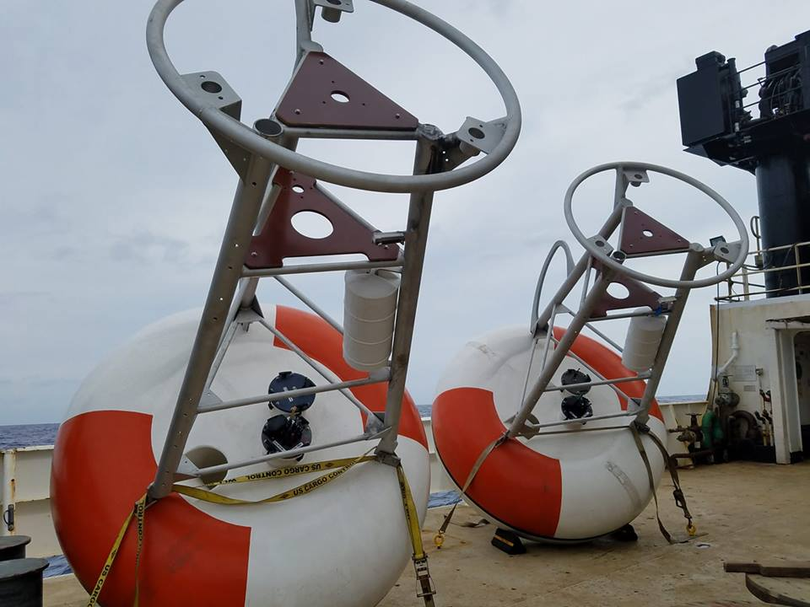
PIRATA Northeast Extension (PNE) cruises, 2019-2020

Slide 2
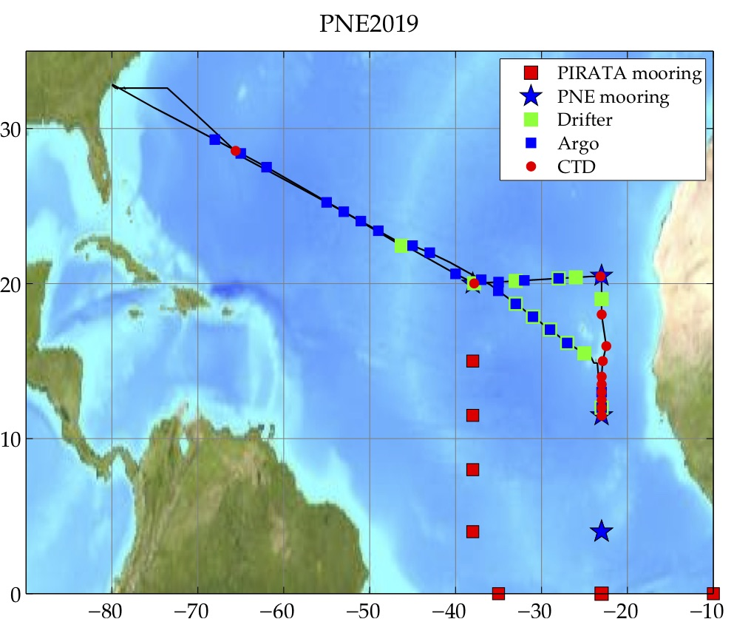
PNE 2019
March 1- 29, 2019 to/from Charleston, South Carolina.
Occurred ~12 months after PNE2018.
Reduced science due to loss of 12 days at sea (government shutdown, mechanical delays).
Three moorings serviced: 11.5ºN, 23ºW; 20.5ºN, 23ºW; 20ºN, 38ºW.
Vessel: NOAA ship
Ronald H. Brown
Chief Scientist:
Renellys Perez,
NOAA/AOML
AEROSE team and Brazilian
Navy observers joined

Slide 3
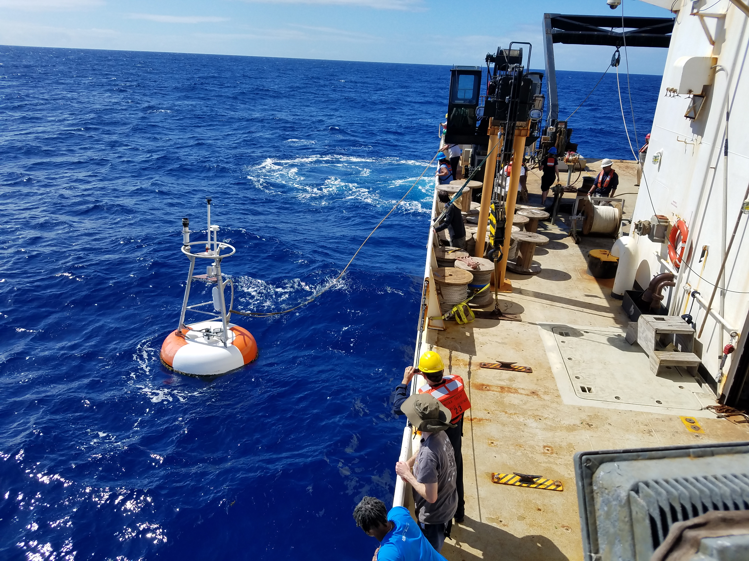
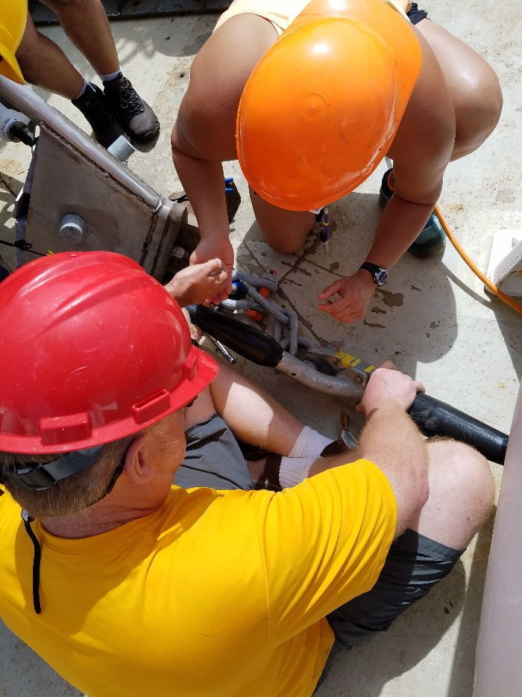
T-Flex mooring operations
Mooring personnel: Steven Kunze (NOAA/PMEL), Denise Kester (UW/JISAO), LT Eduardo Dubeux, 2o Sargento Eric Silva (Brazilian Navy)
Cruise delays/sick crew member prevented recovery at 4°N 23°W. This mooring was serviced May 2019 by Dave Zimmerman and Ryan Wells (UW/JISAO) aboard R/V Thomas G. Thompson.

Slide 4
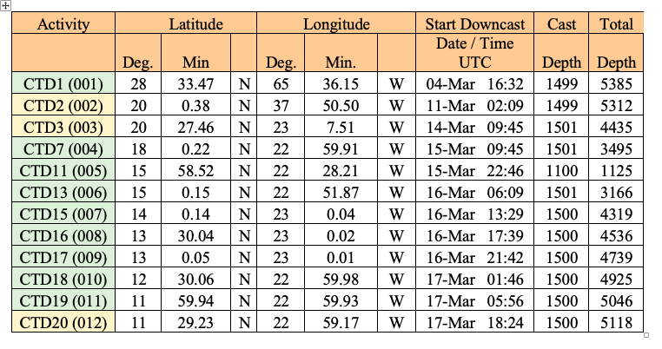
Only 12 CTD+LADCP casts
Hydrography Team
CTDs at the three mooring sites, plus 8 CTDs between 2nd and 3rd mooring. ~50 of the planned stations cut.

Slide 5
Ocean/atmosphere observations
22 Argo floats and 14 surface drifters deployed, monitored Sargassum along cruise track.
Underway shipboard ADCP/TSG/pCO2/M-AERI data collected. There were cavitation issues with the TSG which were partially fixed during the cruise.
AEROSE: 101 radiosondes and 8 ozonesondes, atmospheric chemistry measurements during strong dust event.
8 undergrad/grad students participated.
Delivered food/water to Jean-Jaques Savin (transiting Atlantic in barrel).

Slide 6
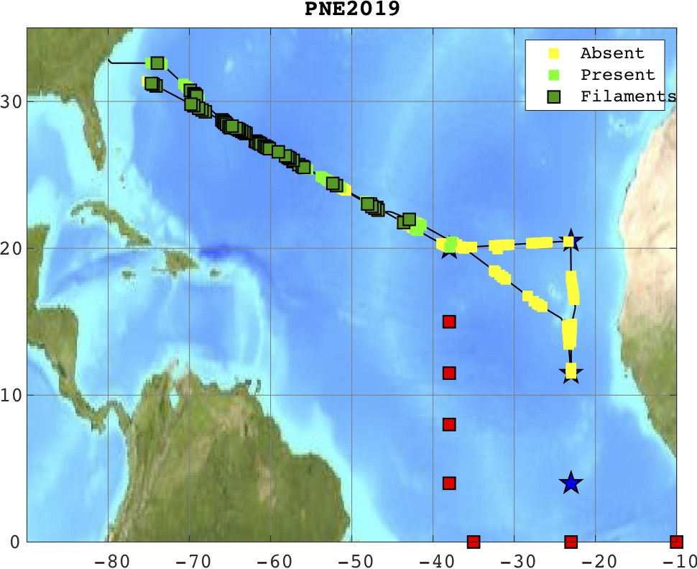
Sargassum analysis
Observations classified as: none, trace, isolated, filaments, rafts

Slide 7
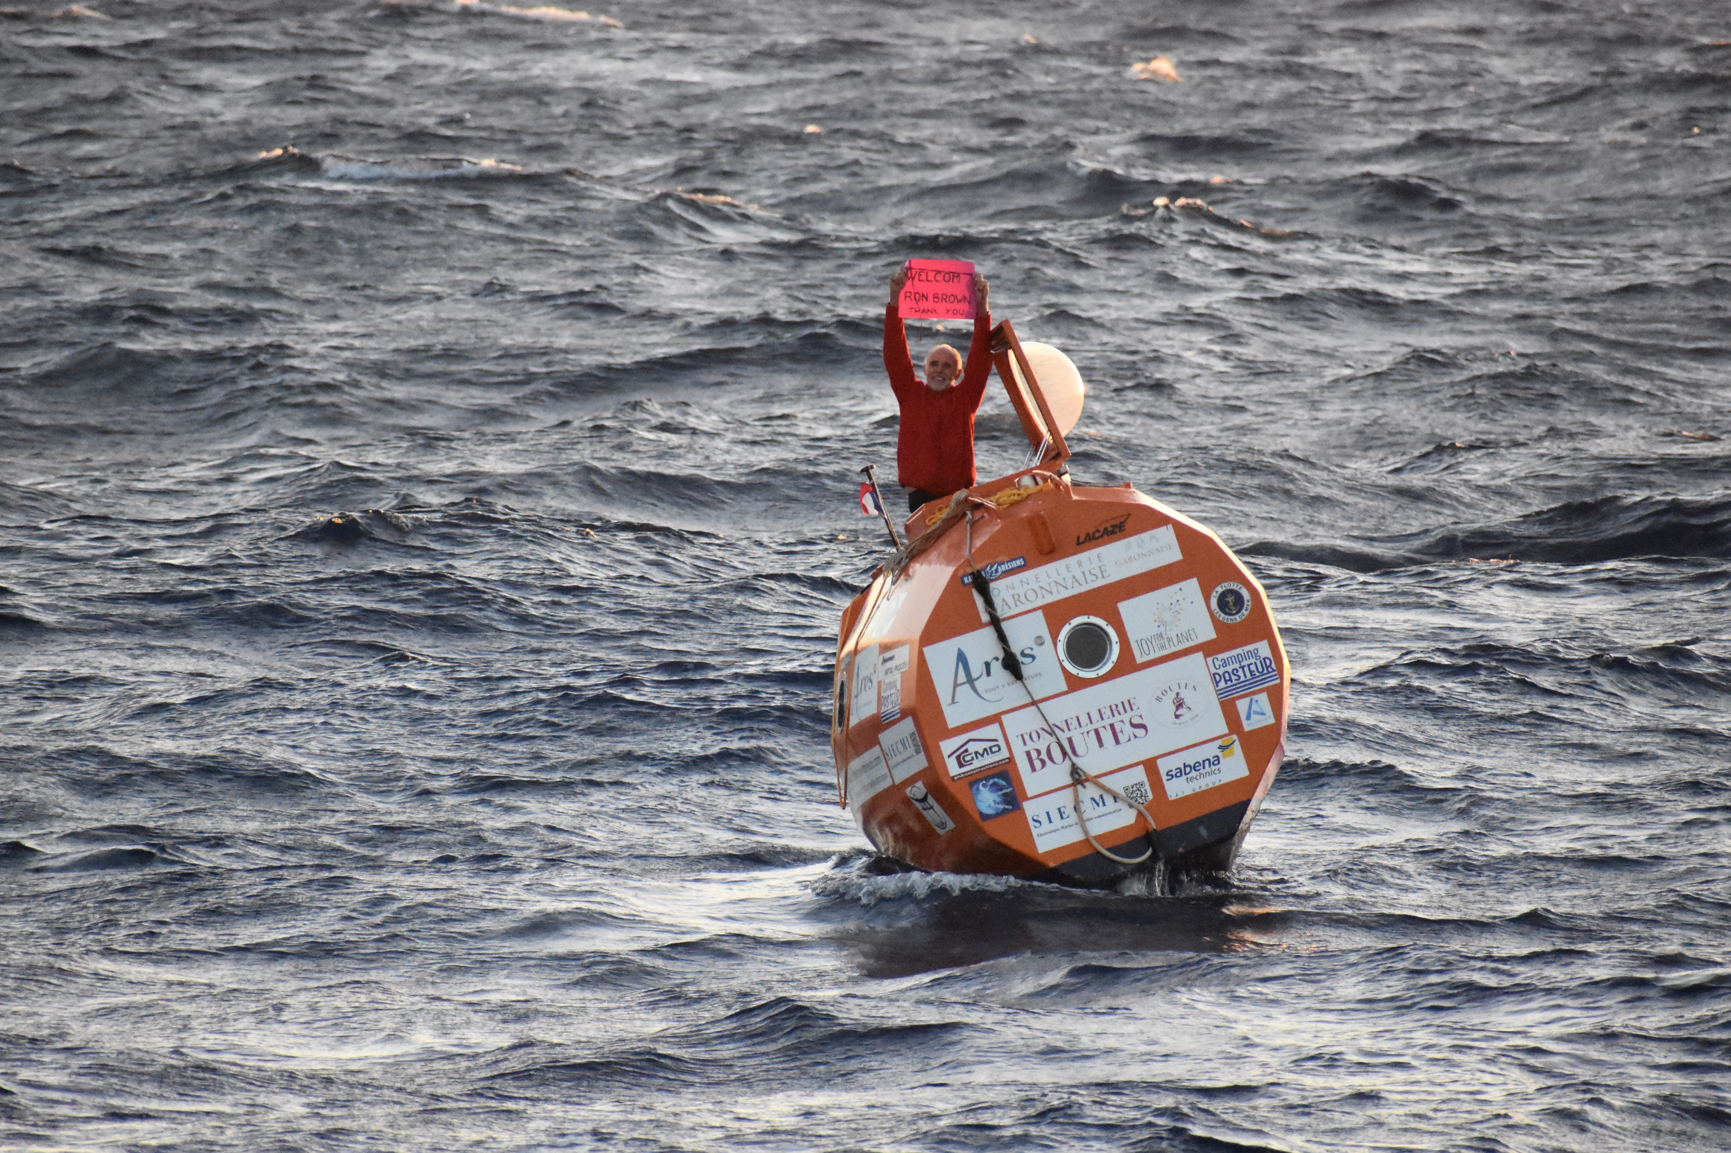
2000 nm down, 1000 to go.

Slide 8
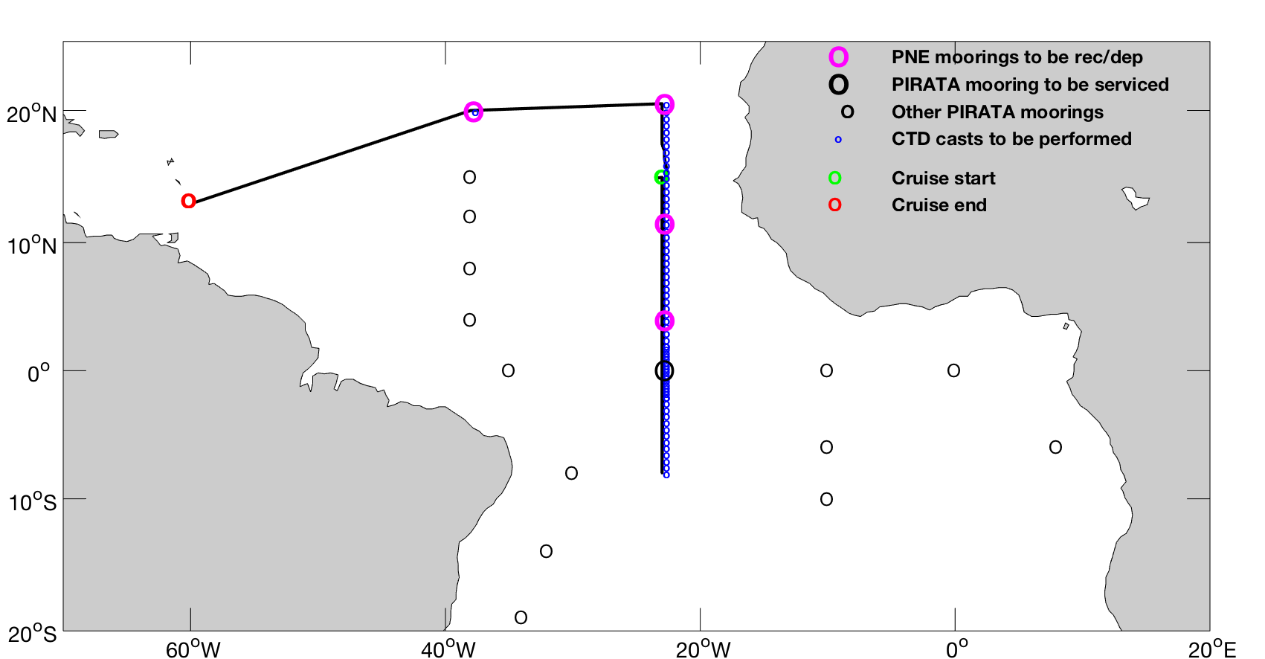
PNE 2020 –TBD
Scheduled on the R/V Ronald H. Brown May 12 – June 11:
Praia, Cape Verde to Bridgetown, Barbados
Chief Scientist:
Greg Foltz,
NOAA/AOML
Science party: 15+
68 CTD/LADCP/O₂
AEROSE (Howard Univ, NOAA/NESDIS)
Macroalgae research group (DOE project)
Latest update: June 1 at the earliest

Slide 9
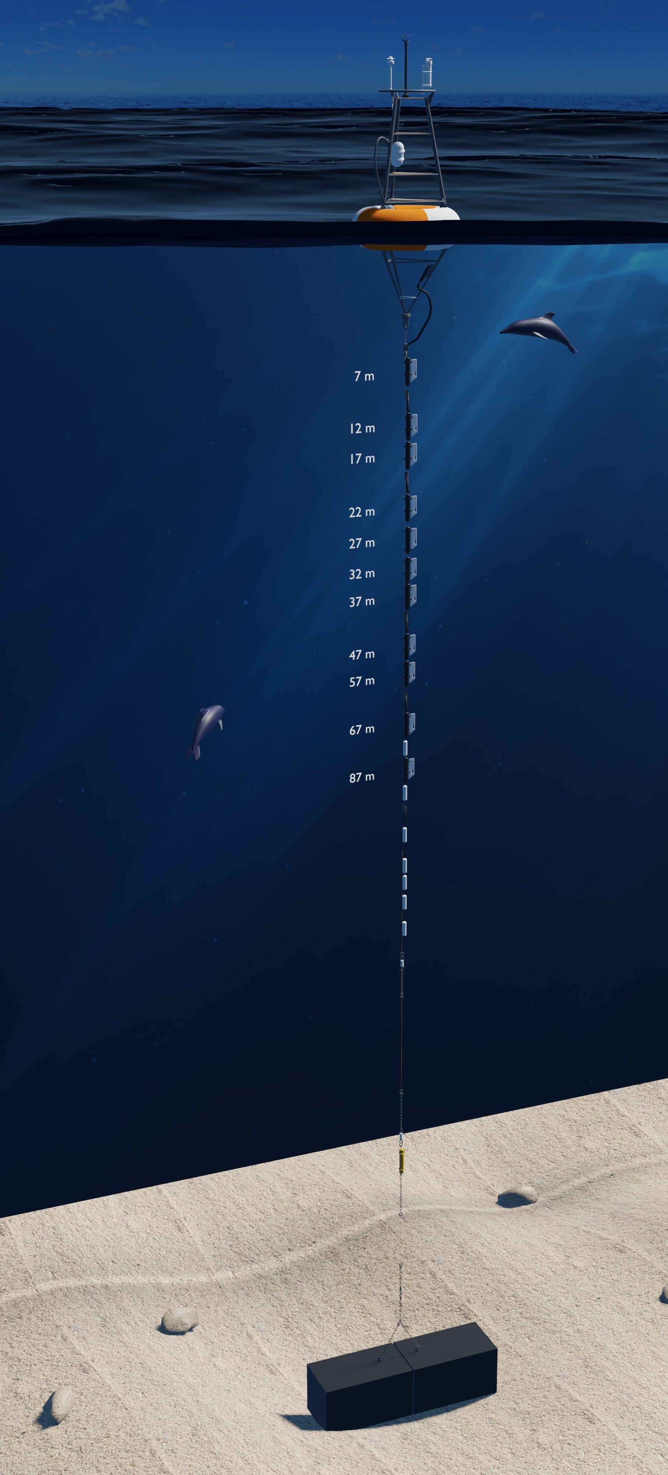
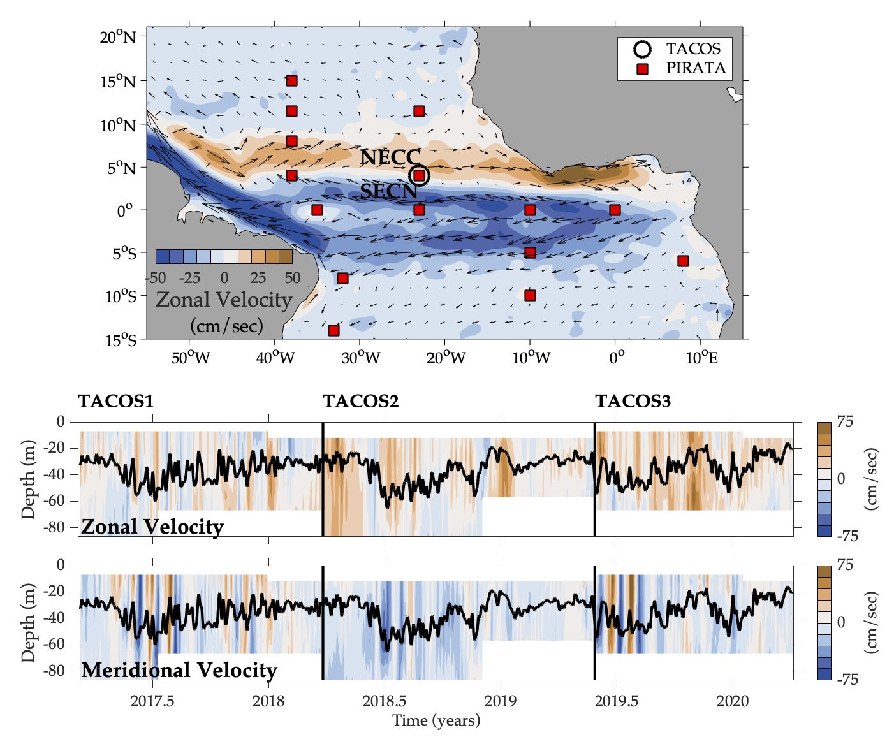
TACOS Update
  TACOS1:
  Mar 2017 – Mar 2018
  (10 AOML + 1 PMEL)
  TACOS2:
  Mar 2018 – May 2019
  (5 PMEL)
  TACOS3:
  May 2019 – present
  (10 AOML + 1 PMEL)
# of current meters:
11
5
11

Slide 10
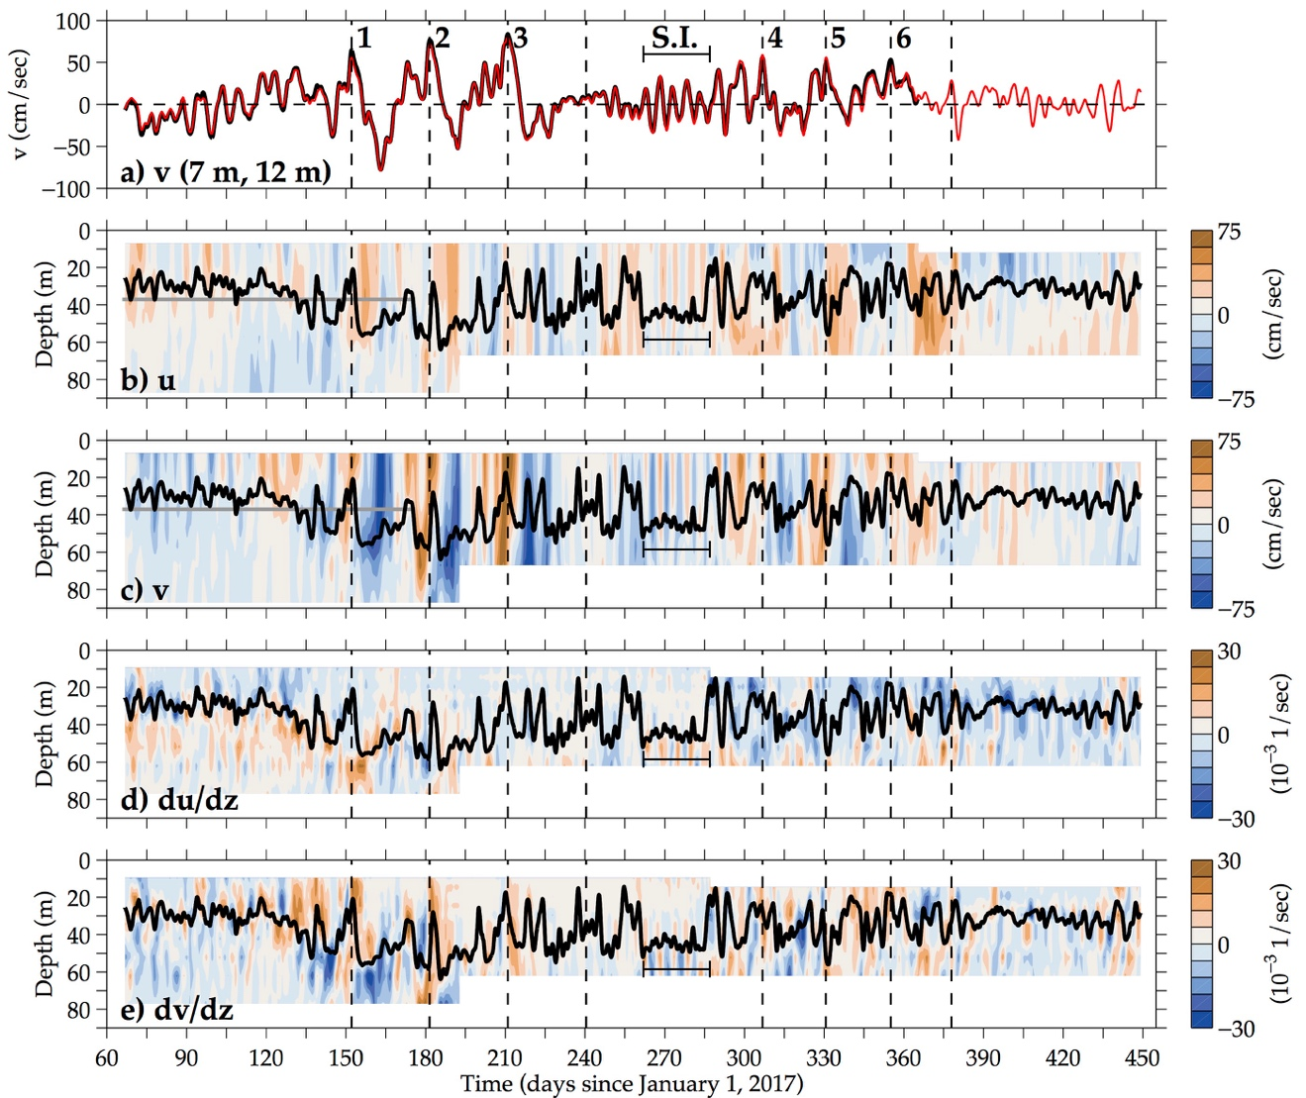
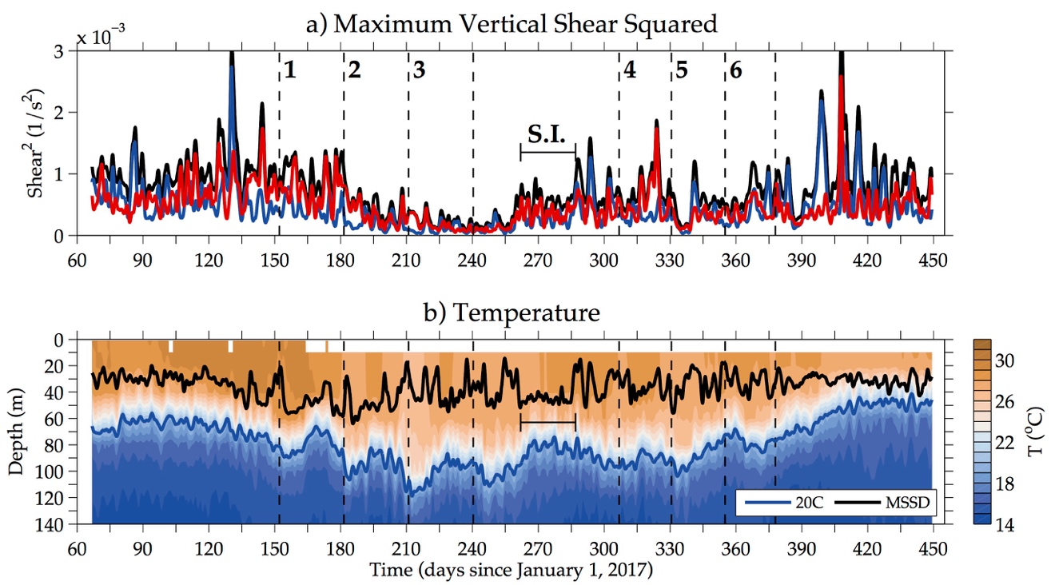
TACOS publications
Perez, R. C., G. R. Foltz, R. Lumpkin, and C. Schmid, 2019: Direct measurements of upper ocean horizontal velocity and vertical shear in the tropical North Atlantic Ocean at 4ºN, 23ºW, J. Geophys. Res. Oceans, 124, 4133-4151, doi:10.1029/2019JC015064.
Seasonal, intraseasonal (TIW) variations during 2017-18.

Slide 11
TACOS publications
Foltz, G. R., R. Hummels, M. Dengler, R. C. Perez, and M. Araujo, 2020: Vertical turbulent cooling of the mixed layer in the Atlantic ITCZ and trade wind regions, J. Geophys. Res. Oceans, 125, doi:10.1029/2019JC015529.
Vertical turbulent cooling of mixed layer
Seasonal variations of shear, turbulent cooling of SST.
Working with M. Harrison (GFDL) to compare to numerical model.

Slide 12
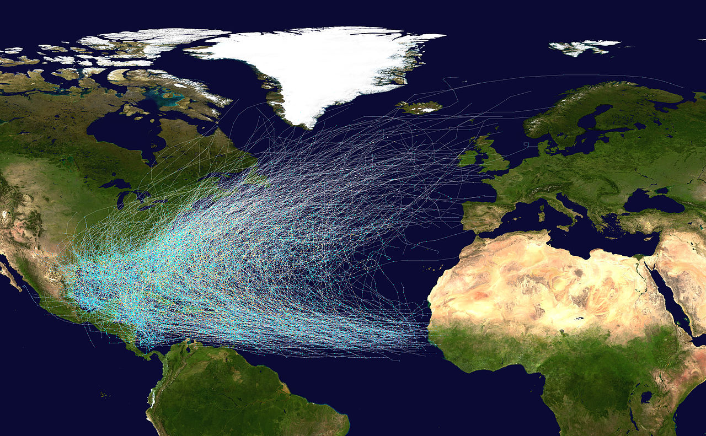
Next TACOS deployment: 20ºN, 38ºW

Slide 13
Ph.D. student
Christophersen, J. A., G. R. Foltz, and R. C. Perez, 2020: Surface expressions of atmospheric thermal tides in the tropical Atlantic and their impact on open-ocean precipitation, J. Geophys. Res. Atmos., in revision.
a)
b)
Quantification of atmos. thermal tides at PIRATA mooring locations and their impacts on rainfall.
c)
d)

Slide 14
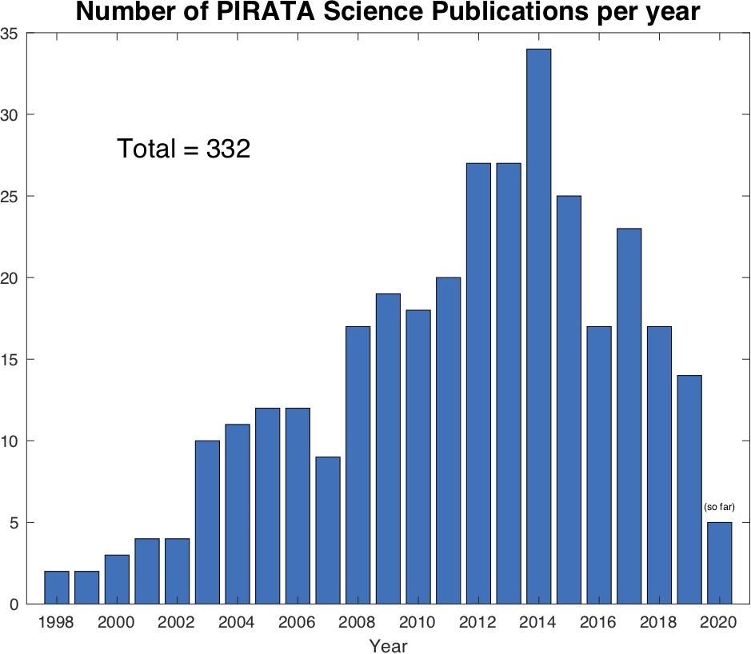
PNE web pages, PIRATA bibliography
PNE web pages maintained by Renellys Perez since 2020.
Email bibliography updates to Renellys.C.Perez@noaa.gov.
332 peer-reviewed publications as of 14 April 2020.

Slide 15
