Slide 1
SG609 vs SG617
Unpumped CTD vs. pumped CTD

Slide 2
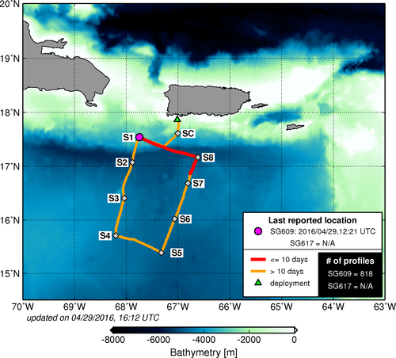
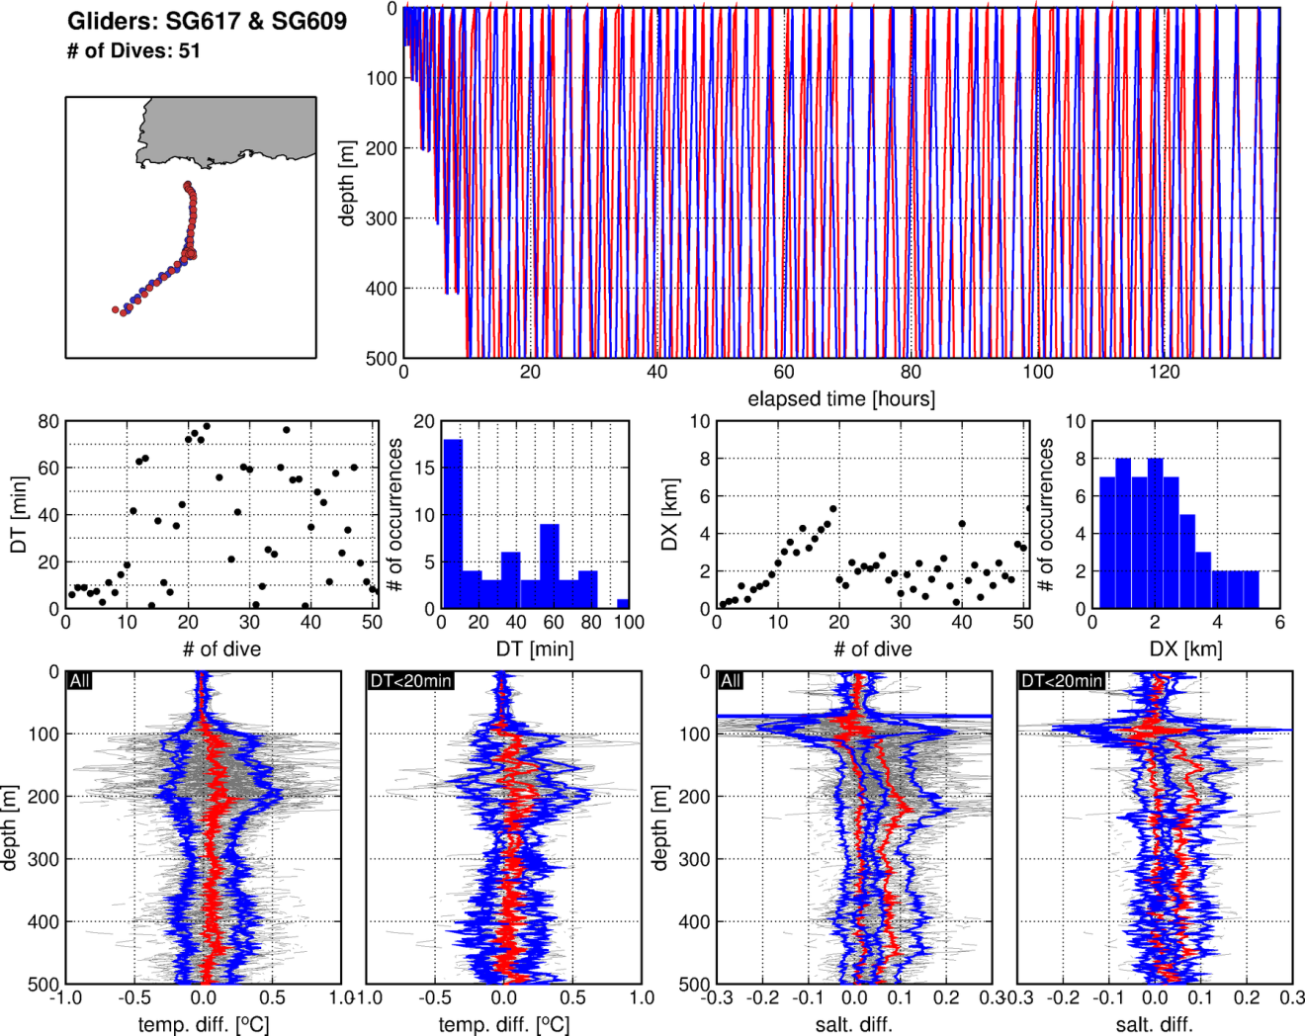
Comparison Dataset
03/10/2016 – 03/16/2016
Deployment Site -> SC (2days) -> ST1
SG609 (Unpumped CTD): 51 dives
SG617 (Pumped CTD): 59 dives
51 pairs !
Deployment site
SC
ST1

Slide 3
Dive-pairs Characteristics
Dive-pairs were chosen selecting smaller time difference
Time difference
Most pairs within class of DT<10
21 profiles within class DT<20 min
Distance
Most pairs within class of DX<4km
All pairs with DX < 8 km

Slide 4
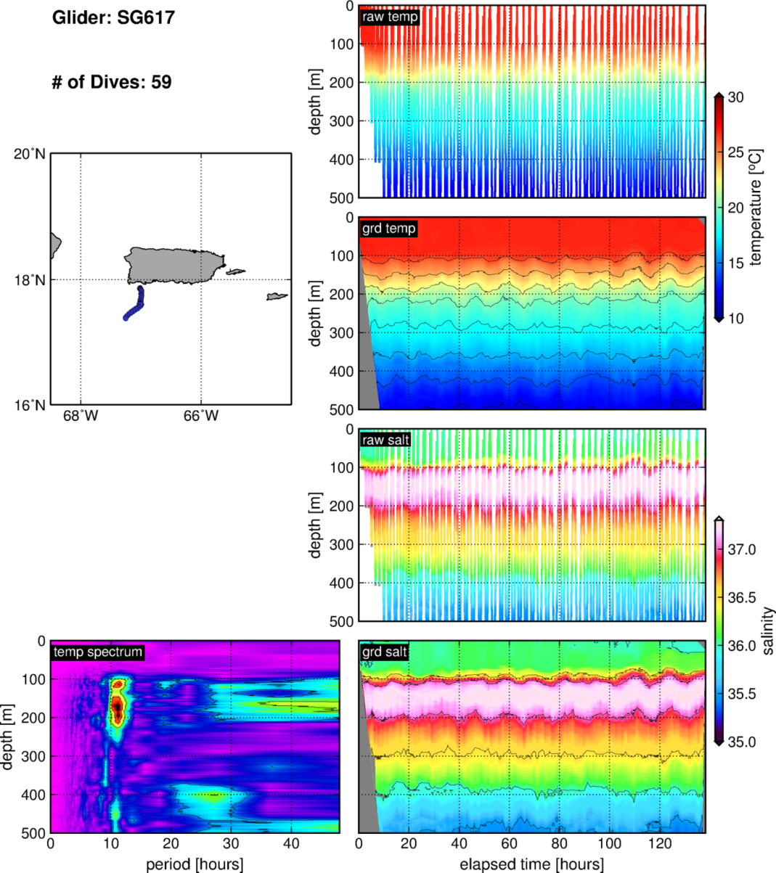
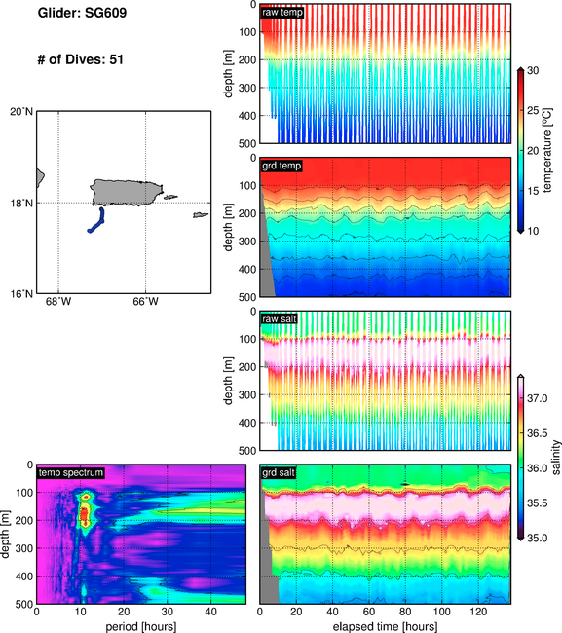
~12 hours periodicity in the thermocline -> semi-diurnal tides (Ocean Dynamics)!

Slide 5
12
3 hours
12 hours
~12 hours periodicity in the thermocline -> semi-diurnal tides (Ocean Dynamics)!

Slide 6
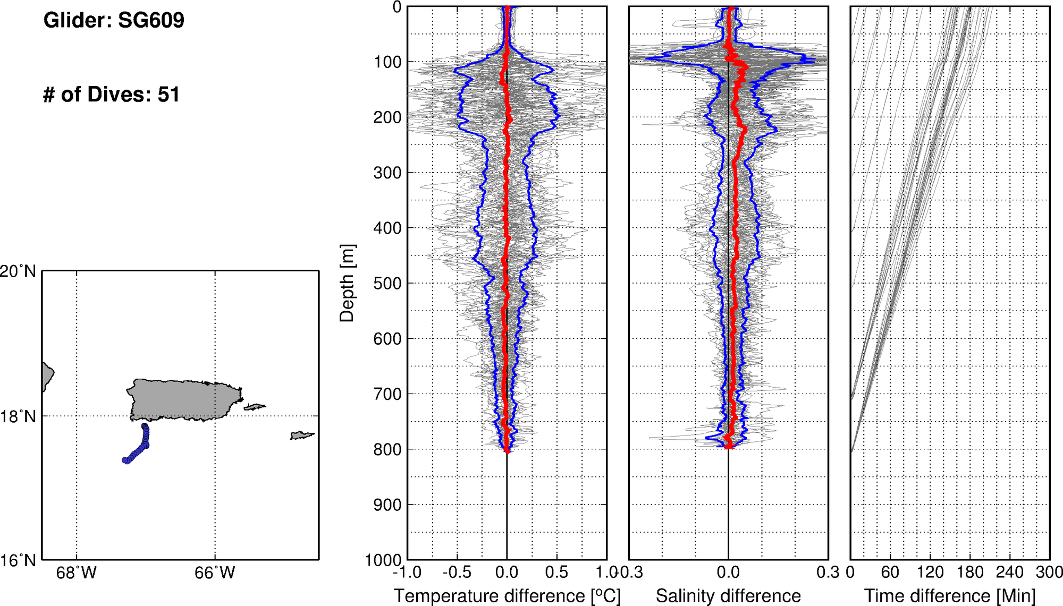
SG609: dive to climb differences (Unpumped CTD)
Temperature Difference
Up to 1.5C in the thermocline
Mean Diff = 0C ± 0.5C

Slide 7
SG609: dive to climb differences (Unpumped CTD)
Salt Difference
Up to 0.5 in the thermocline
Mean Diff = up to +0.05 ± 0.2
SALT: Small positive biases on climb
Differences mostly due to:
Ocean Dynamics / Tides (!!)
Large differences between individual profiles
Instrument biases: climb vs. dive
Smaller differences that appear on statistical averages

Slide 8
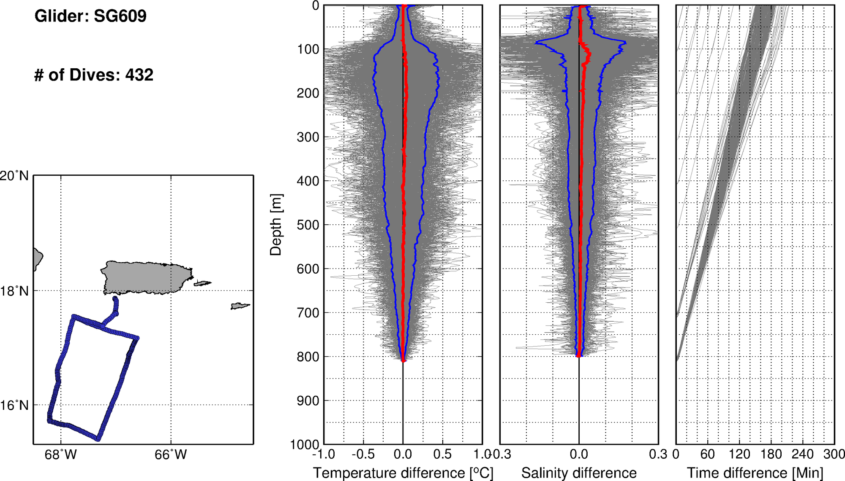
SG609: dive to climb differences (Unpumped CTD)
Salt Difference
Up to 0.5 in the thermocline
Mean Diff = up to +0.05 ± 0.2
SALT: Small positive biases on climb

Slide 9
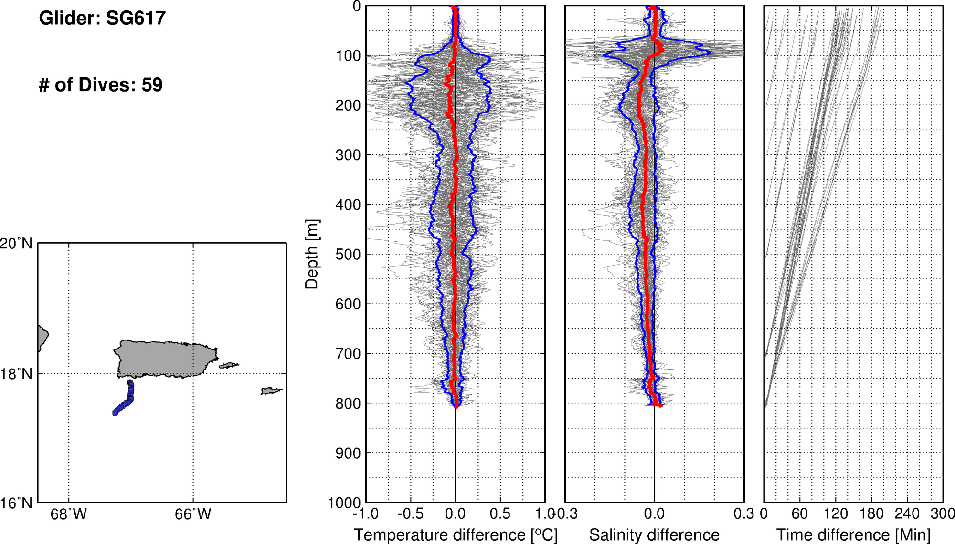
SG617: dive to climb differences (Pumped CTD)
Salt Difference
Up to 0.5 in the thermocline
Mean Diff = up to -0.05 ± 0.05
SALT: Small negative biases on climb

Slide 10
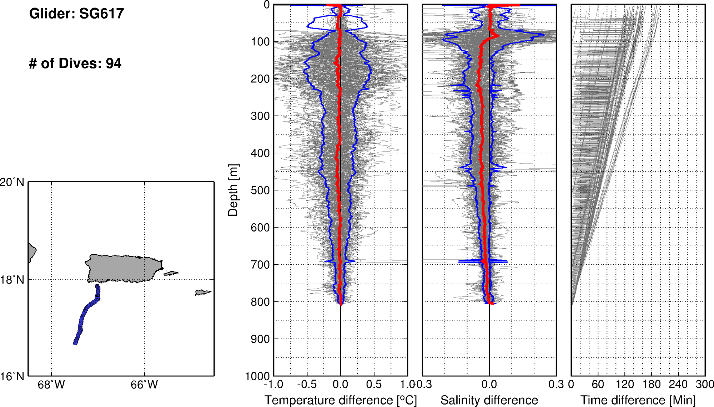
SG617: dive to climb differences (Pumped CTD)
Salt Difference
Up to 0.5 in the thermocline
Mean Diff = up to -0.05 ± 0.06
SALT: Small negative biases on climb

Slide 12
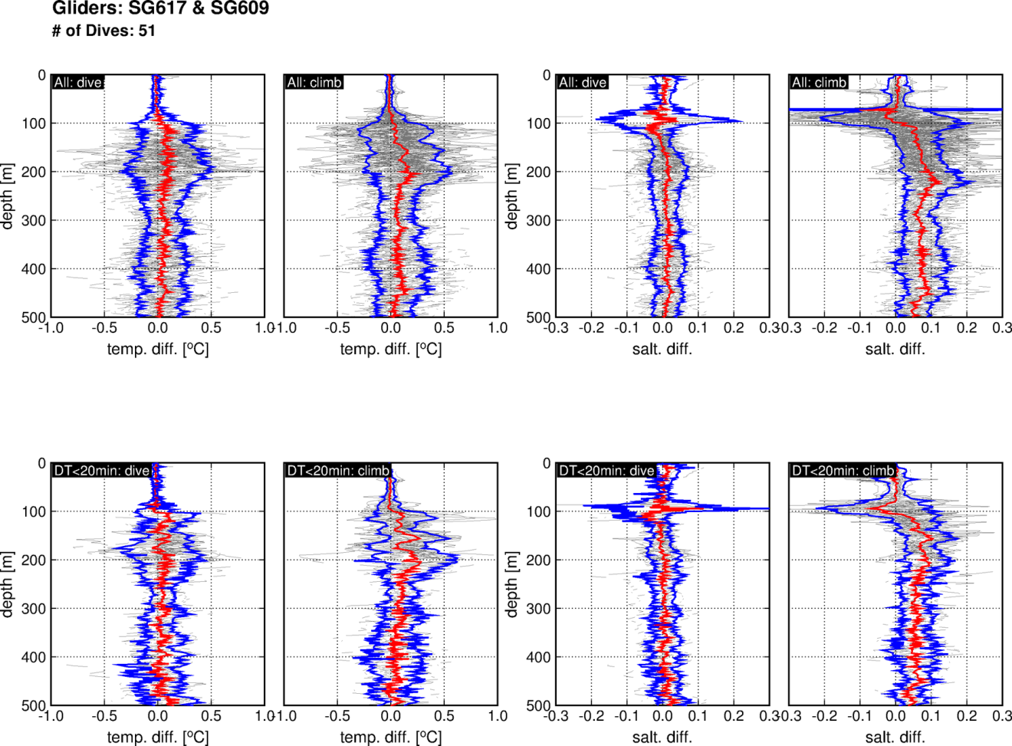
Plots show: SG609 minus SG617

Slide 14
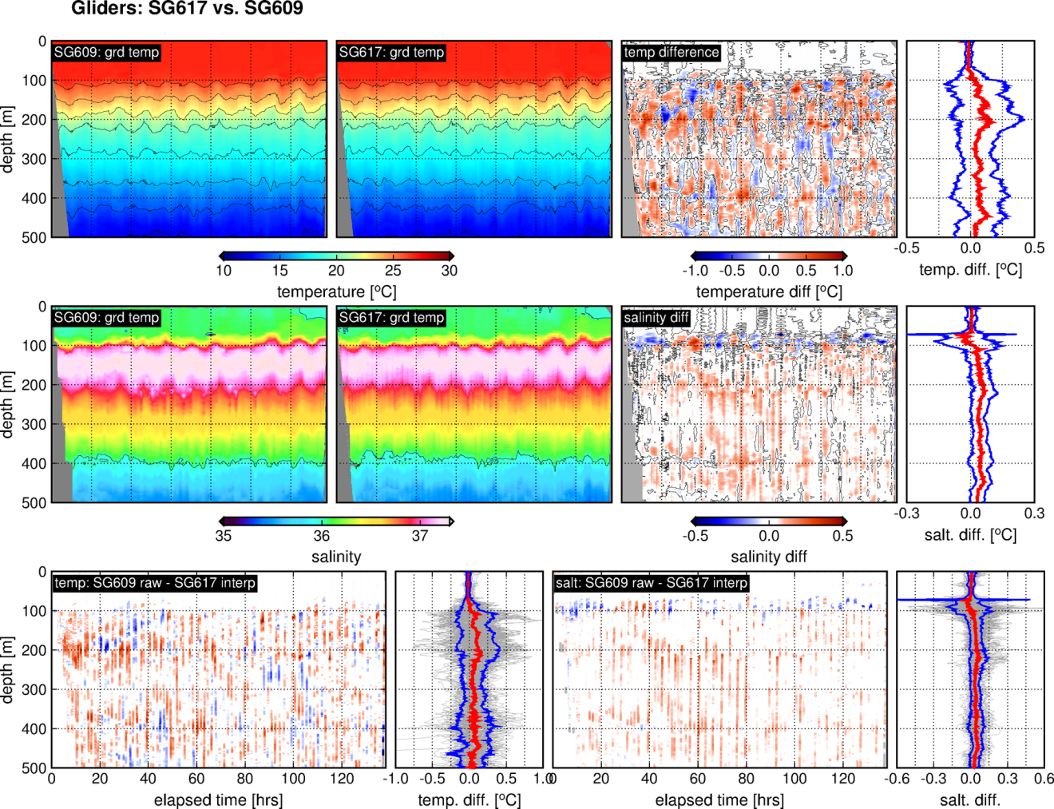

Slide 15
Summary – main conclusions
SG609: Small positive salinity biases on climb (up to +0.03 ± 0.2)
SG617: Small negative salinity biases on climb (up to -0.05 ± 0.05)
SG609 vs. SG617: SG609 minus SG617
  Temperature: differences slightly positive, but not statistically different from zero
  Salinity:
    DIVE: Differences statistically equal to zero
    CLIMB: Differences up to 0.1 ± 0.05
Are differences between pumped and unpumped CTD signiticant?
  Looks like biases in the climb of both gliders dominate the salinity differences, rather than differences caused by pumped and unpumped CTD
Further Analysis (?), Paper (?)

