Slide 1
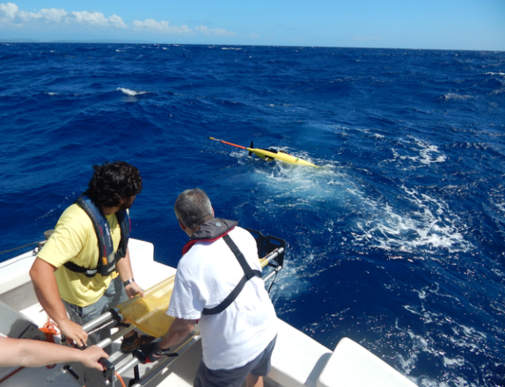
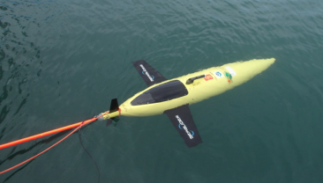
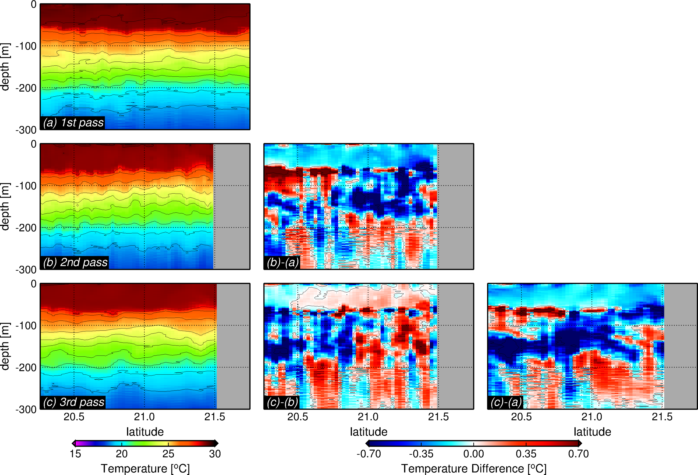
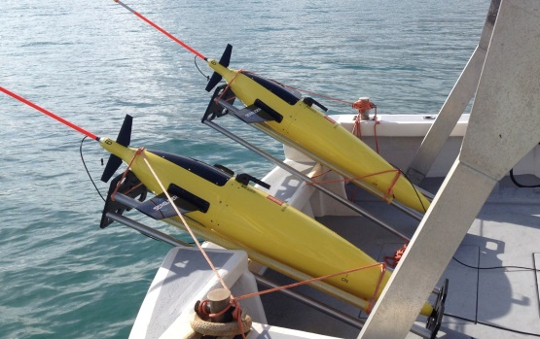
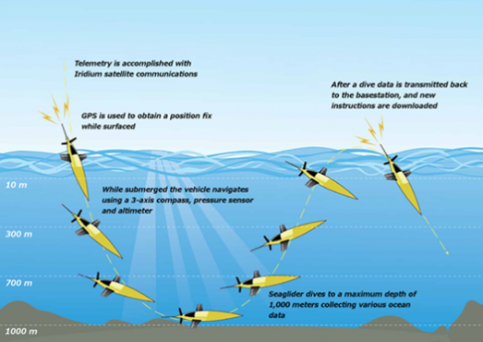
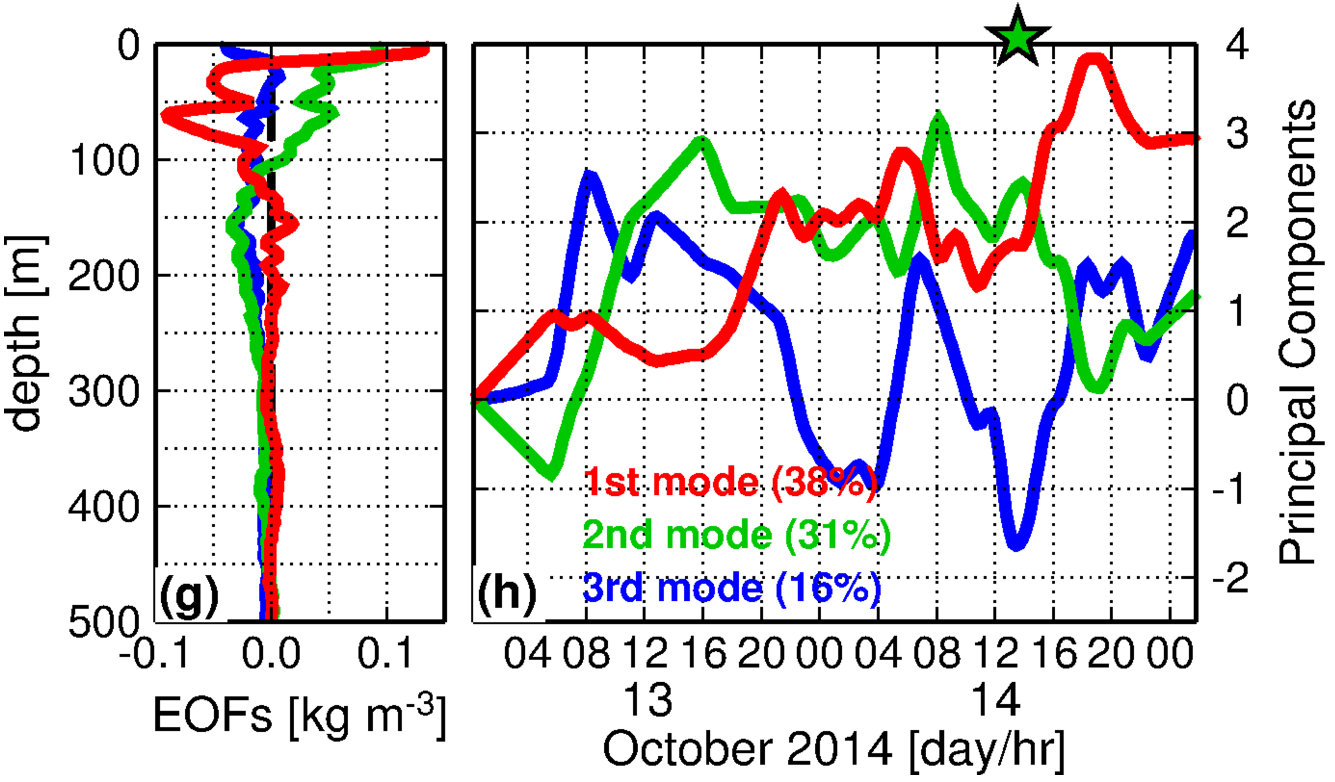
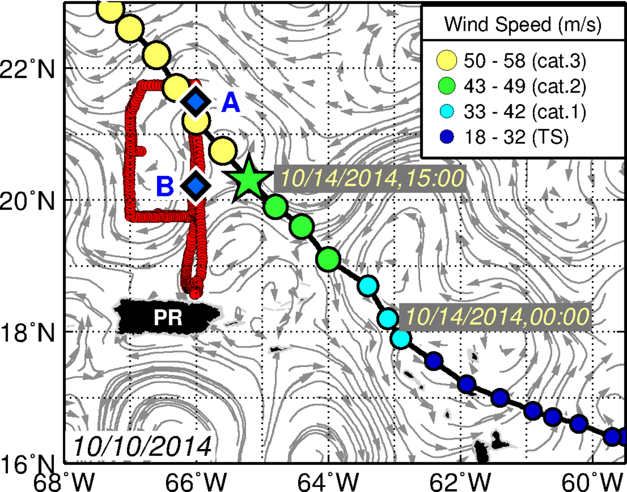
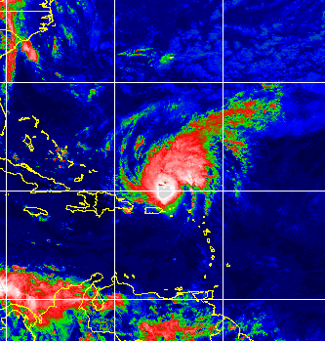
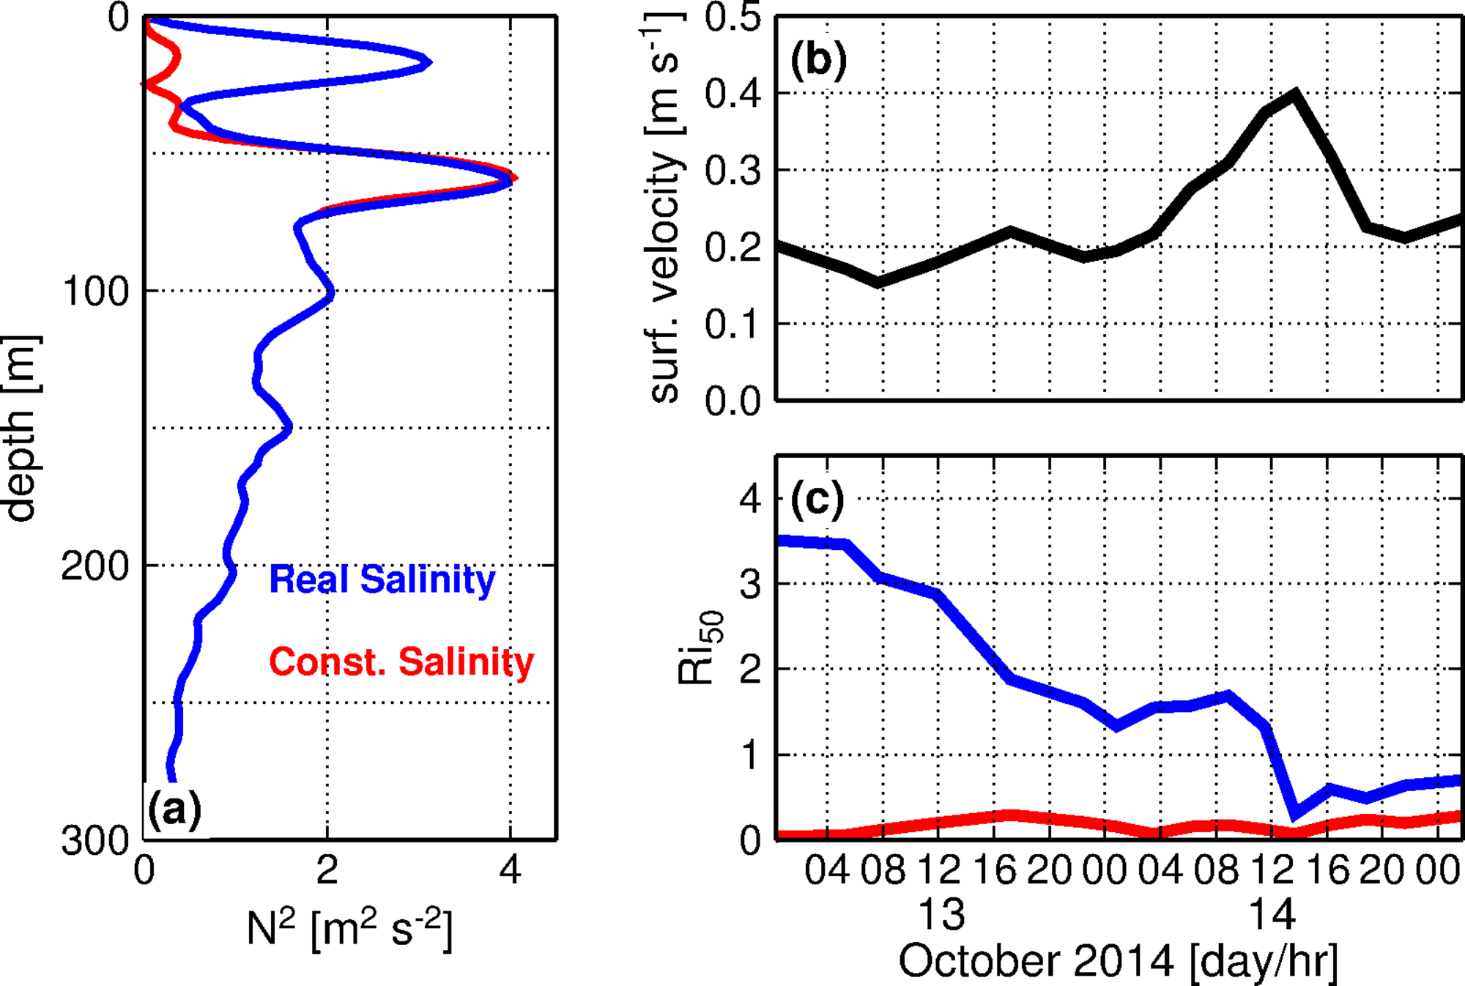
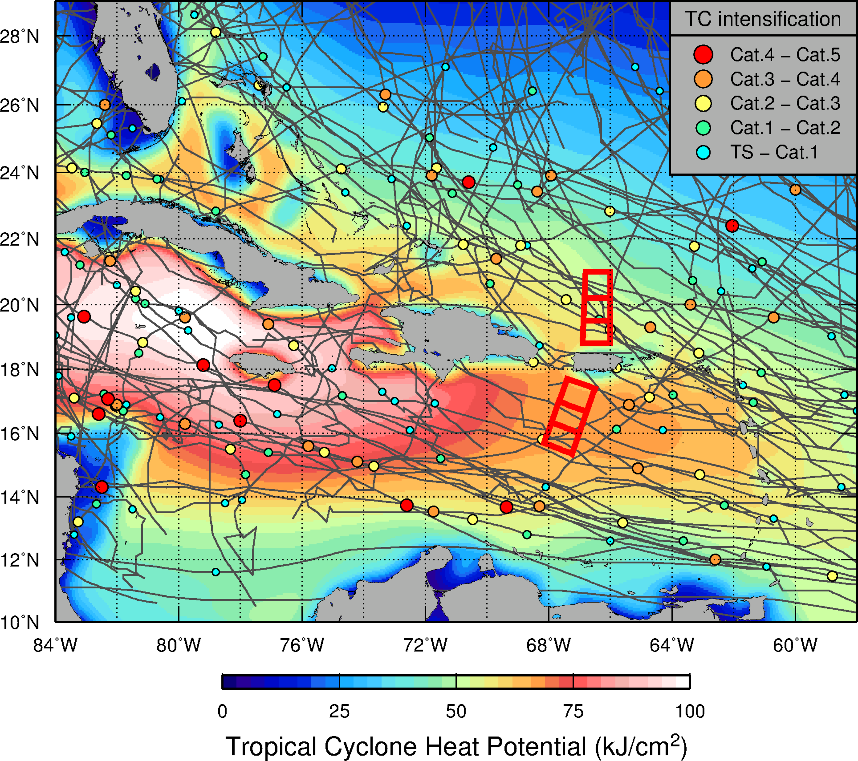
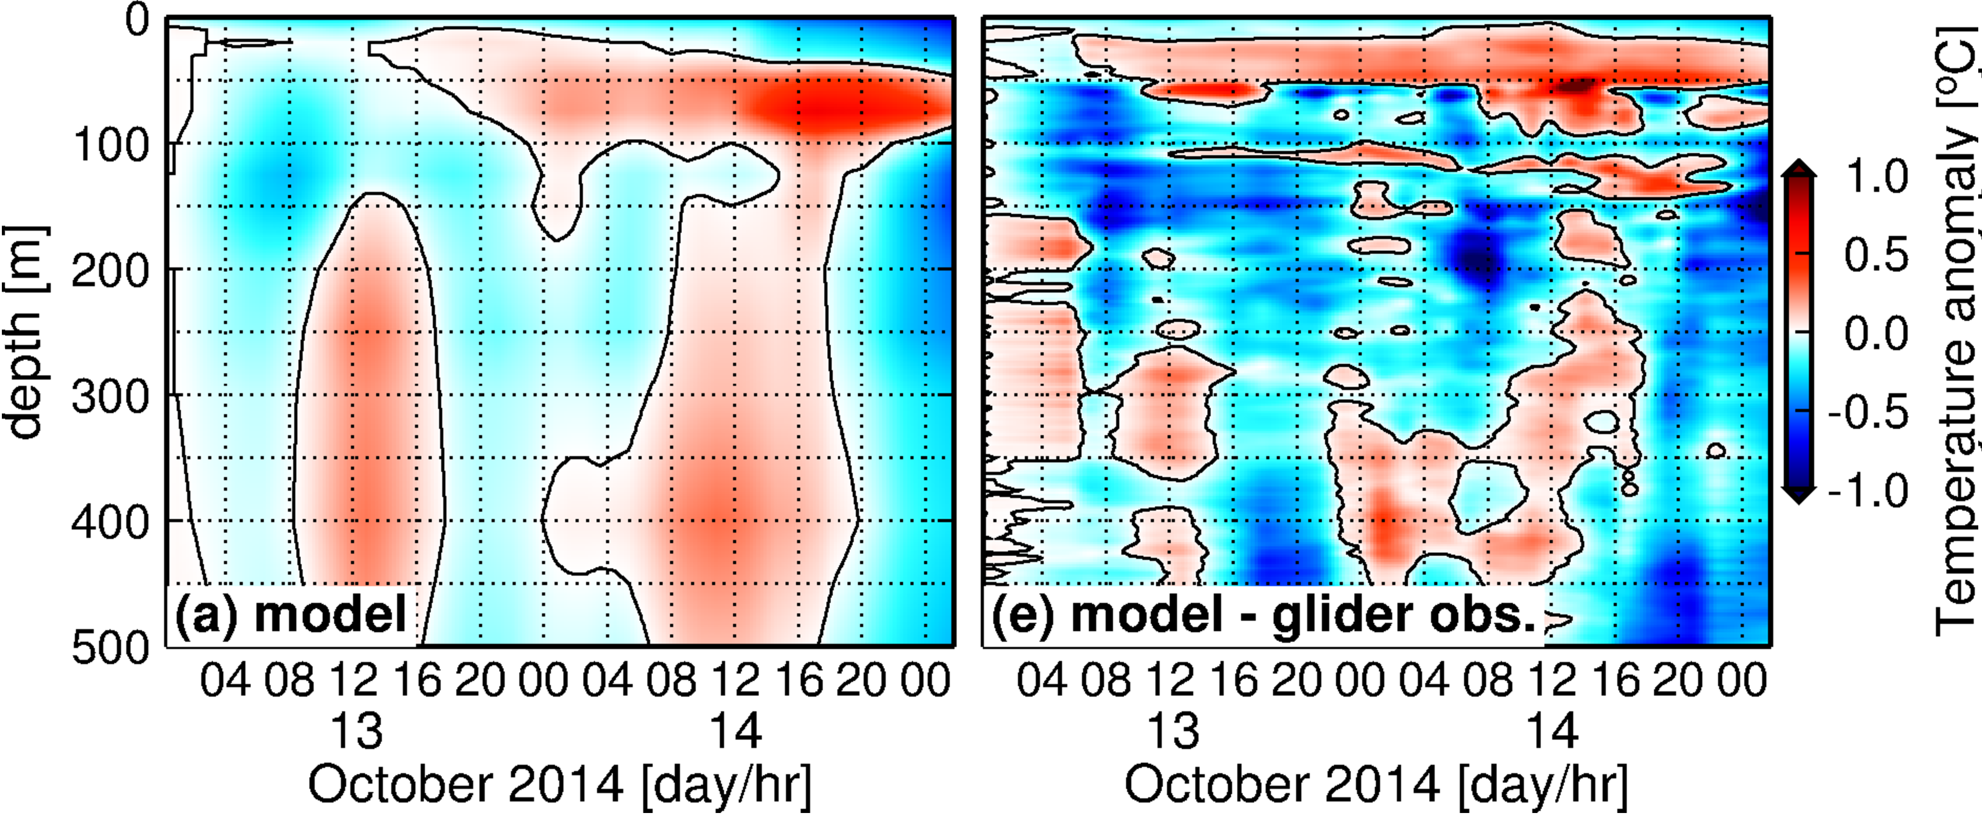
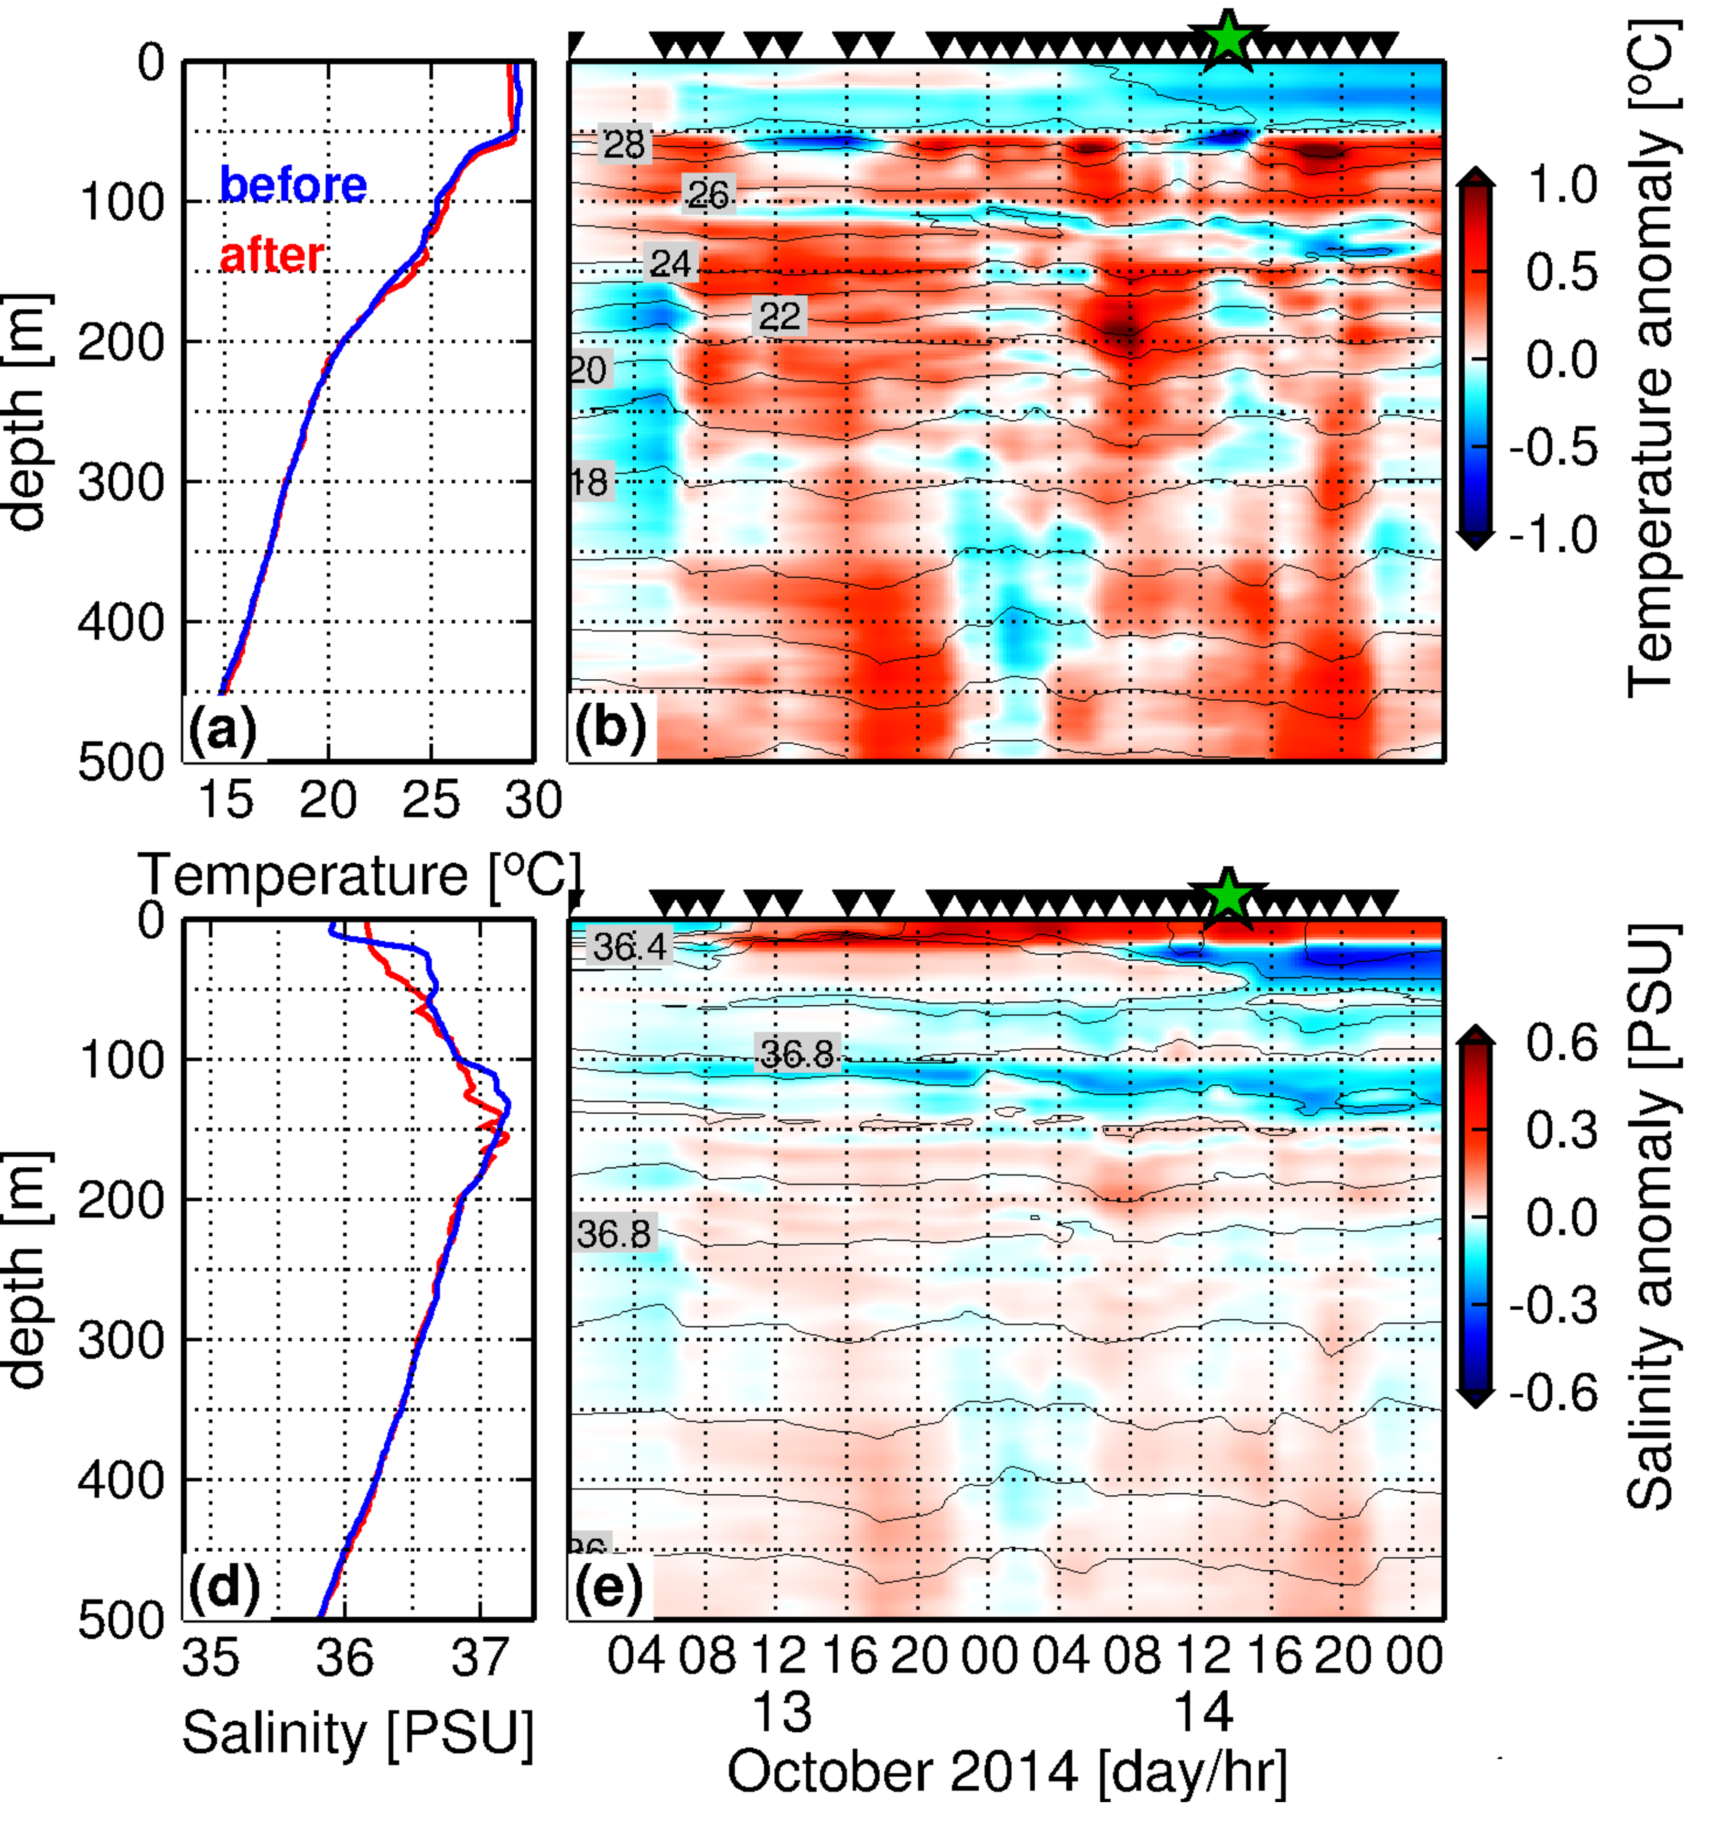
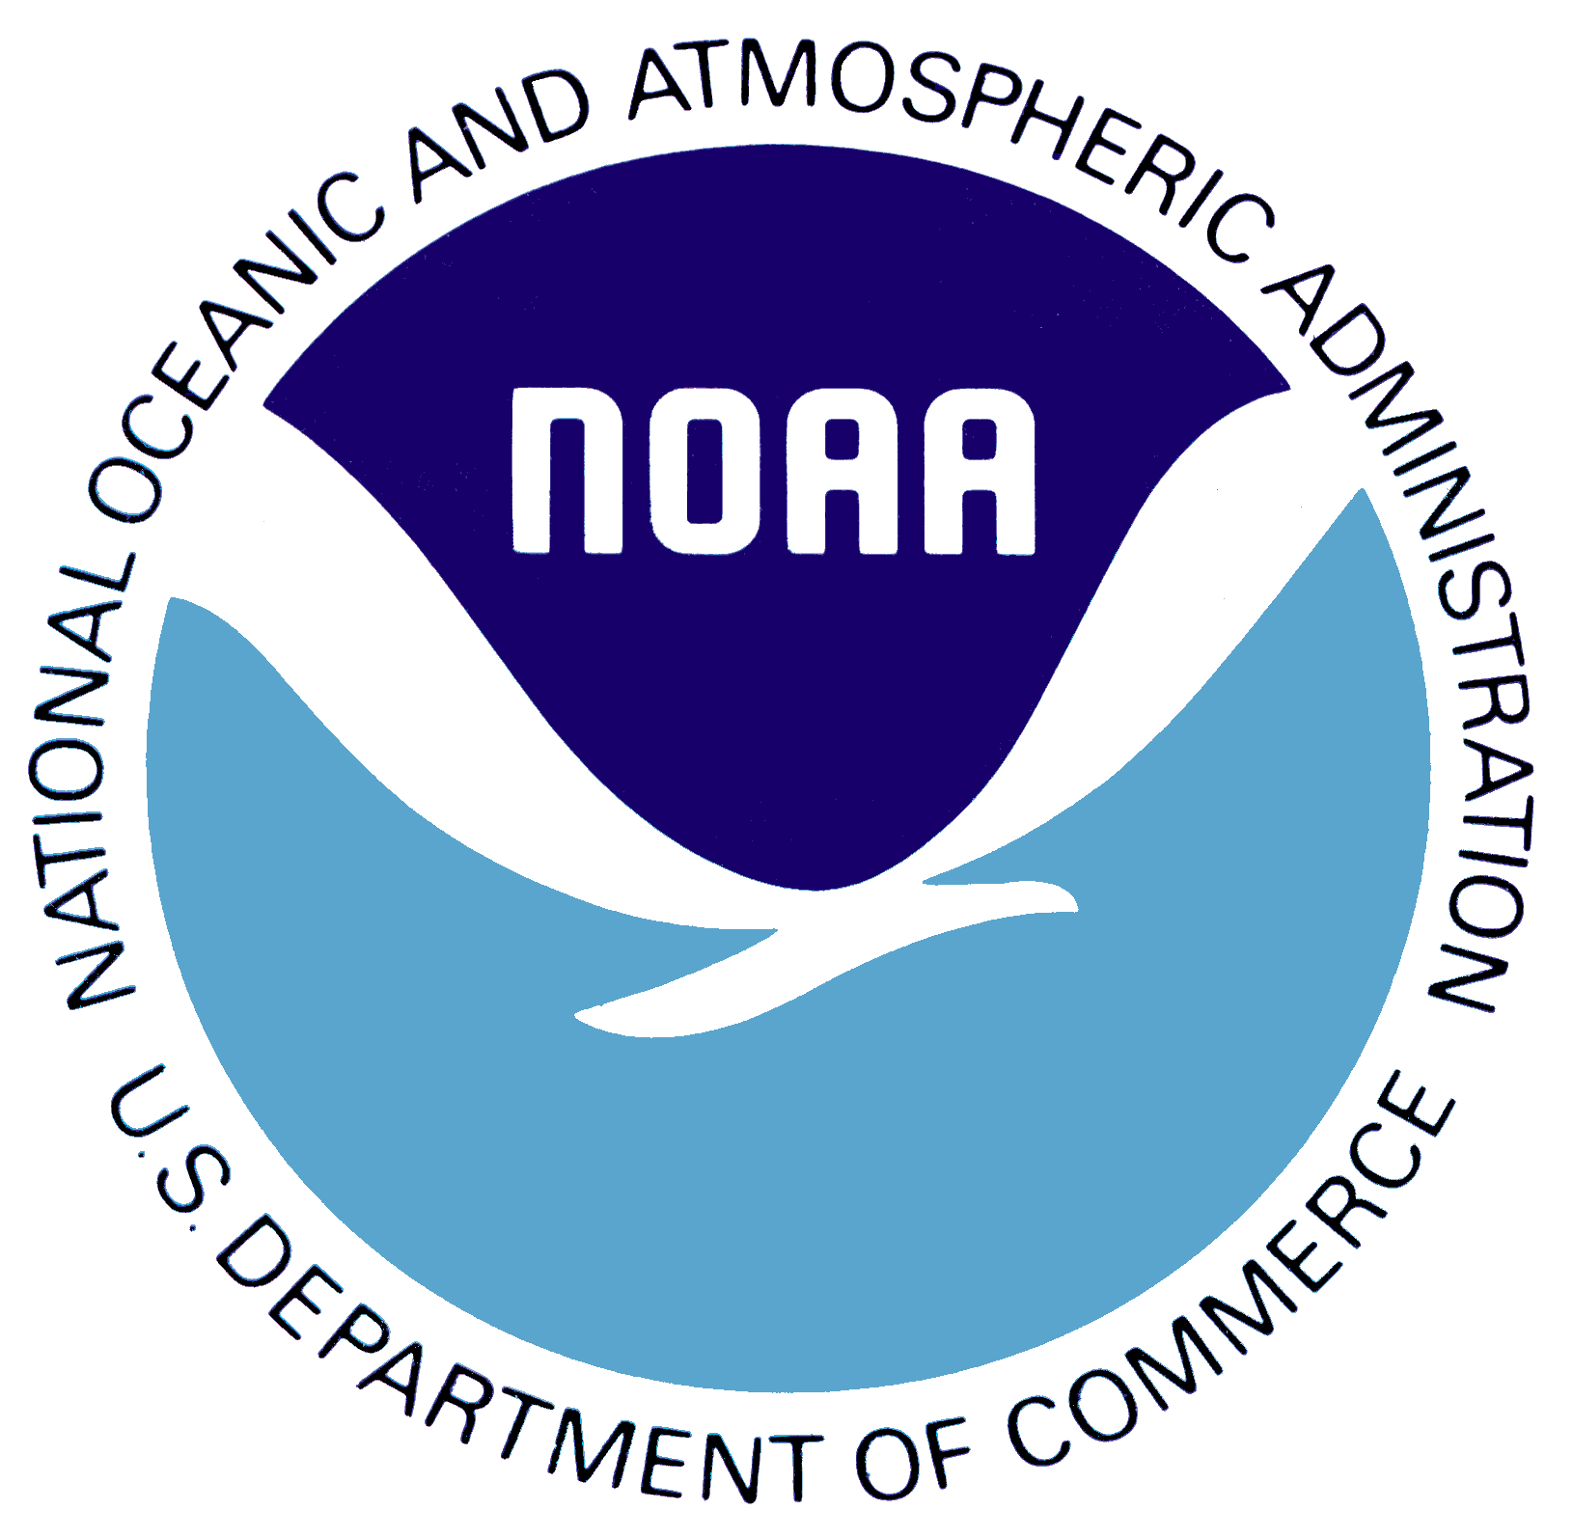
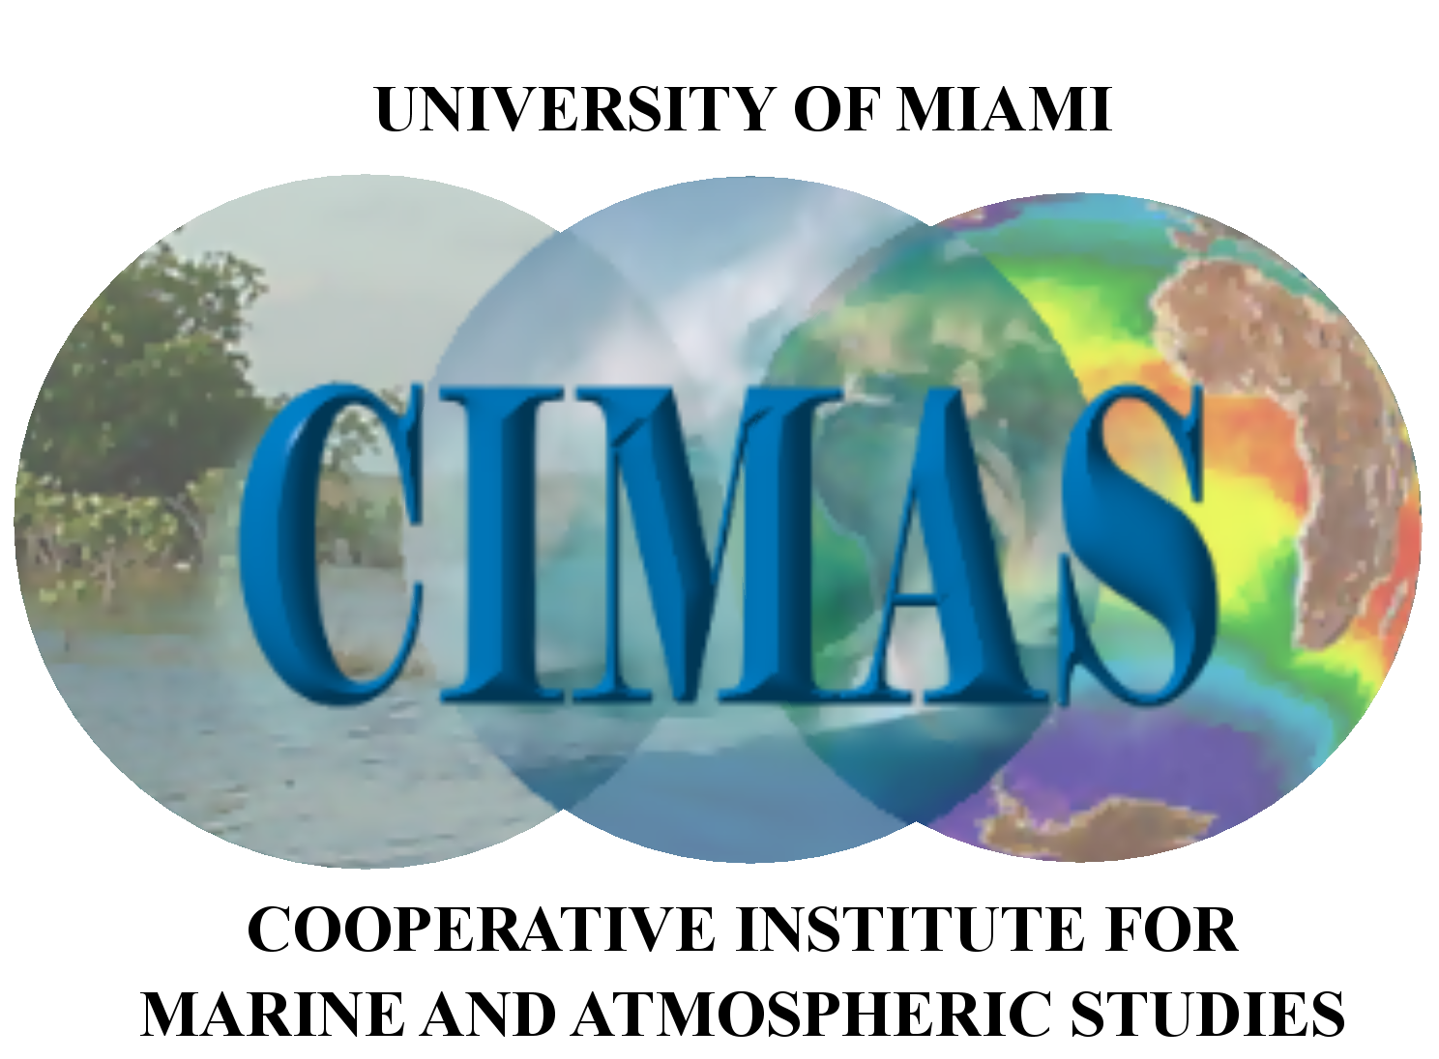

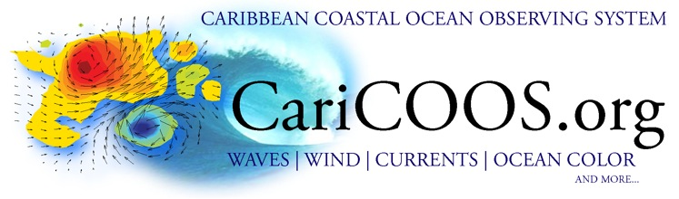



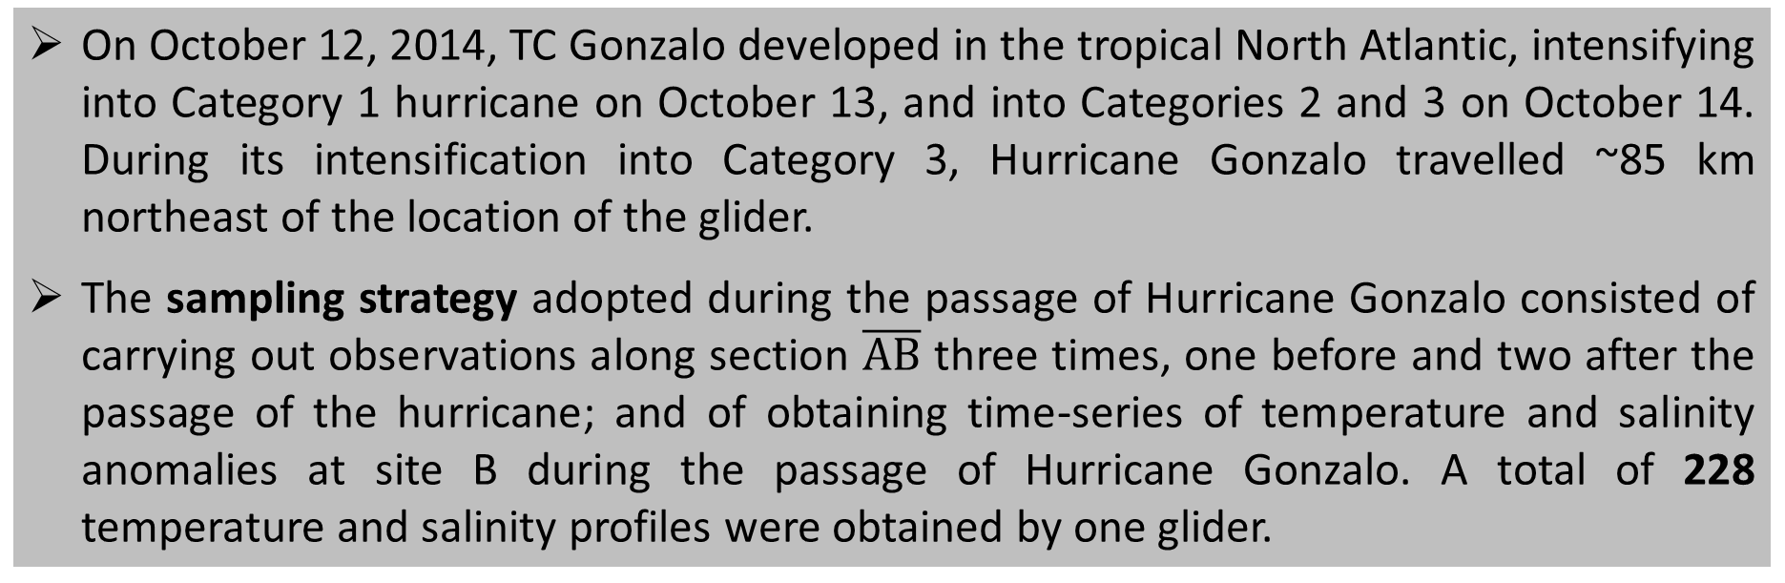
Upper ocean response to Hurricane Gonzalo (2014): Salinity effects revealed by targeted and sustained underwater glider observations
Ricardo Domingues^{1,2}, Gustavo Goni², Francis Bringas², Sang-Ki Lee^{1,2}, Hyun-Sook Kim^{3,4}, George Halliwell², Jili Dong^{1,2}, Julio Morel^{5,6}, and Luis Pomales⁵
Ocean Sciences Meeting, New Orleans, February 2016. Poster: A54C-2736
3. Underwater Gliders
6. Post-storm
Abstract
Stronger cooling observed in the proximity of site A possibly linked with two processes: wind-driven rightward biased cooling, and intensified upwelling in the vicinity of the track of the hurricane. 11 days after the passage of Hurricane Gonzalo, the upper-ocean started warming above 50m
A network of underwater gliders was implemented in 2014 by NOAA/AOML as part of a multi-institutional project to carry out sustained and targeted upper-ocean observations to 1000m depth in the Caribbean Sea and Tropical North Atlantic Ocean in order to enhance our knowledge on the role that the ocean plays in the intensification of TCs, and to assess the impact of these observations on the TC intensity forecast.
During Hurricane Gonzalo, for the first time gliders were used to obtain ocean observations at a fixed location during the passage of a Atlantic hurricane, and along a repeat section to assess upper-ocean changes and recovery after the hurricane. Hurricane Gonzalo (2014) traveled within 85km from the location of an underwater glider situated north of Puerto Rico. Observations collected before, during, and after the passage of this hurricane were analyzed to improve our understanding of the upper-ocean response to hurricane winds. Analysis of these observations revealed that salinity potentially played an important role in modulating the upper-ocean response to Hurricane Gonzalo. a near-surface barrier-layer likely suppressed the hurricane-induced upper-ocean cooling, leading to smaller than expected temperature changes. Comparison with a coupled ocean-atmosphere hurricane model indicates that model observations discrepancies are largely linked to salinity effects described. These results may potentially lead to improvements in ocean simulations on the coupled model used for hurricane forecasts, which can ultimately bring benefits to the society by improving hurricane predictions.
A: pre-storm
Figure 4. (A) Pre-storm temperature section (October 8-13). (B) 1st post-storm (October 15-23), and (C) 2nd post-storm (October 23-28) temperature sections.
B: 1st post-storm
(B) – (A)
An underwater glider is an autonomous underwater vehicle (AUV) that uses small changes in buoyancy together with wings to propel itself by converting vertical motion into horizontal motion. Thanks to a very small consumption of energy, underwater gliders have longer ranges when compared to other AUVs, being able to measure several ocean parameters during months, including temperature, salinity, and dissolved oxygen.
C: 2nd post-storm
(C) – (B)
(C) – (A)
Site B
Site A
7. Data Analysis & Upper-ocean Processes
Changes observed during storm above 130m were consistent with wind-forced mixing, which were captured by the first mode of the density variability. The second and third modes exhibited periodic changes that indicate background motions due to internal tides and near-inertial baroclinic motions partly forced by the storm.
4. Hurricane Gonzalo (2014)
IR-NHC: CIMSS
1. Motivation
Estimates of Richardson Number (Ri₅₀) indicate that initial conditions at site B were characterized by strong stratification, with large values of ~3. The large value of Ri50 at the beginning of the record at site B imply the dominance of stratification effects over vertical shear effects, indicating that turbulent mixing was likely partially suppressed in this location.
Figure 2. (left) Track followed by the glider (red points) north of Puerto Rico (PR) during July-November 2014. The track of Hurricane Gonzalo is shown by colored circles. (right) Infra-red (IR) image from Gonzalo on October 14, 2014.
On October 12, 2014, TC Gonzalo developed in the tropical North Atlantic, intensifying into Category 1 hurricane on October 13, and into Categories 2 and 3 on October 14. During its intensification into Category 3, Hurricane Gonzalo travelled ~85 km northeast of the location of the glider.
The sampling strategy adopted during the passage of Hurricane Gonzalo consisted of carrying out observations along section $\overline{AB}$ three times, one before and two after the passage of the hurricane; and of obtaining time-series of temperature and salinity anomalies at site B during the passage of Hurricane Gonzalo. A total of 228 temperature and salinity profiles were obtained by one glider.
8. Modeling results: HYCOM-HWRF
The model overestimated the surface cooling by 0.2°C, possibly because of discrepancies in initial conditions for salinity.
Larger SST cooling in the model may have lead to an underestimated intensity forecast for Gonzalo.
A: model
B: model – glider
5. Pre-storm & During storm
Key results & Conclusions
Figure 1. Historical tracks of Tropical Cyclones that travelled through the Caribbean Sea and Tropical North Atlantic waters overlaid on the field of Tropical Cyclone Heat Potential for the Atlantic Hurricane season during 1993-2012. Markers indicate the location where intensification was observed.
Figure 3. (A) Pre-storm (blue line) and post-storm (red line) temperature profiles at site B. (B) Depth-time diagram of temperature anomalies during October 13-15 at site B. (C) same as Figure 3A, but for salinity. (D) Same as Figure 3C, but for salinity.
During the first 18 months of this project, approximately 8,000 temperature and salinity profiles were collected in areas where hurricanes often travel and intensify
Observations collected during Hurricane Gonzalo showed that:
  Upper-ocean cooling forced by winds of Hurricane Gonzalo was small
  Mixing-induced cooling was partially suppressed by near-surface stratification due to salinity conditions, which defined a surface barrier layer
  Upper-ocean response to Hurricane Gonzalo involved multiple ocean processes, such as wind-driven mixing and upwelling, and near-inertial baroclinic motions
  Hurricane forecasts: A better representation of salinity features, such as the shallow low salinity layer observed above 20m, may help improve future hurricane forecasts
  These results emphasize the value of sustained and targeted ocean observations by underwater gliders for tropical cyclone intensification studies.
Tropical Cyclones are commonly observed to travel and intensify over the Caribbean Sea and Tropical North Atlantic in areas off Puerto Rico, which are characterized by high values of Upper Ocean Heat Content during the Atlantic Hurricane Season.
Yet, very few observations have been collected in these areas during the last few decades
Currently, there are no ocean observing system in place in the area to provide data on a sustained fashion to support Hurricane research and forecasts.
A
B
Pre-storm conditions at site B were marked by the presence of a shallow low-salinity layer above 20m (Figure 3b) that was associated with the presence of a barrier layer
During the storm: small cooling of -0.4°C was observed above 50m; below 50m, temperature and salinity anomalies were dominated by alternating positive and negative values.
2. Goal & Objectives
Improve understanding about the role that the ocean plays in the intensification of tropical cyclones
Implement a network of underwater gliders to carry out sustained and targeted ocean observations
Investigate the response of the ocean to hurricane force winds
Assess the impact of glider observations on tropical cyclone seasonal and intensity forecasts
C
D
Domingues, R., G. Goni, F. Bringas, S.-K. Lee, H.-S. Kim, G. Halliwell, J. Dong, J. Morell, and L. Pomales (2015), Upper ocean response to Hurricane Gonzalo (2015): Salinity effects revealed by targeted and sustained underwater glider observations, Geophys. Res. Lett., 42, doi:10.1002/2015GL065378.
Acknowledgments
This work was funded by the Disaster Relief Appropriations Act of 2013 known as the Sandy Supplemental, and supported by NOAA/AOML, UPRM, UM/CIMAS, NOAA/NDBC, NOAA/IOOS, CariCOOS, and ANAMAR.
Affiliations & Contact Information
Corresponding author e-mail: Ricardo.Domingues@noaa.gov
More information: http://www.aoml.noaa.gov/phod/gliders
¹Cooperative Institute for Marine and Atmospheric Studies, University of Miami, USA;
²Atlantic Oceanographic and Meteorological Laboratory, NOAA/OAR, USA
³I. M. Systems Group Inc., and Marine Modeling and Analysis Branch, USA
⁴Environmental Modeling Center, NOAA/NWS, USA
⁵University of Puerto Rico Mayaguez, Puerto Rico
⁶Caribbean Coastal Observing System, CariCOOS
Please scan the QR code below to obtain a copy of:
This poster
GRL paper

