Slide 1
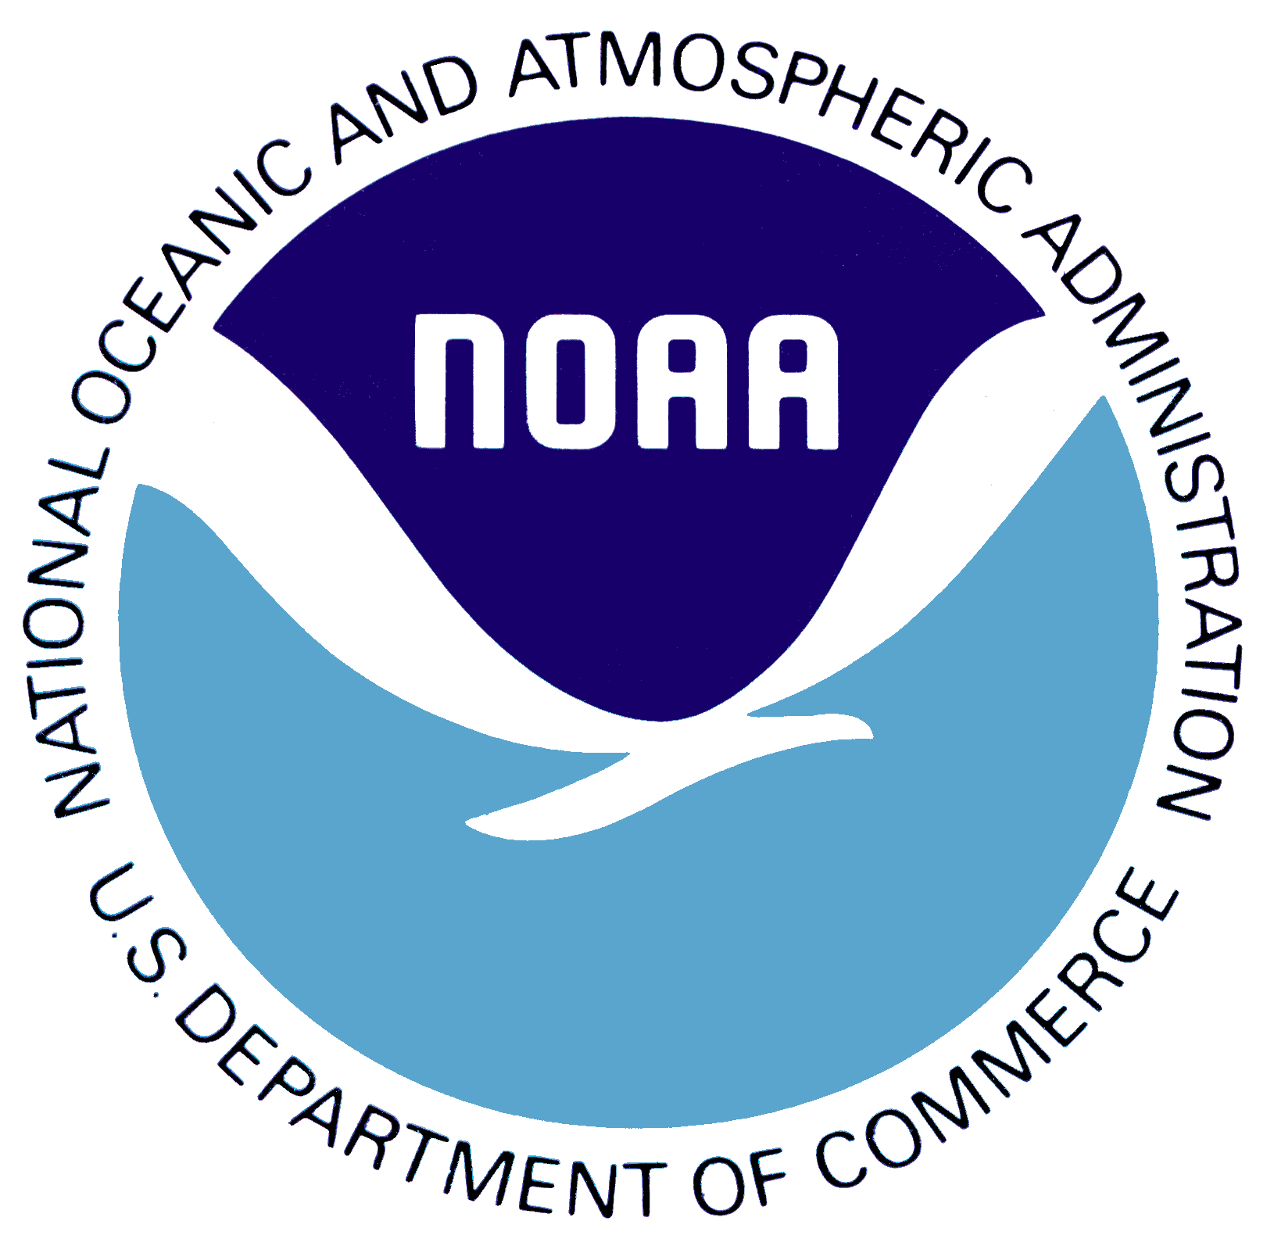
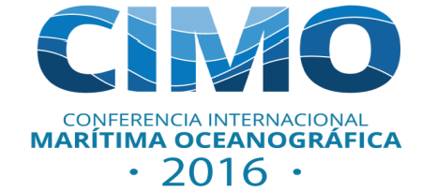
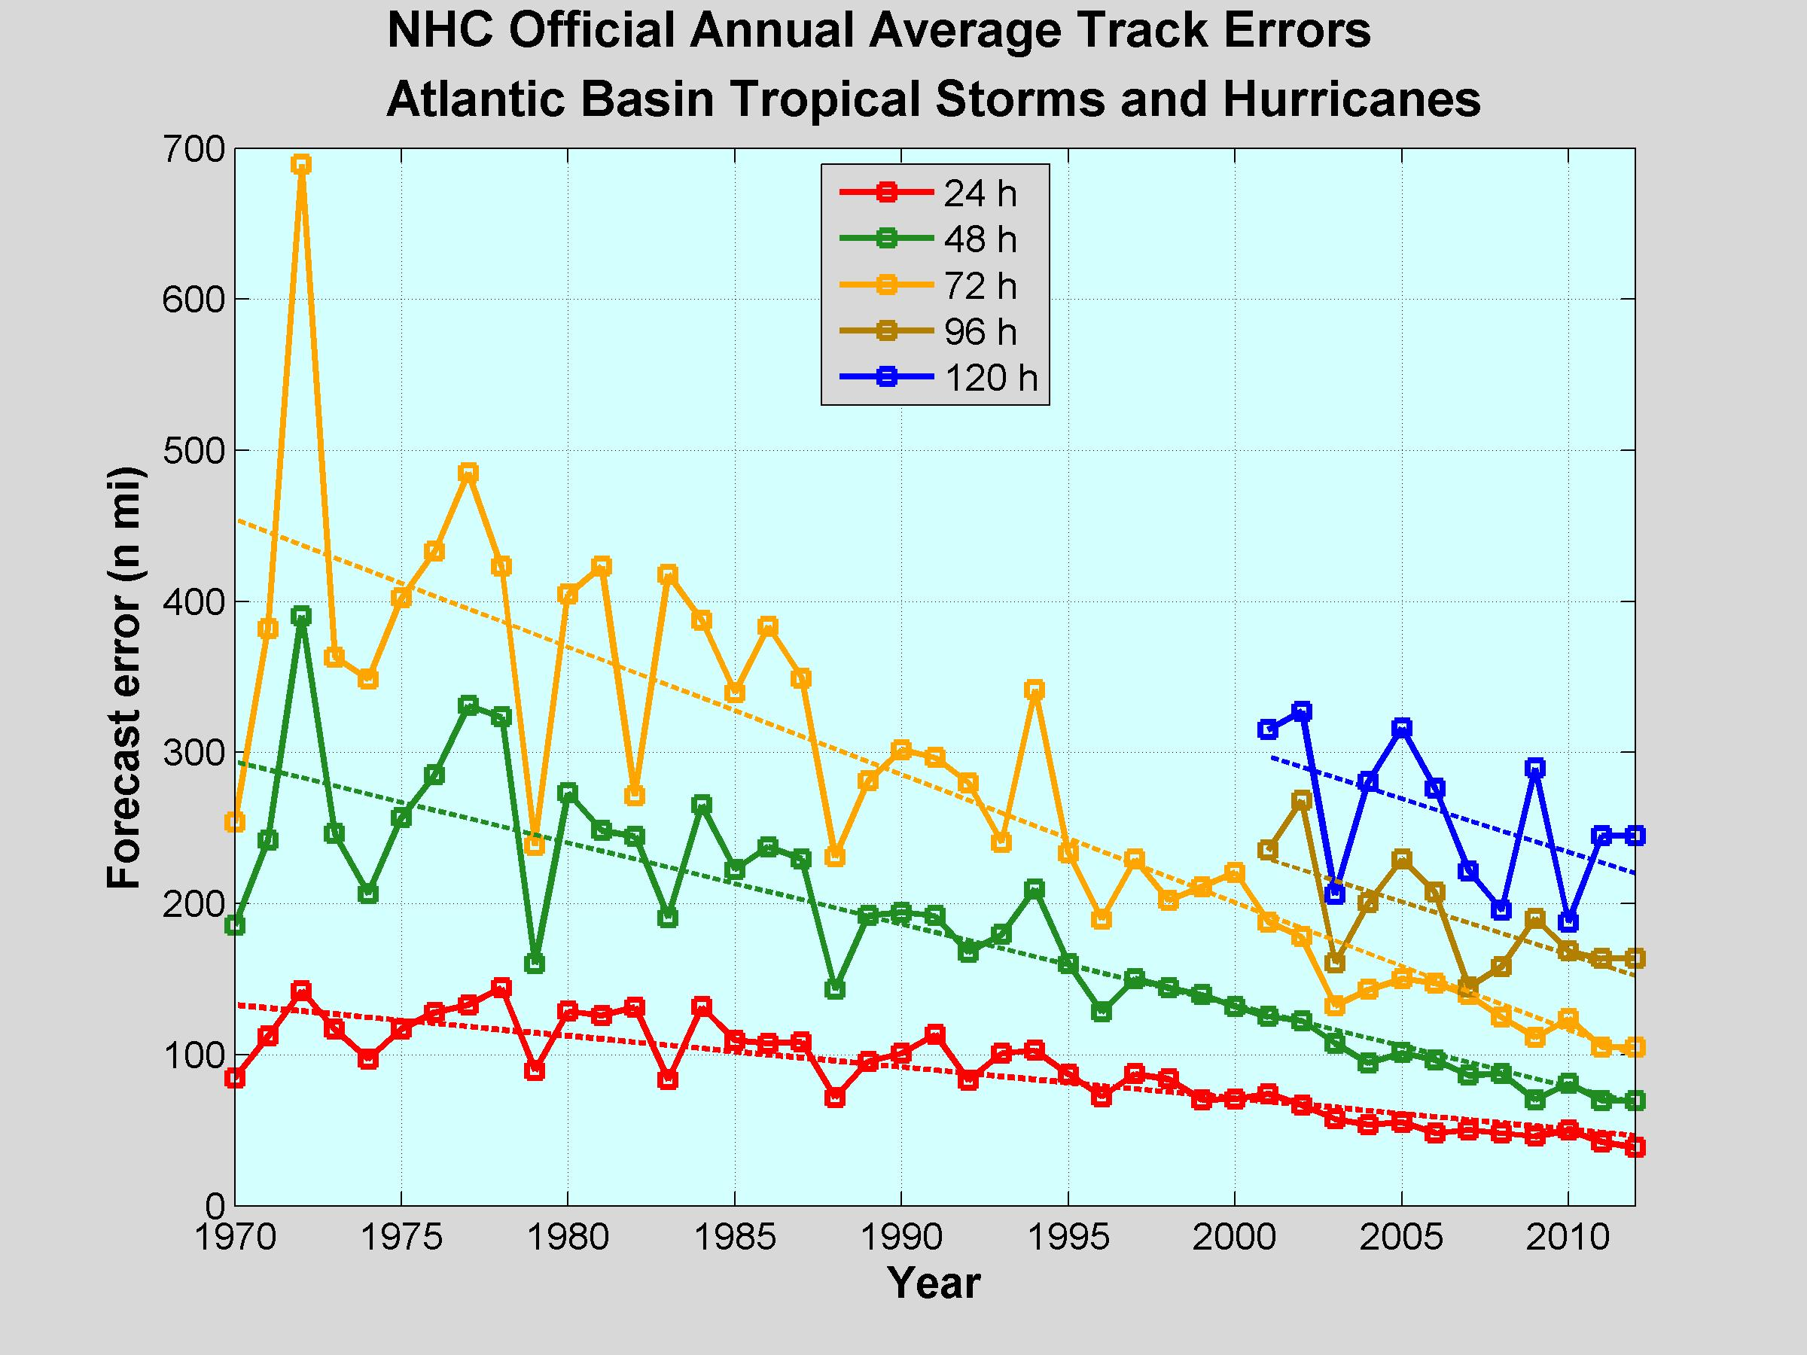
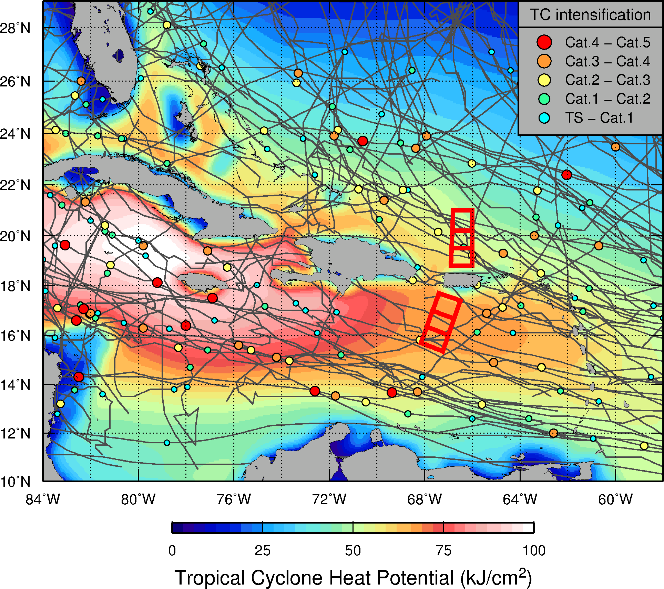
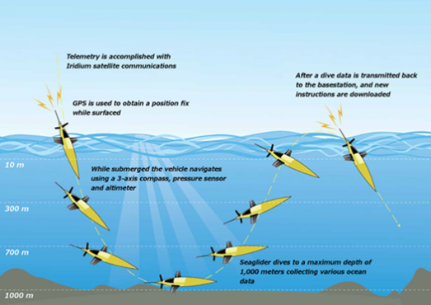
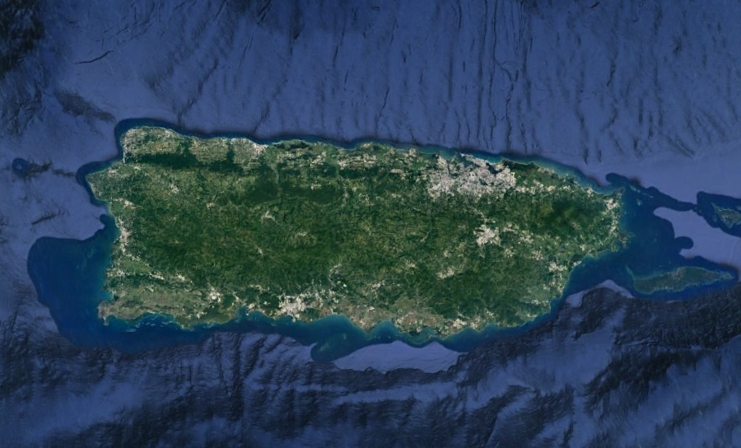
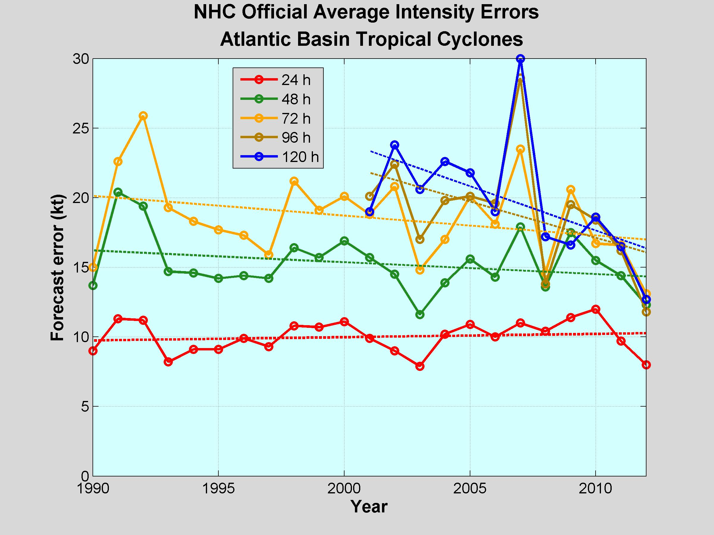
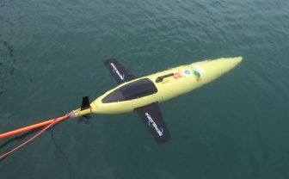
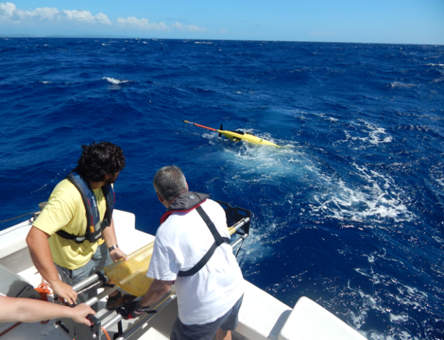
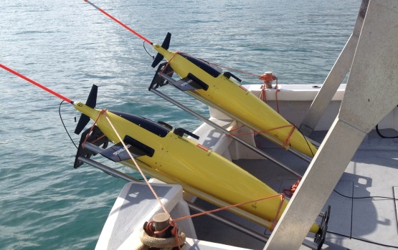
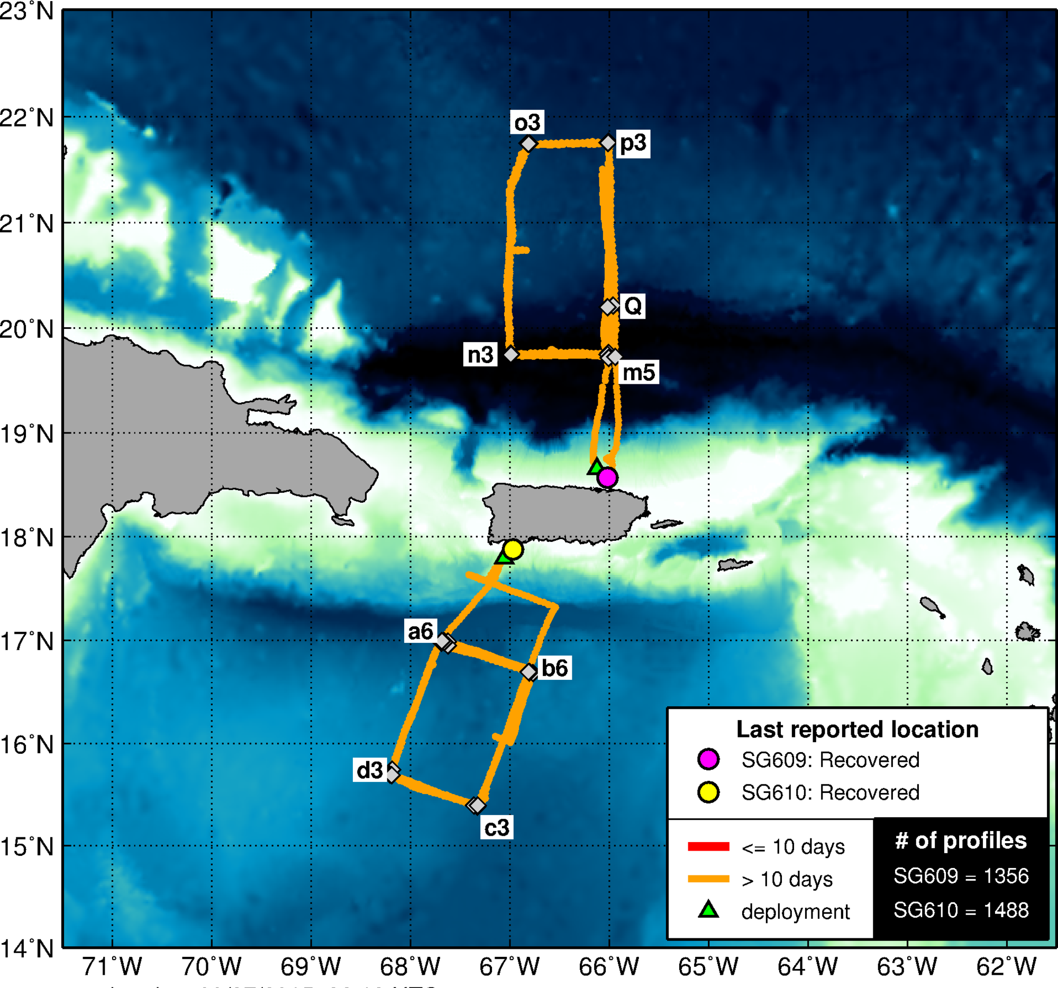
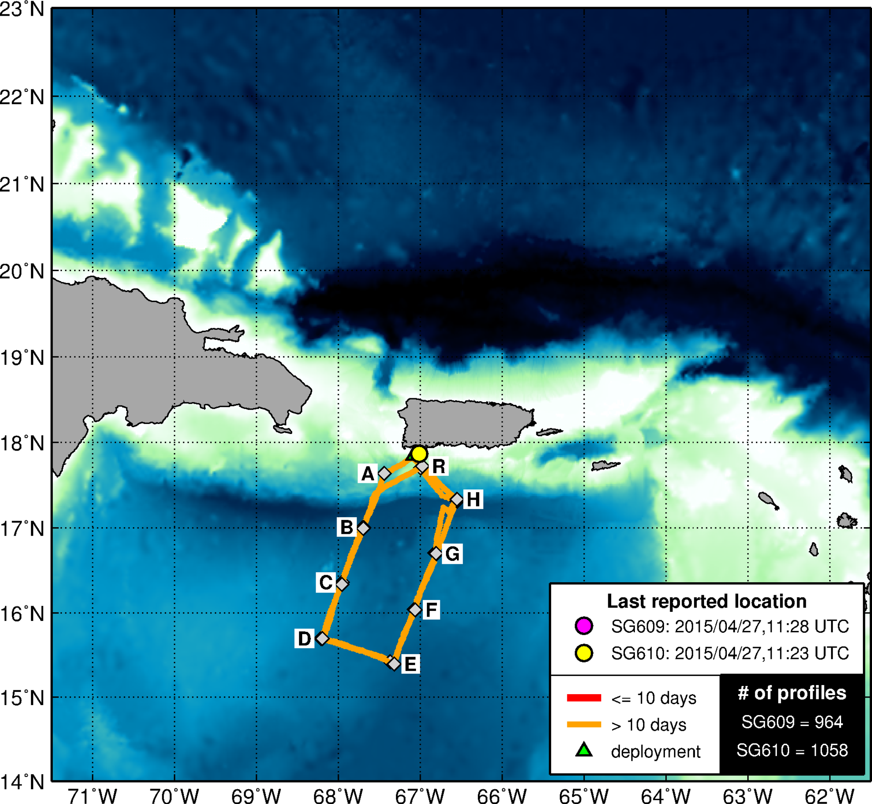

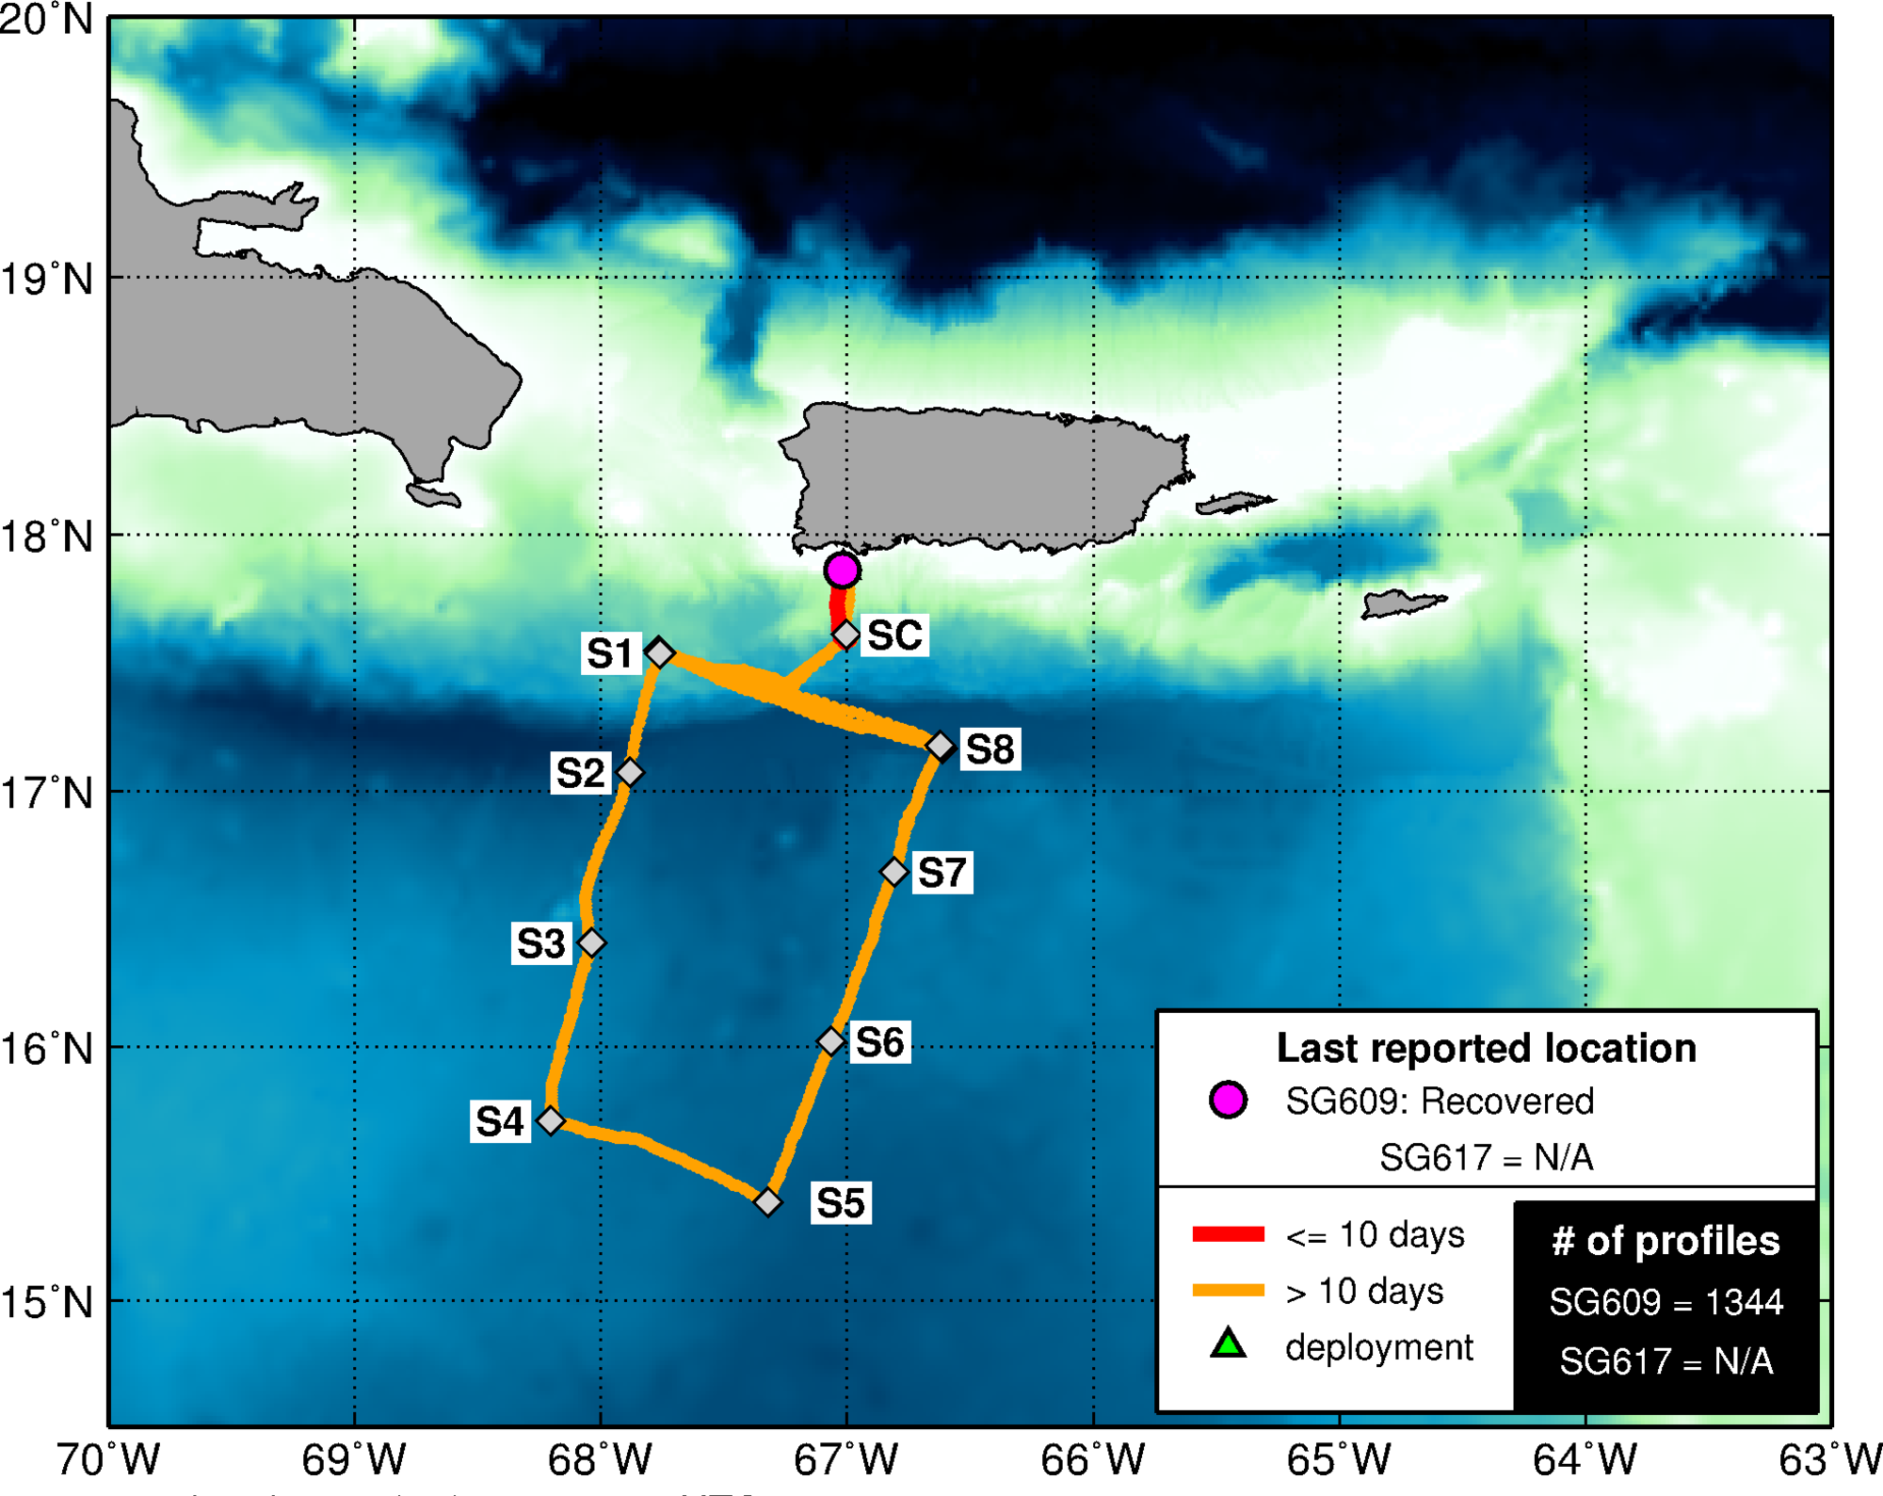
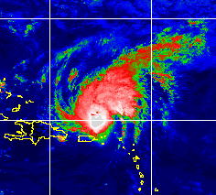

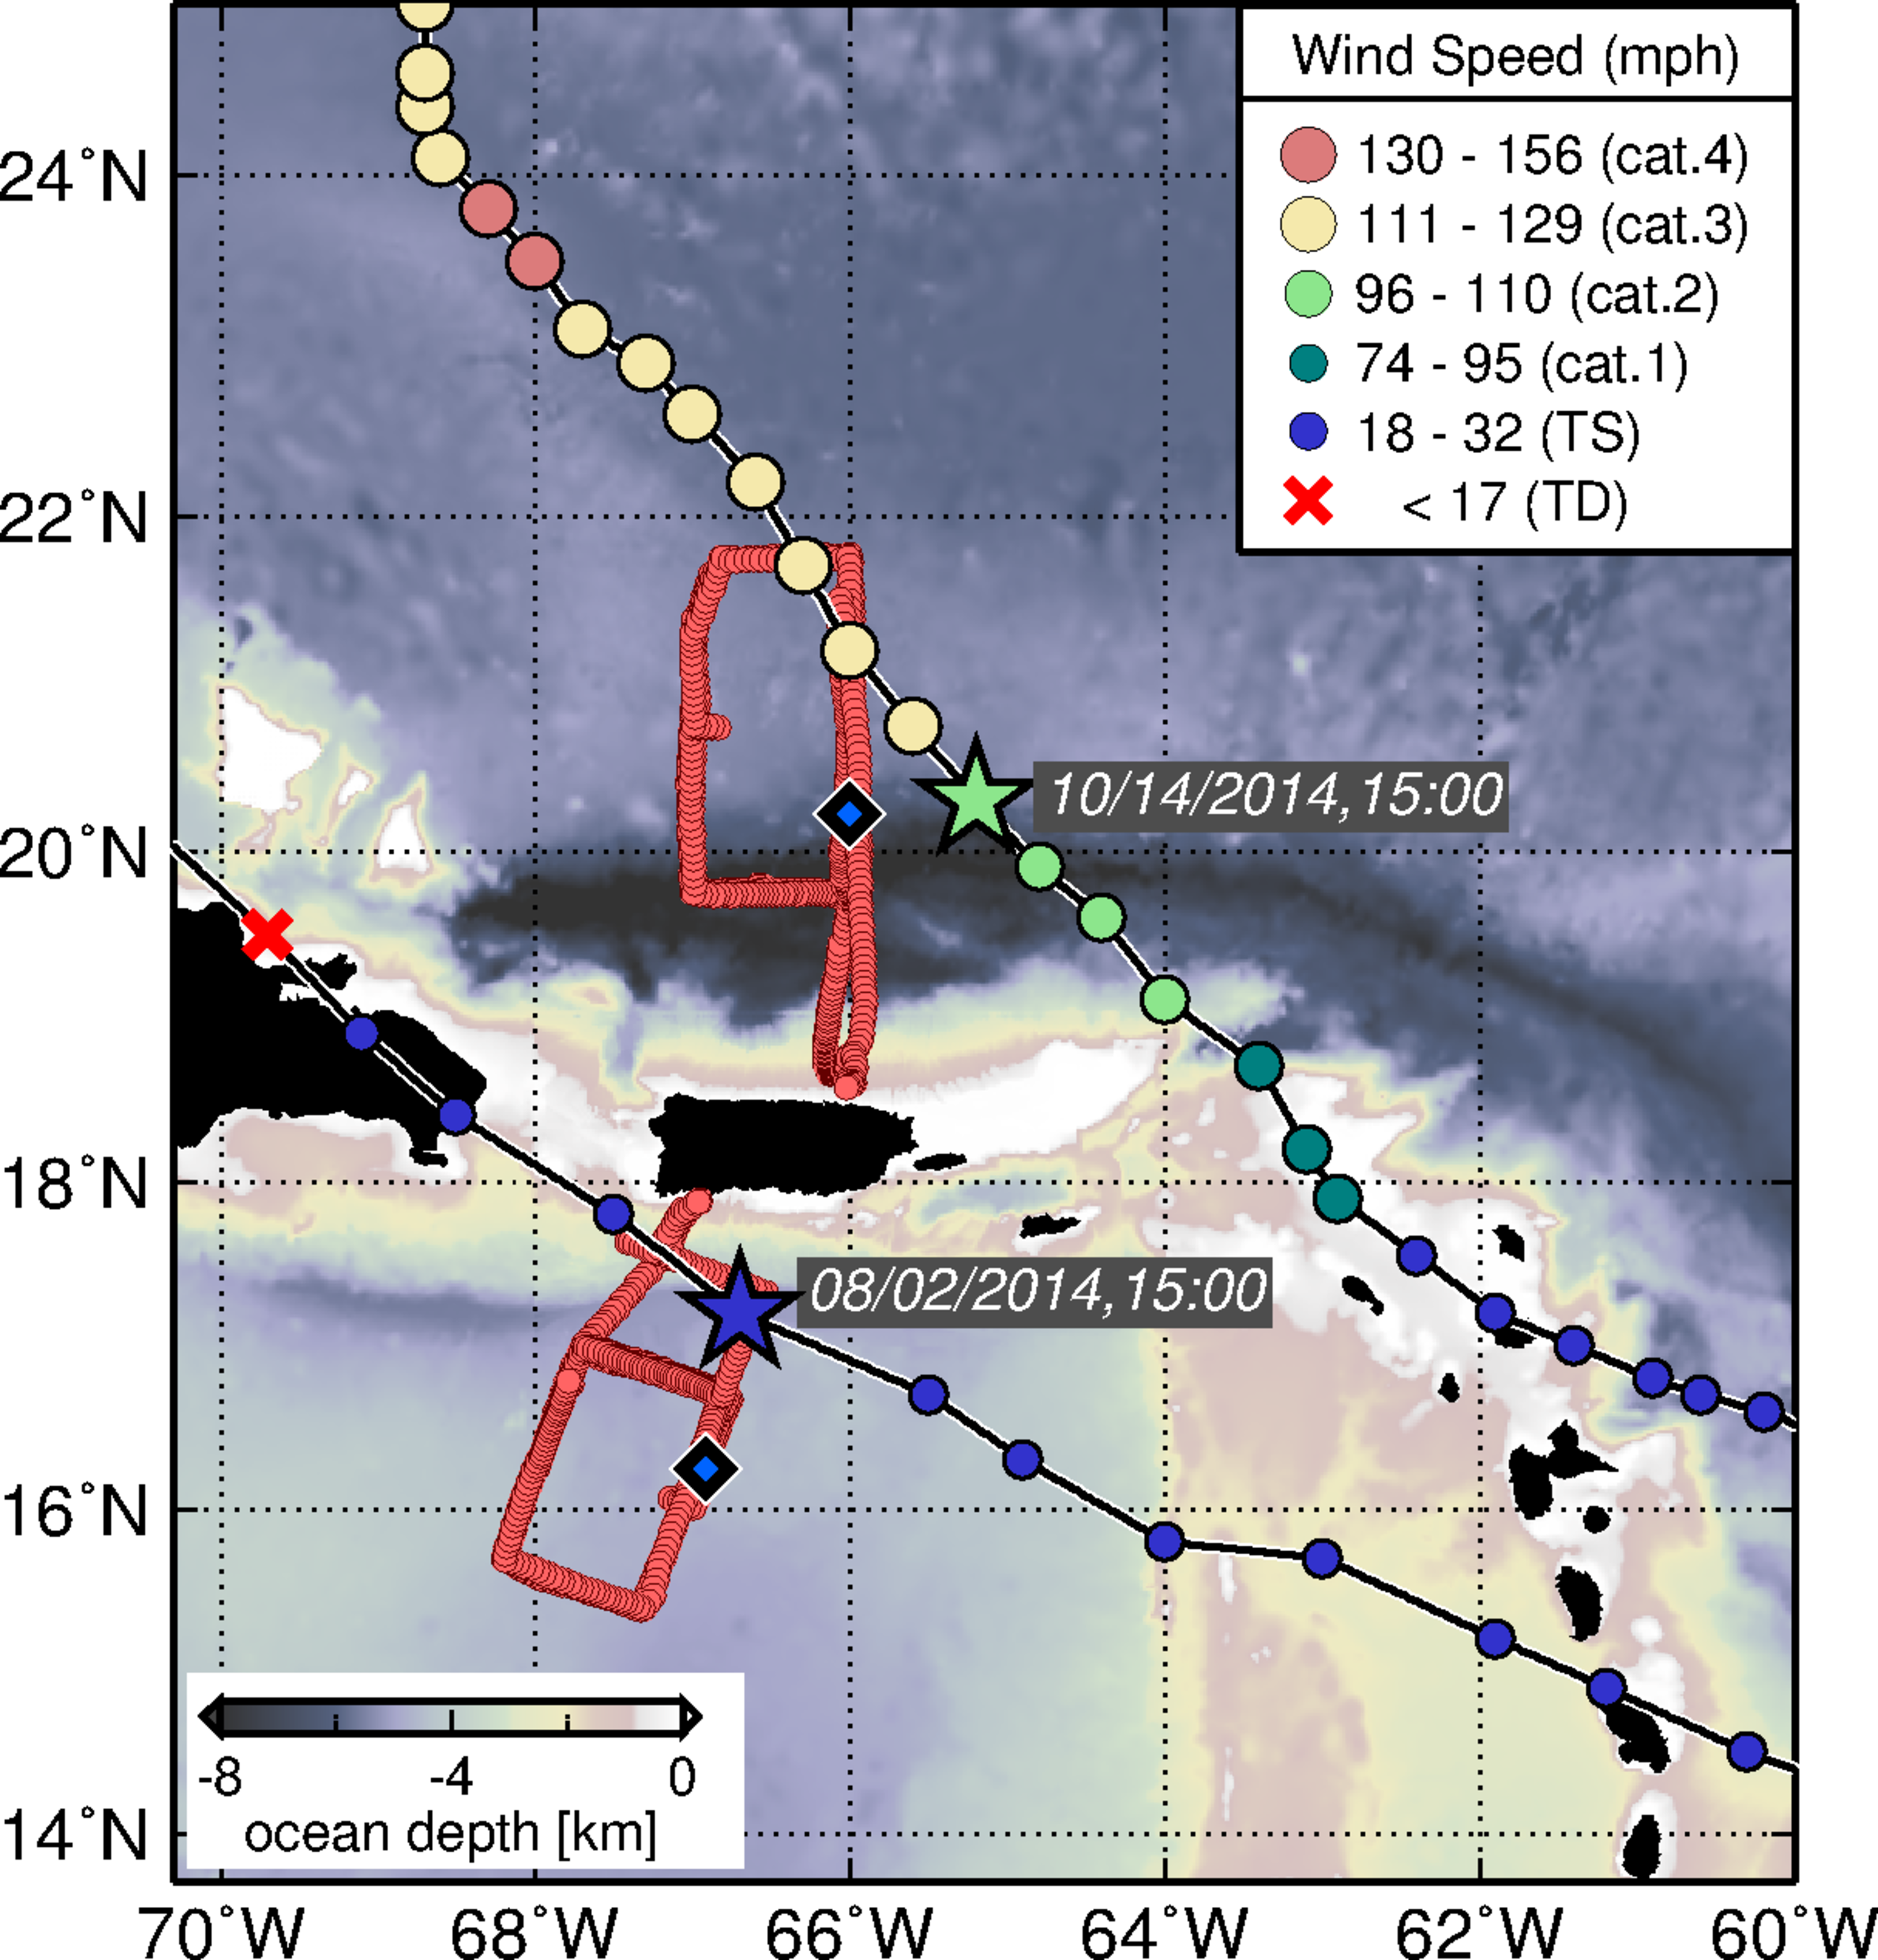
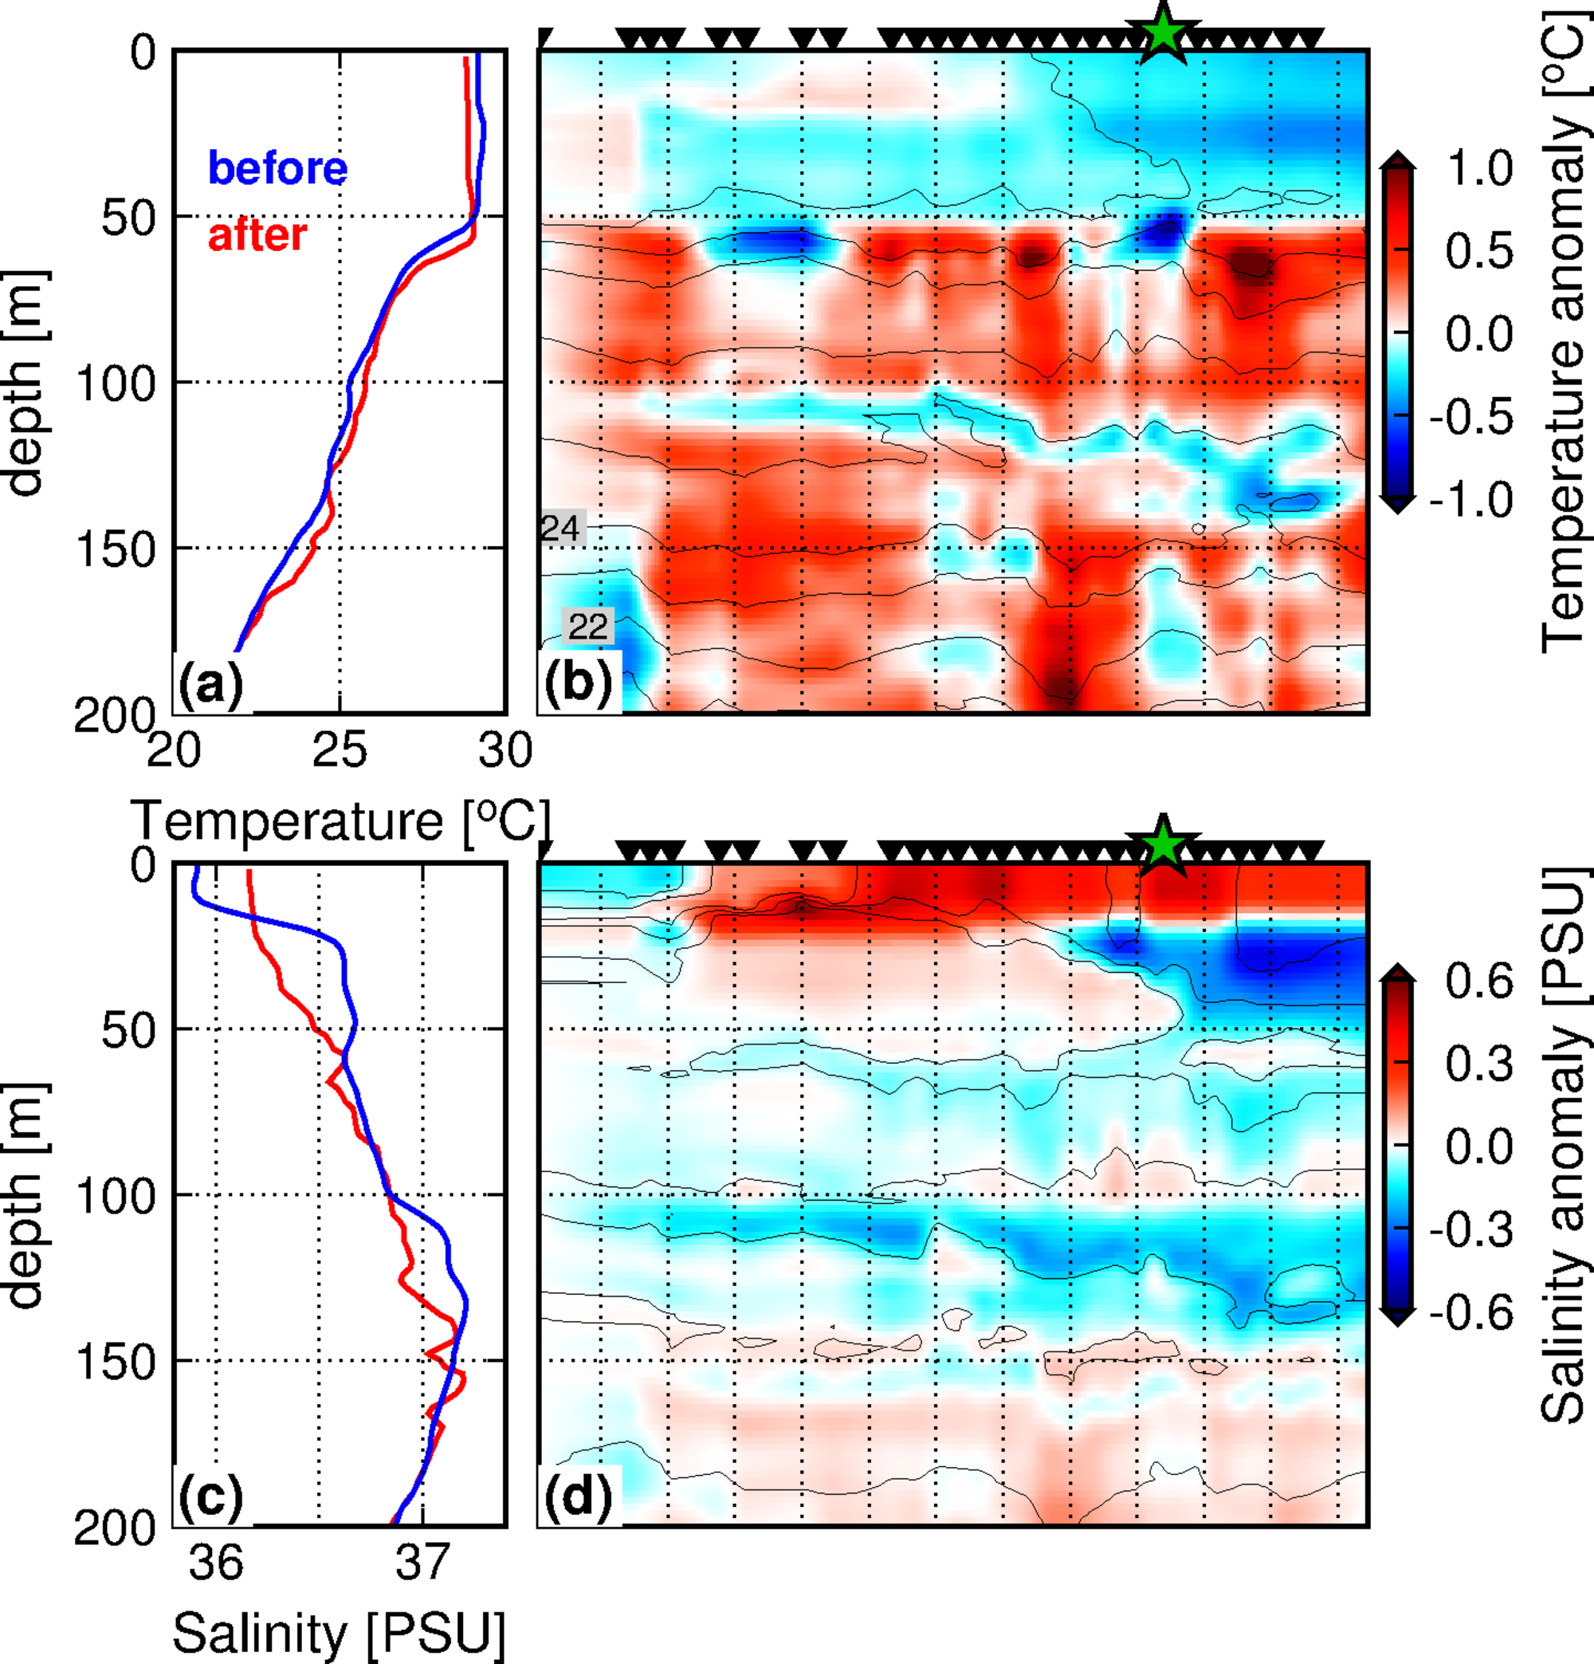
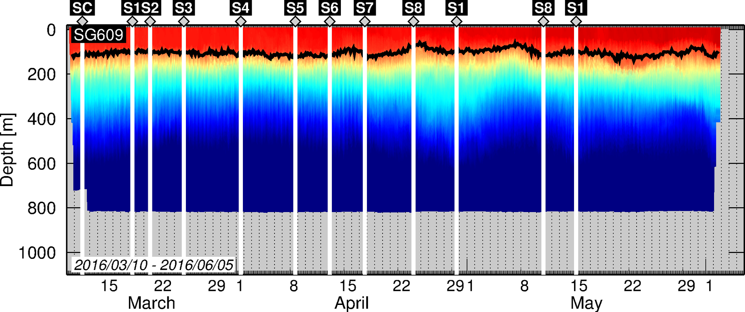

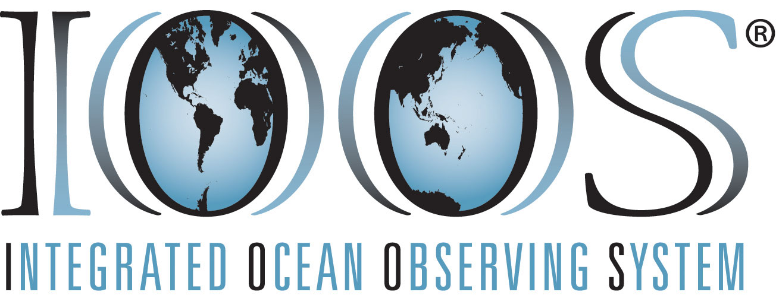



NOAA/AOML – CARICOOS Hurricane Underwater Glider Operations
Gustavo Jorge Goni¹, Francis Bringas¹, Ricardo Domingues^{2,1}, Jili Dong ^{2,1}, Grant Rawson^{2,1}, Julio Morell³, George Halliwell¹, Sang-Ki Lee¹, Hyun-Sook Kim⁴, Luis Pomales³, Becky Baltes⁵, Richard Bouchard⁶, Yamil Rodriguez⁷
PR
Conferencia Internacional Marítima Oceanográfica
Santo Domingo, Dominican Republic, September 13-14, 2016
2. Goal and Objectives
The goal of this work is to enhance our understanding of air-sea interaction processes during hurricane force wind events. In order to accomplish this goal, the network of hurricane underwater gliders was implemented to:
Assess the impact of hurricane force winds on upper ocean density structure, and
Assess the impact of ocean profile data from underwater gliders in hurricane intensity forecasts
1. Motivation
3. Underwater Gliders
Glider port at La Parguera, PR
In the tropical North Atlantic Ocean and Caribbean Sea, there is not a sustained ocean observing system in place in support of TC intensity forecasts.
These areas are characterized by large ocean heat content, which under appropriate atmospheric conditions, may play a role in TC intensification. Therefore, a network of gliders was implemented to monitor in real time the upper ocean density (temperature, salinity) conditions.
Underwater gliders are autonomous underwater vehicles (AUVs) that can be remotely operated under TC wind conditions. They can be configured with different oceanographic sensors, such as sensors to measure temperature, salinity, and dissolved oxygen.
Tropical Cyclone (TC) track forecast error has decreased over the last two decades, while the intensity forecast error has approximately remain the same.
4. Operations timeline
First paper published, Domingues et al., (2015)
Second paper submitted, Dong et al., (under review)
Proposal
(October 2013)
Disaster Relief Appropriations Act of 2013,
“Sandy Supplemental”
Purchase of Gliders
(March 2014)
Mission 05 start
Gliders Delivered
(July 2014)
Funded
(December 2013)
Training
(June 2014)
H. Gonzalo
(Oct, 2014)
TS Bertha
(Aug, 2014)
Mission 01
July – November 2014
Mission 02
February – April, 2015
Mission 03
July – November, 2015
TS Erika
(Aug, 2015)
Mission 04
March– June, 2016
2013
2014
2015
2016
5. Key results
6. Data Distribution
Ocean Observations
Coupled Hurricane Forecast
1
2
Minimum Pressure
Data are transmitted in real-time into the Global Telecommunication Systems (GTS), and distributed through NOAA-AOML webpages, and through NOAA Integrated Ocean Observing System (IOOS) Data Assembly Center (DAC)
These data are also used to initialize Tropical Cyclone forecast models
Best track
NODA
ALL
Hurricane Gonzalo
before
after
Temperature
TS Bertha
7. Operation Highlights
1. During Hurricane Gonzalo, glider observations revealed that upper-ocean cooling was partially suppressed by a near-surface barrier layer, that was characterized by enhanced stratification due to low salinity conditions.
Maximum Wind
Four underwater glider missions were successfully completed during 2014-2016. The fifth mission implemented during the 2016 North Atlantic Hurricane Season is currently underway with four gliders in the field.
Approximately 10,000 profiles of each measured parameter (temperature, salinity, and dissolved oxygen) were collected during the first two years of operations, including unique datasets under TC wind conditions.
2. Assimilation of underwater glider data along with other ocean observations had a positive impact on Hurricane Gonzalo intensity forecast using the next generation ocean-atmosphere coupled HYCOM – HWRF model.
Publications
Domingues et al., (2015), Upper ocean response to Hurricane Gonzalo (2015): Salinity effects revealed by targeted and sustained underwater glider observations, Geophys. Res. Lett., 42.
Dong et al., (under review) Impact of underwater glider on Hurricane Gonzalo (2014) forecast. Manuscript currently under review at Weather Forecasting.
Acknowledgments
This work was originally funded by the Disaster Relief Appropriations Act of 2013 known as the Sandy Supplemental. This project is currently funded by NOAA/OAR, NOAA/AOML, and CARICOOS, and supported by UPRM, UM/CIMAS, NOAA/NDBC, NOAA/IOOS, NOAA/EMC, and ANAMAR.
Affiliations
1 NOAA/AOML, Miami, Florida, USA
2 University of Miami, CIMAS, Miami, Florida, USA
3 University of Puerto Rico, Mayagues, Puerto Rico, and CARICOOS
4 NOAA/EMC, College Park, Maryland, USA
5 IOOS Office, Silver Spring, MD, USA
6 NOAA/NDBC, Stennis, Miss, USA
7 ANAMAR, Santo Domingo, Dominican Republic
Gliders Live Monitoring
PDF of this poster

