Slide 1
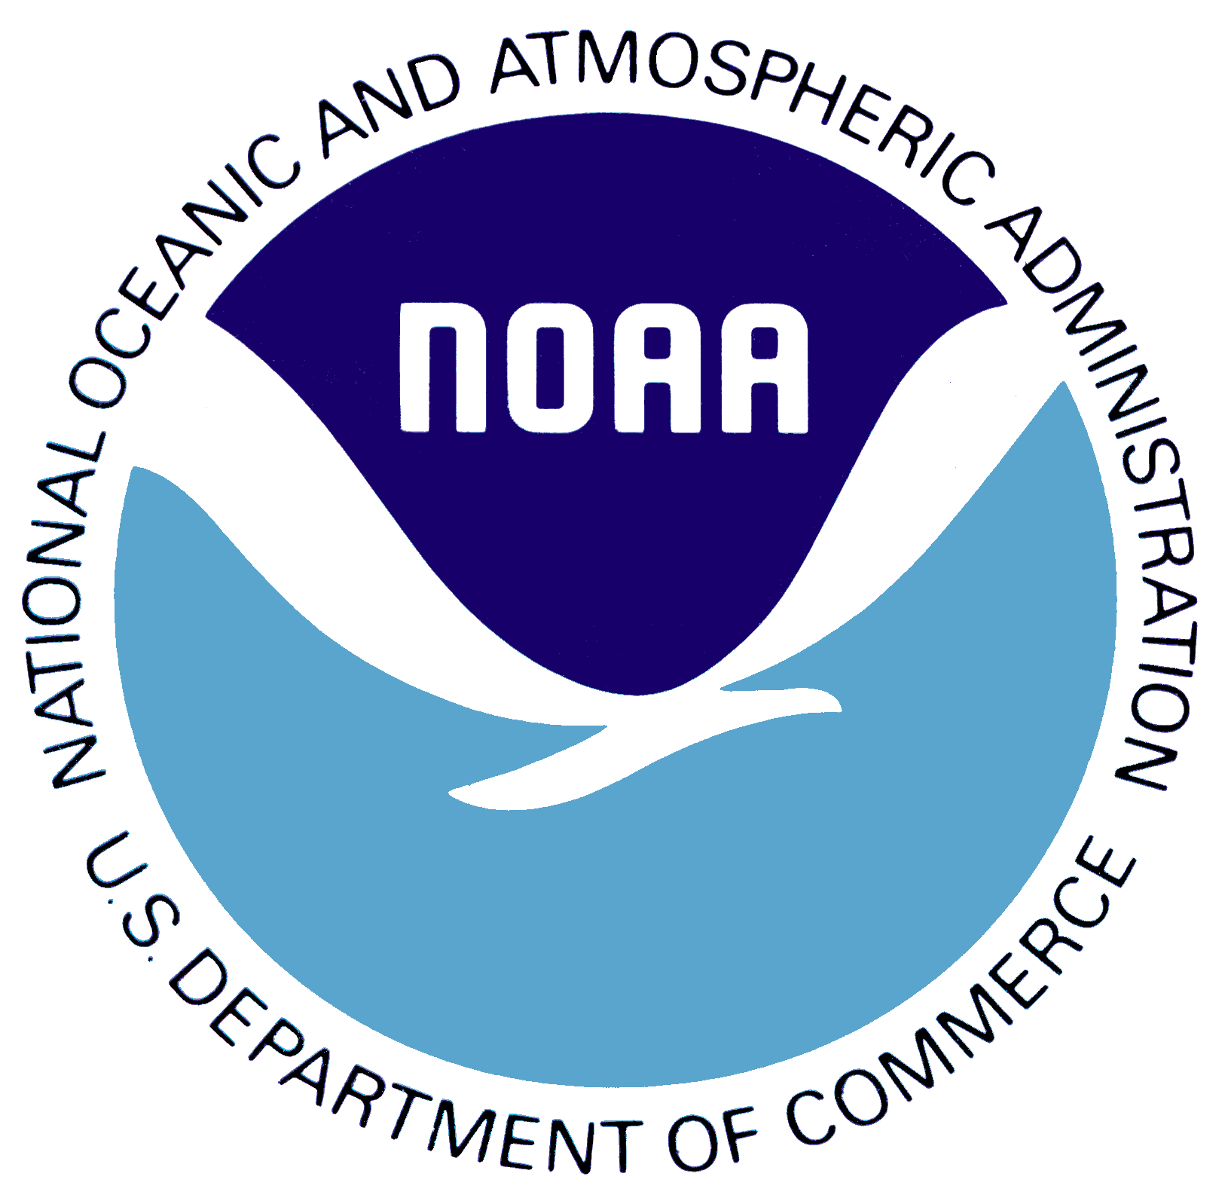
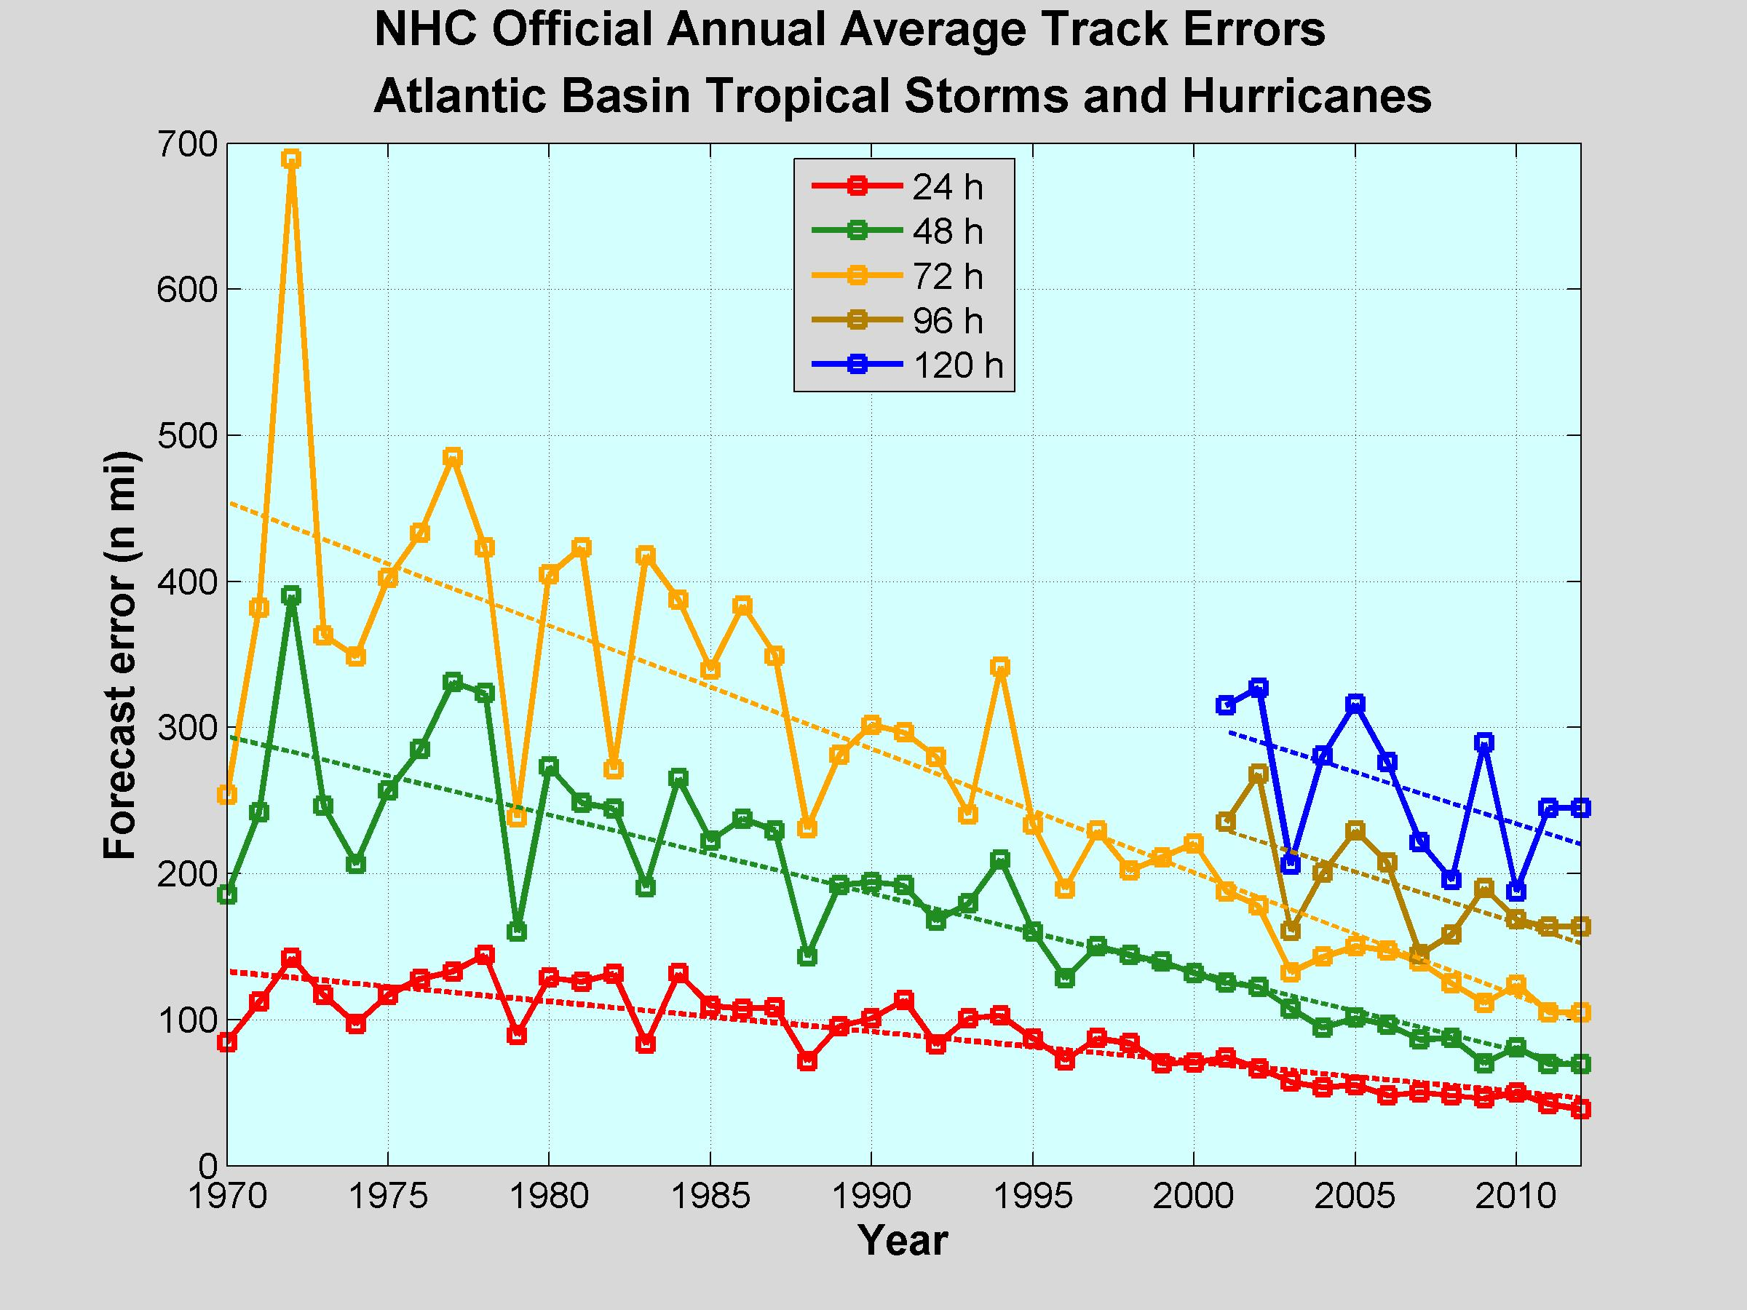
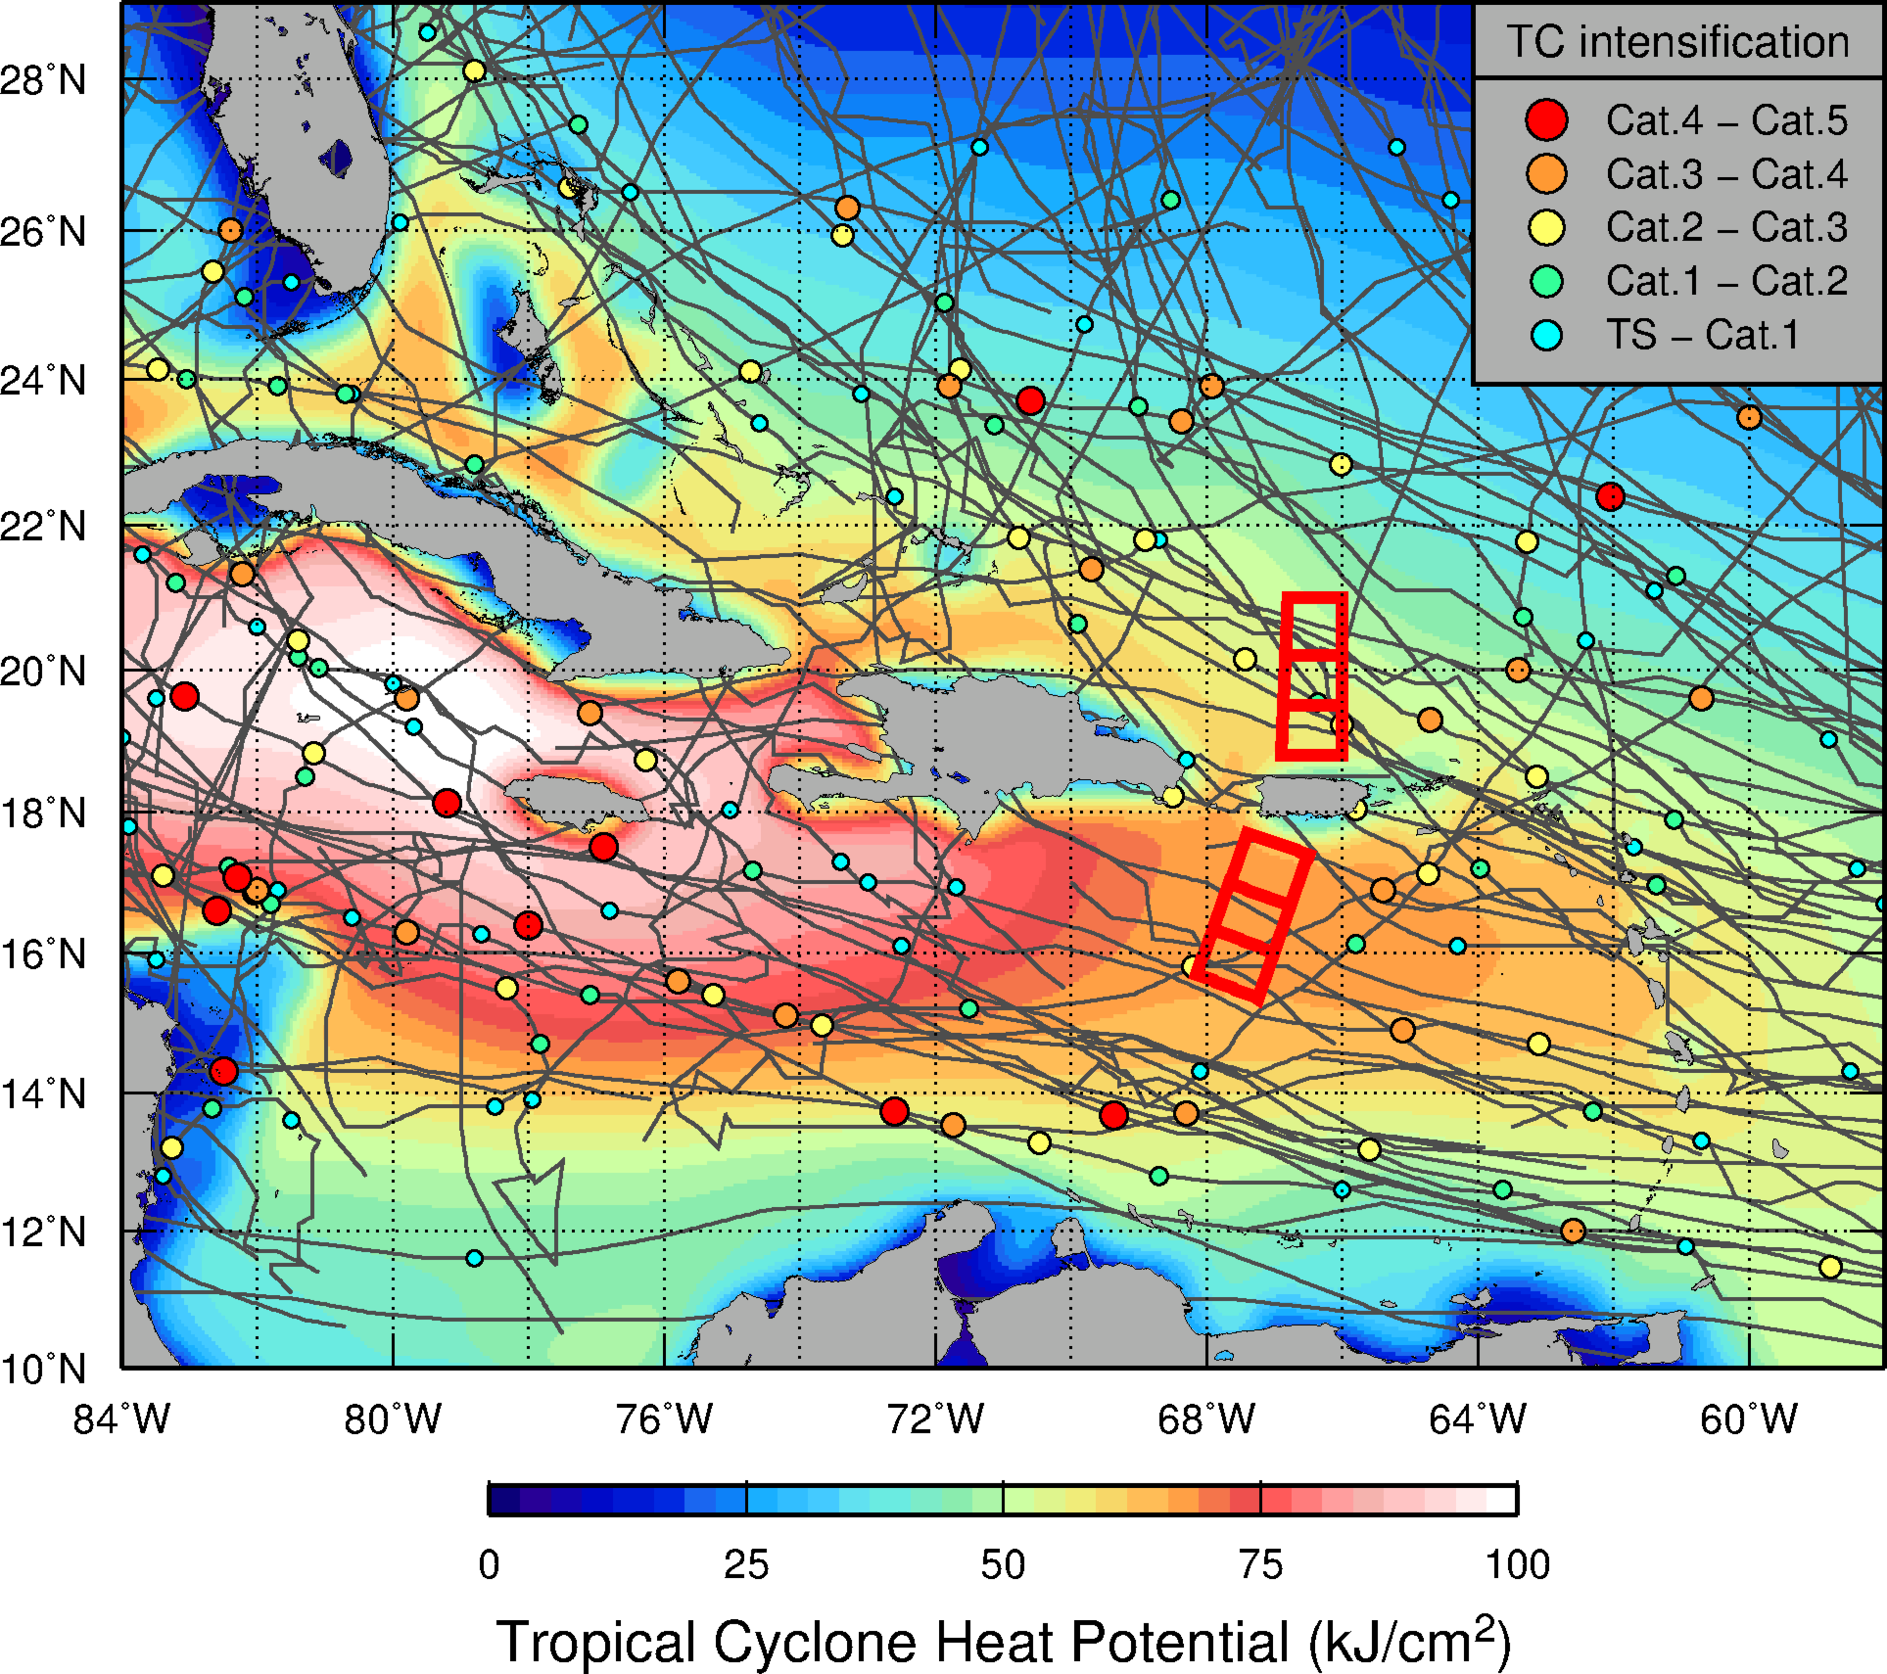
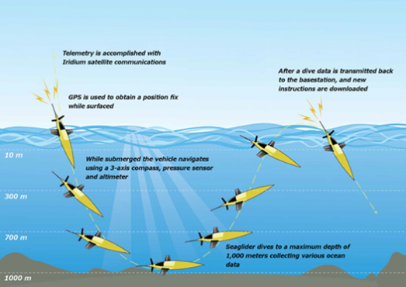
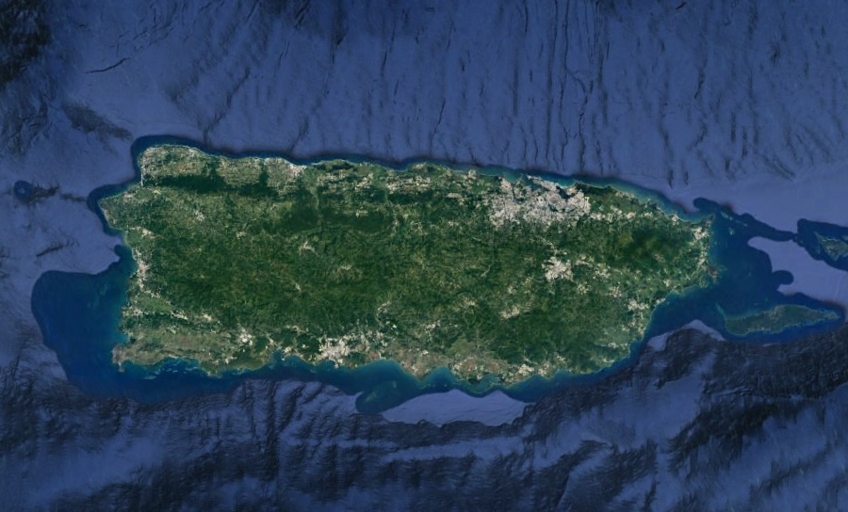
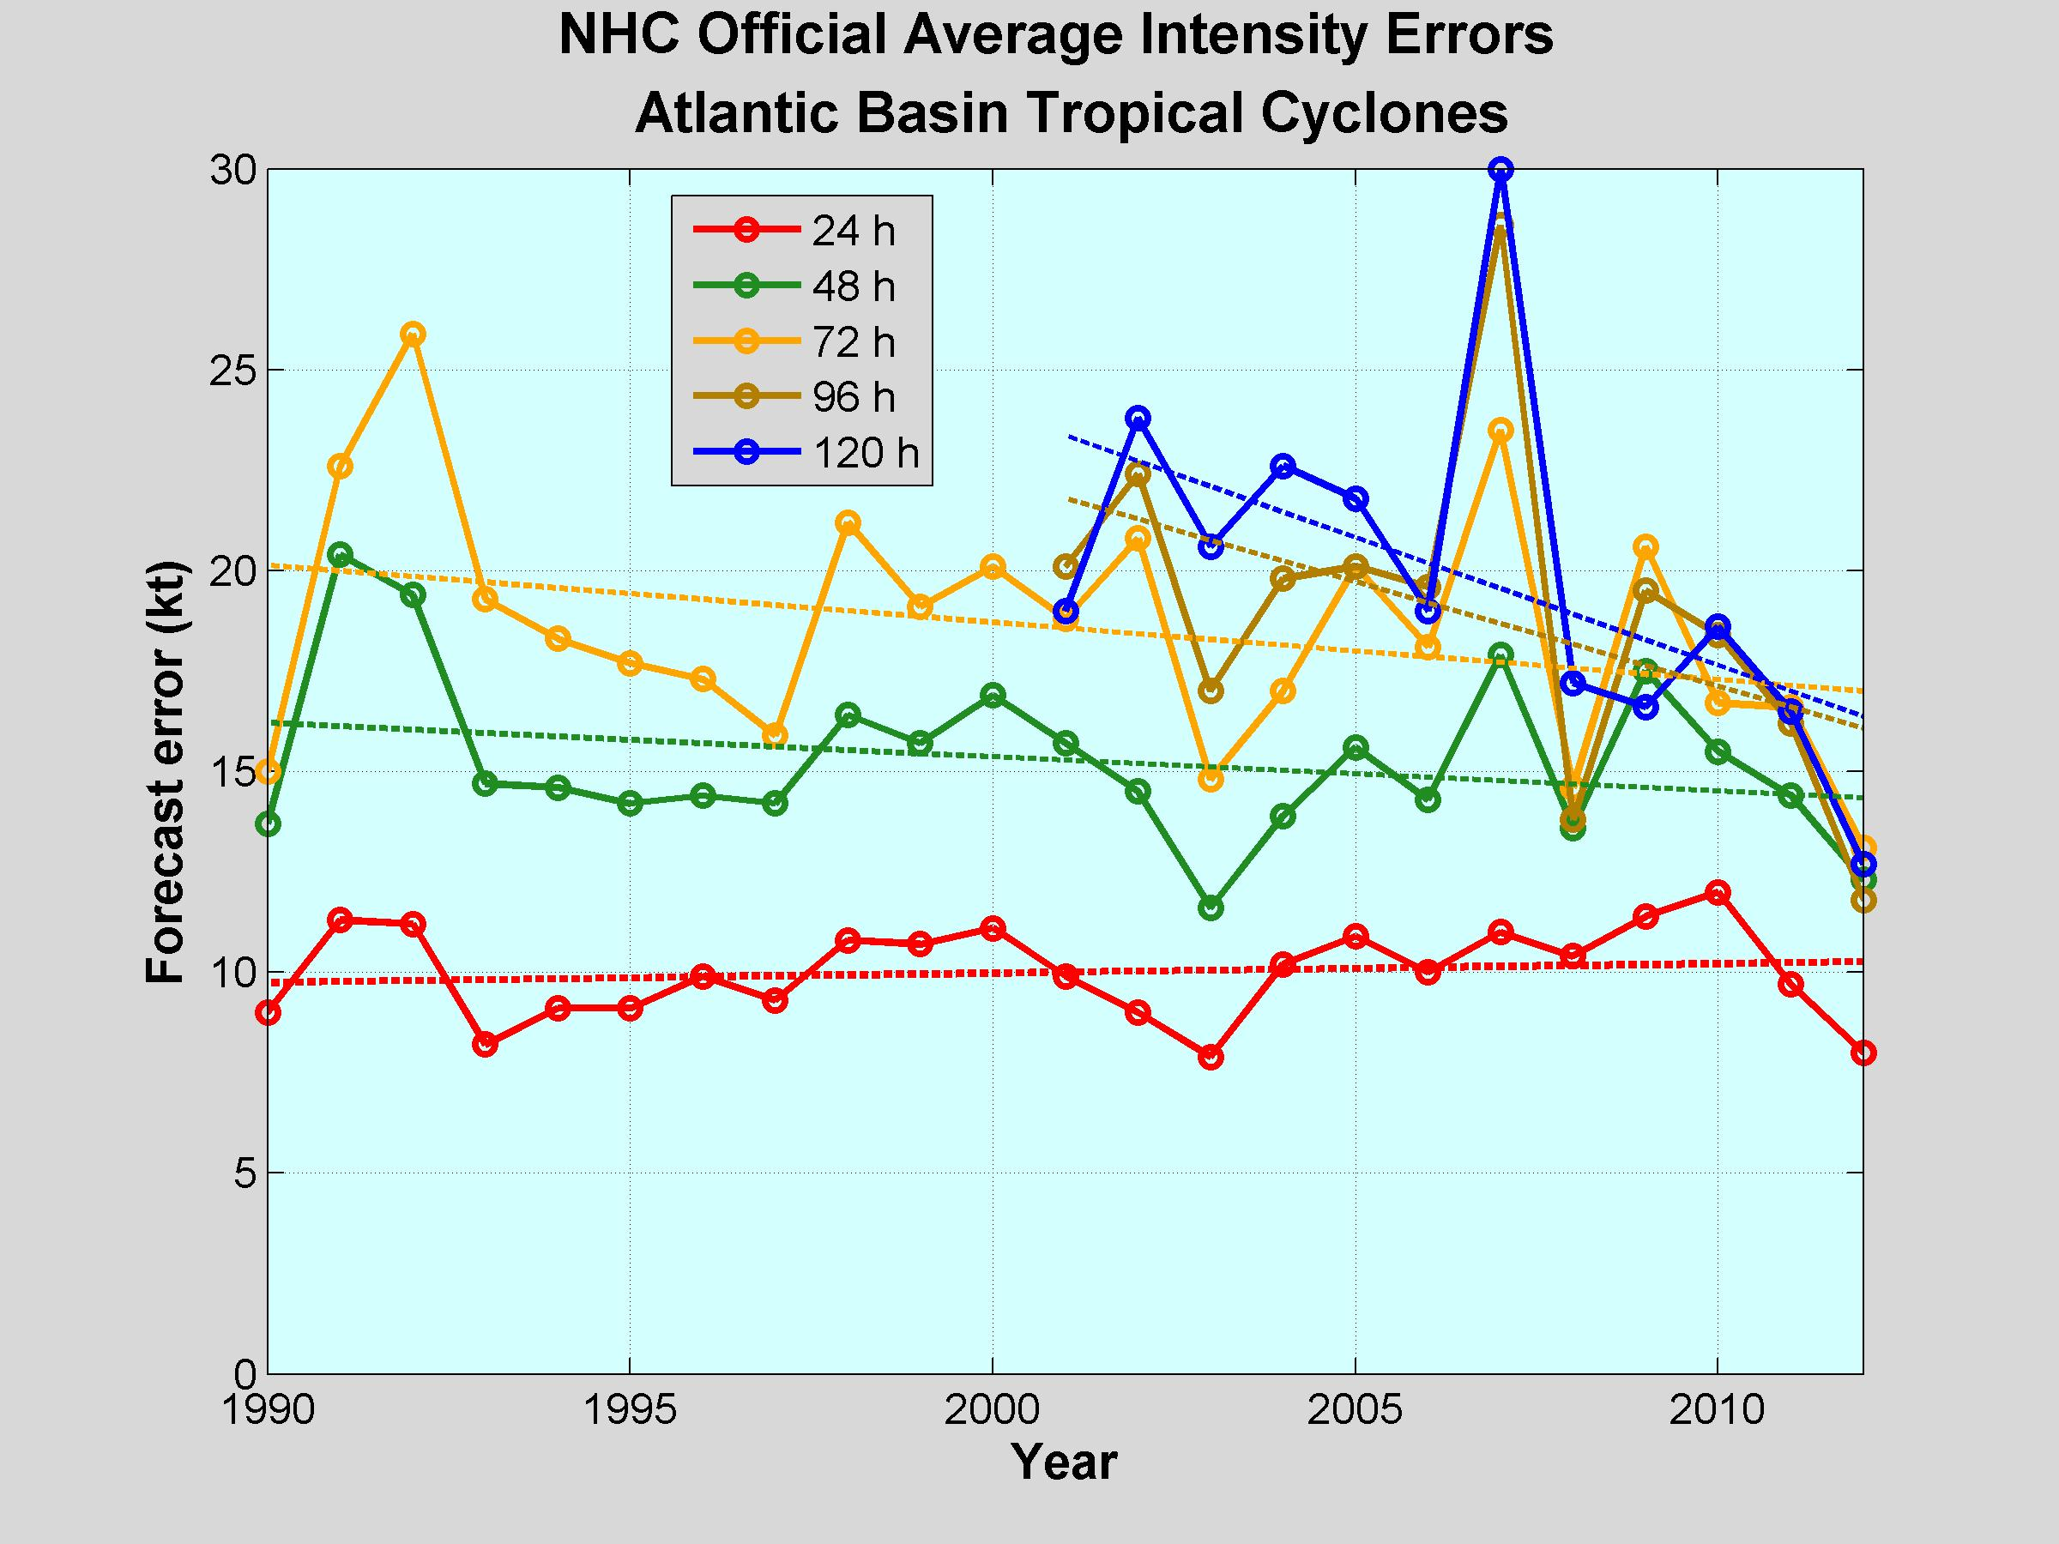
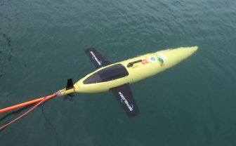
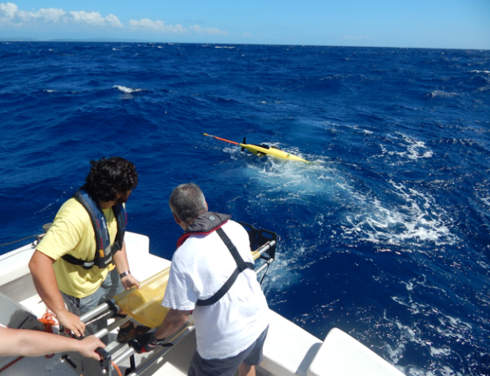
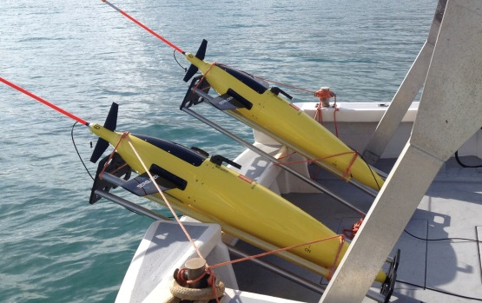
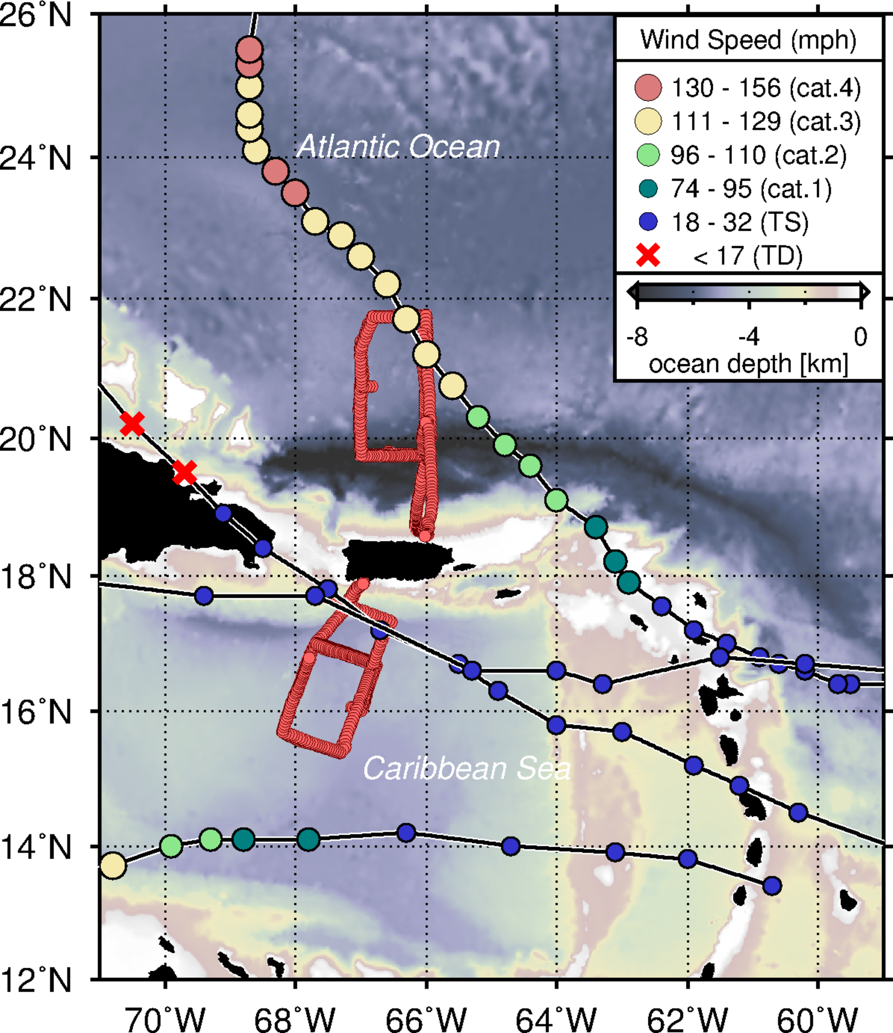
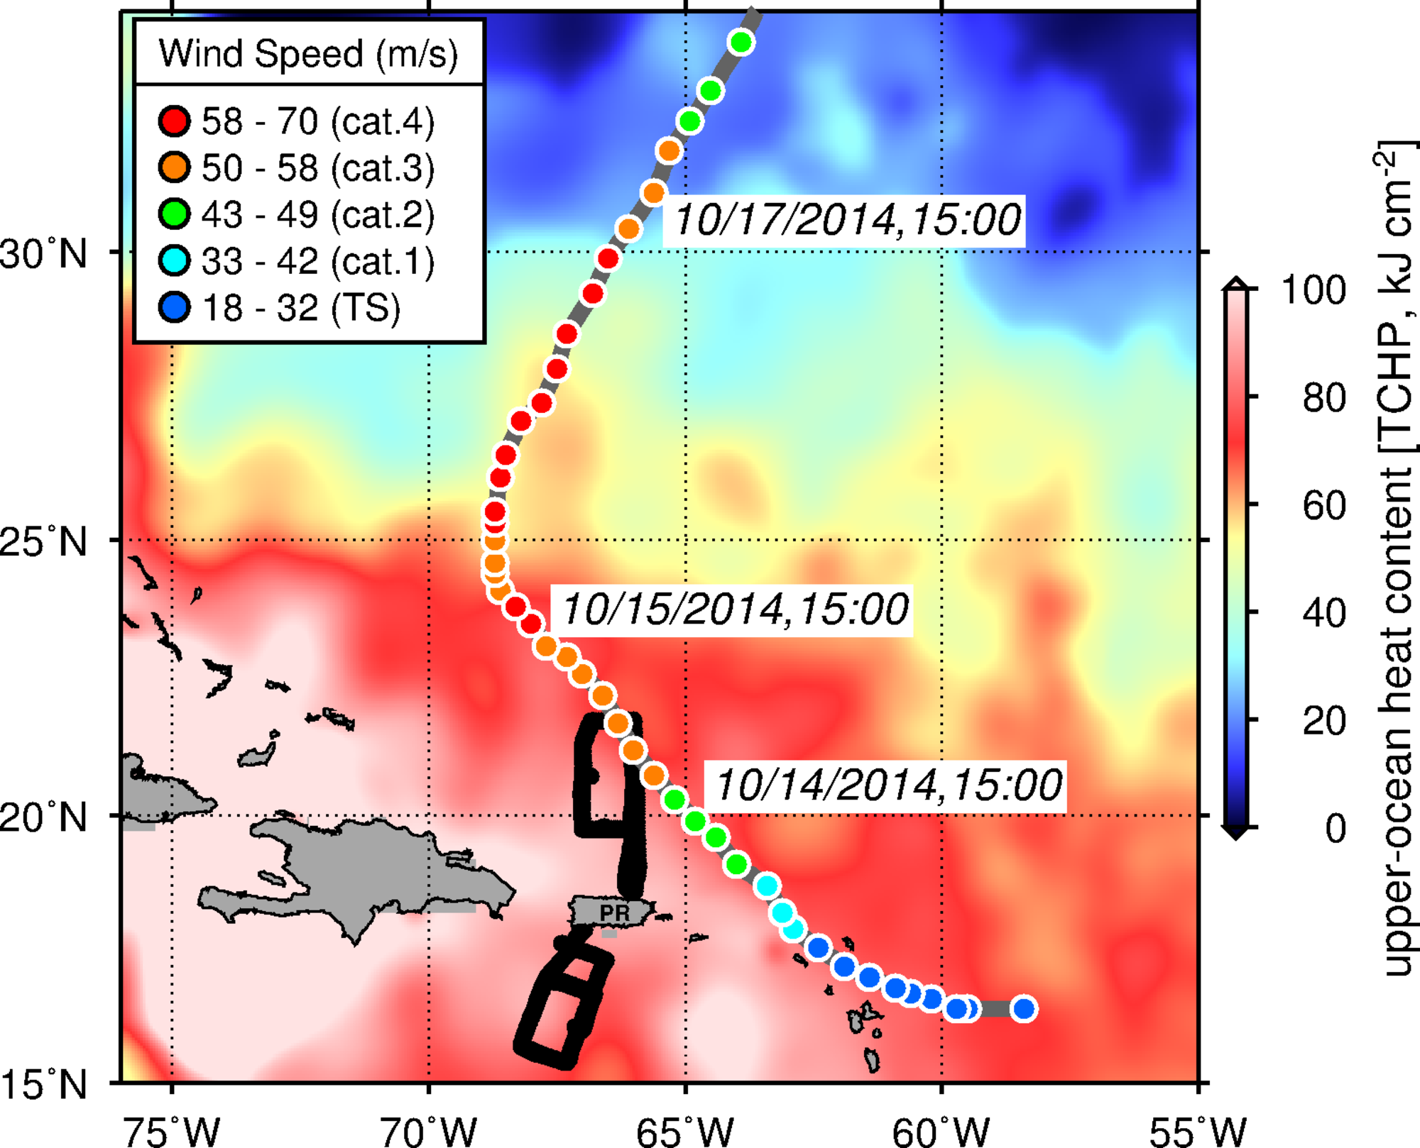
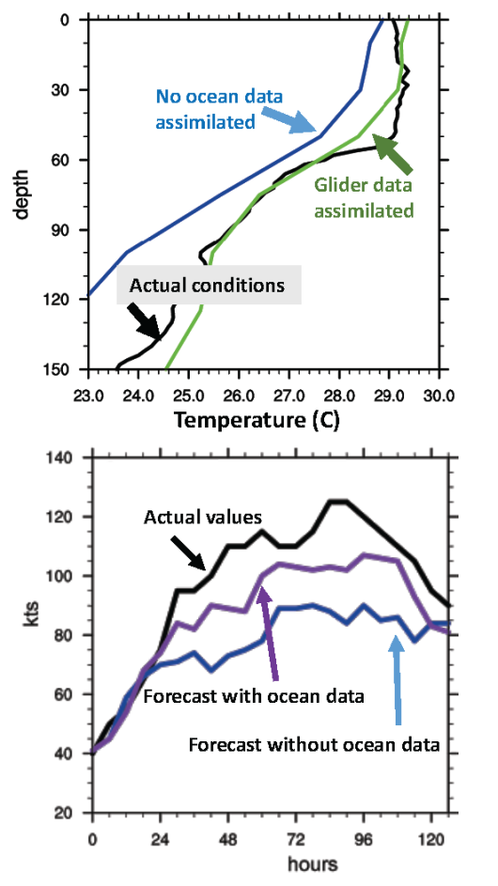

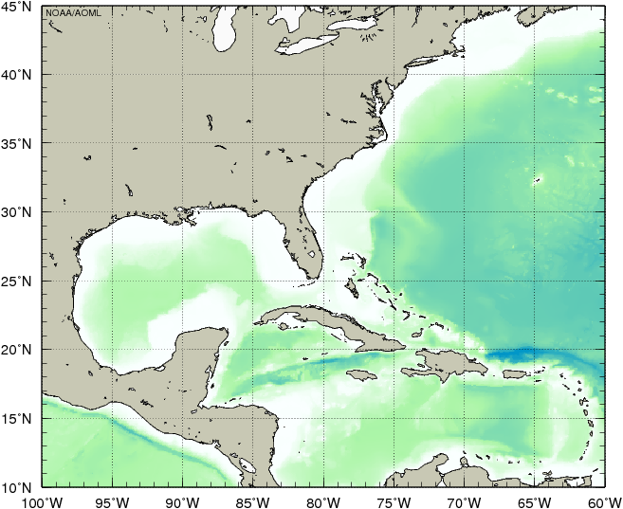

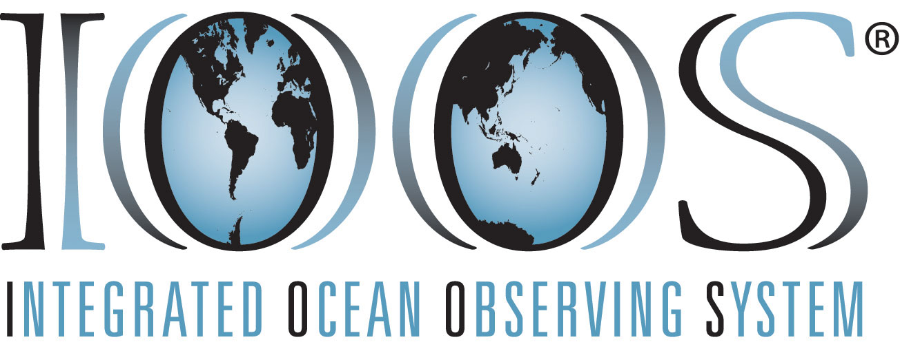



AOML-CARICOOS Underwater Glider Observations in the Caribbean Sea and Tropical North Atlantic Ocean in Support of Tropical Cyclone Studies and Forecasts
Gustavo Jorge Goni¹ (Gustavo.Goni@noaa.gov), Jili Dong ⁴, Ricardo Domingues ^{2,1}, Julio Morell ³, Francis Bringas ¹ , George Halliwell ¹, Hyun-Sook Kim ¹, Becky Baltles ⁵, Richard Bouchard ⁶, Luis Pomales ³, and Yamil Rodriguez ⁷
1. Motivation
2. Goal and Objectives
The goal of this work is to enhance our understanding of air-sea interaction processes during hurricane force wind events. In order to accomplish this goal, the network of hurricane underwater gliders was implemented to:
Assess the impact of hurricane force winds on upper ocean density structure, and
Assess the impact of ocean profile data from underwater gliders in hurricane intensity forecasts
3. Underwater Gliders
Glider port at La Parguera, PR
Ocean heat content has been linked to the intensification of hurricanes
Over the past 50 years, few ocean heat content observations have been available in the Caribbean and tropical North Atlantic off Puerto Rico
Underwater gliders are autonomous underwater vehicles (AUVs) that can be remotely operated under TC wind conditions. They can be configured with different oceanographic sensors, such as sensors to measure temperature, salinity, and dissolved oxygen.
Tropical Cyclone (TC) track forecast error has decreased over the last two decades, while the intensity forecast error has approximately remain the same.
4. Operations
5. Key results
AOML uses four gliders that each collect 10-20 profiles per day from the surface of the ocean to 1-km depth
A long battery life enables the gliders to gather data during the full Atlantic hurricane season
Measurements are transmitted in real-time to data centers for use in operational ocean and hurricane forecasts
Gliders currently collect approximately 10,000 ocean profile observations per hurricane season, including during hurricane-force conditions
This effort has collected unique observations under tropical cyclone wind conditions during:
  Tropical Storm Bertha (August, 2014)
  Hurricane Gonzalo (October, 2014)
  Tropical Storm Erika (August, 2015)
  Hurricane Matthew (September, 2016)
A
Bertha (2014)
Gonzalo (2014)
B
Erika (2015)
Actual conditions
Matthew (2016)
Glider data have reduced errors in the ocean characterization used to initialize ocean-atmosphere forecast models (A)
Ocean observations significantly reduced intensity forecast errors for Hurricane Gonzalo (2014) (B)
Forecast hour
6. Gliders for 2017 NOAA Hurricane field Program
7. Highlights
NOAA/AOML-CARICOOS
NOAA/AOML-CARICOOS-NOAA/NDBC
MARACOOS/Rutgers University
WHOI
Bermuda Institute of Oceanography
Naval Oceanographic Office
Texas A&M University
Univ. Southern Mississippi
Mote Marine Laboratory
Several glider missions in place in the tropical Atlantic, Caribbean Sea and Gulf of Mexico.
Underwater gliders provide critical temperature and salinity profile data in real-time even during tropical cyclone wind conditions.
Upper ocean low salinity layer, which often play an important role in intensification, was not adequately initialized in HYCOM model during Hurricane Gonzalo (2014). Glider data improved ocean initialization when assimilated within HYCOM-HWRF model.
Upper ocean data reduced the error in intensity forecast of Gonzalo (2014) by up to 50%
Publications
Domingues et al., (2015), Upper ocean response to Hurricane Gonzalo (2015): Salinity effects revealed by targeted and sustained underwater glider observations, Geophys. Res. Lett., 42.
Dong et al., (2017) Impact of underwater glider on Hurricane Gonzalo (2014) forecast. Weather and Forecasting, 32(3), 1143-1159.
Goni et al., (2015): [Global Oceans] Tropical cyclone heat potential, [in "State of the Climate in 2014"]. Bull. Amer. Meteor. Soc ., S121-S122, 96, (7).
Supported by:
Disaster Relief Appropriations Act (Sandy Supplemental funds)
NOAA AOML
IOOS and CARICOOS
OAR AAA Reserve 2015 and 2016
Affiliations
1 NOAA/AOML, Miami, Florida, USA
2 University of Miami, CIMAS, Miami, Florida, USA
3 University of Puerto Rico, Mayagues, Puerto Rico, and CariCOOS
4 NOAA/EMC, College Park, Maryland, USA
5 IOOS Office, Silver Spring, MD, USA
6 NOAA/NDBC, Stennis, Miss, USA
7 ANAMAR, Santo Domingo, Dominican Republic
Gliders Live Monitoring
PDF of this poster

