Slide 1
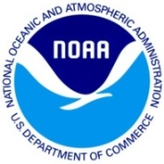


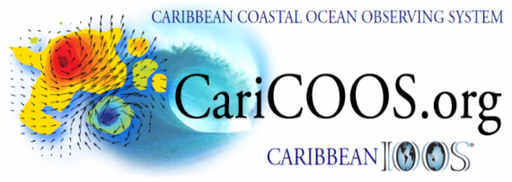
Sustained and Targeted Ocean Observations for Improving Atlantic Tropical Cyclone Intensity and Hurricane Seasonal Forecasts
Ricardo Domingues^{1,2}, Gustavo Goni², and other AOML/CIMAS project members
¹CIMAS – University of Miami
²Atlantic Oceanographic and Meteorological Laboratory – NOAA
AOML/CIMAS project members: Sang-Ki Lee, George Halliwell, Francis Bringas, Grant Rawson, Hyun-Sook Kim, Jili Dong, Julio Morell, Luis Pomales, Walt McCall and Richard Bouchard
A project funded by the Disaster Relief Appropriations Act known as Sandy Supplemental, and by NOAA/AOML, UPRM and CariCOOS
IASCLiP Virtual Workshop, September 10, 2015
Session IV

Slide 2
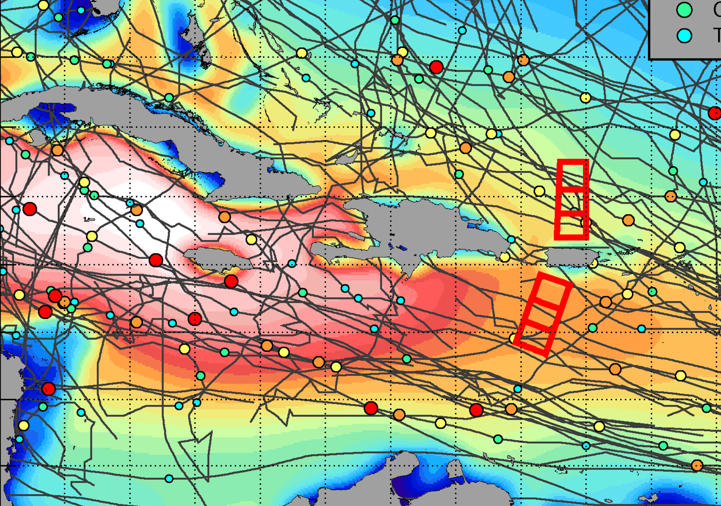
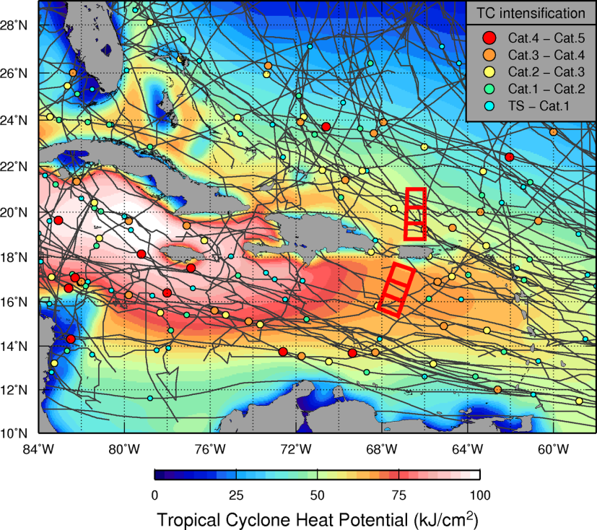
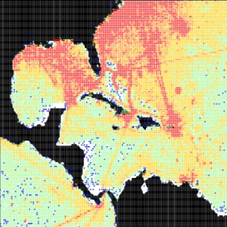
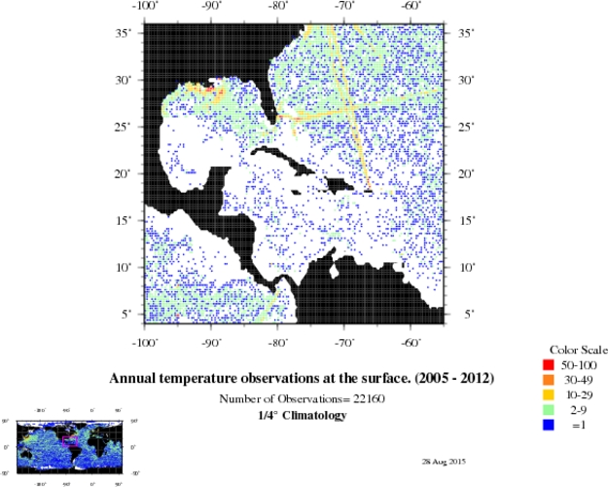
Motivation
World Ocean Atlas 2013: # of Temperature profiles
1955-2012
DO
PR
2005-2012
Number of obs.
< 200
Need for UOHC obs.!

Slide 3
Goal
NOAA/AOML proposed a multi-insitutional
effort with the goal of:
Implementing a network of underwater gliders to carry out sustained and targeted ocean observations
  Investigate the response of the ocean to hurricane force winds
  Improve understanding about the role that the ocean plays in the intensification of tropical cyclones
  Help improve tropical cyclone seasonal and intensity forecasts
DO
PR

Slide 4
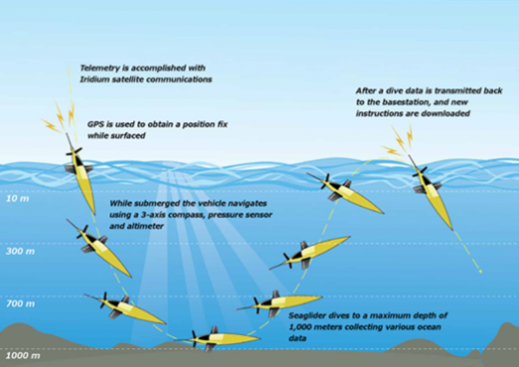
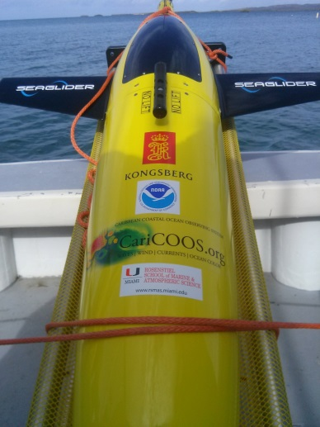
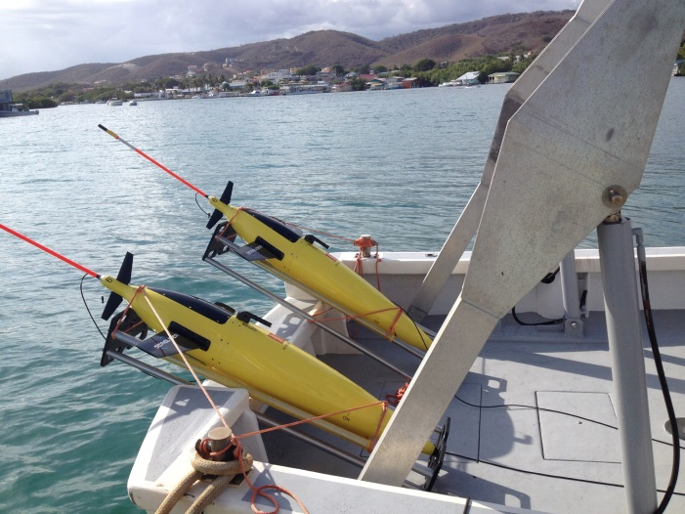
What is an underwater glider?
Autonomous Underwater Vehicle (AUV)
  No motor or propellor
  Uses changes in buoyancy and fixed wings to create forward momentum
  Remotely operated
Can be fitted with a big variety of oceanographic sensors
  CTD, Dissolved Oxygen, Chlo-a, CDOM, pCO_{2,}and etc.
  Surface and depth-averaged currents
Specifications
  Dives to 1000m
  5 Dives p/day (10 profiles)
  ~3km horizontal resolution
  Travel 15-20 km per day
  4-5 months of battery life

Slide 5

Timeline of AOML’s glider operations
Hurricane Gonzalo
(October, 2014)
Domingues et al. (2015)
TS Bertha
(August, 2014)
TS Erika
(August, 2015)
Funded
(December 2013)
Training
(June 2014)
Proposal
(October 2013)
Purchase of Gliders
(March 2014)
Gliders delivered
(July 2014)
Gliders refurbishment
Gliders refurbishment
Mission 01
Hurricane Season 2014
Period: July – November 2014
Deployments
  Tropical North Atlantic
  Caribbean Sea
2844 T & S profiles collected
Mission 02
Off Hurricane Season
Period: February – April 2015
New Oxygen Sensor Added!
Deployments
  Caribbean Sea
2022 T, S, & DO profiles collected
Mission 03
Hurricane Season 2015
Currently Underway
Deployments in July 2015
  Tropical North Atlantic
  Caribbean Sea
Over 1000 T, S, & DO profiles collected so far.

Slide 6
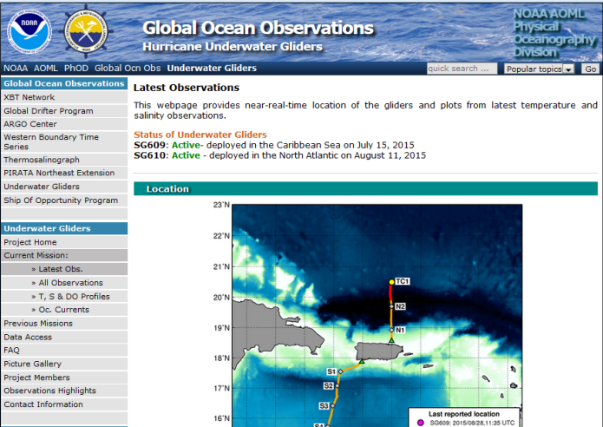
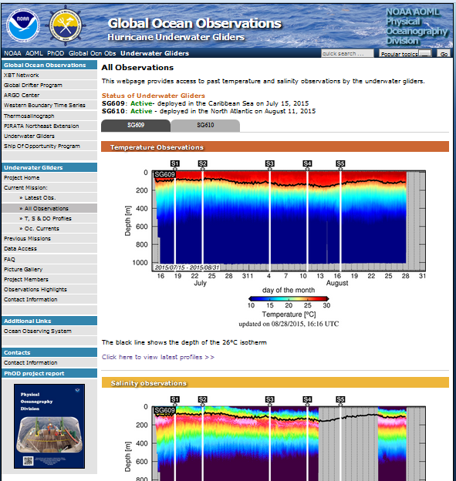
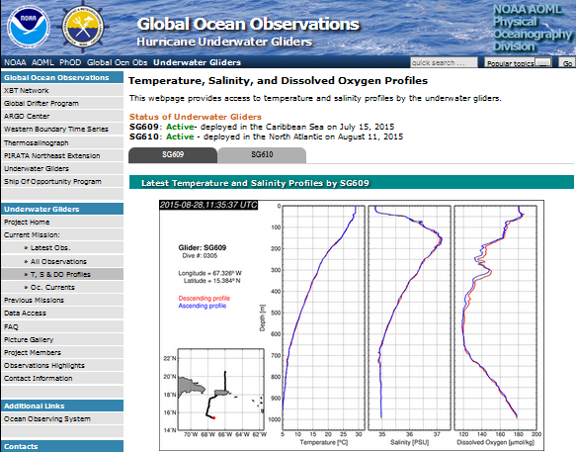
Data distribution
Real time data distribution
PhOD/AOML website
  http://www.aoml.noaa.gov/phod/gliders
  Current and past location of gliders
  All observations
  Individual T, S & DO profiles
  Data Access
NOAA’s Integrated Ocean Observing System - IOOS
  http://www.ioos.noaa.gov/
Global Telecommunications System – GTS
  Assimilated into forecasting systems

Slide 7
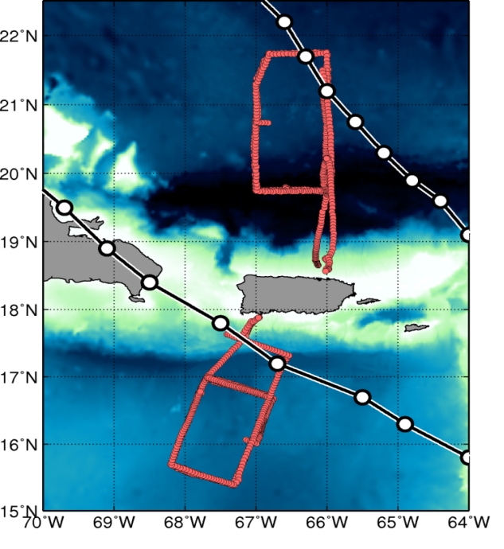
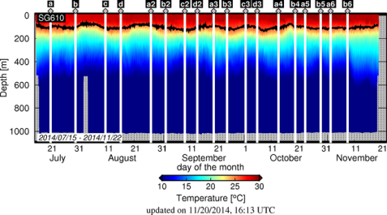
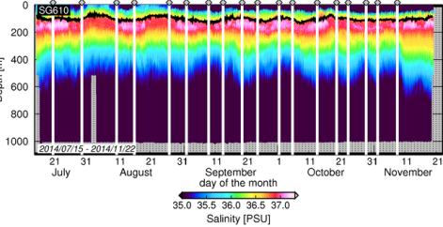
Mission 01 – Hurricane Season 2014
Hurricane Gonzalo
(October, 2014)
Summary - Mission 01: Hurricane Season 2014
Period: July – November, 2014
Location
  Tropical North Atlantic
  Caribbean Sea
2844 T & S profiles collected
  1356 from Tropical North Atlantic
  1488 from Caribbean Sea
Observations include data collected during TC wind conditions
  Tropical Storm Bertha
  Hurricane Gonzalo
    Domingues et al., (2015),
    Goni et al. (2015)
TS Bertha
(August, 2014)

Slide 8
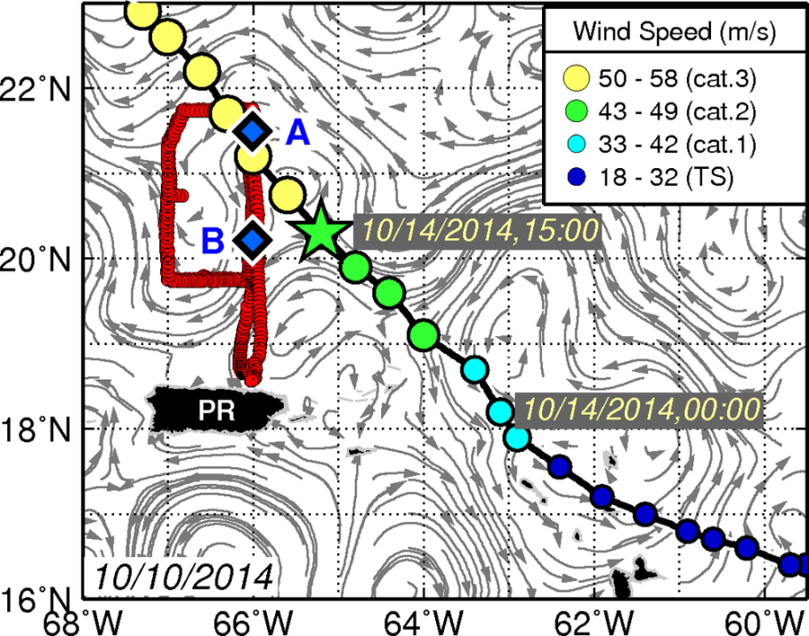
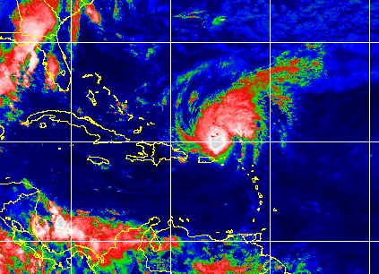
Hurricane Gonzalo (2014)
TC Gonzalo (October 12)
  Category 1 (October 13 21Z)
  Category 2 (October 14 00Z)
  Category 3 (October 14 15Z)
October 14 15Z
  Hurricane Gonzalo travelled 85km northeast from the location of one glider
Sampling strategy
  Prestorm (October 8-13)
    T & S observations along section AB
  During storm (October 13-15)
    T & S time-series at site B
  Poststorm
    1st poststorm section AB (October 15-23)
    2nd poststorm section AB (October 23-28)
  Total of 228 T & S profiles
October 14 15Z
IR-NHC: CIMSS
Domingues, R., G. Goni, F. Bringas, S.-K. Lee, H.-S. Kim, G. Halliwell, J. Dong, J. Morell, and L. Pomales (2015), Upper ocean response to Hurricane Gonzalo (2014): Salinity effects revealed by targeted and sustained underwater glider observations, Geophys. Res. Lett., 42, doi:10.1002/2015GL065378.

Slide 9
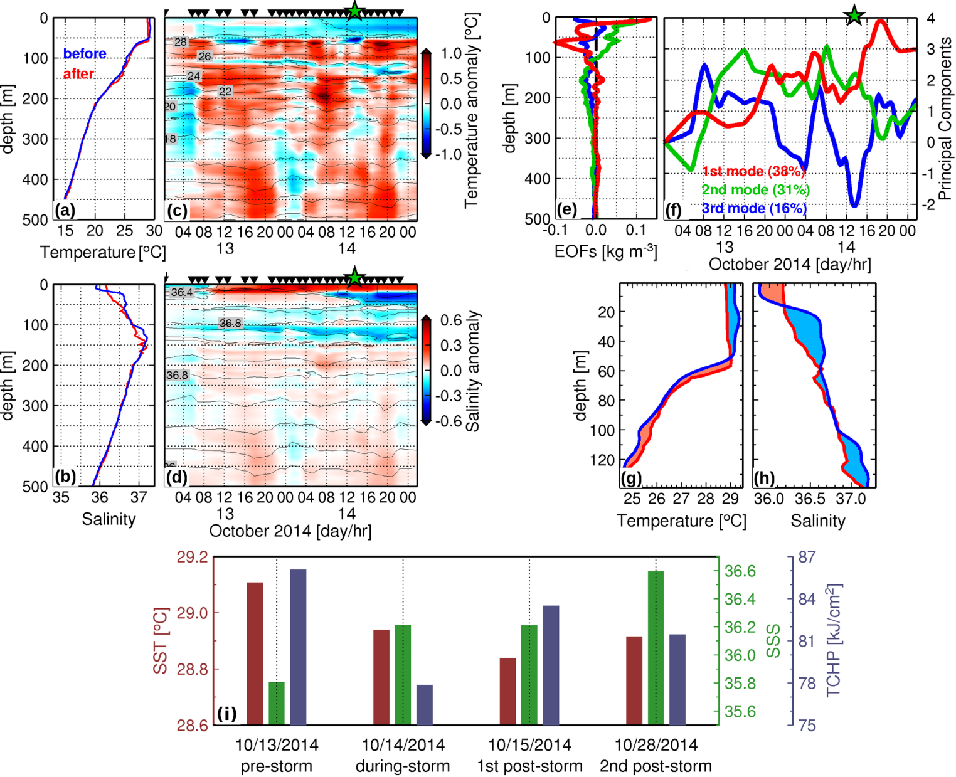

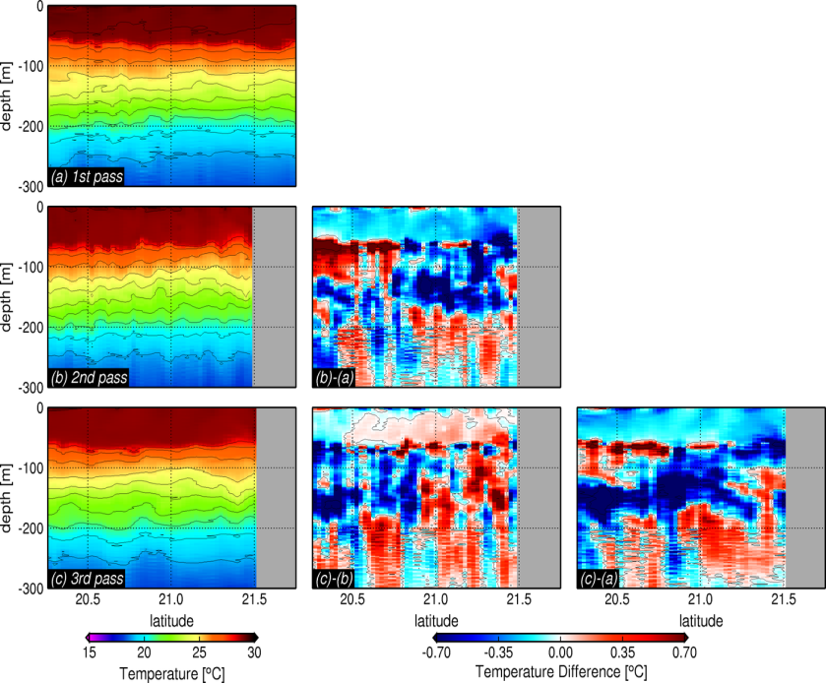
Ocean response to Hurricane Gonzalo
Domingues et al. (2015)
Main findings
Complex upper-ocean response linked with multiple ocean processes
Important role of salinity: -> Small surface cooling of 0.4C
    Barrier layer has likely reduced the hurricane forced turbulent mixing
Partial recovery of the upper-ocean 11 days after the storm
HWRF-HYCOM overestimated upper ocean cooling -> salinity effects were absent in model simulations
Domingues, R., G. Goni, F. Bringas, S.-K. Lee, H.-S. Kim, G. Halliwell, J. Dong, J. Morell, and L. Pomales (2015), Upper ocean response to Hurricane Gonzalo (2014): Salinity effects revealed by targeted and sustained underwater glider observations, Geophys. Res. Lett., 42, doi:10.1002/2015GL065378.

Slide 10
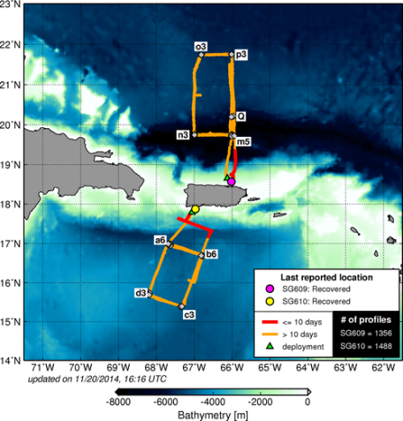
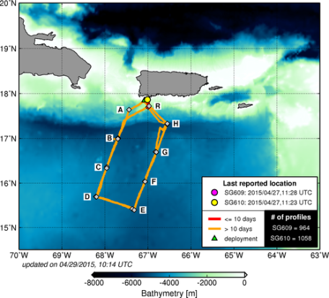
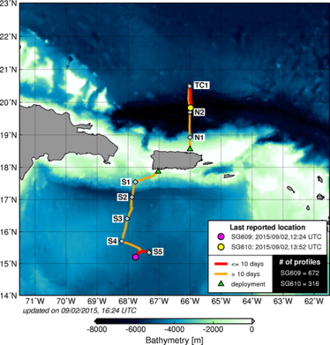
Summary
A network of underwater gliders has been implemented in the Tropical North Atlantic and Caribbean Sea
To date, over 6000 profiles were collected in these areas, including observations under TC conditions
Glider observations under Hurricane Gonzalo
  Small surface cooling: 0.4C -> Barrier layer has likely reduced the hurricane forced turbulent mixing
  Observations suggested the influence of multiple processes forced by hurricane winds.
  The results obtained during Hurricane Gonzalo emphasize the value of the targeted and sustained observations obtained by underwater gliders.
Future work
  Glider observations will continue in 2016
    Repeat transects
    New glider starting in January 2016
    New sensors: Chlo-a, CDOM
Mission 01
Mission 02
Mission 03

Slide 11
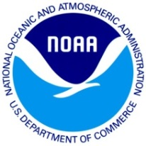

Thank you
Contact: Ricardo.Domingues@noaa.gov
More information: http://www.aoml.noaa.gov/phod/gliders

Slide 12
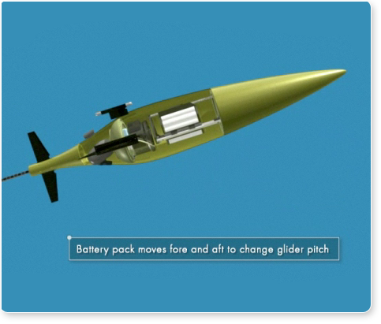
Seaglider Pitch

Slide 13
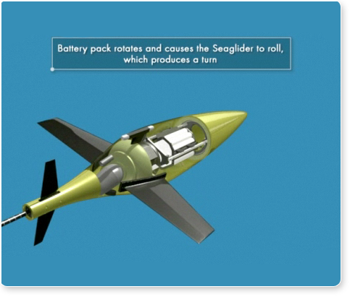
Seaglider Roll

Slide 14
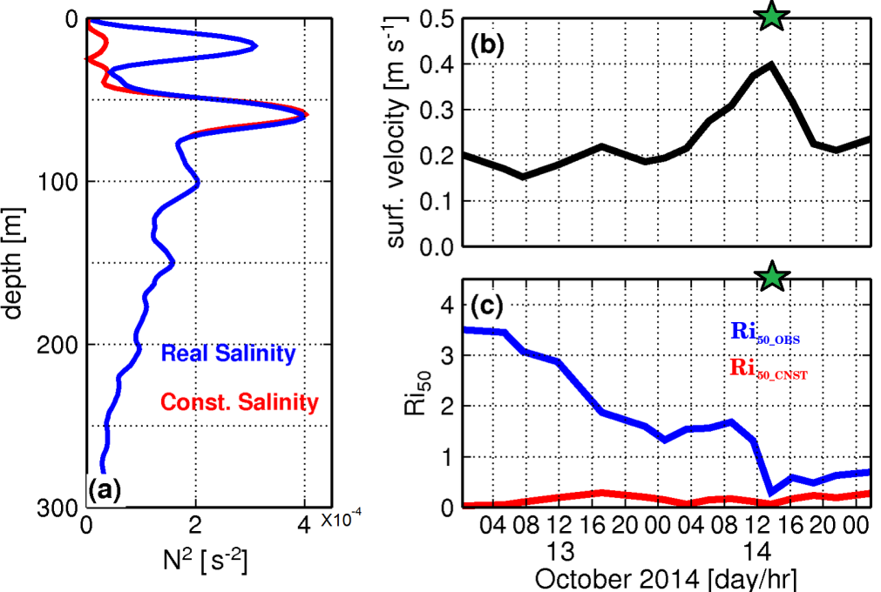
Ocean response to Hurricane Gonzalo
Prestorm observations
Conditions
  Isothermal layer above 50m (29C)
  Shallow low-salinity layer above 20m
    Barrier Layer
During storm observations
Development of:
  Mixing-related anomalies above 130m
  Alternating anomalies between 130-500m (internal tides & baroclinic motions)
Small surface cooling: 0.4C
  Barrier layer has likely reduced the hurricane forced turbulent mixing

Slide 15
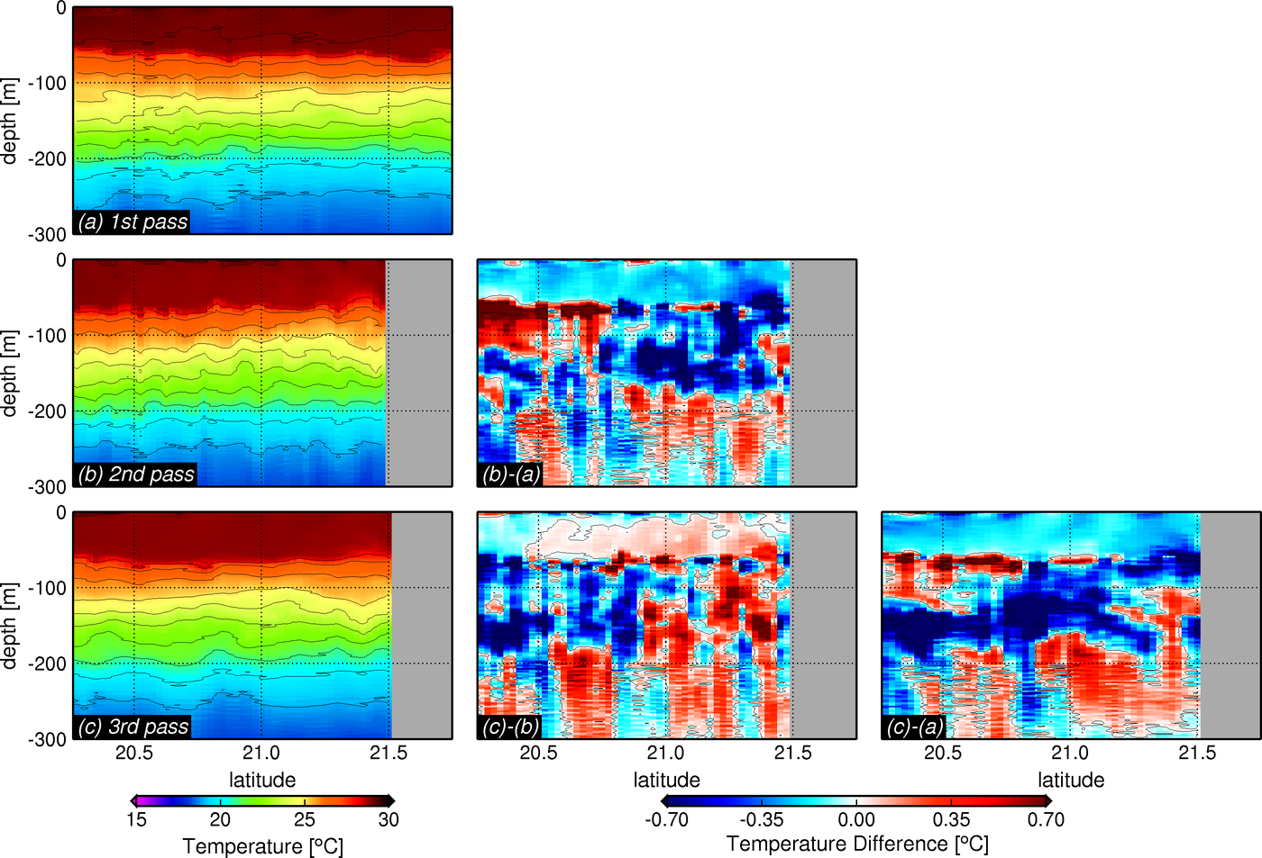

Ocean response to Hurricane Gonzalo
Poststorm observations
  1st Poststorm section (October 15-23)
  overall cooling of the water column close to site A due to:
    Rightward biased coolling
    Upwelling
  2nd Poststorm section (October 23-28)
  Partial recovery of the ocean
B
A
Prestorm
1st poststorm
2nd poststorm
Domingues, R., G. Goni, F. Bringas, S.-K. Lee, H.-S. Kim, G. Halliwell, J. Dong, J. Morell, and L. Pomales (2015), Upper ocean response to Hurricane Gonzalo (2014): Salinity effects revealed by targeted and sustained underwater glider observations, Geophys. Res. Lett., 42, doi:10.1002/2015GL065378.

