Slide 1
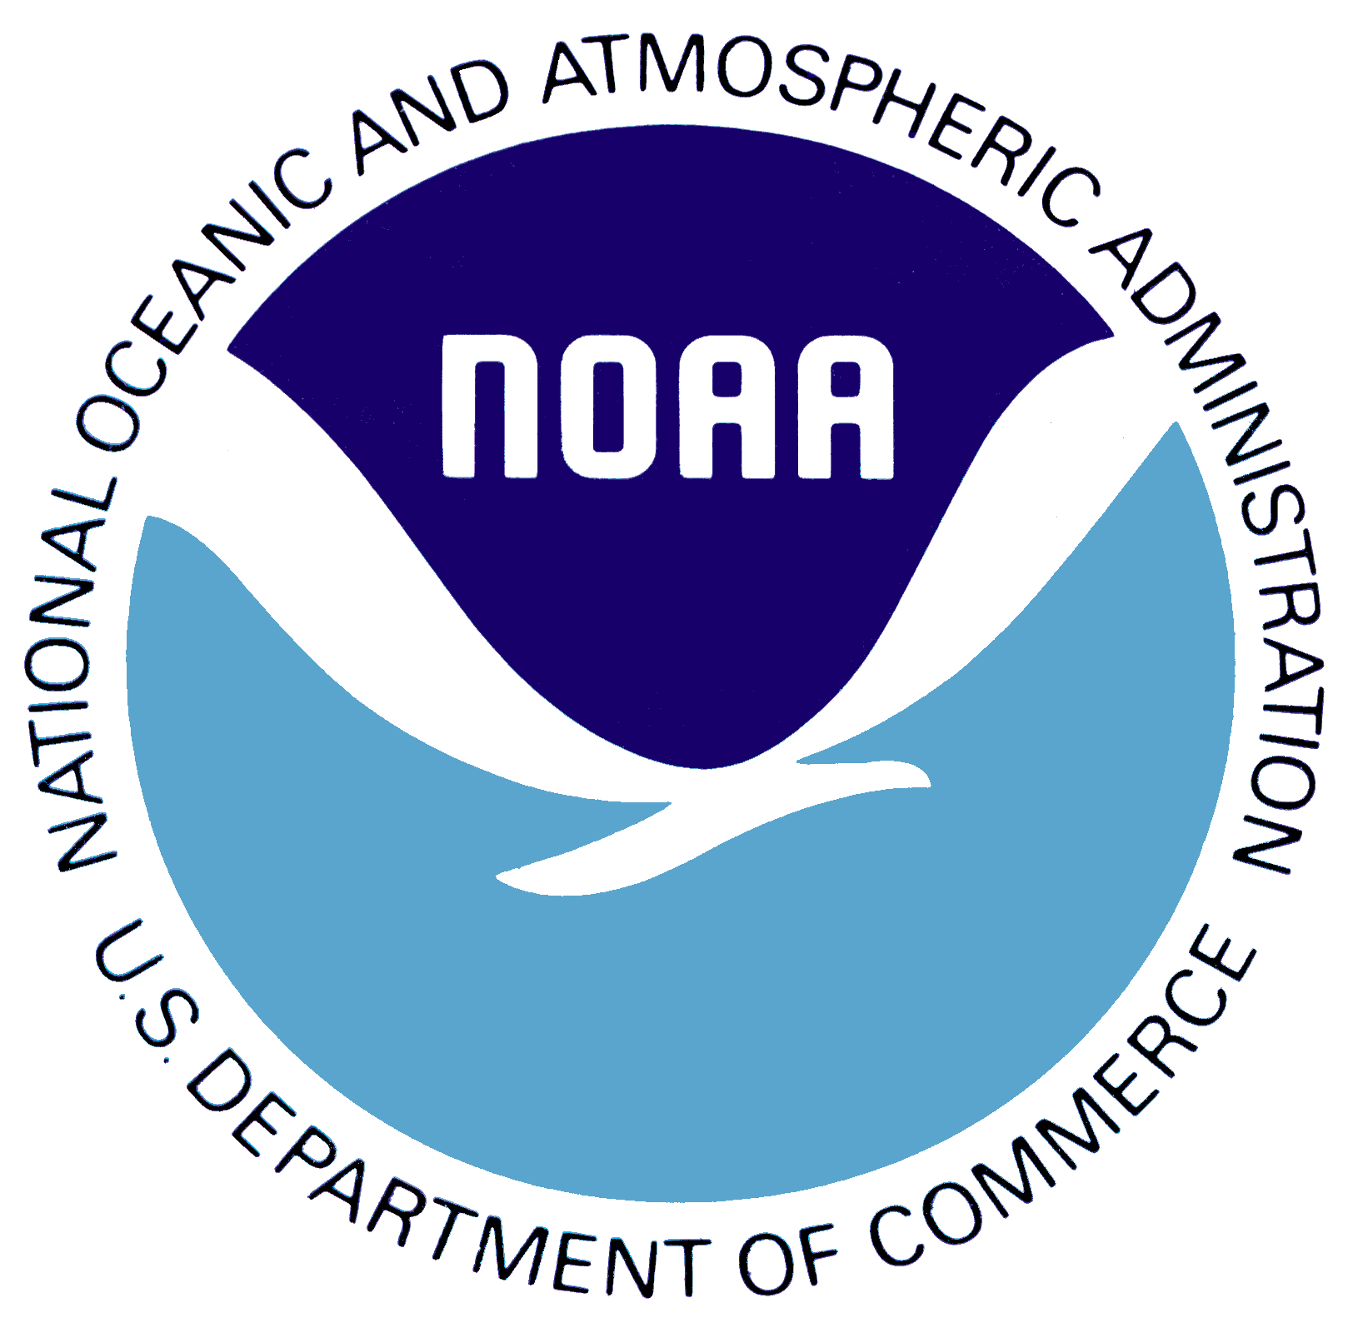
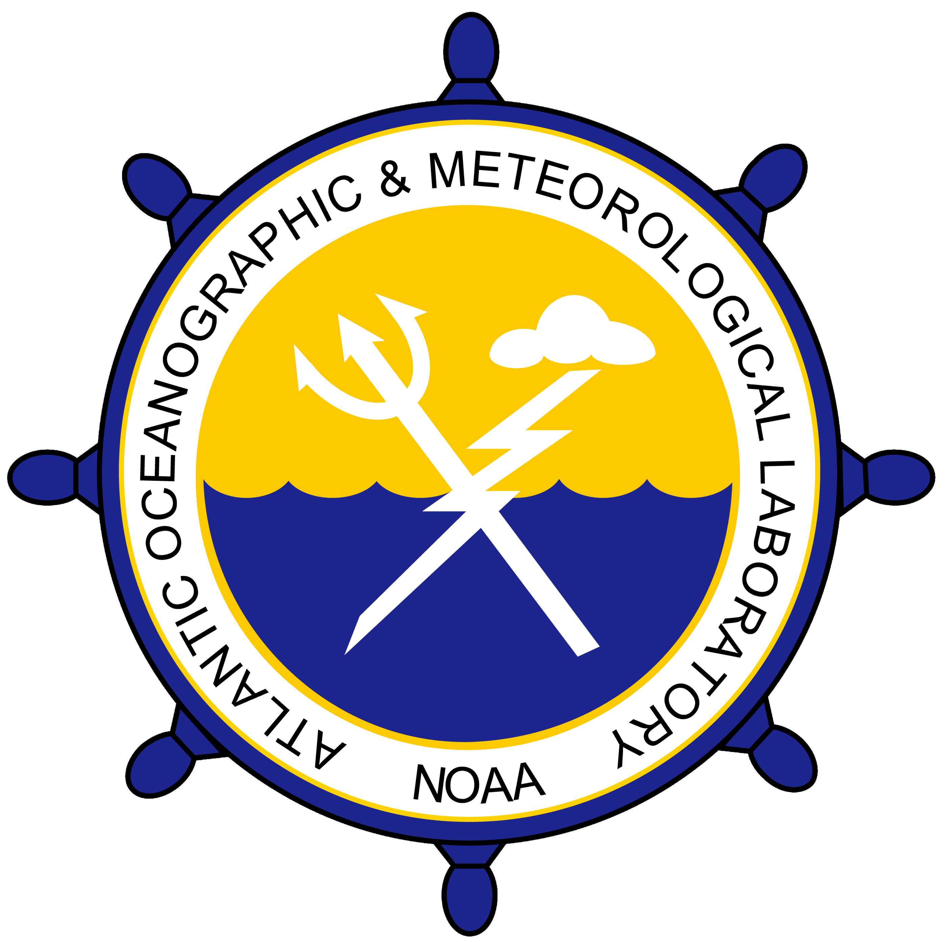
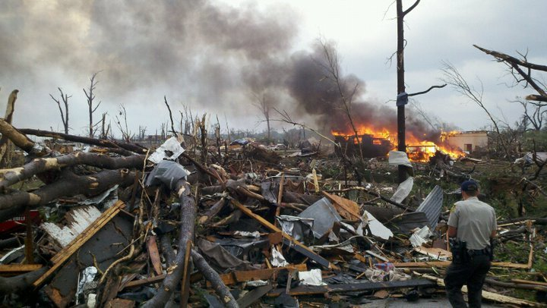
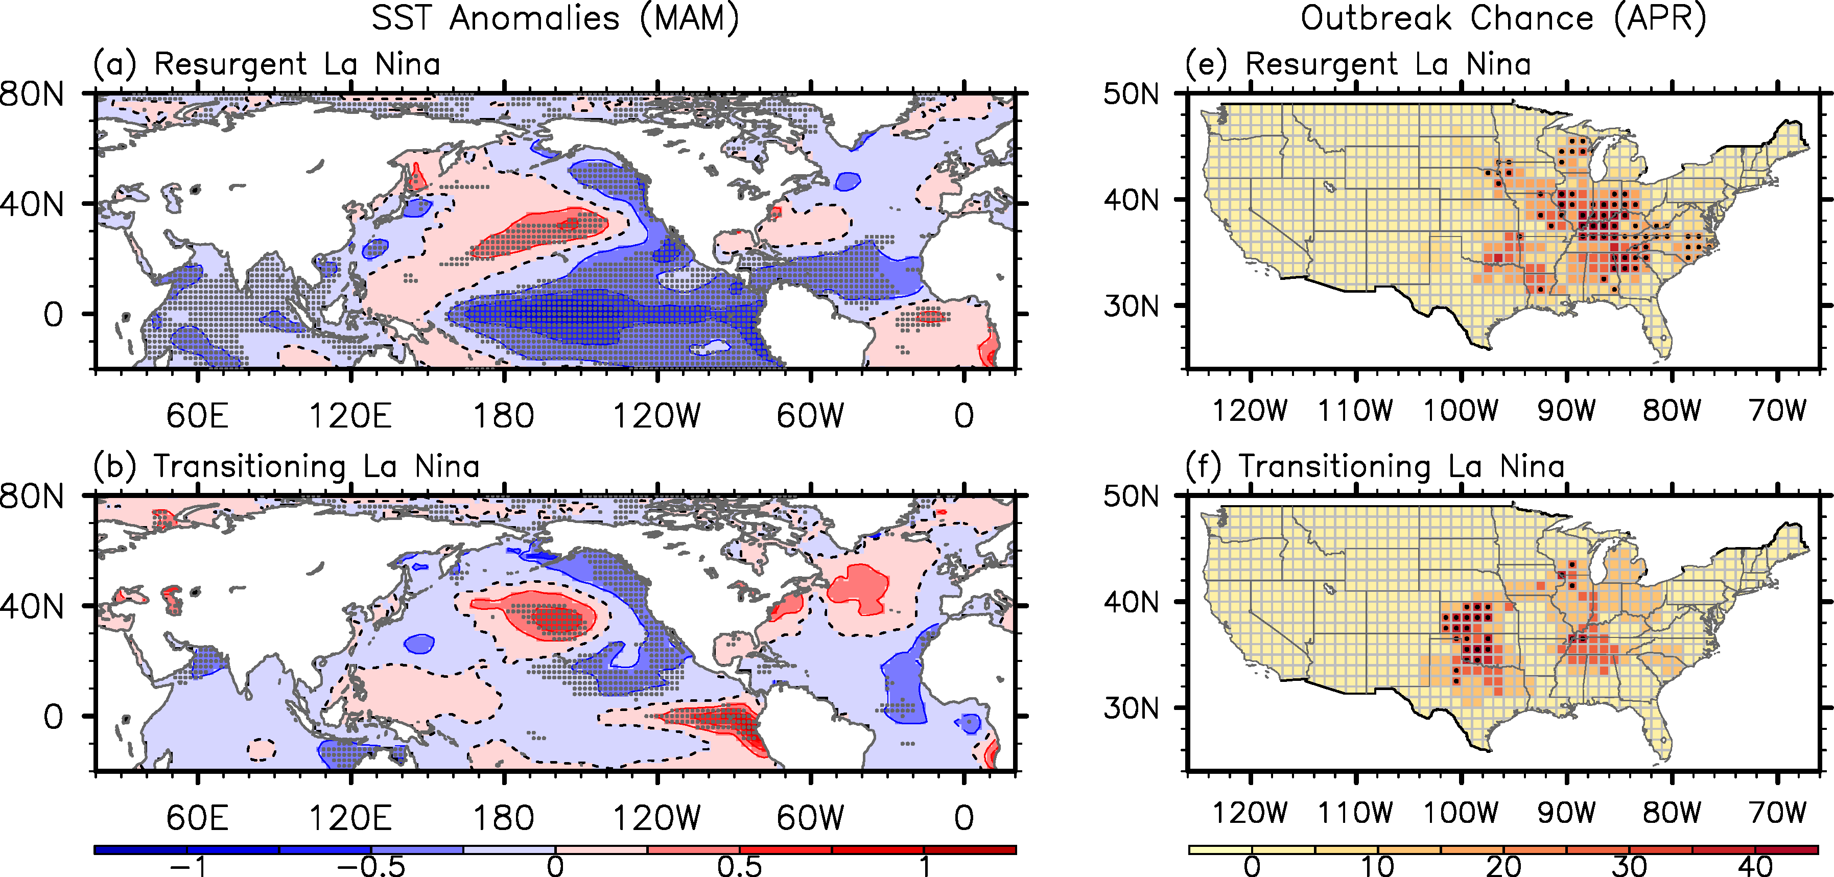
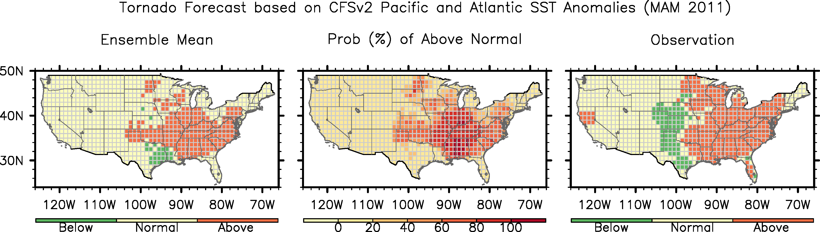

National Oceanic and Atmospheric Administration
Atlantic Oceanographic and Meteorological Laboratory
Physical Oceanography Division – PHOD
Miami, FL
Oceanographers Help Improve Outlooks of U.S. Tornado Outbreaks
Recent violent and widespread tornado outbreaks in the U.S., such as those that occurred in the spring of 2011, have caused devastating societal impacts with significant loss of life and property.
PHOD scientists are working toward achieving the capacity to predict U.S. tornadoes and other severe spring weather risks before the season begins in March 1.
Destruction caused by a violent EF4 Tornado in April 29, 2011 Tuscaloosa, Alabama
SST Anomalies (March-May)
Probability of Outbreak (April)
In 2013, PHOD scientists found that the springtime El Niño-Southern Oscillation (ENSO) climate phenomenon generates large-scale atmospheric conditions that are conducive to intense tornado outbreaks in the U.S.
La Niña that rebuilds into La Niña
La Niña that rebuilds into La Niña
La Niña that transitions to El Niño
La Niña that transitions to El Niño
Tornado activity forecast (outlook) for March-May of 2011
using February 2011 initial conditions
Since 2016, PHOD scientists
have provided NOAA’s National Weather Service with a seasonal outlook for US regional tornado activity. This outlook is used as a forecast tool for the NOAA Climate Prediction Center’s experimental Seasonal Severe Weather Outlook.
Outlook (activity)
Probability of above normal (%)
Observation (activity)
The hybrid forecast model initialized in February of 2011 successfully captures the increased tornado activity in the Ohio Valley and Southeast during March-May of 2011.
PDF of this poster
References:
Lee, S.-K., A. T. Wittenberg, D. B. Enfield, S. J. Weaver, C. Wang and R. Atlas, 2016: U.S. regional tornado outbreaks and their links to ENSO flavors and North Atlantic SST variability. Environ. Res. Lett., 11, 044008.
Lee, S.-K., P. N. DiNezio, E.-S. Chung, S.-W. Yeh, A. T. Wittenberg and C. Wang, 2014: Spring persistence, transition and resurgence of El Nino. Geophys. Res. Lett., 41, 8578-8585.
Lee, S.-K., B. E. Mapes, C. Wang, D. B. Enfield and S. J. Weaver, 2014: Springtime ENSO phase evolution and its relation to rainfall in the continental U.S. Geophys. Res. Lett., 41, 1673-1680.
Lee, S.-K., R. Atlas, D. B. Enfield, C. Wang and H. Liu, 2013: Is there an optimal ENSO pattern that enhances large-scale atmospheric processes conducive to major tornado outbreaks in the U.S.? J. Climate, 26, 1626-1642.

