Slide 1
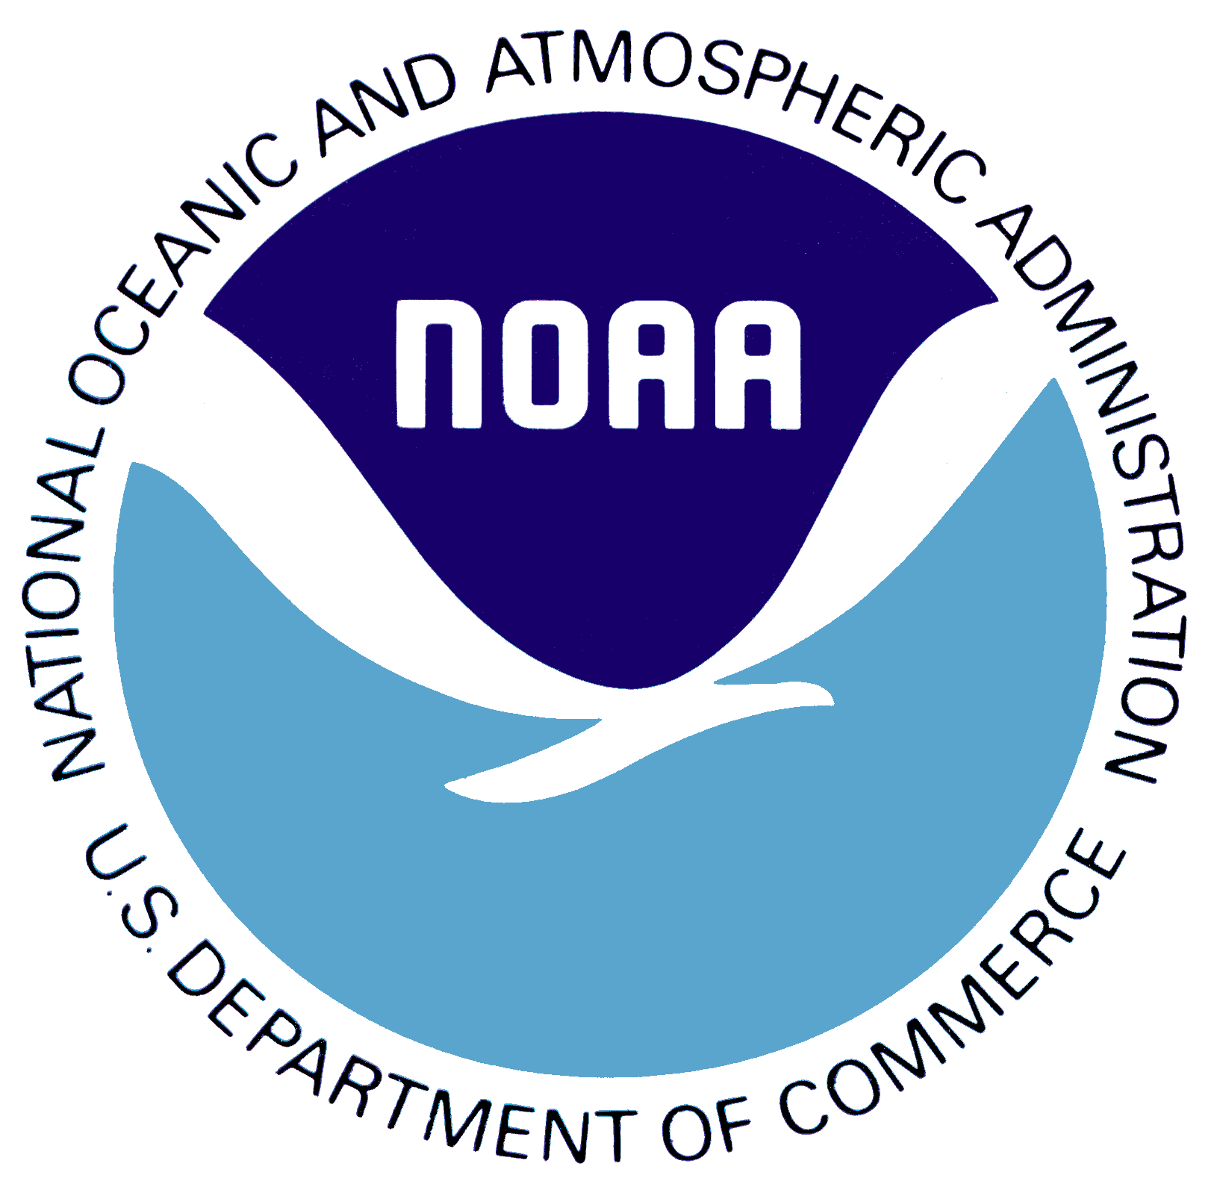
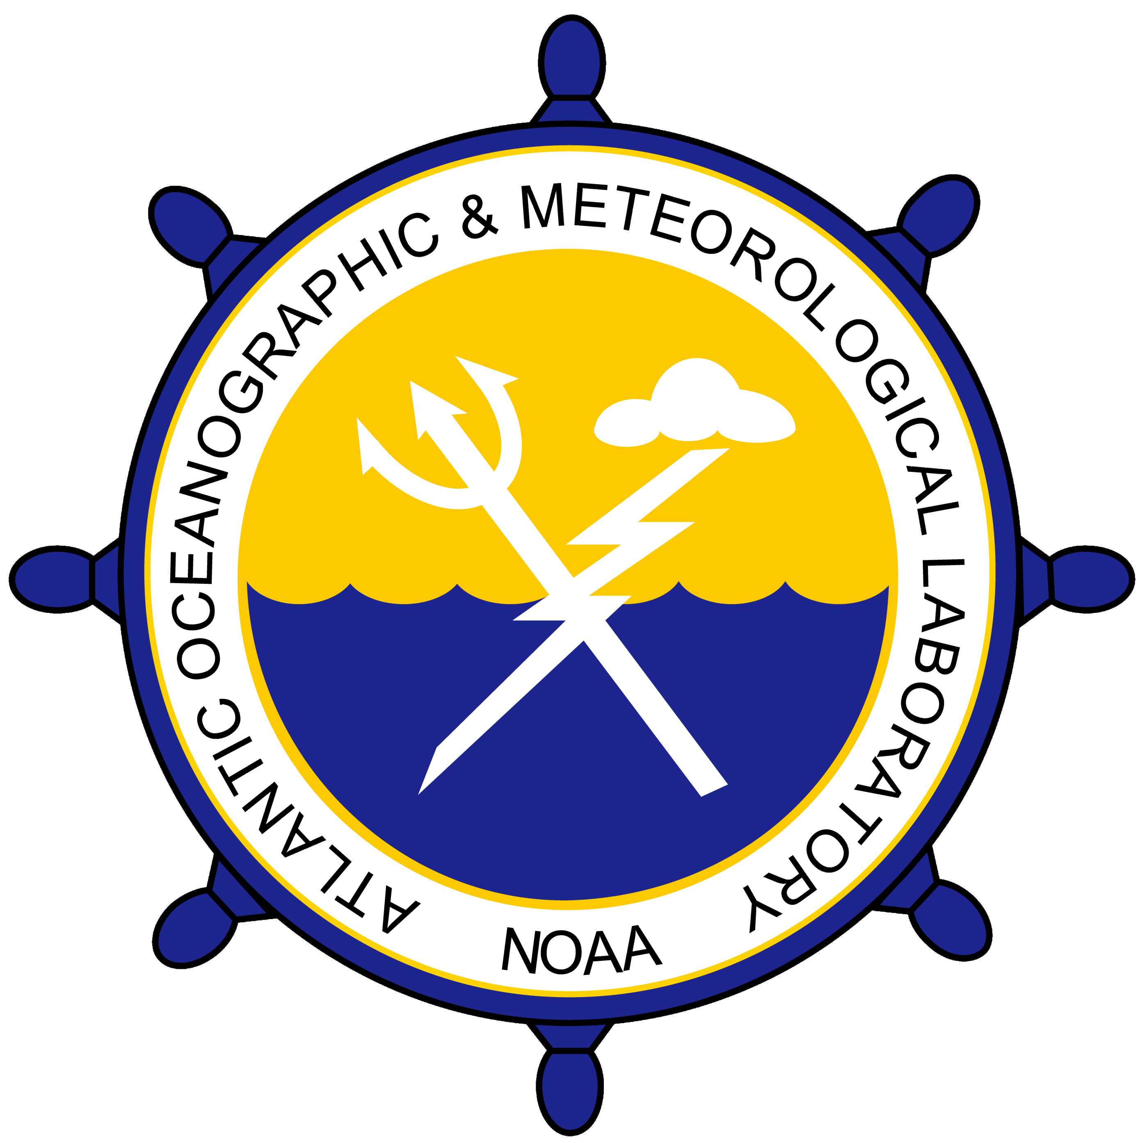
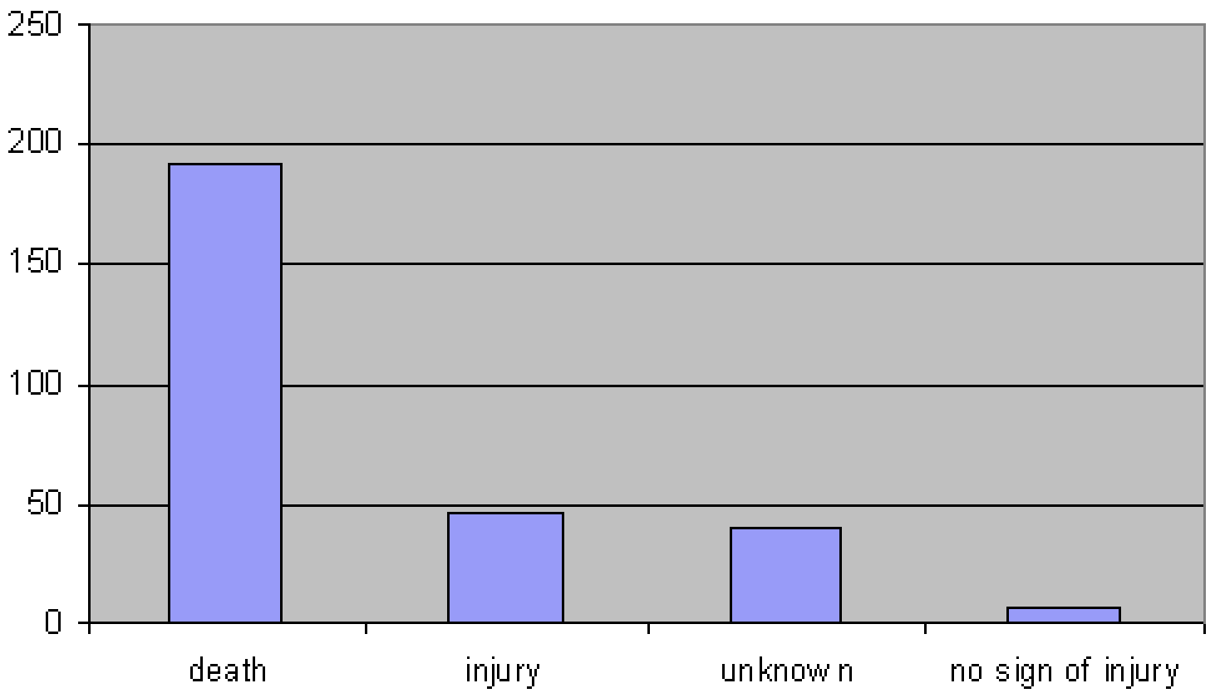
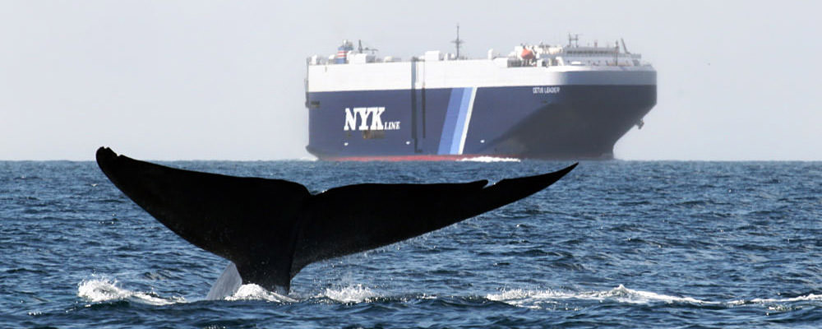
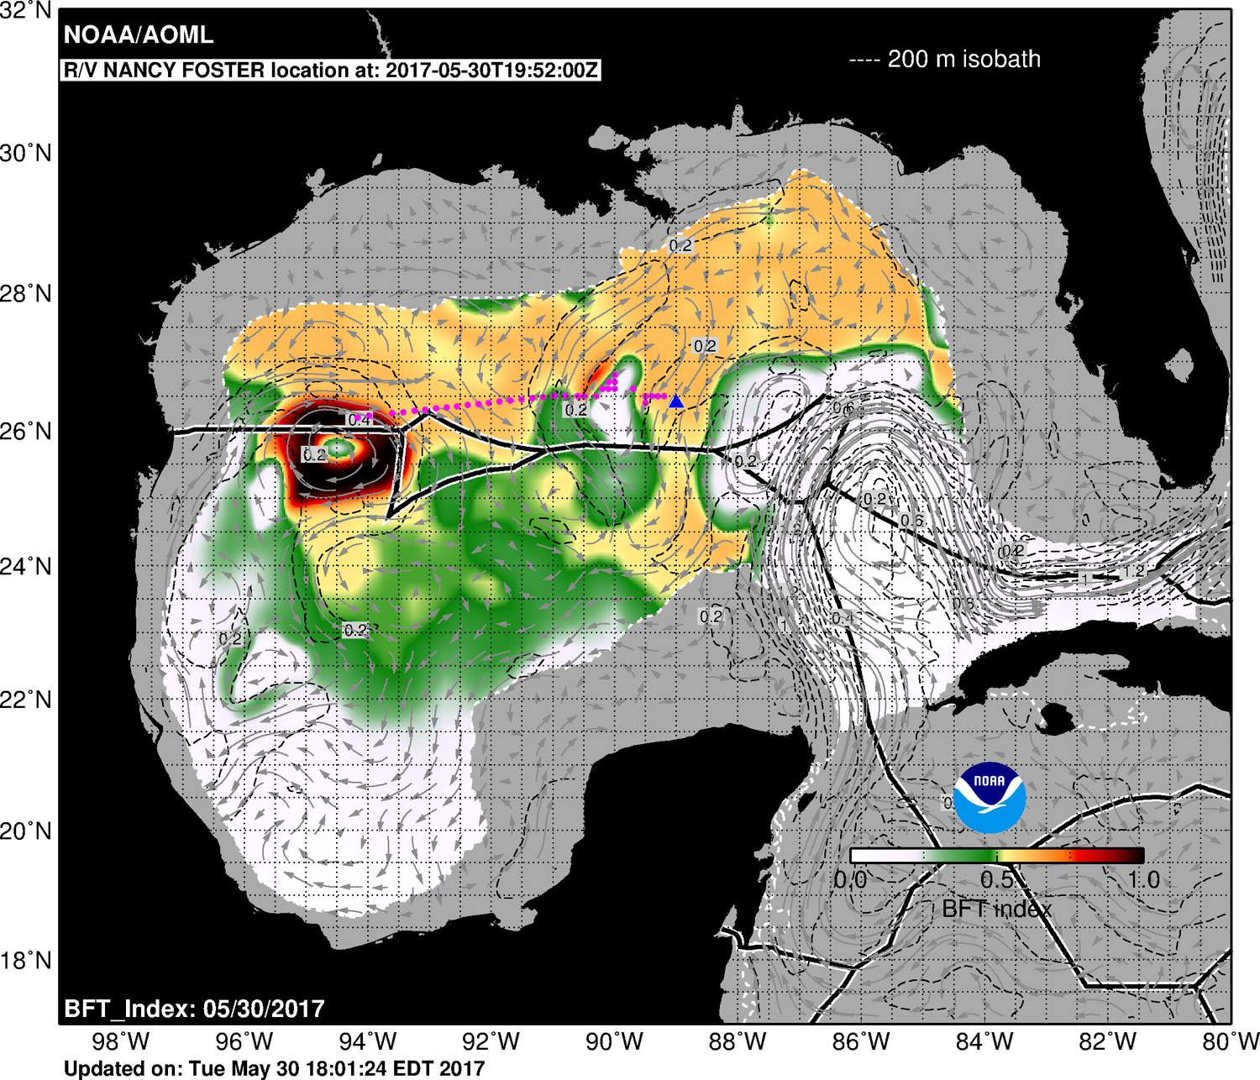
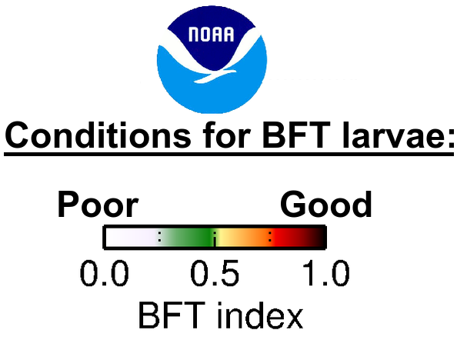
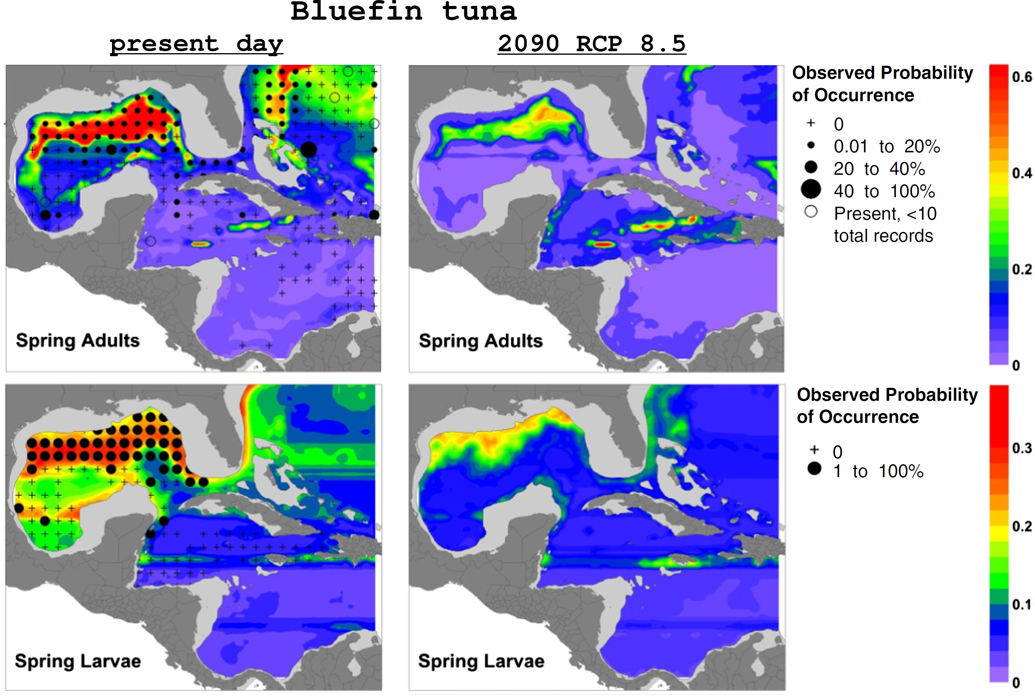

National Oceanic and Atmospheric Administration
Atlantic Oceanographic and Meteorological Laboratory
Physical Oceanography Division – PHOD
Miami, FL
Ocean Monitoring to Protect Marine Mammals and Manage Fisheries
Ship strikes are a major source of injury and death for critically endangered North Atlantic right whales.
The Physical Oceanography Division has developed and currently hosts the Mandatory Ship Reporting System, which is operated by NOAA's National Marine Fisheries Service and the United States Coast Guard, to protect whales by reducing the number of ship strikes and improve overall maritime safety.
250
200
150
100
50
0
Source: NOAA
number of ship strikes
death injury unknown no sign of injury
impact to large whales
PHOD researchers also provide real-time ocean products that are used by NOAA's National Marine Fisheries Service to improve stock assessment and management of Atlantic bluefin tuna.
Ocean features often present favorable (yellow to red in the map) habitat conditions for many commercially important species of fish in the Gulf of Mexico.
Probability of Bluefin tuna Occurrence
present day 2090
Observed
0.6
0.4
0.2
0
Additionally, modelling studies by PHOD scientists show that projected ocean warming during the 21st century will likely cause habitat losses at spawning grounds in the northern Gulf of Mexico for Atlantic bluefin tuna.
Probability based on Ocean Conditions
Observed Probability of
Larvae Occurrence'
0.3
0.2
0.1
0
Observed
Source: Muhling et al., (2015).
PDF of this poster
References:
Domingues et al., (2016). Variability of preferred environmental conditions for Atlantic bluefin tuna (Thunnus thynnus) larvae in the Gulf of Mexico during 1993–2011. Fisheries Oceanography, 25(3), 320-336.
Liu et al., (2015). Potential impact of climate change on the Intra-Americas Sea: Part-1. A dynamic downscaling of the CMIP5 model projections. Journal of Marine Systems, 148, 56-69.
Muhling et al. (2015), Potential impact of climate change on the Intra-Americas Sea: Part 2. Implications for Atlantic bluefin tuna and skipjack tuna adult and larval habitats. Journal of Marine Systems, 148, 1-13.

