Slide 1
Sources of transient annual variability for the Florida Current transport
Ricardo Domingues
rdomingues@rsmas.miami.edu
Advisor: William Johns
Meteorology and Physical Oceanography
Student seminars
Miami, December 10, 2014

Slide 2
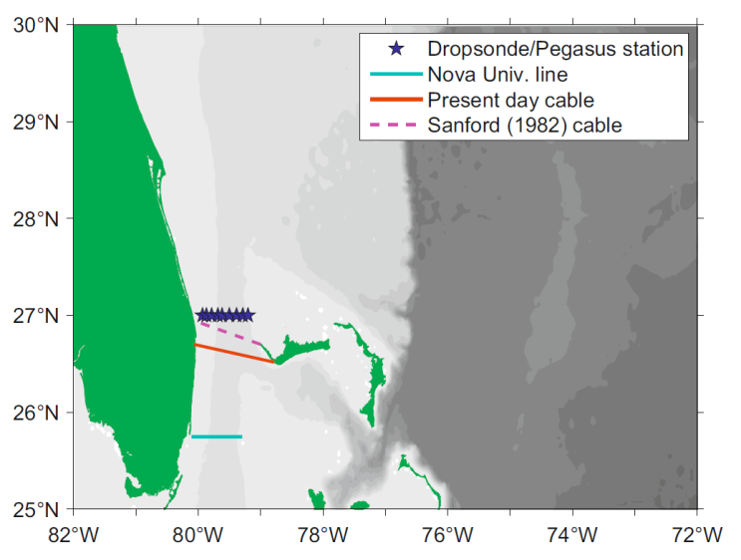
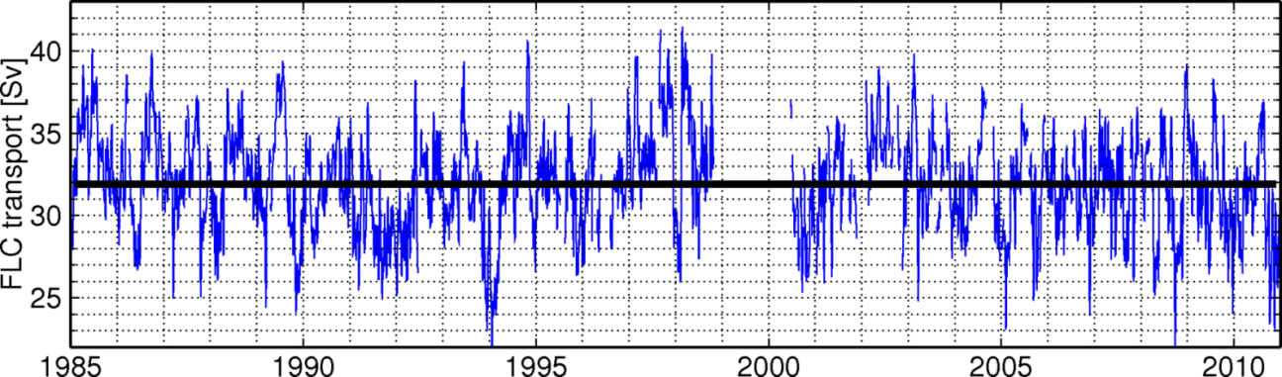
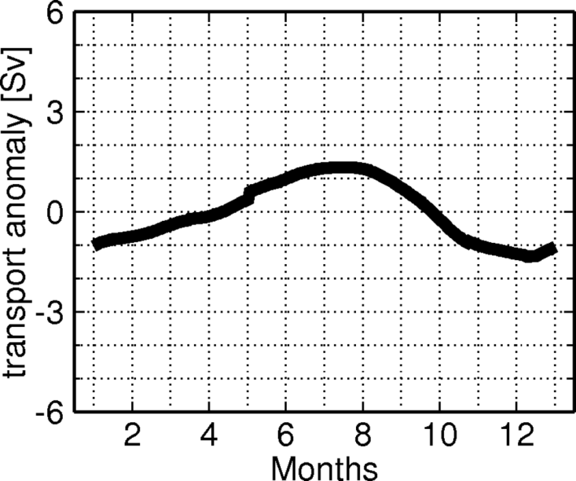
Florida Current Annual Variability
Florida Current Transport
Meinen et al., (2010)
Peak during late summer
Low values during fall/winter
Niiler and Richardson (1973);
Schott et al., (1988)
Baringer and Larsen (2001);
Meinen et al., (2010)

Slide 3
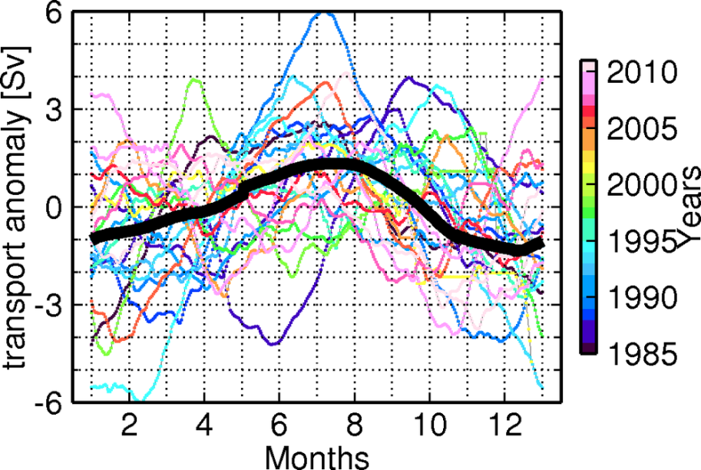
Florida Current Annual Variability
Florida Current Transport
Meinen et al., (2010)
73-525 days frequency Band
Amplified Annual Cycle
90º phase displacement
Semi-annual Cycle

Slide 4
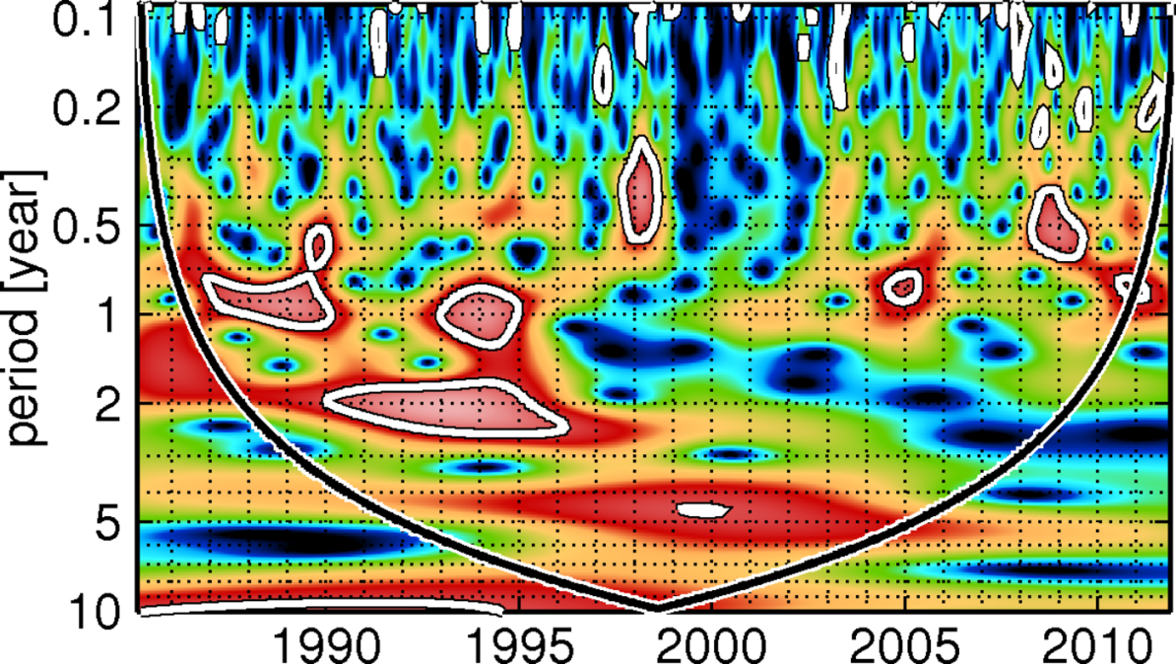
Florida Current Transport Wavelet Transform
Meinen et al., (2010)
73-525 days
frequency band

Slide 5
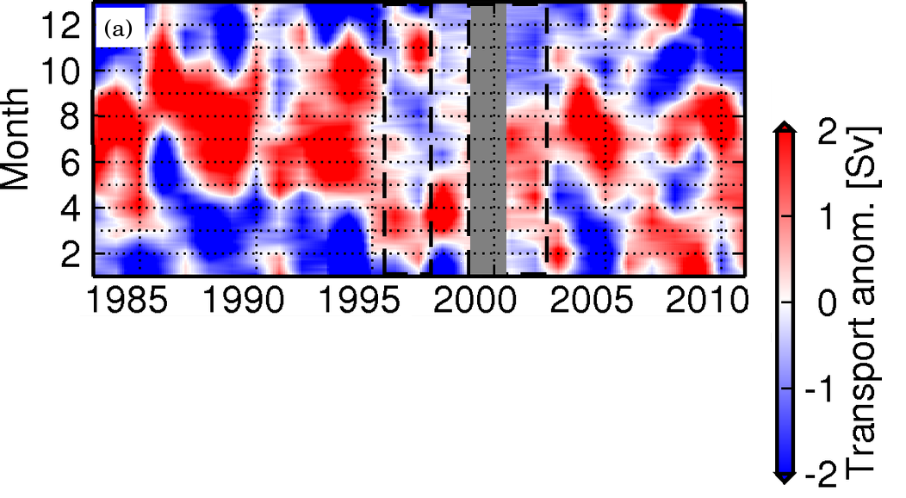
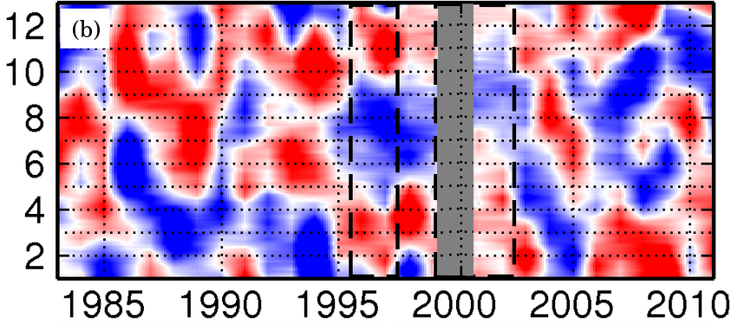
Florida Current Annual Variability
Florida Current Transport
73-525 Frequency Band
Static Annual Variability
Transient Annual Variability

Slide 6
Florida Current Annual Variability
Baringer and Larsen (2001)
  First reported changes in the FC annual phase
  1982-1990 (amplified annual cycle) vs. 1991-1998 (semi-annual cycle)
Meinen et al. (2010)
  2001-2007 (weak semi-annual cycle)
  Suggested that different processes, other than the local wind forcing, may drive the observed interannual variability of the FC annual cycle
Meinen et al. (2010)
Baringer and Larsen (2001)
Static + Transient

Slide 7
Sources of Annual Variability
Static component
  Along-channel wind stress + Upstream/Downstream wind stress curl (Schott et al., 1988)
Transient component
  What drives the transient component of the Florida Current annual variability?
    One source of variability are the first baroclinic westward propagating signals in the North Atlantic (Polito and Liu, 2003)
      WPS explains over 30% of the SHA variability on North Atlantic:
~15% by the semi-annual wave
~10% by the annual wave

Slide 8
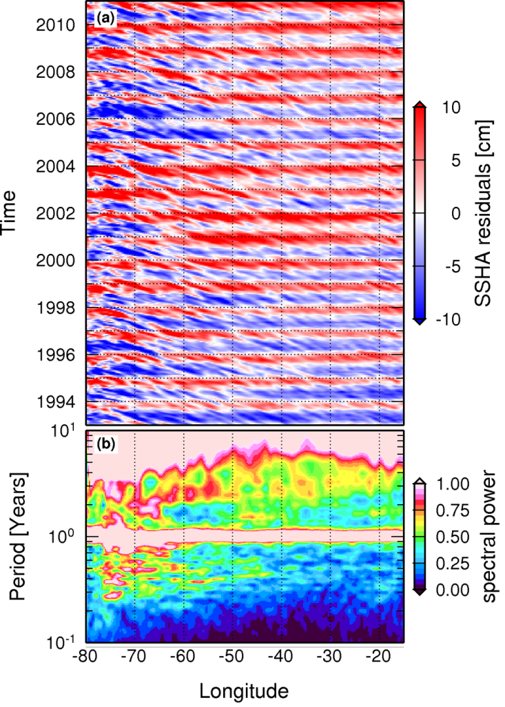
Introduction
AVISO Sea Height Anomaly 27ºN - RAW
Strong annual periodicity linked with the cross-basin seasonal warming of the upper layer: static component

Slide 9
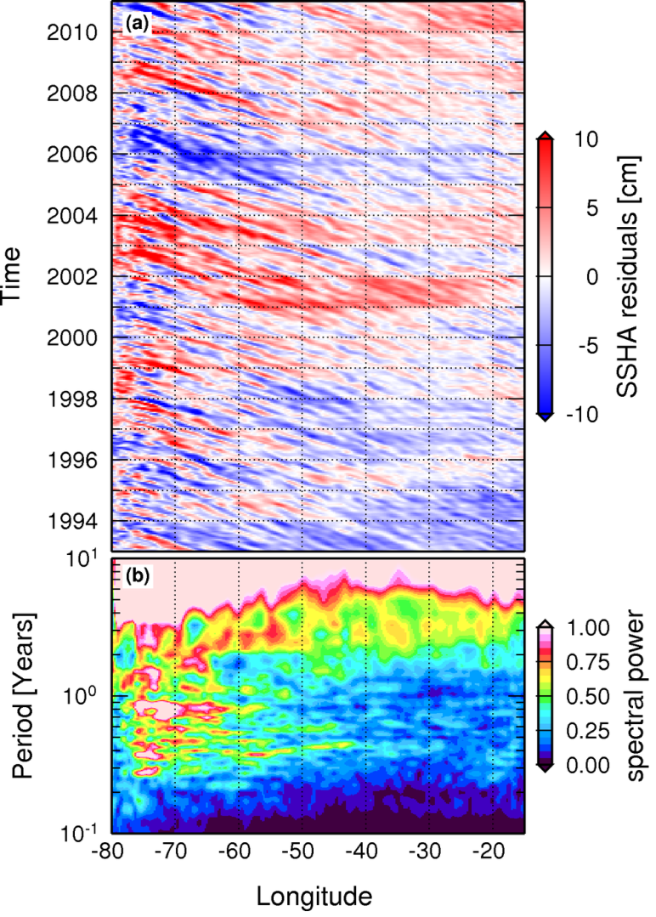
Introduction
AVISO Sea Height Anomaly 27ºN – Static Annual Cycle removed (residuals)
Interannual SHA variability
Westward propagating signals are more visible

Slide 10
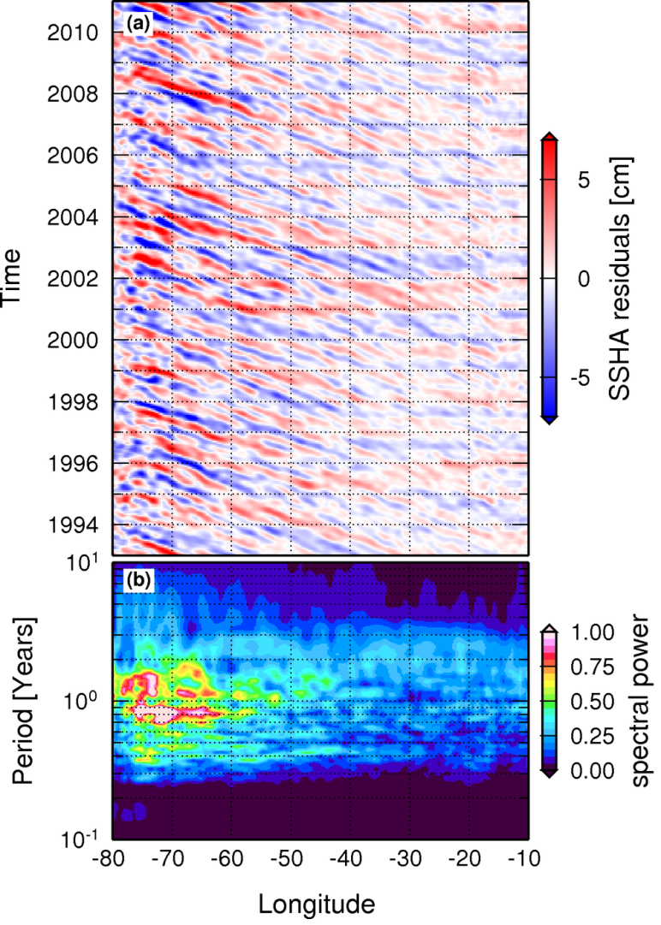
Introduction
AVISO Sea Height Anomaly 27ºN– Residuals + 53-525 days frequency band
Frequency band mostly linked with westward propagating signals in the North Atlantic

Slide 11
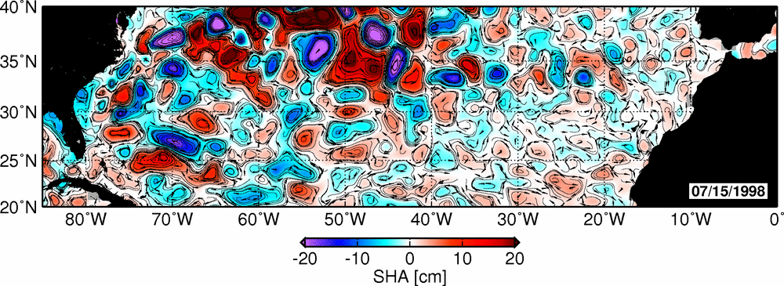
Westward Propagating Signals on the NA
AVISO Sea Height Anomaly 27ºN– Residuals + 53-525 days frequency band
Mesoscale eddies

Slide 12
Sources of Annual Variability
Static component
  Along-channel wind stress + Upstream/Downstream wind stress curl (Schott et al., 1988)
Transient component
  What drives the transient component of the Florida Current annual varibility?
    One source of variability are the first baroclinic/westward propagating signals (WPS) in the North Atlantic, which is dominated by the semi-annual and annual waves (Polito and Liu, 2003)
    Frajka-Williams et al., (2007) provided evidence of the WPSs on annual variability of the Florida Current Transport
    Domingues and Baringer (in preparation) quantified that ~50% of transient component can be accounted by the sea level variability linked with WPSs

Slide 13
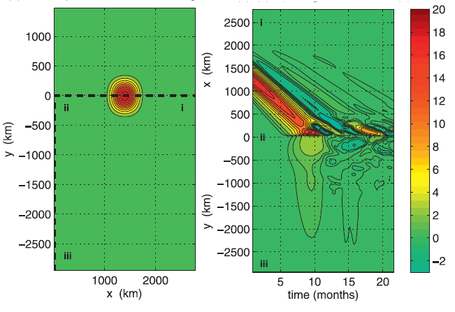
FC response to WPSs
What are the dynamical mechanisms driving the FC response due to to WPSs?
Some idealized experiments of eddies at the western boundary:
Nof (1999): Strange encounters of eddies with walls (fate of the eddie)
  Two subprocesses in approximate balace:
    β-induced equatorward tendency
    Rocket effect: tendency of the ring to be pushed poleward due to equatoward leakage that is established along the wall
  Similar mechanisms may be observed at the Gulf Stream
Kanzow et al., (2009)
  Fast Kelvin wave propagating southward
  Poleward migration of the eddy linked
  with the rocket effect
Kanzow et aal., (2009)

Slide 14
Goal
Improve the understanding on the Florida Currrent annual variability by evaluating its response to westward propagating signals
In order to accomplish this, idealized and realistic numerical simulations will be employed to:
Describe the dynamic mechanisms involved
Understand the role of background circulation in the modulation of the response at the western boundary
Evaluate the role of realistic topography on the responses
Provide new insights on the Western Boundary Currents vs. Eddies problem

Slide 15
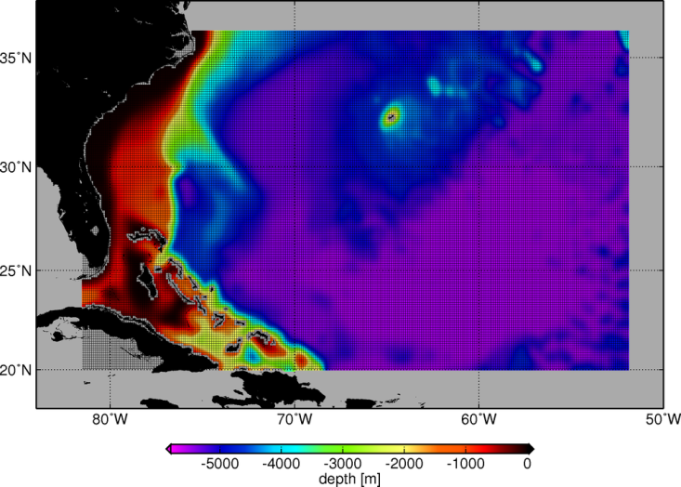
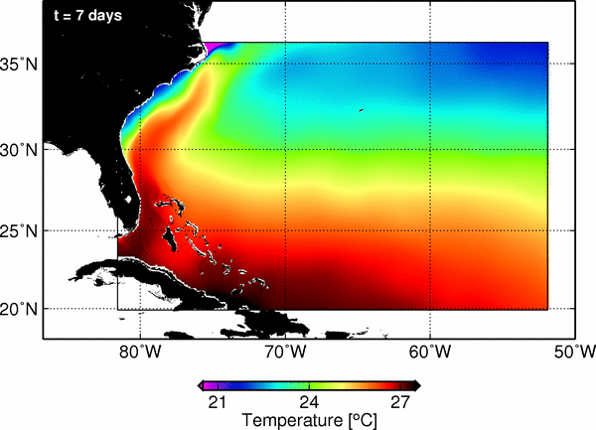
Regional Ocean Modelling System - ROMS
Domain:
  82ºW-52ºW; 20ºN-36ºN
  28 vertical layers
  XX vs. YY grid points
~1/12º horizontal resolution
Three set of experiments:
1. Role of topographic
2. Role of the background FC flow
3. Eddies impinging in different latitudes

Slide 16

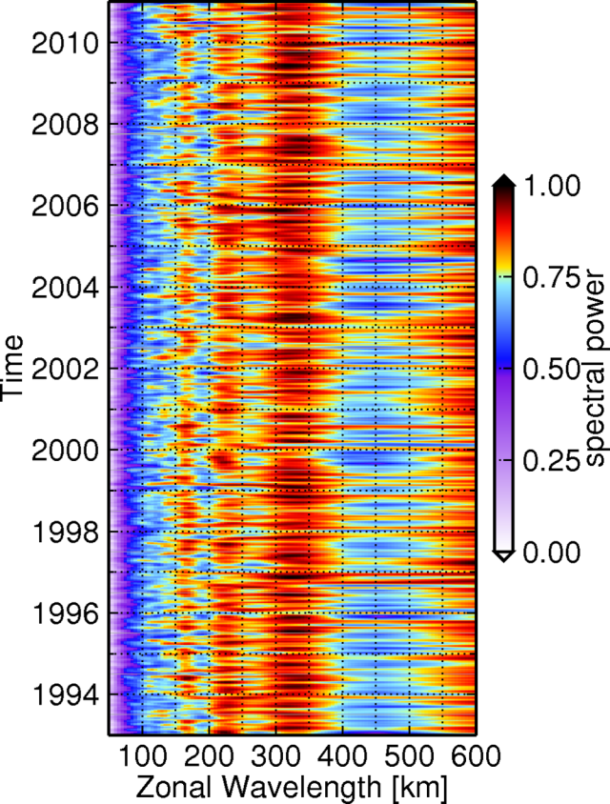
Wavelengths at 27ºN

Slide 17
Thank you
Ricardo Domingues
rdomingues@rsmas.miami.edu
Advisor: William Johns
Meteorology and Physical Oceanography
Student seminars
Miami, December 10, 2014

