Slide 1
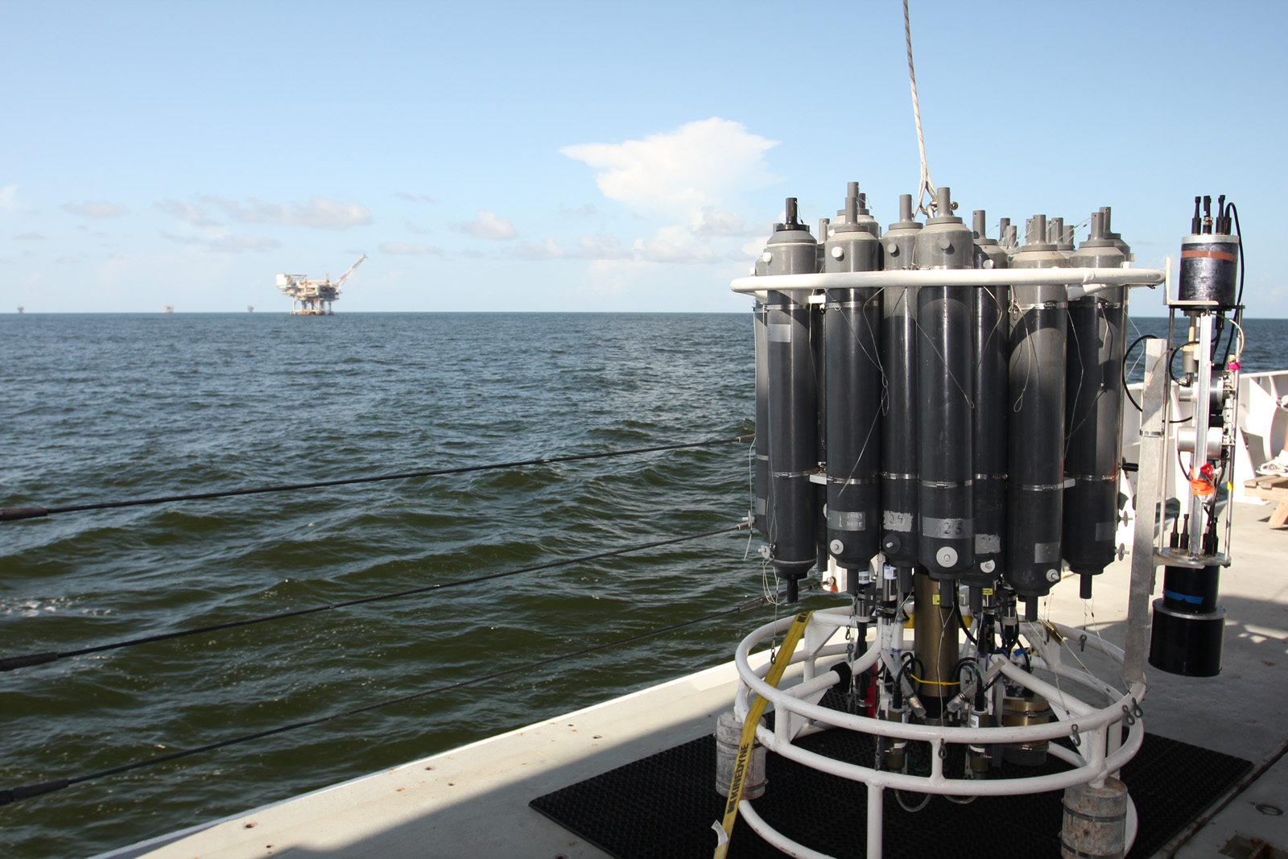
Anthropogenic Forcing on Local to Regional Scales
with focus on the ocean carbon cycle
Rik Wanninkhof
NOAA/AOML

Slide 2
Outline:
A flavor of divisional activities
The global carbon problem
Quantification of CO₂ uptake by the ocean
Ocean Acidification as a carbon problem: Ocean response / Coral reef impacts

Slide 3
AOML’s Ocean Chemistry Division (OCD)
A dozen investigators; total personnel ≈ 30
Core research strength :
“Study of forcing and ecological response of anthropogenic stressors on local to global scale”
Approach:
Integrative and collaborative with municipalities, academic, international and NOAA partners
Examples-
Local – Urban oceanography
Local- microbiology- disease vectors on beaches (ocean and human health)- technology transfer award
Regional to Global-Nutrient cycling
Regional- Integrated Ecosystem assessment for the Gulf of Mexico and SE coast
Regional to global- carbon cycling

Slide 4
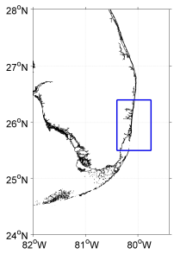
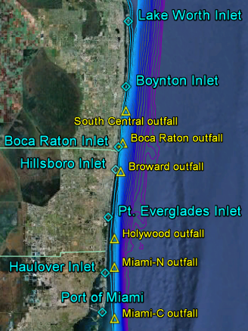
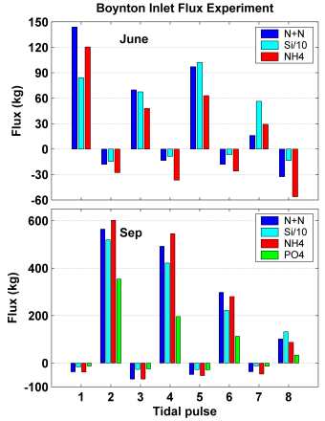
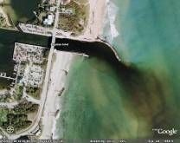
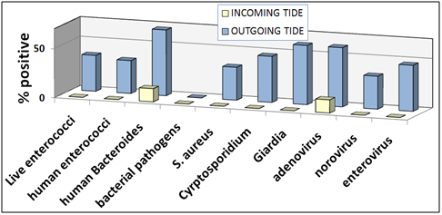
Land Based Sources of Pollution/Urban Oceanography
Anthropogenic Stressors on Florida Coastal Ecosystems
Outlets vs Outfalls
Nutrient fluxes through inlets into SE Florida’s coastal ocean
Effects of treated-wastewater ocean outfall plumes on coral reefs
Human health impacts from outfall and inlet effluent
Pathogens found in flood (white) and ebb (blue) flow at Boynton Inlet
http://www.aoml.noaa.gov/themes/CoastalRegional/projects/FACE/faceweb.htm

Slide 5
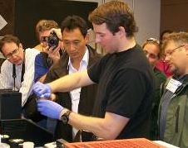
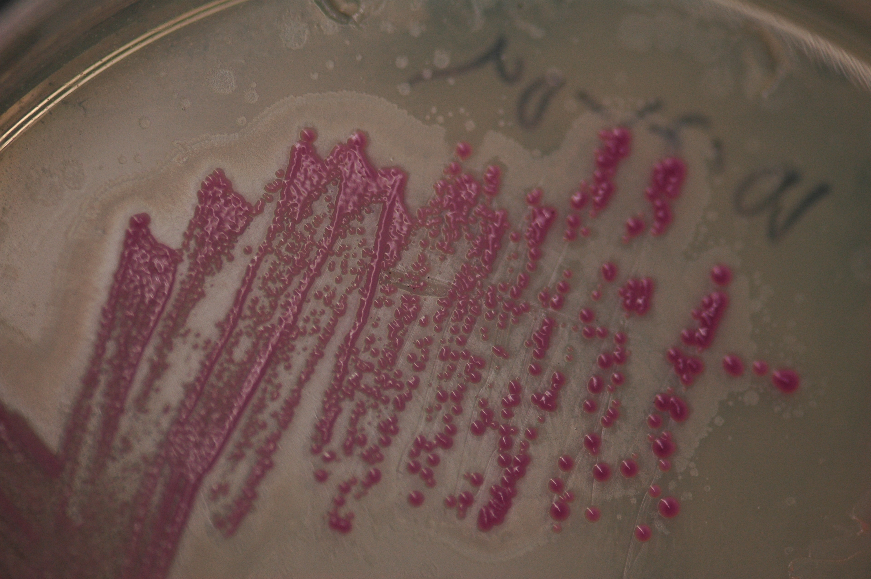
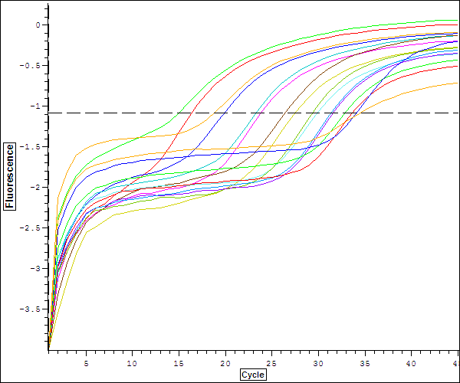
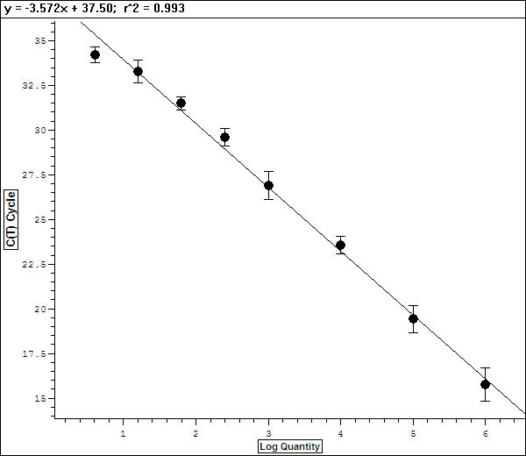
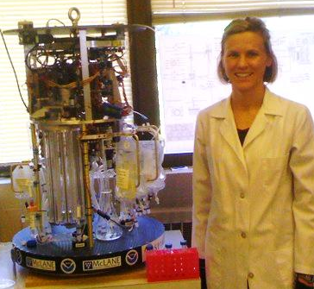
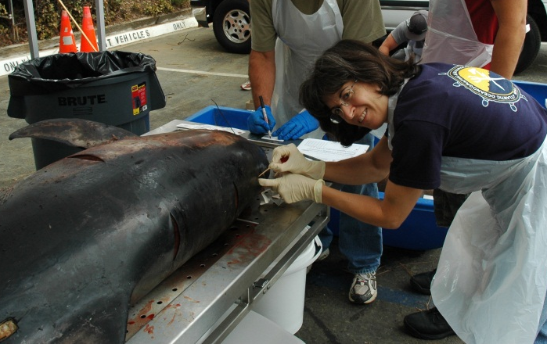
Environmental Microbiology
Molecular Assay Development, Deployment, & Transfer
Winner
OAR 2012 Technology Transfer Award
Inter-Agency Collaboration, & Stakeholder Training
Direct Detection of Pathogens
Plume Tracking & Water Quality Assessment w/links to land-based sources of pollution
Marine Mammal Pathogen Assessment
Improving Sample Processing for Molecular Applications and Biosensing Technology

Slide 6
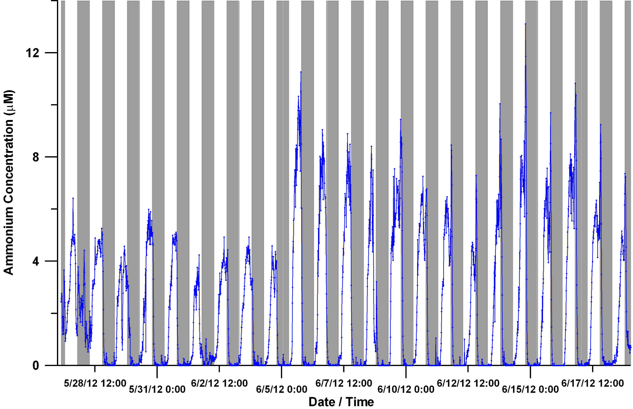
Nutrient Dynamics
Instrument development and serendipity
(or “transformative research”)
Amornthammarong and Zhang
Production of ammonium from photochemical degradation of DOM
Unknown loss mechanism

Slide 7
Integrated Ecosystem Assessments (IEA)
Risk Scores of State Indicators for the Gulf of Mexico
Relating disparate processes, populations and locations on a common scale to aid decision making

Slide 8
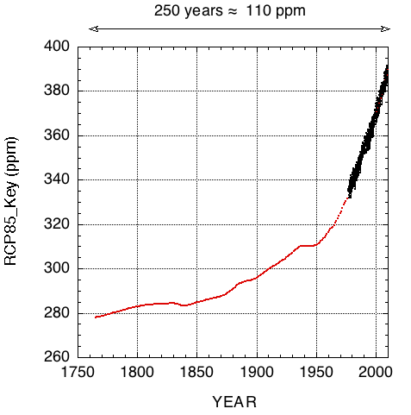
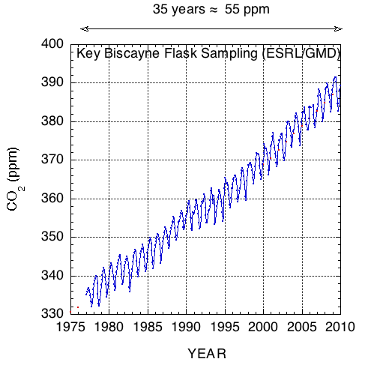
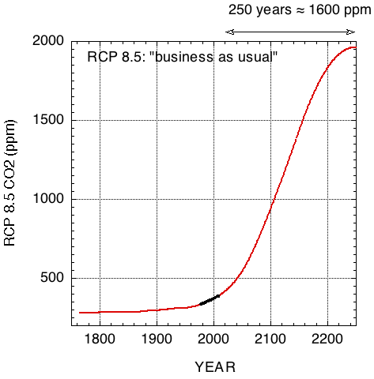
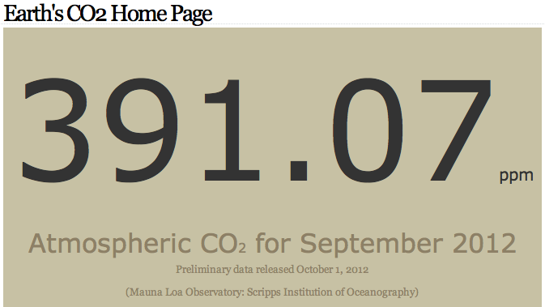
The Global Carbon Problem
The anthropocene
The recent past The present The future
CO2now.org
Atmospheric CO₂ levels constant (+- 5 ppm) for past thousands of year despite major gross exchanges between atmosphere, biosphere and ocean.
Fossil fuel burning increases atmospheric CO₂ levels at an increasing rate.
The future projections suggest an “adapt or perish” scenario for ecosystems and human populations
Meaningful mitigation strategies have to address emissions and have to be verified. [carbon accounting]

Slide 9
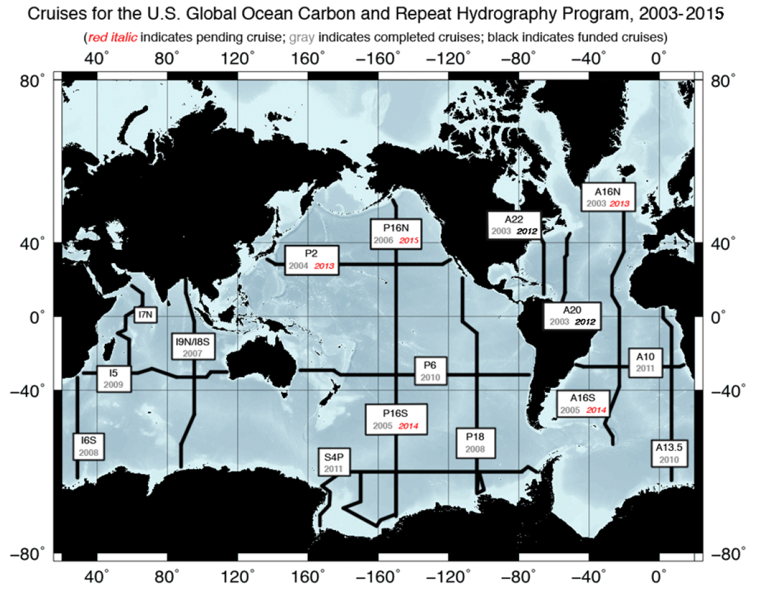
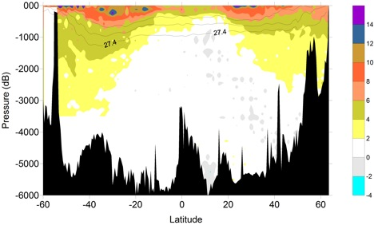
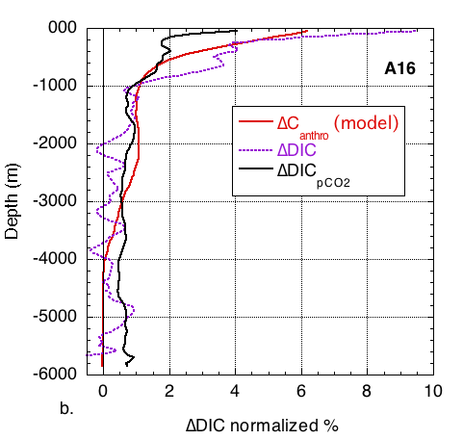
Carbon Accounting in the Ocean
Changes in anthropogenic ocean carbon inventories on decadal time scales- Repeat hydrography
Most Decadal changes in the top 2000 m but new techniques show change in deep water

Slide 10
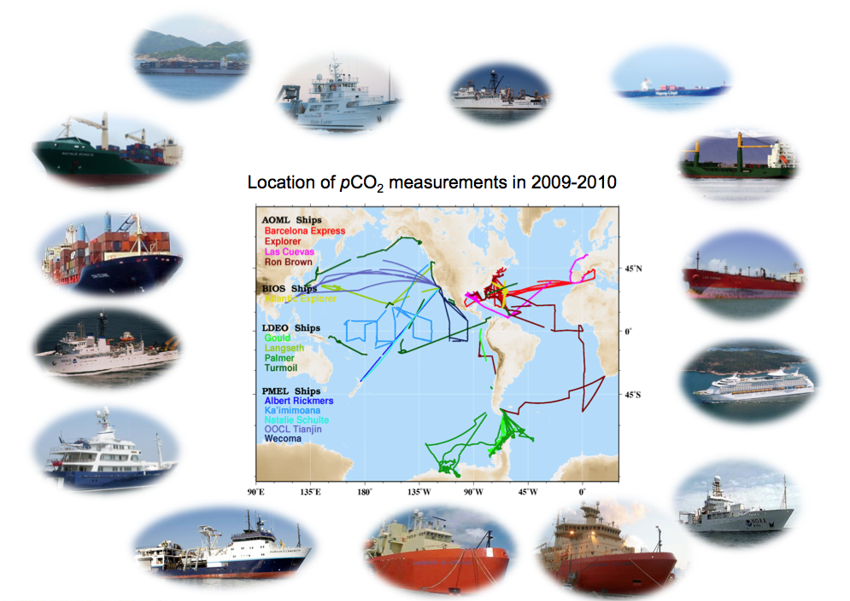
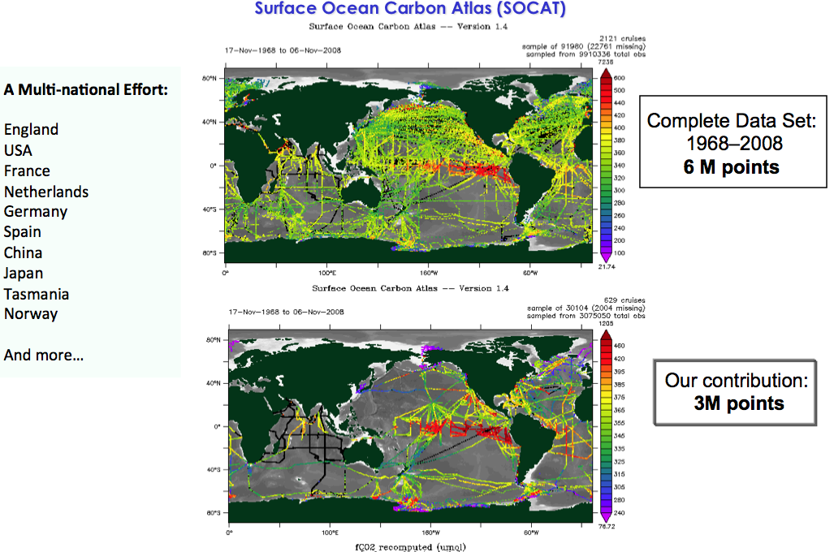
Carbon accounting – Sea-air fluxes on seasonal timescales
Sea-air CO₂ flux = f(<U²>) ∆pCO₂
NOAA supports the largest ship of opportunity pCO₂ measurement campaign in the world
NOAA is a leader and major contributor to global data management and synthesis efforts (SOCAT)

Slide 11
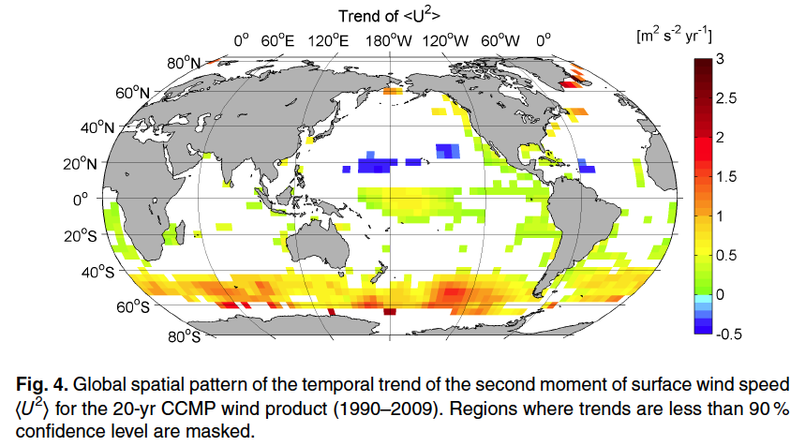
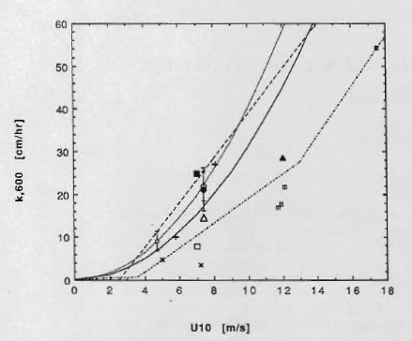
Carbon accounting – Sea-air fluxes on seasonal timescales
Sea-air flux = f(<U²>) ∆pCO₂
Relationship Between Wind Speed and Gas Exchange Over the Ocean
2012 ASLO John Martin Award for its high impact on research in the field
Atlas, R., Hoffman, R.N., Ardizzone, J., Leidner, S.M., Jusem, J.C., Smith, D.K., Gombos, D., 2011. A cross-calibrated multiplatform ocean surface wind velocity product for meteorological and oceanographic applications. Bull. Amer. Meteor. Soc. 92, 157-174.
Wanninkhof, R., Asher, W.E., Ho, D.T., Sweeney, C.S., McGillis, W.R., 2009. Advances in Quantifying Air-Sea Gas Exchange and Environmental Forcing. Annual Reviews Mar. Science 1, 213-244.

Slide 12
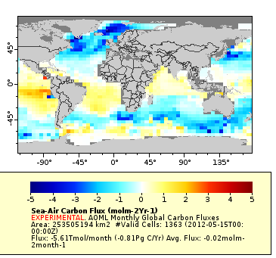
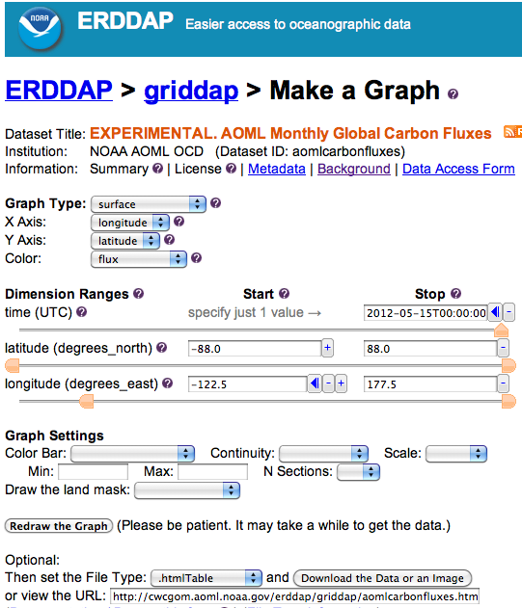
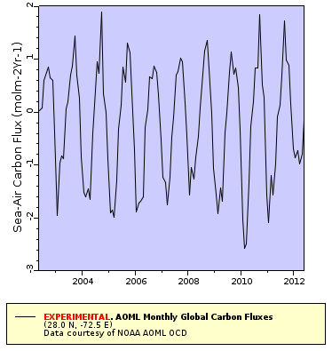
Carbon accounting – Flux Mapper
http://cwcgom.aoml.noaa.gov/erddap/griddap/aomlcarbonfluxes.graph
Global contemporary sea-air-CO₂ flux estimate
May, 2012
Time series of sea-air CO₂ fluxes (off of FL)

Slide 13
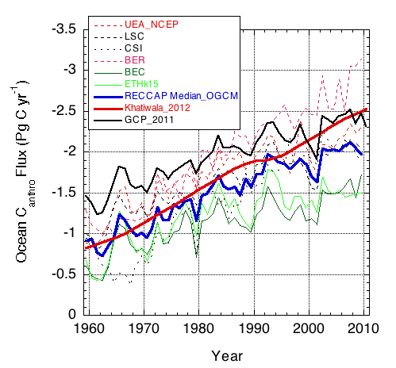
Carbon Accounting – Decadal Discrepancies in models
Regional Carbon Cycle Assessment Project (RECCAP)
Sea-air CO₂ fluxes based on empirical data based approaches & biogeochemical ocean models show less uptake than inventory based measurements and models used in projections.
Wanninkhof et al., 2012, Biogeosciences, under review

Slide 14
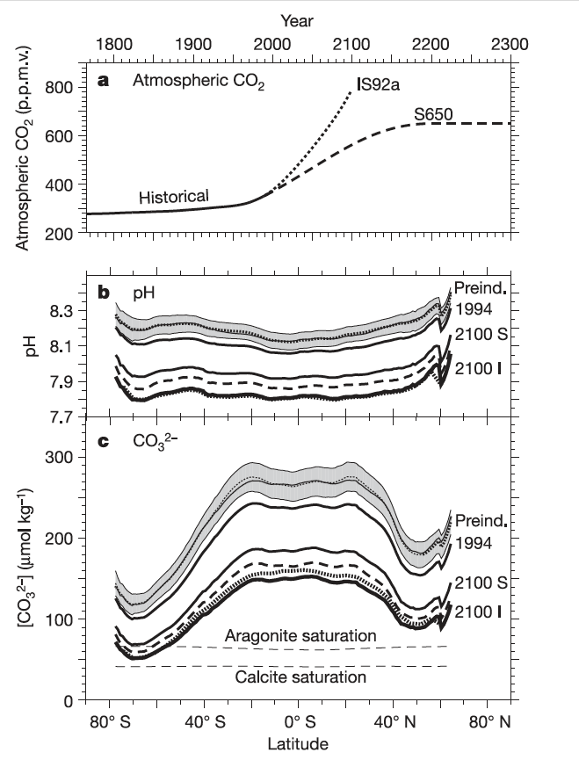
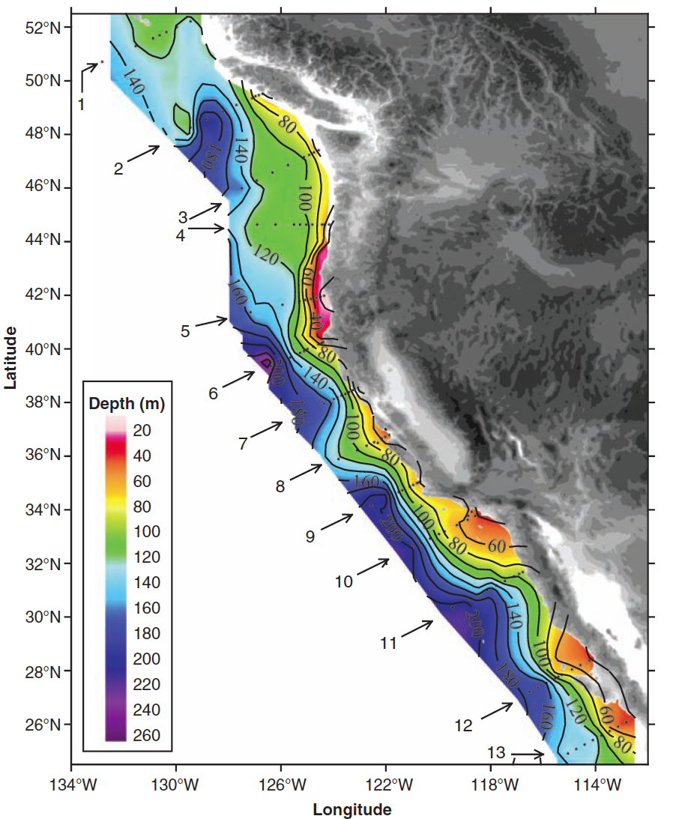
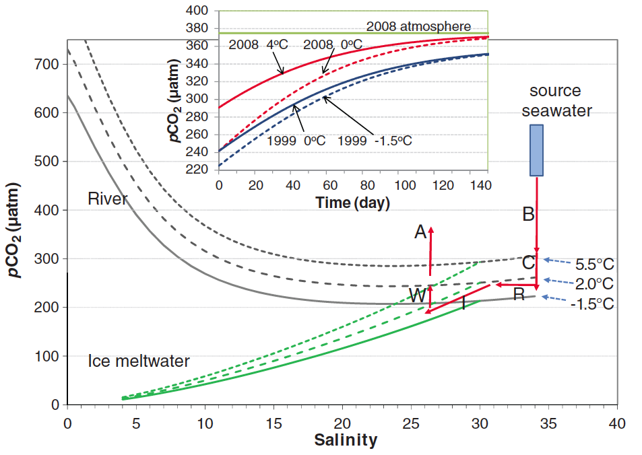
Impacts: Increase in carbon leads to Ocean Acidification (OA)
Three types of OA:
Caused by atmospheric CO₂ uptake by the ocean (Anthropogenic OA)
Caused by natural variability in the ocean carbon cycle (Natural OA)
Caused by perturbation of climate (Climate induced OA)
(4.) Interplay of the three types
Examples
Anthro OA
Natural OA
Climate induced OA
Arctic warming & melting
Orr et al, 2005
Feely et al. 2008
Cai et al. 2010

Slide 15
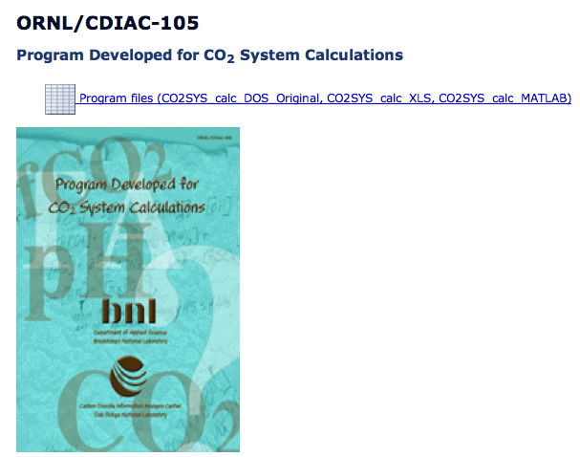
Impacts: Increase in carbon leads to Ocean Acidification (OA)
Changes in different inorganic carbon species cause different responses
CO₂ + H₂O = H⁺ + HCO₃⁻
H⁺ + CO₃⁻⁻ = HCO₃⁻
CaCO₃ + CO₂ + H₂O = 2HCO₃⁻ + Ca²⁺
100,000 CO₂ molecules entering the ocean:
+ 7,000 CO₂ Cell physiology (-)
+156,000 HCO₃⁻ Photosynthesis (+)
- 63,000 CO₃— Calcification (-)
+4 H⁺ Cells/Calcifi. (-)
CO₂Sys (D. Pierrot, AOML)

Slide 16
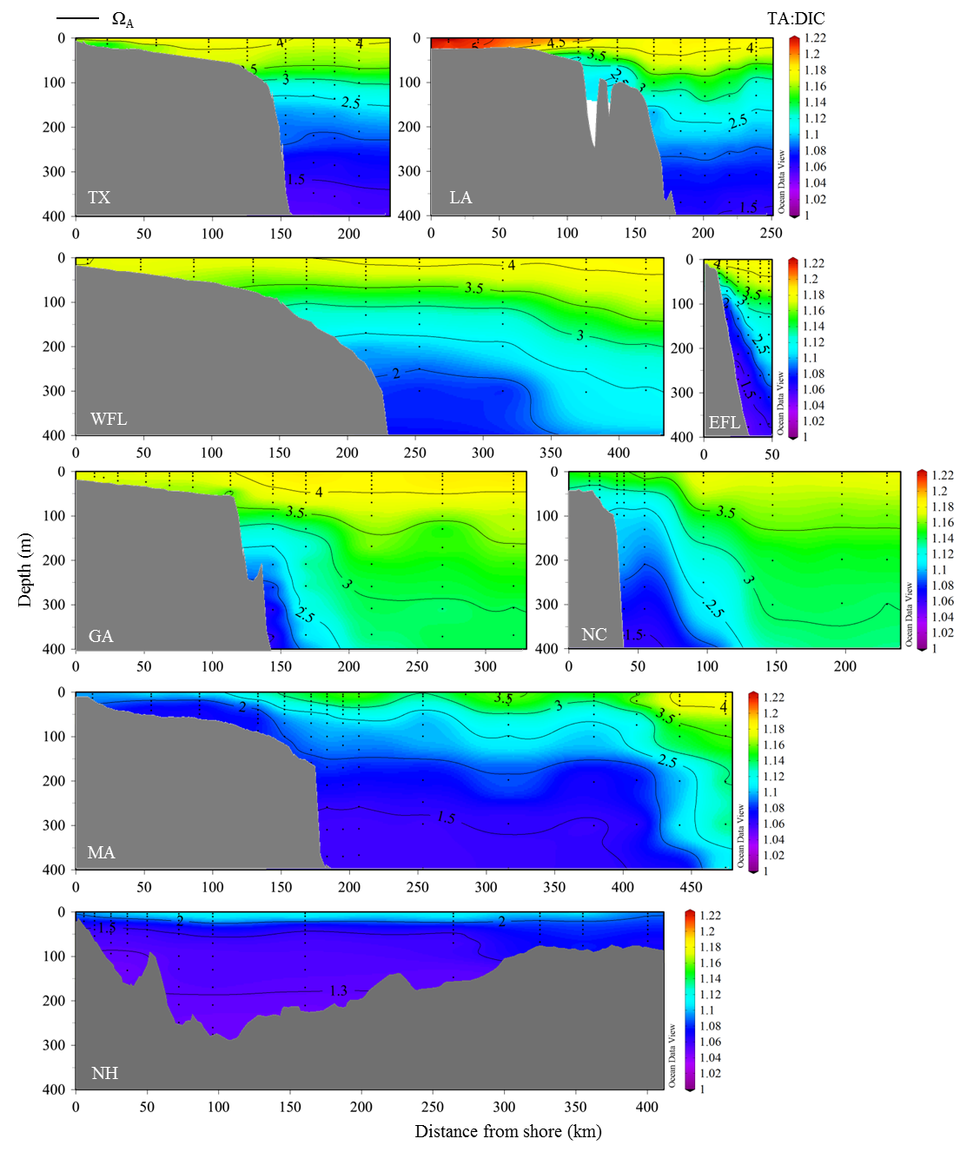
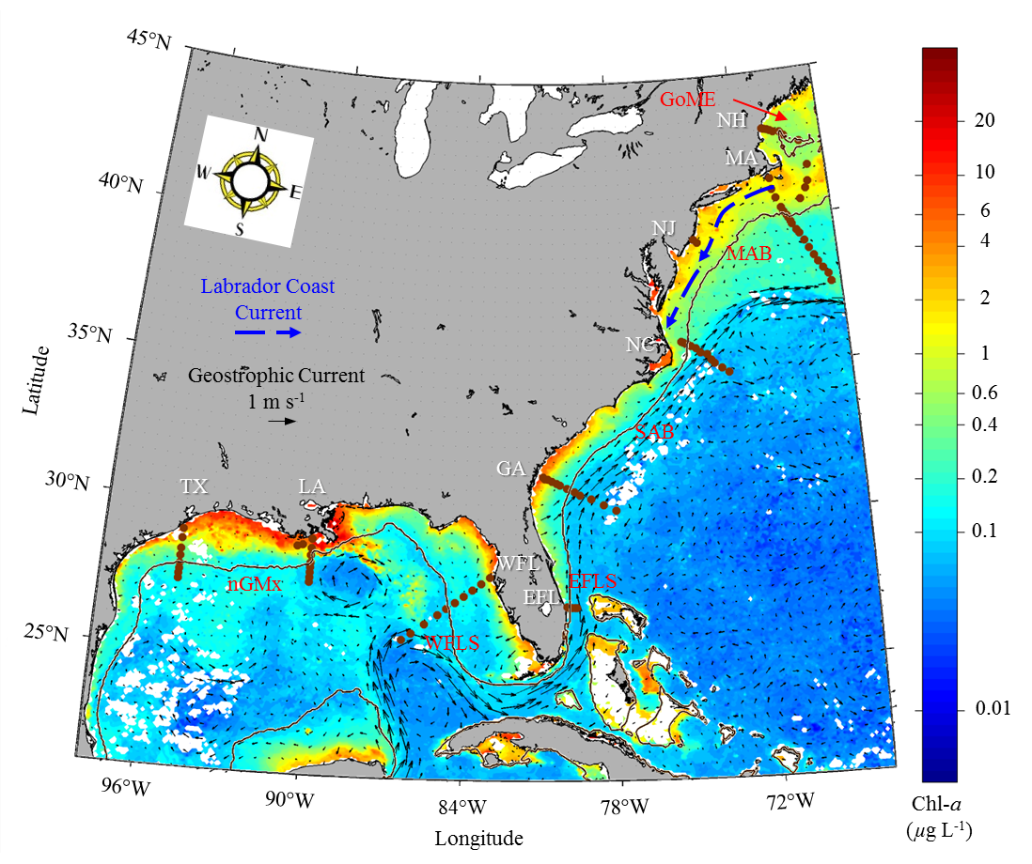
Coastal OA Monitoring
Federal Ocean Acidification Research and Monitoring Act(FOARAM) Act
Gulf of Mexico and East Coast Carbon Cruise (GOMECC-2007)
A strong trend in decreasing carbonate ion Northward
Wang et al., L&O accepted 2012

Slide 17
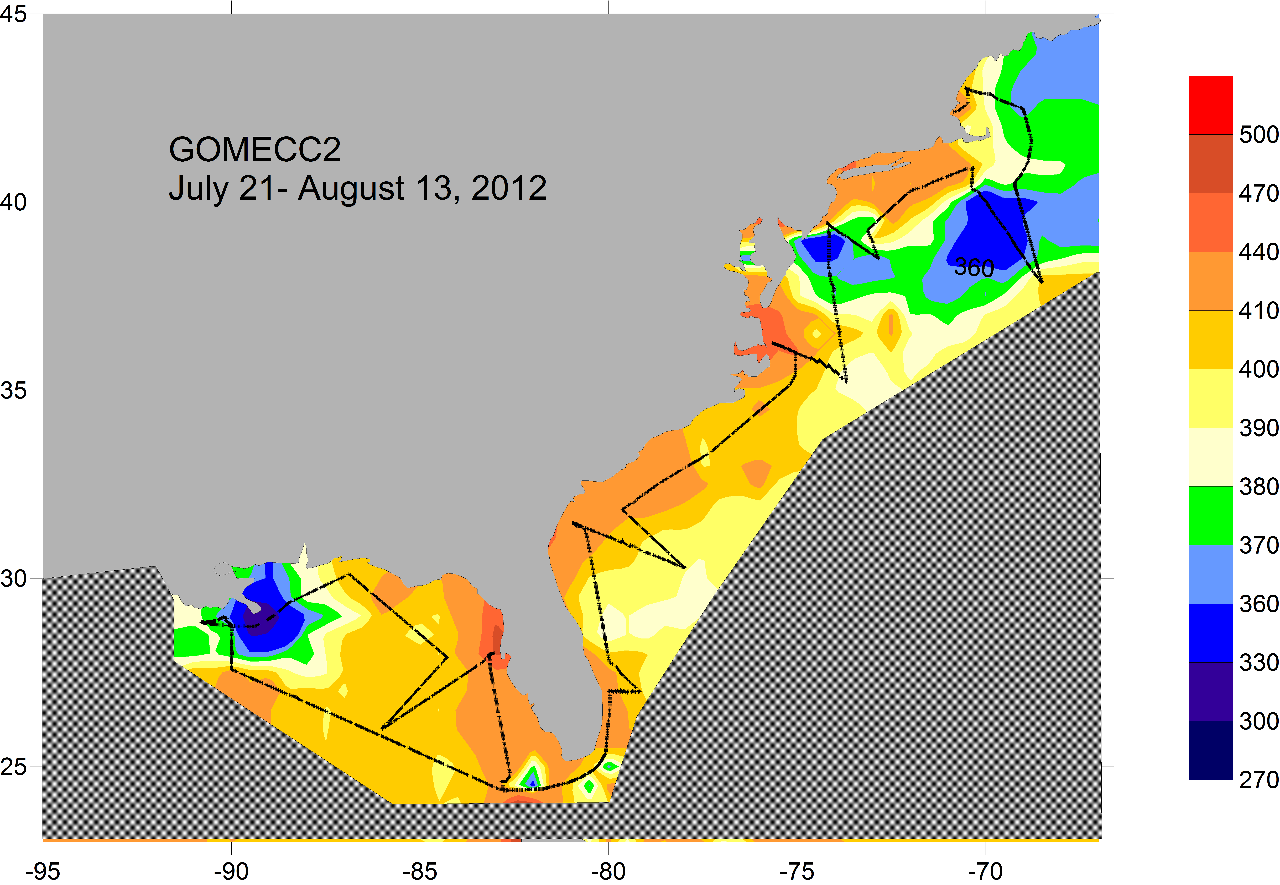
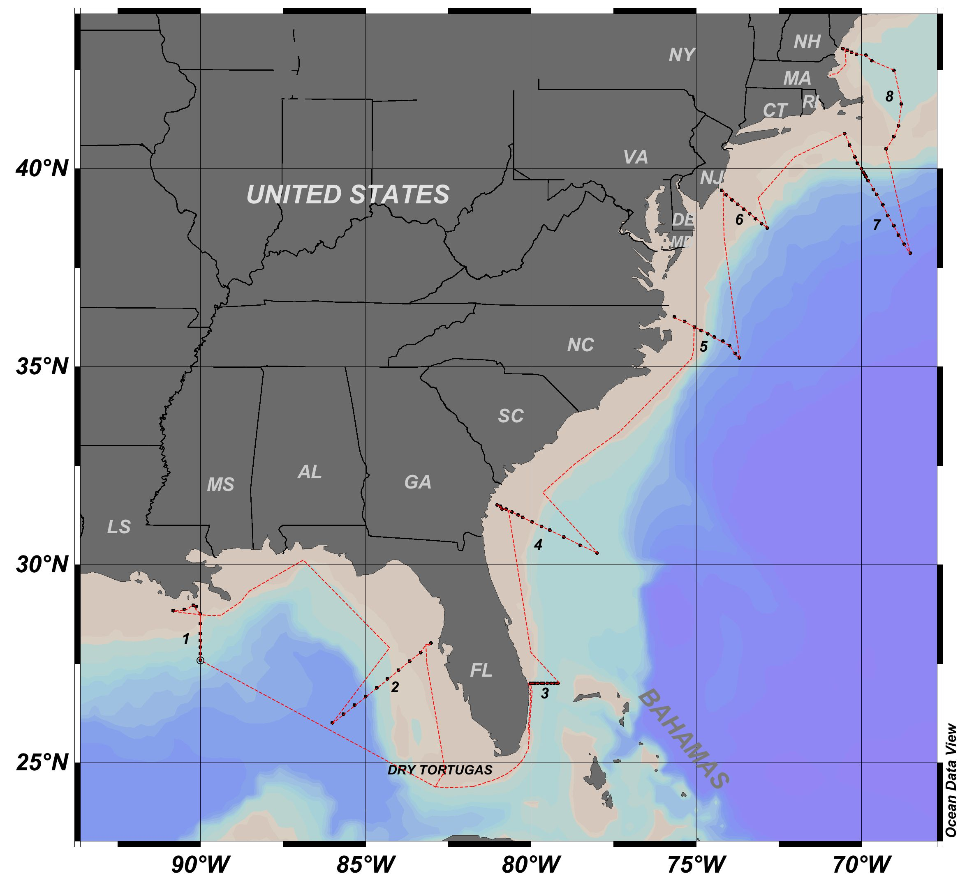
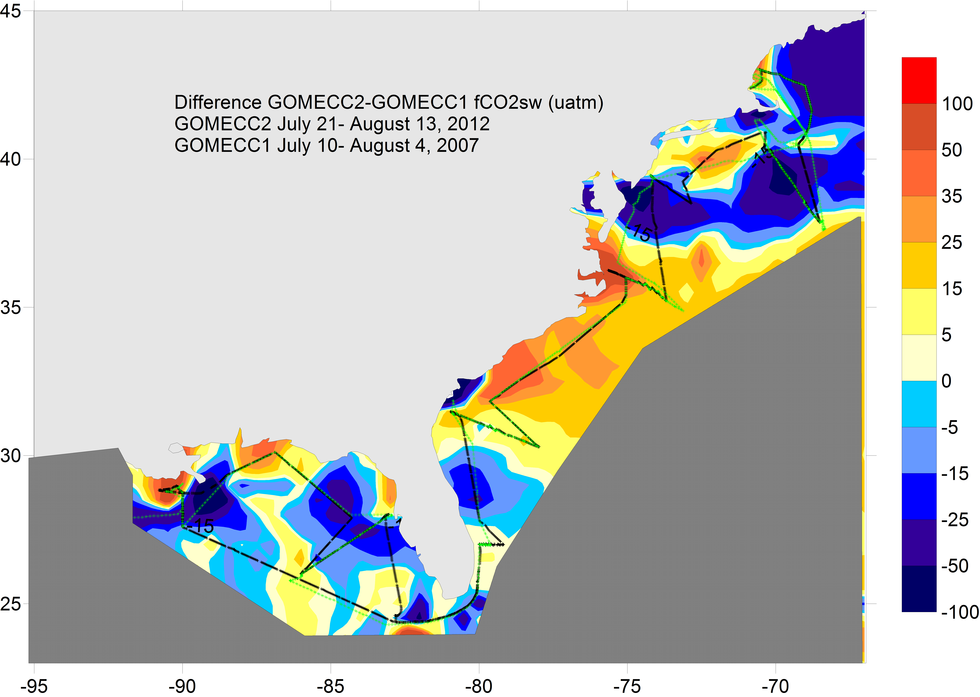
Coastal OA monitoring
Gulf of Mexico and East Coast Carbon Cruise (GOMECC2-2007)
≈ 10 ppm change in 5-years

Slide 18
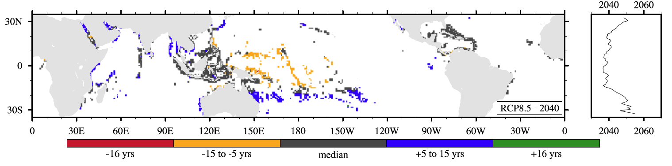
Multi-Stressors for Corals
#1 Acute Stress for corals: Warming/coral bleaching
Van Hooidonk, submitted Nature Climate Change
For RCP 8.5 emissions projections most of the corals reefs will exceed their thermal thresholds by 2040.
Large Areas in SW Pacific will experience persistent Coral bleaching by 2025 (13 years from now).
Situation is worse when adding addition stress such as OA.

Slide 19
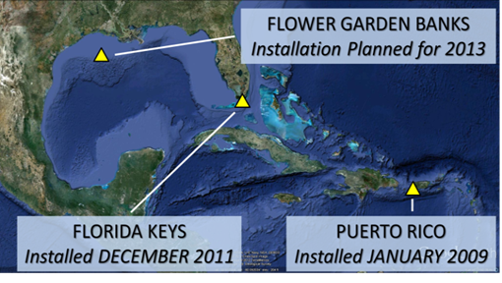
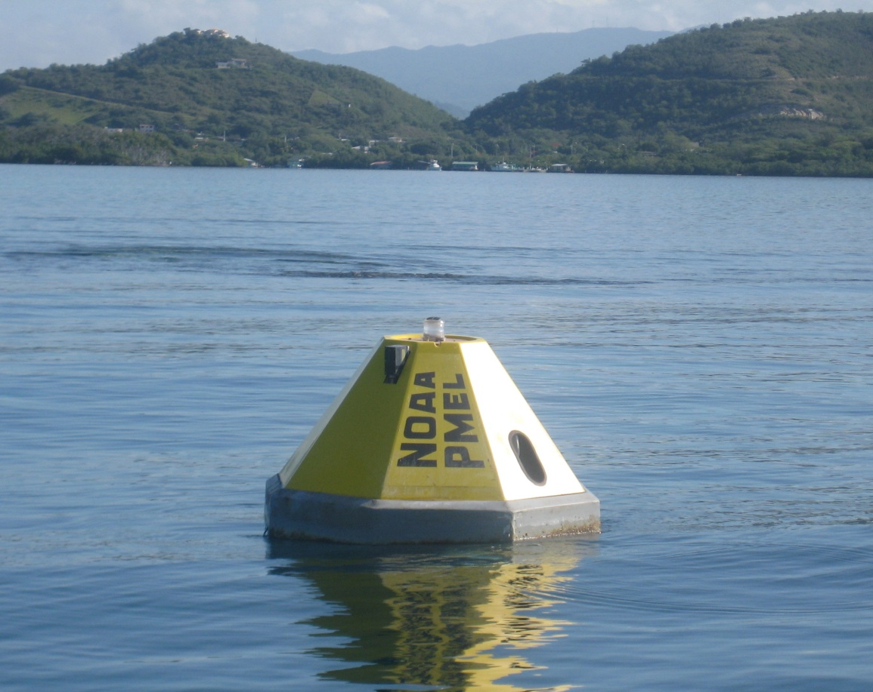
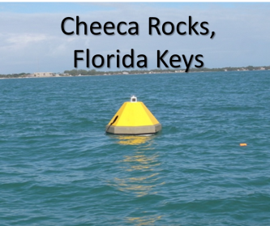
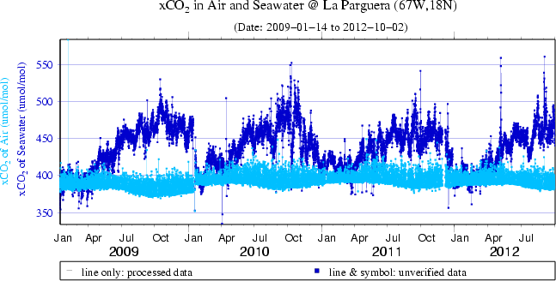
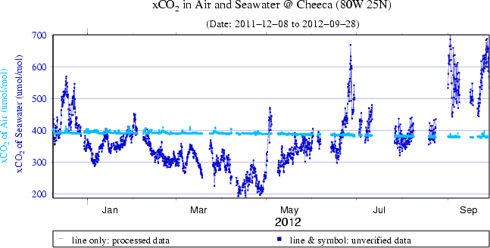

Coral Reef Ocean Acidification Monitoring
I. Physical Monitoring
La Parguera,
Puerto Rico
Location of sites in Atlantic
Puerto Rico:
2009-present
FL Keys:
2011-present
Objective:
Monitor Progression of
Ocean Acidification on US Coral Reefs
CO₂ in seawater, CO₂ in atmosphere
Researchers: D. Manzello, I. Enochs, R. Carlton, K. Helmle, R. van Hooidonk, J. Hendee, D. Gledhill

Slide 20
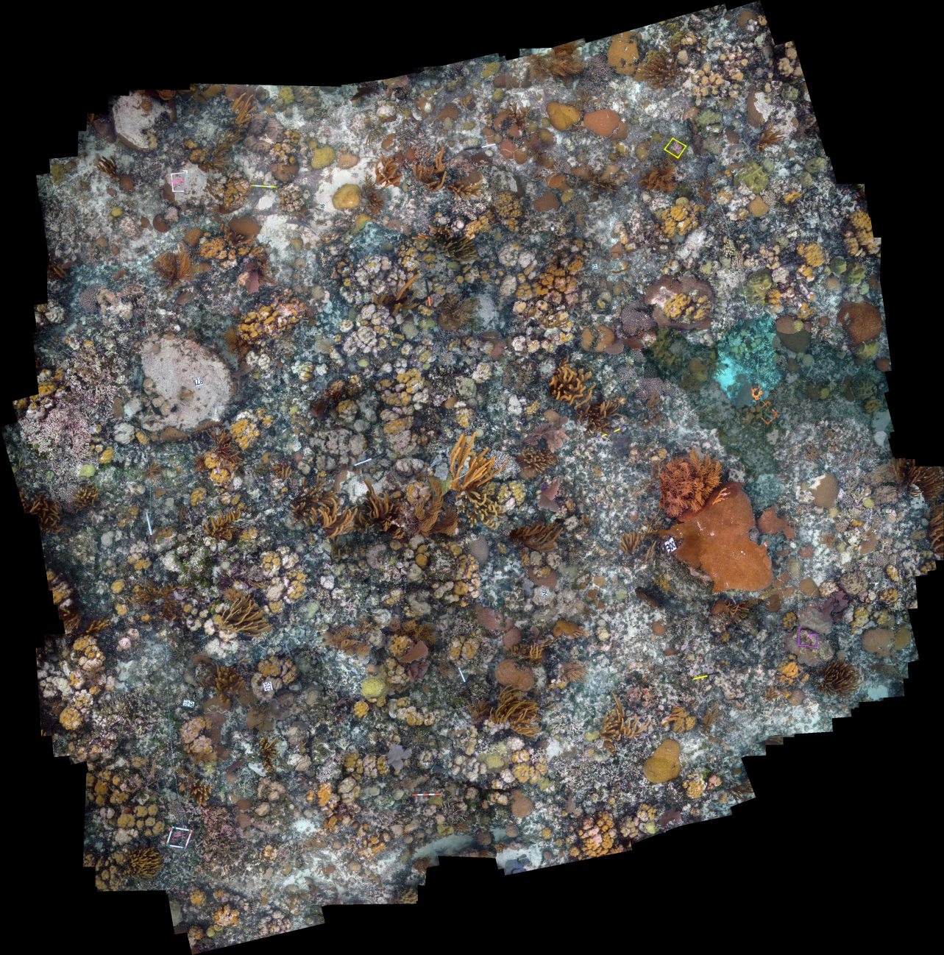

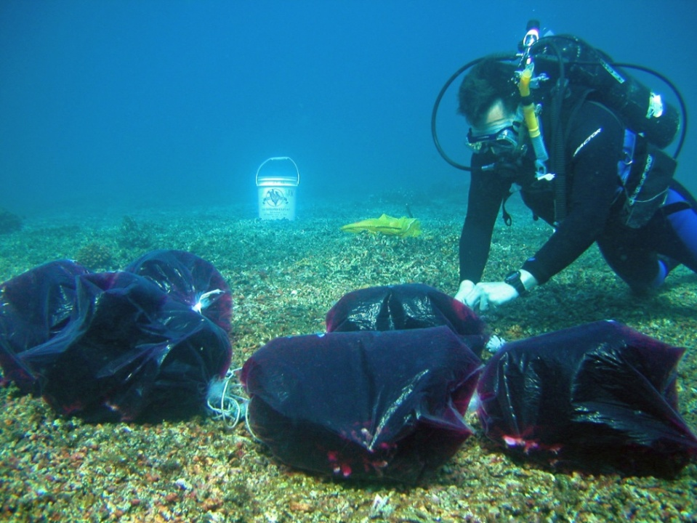
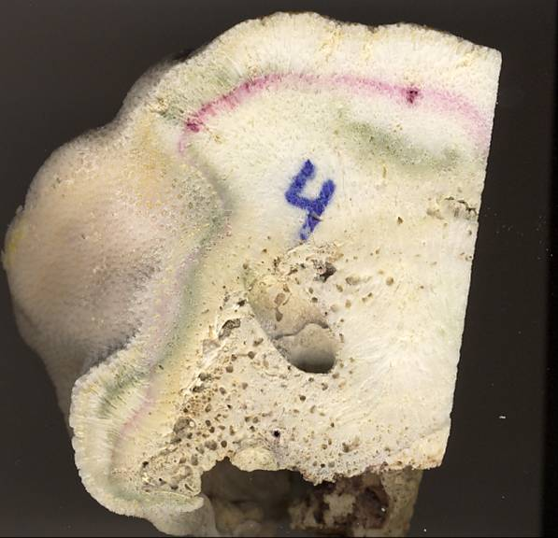
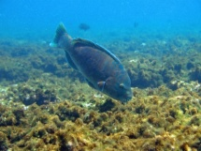
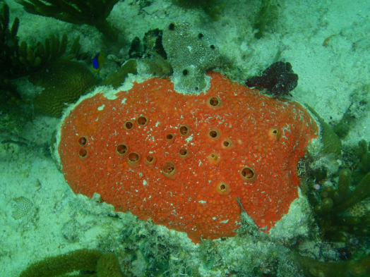
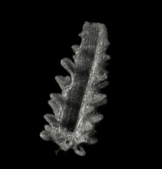
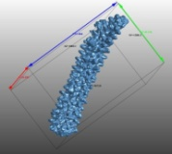


Coral Reef Ocean Acidification Monitoring
II. Ecosystem Response Monitoring
Net Gain/Loss = Accretion (Growth) – Erosion (Decay)
Measurements Obtained at Sentinel sites
-Net Ecosystem Calcification
-Net Community Productivity
-High-Resolution Benthic Characterization
-Species-specific Coral Calcification
-Bio-erosion
-Dissolution
CaCO₃ Budget
=
CaCO₃ Production – CaCO₃ Loss
i.e., The Reef
Objective:
Monitor Ecosystem Impacts of
Ocean Acidification on US coral reefs
Alizarin Staining
Historical
Records
Micro-CT
3-D Scanning

Slide 21

Coral Reef Ocean Acidification Monitoring
III. Monitoring Rates
Apparatus for boundary layer gradient flux measurements
Cross system: Coral Reef Oxygen Sensing System
micro-meteorology for the ocean

Slide 22

Coral Reef Ocean Acidification Monitoring
III. Monitoring Rates
Boundary-layer Net Community Production Rates (NCP) rate estimates
NCP Cheeca Rocks January vs May 2012

Slide 23
Coral Reef Ocean Acidification Monitoring
III. Monitoring Rates
Boundary-layer Net Ecosystem Calcification Rates (NEC) rate estimates
ΔTA range +0.3 to -3.1
Avg SE of ΔTA ± 1.7
Hours of the day

Slide 24
Looking ahead
Advancing new methodologies and instrumentation to provide local stakeholders improved information on coastal nutrient stress and ecological response/health impacts.
Regional Integrated Ecosystem Assessments.
Providing data based constraints for national and international assessments.
Build-up of the OA monitoring system for CO₂ forcing, and coral and coastal ecological responses.

