Slide 1
A Pareto Model for Extreme US Hurricane Damage
H.E. Willoughby, Dept. of Earth and Environment, FIU
Data: Pielke and Landsea Natural Hazards Review, 2005.
Historical damage Normalized for:
  Inflation
  Population
  Index of Wealth
  Sensibly constant 1900-present
Pareto Distributions
  Power law Pr{d > D} = p₀(D₀/D)^{κ} = Exeedance Probability = 1−CDF
  Requires κ > 1 for bounded mean and κ > 2 for bounded variance.
  Used to model “fat” tails of distributions.
  Here I use p₀ = 0.1, yielding D₀ = $34.3B and κ = 1.374
  One such storm a decade (10FEB11)

Slide 2
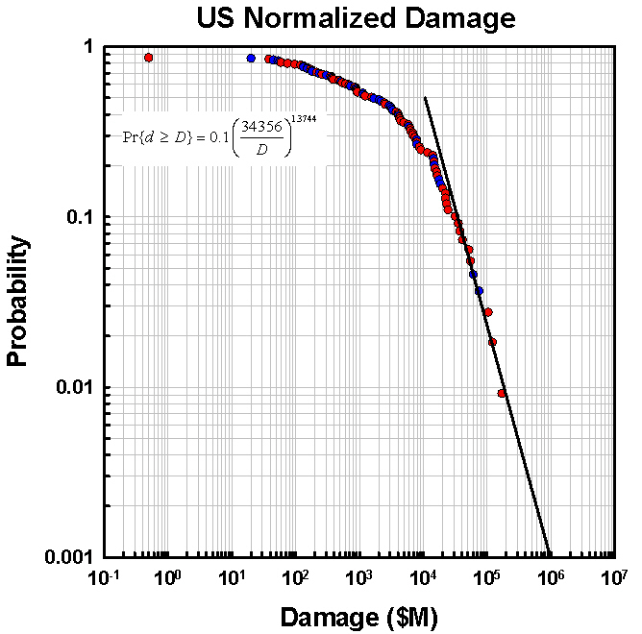

Slide 3
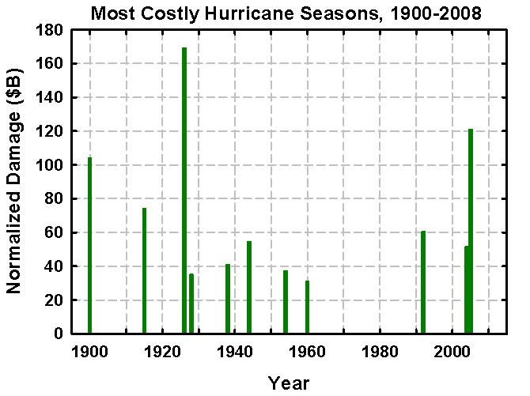

Slide 4
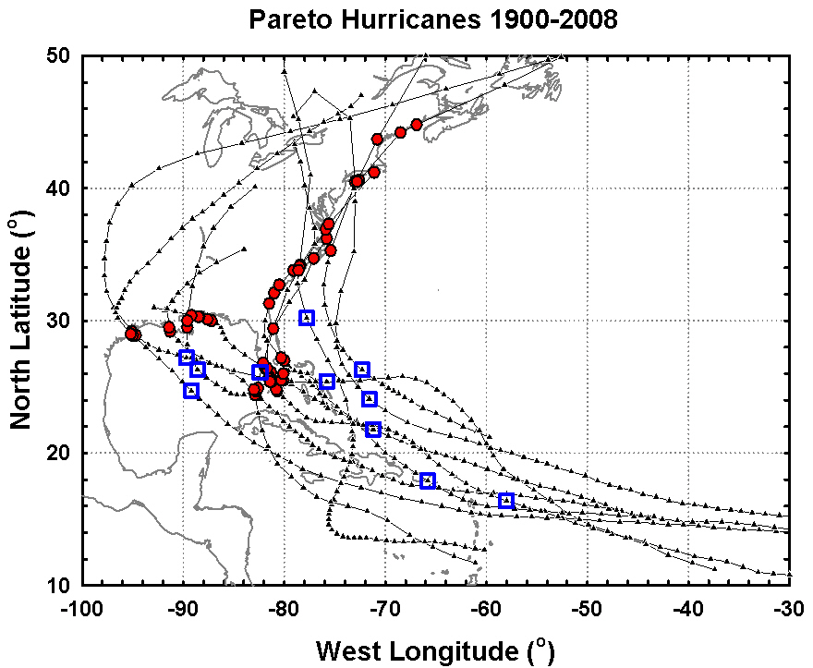

Slide 5
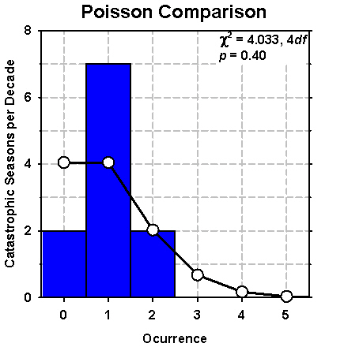
Conclusions
Pareto Distribution fits most damaging 10% of hurricane seasons reasonably well.
  But may be pessimistic
Poisson occurrence in time
  No trend
  1970-1994 lull
  More random than expected, but not significantly so.
Return periods:
  100 yr $183B
  200 yr $304B
  500 yr $592B
  1000 yr $980B
11 Pareto seasons caused $710B in normalized damage (64% of total)
Annual mean from Pareto Distribution is $12.6B
  > $11B actual mean damage.

