Slide 1
Adrian Synoptic Errors
Chris Landsea
NHC

Slide 2
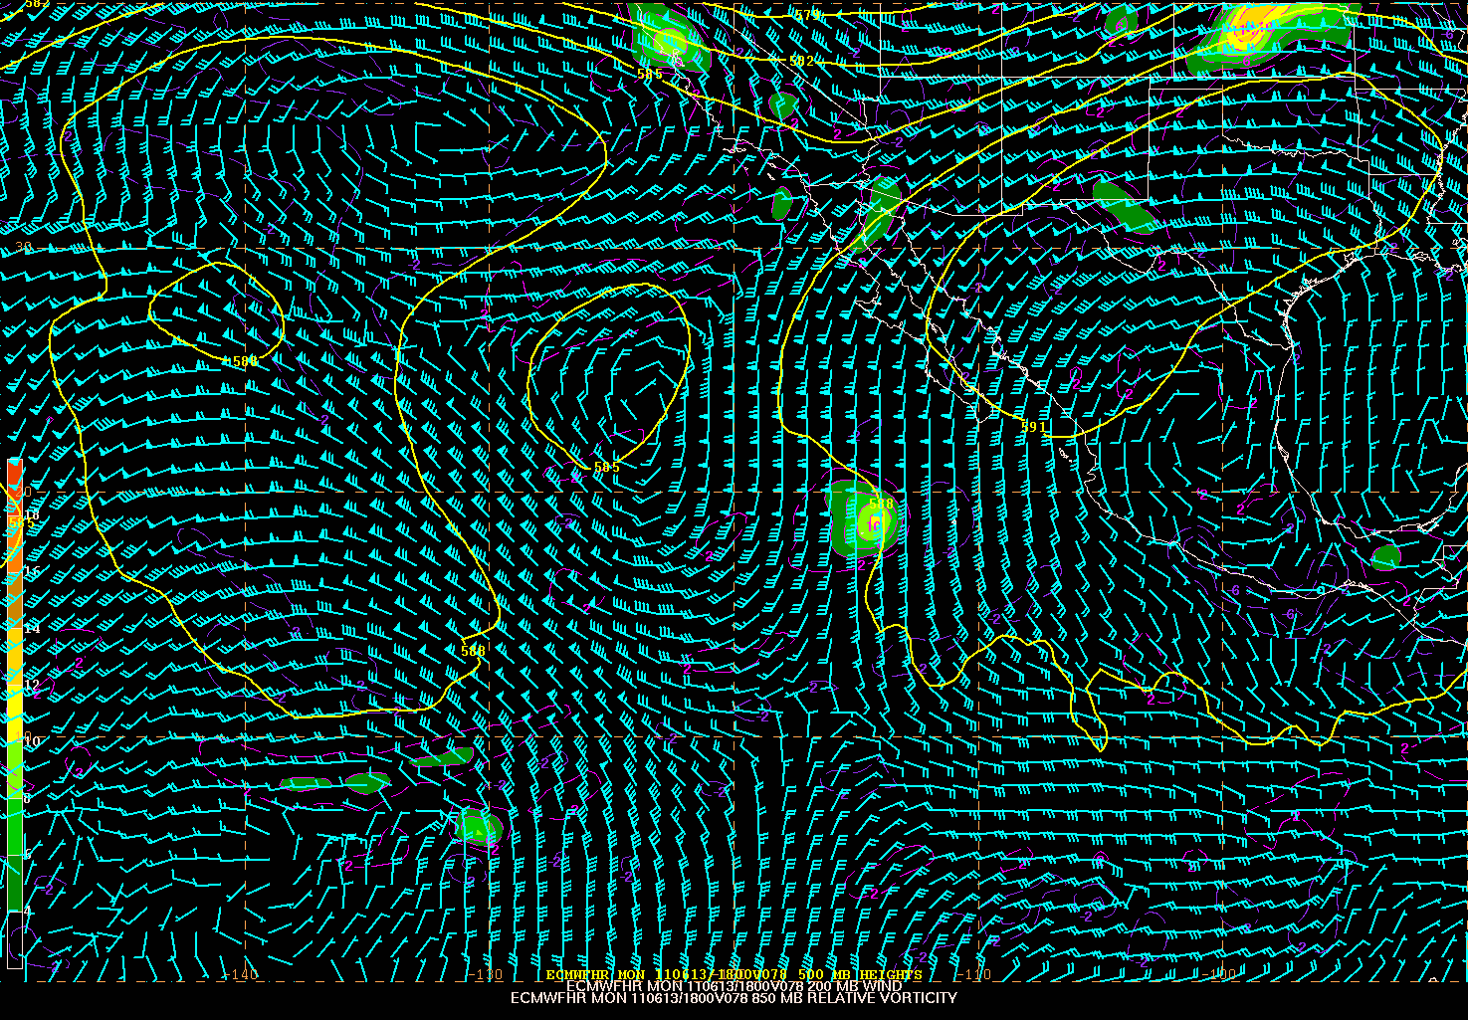
ECMWF Forecast
78 h – 06/13/18z Ver

Slide 3
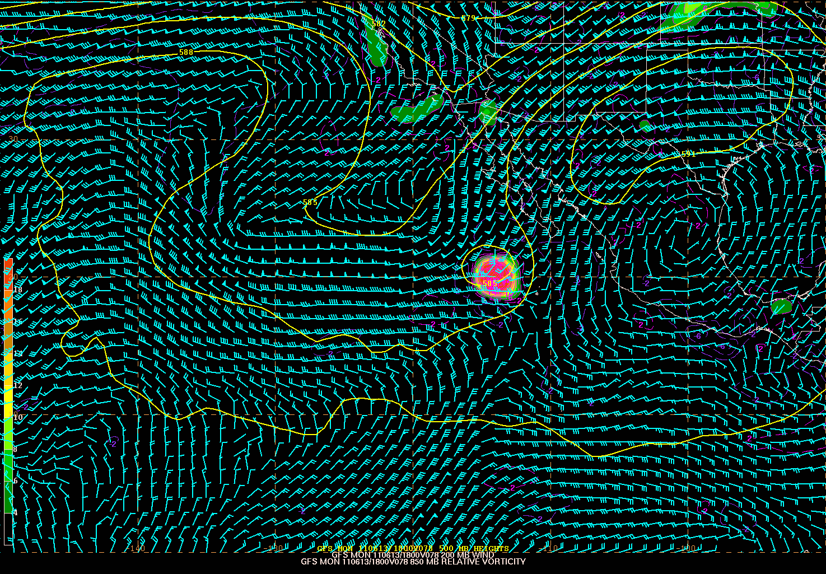
GFS Forecast
78 h – 06/13/18z Ver

Slide 4
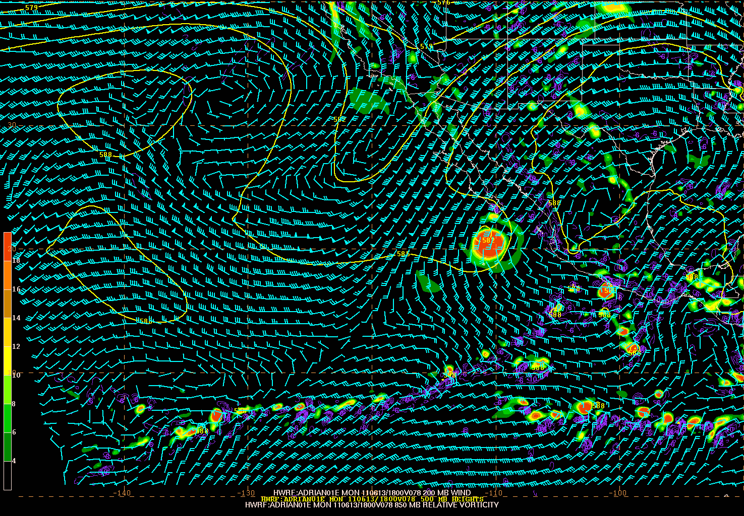
HWRF Forecast
78 h – 06/13/18z Ver

Slide 5
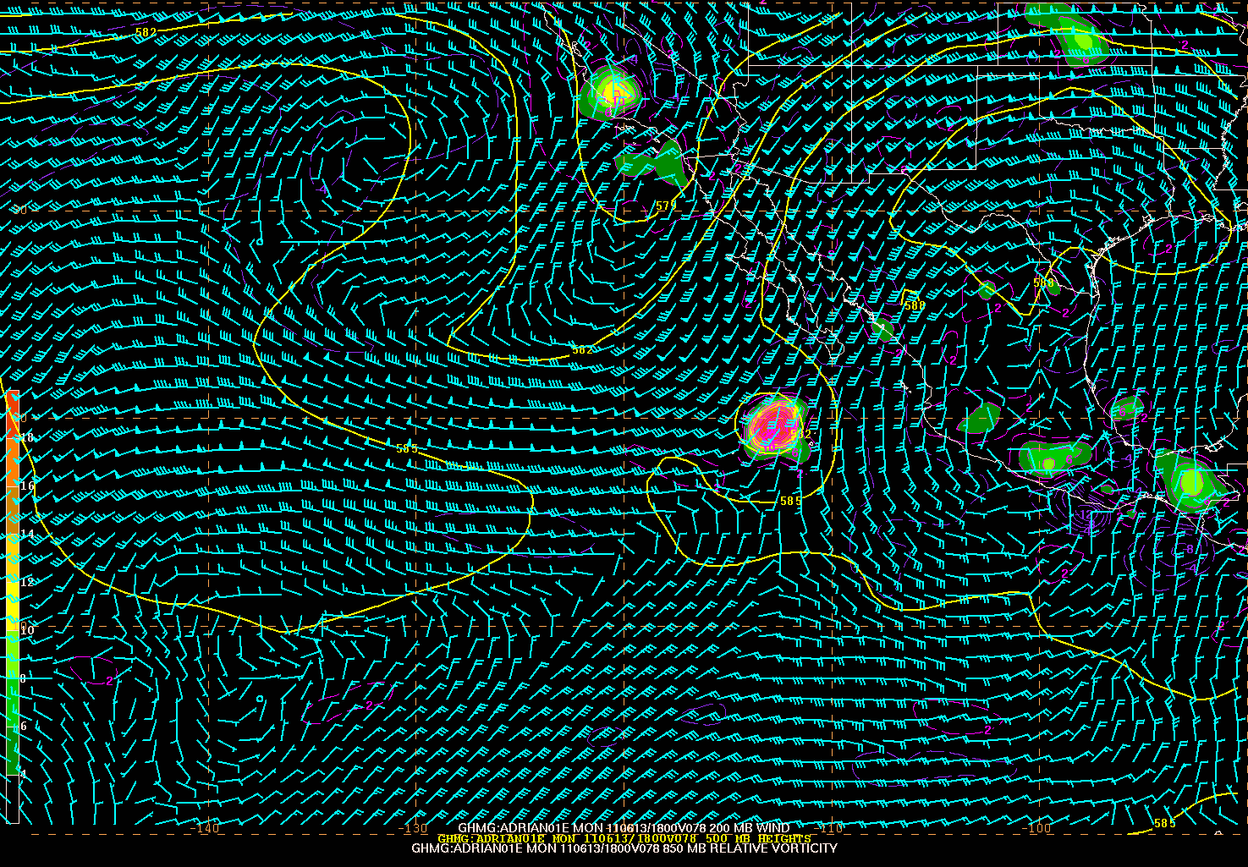
GFDL Forecast
78 h – 06/13/18z Ver

Slide 6
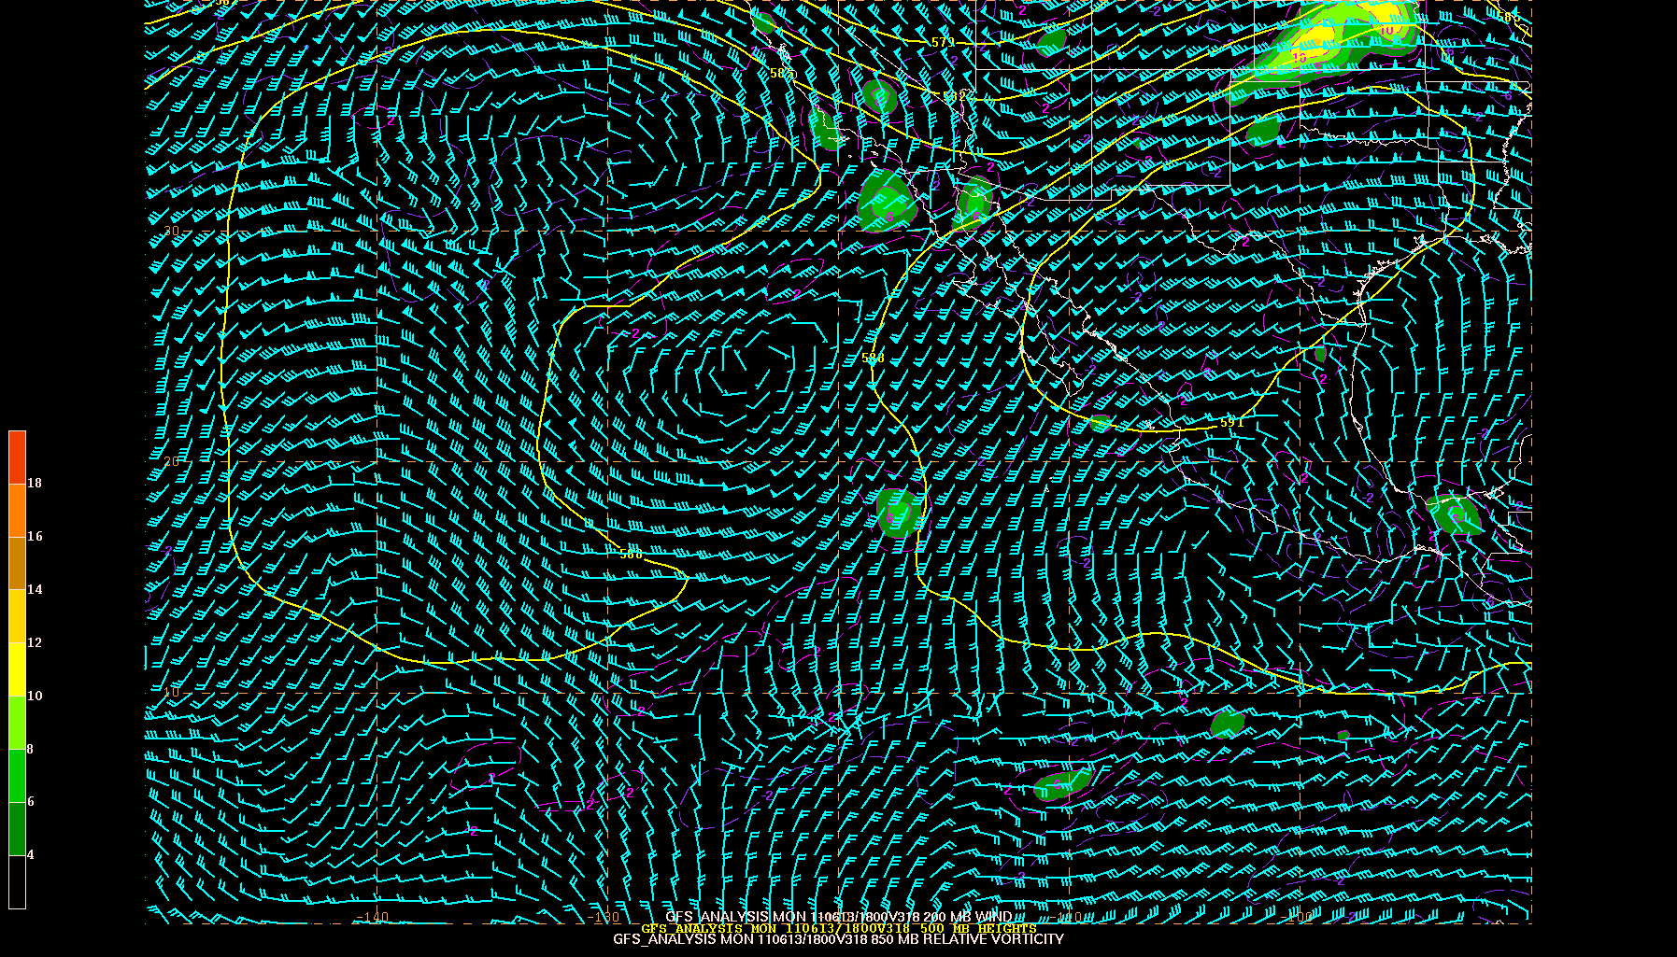
06/13/18z
Verification

