Slide 1
HWRF Nesting and
Nest Moving
Xuejin Zhang¹ and S. G. Gopalakrishnan²
¹ CIMAS, University of Miami
² NOAA/AOML/HRD
WRF for Hurricane Tutorial, 26-29 April 2011, Boulder, CO

Slide 2
Acknowledgement
John Michalakes (MMM, NCAR)
Robert Tuleya (GFDL/EMC) and Morris Bender (GFDL)
Dusan Jovic, Zavisa Janjic, Thomas Black (EMC)
Vijay Talapragada and Samuel Trahan(HWRF team at EMC)
Kao-San Yeh (CIMAS, University of Miami)
Thiago Quirino (AOML/HRD)
Frank Marks (AOML/HRD) and Robert Atlas (AOML)
HFIP & DTC

Slide 3
HWRF Grid Structure
Horizontal: Rotated Latitude-Longitude E-Grid
Vertical: σ-p hybrid
Nesting
  Coincident grid points at start and end points
  Fixed nest ratio: 1:3
  Moving one grid each time

Slide 4
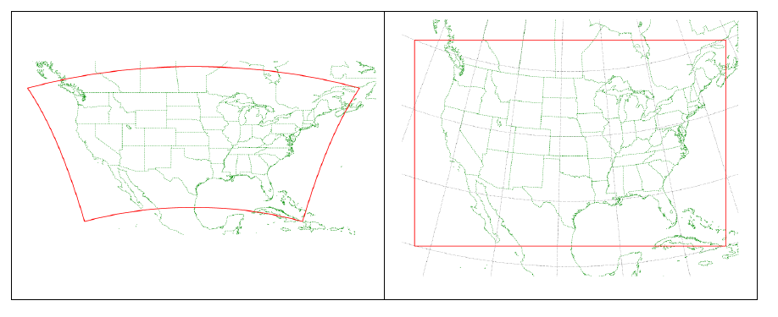
Rotated latitude-longitude domain
Regular Latitude-Longitude map background
Rotated Latitude-Longitude map background
Credit: Zavisa Janjic WRF-NMM Tutorial

Slide 5
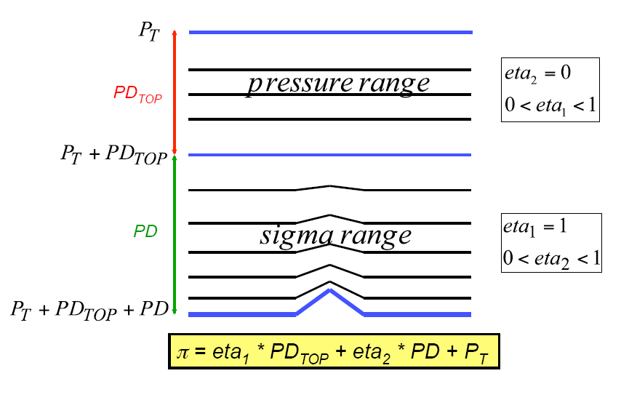
Sigma-Pressure Hybrid Coordinate
Credit: Zavisa Janjic WRF-NMM Tutorial

Slide 6
E-GRID Structure
l
w
l
w
l
w
l
w
l
w
l
w
l
w
l
w
l
w
j = JME
l
w
l
w
l
w
l
w
l
JME - 1
w
l
w
l
w
l
w
l
w
JME - 2
l
w
l
w
l
w
l
w
l
w
l
w
l
w
l
w
l
w
JMS+2
l
w
l
w
l
w
l
w
l
JMS+1
w
l
w
l
w
l
w
l
w
j = JMS
i = IMS
IMS+1
IME-1
i = IME
l
w
l
w
l
w
l
w
l

Slide 7
Nesting approach
E-grid indexing
Nearest neighbor is along the diagonal
Interpolations consistent with model dynamics along the diagonal
Boundary conditions use square grid volume
Vertical mass adjustment

Slide 8
Salient features: Initial Conditions
Bi-linear Interpolation along the horizontal
Nearest neighbor for land state variables except terrain
Simplified land-surface treatment that avoids the need for additional inputs such as the soil temperatures, soil moisture or SSTs over isolated land or water bodies inconsistent with the parent domain (This will be changed when we introduce new high resolution data)

Slide 9
E-GRID Refinement: Mass Grid Points
l
w
l
w
l
w
l
w
l
l
l
l
l
l
l
w
l
w
w
w
w
l
l
l
l
l
l
l
l
l
l
l
l
l
l
l
j = JME
l
l
l
l
l
l
l
l
l
l
l
l
l
l
l
l
l
l
l
l
w
l
l
w
l
l
w
l
l
w
l
l
l
l
l
l
l
l
l
l
l
l
l
l
l
l
l
l
l
l
l
JME - 1
l
l
l
l
l
l
l
l
l
l
l
l
l
l
l
l
l
l
l
l
l
l
w
l
l
w
l
l
w
l
l
w
l
l
w
l
l
l
l
l
l
l
l
l
l
l
l
l
l
l
l
JME - 2
l
l
l
l
l
l
l
l
l
l
l
l
l
l
l
l
l
l
l
l
l
w
l
l
w
l
l
w
l
l
w
l
l
l
l
l
l
l
l
l
l
l
l
l
l
l
l
l
l
l
l
l
l
l
l
l
l
l
l
l
l
l
l
l
l
l
l
l
l
l
l
l
l
w
l
l
w
l
l
w
l
l
w
l
l
w
l
l
l
l
l
l
l
l
l
l
l
l
l
l
l
l
JMS+2
l
l
l
l
l
l
l
l
l
l
l
l
l
l
l
l
l
l
l
l
l
w
l
l
w
l
l
w
l
l
w
l
l
l
l
l
l
l
l
l
l
l
l
l
l
l
l
l
l
l
l
JMS+1
l
l
l
l
l
l
l
l
l
l
l
l
l
l
l
l
l
l
l
l
l
l
w
l
l
w
l
l
w
l
l
w
l
l
w
l
l
l
l
l
l
l
l
l
l
l
l
l
l
l
l
j = JMS
l
l
l
l
l
l
l
l
l
l
l
l
i = IMS
IMS+1
IME-1
i = IME
l
w
l
l
w
l
l
w
l
l
w
l
l
l
l

Slide 10
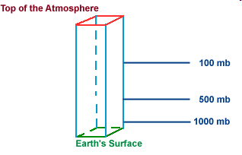
Vertical Mass Adjustment
50 hPa
50 hPa
50 hPa
100 hPa
420 hPa
Downscale
420 hPa
500 hPa
Feedback
850 hPa
Earth’s Surface
1000 hPa
Earth’s Surface
Coarse Grid
Reference Surface
Fine Grid
Pressure NOT directly interpolated from parent hybrid to nested hybrid (sigmas don’t match!)
The height, temperature and moisture fields from the parent domain are vertically interpolated onto pre-defined standard pressure surfaces.
The above meteorological fields from the parent domain are further interpolated horizontally onto nested grids on the same pressure surface.
Finally, by using the high-resolution topography over the nested domain, pseudo hydrostatic mass balancing is carried out to prescribe the initial values in the nested domain.

Slide 11
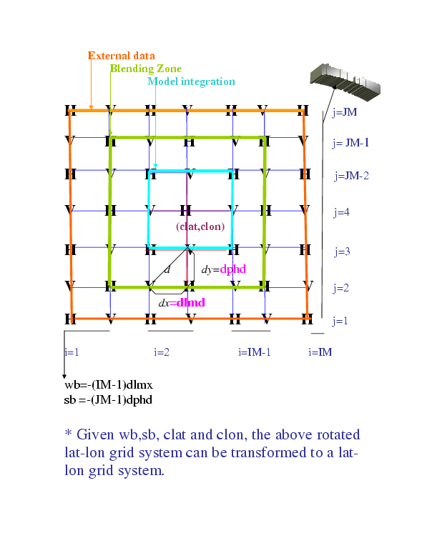
HWRF NESTED BOUNDARY CONDITIONS
j=JM
j=JM-1
j=JM-2
j=3
j=2
j=1
i=1
i=2
i=IM-1
i=IM
External Data: Prescribed from the parent after mass adjustment of hydrostatic variables/ direct interpolation of other variables
Blending Zone: Simple 4 point averaging
Dynamic Interface: Model integration starts from 3rd row/column
Leading edge: following same procedure of initial condition

Slide 12
Feedback
9 point average
Weighed equally between the parent and nest average
Same vertical mass adjustment procedure

Slide 13
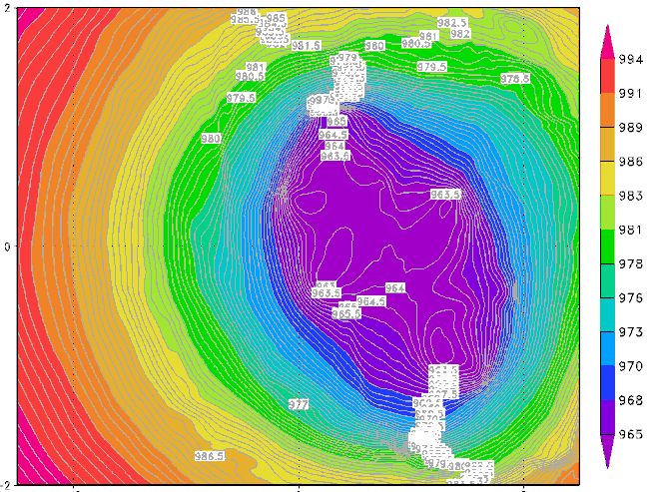
Nest moving Algorithm
Mathematical requirements
  Stable and unique storm center
Computational requirements
  Effective and efficient
Solution
  Dynamic Pressure (Operational procedure)
  Centroid MSLP (New)
  Range limit to start moving (resolution dependent)
Montgomery et al.(BAMS 2006)
C

Slide 14
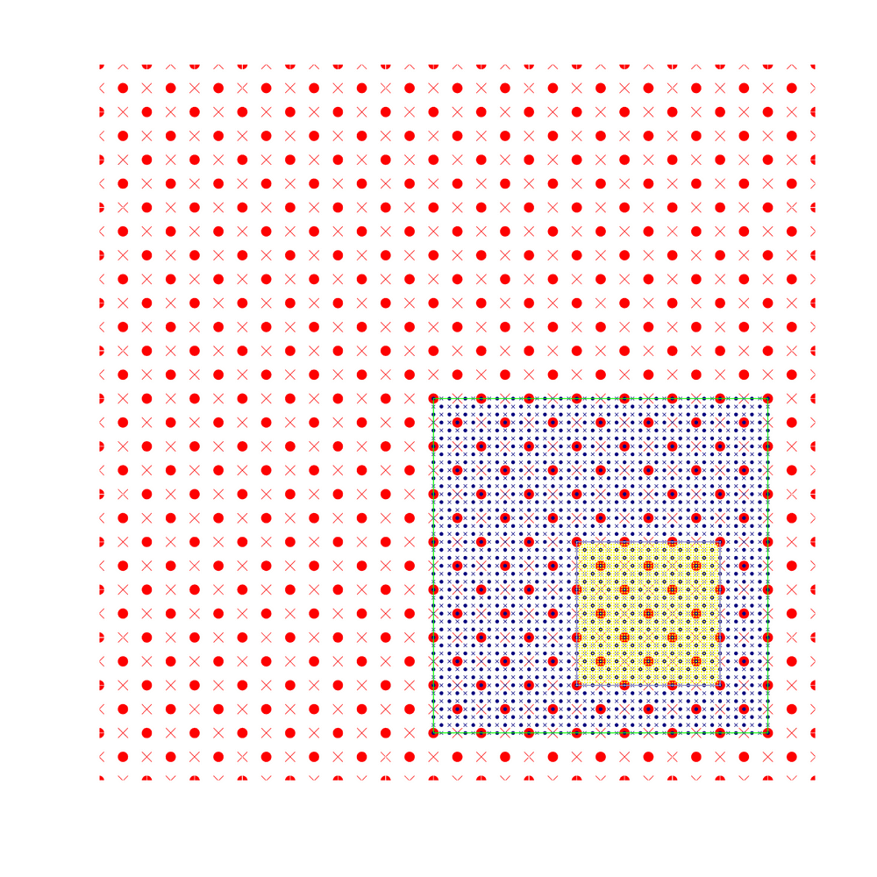
Nest movement

Slide 15
HWRF namelist.input: nest specific!
&domains
max_dom = 2,
grid_id = 1, 2,
parent_id = 0, 1,
&time_control
start_year = 2008, 2008,
start_month = 09, 09,
start_day = 09, 09,
start_hour = 00, 00,
start_minute = 00, 00,
start_second = 00, 00,
end_year = 2008, 2008,
end_month = 09, 09,
end_day = 09, 09,
end_hour = 06, 06,
end_minute = 00, 00,
end_second = 00, 00,
./frame/LOGICAL FUNCTION nests_to_open
CALL nl_get_max_dom ( 1, max_dom )
DO nestid = 2, max_dom
IF ( .NOT. active_domain( nestid ) ) THEN
CALL nl_get_parent_id ( nestid, parent_id )
IF ( parent_id .EQ. parent%id ) THEN
CALL nl_get_start_year (nestid,s_yr)
CALL nl_get_end_year (nestid,e_yr)
CALL nl_get_start_month (nestid,s_mm)
CALL nl_get_end_month (nestid,e_mm)
CALL nl_get_start_day (nestid,s_dd)
CALL nl_get_end_day (nestid,e_dd)
CALL nl_get_start_hour (nestid,s_h)
CALL nl_get_end_hour (nestid,e_h)
CALL nl_get_start_minute (nestid,s_m)
CALL nl_get_end_minute (nestid,e_m)
CALL nl_get_start_second (nestid,s_s)
CALL nl_get_end_second (nestid,e_s)
………….
ENDDO

Slide 16
Domain configuration for the nest
&domains
time_step = 54,
time_step_fract_num = 0,
time_step_fract_den = 1,
max_dom = 2,
s_we = 1, 1,
e_we = 216, 60,
s_sn = 1, 1,
e_sn = 432, 100,
s_vert = 1, 1,
e_vert = 43, 43,
parent_grid_ratio = 1, 3,
parent_time_step_ratio= 1, 3,
dx = .18, 0.06,
dy = .18, 0.06,
./frame/MODULE module_integrate
RECURSIVE SUBROUTINE integrate
DO WHILE ( nests_to_open( grid , nestid , kid ) )
a_nest_was_opened = .true.
CALL med_pre_nest_initial ( grid , nestid , &
config_flags )
CALL alloc_and_configure_domain &
( domain_id = nestid , grid = new_nest , &
& parent = grid , & kid = kid )
CALL Setup_Timekeeping (new_nest)
CALL med_nest_initial( grid , new_nest , config_flags )
END DO
Dummy for the
nested domain

Slide 17
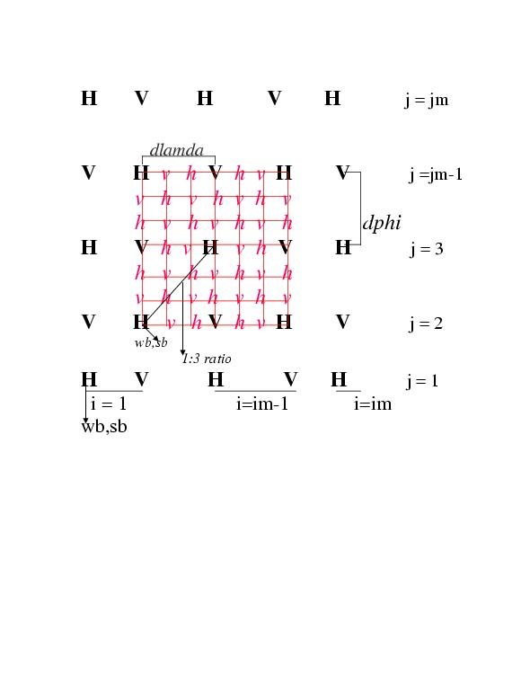
HWRF: ISTART, JSTART AND GRID MOTION
&domains
grid_id = 1, 5,
i_parent_start = 0, ISTART1,
j_parent_start = 0, JSTART1,
num_moves = -99,
Option for automatic grid motion, specifically for Hurricanes; For locating the initial grid based on storm center, we are providing a utility ../hwrf-utilities/vortex_init/hwrf_set_ijstart/swcorner_dynamic.F. This code is compiled as part of the hwrf-utilities component of HWRF.

Slide 18
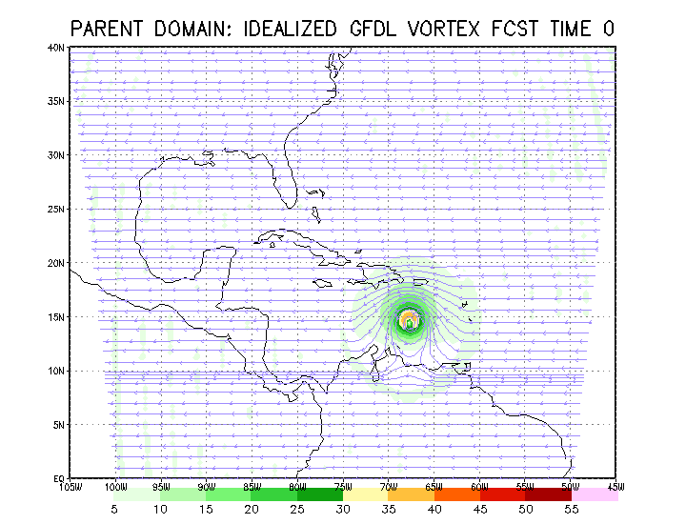
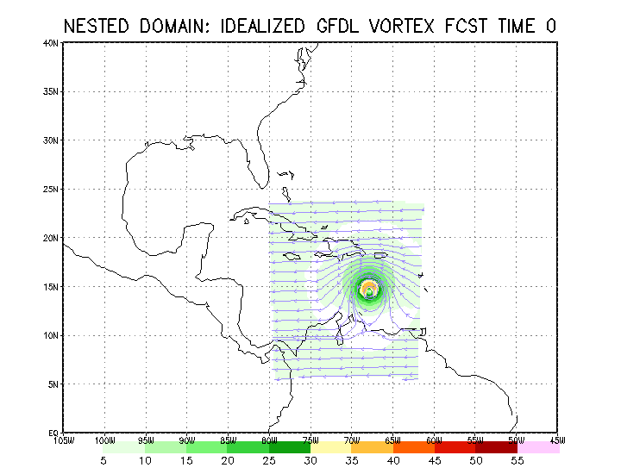
Basic Testing of the Nest Dynamics
Parent domain of the size of about 60º x 60º at 36 km resolution
Nested domain of the size of about 20º x 20º at 12 km resolution
* The initial condition for this idealized case did not include topography and land, however, as in the case of static, one-way nest the code is general enough to take care of topography.

Slide 19
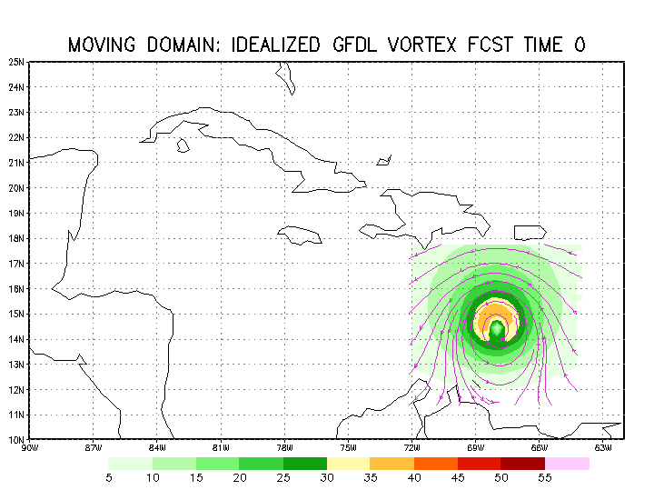
Moving domain of size of about 7⁰x7⁰ at about 12 km resolution
Despite the small size of the nested domain, as long as the vortex is located in the center of the nest, we see the effect of lateral boundary diffusion to be limited and we are indeed able to hold on to the intensities!

Slide 20
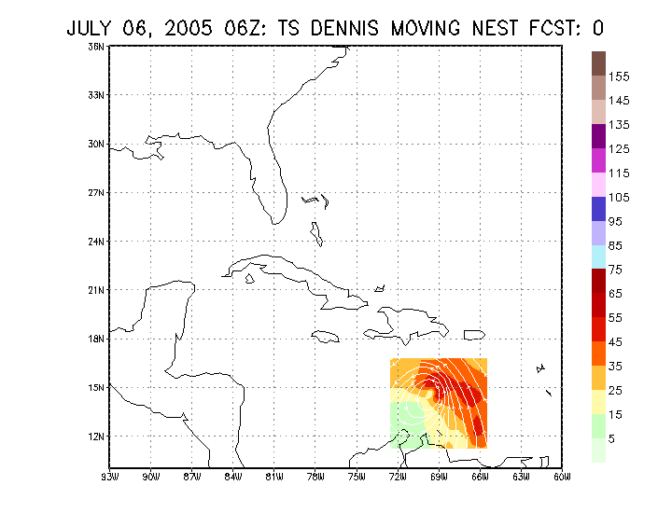
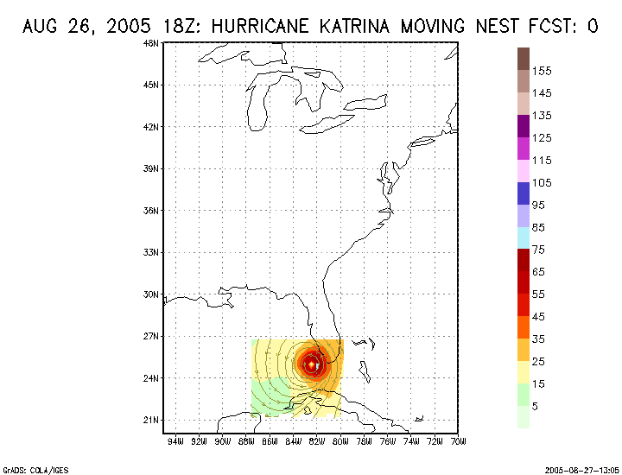
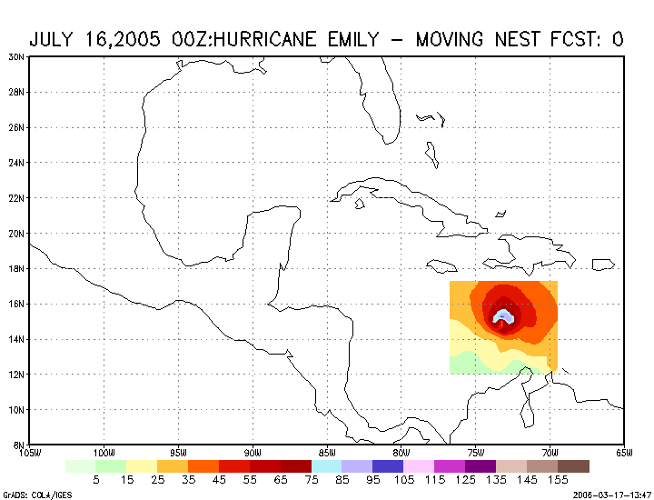
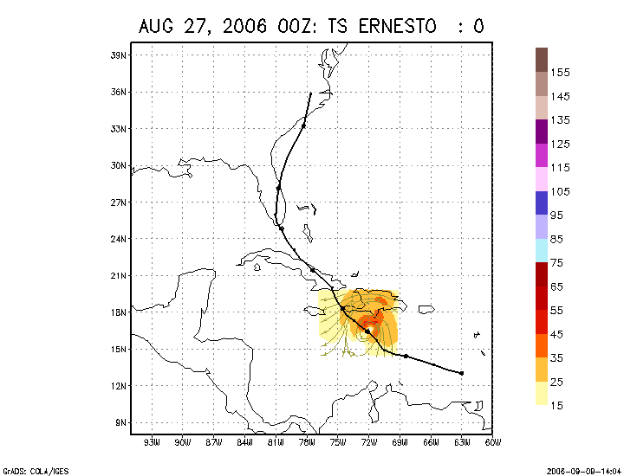
Examples of Pre-implementation Testing of HWRF
HWRF DENNIS
HWRF Katrina, 2005
HWRF Emily, 2005
HWRF Ernesto, 2006

Slide 21
Future updates (Coming soon)
Idealized simulation capability
Multiple domain capability
Useful utility and advanced diagnostic and analysis tools

Slide 22
Idealized Simulation Capability
Development tool
  Test dynamic core
  Test downscaling methodology
Physics scheme test
  Test parameterization scheme
  Adjust parameters
  Physics scheme optimalization
Research tool

Slide 23
Advancing the HWRF: Setting up multiple domains
Option 1: Both grid 2 and
grid 3 are children of grid 1.
&domains
max_dom = 3,
grid_id = 1, 2, 3,
parent_id = 0, 1, 1,
&domains
max_dom = 3,
grid_id = 1, 2, 3,
parent_id = 0, 1, 2,
Option 2: grid 3 child of grid 2
& grid 2 child of grid 1.

Slide 24
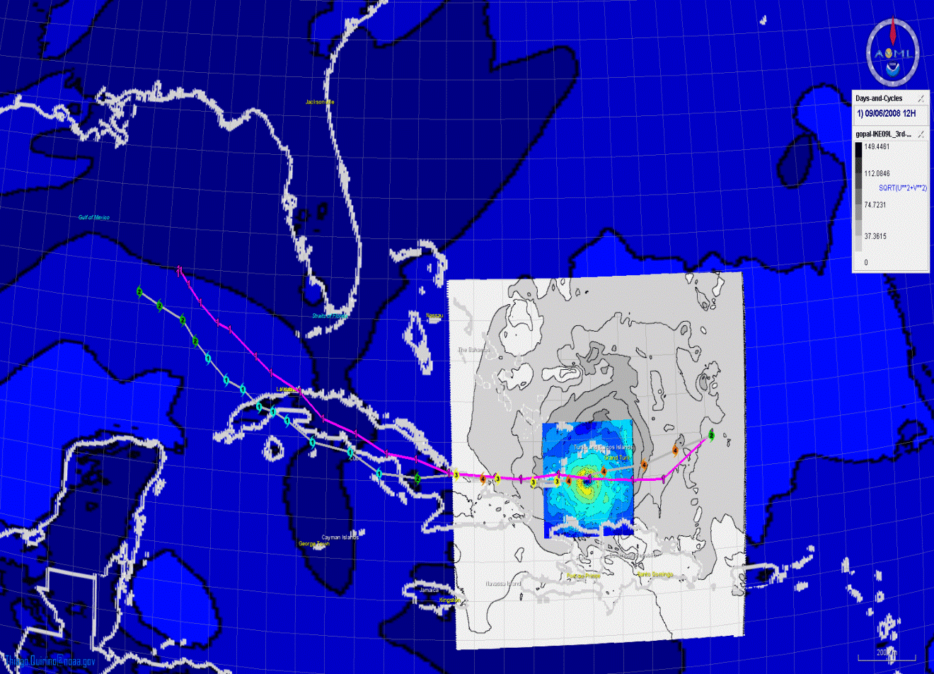
Third nest
Modified approach for multiple nesting

Slide 25
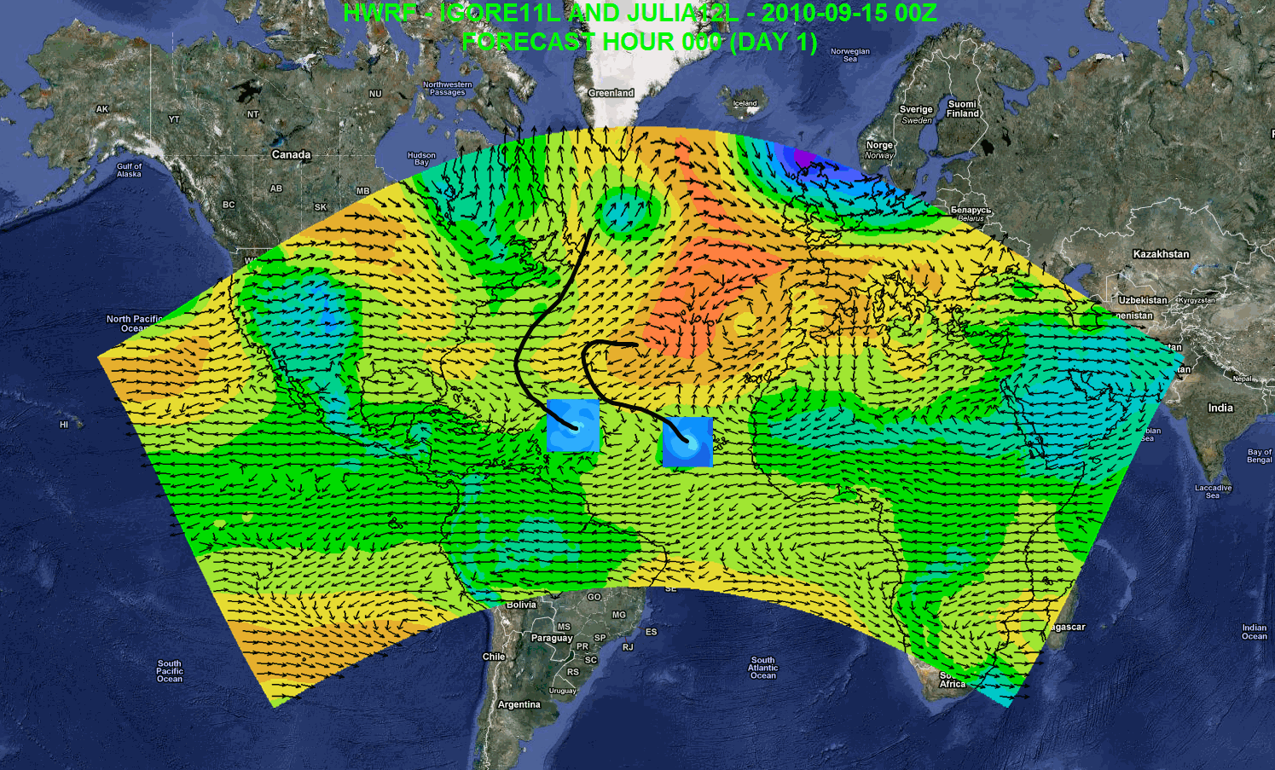
Thinking Big with 3.3+!
Basin scale domain
7 days forecast
SDA and cycling
Regional ensembles/products
Daily Tropical Outlook/genesis
Computational Efficiency (27:9;about 2 h; 168 CPUs)

Slide 26
Useful Diagnostic and Analysis Tools
Diffwrf untility
  Read HWRF output
  Generate model native track
Diapost
  Read HWRF output (current only read netCDF format)
  Grid conversion
    E-grid to A-grid
    E-grid to Lat-Lon grid
    E-grid to cylindrical grid
  Vertical coordination
    Hybrid to pressure level
    Hybrid to height level
  Diagnostic function
  Tracker
  Graphic function

Slide 27
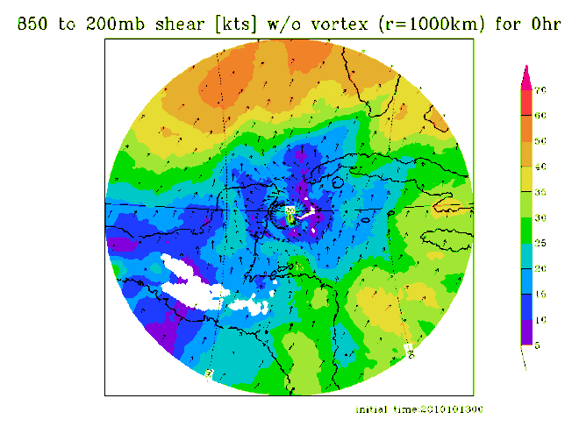
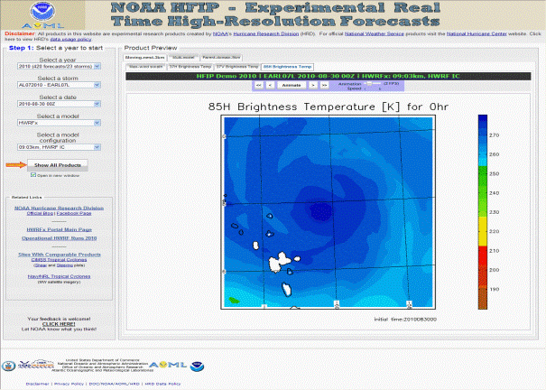
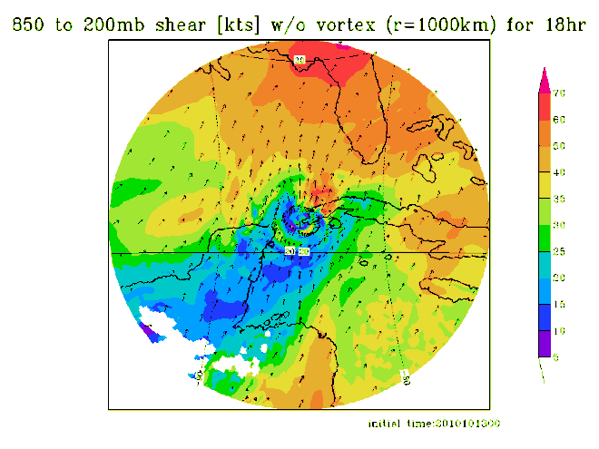
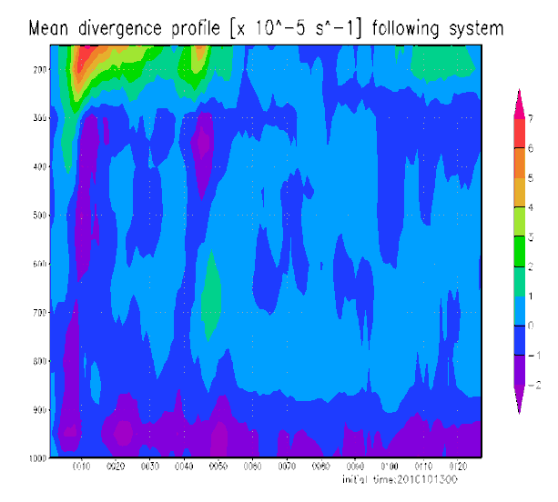
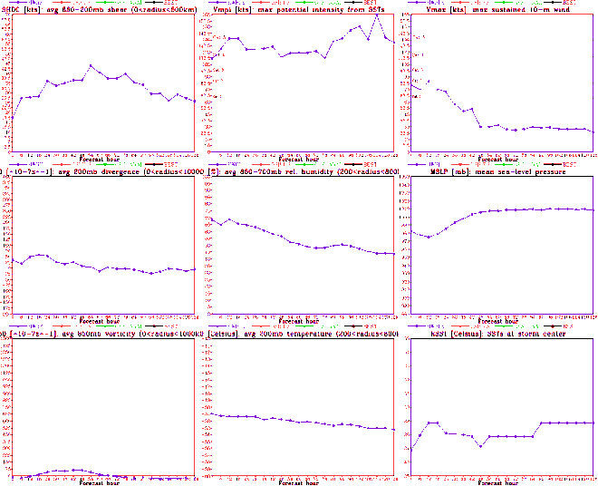
NOAA’s Web Portal For High Resolution Products
https://storm.aoml.noaa.gov/realtime
HFIP stream 2 (9/3 km resolution)
  HWRFX with HWRF IC
  HWRFX with HEDAS IC
  HWRFV3.2
All Storms of 2010
  4 cycles per day
  431 cases in 24 storms
HRH Test & Ideal Cases
19 main products; e.g.,
  Synthetic microwave imagery
  SHIPS predictors
  Shear and Steering
  Time-height cross-sections
  Swaths (wind and rainfall)
Advanced Real-Time Products to
support forecasts at 3-km resolution
Hurricane Paula
Hurricane Paula
27
Notes:
Demo 2011 season; Not only we have improved the products but also added a suite of NOAA HWRF systems at different configurations.
Example of Hurricane Paula
27

