Slide 1
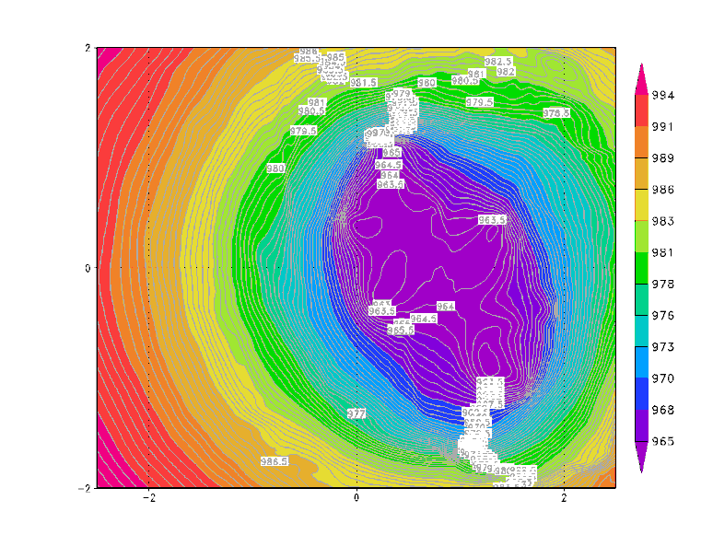
Key Issues
Moving nest algorithm
  Mathematical requirements
    Stable and unique storm center
  Computational requirements
    Effective and efficient
  Solution
    Centroid MSLP
    Range limit to start moving (resolution dependent)
Montgomery et al.(2006)
C

Slide 2
